Slide 1
Report from the LHC Run-III Configuration Working Group
G. Arduini, M. Barnes, H. Bartosik, K. Brodzinski, X. Buffat, F. Cerutti, S. Fartoukh,
B. Goddard, G. Iadarola, N. Karastathis, S. Le Naour, A. Lechner, J. Maestre Heredia, A. Mereghetti, E. Metral, D. Missiaen, N. Mounet, F.X. Nuiri, S. Papadopoulou,
Y. Papaphilippou, B. Petersen, C. Schwick, G. Rumolo, B. Salvant, M. Solfaroli Camillocci, G. Sterbini, H. Timko, R. Tomas Garcia, J. Uythoven, J. Wenninger
9th LHC Operations Evian Workshop
01/02/2019

Slide 2
LHC Run-III Configuration Working Group
LCR3 WG Mandate
Prepare LHC operational scenarios for the third exploitation period of the LHC and assess them in terms of performance reach, expected limitations & action plan to overcome them.
The working group reports to the LHC Machine Committee.
Contributors
Collaborative effort between many colleagues from:
BE-ABP, BE-RF, BE-OP, EN-SMM, EN-STI,
LPC, TE-ABT, TE-CRG, TE-MPE, TE-MSC
& many more
Thank you!
Indico Agendas: https://indico.cern.ch/category/10387/

Slide 3
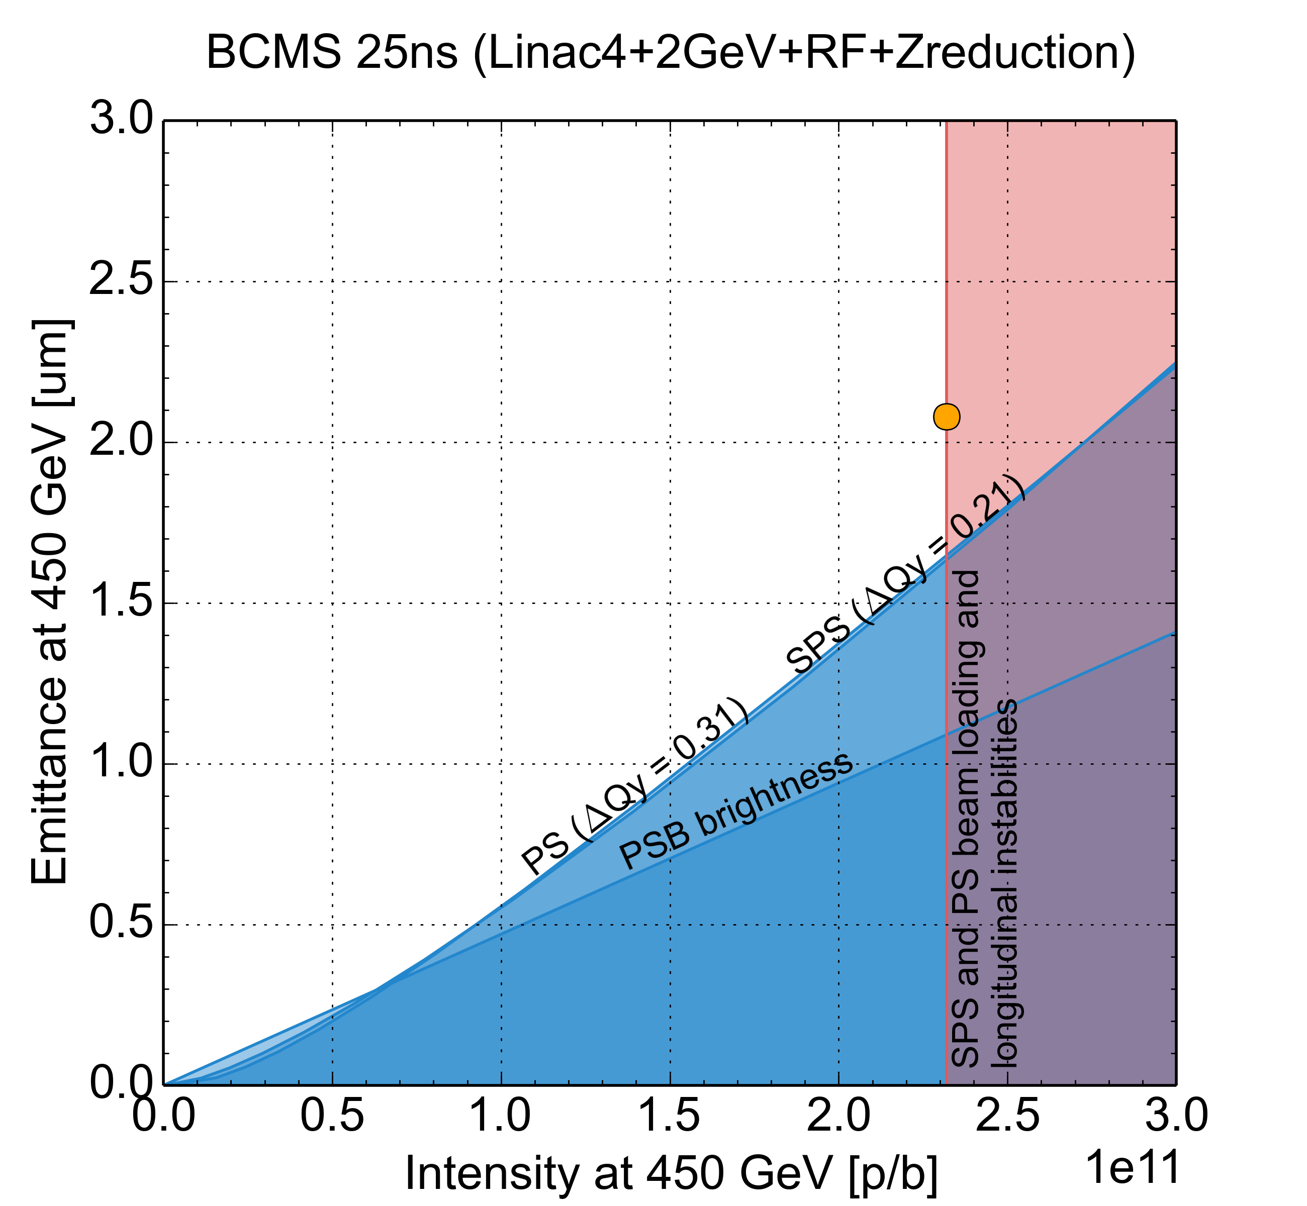
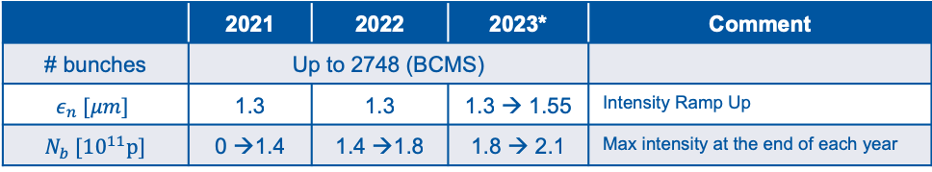
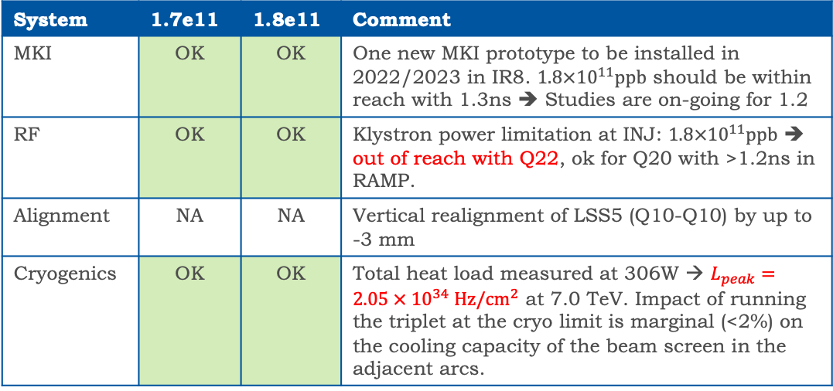
Deliverables & Equipment Group Constraints
Very clear forecast from LIU for the commissioning plan:
  Gradual intensity ramp up over Run-III.
At the LHC, can we inject, accelerate, collide and safely dump such a beam?
H. Bartosik, G. Rumolo, et al.
 | 2021 | 2022 | 2023* | Comment
# bunches | Up to 2748 (BCMS)
$$ε_{n} [μm]$$ | 1.3 | 1.3 | 1.3 → 1.55 | Intensity Ramp Up
$N_{b} [{10}^{11}p]$ | 0 →1.4 | 1.4 →1.8 | 1.8 → 2.1 | Max intensity at the end of each year
End of
2023
End of
2022
* Not including 2024 when the LHC is in shutdown but the injectors are fully operational.
End of
2021
System | 1.7e11 | 1.8e11 | Comment
MKI | OK | OK | One new MKI prototype to be installed in 2022/2023 in IR8. $1.8×{10}^{11}ppb$ should be within reach with 1.3ns ➔ Studies are on-going for 1.2
RF | OK | OK | Klystron power limitation at INJ: $1.8×{10}^{11}ppb$ ➔ out of reach with Q22, ok for Q20 with >1.2ns in RAMP.
Alignment | NA | NA | Vertical realignment of LSS5 (Q10-Q10) by up to -3 mm
Cryogenics | OK | OK | Total heat load measured at 306W → $L_{peak}=2.05 × {10}^{34} Hz/cm^{2}$ at 7.0 TeV. Impact of running the triplet at the cryo limit is marginal (<2%) on the cooling capacity of the beam screen in the adjacent arcs.
M. Barnes, K. Brodzinski, B. Goddard, A. Lechner, J. Maestre Heredia, A. Mereghetti, D. Missiaen, F.X. Nuiri, B. Salvant, H. Timko, J. Uythoven, J. Wenninger, et al.

Slide 4
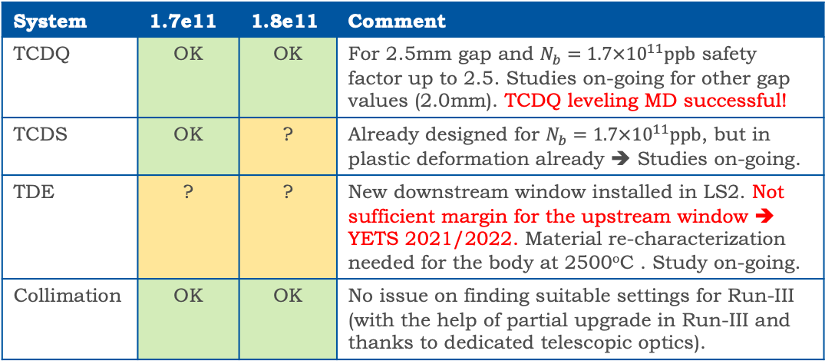
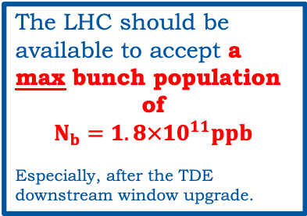
Deliverables & Equipment Group Constraints
Very clear forecast from LIU for the commissioning plan:
  Gradual intensity ramp up over Run-III.
At the LHC, can we inject, accelerate, collide and safely dump such a beam?
H. Bartosik, G. Rumolo, et al.
 | 2021 | 2022 | 2023* | Comment
# bunches | Up to 2748 (BCMS)
$$ε_{n} [μm]$$ | 1.3 | 1.3 | 1.3 → 1.55 | Intensity Ramp Up
$N_{b} [{10}^{11}p]$ | 0 →1.4 | 1.4 →1.8 | 1.8 → 2.1 | Max intensity at the end of each year
End of
2023
End of
2022
* Not including 2024 when the LHC is in shutdown but the injectors are fully operational.
End of
2021
System | 1.7e11 | 1.8e11 | Comment
TCDQ | OK | OK | For 2.5mm gap and $N_{b}=1.7×{10}^{11}ppb$ safety factor up to 2.5. Studies on-going for other gap values (2.0mm). TCDQ leveling MD successful!
TCDS | OK | ? | Already designed for $N_{b}=1.7×{10}^{11}ppb$, but in plastic deformation already ➔ Studies on-going.
TDE | ? | ? | New downstream window installed in LS2. Not sufficient margin for the upstream window ➔ YETS 2021/2022. Material re-characterization needed for the body at 2500^{ο}C . Study on-going.
Collimation | OK | OK | No issue on finding suitable settings for Run-III (with the help of partial upgrade in Run-III and thanks to dedicated telescopic optics).
The LHC should be available to accept a max bunch population
of
$$N_{b}=1.8×{10}^{11}ppb$$
Especially, after the TDE downstream window upgrade.
M. Barnes, K. Brodzinski, B. Goddard, A. Lechner, J. Maestre Heredia, A. Mereghetti, D. Missiaen, F.X. Nuiri, B. Salvant, H. Timko, J. Uythoven, J. Wenninger, et al.

Slide 5
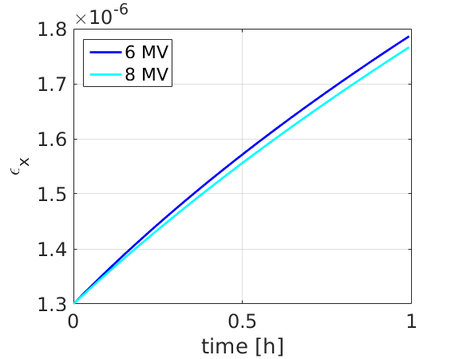
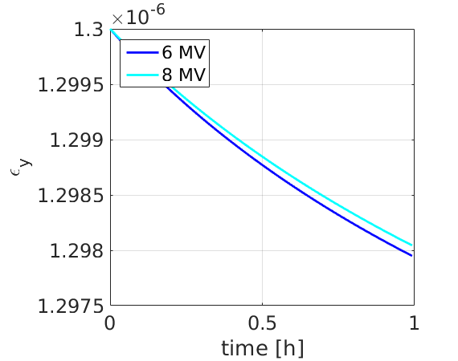
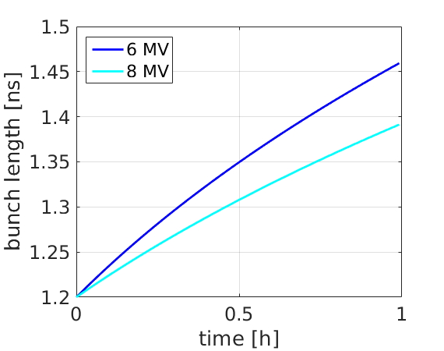
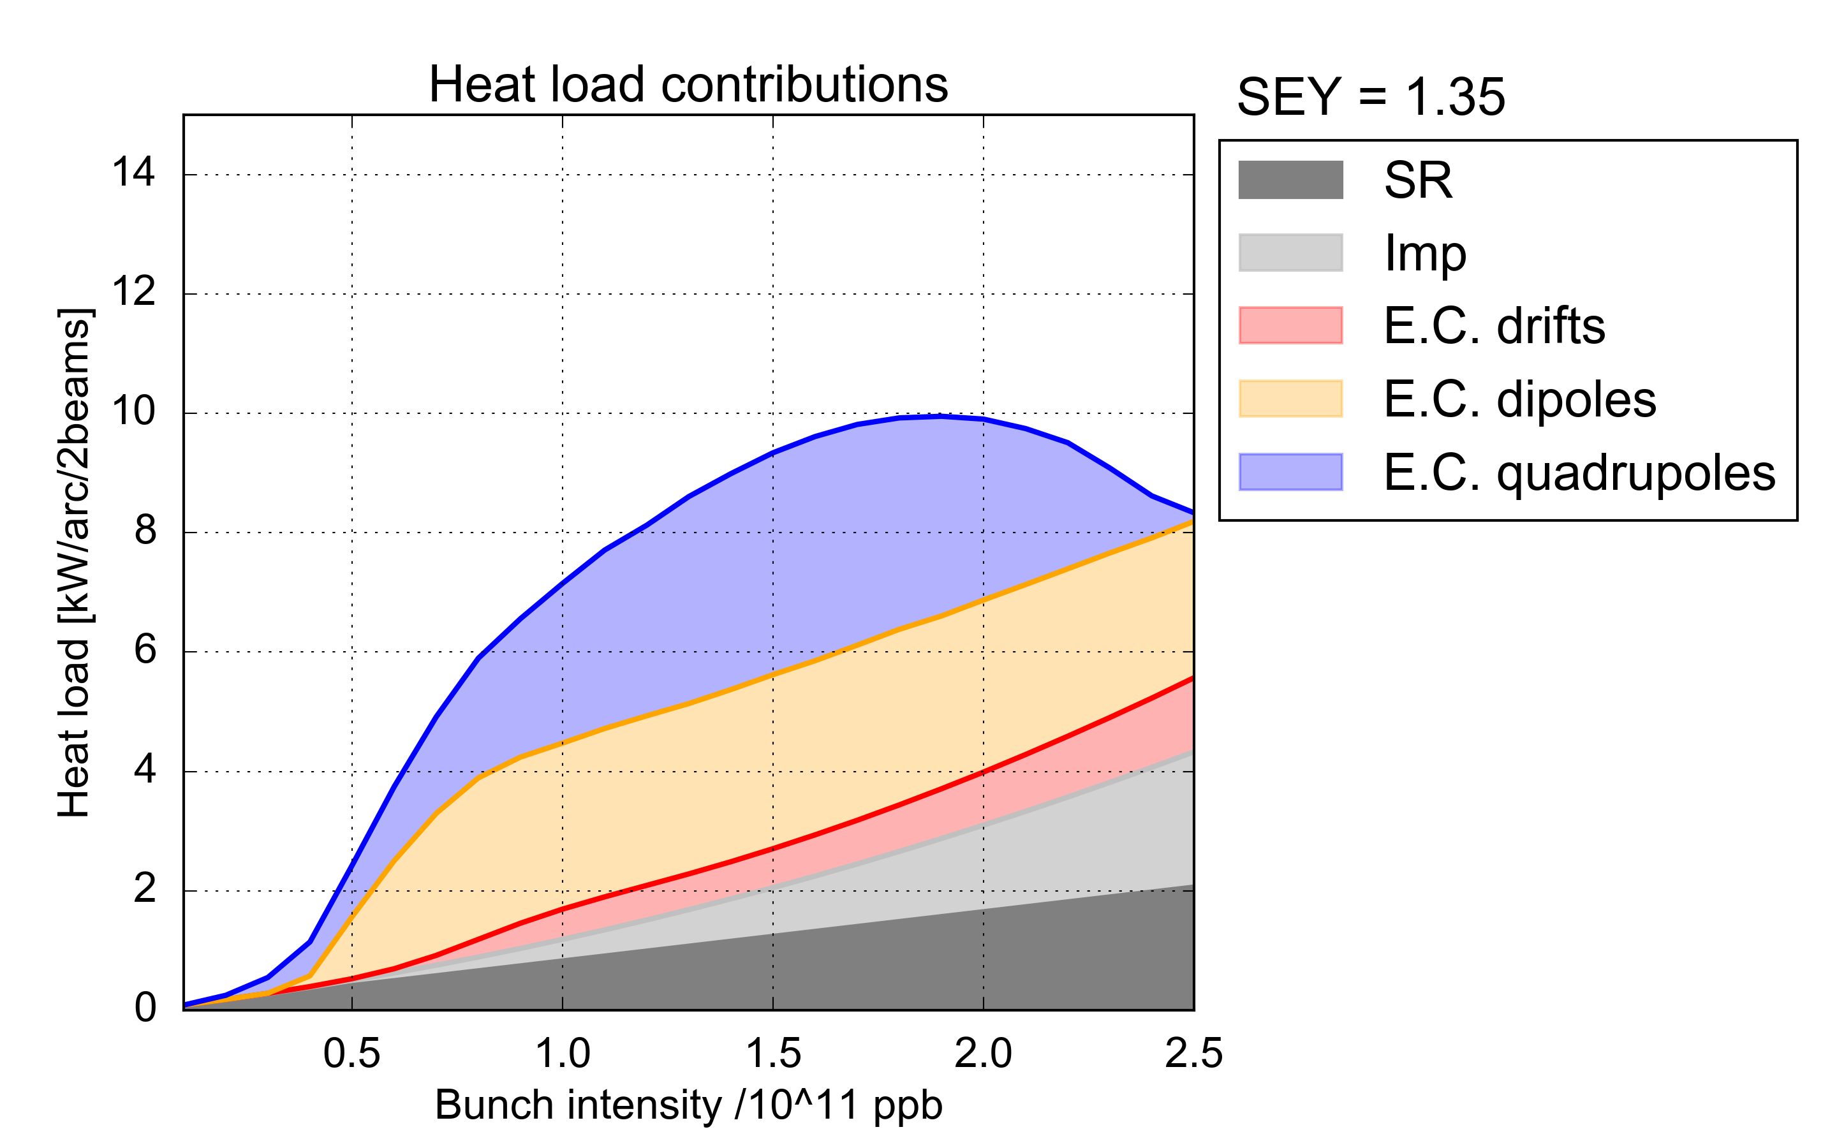


When the protons are in the LHC (I)
IBS+SR Estimates
$N_{b}=1.8×{10}^{11} ppb$,
$ϵ_{n}^{inj}=1.3 μm$ $\&{ σ}_{L}=1.2 ns$
Horizontal Emittance Growth @ FB: $≈0.5μm/h$ (additional effects, e.g. e-cloud, not considered here)
Two scenarios considered at Start SB: 1.8 μm & 2.5 μm
S. Papadopoulou, Y. Papaphilippou et al.
Heat Load Estimates
Pure BCMS
Baseline: Pure BCMS
9.7 kW/arc (195 W/hc)
5x48 bpi, 2736 collisions in ATLAS/CMS, 2250/2376 in Alice/LHCb
Backup: Mixed BCMS with 8b+4e (56b) inserts
Required for the 25% missing cryo-cooling capacity.
9.2% less collisions at IP1/5 compared to pure BCMS scheme
Operationally viable under the two beam (INTR/NOM) injection scheme, but could require some overhead until fully automatized.
BCMS: extra margin than the 25ns standard.
Almost within the capacity for $1.8×{10}^{11} ppb$.
Assuming no degradation during LS2!
G. Iadarola, M. Solfaroli Camillocci, J. Wenninger et al.
* 25ns_2492b_2484_1949_2131_240bpi_13inj_800ns_bs200n_run3study

Slide 6
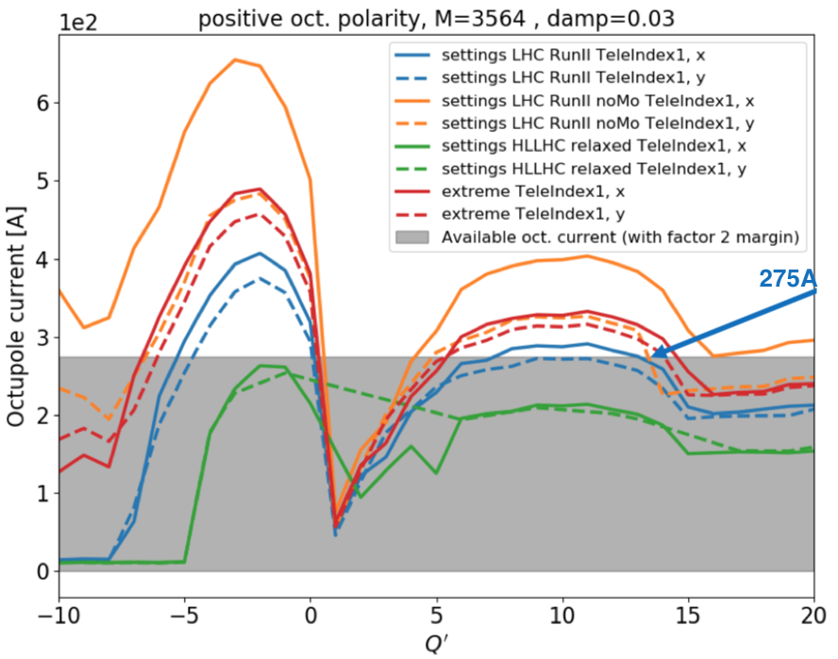

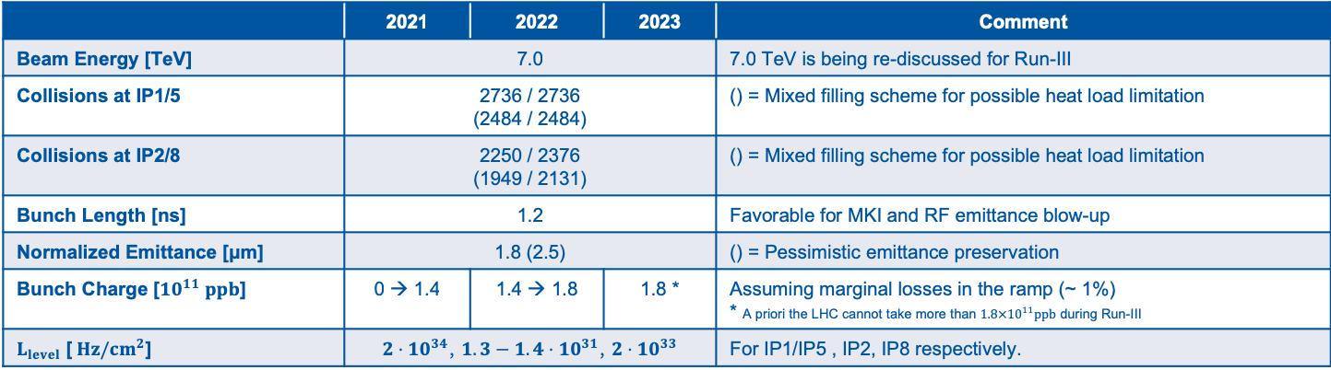
When the protons are in the LHC (II)
Stability Concerns
Without BBLR there is some stability margin due to the collimator upgrade.
The operational polarity of the octupoles has not been decided yet.
  The critical point for IMO>0: end of ramp ➔ Stability guaranteed even in the most demanding configuration.
  The critical point for IMO<0: end of squeeze ➔ can create issues in ADJUST and/or with offset leveling mode ➔ we need $≈$300A of octupole current at a tele-index of 2.5 to allow for any long-range separation.
The telescopic index needs to be applied already in the RAMP to increase the effectiveness of the octupoles → CRDS MD successful!
The TMCI threshold is pushed further away ($4.7×{10}^{11}ppb$) compared to Run-II.
X. Buffat, E. Metral, N. Mounet, et al.
 | 2021 | 2022 | 2023 | Comment
Beam Energy [TeV] | 7.0 |  |  | 7.0 TeV is being re-discussed for Run-III
Collisions at IP1/5 | 2736 / 2736 (2484 / 2484) |  |  | () = Mixed filling scheme for possible heat load limitation
Collisions at IP2/8 | 2250 / 2376 (1949 / 2131) |  |  | () = Mixed filling scheme for possible heat load limitation
Bunch Length [ns] | 1.2 |  |  | Favorable for MKI and RF emittance blow-up
Normalized Emittance [μm] | 1.8 (2.5) |  |  | () = Pessimistic emittance preservation
Bunch Charge [${10}^{11} ppb$] | 0 → 1.4 | 1.4 → 1.8 | 1.8 * | Assuming marginal losses in the ramp (~ 1%) * A priori the LHC cannot take more than $1.8×{10}^{11}ppb$ during Run-III
$L_{level}$ [$Hz/cm^{2}$] | $2⋅10^{34}$, $1.3−1.4⋅10^{31}$, $2⋅10^{33}$ |  |  | For IP1/IP5 , IP2, IP8 respectively.

Slide 7
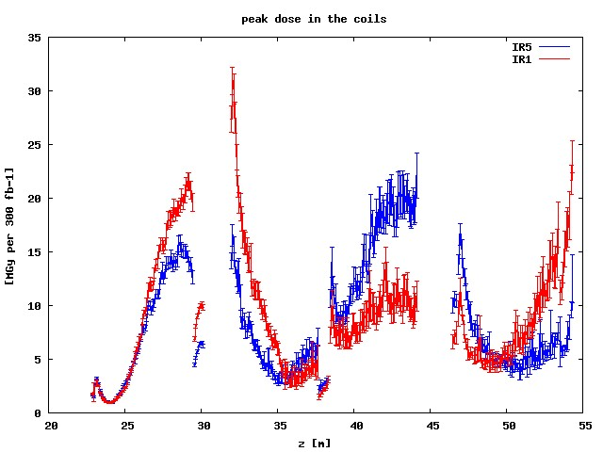
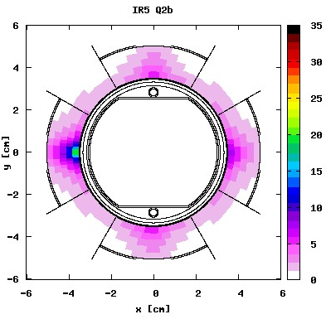
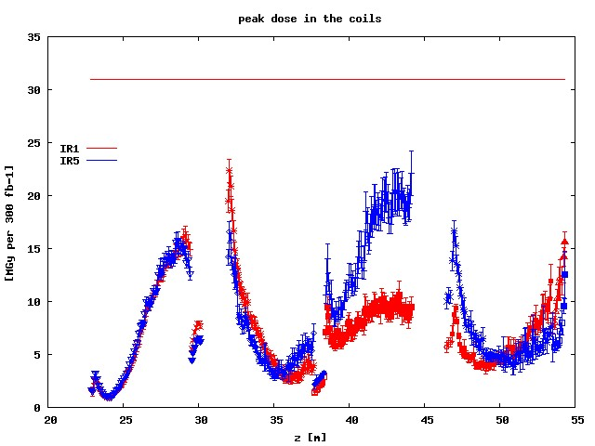
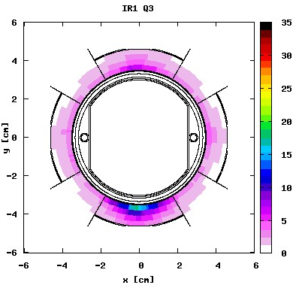
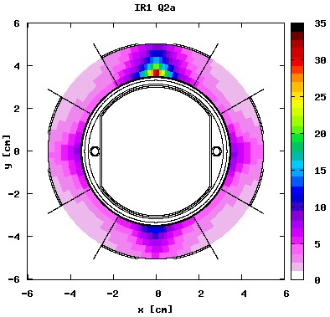
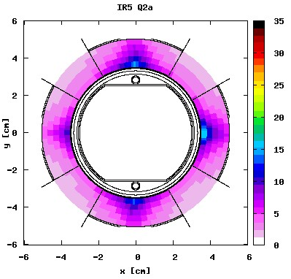
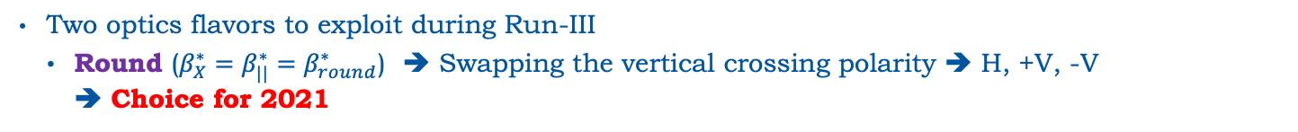
Optics Flavors & Triplet Lifetime (I)
The triplet lifetime shall extend until LS3, but should not be an obstacle to the luminosity production in Run-III ➔ Run-I/II: Optics can affect IT lifetime.
Triplet dose limit: 30 MGy
Two optics flavors to exploit during Run-III
    Round ($β_{X}^{∗}=β_{||}^{∗}=β_{round}^{∗}$) ➔ Swapping the vertical crossing polarity ➔ H, +V, -V
    ➔ Choice for 2021
Reversing V Polarity
IR5 (H)
IR1 (V)
x
IR5 Q2b
x
IR1 Q3
x
x
round optics
142.5 urad half crossing angle
[ 3mm radial resolution]
r=30% decrease
➔
40% increase in integrated luminosity
IR1 Q2a
IR5 Q2a
F. Cerutti, et al.

Slide 8
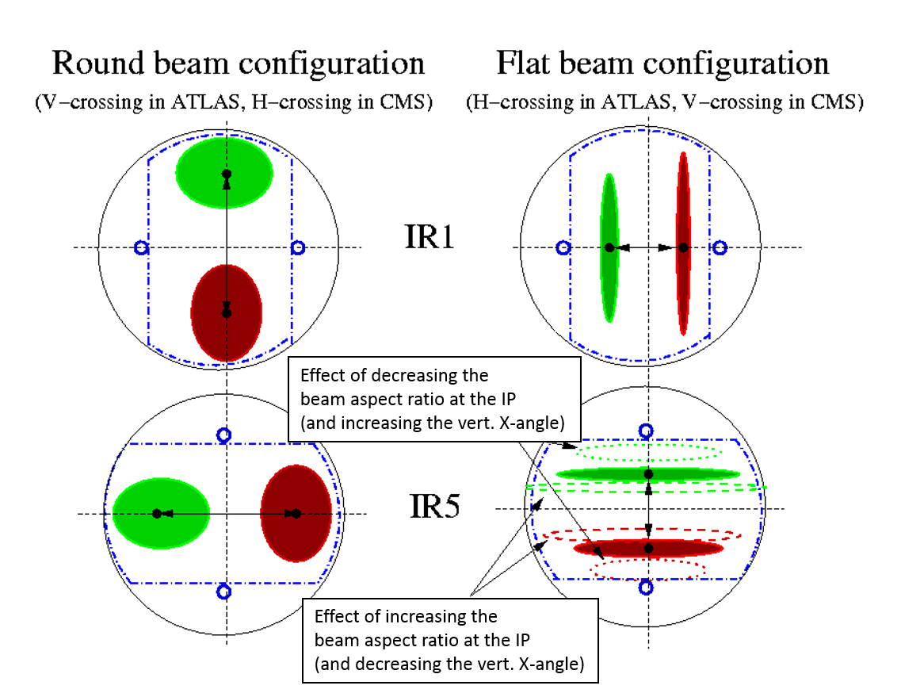
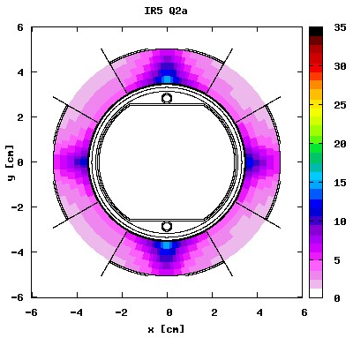
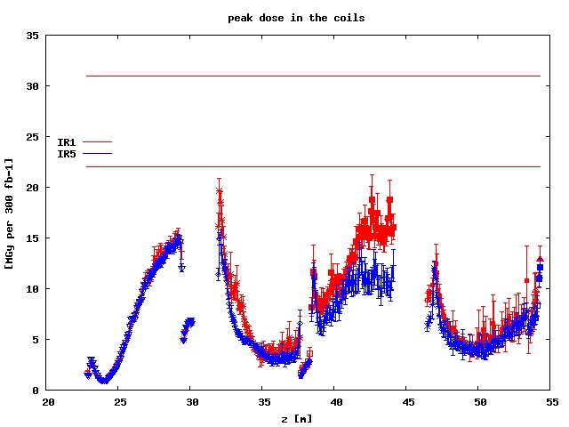
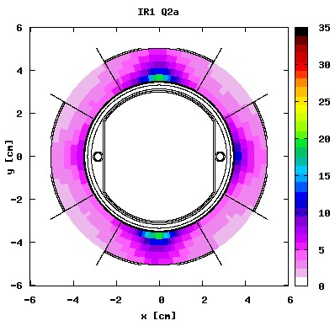
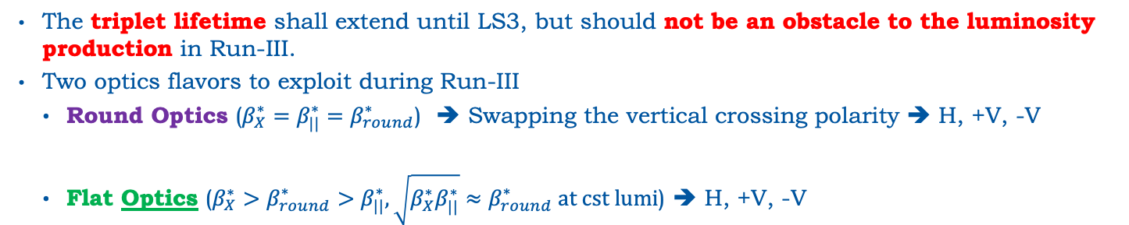
Optics Flavors & Triplet Lifetime (II)
The triplet lifetime shall extend until LS3, but should not be an obstacle to the luminosity production in Run-III.
Two optics flavors to exploit during Run-III
    Round Optics ($β_{X}^{∗}=β_{||}^{∗}=β_{round}^{∗}$) ➔ Swapping the vertical crossing polarity ➔ H, +V, -V
    Flat Optics ($β_{X}^{∗}>{β_{round}^{∗}>β}_{||}^{∗}, \sqrt{β_{X}^{∗}β_{||}^{∗}}≈β_{round}^{∗} at cst lumi$) ➔ H, +V, -V
Triplet dose limit: 30 MGy
The crossing angle is rotated by 90deg and deployed in the plane of highest β* to minimize the loss factor.
r=35% decrease
➔
50% increase in integrated luminosity
F. Cerutti, et al.

Slide 9
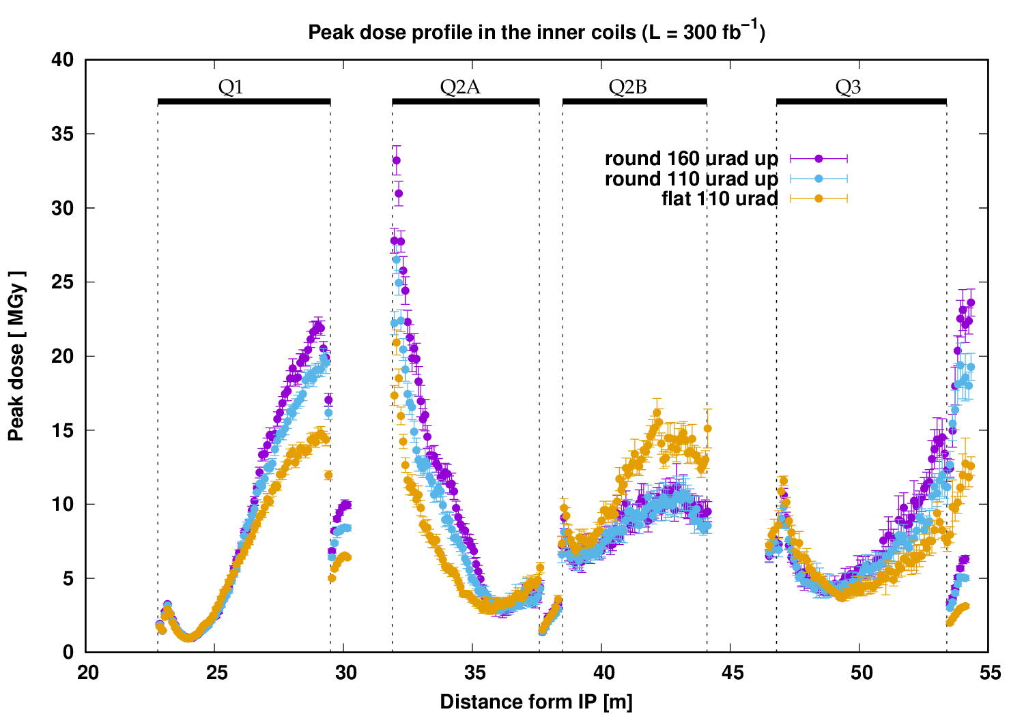


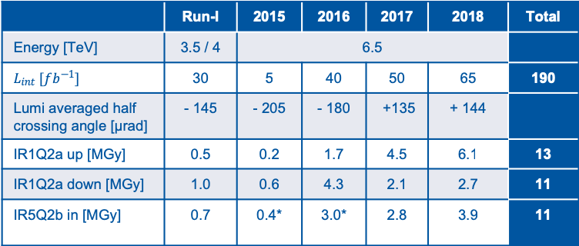
Optics Flavors & Triplet Lifetime (III)
The triplet lifetime shall extend until LS3, but should not be an obstacle to the luminosity production in Run-III.
Two optics flavors to exploit during Run-III
    Round Optics ($β_{X}^{∗}=β_{||}^{∗}=β_{round}^{∗}$) ➔ Swapping the vertical crossing polarity ➔ H, +V, -V
    Flat Optics ($β_{X}^{∗}>{β_{round}^{∗}>β}_{||}^{∗}, \sqrt{β_{X}^{∗}β_{||}^{∗}}≈β_{round}^{∗} at cst lumi$) ➔ H, +V, -V
Triplet dose limit: 30 MGy
F. Cerutti, et al.
 | Run-I | 2015 | 2016 | 2017 | 2018 | Total
Energy [TeV] | 3.5 / 4 | 6.5
$$L_{int} [fb^{−1}]$$ | 30 | 5 | 40 | 50 | 65 | 190
Lumi averaged half crossing angle [μrad] | - 145 | - 205 | - 180 | +135 | + 144
IR1Q2a up [MGy] | 0.5 | 0.2 | 1.7 | 4.5 | 6.1 | 13
IR1Q2a down [MGy] | 1.0 | 0.6 | 4.3 | 2.1 | 2.7 | 11
IR5Q2b in [MGy] | 0.7 | 0.4* | 3.0* | 2.8 | 3.9 | 11
* Crossing angle dependence in IR5 not fully studied yet
The target of any operational scenario would be to keep the crossing-angle as small as possible for as long as possible, without sacrificing performance. ➔ “Safely operating just above the BB limit” !
Flat optics is an appealing option on reducing the peak dose
In terms of triplet lifetime, cryogenics and experiments (pileup) there is no foreseen constraint in constantly operating at a luminosity of $2.0×{10}^{34} Hz/cm^{2}$

Slide 10
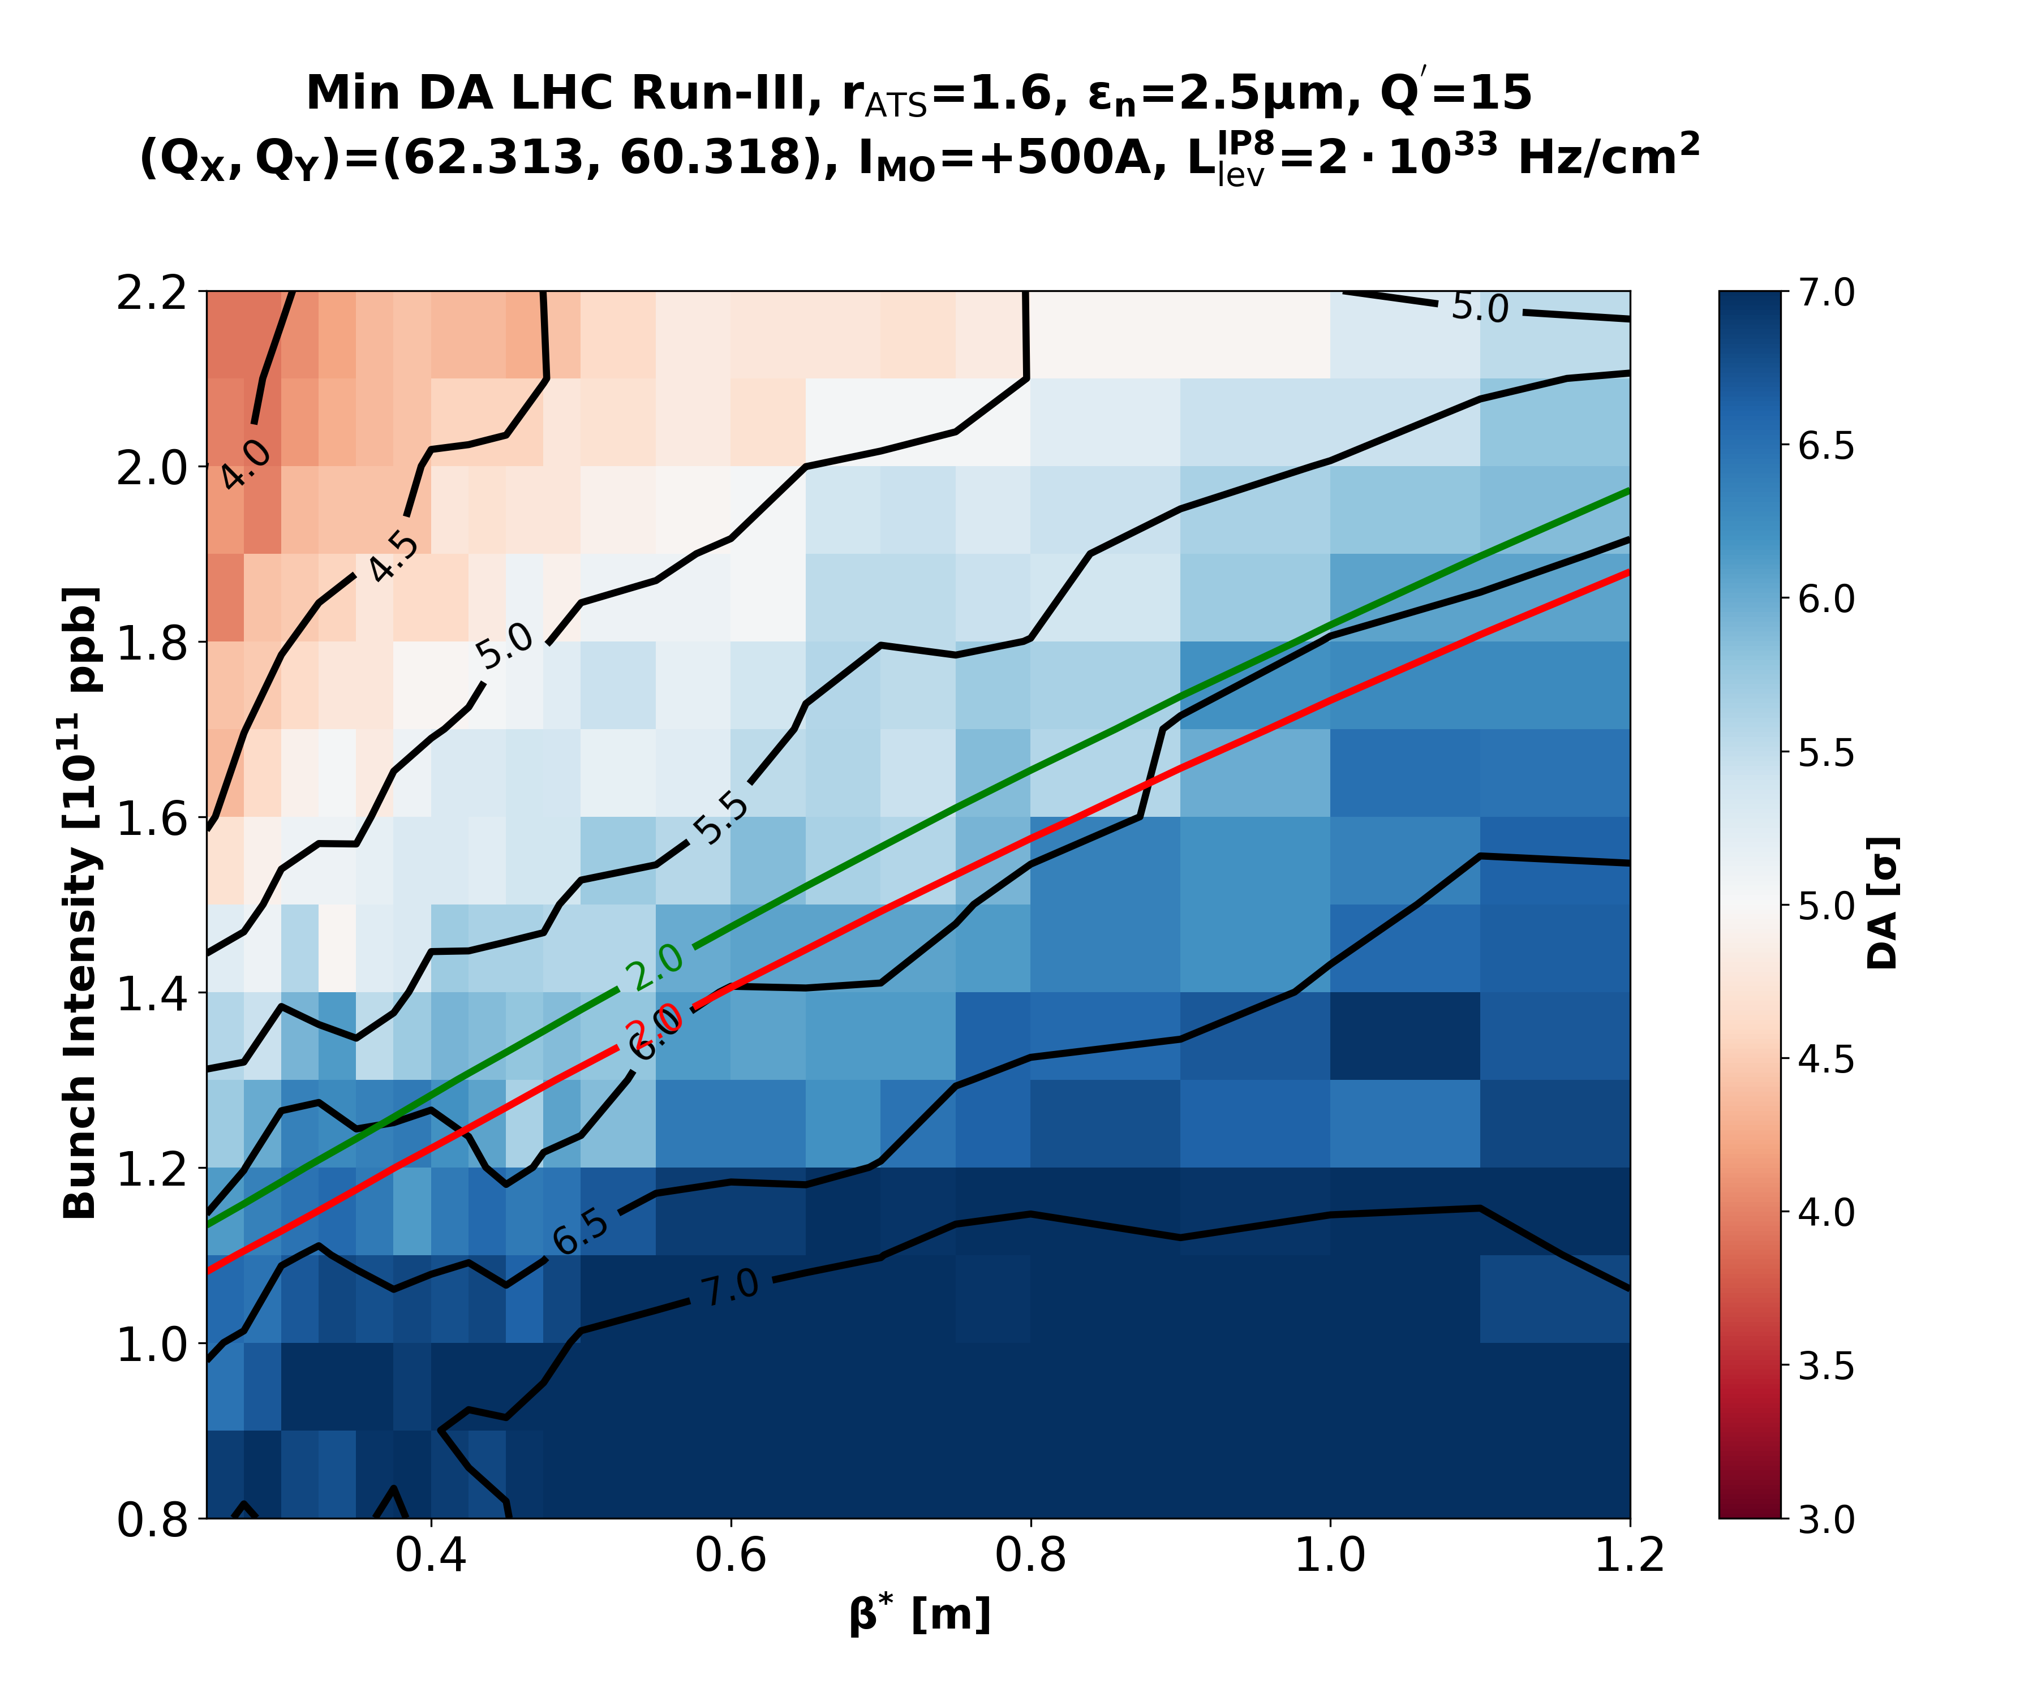
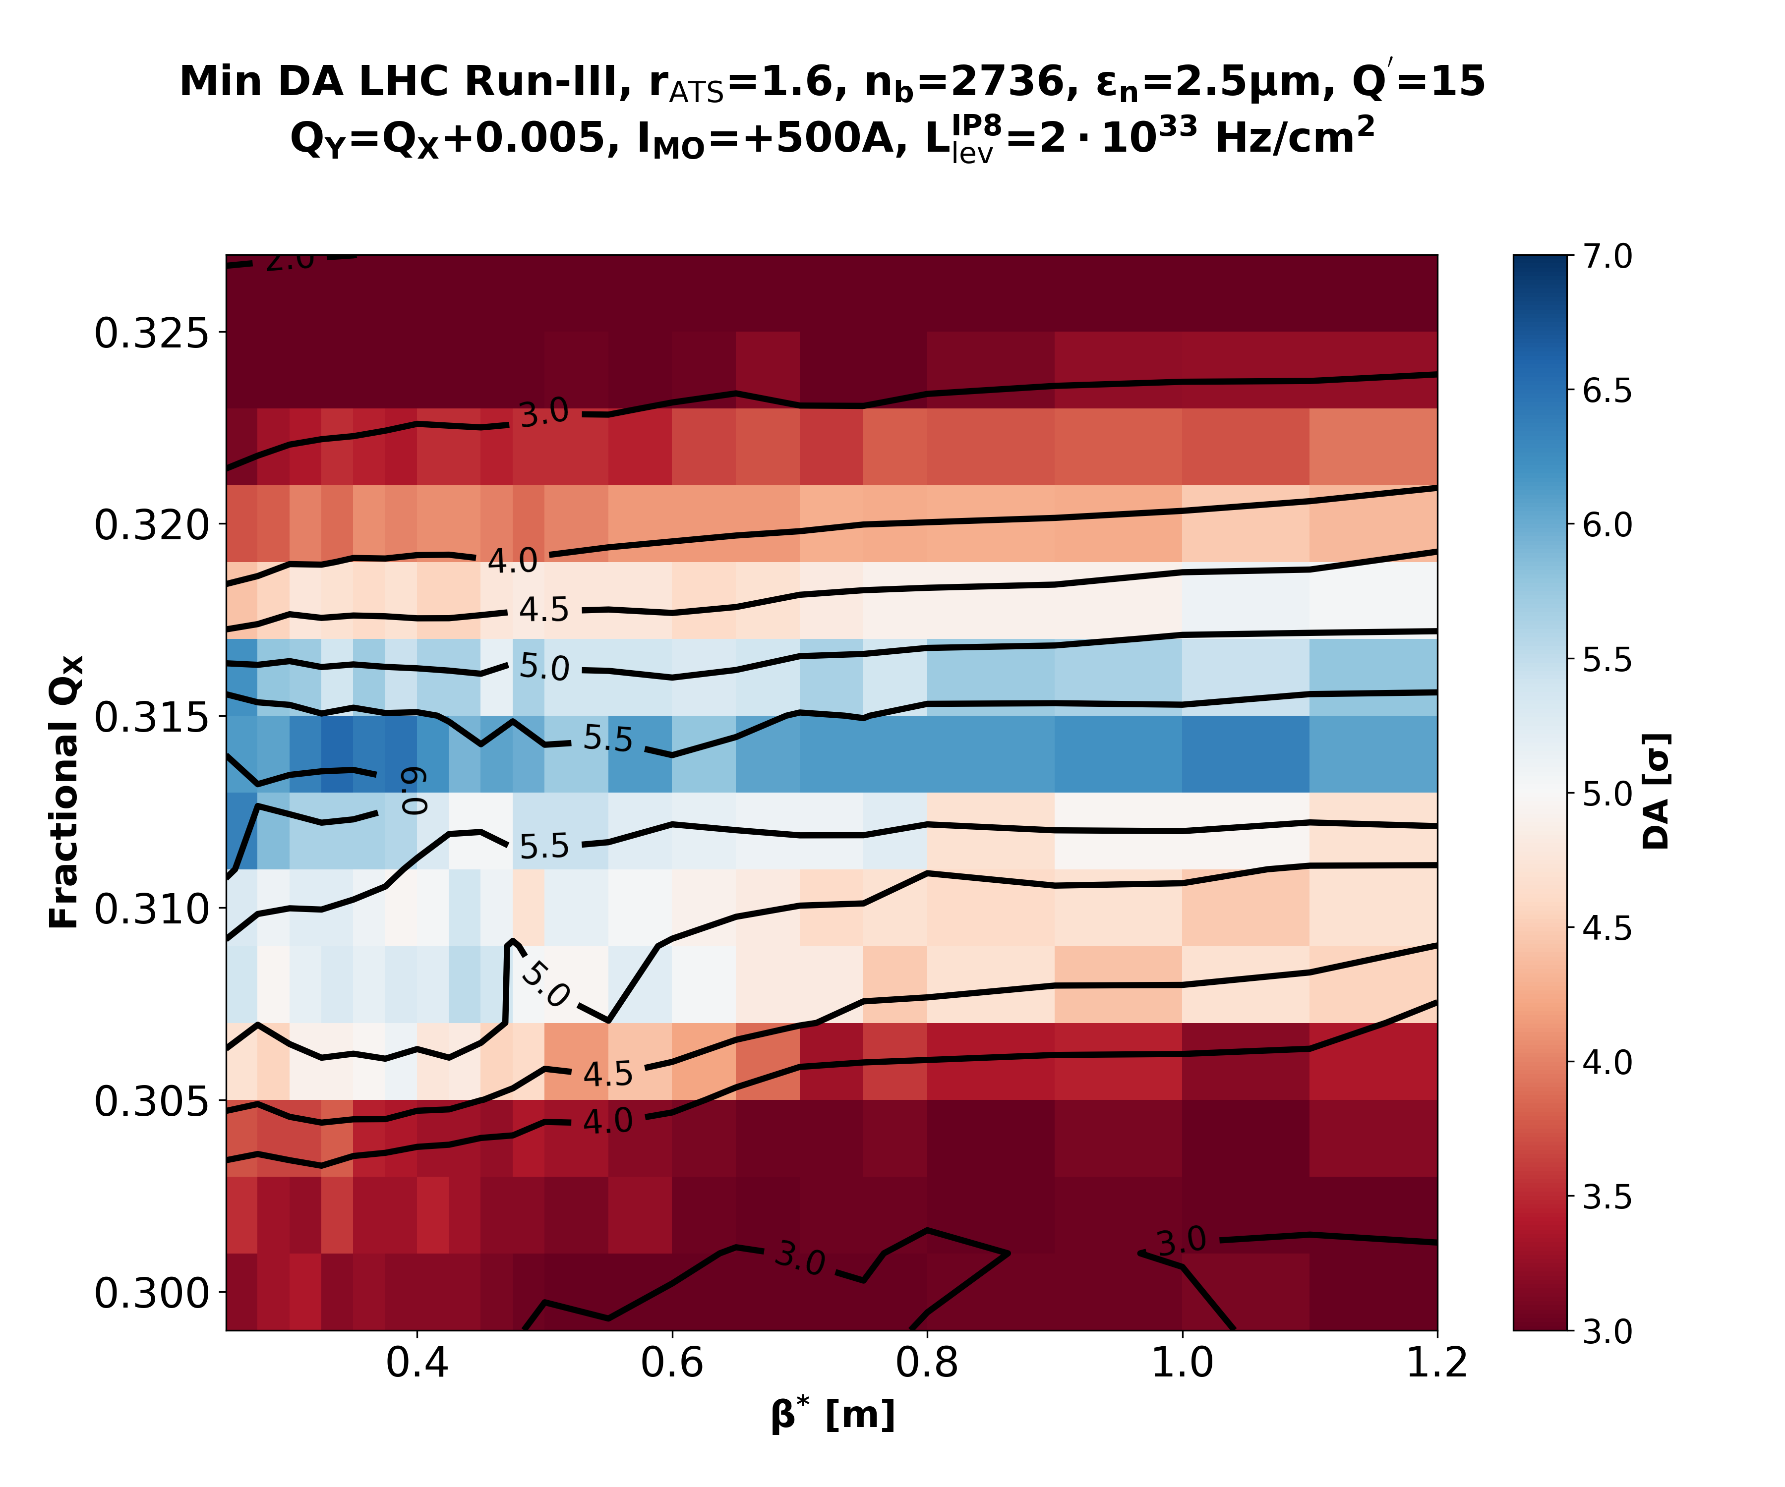
Running Scenarios under the guidance of Beam-Beam simulations
We use Dynamic Aperture beam-beam simulations to estimate the beam lifetime.
  DA simulations were proved to be a helpful “tool” to guide the LHC operation during Run-II (tune optimizations, anti-leveling, etc).
Based on our experience, we set a target DA for LHC >5.0σ
In the regime of optimal tune, the crossing angle is (almost) a linear function of the bunch charge.
Large dynamic range of β*: 20% in 2018 ➔ up to 500% in 2023
Not all the luminosity shall be produced at the maximum crossing angle (IT lifetime)
De facto parametric variation of the crossing angle with β* shall be established.
2736b
2484b
It works!
Could spend the DA budget in refining the function and keep margin for non simulated effects.

Slide 11


STABLE BEAMS (in 2023)
* Contribution of IR8 included.
Not Including major losses beyond expectation.
*
Start of Bunch Length Leveling:
$9.4h$ at $N_{b}=1.26⋅10^{11}ppb$
53 events
1.31$fb^{−1}$
A large range of End-of-RAMP β* should be
accommodated in the commissioned optics,
especially if we consider a global Run-III optics (all years)!
Total Leveling Time: 11.2h

Slide 12
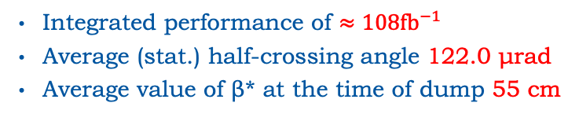
Looking into our crystal ball
Using the above (ideal) scenario and the 2018 fill statistics
Possible impact of larger intensity and higher energy on the machine availability is not considered.
No significant impact (<2%) on the performance, from the number of bunches or emittance preservation due to leveling (assuming no other losses).
Integrated performance of $≈108fb^{−1}$
Average (stat.) half-crossing angle 122.0 μrad
Average value of β* at the time of dump 55 cm

Slide 13

What about flat optics?
    The potential of the flat optics is limited by the levelled luminosity of $2×{10}^{34}Hz/cm^{2}$.
    Could be an interesting alternative for boosting performance in the low-intensity regime.
Levelling at $2.0×{10}^{34}Hz/cm^{2}$
    On the other hand, to ease the LHC commissioning, for 2021 there is a preference to stick to the well-known round optics.
    For the operation of 2022/2023 the decision on optics is postponed for EYETS-2021/2022.
      based on MDs and re-evaluation of the need (with refined forecast of Run-III performance, confirmation of the CERN master schedule, etc.)
      However, some information is already available!

Slide 14
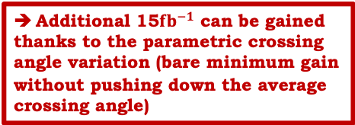

Triplet Lifetime Forecast
Run-III PROSPECTS | up to now | 2021 | 2022 | 2023 | up to triplet replacement
beam energy [TeV] |  | 7
integrated lumi [fb⁻¹] | 190 | 25 | 90 | 120 | 425
ROUND OPTICS
lumi averaged half cross. angle [urad] |  | -162 | -148 (-162) | +134 (+162)
IR1 Q2a up [MGy] | 13 | 1.2 | 4.2 | 11.9 (13.4) | 30 (32)
IR1 Q2a down [MGy] | 11 | 2.8 | 9.5 (10.0) | 5.6 | 29 (29)
IR5 Q2b inward [MGy] | 11 | 1.9* | 6.2* (6.8*) | 7.5* (9.1*) | 27 (29)
FLAT OPTICS
lumi averaged half cross. angle [urad] |  | 130 | 130 | 130
IR1 Q2a up [MGy] | 13 | 1.7 | 6.0 | 8.0 | 29
IR1 Q2a down [MGy] | 11 | 1.7 | 6.0 | 8.0 | 27
IR5 Q2b inward [MGy] | 11 | 1.0 | 3.6 | 4.8 | ** 20
With the help of crossing angle
polarity inversion, 235 $fb^{−1}$ could be
added at 14 TeV c.m. before reaching the 30MGy limit.
* crossing angle dependence
in IR5 not properly studied yet
Additional 15$fb^{−1}$ can be gained
thanks to the parametric crossing angle variation (bare minimum gain without pushing down the average crossing angle)
** assuming IR5 polarity
inversion in 2023
Flat optics remain an interesting configuration for 2022/2023:
It would provide a small additional margin in IR1,
Preserve to a sizeable extend the CMS triplets, to serve as IR8 spare magnets for the HL-LHC era
F. Cerutti, et al.

Slide 15
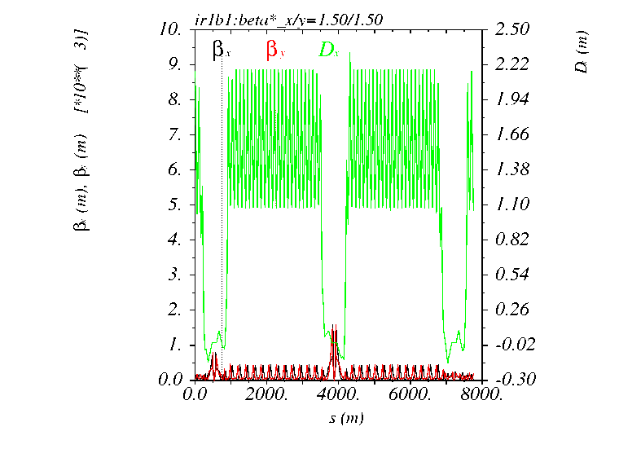
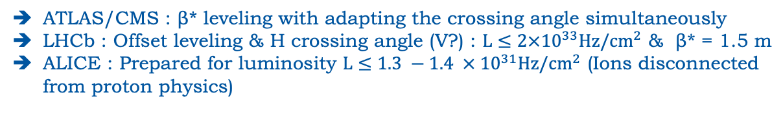
Conceptual Design of Run-III optics
The strategy on STABLE works conceptually → need to complete the picture with the full LHC Cycle
INJPHYS
➔ Optics are a priori unchanged with respect to 2017/2018
RAMP
➔ Telescope needs to be deployed to increase the efficiency of octupoles for Landau damping
SQUEEZE
➔ No SQUEEZE BP
STABLE
Collide & Squeeze ➔ Large range of Start SB β* & Tele-index of 2-3
Preference from FP to squeeze in tele-mode: keeping a constant R-matrix from the IP to the Roman Pots.
ATLAS/CMS : β* leveling with adapting the crossing angle simultaneously
LHCb : Offset leveling & H crossing angle (V?) : $L≤2×{10}^{33}Hz/cm^{2}$ & β* = 1.5 m
ALICE : Prepared for luminosity $L≤1.3 −1.4 × {10}^{31}Hz/cm^{2}$ (Ions disconnected from proton physics)
ROUND: β* leveling from 1.5 m to 24 cm
Considering in addition, the allowed range of [1/4, 4] for the tele-index for match-ability, the only possible approach is to start the β* leveling from an anti-telescope, cross the 1/1 tele-index and continue in telescopic SQUEEZE.
Combined Ramp and Anti-Telescopic Squeeze (CRATS)

Slide 16
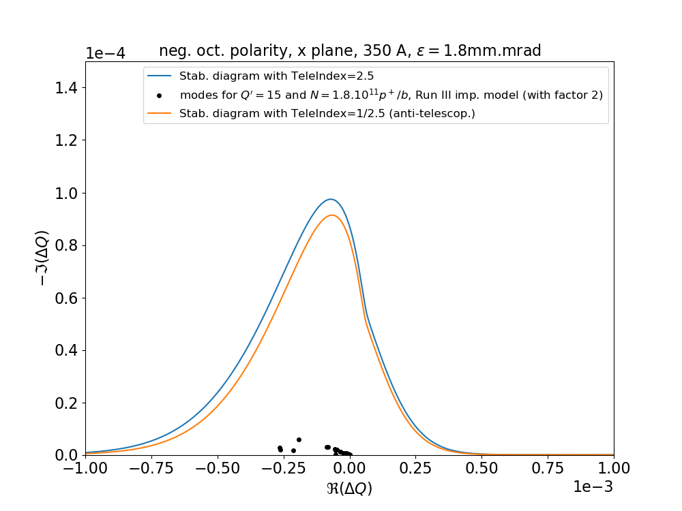
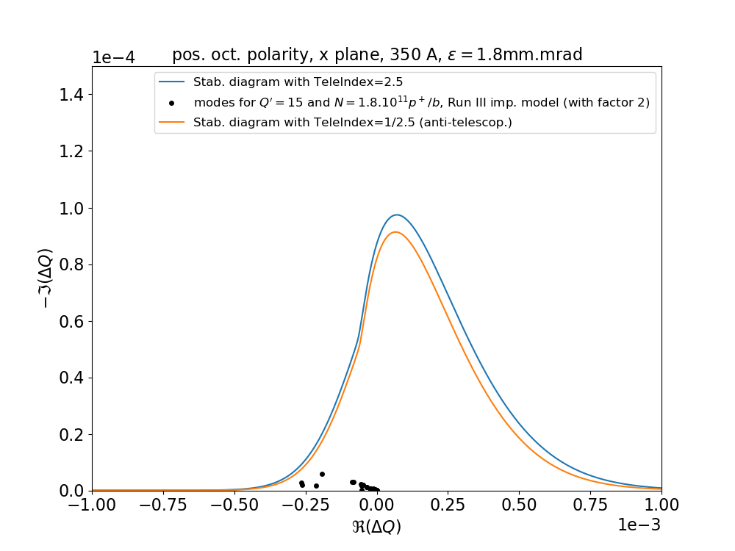
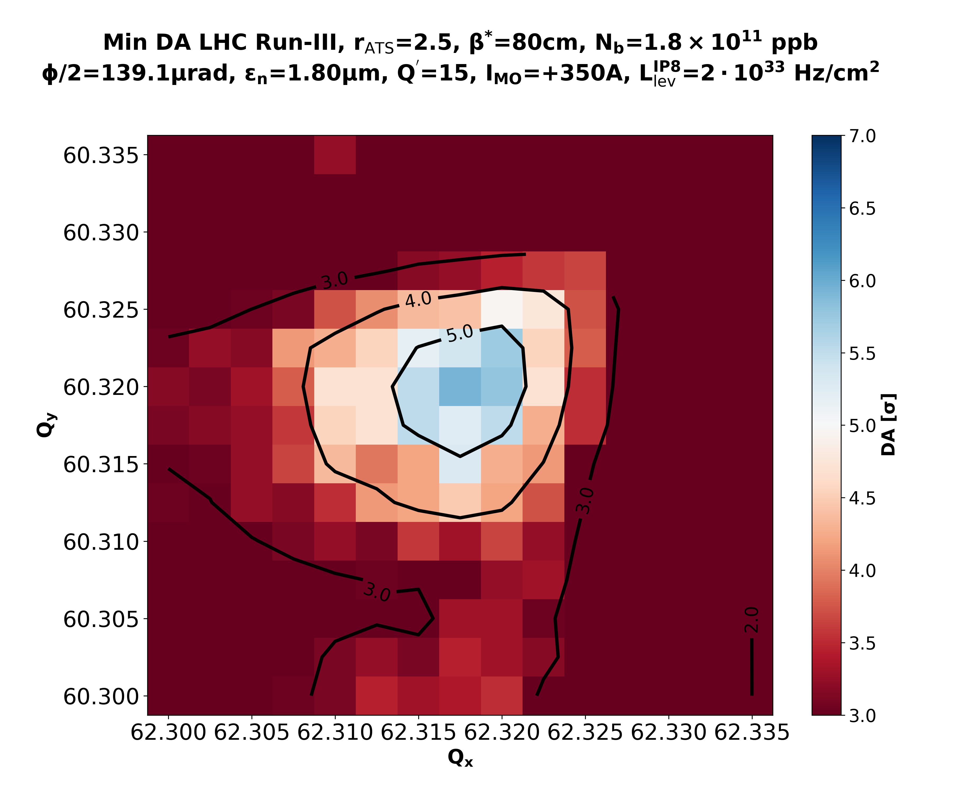
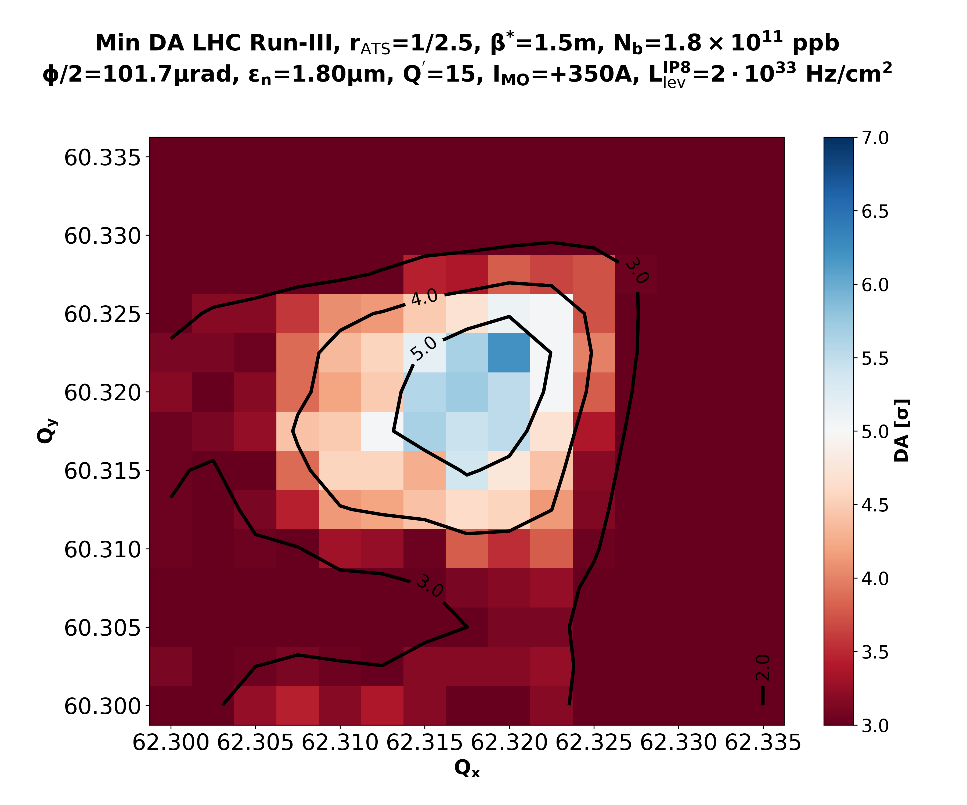
Concerning the anti-telescope
Starting from an anti-telescope configuration we get:
Predicted MO thresholds @ FT and benefits from (anti-)telescopic optics
* The ramp will a priori change from 2021 to 2022, unless
good news in the MO measured thresholds.
MO thresholds [A] @ 7 TeV (IMO>0) * Including factor 2.0 margin | 2021 (1.4/1.8 brightness) | 2022/2023 (1.8/1.8 brightness)
Tele index of 1 (standard) | 430 | 550
Tele-index of 2.5 (telescopic) | 275 | 350
Tele-index of 1.8 (telescopic) | 350 | 455
Tele-index of 1/1.8 (anti-telescopic) | 350 | 500
Tele-index of 1/2.5 (anti-telescopic) | 305 | 350
Choice of EoR telescopic parameters | 2021 | 2022 |  | 2023
EoR β* [m] at IP1 & IP5 | 1.1 | 1.5
EoR pre-squeezed β* [m] | 0.6
Tele-index (anti-telescopic) | 0.6/1.1 = 1/1.8 | 0.6/1.5 = 1/2.5 | 0.6/1.5 = 1/2.5
IMO<0
IMO>0
Stability
Beam-Beam
N. Mounet, et al.

Slide 17
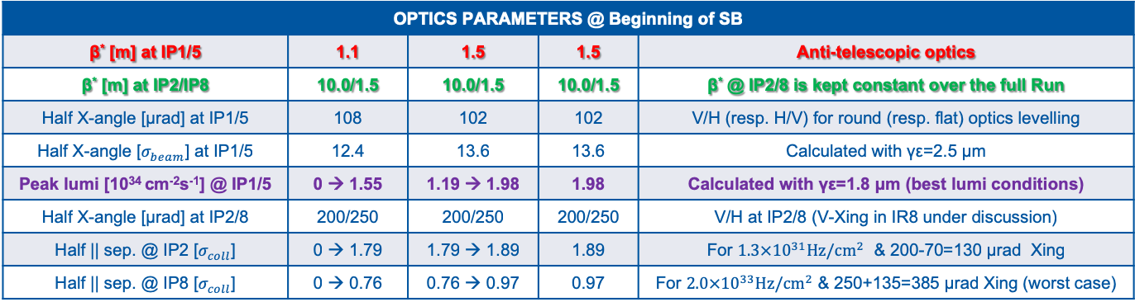
Beam Parameters at End of RAMP
 | 2021 | 2022 | 2023 | Comment
Beam energy [TeV] | 7.0 |  |  | 7 TeV is being re-discussed for Run III
Collisions at IP1/5 & IP2/IP8 | 2736/2736 & 2250/2376 |  |  | Possible heat-load limitation not included
Bunch length [ns] | 1.2 | 1.2 | 1.2 | 1.0 ns after ~10 h of SB, then kept constant
Normalized emittance [μm] | 2.5 | 2.5 | 2.5 | Huge margin taken (could be as small as 1.8 μm)
Bunch charge [10¹¹ ppb] | 0 → 1.4 | 1.4 → 1.8 | 1.8 | Intensity ramp up within each year
OPTICS PARAMETERS @ Beginning of SB
β* [m] at IP1/5 | 1.1 | 1.5 | 1.5 | Anti-telescopic optics
β* [m] at IP2/IP8 | 10.0/1.5 | 10.0/1.5 | 10.0/1.5 | β* @ IP2/8 is kept constant over the full Run
Half X-angle [μrad] at IP1/5 | 108 | 102 | 102 | V/H (resp. H/V) for round (resp. flat) optics levelling
Half X-angle [$σ_{beam}$] at IP1/5 | 12.4 | 13.6 | 13.6 | Calculated with γε=2.5 μm
Peak lumi [10³⁴ cm⁻²s⁻¹] @ IP1/5 | 0 → 1.55 | 1.19 → 1.98 | 1.98 | Calculated with γε=1.8 μm (best lumi conditions)
Half X-angle [μrad] at IP2/8 | 200/250 | 200/250 | 200/250 | V/H at IP2/8 (V-Xing in IR8 under discussion)
Half || sep. @ IP2 [$σ_{coll}$] | 0 → 1.79 | 1.79 → 1.89 | 1.89 | For $1.3×{10}^{31}Hz/cm^{2}$ & 200-70=130 μrad Xing
Half || sep. @ IP8 [$σ_{coll}$] | 0 → 0.76 | 0.76 → 0.97 | 0.97 | For $2.0×{10}^{33}Hz/cm^{2}$ & 250+135=385 μrad Xing (worst case)

Slide 18
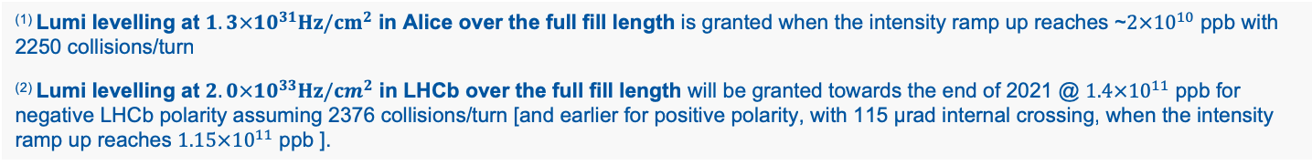
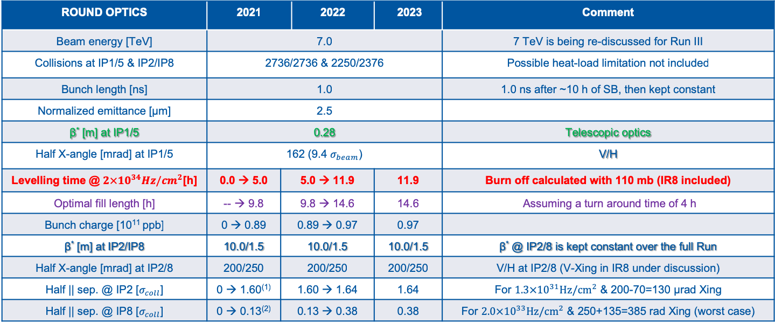
Beam Parameters at End of STABLE (Round Case)
ROUND OPTICS | 2021 |  | 2022 | 2023 | Comment
Beam energy [TeV] | 7.0 |  |  |  | 7 TeV is being re-discussed for Run III
Collisions at IP1/5 & IP2/IP8 | 2736/2736 & 2250/2376 |  |  |  | Possible heat-load limitation not included
Bunch length [ns] | 1.0 |  |  |  | 1.0 ns after ~10 h of SB, then kept constant
Normalized emittance [μm] | 2.5
β* [m] at IP1/5 | 0.28 |  |  |  | Telescopic optics
Half X-angle [mrad] at IP1/5 | 162 (9.4 $σ_{beam}$) |  |  |  | V/H
Levelling time @ $2×{10}^{34}Hz/cm^{2}$[h] | 0.0 → 5.0 | 5.0 → 11.9 |  | 11.9 | Burn off calculated with 110 mb (IR8 included)
Optimal fill length [h] | -- → 9.8 | 9.8 → 14.6 |  | 14.6 | Assuming a turn around time of 4 h
Bunch charge [10¹¹ ppb] | 0 → 0.89 | 0.89 → 0.97 |  | 0.97
β* [m] at IP2/IP8 | 10.0/1.5 | 10.0/1.5 |  | 10.0/1.5 | β* @ IP2/8 is kept constant over the full Run
Half X-angle [mrad] at IP2/8 | 200/250 | 200/250 |  | 200/250 | V/H at IP2/8 (V-Xing in IR8 under discussion)
Half || sep. @ IP2 [$σ_{coll}$] | 0 → 1.60⁽¹⁾ | 1.60 → 1.64 |  | 1.64 | For $1.3×{10}^{31}Hz/cm^{2}$ & 200-70=130 μrad Xing
Half || sep. @ IP8 [$σ_{coll}$] | 0 → 0.13⁽²⁾ | 0.13 → 0.38 |  | 0.38 | For $2.0×{10}^{33}Hz/cm^{2}$ & 250+135=385 rad Xing (worst case)
⁽¹⁾ Lumi levelling at $1.3×{10}^{31}Hz/cm^{2}$ in Alice over the full fill length is granted when the intensity ramp up reaches ~$2×{10}^{10}$ ppb with 2250 collisions/turn
⁽²⁾ Lumi levelling at $2.0×{10}^{33}Hz/cm^{2}$ in LHCb over the full fill length will be granted towards the end of 2021 @ $1.4×{10}^{11}$ ppb for negative LHCb polarity assuming 2376 collisions/turn [and earlier for positive polarity, with 115 μrad internal crossing, when the intensity ramp up reaches $1.15×{10}^{11}$ ppb ].

Slide 19
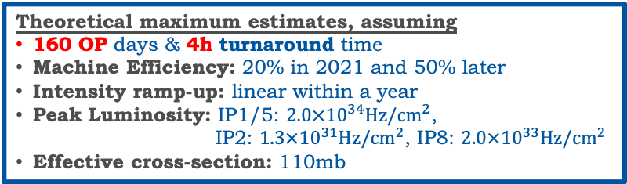
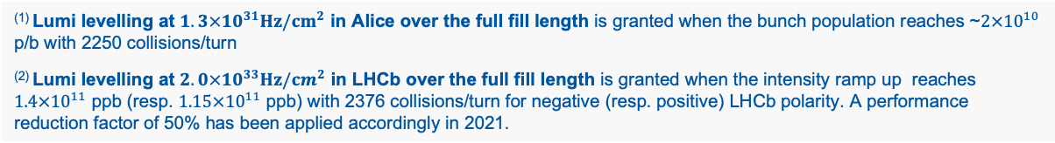
A Performance Forecast
Experiment | Target for Run-III
ATLAS & CMS | As much as possible! (pileup < 60 events)
Alice | 200 pb⁻¹
LHCb | > 15 fb⁻¹ (50 fb⁻¹ by LS4)
Theoretical maximum estimates, assuming
160 OP days & 4h turnaround time
Machine Efficiency: 20% in 2021 and 50% later
Intensity ramp-up: linear within a year
Peak Luminosity: IP1/5: $2.0×{10}^{34}Hz/cm^{2}$,
IP2: $1.3×{10}^{31}Hz/cm^{2}$, IP8: $2.0×{10}^{33}Hz/cm^{2}$
Effective cross-section: 110mb
 | 2021 | 2022 | 2023
Intensity ramp up [10¹¹ ppb] | 0 → 1.4 | 1.4 → 1.8 | 1.8
Round optics (Flat optics)
Optimal fill length [h] | -- → 9.8 (10.8) | 9.8 (10.8) → 14.6 (16.4) | 14.6 (16.4)
β* [m] at IP1/5 | 0.28 (0.50/0.15)
Integrated lumi in IR1/5 [fb⁻¹] | 18 (19) | 97 (102) | 106 (110)
β* [m] at IP2 | 10.0
Integrated lumi in IR2 [pb⁻¹] | 36⁽¹⁾ | 90 | 90
β* [m] at IP8 | 1.5
Integrated lumi in IR8 [fb⁻¹] | ~ 3⁽²⁾ | 14 | 14
411 (421)
Exceeds target
⁽¹⁾ Lumi levelling at $1.3×{10}^{31}Hz/cm^{2}$ in Alice over the full fill length is granted when the bunch population reaches ~$2×{10}^{10}$ p/b with 2250 collisions/turn
⁽²⁾ Lumi levelling at $2.0×{10}^{33}Hz/cm^{2}$ in LHCb over the full fill length is granted when the intensity ramp up reaches $1.4×{10}^{11}$ ppb (resp. $1.15×{10}^{11}$ ppb) with 2376 collisions/turn for negative (resp. positive) LHCb polarity. A performance reduction factor of 50% has been applied accordingly in 2021.

Slide 20
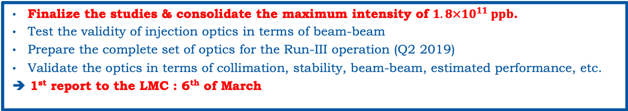
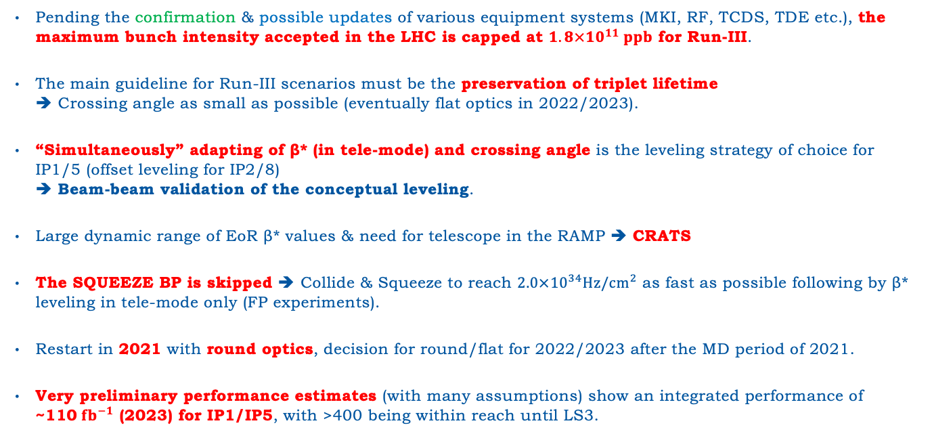
Summary
Pending the confirmation & possible updates of various equipment systems (MKI, RF, TCDS, TDE etc.), the maximum bunch intensity accepted in the LHC is capped at $1.8×{10}^{11} ppb$ for Run-III.
The main guideline for Run-III scenarios must be the preservation of triplet lifetime
➔ Crossing angle as small as possible (eventually flat optics in 2022/2023).
“Simultaneously” adapting of β* (in tele-mode) and crossing angle is the leveling strategy of choice for IP1/5 (offset leveling for IP2/8)
➔ Beam-beam validation of the conceptual leveling.
Large dynamic range of EoR β* values & need for telescope in the RAMP ➔ CRATS
The SQUEEZE BP is skipped ➔ Collide & Squeeze to reach $2.0×{10}^{34}Hz/cm^{2}$ as fast as possible following by β* leveling in tele-mode only (FP experiments).
Restart in 2021 with round optics, decision for round/flat for 2022/2023 after the MD period of 2021.
Very preliminary performance estimates (with many assumptions) show an integrated performance of ~110$fb^{−1}$ (2023) for IP1/IP5, with >400 being within reach until LS3.
Short-time plan of the WG
Finalize the studies & consolidate the maximum intensity of $1.8×{10}^{11} ppb$.
Test the validity of injection optics in terms of beam-beam
Prepare the complete set of optics for the Run-III operation (Q2 2019)
Validate the optics in terms of collimation, stability, beam-beam, estimated performance, etc.
➔ 1st report to the LMC : 6th of March

Slide 21
Thank you for your attention!

