Slide 1

OpenSE 2.0 Task force
Task Force II : Project Lifecycle and Key deliverables
B. Ferreira, E. Peyrat, E. Harrouch, T. Wijnands

Slide 2
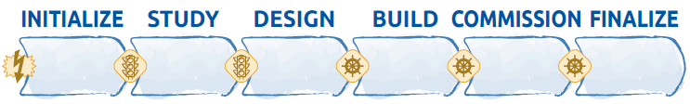
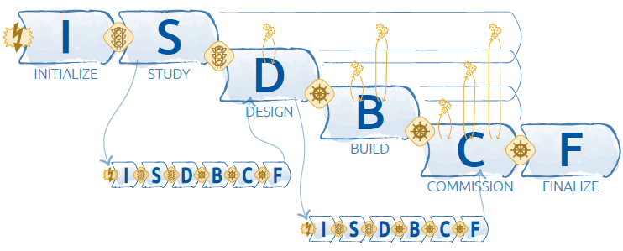
OpenSE – Lifecycles as they are today
(Version 1.0.02 – February 2016)
Chapter II – 5 pages
What is a Lifecycle
The OpenSE Lifecycle
The Facility LifeCycle
    Interphase Decision Points
    Six project Phases
    Tailoring of project Phases
The Reticular and Fractal Nature

Slide 3
OpenSE Lifecycle – evaluation
What works well
What may be improved
Excellent for construction of beam facilities (e.g. EA Upgrade project)
Commissioning phase properly integrated
Many examples and expertise on the use of such lifecycles exist at CERN
Senior Managers/Steering Board understand and have worked with such kind of cycles before
Document templates/examples available
More flexibility in project lifecycle design
Provide guidelines on how to design a project lifecycle taking into account :
  Control needs of the sponsors
  Nature of project
  Area of application
Provide CERN examples of lifecycles for non beam facility construction projects (repository)
“We have a teacher who provides us with the knowledge, but we need a facilitator to get going”

Slide 4
OpenSE 2.0 – generic lifecycle
Starting
the project
Organize
and prepare
Carry out the work
Ending the Project
Project Phase
Project Phase
Project Phase
Project Phase
Start dates
End dates
Level of control
Involvement of senior management/sponsor is needed when the project lifecycle is designed
Project Phase : ‘A collection of logically related project activities that culminates in the completion of one or more deliverables’

Slide 5
Project Phases
Examples of phase names :
Criteria to establish a phase :
Concept development
Feasibility Study
Customer Requirements
Solution Development
Design
Prototype
Build
Test
Transition
Commissioning
Milestone review
Lessons learned
Management Needs
Nature of the project
Unique characteristics of the company or the technology
Project elements including technology, engineering, business, process or legal
Decision points

Slide 6
OpenSE 2.0 – Rules for Project Phases
Minimum number of project phases is 4
At the start of a phase in the project lifecycle, the following must be defined
  Start/end dates of each phase
  Resources that will be needed for that phase
  Criteria to entry the phase
  Criteria to exit the phase
  Project Performance measurement data that will provided during the phase :
    What indicators ?
    How often ?
    To whom ?
    How will this data will be communicated/documented ?

Slide 7
OpenSE 2.0 – 3 lifecycle types
 | Predictive | Iterative | Agile
Requirements | Defined up front | Elaborated periodically | Elaborated frequently
Delivery | Final delivery at the end | Deliver subsets | Deliver small and ‘customer valued’ subsets
Change | Constrained | Incorporate occasionally | Continuous change during delivery
Stakeholders | Key Stakeholders Involved only at key mile stones | Key stakeholders regularly involved | Key stakeholders continuously involved
Risk & Cost | Controlled via detailed planning Cost control via EVM for entire project | Risk and cost are controlled by progressively elaborating the plans with new information | Risk and cost are controlled as the user requirements and the constraints emerge during the project
Authority of the PM | High | Medium | Low

Slide 8
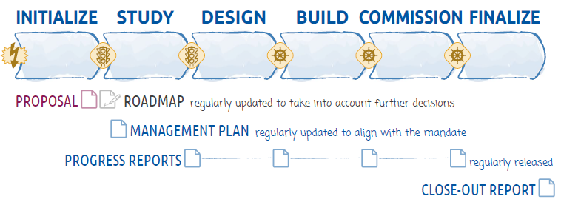
OpenSE – Key deliverables as they are today
(Version 1.0.02 – February 2016)

Slide 9
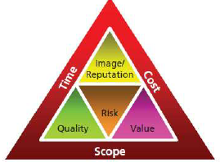
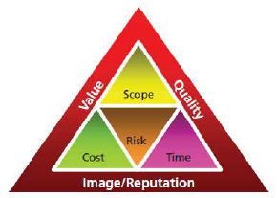
OpenSE 2.0 – Include Value Management !
Project Charter/Roadmap
Project Management Plan
AND
Project Business case
Benefits management plan
Project Charter/Roadmap
Project Management Plan

Slide 10
OpenSE 2.0 – Initializing
Business case – some remarks
Another name is needed for this document to better fit the organizational culture
Needs to be produced/approved at the same time as the project proposal/roadmap
Will be a guidance when evaluating the project at a phase gate
Positive
Negative
! Also consider other resources (e.g. Barnes 2001) :
Human capital (skills, expertise, ..)
Organizational capital (structures, procedures, work instructions, admin …)
Physical capital (plant, primary goods, space on site, financial ..)

Slide 11
The lazy project managers’ Business Case (without excel !)
Question 1 : Are the ‘pain’, the ‘need’ or the ‘desire’ clearly defined (P-N-D statement) ?
Question 2 : Is the proposed solution compelling and in line with the strategy of the group/department/organization or project ?
Question 3 : Would the (strategic, operational) objectives of the organization be at risk if nothing were done?
Question 4 : What are the alternative solutions and why are these not preferred? Is this solution really the best choice ?
Question 5 : Will the desired outcome satisfy the stakeholders/sponsors ?
Question 6 : What are the risks and what are the opportunities ? Are they manageable with the resources we ask for?
Question 7 : Is the level of uncertainty due to ‘unknown’ unknowns in the project acceptable ?
Question 8 : Is there a clear definition of project success and a clear definition of project failure?
Question 9 : Can all the required resources realistically be obtained?
Question 10 : Is the team capable and motivated of delivering success?

Slide 12
OpenSE 2.0 – Benefits Management Plan
Environmental Assessment (Internal/External)
Business Case
Benefits Plan
Project Charter
Project Management Plan

Slide 13
The lazy project managers’ Benefits Management plan
How to create, optimize and sustain the benefit provided at the end of the project ?
Question 1 : What are the benefits envisaged by the project ?
Question 2 : How will the performance of the benefits be measured ? (KPI ?)
Question 3 : What are the acceptance criteria for a created benefit ?
Question 4 : What is the timeframe for realizing the benefits ?
Question 5 : What are the negative impacts of the benefits ? (what does the change mean ?)
Question 6 : Who is impacted by the change ? (who are the stakeholders)
Question 7 : Who will be in charge of realizing the benefit ? (owner of the new idea, service, product)
Question 8 : When will the ongoing responsibility be transferred ? (end of project/start operations)
Question 9 : : How will the ongoing responsibility be transferred ? (task force, transition project, activity)
Question 10 : How will the benefits be sustained ? (operational resources ?)

Slide 14
OpenSE 2.0 – Documentation @ phase gates
‘every phase needs to be initialized, planned, executed, monitored and controlled and closed’
At the start/end of a project phase, compare the project information against the information that can be found in :
Project Proposal/Roadmap
Project Management Plan
Project Business case
Benefits management plan
Results of this comparison by the Project Board can be :
Continue to the next phase - RAS
Remain in the current phase
Rework deliverables from the current phase
Stop the project
Continue to next phase with modifications

Slide 15
OpenSE 2.0 – summary of recommendations
Final Notes :
Should we also allow for flexibility in the documentation?
Can/should the Level of details / amount of content in each document be adapted to each type of project, and to the expectations from the project's authority representatives?
Allow for more flexibility in the project lifecycle design
Include Project Value management (‘business case’, benefits plan)
Measure impact (change) due to use of the project deliverables after the project closure

