Slide 1

OpenSE 2.0 Task force
Task Force V : Cost Estimating and Progress Monitoring
E. Harrouch, T. Wijnands, S. Prodon, M. Mendes, P. Martinez, R. Martins

Slide 2
OpenSE – Project Costing as it is today
(Version 1.0.02 – February 2016

Slide 3
OpenSE 2.0 – Elements that have been considered in the task force
Establish Project Work Breakdown
FBS
OBS
PBS
Identify Cost drivers and the Elements of Cost
Planning Budgeting and forecasting
Estimate costs :
Analogous
Parametric
Bottom up
Establish project cost baseline and project budget
Monitor and Control Project progress
Project Funding Requirements
Manage project change
Monitor and control
Earned Value
Earned Schedule

Slide 4
OpenSE 2.0 : The foundation for Project Cost Estimation is the WBS
Managing scope : to ensure that the project includes all the work required and only the work required.
Scope Management
What Consequences for Cost Estimating ?
Planning
Plan Scope Management
Collect Requirements
Define Scope
Create your WBS
Monitoring and control
Control scope
Validate Scope
What type of work breakdown do I make ?
What kind of Cost estimating Techniques do I use ?
Analogous
Parametric
Bottom up
Contractor Bid analysis
What kind of estimating techniques do I use ?
Deterministic estimate
Three point estimate (PERT)
How and what kind of reserves do I include ?
Contingency reserve
(included in the estimate)
Management reserve
(managed by the project sponsor)

Slide 5
OpenSE 2.0 : What types of breakdown could we also use ?
Functional Breakdown Structure – FBS -
Management
Administration
Manufacturing
Tooling
Integration
Organizational Breakdown Structure –OBS-
EN department
HR department
Company XYZ
SMB department
Product Breakdown structure – PBS-
Hardware
    electrical
    cooling
    Software
    Systems Level Cost
    System Engineering
    Integration
    Tests
CERN standardized Elements Of Cost
-EOC-
Labor costs (not staff)
General and Admin costs
Materials (raw, purchased parts, cost of overheads)
Other Direct Charges (e.g. travel, consultancy)
Overhead (e.g. fringe benefits)
Subcontracts
in CHF !
‘Every breakdown approach draws on the same cost data but applies to a different category. Each CHF can be assigned to a product, an organizational unit and a function and be identified with an element of cost’
NASA cost estimating Handbook v4.0

Slide 6
OpenSE 2.0 : Determine cost drivers per work package
Example of an OBS that is using standard EOCs
Project
Department X
Company Y
Unit Z
Labor costs 40
Material costs 30
Admin costs 75
Direct Charges 200
Overheads 10
Total 355
Labor costs 20
Material costs 210
Admin costs 15
Direct Charges 10
Overheads 7
Total 262
Labor costs 150
Material costs 70
Admin costs 45
Direct Charges 0
Overheads 5
Total 270
Different types of Break Downs for scoping/de-scoping and resource levelling

Slide 7
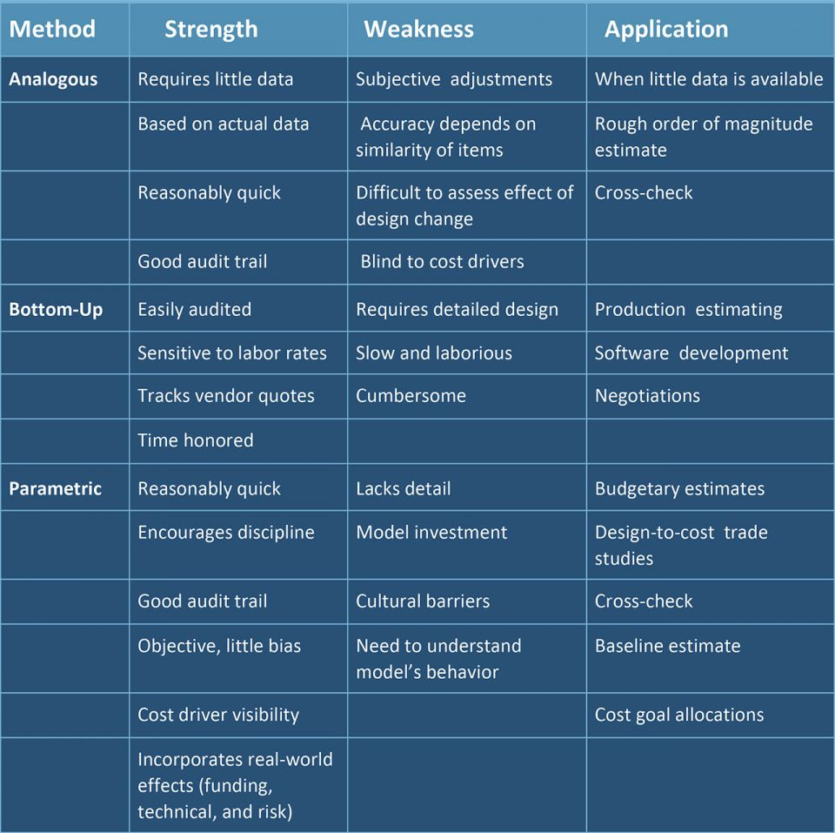
OpenSE 2.0 : Techniques to Estimate costs
OpenSE today – cost estimating techniques
The main techniques are already in the OpenSE standard today
We may add contractor bid analysis.
Contractor Bid Analysis is where you figure out the cost of a project by comparing the bids submitted by many suppliers using criteria such as
Records from previous deals
Meeting with quality needs
Seller capacity and resources
Meeting deadlines in records
Financial capability

Slide 8
OpenSE 2.0 : Management reserve and contingencies
What do we want as the contingency allowances for a CERN project ?
Project Budget
Management Reserve
BAC/EVM
Cost Baseline
Control Accounts
Contingency
Reserve
Works Package
Cost estimate
Contingency
Reserve
Activity
Cost estimate
Adapted from PMBok Sixth Edition, Project Management Institute

Slide 9
OpenSE 2.0 : Establishment of a Project Budget
Sales Price of the project
Project Budget
BAC from the
WBS
Management
Reserve
Contingency
(% BAC or other)
Risk Responses
Overheads
Margin or profit
Adapted from PMBok Sixth Edition, Project Management Institute

Slide 10
OpenSE 2.0 : Open Issues on Estimate costs
A guideline for cost estimating for CERN projects in the OpenSE 2.0 framework could be useful so that we can compare project cost estimates on an equal basis. For example :
What costs should be included and what costs should not ?
What costs should be discounted and at what rate ?
How to deal with FOREX ?
How to deal with CHF/EUR exchange rate fluctuations ?
How to manage uncertainties in the cost estimates ?
What data needs to be communicated to the DPO ?
…
The guide may also address the issues of discounting project costs
The guide may also address the issues of reserves and contingency

Slide 11
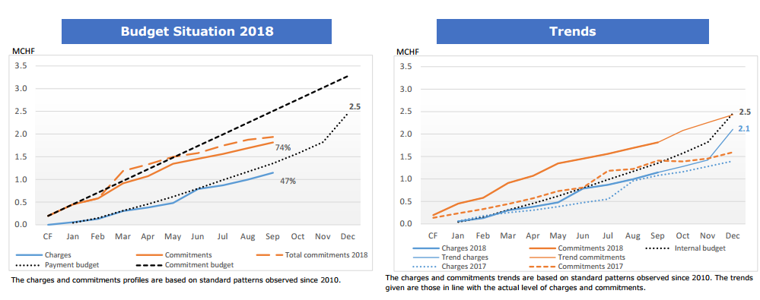
OpenSE 2.0 : Control of progress – financial data
Financial data provided by the RPC group for a CERN registered project

Slide 12
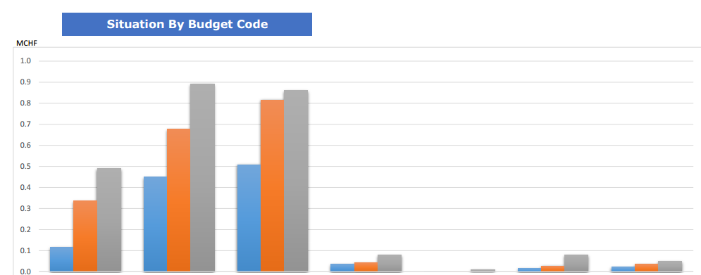
OpenSE 2.0 : Control of progress – financial data
Financial data provided by the RPC group for a CERN registered project

Slide 13
OpenSE 2.0 : Other Ideas for Monitoring expenditure in a project
EVM – this would probably need a separate taskforce !
Committed vs cost to completion
Charged vs Committed against total budget
Paid vs cost to completion
Nbr of milestones made Nbr of milestones missed
Candle bars
Fever charts *for critical chain*
Nbr tasks completed
Critical Path monitoring

