Slide 1
Requirements
Engineering
Contributors:
Christelle Gaignant, Paula Martinez Urios,
Jenni Kaipainen, Thijs Wijnands, Pierre Bonnal

Slide 2
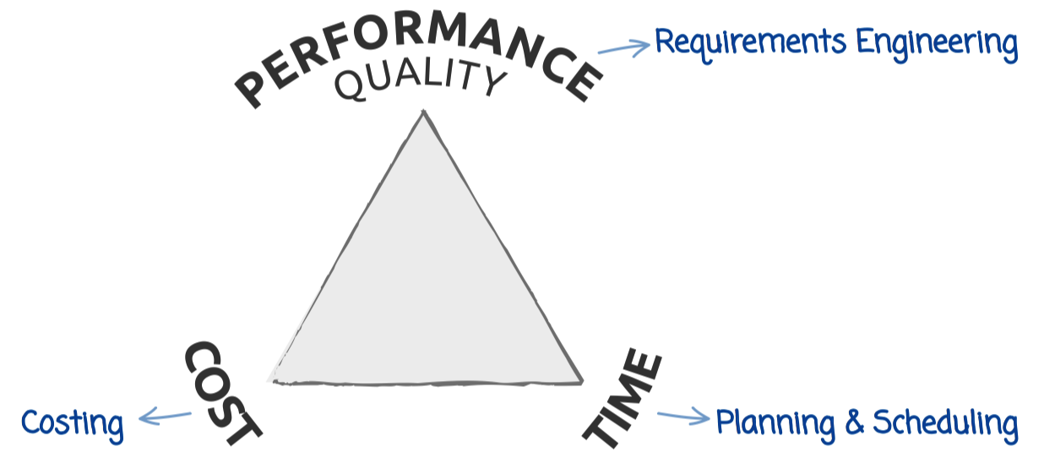
RE at a glance
One of the “three corners” of the project
management triangle
The “corner” which received attention the most recently (advent in the mid 1960’s)

Slide 3
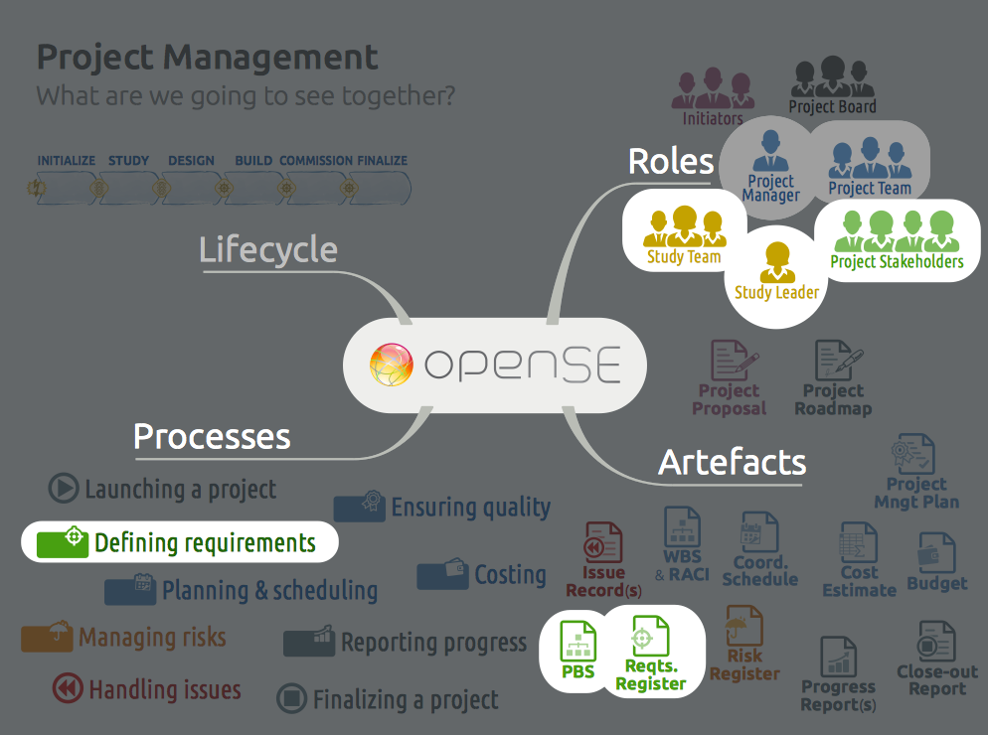
RE in openSE
In the openSE booklet (v. 1.02) → not that much
In the training material → substantially more
(Ulrich & Eppinger textbook, ISO/IEC/IEEE 29148:2011, IREB.org)

Slide 4
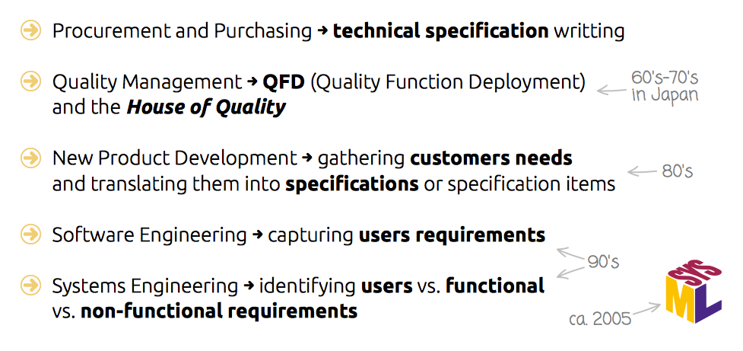
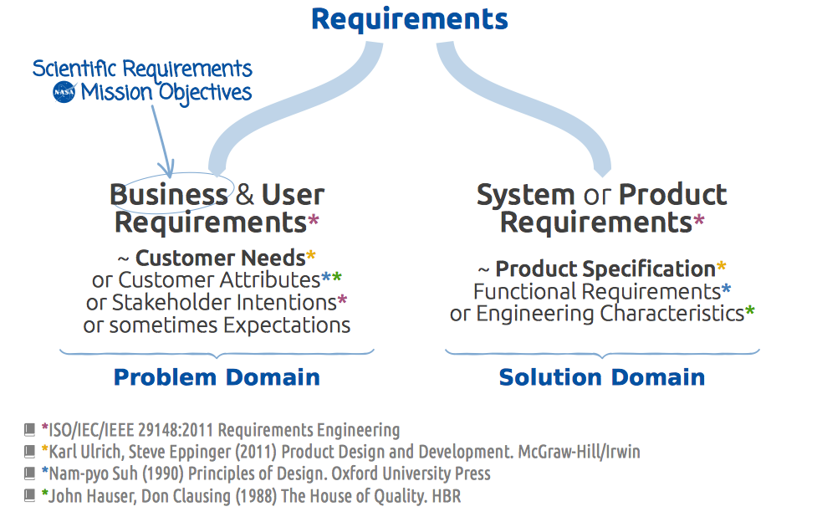
RE in openSE training

Slide 5
RE in openSE training
What to improve ?
Tailoring to project specificities/complexity
Stakeholder identification
with focus on Safety
Needs gathering and validation global practices vs. practices at CERN*
Requirements formulation and verification global practices vs. practices at CERN*
RE software, examples, case studies and other resources to share
* On science-related technical projects

Slide 6
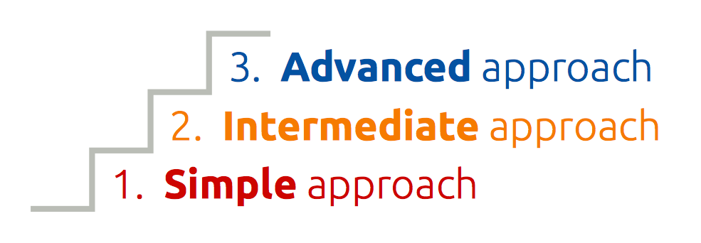
1.
Tailoring to project specificities/ complexity
Three approaches corresponding
to three levels of enhancement expectations
Training focused on the intermediate approach
Information given on advanced practices with
large-scale projects (HL-LHC, etc.)

Slide 7
2.
Stakeholders identification
Stakeholders shall be understood as:
  Physical persons
  Organizational entities (a group, a committee)
  Partners (institutes, contractors), or
  Published/released information (rules, stds.)
Five groups of stakeholders:
  Material resource providers to the project
  (money, in-kind contributions)
  Manpower providers to the project
  (line management of assigned participants)
  End users of the project deliverables
  (future operators, maintenance team, etc.)
  Top management (strategists, i.e. GLs, DHs, directors according to the project size)
  Regulators to the project (those who set
  the rules, or the rules themselves)

Slide 8

2.
Stakeholders identification
Safety-related stakeholders at CERN:
Simple and intermediate approaches
(small projects, dept. projects, LSP WPs) :
  People: HSE, PSO, DSO, TSO, safety experts
  and SSOs, EROS, safety correspondents from other WPs, etc.
  Documents: various safety rules, LSA, operational procedures and guidelines, Project Safety Plan + associated project procedures and guidelines, etc.
Advanced approach (large-scale projects at CERN as a whole)
  People: HSE, DSOs, TSOs, safety experts and SSOs, tripartite, collaboration safety officers, etc.
  Documents: various safety rules, LSA,
  operational procedures and guidelines,
  etc.

Slide 9
2.
Stakeholders identification
Integrate types and groups of stakeholder in the openSE booklet
Adapt training material accordingly
Release a vademecum and some examples on the openSE twiki pages

Slide 10
3.1.
Needs gathering/ validation
Examples at CERN
Functional Specification (LHC Project)
Conceptual Specification (HL-LHC Project)
Users Requirement Document
~ Work Package Description
Spreadsheet-based Requirement Register
(HSE projects)

Slide 11
3.2.
Requirements formulation/ verification
Examples at CERN
Engineering Specification
Technical Specification for Procurement
Spreadsheet-based Requirement Register
(HSE projects)

Slide 12
3.
Needs and requirements
Feature CERN practices in the training material
Develop and provide scientific-facility-related examples (cordless screwdriver, mountain bike fork and SmartHalo)
Share some CERN examples on the openSE twiki pages

Slide 13

4.
RE Software and Templates
Shall we promote a RE software? No!
However, comprehensive spreadsheet templates and examples can be provided

Slide 14
4.
RE Software and Templates
Develop a spreadsheet-based requirements register and publish it on the openSE website and openSE twiki pages
Share links to SE software on the openSE twiki pages

Slide 15


Summary
Process & Tools | Simple approach | Intermediate approach | Advanced approach
Stakeholders identification | yes | yes | yes
Needs gathering and validation | yes however no distinction between needs and reqts. | dedicated process with stakeholder
Reqts. formulation and verification (against needs) |  | dedicated process within project team
Requirements register | embedded in the Project Roadmap | User Reqts. Document | consider dedicated database DOORS, InnoSlate
Reqts. Eng. process formulation | informal | § in Project Management Plan | Reqts. Management Plan
Deviations from plans | Adhoc with stakeholders | Through ECRs, NC, FAT, SAT, Safety Inspection Reports, etc. | RE DB monitored deviations

Slide 16
Take
Away
openSE quite aligned with generally agreed global good practices:
Stakeholders – Needs – Reqts. – V&V
Tailored →
openSE booklet and training
material → slightly enhanced
A few examples, case studies and templates → to be developed/ collected and shared

Slide 17
Thanks

