Slide 1
Project Roadmapping Task Force
Contributors: M. Mendes, T. Wijnands, J. Kaipainen, P. Martínez Urios

Slide 2

Mandate and Scope
Goals:
  reviewing openSE knowledge domain as featured in the openSE booklet and as brought to openSE training participants,
  discussing their appropriateness w.r.t. projects typologies at CERN,
  eventually discussing their alignment with standards such as PMBoK, HERMES, PRINCE2.
  eventually discussing limitations with IT support tools such as MS Project, various templates, etc.
  listing/proposing/suggesting improvements (with rationale), for both the booklet and the openSE training material, supported by a rationale.
Scope of this task force:

Slide 3
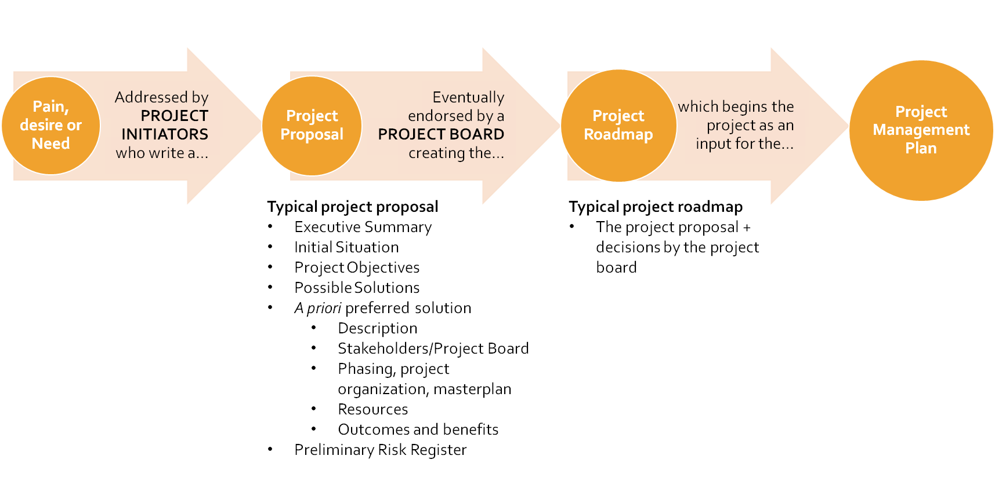
Project Roadmapping in openSE

Slide 4

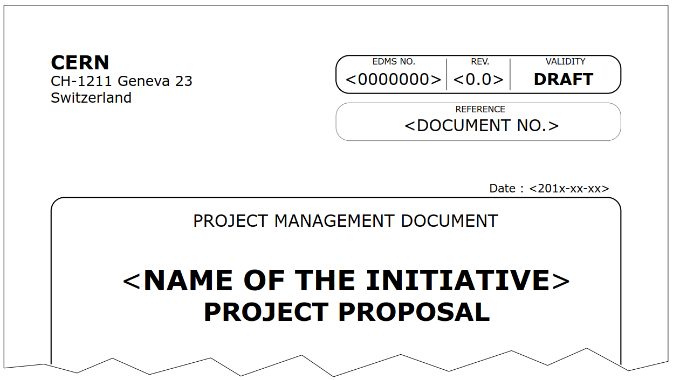
Material available @ CERN
Template available on EDMS:
Authoring guidelines are also available in the same EDMS document.
Not necessarily a very strict structure (use it as guidelines).
Administrative form to allocate budget to the project: Project Request Form on EDH.

Slide 5
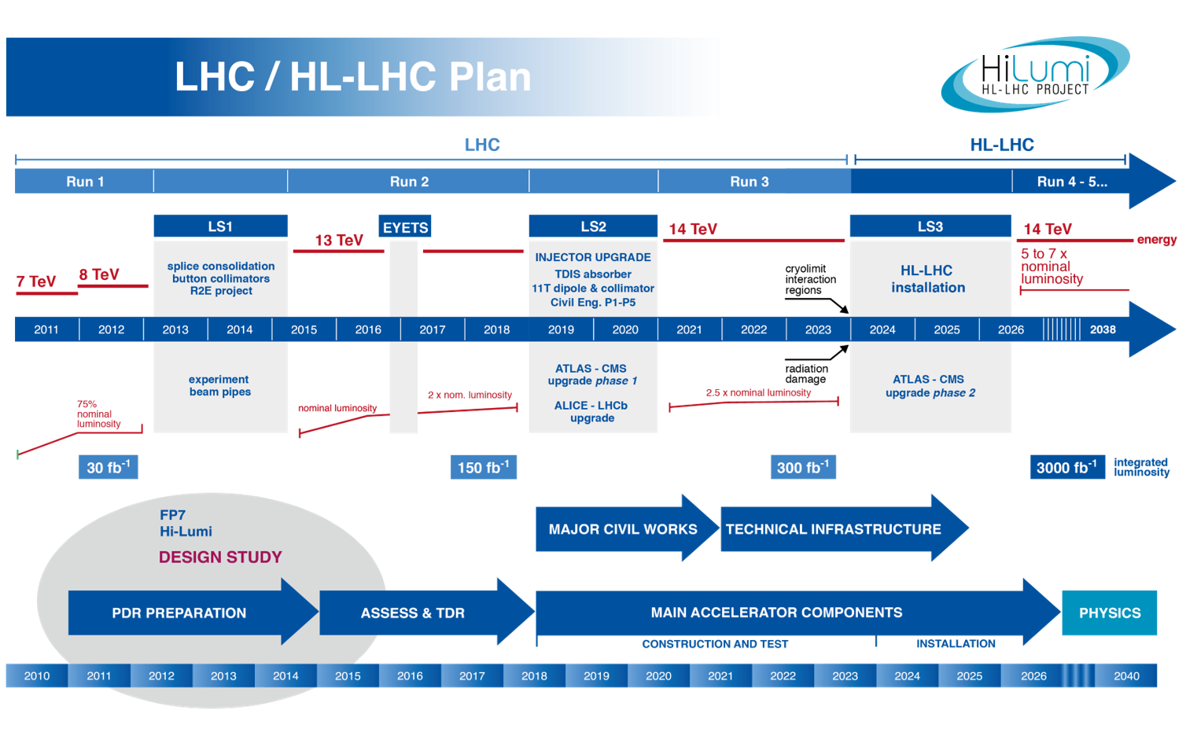
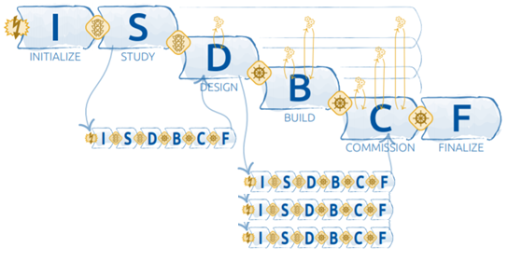
The example of HL-LHC Project

Slide 6
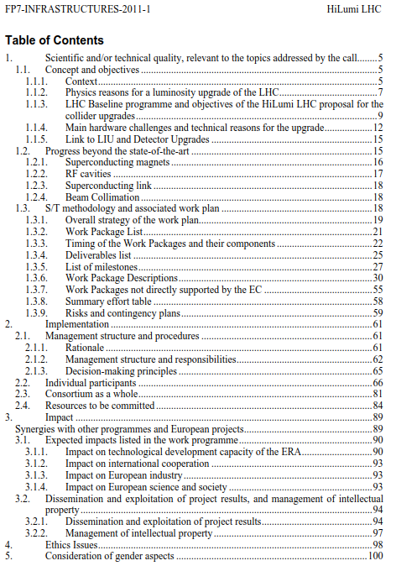
Proposal of HL-LHC Design Study

Slide 7
Proposal of HL-LHC Design Study
Most significant aspects:
Current situation
Objectives
Technical description

Slide 8
Proposal of HL-LHC Design Study
Most significant aspects:
Current situation
Objectives
Technical description
Project organization
Work breakdown structure
Deliverables
Master plan and milestones
Risks and contigencies

Slide 9
Proposal of HL-LHC Design Study
Most significant aspects:
Current situation
Objectives
Technical description
Project organization
Work breakdown structure
Deliverables
Master plan and milestones
Risks and contigencies
Resources
Stakeholders
Impacts
Management of intellectual property

Slide 10
Proposal of HL-LHC Design Study
Most significant aspects:
Current situation
Objectives
Technical description
Project organization
Work breakdown structure
Deliverables
Master plan and milestones
Risks and contigencies
Resources
Stakeholders
Impacts
Management of intellectual property

Slide 11
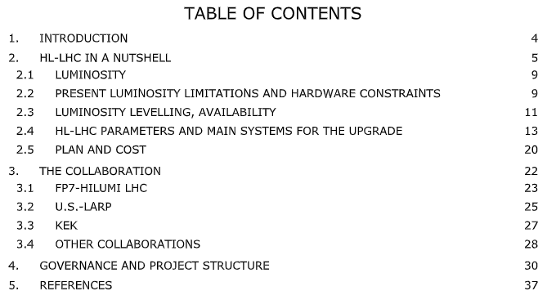
HL-LHC Project Description
Most significant aspects:
Objectives
Technical description
Cost estimate
Master plan
Stakeholders
Project organization
Work breakdown structure

Slide 12
What can be improved?
In the training slides/material…
Build a database of project proposals at CERN, to use as a general guide.
The task force collected some Project Proposals:
  HL-LHC
  FCC Study
  HIE-ISOLDE
  Other smaller projects

Slide 13
What can be improved?
In the booklet/template…
Consider the addition of new items on the structure of a proposal, supported by the standards and already included in some of the examples:
  assumptions and constraints,
  impact (negative and positive),
  a preliminary breakdown structure: PBS, WBS, BBS…
  management of Intellectual Property.
Make the content of Project Proposal and Project Roadmap section (p. 44) more coherent with the template and the training slides (44 & 46); add to the booklet a short description of each of the parts.

Slide 14
Thanks to the openSE team for taking the initiative, the time and the patience to receive input, and to the participants, for their valuable contribution !

