Slide 1

OpenSE 2.0 Task force
Task Force VI : Agile Inclusion
E. Peyrat, R. Franqueira Ximenes, R. Martins, T. Wijnands

Slide 2
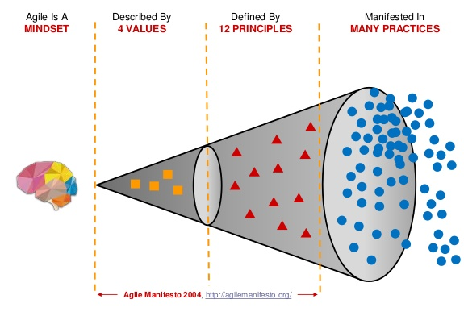
Agile Mindset

Slide 3
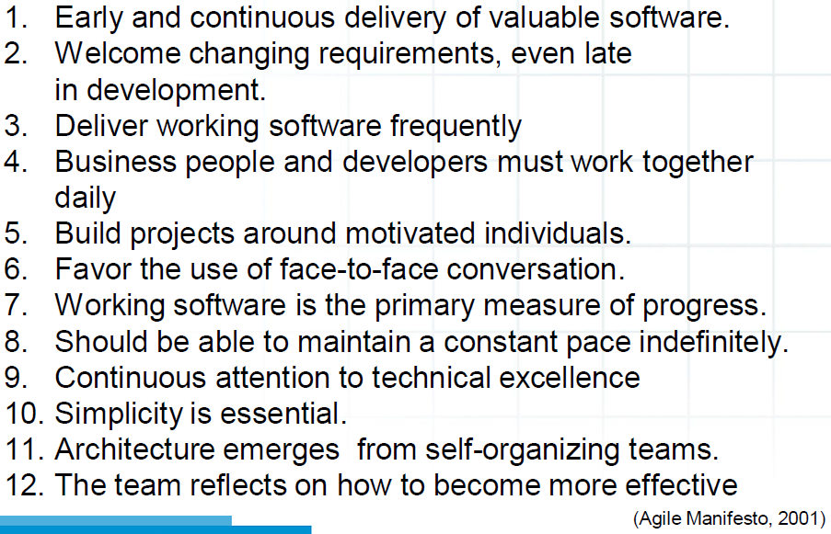
12 Principles of the Agile manifesto

Slide 4

Strategies to fulfill Agile values and principles
Adopt a formal AGILE approach
Top down approach
Implement changes to project practices
  Changes to project management practices when value can be created using an Agile approach/methodology
  Build on existing experience at CERN
Agile practice guide PMI 2018

Slide 7
NOT Agile “for the sake of Agile”

Slide 8
Inclusion of Agile in OpenSE – why ?
 | Predictive | Agile
Requirements | Fixed | Dynamic
Activities | Performed once | Repeat until correct
Delivery | Single Delivery | Frequent & small
Goals | Manage Costs | Customer value via Feedback

Slide 9
Inclusion of Agile in OpenSE – where ?
Agile Teams
Small teams (5-7 persons)
Servant leadership (SCRUM Master)
Team has to be Dedicated to the work
Ultimate responsibility with a group or department
Colocation
Excellent effective and efficient and frequent communication
Mixed team of specialists and generalists
Stable work environment (no competing for work or vacancies)
Willingness to be a ‘self organized’ team
Open space type of working environment

Slide 10
Inclusion of Agile in OpenSE – how ?
Requirements
Analysis
Design
Build
Test
Deliver
Requirements
Analysis
Design
Build
Test
Deliver
Requirements
Analysis
Design
Build
Test
Deliver
Feature 1
Feature 2
Feature 3
Example of a hybrid Predictive and Cadence Life cycle
that Implements 3 features

Slide 11
Key Points to consider when considering agile
Can we be more successful using agile ?
Are all requirements clear at the start of the project ? No, use agile !
Is customer/end user feedback required ? Yes, use agile !
Do we need to manage risks as new ideas are explored ?
Do we have an experienced servant leader ?

Slide 12
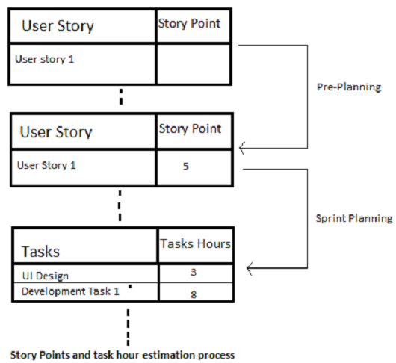
Inclusion of Agile in OpenSE – controls ?
EVM in an Agile Context – this is not a problem
Other metrics :
Features complete, remaining and total
Story points remaining
Story points completed
Kanban Board

Slide 13
