Slide 1
Task force summaries
OpenSE Forum
11th October 2018

Slide 2
Overview
Part 1
Lifecycles & Key Deliverables
Planning and Scheduling
Cost Estimation & Progress Monitoring
Part 2
Requirements Engineering
Project Roadmapping
Agility-Inclusion

Slide 3
This Afternoon
1) A recap on the presentations from this morning, highlighting the main elements. Opportunity for comment and discussion during this phase.
Coffee
2) Final conclusion based on Taskforce findings and the summary of group discussions.

Slide 4
Lifecycles & Key Deliverables

Slide 5
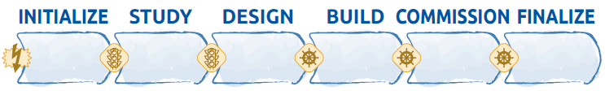
Starting
Point
Chapter II – 5 pages
What is a Lifecycle
The OpenSE Lifecycle
The Facility LifeCycle
    Interphase Decision Points
    Six project Phases
    Tailoring of project Phases
The Reticular and Fractal Nature

Slide 6
Proposed Rules
Minimum number of project phases is 4
At the start of a phase in the project lifecycle, the following must be defined
  Start/end dates of each phase
  Resources
  Entry criteria
  Exit criteria
  Performance measurement data :
    What indicators ?
    How often ?
    To whom ?
    How will this data will be communicated/documented ?

Slide 7
Lifecycle types
 | Predictive | Iterative | Agile
Requirements | Defined up front | Elaborated periodically | Elaborated frequently
Delivery | Final delivery at the end | Deliver subsets | Deliver small and ‘customer valued’ subsets
Change | Constrained | Incorporate occasionally | Continuous change during delivery
Stakeholders | Key Stakeholders Involved only at key mile stones | Key stakeholders regularly involved | Key stakeholders continuously involved
Risk & Cost | Controlled via detailed planning Cost control via EVM for entire project | Risk and cost are controlled by progressively elaborating the plans with new information | Risk and cost are controlled as the user requirements and the constraints emerge during the project
Authority of the PM | High | Medium | Low

Slide 8
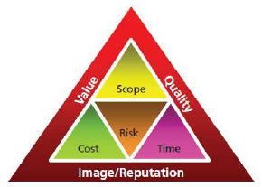
Defining Value or Benefit
Project Charter/Roadmap
Project Management Plan
AND
Project Business case
Benefits management plan

Slide 9
Benefits Plan
Environmental Assessment (Internal/External)
Business Case
Benefits Plan
Project Charter
Project Management Plan

Slide 10
Summary
Allow for more flexibility in the project lifecycle design
Include Project Value management (‘business case’, benefits plan)
Measure impact (change) due to use of the project deliverables after the project closure
Final Notes :
Should we also allow for flexibility in the documentation?
Can/should the Level of details / amount of content in each document be adapted to each type of project, and to the expectations from the project's authority representatives?

Slide 11
Discussion

Slide 12
Planning & Scheduling

Slide 13
Starting Point
Review of documentation and training materials for planning and scheduling activities.
There are no OpenSE documents related to planning and scheduling
We suggest to either
  Write these guidelines which could be indeed be very useful material
  Or remove any references to them

Slide 14
Training
&
User Groups
Organise courses for different types of audiences:
  Advanced vs Beginners
In parallel to existing courses
  Organise user forums to share i.e. MS Project tricks, hints and best practices with the community
  Material presented during the PMMU could be referenced during the courses

Slide 15
Training
Content
Include a glossary of terms
Suggest tools that could be used to create i.e. master schedules or WBS/PBS
Provide CERN examples when possible
OpenSE is in general engineering oriented, perhaps we should make it more general?

Slide 16
Tools & Support
Tools
Big Tools (Project, EVM etc.)
Little Tools (Spreadsheets)
Include a glossary of terms
Suggest tools that could be used to create i.e. master schedules or WBS/PBS
Provide CERN examples when possible
OpenSE is in general engineering oriented, perhaps we should make it more general?
Support
We are all looking forward to future user forums
But other formats could be considered as well, a grass-roots approach and inter-departmental strategies

Slide 17
OpenSE Curriculum
Three levels of training are required
  Beginners
  Advanced
  Senior management
Each group is different, with different training needs

Slide 18
Tools
Include a glossary of terms
Suggest tools that could be used to create i.e. master schedules or WBS/PBS
Provide CERN examples when possible
OpenSE is in general engineering oriented, perhaps we should make it more general?

Slide 19
Discussion

Slide 20
Cost Estimating & Progress Monitoring

Slide 21
Starting Point

Slide 22
An Alternative Breakdown
Functional Breakdown Structure – FBS -
Management
Administration
Manufacturing
Tooling
Integration
CERN standardized Elements Of Cost
-EOC-
Organizational Breakdown Structure –OBS-
EN department
HR department
Company XYZ
SMB department
Product Breakdown structure – PBS-
Hardware
    electrical
    cooling
    Software
    Systems Level Cost
    System Engineering
    Integration
    Tests

Slide 23
Cost Estimation
Techniques
We may add contractor bid analysis.
Contractor Bid Analysis is where you figure out the cost of a project by comparing the bids submitted by many suppliers using criteria such as
Records from previous deals
Meeting with quality needs
Seller capacity and resources
Meeting deadlines in records
Financial capability

Slide 24
Budgets
& Risks
Sales Price of the project (Budget)
BAC from the
WBS
Management
Reserve
Contingency
(% BAC or other)
Risk Responses
Overheads
Margin or profit
Adapted from PMBok Sixth Edition, Project Management Institute

Slide 25
Specific Cost
Issues
All projects should make cost estimates on an equal basis.
We need standardized answers to the following questions:
What costs should be included and what costs should not?
What costs should be discounted and at what rate ?
How to deal with FOREX ?
How to deal with CHF/EUR exchange rate fluctuations ?
How to manage uncertainties in the cost estimates ?
What data needs to be communicated to the DPO ?

Slide 26
Items for future study
Earned Value Management, needs a separate task force
Other areas where we could be more concrete:
Committed vs cost to completion
Charged vs Committed against total budget
Paid vs Cost to completion
Tracking completed tasks (smaller scale projects)
Critical Path monitoring
Potential visual representations:
Milestone charts (made vs missed)
Candle bars
Fever charts for critical chain

Slide 27
Items for future study
Earned Value Management, needs a separate task force
Other areas where we could be more concrete:
Committed vs cost to completion
Charged vs Committed against total budget
Paid vs Cost to completion
Tracking completed tasks (smaller scale projects)
Critical Path monitoring
Potential visual representations:
Milestone charts (made vs missed)
Candle bars
Fever charts for critical chain

Slide 28
Discussion

Slide 29
Requirements
Engineering

Slide 30
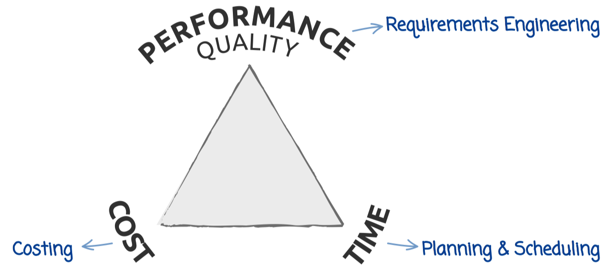
Starting point

Slide 31
Training
What to improve ?
Tailoring to project specificities/complexity
Stakeholder identification with focus on Safety
Needs gathering and validation global practices vs. practices at CERN*
Requirements formulation and verification global practices vs. practices at CERN*
RE software, examples, case studies and other resources to share
* On science-related technical projects

Slide 32
Stakeholder
Identification
  Stakeholders as people, organisations, partners or information.
  Material resource providers to the project
  (money, in-kind contributions)
  Manpower providers to the project
  (line management of assigned participants)
  End users of the project deliverables
  (future operators, maintenance team, etc.)
  Top management (strategists, i.e. GLs, DHs, directors according to the project size)
  Regulators to the project (those who set
  the rules, or the rules themselves)

Slide 33
Better
Identification
Safety-related stakeholders at CERN:
Simple and intermediate approaches
(small projects, dept. projects, LSP WPs) :
  People: HSE, PSO, DSO, TSO, safety experts
  and SSOs, EROS.
  Documents: various safety rules, LSA, operational procedures and guidelines, Project Safety Plan
  Add CERN Specific Examples

Slide 34
Software
And Templates
Software -> Not the answer to RE at CERN.
A spreadsheet template & examples can be provided instead.
Develop a spreadsheet-based requirements register for openSE and share it.

Slide 35


Requirements Engineering: Summary
Process & Tools | Simple approach | Intermediate approach | Advanced approach
Stakeholders identification | yes | yes | yes
Needs gathering and validation | yes however no distinction between needs and reqts. | dedicated process with stakeholder
Reqts. formulation and verification (against needs) |  | dedicated process within project team
Requirements register | embedded in the Project Roadmap | User Reqts. Document | consider dedicated database DOORS, InnoSlate
Reqts. Eng. process formulation | informal | § in Project Management Plan | Reqts. Management Plan
Deviations from plans | Adhoc with stakeholders | Through ECRs, NC, FAT, SAT, Safety Inspection Reports, etc. | RE DB monitored deviations

Slide 36
Discussion

Slide 37
Project Roadmapping

Slide 38
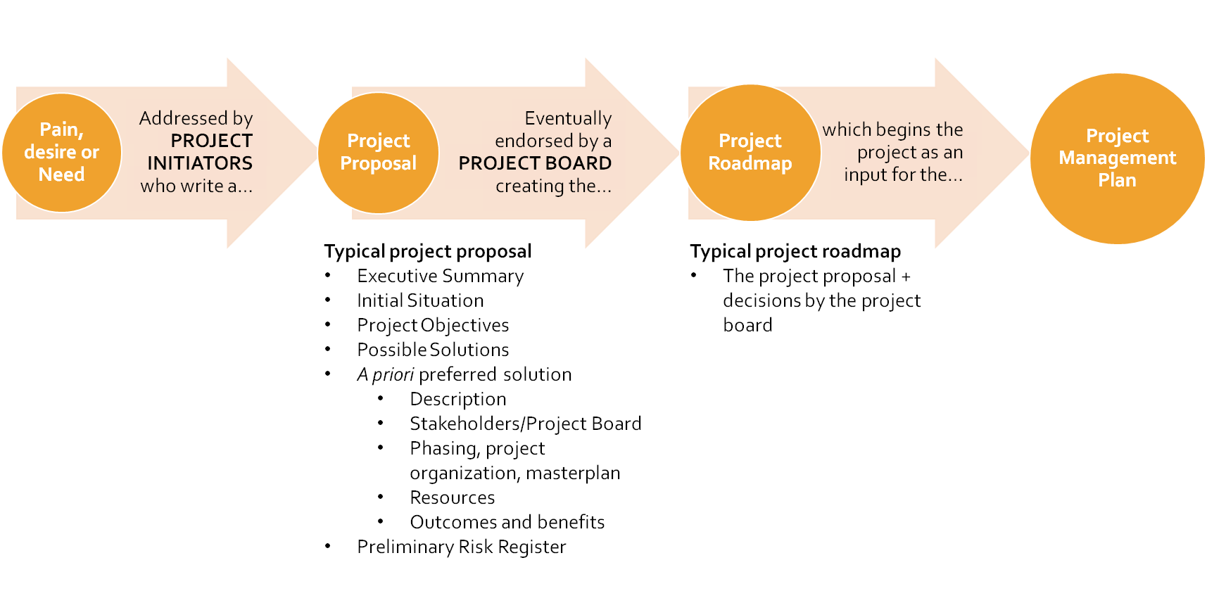
Starting Point
Project Roadmapping in openSE

Slide 39

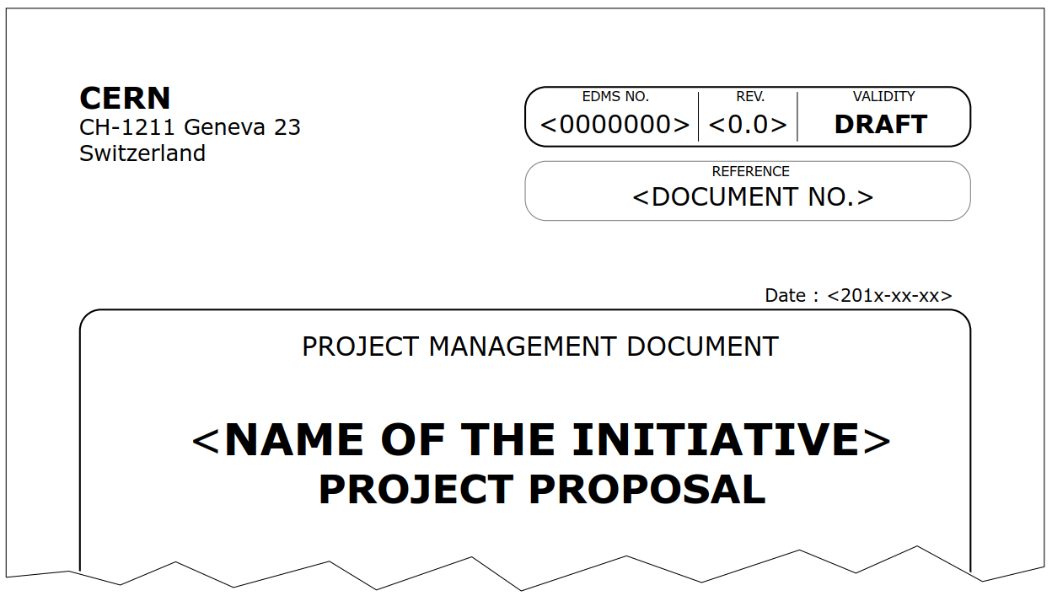
Current tools & procedures
Template available on EDMS:
Authoring guidelines are also available in the same EDMS document.
Not necessarily a very strict structure (use it as guidelines).
Administrative form to allocate budget to the project: Project Request Form on EDH.

Slide 40
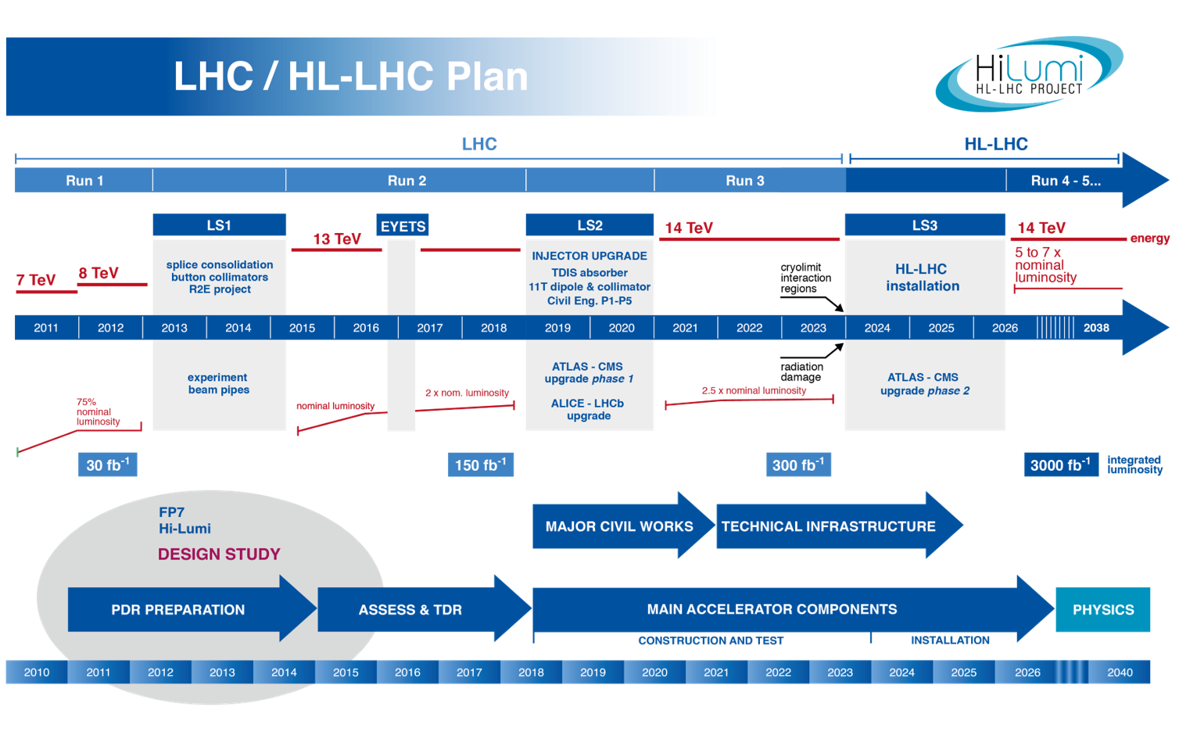
Small,
Medium,
Large
Projects,
Programmes and
Portfolios
Roadmaps for a project need to be understood in the context of the larger program for very large scale works (Hi-Lumi)

Slide 41
Proposals for improvement
Roadmaps for programmes and portfolios need to be elaborated progressively (5 years for Hi-Lumi between proposal & detailed definitions), which needs to be reflected in OpenSE
Structure of the proposal is important, we must be clearer about:
  assumptions and constraints,
  impact (negative and positive),
  a preliminary breakdown structure: PBS, WBS, BBS…
  management of Intellectual Property.
Revise content of Project Proposal and Project Roadmap section (p. 44), with templates and training slides.

Slide 42
Discussion

Slide 43
Agile
Inclusion

Slide 44
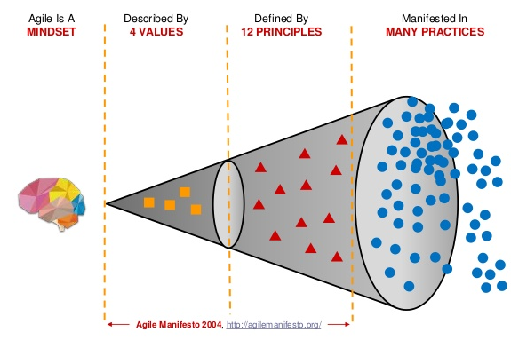
Starting
Point
What is Agile?
Today it is used predominantly in the IT department, there is a significant gap between CERN business as usual and agile practices

Slide 45
Why
Agile?
Not for the sake of being Agile, but…
Can it make the ‘customer’ happier?
But not applicable everywhere (Civil Engineering?)
Parameter | Predictive | Agile
Requirements | Fixed | Dynamic
Activities | Performed once | Repeat until correct
Delivery | Single Delivery | Frequent & small
Goals | Manage Costs | Customer value via Feedback

Slide 46
Agile
What?
An agile team looks like this:
A team based approach, radically different dynamics.
Agile Teams
Small (5-7 persons)
Servant leader
Dedicated team
Ultimate responsibility with a group/department
Colocation
Frequent communication
Mixed team (specialists/generalists)
Stable environment
Will to be ‘self organized’ team
Open plan office

Slide 47
Agile
How?
Modular approach required, as it will only apply to part of the project or part of the whole project team.
One phase of a project might be best suited to agile (hybrid predictive or cadence life cycle).
Need suitable leadership – Servant Leaders or Scrum Masters, which we might not have.
We also need customers and end users to provide feedback, more experience is better.
We need to be able to manage risk as new ideas are explored.

Slide 48
Discussion

Slide 49
Let’s discuss in
1) Group sessions
2) Plenary session

Slide 50
Discussion
Break-out

