Slide 1
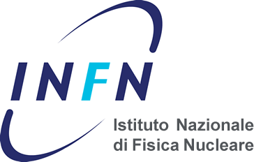
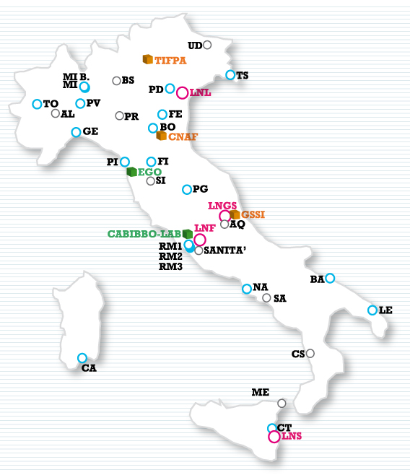
INSIGHTS
Presentation of node: INFN-PD
Kick-off meeting, Padova September 26th 2018
Tommaso Dorigo, INFN- Sezione di Padova

Slide 2
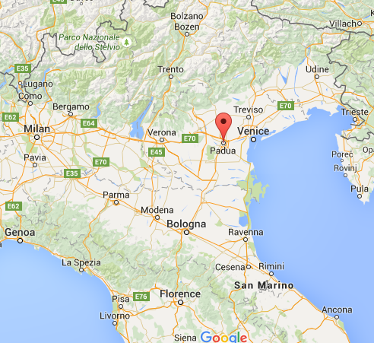
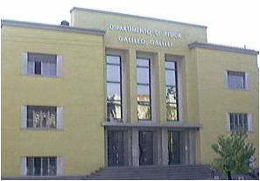
INFN-Padova overview
The Istituto Nazionale di Fisica Nucleare, INFN, is a public-law body founded in 1951. The Institute promotes co-ordinates and carries out scientific research in the field of nuclear physics, elementary particles and basic interactions, as well as technological research and development required for activities in the above fields. INFN carries out its activity through 19 units (sezioni) located in the Italian Universities and 4 National Laboratories. The detection of elementary particles has been always one of the major skills of INFN which, in the framework of many international collaborations has realized complex detection systems including mechanics, electronics, data acquisition and data analysis.
Padova is one of the main units. The INFN-Padova director is Dr. Mauro Mezzetto
INFN-Padova participates in the following experiments and activities:
Subnuclear physics with accelerators: CMS, LHCb, ALICE, BELLE-2
Neutrino physics: ICARUS, OPERA, T2K, Gerda, Nessie, ...
... in particular the Padova team is the largest Italian group partecipating to CMS (muon system, tracker, trigger and analysis)
INFN-PD is located in the main building of the Department of Physics and Astronomy of the University of Padova.

Slide 3
Staff and activities
The INFN-PD staff in the network participates in the CMS experiment
  Tommaso Dorigo is the PI of the node
  Prof. Bruno Scarpa is a co-supervisor
  Prof. Franco Simonetto is a co-supervisor
  Prof. Martino Margoni is a co-supervisor
  Administrative staff include Luisa Iacono. Giorgia Salvato, and Alessandra Lombardo
The group’s interests relevant to the network activities include rare B decay searches
  we contributed to B→μμ searches from Run1 data
  we recently also published an article on angular distributions in B→kμμ decays
We are also active in the Higgs WG (HH searches), as well as in diboson searches, exotica searches, and other topics
Padova has relevant responsibilities in hardware for CMS (we designed and built the drift chambers for muons, as well as parts of the inner tracker)
The ESR Hevjin Yarar will mainly work on developing statistical tools for a CMS search of a rare B decay
Tommaso Dorigo is the outreach coordinator of INSIGHTS and he will try to ensure that our public engagement action is up to the task
I cannot promise it for him, but prof. Scarpa should be considered a resource for the network, in particular for statistical issues in Bayesian analysis

