Slide 1
INSIGHTS - Nikhef
Wouter Verkerke (Nikhef/University of Amsterdam)
P. Ferrari (Nikhef)
Rahul Balasubramanian (Nikhef/UvA)

Slide 2
Nikhef & ATLAS group
Nikhef is the national institute for particle physics in the Netherlands
  Consortium of national science funding agency (NWO)
  and 5 Dutch universities (UvA, VU, Utrecht, Groningen, Nijmegen)
  About 60 staff, 90 PhD students, 25 postdocs
  Participation in ATLAS, LHCb. Alice, Xenon, Virgo, KM3Net
  Also Detector R&D, Physics computing groups, Mechanical/Electronics/Computer Science engineering departments
INSIGHTS participation embedded in the ATLAS group
  13 staff scientists, 17 PhD students, 5 postdocs
  Construction of ATLAS: muon chambers, tracker end cap, DAQ system,
  also host of a Tier-1 computing facility
  Physics focus on Higgs physics, (EW) SUSY, Lepton Flavor Violation searches
  Long-running expertise in statistical modeling/combination for Higgs property measurements
    I was ATLAS Stat Forum Convener, ATLAS Higgs Combination subgroup convener.
    Now member of ATLAS Stat Committee (+2 former PhD students of me)

Slide 3
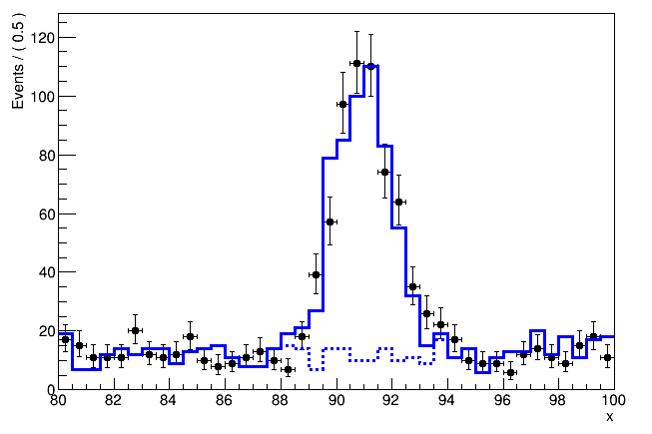
The ESR project – Effective Langrangian Morphing
Context – General goal is construct parametric probability model that expresses (Higgs) physics distributions.
Distributions are not analytically calculable, instead obtain from MC simulation chain: hard physics simulation → soft physics simultation → detector simulation → detectpr reconstruction
Empirical distribution is modeled as a histogram

Slide 4
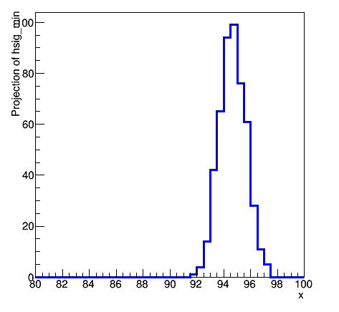
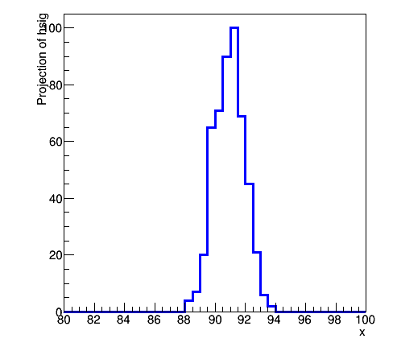
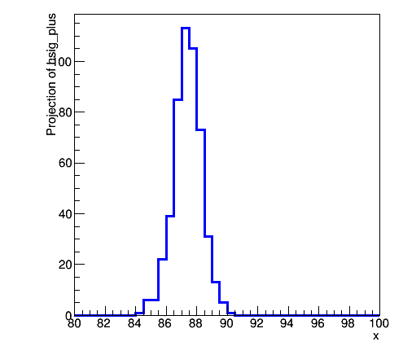
Morphing basics
Central issue – how to express degrees of freedom in a histogram-based probability model
  To express signal parameters (of interest)
  To express (systematic) uncertainties associated with modeling
For parameters that scale rates only – procedure straightforward: introduce scale factor in histogram
For parameters that introduce
shape changes – more complex:
introduce a
morphing procedure
s(x)|_{α=+1}
s(x)|_{α=0}
s(x,α=+1)
s(x)|_{α=-1}
s(x,α=0)
s(x,α=-1)

Slide 5
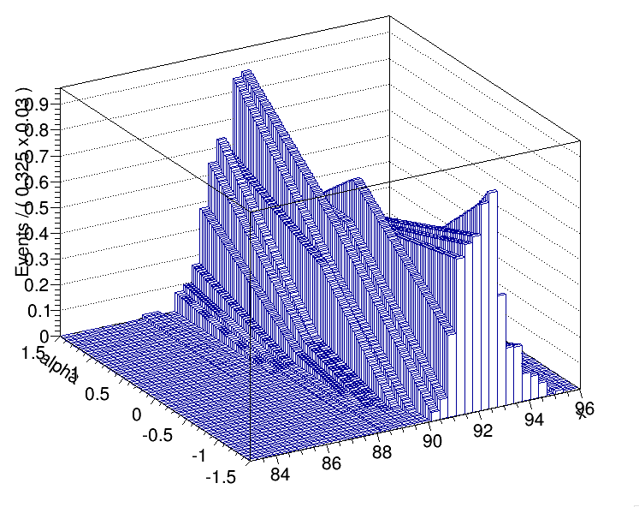
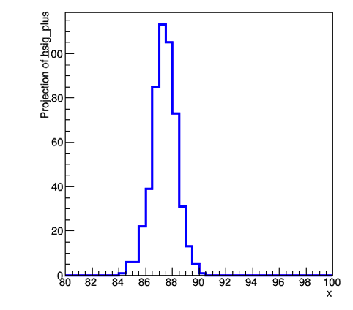
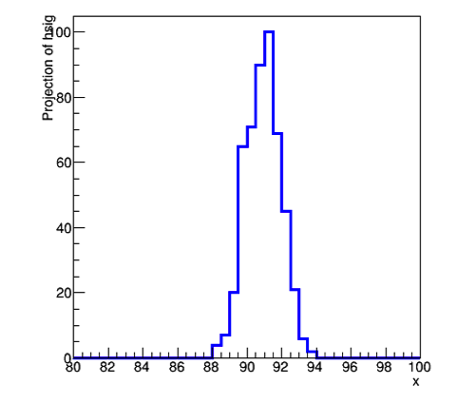

Assumption made in morphing
Some assumptions are always made in constructed interpolated shapes. Simplest assumption is piece-wise linear interpolation in each bin
OK for modeling systematic uncertainties
For modeling physics parameters
need for physically meaningful
interpolation algorithm needed
α
x
Wouter Verkerke, NIKHEF

Slide 6
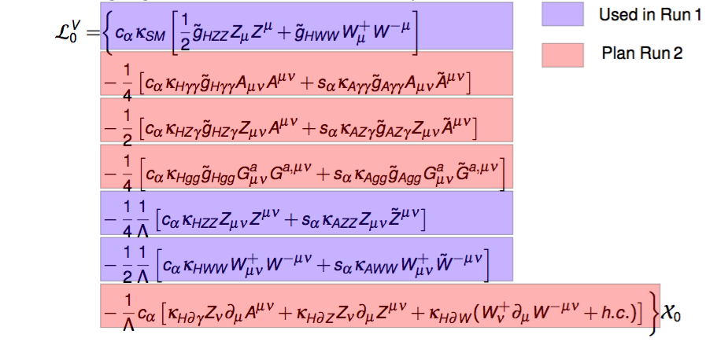
Effective Lagrangian Morphing
For (Higgs) Physics: aim is to describe statistica model of observed data that expresses coefficients of an (Effective) Lagrangian model as model parameters

Slide 7

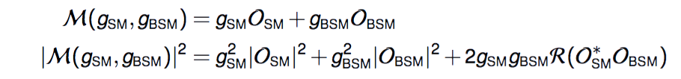
Consider a new approach to model building (morphing)
While moment morphing is usually better than vertical morphing, underlying transformations are not rooted in physics principles, but rather assumption on linear adjustments of moments
If we start from (EFT) assumption that model is built from sum of amplitudes with coefficients, can also build a morphing function based on that physics principle → “EFT morphing”
Consider first simplest scenario with 1 non-SM coupling in production only (or decay only) → Two parameters g_{SM}, g_{BSM} that affect ME

Slide 8
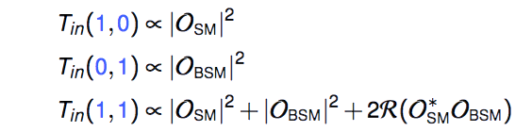
EFT morphing approach
Number of input distributions needed = number of terms in M²
For this simplest case need 3 templates, e.g.
Then observable distributions for |M|² for any value of g_{SM},g_{BSM} is
Interpolation accurate for all values of g_{SM},g_{BSM}, in limit that |M|
is described by formula above

Slide 9
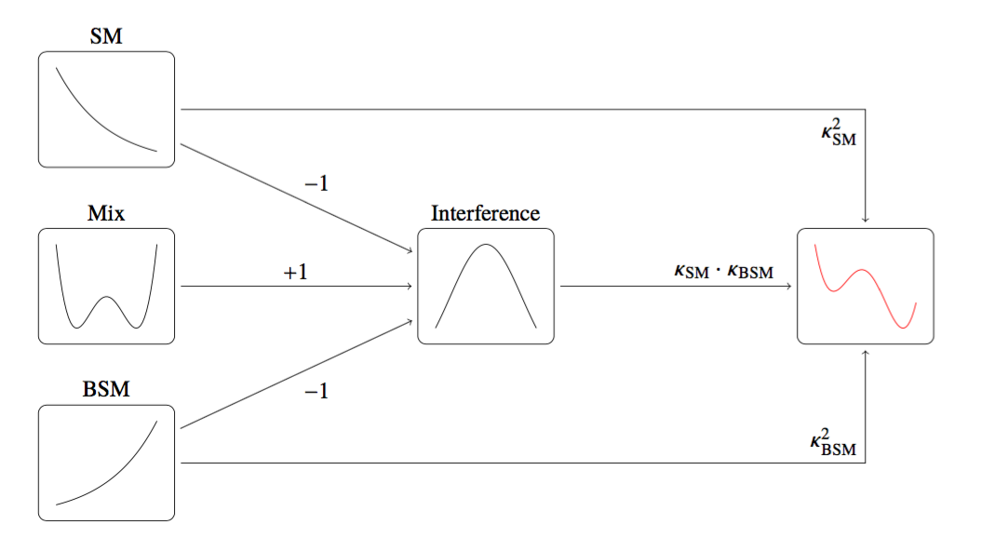
EFT morphing approach
Note that this is effectively ‘vertical interpolation’ morphing – but with specific choice of sampling points!

Slide 10
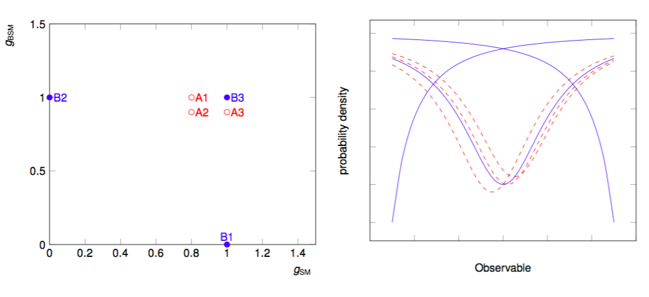
Illustration of EFT morphing
Example of morphing of 1D observable distribution with 2 theory parameters

Slide 11
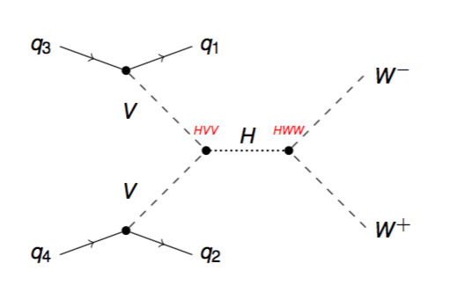
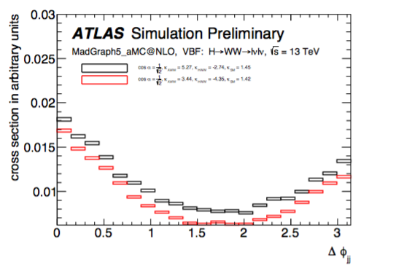
A concrete example VBH → H → WW
k_{SM}
k_{HWW}
k_{AWW}
3 shared parameters
→ 15 terms in |M|² expression
→ 15 input distributions needed
T_{out}(k_{SM},k_{HWW,}k_{AWW}) = Σ w_{i}(k_{SM},k_{HWW,}k_{AWW}) * T_{in,i}
Template histograms
Template weights (polynomials in k_{i})

Slide 12
A concrete example VBH → H → WW
Reminder: modeling of VBH→H→WW in k-framework
T_{out} = (0.74K_{W}²+0.26k_{Z}²) * K_{W}² * T_{in}
k_{SM}
k_{HWW}
k_{AWW}
3 shared parameters
→ 15 terms in |M|² expression
→ 15 input distributions needed
T_{out}(k_{SM},k_{HWW,}k_{AWW}) = Σ w_{i}(k_{SM},k_{HWW,}k_{AWW}) * T_{in,i}
Template histograms
Template weights (polynomials in k_{i})

Slide 13
Effective Lagrangian Morphing
Software output of project – framework for ELM morphing algorithms in RooFit (independent of specific physics scenario)
  Morphing only requires that any differential cross section can be expressed as a polynomial in coupling parameters.
Physics output of project – Higgs (combination) measurement using ELM morphing techniques

