Slide 1

Hej! ^_^
Nathan Simpson
Caterina Doglioni
Else Lytken (in spirit)

Slide 2
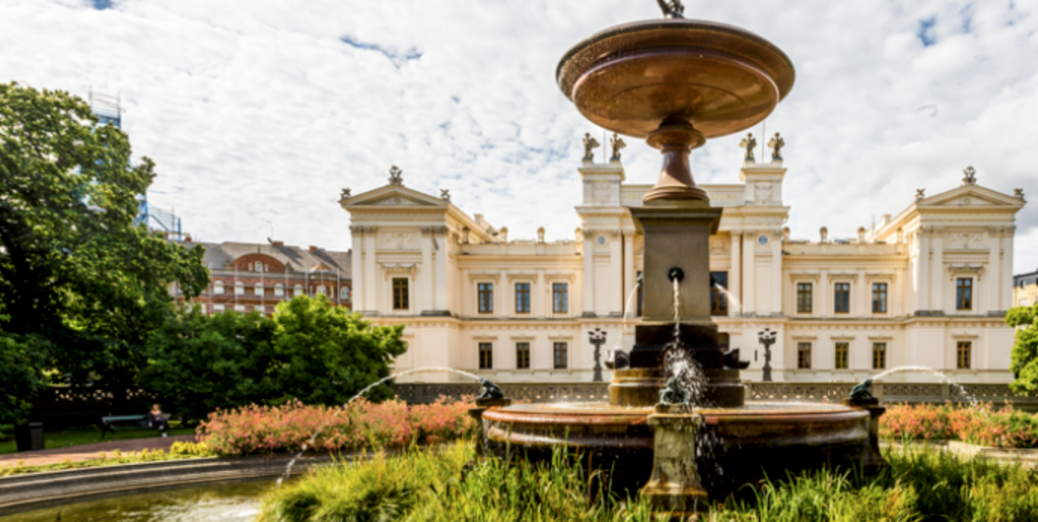
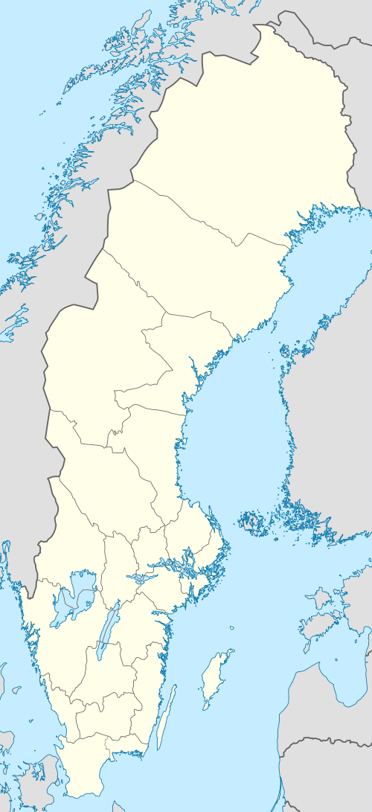
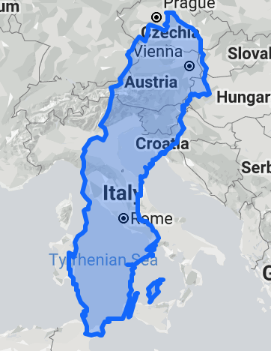
Lund University
https://www.lunduniversity.lu.se/about-lund-university
Founded in 1666
42000 students, 7500 staff
Faculty of science: 1900 students, 330 PhD students and 700 employees
Physics: 350 scientists
Experimental particle physics: ATLAS and ALICE group (see next slide for ATLAS)
  Joining a new experiment: a Light Dark Matter eXperiment(LDMX)
Theoretical particle physics:
home of the Pythia event generator
  Newly hired assistant professors:
  Madgraph and Sherpa
Hosted 2016 edition of MLHEP summer school
AIML@LU interdisciplinary effort in ML: http://aiml.lu.se

Slide 3
The Lund-ATLAS group
6 “seniors” (Else Lytken, Caterina Doglioni, Ruth Poettgen, Torsten Akesson, Vincent Hedberg, Oxana Smirnova) involved in BSM searches (dark matter/new physics with Higgs), operations (jet trigger and TRT), upgrade (ITK), computing
6 ATLAS PhD students + Nathan:
Eric Corrigan and Eva Hansen (jets and dark matter), Eleni Skorda(TRT and dark matter), Trine Poulsen(jets and new physics with top quarks), Katja Mankinen (TRT and BSM with Higgs), Caterina Marcon (computing, jets and dark matter)
4 postdocs:
Kristian Gregersen (BSM with Higgs, dark matter), Will Kalderon(trigger-level analysis and jets, dark matter), Geoffrey Mullier(ITK/LDMX), Lene Kristian Bryngemark(LDMX/dark sectors)
Local training of INSIGHTS interest:
COMPUTE graduate school: http://cbbp.thep.lu.se/compute/index.php
Yearly particle physics school (recent topics: dark matter, GEANT4)

Slide 4
The Lund-ATLAS group
Equal Opportunities Officer in INSIGHTS (1 year rotation)
6 “seniors” (Else Lytken, Caterina Doglioni, Ruth Poettgen, Torsten Akesson, Vincent Hedberg, Oxana Smirnova) involved in BSM searches (dark matter/new physics with Higgs), operations (jet trigger and TRT), upgrade (ITK), computing
6 ATLAS PhD students + Nathan:
Eric Corrigan and Eva Hansen (jets and dark matter), Eleni Skorda(TRT and dark matter), Trine Poulsen(jets and new physics with top quarks), Katja Mankinen (TRT and BSM with Higgs), Caterina Marcon (computing, jets and dark matter)
4 postdocs:
Kristian Gregersen (BSM with Higgs, dark matter), Will Kalderon(trigger-level analysis and jets, dark matter), Geoffrey Mullier(ITK/LDMX), Lene Kristian Bryngemark(LDMX/dark sectors)
Local training of INSIGHTS interest:
COMPUTE graduate school: http://cbbp.thep.lu.se/compute/index.php
Yearly particle physics school (recent topics: dark matter, GEANT4)

Slide 5
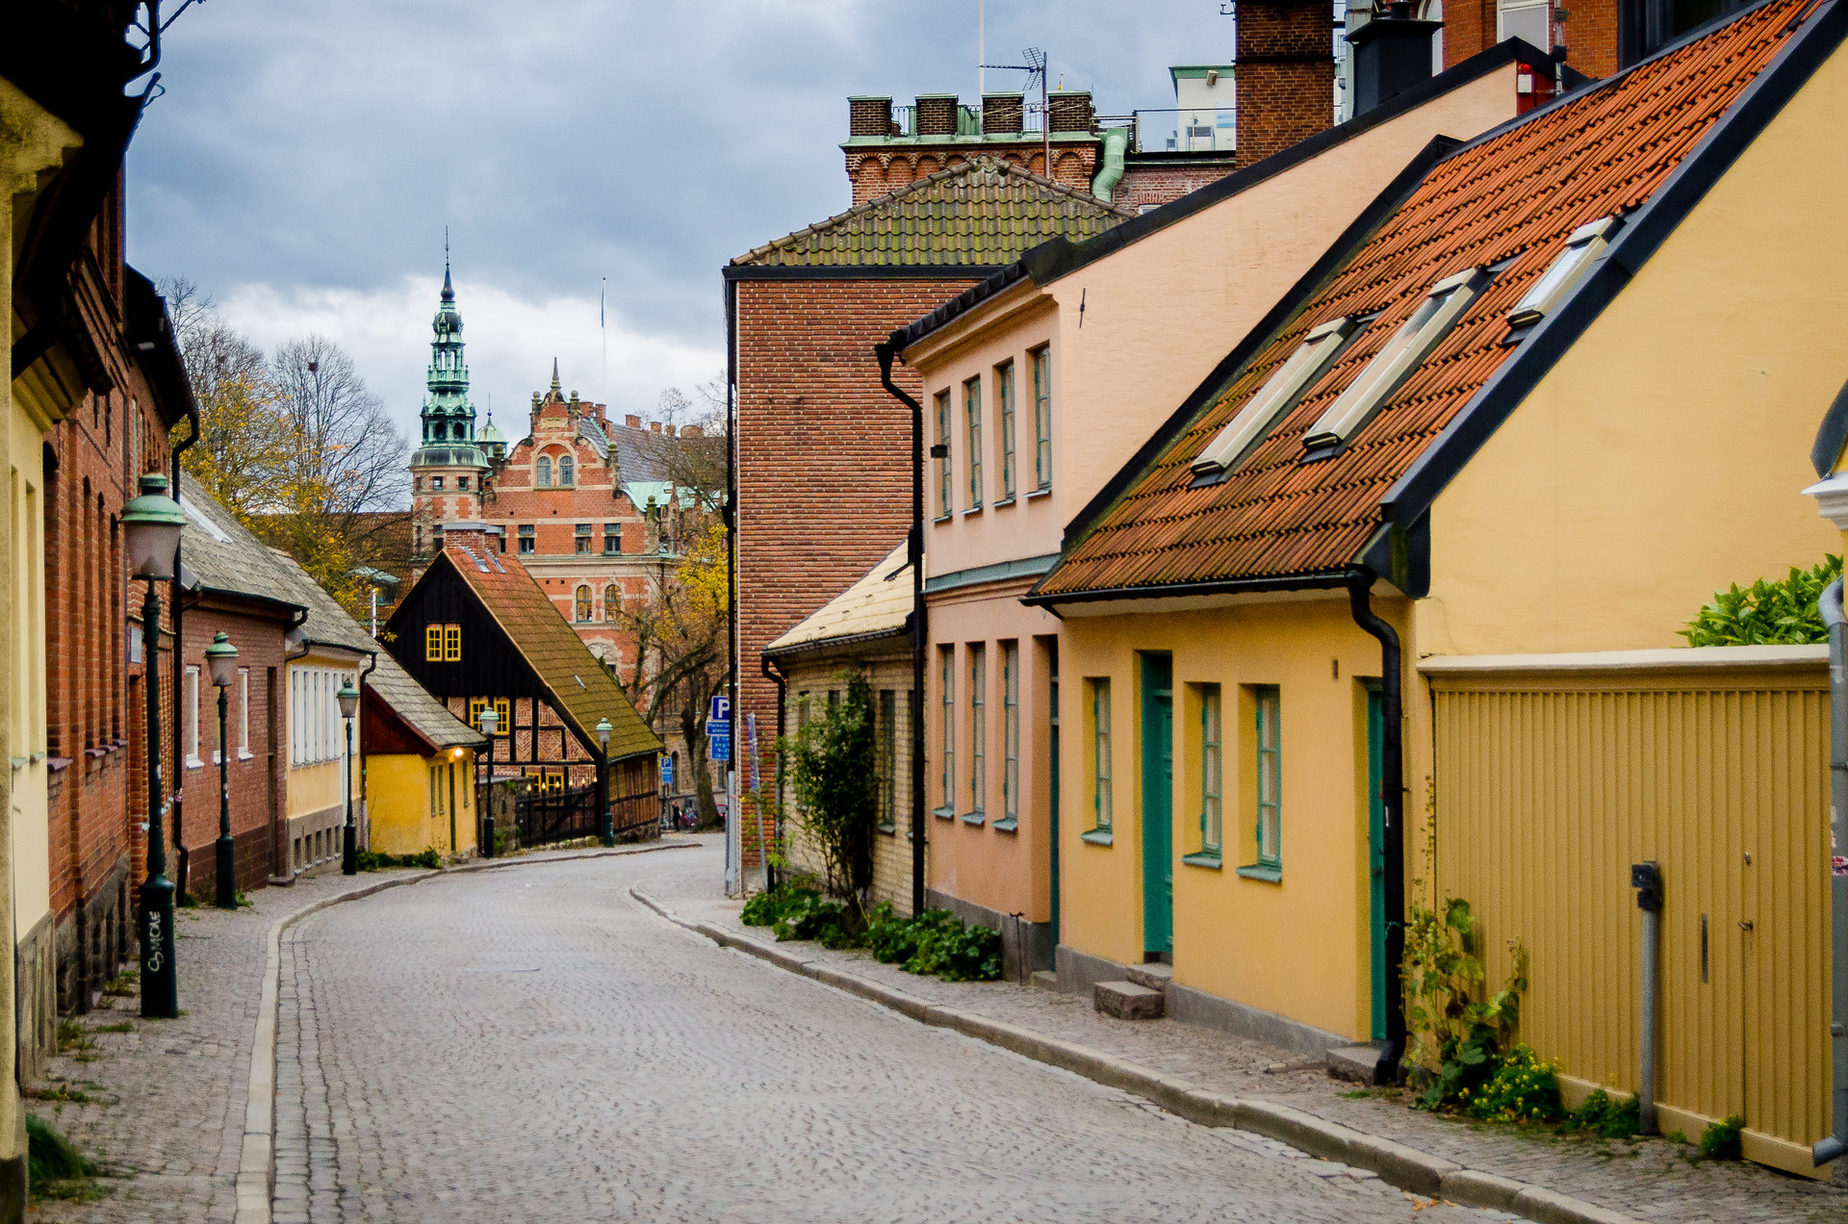
Lund, Sverige
Everyone drinks coffee all the time
Pretty
Cold
Yes, alcohol is expensive

Slide 6
nathan.exe
tall
weird hair
loves Nintendo
did some stats under the guise of physics
from the “North” of England

Slide 7
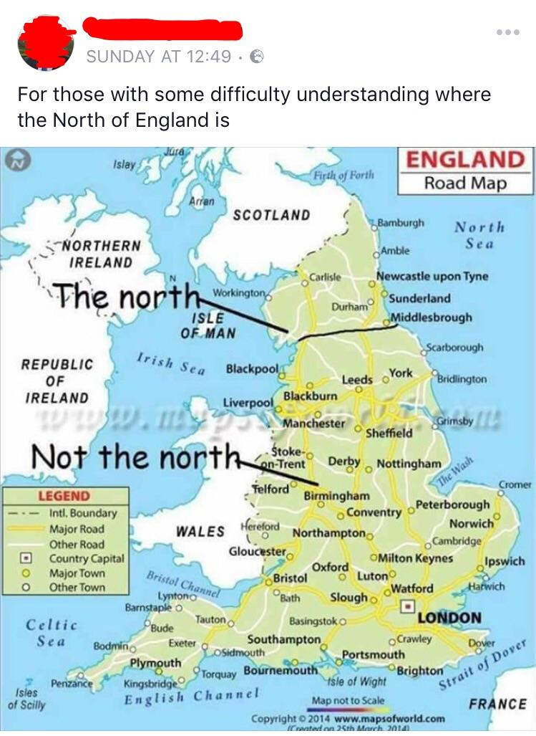
Me!

Slide 8

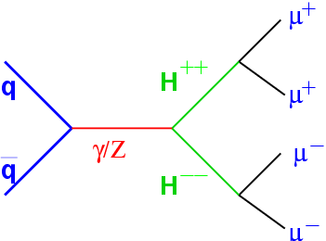
New S
Exotic doubly charged searches!
ML useful in selection -- for instance, hadronic taus (BDTs need update!)
Statistical tools to carry out analyses
Secondments: CERN/Pangea
?

Slide 9
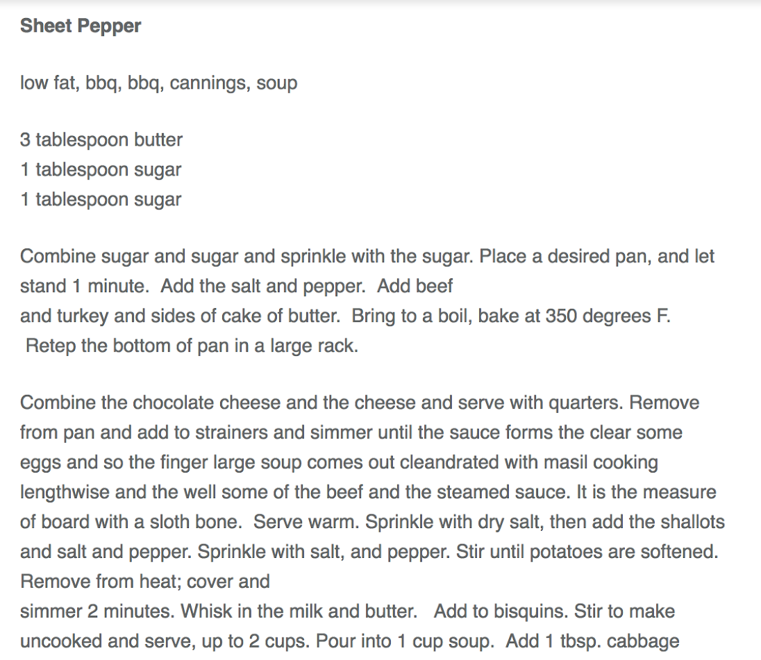
My favourite ML application:
Supervised learning to generate original recipes

Slide 10

Pre-INSIGHTS work @

Slide 11
The Matrix Element Method

Slide 12
The (Bayesian) Matrix Element Method
Prior
Likelihood
Evidence
Joint probability of data and truth

Slide 13
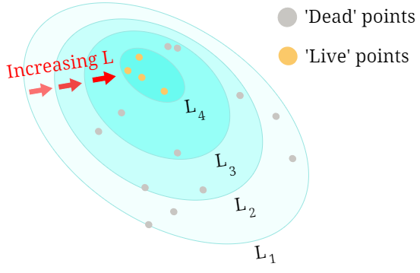
Courtroom MCMC (with evidence)

Slide 14
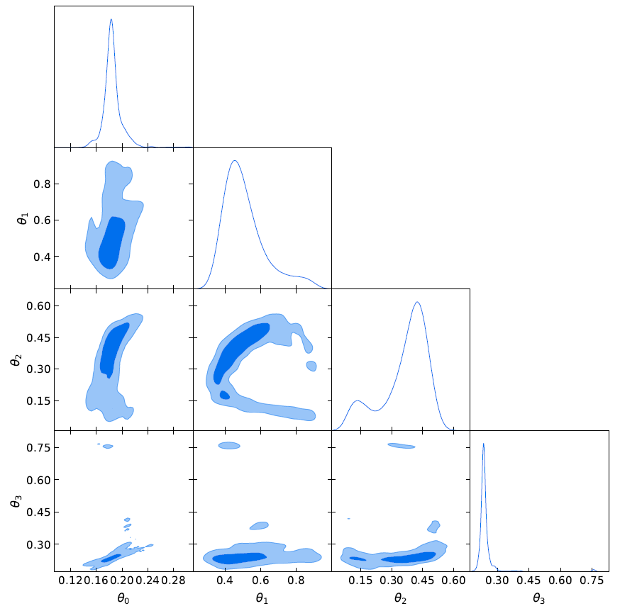
Results

Slide 15
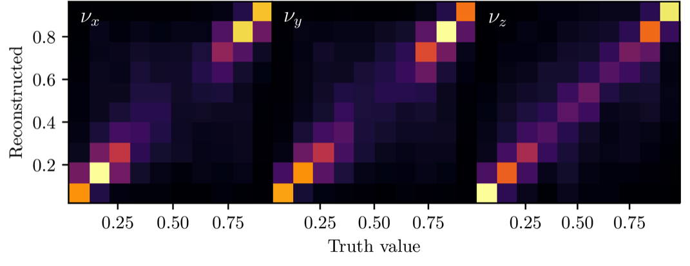
Results

Slide 16
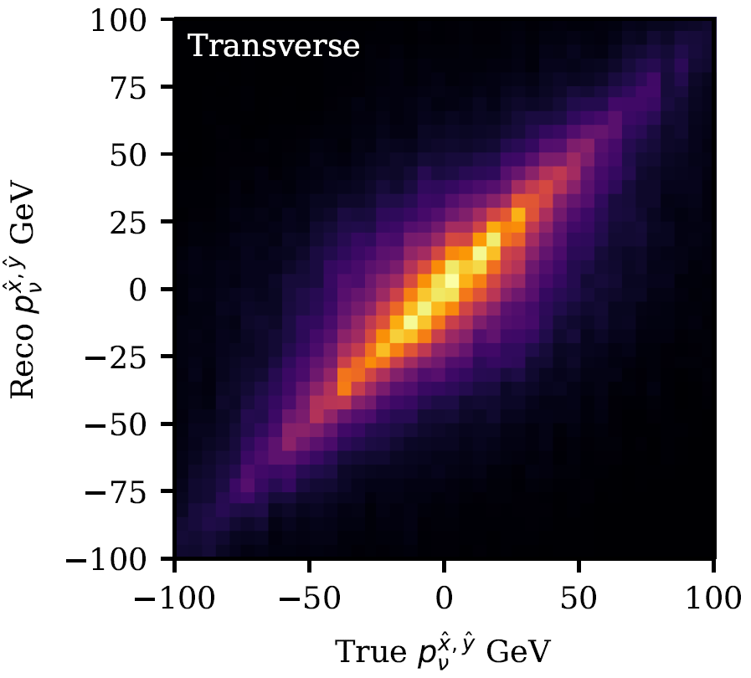
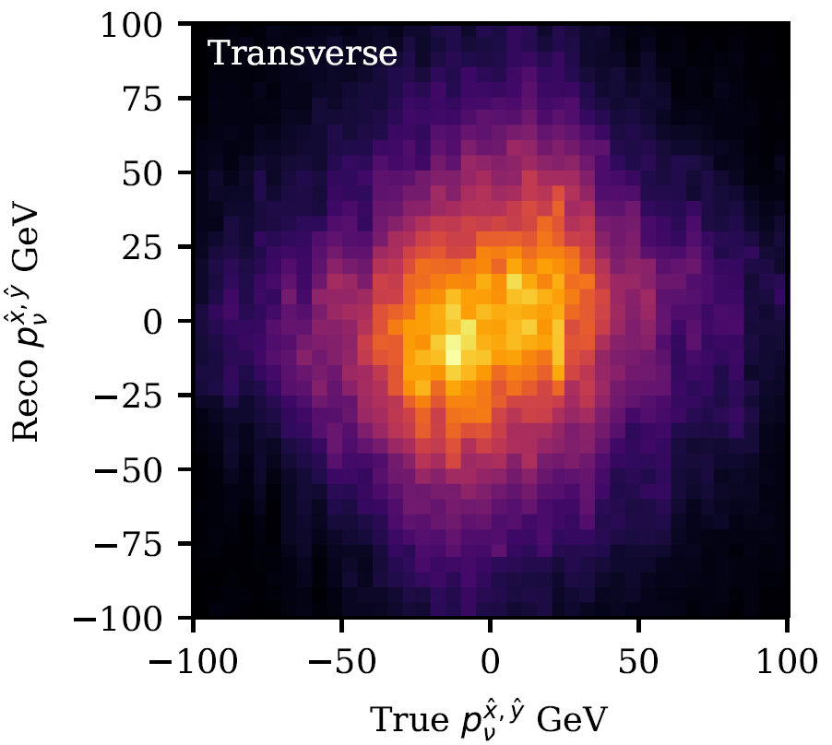
Results
Clean events
ATLAS events

Slide 17
Thanks for listening!
Tack så mycket!

