Slide 1
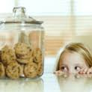
Self-Control, Willpower, and Ego Depletion
Roy F. Baumeister
University of Queensland &
Florida State University

Slide 2
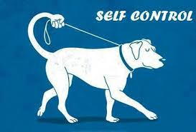
What is Self-Control?
Overriding responses, changing oneself
  Thoughts, emotions, impulses, performance

Slide 3
What is Self-Control?
Overriding responses, changing oneself
  Thoughts, emotions, impulses, performance
Regulate: Change based on idea (standard)
Vital for human social life (culture)
Managing motivational conflict
Key to understanding self
Psychological basis of morality
Basis for free will

Slide 4
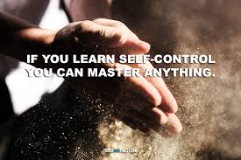
Value of Self-Control
Longitudinal studies
Positive correlations with good outcomes …
Cf. self-esteem

Slide 5

Value of Self-Control
Success in work, school
Good relationships
Happy, low stress
Adjustment, mental health
Physical health
Money problems, debt
Good behavior (vs. crime, abuse, prejudice)
Longevity
Most major personal problems include self-control failure

Slide 6
First Hints
Pattern noticed common to multiple literatures ( Quitting smoking, dieting, alcohol, possibly sex, aggression )
Self-control deteriorates over time
  Also following other demands
  Dieters trying to quit smoking at same time do badly at both
    Also poor affect regulation

Slide 7
Ego Depletion Theory
Limited resource
Performance declines as willpower depleted
Linked to blood glucose
Also used for choice, intelligent thought, initiative
  Also non-behavioral functions, such as immune system

Slide 8

Perseverance Despite Frustrating Failure
Radish
Chocolate
No-Food Control

Slide 9
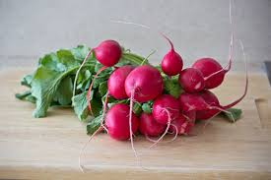
Perseverance Despite Frustrating Failure
Radish 8.35 minutes
Chocolate 18.90
No-Food Control 20.86

Slide 10
Ego Depletion in Daily Life
Depletion score: sum of previous resistance attempts on same day, weighted by temporal distance

Slide 11
First Revisions
Initial idea: running out of fuel. Suspected as like muscle tiredness, insufficient energy to perform task
Problem findings: depletion could be overcome with incentives
Revised: depletion is conservation, not exhaustion
  You can overcome it
  But then you’re super depleted
  Mimic depletion when anticipating future
(Turns out muscle tiredness is like that too.)

Slide 12
Muscle Metaphor
Tired following exertion
Conservation, not exhaustion
Exercise increases strength
  Building character

Slide 13
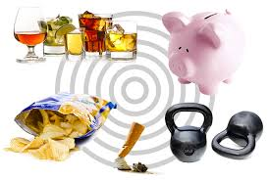
One Willpower, not Many
Control thoughts
Control feelings
Impulse control
Task performance

Slide 14
Various consequences
Intelligence, reasoning
Interpersonal
Aggression
Morality, dishonesty
Impulse spending
…Automatic responses remain intact and gain in relative control over behavior

Slide 15
Strength Beyond Self-Control
Choice is depleting
  Decision fatigue
  Free will

Slide 16
Decision Fatigue:
Cold Pressor Performance
Choices (Depln) 27.7
No Choices 67.4
Vohs et al. (2008) J. Pers. Soc. Psy.
Measure: Seconds holding hand in ice water
Source: Vohs et al. 2008

Slide 17
Decision Fatigue Summary:
Choosing While Depleted
Postpone/avoid decision
Less compromise
Default option, passive, status quo
  Note Banker studies on dictator game: status quo bias, not selfishness
Impulse, self-indulge
Irrational bias (asymmetric dominance decoy effect)

Slide 18
Nature of Decision Fatigue
Note depletion effects on decisions cannot precisely parallel self-control
Shift toward low-effort styles
Avoid risk, no compromise, irrational bias, short-term, status quo bias (conservative)

Slide 19
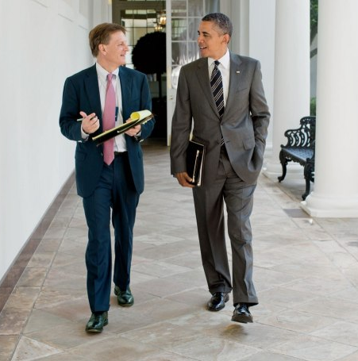

Slide 20
Obama interview
“You’ll see I wear only gray or blue suits,” he said. “I’m trying to pare down decisions. I don’t want to make decisions about what I’m eating or wearing. Because I have too many other decisions to make.” He mentioned research that shows the simple act of making decisions degrades one’s ability to make further decisions. “You need to focus your decision-making energy. You need to routinize yourself. You can’t be going through the day distracted by trivia.”

Slide 21
Strength Beyond Self-Control
Choice is depleting
  Decision fatigue
Active vs. passive (initiative)…

Slide 22
Depletion Causes Passivity?
Absence of top-down control
Possible disinhibited activity
But reduces taking initiative
Vonasch et al. (in press). Motivation Science.

Slide 23
Taking the Easy Way Out
Depletion reduces top-down mental control
So the automatic, unconscious mind takes over… and does whatever is simpler
Experiment on eating nuts: Eat all you want
  People who got peanuts without shells ate more when depleted
  People who get peanuts still in shells ate less when depleted

Slide 24
Depletion in a Nutshell

Slide 25
Free Will Revisited
Unlikely that free will exists independent of these processes of self-control, rational choice, and initiative
If there is free will, this is it
If there is no free will, this is what is mistaken for it

Slide 26
Strength Beyond Self-Control
Choice is depleting
  Decision fatigue
  Free will
Active vs. passive (initiative)…
Planning
Uncertainty
Keeping secrets

Slide 27
Trait Self-Control
Note, no interaction with depletion in lab
But in life, much more reports of feeling depleted among the low TSC
  In lab, everyone does the same task, so it’s equally depleting
  Outside, mismanaged life means many more depleting experiences
High trait SC not more willpower, just used better
Manage habits; also more planning

Slide 28
High on Trait Self-Control
Less frequent resistance!
Fewer problematic desires
Less guilt
  From other work: lower life stress
Implications: Playing offense, avoiding problems
Hofmann et al. (2012) J. Pers. Soc. Psych.

Slide 29
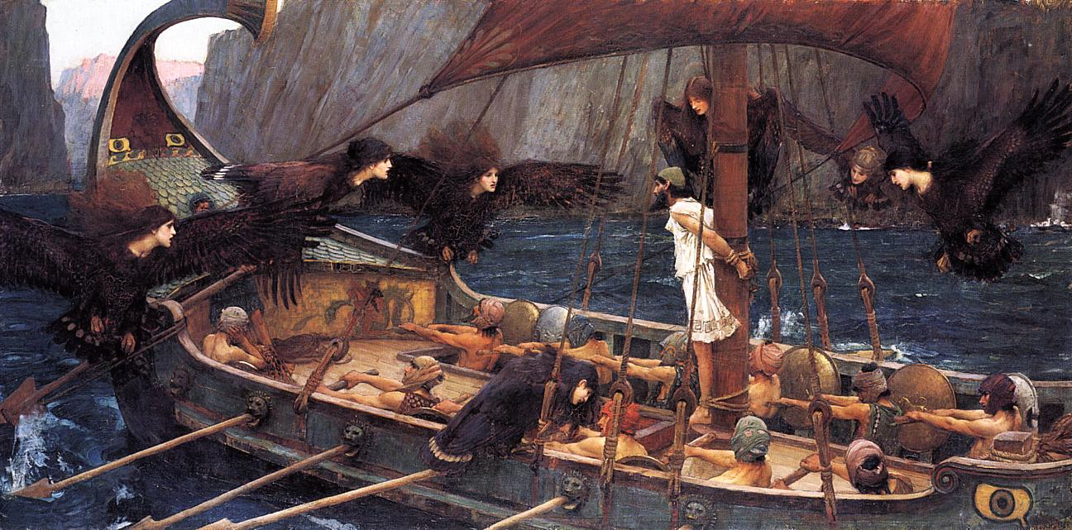
http://en.wikipedia.org/wiki/File:John_William_Waterhouse_Ulysses_and_the_Sirens_%281891%29.jpg

Slide 30
Trait Self-Control
Many positive outcomes
  Cf. self-esteem
Opposites attract (but don’t last)
  And can two undercontrolled lovers find happiness together?

Slide 31
What Gets Depleted?
Is willpower just a metaphor…or something real?
Can energy models be revived?
How are mind and body linked?

Slide 32
Willpower More than Metaphor?
The Mardi Gras Effect study
Glucose is relevant
  PMS?
Allocation rather than running out

Slide 33
Self-Control Burns Glucose?
Glucose as fuel for brain
Some psychological processes consume more glucose than others
Glucose deficiencies have been found among people with self-control deficits (e.g., juvenile delinquents)

Slide 34
Lab Studies on Glucose
Acts of self-control might reduce levels of glucose in bloodstream (?)
Low levels of glucose predict poor performance on subsequent self-control tasks
Administering glucose counteracts effects of depletion
  (Though so does mere taste)

Slide 35
Glucose and Decisions
Asymmetric dominance effect
Probability matching
Delay discounting

Slide 36
Understanding Glucose
Self-control
Allocation
Immune system
Premenstrual syndrome (PMS)

Slide 37
New Emerging View
Glucose is a big part of willpower
  Body conserves naturally
“Central governor” does not have inventory of body’s energy reserves
  Estimates consumption from byproducts (adenosine), “counting the ashes”
  Errs on side of conserving
Evolved to protect immune system, etc.

Slide 38
So…
Mind and body act as if a resource is being depleted by self-control
AND a physical energy resource is genuinely being depleted
But those two facts are only loosely related
  Cf. physical muscles

Slide 39
Improvement via Depletion?
Interracial interaction
Leadership studies

Slide 40
Ego Depletion Controversial?
Alternative explanations
No effect
(Contradictory)

Slide 41
Does Ego Depletion…
Always occur under all circumstances?
Sometimes occur under some circumstances?
Never occur under any circumstances?

Slide 42
Challenges, Alternative Theories
Selective allocation of glucose
Just motivation and attention
  But self-reported motivation doesn’t change
All in your head/ expectations

Slide 43
Conclusion
Energy
Conservation
Building character
Trait and state
Decisions
Initiative, active/passive
Glucose

Slide 44
The End

Slide 45

Depletion & Passivity
Attention control manipulation: watched video of person, words at bottom, instructions to ignore or not
Second task, seated at computer for instructions. Blue screen only.
Measure: How long did they sit there without doing anything, as opposed to fetching the experimenter?

Slide 46

Duration of Passive Sitting
Attention Regulated 5.6 minutes
No Depletion Control 2.7 minutes

Slide 47
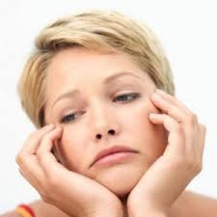
Thus,
Depleted people are more passive. More prone to do nothing and to choose “default” option.

Slide 48
Selfishness or Passivity?
Dictator game
First studies, depleted persons kept more for self
But confound: That’s where money was
Later studies separated divider from initial stakeholder
Depleted people left the money where it was

Slide 49
Dec 2018
B school, few brief interruptions, ran seriously over. Need to trim down to an hour.
Nicole suggests shortening the section on passivity. Keep the peanut shell study.

Slide 50
Applied to Morality
More immoral behavior
  Cheating, lying

Slide 51
Moral Judgment?
Moral muscle assumes constant judgment
Trolley problem, etc
No reliable effects of depletion or low self-control
BUT: process dissociation studies
  E.g., smother baby to save group from death, or only from non-fatal manual labor conscription
Avoid harm (D) vs.maximize total outcomes (U)
High trait self-control folks are higher on both

