Slide 1
“I never think about the future … it is coming soon enough!”
—Albert Einstein
“Life can only be understood backwards; but it must be lived forwards”
—Søren Kierkegaard
“My interest is in the future, because I am going to spend the rest of my life there”
—Charles F. Kettering
“Everybody has a plan, until they get punched in the mouth”
—Mike Tyson
“Never make predictions, especially about the future”
— Casey Stengel

Slide 2
Thinking about the Future:
Whether, When, Why, How, Who, What … and So What?
Roy F. Baumeister
Florida State University
& University of Queensland

Slide 3
Thanks
To coauthors for ideas
  Martin Seligman, Peter Railton, Chandra Sripada, Gabriele Oettingen
To collaborators for research work
  Wilhelm Hofmann, Andrew Monroe, Kathleen Vohs, Sarah Ainsworth, Michael Ent, Hallgeir Sjåstad
To John Templeton Foundation for funding

Slide 4
About the Future
Psychology studies the past
  Causal models of behavior
  Studies of memory
Easier to know past than future
But people think more about future than past
Why? Future has advantages
  Can still change it
  Adaptive to orient toward future
  Direction of evolution?
Notes:
Basic struggle to enable any information other than the present moment’s immediate sensory input to guide behavior

Slide 5
What Were You Thinking?
Past, Present, and Future in a Random Sample of Everyday Thoughts

Slide 6
Goals of Study
Explore content of everyday thoughts
  Lab thoughts may not be the same
Examine how thoughts use time
What emotions, thoughts, etc. accompany thinking about the future?

Slide 7
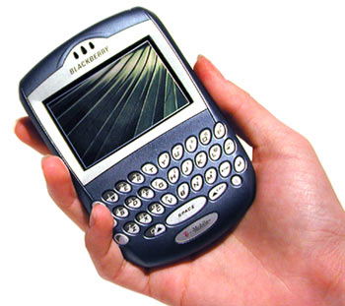
Method
Sample
  N = 492 (62% female) adults from
  the USA
  46.5% students
  Mean age = 28.8 (range 18 to 67)
Schedule
  6 random signals/day
  For 3 days
  Then questions about most recent thought

Slide 8
Defining Past, Present, Future
Present defined as within 5 minutes of now
  Future starts after that
  Same for past
Supplementary analyses starting the future a week hence, or a month

Slide 9
How Often?
% of Total Thoughts
Past only 4 %
Present only 40 %
Future only 14 %
Notes:
Note that combinations are far less frequent than ‘pure’ one-time-zone thoughts … EXCEPT present plus future … as common as ‘pure’ future and more than past

Slide 10
How Often?
% of Total Thoughts
Past only 3.8 %
Present only 39.8 %
Future only 14.2 %
Past and present 2.1 %
Past and future 0.9 %
Present and future 12.1 % ←
Past, present & future 2.3 %
None (no time) 24.4 %
+_________________+___________
TOTAL 100 %
Notes:
Note that combinations are far less frequent than ‘pure’ one-time-zone thoughts … EXCEPT present plus future … as common as ‘pure’ future and more than past

Slide 11
So:
People think much more about future than past

Slide 12
Time frame: future
Notes:
Most prospection emphasizes the near future, up to a year
PRAGMATIC !!

Slide 13
Pragmatic
People mainly think about the near future

Slide 14
Time frame: past
Notes:
Past drops off beyond about 10 years ago … Past has longer tail than future

Slide 15
Thoughts without Time (24.4%)
Less meaningful
Less under voluntary control… BUT
Less mental fatigue
Less exciting/arousing
Less happy BUT
Less angry, anxious, stress, disappointment
More about self than others
  Also more frequent when alone than with others, contrary to all other categories with any time aspect
Thoughts were neither more nor less pleasant
  (if anything, trend toward more)

Slide 16
Implications
Rich human experience occurs within time
  Meaningful
  Emotion
  Social life: Being with others increases temporality; alone, thoughts drift toward more about self, outside of time
  Presence of others increases focus on the present

Slide 17
Thought Content…
What were you thinking about?
  When thinking about past, present, future…

Slide 18
Describing Thoughts about the Past

Slide 19
Past: Summary
Implications of past for future are common
  Single biggest category
  Pragmatic
Also trying to understand
Replaying, including counterfactual
  Thus thinking about the past has pragmatic coloring
Also some involuntary ruminating

Slide 20
Thoughts about the Past:
Nutshell Summary
So what?
  (Implications for future)
and What the ***k??
  (Trying to figure out)

Slide 21
Describing Thoughts about the Present
Notes:
Biggest: doing what I intend, doing what I’m supposed to do, paying attention to what I’m doing, trying to figure out; ALSO implications of present for future; and enjoying, savoring

Slide 22
Thus
Pragmatic
  Focused on present activities, tasks
  Figure out whazzup
  Implications for future
Enjoy, savor, elaborate

Slide 23
Describing Thoughts about the Future
Notes:
Planning dominates. (Too bad about Stage 2 grants: no planning.)
ALSO BIG: what you hope to do, hope will happen, wonder what will happen, what you have to do, what you will do;

Slide 24
Implications: Prospection
Highly pragmatic: planning, anticipating, preparing
Emphasize possibilities, uncertainty
Future as “matrix of maybe”

Slide 25
Planning Vs. Other Future Thoughts
Planning is (more) meaningful and pleasant
Lower stress, anger, anxiety
Higher control over thoughts
Less mental fatigue
Highly involving

Slide 26
Subjective Experience and Time
Responses extended from earlier/later the same day, to multiple days, weeks, months, years, up to “before I was born” and “after my life”
Each thought was classified according to the farthest time from the present that it invoked

Slide 27
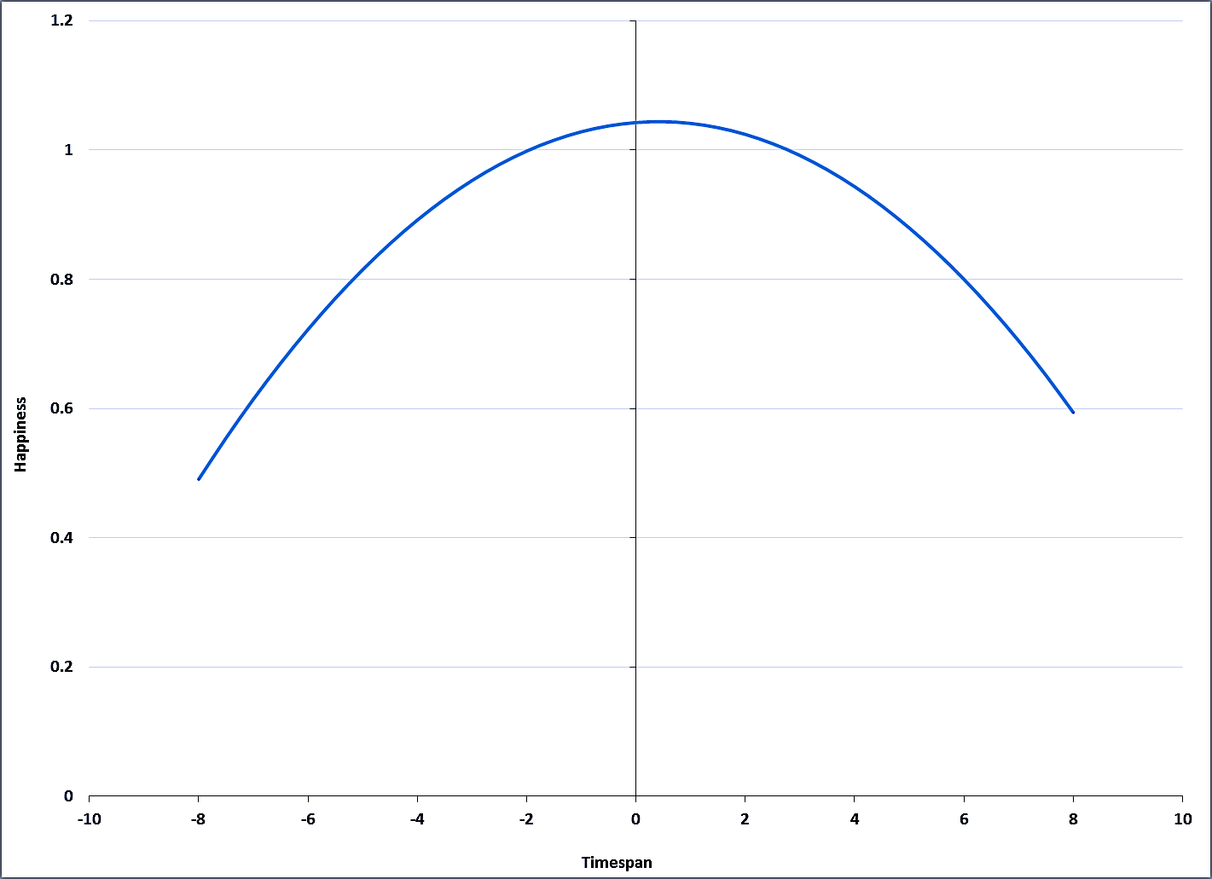
HAPPINESS
Happiness
Timespan
Notes:
Quad effect, not linear. Happiness is in the present. Distant future and past, much less happy

Slide 28
So, emotion is in present moment?

Slide 29
So, emotion is in present moment?
No! Only for positive feelings.
Negative emotions show a different picture…

Slide 30
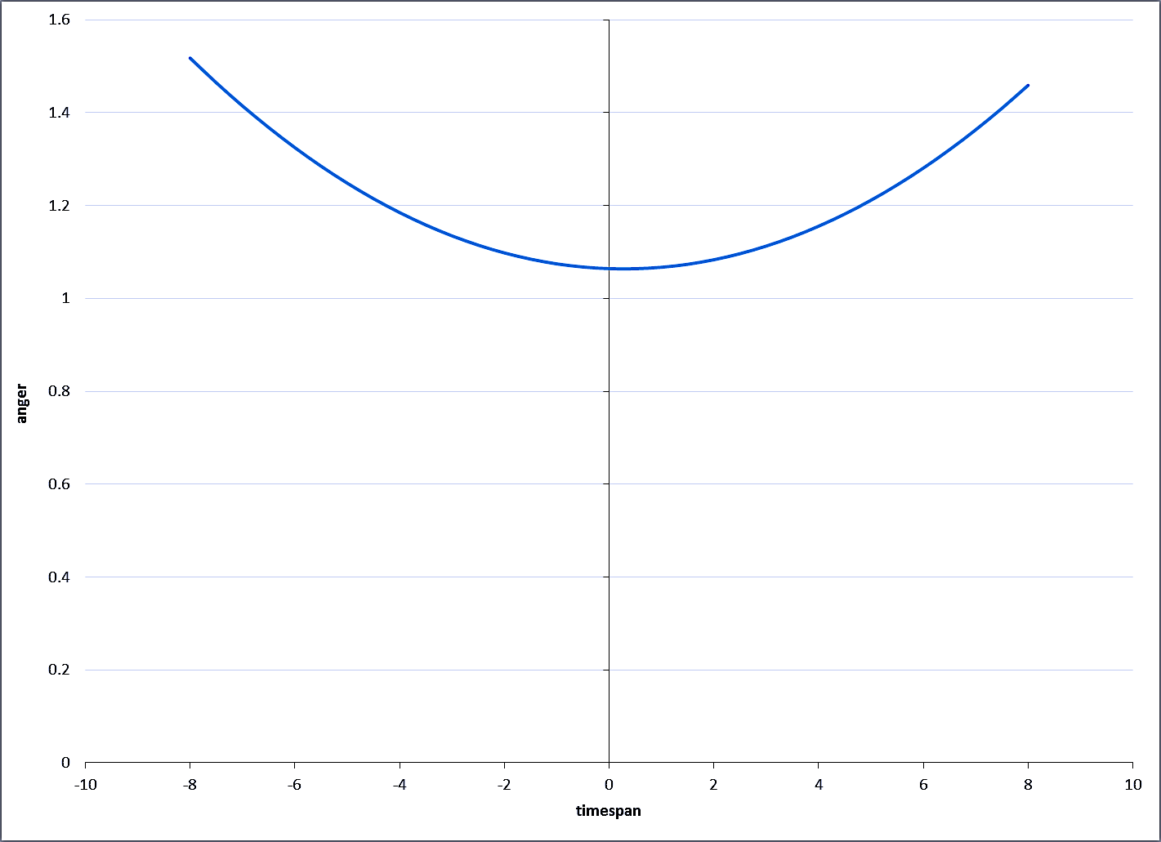
ANGER
Anger
Timespan
Notes:
Quad yes, linear no. But there were some high values for very recent past, like earlier today, yesterday

Slide 31
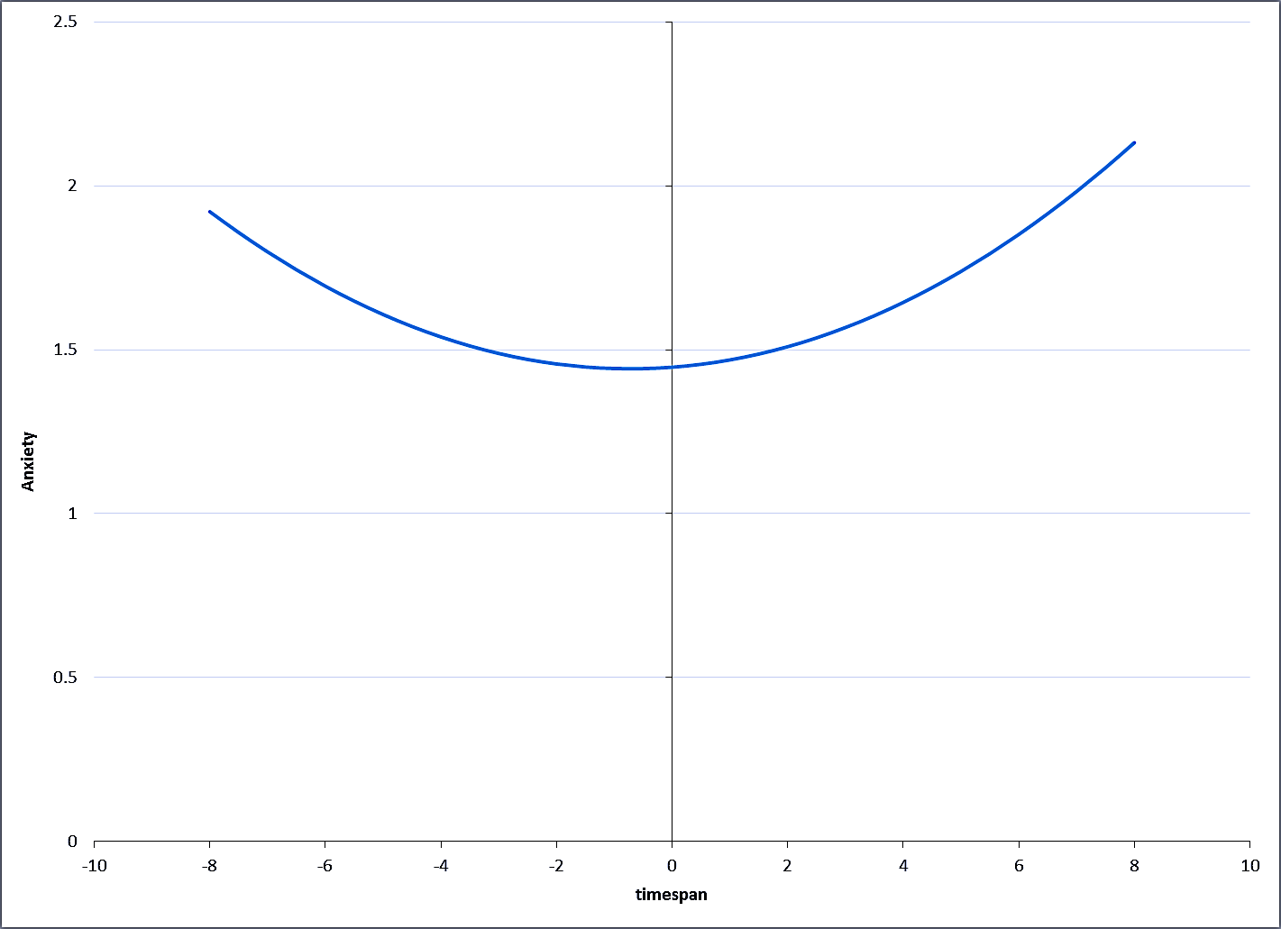
ANXIETY
Anxiety
Timespan
Notes:
Quadratic yes, linear no

Slide 32
Emotion Circumplex
Valence (positive/negative)
Arousal (excitement)

Slide 33
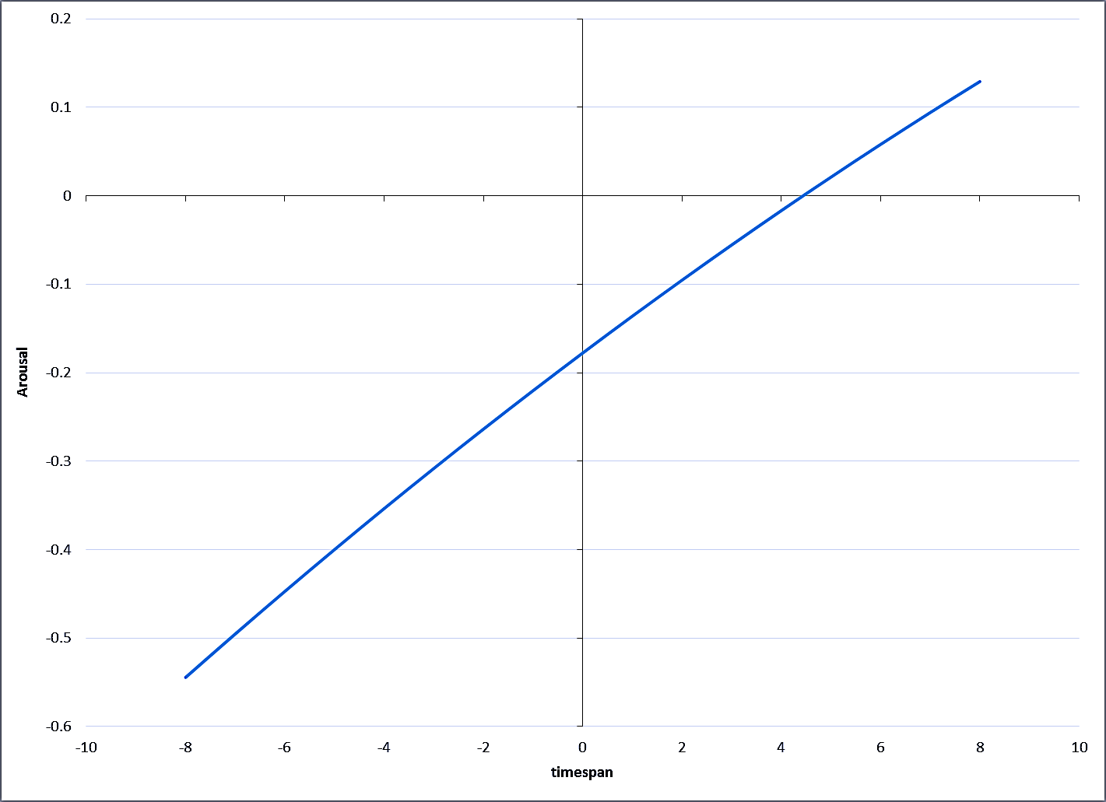
AROUSAL (Excited)
Arousal
Timespan
Notes:
Linear not quad

Slide 34
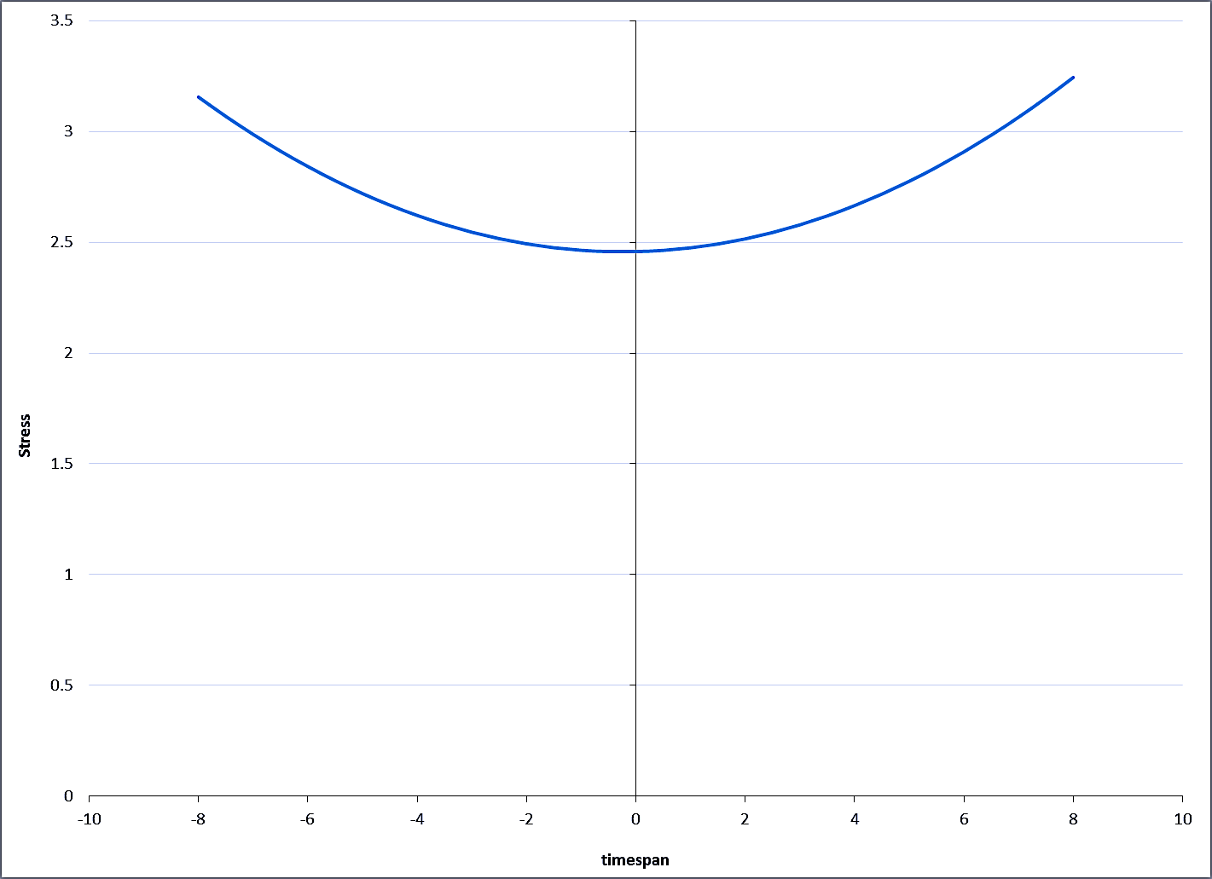
STRESS
Stress
Timespan
Notes:
Quad yes, linear no

Slide 35
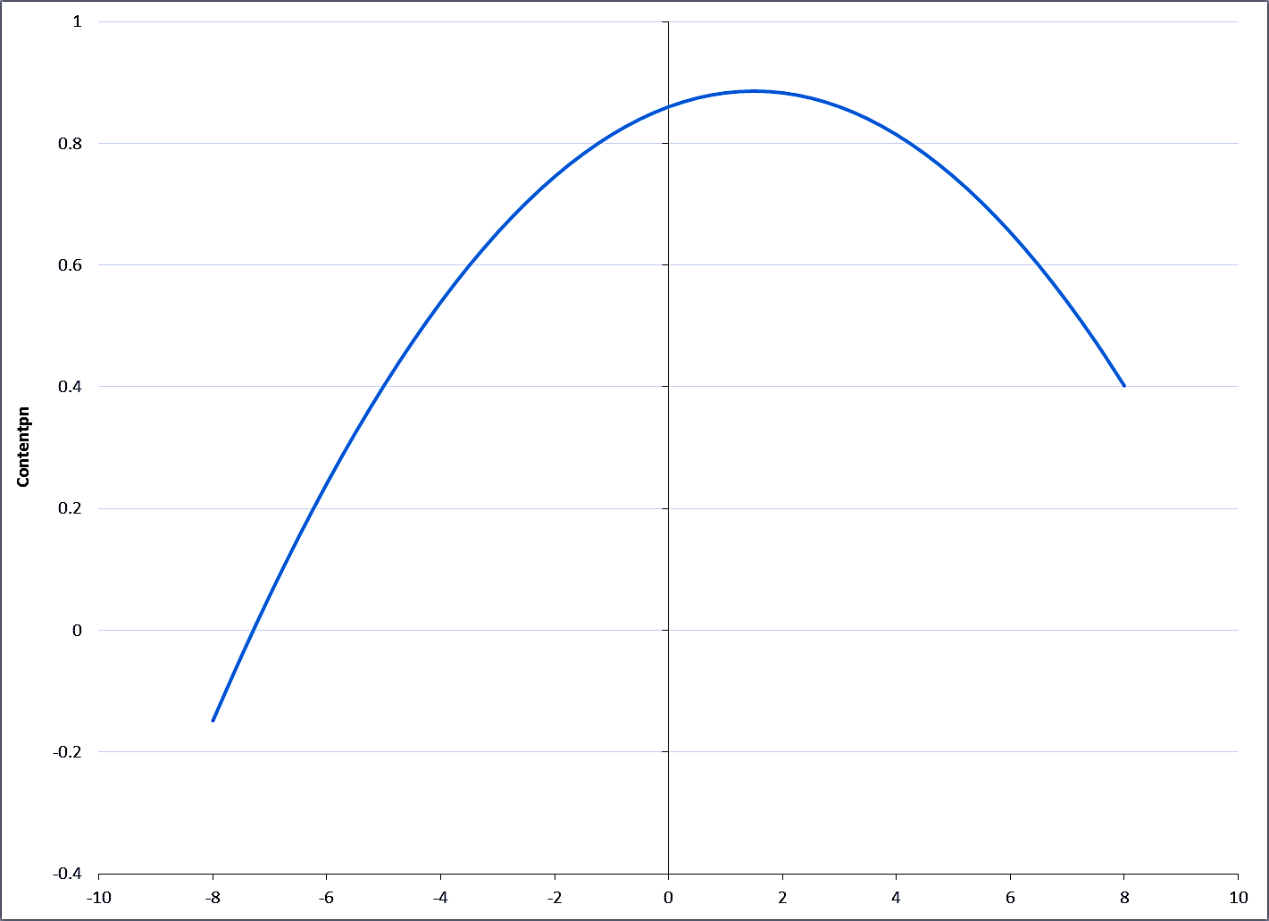
PLEASANT VS. UNPLEASANT THOUGHT
Content
Timespan
Notes:
Quad and linear. Thoughts about present (plus later today, tomorrow) are most pleasant

Slide 36
Present Focus is Better?
Mindfulness: focus in present
More positive emotion
Less negative emotion
Less stress
Thought itself is more pleasant

Slide 37
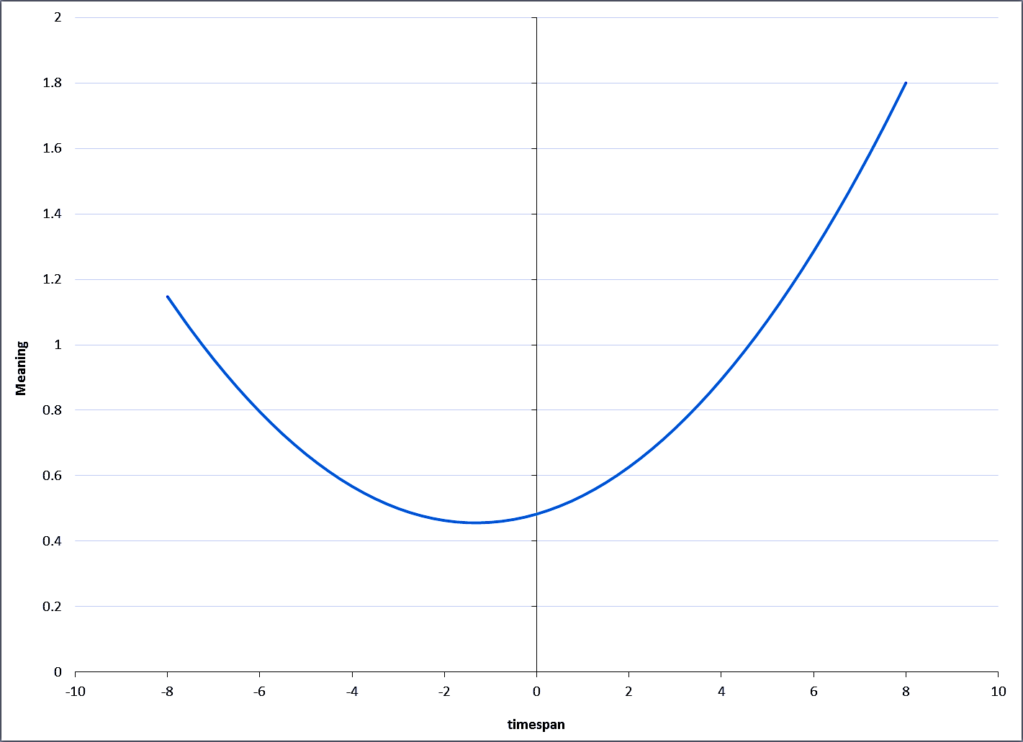
MEANINGFUL
Meaning
Timespan
Notes:
Quad and linear: the J curve
So we can have a simpleminded pleasure by living in present, but we lose meaning

Slide 38
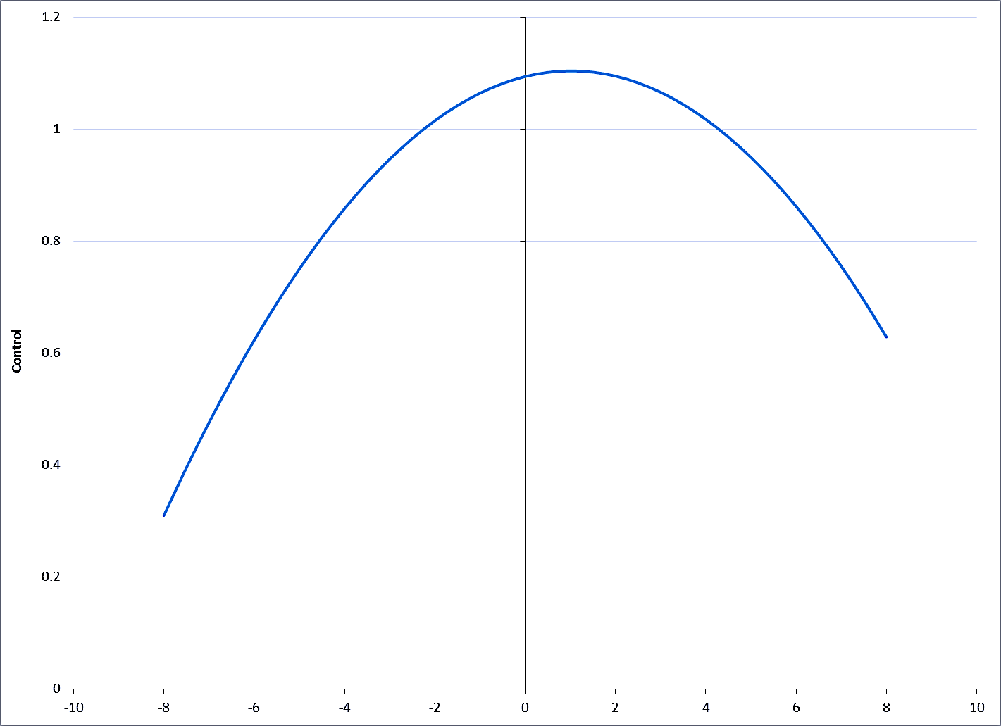
THOUGHT WAS UNDER CONSCIOUS CONTROL
Control
Timespan
Notes:
Another J curve: Fatigued mind especially goes to past
Both linear and quadratic effects were significant.
Completely opposite to what I thought: animals naturally focus on the present, so I thought that would be easy, mental time travel would require control

Slide 39
Part Summary & Implications
Present is happy
Future is meaningful
Many curvilinear relationships: time travel into either past or future differs from present
(Negative) emotion increases away from present
The tired mind wanders in time (esp. past)
  It takes effort to stay focused on the present
The future is more exciting than present /past
  Also more about myself

Slide 40
Linking Past, Present, and Future
Combining across time ‘zones’
  Future plus present is most common
More meaning
More negative emotion

Slide 41
Combining Past, Present, Future
Compared to thoughts that focused on only past or present or future, thoughts that combined two or more were …
  More meaningful
  More arousal / excitement
  More anger & frustration, more stress
  More anxiety & disappointment
  Less happiness (though present-future comb was happy)
Note mainly present-plus-future vs. present and future

Slide 42
Death, the Ultimate Future?
Death inevitable…
Theories emphasize mortality as most important fact of life
  Prospection is ultimately a downer

Slide 43
Death, the Ultimate Future?
Death inevitable
Theories emphasize mortality as most important fact of life
  Prospection is ultimately a downer
Hardly any thoughts (<1% of total)
  Not own death (often past, others)

Slide 44
People Are Different:
Who Thinks about the Future?
Major personality differences
Trait predictors of % future thoughts

Slide 45
Personality: Who Thinks of Future?
Trait predictors of % future thoughts
  Most of our hunches yielded nothing
  More differences on past than future…

Slide 46
Personality: Who Thinks of Future?
Trait predictors of % future thoughts
  Most of our hunches yielded nothing
  More differences on past than future
  Apparently, Everybody thinks about the future
    Especially optimistic, happy people, and those who seek closure
    Thinking about the past is optional

Slide 47
Personality: Who Thinks of Past?
Some people think more about the past than others
  High neurotic, low agreeable, low conscientious, low self-esteem, rumination, depression, pessimism

Slide 48
Personality Summary
Everybody thinks about the future
Thinking about the past appeals to unpleasant people:
  Argumentative, undisciplined, grumpy, impulsive, unfriendly complainers

Slide 49
Now to the Laboratory
Can study specific thought processes under controlled conditions
  Unlike in everyday life

Slide 50
What Does a Future Mindset Do?
Context: Past evidence of optimistic predictions
Consistent across domains, samples
  More likely than average to have good future: success, love, health
  Less likely than average to have bad future events
Notes:
E.g., get divorced, become alcoholic, major illness

Slide 51
Implication of Prediction Findings
The Future is Bright !!!

Slide 52
Putting Money Where Mouth
Play it safe or go for high-reward, high-risk option?
Contemplating the future increases optimism
  So one doesn’t worry as much about risk
Therefore, after prospection, people will accept high risk to pursue high reward
  A future mindset will increase risk taking

Slide 53
Exploring the Future Mindset: Experimental Approach
Instill temporary future-oriented mindset
  Write about your future self (compared to self now)
  Re-write sentences referring to future (compared to present)
Measure consequences
  Optimism, risk-taking
  Trust
  Moral judgment
Monroe, Ainsworth, Vohs, & Baumeister, 2017, J. Exp. Soc. Psy

Slide 54
Investment Optimism Experiment
Write brief message on present or future self
  Discuss what your life is like now or what your life will be like in ten years
After that, make investment choices
  high-risk, high-reward vs. low-risk, low-reward
Prediction: after thinking of future, people will favor high-risk, high-reward options
  Because of optimistic bias

Slide 55
Future Mindset Avoids Risk !
4-item scale yields 10-point preference
  10 = favor risky investments
Wrote about current self, risk = 4.94
Wrote about future self, risk = 4.41
Thus on hypothetical choices, people shifted toward safer investments after contemplating long term
    What happened to all that optimism???

Slide 56
Trust Experiment
Future mindset: read, re-write sentences referring to future or present
  “I find myself sometimes thinking about how my life might be in the future”
  “I find myself sometimes thinking about what is going on in my life right now”
Trust game…

Slide 57
Trust game
You get $10, can keep, invest, or divide
Invested money is quadrupled and given to another player, who may keep or share
10 games with different partners
One game will be selected (randomly) for real play and real money

Slide 58
Predictions: Future Mindset and Trust Game
Optimism will predict more trust?
  Or risk-averse pessimism lead to less trust?
Or maybe it’s more complicated….

Slide 59
Does a Future Mindset Increase
Use of Relevant Information?
Showed picture ostensibly of the other player in each game
Chosen from among those rated most & least trustworthy

Slide 60
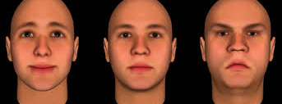

Slide 61
Competing Predictions
Thinking of future should increase optimism, confidence
  hence high trust
Thinking of future may make people avoid risk
  hence low trust
***Thinking of future of future may cause people to use information more
  Hence trust the trustworthy faces, distrust the others
  (***Most interesting and adaptive prediction)

Slide 62
Future Mindset Reduces Trust
Notes:
No interaction with trustworthiness, that effect remained constant regardless of thinking about the future

Slide 63
Exp 3: Future Mindset and Moral Judgments
More forgiving?
  Let bygones be bygones
  Reach out, maintain relationships, confidence about future
  Risky to tolerate ?
More punitive?
  Judge others, uphold rules
  More worried about future problems?

Slide 64
Experiment 3: Future Mindset and Moral Judgments
Method: Re-write statements about present or future
Judge 12 scenarios
  Half morally bad, half morally good
  Performed actions, or desired to perform them, or merely thought about them
    E.g., setting house on fire to collect insurance

Slide 65
Moral judgment findings
Future mindset intensified blame for bad acts
Future mindset did not affect praise for virtuous acts
  Bad is stronger, and more important, than good
  Thinking about future emphasizes preventing bad things from happening
Actions were judged more strongly than thoughts or desires
  No interaction with future mindset

Slide 66
Prospection Increases Blame Only

Slide 67
Implication of Moral Judgment Findings
More concern over future problems
Hence more condemnation of wrongdoers

Slide 68
Summary of Lab Findings
Thinking about future reduced risk-taking, favoring safe investment
Also reduced trust
  Of both trustworthy and untrustworthy people
Also increased moral blaming
  But no effect on praise for virtuous acts
General: seek safety, avoid risk
Monroe et al., J. Exp. Soc. Psy 2017

Slide 69
The Future is Dark ???
Optimism, positive feelings should increase risk taking, but we found the opposite
Future mindset creates emphasis on avoiding problems, misfortunes, loss
How to reconcile with all the evidence of optimistic predictions?

Slide 70
Need New Theory?
Most work has emphasized prediction
Evidence points toward pragmatic orientation
  “What is going to happen?” vs.
  “What do I want?” and “What should I do?”
Core idea: Thinking about the future is for guiding action, dealing with practical concerns

Slide 71
Integrating Findings…
Predictions are optimistic but plans are cautious
Separate steps in pragmatic prospection
  First think what you want
    Focus on the positive!
    Without the goal, pragmatism is useless
  Then think how to bring it about
    Be practical
    Focus on the negative!

Slide 72
Two Steps?
Step one: dream big
Step two: get real

Slide 73
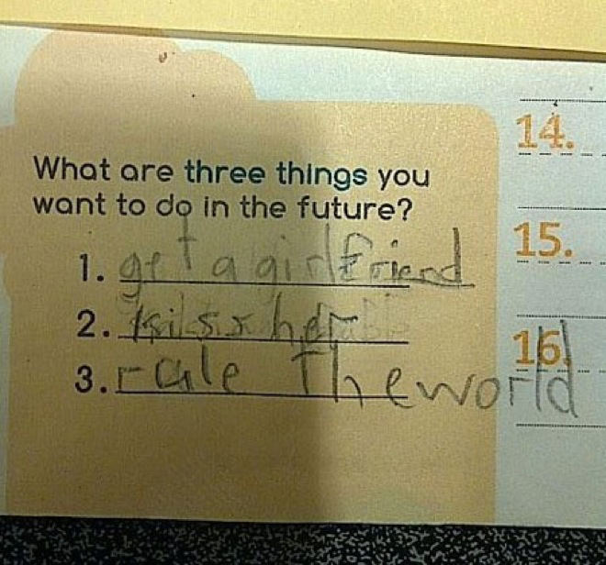

Slide 74
Two Steps Experiment
Fast vs. slow prediction should bring different levels of optimism
Step one: dream big: fast responses optimistic
Step two: get real: slow responses realistic

Slide 75
Method
Two pre-registered studies, total N=500
Predictions about future, on computer
  Same questions to everyone
10-second timer
Instructions, either…
  Respond fast, before the 10 seconds
  Respond slowly, after the 10 seconds
Study 1: Estimate probabilities for future good events
Study 2: Predict 3 specific events, self relative to others
Sjåstad & Baumeister, in preparation

Slide 76
Measures (Study 1)
What is probability that you will…
  Live past age 80
  In five years, will
    Be in romantic relationship
    Have successful career
    Achieve your most important goals
    Future life will be better than past

Slide 77
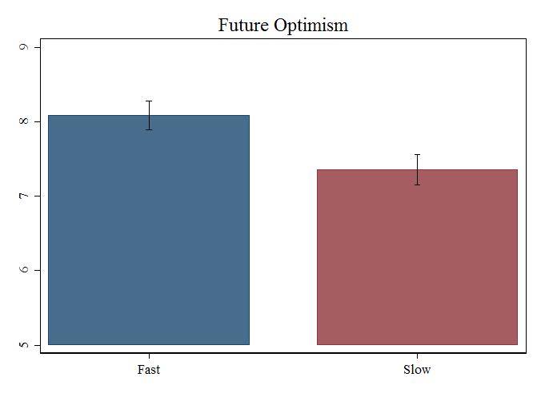
Faster = More Optimistic
(Sjåstad & Baumeister, 2018)
N=200, online experiment, USA
  Fast (vs slow) judgments were significantly more optimistic about the future
  p < .01, d = .37
  Successfully replicated in Norway, both for positive and negative events (pre-registered, N=300)
Notes:
Two-stage model: Theory and evidence.
200 participants were randomly assigned to make very rapid predictions, or to wait and deliberate for at least 10 seconds before they responded. An optimism scale consisting of five prediction items: Live past 80, in five years today: be in a romantic relationship, have a successful career, achieve all your most important goals, future life be better than your life in the past.
On average, fast predictions were significantly more optimistic than slow predictions (p=.010, d=.37).
Manipulation check also showed that participants actually complied with the instruction of responding very fast or slow, depending on condition, and comprehension checks confirmed that participants had read and understood the questions.

Slide 78
Summary of Findings
Fast responses were unrealistically optimistic
Slow responses were more realistic
  though still slightly optimistic
Fast-optimism effect is bigger for negative events than positive ones
  (Suggests it really does take more time to think about bad events actually happening)
Sjåstad & Baumeister, in preparation

Slide 79
Conclusion: Limits of Optimism
Yes, quick predictions about the future are optimistic
But after few seconds’ delay, that diminishes sharply
Pragmatic prospection starts with thinking of desired outcome, then realistically making a plan to get there

Slide 80
Prediction vs. Pragmatic Prospection
Prediction: Future as what will happen
Pragmatic prospection: Future as what is possible, what might happen
  And how to produce the desired outcomes
  Useful to predict choice points, performance demands, contingencies

Slide 81
Pragmatic Prospection Theory
Purpose of thinking of future is to produce practical benefits
  Especially by guiding action
  Prediction is helpful but secondary
  Predict points of uncertainty, not end results
Thinking of future starts by asking what you want, ideally
  Then assess whether good outcome is feasible
  If so, make plans, deal with anticipated roadblocks
Baumeister, Vohs, & Oettingen, 2016, Review of General Psych

Slide 82
Pragmatic Prospection Theory Cont’d
Backward causality (teleology)
  Connects by meaning
Assume multiple possible outcomes
  Subjective indeterminacy; opportunity, threat
  Future as matrix of possibilities …
Baumeister, Vohs, & Oettingen, 2016, Review of General Psych

Slide 83
The Matrix of Maybe
Prediction often assumes the future is already determined, and a particular outcome is inevitable
  Future as a single road
  Destiny, fate, horoscope, scientific determinism
Alternatively, future is multiple alternative possibilities, only some of which will come true
  Yet to be determined
  Future as many crossroads

Slide 84
Understanding Future as Matrix of Maybe
A recent evolutionary advance?
Redshaw & Suddendorf: human children (2-4 yrs) vs. adult chimpanzees, orangutans, gorillas
Method: drop treat into tube, must catch it when it comes out the bottom

Slide 85
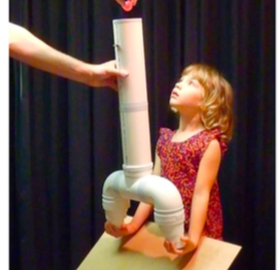

Slide 86
Only Humans
Human 2-year-olds struggled
But by 3, they got it fast
Once they solved it, they got it every time
Apes: never figured it out
  Even if they stumbled onto the idea of using both hands, they didn’t sustain

Slide 87
Evidence for Matrix of Maybe
People bet more on future than past (even if all else is identical): future seen as changeable
Anticipated emotions are helpful guides
  Actual current emotions often cause trouble
People moralize the future especially
Voters prefer optimistic leaders
  They like the rosy future
Potential is valued over achievement (!)
Keeping doors open
Baumeister, Maranges, & Sjåstad (2018) Psych and Consciousness

Slide 88
Planning
Essentially pragmatic
  Both in purpose and in actual effects
  Advantage: can decide calmly, not in heat of moment
Assumes multiple possible outcomes
Teleology
Anticipated emotion is the main purpose of emotion?
Action planning vs. coping planning
  Action planning helps get started, coping planning increases long-term success
Notes:
Anticipated regret will alter plan. Note Damasio, people lacking emotional response have trouble deciding which plan is best
You can write the email while mad, but don’t send it

Slide 89
Peace of Mind vs. Stress
Intrusive thoughts about unfinished tasks
  Zeigarnik effect

Slide 90
Why Do Those Thoughts Intrude?
Thoughts of goals that have not been completed
Two main theories
  First: The unconscious is taking care of business, and it just keeps the conscious mind informed
  Second: The unconscious needs consciousness to help get it done, so it nags the conscious mind until the job is finished

Slide 91
Turns out, it’s a third reason
Make plans, in form of “implementation intentions”
  Research program by Gollwitzer
Specific plan: what to do and when to do it. The more precise (on both!), the better.

Slide 92
Testing for Zeigarnik Effect
Effect vanishes if you merely make a plan
  Even though you haven’t reached the goal
    Even though you haven’t made any actual progress !
Thus, intrusive thoughts occur because the unconscious is nagging the conscious mind to make a specific plan for action.

Slide 93
Implications
Thus, why do you have those annoying thoughts about stuff you need to do? To quiet them, so you can relax at night, it helps to have made a specific plan of when you will do those things.
It’s not that you will keep having those interfering thoughts until everything is done
  “Everything is done” – never happens

Slide 94
The Power of Planning
Some of stress is intrusive thoughts about things needing to be done
These occur because the unconscious needs conscious thinking to make a specific plan
Make a plan, and the intrusive thoughts subside
  “If/when X, I will do Y”

Slide 95
Planning Takes Mental Effort
Forming
Revising

Slide 96
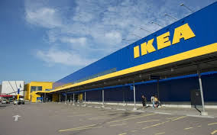
Decision Fatigue and Planning
Field-Experiment (N=112, Bergen, Norway)
H1: Decision fatigue will cause planning aversion (i.e. lower willingness to plan)
“If you had 20 minutes for your disposal right now, please tell us how much you would like to do each activity below by rating each of them on a scale from 0 (Not at all) to 10 (Very much so).”
  Take a relaxing “time out”
  Make a plan for the next four weeks
Aspiration level (goals): Compared to how you live your life right now, what are your goals for the next four weeks? Health/Private economy/Moral concern, Pro-sociality (0=Much worse, 10=Much better)
Notes:
Manipulate: entering of leaving Ikea. Assume leavers will have some decision fatigue.

Slide 97
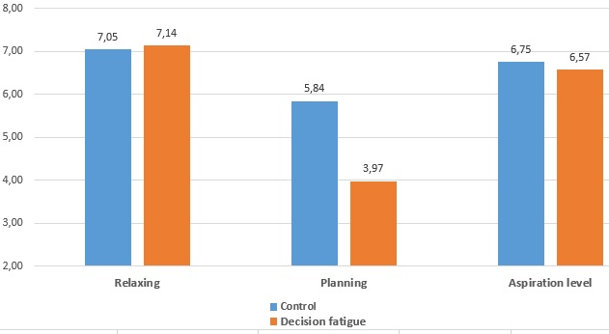
Study 2: Sjastad & Baumeister, in press, J. Exp. Soc. Psych.
Field-Experiment (N=112, Bergen, Norway)
Decision fatigue caused planning aversion;
did not influence aspiration level (goals)

Slide 98
Findings: Planning Takes Effort
Laboratory ego depletion manipulation reduced willingness to plan
Effort avoidance mediates
Depletion had no effects on desire to relax or on level of aspiration (goal setting)
Low self-control people do less planning
Sjåstad & Baumeister, in press, J. Exp. Soc. Psych.

Slide 99
Emotions and Prospection
Anticipated emotions guide behavior
So… do people adjust their emotional expectations, in order to motivate themselves…???
DeWall et al. (2016), Emotion Review

Slide 100
Emotion: Managing Expectations
Aesop’s fox and the sour grapes:
  Revising anticipated emotion?
  Or, are lofty goals (“greener grass”) all the more motivating?
Method: Ps did first test of “intuitive intelligence”
  Told they got 2 or 5 of 6 right
Prepare for second test
  Told would be prize to get all 6
  How happy would you be to score 6?
Then actually took test and received perfect score of 6 correct
Measured actual happiness
  Aesop vs. boost from pleasant surprise

Slide 101
Pilot Study
Predicting how others would react
Predicted people would be happier to improve from 2 to 6 than from 5 to 6
Thus opposite of Aesop’s hypothesis
  Greener grass across the fence is better

Slide 102
But when predicting for self…
Took first test
Told either 2 or 5 correct, out of 6
Predicted happiness if got 6 on second test
Also measured actual happiness when it came true

Slide 103
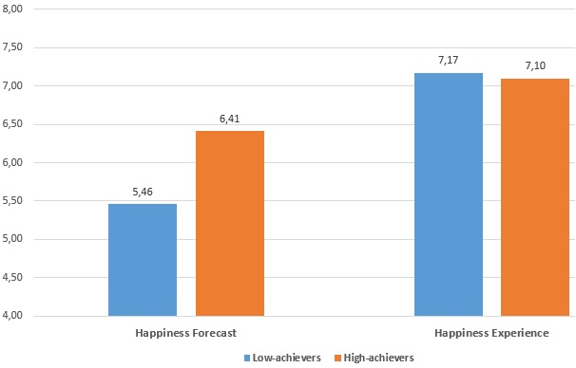
Study 2: Sjastad, Baumeister & Ent, in preparation
Predicted and Actual Happiness

Slide 104
(Results)
Those who got 2 right predicted less happiness (if they would get 6 next time) than those who got 5
In the event, they were equally happy
Conclusion: People adjust expectations downward, assume unreachable goal will not bring joy

Slide 105
Moral Reward and Punishment
Deserve reward for your good deeds?
Past 5.16
Future 6.37
Deserve punishment for your misdeeds?
Past 5.34
Future 6.85
Thus, future is morally more important than past
Sjastad & Baumeister, 2015/ unpublished

Slide 106
Conclusions: Moral Asymmetry
Deserve more praise, blame for future actions than for past
Pragmatic orientation: Future can still be changed
Moralizing the future!

Slide 107
Main Conclusions
Primacy of prospection
  Much more thought about future than past
  Future plus present also important
  Even when think of past or present, often focus on implications for future

Slide 108
Main Conclusions:
Pragmatic Prospection
Present and fairly near future
Focus on multiple possibilities, not certainties
Emphasis on what I will do
Links to present
Planning…

Slide 109
Main Conclusions:
Happy vs Meaningful
(Mindful) happiness: focus on present
Meaningfulness: focus on future
Or, especially, link past-present-future

Slide 110
Main Conclusions: Planning
Planning (vs. other future thoughts)
  Meaningful
  Emotionally positive
  Takes effort, control
  Alone or with others (equal)
Notes:
Going forward: Shift away from emphasis on mere prediction, instead focus more on planning

Slide 111
Main Conclusions: Planning
Focusing on the present removes anxiety, increases happiness
But making a plan reduces anxiety over future
  Also reduces stress, intrusive worries
The unconscious mind wants very specific plans
Pragmatic prospection is about preparing what to do
  Not just predicting what will turn out

Slide 112
Thinking about Future
Pragmatic prospection has two steps
  First, what you want: dream big
  Second, how to reach that: get real
Both are important
Future as matrix of maybe
  Don’t just think about best-case scenario

Slide 113
Final Thoughts
The past can be known, but the future can still be shaped and changed
Basing actions on the future rather than the past is adaptive

Slide 114
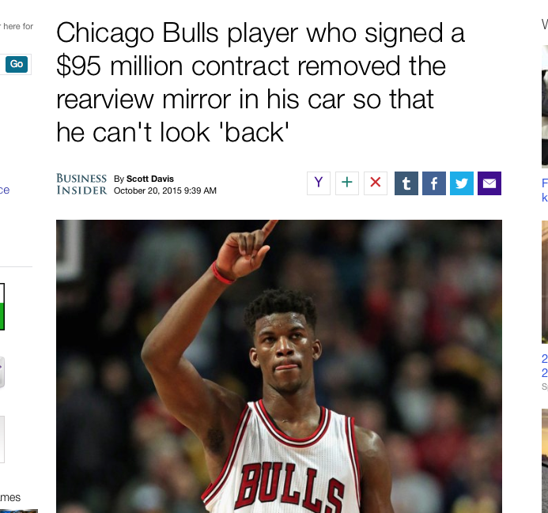

Slide 115
The End !

Slide 116
Notes from 10/2018
BetterUp conf
About 5 min too long – skipped the Aesop study; condensed the Ikea but conveyed gist

Slide 117
Thoughts about the Past:
Nutshell Summary
So what?
and What the ***k??

Slide 118
Has This Happened to You?
You are involved in something, maybe even something fun, but you keep getting annoying thoughts popping into your mind that there are things you need to do. Work, duty, etc.
  You know you will take care of those things in due course; there’s nothing you can do now. But those intrusive thoughts keep disturbing and distracting you.

Slide 119
Peace of Mind vs. Stress
Intrusive thoughts about things you need to do
Meet Bluma Zeigarnik

Slide 120
(What is the Unconscious?)
Freud: a dungeon full of your naughtiest thoughts, that you cannot acknowledge
  Or a seething cauldron of wicked impulses that could wreak havoc if let loose

Slide 121
(What is the Unconscious?)
Freud: a dungeon full of your naughtiest thoughts, that you cannot acknowledge
  Or a seething cauldron of wicked impulses that could wreak havoc if let loose
Modern: your support staff that runs the show while you focus on the big picture or get distracted

