Slide 1
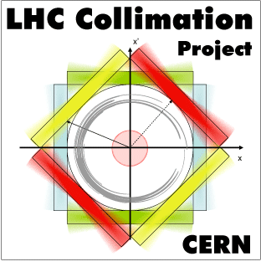

LHC Operational Experience with Proton Beams
M. D’Andrea, D. Mirarchi, R. Rossi, S. Redaelli, W. Scandale
Acknowledgments:
M. Butcher, M. Di Castro, C.A. Dionisio Barreto, A. Masi, P. Serrano Galvez, … (EN-SMM)
UA9 Collaboration, BE-ABP, EN-STI, BE-OP
HL-LHC Crystal Collimation Day, 19 October 2018, CERN

Slide 2
Outline
Methods for Crystal Characterization
Observations with Protons
Crystal Collimation in Dynamical Phases
Conclusions

Slide 3
Outline
Methods for Crystal Characterization
Observations with Protons
Crystal Collimation in Dynamical Phases
Conclusions

Slide 4
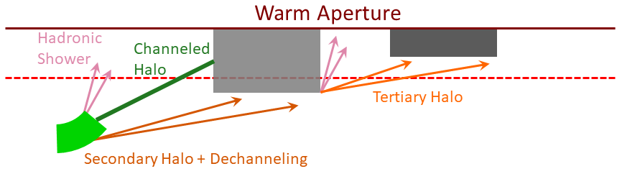
Crystal Collimation Layout
Four crystals installed in IP7: one per plane per beam
absorber
Notes:
Four crystals have been installed between 2015 and 2018 in IP7, which houses the betatron cleaning part of the LHC collimation system
Semi-analytical studies and full tracking simulations using nominal LHC optics have been carried out to find the best layout.
Requirements: channeled beam must be intercepted with enough clearance by downstream TCSGs, aperture constraints must be respected, collimation cleaning performances must be optimized

Slide 5
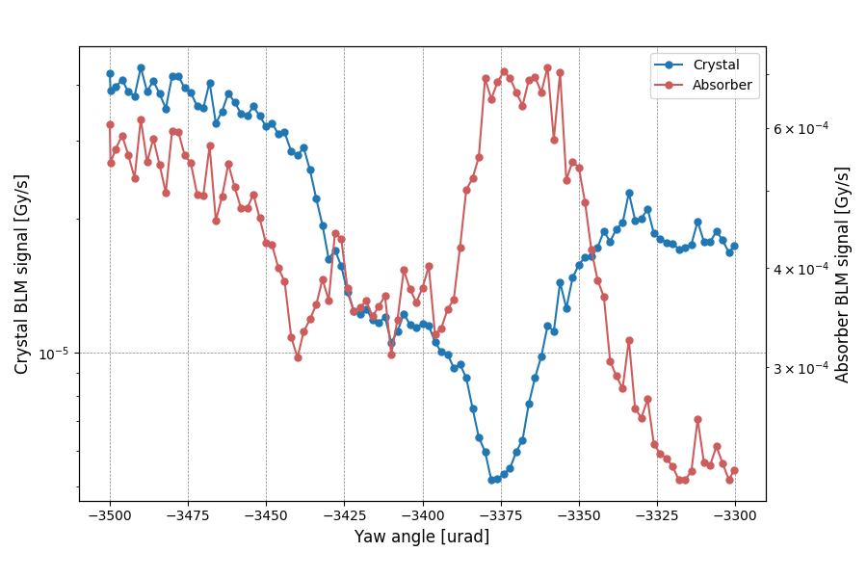
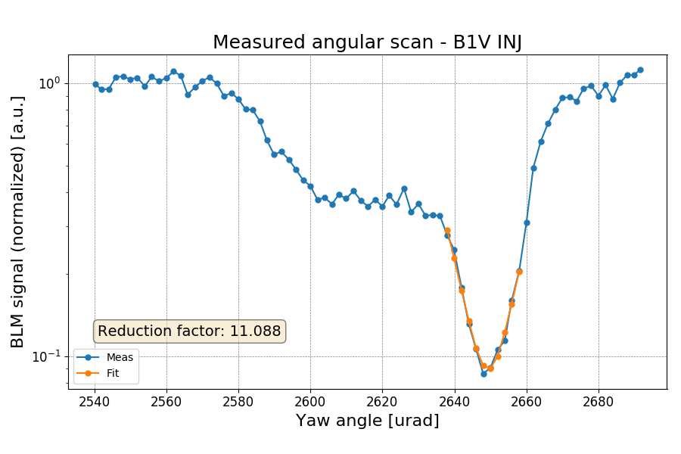
Angular Scan
The crystal device is aligned to the beam halo and rotates around its axis
What we look at:
What we look for:
decreased losses at the crystal
optimal channeling orientation
increased losses at the absorber
reduction factor
AM
VR
CH
AM
Background subtracted, normalization to lost particles flux and amorphous level
Notes:
Method used to establish channeling: crystal orientation changed with respect to beam direction (after beam based alignment -> crystal is primary)
In channeling orientation nuclear interactions in the crystal are reduced: we look for a reduction in losses at the crystal
Consequently, losses increase at the collimator used as absorber, which catches the channeled beam
After normalizing the signal at the crystal for the beam flux, familiar angular scan shape is reconstructed: amorphous, volume reflection, channeling
This allows to find optimal channeling orientation and losses reduction factor

Slide 6
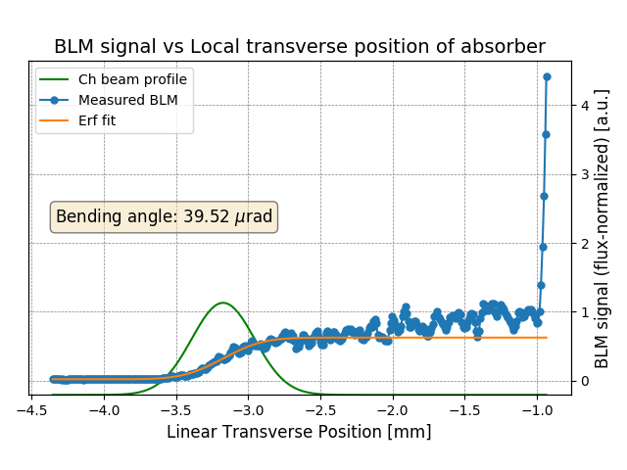
Linear Scan
The absorber is retracted and inserted until it touches the primary beam, with the crystal in channeling orientation
What we look at:
losses at the absorber as a function of its transverse position
Primary Beam
After normalization to losses when the primary beam is touched, the height of the error function gives directly the efficiency
What we look for:
multiturn channeling efficiency
characterization of channeled beam and crystal bending angle
Distance between channeled and primary beam is converted into deflection angle using the transfer matrix
Notes:
Crystal is left in channeling orientation, while the absorber is retracted and then inserted until it touches the beam: it intercepts the whole channeled beam
Losses at the absorber as a function of its transverse position allow to reconstruct the profile of the channeled beam
The profile is fitted with an error function (the integral of a gaussian): after normalization with respect to losses when the primary beam is touched allows to find the channeling efficiency
The derivative of the fitted profile is the channeled beam gaussian: distance between the mean value of the gaussian and the point where the beam is touched can be converted into deflection with the transfer matrix -> method to check the bending angle of the crystal

Slide 7
Loss Maps
The beam is blown up with ADT (transverse white noise) to generate controlled losses around the machine
Dump
β-coll
ATLAS
δp/p-coll
CMS
ALICE
LHCb
R. Rossi
Notes:
The beam is blown up with the ADT to generate controlled losses around the machine: standard method used to check collimation hierarchy
This is an example of a B1 loss map with the standard collimation system
The area of interest for our discussion is of course IP7, where we can see the usual collimator hierarchy: highest losses at the primary collimator and then showers downstream

Slide 8
Crystal and Std Collimation Comparison
standard
Cold region after collimation insertion is divided in areas corresponding to dispersive peaks
ABS
crystal
CRY
New normalization needed: losses at crystal are not proportional to the number of particles entering the collimation system
Losses normalized to beam flux to allow direct comparison
R. Rossi
Notes:
To compare the two schemes, the cold region downstream of the collimation insertion is divided in various areas (dispersive peaks) -> cleaning inefficiency (leakage) for each of them
Normally losses are normalized to the number of particles entering the collimation system (i.e. losses at the primary), but with crystal collimation the crystal is actually the primary but doesn’t have the highest losses: new normalization needed
Losses normalized to the fitted beam flux during the loss map to allow direct comparison

Slide 9
Outline
Methods for Crystal Characterization
Observations with Protons
Crystal Collimation in Dynamical Phases
Conclusions

Slide 10
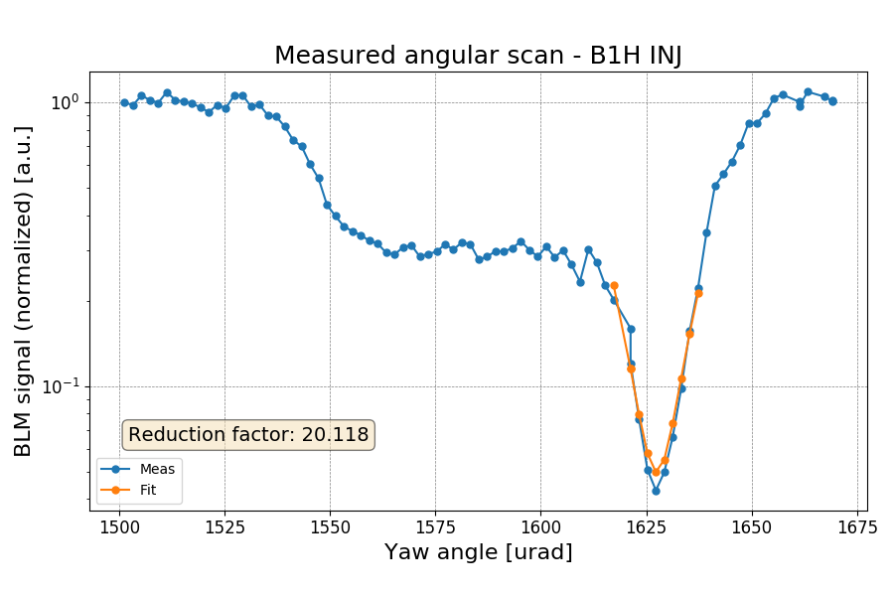
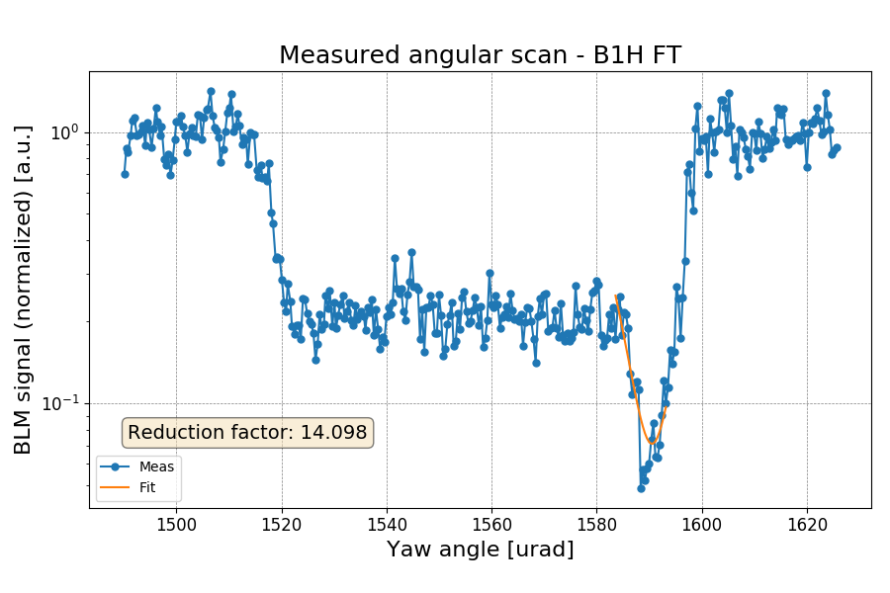
Channeling Observations
Channeling was successfully observed for the first time at LHC energies in 2015 and then re-established in subsequent measurements in the following 4 years
Setup is quick and measurements are highly reproducible thanks to the high goniometer precision
Notes:
Channeling was successfully found in many measurement: the procedure has been standardized and has become very quick. Measurements are highly reproducible thanks to the high precision of the goniometer hardware
In these plots, an example of an angular scan at injection for the B1H crystal and a more detailed angular scan at flat top for the same crystal

Slide 11

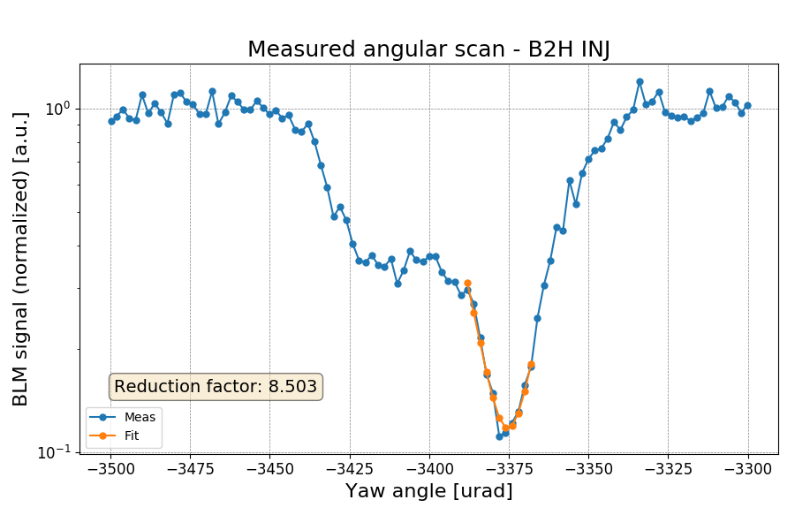

B2H Crystal Goniometer Replacement
B2H crystal was replaced during 2017 YETS due to an issue with the alignment during installation
CERN-ACC-NOTE-2018-0067
old
Skew
Skew
Planar CH
R. Rossi
Impossible to correct remotely with present hardware: the whole device was replaced
new
Measurements with B2H performed this year and currently under analysis
Notes:
B2H crystal was replaced due to puzzling results caused by an alignment problem during installation: the alignment was very close to axial channeling, allowing particles to be trapped not only in the intended plane, but also in skew planes. This spoils the shape of the angular scan and the performances of the crystal
Measurements with the newly installed crystal have been carried out during this year and are currently under analysis. Preliminary results do not show the same behaviour

Slide 12
Measured Bending Angle Overview
Crystal | Bending Angle [μrad]
B1H | 63.2 ± 1.7
B1V | 39.8 ± 2.3
B2V | 56.5 ± 1.5
B2H not reported: analysis ongoing
Crystals installed in B1 turned out to be not optimal for LHC operations: experience with these crystals allowed to better establish specifics for future installations
B1H has a larger bending angle: the radius is closer to the critical value
In this condition, dechanneling at flat top is enhanced and efficiency is reduced
Notes:
Here is an overview of the bending angle measurements for the other three crystals
B1 crystals are out of specifics: B1V has a smaller bending angle (larger radius), B1H has a larger bending angle (smaller radius)
In particular, the bending radius of B1H is too close to the critical value: we will see that this enhances the dechanneling population at flat top and reduces the efficiency of the crystal

Slide 13
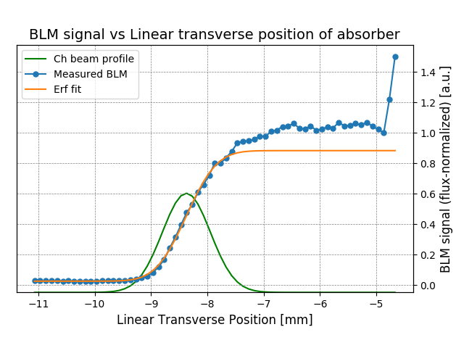
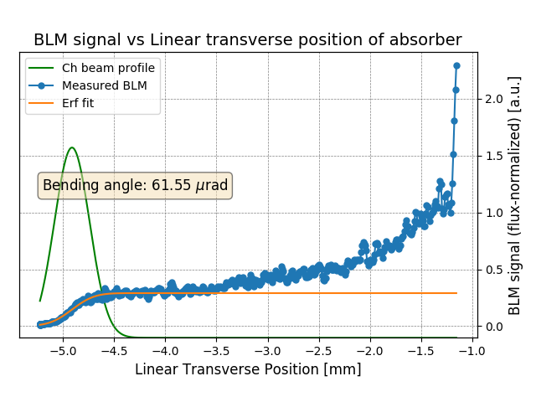
Effects of Bending Radius on CH Efficiency
Injection:
B1H
B1V
~88%
~87%
R. Rossi
Flat top:
B1H
B1V
~30%
~75%
Notes:
Here I will show a comparison of linear scans for B1H (over specifics in terms of bending angle) and B1V (under specifics)
At injection they seem to behave in the same way, with similar multiturn channeling efficiencies
However, at flat top they show remarkably different behaviors. For B1H we see increased losses at small deflection angle, which indicate an enhanced dechanneling population: as a result, the channeling efficiency is reduced, while no significant change shows for B1V

Slide 14
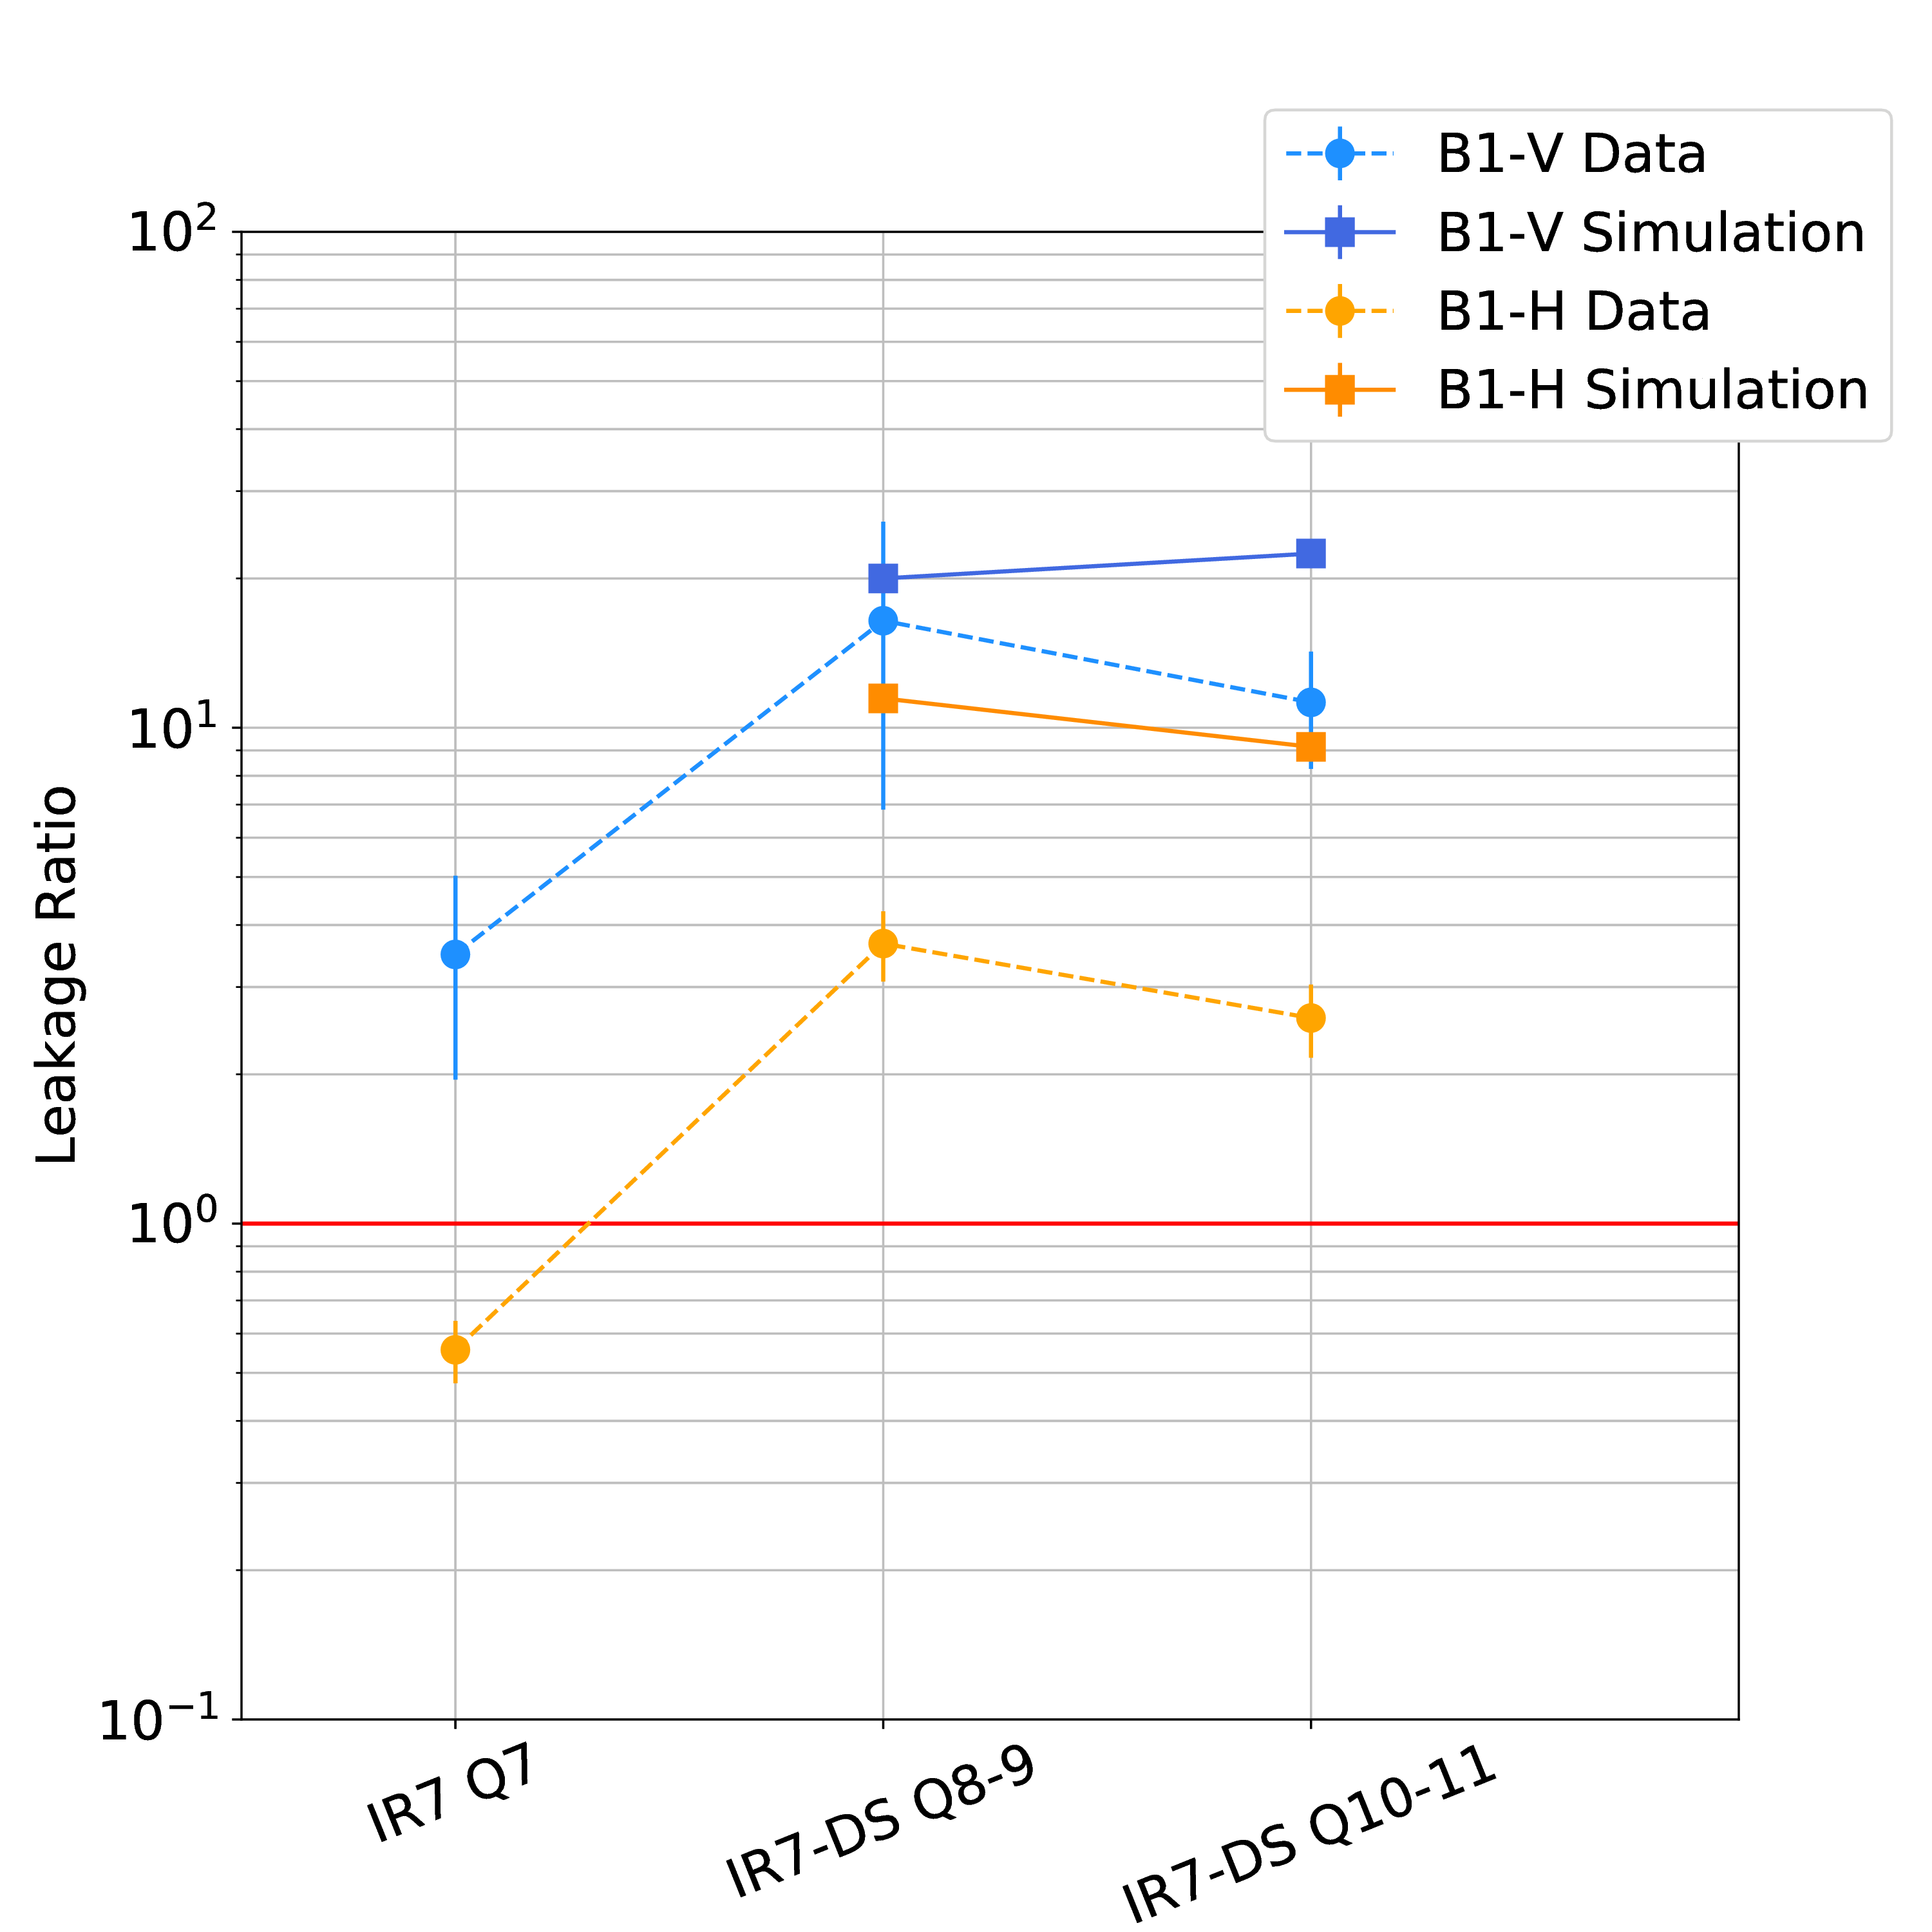

Cleaning Inefficiency with Protons
Significant improvement (factor ~10) observed in the DS for B1V
Analogous results observed for B2V
No significant improvement observed on B1H (possibly due to high dechanneling)
Comparison with simulation shows good agreement for B1V and a significant difference for B1H
No analytical description for bending radius close to critical value: not reproducible in simulations
B1V
B1H
R. Rossi
Notes:
Cleaning inefficiency has been measured with various settings which include different apertures of downstream TCSGs and TCLAs (nominal or larger)
These plot show the ratio between leakage with standard system and with crystals: ratio larger than 1 means improvement
B1H shows no significant improvement in cleaning (perhaps due to the reduced efficiency caused by the large bending angle)
B1V on the other hand shows a significant improvement of a factor 10 in the DS: promising!
B2 performance is currently under study after the new installation
Comparison with simulations shows good agreement for B1V, but an important discrepancy for B1H: this is believed to be caused by the low bending radius, which cannot be effectively handled in simulations since there’s no analytical description

Slide 15
Outline
Methods for Crystal Characterization
Observations with Protons
Crystal Collimation in Dynamical Phases
Conclusions

Slide 16
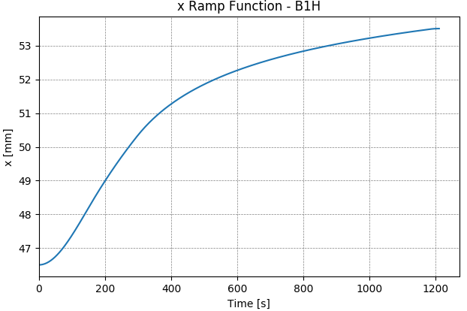
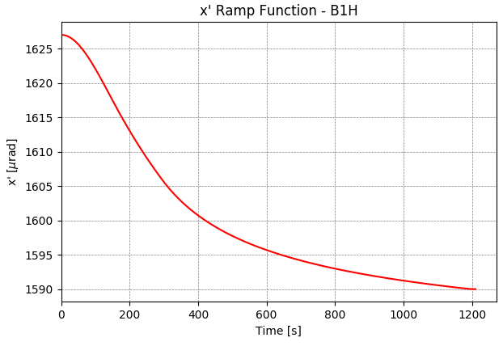
Crystal Collimation in Dynamical Phases
In order be used during operations, crystals need to be kept in channeling orientation during dynamical phases such as the energy ramp
Challenges:
shrinking of beam size and change in angular distribution due to adiabatic dumping
change in critical angle (from ~10 μrad to ~2 μrad) and acceptance
Functions need to be prepared to move the crystals: same formula used for standard collimators, but adapted also for rotational stage
$$x\left(t\right)=x_{c}−\left[n_{inj}+\frac{n_{ft}−n_{inj}}{γ_{ft}−γ_{inj}}\left(γ\left(t\right)−γ_{inj}\right)\right]\left[{\tilde{σ}}_{inj}+\frac{{\tilde{σ}}_{ft}−{\tilde{σ}}_{inj}}{γ_{ft}−γ_{inj}}\left(γ\left(t\right)−γ_{inj}\right)\right]\frac{1}{\sqrt{γ(t)}}$$
~7 mm
~35 μrad
Initial and final positions fixed to measurements
Notes:
To deploy crystal collimation it’s mandatory to verify if the goniometer hardware is reliable enough to keep the crystals in channeling during the dynamics phases: energy ramp
Challenges during energy ramp: adiabatic dumping changes the beam size and the angular distribution, furthermore the crystal critical angle reduces a lot with the energy (and obviously the acceptance aswell)
Functions need to be generated to move the crystal and accommodate this changes: these are generated in the same way as the ones for standard collimators (this time for the rotational stage also), i.e. there’s a dependence on the gamma factor and a linear interpolation of the dependence on the n sigma
Initial (injection) and final (flat top) positions are fixed to the measured ones
The extremely high precision of the goniometer hardware is key to make these operations possible

Slide 17
First Ramp Attempt with B1H
First attempt in 2016: channeling conditions evaluated during the ramp (continuous loss maps) by the ratio of losses at crystal and absorber
Well under control (ratio < 10⁻²) for the whole ramp!
channeling
CERN-ACC-NOTE-2018-0053
amorphous
Second attempt this year with all four crystals: analysis ongoing
R. Rossi
Notes:
Channeling conditions are evaluated during the ramp by means of continuous loss maps (blow up of the beam at specific energies while the ramp keeps going)
Comparison between loss maps with the crystal in channeling and amorphous orientation: channeling is seen when losses at the crystal are two orders of magnitude lower than losses at the absorber
First attempt in 2016: channeling orientation was successfully maintained throughout the whole ramp
Second attempt this year (two weeks ago, during MD3) with all four crystals: analysis ongoing

Slide 18
Outline
Methods for Crystal Characterization
Observations with Protons
Crystal Collimation in Dynamical Phases
Conclusions

Slide 19
Conclusions
Crystal channeling was successfully established during 4 years of testing
  procedure is quick
  measurements are highly reproducible thanks to high precision goniometer hardware
B1 crystals turned out not optimal for LHC operations, but still useful for studies
  better grasp of crystal specifics for future installations
  quantitative evaluation of small bending radius effects on dechanneling population
Crystals with larger bending radius (B1V, B2V) show good agreement between simulations and measurements
Discrepancies observed for B1H are believed to be caused by the extreme conditions in terms of bending radius
  no analytical description of enhanced dechanneling
Channeling conditions were successfully maintained during the energy ramp, paving the path for potential operational use
  second attempt performed this year with all four crystals, analysis ongoing
Detailed characterization of the newly installed B2H crystal is ongoing

Slide 20
Thank you for your attention

