Slide 1
LHC Operational Experience with Heavy Ion Beams
19/10/2018 – HL-LHC Crystal Collimation Day
Roberto Rossi
Daniele Mirarchi, Stefano Redaelli, Walter Scandale
Acknowledgments: UA9 Collaboration, EN-SMM, BE-ABP, EN-STI, BE-OP

Slide 2
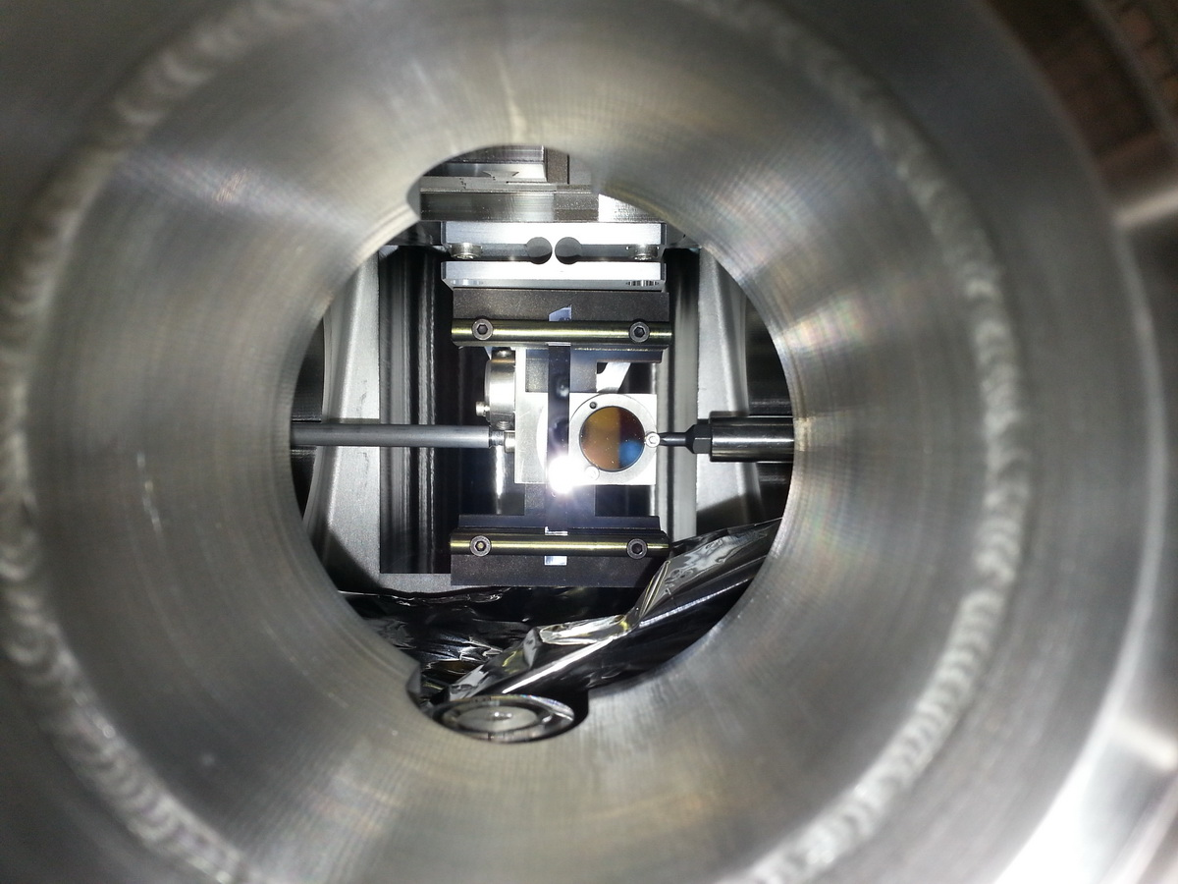
Outline
Review of measurements performed with ion beam
  Crystal angular scans
  Collimator linear scans
Cleaning with Xe ion beams
Cleaning with Pb ion beams
Proposed settings strategy and plans for tests in 2018
Conclusions
Strip silicon crystal installed on the horizontal B1 goniometer in LHC.

Slide 3
Heavy Ion Tests Overview
Test with heavy ion carried out from
2015 to 2017 (one per year)
A total of 36 h were allowed with ion beams
  ~ 20h used for measurements
Details about procedures, analysis and results are presented in MD notes:
  CERN-ACC-NOTE-2018-0004
  CERN-ACC-NOTE-2018-xxxx
A report on Xenon beam measurement in the doctoral thesis:
  CERN-THESIS-2017-424
Notes:
20 of the 36 hours allowed was actually used for the ion beams MDs
Inefficiency especially with Pb beams
We have reported the detailed procedures and in a doctoral thesis the results presented in these slides

Slide 4
Outline
Review of measurements performed with ion beam
  Crystal angular scans
  Collimator linear scans
Cleaning with Xe ion beams
Cleaning with Pb ion beams
Proposed settings strategy and plans for tests in 2018
Conclusions
Strip silicon crystal installed on the horizontal B1 goniometer in LHC.

Slide 5
Ions Angular Scans
Channeling with ion beams of such energies observed for the first time in LHC
B1-H
B1-H
Pb @ 450 Z GeV
Pb @ 6.5 Z TeV
B1-V
B1-H
Xe @ 6.5 Z TeV
Xe @ 6.5 Z TeV
Notes:
LHC has been an unique facility not only for protons but also for heavy ion beams
Channeling has been observed for the first time with Pb ions of such energies
For Xe beams was the first ever test (at any energy)
Angular scan shape are consistent with proton observations

Slide 6
Ions Collimator Scans
As for proton beams the observables are:
Bending angle ~ 40 µrad
Multi-turn efficiency ~ 65 %
B1-V Pb @ 6.5 Z TeV
Notes:
Also linear collimator scans were used, as for protons, to establish
The bending angle
The multi-turn channeling efficiency

Slide 7
Overview
Crystal | ID | Bending Angle [µrad] | Multi-Turn Efficiency [%]
 |  |  | @ 450 Z GeV | @ 6.5 Z TeV
B1-H | STF75 | 63.2 ± 1.7 | 75 ± 5 | 37 ± 3
B1-V | QMP34 | 39.8 ± 2.3 | 86 ± 3 | 64 ± 3
B2-V* | QMP52 | 56.5 ± 1.5 | - | -
* No linear scan with ion beams available
For each crystal it has been evaluated:
  the deflection angle (is averaged over all the measurements, both protons and ions)
  The Multi-Turn channeling efficiency (averaged on Xe and Pb measurements)
Notes:
The bending angle is averaged for all the measurements performed
B2-H is missing for an alignment problem during installations

Slide 8
Outline
Review of measurements performed with ion beam
  Crystal angular scans
  Collimator linear scans
Cleaning with Xe ion beams
Cleaning with Pb ion beams
Proposed settings strategy and plans for tests in 2018
Conclusions
Strip silicon crystal installed on the horizontal B1 goniometer in LHC.

Slide 9
Crystal Collimation Xenon Cleaning
Dump
β-coll
δp/p-coll
Standard
Dump
β-coll
Crystal
δp/p-coll
Looking at loss maps along the ring: no dangerous peaks with crystal
Notes:
The loss maps shows with Xe beams an improvement when crystal collimation is used
general reduction of background along all the ring
no dangerous peaks observed

Slide 10
Ions Loss Maps
β-coll
Extra region added for LM anlysis: Q12-13
δp/p-coll
Dump
Notes:
A spike in losses in near Q12 and 13 was observed in 2015
This region correspond to a third peak in D(s) function
It is added to the previous regions for performance evaluation

Slide 11
Crystal Collimation Concept for Xe Test
C
W
B1-H showed large dechanneled population at low deflection angles
Indication (SPS & LHC) of higher losses when C collimator is used as absorber
Notes:
The sketch shows again how the concept of the two collimations work
Test with Xe was driven by main observation
B1-H has a high population of particles at low deflection
The idea was to close a bit more the the secondary C collimators
Previous observation (both SPS and LHC, and with both p and Pb) suggested leakage from C collimators
To catch these particles the idea was to close the absorber W collimators

Slide 12
Different Absorber Collimator Apertures
C
W
Tighter absorber collimator settings correspond to an improvement of leakage at first dispersive peak
Off-momentum particles produced by secondary collimators (C) can be stopped using higher Z absorber, e.g. absorber collimators (W)
Notes:
In the plot, as in Marco’s presentation, the Leakege Ratios (Standard to crystal collimation) are showed
- >1 better, <1 worse
Closing the W collimators increase the performances at first dispersive peak of DS
The off momentum particles escaping form secondary C collimators are stopped by W collimators

Slide 13
Different Downstream Collimator Aperture
C
W
Tighter settings of both secondary and absorber collimators improve cleaning in both DS and ARC regions
B1-H wide dechanneling distribution escapes the downstream collimators and it is lost in both DS and ARC
Notes:
If we move instead both Secondaries and Aborbers
Cleaning is improved in all DS + ARC regions
The system is stopping the dechanneled population generated by B1-H at top energy

Slide 14
Crystal Collimation Xenon Cleaning
When standard collimation is used with tight settings, only a small difference is observed in Q7 (more showers), while a large difference observed for crystal collimation
An improvement larger than an order of magnitude is observed in the IR7-DS
Notes:
Several configuration tested
The best case is observed when all downstream collimators are closed
Both TCSG (graphite) and TCLA (tungsten)
Performance improved by more than one order of magnitude in the DS
The price is the high losses in the first cold magnet (Q7) probably due to showers from TCLA
To be verified

Slide 15
Comparison with QM crystals
With QM crystals, with same tight settings, the same magnitude of improvement is not observed
To consider:
Both QM are mounted on vertical plane
B1-V and B2-V show better results with protons
Might be indication of differences between the two technologies (ST vs QM), with heavy ions at such energies
To be further investigate in 2018 Pb tests
Notes:
With QM crystals a very slight improvement is observed but not of the same magnitude ad for B1-H Strip
Even though both crystals are in V plane they showed better cleaning with proton beams
Might be an indication of a different behaviour of the two technologies with heavy ion beams

Slide 16
Outline
Review of measurements performed with ion beam
  Crystal angular scans
  Collimator linear scans
Cleaning with Xe ion beams
Cleaning with Pb ion beams
Proposed settings strategy and plans for tests in 2018
Conclusions
Strip silicon crystal installed on the horizontal B1 goniometer in LHC.

Slide 17
Pb Ion Cleaning Results
No significant improvement in any configuration tested with Pb beams
C and W absorbers closed up to the nominal aperture (7.5 and 11 σ)
Notes:
- With Pb beams no major improvement were measured
- But only standard settings (for both W and C absorbers) were tested

Slide 18
Outline
Review of measurements performed with ion beam
  Crystal angular scans
  Collimator linear scans
Cleaning with Xe ion beams
Cleaning with Pb ion beams
Proposed settings strategy and plans for tests in 2018
Conclusions
Strip silicon crystal installed on the horizontal B1 goniometer in LHC.

Slide 19
Pb ions test in 2018
The crucial tests will be held in November this year
  Operational Tests (as an End of Fill test)
  Machine Development Tests
The main objective will be to measure cleaning performances with same tight configuration tested with Xe
Notes:
Test with Pb will be completed later in Novemebr
Also a test with partially striped Pb ions is programmed for the end of the month
- The main activity will be the cleaning performances measurement with the optimized settings, used with Xe ions

Slide 20
Outline
Review of measurements performed with ion beam
  Crystal angular scans
  Collimator linear scans
Cleaning with Xe ion beams
Cleaning with Pb ion beams
Proposed settings strategy and plans for tests in 2018
Conclusions
Strip silicon crystal installed on the horizontal B1 goniometer in LHC.

Slide 21
Conclusions
  Crystal channeling with heavy ion beams of such energies observed for the first time
    Observations coherent with previous SPS measurements with heavy ions
    Crystal’s bending angles and multi-turn efficiency characterised as for proton beams
  Cleaning test with Xe ions showed an improvement higher than a factor 10 in DS, and clarified several points:
    B1-H crystal feature needs tighter absorber settings to compensate the large dechanneled population
    Debris coming from secondary collimators (C) is observable at the first dispersive peak in DS, closing absorber collimators (W) improve cleaning
    No improvement with QM crystals up to now, might indicate difference with ST technology at these conditions
  Final Goal:
  Achieve with Pb the improved cleaning observed with Xe beams

Slide 22
BACKUP

Slide 23
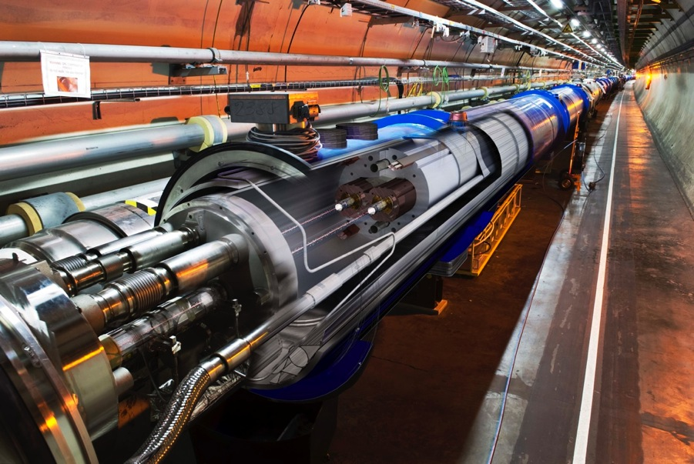
Applications
Superconducting magnets:
T = 1.9 K
quench limit ~ 15-50mJ/cm³
Aperture: r = 17/22 mm
Collimation system is needed!
η = 10⁻⁴ is the actual performance
Stored energy in the machine:
LHC 2016: 280 MJ
LHC design: 360 MJ
For the HL-LHC is foreseen:
Increased beam stored energy: 362MJ → 700MJ at 7 TeV
  Collimation cleaning versus quench limits of superconducting magnets
Larger bunch intensity (I_{b}=2.3x10¹¹p) in smaller emittance (2.0 μm)
  Collimation impedance versus beam stability
Operational efficiency is a must for HL-LHC! Collimators: high precision devices that must work in high radiation environment
Upgraded ion performance (6 x 10²⁷cm⁻²s⁻¹, i.e. 6 x nominal)
Notes:
Low operation temperature
Low quench limit
With such a stored energy a very small fraction of energy deposited locally could quench the magnets
Uncontrolled loss of beam tails
n collimation cleaning
Inefficiency factor -> for each 10000 p 1 is lost in a cold magnet
Upgrade for HL-LHC
2x stored energy but same quench limit ->
collimation performances has to remain the same we have now (protons)
With ions? No solution neither for run III
Each bunch is 2x more populated and smaller
smaller gaps increase impedance

Slide 24
Crystal Collimation for HL-LHC
For the future HL-LHC an upgrade of the actual collimation system is required
  Good baseline solution for proton beams
  No solution for lead ion beams
Crystal collimation could improve the ion cleaning and is one of the R&D subject
Different challenges to be addressed
Understanding limitations of present Collimation System
Channeling assessment at LHC energy range for both proton and ion beams
Experimental assessment of crystal collimation performance in the LHC for both proton and ion beams
Understanding of experimental results in simulation
Study and design of an absorber stage
Design of new layouts for a complete crystal system on both beams
✓
✓
✓
✓
Notes:
In the actual baseline are foreseen 11T dipoles and new materials -> still no solutions for ions coll
Only 1 11T dipole in the baseline!!
Crystal coll challenges:
Angular accurancy
Better cleaning
Robustness to LHC/HL-LHC operation
Absorber

Slide 25
Where are we?
In recent years several Master/PhD works have been carried out in the Collimation Team towards a demonstration of the feasibility (simulations and/or measurements):
V. Previtali: CERN-THESIS-2010-133 (2010, PhD) simulation code for SixTrack
D. Mirarchi: CERN-THESIS-2011-136 (2011, master) measurements on SPS
CERN-ACC-2015-0143 (2015, PhD) improvement of simulation tools and benchmark, design of the crystal system prototype installed in the LHC
R. Rossi: CERN-THESIS-2014-187 (2014, master); measurements on single pass for simulation benchmark
The setup for the PhD is built on those works, especially for the simulation tool that I’m using every day

Slide 26

Collimation System in LHC
To protect the superconductive magnets from high energy deposition induced by lost particles
Collimation system is needed!
η = 10⁻⁴ is the actual performance in LHC
Halo cleaning: reduce the risk of magnet quenches
Concentration of losses/activation in controlled areas
Avoid many hot locations around the 27km-long tunnel
TCP
TCSG
TCLA
Multistage system of 50 collimators per beam.
LHC: only machine where collimation must be used continuously in operation
The cleaning inefficiency with ions drops to 10⁻²!

Slide 27

Crystal Collimation
Advantages of crystal collimation at the LHC:
Improve collimation cleaning (by a factor 10);
  Reducing off-momentum losses in DS
Lower impedance;
  Less collimators at larger gaps
Amorphous (0.6 m of C)
<θ>MCS ~ 3.4 μrad (7 TeV)
<θ> ~ 50 μrad (7 TeV)
Crystal
(Channeling)
(4 mm Si)
310 T equivalent magnetic field!
Crystal collimation could improve the ion cleaning and is one of the R&D subject for HL-LHC upgrade
Notes:
Using channeling for collimation
Particle bent on one single absorber
MCS vs CH
improve cleaning and impedance
Considered to be used for ion cleaning

Slide 28
Crystal Collimation Layout
Semi-analytical studies and full tracking simulations has been provided to find the best layout for the LHC test stand.
The major requirements (for both injection and flat top) have been studied [1]:
Intercept the channeled halo with enough clearance by the TCSGs downstream
Respect the aperture constraints
Collimation cleaning performances optimisation
Crystal request defined before 2014 restart:
  Bending angle: 50 μrad
  Length: 4 mm
absorber
R[m] |  | 𝝷_{b} [𝝻rad]
 |  | 40 | 50 | 60
l [mm] | 3 | 75 | 60 | 50
 | 4 | 100 | 80 | 66.7
 | 5 | 125 | 100 | 83.3
[1] D. Mirarchi, et al., Design and implementations of crystal collimation test stand at the Large Hadron Collider, Eur. Phys. J. C, 77 (6) (2017), p. 424
R_{c}∼15.6 m @6.5 TeV
Notes:
Semi-analytical studies have been produced using the nominal LHC optics
Evaluates the channeling halo trajectories around the machine (first stage for system installations)
Sufficient clearance at both LHC energies (inj 450, ft 6.5)
Respect aperture constraints
Optimasation of parameters
5 mm too many losses in DS
3 mm too close to critical radius
4 mm, 40 low clearance at injection, 60 too close critical angle

Slide 29
Channeling Observation
1. Angular Scan
local losses
vs
crystal angular orientation
Beam
First Observation of Channeling in LHC @ 6.5 TeV!
AM/CH
loss reduction
RF 24.0
Notes:
To establish channeling angular scan is used
Modifying the orientation of the cyrstal wrt the beam direction
In channeling reduced nuclear interactions -> lowest local losses
Well reproduced in simulations
Reduction factor to amorphous orientation is used to evaluate the crystal performances

Slide 30
Collimation System @ LHC
Halo cleaning: reduce the risk of magnet quenches
Concentration of losses/activation in controlled areas
Avoid many hot locations around the 27km-long tunnel
TCP
TCSG
TCLA
Multistage system of 50 collimators per beam.
LHC: only machine where collimation must be used continuously in operation
β-coll
ATLAS
Dump
δp/p-coll
CMS
ALICE
LHCb
Notes:
collimation system clean the beam halo by mean of MCS with several collimation stages (hierarchy)
Name TCP, TCSG and TCLAs
cleaning, losses
Complex system with more than 50 coll per beam
loss maps and local cleaning use BLM along LHC to check losses (describe plot)
Higher losses in IR7 -> near the coll system is measured its efficiency

Slide 31
Collimation System @ LHC
Main limitations
Proton beams
  Single diffractive interactions
  small deflection & non-negligible δp/p ➔ escape from insertion and are lost in the IR7-DS if δp/p > 10⁻²
Lead ion beams
  Fragmentation and dissociation events
  particles with different magnetic rigidity (q/m)➔ lost in the IR7-DS reducing of two order of magnitude the collimation system performance wrt to proton collimation
  Impedance
  Big number of collimators at small gap ➔ 90% contribution to whole machine impedance
The cleaning inefficiency in the LHC is up to 10⁻⁴
The cleaning inefficiency with ions drops to 10⁻²!
Notes:
Zoom in IR7
High peaks in blue -> DS cold magnet
diffractive
particle with small angle pass trough the other collimators
different momentum lost on dispersion peak ( 10^-2, 2m, 20 cm pipe)
For lead ions also fragmentation and dissociation cause inefficiency
Many collimators close to the beam -> high impedance
To measure performance normalising to TCP loss (# particles in collimation)
With protons inefficiency in IR7-DS about 1e-4
With ions no solution -> the present system 1e-2

Slide 32
Angular Scans - Methodology
Fitting losses in Channeling with a parabolic function is the method used to evaluate both the best goniometer orientation for channeling and the average loss value in that point.
Notes:
In angular scans local losses at crystal are reduced when it is oriented in channeling
reduction of nuclear interaction
To evaluate the performance reduction factor to AM orientation
2nd order fit to average losses in channeling orientation
Inserire plot con simulazioni

Slide 33
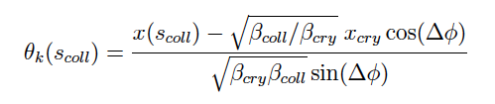
Halo Scraping - Methodology
Losses recorded with BLM at goniometer position normalized to beam.
The X axis is converted in deflection angle using
The error function fit gives info about the channeled beam properties as deflection angle and beam sigma
Notes:
In channleing orientation one of the collimators downstream can be used to intercept the channeled halo
Local losses show a rise when deflected halo is intercepted
Using a simple transport matrix it is possible to evaluate the deflection given by the crystal, at coll position
Error function fit is the integral of the gaussian distribution of the deflected particles

Slide 34
Channeling Observation
2. Absorber Scan
local losses
vs
collimator transverse position
Beam
~ 84 %
θ_{b} ~ 55 μrad
With Transport Matrix can be evaluated the deflection angle
Losses at channeling plateau, normalised to the primary beam spike, can evaluate the multiturn channeling efficiency
Notes:
With crystal in channeling a downstream collimator can intercept the channeled halo
The local transverse position of the channelled halo is well reproduced in the simulations (within 100 um)
Using a simple transport matrix it is possible to evaluate the deflection given by the crystal
Error function fit is the integral of the gaussian distribution of the deflected particles
Also, normalising losses to primary beam spike, the plateau gives an avaluation of channeling multiturn efficiency

Slide 35
Ions Angular Scans
Channeling Reduction Factors in agreement between xenon and lead ions observations.
In comparison with protons, the reduction factor is about a factor ~2 lower.
Notes:
Also in this case reduction factors have been measured
Good agreement between Pb and Xe ion beam measurements
Wrt protons, RF are about a factor two lower
add b2V on p vs Xe

Slide 36
Ions Collimator Linear Scans
B1- V @ 6.5 Z TeV
B1-H @ 450 Z GeV
Pb
Pb
Xe
Xe
All measurements confirmed proton observations about bending angle for each crystals
Notes:
Linear scans with TCSGs collimators also performed
Achieved same control of the channeled beam as for proton beams
All deflection angle measurements were merged with proton measurements to characterise the crystals

Slide 37
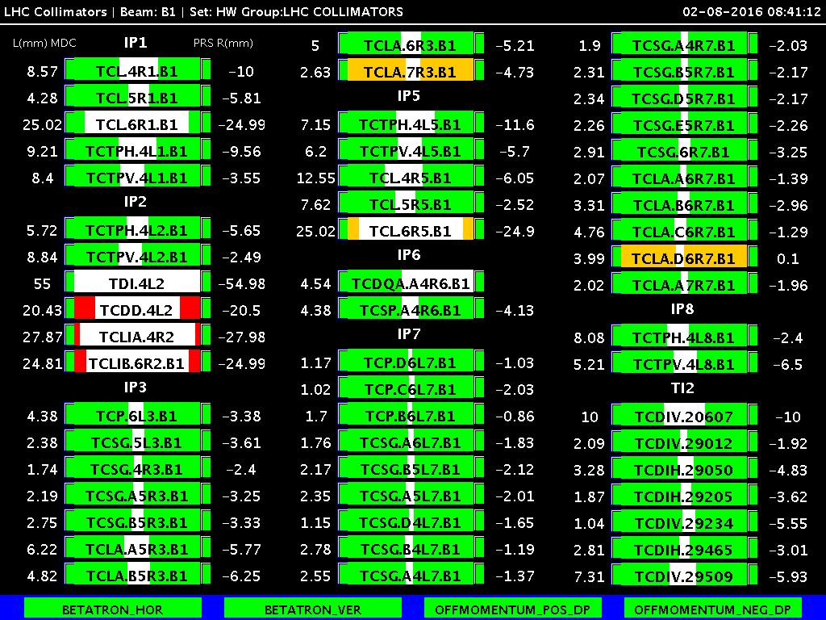
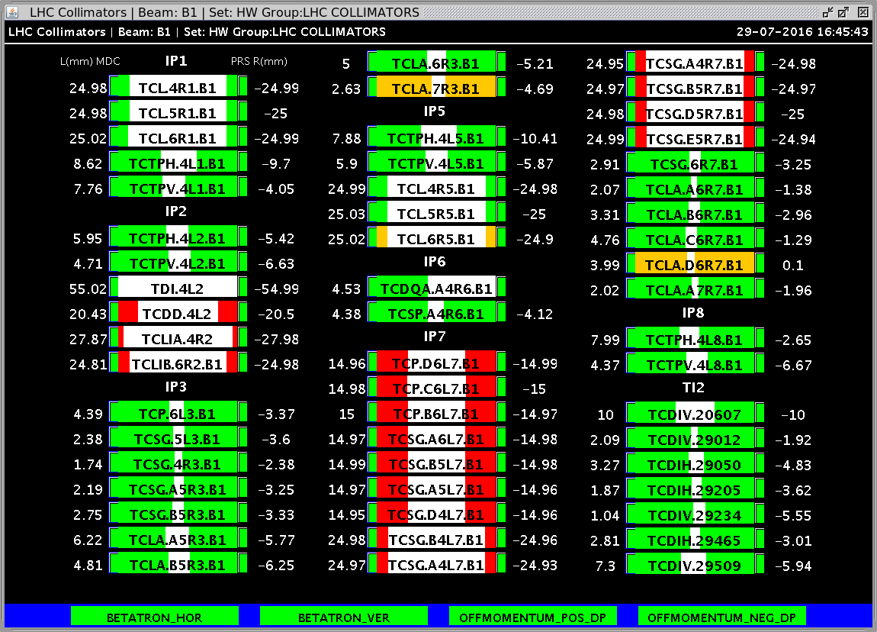
Collimation Loss Maps
Present IR7 — tight settings
1 crystal, TCSG + TCLA
Beam
crystal
Notes:
The loss pattern is pretty different as is different the collimator setup used
Standard collimation shows loss hierarchy, with higher losses on primary collimator (Normalisation)
Crystal has reduced losses on its primary stage (crystal in channeling reduces local nuclear interactions)
The hierarchy is back after the first absorber

Slide 38
Collimation Cleaning - Methods
Normalisation to beam flux ➔ Particles lost in collimation system
To compare the crystal collimation to the standard collimation the leakage of particles in specific region near to the IR7-DS is evaluated by normalizing losses to the beam flux.
Notes:
To compare the two systems a normalisation to the beam flux is needed
Particles lost from the machine due to collimation
Several areas in the first cold region after the collimation insertion are used to evaluate the leakeage of particles
The leakage define the performance of the collimation system

Slide 40
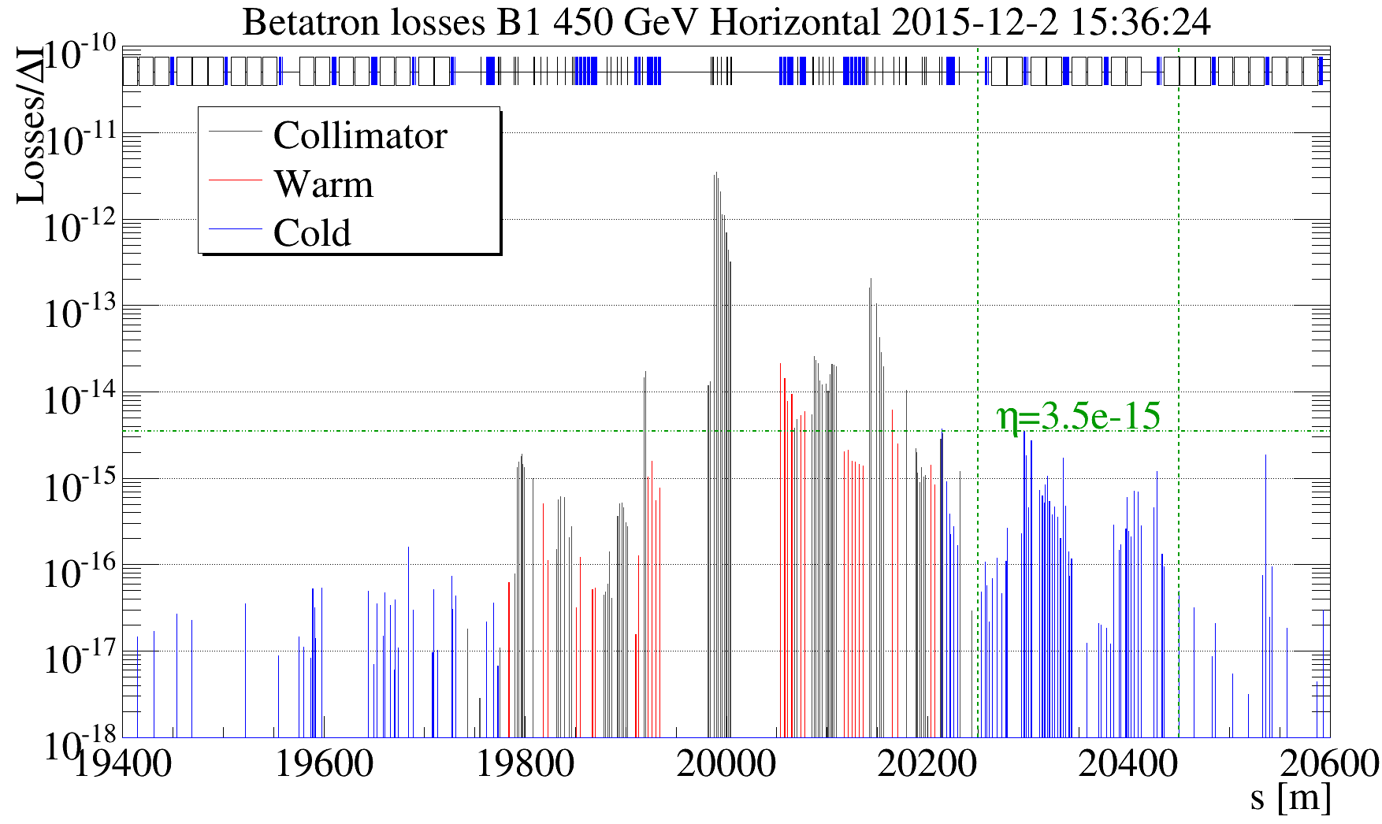
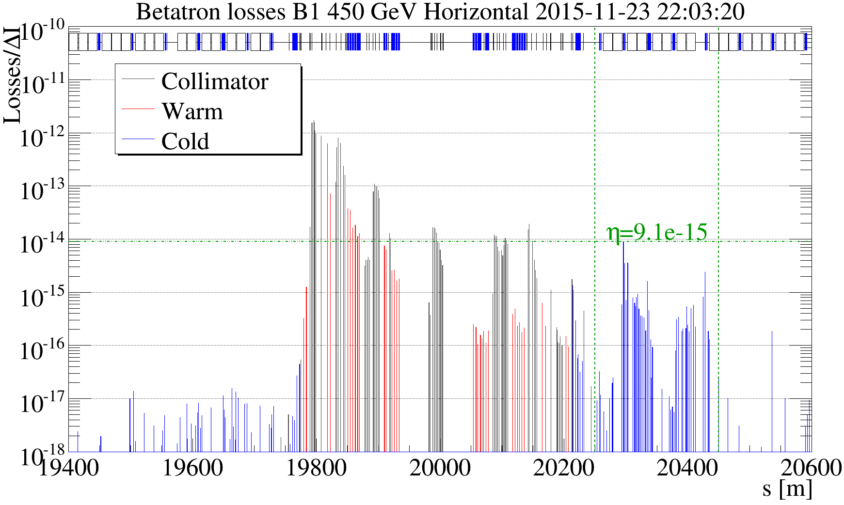
Ions Loss Maps @ 450 Z GeV
Loss maps measurements was performed as during standard collimation tests
TCSG.B4L7
crystal
standard
crystal
the leakage to IR7-DS is evaluated normalizing the BLM losses to the charges lost per second
the leakage to IR7-DS improves by a factor of about 2.6
better results are expected improving the clearance between crystals and TCSGs
note: the system is optimized for 6.5 TeV!
Notes:
normalized to charge lost per second
leakage already improved at injection, while system is optimized for top energy
the clearance is given by the actual system in which the crystal are inserted (transparent for standard operation)

Slide 41
Collimation cleaning setup
In lead ion test a small improvement were observed when the first secondary collimator was moved to tighter apertures.
D4L7 @ 7.0 σ
D4L7 @ 7.5 σ
D4L7 @ 8.0 σ
With Xe was decided to explore different settings, using also TCLAs to different apertures.
Notes:
One can observe in B1-V case, that moving one collimator to closer settings, improved the cleaning coherently
This plus the improved understanding of crystals characteristics (e.g. B1-H feature)
Led to the idea of use new collimator settings, this time using also TCLA at apertures different than nominal ones

