Slide 1
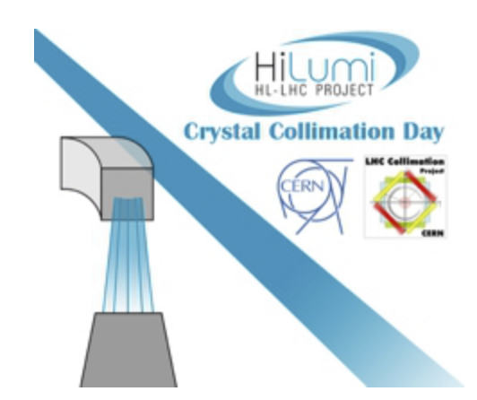
HL-LHC Crystal collimator day
Crystal HW LHC implementation
I. Lamas Garcia, R. Seidenbinder, C. Bahamonde, S. Gilardoni, M. Calviani (EN-STI)
in collaboration with EN-SMM

Slide 2
Outlook
Review of present system installed in the LHC machine
Review of two version 1 installed goniometer, history and issues
Review of two version 2 installed goniometer, history and issues
Summary of new design (version 3) advantages plus possible new upgrades
Radiation protection aspects and how much time it would take to change crystal and stage?
Technical feasibility of the different proposed scenarios
Conclusions

Slide 3
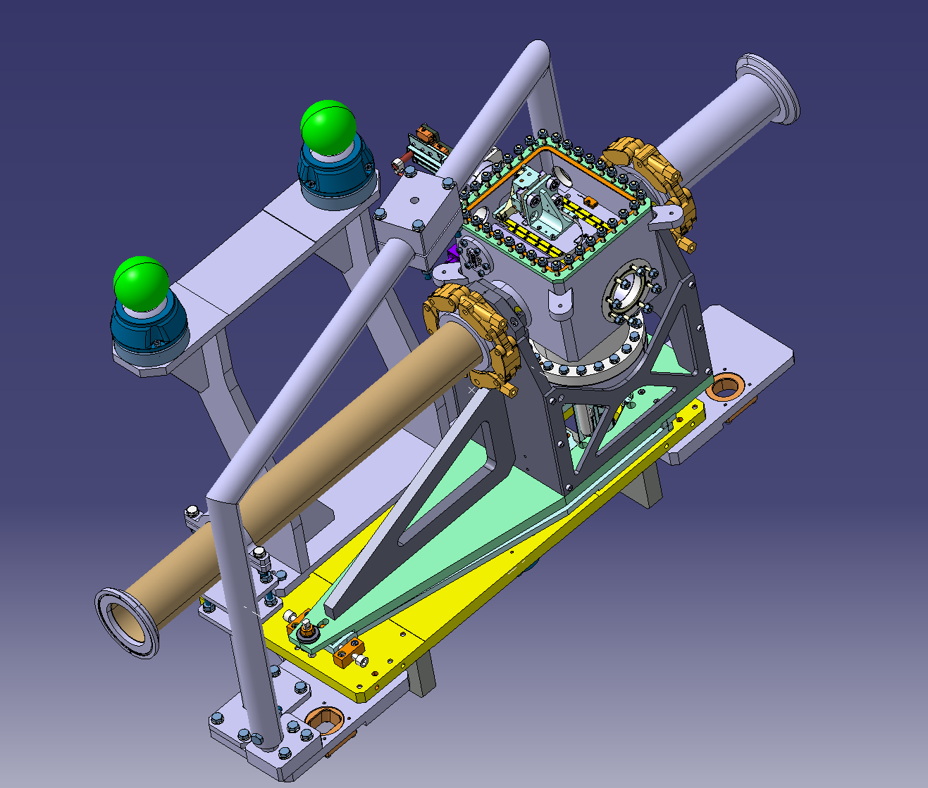
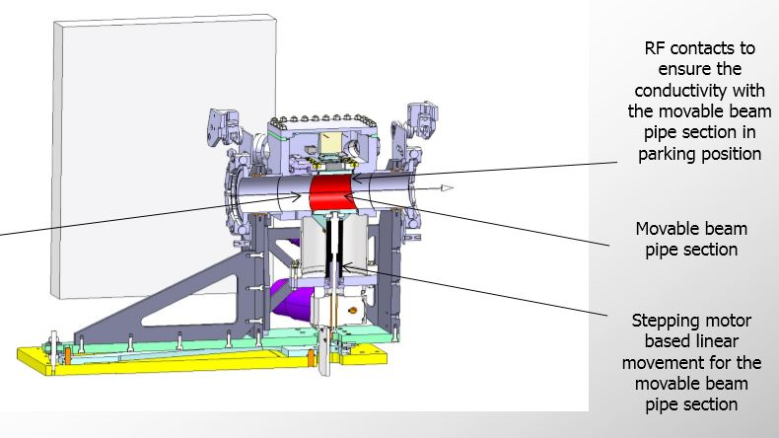
Review of present system installed in the LHC machine
Functional Type | Position | Crystal Type | Installation Year | Version
TCPCH | A4L7.B1 | SD (INFN) | 2013 (LS1) | 1
TCPCV | A6L7.B1 | QM (PINP) | 2013 (LS1) | 1
TCPCH | A5R7.B2 | SD (PINP) | 2018 | 2
TCPCV | A6R7.B2 | QM (PINP) | 2017 | 2
See M. Garattini’s talk
v2

Slide 4
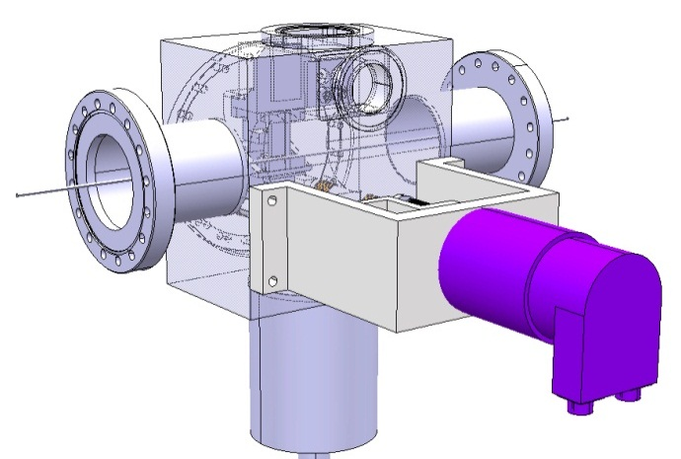
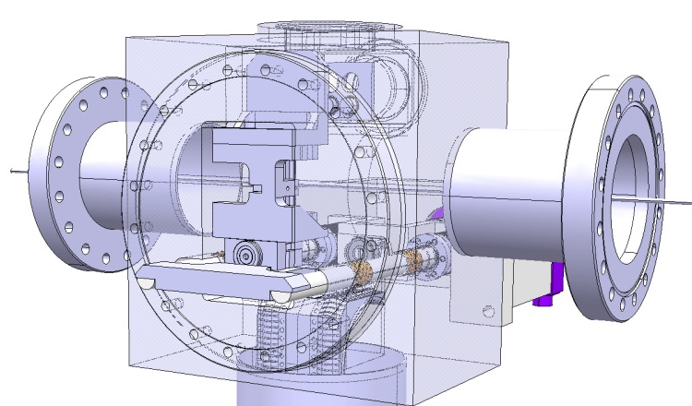
Review of version 1 goniometer, history and issues
1st proposal version 1 included (prior to LS1):
  The crystals parking position is located on the external side
  Linear positioning/guiding system
  View port in front of the crystal
  Volume closed with a kind of portion of chamber just by closing the C-shape
  Electrical contact between the tank and portion of the chamber

Slide 5
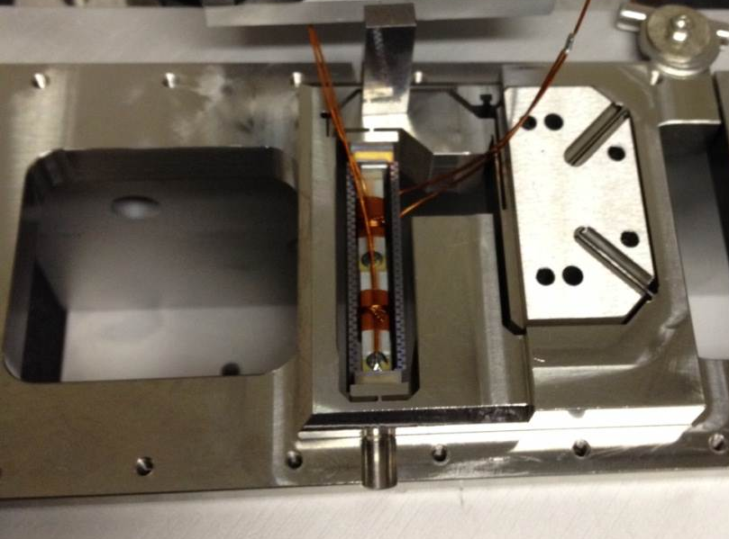
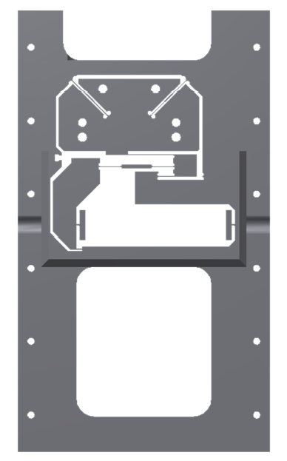
Review of version 1 goniometer, history and issues
Final proposal version 1 included:
  First generation of rotational stage, with piezo installed at 90 deg with respect to the piston/rotor
  Interferometric heads inside the vacuum, i.e. impossible to modify after closure of the tank
piezo

Slide 6
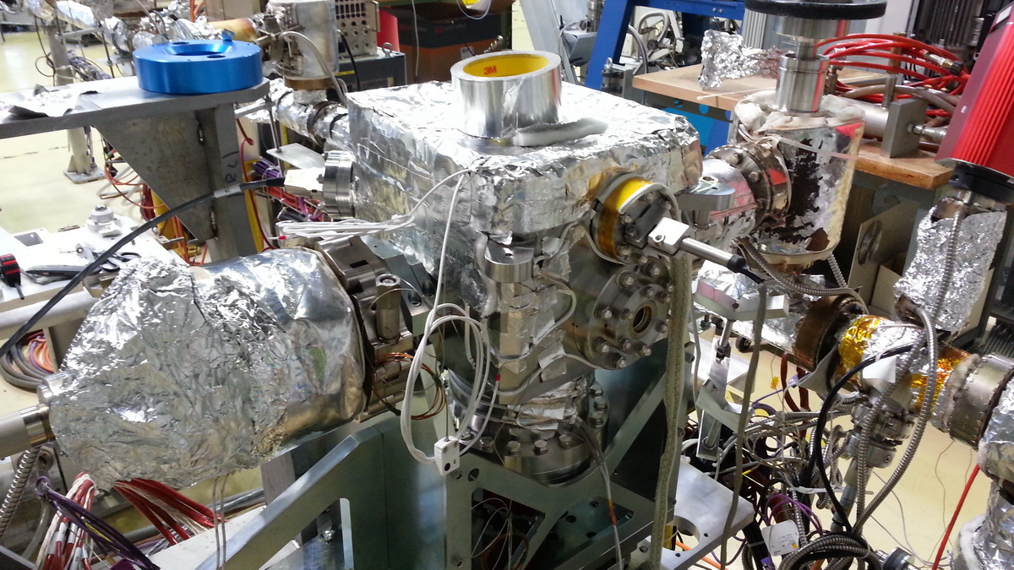
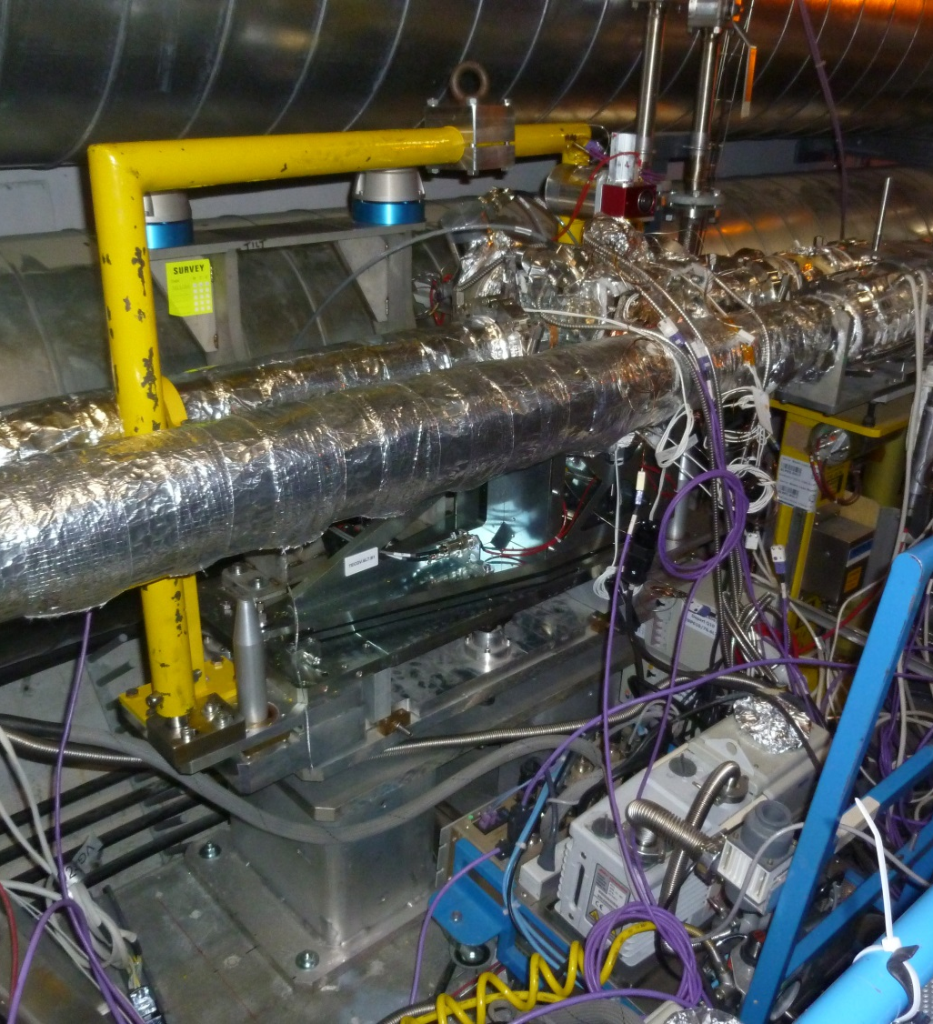
Review of version 1 goniometer, history and issues
Final proposal version 1 included:
  A lifting arm and supports for survey reference points
  The center of gravity of the device was outside of the collimator stability plane – counterweight to move the center of gravity has been added
Temperature limitations of optic fiber feedthrough for interferometric heads made device unbakeable
Two version 1 Crystal Collimators installed during LS1

Slide 7
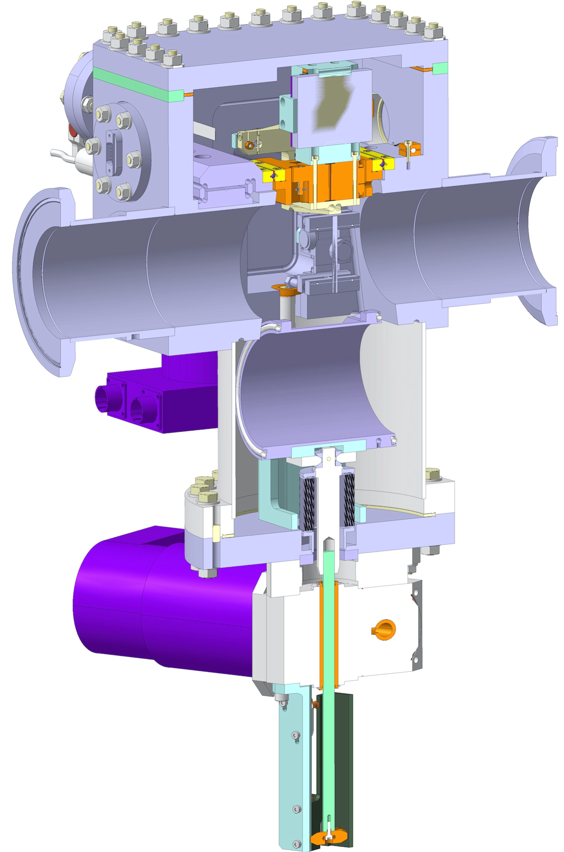
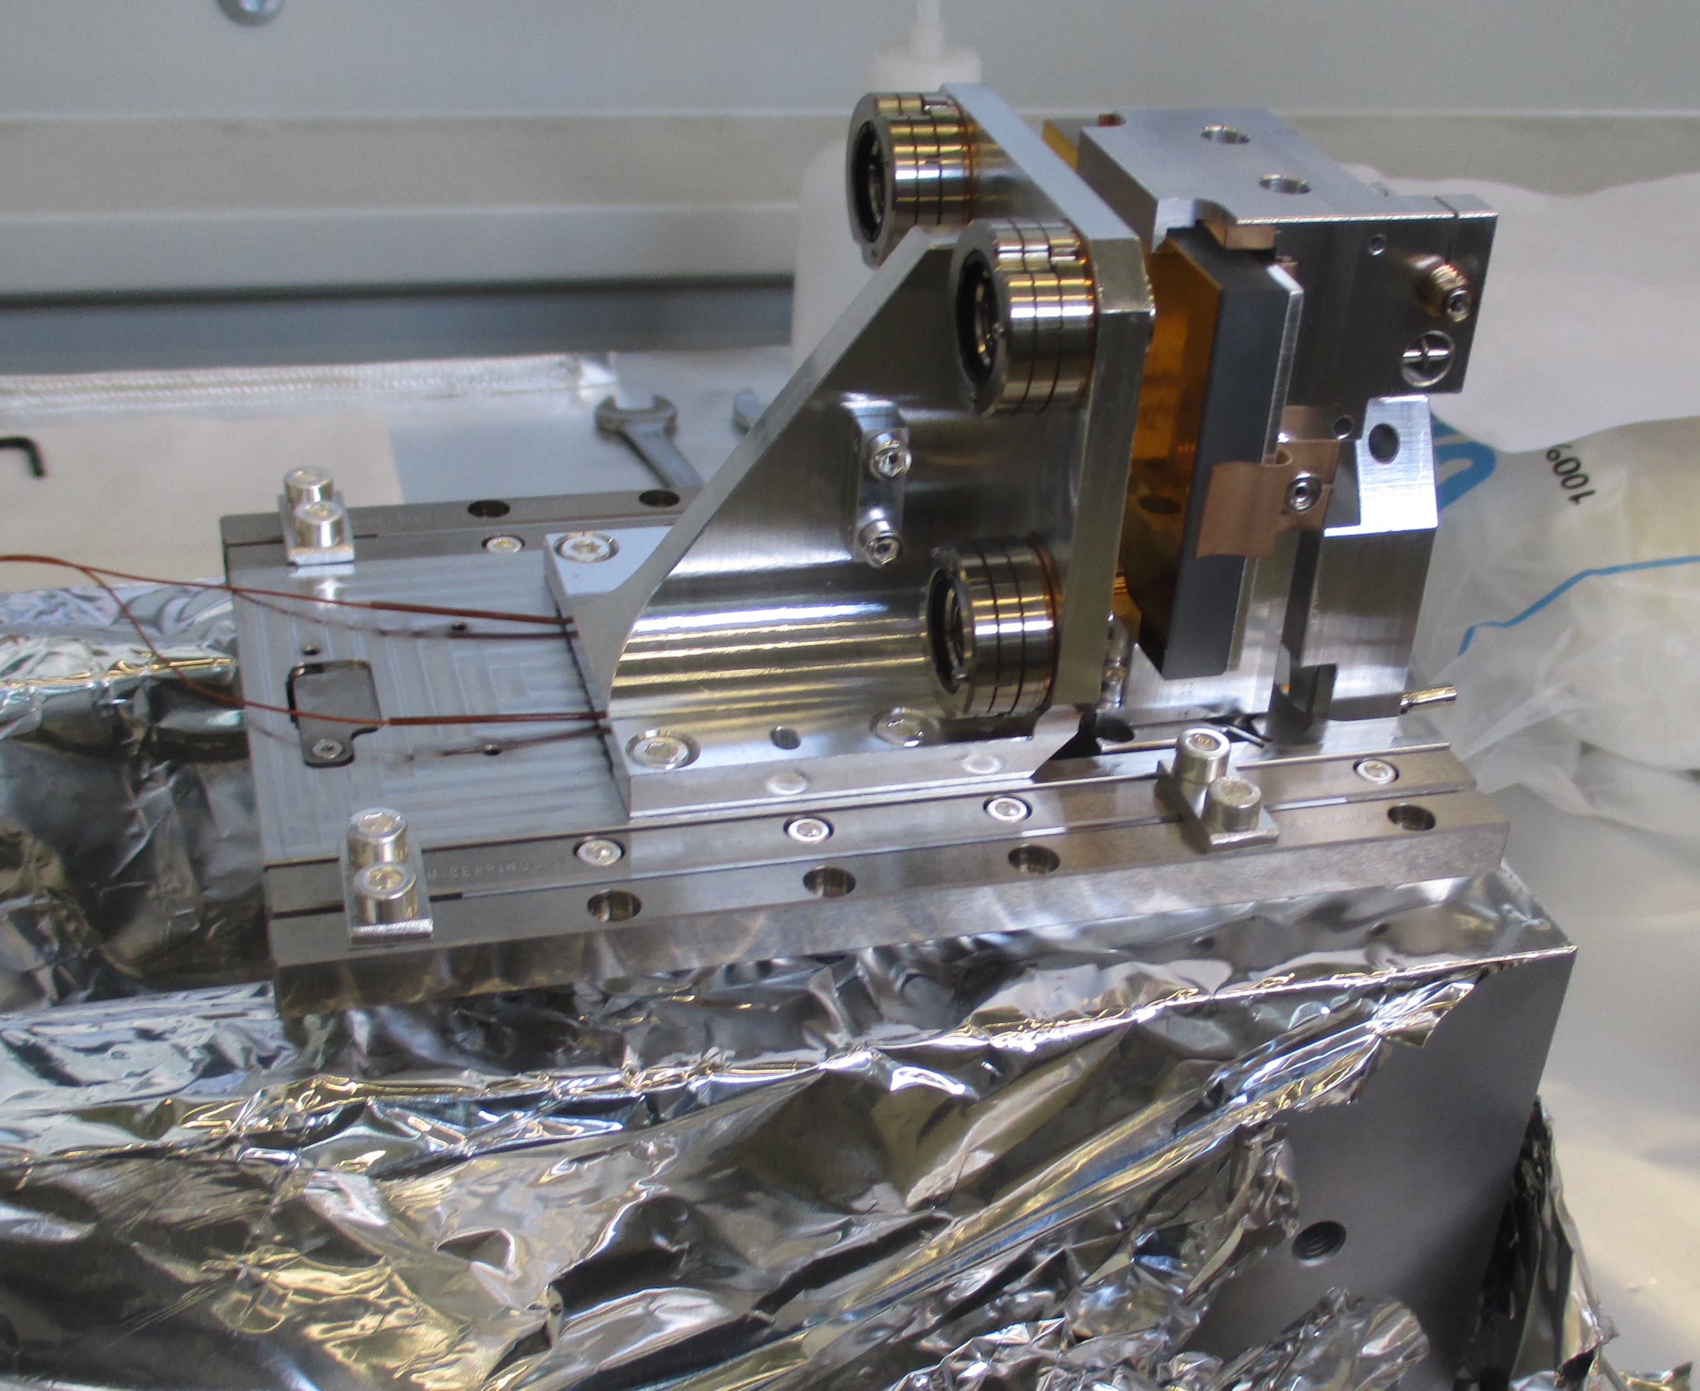
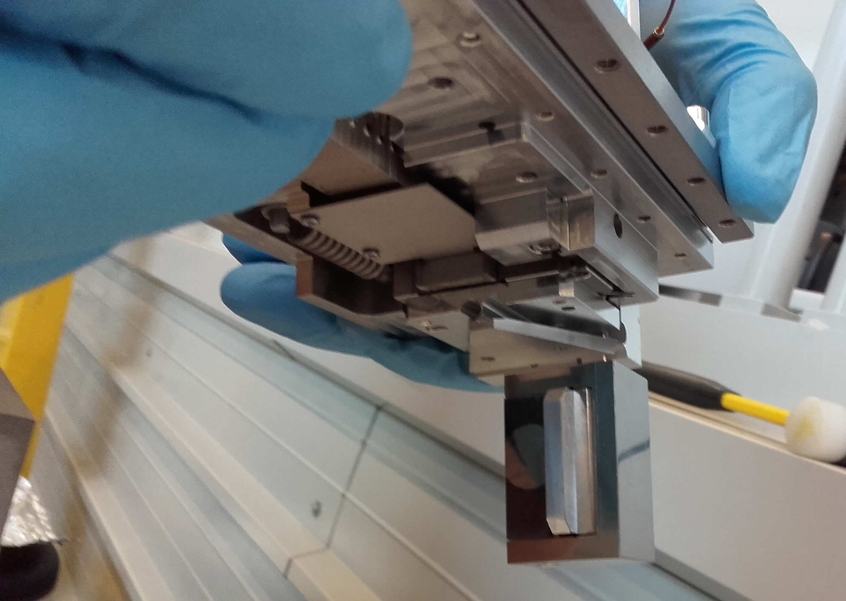
Review of version 2 goniometer, history and issues
Final proposal version 2 included:
  A new design of the mechanical stage including a different kinematic chain
  A new design of the mirror, optic heads support and the crystal holder, interferometer heads still inside the vacuum tank
  Validated UHV optic fiber feedthroughs
    → Bake able device

Slide 8
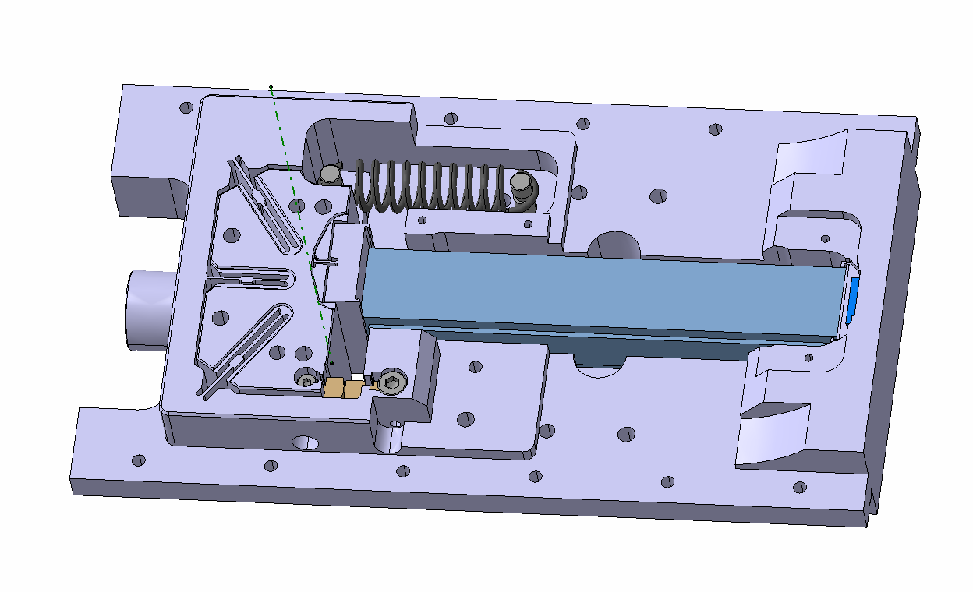
Rotational stage
To ensure the contact between the piezo and piston. Moreover, it is responsible of returning the rotor to the initial position.
Pre-load spring
Piezoelectric material
Active material that pushes the piston. The stroke of the piezo is controlled via electric field
Rotor
Part that allows the rotation of the rotor by an elastic deformation of the blades.
Blades
Piston
To avoid possible relative movements of the piezo during bake out. This part ensures a continuous contact between the rotational stage and piezo.
Stopper
To limit the maximum rotational movement of the rotor.
Wedge

Slide 9
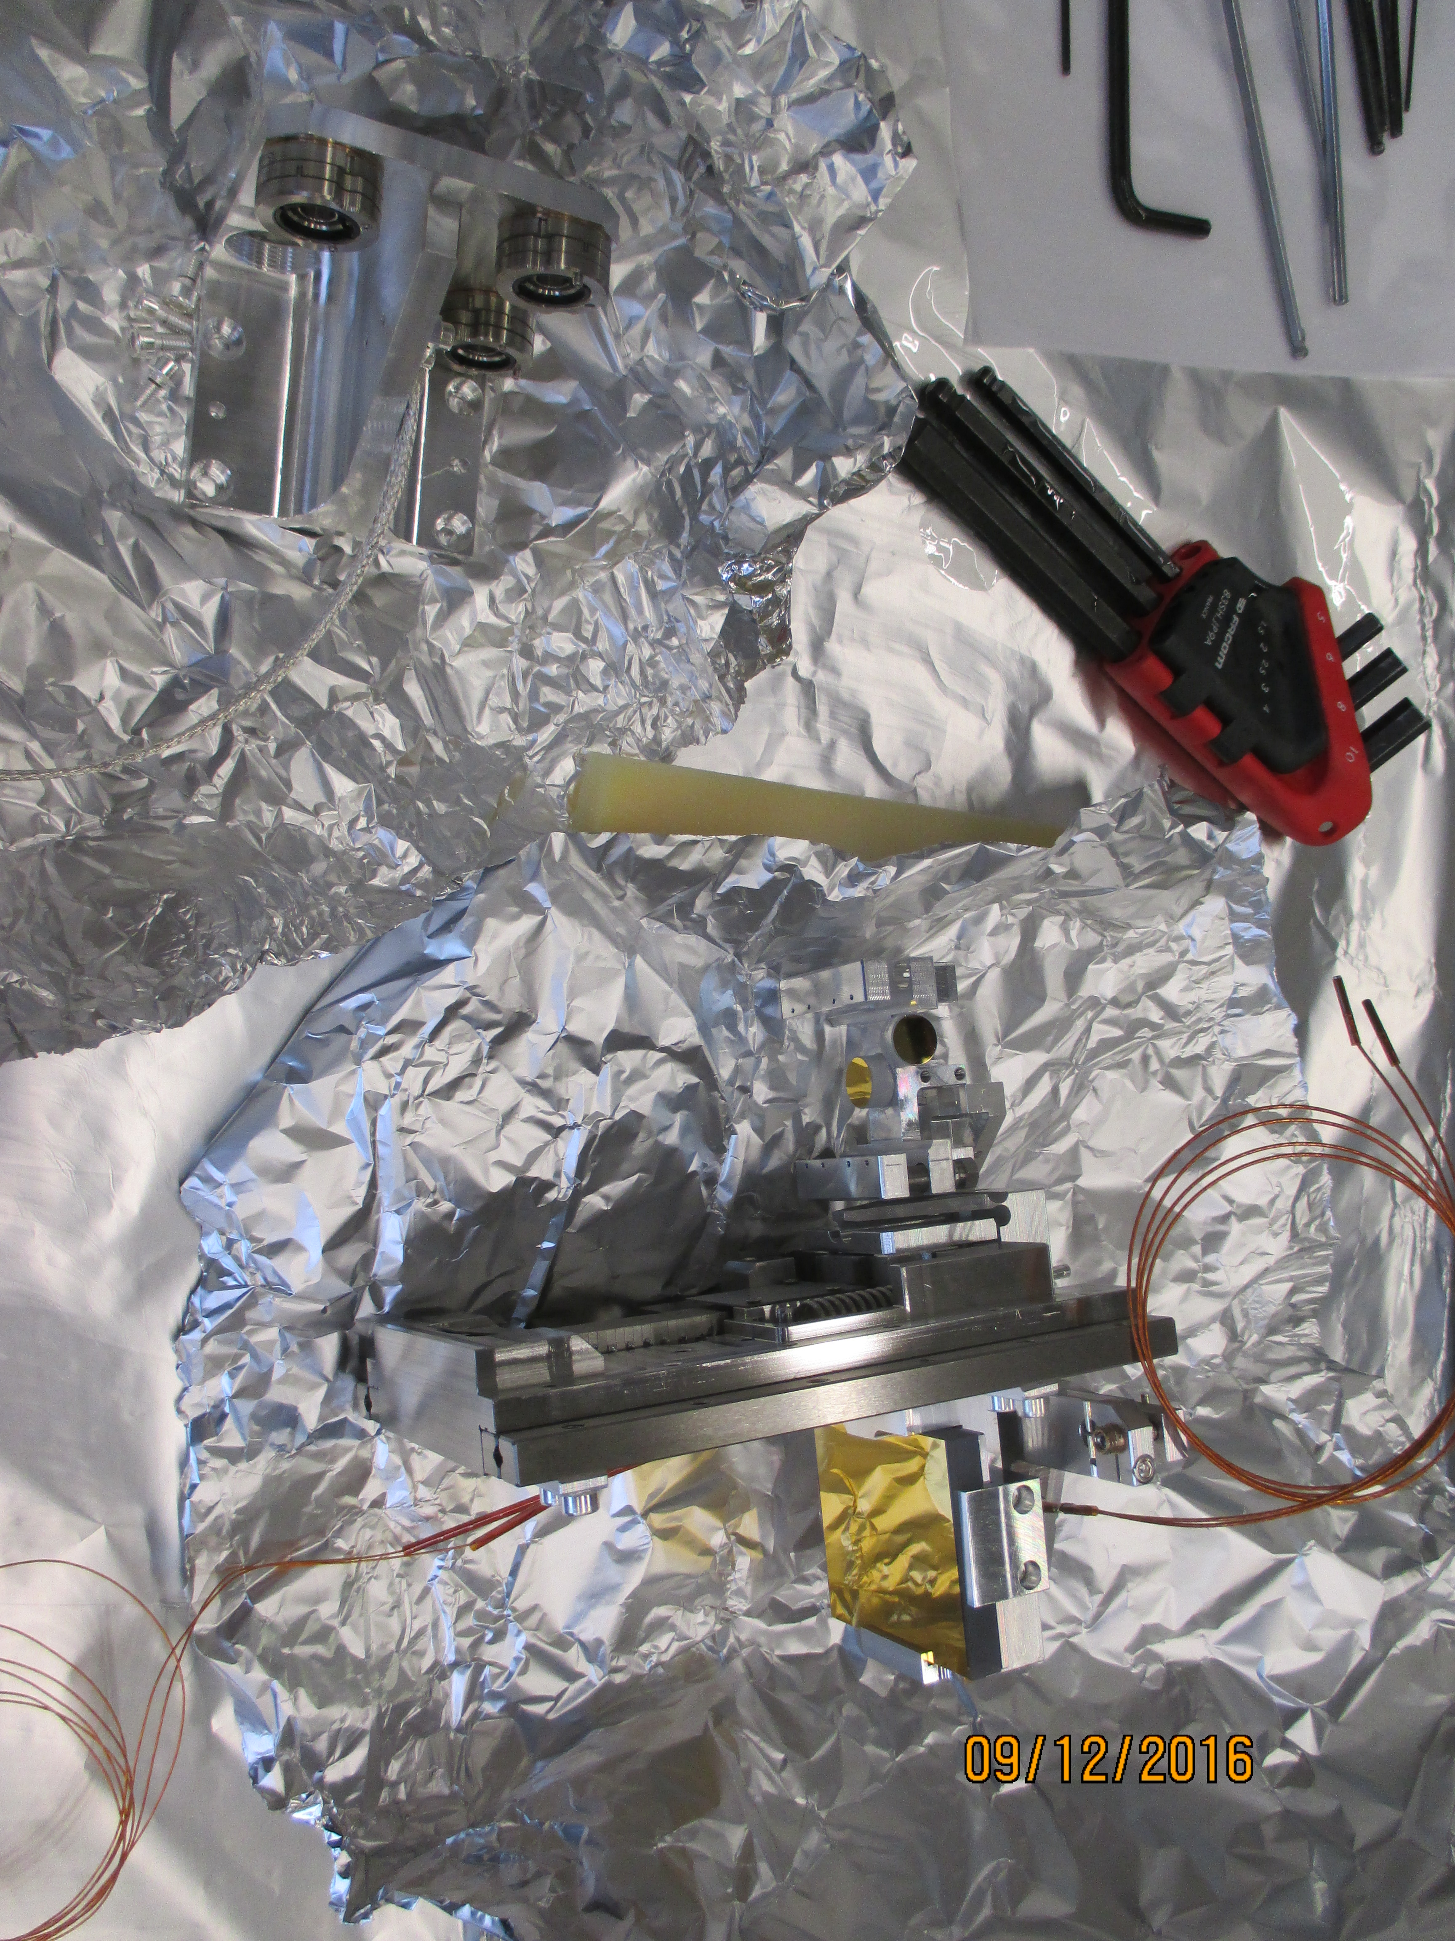
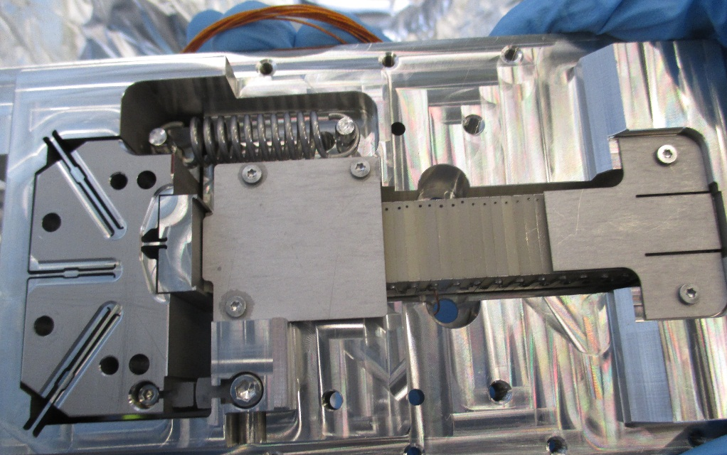
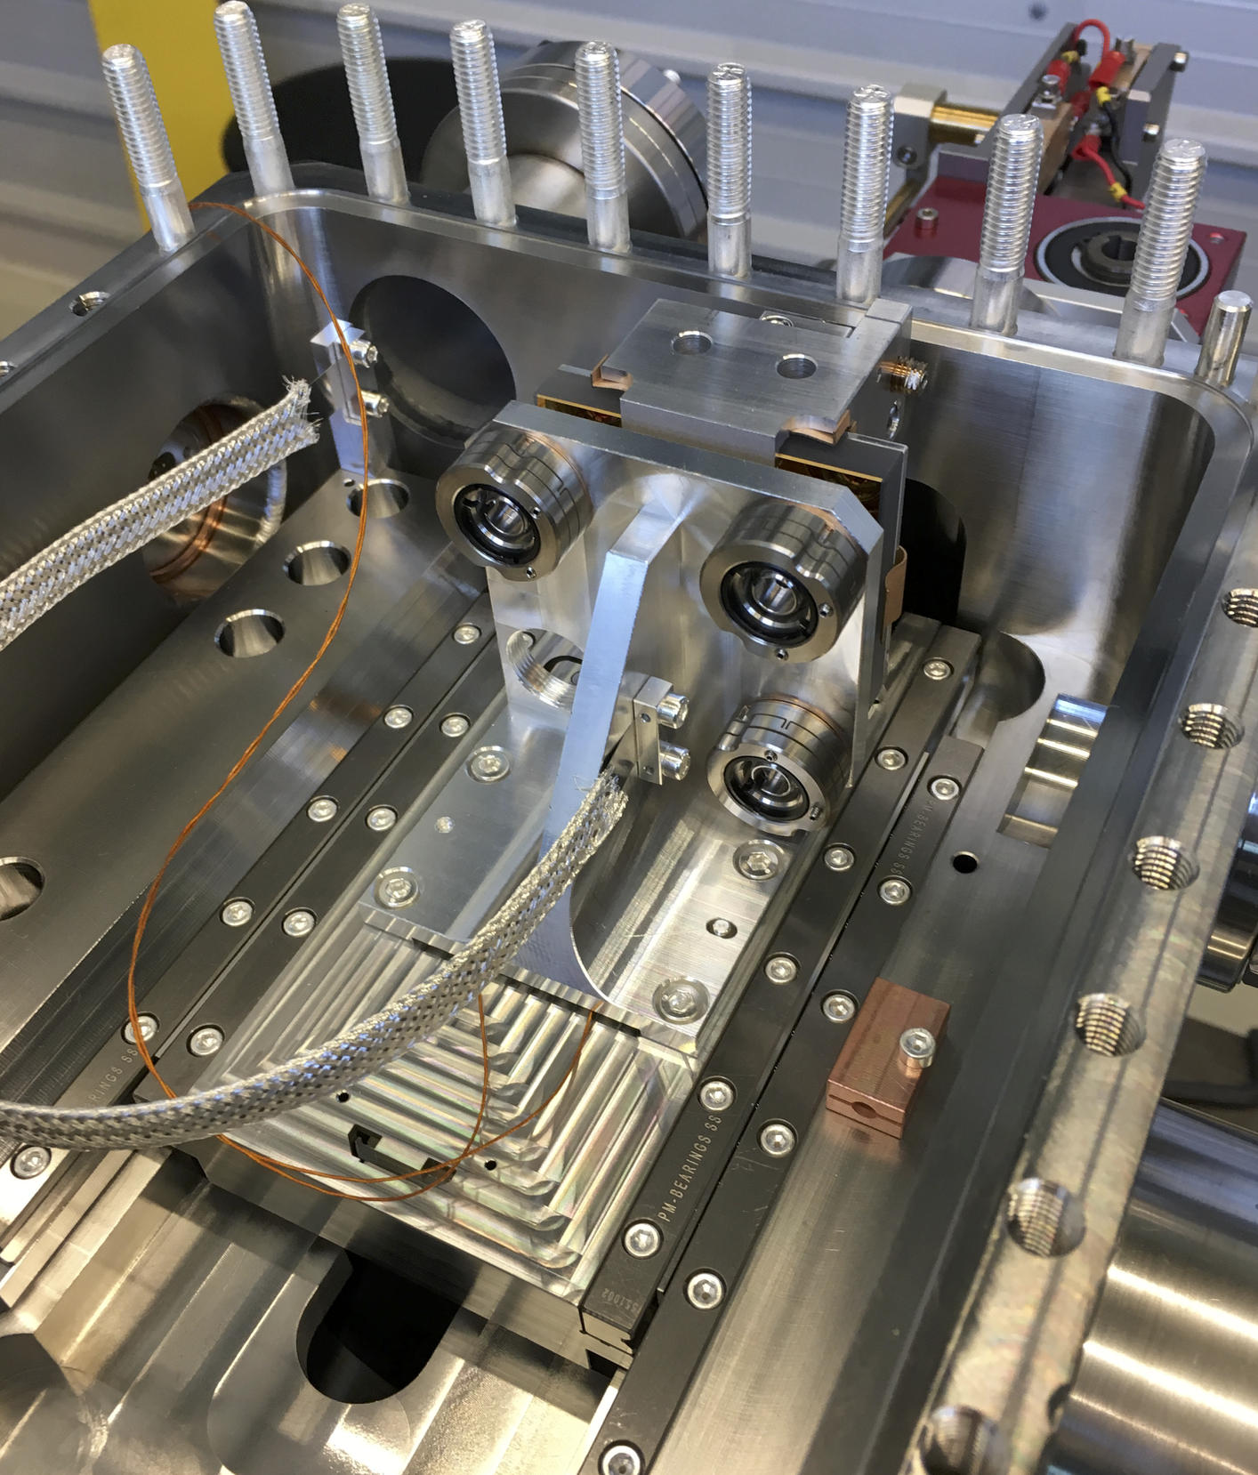
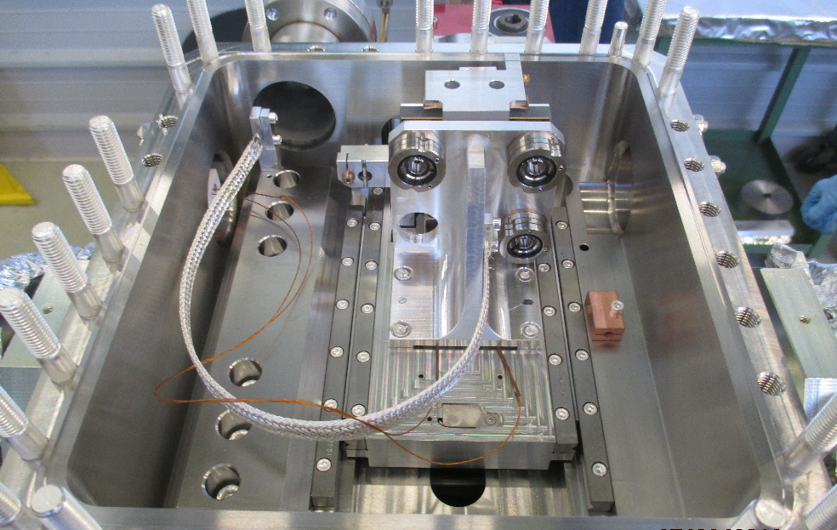
Review of version 2 goniometer, history and issues

Slide 10
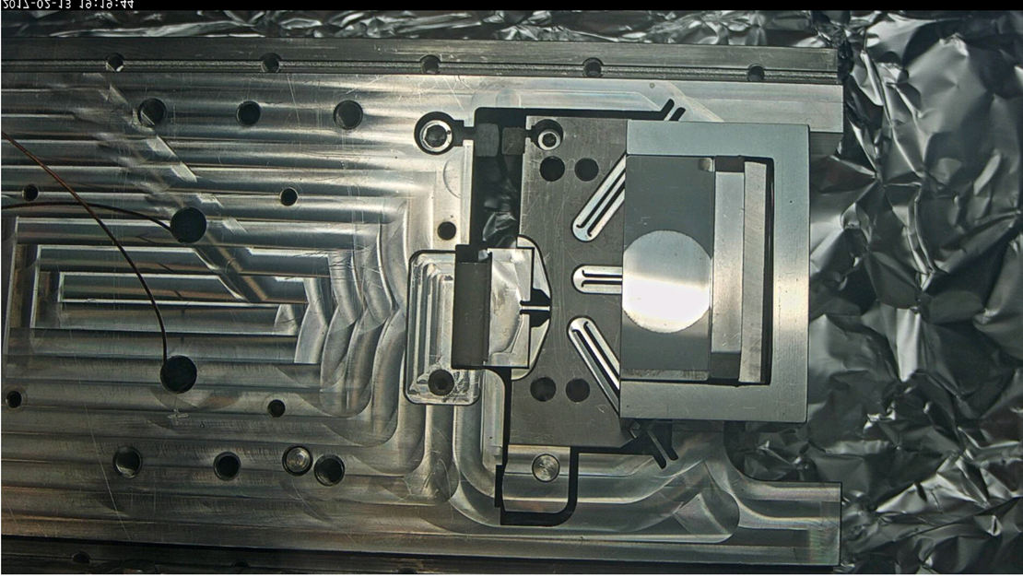
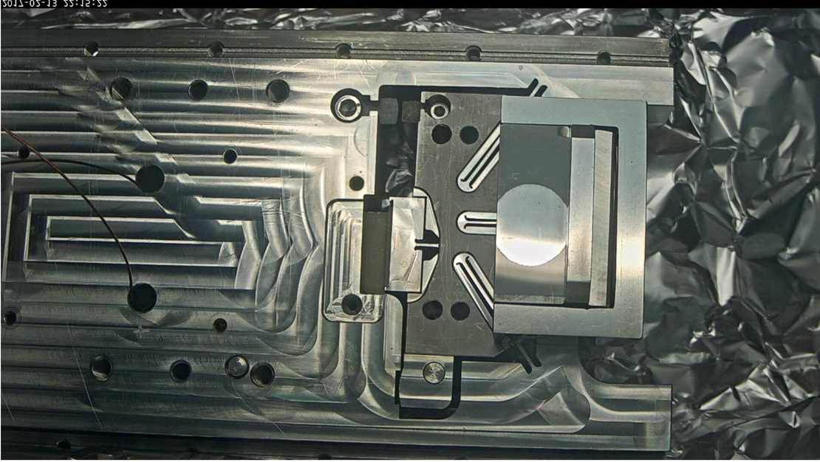
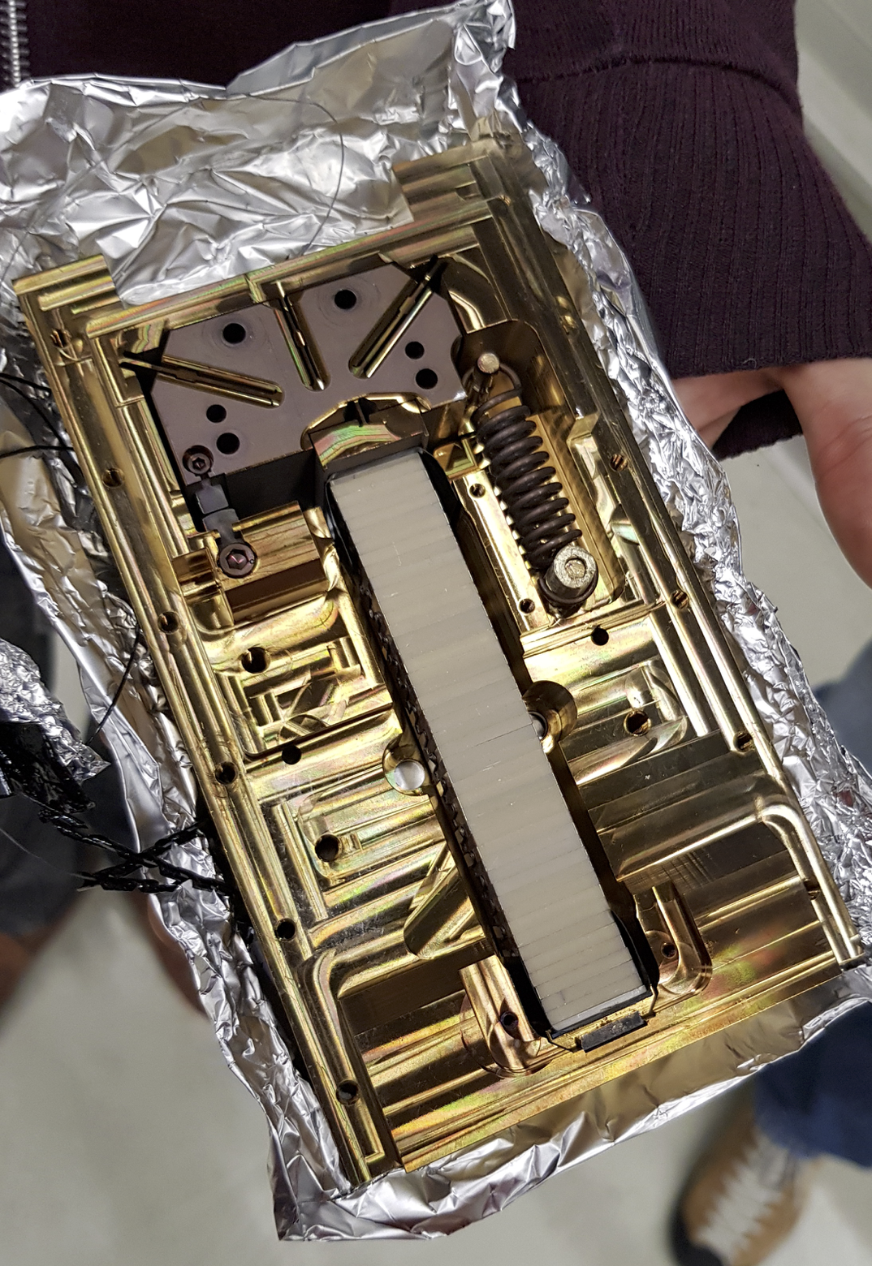
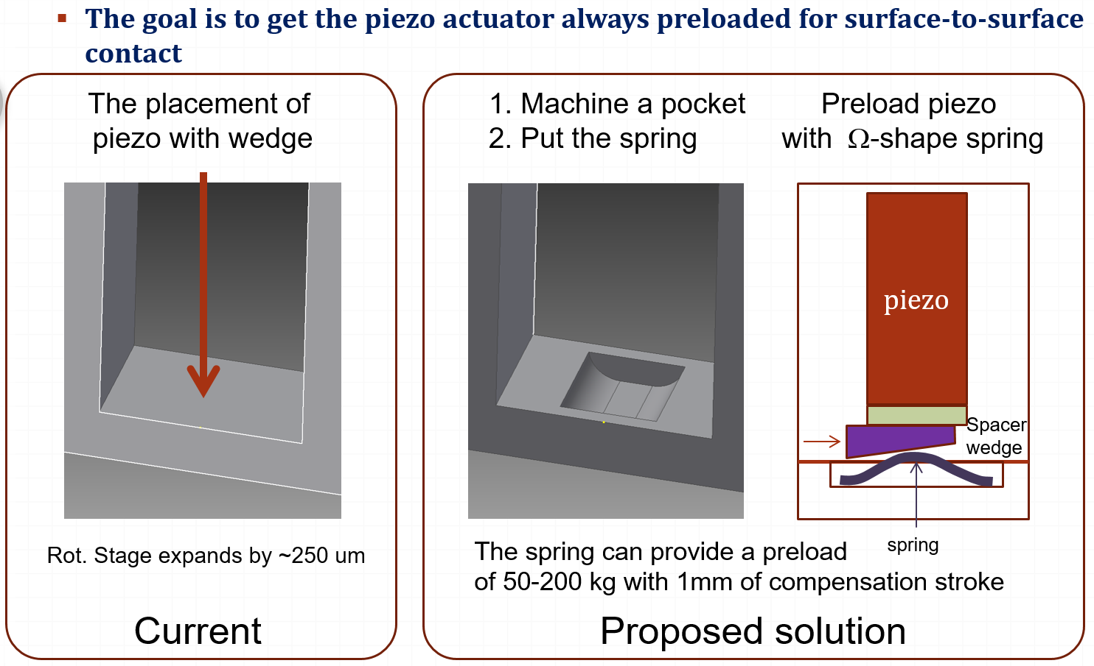
Review of version 2 goniometer, history and issues
During the mechanical stage validation thermal cycle, a modification of the angular range was found
  Due to different thermal expansion between the stainless steel frame and the stacked ceramic piezo
Preload of the piezo is a key parameters → a compensated elastic contact was developed and put in operation
50degC
185degC

Slide 11
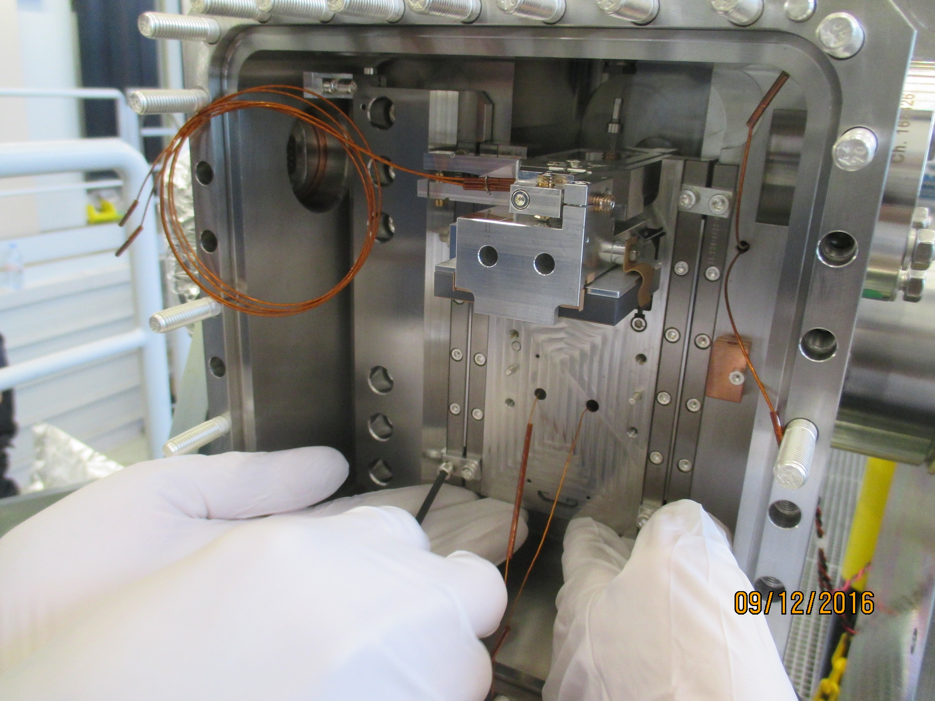
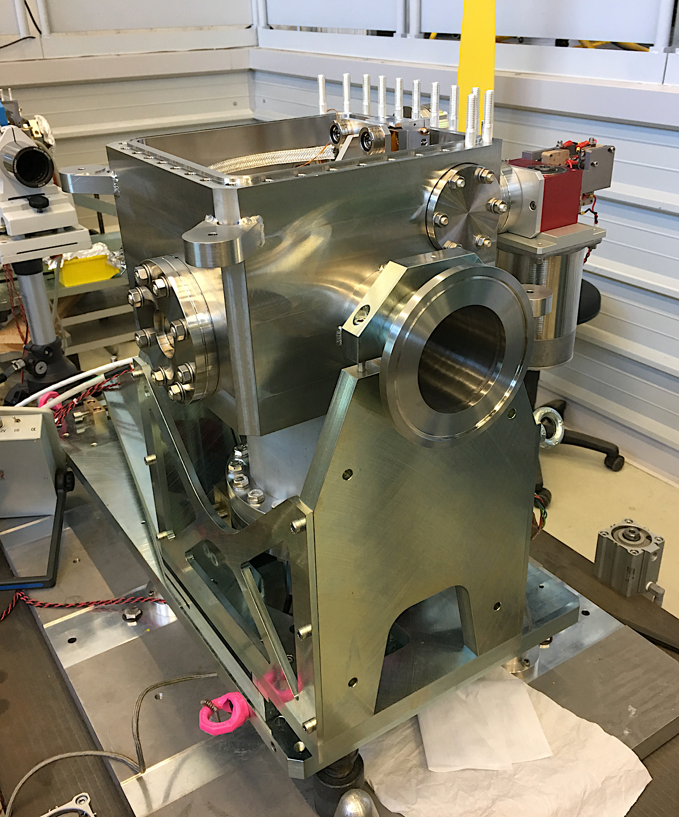
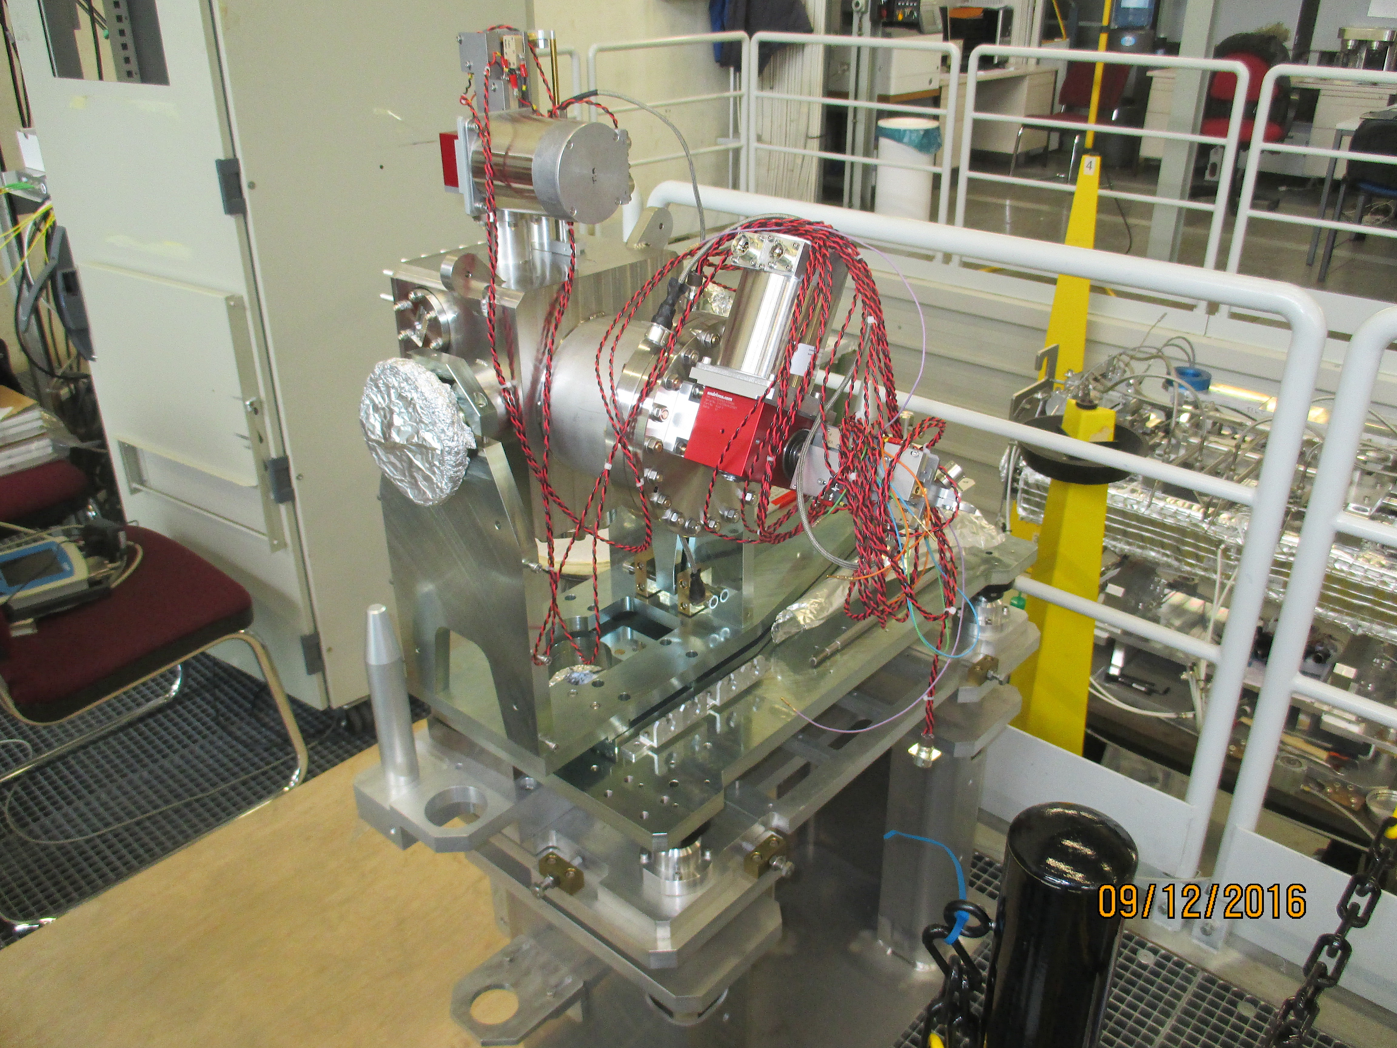
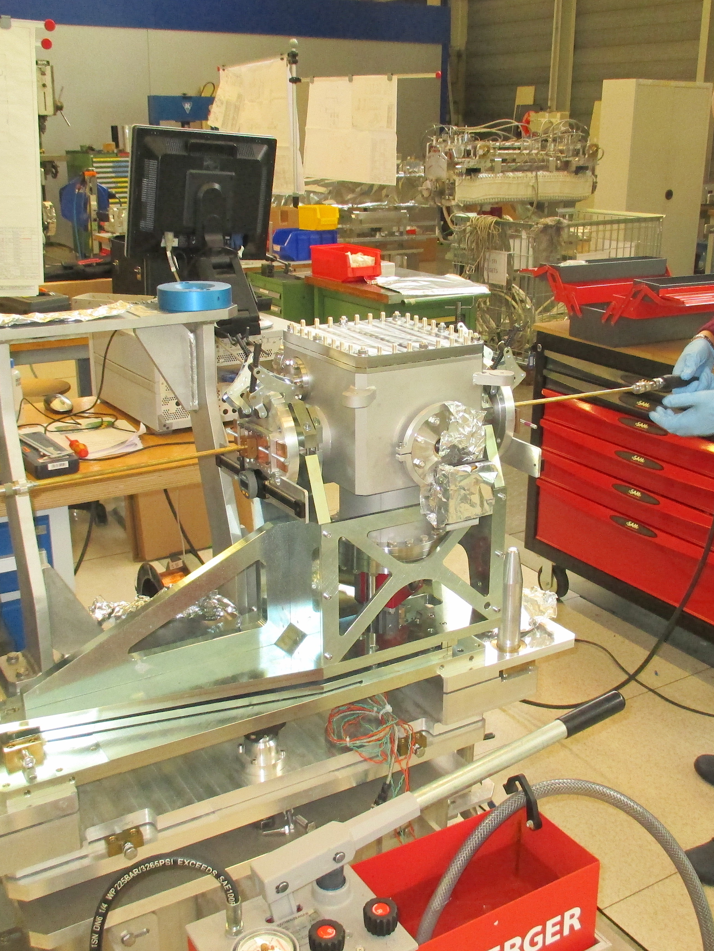
Review of version 2 goniometer, history and issues
Two version 2 (V & H) crystal collimators were assembled, aligned, adjusted, tested (mechanical, electrical, impedance), validated and baked
Two version 2 Crystal Collimators installed during YETS2016/2017

Slide 12
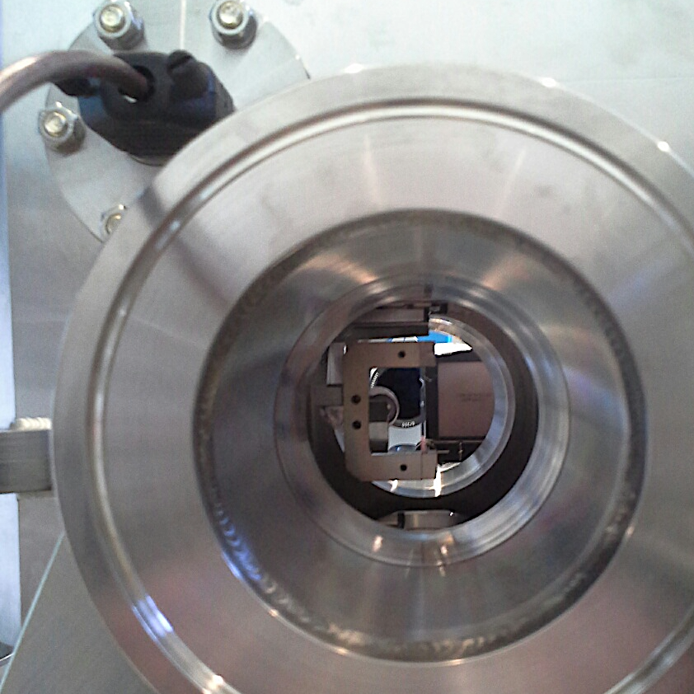
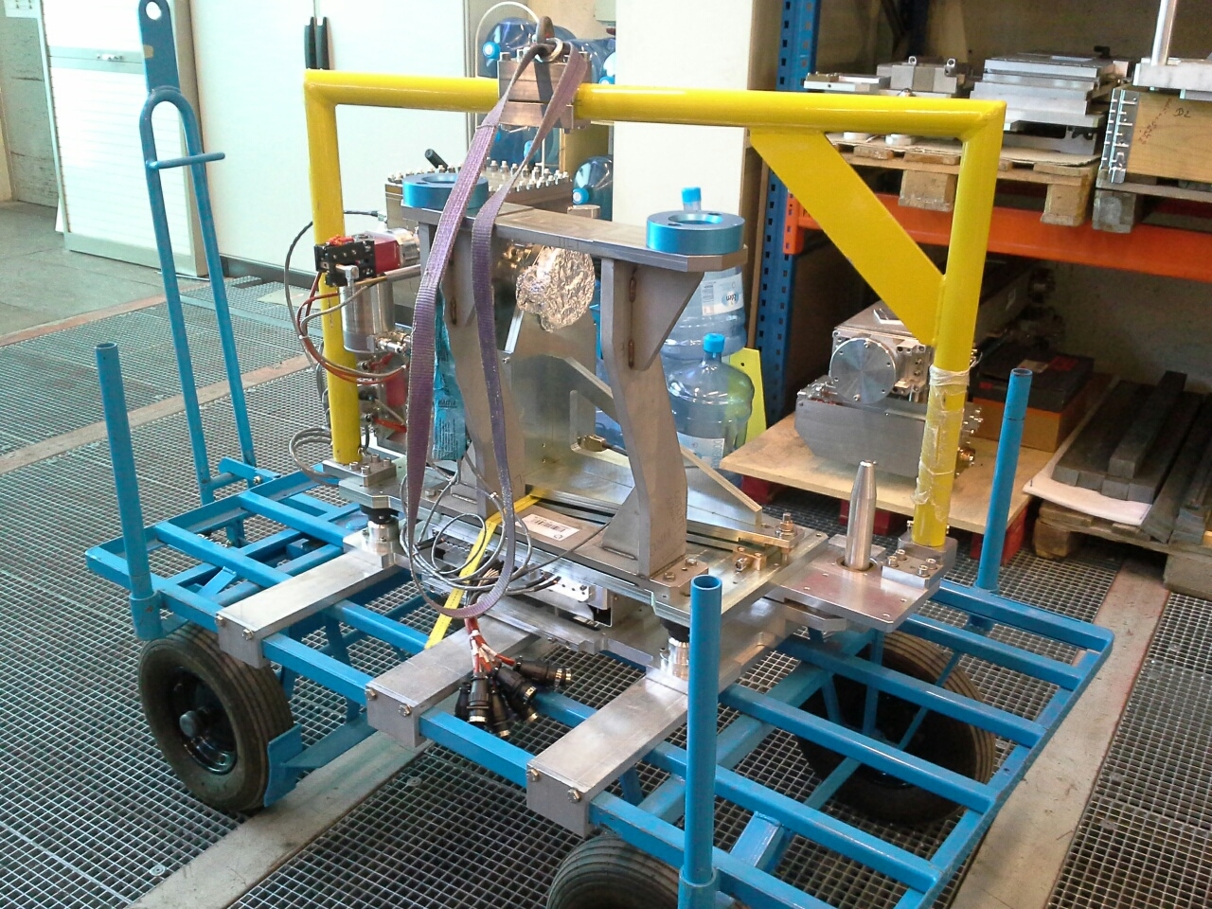
Review of version 2 goniometer, history and issues
After an MD, data showed TCPCH.A5R7.B2 not correct crystal roll angle → reflection of skew planes
Required an exchange of the complete hardware
  Installation of the only remaining available unit, used also for testing → no more available for further studies/development/SPARE
TCPCH version 2 Crystal Collimator replace by same type during YETS2017/2018
Holder w/ crystal

Slide 13
Goniometer assembly version 3
Due to several technical issues encountered during the operation of version 2 and version 1, it was decided to proceed towards the design of a version 3 during 2017-2018, in order to have a “well thought” design within CERN
In addition, version 1 and version 2 were basically manufactured outside, with no control of the mechanical design and drawings (no CATIA model available)
This version will be the reference for new potential production
NB: no prototype was financed – the mechanical & control parts have to be validated for final construction
NB2: still no possibility for realignment from outside of the tank

Slide 14
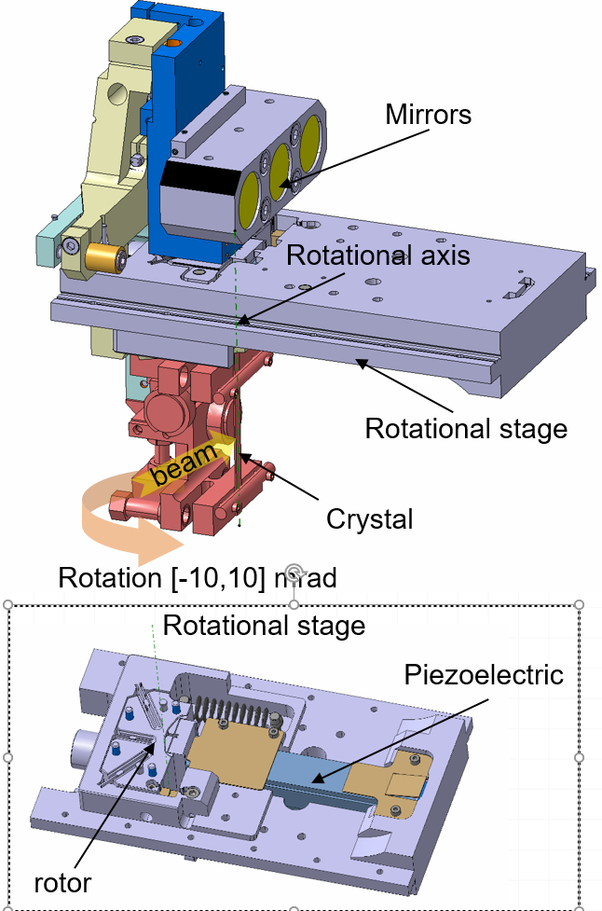
Summary of new design (version 3)
Increase of clearance between crystal and beam pipe
Additional viewport to anticipate possible interference
Movement of the interferometric heads outside of the vacuum tank, plus possibility to independently align each mirror
Increased stroke for stage and beam pipe
Addition of mechanical positioning references
Improved hoisting point to be balanced with respect to center of gravity

Slide 15
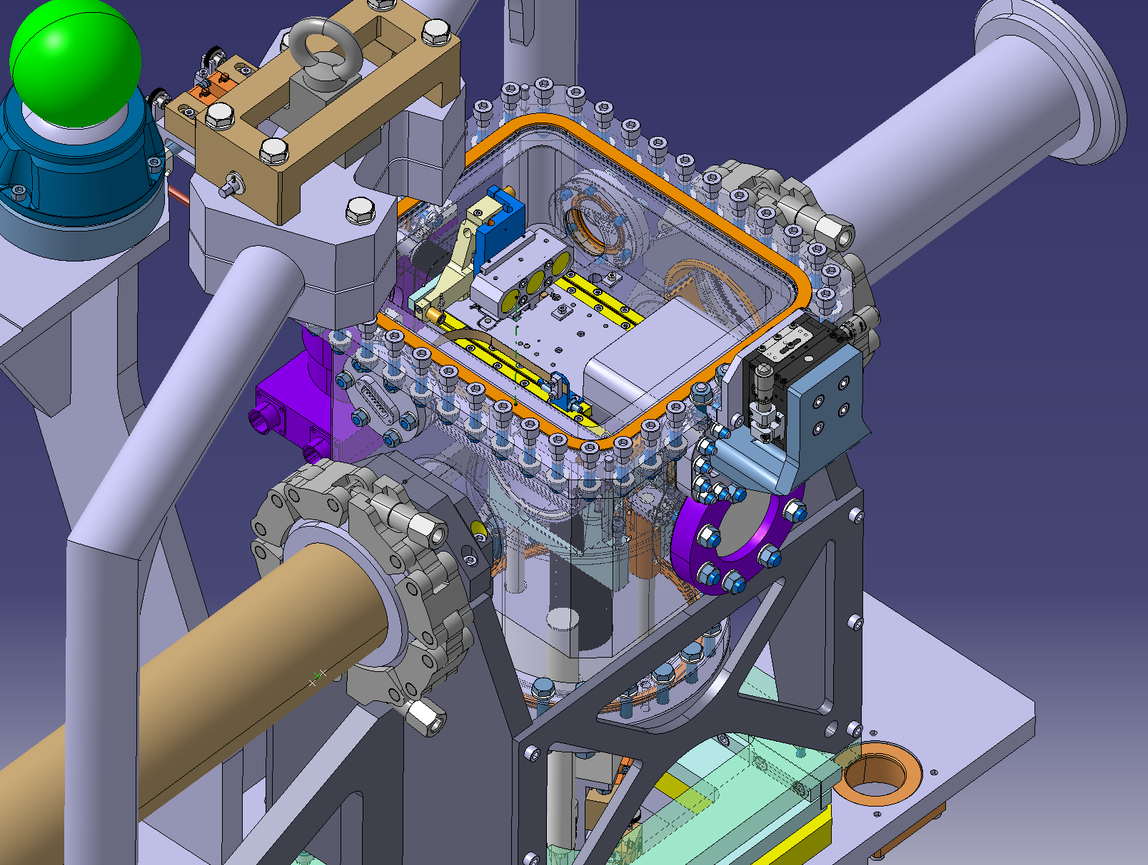
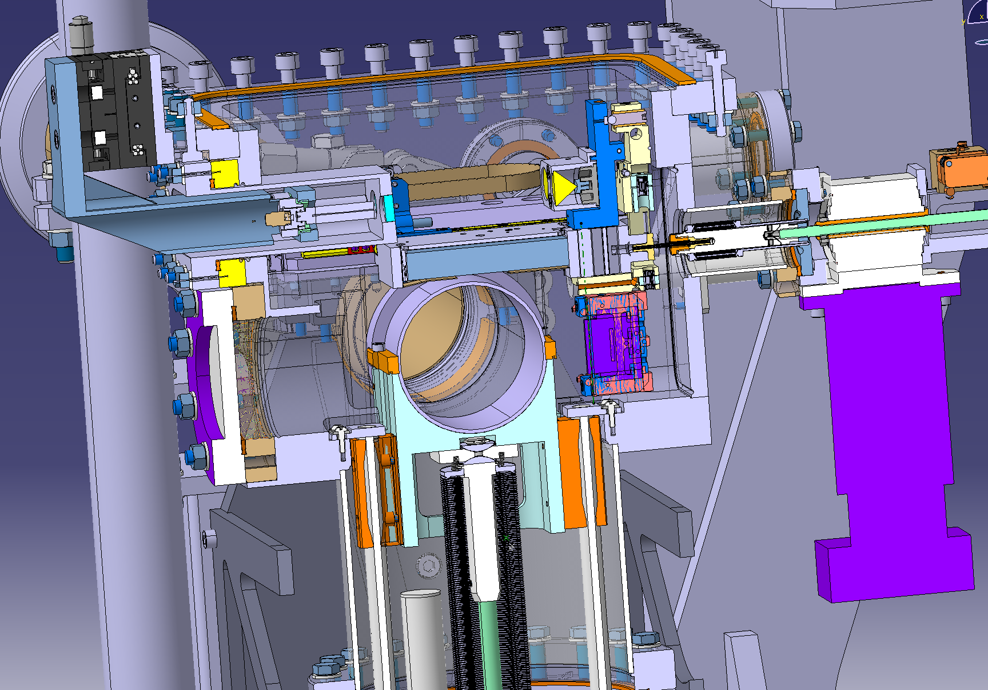
mirrors
V3 design
Interferometric heads on micrometric plate
Crystal holder in out-beam position

Slide 16
Mechanical modelling of version 3
In order to better understand the behavior of the system & anticipate potential issue, a suite of FEM analysis have been performed
  Elastic behavior of the piezo + mechanical stage subassembly
  Definition of the initial pre-load necessary to reach the require angular range
  Mechanical analysis (stressed, deformation, buckling) of the piezo-mechanical stage subassembly
  Modal analysis of the piezo-mechanical stage subassembly
  Mechanical analysis of crystal collimator during bake-out
  Mechanical analysis of crystal collimator and lifting tool during transport
Will be documented in a dedicated EDMS document

Slide 17
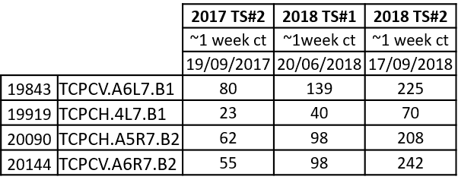
Radiation protection aspects related to crystals
Current values measured on the TCPC installed in the LHC – clearly dependent on the use of the device → difficult to make projections towards LS2
μSv/h @ 40 cm
Radioactive crystal collimator in storage (HCTCPC_001-CZ000001) is at around ~300 uSv/h at contact with the tank

Slide 18
How much time would it take to change the crystal and stage?
In order to prepare it for installation, the activities that require working at close distance are (based on real work):
  Set up crystal collimator in 272 survey pit and removal of heating straps ➔ 2h
  Opening of the tank and removal of the mechanical stage subassembly ➔ 4h
  Mechanical stage thermal cycle including crystal and crystal holder ➔ 2h (effective)
  Installation of mechanical stage subassembly and shim to avoid parasitic angles in linear stroke ➔ 8h
  Adjustment of LVDTs and switches ➔ 2h
  Alignment/adjustment of tank and crystal ➔ 8h
  Closing up tank and installation of heating straps ➔ 4h
  Bake-out ➔ 4h (effective)
TOTAL time at <40 cm from the tank O(30 hours)

Slide 19
Comment on technical feasibility of different scenarios
Scenario 1 = basic interventions outside the tank, in the tunnel
  Potentially possible, but it would depend on the dose rate in P7 close to the TCPCs and the foreseen duration of work (30 minutes / 1 hours estimated)
  Pending detailed analysis by RP and validation of WDP
Scenario 2 = required opening of tank to exchange crystal (and stage)
  Would require transport of the gonio tank on the surface (b 272) and opening of the assembly, including realignment, etc.
  Given the time required (O(30 hours)) and the equipment dose rate, assuming 100 μSv/h at 40 cm → estimated collective dose would be too high (O(several mSv))
  Option very unlikely, pending final survey from RP at the end of the year and projections during LS2

Slide 20
Comment on technical feasibility of different scenarios
Scenario 3 = new generation of goniometers
  Replacement of full 4 crystal systems not compatible with LS2 (counting only on CERN resources) due to:
    Purchasing procedures
    Available man-power
    Time available between now and end of LS2
  Potential to start procuring 1 unit towards the end of LS2 should serve as a prototype unit to validate mechanics and controls and spare of existing system
Procurement of 4+ units would be possible only after the end of LS2 (clear functional specification required) with installation at first YETS after LS2
All of these pending the results of last MD – crash program needed in case MD reveals that 1 or 2 crystals have to be changed for beam dynamic reasons or operational scenarios to be re-discussed

Slide 21
Conclusion
Reviewed the different generations of crystal goniometers installed in the LHC machine
Difference scenarios for installation and re-work briefly discussed
It will be difficult – if not impossible - to rework a radioactive v2 coming from the LHC tunnel
Procurement of a new v3 goniometer only possible towards the end of LS2 at the level of a prototype if counting only on CERN resources
  To be revised if beam dynamics shows that it is not possible to use the existing system

Slide 22
Thanks a lot

Slide 24
