Slide 2
2nd RF preparation meeting
13.09.2018
AD Consolidation Review 21.09.2018
W. Hofle

Slide 3
Decisions on 28.08.2018
Two presentations on 21.09.2018:
  Wolfgang Hofle:
    Overview
    C10 RF system
    Beam Dynamics
    Controls (PLC)
    Stochastic Cooling
    Longitudinal pick-up
  Maria Elena Angoletta:
    Replacement of C02 with Finemet
    LLRF for C02
    Longitudinal Schottky measurement system for intensity, spectrum and Δp/p measurement of the beam (unbunched)

Slide 4
Active consolidation for AD in RF
https://edms.cern.ch/document/2001429/1
Status | WP | WPH |  | BC | Descr. | EDMS | PLAN | 2018 | 2019 | 2020 | 2021 | 2022 | 2023 | 2024 | 2025 | Total | Comments
Active | 25 | BE/RF | M.Haase | 69515 | AD RF C02 Finemet | 1552197 |  | 35 | 100 | 65 |  |  |  |  |  |  | bakeout eq. ?
Active | 26 | BE/RF | ME.Angoletta | 69515 | AD RF LL/Schottky | 1578121 |  | 30 | 60 | 30
Active | 27 | BE/RF | W.Hofle | 69516 | AD s-cooling | 1689140 |  | 214 |  |  |  |  |  |  |  |  | amplifiers?
Active | 28 | BE/RF | M.Haase | 69517 | AD RF C10 valves/upgrade |  |  | 400
D3 | 29 | BE/RF | E.Jensen |  | AD RF C10 new system |  |  |  |  |  |  |  |  |  |  |  | If TH166 tests fail
List complete → yes
EDMS documents → being worked on
Requests to other Groups ? [CV: make cooling of magnets CW at 3.5 GeV/c] → test done, did not achieve cw operation of at 3.5 GeV/c, but could achieve imporvement for MD
Situation with C10 now ok → no; one system with refurbished tube (input from IS ok)
Precision and granularity with time of Δp/p and spectra during cooling → Maria Elena
Tomoscope ok -> Yes
10 MHz reference clock → ok ; cabling, analog signals, OASIS
Beam dynamics → input from Alan

Slide 5
C10 RF system
see input from IS section (Matthias)
Risk Scores

Slide 6
Beam Dynamics
Rebuild expertise and prepare cycles for Finemet era
  C10
    simulation and optimisation of bunch rotation at injection (3.5 GeV/c) as function of available voltage
    Establish procedure for phasing of cavities.
  C02 replacement by Finemet
    adiabatic capture & de-bunching simulations at 3.5 GeV/c, 2 Gev, 300 MeV/c and 100MeV/c, plus bunch rotation at 100 MeV/c extraction
    recommend the best adapted voltage program to capture the beam at each of the energies
    simulations using the phase and radial loops for the ramps 3.5-2 GeV/c, 2 Gev/c to 300 MeV/c and from 300 MeV/c to 100 MeV/c. Recommend the best adapted phase and radial loop gain settings plus harmonic number for each of the ramps.
  No plans for intensity increase or more bunches (RP/target cooling) t.b.c.
A. Findlay

Slide 7
Controls (PLC)
Input from Luca Arnaudon (next slides)

Slide 8
C02 resp D.Landre this will be replaced by a FINEMET cavity planned for LS2
C10 resp C. Oliveira
New control already in place no actions foreseen
TFB (Damper) resp D.Landre
New control already in place no actions foreseen
FINEMET RF Cavity (ELENA) resp D.Landre
New control already in place no actions foreseen
PU movement control resp L.Arnaudon
New control already in place
prototype to replace home made controller with modern PLC ? (B. Lefort +C.Oliveira)
(estim. 15KCHF)

Slide 9
Optical notch filter resp L.Arnaudon if operation is validated: purchase parts for a second system plus spares and design a new housing and PLC based controls
Platform Fritz resp C. Oliveira
Platform to be raised ?
Control renovation to replace with modern PLC and refactor the platform HW to gain delay and maintenance ease (B. Lefort + C. Oliveira + L. Arnaudon)
Scool Amplifiers & controls resp D. Landre + C. Oliveira + P. Freyermuth
We can do a prototype a PCB for the amplifiers bias control (bad contacts) ( est. 20KCHF )
Controls HW ok we need to move to FESA3 and pass the responsibility to CS / SW team
Labelling of all cables and parts to prepare Remove the control racks and amplifiers for opening of the roof is being planned LS2 (FSU)
CRYO Temperatures resp C. Oliveira
Some still KO do we open to fix the probes? EMC filters

Slide 10
Cooling FFT CRIO resp L.Arnaudon (+ labview team)
No changes foresee
RF delay trombones resp L. Arnaudon
No changes foresee remove if not required after optical notch installation
Comment Wolfgang: To be decided.

Slide 11
Stochastic Cooling
Wolfgang for RF

Slide 12
Longitudinal Pick-up
Wolfgang and Alan

Slide 13
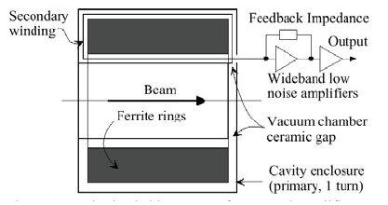
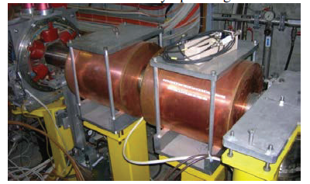
AD longitudinal pick-ups
F. Pedersen
Documentation with Alan Findlay (3 pick-ups, 1 HF PU, 2 LF PU)
1 LF PU in transfer line; 1 HF PU and 1 LF PU in AD ring
Long Schottky (Maria Elena Angoletta)
Signals used for intensity measurement and momentum spread of the unbunched beam
AD transverse Schottky: originally Maria Elena, pick-up by BI → now BI
State of legacy “42” MHz Schottky not clear, documentation with Wolfgang

Slide 14
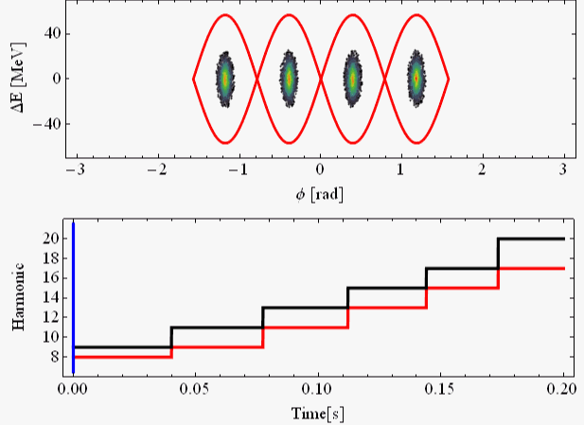
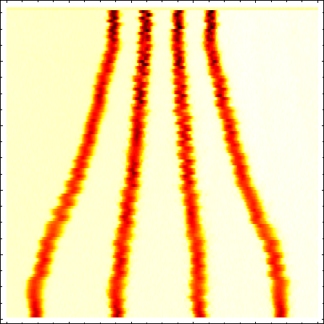
Batch Compression in PS for AD Beam
AD: f_{rev,AD} = 10/3 f_{rev,PS} → Compress batch to < 30% T_{rev}
Slowly change h = 8 → 9 → 11 → 13 → 15 → 17 → 20
h = h₀
Amplitude
h = h₀ +1…3
Time
No changes ?
200 ms
Heiko Damerau
Compress four bunches to 20 % of the machine circumference
14

Slide 15
Spare

Slide 16
Request to have a Review
Dear Colleagues
Following the latest MTP exercise, a Cost and Schedule Review (CSR) has been requested to be organized by the AD consolidation program leader and the AD Technical Coordinator.
The date for this review is 21st of September 2018. The mandate of the review is attached to this mail.
We would like to kindly ask you to present the status of the Work Package you are responsible for at the occasion of this CSR.
The idea is to summarize the work already completed, then focus on the remaining tasks, the corresponding schedule and the budget situation.
See the proposed agenda below. Your feedback is welcome !
Could you please be so kind as to confirm your participation asap for the ease of the organization ? In case you are not available, thanks do name a delegate.
Many thanks, kind regards.
Francois Butin, Tommy Eriksson

Slide 17
Agenda proposed by F. Butin
Provisional agenda, TBC:
1. Current status of the masterplan and
Implementation priorities T. Eriksson (20’)
2. Overall budget situation L. Van Den Boogaard (15’)
3. Magnets AD + Target area A. Newborough (20’)
4. Power converters JP. Burnet (15’)
5. Vacuum system J. Ferreira-Somoza (15’)
6. RF (C02, C10, LL/Schottky, Stoch cooling) W. Hoefle (40’)
7. Kickers & Horn testbench E. Carlier (20’)
8. Horn Ignitrons G. Grawer (15’)
9. Instrumentation L. Soby (15’)
10. e-cooler G. Tranquille (15’)
11. CV A. Broche (15’)
12. Cryogenics distribution D. Delikaris (20’)
13. Target Area renovation M. Calviani (40’)
14. Risk analysis,
mitigation options F. Butin (20’)

Slide 18
Review of AD Consolidation on 21st September 2018
“Cost & Schedule type of Review”
Review Panel Members: proposal: Mike Lamont [ACC-CONS], Rende Steerenberg [OP], Mar Capeans [TE], Henric Wilkens [EP], Luigi Serio [EN], Sylvie Prodon [FAP]
For info: Lisette Van den Boogaard
The Review Panel will receive all support material (project documents, draft planning and activity summaries) latest by September 15th, with the review scheduled for September 21st.

