Slide 1
Towards HL-LHCV1.4
R. De Maria, D. Gamba, F. Plassard
WP2 meeting 18/9/2018

Slide 2
TOC
Layout changes
IR1/5 Optics updates
Aperture update with remote alignment
IR4 Optics update (instrumentation and e-lens)
IR6 Optics update (TCDQ gap)
Crossing plane choice WP2

Slide 3
Layout main changes
MCBXFB
MCBXFB
MCBXFA
HLLHCV1.3
IP
Q1
HV
Q2a
Q2b
HV
Q3
HV
CP
D1
1.9K
B1(E)
D2
H
V
C
C
H
V
H
V
Q4
H
V
H
Q5
MBRD
V
H
C
C
V
H
V
H
MQY
V
H
V
MQY
B2(I)
MCBRD
1.9 K
MCBY
1.9 K
MCBY
1.9 K
MCBXFB
MCBXFB
MCBXFA
HLLHCV1.4
IP
Q1
HV
Q2a
Q2b
HV
Q3
HV
CP
D1
1.9K
B1(E)
D2
H
V
C
C
H
V
H
Q4
H
Q5
MBRD
V
H
C
C
V
H
V
MQY
V
MQML
B2(I)
MCBRD
1.9 K
MCBY
4.5 K
MCBC
4.5 K
Changes with respect to the baseline:
Q4: reusing existing cold mass (3 correctors instead of 4), no need of 1.9 K.
Q5: reusing existing Q5 cold mass (1 corrector instead of 3), no need of 1.9 K.
Full deployment of remote alignment system to be used with safe beam.
Chamonix 2018

Slide 4
Layout Changes HLLHC1.3 → 1.4
Layout changes:
IR1/5: 2+2 crab cavities → 2 crab cavities only
IR1/5: Q4, 4xMCBY+MQY 1.9 K → 3xMCBY+MQY 4.5 K
IR1/5: Q5 3xMCBY+MQY 1.9 K → 1xMCBC+MQML 4.5 K
IR1/5: Remote alignment system (i.e. machine can be realigned during beam commissioning for IP shift and orbit flattening)
IR1/5: Q4, Q5 displaced towards the arc from 10.047 m, 11 m w.r.t LHC to 10.5 m w.r.t LHC
IR1/5: New specification for TCTPV-TCTPH-TCLX stroke and apertures
IR1/5: Changes length/position of correctors in CP
IR7: MBH+TCLD, MQW (not the absorber)
IR2: TCLD, TDIS
IR8: TANB
Layout stabilizing changes:
Final positions of correctors in CP
Displacement BPM in D2 from IP side to non-IP side
Small change in MCBRD positions
Final position MASK Q4 (linked to the new Q4 end cap)
Extended D1 beam-screen
Overall review with mechanical drawings

Slide 5
Changes HLLHC1.3 → 1.4
Optics changes:
Crossing bumps re-optimized thanks to remote alignment system
Dedicated optics for 7 TeV (using 7.5 TeV equivalent currents where needed) for improved crabbing angle
IR7 optics with MQW changes
IR4 optimized for instrumentation and e-lens
IR6 reviewed and re-optimized for TCDQ gaps, Q5 strengths
IR8 β*=1.5 m

Slide 6
Crabbing angle and IR1/5 optics
B2(E)
B1(E)
C
C
C
C
C
C
C
C
B2(I)
B1(I)
Crab angle [µrad] | Q7 [T/m] | Same IR1/5 Optics | H Optimized Optics | V Optimized Optics
HL1.3 | 200 | 380 | n/a | n/a
HL1.4 | 200 | 375 | 388 | 375
HL1.4 | 214 | 388 | 400 | 390
5 µrad lost due to Q4-Q5 displacement from HL1.3 to HL1.4.
Higher than nominal Q7 current allow to increase crabbing angle
Different optics for IR1/IR5 can optimize a given crabbing plane.
With the present crab cavity layout (same for 1/5) H crossing is favored, therefore different layouts can still improve overall crab crossing.
Crab cavity voltage optimization has some impact on aperture and forward physics.

Slide 7
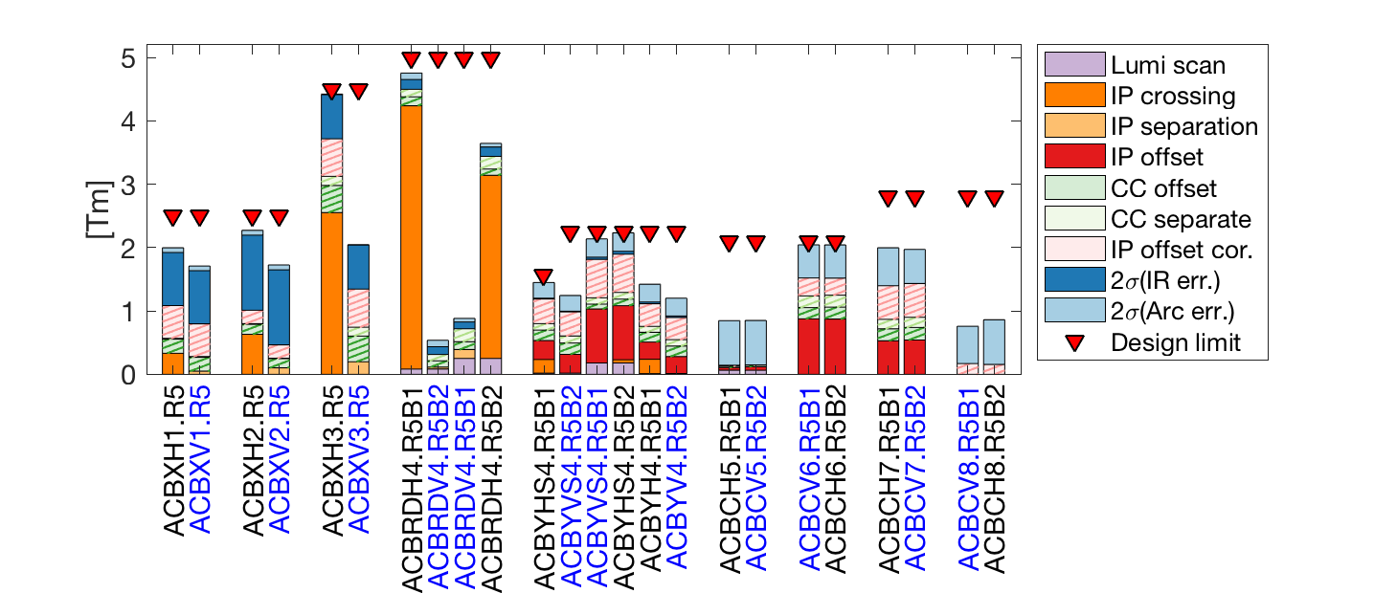
Summary of strengths with remote alignment
Knobs and correction for:
±295 µrad crossing angle in H/V plane (H in the figure)
±0.75 mm separation in V/H plane (V in the figure)
±2 mm IP offset with correctors + Q1-Q4 displaced by 2 mm
±100 um IP movement independent for B1/B2 for lumiscan
2 σ correction of ±0.5 mm residual quad. misalignment and ±1 mrad dipole tilt.
Back-up for remote alignment, implies loss of aperture:
±0.5 mm B1/B2 separation at CC (back for remote alignment loss of aperture)
±0.5 mum B1 and B2 orbit offset at CC
±1.2 mm of IP offset with correctors (fall-back for remote alignment loss of aperture)
Example for Right 5 with H crossing.
Symmetries applies for V crossing and left side.

Slide 8
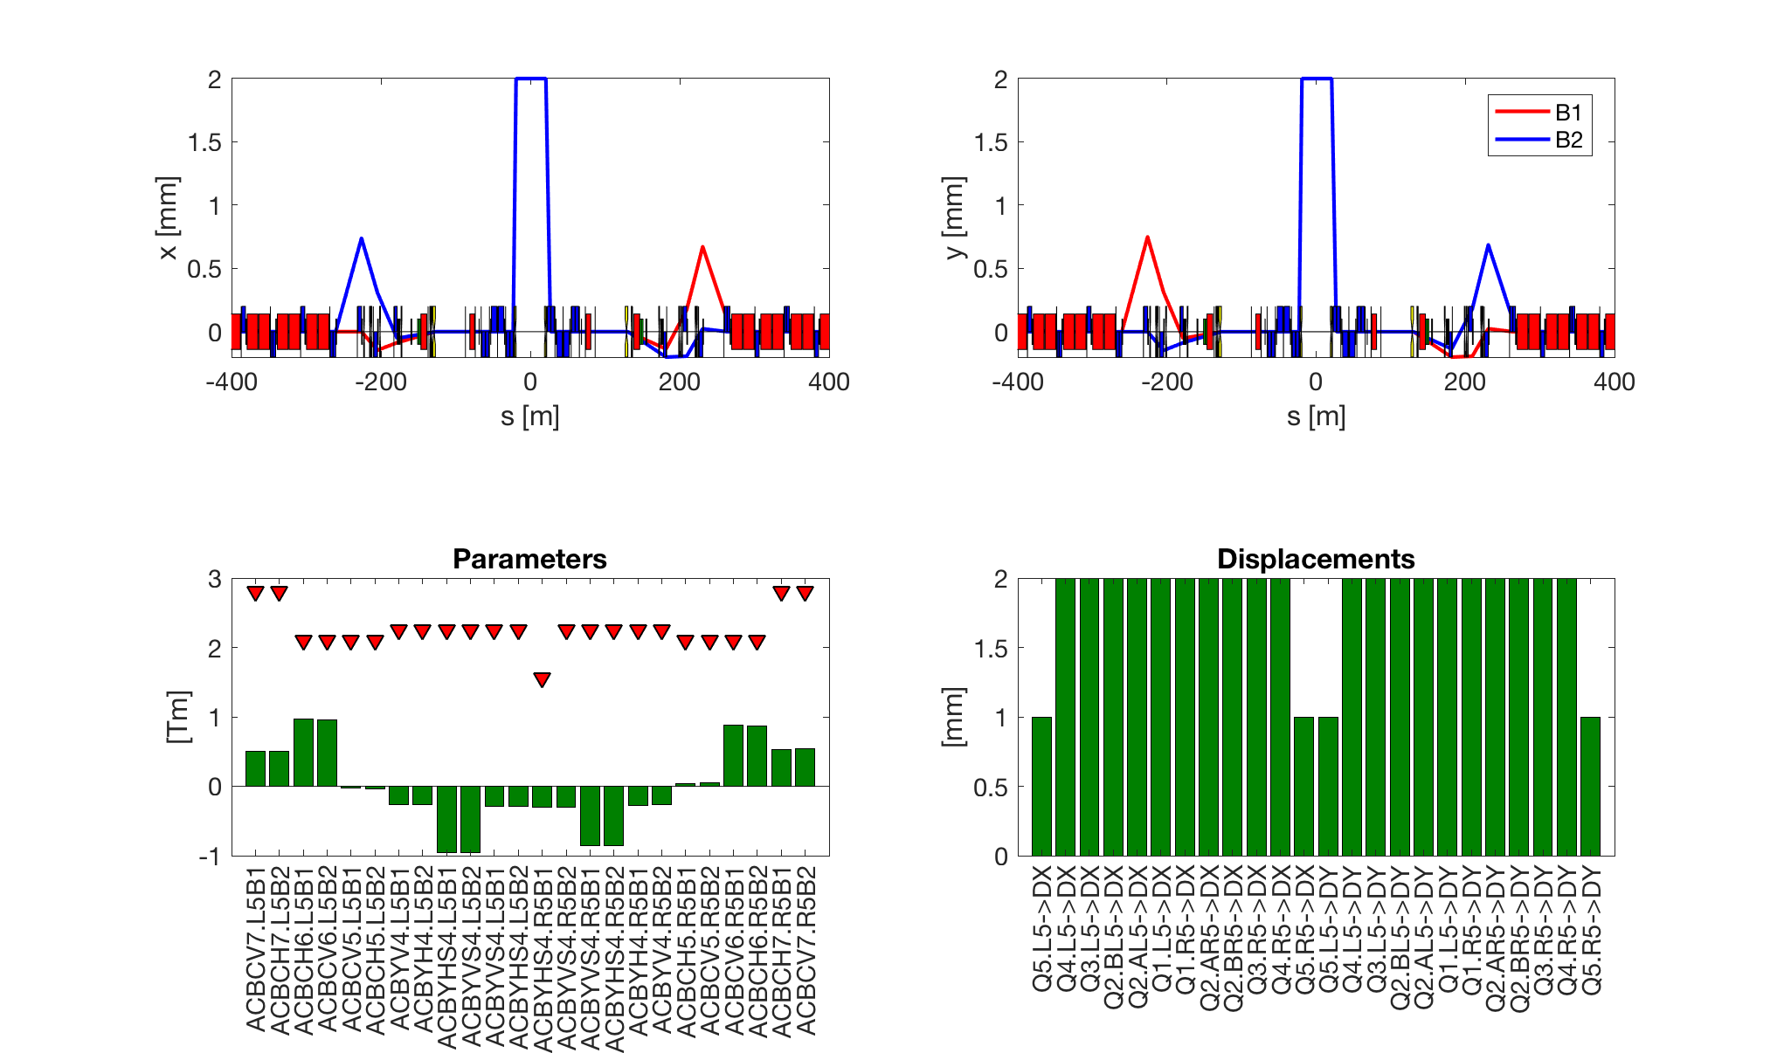
IP offset (2mm) with remote alignment
Residual orbit and orbit corrector minimized with the remote alignment from Q1-Q5 and correctors from Q4 to Q7

Slide 9
Apertures: Round 15 cm, 10.5 σ
 | Mech | Beam | Offset
TAXS | 22.6 | 17.9 | 15.6
Q1 | 20.5 | 16.9 | 16.9
Q23 | 15.4 | 12.6 | 12.6
D1 | 16.3 | 13.3 | 13.3
TAXN | 21.2 | 17.5 | 17.5
D2 | 23.2 | 18.7 | 18.7
D2 Corr. | 24.1 | 19.7 | 19.7
CRABS | 33 | 27.6 | 27.6
Q4 Mask | 23.6 | 18.6 | 18.6
Q4 Corr. | 25.1 | 19.9 | 19.9
Q4 | 27 | 21.6 | 21.6
Q5 Mask | 26.2 | 20.8 | 20.4
Q5 Corr. | 27.2 | 21.6 | 21.3
Q5 | 27.6 | 22 | 21.7
Q6 Mask | 33.9 | 27.2 | 26
Q6 Corr. | 35 | 28.1 | 26.9
Q6 | 35.4 | 28.5 | 27.6
θ_{c}= ± 250 μrad;
d_{sep}= ± 0.0 mm;
Mech: best possible aperture with beam screen shape tolerances,
ground motion and fiducialization margins (being reviewed)
Beam: as before with beam imperfections
Offset: as before with IP shift suing remote alignment
Design Principle: Triplet should always be the aperture bottleneck.
Aperture in σ at 2.5 μm/γ at 7 TeV
Increased aperture margins thanks to remote alignment

Slide 10
Apertures: Flat 15 cm, 11.8 σ
 | Mech | Beam | Offset
TAXS | 19.1 | 15.1 | 13.2
Q1 | 18.2 | 15.0 | 15.0
Q23 | 14.7 | 12.1 | 12.1
D1 | 15 | 12.3 | 12.3
TAXN | 16.5 | 13.4 | 13.4
D2 | 17.6 | 14.3 | 14.3
D2 Corr. | 19.3 | 15.8 | 15.8
CRABS | 23.4 | 19.7 | 19.7
Q4 Mask | 16.7 | 13.0 | 13.0
Q4 Corr. | 17.8 | 13.9 | 13.9
Q4 | 19.1 | 15.0 | 15.0
Q5 Mask | 18.7 | 14.5 | 14.2
Q5 Corr. | 19.4 | 15.1 | 14.9
Q5 | 19.5 | 15.4 | 15.1
Q6 Mask | 24.1 | 19.1 | 18.2
Q6 Corr. | 25.1 | 19.8 | 18.9
Q6 | 25.1 | 20.1 | 19.4
θ_{c}= ± 245 μrad;
d_{sep}= ± 0.0 mm;
Mech: best possible aperture with beam screen shape tolerances,
ground motion and fiducialization margins (being reviewed)
Beam: as before with beam imperfections
Offset: as before with IP shift suing remote alignment
Design Principle: Triplet should always be the aperture bottleneck.
Aperture in σ at 2.5 μm/γ at 7 TeV
Sufficient aperture margins thanks to remote alignment

Slide 11
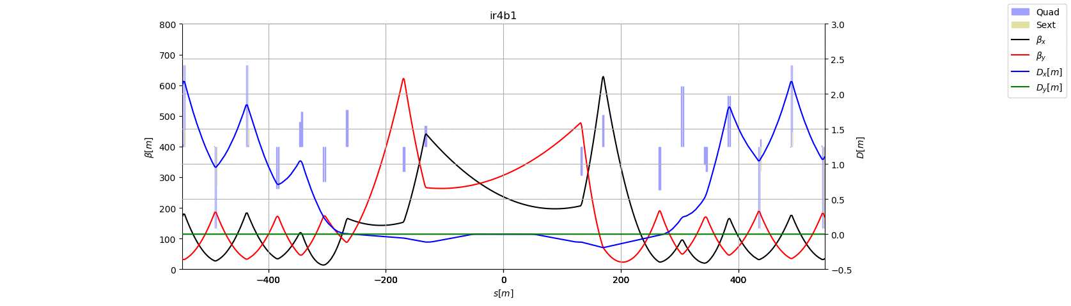
IR4 optics actions from BI
Follow-up from several meetings WP2-WP13 meetings:
Use improved injection optics without optics change during the ramp (as first iteration)
Increase the minimum beta at the BSRT above 200 m while keeping the beta at HEL bigger than 250 m.
Solution given to WP13.
BI is investigating the optics for possible feedback.
Aperture of 50 mm for e-lens possible.
Example of optics transition Beam 1 Round optics

Slide 12
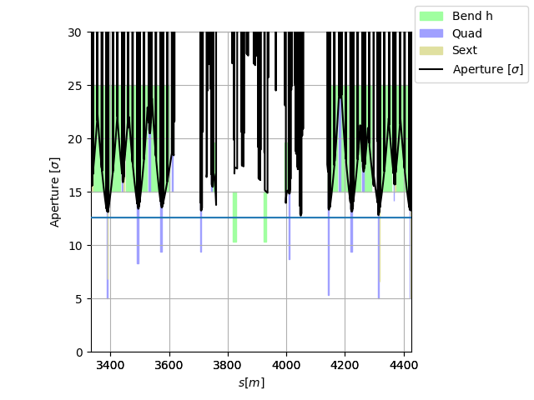
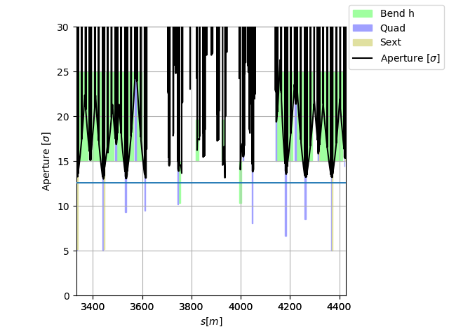
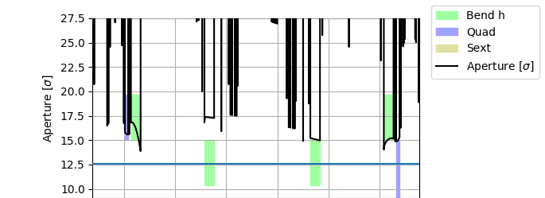
New IR4 Injection Optics
Aperture at injection above the target of 12.6 σ using HL-LHC aperture tolerances.
Diameter 50 mm would still fit

Slide 13
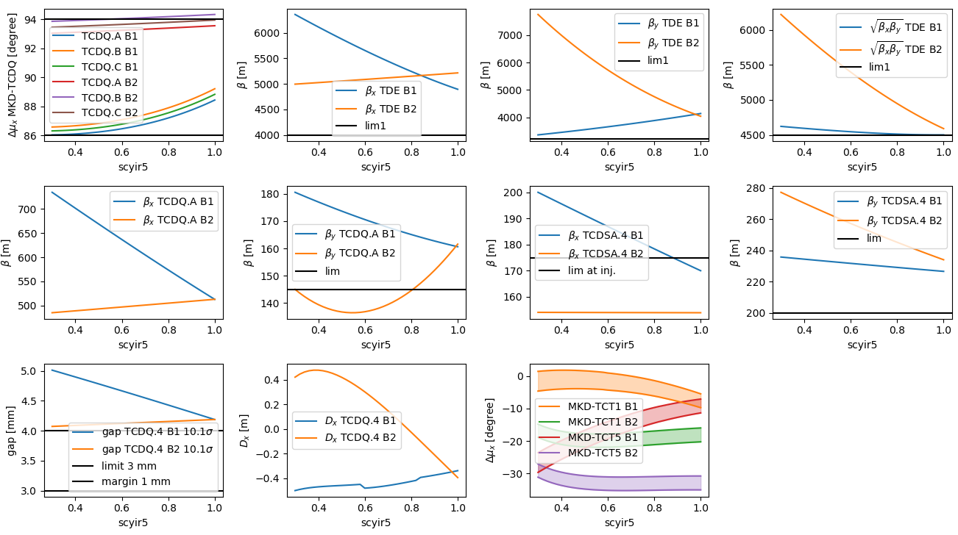
IR6 TCDQ Constraints
TCDQ gaps | Old [mm] | New^{[0]} [mm]
Min real gap | 3 | 3^{[1]}
Interlock | 1.2 | 0.8-0.5^{[2]}
Position accuracy, β-beat | 0.3 | 0.3
Dispersion δ =2e-4 | 0.4^{[3]} | 0.1^{[4]}
Total margin | 1.9 | 0.9-1.2
[0] Meeting WP2-WP5-WP14 23/1/2018
[1] Base on present FLUKA and ANSYS studies at 2.2 10¹¹. Lower for lower ppb?
[2] Based on studies with DOROS TCSP BPM. J.W. 0.5 mm in LCR3 meeting.
[3] Dx = 2 m very large
[4] Dx = 0.5 m should be sufficient
BETS: fixed gap at flat top in mm.
Implies gap chosen to be the one for the ideal setting (10.1 σ or +1 from TCS) at the end of the squeeze.
15
β* [cm]
50
TCDQ settings:
Beam 1: β increases during the squeeze :
  5 mm: from 12.3σ →10.1 σ:
Beam 2: β decreases during the squeeze
  4.1 mm: from 9.6 σ → 10.1 σ.
Round squeeze
(not ATS in the ramp)
For flat optics Beam 2 β increases during the squeeze instead and gap >4.2 mm
ATS scaling factor

Slide 14
Protected Apertures
Δµ_{x} MKD-TCT [°] | Aperture [σ@2.5µm]
0-20 | 11.2
30 | 11.9
40 | 12.9
50 | 13.8
60 | 14.5
70-90 | 14.6
No TCT | 19.4
Injection | 12.6
Parameter | 7 TeV | 0.45 TeV
Radial CO [mm] | 2
Mom offset | 2 10⁻⁴
Dispersion | 0.1
Beam size | 1.1 | 1.05
In addition there is:
Ground motion and fiducialization ~2.5 mm
Shape tolerances ~1-3 mm
Depends on the equipment and it is being reviewed with possible gains.
R. Bruce et al. CERN-ACC-2017-0051

Slide 15
Figure of merit of optics options
 | Baseline HL1.4
 | Round | FlatCC | Flat
β* Xing/Sep [cm] | 15/15 | 18/7.5 | 30/7.5
Xing angle [μrad] | ±250 | ±240 | ±245
TCDQ gap¹⁾ B1/B2 [mm] | 5.0/4.1 | 4.7/4.1 | 4.7/4.5
Q5.L6 [T/m] | 165 | 167 | 171
Q5.R6 [T/m] | 159 | 160 | 161
MKD-TCT [°] IP5 | 30 | 22 | 25
Protected H²⁾ Ap. [σ] IP5 | 11.9 | 11.4 | 11.7
Protected V²⁾ Ap. [σ] IP5 | 10.4-11.2 | 10.4-11.2 | 10.4-11.2
Crossing plane IP5 | V or H | H | H
Aperture³⁾ Xing [σ] | 13.2 | 14.2 | 15.6
Aperture³⁾ Sep [σ] | 16.5 | 12.7 | 12.9
Target 4.1 mm proposed, 5.2 mm requested (C. Bracco)
assuming different settings for TCTH and TCTV, which is under study (R. Bruce)
with/without fully remote alignment
Free choice of crossing plane:
HV give more margin for round, but strongly limits FlatCC

Slide 16
Crossing plane choice
Optics scenario | Observables | H1-V5 | V1–H5
Round optics β*=15 cm (with present CC β*=18/15 cm gives marginally larger virtual lumi. than β*=15/15 cm ) | Aperture margins crossing plane. Can be used to: relax collimator hierarchy or relax MKD-TCT constraints or reduce β* only if crab cavities have larger voltage than nominal or if we can cope with stronger long range BB interactions | 2.8 σ | 1.3 σ
 | TCDQ gaps | At the limit | At the limit
Flat optics with CC β*=18/7.5 cm (without CC we can change the crossing plan at will). | Aperture margins separation plane. Can be used to: relax collimator hierarchy or relax MKD-TCT constraints or reduce β* in the parallel separation plane regardless of crab cavities and BB interactions | -1.6 σ | 1.5 σ
 | TCDQ gaps | At the limit | Good
Forward physics studies are on-going, need very detailed studies: V crossing good for low mass (increase normalized dispersion around Q5), but bad for high mass (increase cut from TCL4). No recommendation available yet.

Slide 17
Backup

Slide 18
Layout changes
MCBXFB
MCBXFB
MCBXFA
HLLHCV1.3
IP
Q1
HV
Q2a
Q2b
HV
Q3
HV
CP
D1
1.9K
B1(E)
D2
H
V
C
C
H
V
H
V
Q4
H
V
H
Q5
MBRD
V
H
C
C
V
H
V
H
MQY
V
H
V
MQY
B2(I)
MCBRD
1.9 K
MCBY
1.9 K
MCBY
1.9 K
MCBXFB
MCBXFB
MCBXFA
HLLHCV1.4
IP
Q1
HV
Q2a
Q2b
HV
Q3
HV
CP
D1
1.9K
B1(E)
D2
H
V
C
C
H
V
H
Q4
H
Q5
MBRD
V
H
C
C
V
H
V
MQY
V
MQML
B2(I)
MCBRD
1.9 K
MCBY
4.5 K
MCBC
4.5 K
Changes with respect to the baseline:
Q4: reusing existing cold mass (3 correctors instead of 4), no need of 1.9 K.
Q5: reusing existing Q5 cold mass (1 corrector instead of 3), no need of 1.9 K.
Full deployment of remote alignment system to be used with safe beam.

Slide 19
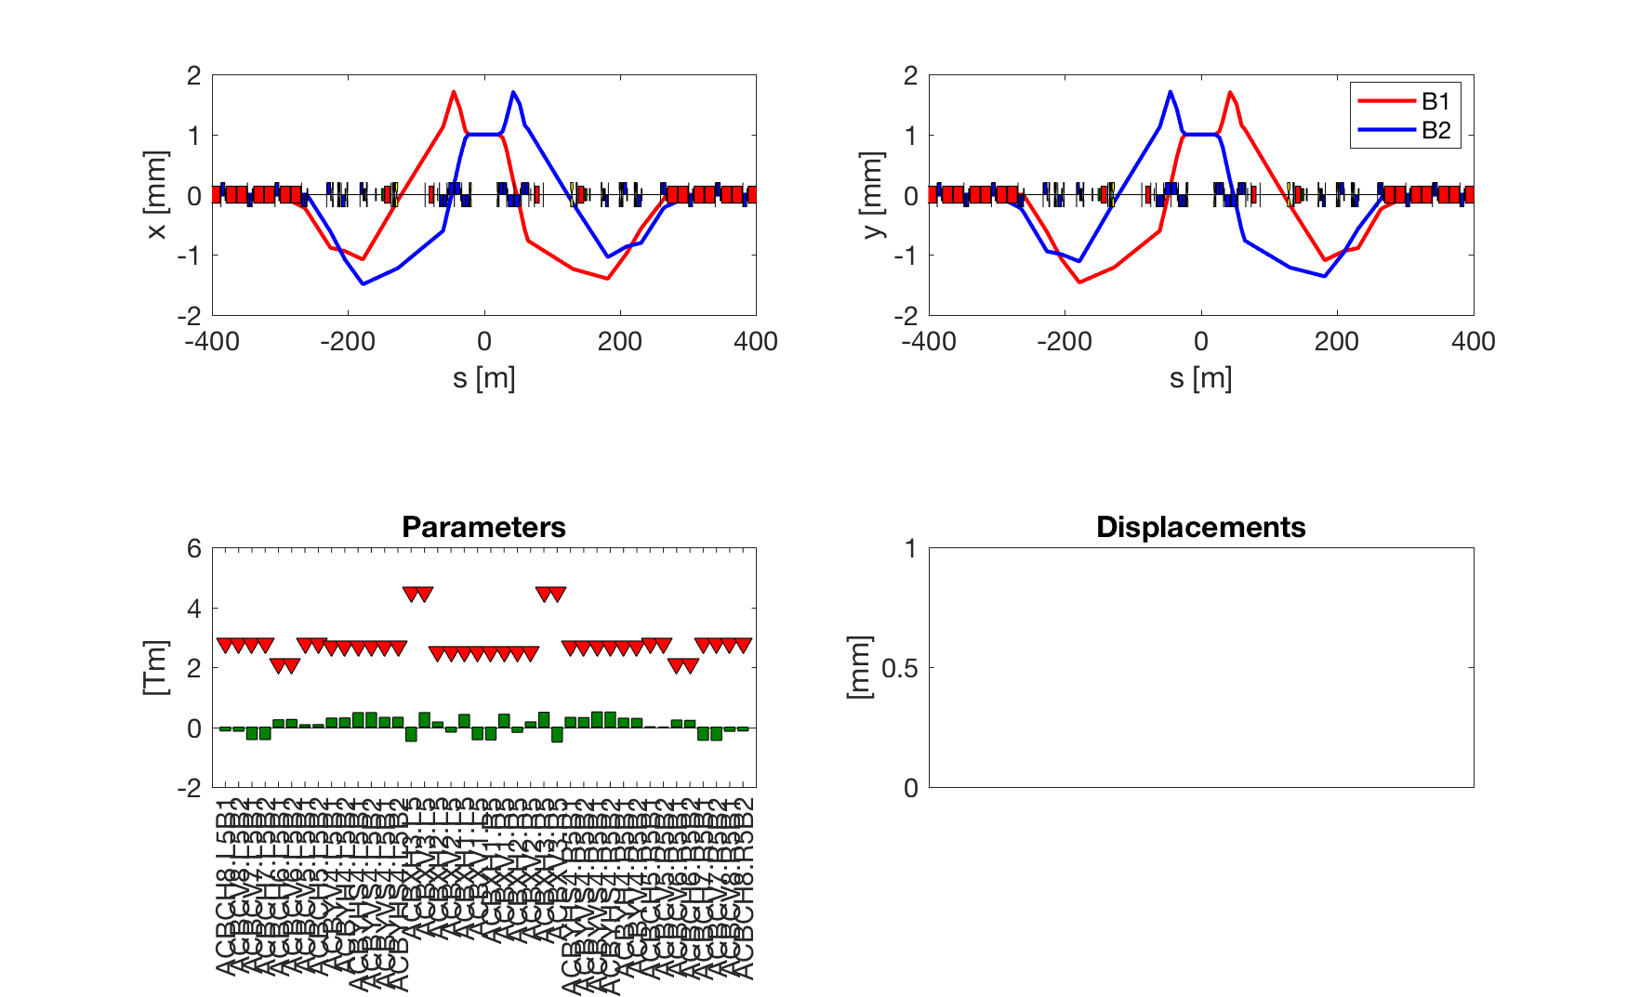
IP offset with correctors only (up to Q8) (+1mm)

Slide 20
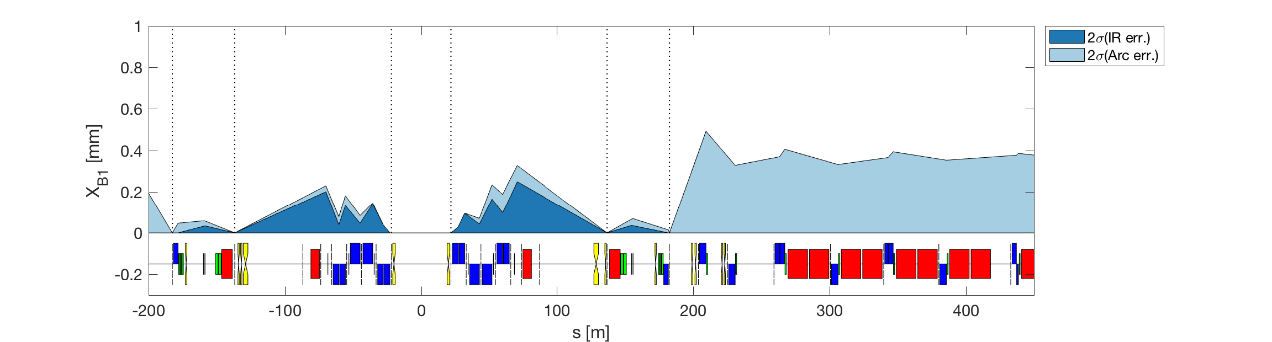
Orbit corrected as usual at relevant BPMs
Errors:
  All square distributions
    (i.e. if ±0.5 mm, then sigma = 0.5/sqrt(3) = 0.2887 mm)
  Quadrupoles
    ±0.5mm DX/DY, ±10mm DS, ±0.002 DKR1, ±1 mrad DPSI.
      Presently considering only DX/DY on quadrupoles. Normally DS/DKR1/DPSI has minor impact.
      To be repeated with “nominal” crossing condition.
  Dipoles
    ±10mm DS, ±0.002 DKR0, ±0.5 mrad DPSI.
Do not include BPM errors, but to be compared with 2 mm budget in aperture calculations.

Slide 21
MQW
DCUM | Old slots | Old Circuit | New slots | New Circuit
19870.8 | MQWA.A5L7 | RQ5.LR7 | MQWA.A5L7 | RQ5.LR7
19867.0 | MQWA.B5L7 | RQ5.LR7 | MQWA.B5L7 | RQ5.LR7
19863.2 | MQWB.5L7 | RQT5.L7 | MQWA.C5L7 | RQ5.LR7
19859.4 | MQWA.C5L7 | RQ5.LR7 | MQWA.D5L7 | RQ5.LR7
19855.6 | MQWA.D5L7 | RQ5.LR7 | MQWA.E5L7 | RQ5.LR7
19851.8 | MQWA.E5L7 | RQ5.LR7 | removed | removed
20117.5 | MQWA.A5R7 | RQ5.LR7 | MQWA.A5R7 | RQ5.LR7
20121.3 | MQWA.B5R7 | RQ5.LR7 | MQWA.B5R7 | RQ5.LR7
20125.1 | MQWB.5R7 | RQT5.R7 | MQWA.C5R7 | RQ5.LR7
20128.9 | MQWA.C5R7 | RQ5.LR7 | MQWA.D5R7 | RQ5.LR7
20132.7 | MQWA.D5R7 | RQ5.LR7 | MQWA.E5R7 | RQ5.LR7
20136.5 | MQWA.E5R7 | RQ5.LR7 | removed | removed
Radiation Shielding Installation and Possible Optics Change for the MBW and MQW Magnets in IR 3 and 7 of the LHC. Second phase LS2 LS3 and HL-LHC. LHC-MW-EC-0002 v.1.1
Injection optics from R. Bruce, from a branch of HL-LHCV1.3.

Slide 22
Corrector package
Magnet name |  | Integrated field at R_{ref}=50 mm [T m] |  | Magnet coil length [mm] |  | Magnet length [1] [mm] |  | Magnetic [3] length [mm]
 |  | Base line | New value | Base Line [2] | New value | Baseline | New Value | TDR | New Value
Skew quadrupole | MCQSXF | 1.000 | 0.700 | 728 | 528 | 814 | 614 | 807 | 462
Normal sextupole | MCSXF | 0.063 | 0.095 | 132 | 192 | 194 | 254 | 111 | 171
Skew sextupole | MCSSXF | 0.063 | 0.095 | 132 | 192 | 194 | 254 | 111 | 171
Normal octupole | MCOXF | 0.046 | 0.069 | 119,6 | 169,6 | 183 | 233 | 87 | 151
Skew octupole | MCOSXF | 0.046 | 0.069 | 119,6 | 169,6 | 183 | 233 | 87 | 151
Normal decapole | MCDXF | 0.025 | 0.037 | 118,6 | 168,6 | 183 | 233 | 95 | 138
Skew decapole | MCDSXF | 0.025 | 0.037 | 118,6 | 168,6 | 183 | 233 | 95 | 138
Normal dodecapole | MCTXF | 0.086 | 0.086 | 490 | 490 | 575 | 575 | 430 | 465
Skew dodecapole | MCTSXF | 0.017 | 0.017 | 135 | 135 | 200 | 200 | 89 | 92
Source: https://edms.cern.ch/document/1963788/1.0 HL-LHC ECR: WP3 CHANGE OF QUADRUPOLE, SEXTUPOLE, OCTUPOLE AND DECAPOLE CORRECTORS INTEGRATED FIELD
[1]: not the magnetic length; [2] values differ slightly from TDR;

Slide 23
New IR4: No Optics changes
β_{xB1}/β_{yB1} β_{xB2}/β_{yB2}[m] | Pos. | HLLHC <=V1.3 (inj.) | HLLHC 1.4 Inj | LHC 1.4 Round 15cm
e-lens | D3 | 232/212/281/263 | 280/280/280/280 | 280/280/280/280
BSRT/I | D3 | 136/270/191/365 | 206/351/206/384 | 206/351/206/384
BGI | D3-4 | 279/208/321/245 | 314/270/314/262 | 314/270/314/262
WS | D3-4 | 130/320/178/435 | 197/402/197/453 | 197/402/197/453
BQSH | Q5-7 | 426/ 92/425/226 | 577/ 58/405/240 | 515/109/405/240
BQSV | Q5-7 | 142/371/130/491 | 201/451/124/506 | 201/451/ 76/559
BPLH1 | Q5-7 | 400/135/420/256 | 543/117/396/270 | 481/165/387/276
BPLH2 | Q5-7 | 403/ 89/431/165 | 543/ 51/479/168 | 492/104/432/230
BPLV | Q5-7 | 193/337/180/500 | 260/389/201/517 | 251/405/201/517
BQLV2 | Q5-7 | -/-/129/470 | -/-/124/483 | -/-/ 73/530
BPLX | Q5-7 | 277/234/296/356 | 375/246/280/371 | 346/283/251/397
Flat 30/7.5 cm and 18/7.5 cm optics are also possible.

Slide 24
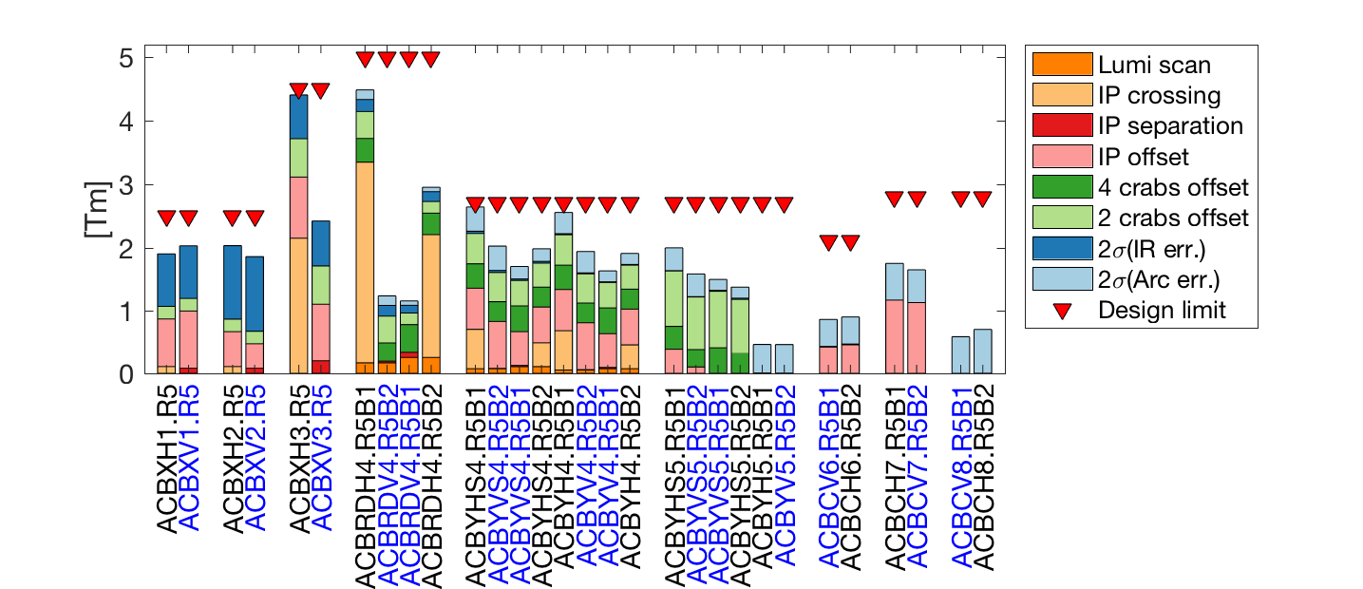
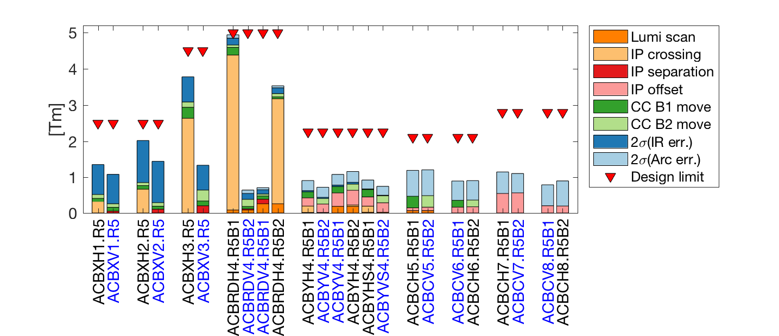
Orbit corrector strength budget
HLLHCV1.3
Right Point 5, H crossing.
The following symmetries apply:
Left B1 -> Right B2,
Left B2 -> Right B1
H Point 5 -> V Point 1
HLLHCV1.4:
orbit bumps reduced at the crab cavities
IP offset performed by remote alignment
Limited crab beam adjustment still possible
Crossing: ±295 μrad
Separation: ±0.75 mm
IP Offset: ±2.0 mm with re-alignment
Luminosity scan: ±100 μm
Crab knobs: ± 0.5 mm (baseline only)
Imperfection (2σ): from uniform distribution of mainly ±0.5 mm quad. alignment and 0.5 mrad / 20 units dipole errors.
IP
Q1 Q2 Q3 D2
Triplets
Q4 Q5 Q6-8
Matching section
HLLHCV1.4
IP
Q1 Q2 Q3 D2
Triplets
Q4 Q5 Q6-8
Matching section

Slide 25

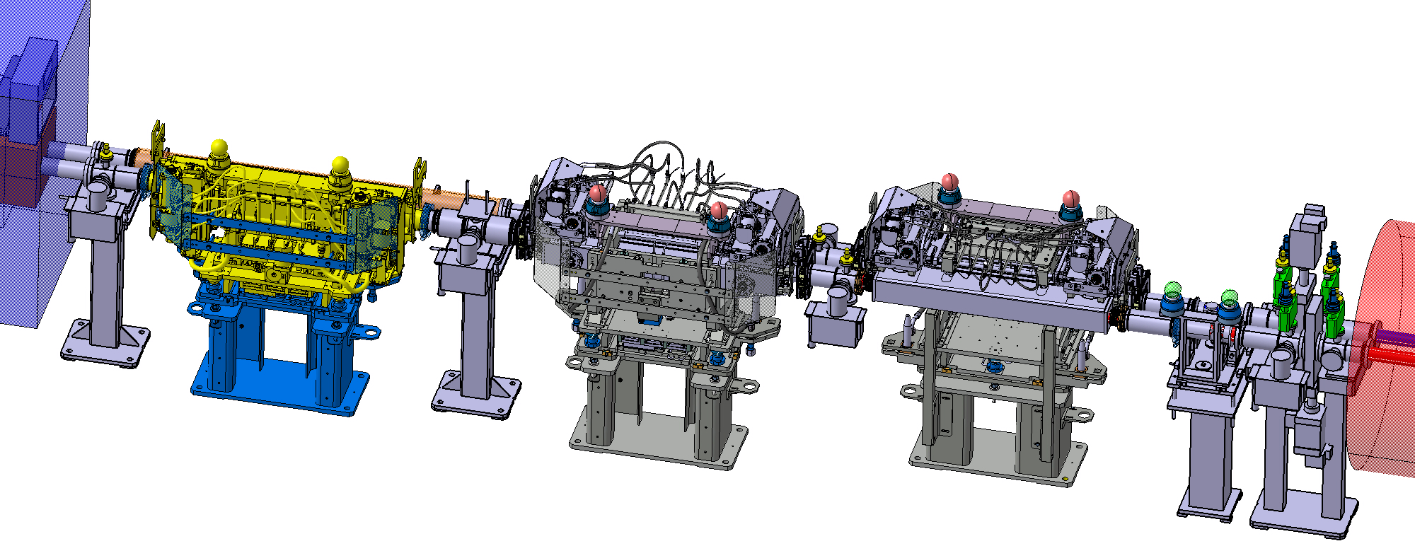
TCLX – TCPH issues in HLLHC
Beam size in between TAXN – D2 is much larger than LHC due to lower β* and D2 closer to the triplet, beam separation smaller than LHC because D1 – D2 distance is shorter.
TCLX needs thicker internal jaw to provide dose protection to D2
-> Larger stroke in less space.
  TAXN
  D2
  TCTPV
  TCTPH
  TCLX

Slide 26
TCL-TCT Aperture specifications
Offset (X,Y) | Baseline | Remote alignment
Ground Motion + Fiduc. | ~2 mm | ~0.5 mm
Orbit Error + crab adj. | 2.5 mm | 2.5 mm
Collimator stroke | 15 σ + 10 % (β-beat) | 15 σ + 10 % (β-beat)
Protected aperture | 12 σ + 10 % (β-beat) | 12 σ + 10 % (β-beat)
2 mm IP shift | With orbit correctors | With re-alignment
A_{y}
A_{x}
Sep.
Round 15 cm | A_{x} [mm] | A_{y} [mm] | A_{x} [mm] | A_{y} [mm] | Sep. [mm]
TCLX | 36.4 | 27.9 | 31.9 | 26.1 | 86.0-87.5
VTCLX | 28.0 | 36.4 | 26.1 | 31.9 | 86.0-87.5
TCTPH | 28.5 | 37.1 | 26.5 | 32.7 | 83.4-84.9
VTCTPH | 37.0 | 28.1 | 32.5 | 26.4 | 83.4-84.9
TCTPV | 28.9 | 38.0 | 26.9 | 33.7 | 80.4-81.9
VTCTPV | 38.1 | 28.7 | 33.7 | 26.9 | 80.4-81.9
Flat 7.5/18 cm | A_{x} [mm] | A_{y} [mm] | A_{x} [mm] | A_{y} [mm] | Sep. [mm]
TCLX | 42.8 | 33.8 | 38.3 | 32.0 | 86.0-87.5
VTCLX | 33.9 | 42.9 | 32.1 | 38.4 | 86.0-87.5
TCTPH | 34.2 | 43.5 | 32.3 | 39.1 | 83.4-84.9
VTCPTH | 43.3 | 34.0 | 38.8 | 32.2 | 83.4-84.9
TCTPV | 34.5 | 44.3 | 32.6 | 39.9 | 80.4-81.9
VTCTPV | 44.2 | 34.5 | 39.8 | 32.5 | 80.4-81.9
ColUSM, 23/2/2018

Slide 27
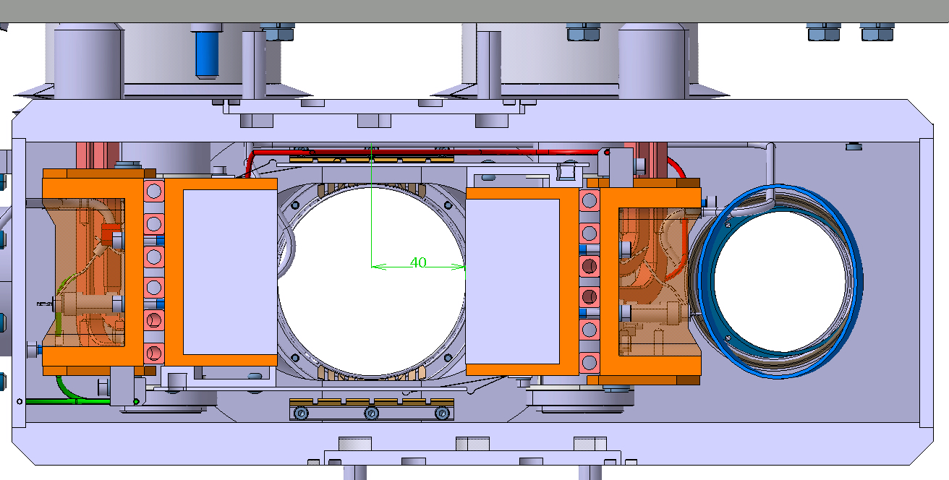
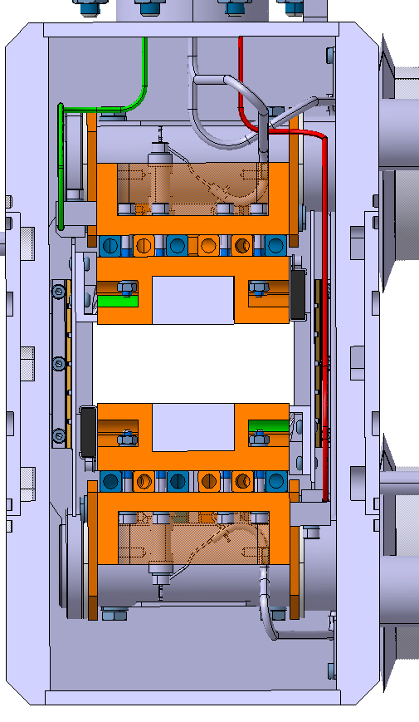
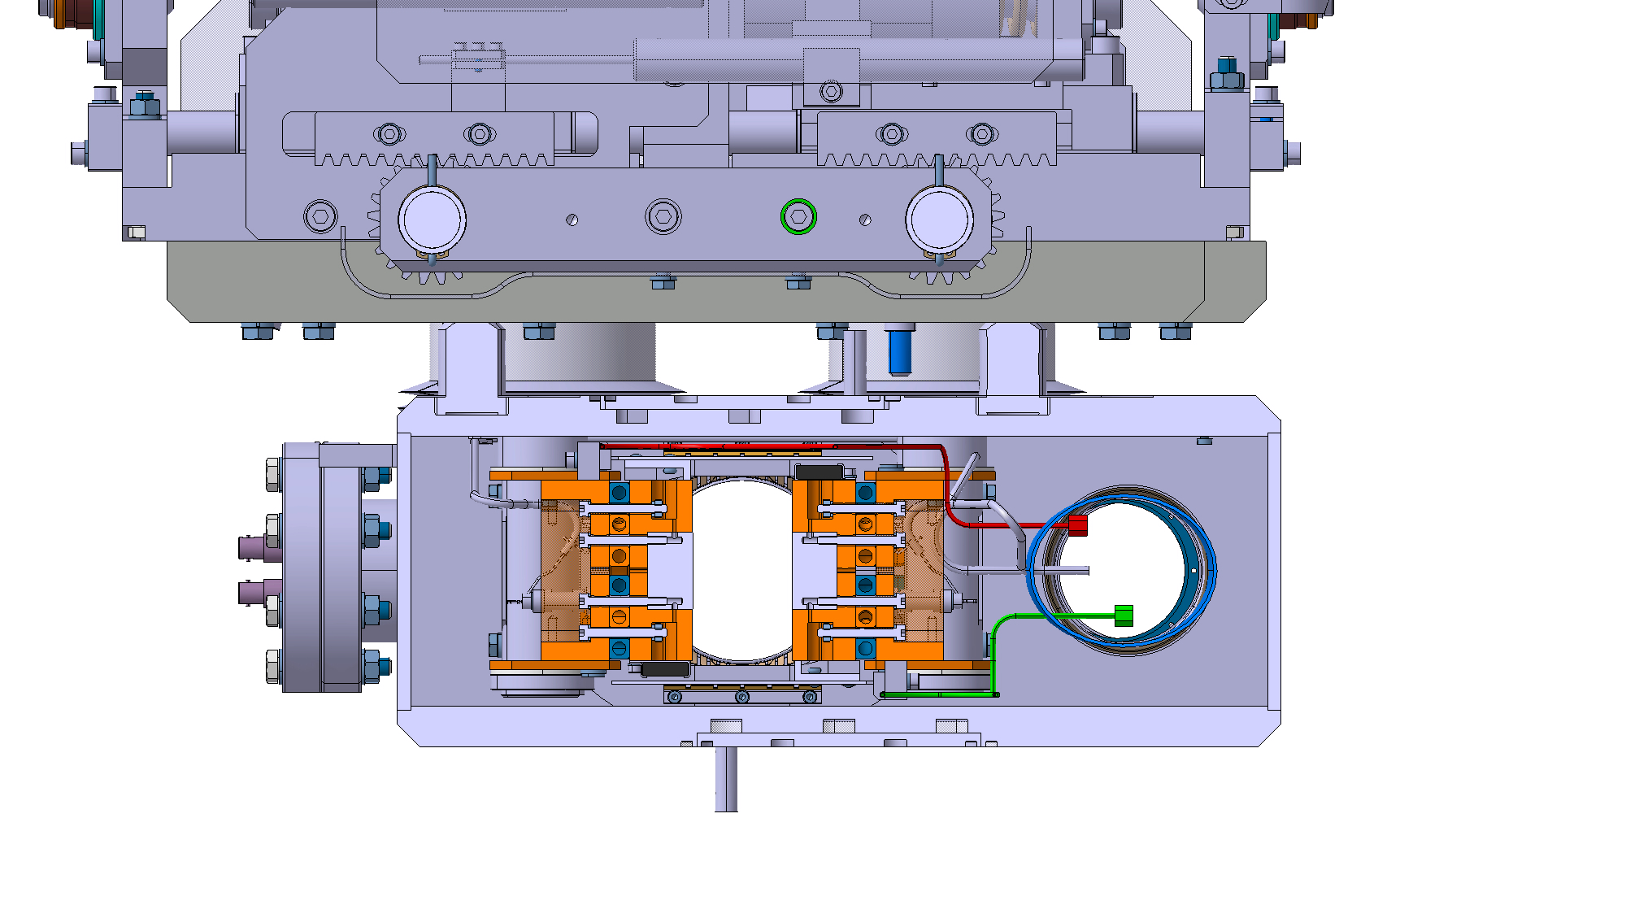
New design proposal
TCTPV
TCLX - 4 mm gap
 | Stroke | Chamber H/V
TCLX | 40 mm | 65/80 mm
TCTPH | 32.5 mm | 80/65 mm
TCTPV | 40 mm | n/a
TCTPH
Remote alignment meeting, L. Gentini, 31/5/2018

Slide 28
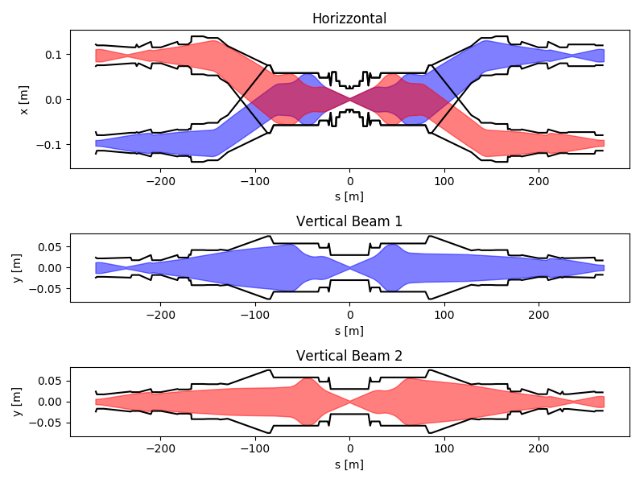
Aperture for vacuum layout
WP12 asked beam envelope without mechanical, alignment and fiducialization tolerances to specify vacuum apertures.
The request inverts the typical work flow because mechanical, alignment and fiducialization are not finalized.
Recipe given:
Beam stay clear =
1.1 n_{σ} σ_{nominal} + 2 mm
where:
n_{σ} = 13.25 up to D1
n_{σ} = 15 TAXN-Q5
n_{σ} = 20 sigma Q6 to Q7.
In addition, new vacuum aperture should always have larger margins than those found in the triplet.
Table available here.
Consistent with present hardware and avoid additional aperture bottleneck.

Slide 29
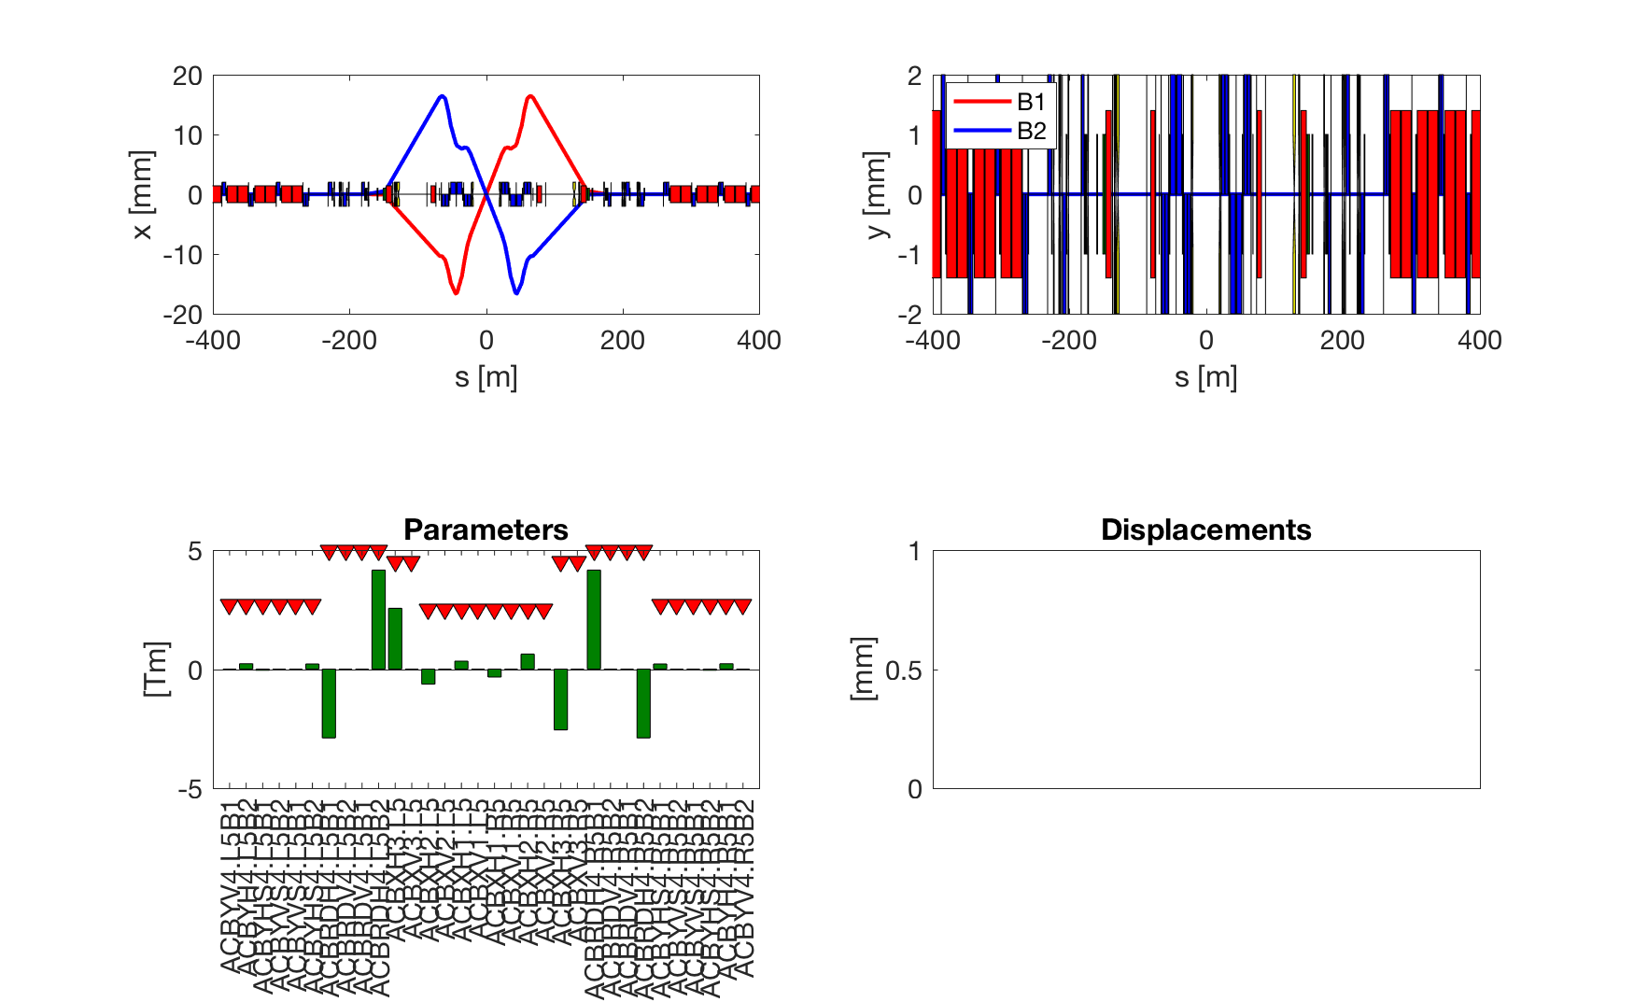
IP crossing (+-295 urad)

Slide 30
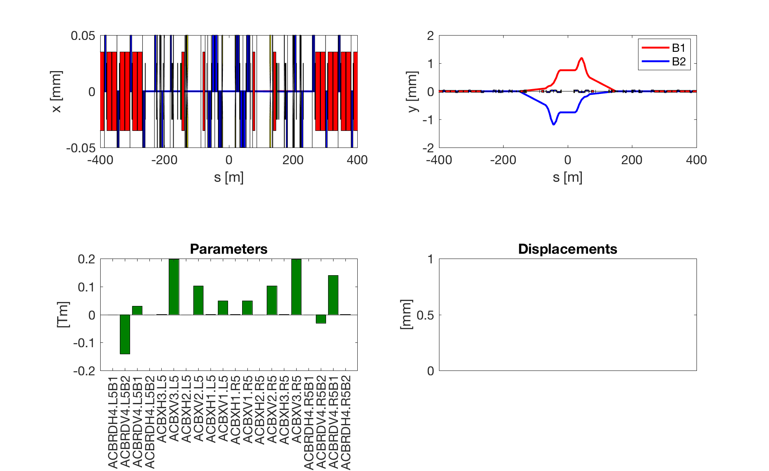
IP separation (+- 0.75 mm)

Slide 31
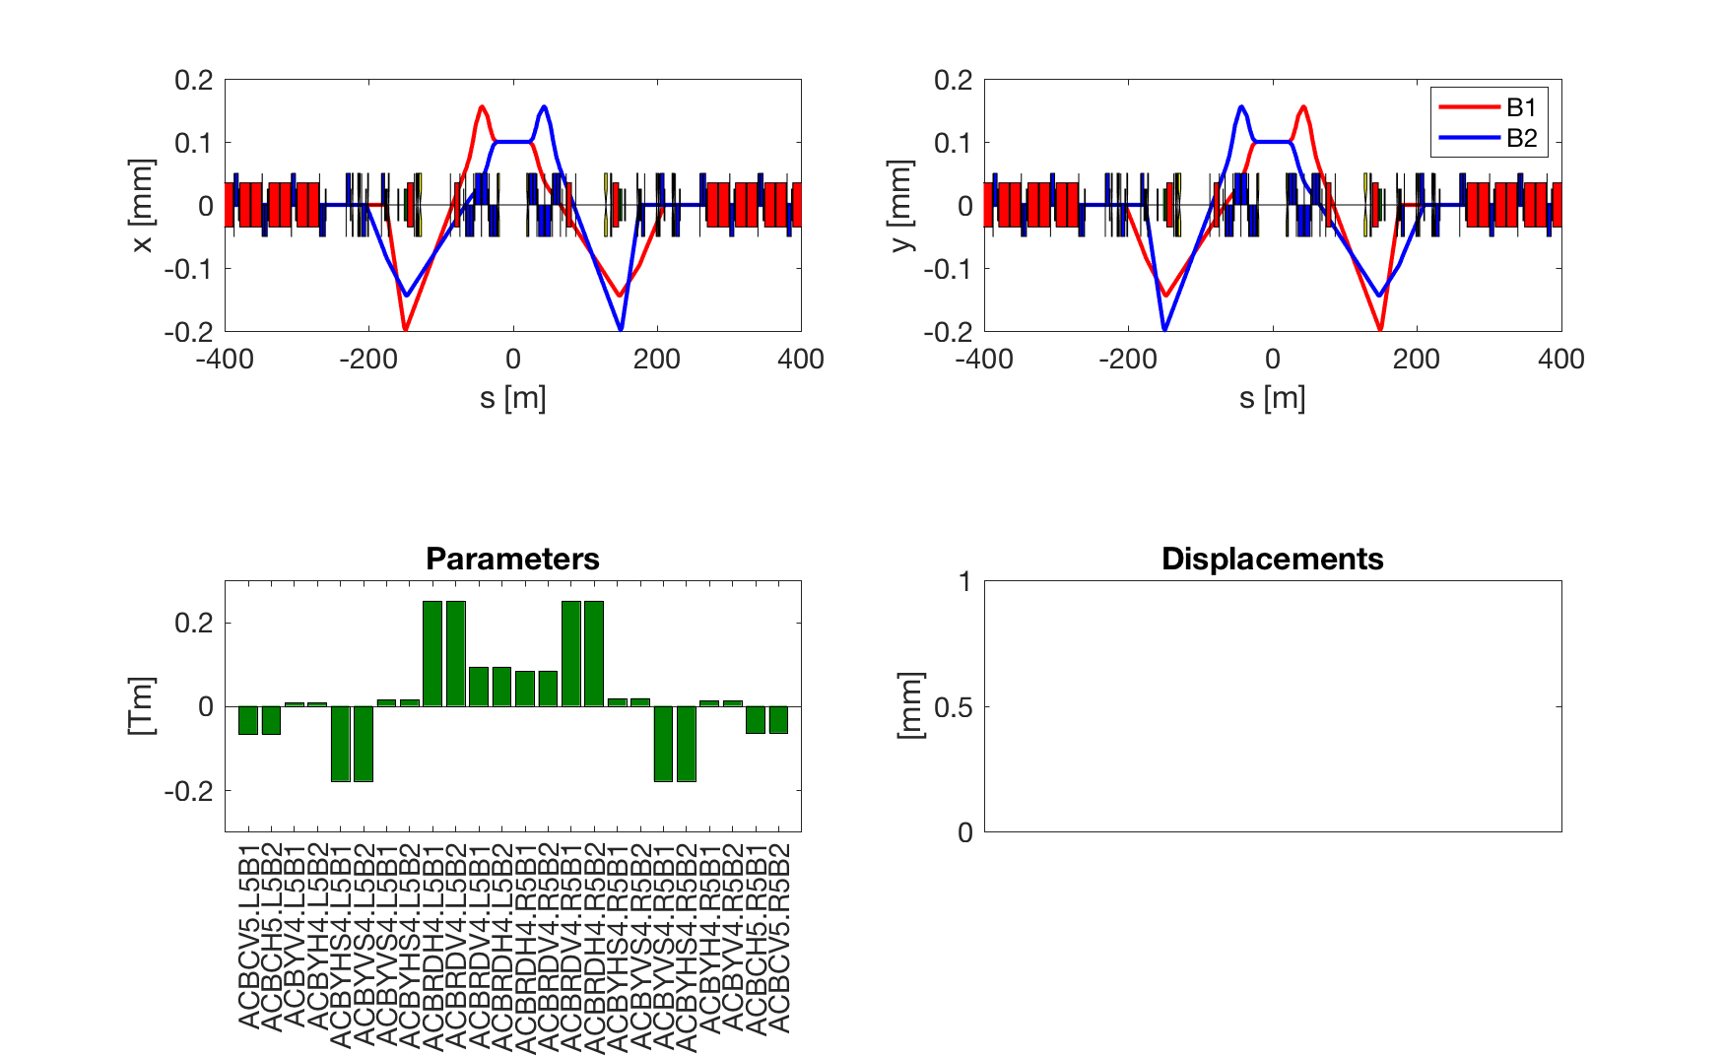
Lumiscan (+- 100 um)

Slide 32
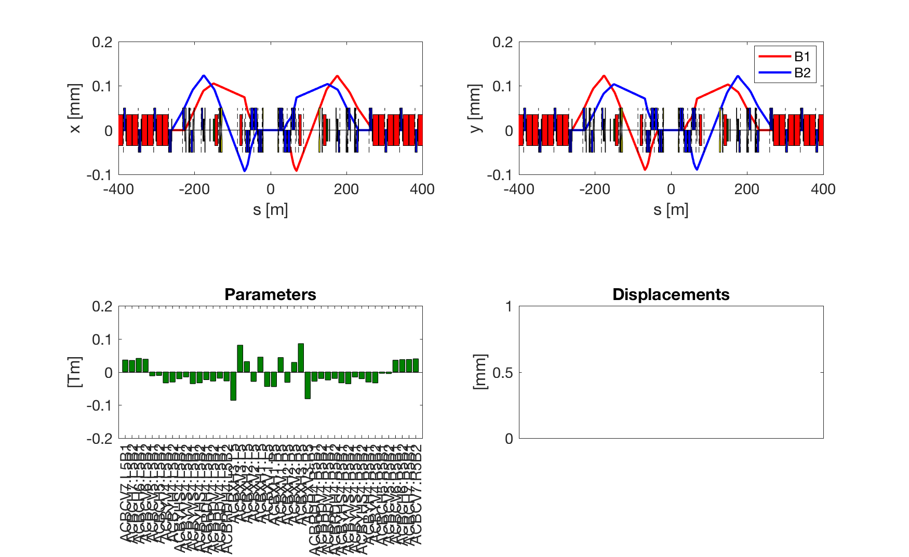
CC offset (100 um)

Slide 33
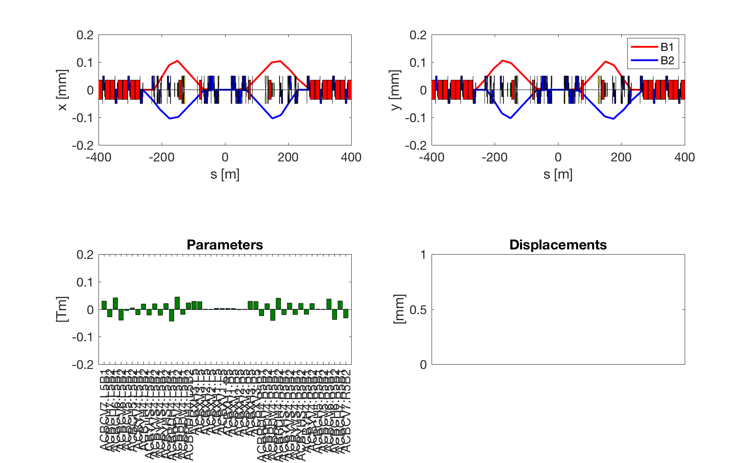
CC separation (+- 100 um)

Slide 34
IR6 Current
Latest measurements, LMC 21/3/2018, A. Verveij
 | Current [A] | Gradient [T/m]
Nominal | 3610 | 160.0
Ultimate | 3900 | 172.8
SS Limit 4.5K | 4200 | 186.1
SS Limit 1.5K | 5800 | 257.0
Training | 3950 | 175.0
 | HLLHCV1.4 @ 7TeV
 | Round | FlatCC | Flat
β* Xing/Sep [cm] | 15/15 | 18/7.5 | 30/7.5
Q5.L6 [T/m] | 163/165 | 160/167 | 148/171
Q5.R6 [T/m] | 159/151 | 160/150 | 161/147
Few T/m reduction w.r.t
HL1.3 in particular for Q5.R6
NoMs14 branch to be done.
One needs to add 1% margin for optics correction + 50 amps.
7.5 TeV operation should guaranteed for Run V.

Slide 35
Preview Next steps
To release version 1.4:
Decision or study new position for Q4/Q5 for cryogenic integration. [Done]
Decision on how to gain 30 cm in between D2/crab cavities. [Done]
Consistency check between drawings and optics model. [On going]
Optimization crossing schemes and other orbit bumps. [Done]
Finalization IR6 optics and IR4 optics. [On going]
Freeze mechanical, ground motion, fiduc. tolerances. [On going]
Computation aperture margins and phase advance tunability. [On going]
Evaluation/choice of crossing planes. [On going]
Studies in parallel:
Study optics at 7 TeV with ultimate currents in Q7 (more urgent if we want to ask for an hardware test at the end of the run). [Done]
Update MS10 branch and follow-up of the DA studies. [On Going]
Optics optimization for forward physics. [On Going ]

Slide 36
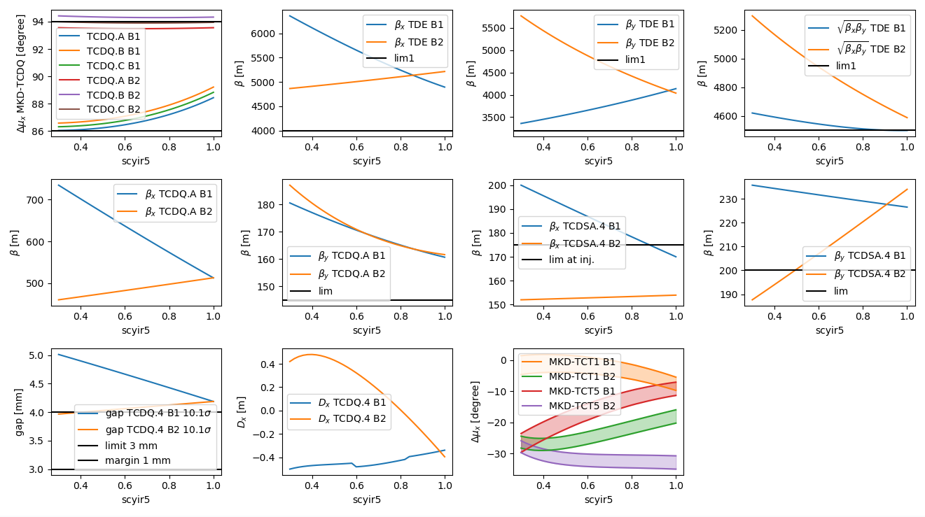
Round
Possible improvement: increase TCDQ gap in B2

Slide 37
Round Optics
TCDQ settings:
Beam1: 5 mm: from 12.3σ →10.1 σ: β increases during the squeeze
Beam2: 3.9 mm: from 9.6 σ → 10.1 σ. β decreases during the squeeze

Slide 38
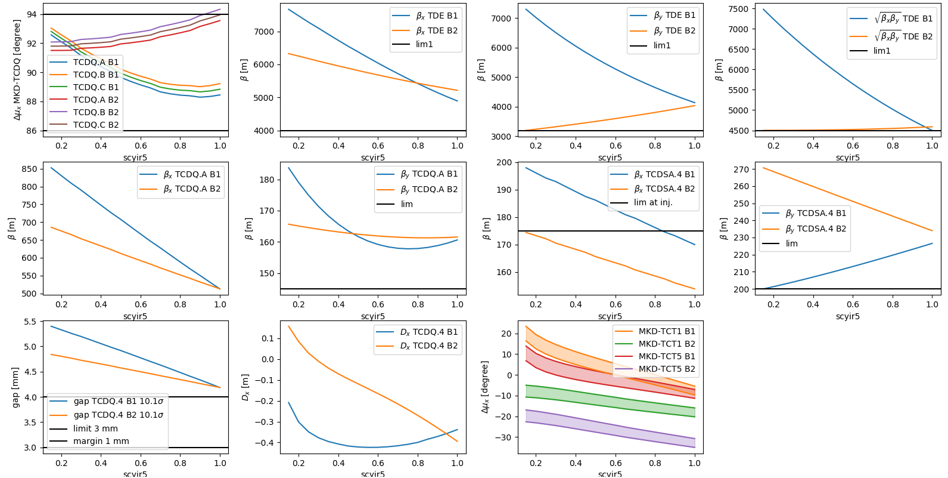
Flat (7.5/30 cm)

Slide 39
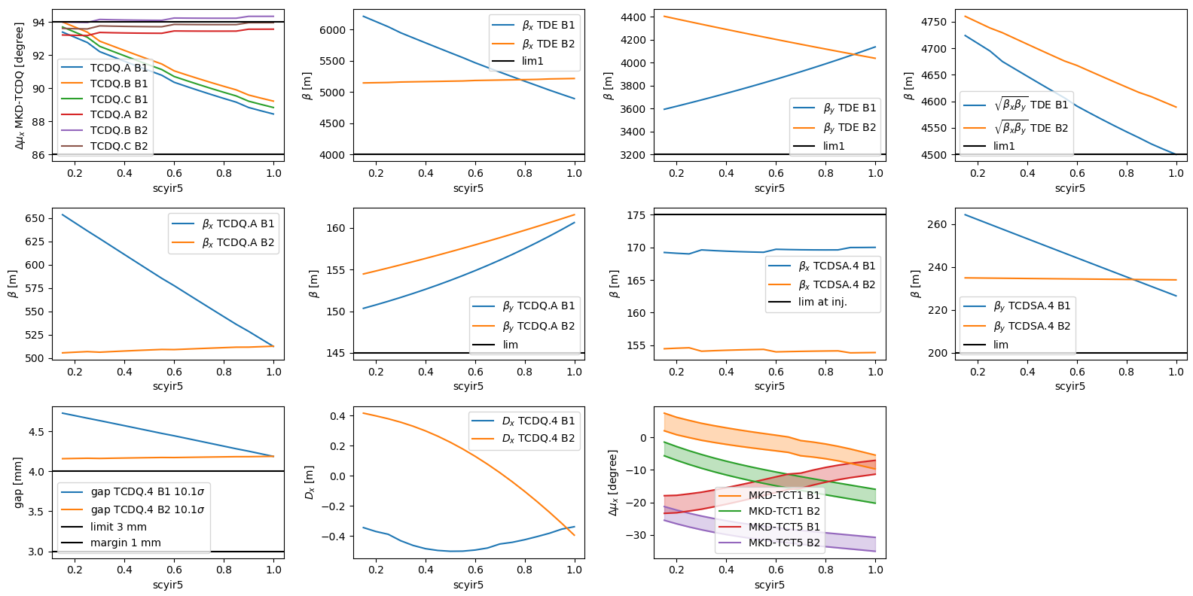
FlatCC (7.5/18 cm)

