Slide 1
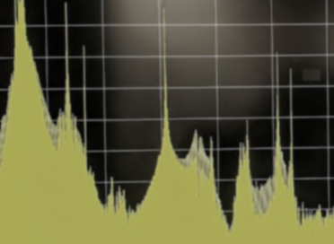
Update on DQW HOMs
J. A. Mitchell
131st HL-LHC WP2 Meeting
CERN-Internal, 25th September 2018

Slide 2
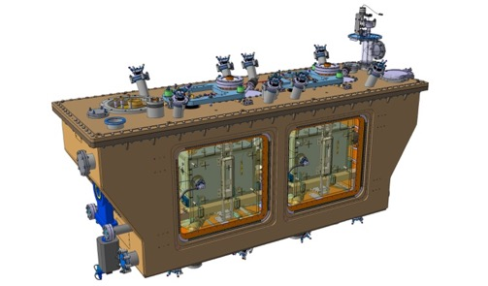
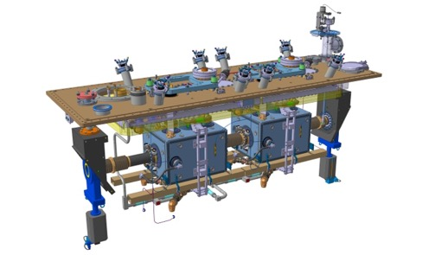
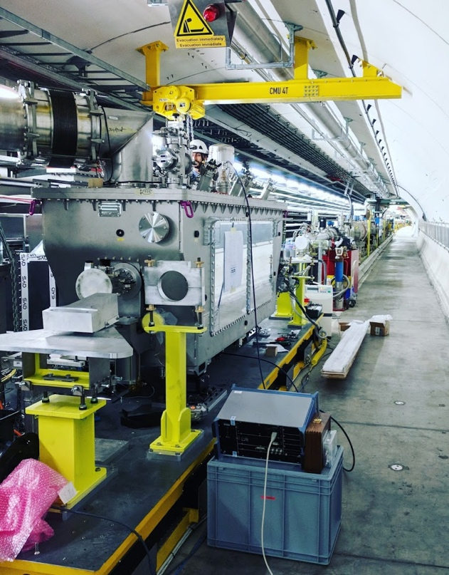
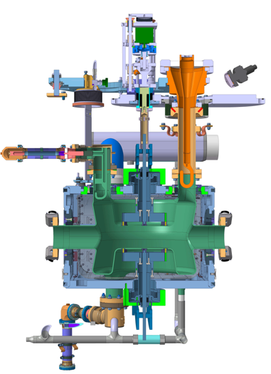
SPS Crab Test Stand
Field probe
Tuner
HOM Couplers (x3)
FPC
DQW crab cavity (vertical)
Helium Vessel
Cold magnetic shielding

Slide 3
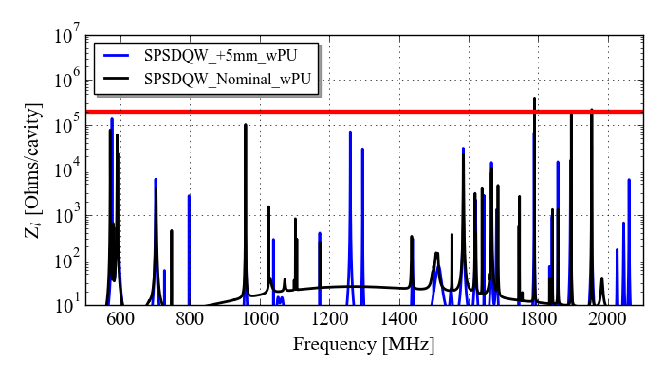
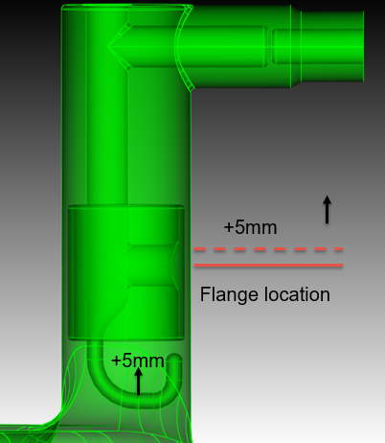
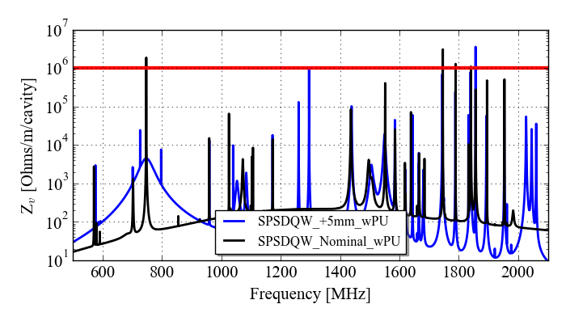
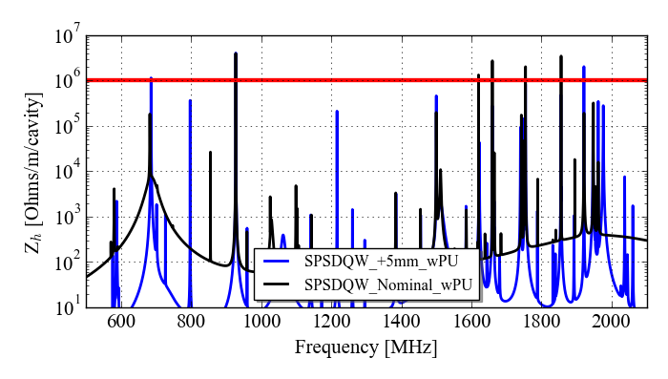
Ancillaries: Non-conformity
All HOM coupler ports are + 5 mm compared to design.
Reduces coupling to majority of HOMs
Does not present impedance issue for SPS test.

Slide 4
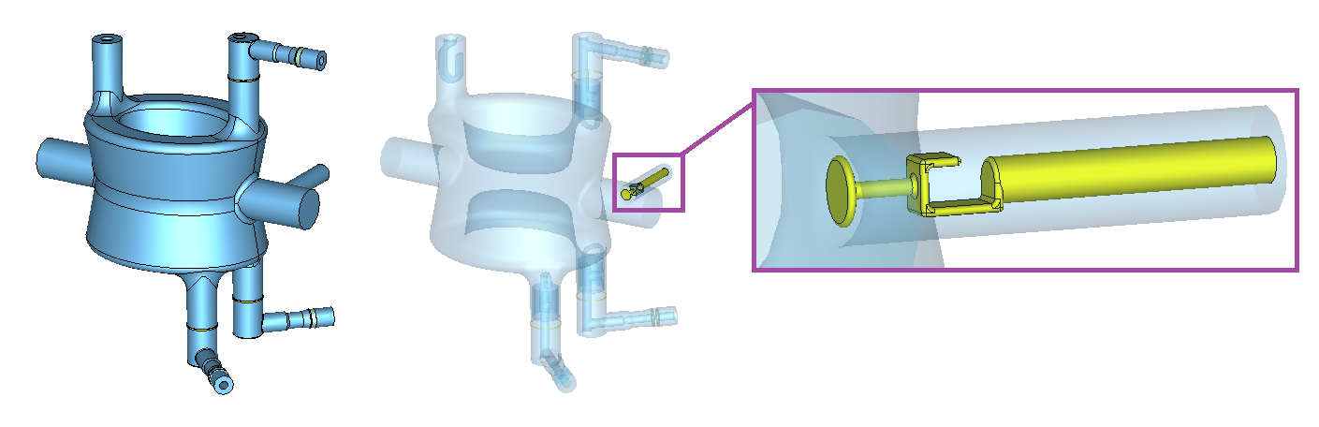
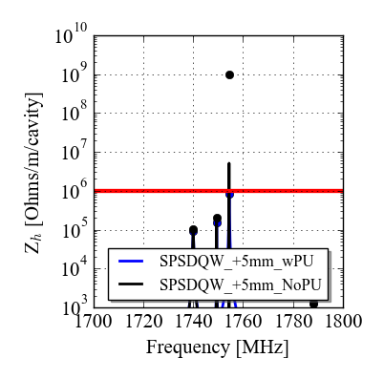
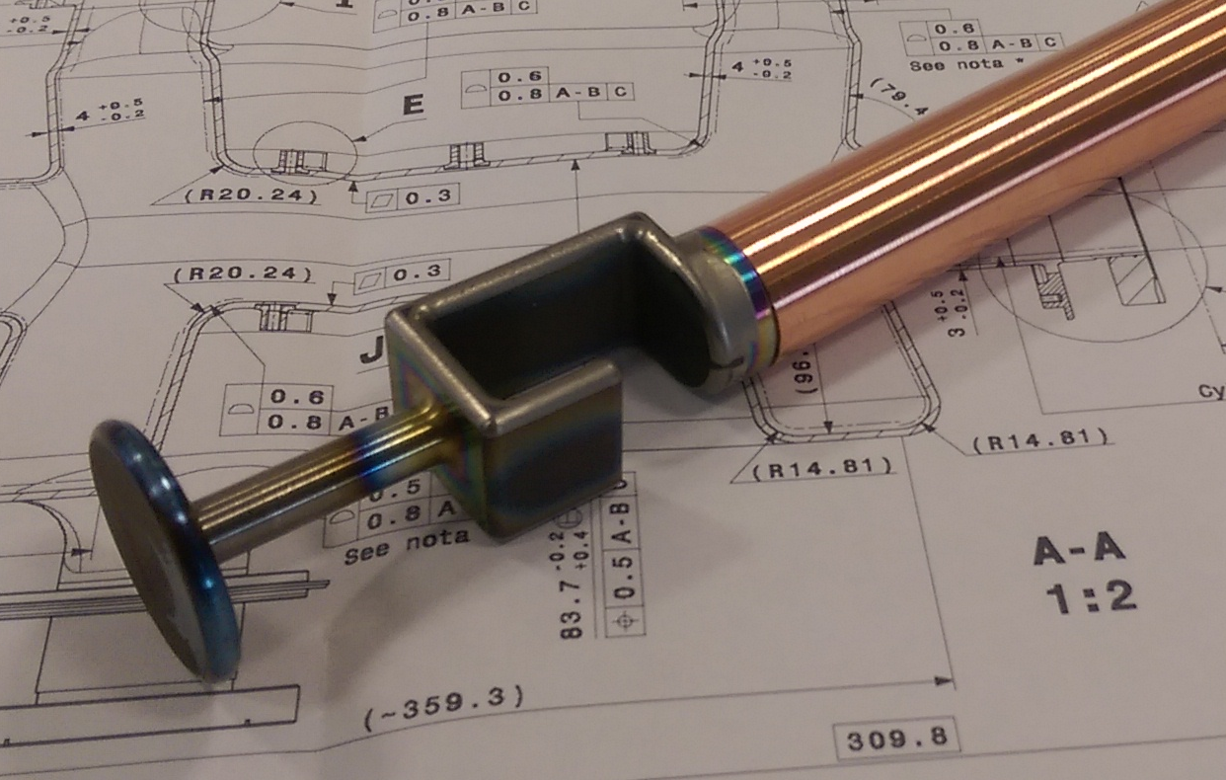
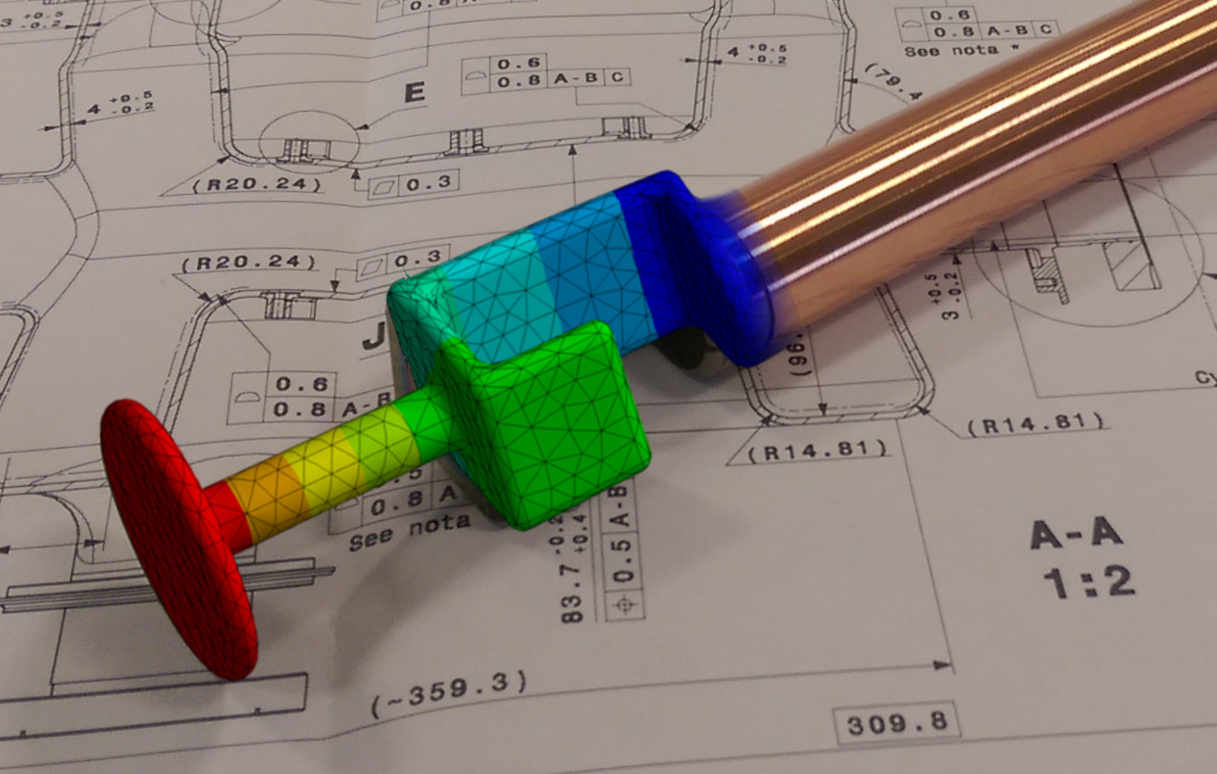
Ancillaries: Field probe as fourth HOM coupler
The pick-up is designed extract 1 W at the fundamental mode frequency → Q_{e} = 1.6 x 10¹⁰.
It is also a HOM coupler for the 1.75 GHz mode → cannot couple to this mode with HOM couplers.
The PU is made from Nb and Cu to avoid heating.

Slide 5
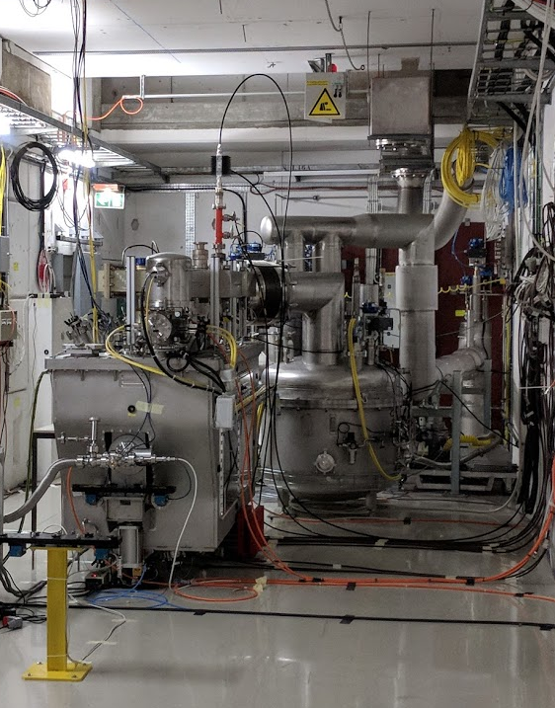
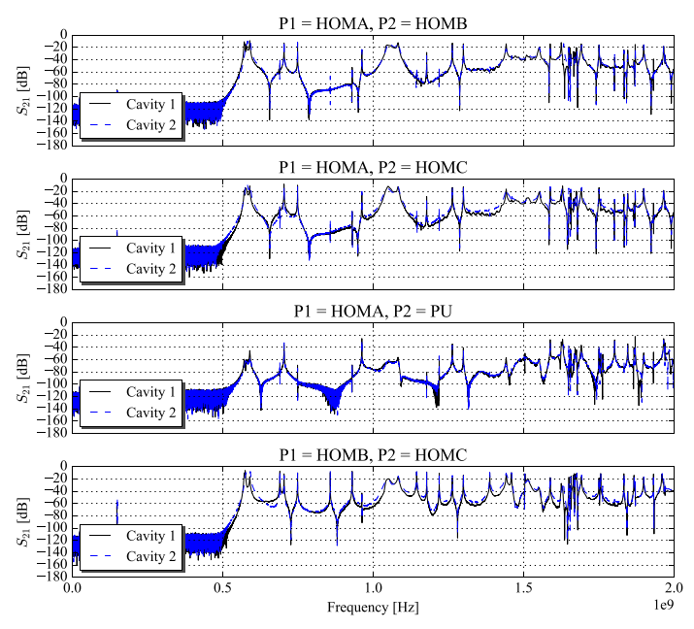
Mode measurements
Transmission measurements using VNA in cryomodule cold test in M7 buncker.

Slide 6
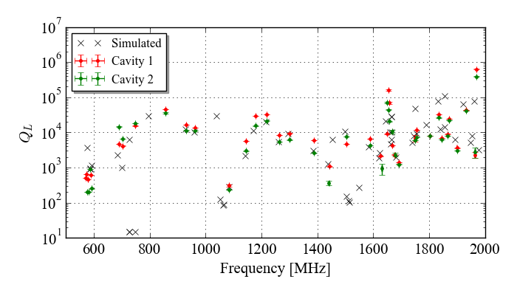
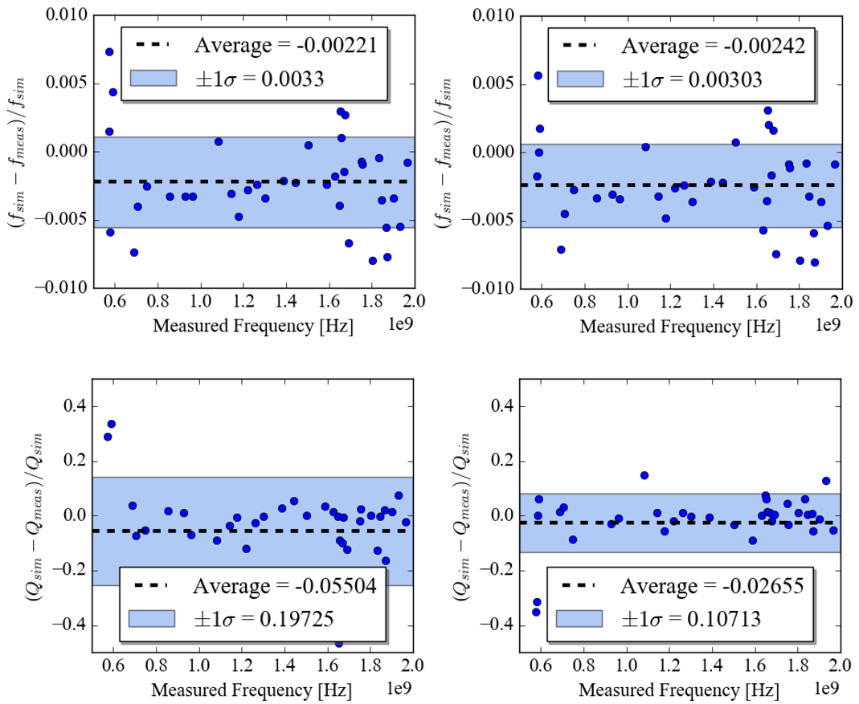
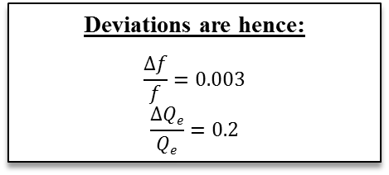
Mode measurements
Transmission measurements using VNA in cryomodule cold test in M7 buncker.
Deviations are hence:
$$\frac{Δf}{f}=0.003$$
$$\frac{ΔQe}{Qe}=0.2$$

Slide 7
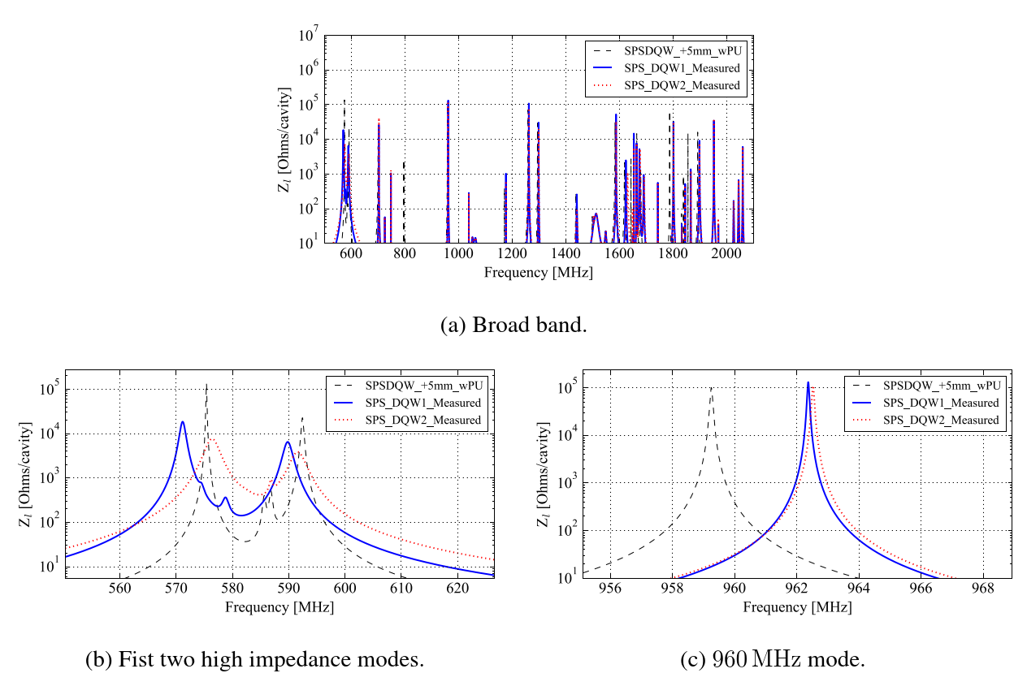
Modified impedance spectra
Impedance spectra:
  Frequencies and Q_{e} values are known for a large number of modes.
  Simulated spectra altered for both cavities.
  Note, remembering to use the +5 mm simulation results!
For both cavities the 960 MHz mode has increased in frequency.
From BELOW to ABOVE the harmonic!
This shows it is feasible for the mode to be excited by the 24th harmonic at 25 ns bunch spacing.

Slide 8
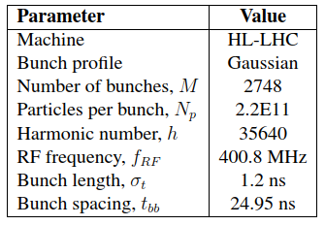
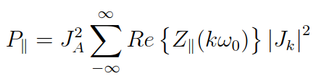
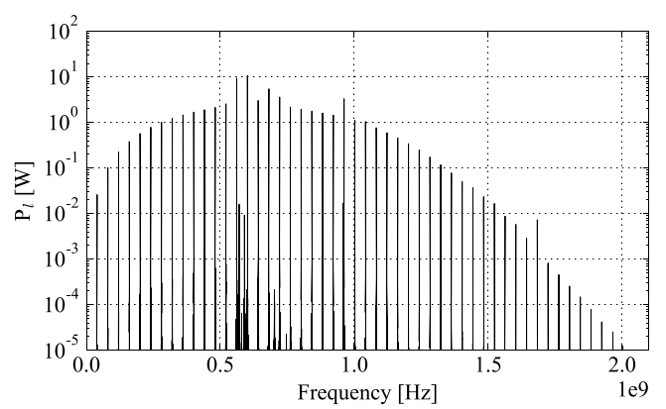
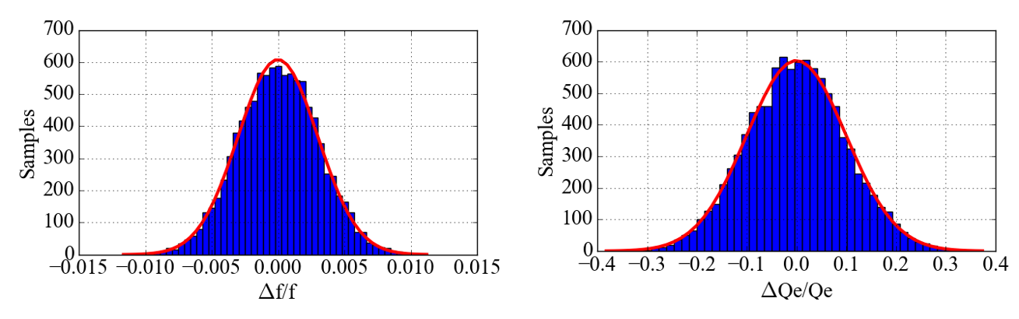
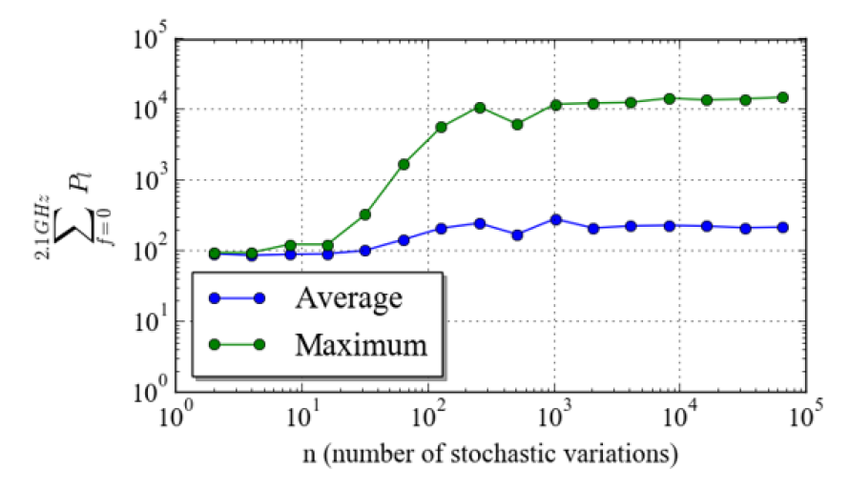

HOM power: effect of frequency and Q_{e} shift
Using SPS HOM coupler and HL-LHC parameters:
$$ΣP<100 W$$
However, the frequency and Q_{e} of the modes can change.
Stochastically varying these two parameters, a worst-case power can be calculated.
13 times larger than 1 kW limit.
Due to mode at 960 MHz – coupler needs to be altered.

Slide 9
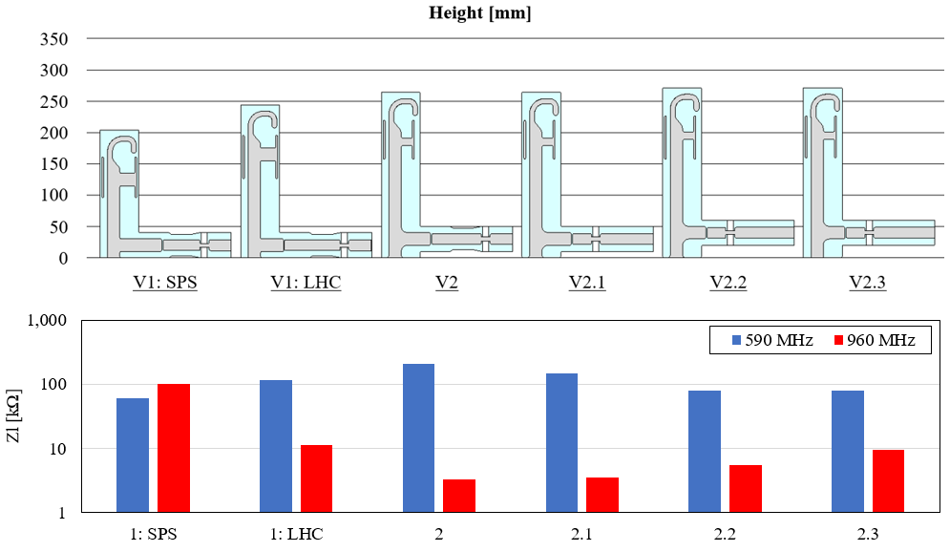
Re-design
The coupler should be altered to:
  Improve ease of manufacture (not thoroughly detailed in this presentation).
  Reduce transverse impedance below threshold.
  Reduce maximum foreseeable HOM power to below 1 kW.
Assembly constraints…
Presented at HiLumi’17

Slide 10
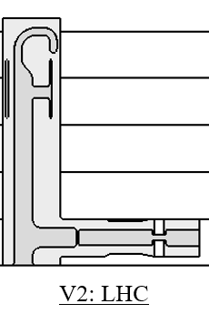
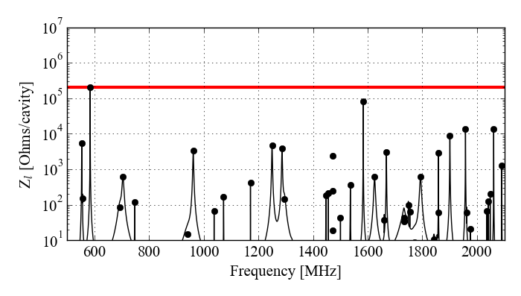
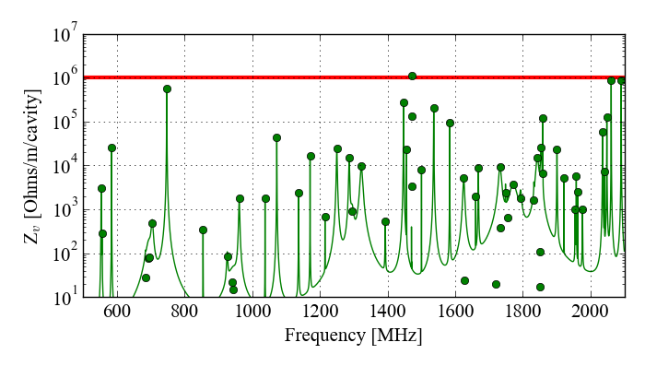
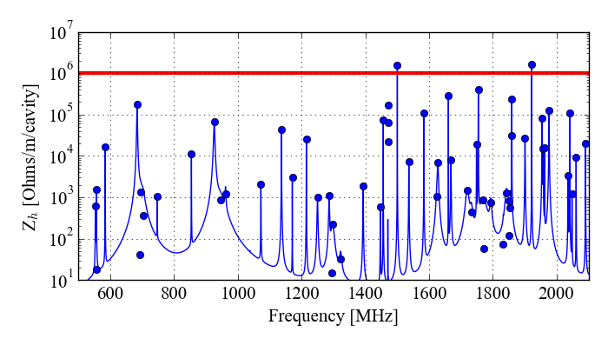
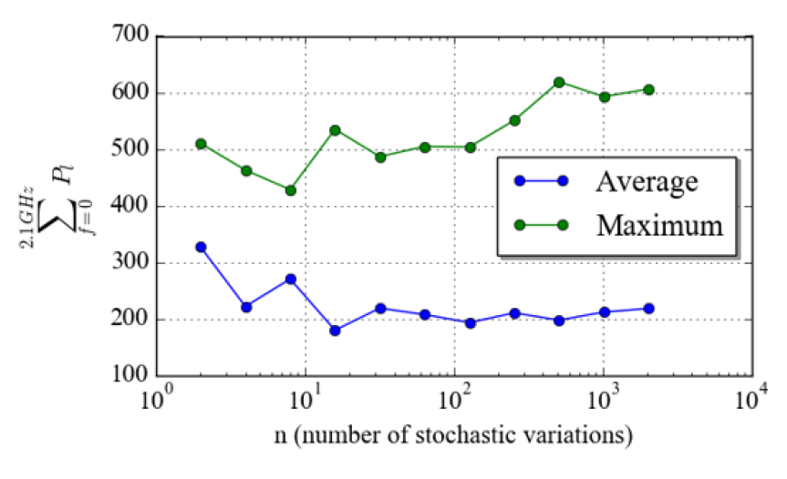
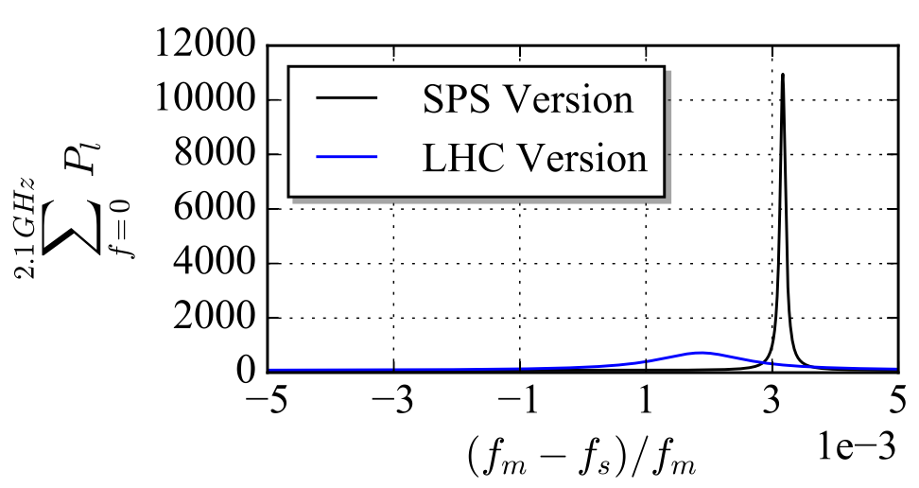
DQW HOMC V2
Impedance
Power
Highest power still a result of the 960 MHz mode.
If we vary this mode in frequency:

Slide 11
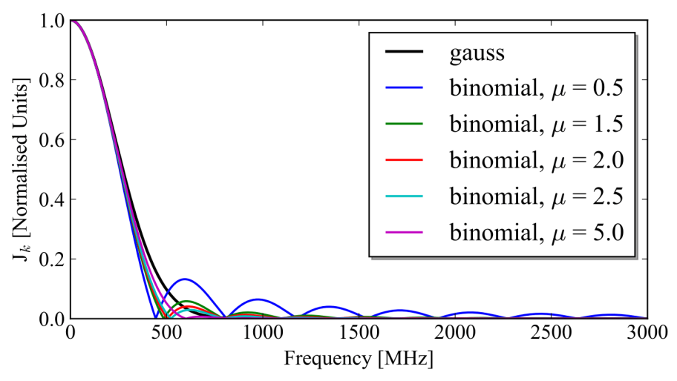
Measurements with beam
Measurement aims:
  Validate we can predict HOM power accurately.
  Validate we have not ‘missed modes’ in simulation.
  Validate power increases with intensity (and bunch number) as expected.
A binomial distribution was initially used to represent the bunch profile.
H1
H2
H3

Slide 12
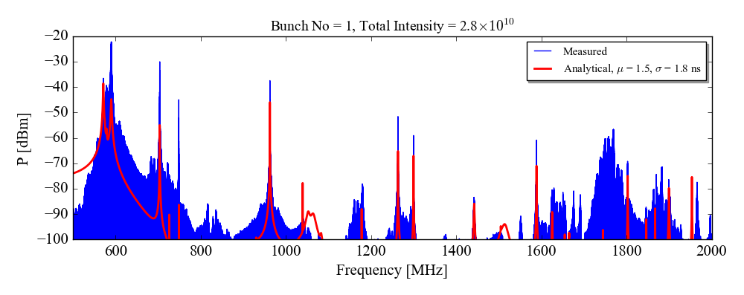
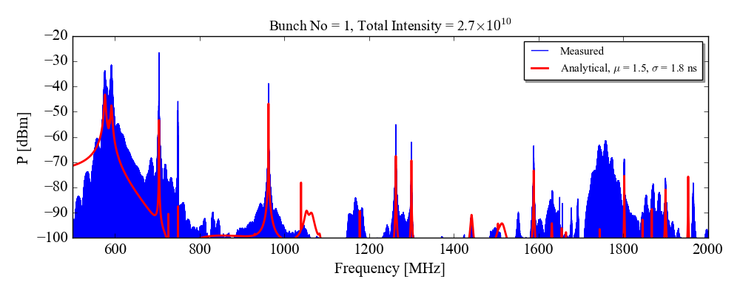
Meas. with Beam: Single Bunch
27/08/2018: MD4
Cavity 1 - HOMC1
Cavity 2 - HOMC1
Analytic underestimates
Unforeseen power at 1.8 GHz

Slide 13
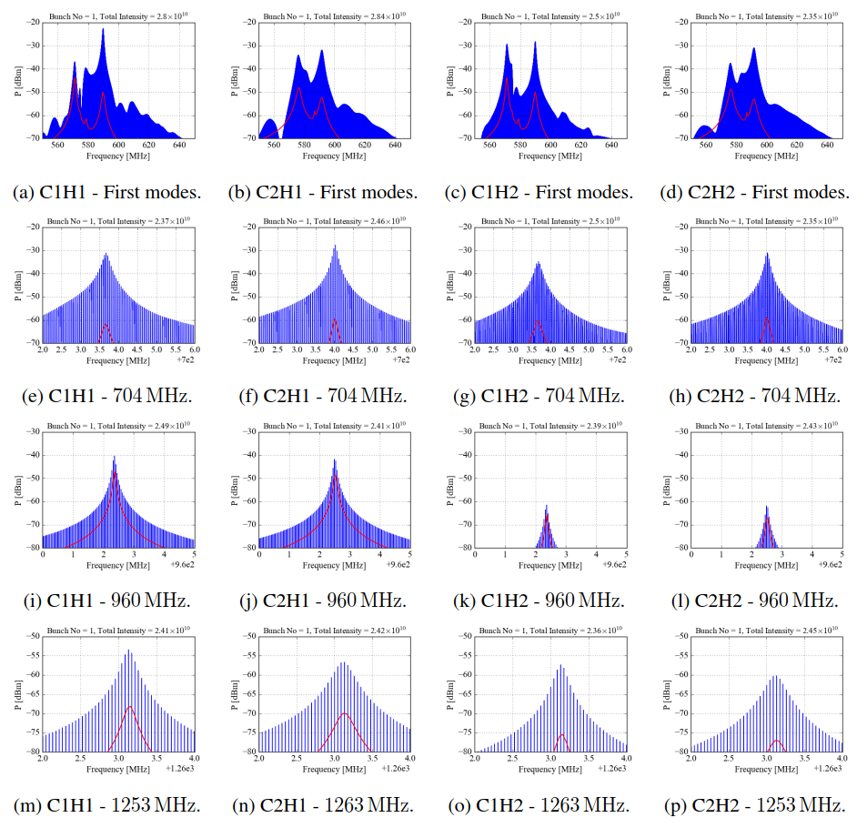
Meas. with Beam: Single Bunch
27/08/2018: MD4
Mode [MHz]
Top HOM Coupler
Bottom HOM Coupler
580
704
960
1263
High resolution narrow band scans also taken on high Z_{l} modes.
Analytic under-represents power in all cases.
Large coupling difference seen between modes.

Slide 14
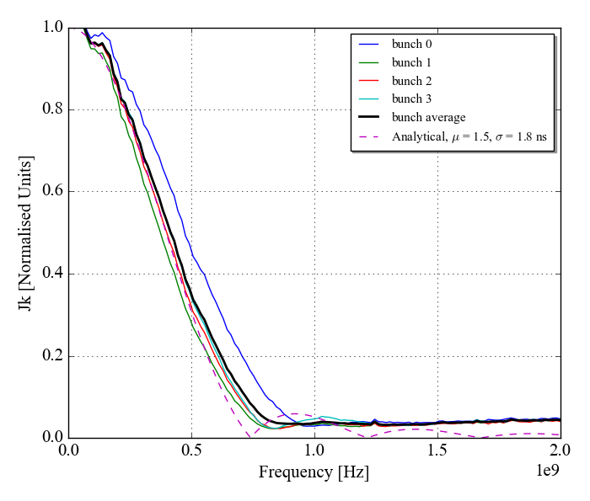
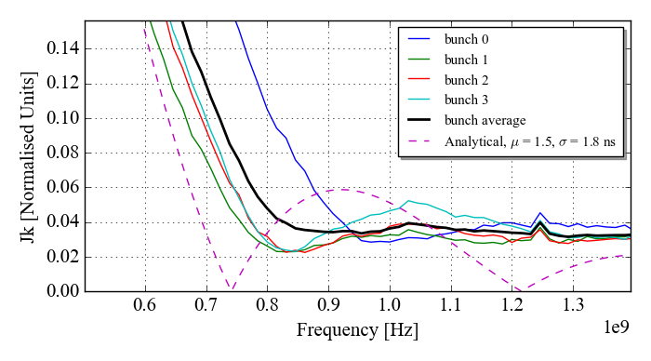
Meas. with Beam: Measured Profile
05/09/2018: MD5
To evaluate whether the beam profile was the cause of the underestimation.
In the following crab cavity test (MD5) the bunch profile was measured during the coasts.
This time multiple bunches were used with a bunch spacing of ~ 525 ns.
Courtesy of M. Schwarz

Slide 15
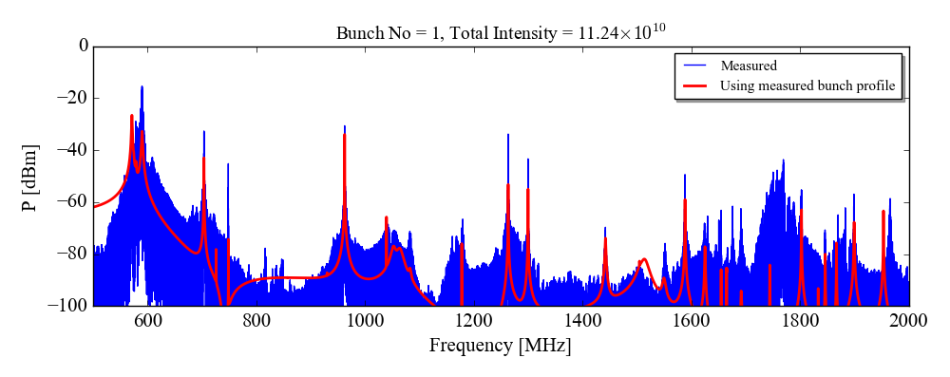
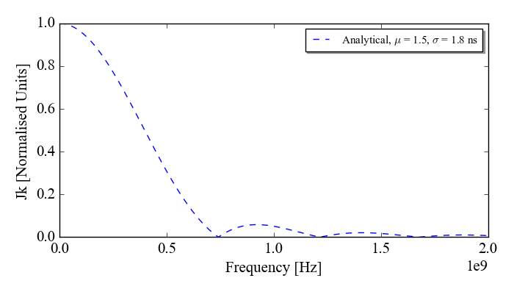
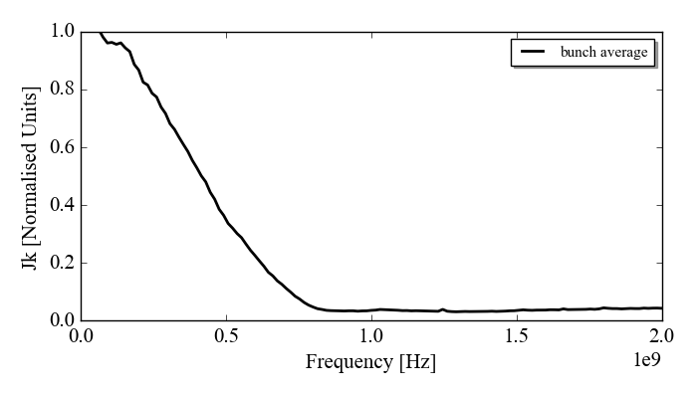
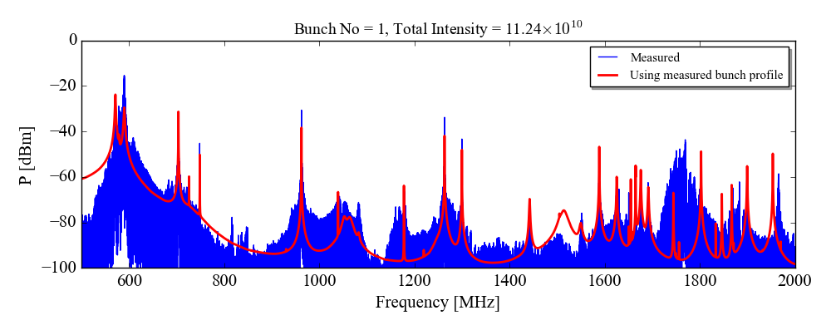
Meas. with Beam: Measured Bunch Profile
05/09/2018: MD5
Predicted is total power, not accounting for intra-coupler power flux.
There are still discrepancies between the measured and analytical.
This is under investigation:
  Cable transfer function, mechanical position of HOM couplers, calibrations, bellows etc…

Slide 16
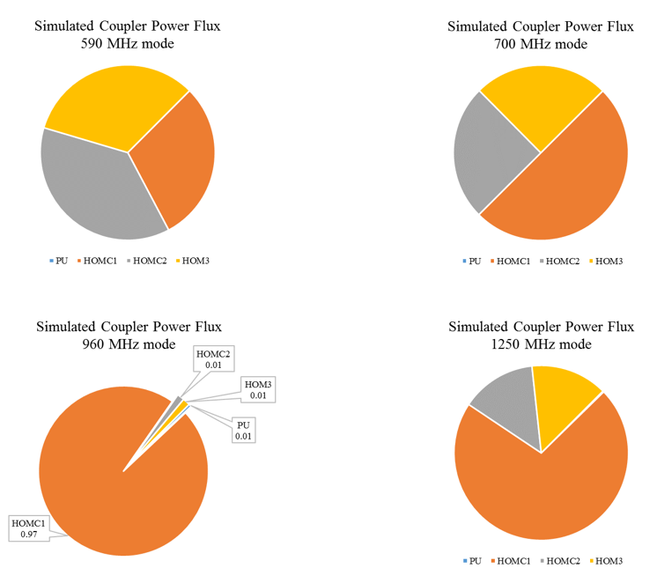
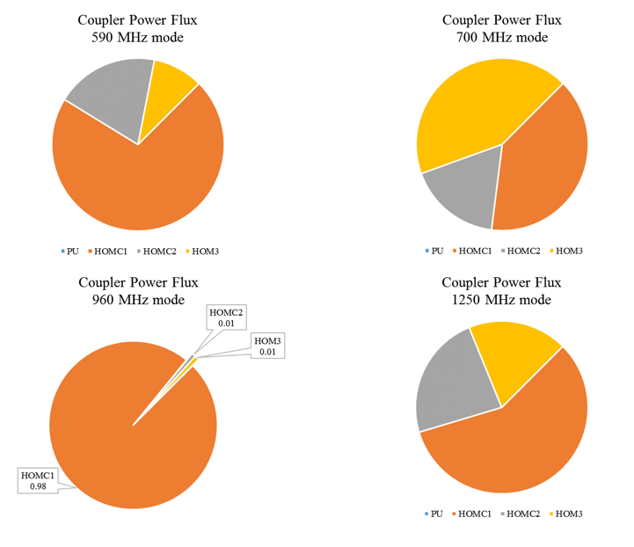
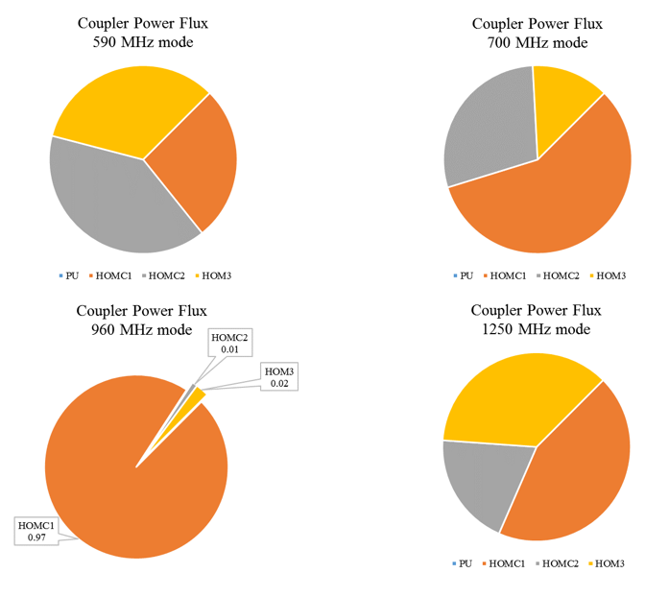
Meas. with Beam: Power Distribution
H1
H2
H3
Measured power ratio for 4 high longitudinal impedance modes.
Cavity 1
Cavity 2

Slide 17
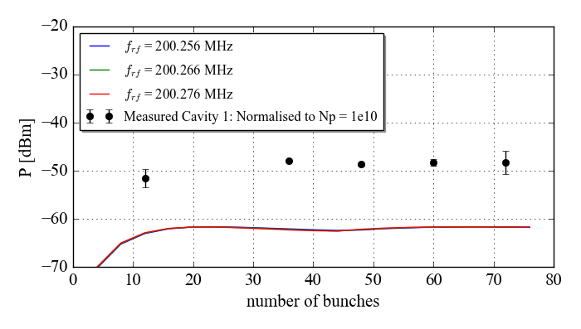
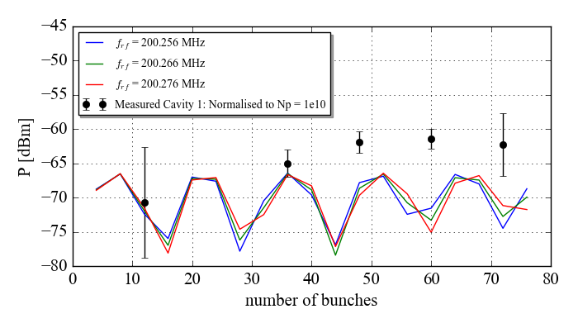
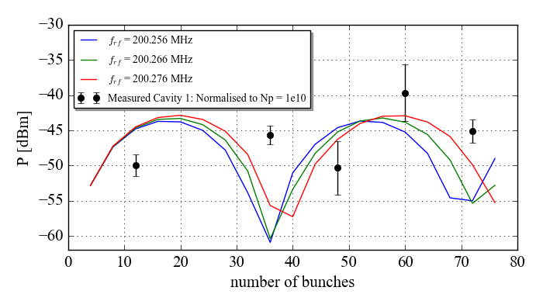
Meas. with Beam: Multibunch
27/08/2018: MD3
Cavity 1
590 MHz
700 MHz
960 MHz
590 MHz mode is underestimated by > 10 dB.
Using measured profile could account for 5 dB.
Q or R/Q is underestimated.

Slide 18
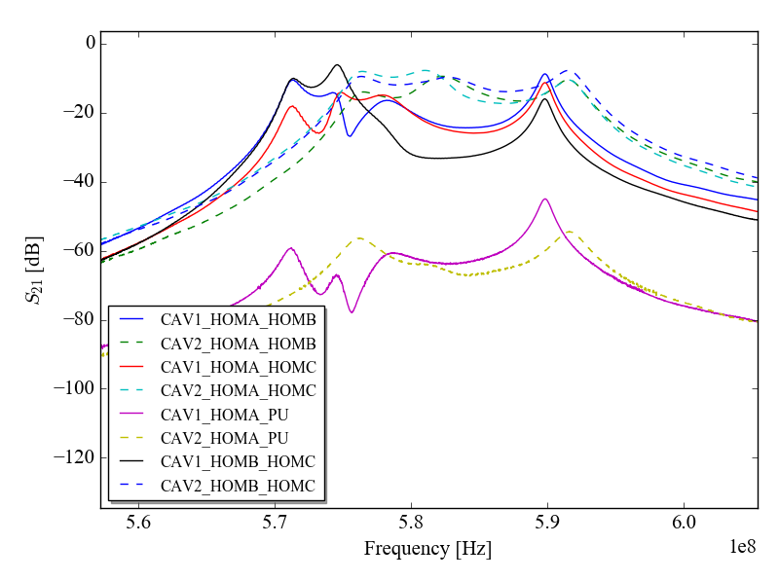
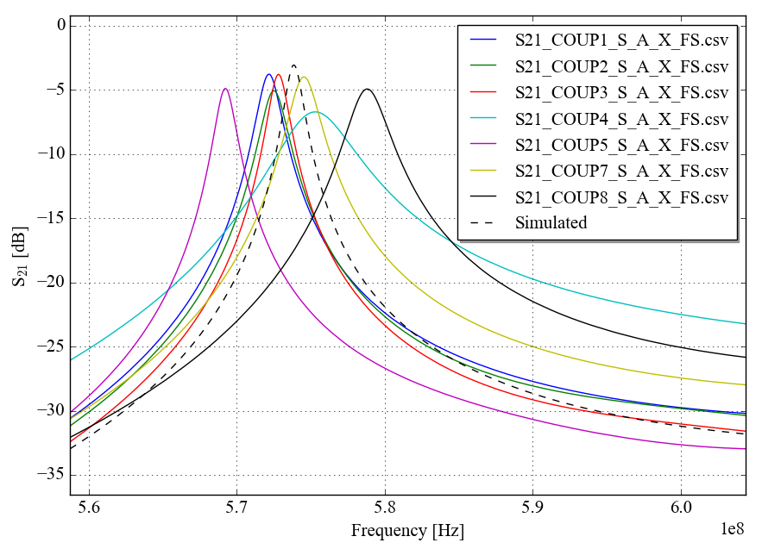
First HOMs
590 MHz mode is higher in power than predicted by > 10 dB
Decrease in damping:
  Transmission measurements on cavity show the difference between cavities.
  Test box measurements show a large deviation in the coupler’s ‘transfer function’.
  Tolerance on LHC couplers should be larger.
Notes:
X-scale
Differences in coupling – under investigation

Slide 19
Conclusions
LHC HOM Coupler in final stages.
  Files stored with CST models on EDMS.
HOM Power compared with single-bunch and multi-bunch.
  Under-represented by analytic bunch profile.
Notable Observations:
  960 MHz is dominant mode for power and > 95 % through top HOM coupler.
  590 MHz mode is 10 dB higher than expected.
  High frequency power not expected – being investigated.

Slide 20
Update on DQW Multipoles
J. A. Mitchell
131st HL-LHC WP2 Meeting
CERN-Internal, 25th September 2018

Slide 21
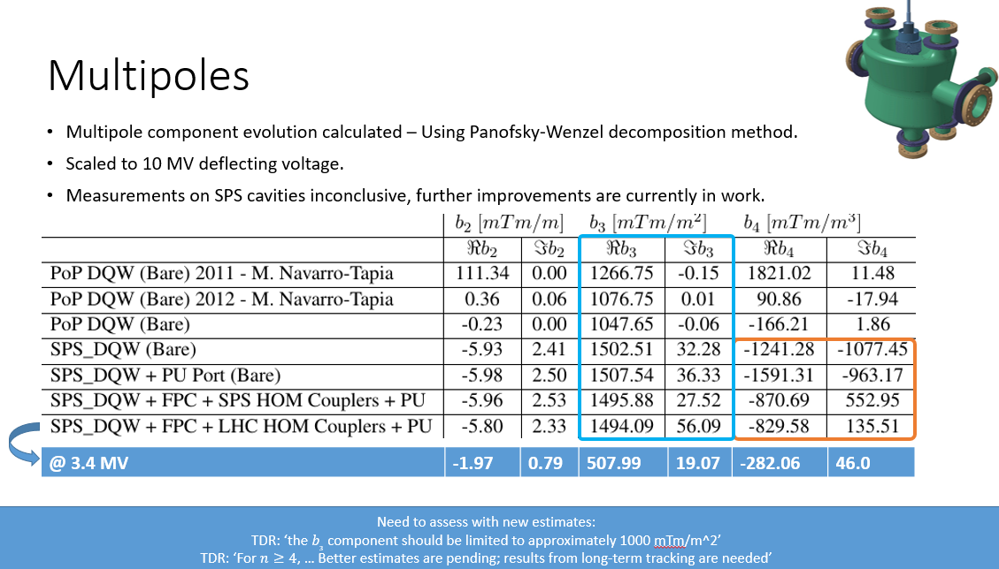
Simulations
WP2 Meeting, 22nd May 2018: Main comments
Does the b3 increase so much with the new ports?
Is the large increase in b4 realistic?

Slide 22
Simulations
Units: mTm/m^{(n-1)}
Benchmarked with another person.
VT = 10 MV | re{b2} | im{b2} | re{b3} | im{b3} | re{b4} | im{b4}
Panofsky Wenzel @ 25 mm | -6 | 2 | -1494 | -56 | -830 | 135
PW @ 30 mm | -6 | 3 | -1491 | -19 | -466 | 629
LF @ 30 mm | -6 | 3 | -1505 | -32 | -575 | 498
K. Papke
b3 is realistic and greater than specified 1000 mT/m².
b4 needs investigation into radial convergence.

Slide 23



Measurements
Azimuthal bead-pull measurements using metallic and dielectric needles.
We are able to measure the b1 and b3 components.
Working to evaluate to what accuracy we can measure them to.
Courtesy of Paul-Francois Gapais (see summer student report).

