Slide 1

Transverse Emittance growth with crab cavity RF noise
P. Baudrenghien, CERN, BE-RF
T. Mastoridis, California Polytechnic State University, San Luis Obispo, USA
E. Yamakawa, University of Lancaster, Lancaster, UK
Presented by L.R. Carver, University of Liverpool, Liverpool, UK
WP2 meeting on HL-LHC crab cavities, Sept 25th 2018

Slide 2
Warning…
The numbers presented here are “raw values”, as measured during the MD, with no post-analysis
Worth noting is the difference of definition of emittance between the calculated (from noise power spectral density) and measured (from wire scanners):
  Calculated computes the rms value of the transverse distribution from beam parameters and measured noise spectrum (formulas on slide 4)
  Measured gives the sigma square value of a Gaussian fit (plus offset and baseline tilt fit) to the measured transverse distribution.

Slide 3
Data taking
MD5 occurred on Sept 5th 2018
Coasts at 270 GeV/c with 4 bunches (~3e10 ppb, 4σt=1.8 ns)
CC1 idling (no RF), CC2 field at ~1 MV
4 coasts with some varying settings during each coast.
Transverse emittance measured with Wire Scanners (Lee)
  Average emittance over 4 bunches is used
RF noise added vectorially -> always a mixture of phase and amplitude noise. Tried to minimize amplitude noise. Phase noise was always dominant
RF noise (PM and AM) covered a band from DC to 10 kHz only -> excites the first betatron band only (around 8 kHz)
CC2 phase and amplitude noise Power Spectral Density measured with Signal analyser
ADT off, 800 MHz off, longitudinal feedback and damper off.

Slide 4
Calculations. Unnormalized Emittance
Phase noise
Beam parameters
Geometric factor (bunch length)
Depends on the overlap between phase noise spectrum and betatron tune distribution
Noise spectrum is aliased at f_{rev}
The “phase-noise geometric factor” decreases with bunch length
Depends on the overlap between phase noise spectrum and synchro-betatron tune distribution
The “amplitude-noise geometric factor” increases with bunch length.
Amplitude noise
  See P. Baudrenghien and T. Mastoridis, “Transverse emittance growth due to rf noise in the high-luminosity lhc crab cavities,” Phys. Rev. Accel. Beams 18, 101001 (2015).https://journals.aps.org/prab/abstract/10.1103/PhysRevSTAB.18.101001

Slide 5
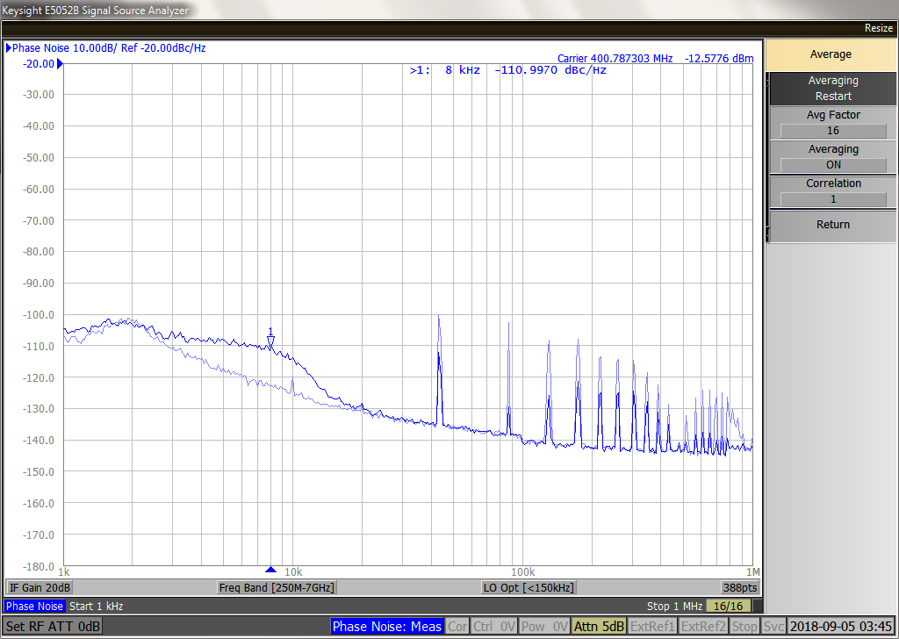
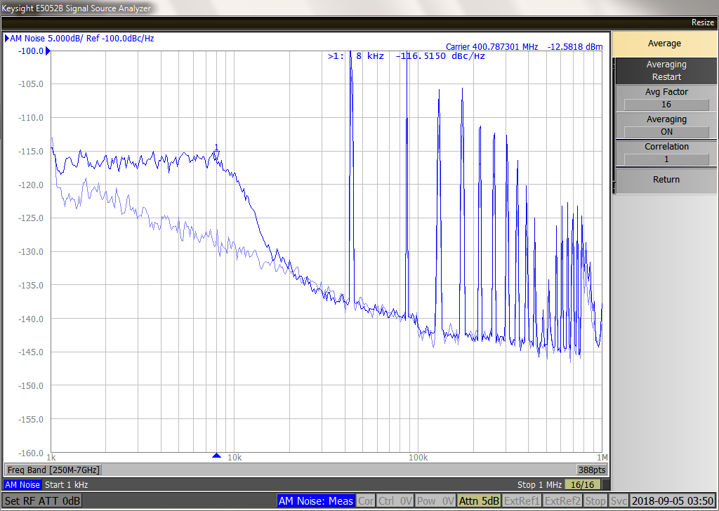
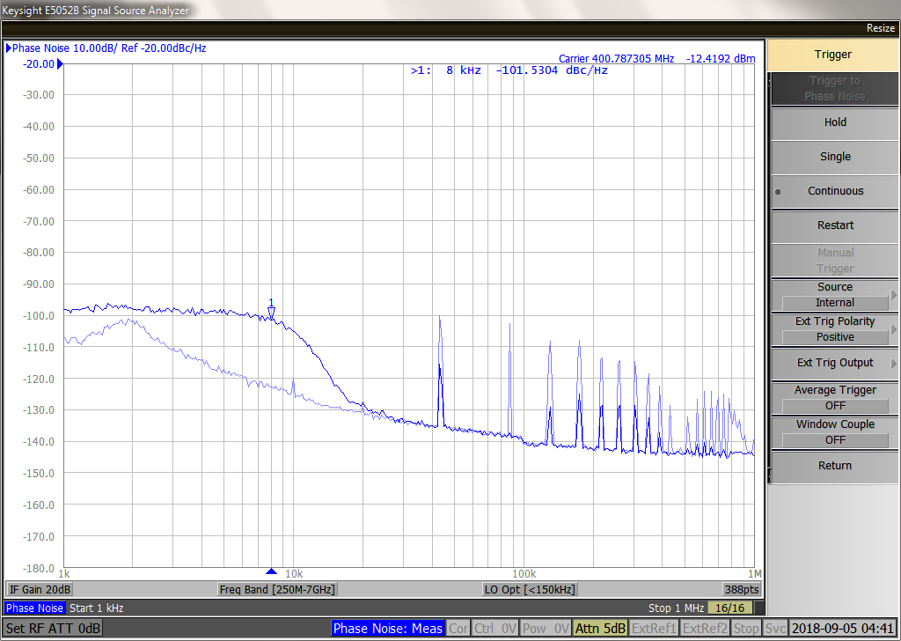
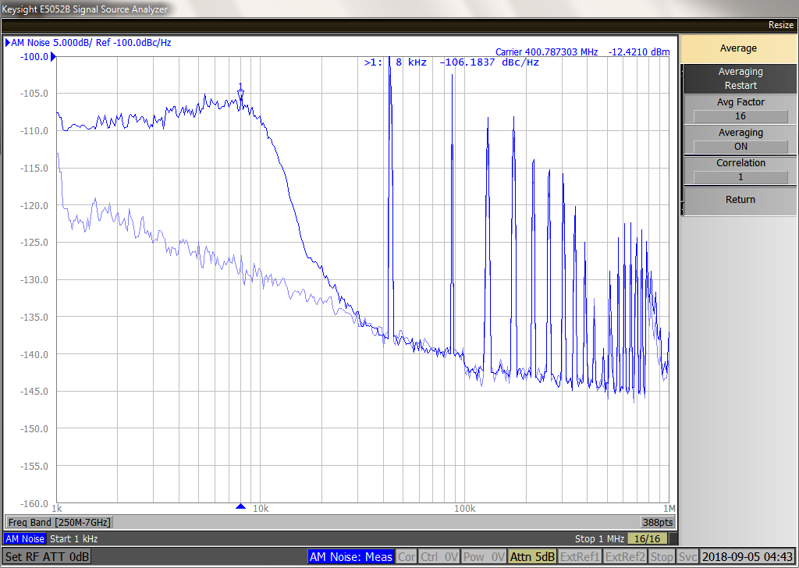
Noise spectra measured in Ant CC2
Phase noise, 10 dB/div,
excitation power P
No excitation
No excitation
AM noise, 5 dB/div,
excitation power P
Phase noise, 10 dB/div,
excitation power 10 P
No excitation
No excitation
AM noise, 5 dB/div,
excitation power 10 P
Left: Phase noise PSD. Right: AM PSD. 1 kHz – 1 MHz
Top: -10 dBm excitation, bottom: 0 dBm excitation (10 times more power)
Background trace shows PSD without noise injected. The marker is on the betatron line (8 kHz)
The frev lines are generated by the beam

Slide 6
Results
The agreement is very good for low noise level (small growth rate)
At high levels the calculations over-estimate the growth by factor 2-4
The x-axis is the Phase Noise PSD. Although always smaller, the Amplitude Noise PSD varied during the successive coasts. This explains the different calculated values for very similar Phase Noise PSD, and may partly explain the different measured emittance growth
Still, at high levels the measurements give very different values for coasts with similar measured noise PSD
If we assume a linear dependence with noise power (dotted lines) the calculated values are about three times bigger than measured
Measured (Wire Scan) and calculated (eq. slide 5 using measured spectra) during the coasts with different noise levels.

Slide 7
Plans
Hardware:
  Upgrade firmware to inject exclusively phase or amplitude noise (implemented in LHC)
Data analysis/taking:
  Analyse raw wire-scanner profiles. Do we see tails at high excitation levels that may explain the factor 2-3 difference?
  Compare sigma using Gaussian fit to true rms value
  Confirm with BSRT
More will be presented at the HL-LHC coordination meeting in October

