Slide 1


SPS Crab Cavity MDs
Preliminary MD Results
Lee Carver
With significant input from:
H. Bartosik, P. Baudrenghien, T. Bohl, A. Butterworth, R. Calaga, M. Carla’, W. Hofle, T. Levens, B. Lindstrom, T. Mastoridis, J. Mitchell, G. Papotti, J. Storey, G. Trad, N. Triantafyllou, S. Verdu Andres, E. Yamakawa & all other teams involved in the installation and support of the project
WP2 - 25 September 2018 - CERN

Slide 2
Introduction
5 MDs have occurred. 2 MDs remain.
Updates have been presented at two different MSWG meetings
  https://indico.cern.ch/event/735504/
  https://indico.cern.ch/event/747394/
Will highlight some of the main observations and outline plans for the last 2 MD slots.
The presentation will not be chronological. See MSWG presentations for time-based linear progression.

Slide 3
Overview
MD #1: 23/05/18
  First crabbing of protons. Some phase and voltage scans to understand measurements.
MD #2: 30/05/18
  First ramp to 270 GeV, some attempted studies for a3 and electrical centering but not conclusive.
MD slot on 11/07/18 had to be cancelled due to cavity-cryo issues
MD #3: 18/07/18.
  Issues with cavities meant limited performance. Performed first part of intensity ramp at 26 GeV.
MD #4: 27/08/18
  Focused on coast setup and first emittance growth measurements.
MD #5: 05/09/18
  Explored effect of LLRF noise on emittance growth.

Slide 4
Overview
MD# | Highlights | C1 Peak Volt. [MV] | C2 Peak Volt. [MV] | CM Temp. [K]
1 | First crabbing, phase and voltage scan. | 0.2-0.3 | <0.05 | 4.5
2 | Ramp to 270 GeV, betatron excitation, interesting loss cases. | 1-2 | <0.05 | 4.5
3 | Prelim. a3 measurements, dinosaur losses, intensity ramp, HOM signals | 1 | ~0.3 | 4.5
4 | Setup of crabs for coast cycle. Initial emittance growth coasts. | 1.0 | 0.5 | 2
5 | Emittance growth in coast with and without noise. | 0 | 1 | 2

Slide 5
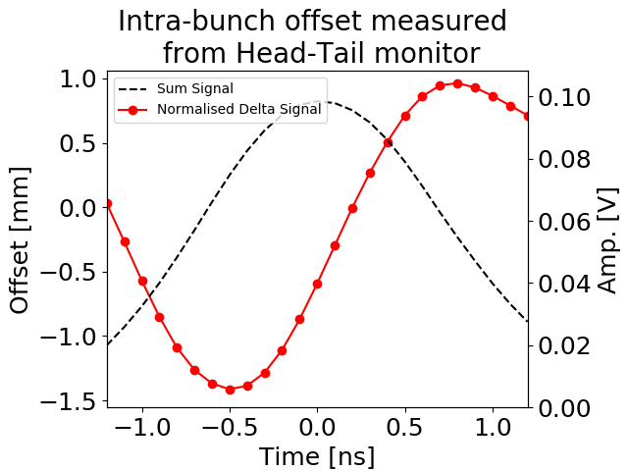
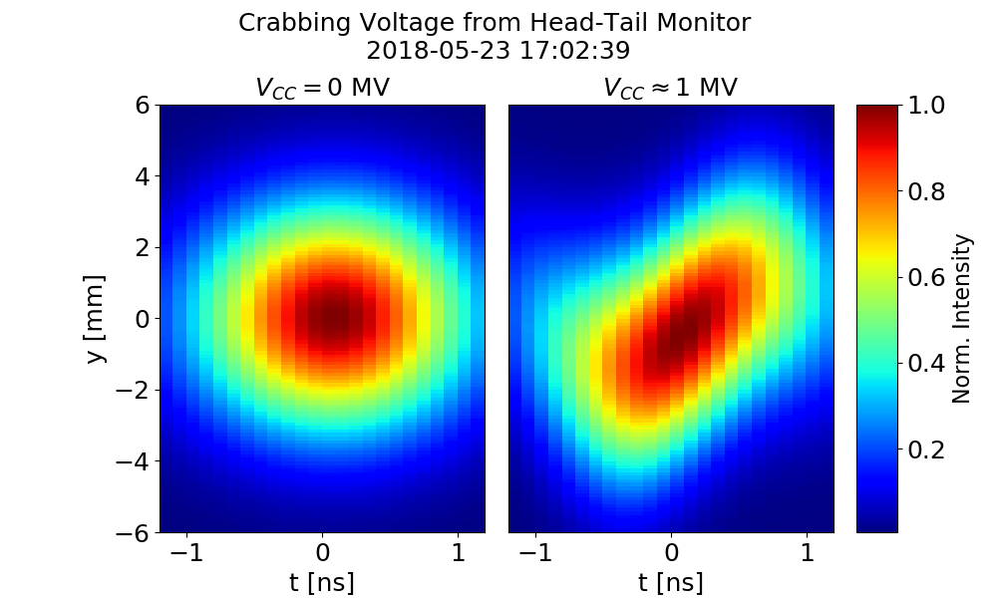
Crabbing: Head Tail Monitor
Crabbing is measured using the Headtail monitor (BPCL.42171).
Background signal is measured at start of every cycle before synchronisation is achieved between main RF (200 MHz) and crab cavities (400 MHz).
  See backup slide for more information on timings.
Background is subtracted from measurements after synchronisation. Provides only synchronised crabbing signal.

Slide 6
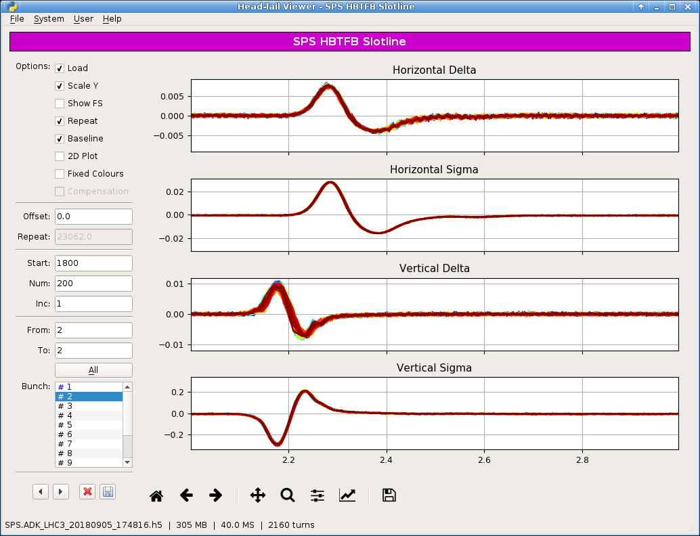
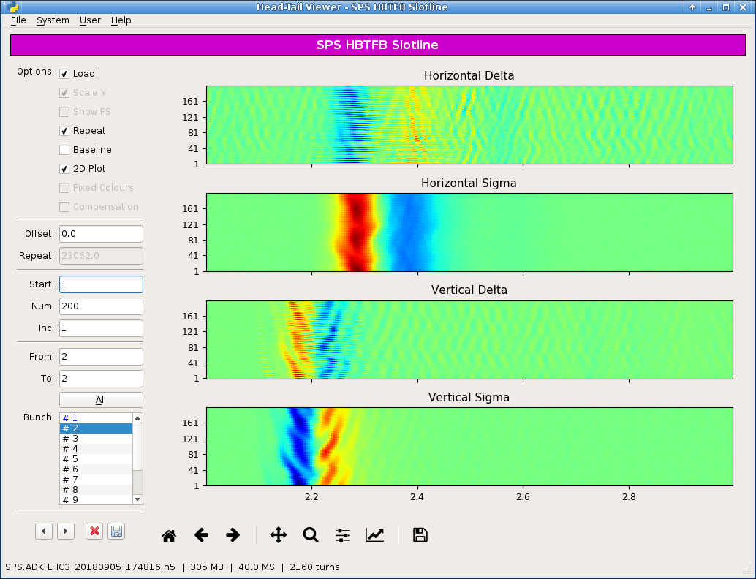
Crabbing: BPW & Slotted Waveguide
Big effort by W. Hofle and T. Levens to setup the slotted waveguide as an intra bunch pickup.
Using the same scope as the HT monitor allowed an easy copy of all HT software.
Identical triggering times for SW and HT monitor. Will attempt to reconstruct crabbing signal from this data.
Available for MD4 and MD5 which was entirely at 270 GeV.
BPW.32101
Slotline

Slide 7
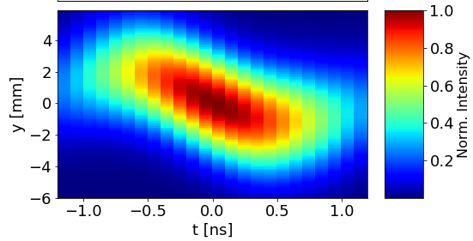
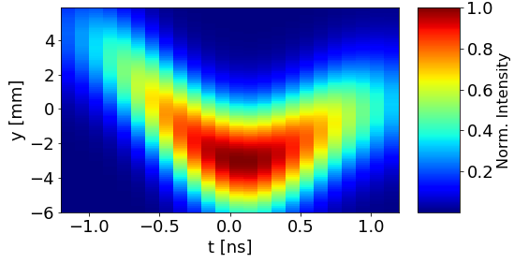
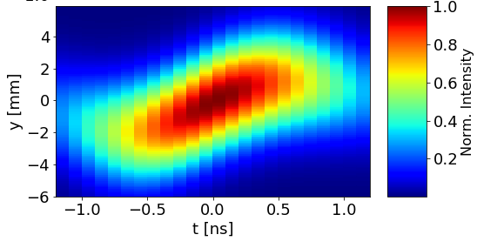
Crabbing: Phase Scan
0 Deg
RF phase scan w.r.t the beam phase with cavity 1
90 Deg
180 Deg
1 MV in cavity 1 (up to 2MV in some cases)
~50 kV in cavity 2, limited by cavity vacuum

Slide 8
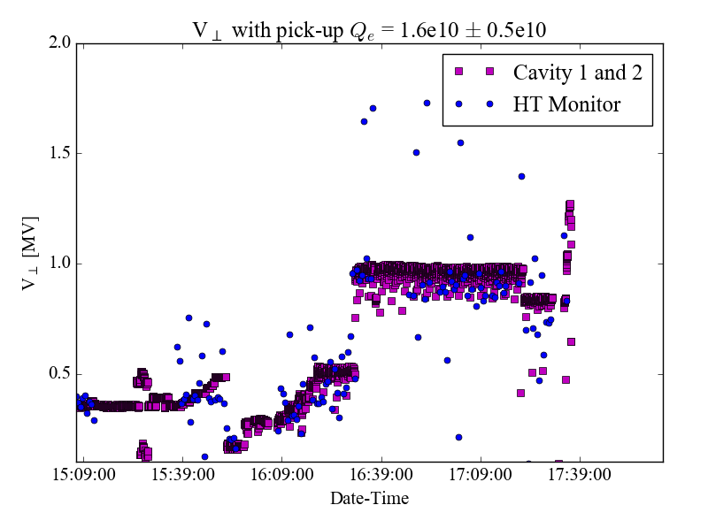
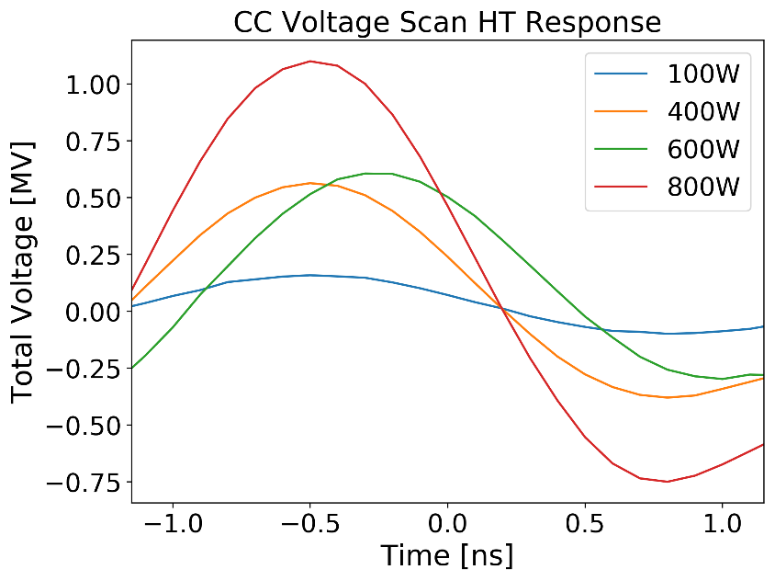
Crabbing: Voltage Scan
CC total voltage calculated from HT monitor vs power sensors on FPC.
Cavity feedback not operational in MD3 so overshoots or undershoots expected.
Reasonable agreement can be found but needs to be repeated.
MD3
MD1

Slide 9
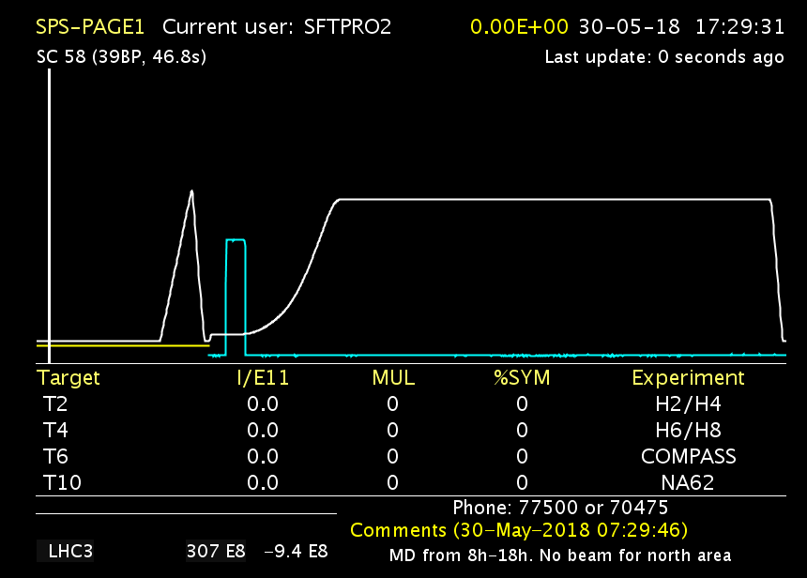
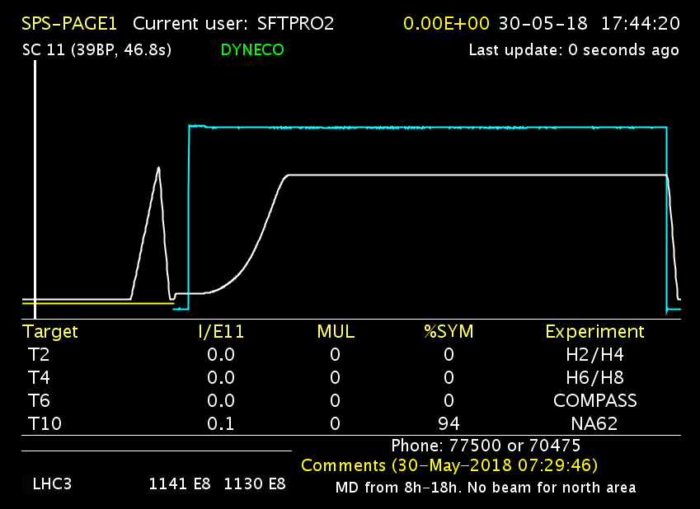
270 GeV Ramp
Cav1 ~1MV (400.787 MHZ), Cav2 off (400.528 MHz)
Beam dumped due to voltage ramp set at start injection
After setting voltage to end of ramp
Successfully reached 270 GeV with no CCs powered during the ramp.
Checked with and w/o transverse feedback for nominal bunch intensities.

Slide 10
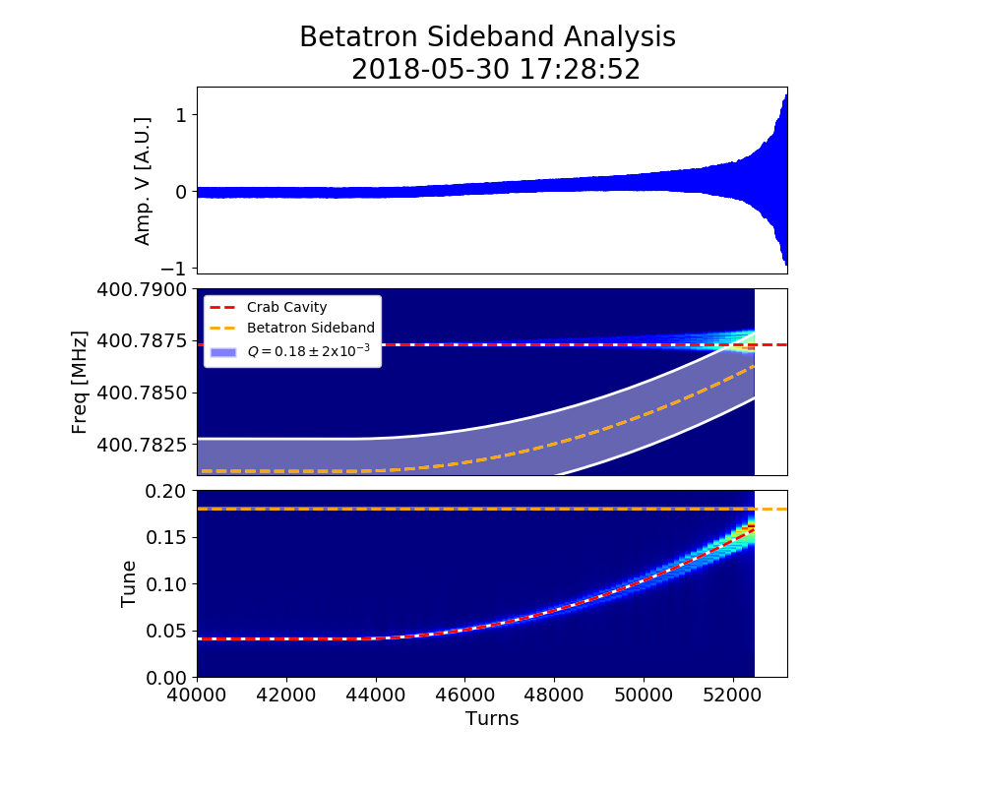
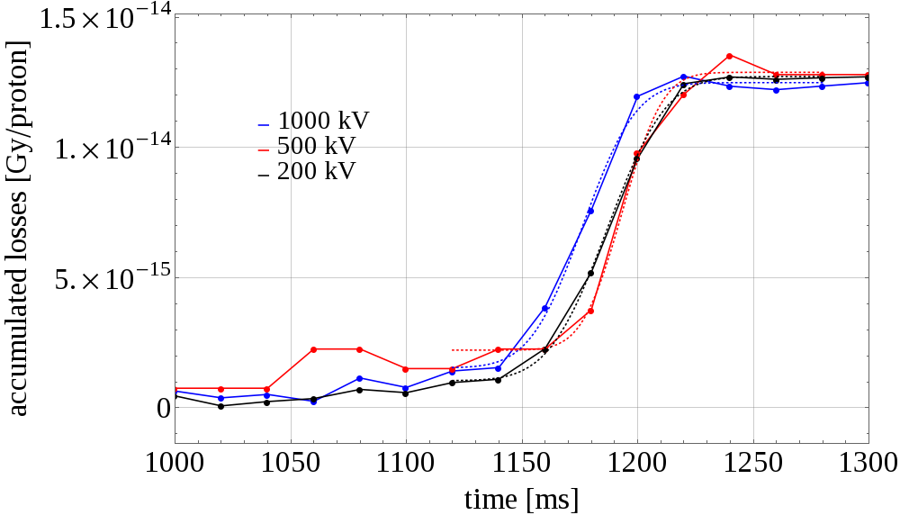

270 GeV Ramp
$Q_{y}=0.18$
Crab cavities not synchronized until flat top (~7s).
Cavities powered to ~1MV from start of the cycle.
Resonant excitation observed as the betatron sideband is crossed.
BLMS 601-607
Loss location determined by orbit & oscillation from crab kick
Examples shown are from different MDs

Slide 11
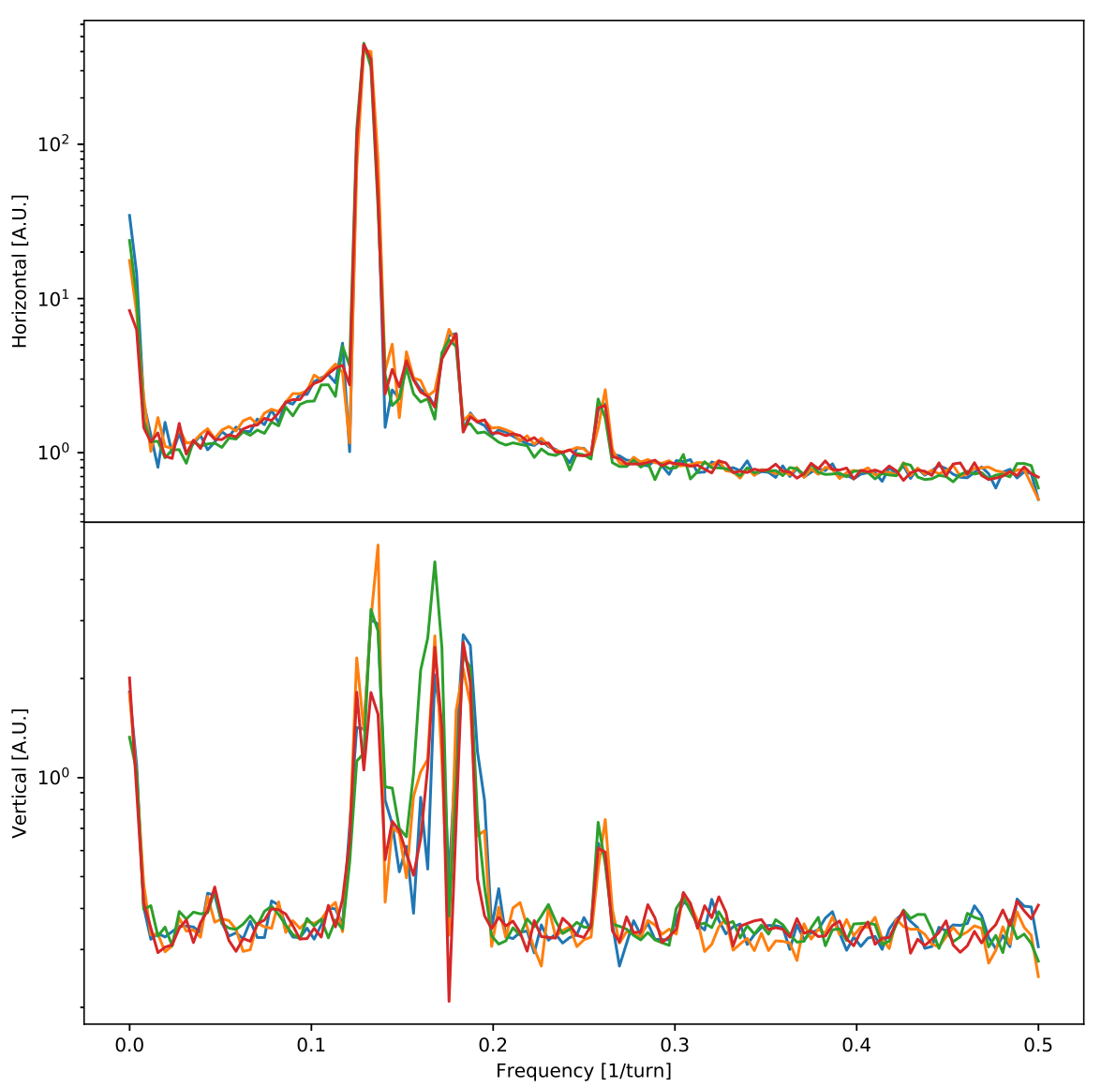
a3 Measurement
Made a first attempt at measuring the a3 from the crab cavities.
Measurements made were clean but conclusions could not be drawn as cavity behaviour was not well controlled.
Will re-measure in MD6 where better conditions are expected.
Kick in H
Qx=0.13
2Qx

Slide 12
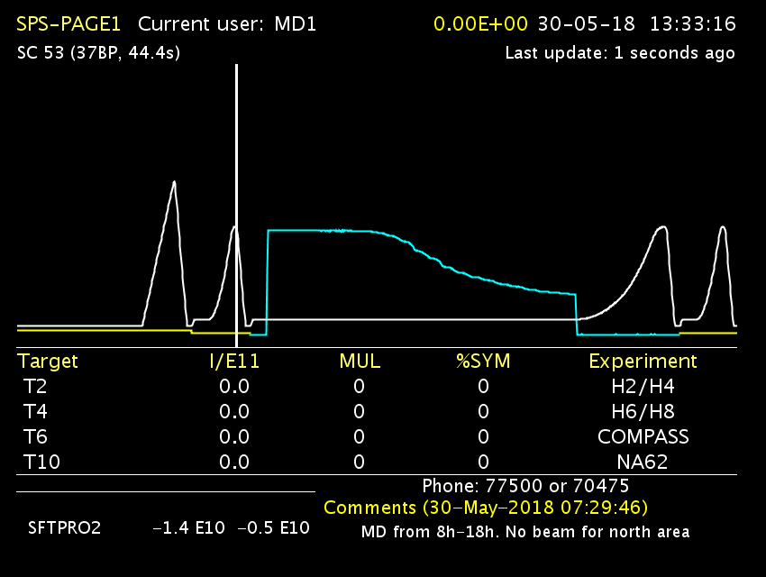
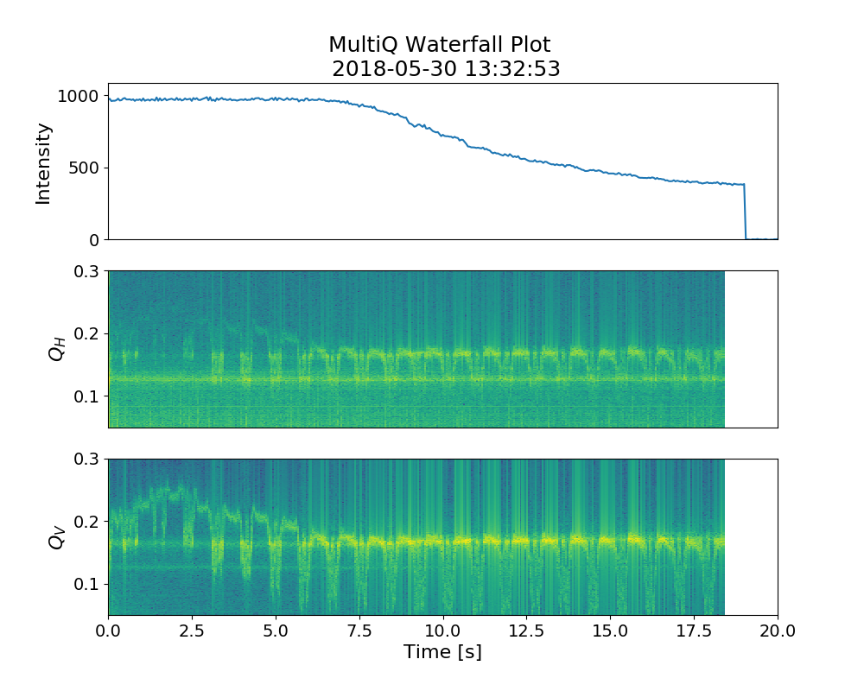
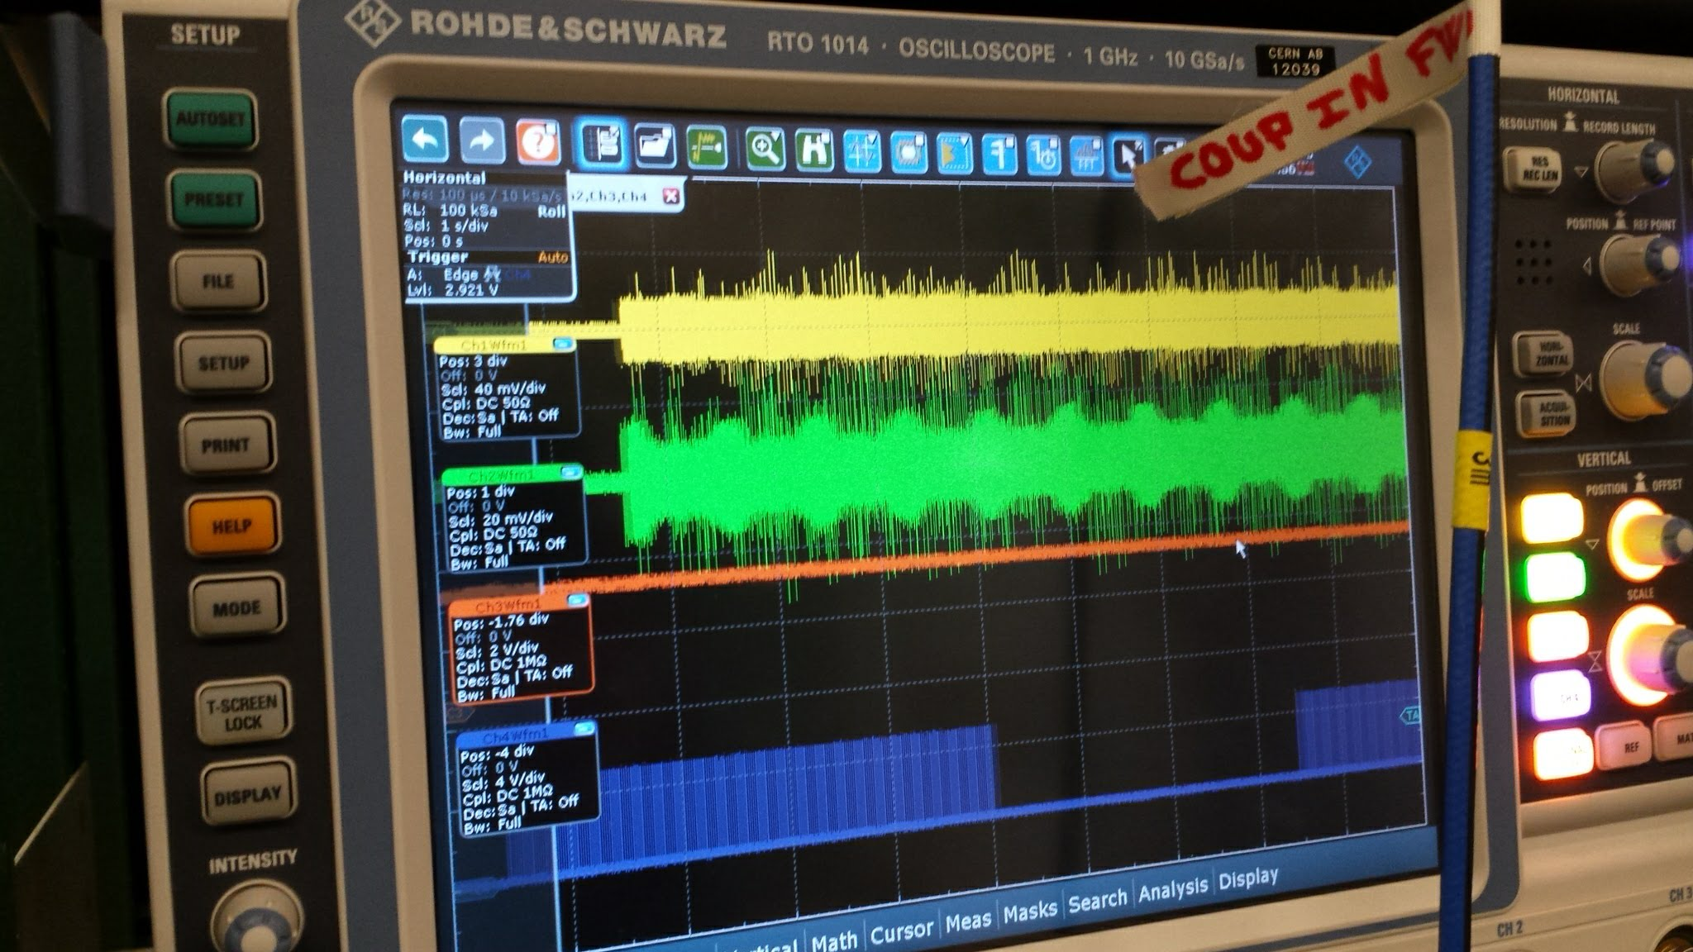
Loss Mechanisms: Frequency Tuner
Slow losses occasionally observed.
Cavity tuner was being setup during this period.
Combination of micro-phonics & desynced between BA3-BA6

Slide 13
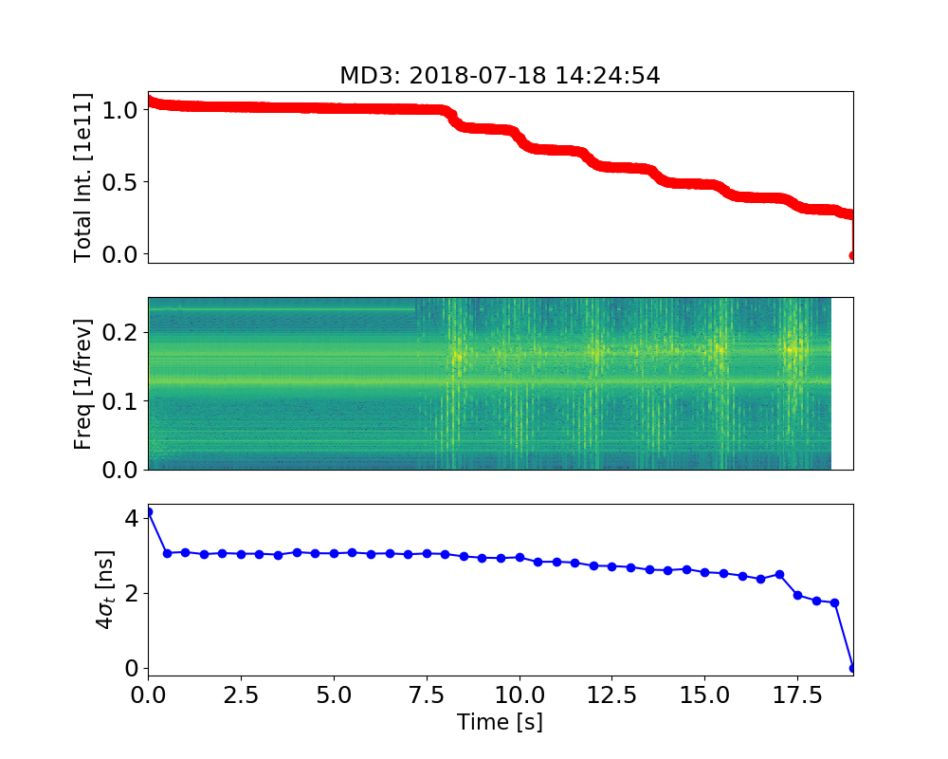
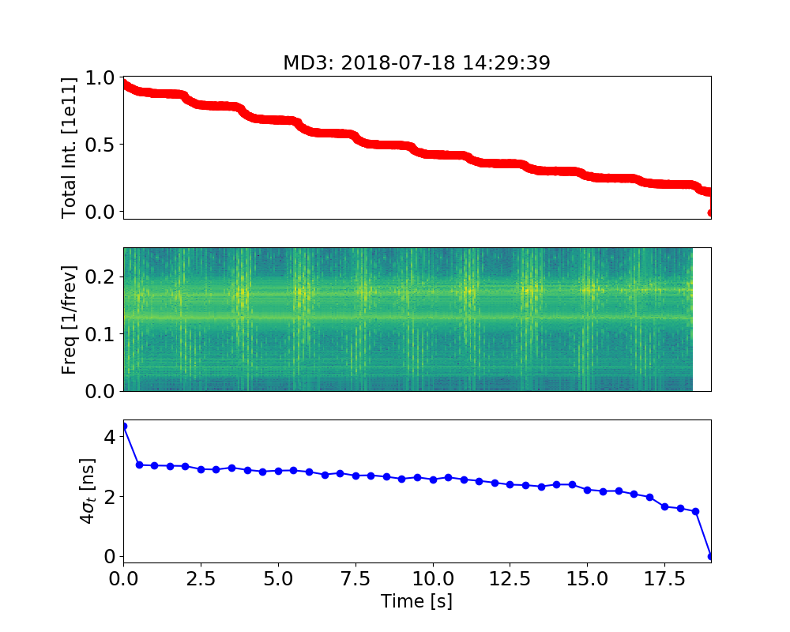
Loss Mechanisms: Cavity Feedback
Issues during setup of cavity feedback caused slow losses.
Not clear exactly what mechanism was at play.
Investigations ongoing.

Slide 14
Still To Do
Transparency checks
Crab dispersion
Electrical Centering
Transverse Feedback Studies
Measurement of a3
Loss maps with crab cavities
AC Dipole like excitation with BA3-BA6 desynchronisation
Intensity ramp-up
See attachment for MD plan for MD6 and MD7 where we will attempt to go to higher intensities.

Slide 15
Thank you

Slide 16
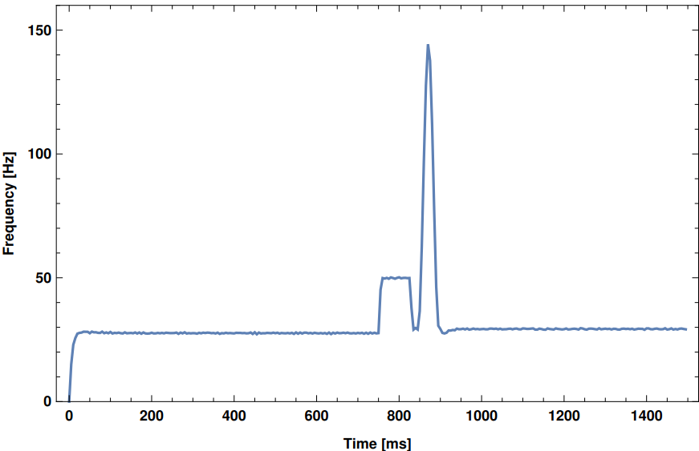
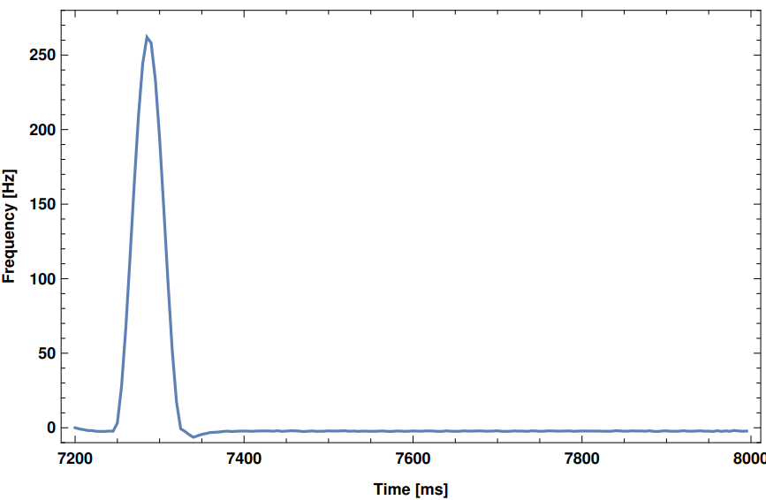
Crab-RF Sychronisation
Crab cavity rf set point from BA6 to BA3
CC ~400 MHz, SPS RF ~200 MHz
Rephasing of SPS RF to become synchronous with crab signal.
26GeV rephasing
Synchronised from ~1s
after injection
270GeV rephasing
Synchronised from ~7.4s
i.e. 0.2s after reaching flat top
Coarse rephasing
Transient
Synchronised
Synchronised

Slide 17
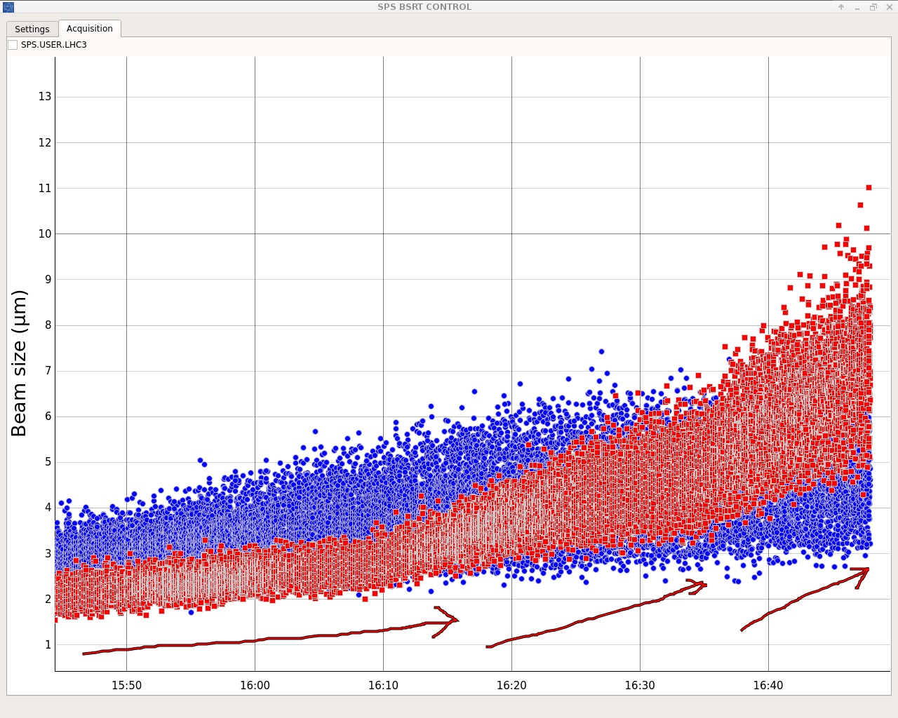
BSRT & BGI
BSRT profiles also logged for 270 GeV, big thanks to G. Trad for his effort.
Analysis still to be done for a thorough comparison to wirescan results.
Some issues with setting up BGI for the coast cycle, unfortunately data not useable but ready for any future coasts.
BSRT

Slide 18
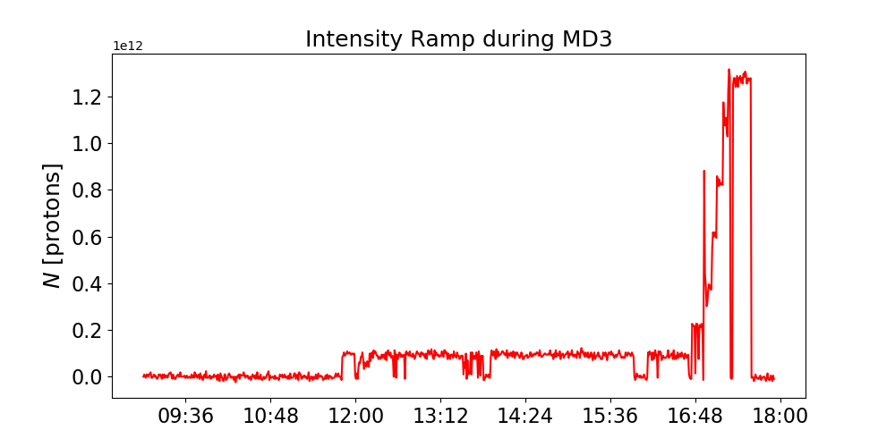
Misc. Figures

Slide 19
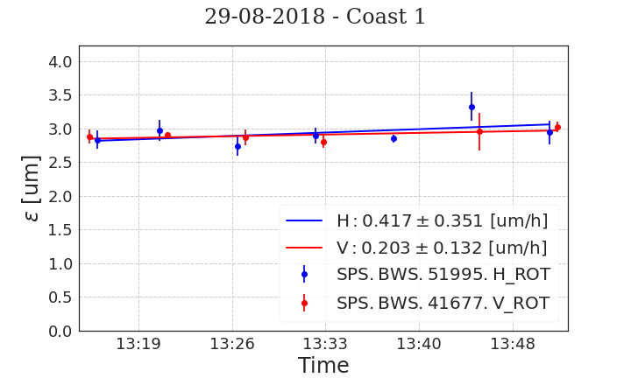
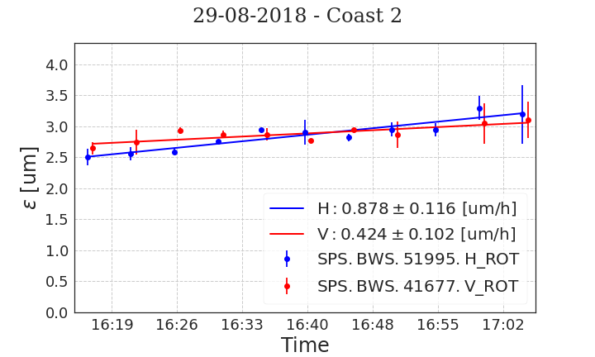
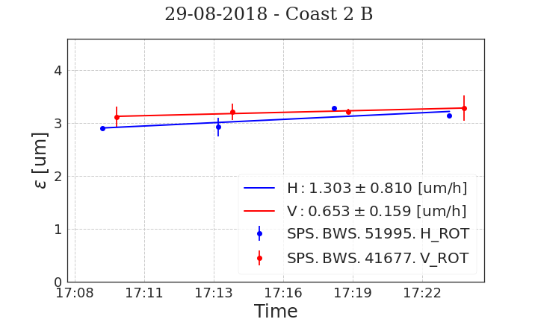
MD4
Emittance growth in coast measurements.
In MD4 we achieved 2 short coasts and 1 long coast (difficult to conclude anything due to large error bars).
Increased noise via RF feedback gain
Crabs off
1.5MV -> 1MV
Prediction: 0.2um/h from crabs
Prediction: 0.6um/h from crabs

Slide 20
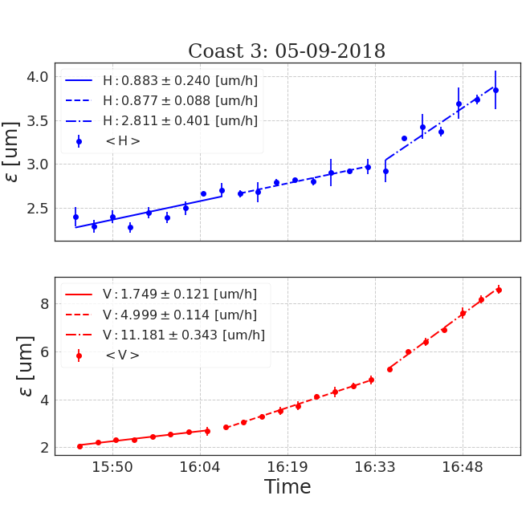
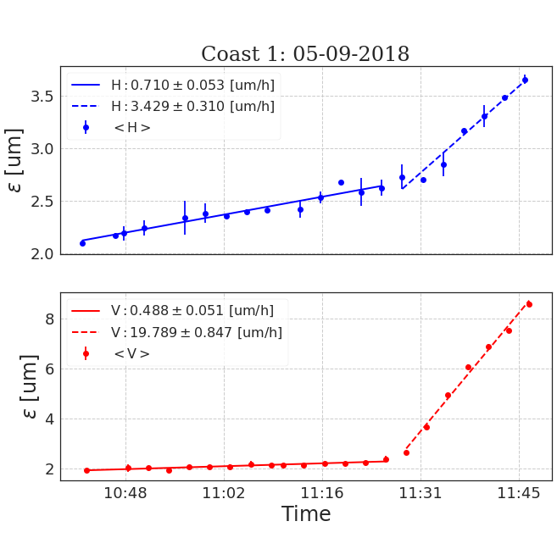
MD5: Summary of Coasts
0 [A.U.]
0 [A.U.]
-5 [A.U.]
Baseline
-10 [A.U.]

Slide 21
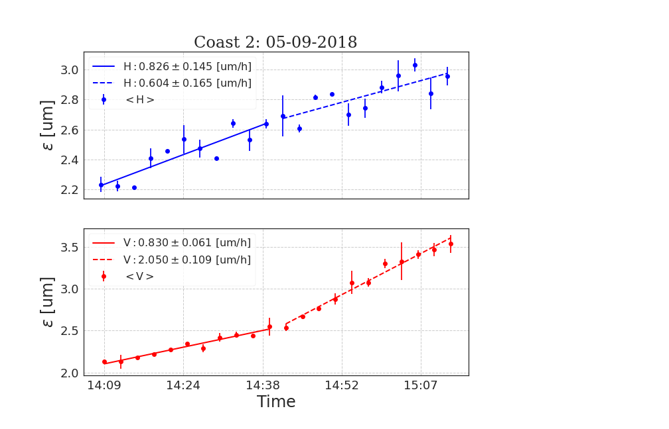
MD5: Summary of Coasts
-5 [A.U.]
-10 [A.U.]

