Slide 1


Analysis of shorts with coil parts in MQXFA
Vittorio Marinozzi – Fermilab

Slide 2
Target
Identify risks due to short between coils and parts. Possibly, evaluate minimum acceptable short resistance
  Simulations of short with parts
  What are possible acceptance criteria?
Cases considered:
  Short from pole-turn to pole
  Short from midplane-turn to end-shoe
  Short from IL pole-turn to OL pole-turn through the pole
  Short from IL midplane-turn to OL midplane-turn through the end-shoe

Slide 3
Assumptions for simulations
Simulations made with STEAM
Current: 17980 A (ultimate)
Dump resistor: 37.5 mΩ
  Most conservative, relative to vertical test.
  Next analysis without dump
Quench heaters: Outer Layer
CLIQ: 500 V, 40 mF
Nominal conductor parameters

Slide 4
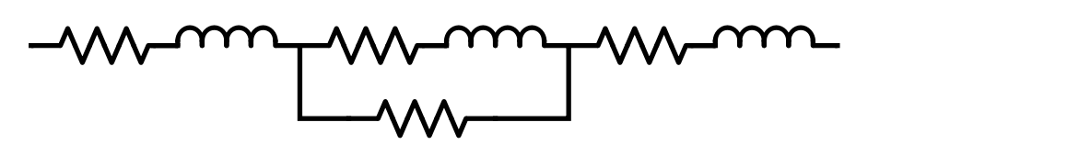
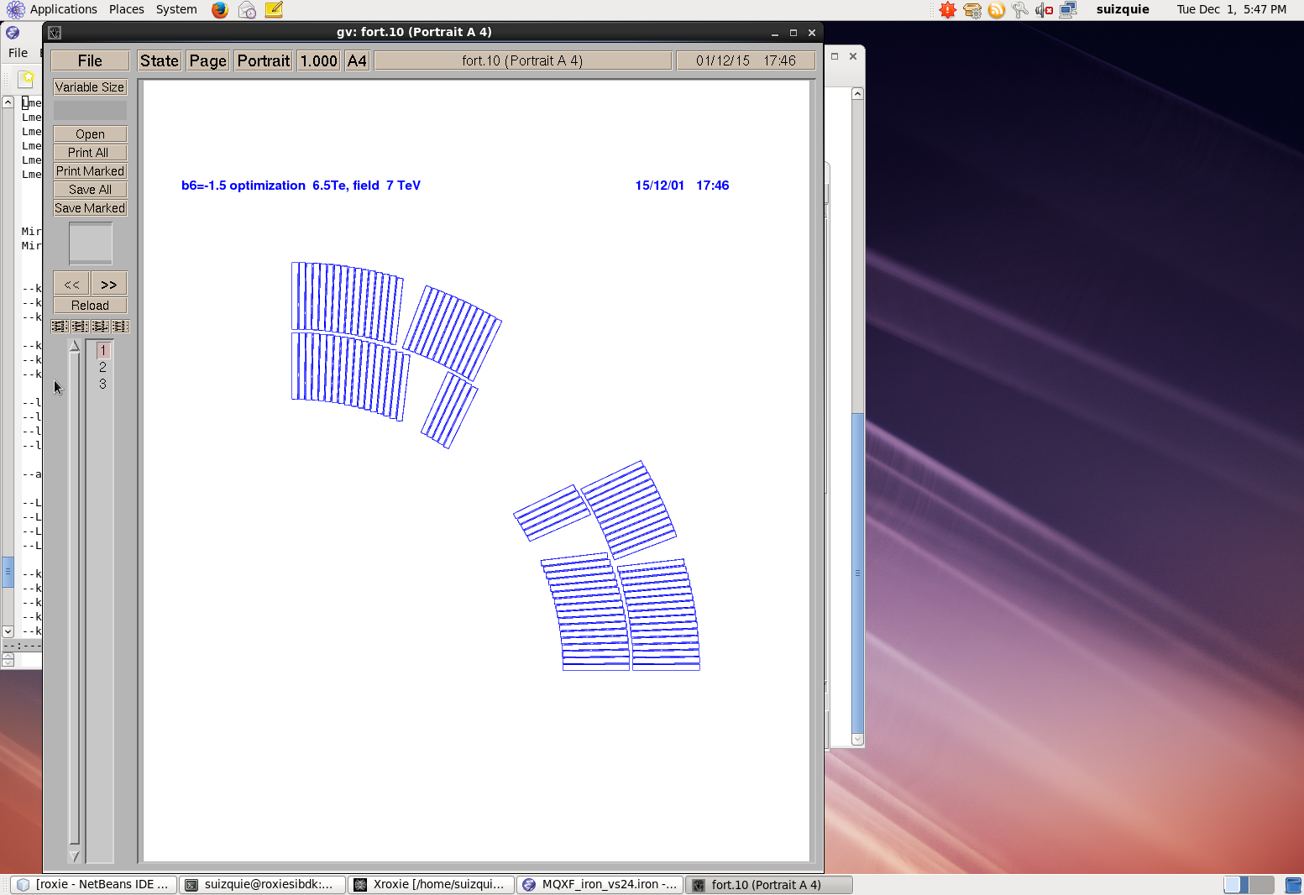
Short from IL pole-turn to OL pole-turn through the pole
Magnet, IL pole turn
1 Turn
OL pole turn, Magnet
R_{s}
R_{s}
R_{s} | 10 Ω, 1 kΩ, 0.1 MΩ, 10 MΩ, 1 GΩ

Slide 5
Short from IL midplane-turn to OL midplane-turn through the end-shoe
Magnet, IL mp turn
1 Coil
OL mp turn, Magnet
R_{s}
R_{s} | 10 Ω, 1 kΩ, 0.1 MΩ, 10 MΩ, 1 GΩ
R_{s}

Slide 6
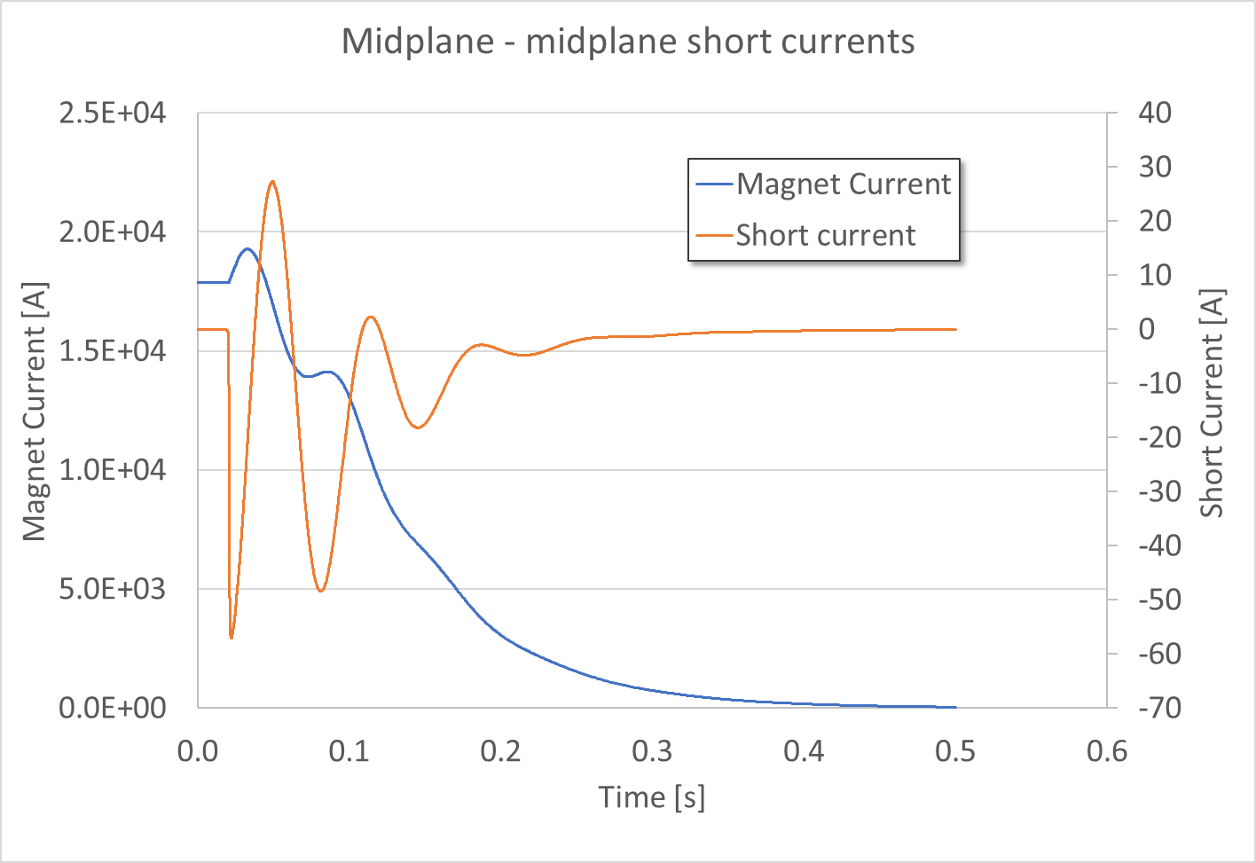
Current discharge

Slide 7
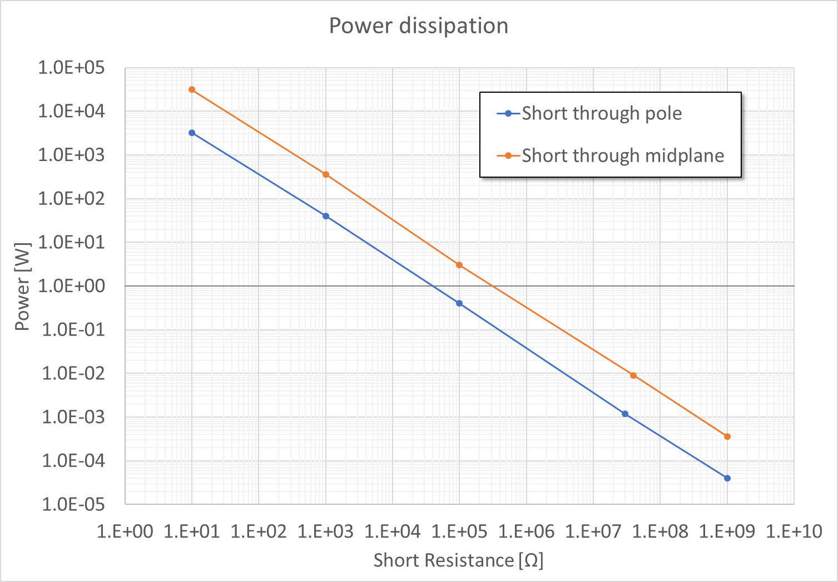
Results

Slide 8
Results
Case | Short resistance [Ω] | Peak Current [A] | Peak power [W]
Pole turn - pole turn | 10 | 18 | 3.2·10³
 | 10³ | 0.2 | 40
 | 10⁵ | 2·10⁻³ | 0.4
 | 3·10⁷ | 6.3·10⁻⁶ | 1.2·10⁻³
 | 10⁹ | 2·10⁻⁷ | 4·10⁻⁵
Midplane turn – midplane turn | 10 | 56 | 3.1·10⁴
 | 10³ | 0.6 | 360
 | 10⁵ | 5.5·10⁻³ | 3.03
 | 4·10⁷ | 1.5·10⁻⁵ | 9·10⁻³
 | 10⁹ | 6·10⁻⁷ | 3.6·10⁻⁴

Slide 9
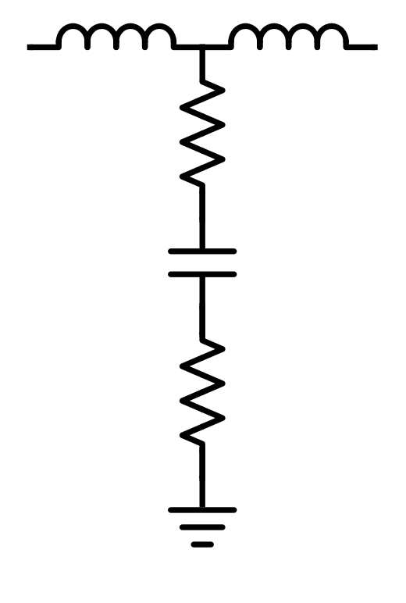
Short from pole-turn to pole
Short resistance
R_{s}
R_{s} | 10 Ω, 1 kΩ, 1 MΩ
C_{p} | 1 mF
R_{tg} | 1 GΩ
Pole capacitance
to ground
C_{p}
Pole resistance
to ground
Pole capacitance is estimated,
to be measured.
R_{tg}

Slide 10
Short from midplane-turn to end-shoe
Short resistance
R_{s}
R_{s} | 10 Ω, 1 kΩ, 1 MΩ
C_{p} | 0.1 mF
R_{tg} | 1 GΩ
End-shoe capacitance
to ground
C_{es}
End-shoe
resistance
to ground
End-shoe capacitance is estimated,
to be measured.
R_{tg}

Slide 11
Results
Case | Short resistance [Ω] | Capacitance [F] | Peak Current [A] | Peak power [W]
Midplane turn - endshoe | 10 | 10⁻⁴ | 0.62 · 10⁻⁹ | 3.85 · 10⁻¹⁸
 | 10³ | 10⁻⁴ | 0.6 · 10⁻⁹ | 3.6 · 10⁻¹⁶
 | 10⁶ | 10⁻⁴ | 0.58 · 10⁻⁹ | 3.36 · 10⁻¹³
Pole turn - pole | 10 | 10⁻³ | 0.54 · 10⁻⁹ | 2.92 · 10⁻¹⁸
 | 10³ | 10⁻³ | 0.53· 10⁻⁹ | 3.03 · 10⁻¹⁶
 | 10⁶ | 10⁻³ | 0.52 · 10⁻⁹ | 2.81 · 10⁻¹³
Is this model correct?
Double short is worse for sure, and cannot be experimentally excluded, so it should define the criteria

Slide 12
Acceptance criteria discussion
HiPot Coil – pole : 500 V
HiPot Coil – end-shoe: 1000 V
What are the criteria used to chose these numbers? Do we want to review them?
Criterion 1: HiPot (maximum voltage during a quench)*f
  Pole turn – pole turn: ~ 50 V
  Midplane turn – midplane turn: ~ 600 V
  f = ?
Criterion 2: Resistance measurement, after defining minimum acceptable resistance based on power dissipation
QXFA Coil Fabrication Electrical QA
HiLumi doc 521

Slide 13
Criterion 2: resistance measurement
Accepting coils based on measurement of resistance with parts can make high voltage HiPot useless
  Example: coil 107, 2.8 MΩ resistance to pole, HiPot failed at 20 V
  Example: 10 MΩ resistance, HiPot with 10 μA leakage current → arc at 100 V
How do we define the maximum accepted power dissipation?
  Difficult to compute the power density

Slide 14
Proposal
Possible criteria (to be discussed):
Coil accepted if resistance to pole > 1 MΩ
  Power dissipation ~ 30 mW in case of double short
  Short likely due to binder, “large” contact surface
Coil accepted if Coil – End-Shoe HiPot > 600 / 3 = 200 V
  600 V is the maximum midplane-midplane voltage
    Short should go through three layers of insulation
  Shorts could have small contact surface (due to insulation damage after positioning the end-shoe, that has sharp edges?)
  Difficult to define the power density
More ideas?

