Slide 1
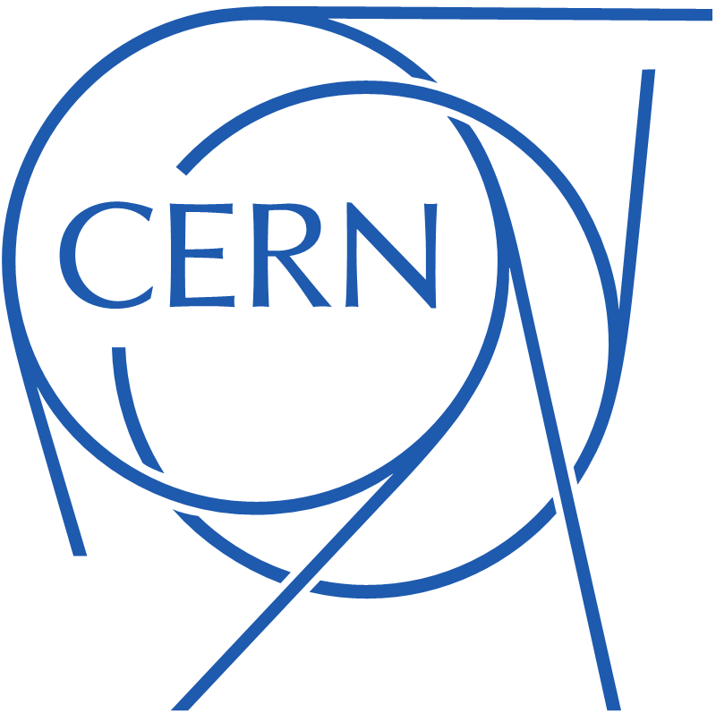

Personnel Protection Systems
New control solutions for safety applications
KT – Innovation Day – 26th October 2018
F. Valentini (BE-ICS-CSE)

Slide 2


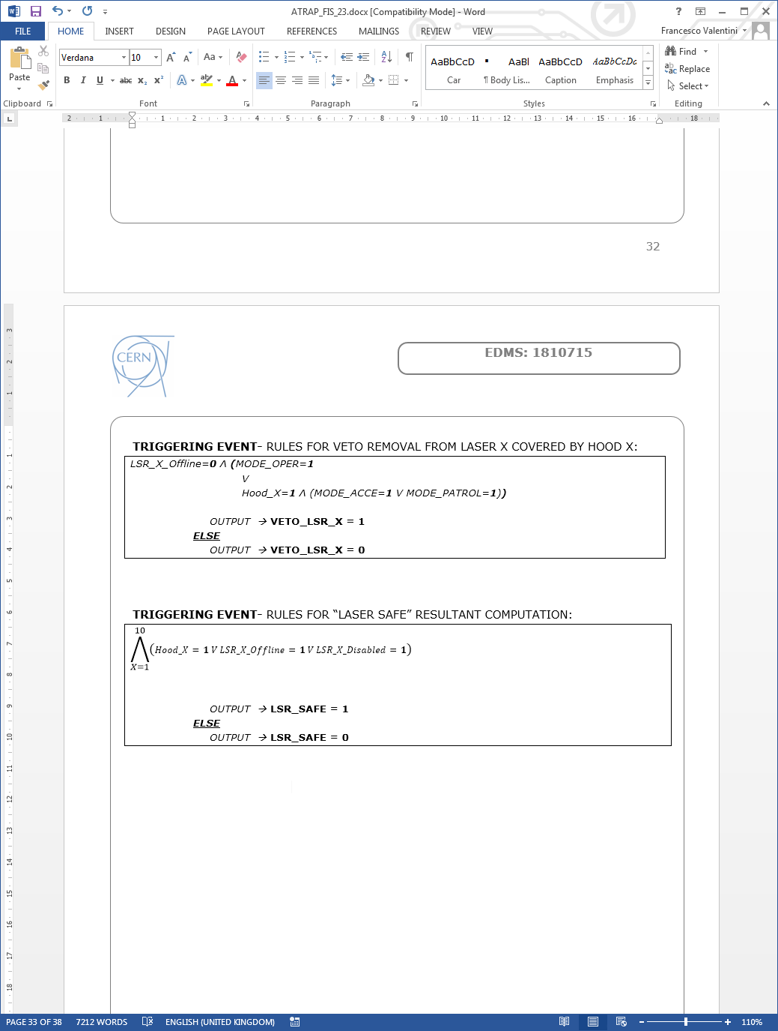
Personnel Protection Systems @ CERN
1
Risk Assessment
All hazards are analyzed and all possible accident scenarios identified.
2
Safety Instrumented Functions
The system’s automatic safety actions are translated into mathematical Boolean formulas.
Development Process
System Architectural Design
3
All safety components and the logic controller are chosen and the detailed design is finalized.
4
PLC Code Development & Cabinets
The logic controller (PLC) is programmed and extensively tested. The electrical cabinet is mounted.
DOMAIN OF OUR
PROPOSITION
5
Site Installation & Commissioning
All mounting and cabling works on site are realized. The electrical cabinet is connected and final commissioning /DSO tests performed.

Slide 3
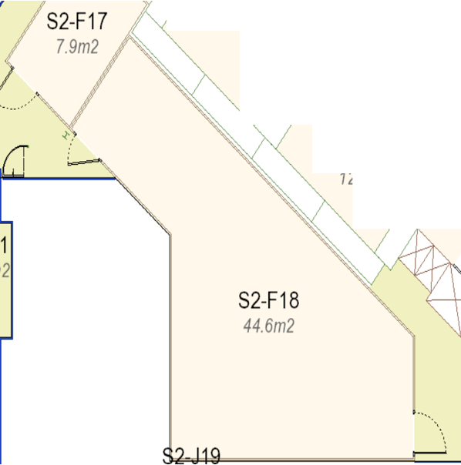
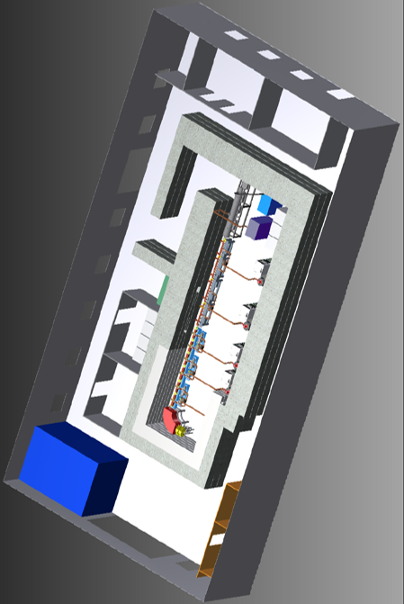
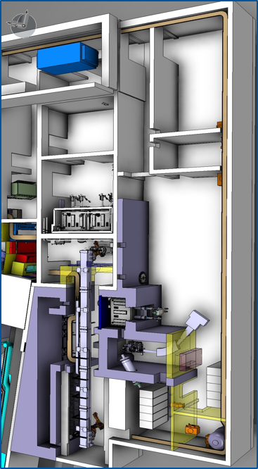
Personnel Protection Systems @ CERN
Small/Medium size
Safety Systems
Experimental Areas
Our proposition intends to help dealing more efficiently with this type of installations by reducing development and maintenance costs related to the logic controller part.
LASER ROOMS
ADAM-LIGHT
MEDICIS LAB
Small rooms with 1 or 2 access doors and max 5 class-4 lasers.
Small bunker with 1 only access door and few hazardous equipment inside.
Few communicating rooms hosting radiological hazards.
TEN similar installations are expected per year !

Slide 4
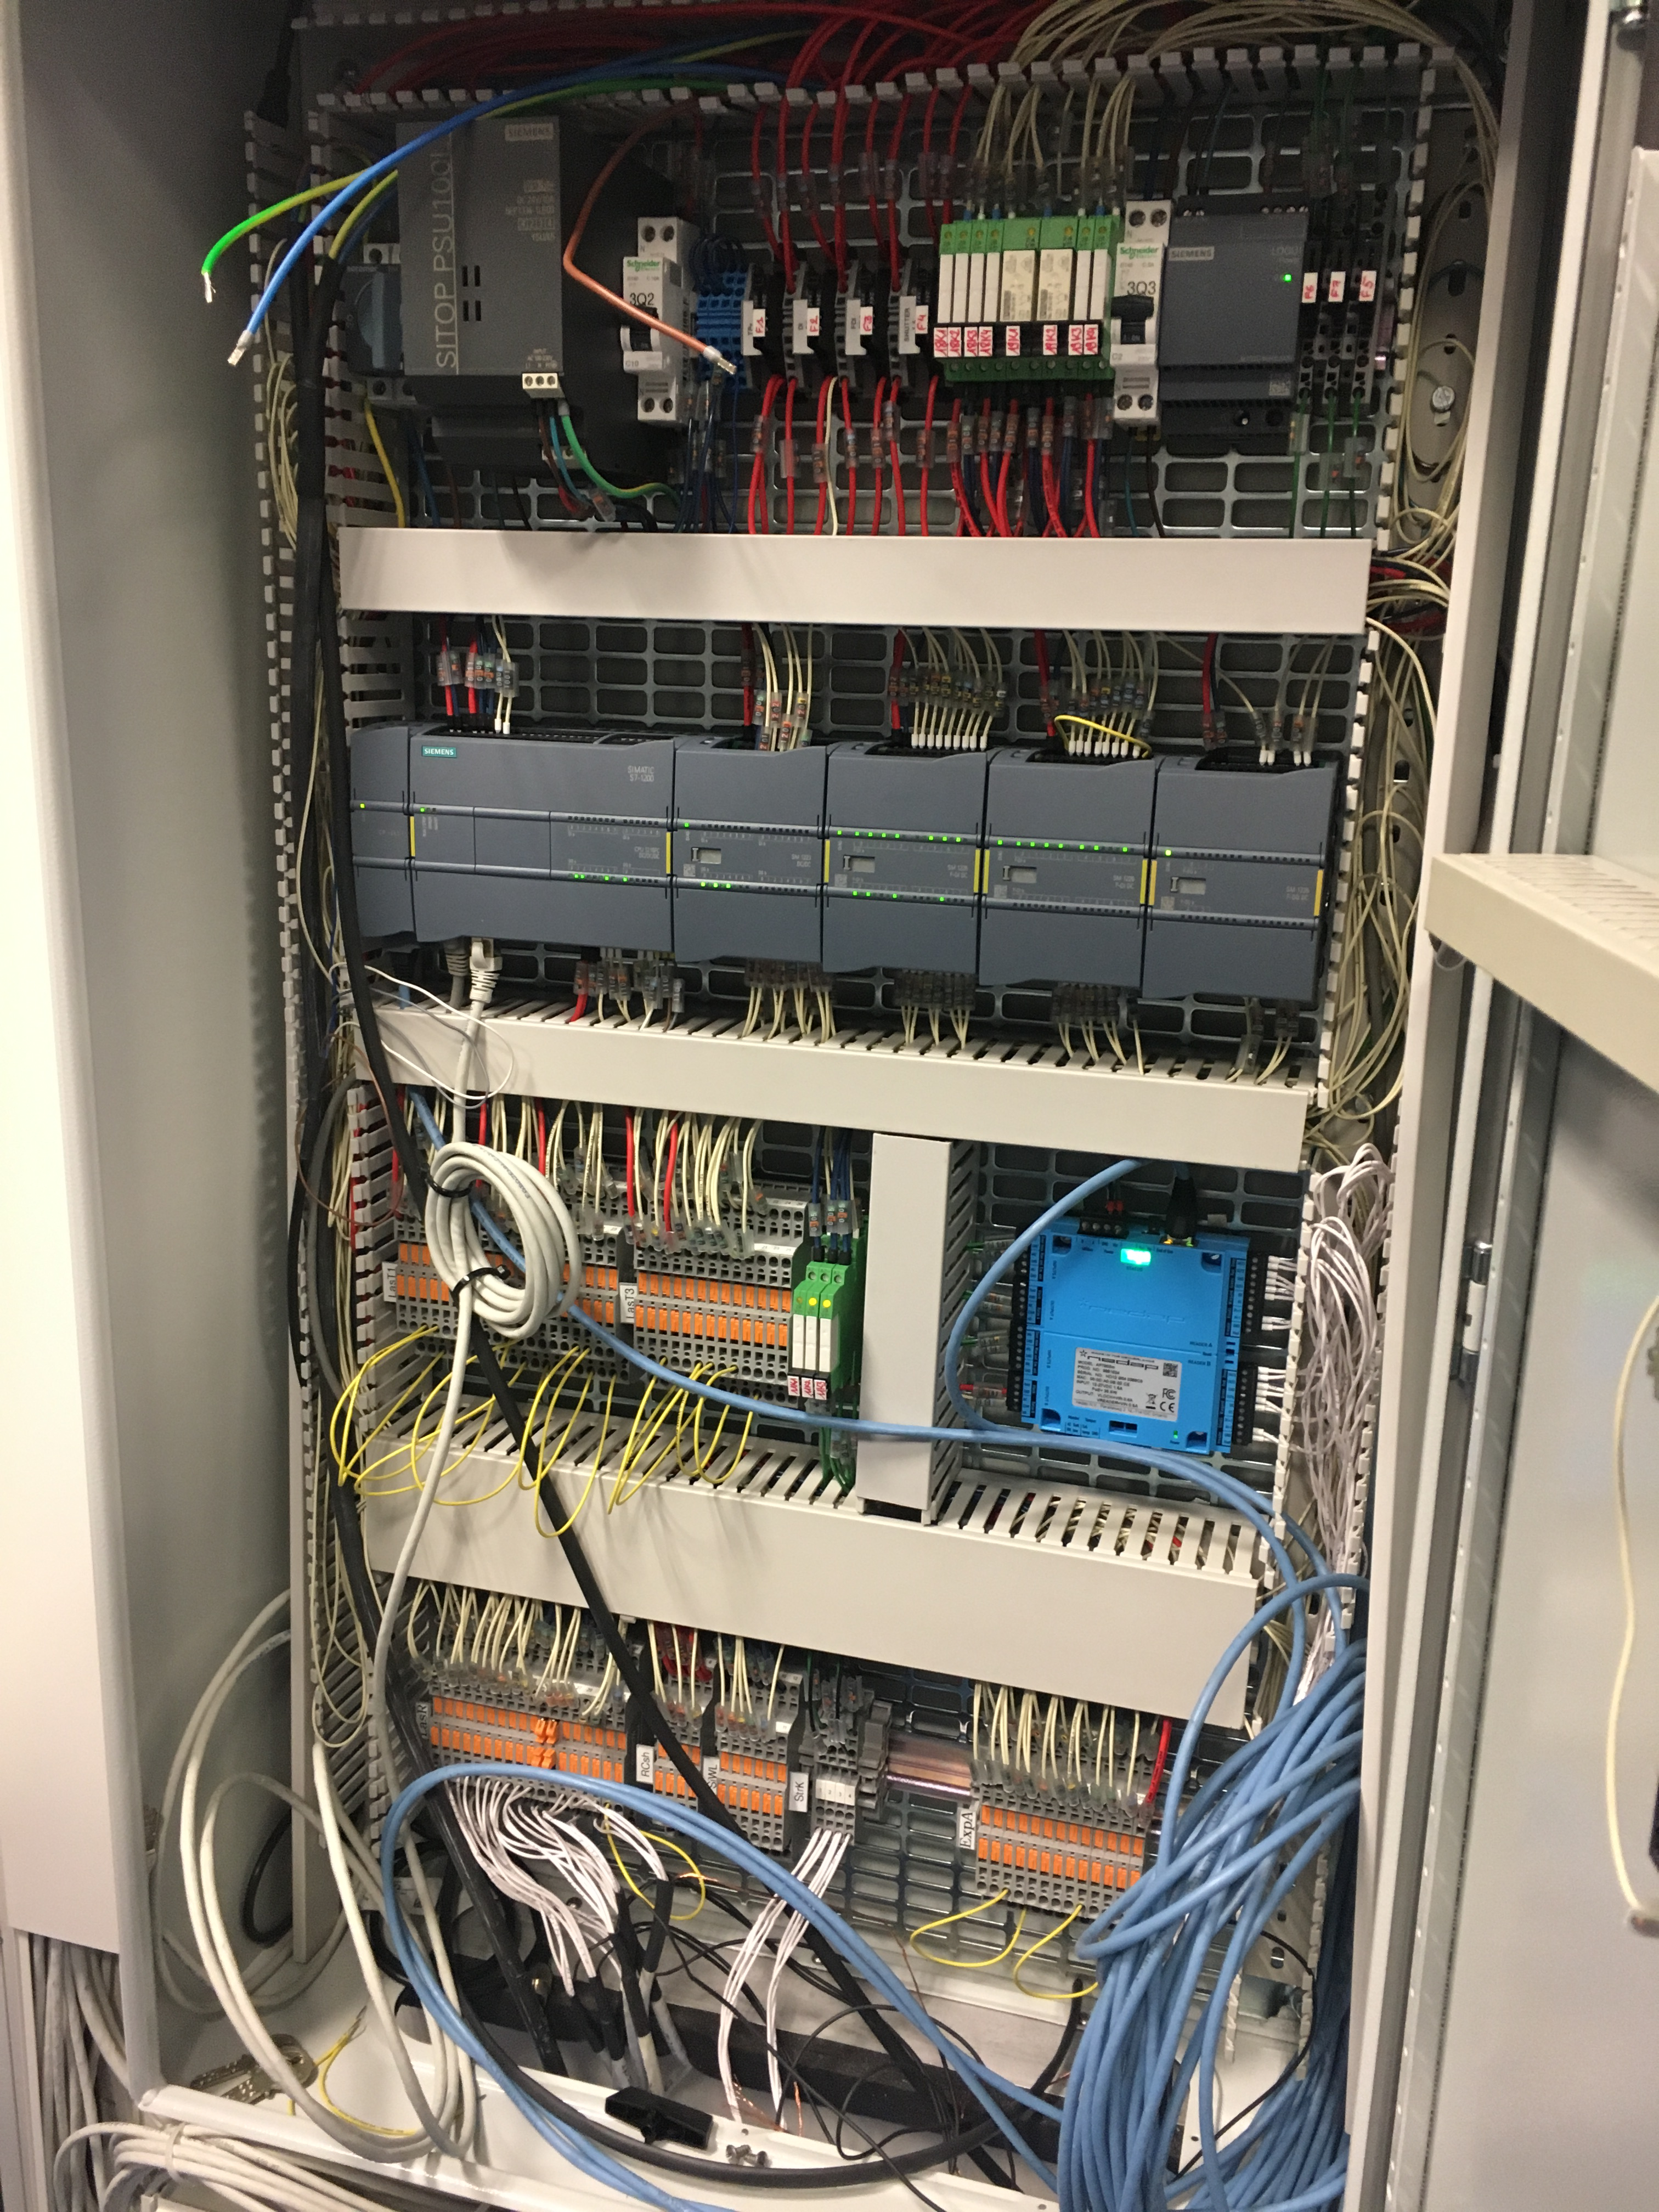
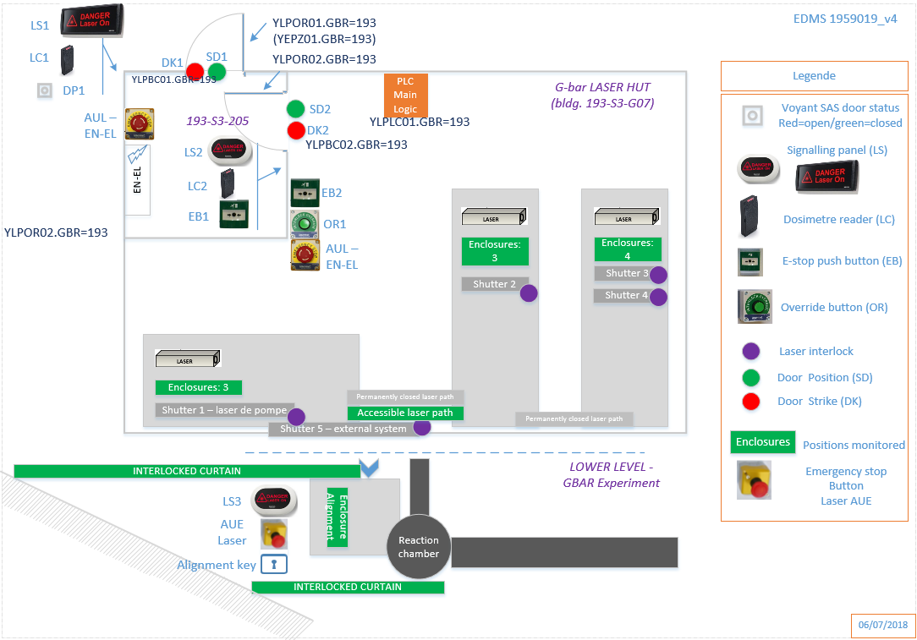
Example: GBAR Laser Room Installation
Inputs: 21 Outputs: 10
Outsourcing cost for the cabinet: 30K CHF

Slide 5



Our Primary Objective
Make Affordable Safety
A safety system can effectively reduce damages to personnel operating in hazardous situations. The cost of the system shall be then considered as an investment that shall however remain reasonably proportional to the Value at Risk.
Reduce Costs for Material & Installations
The material costs for controllers and cabinets cabling are often prohibitive for small size experimental facilities funded by universities or other institutions.
Solution Compliant with SIL-2/3 Requirements
IEC
The conformity on any electrical / electromechanical device related to personnel safety shall be proven against the IEC-61508 standard.
No Specific Software Development
A model of development where any PPS installation has its own version of safety software can become unsustainable after few dozens of instances.
Minimal Maintenance
Minimize the decay of resources that, year after year, remain blocked into maintenance tasks.

Slide 6

Our Proposition
Acknowledgments:
University Federico II (Naples)

Slide 7
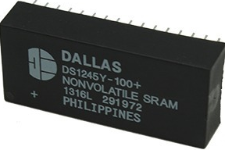
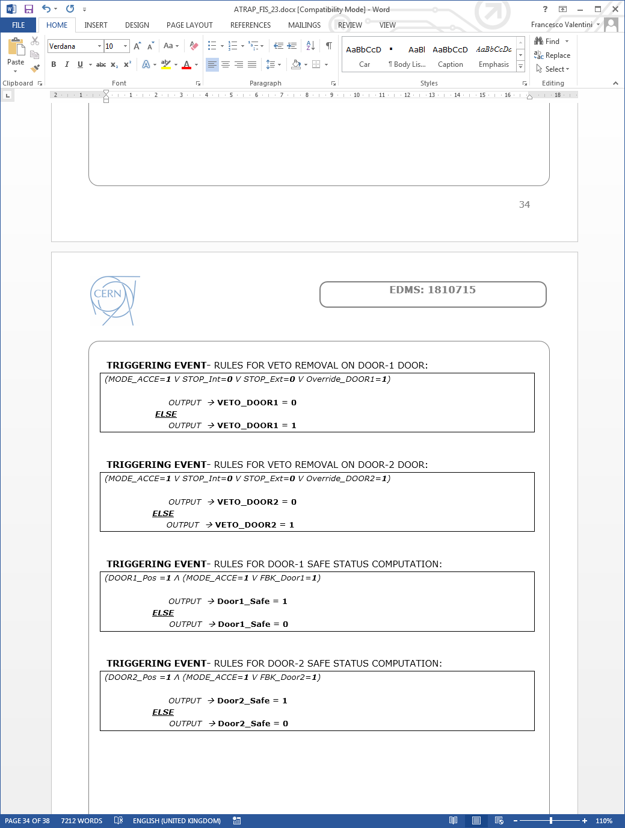
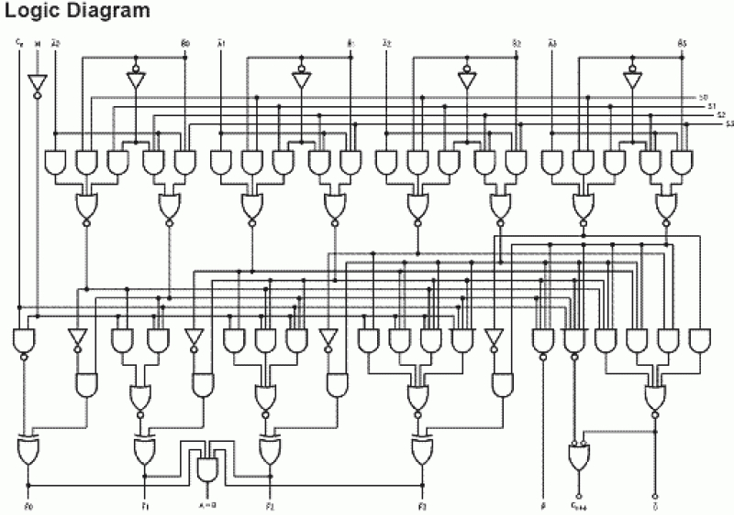
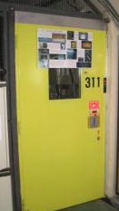
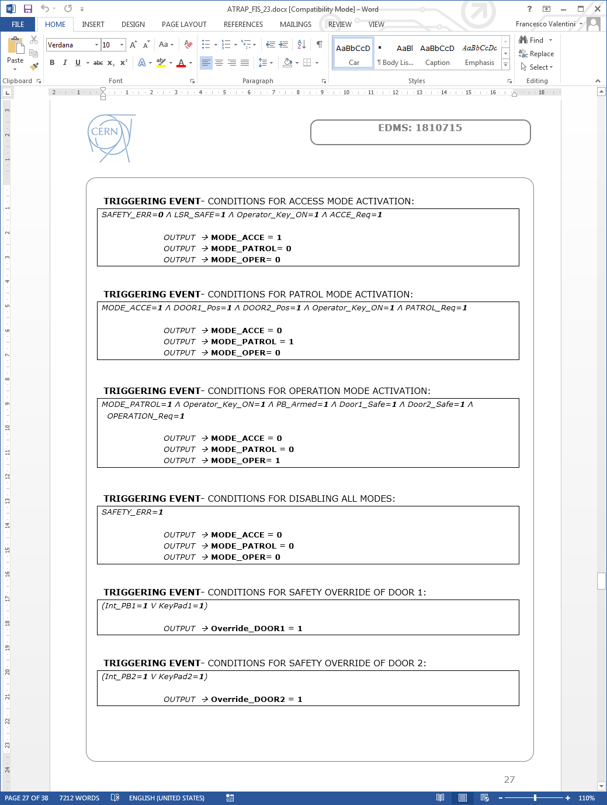
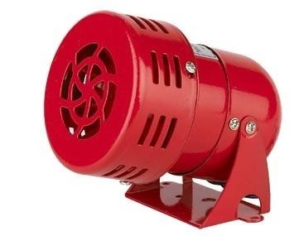
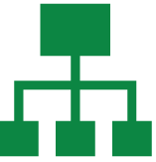
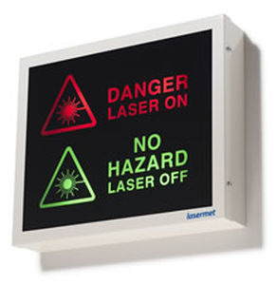
The R&D Activity: basic concept
MTTF: 3’441 Years
Very Simple Logic Solver
10 Years data retention
Lookup Table
Remote Monitoring

Slide 8
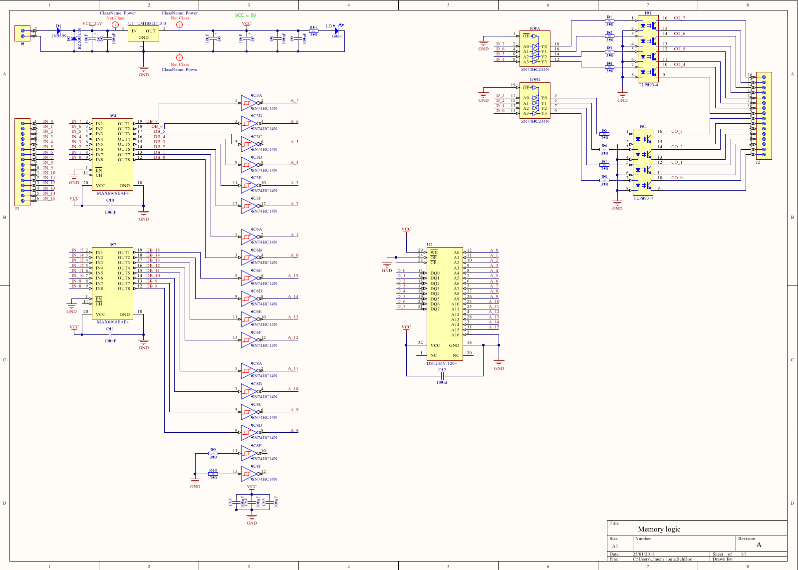
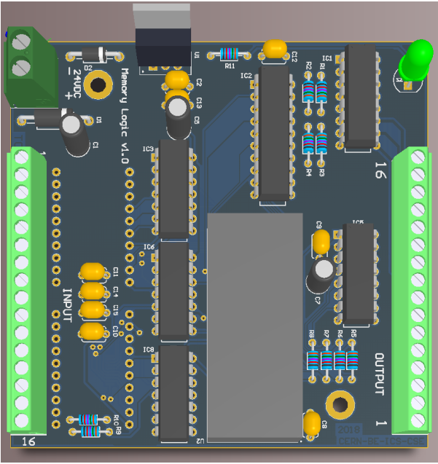
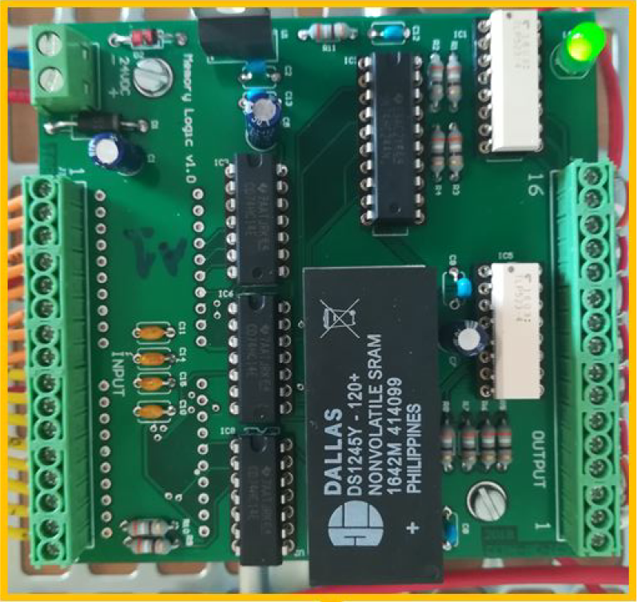
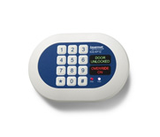
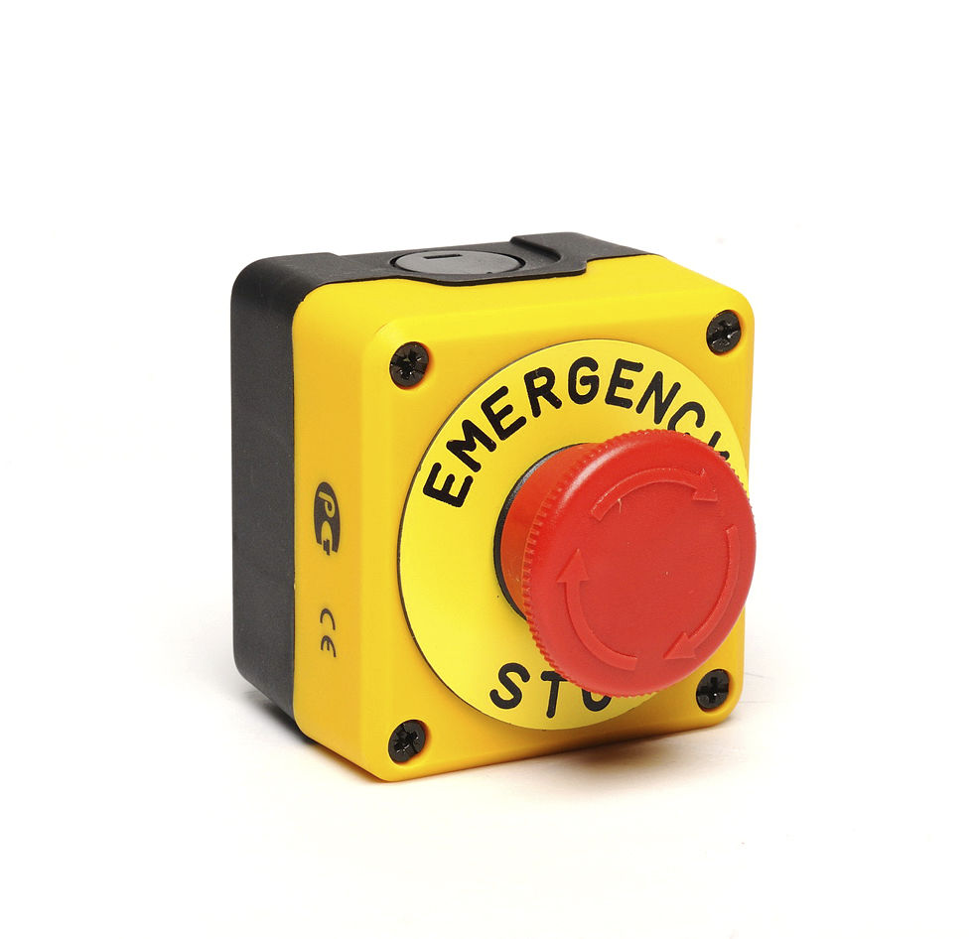
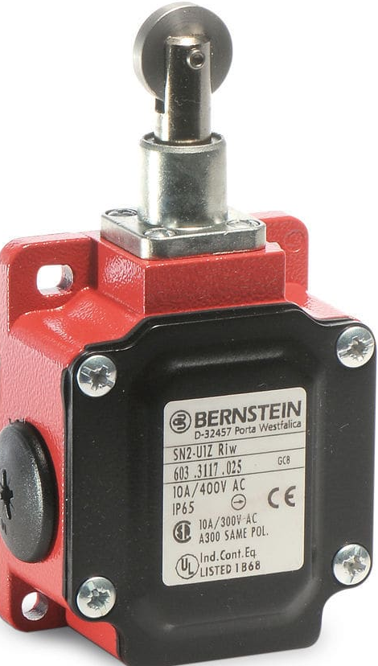
The R&D Activity: first prototype
24V
16 Digital Inputs
8 Digital Outputs

Slide 9
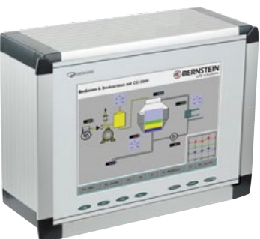

Development Milestones
I
II
III
2019
Add new features:
+GPIO, Network, local HMI, auto-diagnostic
New design & prototyping phase.
Identify generic configurable interlock scenarios.
Reliability studies, tests & conformity certification
Pilot installation
SIL-3 certified

Slide 10
Conclusions
Our proposition allows to:
  Build compact boxes for mural fixation;
  Eliminate costs for big cabinets design, cabling and PLC programming;
  Reduce sensibly the maintenance works.
Fast return on investment after deployment of 2 small/medium size PPS.
Potential applications for renovation of SPS North EXP Areas, 60 Laser rooms and other small facilities @ CERN.
Other areas of application outside CERN
  Medical sector: interlock of radiological treatment rooms;
  Other research laboratories: Alba, ITER, etc.
  Industrial sector: interlock of hazardous machinery.

Slide 12
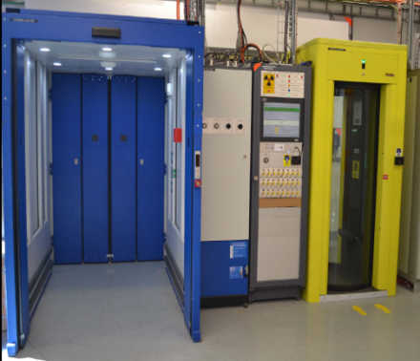
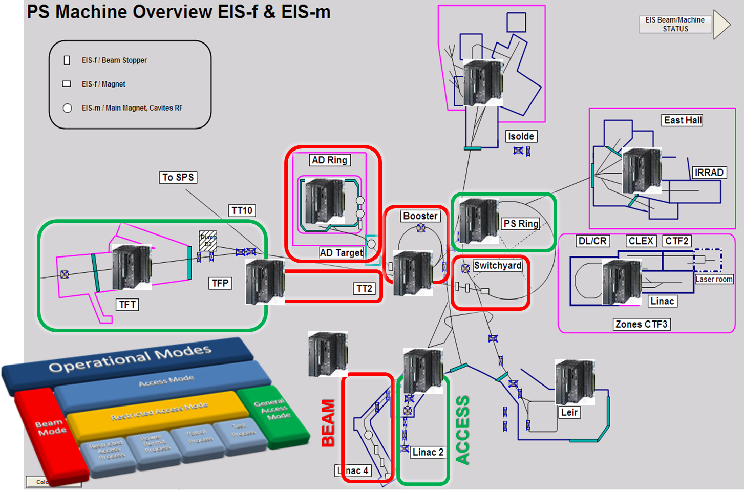
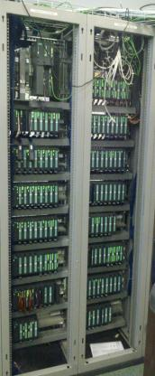
Personnel Protection Systems @ CERN
Large size accelerator Complexes (as LHC, PS, SPS)

Slide 13
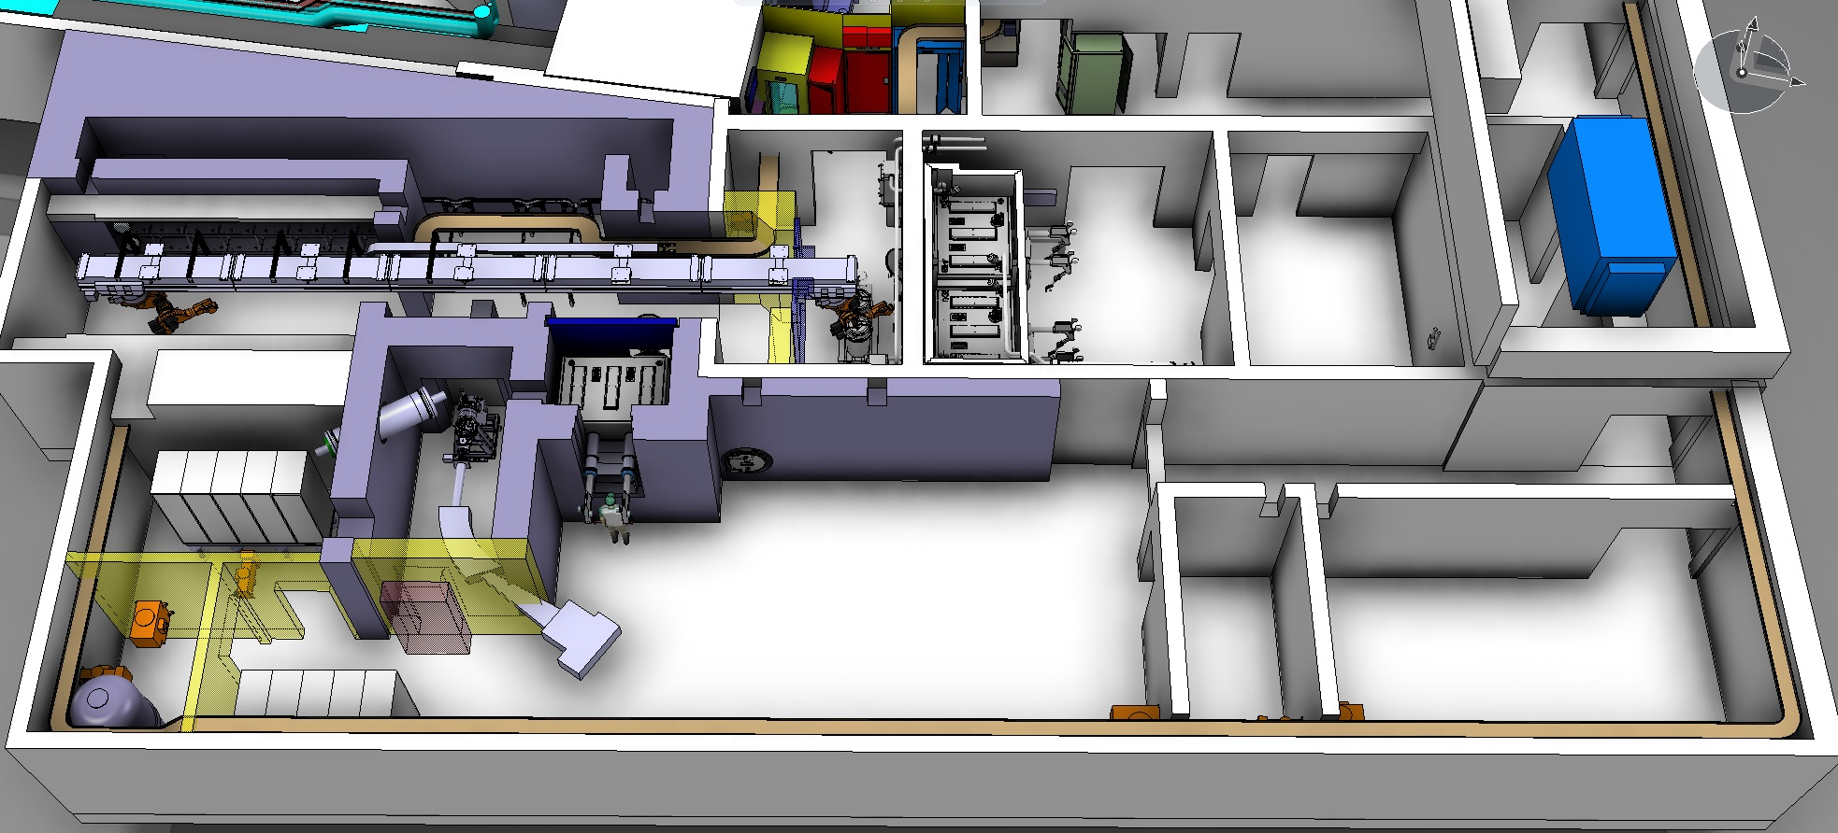
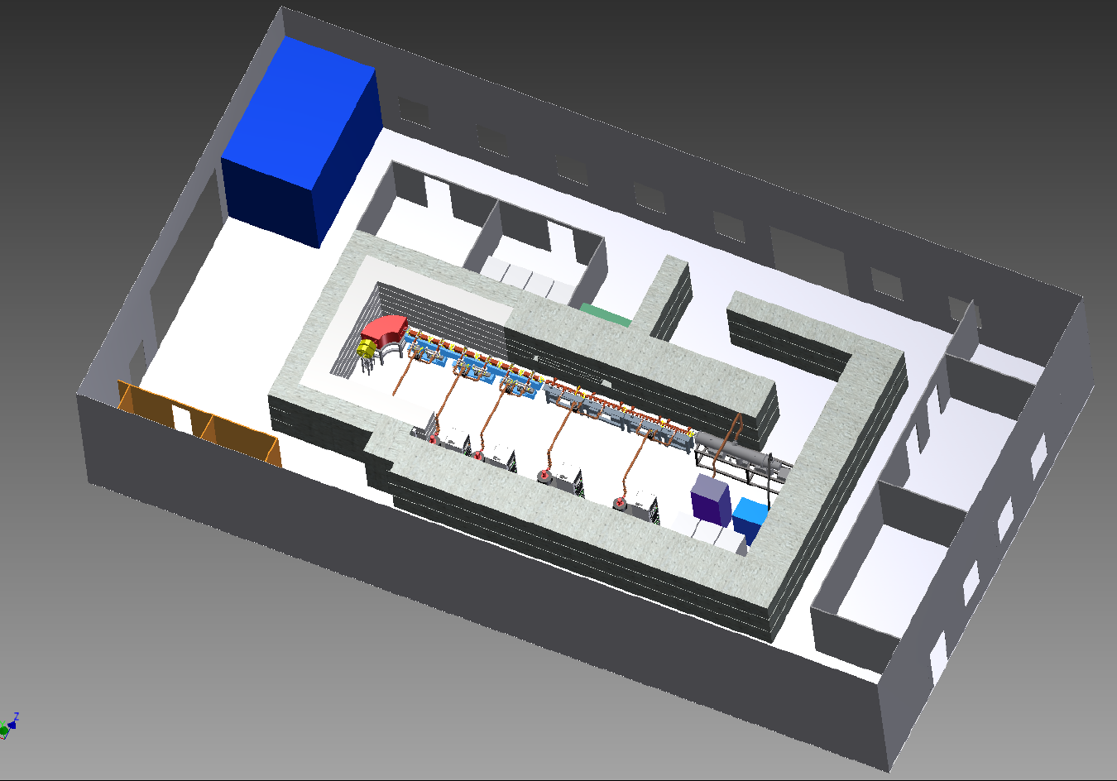
Small/Medium Size PPS (Experimental Areas)
MEDICIS LAB
ADAM-LIGHT Exp
TEN similar installations are requested per year to BE/ICS !

Slide 14
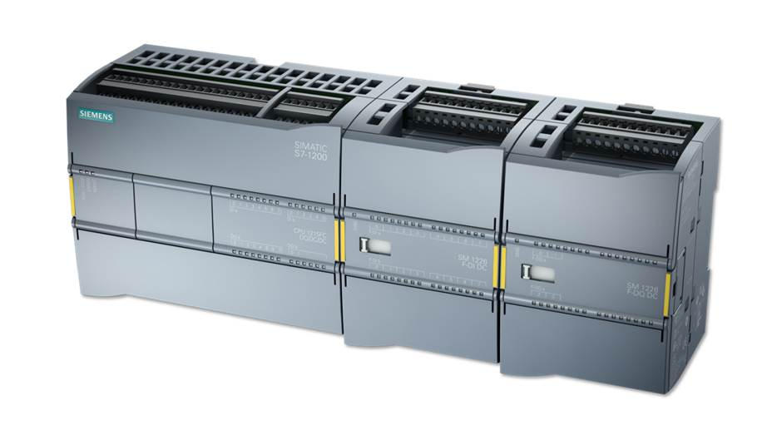
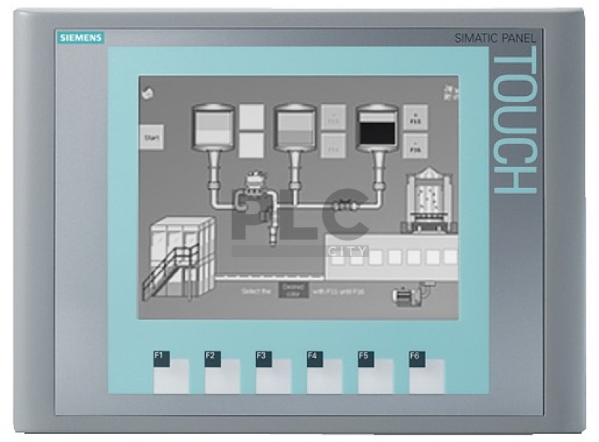
Main Limitations of PLC solutions
Most Basic PLC Configuration:
+
Siemens PLC 1200 Safety series
Siemens Simatic Panel
Cost of Material: approx. 2’500 CHF for Siemens parts.
Production Time: 1 staff engaged for min 2 weeks (1w cabinet mounting, 1w SW development & testing).
Maintenance Costs: dozens of PLCs with different SW to be kept updated.
Siemens Update Policy: annual new releases of PLC firmware and development software impacts on operation of the experiments.

Slide 15
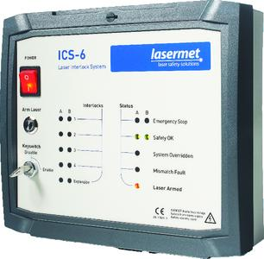
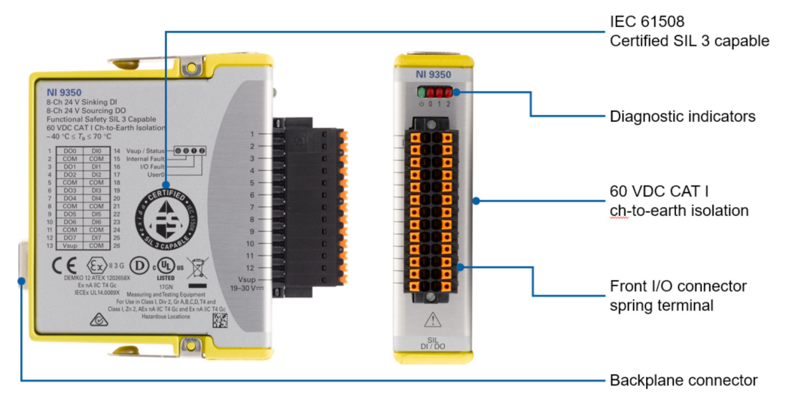

Other available options: two products of interest
Lasermet ICS-6
National Instruments 9350
IEC 60825
Laser safety standard
No Software.
Prebuild interlock logic based on relays.
Interlock logic performed by a reprogrammable FPGA
Compact practical
solution for mural installation.
Disadvantages
Certified only against laser safety standard.
Very limited I/O space (8DI / 8DO) & no com between modules.
Too limited prebuild interlock logic.
Expensive: more than 1’000 usd.
Remote monitoring NOT possible.
Remote monitoring only if integrated in a cRIO chassis.

Slide 16
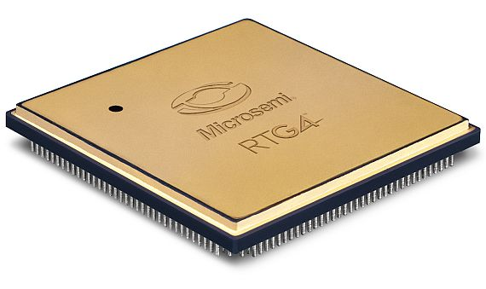
Other available options: FPGAs
Microsemi FPGA
High level of reliability.
Proven in automotive and space applications.
Allows to deploy
compact custom solutions.
Wide range of
Interfaces, including Ethernet.
Disadvantages
A certification against iec-61508 is not available.
Specific techniques of redundant programming shall be adopted.
Programming environment not certified against iec-61508.
Integration in a custom PCB more complex: longer dev times.

Slide 17
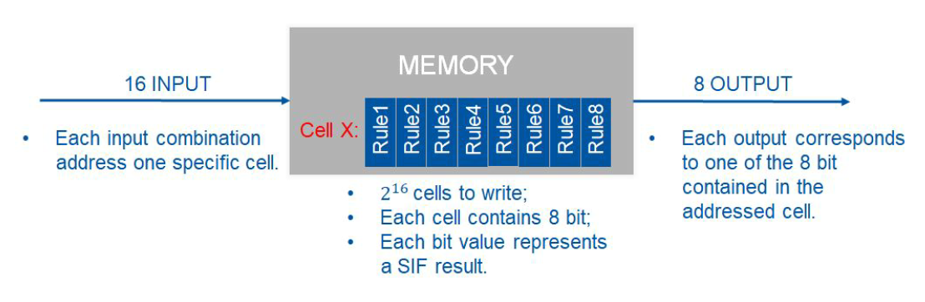
The R&D Activity: basic idea
MTTF: 3’441 Years
10 Years data retention
Lookup Table
16 INPUTS
8 OUTPUTS
Simple Boolean Logic Computation
IF [Premise] THEN [Action]

Slide 18
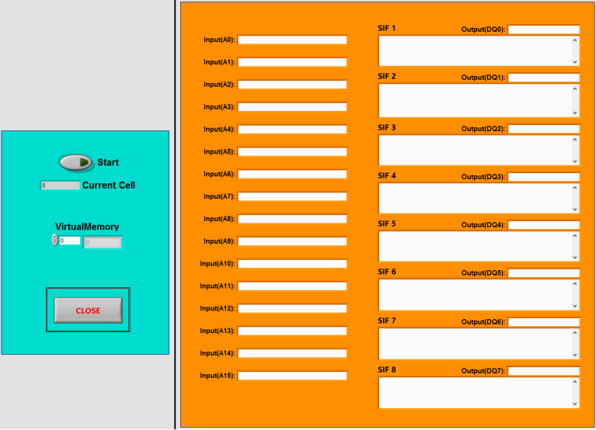
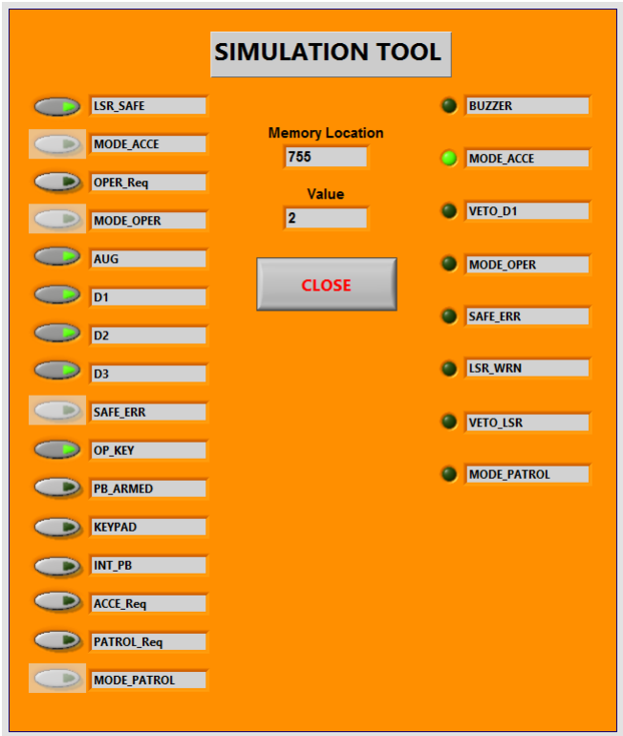
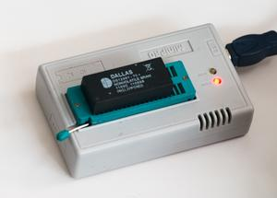
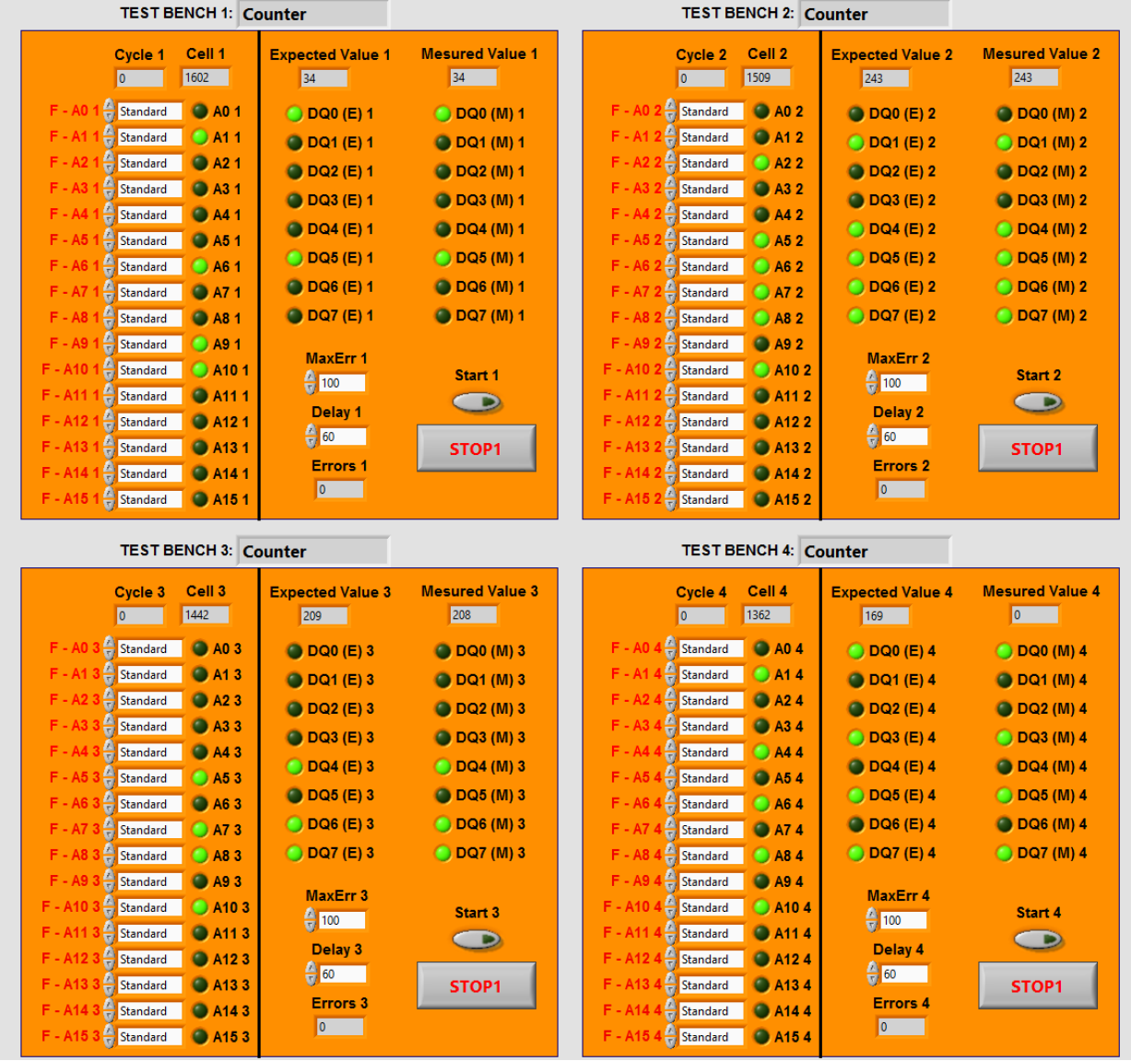
The R&D Activity: software part
(1) Logic Specification
(2) Logic Simulation
(3) Memory Flashing
(4) Exhaustive Testing

