Slide 1

ATS-KT Innovation Day
ATS-KT Innovation day
26th October 2018, Geneva, Switzerland
Development of copper electroformed NEG coated vacuum chambers
Lucia Lain Amador

Slide 2
Outline
Motivation
Idea
Prototypes
Next steps
Applications

Slide 3
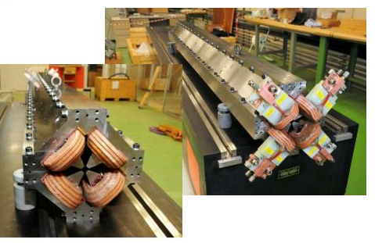
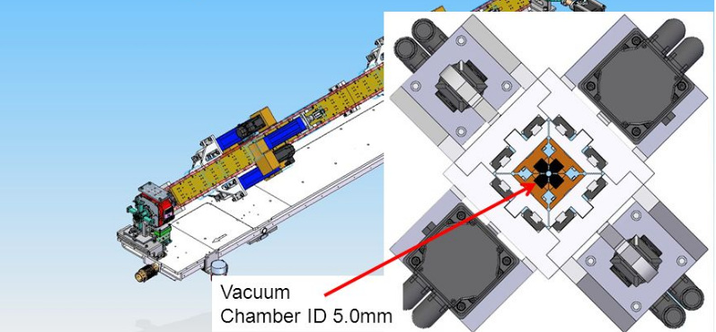
Why?
New generation light source accelerators and CLIC
Next generation synchrotron light sources and CLIC (beam focussing) demand the use of small-aperture beam pipes: magnetic poles closer to the beam.
Big impact on the vacuum system: low conductance vacuum chambers.
Distributed pumping , as getter coating, is needed to keep gas density low.
M. Modena et al. (2014)
CLIC MB quadrupole ^{[1]}
H. D. Nuhn et al., Presentation at FLS (2012),
Delta undulator, SLAC
Vacuum chamber ID ~8 mm
Vacuum chamber ID 5mm
[1] http://clic-study.web.cern.ch

Slide 4
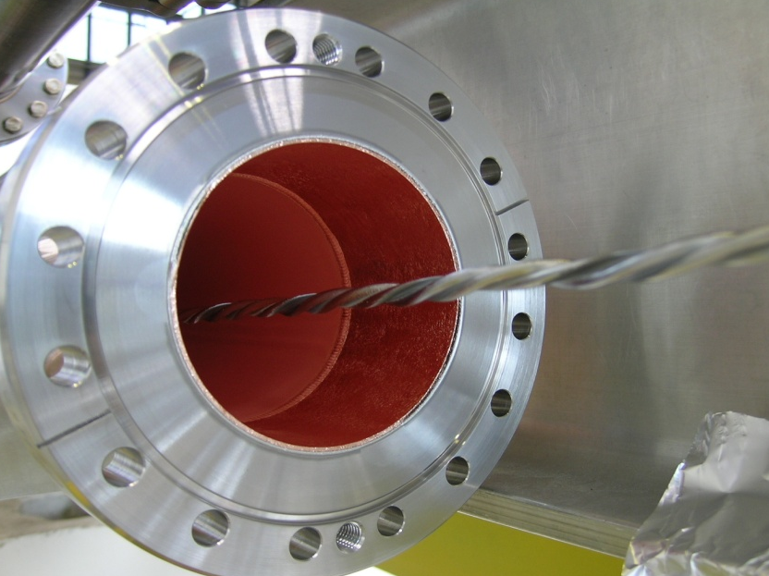
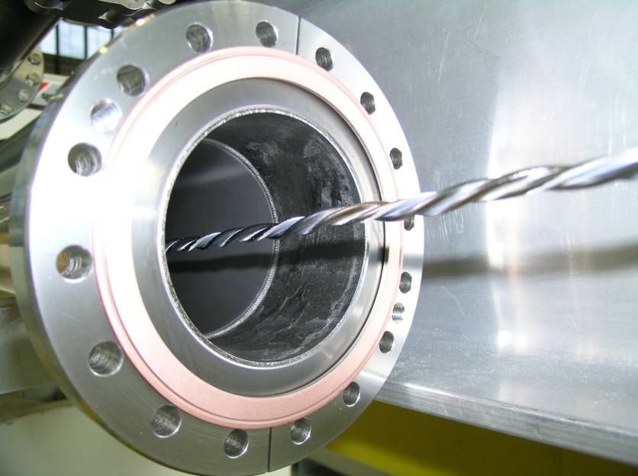
Why?
NEG thin film coating
NEG thin film coating, developed at CERN, is usually performed by DC magnetron sputtering from a twisted Ti, Zr, V wire cathode that is positioned in the vacuum chamber centre.
Before coating
Vacuum chamber
TiZrV cathode
Physical vapor deposition techniques are difficult to apply to few-mm diameter pipes that are several meter long.
After coating
Vacuum chamber
?

Slide 5
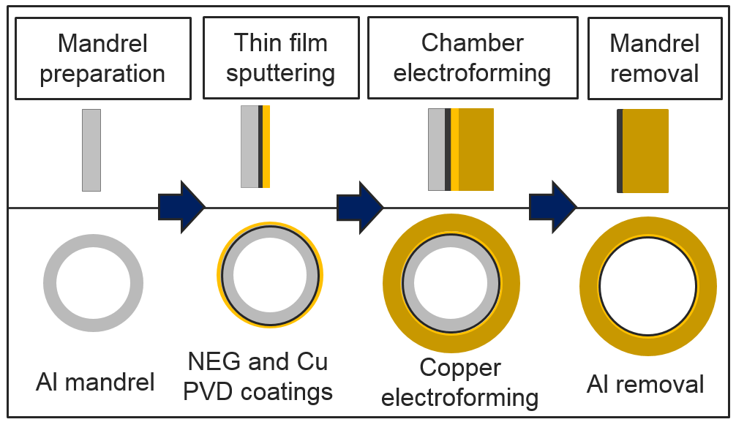
Production/coating technique based on mandrel technology
The vacuum chamber is produced by copper electroforming around a sacrificial aluminium mandrel which is pre-coated with a NEG thin film.

Slide 6
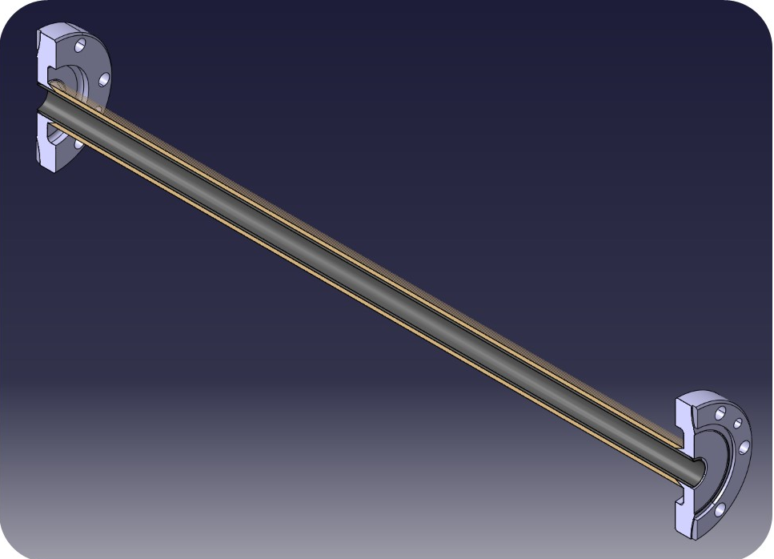
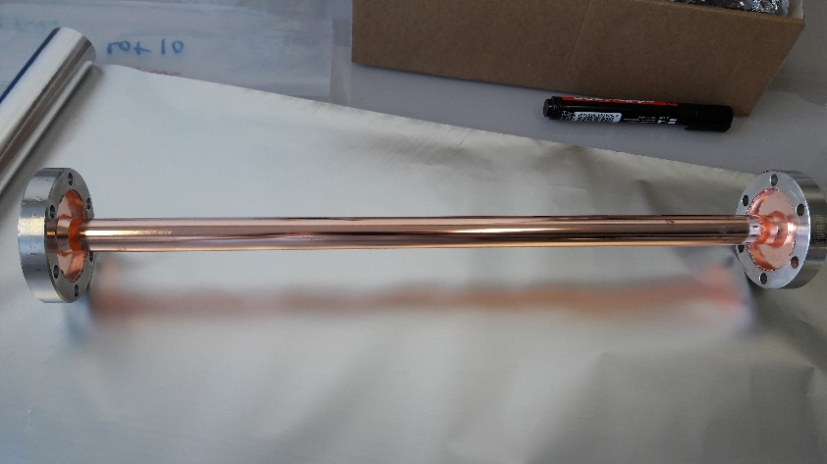
Production/coating technique based on mandrel technology
During the electroforming, the stainless steel flanges are assembled to the chamber without any welding/brazing.

Slide 7
Production/coating technique based on mandrel technology
Advantages of this technique:
Stainless steel joining is produced without EB welding or brazing step.
Uniform coating (composition + thickness) is obtained along the length of the chamber.
Coating reproduces the mandrel topography: If mandrel is polished, coating is very smooth.
Very complex shapes can be coated if a mandrel can be machined.

Slide 8
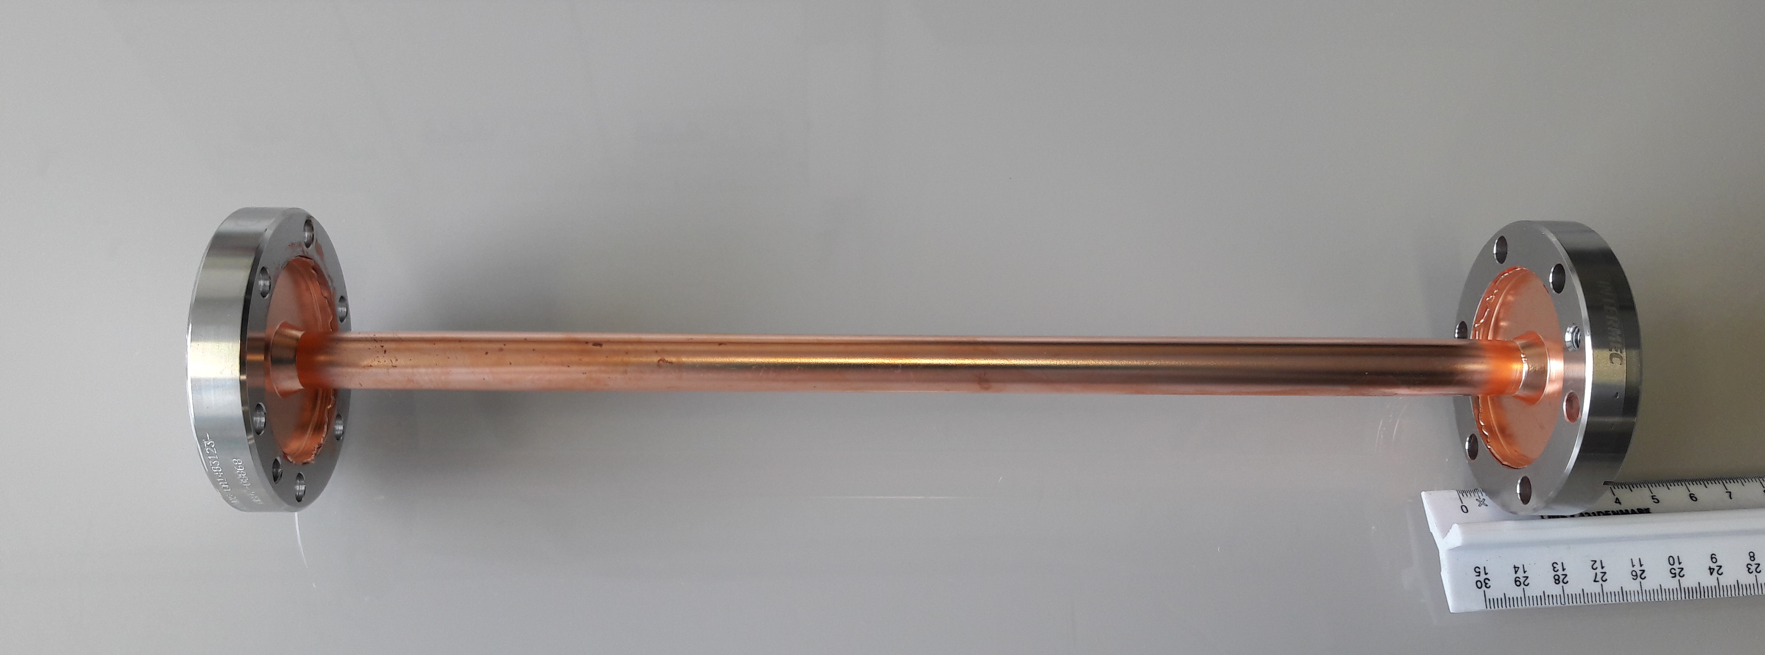
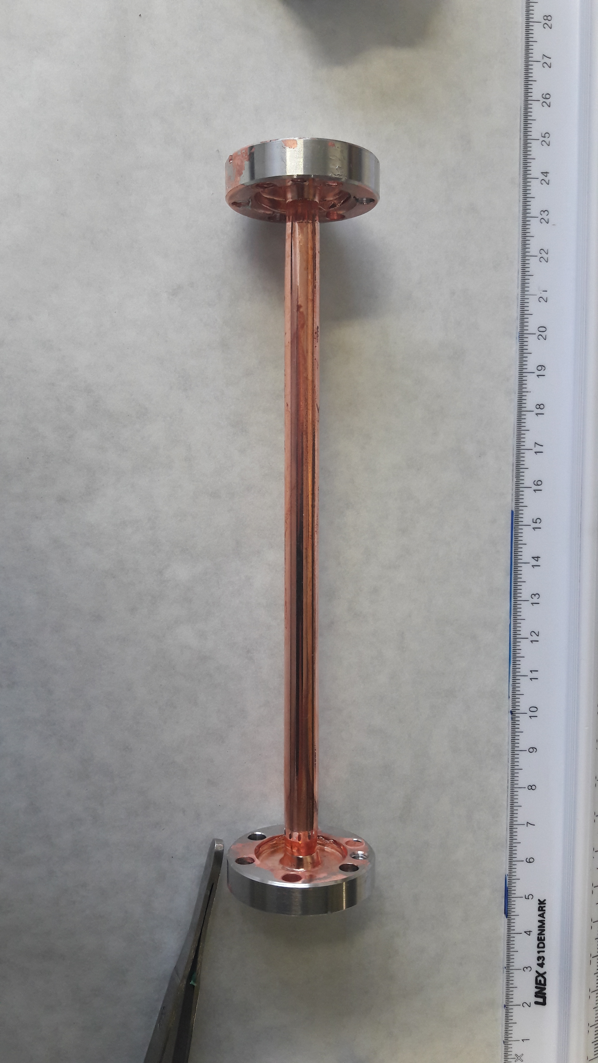
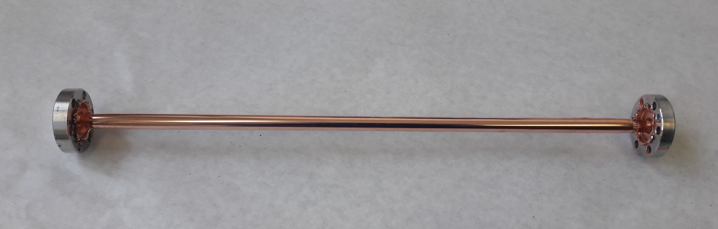
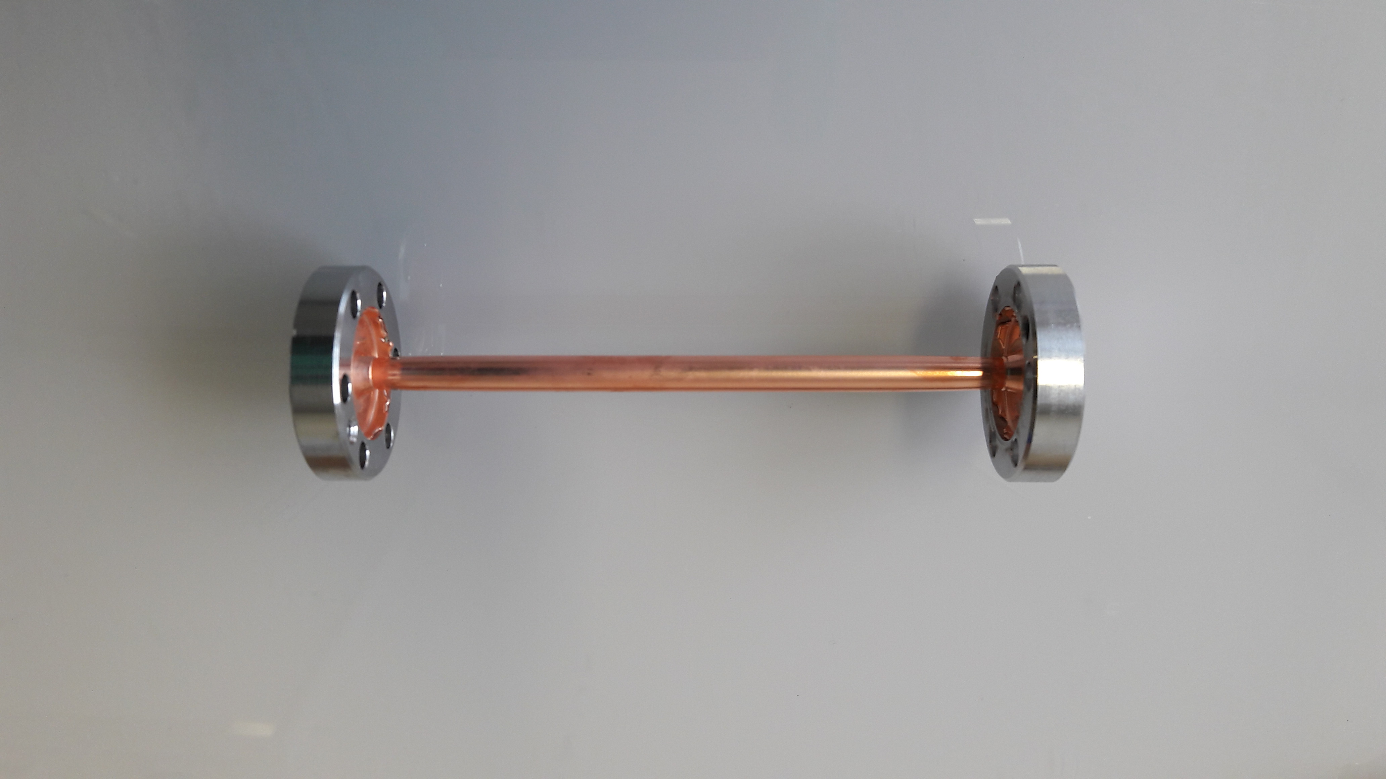
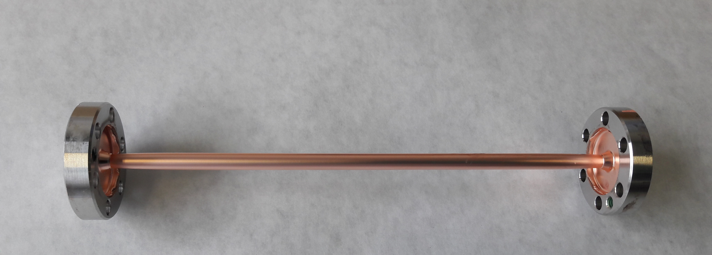
Prototypes
TiZrV coated chamber
Diameter constraint?
Chamber 16 mm diameter
Chamber 12 mm diameter
0.4 m
0.3 m
Chamber 6 mm diameter
Chamber 5 mm diameter
0.15 m
0.3 m
Chamber 4 mm diameter
Chamber 3 mm diameter
0.1 m
0.15 m
Lowest diameter ever NEG coated tube
8

Slide 9
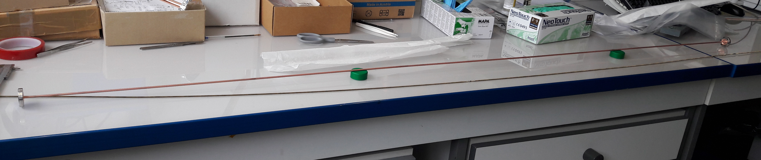
Prototypes
TiZrV coated chamber
Length constraint?
4mm internal diameter, 2 m length TiZrV coated chamber
Ø4mm
2 m
Thickness (μm)
M (%)
Limited only by the depth of the plating bath.
Length [mm]

Slide 10
Prototypes
TiZrV coated chamber
Pumping performance
H₂ sticking probability ( ∼ pumping performance)
NEG reference
Prototypes
H₂ sticking factor reaches reference values (standard coating method), but there is a delay in activation temperature.
10

Slide 11
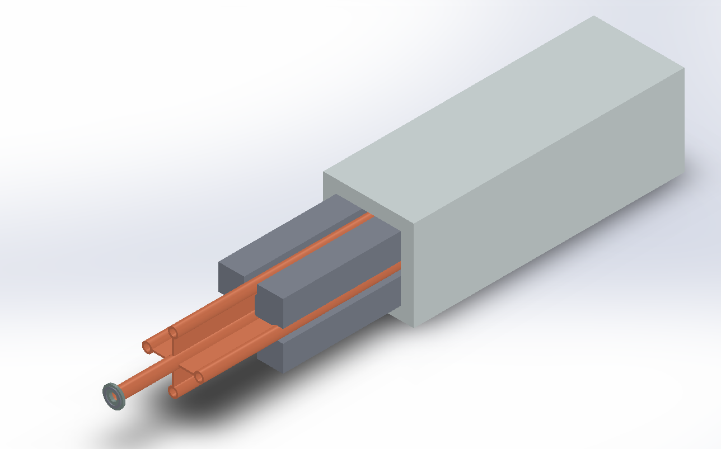
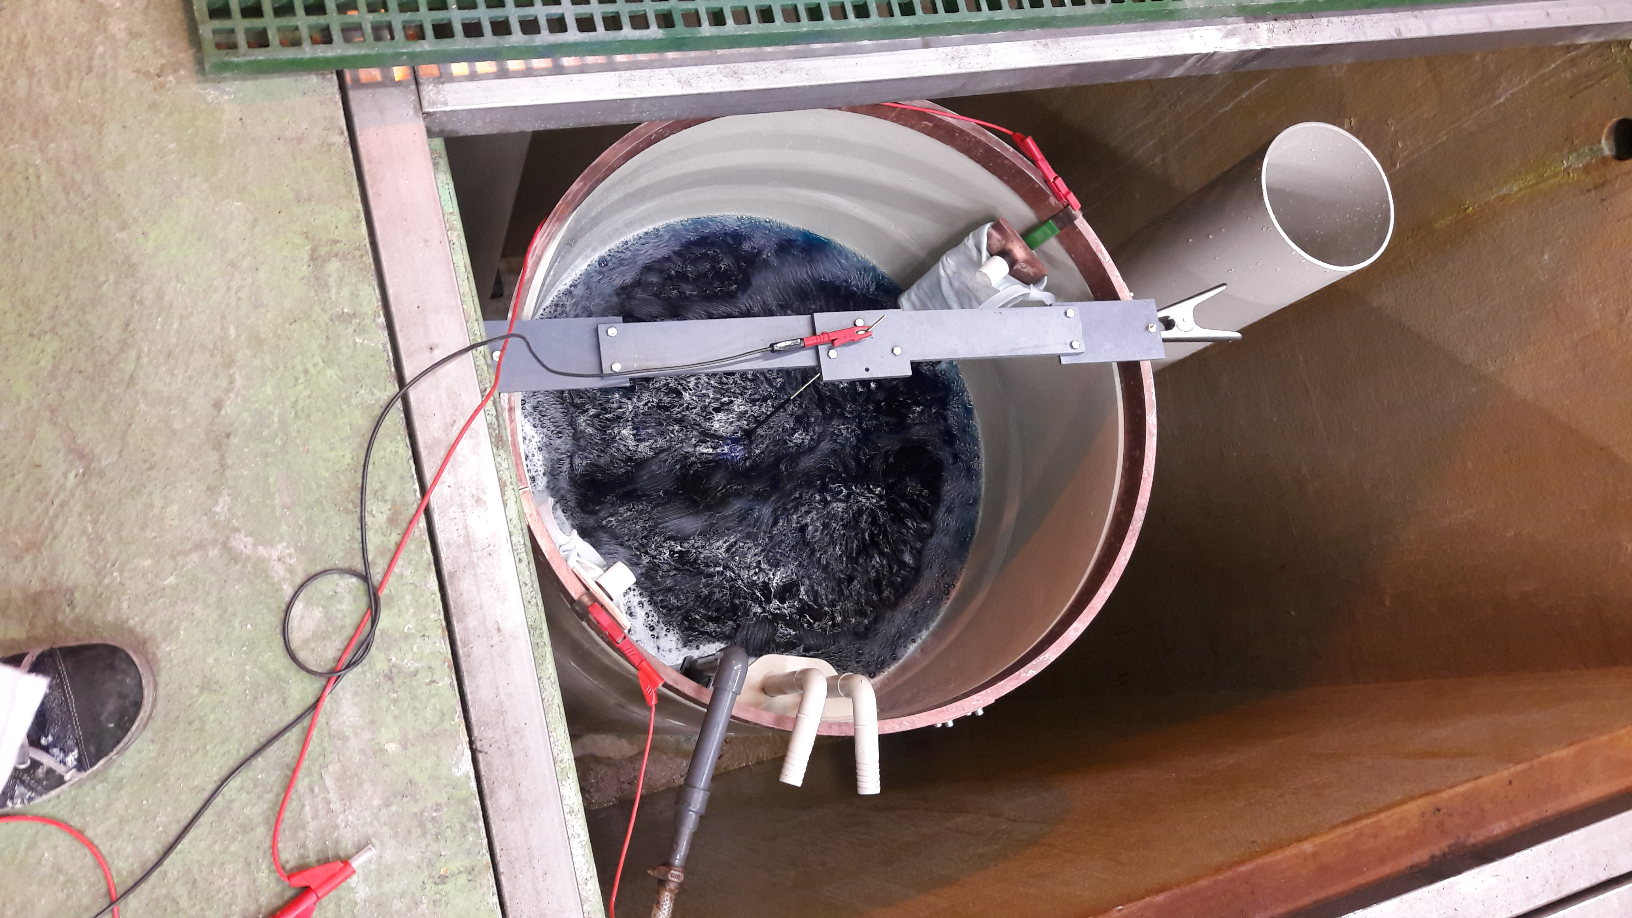
Transfer of the technology to non circular and/or complex geometries.
Joining stiffeners and/or cooling lines by the electroforming process.
Optimization of plating procedures at CERN. Reverse pulse plating to optimize thickness distribution.
Decrease the in-situ activation temperature of the coating.
Further steps
ATS-KT Innovation day
26th October 2018, Geneva, Switzerland
11

Slide 12



Vacuum in the beampipes of CLIC quadrupoles
The idea has been pursued as a PhD work at CERN, in collaboration with the Université de Franche Comté.
High interest is shown from Berkeley Lab (US) and PSI (Zurich) for vacuum chambers of wigglers.
Industrial companies that manufacture vacuum chambers for HEP have also shown interest
Origin of the idea
Interest in HEP community
12

Slide 13
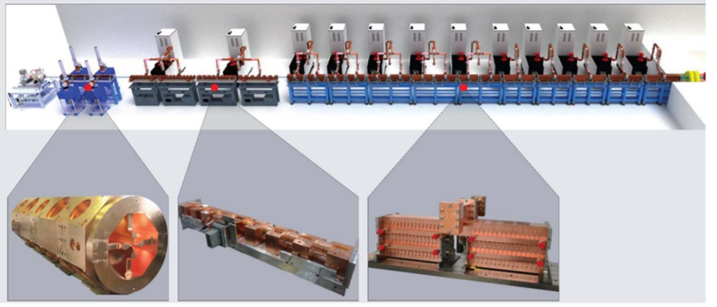
Other applications outside CERN and HEP
TiZrV coated beampipes
Advanced onco-therapy beam-pipes // accelerator for medical research
Free Electron Lasers
A. Degiovanni et al. Proceedings of NAPAC2016, Chicago, IL, USA
LIGHT (LINAC for Image Guided Hadron Therapy)
General idea: thin-film coated copper electroformed assembly
Applications can be expanded to other thin film coatings in complex and/or small geometries.
ATS-KT Innovation day
26th October 2018, Geneva, Switzerland
13

Slide 14
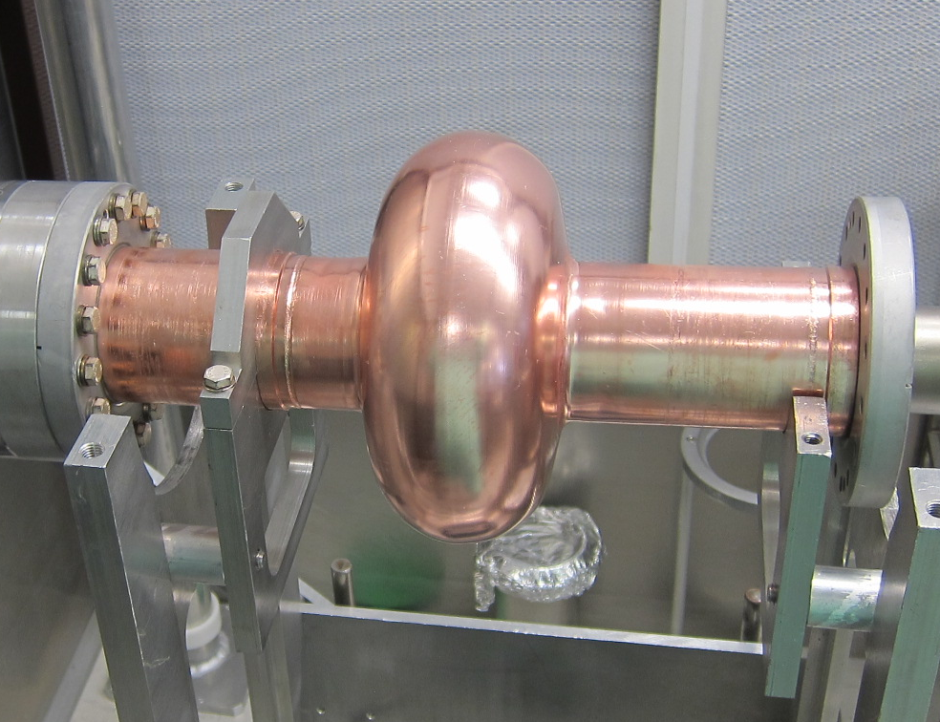
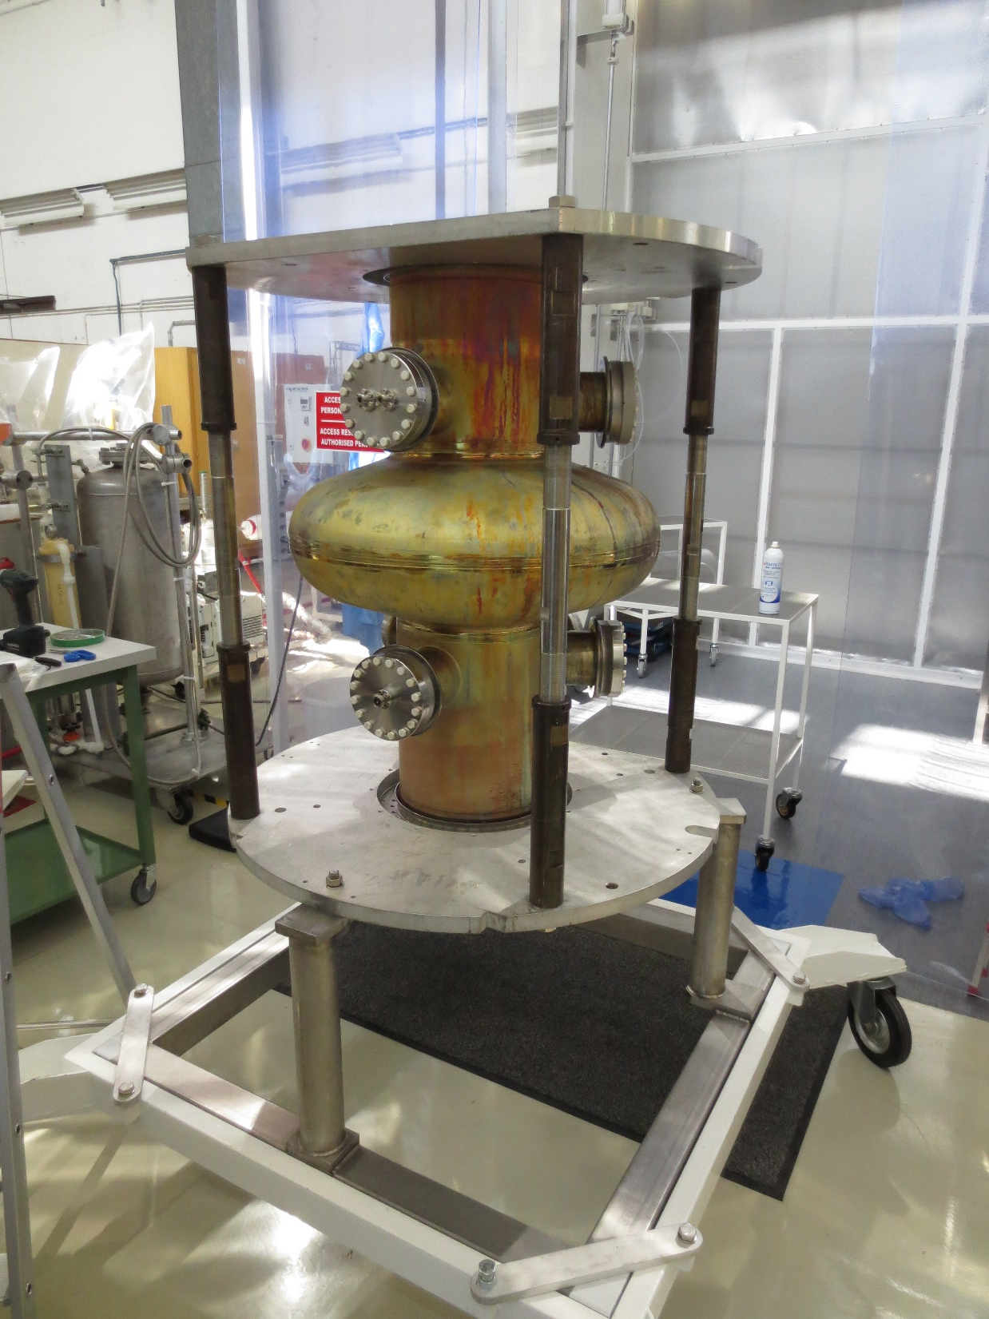
Other applications
RF cavities (to be tested)
Aluminium mandrel polished
No EB welding in the process
High RRR for electroformed copper
Cu cavities made with Cu PVD layer
Nb/Cu cavities made by deposition of Nb and Cu PVD layers on the mandrel
1.3 GHz cavity
LHC cavity
ATS-KT Innovation day
26th October 2018, Geneva, Switzerland
14

Slide 15
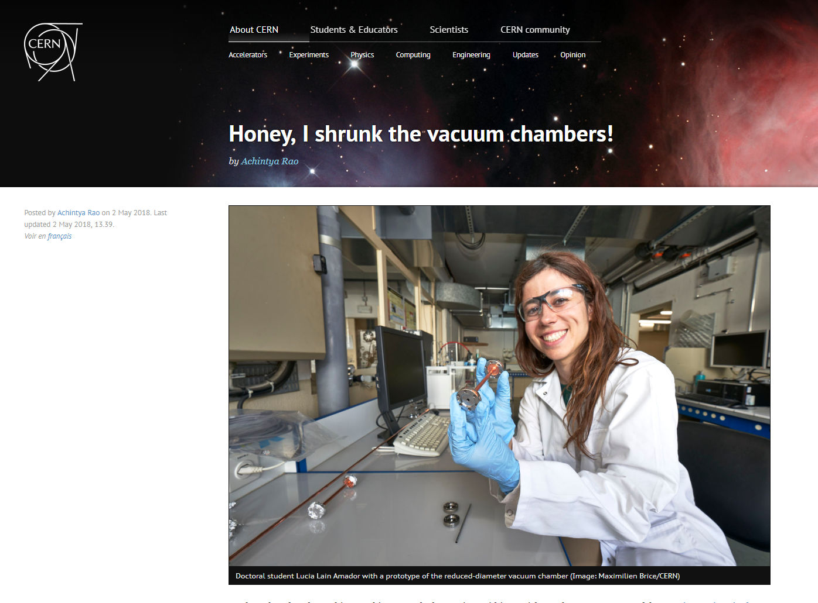
Thank you very much for the attention!
More info:
https://home.cern/about/updates/2018/05/honey-i-shrunk-vacuum-chambers
L. Lain Amador, P. Chiggiato, L. M.A Ferreira, V. Nistor, A. T. Perez Fontenla, M. Taborelli, W. Vollenberg, M-L Doche, J-Y Hihn,J. Vac. Sci. Technol. A, 36, 021601 (2018)
ATS-KT Innovation day
26th October 2018, Geneva, Switzerland

Slide 16
Non evaporable getter (NEG)
Non Evaporable Getter are materials than can pump residual gaseous molecules after thermal activation in vacuum.
During the activation, the surface oxygen diffuses inside the bulk.
T = T_{activation}
T = RT
T = RT
Metal oxide
ATS-KT Innovation day
26th October 2018, Geneva, Switzerland
15

Slide 17
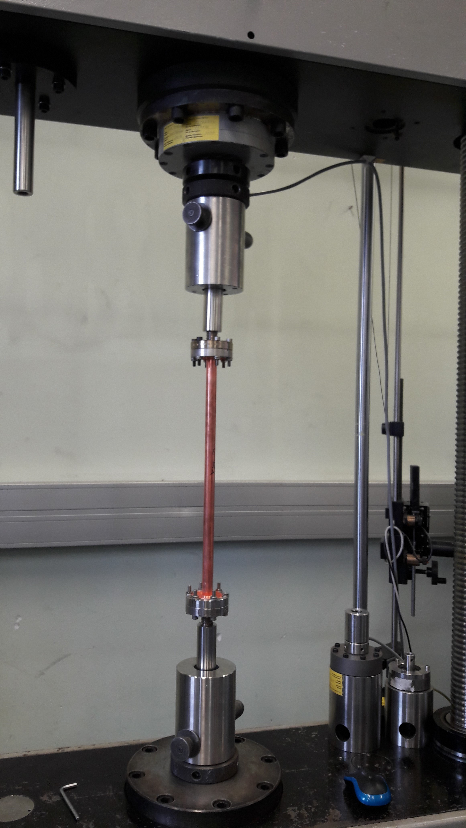
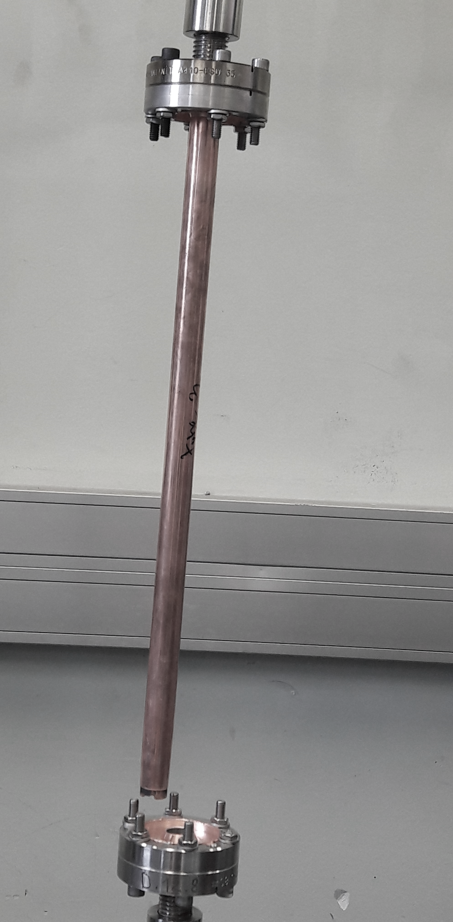
Mechanical performance
Cu OFE cold-worked
350-400 MPa
Cu OFE annealed
180-220 MPa
(280°C)
Chambers before and after bake-out exhibit a tensile strength comparable to Cu OFE
ATS-KT Innovation day
26th October 2018, Geneva, Switzerland
17

