Slide 1

Accelerators ACTIVITY
Experience at the Soltan Institute for Nuclear Studies POLAND
Sławomir Wronka, 27-Nov-09r

Slide 2
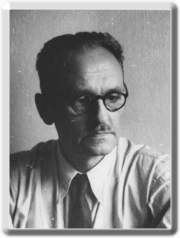
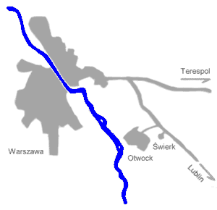
SINS is an unit of the Świerk Research Center
Prof.
Andrzej Sołtan (1897-1959)
Organizer and the first Head of the Institute

Slide 3
Nuclear Centre „Świerk”
IPJ – The Andrzej Soltan
Institute for Nuclear Studies
IEA - Institute of Atomic Energy
ZUOP - Department of Radioactive Waste Management
  44 ha area
  1000 people
  30 km from Warsaw centre

Slide 4
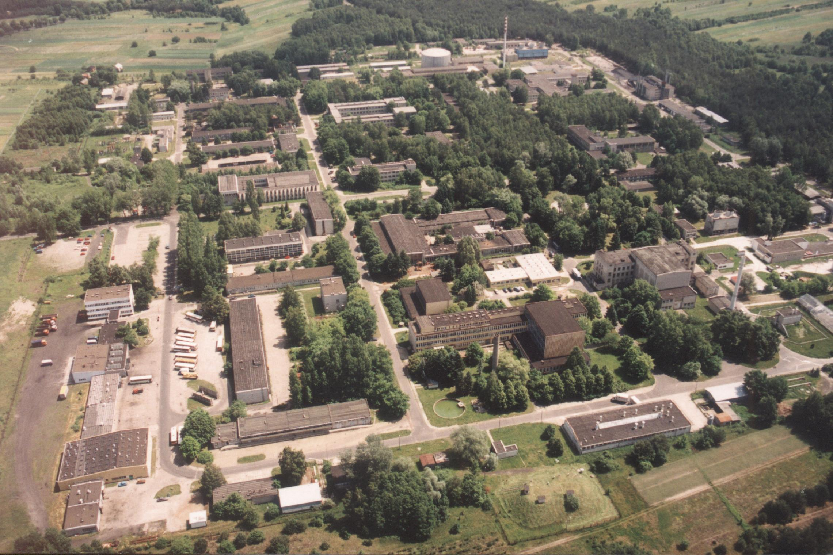
Nuclear Center „Świerk”

Slide 5
IPJ staff: 460 people
139 researchers, including
23 professors
23 PhD hab.
54 PhD
~300 papers in 2007
Non-reserach units:
Department of Training and Consulting: 6 people
  6500 high school students visiting per year
Department of Nuclear Equipement: 106 people
  Commercial production unit
Transport Division: 45 people
papers

Slide 6
Research departments
Nuclear Reactions
Interdisciplinary Applications of Physics
Detectors and Nuclear Electronics
Laboratory for Astroparticle Apparatus
Plasma Physics and Technology
High Energy Physics
Cosmic Ray Physics
Material Studies
Accelerator Physics and Technology

Slide 7
International projects
CERN: Compass, NA48, Alice, CMS, LHCb, NA61, SPL
DESY: ZEUS, HERMES, FLASH, XFEL
Brookhaven: RHIC
GSI Darmstadt: FAIR
Julich: WASA, ANKE
Karlsruhe: Kascade, Kascade Grande, LOPES
GANIL Caen: SPIRAL
Kamioka, Japan: T2K
Polkowice-Sieroszowice?: LAGUNA
Greifswald: Stellarator Wendelstein 7-X
Cadarache: ITER
Satellite missions: POLAR, GRIPS

Slide 8
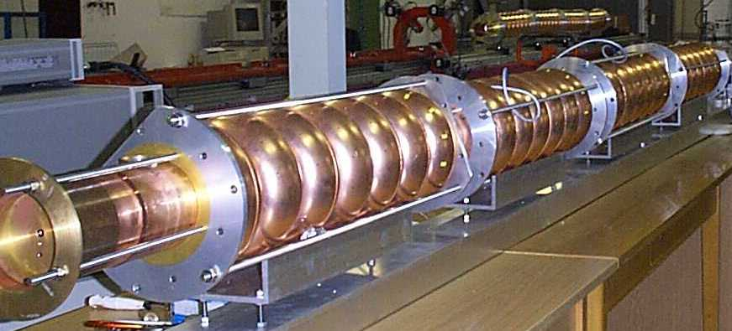
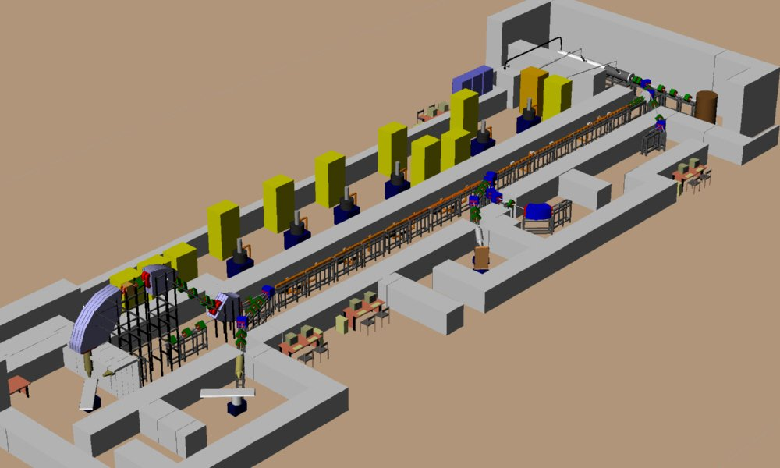
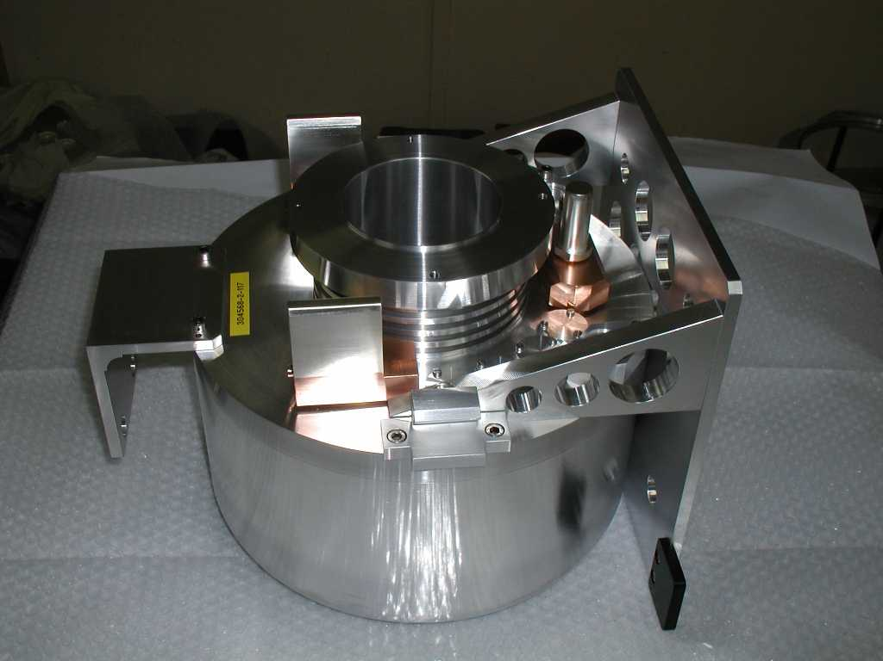
Accelerator technologies
Prototype warm cavities
1.3 GHz for Tesla-FEL,
DESY, Hamburg
      Contract for structures
      of 60 MeV accelerator
      for proton teraphy
      TOP, Frascati
Accelerator target for
Isolde, CERN, Genewa

Slide 9
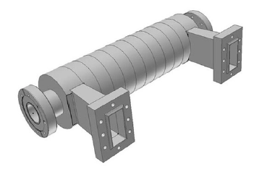
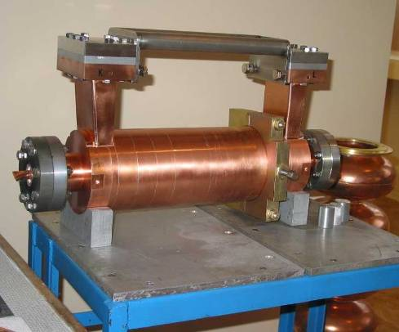
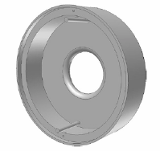
Accelerator technologies
3 GHz deflector for CERN CTF3 combiner ring

Slide 10
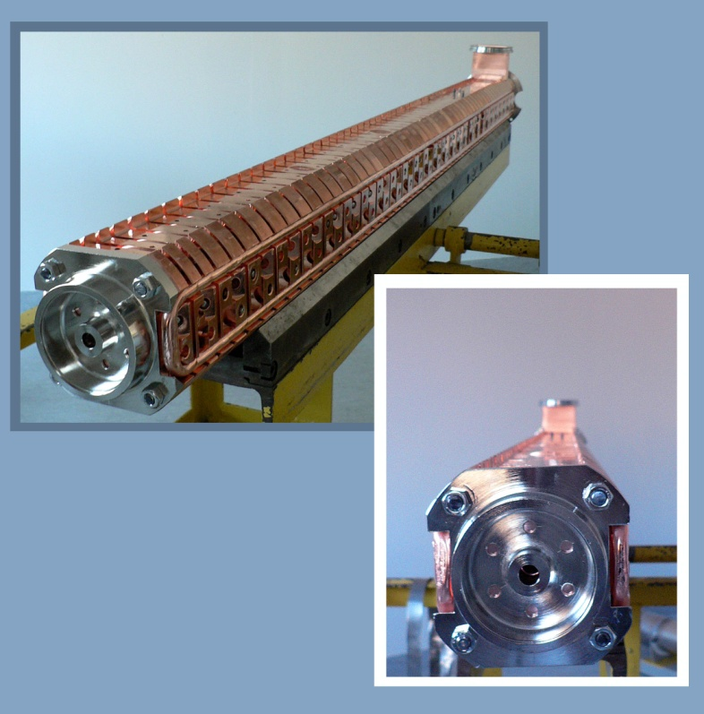
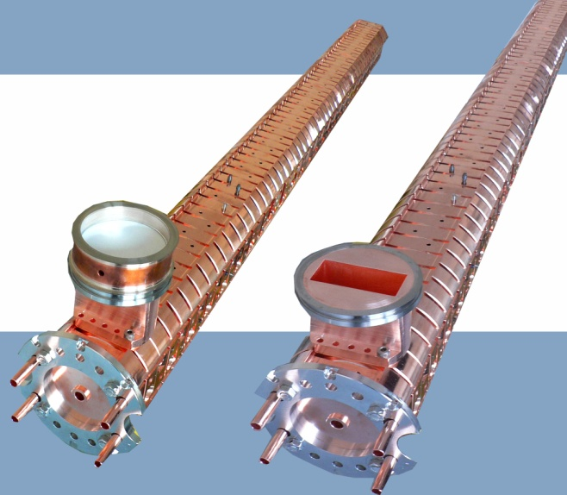
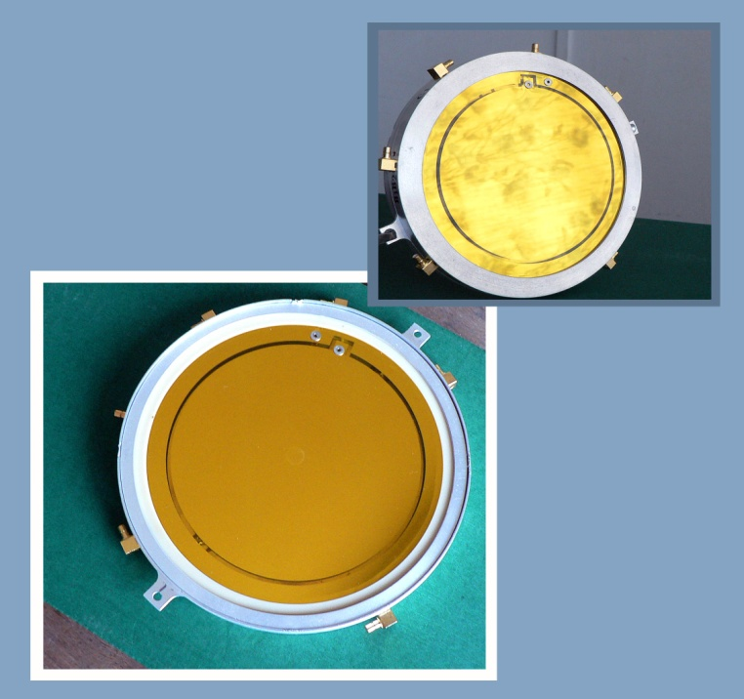
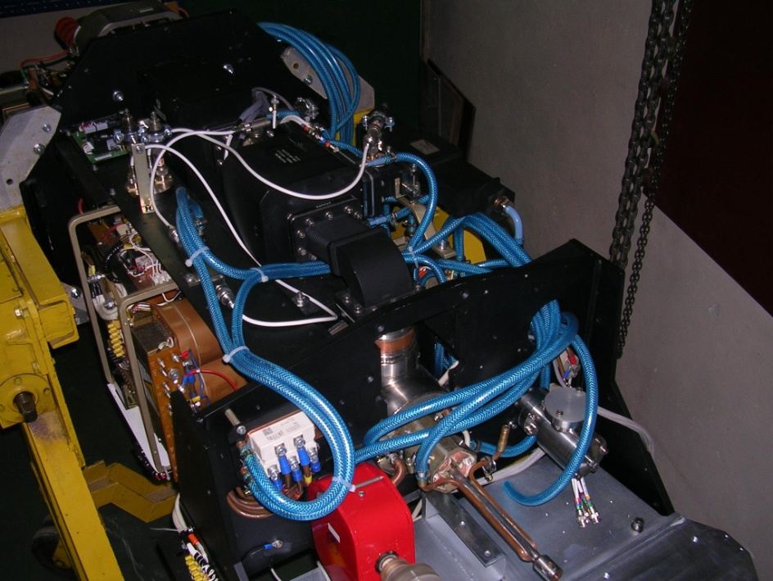
Accelerator technologies

Slide 11
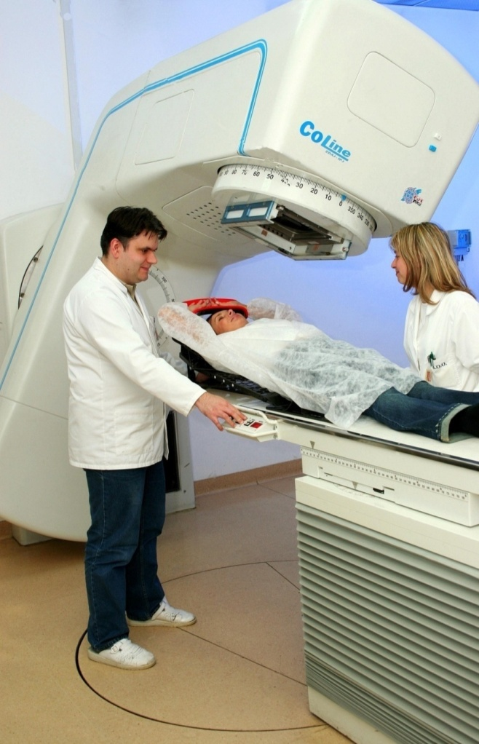
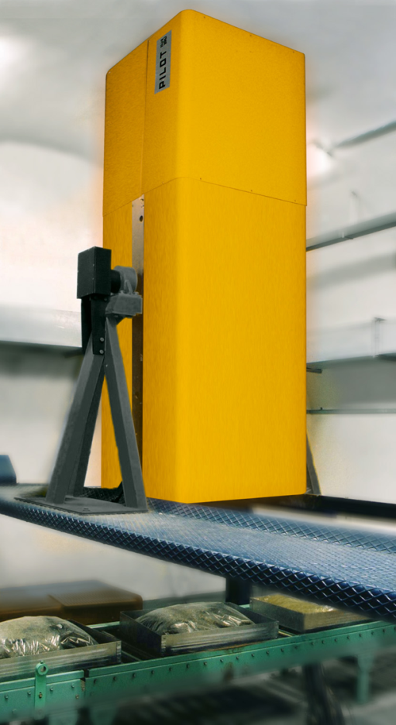
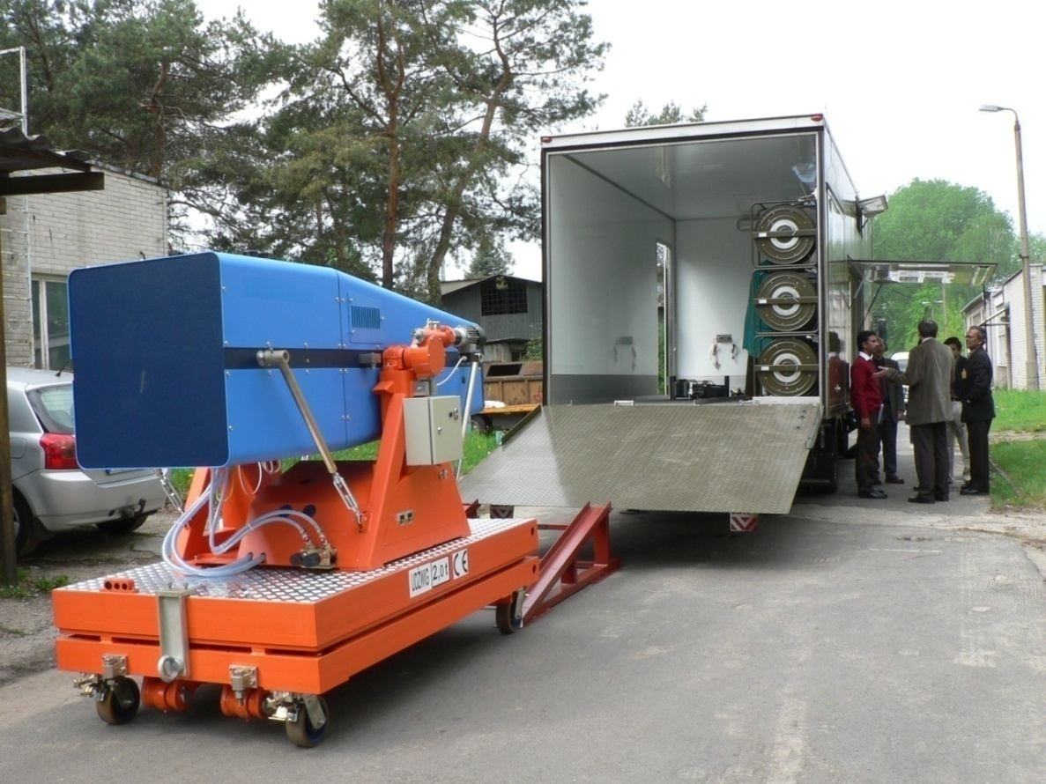
Accelerators for industry and medicine
Hitec-Świerk
Sterilization
Radiotherapy
Radiography

Slide 12
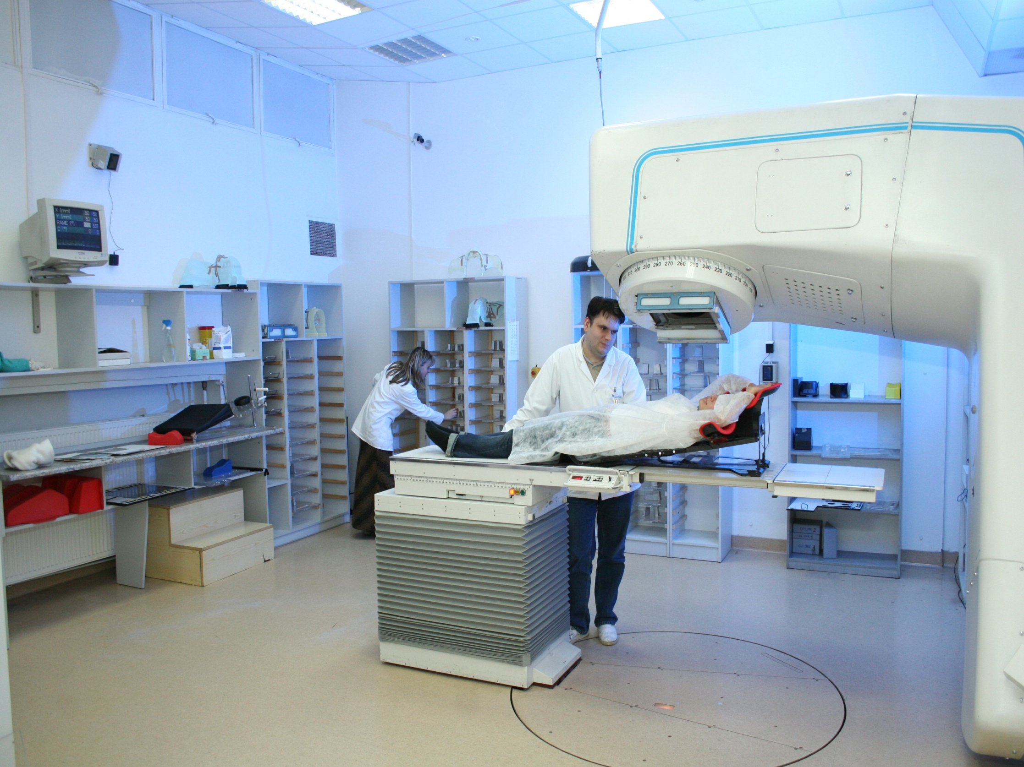

Slide 13

Designing and manufacturing of different collimators for e⁻, n and γ/X beams up to 25MeV
Calculations, simulations and designing of shelters, radiation centers etc.

Slide 14
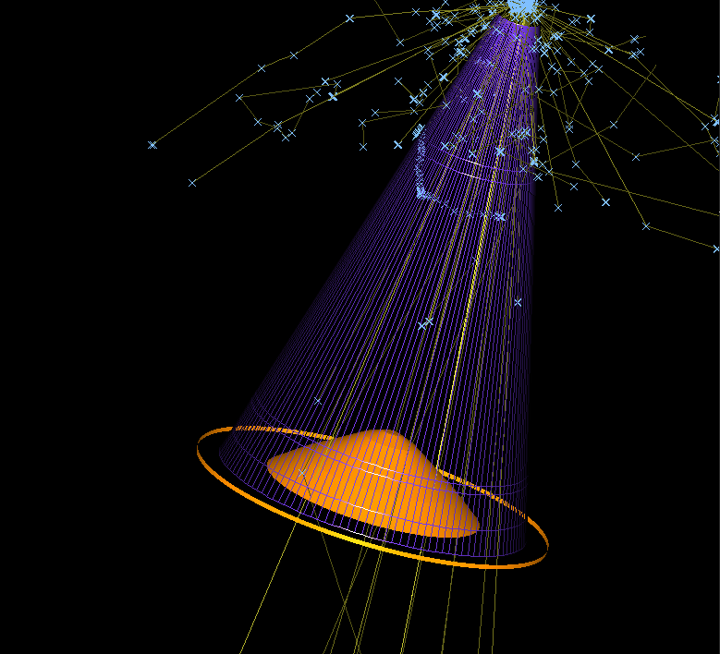
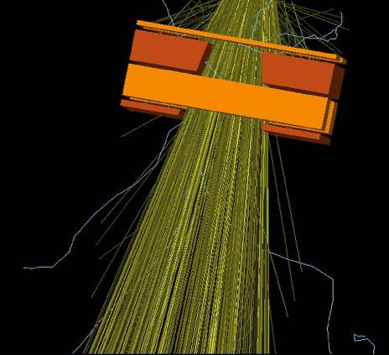
Calculations and design

Slide 15
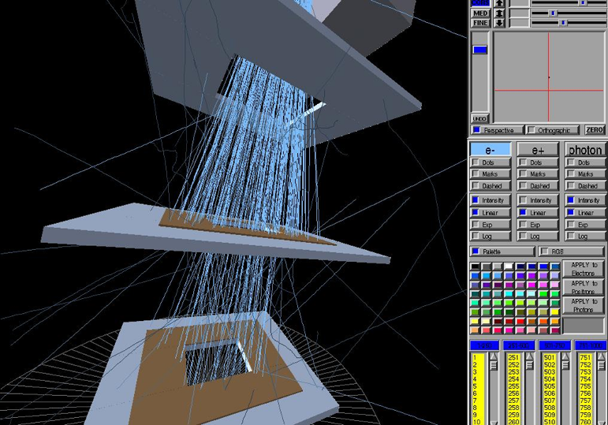
Calculations and design

Slide 16
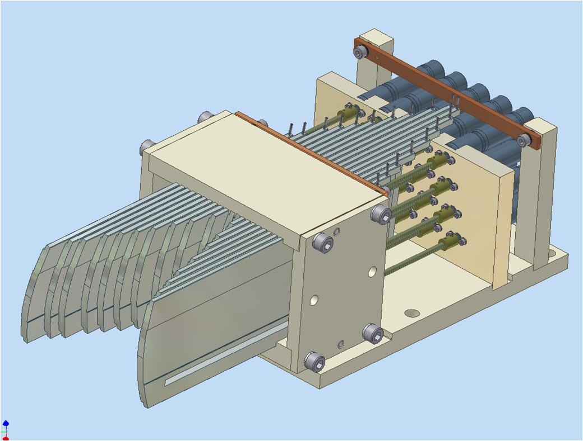
Calculations and design

Slide 17
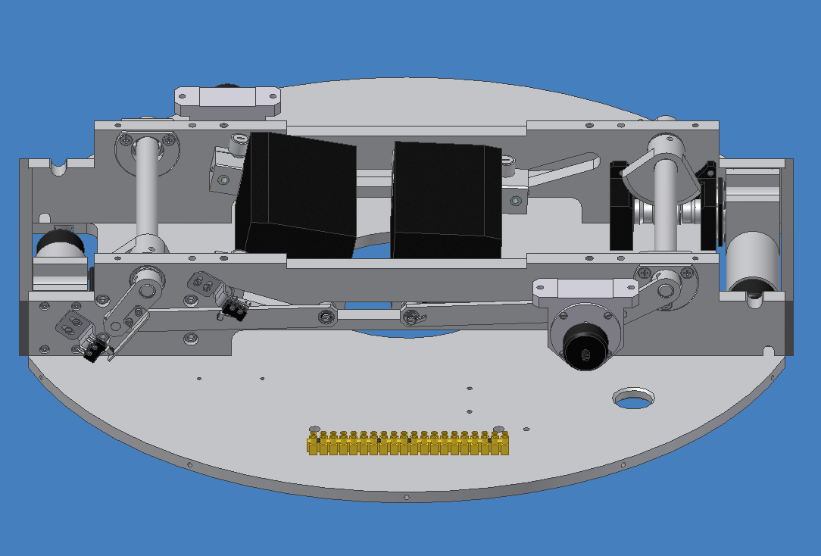
Calculations and design

Slide 18
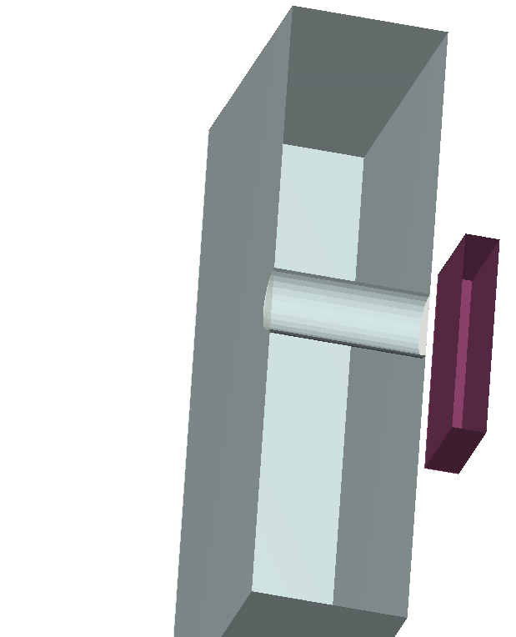
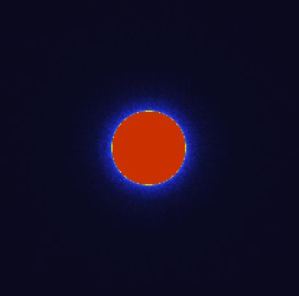
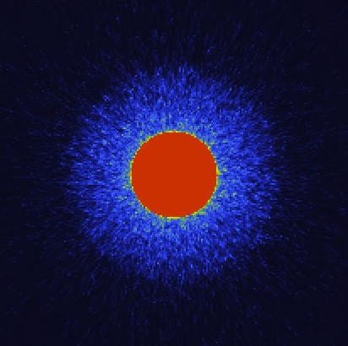

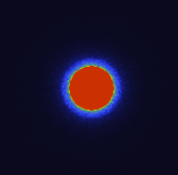
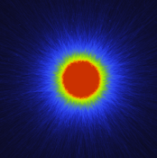
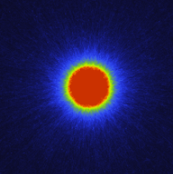
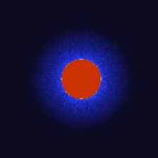
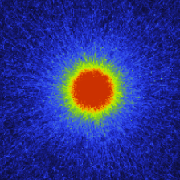
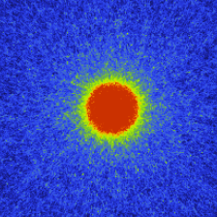
Fluka simulations for SPL
50cm Steel
Total dose
50cm 15cm
50 cm
15 cm
Protons photons neutrons

Slide 19
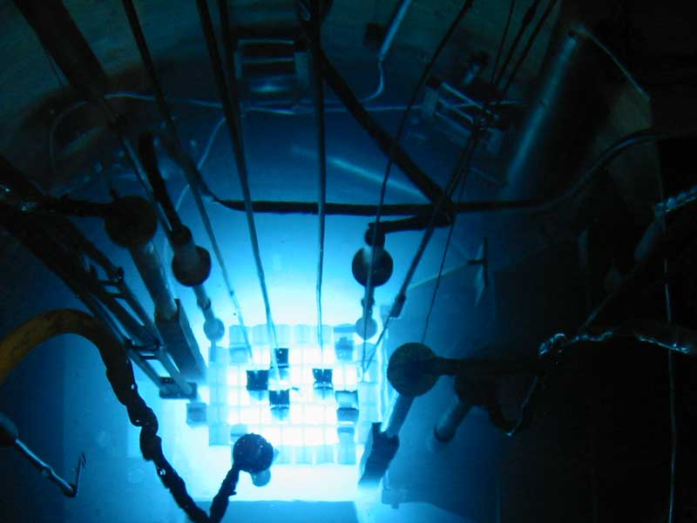
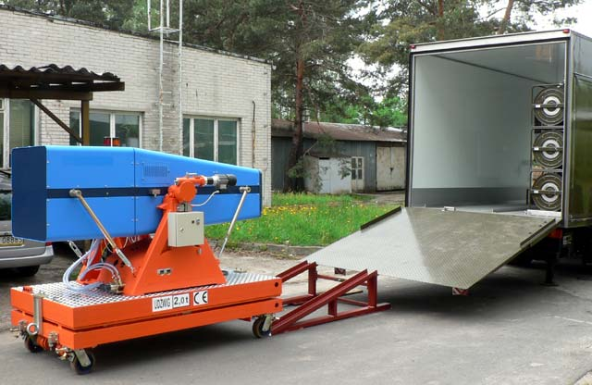
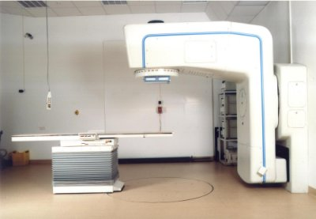
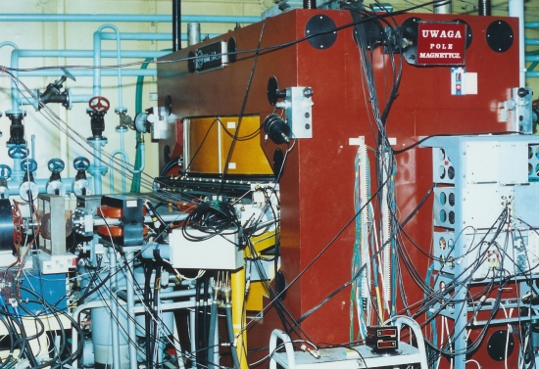
Irradiation possibilities in Świerk
Nuclear reactor MARIA:
  nominal power 30MW,
  thermal neutron flux density 4×10¹⁴ n/cm²·s,
  moderator H2O, beryllium,
Electron linacs:
  Electron beams: 4-20 MeV
  Photon beams: 4-15 MeV
Cyclotron:
  proton beam 25 MeV

