Slide 1



Cavity BPM at CLEAR
A. Lyapin, M. Cargnelutti, M. Wendt
RHUL/iTech/CERN
CLIC Workshop, CERN, 21 January 2019

Slide 2
Outline
Present Cavity BPM system in CLEAR
Experience with the present system
Proposed future system:
  RF down-converter
  Signal processing
  Digitiser
Phased approach to the upgrade
Conclusions

Slide 3
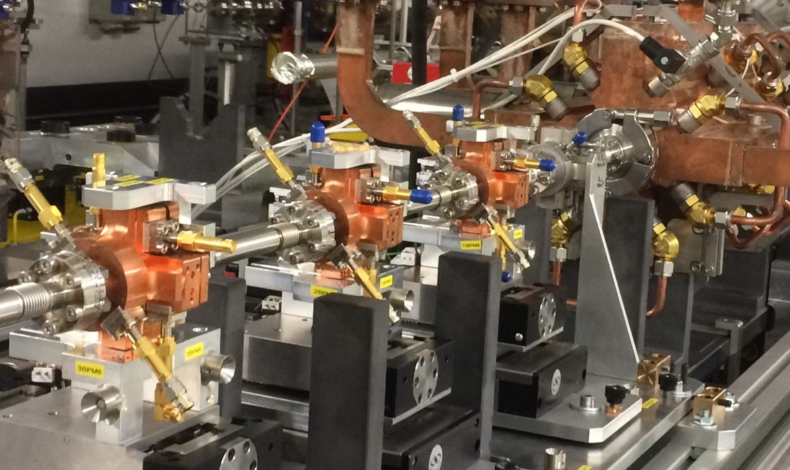
Present CBPM system @CLEAR
A demonstrator system for CLIC main beam cavity BPMs
High spatial (50 nm) and high temporal (50 ns) resolution needed for beam based alignment, wakefield-free steering and online dispersion correction via energy chirped trains
3x 15 GHz low-Q (fast decay) position cavities
Downconversion to a lower frequency for digitisation
Transverse movers for calibration and alignment

Slide 4
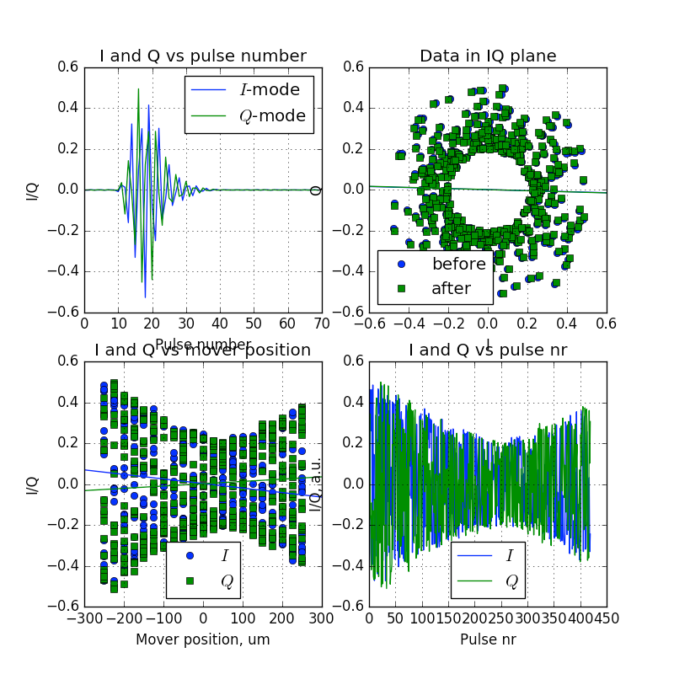
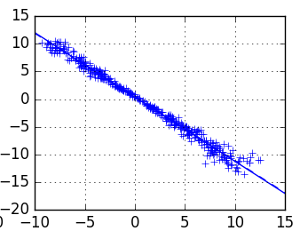
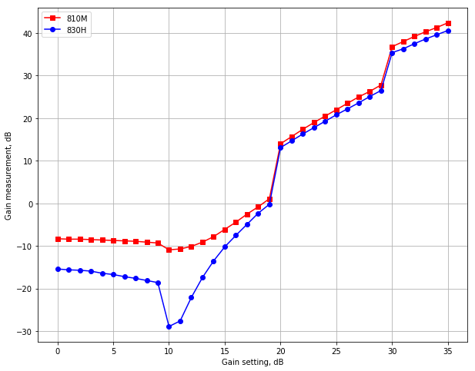

Experience with the present system
A number of issues found, some critical to performance:
Electronics too complex
  Excessively high gain
  Attenuation resulted in increased noise
  Poor linearity
  Radiation hardness issues
+/-100 μm
@50 pC
Electronics control issues
  Impossible to use the optimal setting
  Now fixed with a new control
ADC clocks randomly go out of sync
  Use lower bit resolution digitiser
  Resolution limited to 1-2 m
$$μ$$

Slide 5
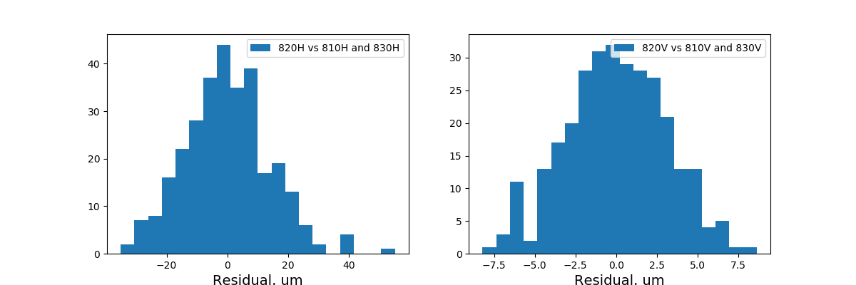
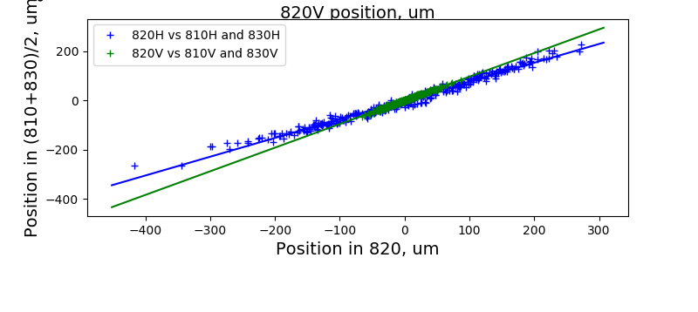

Experience with the present system
The best resolution measurement around 2 m, as expected given the limitations
$$μ$$

Slide 6
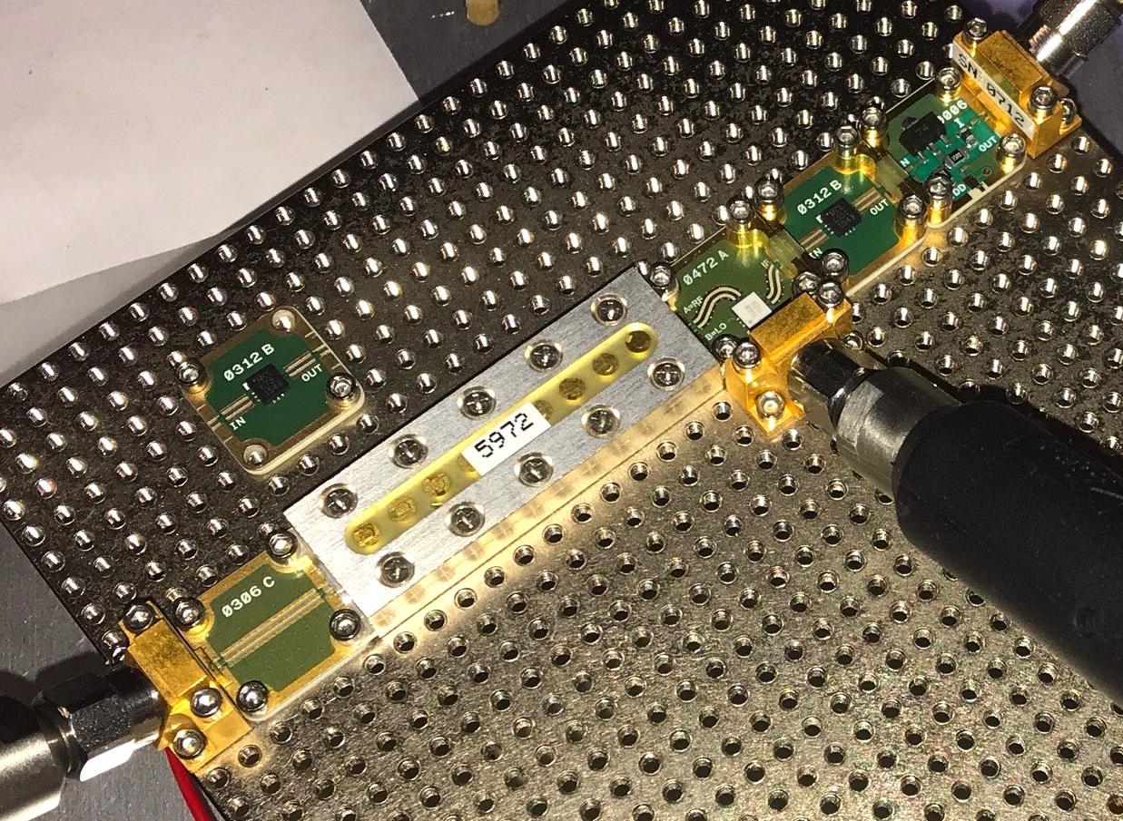
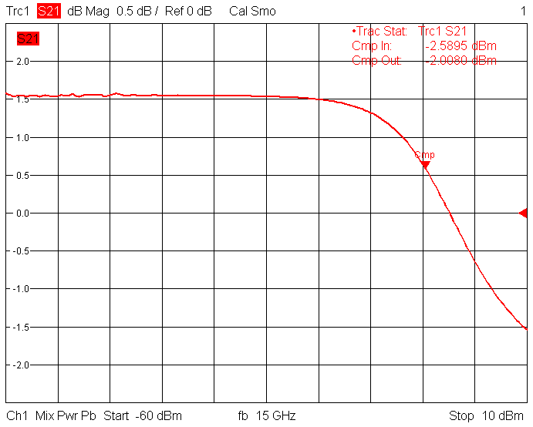
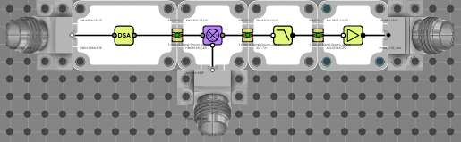
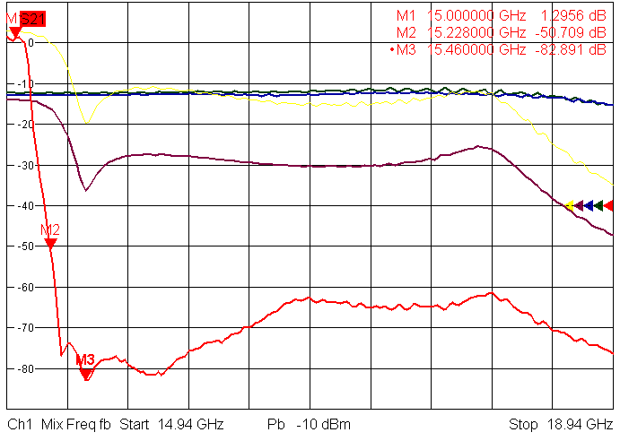
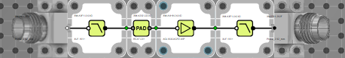
Proposed future system: RF downconverter
Same single-stage downconverter concept, but no excessive gain, linearity important
Use modular “RF Lego” approach by XMicrowave
Minimize control: only front-end step attenuator is controllable, needed for high charge operation with bunch trains
Use rad hard voltage regulators (found to be most sensitive in the old system)

Slide 7
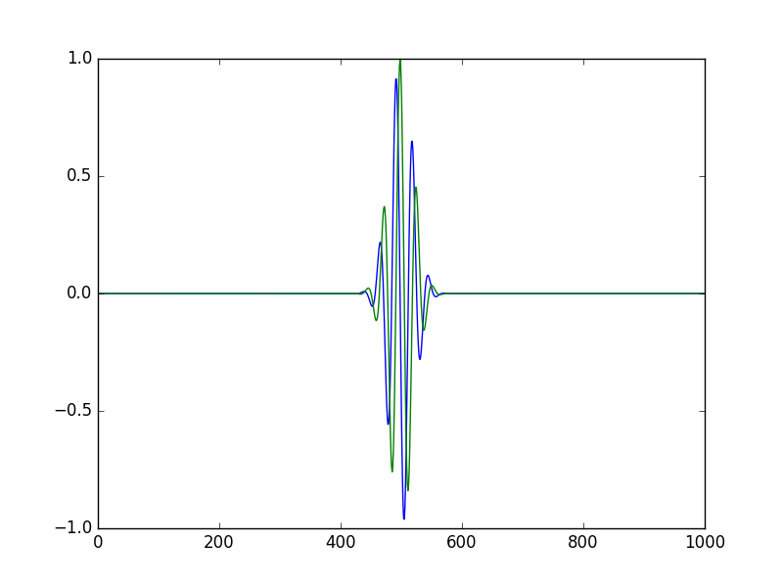
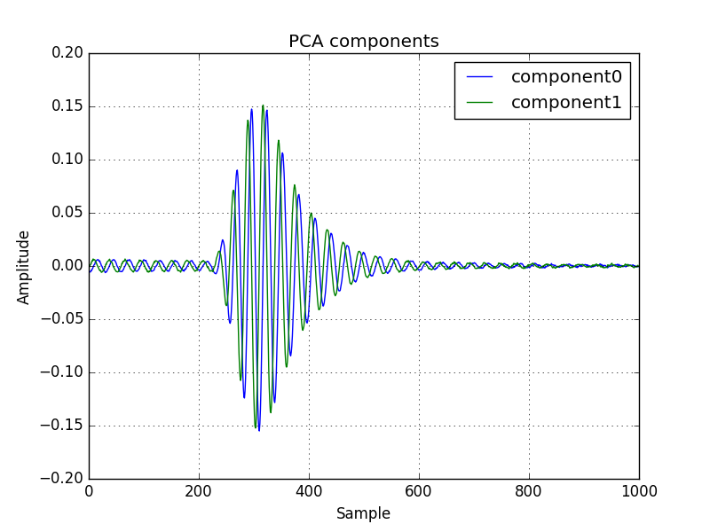
Proposed future system: Signal processing
2 types of analysis tried so far: Digital Down-Conversion (DDC) and Principal Component Analysis (PCA)
In both cases we can use a basis of 2 windowed orthogonal sin/cos-like signals to map the amplitude and phase of the position signals corresponding to a known offset introduced during calibration
DDC: Gaussian window, positioned arbitrarily; PCA: Signal-derived window
We’ve been concentrating on DDC as it is robust, better understood and some corrections, such as for timing changes, are possible, although PCA can deliver higher resolution
Both algorithms can be accelerated using FPGA-based processing
In addition, can use iTech-developed power measurement based method

Slide 8
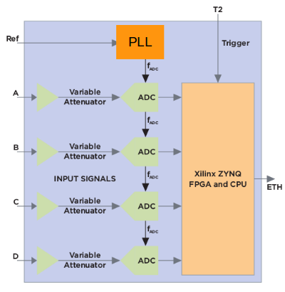
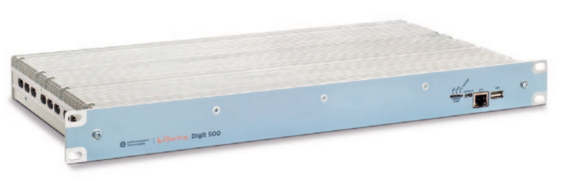
Proposed future system: Digitiser
Libera Digit 500 – AC coupled
4 Channel AC coupled Digitizer
ADC: 500MSps – 14 bit
Bandwidth: 1MHz – 2GHz
32 dB variable gain
Segmented memory with up to
500M ADC samples per channel
Network attached

Slide 9
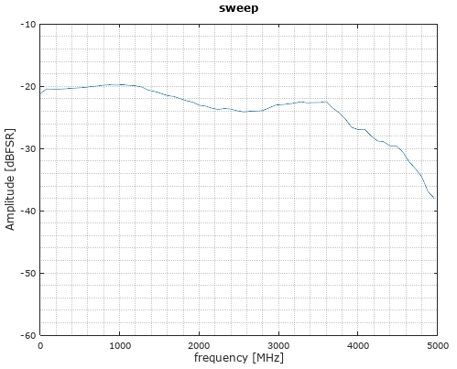
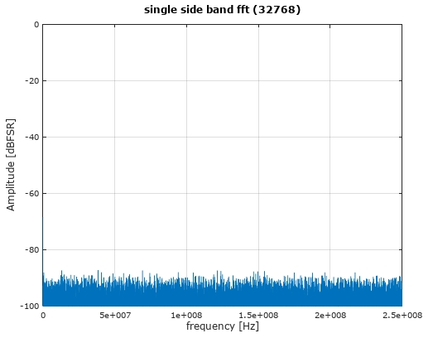
Proposed future system: Digitiser
Digit 500 Performance
Bandwidth measurement
Noise floor measurement
90dB
Equivalent noise
Spectral density:
-143 dBm/Hz
2GHz
Terminated inputs (50Ohm)
Internal attenuation: 32dB

Slide 10
Proposed future system: Digitiser
Project phases
Deliverables
PHASE 1: Proof of principle
New DWC and Digitizer on 1 CavityBPM ADC Data acquisition and Offline post-processing Standalone system (not integrated in CERN controls)
Validation of DWC and Digitizer
First performance assessment
Data processing confirmation

Slide 11
Proposed future system: Digitiser
Project phases
Deliverables
PHASE 1: Proof of principle
New DWC and Digitizer on 1 CavityBPM ADC Data acquisition and Offline post-processing Standalone system (not integrated in CERN controls)
Validation of DWC and Digitizer
First performance assessment
Data processing confirmation
PHASE 2: Online standalone system
New DWC and Digitizers on 3 CavityBPMs ADC Data acquisition and online processing (SW) Standalone system (not integrated in CERN controls)
3 BPM system
Assessment of XY resolution
Calibration confirmation

Slide 12
Proposed future system: Digitiser
Project phases
Deliverables
PHASE 1: Proof of principle
New DWC and Digitizer on 1 CavityBPM ADC Data acquisition and Offline post-processing Standalone system (not integrated in CERN controls)
Validation of DWC and Digitizer
First performance assessment
Data processing confirmation
PHASE 2: Online standalone system
New DWC and Digitizers on 3 CavityBPMs ADC Data acquisition and online processing (SW) Standalone system (not integrated in CERN controls)
3 BPM system
Assessment of XY resolution
Calibration confirmation
PHASE 3: Real-time integrated system
ADC real time processing within the FPGA Integration in CERN controls
Online system,
ready for operation

Slide 13
Proposed future system: Digitiser
Project phases
Proposed timeline
PHASE 1: Proof of principle
New DWC and Digitizer on 1 CavityBPM ADC Data acquisition and Offline post-processing Standalone system (not integrated in CERN controls)
April – May 2019
PHASE 2: Online standalone system
New DWC and Digitizers on 3 CavityBPMs ADC Data acquisition and online processing (SW) Standalone system (not integrated in CERN controls)
July – Nov 2019
PHASE 3: Real-time integrated system
ADC real time processing within the FPGA Integration in CERN controls
Jan 2020 – May 2020

Slide 14
Conclusions
The current CBPM system at CLEAR has shortcomings in the analog front end (gain, linearity) and the digitizer (ADC resolution). The RMS position resolution of the system is limited to 2um.
A new system is proposed with a new downconverter based on modular RF components and a commercial wideband digitizer. The ADC data acquired can be processed with two separate methods (Digital Down Conversion and Principal Component Analysis).

Slide 15
Conclusions
The current CBPM system at CLEAR has shortcomings in the analog front end (gain, linearity) and the digitizer (ADC resolution). The RMS position resolution of the system is limited to 2um.
A new system is proposed with a new downconverter based on modular RF components and a commercial wideband digitizer. The ADC data acquired can be processed with two separate methods (Digital Down Conversion and Principal Component Analysis).
The electronics upgrade is proposed through a three-phase project, starting from the validation of each separate component and progressing with incremental integration with the goal to deliver an online operational system at the end of the project.

