Slide 1

Instrumentation Challenges for CLIC
T. Lefevre on behalf of the CLIC beam instrumentation team
CLIC workshop, 21-25 January 2019, CERN

Slide 2
What have BI teams done since the CDR ?
T. Lefevre on behalf of the CLIC beam instrumentation team
CLIC workshop, 21-25 January 2019, CERN

Slide 3
Outline
CLIC @ 380GeV - PIP
Update on Instrumentation challenges
  High precision/resolution beam instruments
  R&D towards simpler & cheaper alternative solutions
  R&D on Non-invasive beam instrumentation
Conclusions

Slide 4
CLIC PIP - 2018

Slide 5
CLIC PIP - 2018
Beam instruments

Slide 6
Instrumentation challenges
Producing and measuring beams with small emittance (i.e. micron spot size)
Producing and measuring short Bunches (i.e 20fs time resolution)
Conserving small emittance over long distances put very strict requirements on the beam position monitor precision (i.e. 5microns) and resolution (i.e. 10s nm)

Slide 7
Instrumentation challenges
Producing and measuring beams with small emittance (i.e. micron spot size)
Producing and measuring short Bunches (i.e 20fs time resolution)
Conserving small emittance over long distances put very strict requirements on the beam position monitor precision (i.e. 5microns) and resolution (i.e. 10s nm)
Manipulating high charge beams
    Impact on Machine Protection issues
    Impact on Radiation hardness issues
    Require non-intercepting beam diagnostics

Slide 8
Instrumentation challenges
Producing and measuring beams with small emittance (i.e. micron spot size)
Producing and measuring short Bunches (i.e 20fs time resolution)
Conserving small emittance over long distances put very strict requirements on the beam position monitor precision (i.e. 5microns) and resolution (i.e. 10s nm)
As cheap as possible !
As simple as possible !
Manipulating high charge beams
    Impact on Machine Protection issues
    Impact on Radiation hardness issues
    Require non-intercepting beam diagnostics

Slide 9
High resolution BPM

Slide 10
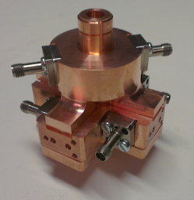



High resolution BPM
CLIC cavity BPM prototype tested on CALIFES / CLEAR
  Aperture: 8mm - Operating frequency: 15 GHz

Slide 11
High resolution BPM
CLIC cavity BPM prototype tested on CALIFES / CLEAR
  Aperture: 8mm - Operating frequency: 15 GHz
  Investigating the time response for long Bunch train observation
  F. J. Cullinan et al., Long bunch trains measured using a prototype cavity beam position monitor for the Compact Linear Collider, Phys. Rev. STAB 18 112802 (2015)
  Some issues of radiation hardness observed requiring an optimization of the read-out electronic

Slide 12
High resolution BPM
CLIC cavity BPM prototype tested on CALIFES / CLEAR
  Aperture: 8mm - Operating frequency: 15 GHz
  Time response for Bunch train observation
  F. J. Cullinan et al., Long bunch trains measured using a prototype cavity beam position monitor for the Compact Linear Collider, Phys. Rev. STAB 18 112802 (2015)
  Some issues of radiation hardness observed requiring an optimization of the read-out electronic
Talk on ‘An acquisition system for Cavity BPM’
by Manuel Cargnelutti – Tuesday at 15h10

Slide 13
Beam Loss Monitors

Slide 14
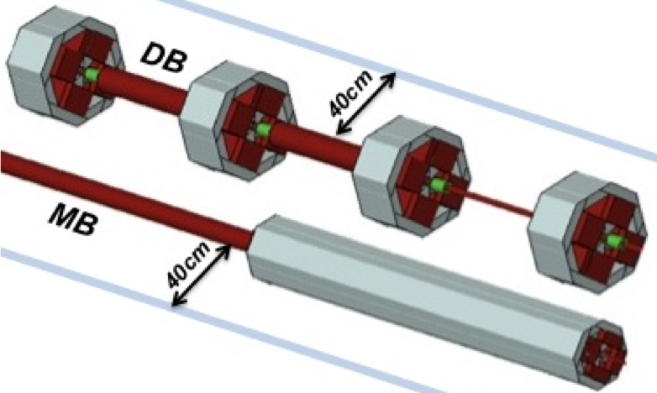
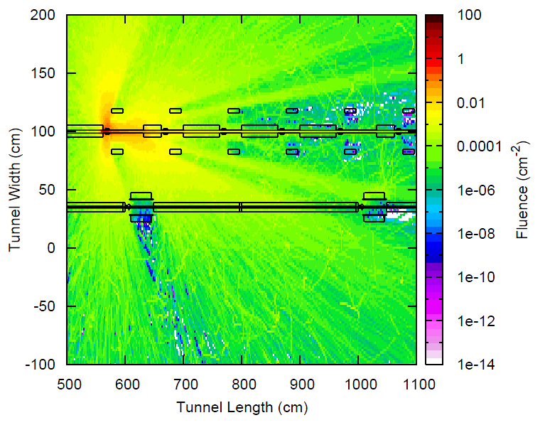
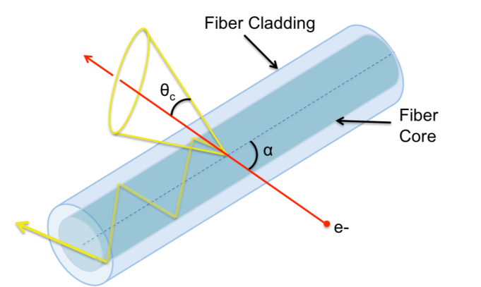


Beam Loss Monitors
Simulations and Design of optical BLM system for CDR in 2012
Drive Beam 2.4GeV
e+/e- fluence

Slide 15
Beam Loss Monitors
Simulations and Design of optical BLM system for CDR in 2012
Since then, … Many experimental studies
  Crosstalk between beam losses from MB and DB : M. Kastriotou et al, “BLM crosstalk studies on the CLIC two-beam module”, IBIC, Melbourne, Australia (2015) pp. 148
  Position resolution of a distributed oBLM system : E. Nebot del busto et al, “Position resolution of optical fibre-based beam loss monitors using long electron pulses”, IBIC, Melbourne, Australia (2015) pp. 580
  RF studies (Breakdown and Dark current): M. Kastriotou et al., “A versatile beam loss monitoring system for CLIC”, IPAC, Busan, Korea, 2016, pp. 286
Drive Beam 2.4GeV
e+/e- fluence

Slide 16
High resolution transverse beam size monitors

Slide 17
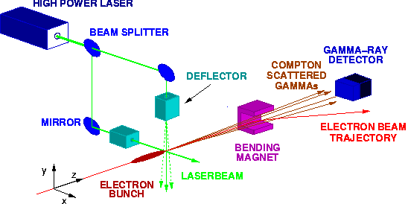
High resolution transverse beam size monitors
Using Laser Wire scanners as a Baseline in CDR-2012
  Based on Compton scattering using high power lasers

Slide 18
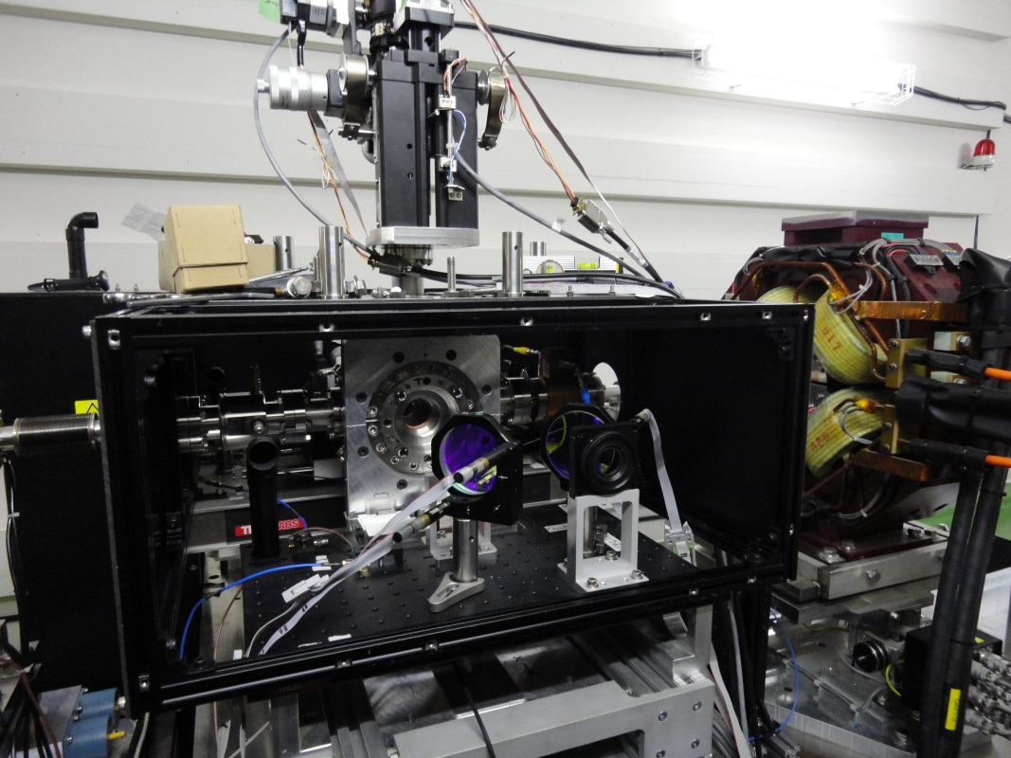
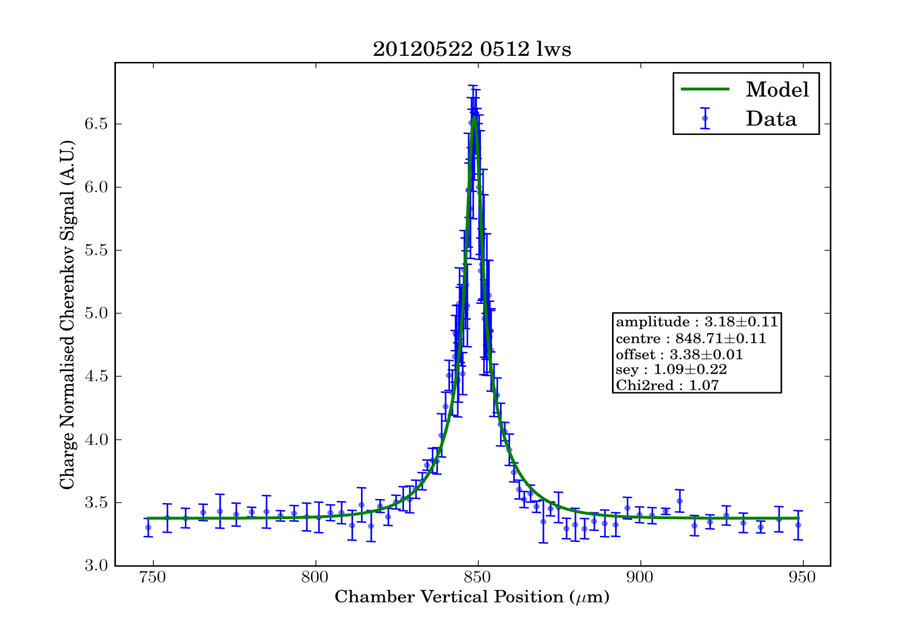



High resolution transverse beam size monitors
Performed using Laser Wire scanner as a Baseline In CDR-2012
  Based on Compton scattering using high power lasers
  10 years on R&D in the 2000s (ATF2)
  S. T. Boogert et al., PRSTAB 13, 122801 (2010)
  L. Corner et al., IPAC, Kyoto, Japan (2010) pp3227

Slide 19
High resolution transverse beam size monitors
Using Laser Wire scanners as a Baseline in CDR-2012
  Based on Compton scattering using high power lasers
  10 years on R&D in the 2000s (ATF2)
  S. T. Boogert et al., PRSTAB 13, 122801 (2010)
  L. Corner et al., IPAC, Kyoto, Japan (2010) pp3227
  Works well but expensive and complex
  Study alternative solutions to reduce the number of LWS in complex

Slide 20
High resolution transverse beam size monitors
Investigating very high resolution imaging system using Optical transition radiation as a simple and cheap solution

Slide 21
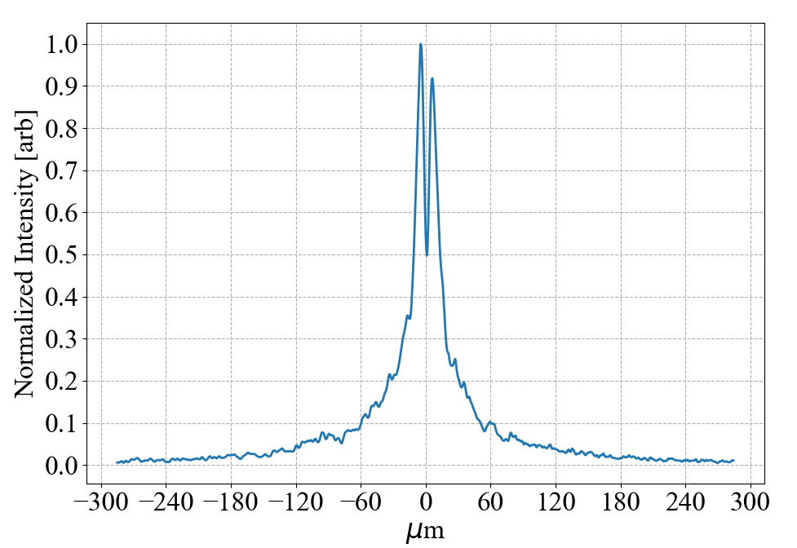
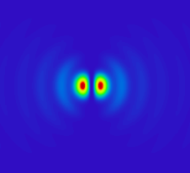
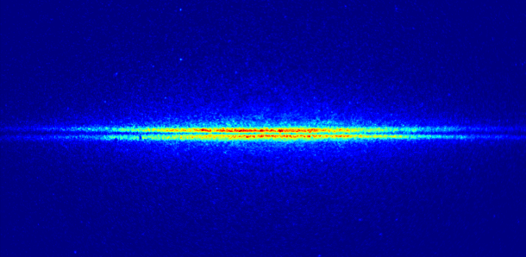
High resolution transverse beam size monitors
Investigating very high resolution imaging system using Optical transition radiation as a simple and cheap solution
Work started in KEK in 2010 : Measuring beam size as visibility of the OTR Point(Particle) Spread Function (P. Karataev et al., PRL 107, 174801 (2011))

Slide 22



High resolution transverse beam size monitors
Investigating very high resolution imaging system using Optical transition radiation as a simple and cheap solution
Work started in KEK in 2010 : Measuring beam size as visibility of the OTR Point(Particle) Spread Function (P. Karataev et al., PRL 107, 174801 (2011))
Sub-micron resolution demonstrated and used since 2015 regularly on our test-stand at ATF2 (B. Bolzon et al., PRSTAB 18, 082803 (2015))

Slide 23
High resolution transverse beam size monitors
Investigating very high resolution imaging system using Optical transition radiation as a simple and cheap solution
Work started in KEK in 2010 : Measuring beam size as visibility of the OTR Point(Particle) Spread Function (P. Karataev et al., PRL 107, 174801 (2011))
Sub-micron resolution demonstrated and used since 2015 regularly on our test-stand at ATF2 (B. Bolzon et al., PRSTAB 18, 082803 (2015))
Talk on ‘Beam diagnostic developments at ATF2’ by Michele Bergamaschi – Tuesday at 14h00

Slide 24
Non-invasive beam size using ODR
Studying non-invasive beam size measurements using Optical diffraction radiation from thin dielectric slits

Slide 25
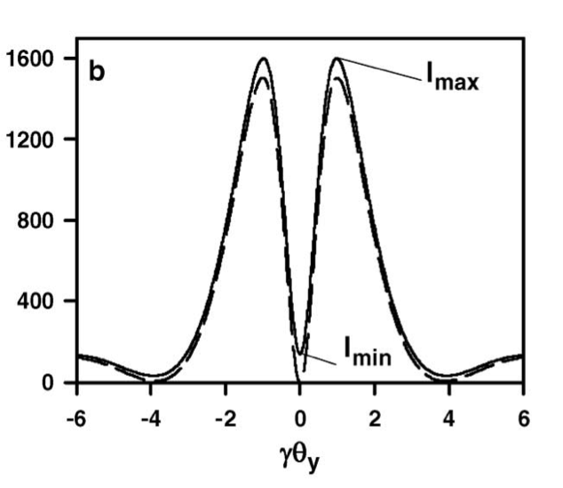
Non-invasive beam size using ODR
Studying non-invasive beam size measurements using Optical diffraction radiation from thin dielectric slits
The beam size is extracted from the visibility I_{min}/I_{max} of the projected vertical component of the ODR angular distribution

Slide 26
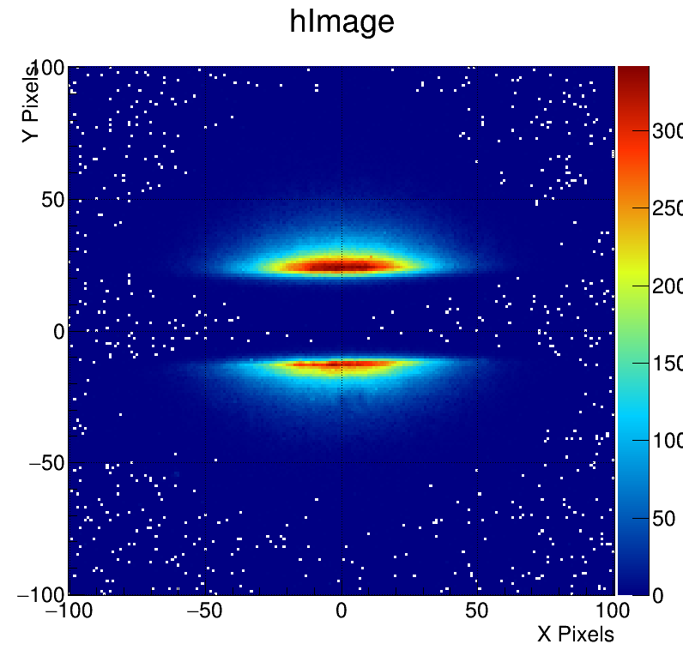
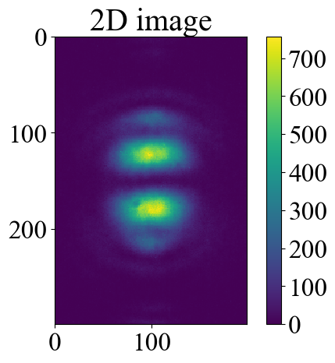
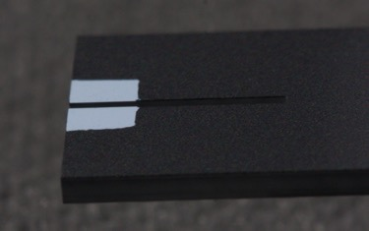

Non-invasive beam size using ODR
Studying non-invasive beam size measurements using Optical diffraction radiation from thin dielectric slits
Work started in 2011 at CESR and then ATF2 since 2015
Direct Image
2D Angular distribution
R&D on slit configurations
and technology
Maximizing emission of DR
Minimizing reflection of SR

Slide 27
Non-invasive beam size using ODR
Studying non-invasive beam size measurements using Optical diffraction radiation from thin dielectric slits
Work started in 2011 at CESR and then ATF2 since 2015
Develop also simulations using Zemax suite (T. Aumeyr et al., PRAB 18, 042801 (2015))
Few microns resolution recently demonstrated at ATF2 (L. Bobb et al., PRAB 21, 032801 (2018) and M. Bergamaschi, PhD thesis, 2018)

Slide 28
Non-invasive beam size using ODR
Studying non-invasive beam size measurements using Optical diffraction radiation from thin dielectric slits
Work started in 2011 at CESR and then ATF2 since 2015
Develop also simulations using Zemax suite (T. Aumeyr et al., PRAB 18, 042801 (2015))
Few microns resolution recently demonstrated at ATF2 (L. Bobb et al., PRAB 21, 032801 (2018) and M. Bergamaschi, PhD thesis, 2018)
Talk on ‘Beam diagnostic developments at ATF2’ by Michele Bergamaschi – Tuesday at 14h00

Slide 29
Looking for better non-invasive monitor !

Slide 30
Looking for better non-invasive monitor !
Looking for higher light yield !
  Diffraction radiation from slits do not generate much photons
Minimizing Synchrotron radiation background → cleaner signal
  DR and SR are emitted at similar angles

Slide 31
Looking for better non-invasive monitor !
Looking for higher light yield !
  Diffraction radiation from slits do not generate much photons
Minimizing Synchrotron radiation background → cleaner signal
  DR and SR are emitted at similar angles
In 2016, we started investigating Cherenkov diffraction radiation in longer dielectrics

Slide 32
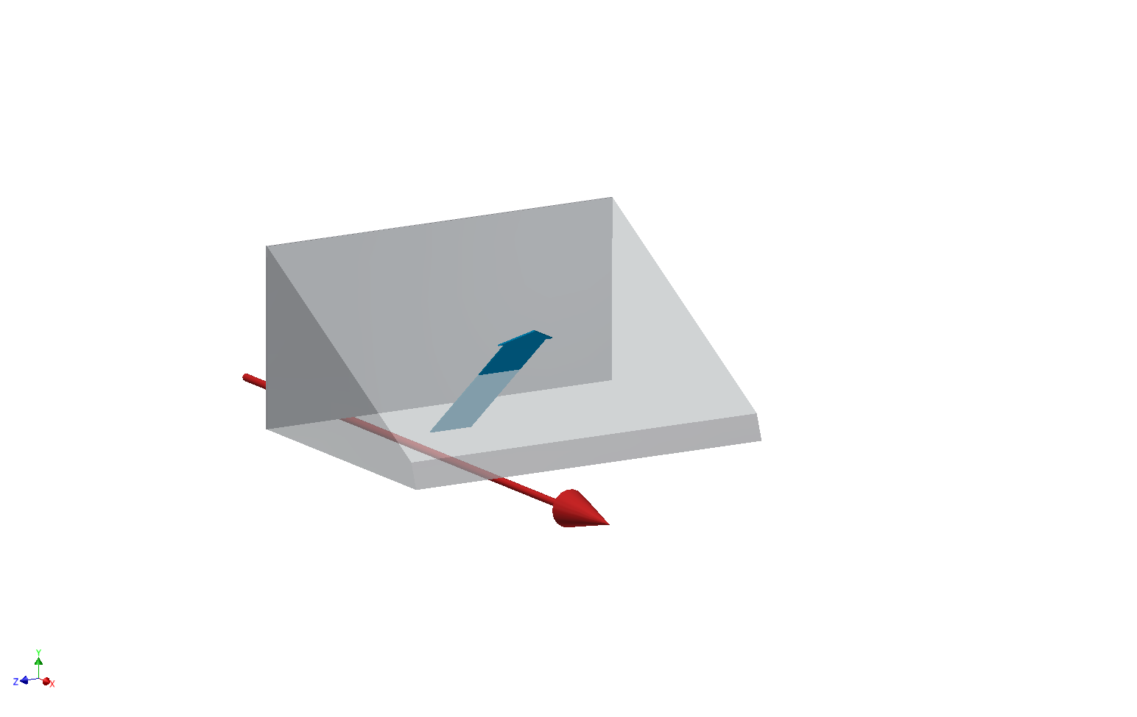
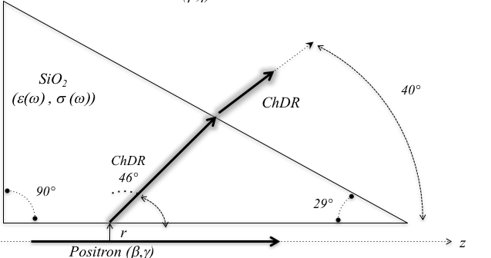
Cherenkov diffraction radiation as a non-invasive monitor
Prototype installed in 2017 on CESR at Cornell University
  Measuring Incoherent Cherenkov diffraction radiation emitted from Positrons in a 2cm long fused silica prism
Cherenkov
Diffraction
Radiation
Positron Beam

Slide 33
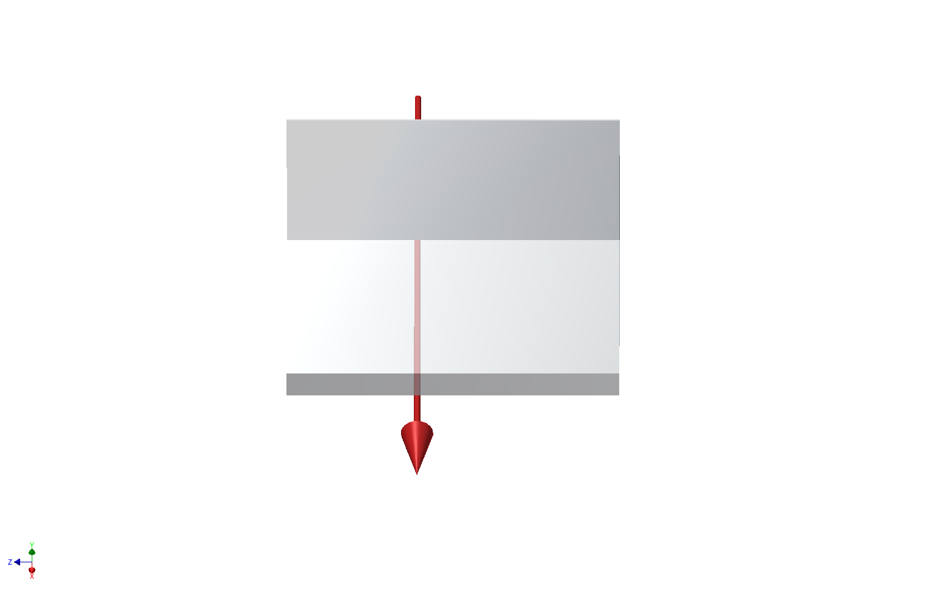
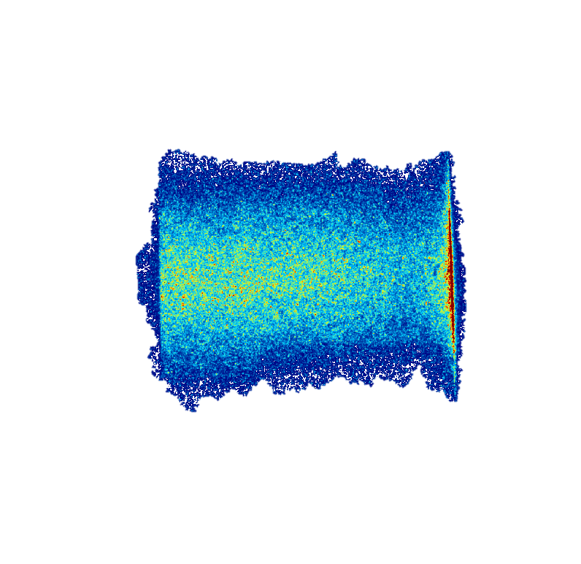
Cherenkov diffraction radiation as a non-invasive monitor
Prototype installed in 2017 on CESR at Cornell University
  Measuring Incoherent Cherenkov diffraction radiation emitted from Positrons in a 2cm long fused silica prism
  Tests performed using 2.1 and 5.3 GeV particles
  R. Kieffer et al., “Direct Observation of Incoherent Cherenkov Diffraction Radiation in the Visible Range”, PRL 121 (2018) 054802
Cherenkov
Diffraction
Radiation
Positron Beam
Positron Beam

Slide 34
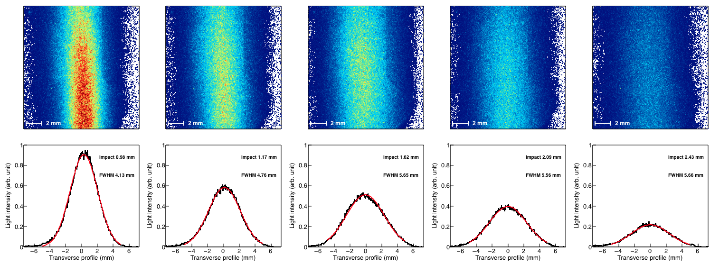
Cherenkov diffraction radiation as a non-invasive monitor
Measuring Beam size :
Large Horizontal beam size at Cornell

Slide 35
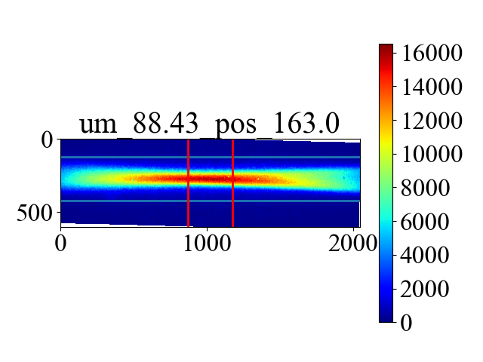
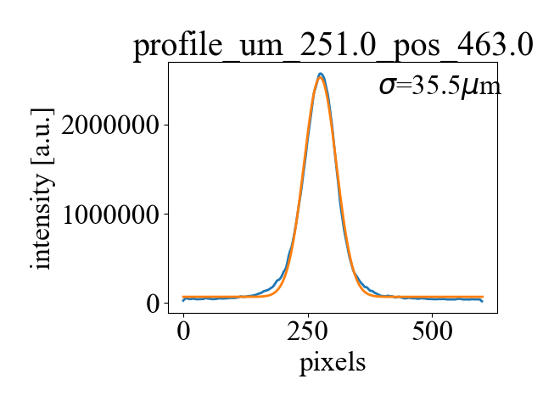
Cherenkov diffraction radiation as a non-invasive monitor
Measuring Beam size :
Large Horizontal beam size at Cornell
Installed a ChDR radiator on ATF2 in 2018
On-going investigation on the resolution limit of such system using very small vertical beam size

Slide 36
Cherenkov diffraction radiation as a non-invasive monitor
Measuring Beam size :
Large Horizontal beam size at Cornell
Installed a ChDR radiator on ATF2 in 2018
Talk on ‘Beam diagnostic developments at ATF2’ by Michele Bergamaschi – Tuesday at 14h00
On-going investigation on the resolution limit of such system using very small vertical beam size

Slide 37
Cherenkov diffraction radiation as a non-invasive monitor
Investigating also Coherent Cherenkov diffraction radiation for beam diagnostic of short bunches

Slide 38
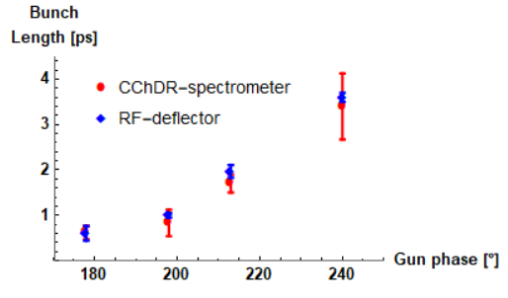
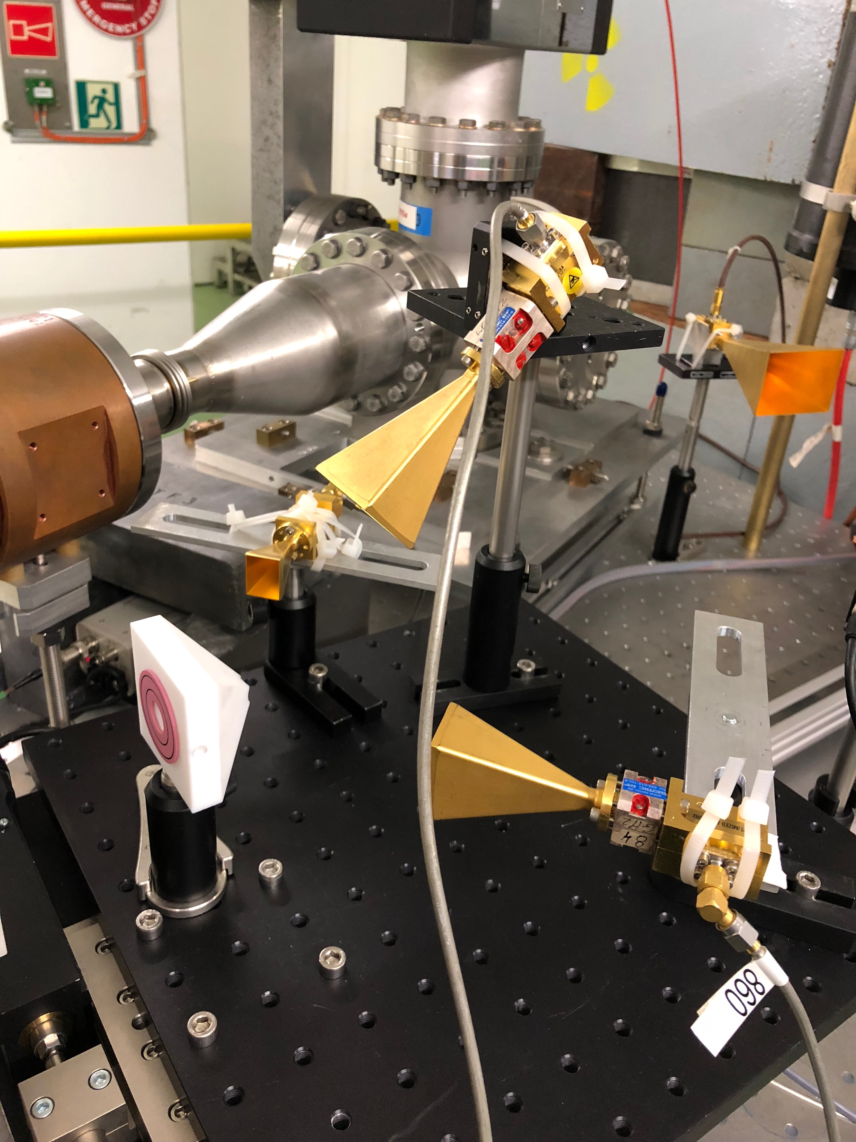
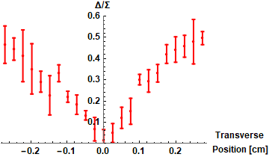
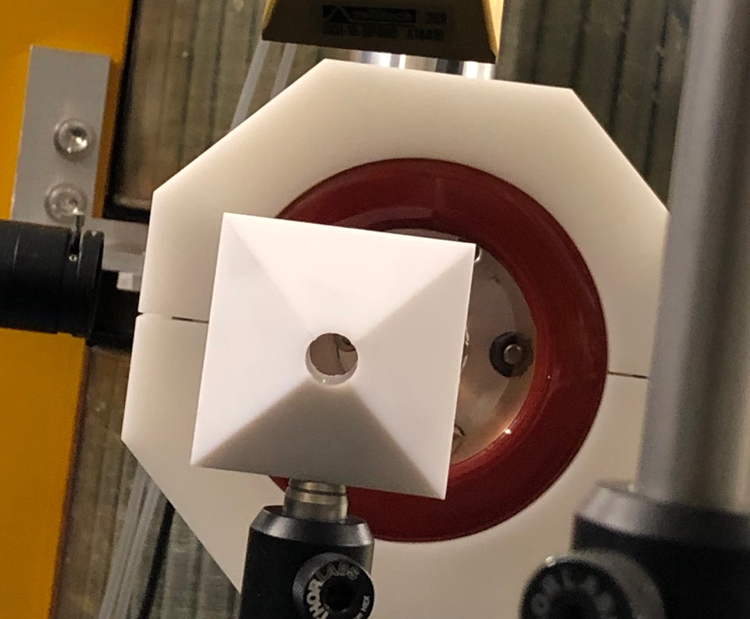
Cherenkov diffraction radiation as a non-invasive monitor
Investigating also Coherent Cherenkov diffraction radiation for beam diagnostic of short bunches
First tests performed on CLEAR performed in 2018 using Teflon radiator
Measuring in 3 bands
(60-90-110GHz)
Bunch length monitor
Pyramidal cone
with 1cm hole
Bunch position monitor

Slide 39
Cherenkov diffraction radiation as a non-invasive monitor
Investigating also Coherent Cherenkov diffraction radiation for beam diagnostic of short bunches
First tests performed on CLEAR performed in 2018 using Teflon radiator
Talk on ‘THz radiation emission studies in CLEAR’
by Alessandro Curcio – Thursday at 15h00
Measuring in 3 bands
(60-90-110GHz)
Bunch length monitor
Pyramidal cone
with 1cm hole
Bunch position monitor

Slide 40
EO detection system for very short bunches

Slide 41
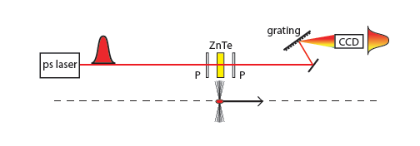


EO detection system for very short bunches
EO Transposition developed at Daresbury lab and Dundee University
S .P. Jamison et al., “Upconversion of a relativistic Coulomb field THz pulse to the near-IR”, Applied Physics Letters 96 (2010) 231114 :
D.A. Walsh et al., “The time resolved measurement of ultrashort terahertz-band electrical field without an ultrashort probe”, Applied Physics Letters 106, 181109 (2015)
Investigating also Coherent Cherenkov diffraction radiation for beam diagnostic of short bunches
First tests performed on CLEAR performed in 2018 using Teflon radiator

Slide 42
EO detection system for very short bunches
EO Transposition developed at Daresbury lab and Dundee University
S .P. Jamison et al., “Upconversion of a relativistic Coulomb field THz pulse to the near-IR”, Applied Physics Letters 96 (2010) 231114 :
D.A. Walsh et al., “The time resolved measurement of ultrashort terahertz-band electrical field without an ultrashort probe”, Applied Physics Letters 106, 181109 (2015)
Moving EOT outside of vacuum system by creating a THz replica of the bunch field using Coherent Cherenkov radiation
Investigating also Coherent Cherenkov diffraction radiation for beam diagnostic of short bunches
First tests performed on CLEAR performed in 2018 using Teflon radiator

Slide 43
Conclusions
CLIC has funded a very wide and rich R&D program since the CDR in 2012
Many studies has led to substantial improvements in cost and performance, simplicity and reliability.
Some R&D Studies are being co-financed by LHC and FCC :
  Supersonic Gas Jet : A. Jeff et al., “A quantum gas jet for non-invasive beam profile measurement”, IBIC, Monterey, USA (2014) : A. Jeff et al., “A gas-jet profile monitor for the CLIC Drive Beam”, IBIC, Oxford, UK (2013) : V. Tzoganis et al., “Design and first operation of a supersonic gas jet based beam profile monitor”, PRAB 20, 062801 (2017)
  Synchrotron radiation interferometry using random structures : M. Siano et al., “Characterizing temporal coherence of visible synchrotron radiation with heterodyne near field speckles”, PRAB 20 110702 (2017)
Several Beam instrumentation test facilities have been put in place at CLEAR@CERN, ATF2@KEK and at Diamond. Talk on ‘Diagnostic R&D in the CLEAR facility’ by T. Lefevre – Thursday at 15h20
Next steps towards a realistic implementation of BI in CLIC !

Slide 44



Thanks for your attention

Slide 45
Thanks for your attention
Many thanks to all the great Students,
Postdocs and Collaborators

Slide 46
Spares

Slide 47


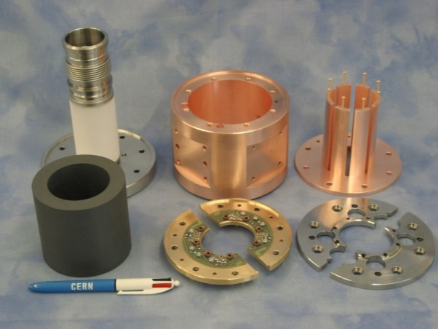
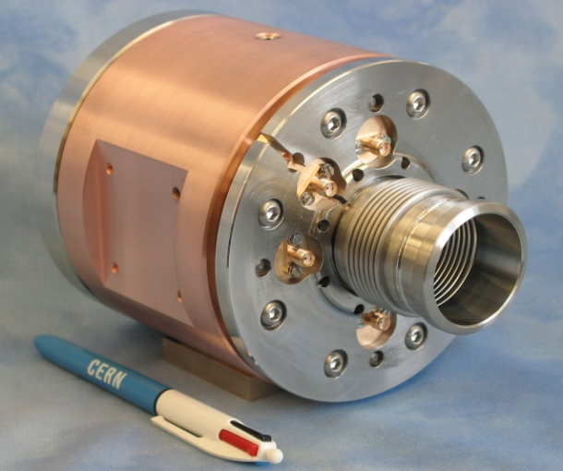
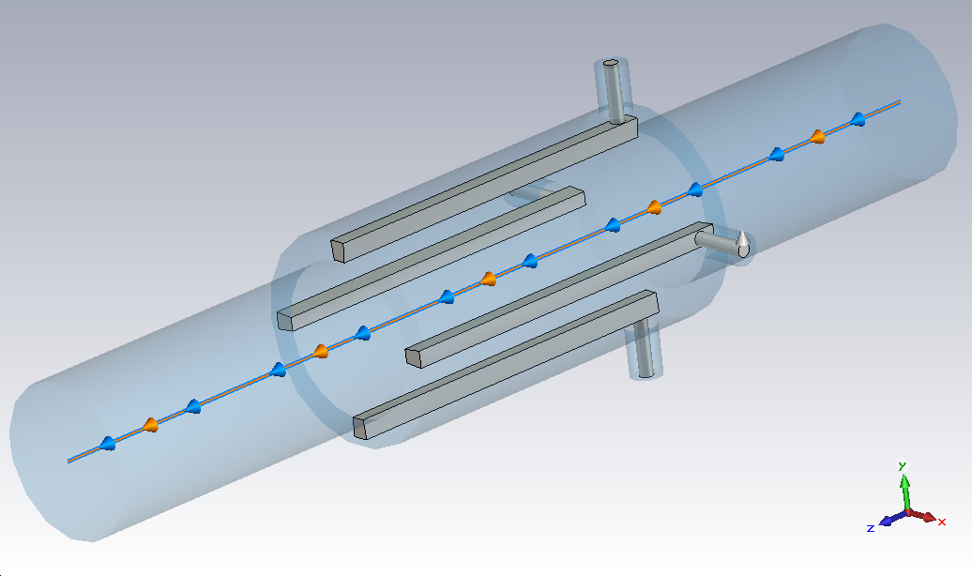
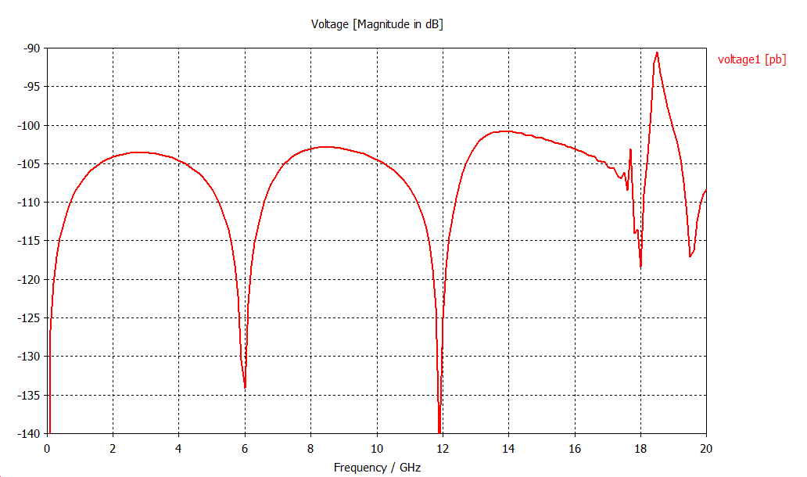
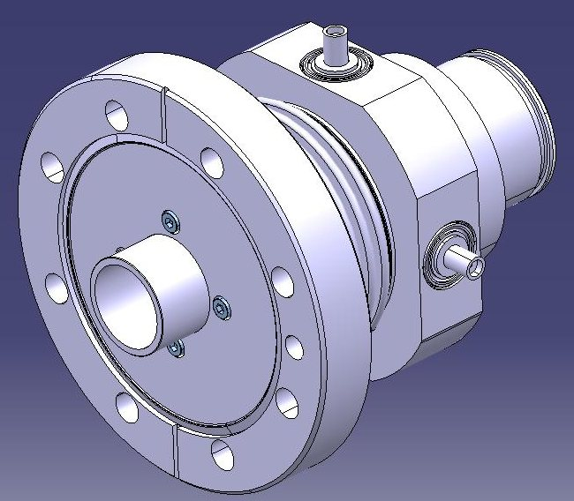
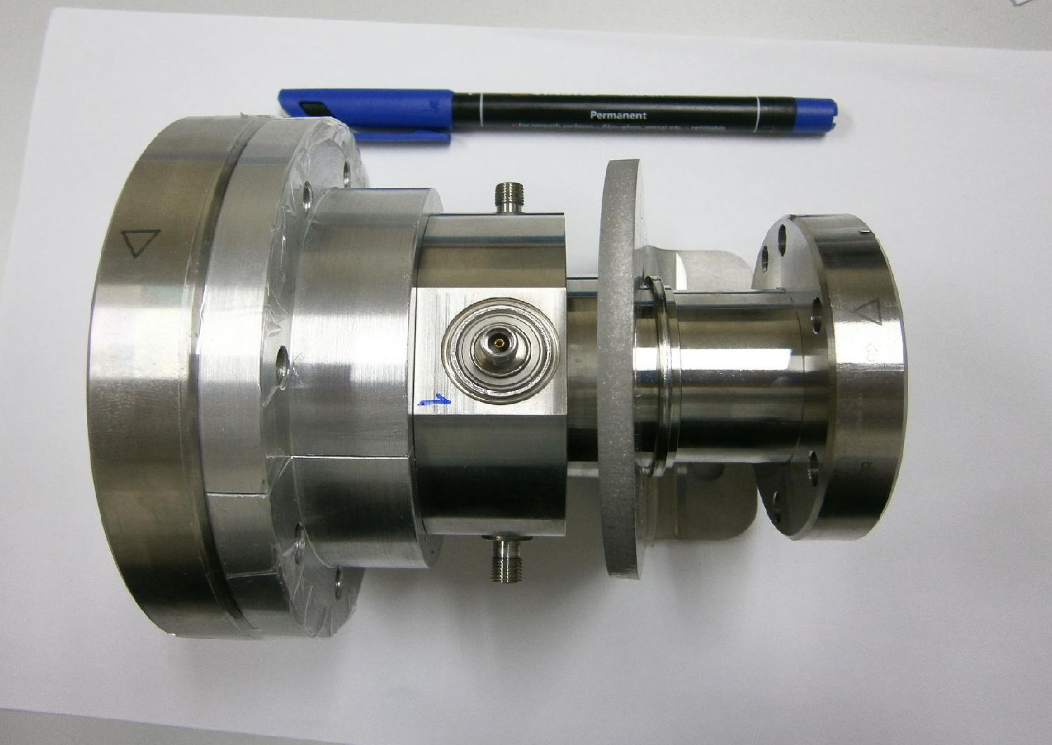
CLIC Drive Beam BPM
Requirements:
  High current 100A – high bunch frequency 12GHz
  In the vicinity of an RF structure producing 100MW @12GHz
  Temporal resolution of 10ns
  2μm resolution over an aperture of 23mm (accurate calibration)
  Simple and Cheap ~ 40k units
CLIC TEST FACILITY 3 uses Inductive Pick-ups
~60 Units ~ 5um resolution measured
M. Gasior
Cheaper alternative based on Stripline Pick-ups (A. Benot-Morell, S. Smith, M. Wendt, L. Soby)
To be tested on CTF3 in 2013

Slide 48
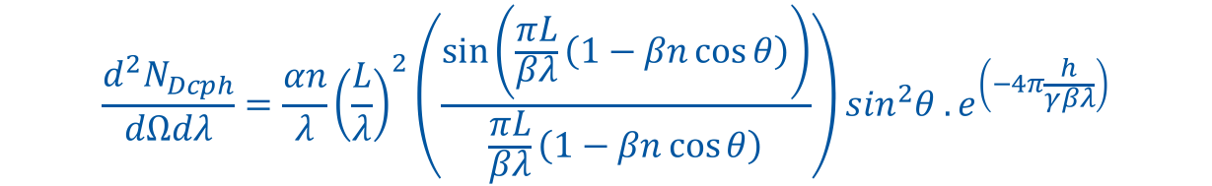
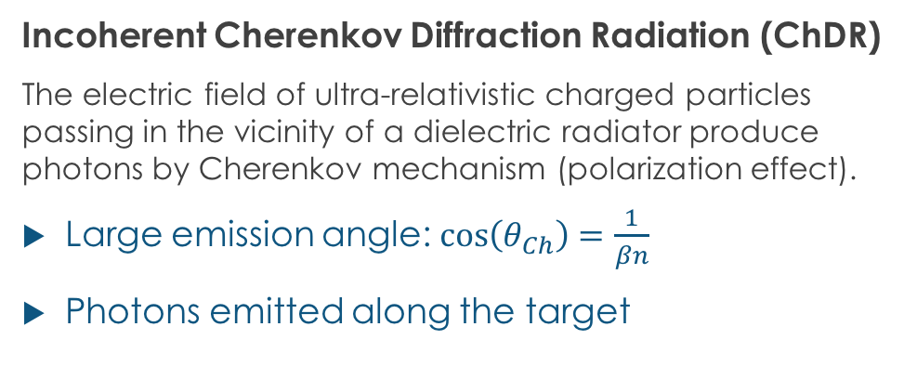

Incoherent Cherenkov Diffraction Radiation
Dielectric
Incoherent Cherenkov Diffraction Radiation (ChDR)
The electric field of ultra-relativistic charged particles passing in the vicinity of a dielectric radiator produce photons by Cherenkov mechanism (polarization effect).
Large emission angle: $\cos\left(θ_{Ch}\right)=\frac{1}{βn}$
Photons emitted along the target
Cherenkov DR
photons
E Field
h
Vacuum
$$θ_{Ch}$$
For a cylindrical geometry
L
Cherenkov emission
Exponential decay
of the particle field
$$\frac{d^{2}N_{Dcph}}{dΩdλ}=\frac{αn}{λ}{\left(\frac{L}{λ}\right)}^{2}\left(\frac{\sin\left(\frac{πL}{βλ}\left(1−βn\cos{θ}\right)\right)}{\frac{πL}{βλ}\left(1−βn\cos{θ}\right)}\right)\sin^{2}θ .e^{\left(−4π\frac{h}{γβλ}\right)}$$
α, fine structure constant
β, normalised beam velocity
γ, beam relativistic factor
θ, angle of observation
T. Lefevre, CLIC workshop 2018, CERN
Ref: A.P. Potylitsyn et al, Diffraction radiation from charged particles, STMP 29 (Springer Berlin Hedeilberg 2010)

Slide 49
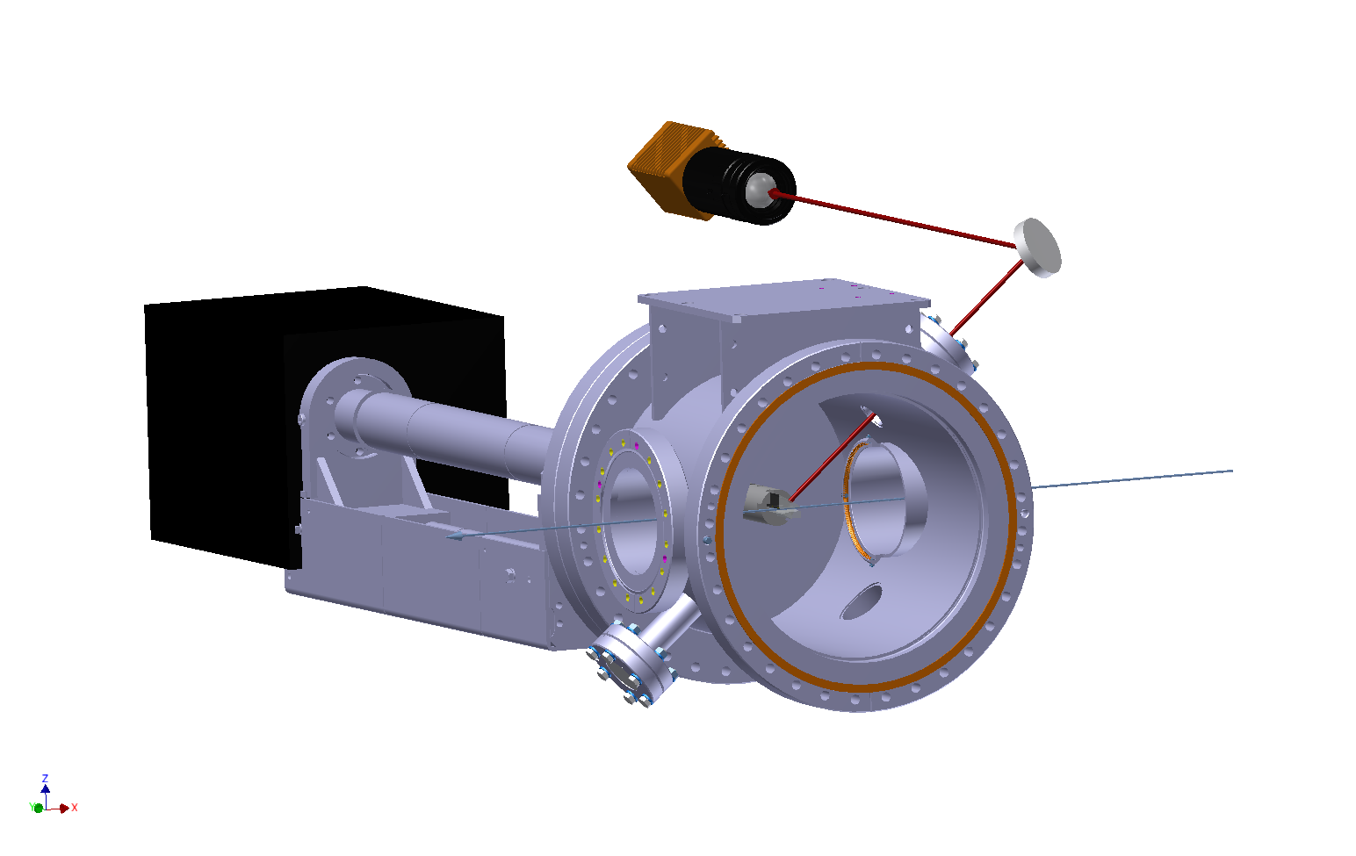
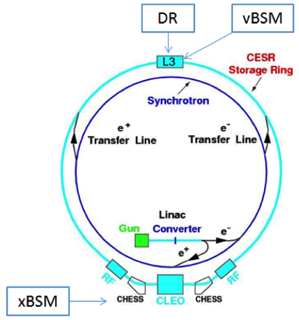
Experimental set-up on CESR (1/3)
Re-using the DR vacuum chamber and optical system
ChDR
Camera
ChDR
One bunch
2.5nC
Target
T. Lefevre, CLIC workshop 2018, CERN

Slide 50
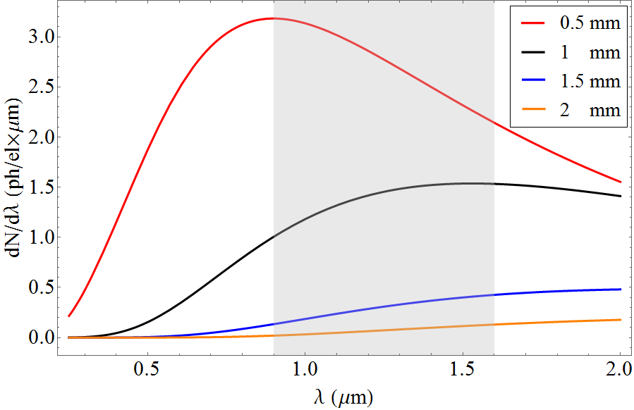
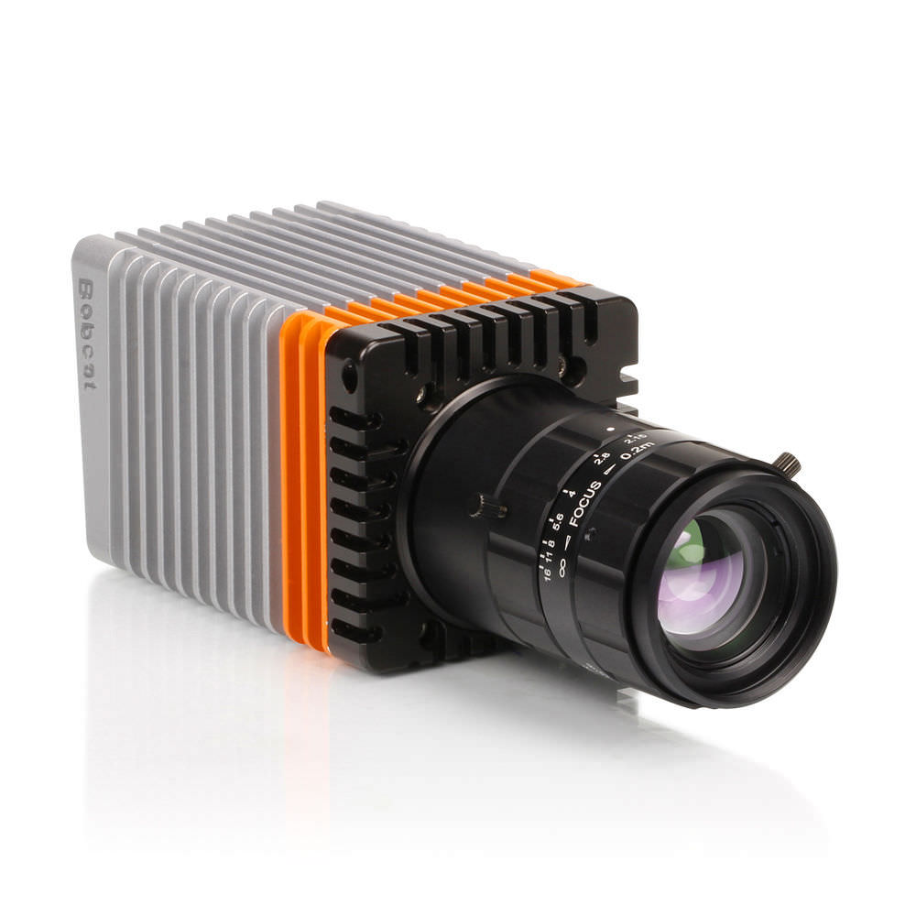
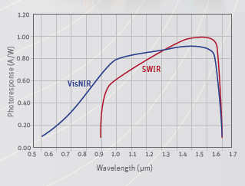
Experimental set-up on CESR (2/3)
Design a 2cm long SiO2 (n=1.46) Cherenkov Diffraction Radiation target
  Testing with 2.1GeV e⁻ and measuring in IR (0.9-1.7um) – April 2017
Xenics Bobcat 640 GigE
Cooled InGaAs 640x512 pixels : 20um pixel pitch
QE up to 80% at 1.6um
14bit ADC
1us-40ms integration window
‘The red curve as been scaled down by 1/3 for better presentation
    M.V. Shevelev and A.S. Konkov, JETP 118, 501 (2014)
T. Lefevre, CLIC workshop 2018, CERN

Slide 51
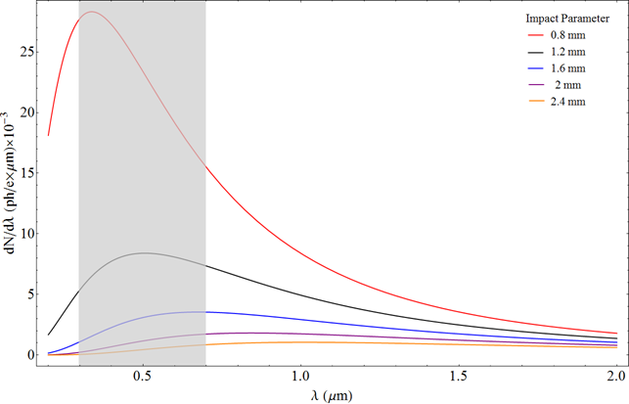
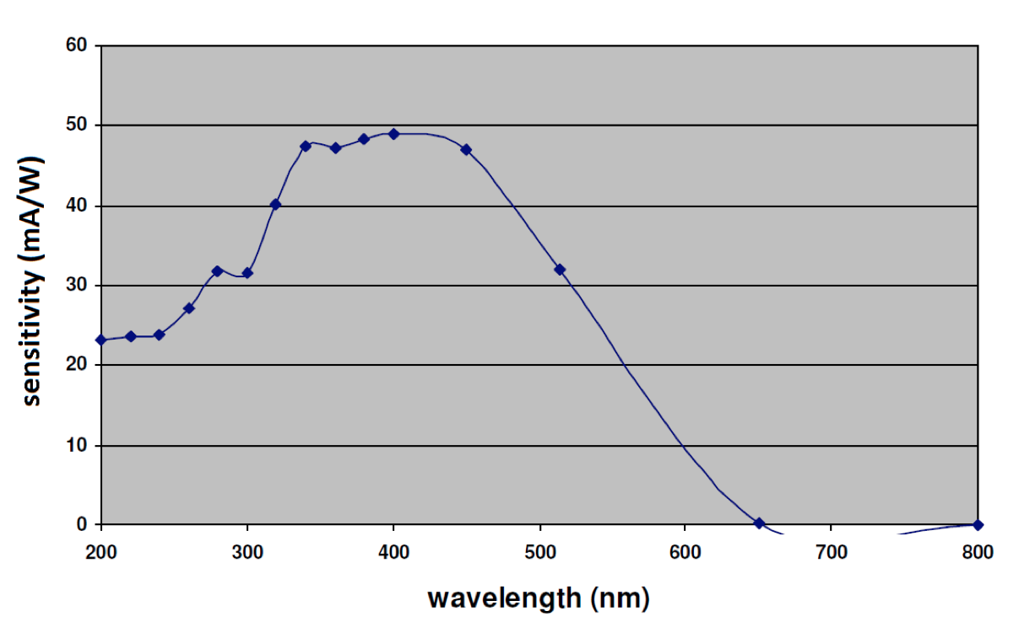
Experimental set-up on CESR (3/3)
Design a 2cm long SiO2 (n=1.46) Cherenkov Diffraction Radiation target
  Testing with 5.3GeV e⁻ / e⁺ and measuring in visible (0.3-0.7um) – October 2017
λ= 400±10nm
λ= 600±10nm
Gated and intensified camera
    M.V. Shevelev and A.S. Konkov, JETP 118, 501 (2014)
T. Lefevre, CLIC workshop 2018, CERN

Slide 52
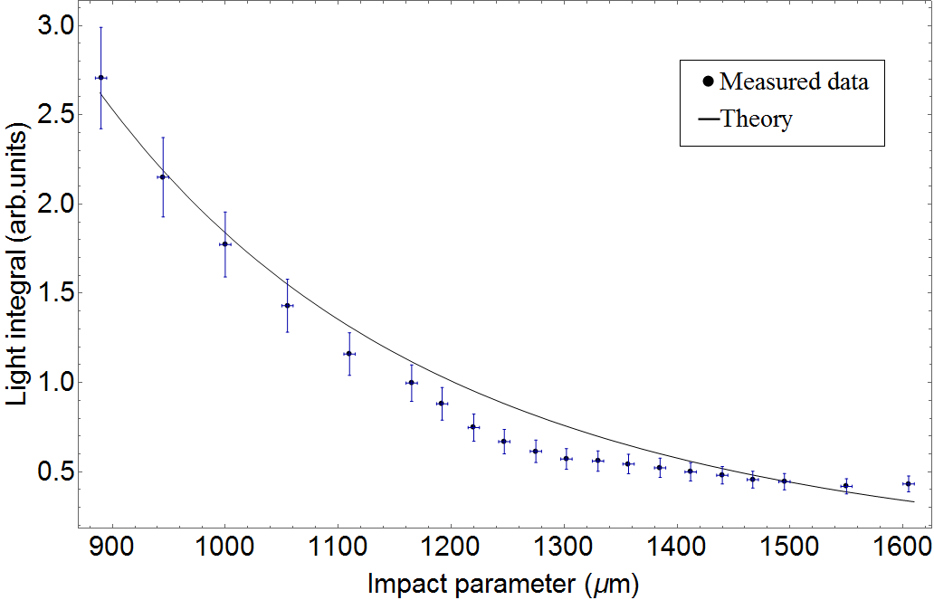
Experimental data : Electron at 2.1GeV
Steering the beam vertically : comparison with simulations
  No wavelength filter – No polarizer
T. Lefevre, CLIC workshop 2018, CERN

Slide 53
Experimental data : Positron at 5.3GeV
Steering the beam vertically
  Wavelength 600±10nm
  Vertical Polarization component
h= 0.96mm 1.17mm 1.52mm 2.09mm 2.43mm
Cherenkov photons yield increasing strongly for smaller impact parameter

Slide 54
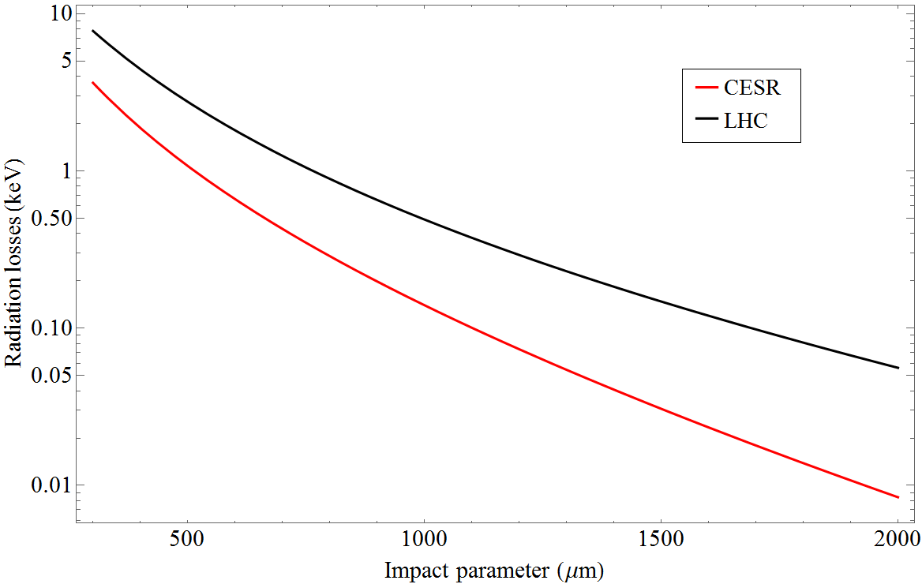
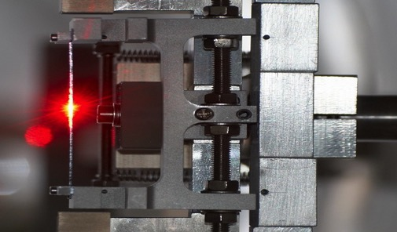
Perspectives for beam instrumentation
Imaging system for relativistic beam
  What is the the smallest beam size measurable ?
    The Cherenkov diffraction PSF should be smaller
    than transition radiation PSF
  → possible tests in 2018 with micron
  beam sizes on ATF2
What is the smallest the beam tilt angle measurable ?
  A non linear response depending on wavelength, beam energy and impact parameter
Measuring counter-propagating beams with very high directivity : BPM for FCC, HE-LHC, …
A Beam Position Monitor for Crystal collimator on LHC
T. Lefevre, LER 2018, CERN

Slide 55
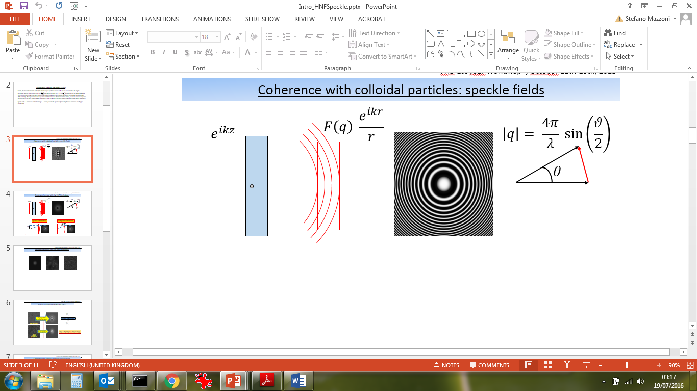
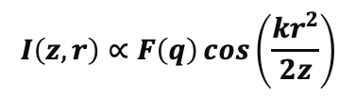
The HNFS technique
Heterodyne Near Field Speckles is a novel stochastic interference technique that gives 2D coherence / beam size information
Measures visibility of interference fringes between transmitted beam (synchrotron radiation) and spherical waves produced by nanoparticles
3 years collaboration between ALBA, U. Milan and CERN funded by CLIC & FCC
In HNFS: intensity is measured at distance z from the scatterers. In case of a single particle:
z
$$I\left(z,r\right)∝F\left(q\right)\cos\left(\frac{kr^{2}}{2z}\right)$$
Where F(q) is the particle form factor, q the scattering wave vector

Slide 56
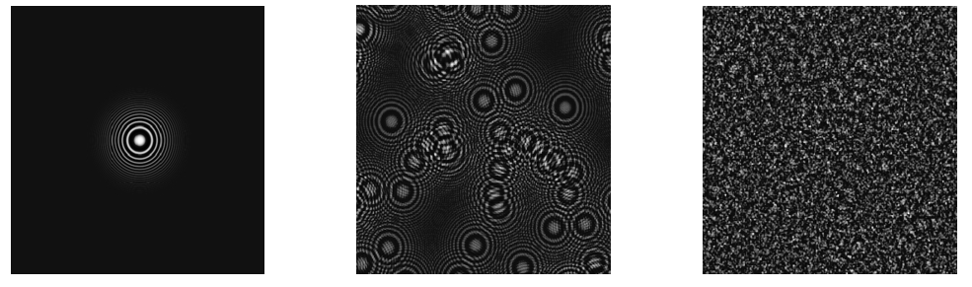
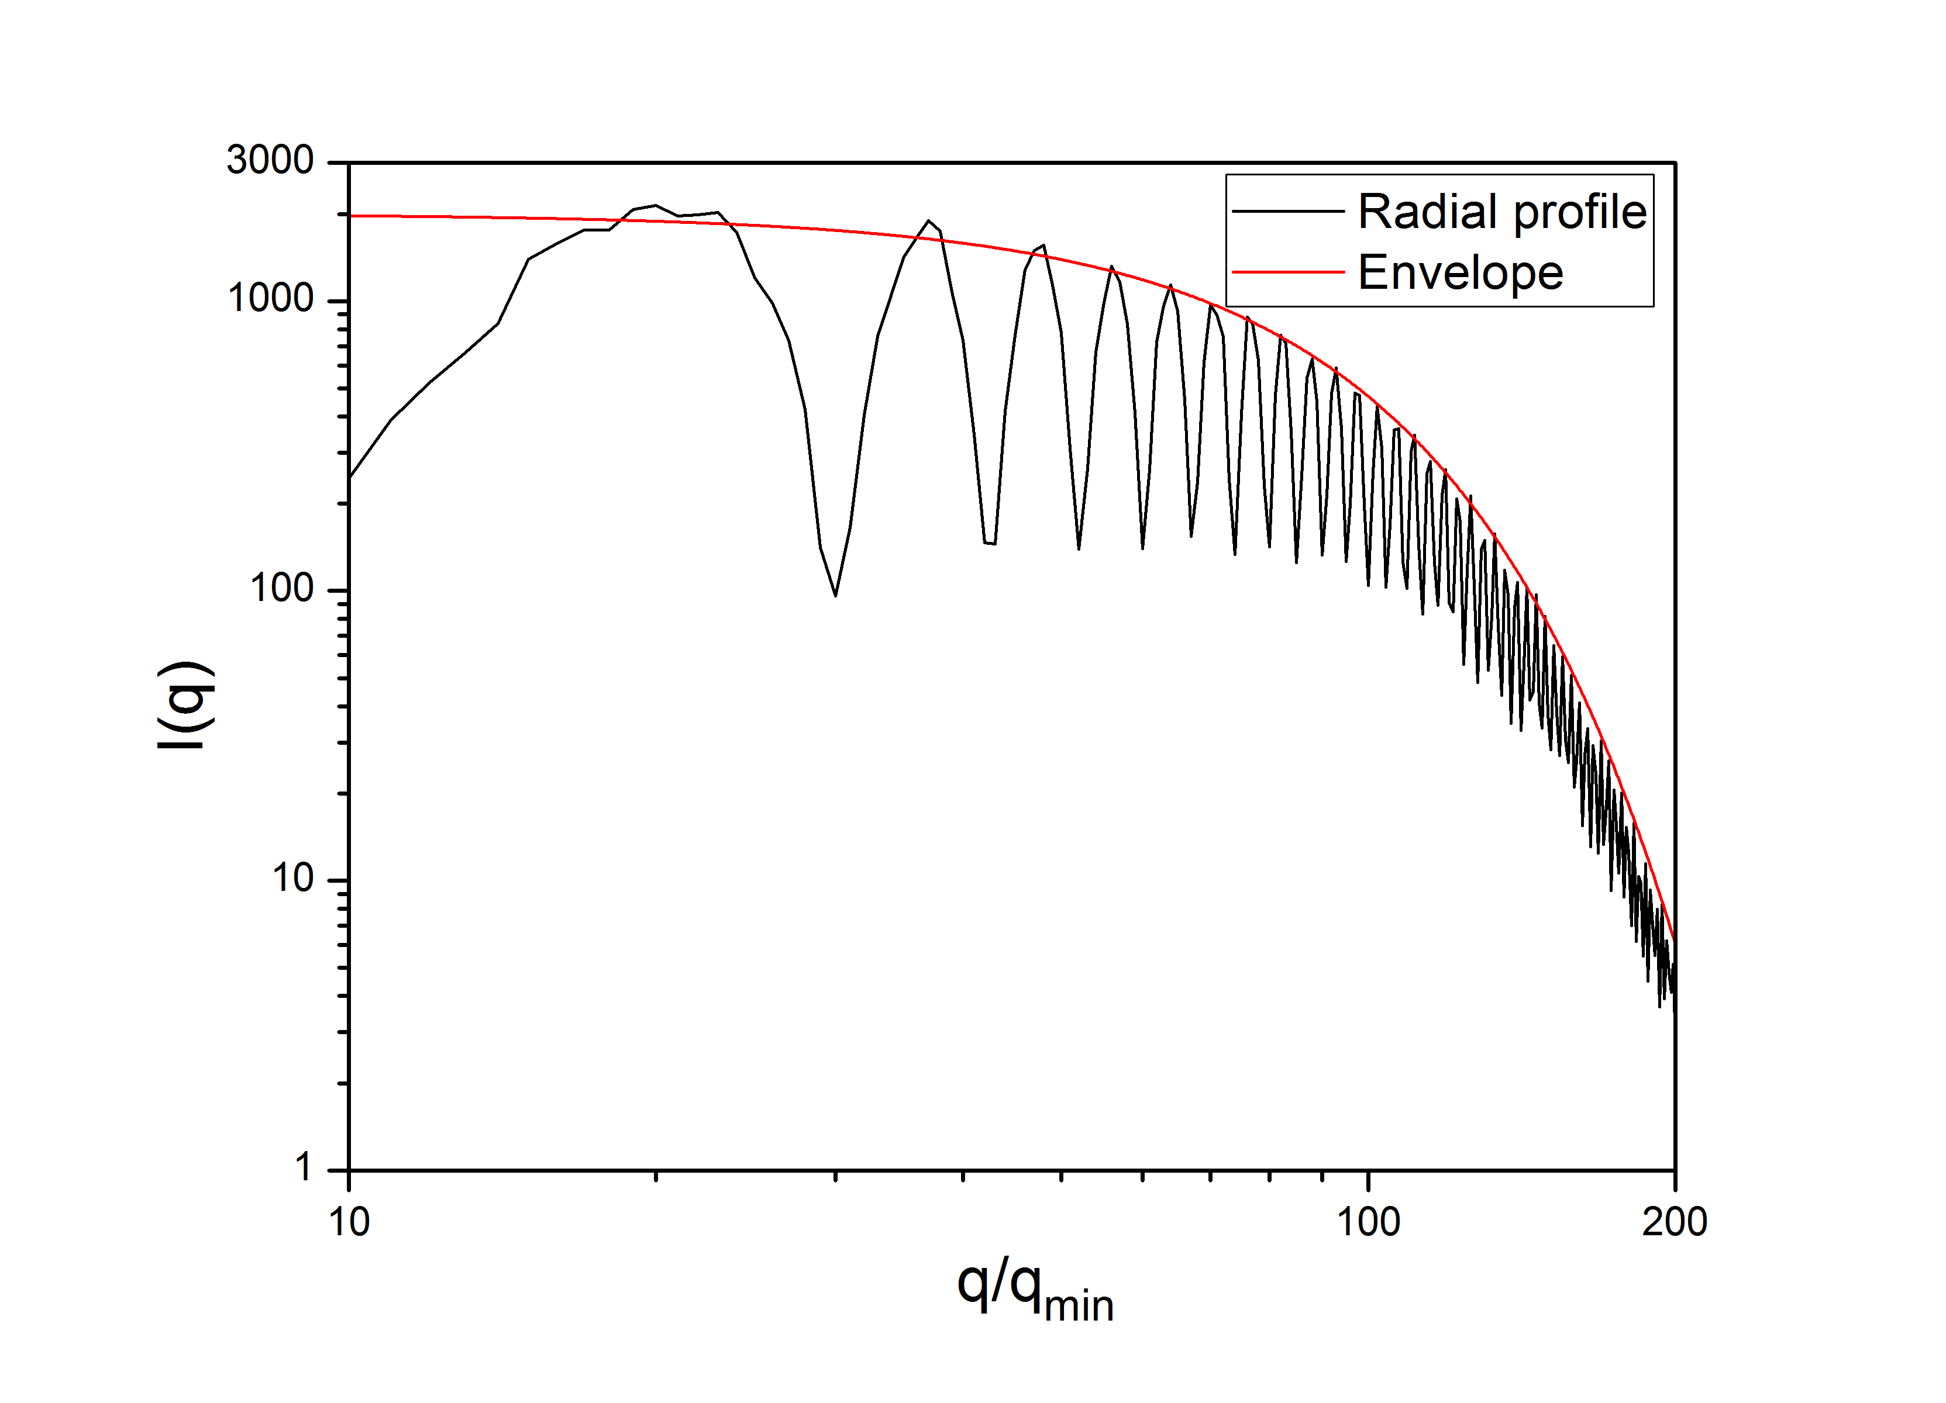
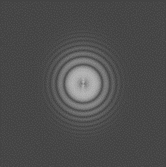
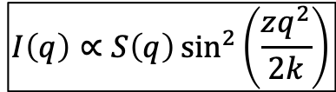

The HNFS technique
When number N of scatterers is LARGE, scattered intensity can be retrieved through the square modulus of Fourier Transform:
N>1
N>>1
$$I\left(z\right)∝F\left(q\right)\cos\left(\frac{kr^{2}}{2z}\right)$$
$${\left|ℱ\right|}^{2}$$
$$I\left(q\right)∝S\left(q\right)\sin^{2}\left(\frac{zq^{2}}{2k}\right)$$
Single particle interferogram modulated by particle form factor
From analysis of I(q) the transverse coherence is measured
intensity profile of the source through Van Cittert Zernike Theorem!

Slide 57



Beam size tests based on HNFS at NCD-SWEET beamline at ALBA in July and Sept. 2018
12.4 KeV X-ray radiation from undulator
Target (a): 500 nm SiO₂ spheres suspended in water at z₁ = 32.5 m from the source. (b) 0.1 mm thick YAG:Ce crystal at z₂ = 252 mm, imaged with a 20X microscope objective (c) onto a CCD camera (d)
2D |FFT|²
fringe visibility
H coherence: 4.7 μm
V coherence: 34 μm
H beam size: 115 ± 6 μm (expected 131 μm)
V beam size: 14.7 ± 1.8 μm (expected 8 μm)
PRELIMINARY!

