Slide 1
Luminosity Challenges
CERN Week 2019
Wednesday, January 23, 2019
Daniel Schulte
For the CLIC collaboration
Thanks to the CLIC team
Not a summary of the working group

Slide 2
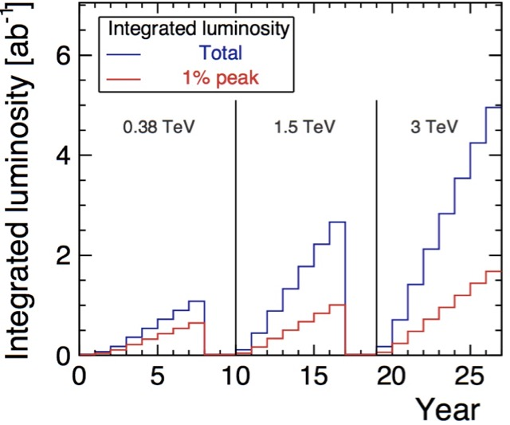
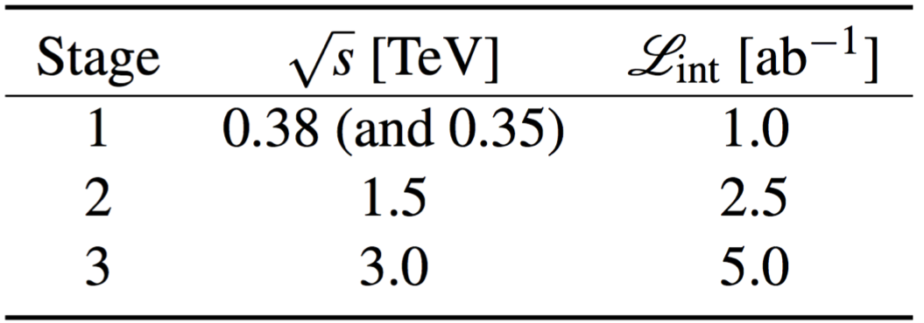
Integrated Luminosity
Integrated luminosity per year is 1.2 x 10⁷ s at full luminosity
First estimate of run time
17 weeks winter shutdown
30 days commissioning
20 days machine development
10 days planned stops
185 days of operation with 75% availability

Slide 3
Luminosity and Parameter Drivers
Can re-write normal luminosity formula
Beam current
(Power and RF limits, beam stability)
Luminosity
spectrum
(Physics)
Beam Quality
(Many systems)

Slide 4
Luminosity and Beam Quality
Damping ring main source of horizontal emittance
But value is OK, as we will see
Total vertical emittance at IP is 30 nm
Imperfections are the main source of final vertical emittance
Require 90% likelihood to meet static emittance growth target
 | Δε_{x} [nm] | Δε_{y} [nm]
 | Total contribution | Design limits | Static imperf. | Dynamic imperf.
Damping ring exit | 700 | 5 | 0 | 0
RTML | 150 | 1 | 2 | 2
Main linac | 50 | 0 | 5 | 5
BDS | 50 | 0 | 5 | 5
sum | “950” | 6 | 12 | 12
Luminosity
spectrum
Important to ensure that target can be met

Slide 5
Imperfections and Mitigation
Misalignment of components
Ground motion
Technical vibrations
Temperature changes
RF jitter
Dynamic magnetic fields
Instrumentation noise
Kicker noise
Magnet field jitter
Component failures
…
Instrumentation
System Design
Tuning, feedback, etc.
Pre-alignment
Wake monitors
Mechanical stabilisation
Thermal stabilisation
Compensating design
RF stabilisation
Phase correction system
Shielding
Cutting edge design
Robust design
…

Slide 6
Damping Rings
2008
2016
Important progress in collaboration with light source community
Studies of lattice and collective effects show that emittance targets can be reached for 3TeV
More intra-beam scattering in CLIC because of short bunches
Currently optimising for 380 GeV
Y. Papaphilippou et al.
We are not fully there
Design for 3 TeV, i.e. aim is 500 nm / 5 nm for 4.1 x 10⁹ particles
For 5.7 x 10⁹ we have 580 nm / 6.7 nm
Adjust design to reach 700 nm / 5 nm, should be straightforward (Yannis)
Better tuning possible?

Slide 7
RTML
Many systems to tune
Linacs, bunch compressors, turn-arounds, spin rotator, …
Achieve target
Imperfections based on main linac and ring assumptions
Can be relaxed to some level
94% likelihood
100% likelihood
A. Latina et al.

Slide 8
Main Linac
H. Meinaud Durand et al.
RF / CLEAR teams
K. Sjobaek et al.
Performance is improving
More to be done
Experimental programme moving ahead
More to be done
A. Latina et al.

Slide 9
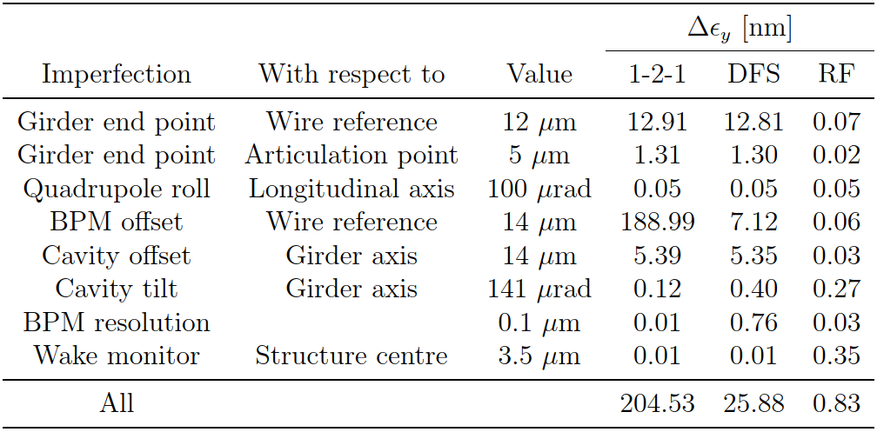
Main Linac Emittance Growth
Emittance growth for different imperfections
Using sophisticated beam-based methods
Exceed the goal with some margin
N. Blaskovic
Less than 1.5 nm with 90% likelihood
Goal: less than 5 nm
Need to verify hardware performance
Improved beam-based techniques could further help
E.g. emittance tuning bumps
0 1 2 3
Emittance growth in nm

Slide 10
Beam Delivery System
Goal 143 nm x 2.9 nm
β_{x} = 8 mm, β_{y} = 0.1 mm
Physics / beam-beam
Have a great design
Quadrupoles outside of detector
Achieves goal at 380 GeV
Achieves goal at 3 TeV but could wish for more
Plenty of work going on
Pastushenko
V. Cilento
R. Yang
R. Bodenstein
D. Arominski
E. Marin Lacoma
Still room for improvements at 3 TeV
And still some improvement at 380 GeV

Slide 11
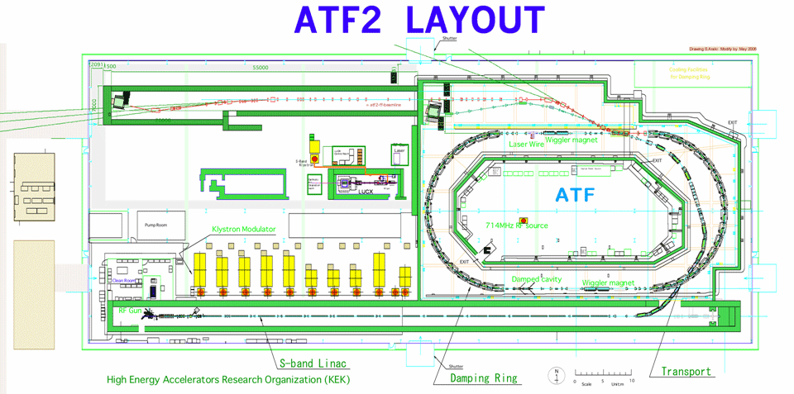
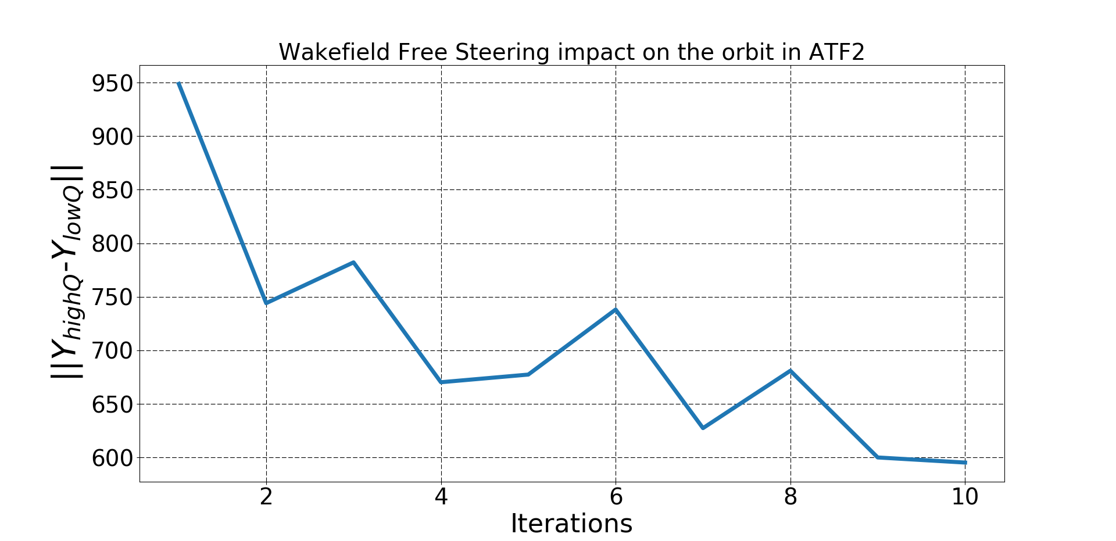
BDS Experiments
ATF2 tests are most important
New opportunities at KEK-B
Much learned on instrumentation, tuning, design, …
Beam jitter: 0.2 / 0.1 σ
No feedback / with feedback
Beam size (41 nm) is close to target (37nm)
P. Thrane et al.
P. Korysko
Wakefield free steering seems to help
Plenty of work going on
Some issues in ATF2 demonstration
Correct horizontal betafunction in test
Impact of bunch charge
Maybe instrumentation problem?
T. Okugi et al.
M. Bergamaschi et al.
D. Bett et al.
Gael Balik et al.

Slide 12
BDS Tuning
Realistic imperfections in BDS
Beam-based alignment and beam size tuning is used
Start with fully used emittance budgets
Aim to reach 110% of promised luminosity with 90% likelihood (10% is budget for dynamic imperfections)
J. Ogren
goal
Two-beam study ongoing at 3 TeV
Small difference in performance
Two-beam tuning
Speed of tuning
Measure and use available fast signals
E. Marin Lacoma

Slide 13
Luminosity Tuning
Significant reduction of measurements
From O(10⁴) to O(10³)
J. Ogren
Luminosity measurement takes time
Still many measurements required
Not clear if we can use radiative Bhabhas
Low rate of low-angle Bhabhas (20-60 s for 1% res.)
Fast signals exist
Beam-beam scans
Beamstrahlung
Pairs
Pairs to optimise the waist
Beamstrahlung optimising one beam
O. Napoly, D.S.
But not strictly proportional to luminosity
Detailed study required
D.S.

Slide 14
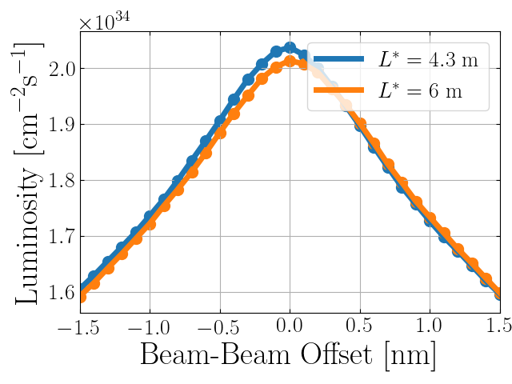
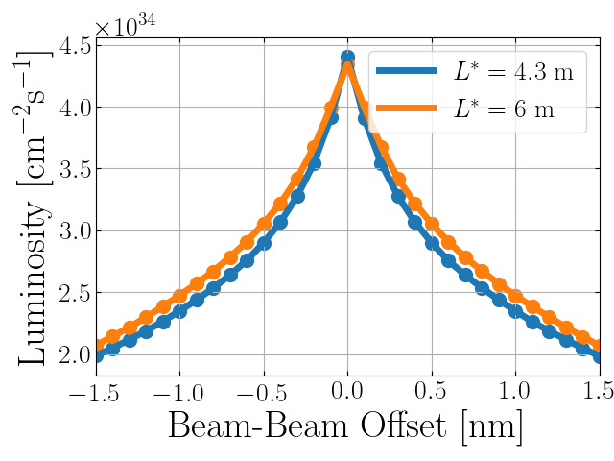
Dynamic Effects
With static imperfections only would obtain
L = 2 x 10³⁴ cm⁻²s⁻¹
30% reserve for dynamic imperfections
Several sources
Ground motion
Beam energy jitter (from drive beam)
Timing jitter
RF jitter in bunch compressors
Magnetic fields
Kicker jitter
…
Typically aim for O(1%) luminosity loss per effect
For higher luminosity dynamic effects are more relevant
5% loss for 0.5 nm
5% loss for 0.05 nm

Slide 15
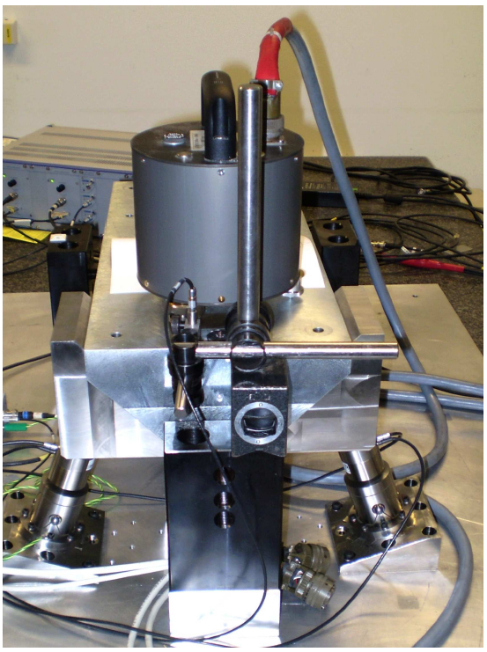
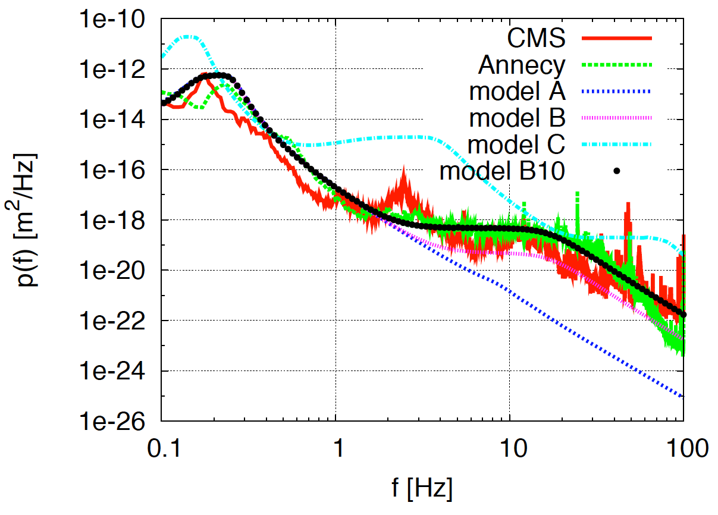
Ground Motion
K. Artoos et al.
At 380 GeV, with B10
0.8 % with preisolator
3 % with no pre-isolator
C. Gohil et al.
J. Pfingstner, J. Snuverink et al.
Luminosity achieved/lost [%]
 | B10
No stab. | 53%/68%
Current stab. | 108%/13%
Future stab. | 118%/3%
Code
A. Jeremie, Kurt Artoos et al.
Machine model
Beam-based feedback
Better than target

Slide 16
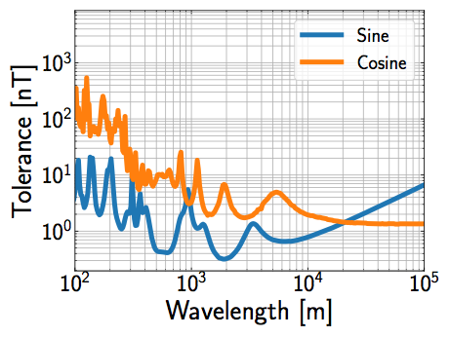
Magnetic Stray Fields
Tolerance tightest in BDS (shown) and RTML
Tolerance approx. 1.3 nT for constant field BDS worse at 380 GeV
Natural sources (mainly OK)
Environmental sources
Technical sources
Natural sources above 1 Hz
Phenomenon | Typical Amplitude
Schumann Resonances | 3 pT
Ionoshpereic Alfven Resonator | 1 pT
Pc1 Pulsations | 0.1 nT
‘Regional’ Lightning (<1000 km) | 0.25 nT
’Local‘ Lightning (<10 km) | 1 nT
Balazs Heilig et al.
Have to study technical and evironmental sources
Ongoing but actually would need all equipment
C. Gohil et al.

Slide 17
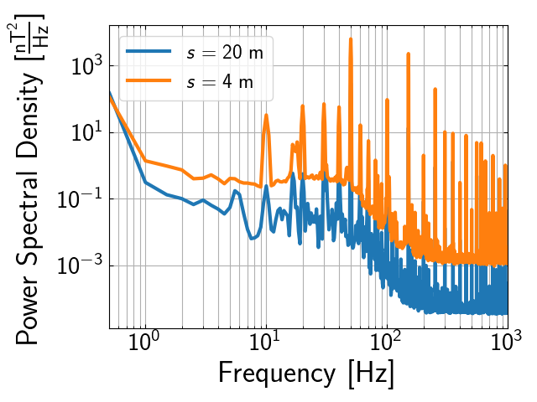
Magnetic Stray Fields
Measurements in CLEAR show large fields O(100 nT)
Some frequencies are hard to cure with beam feedback
But mitigated with beam-based feedback and passive shielding (1mm mu-metal)
More detailed studies required
C. Gohil et al.

Slide 18
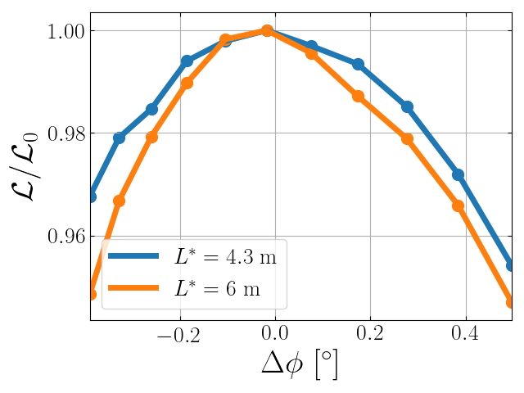
Drive Beam Quality
Drive beam phase tolerance at 380 GeV similar to 3 TeV
CTF3 Pulse current measurement (end of linac)
Losses in the delay loop, different design than in CLIC due to space
3 x smaller beam in CLIC should help
C. Gohil
Parameter | CLIC goal | CTF3 measured
Arrival time | 50 fs | 50 fs
Current after linac | 0.75 x 10⁻³ | 0.54 x 10⁻³
Current at end | 0.75 x 10⁻³ | 2-18 x 10⁻³
Energy | 1.0 x 10⁻³ | 0.7 x 10⁻³
Beam current after combiner ring not quite good enough
Should profit from European E-FEL and SwissFEL
10 x better RF stability than CTF3
Q. Geng
R. Corsini et al.

Slide 19
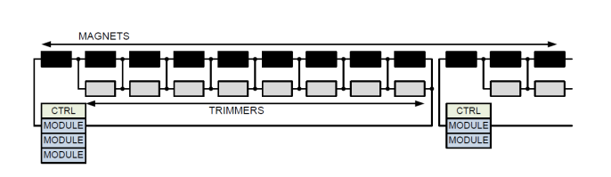
Availability
Availability studies are ongoing
Budgets for subsystems defined
Sofar is OK
Minimising number of power converters ensures sufficient availability of magnet systems
Hot spares ensure sufficient availability of RF units
O. Rey Orozco, A. Apollonio
More work to be done, completeness and system optimisation
Recovery procedures
Lear from other facilites (e.g. light sources and FELs)

Slide 20
Other Topics
Drift-like effects require more attention
Temperature changes are prominent examples
But also variation of power grid, earth magnetic field, timing reference system, degradation due to radiation, creeping of supports, …
Need to characterise the effects
  E.g. movement and deformation of components
Need to identify mitigation methods
  Technology
  Beam dynamics
Need to be able to deal with drifts to match from static to short-term dynamic effects
T. Lefevre et al.
A. Lyapin
Instrumentation
Very much has been done
Still work remains
Additional instrumentation can be useful
Any improvement will help
More / better tuning
Use bumps again
Test some new ideas for beam-based alignment and tuning
First results
C. Rossi et al.
M. Aiba
In RF session
Dark Current
Simulations ongoing
Measurements ongoing / being prepared
Interface with physics
Optimisation of collider parameters for specific measurements
Example operation at Z could yield 2.5 to 45 fb⁻¹ per year
F. Andrianala, P. Roloff, D.S.

Slide 21
Luminosity Considerations
Defined promised performance with margin
But rely on all hardware to work as advertised
Still work to do
More hardware development
Improved tuning
Reduce risk to not achieve our goal

Slide 22
Luminosity Considerations
Defined promised performance with margin
But rely on all hardware to work as advertised
Still work to do
More hardware development
Improved tuning
But can we be lucky?
Could the hardware actually do better?
Can we add useful hardware?
Could we have better tuning?
Should we not push for more luminosity?
Note: Use 3 TeV specifications at 380 GeV for upgrades
Already gives some margin
Reduce risk to not achieve our goal
Opportunity to do even better

Slide 23
Luminosity Considerations
Defined promised performance with margin
But rely on all hardware to work as advertised
Still work to do
More hardware development
Improved tuning
But can we be lucky?
Could the hardware actually do better?
Can we add useful hardware?
Could we have better tuning?
Should we not push for more luminosity?
Note: Use 3 TeV specifications at 380 GeV for upgrades
Already gives some margin
Reduce risk to not achieve our goal
Opportunity to do even better
Define a new ultimate parameter set
Do not promise more for the moment
But prepare to do better
Need to generate close loop between hardware and beam dynamics

Slide 24
Luminosity and Beam Quality
Damping ring main source of horizontal emittance
But value is OK, as we will see
 | Δε_{x} [nm] | Δε_{y} [nm]
 | Total contribution | Design limits | Static imperf. | Dynamic imperf.
Damping ring exit | 700 | 5 | 0 | 0
RTML | 150 | 1 | 2 | 2
Main linac | 50 | 0 | 5 | 5
BDS | 50 | 0 | 5 | 5
sum | “950” | 6 | 12 | 12
Luminosity with no imperfections
L = 4.3 x 10³⁴ cm⁻²s⁻¹
Average expected luminosity with known average static imperfections
L = 3.0 x 10³⁴ cm⁻²s⁻¹
Compared to goal of
L = 1.5 x 10³⁴ cm⁻²s⁻¹
Luminosity
spectrum

Slide 25
Some More Topics
Improve upgrade path studies
Maybe interesting intermediate options
1.5 TeV CLIC same cost as FCC-ee
Maximising luminosity with more beam means higher cost and more power consumption
However the additional cost might be acceptable
  Currently at 380 GeV, RF part of the total power is limited
  Most additional cost is in RF and cooling
Doubling the repetition rate has impact on all systems
Double pulses
  Feed second collider, e.g. for Z production?
Optimisation of collider for physics reach
Can we do something
Gamma-gamma option could be of interest at high energies
If this becomes serious would need some more serious investigation
Future upgrades with novel acceleration technologies
Requirements to reach luminosity
Luminosity related technologies

Slide 26
Conclusion
More work on luminosity remains
Continued effort to make sure that we reach the promised luminosity
Confident but lots of work
Potentially improve the luminosity
Close collaboration of hardware and beam dynamics
Better hardware
New hardware
Additional methods
Will start a working group
With Nuria and Thibaut
Many thanks to the CLIC team
In particular to those who’s name is not mentioned on the slides

Slide 27
Reserve

Slide 28
Hourglass Effect
Taking into account hourglass effect
Luminosity does not improve much below β_{y} < σ_{z}
For flat beams, the optimum is around β_{y} = 0.25 x σ_{z}
Note: This is different for round beams

Slide 29
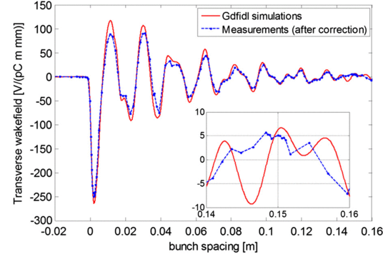
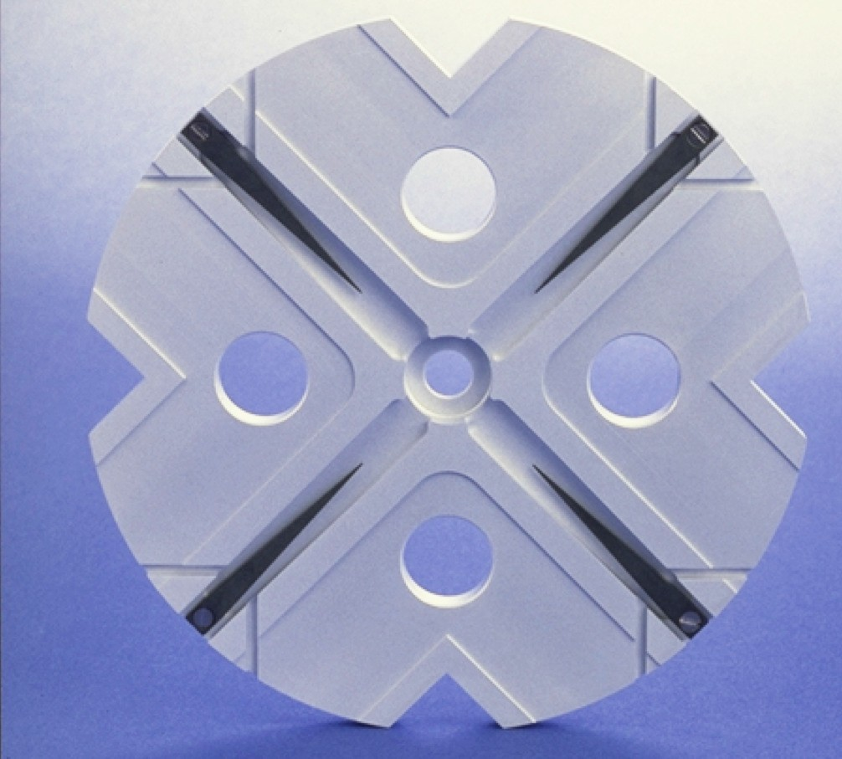
Wakefields and Beam Current
Goal: maximise beam current
Maximise bunch charge
Minimise distance between bunches
2a
Limits are given by wakefields:
With an offset particles produce transverse wakefields
The head kicks the tail, force is defocusing
Can render beam unstable
RF team loves small a
Less power
easier to reach gradient
Beam team hates small a
More wakefields
Beam less stable
Multi-bunch wakefields minimised by damping and detuning

Slide 30
Tricks of the Beam Physics
Make the focus strong again
Use O(10%) of the linac for magnets
Leads to small beta-function
Makes the beam stable (strong spring for an oscillator)
For single bunch use BNS damping (Balakin, Novokhatsky and Smirnov)
Introduce energy chirp that compensates transverse wakefields

Slide 31
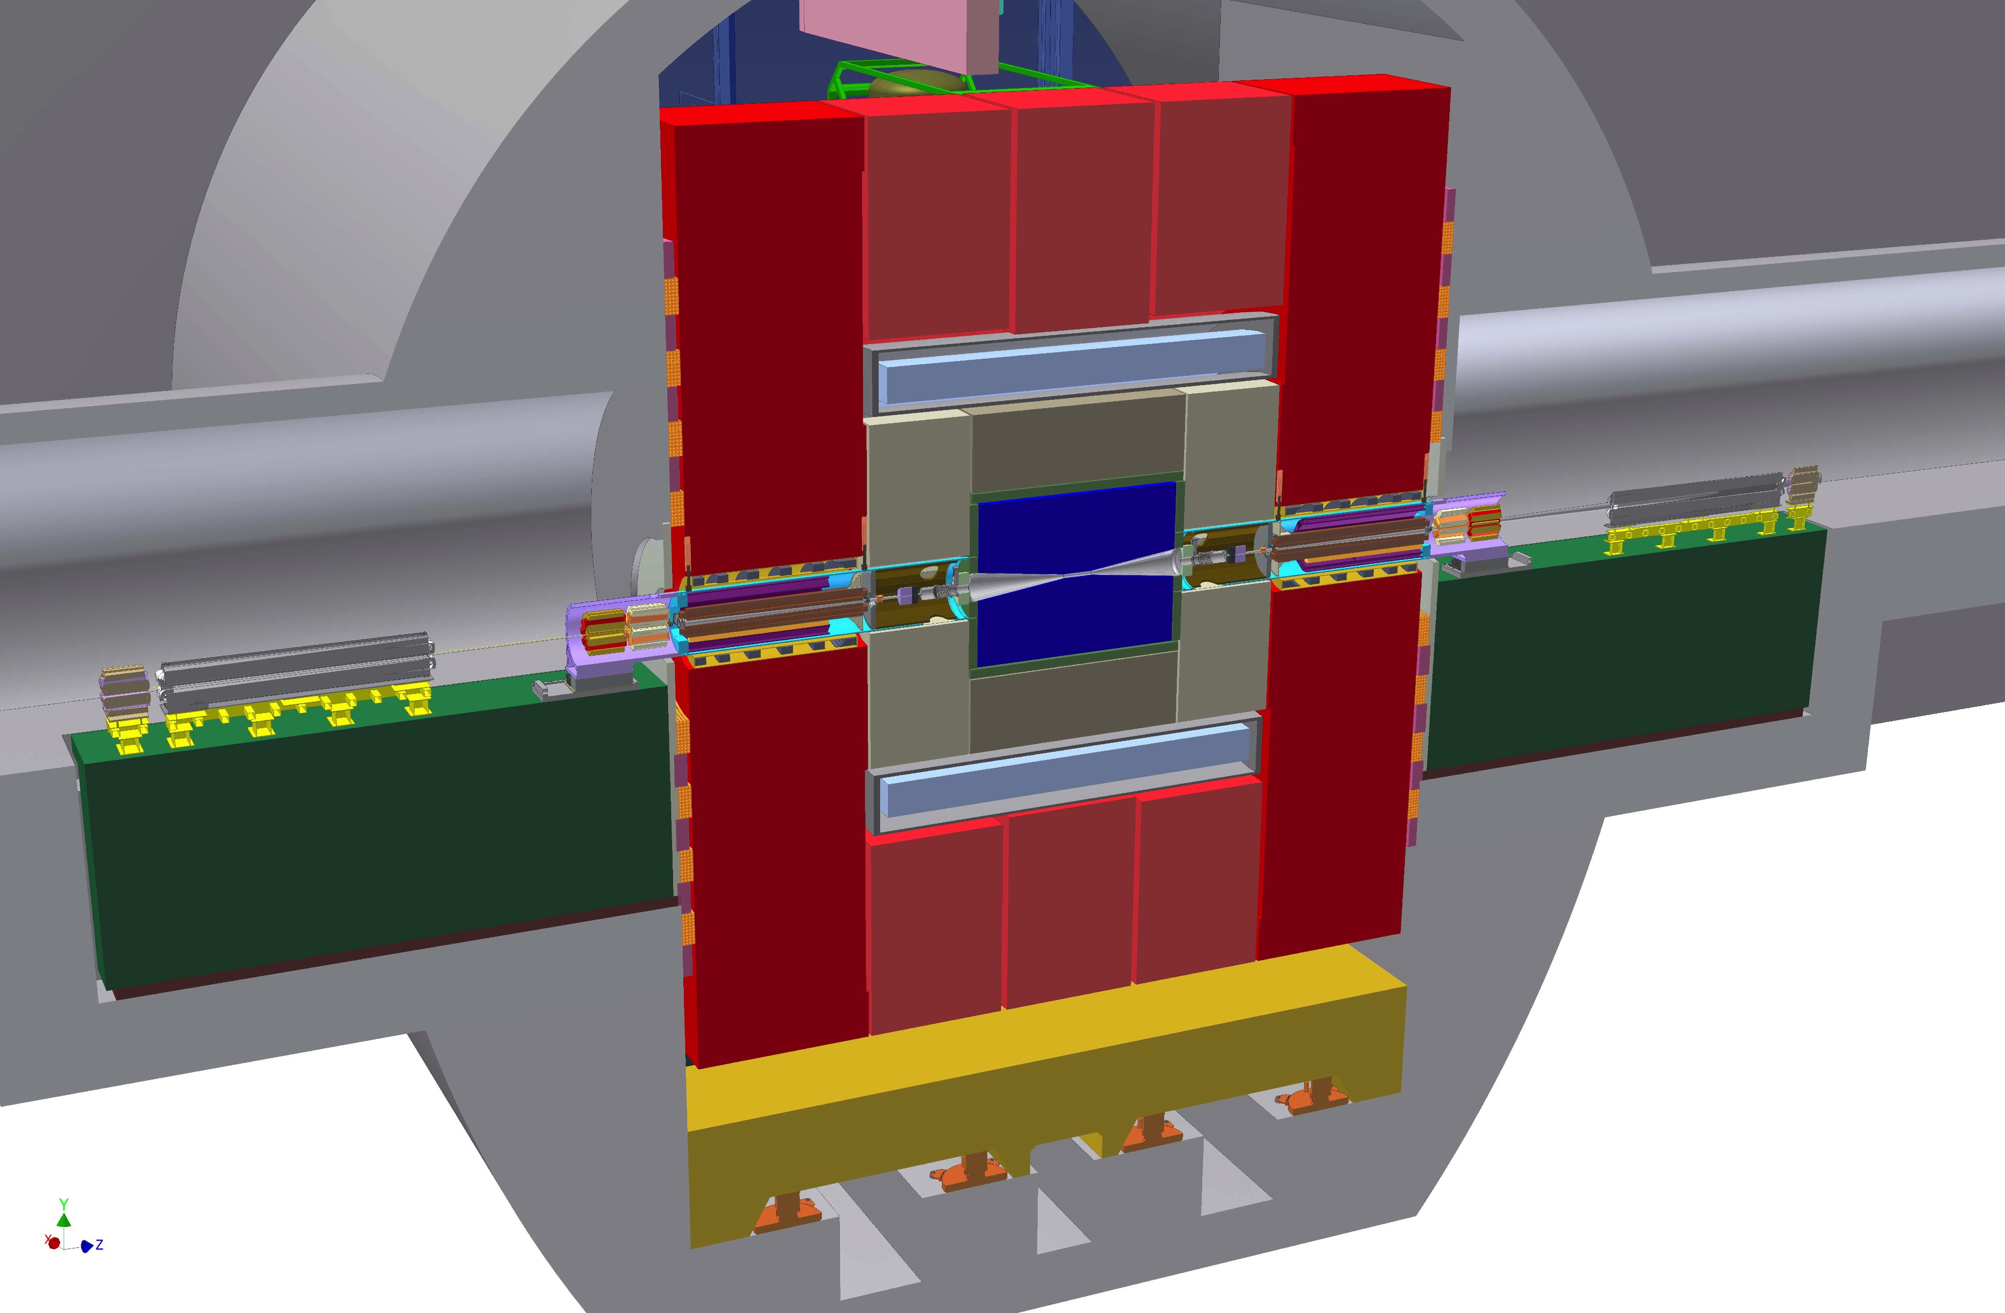
Beam Delivery System
First magnet has been at L* = 3.5 m from the interaction point, inside of detector
Short L* limits chromaticity, the main challenge

Slide 32
Beam Delivery System
First magnet has been at L* = 3.5 m from the interaction point, inside of detector
Limited angular coverage of detector
Magnet is put on cantilever from tunnel
Magnet needed to be shielded from detector solenoid

Slide 33
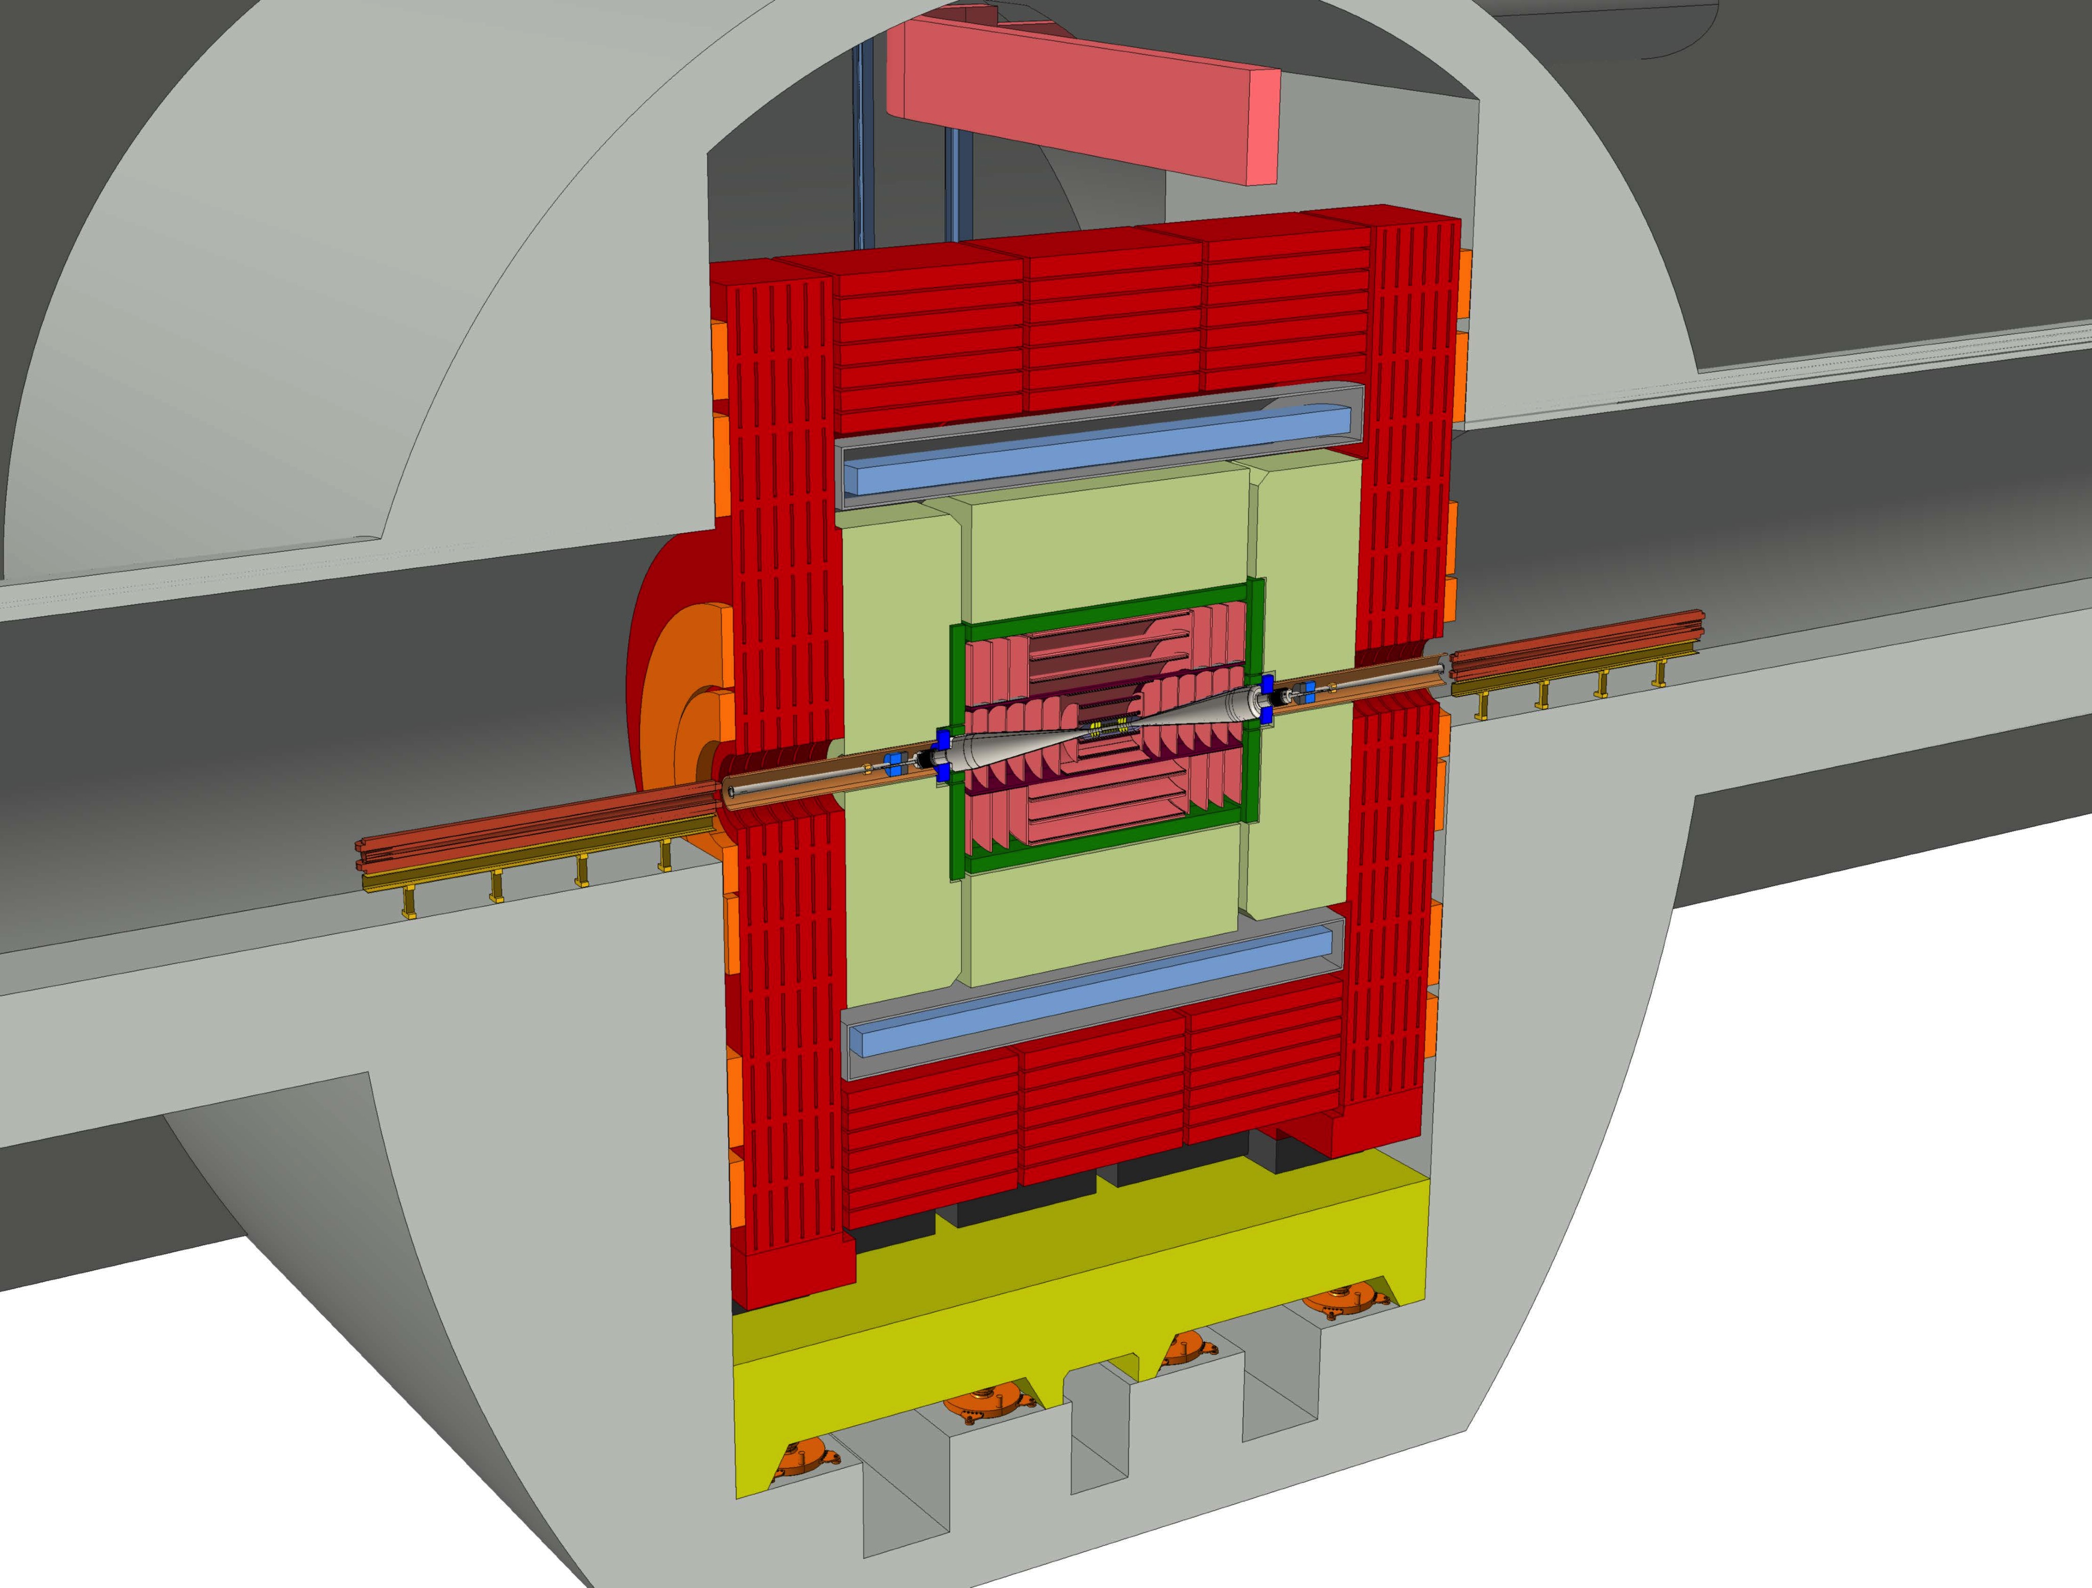
Beam Delivery System
New design with L* = 6 places magnet outside of detector and mitigates high chromaticity
Better for physics
Also easier for equipment:
No shielding solenoid
Final quadrupole can be attached to tunnel floor
✓

Slide 34
Horizontal Optimum
Design value β_{x}= 8 mm
Reaches L_{0.01}/L=60%
The total luminosity L varies strongly with beta-function
But L_{0.01} does not change so much
Hard to push beta-functions that low
Use L_{0.01}/L=60% as criterion
Reasonable compromise for most physics studies

Slide 35
Vertical Optimum
Including pinch effect
Geometric luminosity
No beam-beam forces
Somewhat above optimum because small beta-functions because it is easier for the machine
CLIC choice 100 μm,
reached by beam delivery system

Slide 36
Main Linac Emittance Growth (3 TeV)
imperfection | with respect to | symbol | value | emitt. growth
BPM offset | wire reference | σ_{BPM} | 14 µm | 0.367 nm
BPM resolution |  | σ_{res} | 0.1 µm | 0.04 nm
accelerating structure offset | girder axis | σ₄ | 10 µm | 0.03 nm
accelerating structure tilt | girder axis | σ_{t} | 200 µradian | 0.38 nm
articulation point offset | wire reference | σ₅ | 12 µm | 0.1 nm
girder end point | articulation point | σ₆ | 5 µm | 0.02 nm
wake monitor | structure centre | σ₇ | 3.5 µm | 0.54 nm
quadrupole roll | longitudinal axis | σ_{r} | 100 µradian | ≈ 0.12 nm
Emittance growth for different imperfections
Using sophisticated beam-based methods
Note: The tight tolerances are the price for the strong focusing,
Which allowed high beam current
Goal: less than 10% above Δε_{y} = 5 nm
Further improvement using tuning bumps
0 5 10
Δε_{y,0} [nm]

Slide 37
Phase Jitter

Slide 38
Drive Beam Tolerances
Feedforward (test in CTF3)
Timing reference (FEL)
Emittance ε_{x,y} ≤ 150μm
Transverse jitter ≤ 0.3σ
Current stability 0.75 •10⁻³
Phase stability 0.2° @ 12GHz (with feedforward)
Bunch length stability 1%
Phase stability 0.2° @ 1GHz
= 2.5° @ 12GHz
Correlated energy spread ~1% RMS
RF power stability 0.2% (CTF3)
RF phase stability 0.05° (CTF3)

Slide 39
Drive Beam Quality
Current stability and phase stability are key
Errors lead to wrong main beam energy
Pulse current measurement (end of linac)
Arrival time with feedback
Losses in the delay loop, different design than in CLIC due to space
3 x smaller beam in CLIC should help
Parameter | CLIC goal | CTF3 measured
Arrival time | 50 fs | 50 fs
Current after linac | 0.75 x 10⁻³ | 0.54 x 10⁻³
Current at end | 0.75 x 10⁻³ | 2-18 x 10⁻³
Energy | 1.0 x 10⁻³ | 0.7 x 10⁻³
(✓)

Slide 40
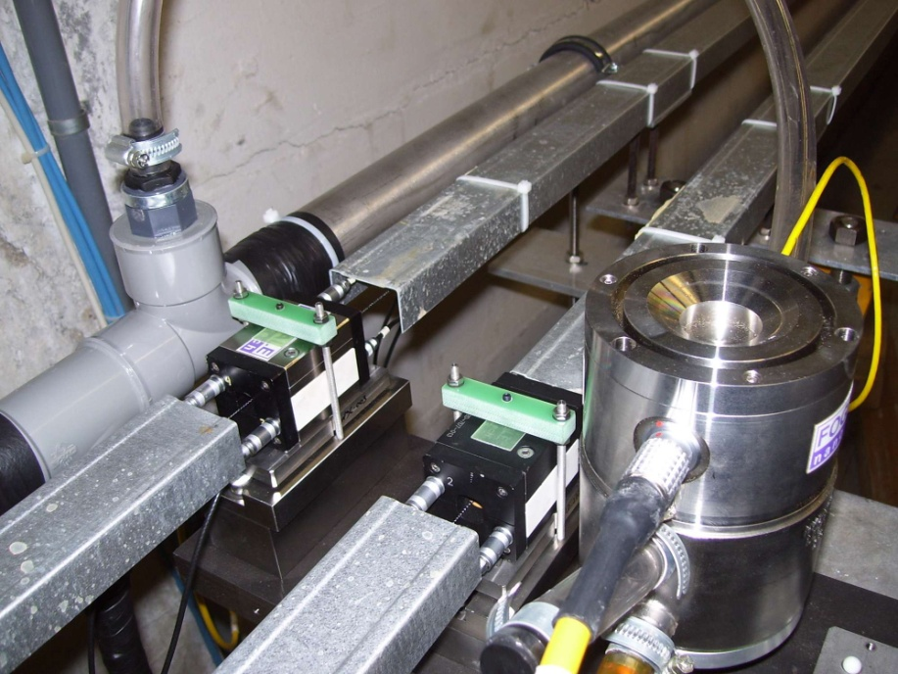

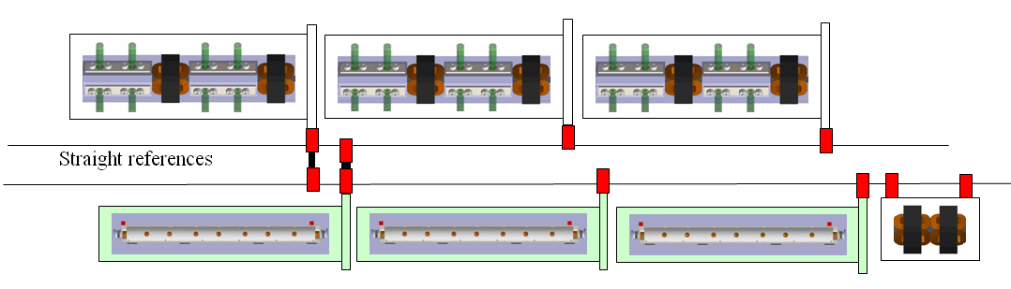
Static Imperfections: Main Linac Alignment
1) Align components accurately on the supporting girders
2) Establish reference system with overlapping wires, has some error but is not critical
3) Align modules remotely to the wires using their sensors and movers
The error for this is most critical misalignment of components is of the order O(10μm)
4) Use sophisticated beam-based alignment such as dispersion free steering (DFS, i.e. different energy beams) to align components
In particular to align BPMs

Slide 41
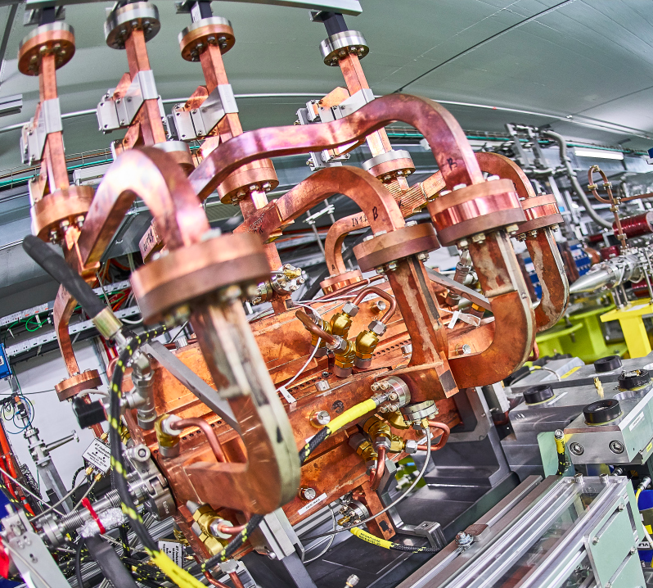
RF Alignment
Structures scattered on girder
Wakefield kick
5) Measure beam offset with wakefield monitor
Move girder to remove mean offset
No net wakefield kick
Limit mainly from
wakefield monitor accuracy (3.5 μm)
reproducibility of wakefield
tiny variation of betatron phase along girder
Wakefield monitor:
Measure wakefield in damping waveguide

Slide 42
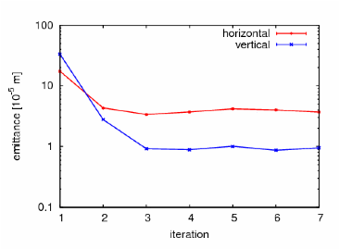
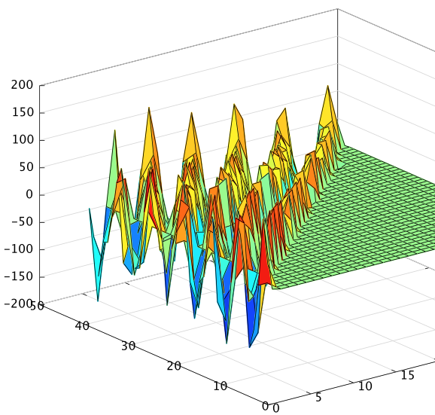
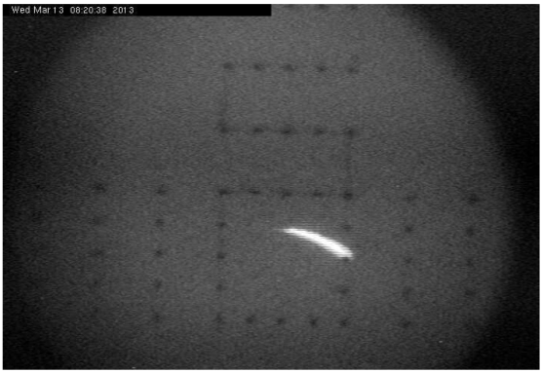
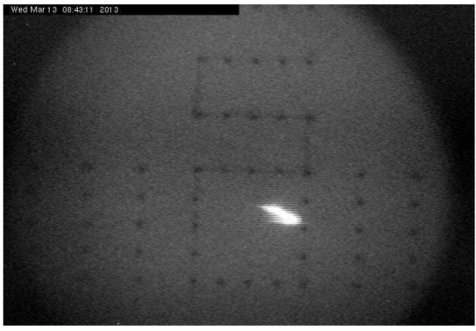
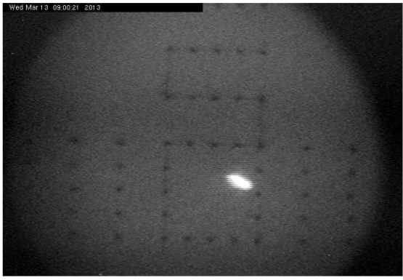
CLIC Beam-Based Alignment Tests at FACET
DFS applied to 500 meters of SLC linac
System identification algorithms to construct model
DFS correction with GUI
Emittance growth is measured
System model
Emittance [10⁻⁵ m ]
iteration
✓
Initial beam
After 1 iteration
After 3 iterations

Slide 43
Beam-beam Feedback
Strong deflection allows to easily measure and correct offset
40 μm beam offset 3m downstream of IP
10 ns from IP to BPM
13 ns to apply correction kick
10 ns from kicker to IP
= 33 ns latency vs. 170 ns beam pulse
Δ_{y} = 0.1σ_{y} = 0.3nm
FONT system (Oxford) tested in ATF 2: 13 ns
3 m

Slide 44
Ground Motion
Beam-trajectory feedback corrects pulse-to-pulse (20 ms)
Cures low frequency ground motion
But not higher frequencies
Ground motion can impact beam trajectory
Andrea Jeremie, Kurt et al.
Beam-trajectory feedback:
Example transfer curve (recursive filter)
Amplification/demagnification
Want to be able to cope with this
(Model B10 similar to CMS hall)
LEP tunnel
0
5
10
15
20
25
demagnification
Frequency [Hz]

Slide 45
Better Beam
Better beam requires better hardware
Smaller imperfections, e.g. BPM resolution
Better compensation of other imperfections, e.g. ground motion compensation
Better beam requires better tuning
Improved methods, we try hard…
Additional methods, e.g. luminosity tuning bumps
If imperfection can be reduced
By factor 2: 60% more luminosity
By factor 4: 100% more luminosity
Better beam is probably more a matter of feasibility than cost
For the moment better concepts should be developed
Change from
“What can we promise in the near future?”
to
“What can we imagine to do even better?”

Slide 46
Key Parameters

