Slide 1

A proposal for a controls and data acquisition demonstrator
Javier Serrano
(with help from Greg Daniluk, Eva Gousiou and Maciej Lipiński)
Clic workshop | 22 jan 2019

Slide 2
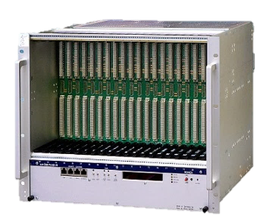
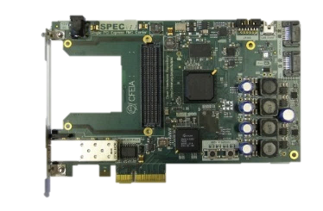
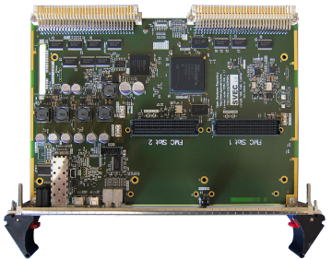

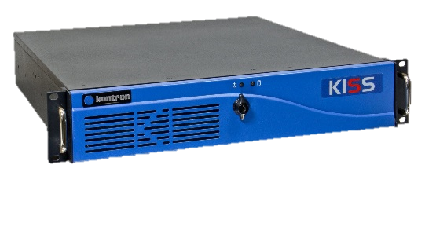

Custom Electronics Architecture
Front-End Tier
Front-End Computer
VME/PICMG/PLC
master
Fieldbus (WorldFIP/PROFINET/etc)
Fieldbus Tier
DIO1
DIO2
DIO3
DIOn
slave
slave
slave
slave
Distributed I/O Tier
actuator
actuator
sensor
sensor

Slide 3
Custom Electronics Architecture
Front-End Tier
Front-End Computer
VME/PICMG/PLC
master
Fieldbus (WorldFIP/PROFINET/etc)
Fieldbus Tier
DIO1
DIO2
DIO3
DIOn
slave
slave
slave
slave
Distributed I/O Tier
actuator
actuator
sensor
sensor

Slide 4



Rad-tol Communication Technologies
GBTx/LpGBTx
performance
500 Gy
2MGy

Slide 5
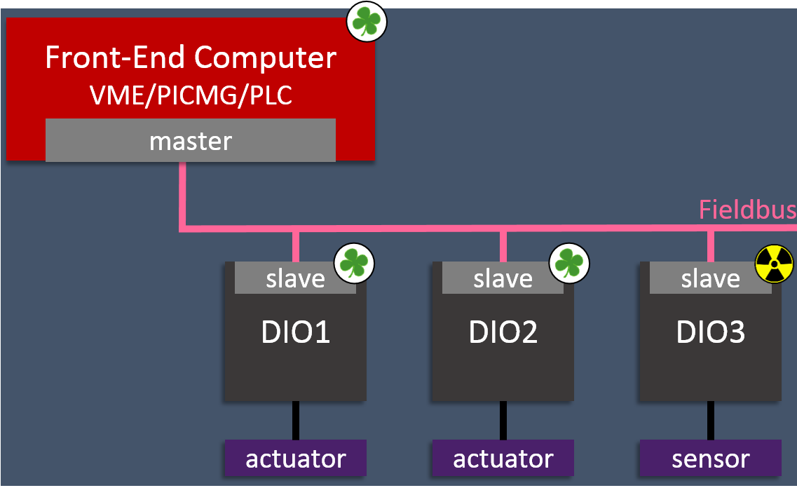
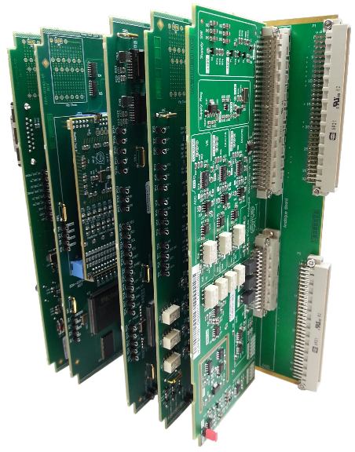
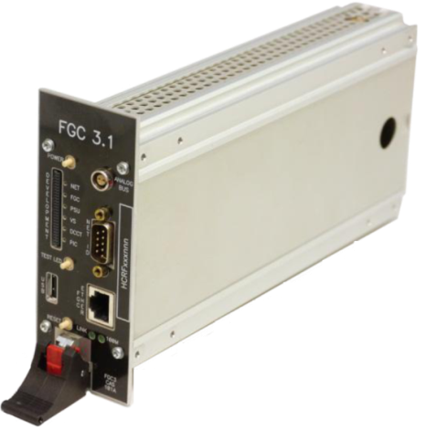
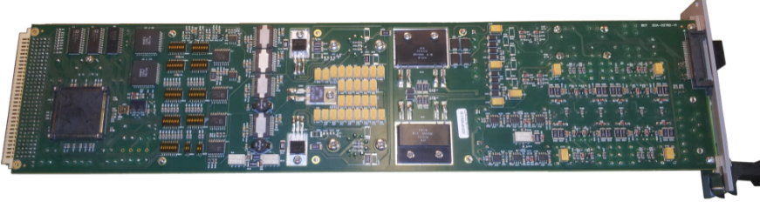
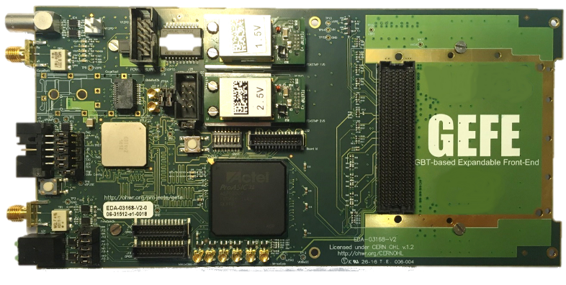
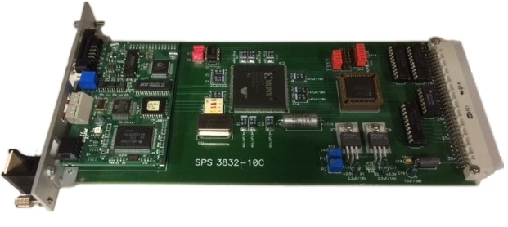
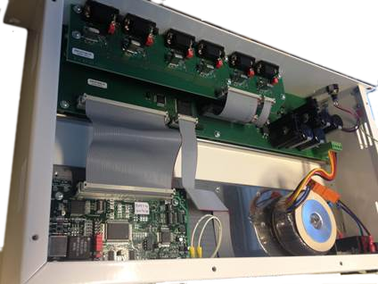
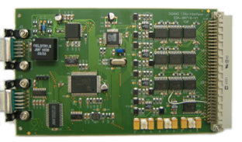
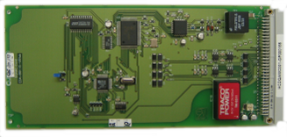
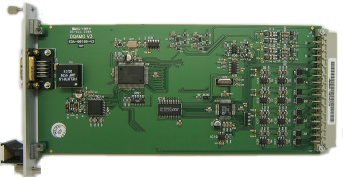
DIOT today
Power Converters
Beam Instrumentation
Cryogenics
Machine Protection
Beam Transfer
Magnets Positioning

Slide 6


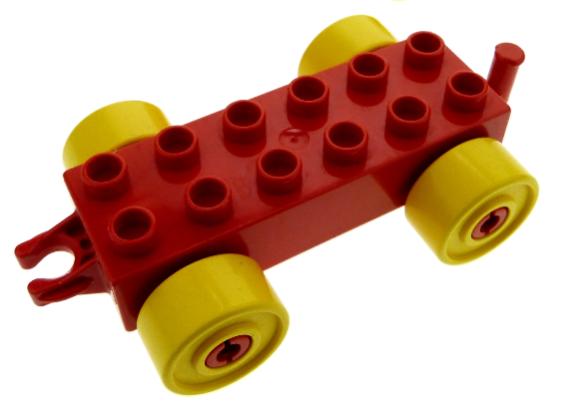
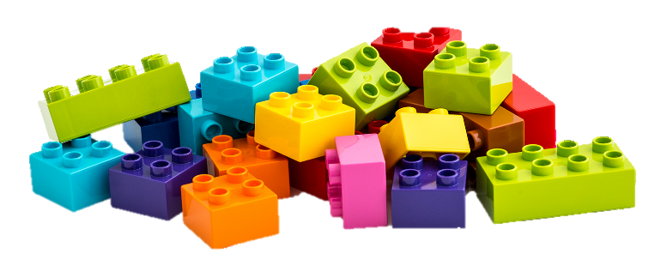



Future DIOT Recipe
Magnets Positioning
Machine Protection
+
=
Beam Transfer
Modular hw kit
Designed with eq.groups
Maintained by BE-CO
App-specific parts
Designed by eq. groups
Beam Instrumentation
RF
More robust designs
Benefit from existing developments
Re-use between equipment groups
In CLIC we go one step further: all groups share a crate
Notes:
Modular hw kit designed by CO in collab with eq. groups
Maintenance by CO

Slide 7
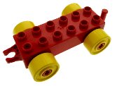

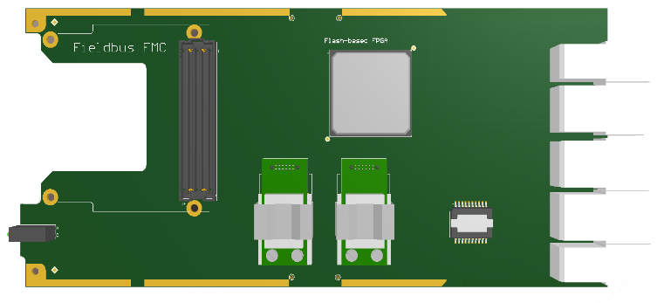
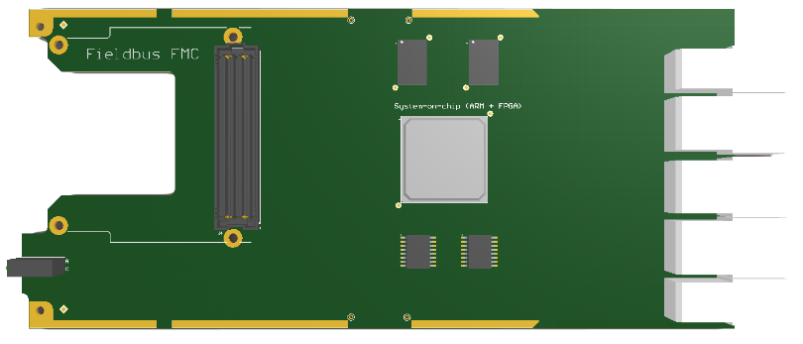
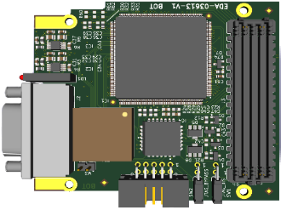
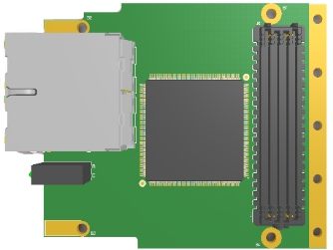
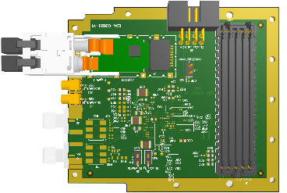
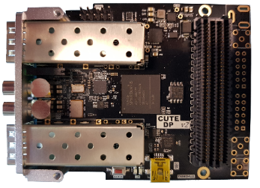
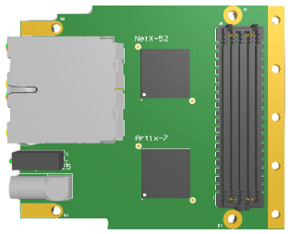
Common hardware kit for DIOT
PSU
Custom space
Radiation-tolerant System Board
System Board
. . . . . . . .
. . . . . . . .
WorldFIP FMC
Powerlink FMC
LpGBTx FMC
White Rabbit FMC
Industrial Ethernet FMC

Slide 8
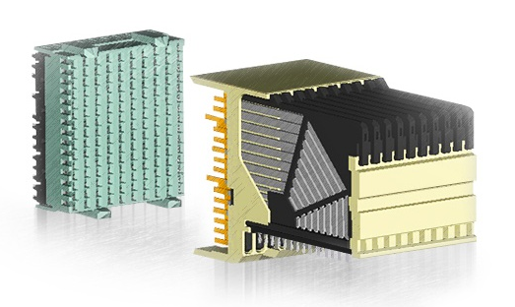
3U Chassis & Backplane
PSU
Custom space
. . . . . . . .
. . . . . . . .
Hosts Power Supply, System Board & Application-specific Peripheral Boards
Low cost crate with 9-slots CompactPCI Serial backplane by default
  Fully passive
  Star-topology differential lanes from System to Peripheral
  AirMax VS connectors
Application-specific backplanes (with the system slot) possible
Optional 1U fan tray
Notes:
No PCIe in radiation
Robust connector used in transportation

Slide 9
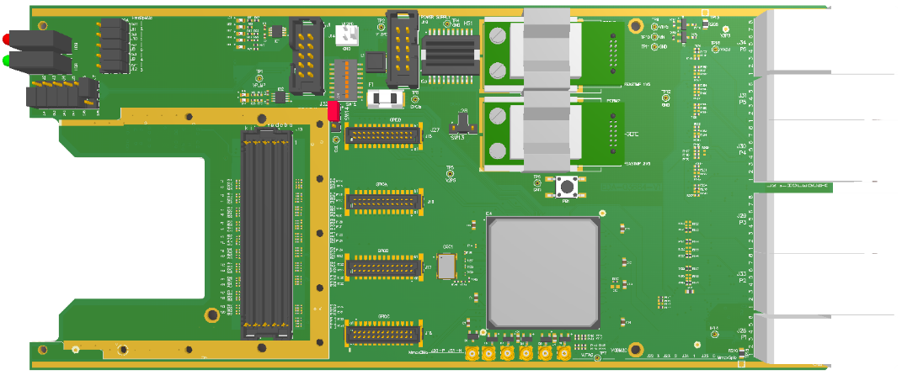
Rad-tol System Board
220mm
Backplane connector:
communication with
peripheral boards
FMC for fieldbus
FPGA for
  application-specific logic
  common crate monitoring and diagnostics

Slide 10
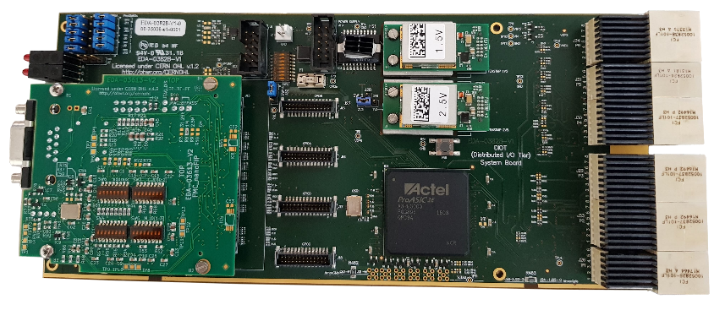
Rad-tol System Board v1.0
EDA-03828
Redesigned C-GEFE (BE-BI)
Added backplane connector to communicate with peripheral boards
Minor fixes (including FMC compatibility)
Together with: BE-BI, TE-MPE, EN-SMM
10 boards produced for lab use
v2.0 in the future, with NanoXplore or Smartfusion2 FPGA

Slide 11
Rad-tol Power Supply
Lalit Patnaik (FELL) dedicated to this task – R2E and HL-LHC funding
Collaboration with R2E and TE-EPC
Survey of currently used rad-tol power supplies
Gathering requirements and drafting specs
  230V AC → DC +12V, +5V, 100W
  TID > 500Gy (1kGy?)
  Redundancy
  PMBus monitoring interface
First lab prototype using FEAST chips as controller of switched supply
Components selection and qualification planned for 2019
https://wikis.cern.ch/display/DIOT/Rad-tol+power+supply

Slide 12
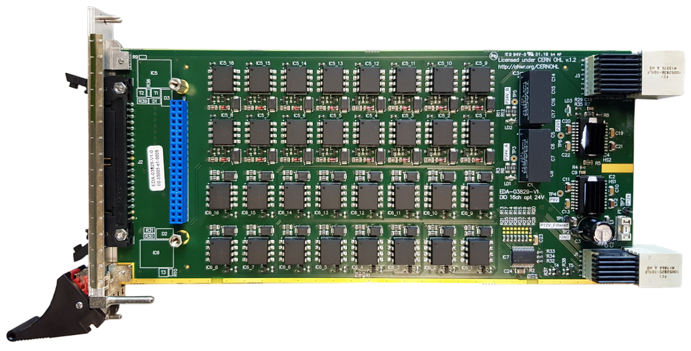
Template Peripheral Board
EDA-03829
I/O board based on requirements for Warm Interlocks application (TE-MPE)
24V generation (TRACO)
16 opto-coupled current loop inputs (HCNR200)
16 opto-coupled relay driving outputs (HCNR200)
Template for future application-specific Peripheral Boards
Radiation tests in 2019

Slide 13
White Rabbit
UTC
Timing Master
WR Switch
WR switch
WR switch
WR switch
WR
node
WR switch
WR
node
WR
node
WR
node
WR
node
WR
node
WR
node
WR
node
WR
node
WR
node
WR
node
WR switch
WR
node
WR
node
WR
node
WR
node
WR
node

Slide 14
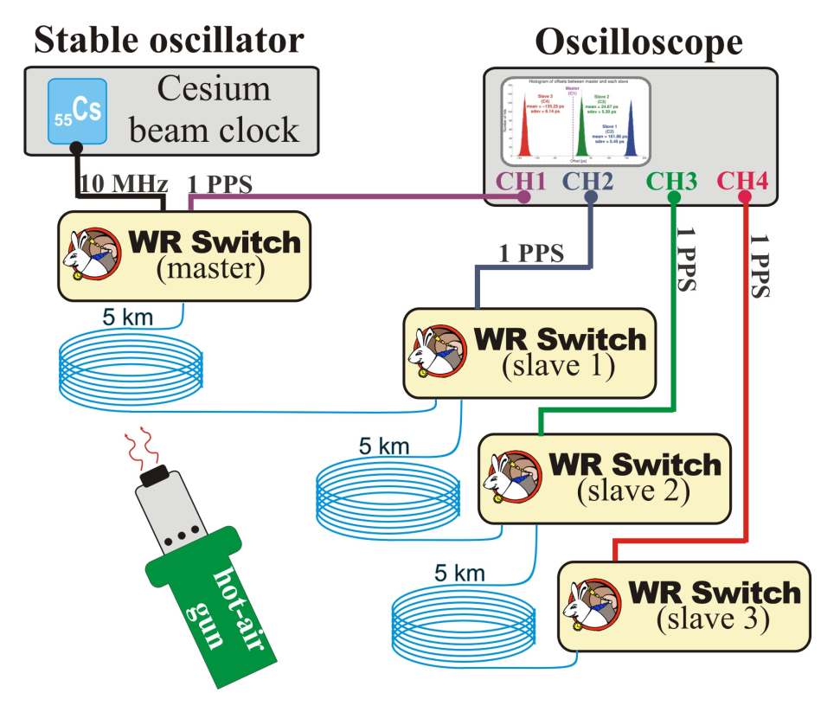
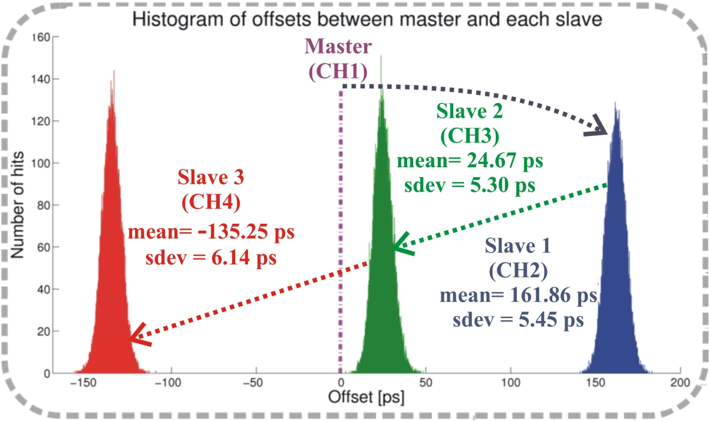
White Rabbit Performance

Slide 15
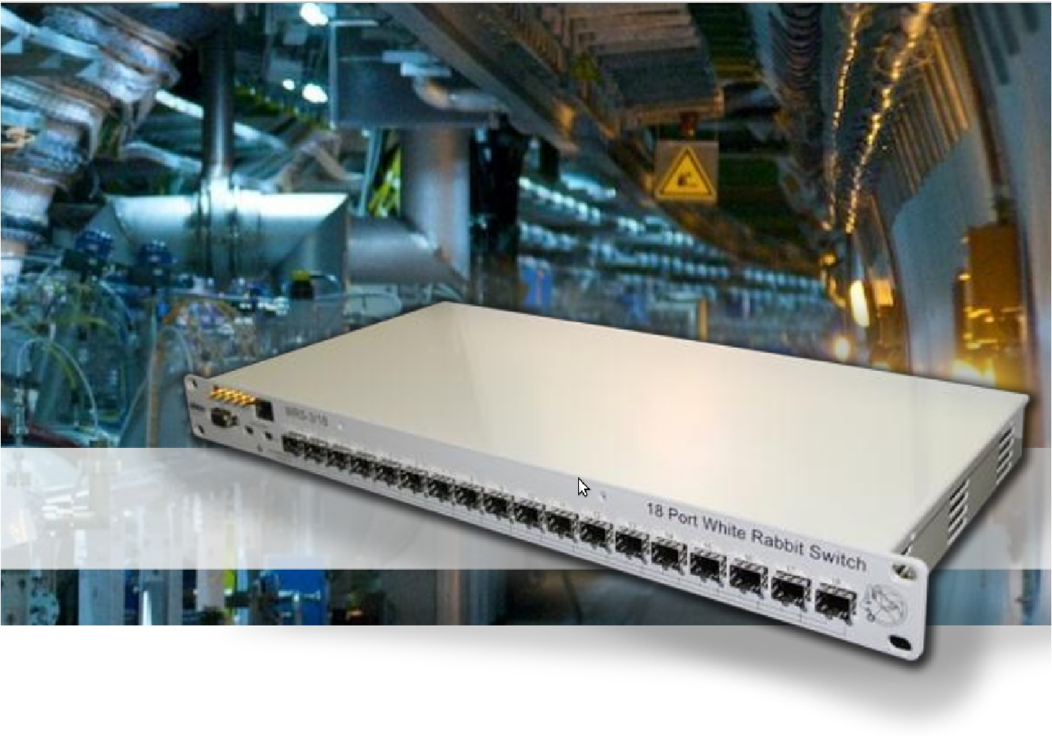
White Rabbit Switch

Slide 16
Proposal
Make a version of the WR switch which can use lpGBT protocol (clocked by an RF-related clock signal) for the physical layer (Q1 2021)
Design lpGBT mezzanine for DIOT system board (Q1 2021)
Identify a use case in CLEAR in collaboration with BE-BI (Q4 2019)
Test (Q4 2021)
  Radiation tolerance
  Power consumption (and possibly power cycling scheme)
  Beam-synchronous acquisition and time-stamping
  Possibilities for daisy-chaining to reduce fibre costs
The resulting demonstrator will provide answers to outstanding questions regarding radiation tolerance, power consumption and cabling costs, and will allow to fine-tune our proposed strategy for controls and data acquisition in CLIC.

Slide 17
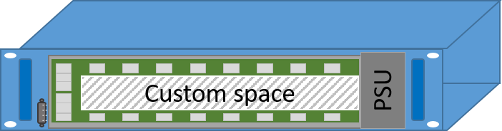

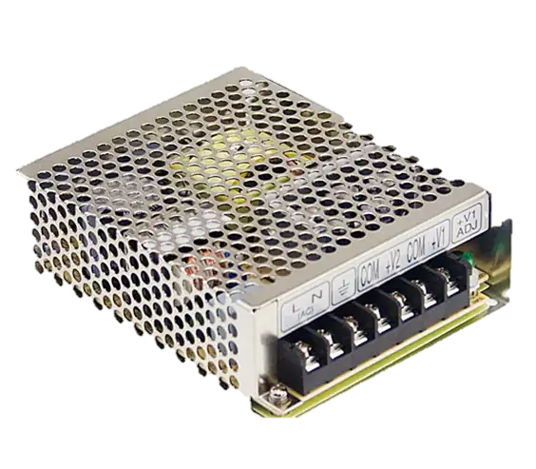
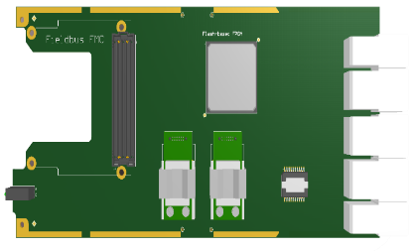


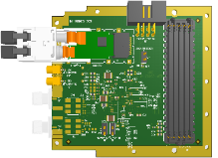
Proposal
lpGBT DIOT
+
+
App-specific
Peripheral boards

Slide 18
Proposal
lpGBT DIOT
lpGBT DIOT
+
+
App-specific
Peripheral boards

Slide 19
Proposal
RF/n
Timing Master
WR Switch
WR switch
WR switch
Colour code:
Timing Master
WR Switch
WR switch
lpGBT DIOT
WR switch
Outside radiation
WR switch
lpGBT DIOT
lpGBT DIOT
lpGBT DIOT
lpGBT DIOT
lpGBT DIOT
lpGBT DIOT
In radiation
lpGBT DIOT
lpGBT DIOT
lpGBT DIOT
lpGBT DIOT
lpGBT DIOT
lpGBT link
WR switch
lpGBT DIOT
WR link
lpGBT DIOT
lpGBT DIOT
lpGBT DIOT
lpGBT DIOT

