Slide 1





High-Gradient Test of a
3 GHz Single-Cell Cavity
4th Annual X-band Structure Collaboration Meeting
Silvia Verdú-Andrés (TERA, IFIC)
U. Amaldi, M. Garlasché (TERA),
R. Bonomi (TERA, Politecnico di Torino),
A. Degiovanni, A. Garonna (TERA, EPFL),
R. Wegner (TERA, CERN), C. Mellace (A.D.A.M.)
03.05.2010
Notes:
Good morning everybody. My name is Silvia Verdú-Andrés. I am glad to present you the work we have recently developed in TERA Foundation, a “High-Gradient Test of a 3 GHz Single-Cell Cavity”.

Slide 2
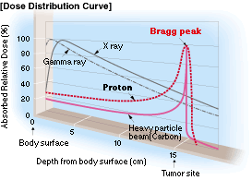
Hadron therapy: the basics
proton
tail
light ion
(carbon)
httt://global.mitsubishielectric.com/bu/particlebeam/index_b.html
200 MeV - 1 nA
protons
4800 MeV – 0.1 nA
carbon ions
(radioresistant tumours)
27 cm
Depth-dose
distribution
Charged hadron beam that loses energy in matter
Tumour
target
Courtesy of PSI
Notes:
Hadrontherapy is the radiotherapy technique that exploits the advantegeous depth-dose profile of hadrons while traversing the matter. Proton beams of 200 MeV and carbon ions beams of about 400 MeV/u are needed for killing tumoural cells at 27 cm depth. Intensity: a couple of nA.
Proton and carbon ion beams present advantegeous depth-dose distributions (Bragg peak) with respect to X rays. Carbon ions beams produce clustered damages to the DNA of the traversed cells which allows the control of tumours which are “radioresistant” to both X-rays and protons.
The depth at which the maximum dose delivery occurs can be modified by changing the beam energy.
The accelerators should provide small currents of proton and carbon ions (less than a couple of nanoamperes) of energies larger than 200 MeV and 400 MeV/u, respectively if one wants to reach tumoural cells located at 27 centimeters depth.

Slide 3
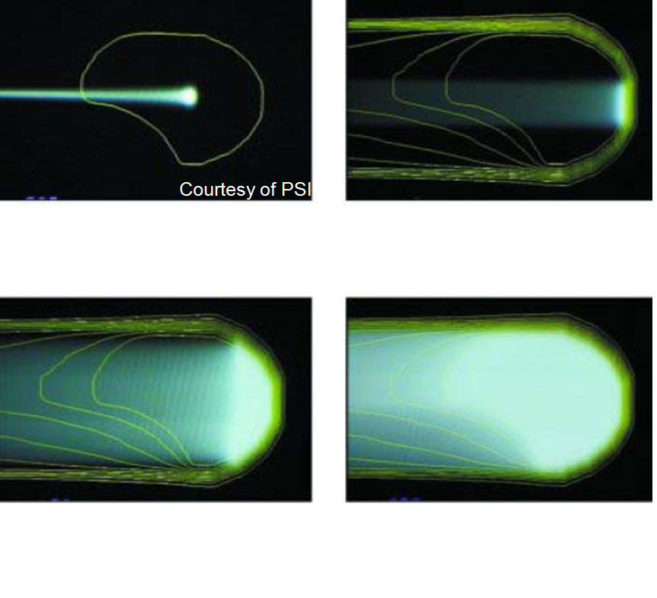
Treating moving organs requires...
Fast Active Energy Modulation
(a couple of ms)
Fast 3D correction of
beam spot position in depth
Single ‘spot’
pencil beam
Lateral scanning with
magnets: 2 ms/step
Fast Cycling machine
(high repetition rate ~ 200-300 Hz)
Tumour
MULTIPAINTING
Depth scanning: ACTIVE ENERGY MODULATION
3D conformal treatment

Slide 4
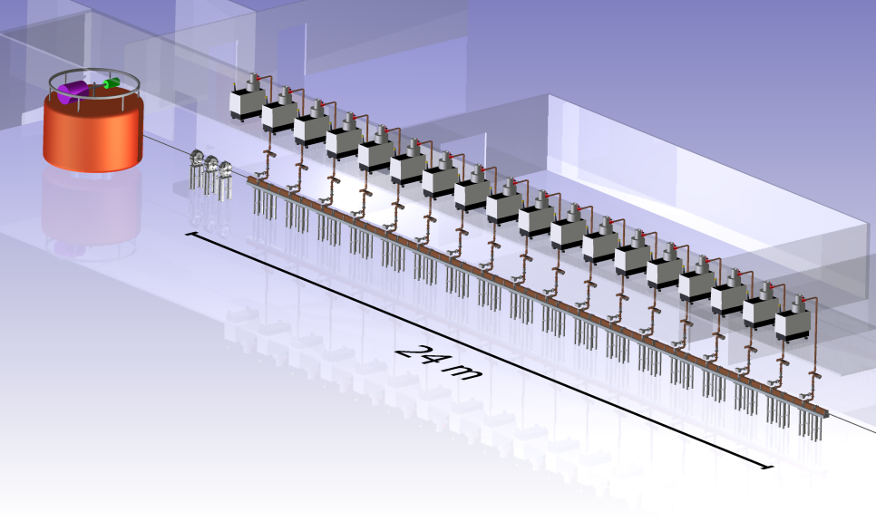
TERA’s proposal: cyclotron + high-freq. linac = cyclinac
Cell Coupled Linac
RF frequency: 5.7 GHz
18 accelerating modules - Length of each module ~ 1.3 m
High gradient : 40 MV/m (TERA+CLIC collaboration)
120
MeV/u
400
MeV/u
CELL COUPLED LINAC
Cell Coupled Linac
Standing-wave structure
RF frequency: 5.7 GHz
CABOTO
(CArbon BOoster for Therapy in Oncology)
Notes:
For these hadrontherapy applications the Italian research foundation TERA proposes a new type of accelerator, the cyclinac, made of a high-frequency linac which boosts the energy of the hadrons accelerated by a cyclotron. CABOTO is the newest proposal of TERA and will accelerate
[TErapia con Radiazioni Adroniche: Application of physics and computing to medicine and biology]
[CABOTO (Carbon BOoster for Therapy in Oncology ) works at a higher frequency of 5,7 GHz, to reduce the overall length. The CCL (Cell Coupled Linac) is made of eighteen 1,3 m long units (gradient = 40 MV/m, Kilpatrick = 2.9).]

Slide 5
Higher accelerating gradients
Smaller complex!
TERA’s proposal:
cyclotron + high-freq. linac = cyclinac
120
MeV/u
CELL COUPLED LINAC
400
MeV/u
Cell Coupled Linac
RF frequency: 5.7 GHz
18 accelerating modules - Length of each module ~ 1.3 m
High gradient : 40 MV/m (TERA+CLIC collaboration)
Cyclinac:
E₀ ~ 40 MV/m ➔ E_{Max} ~ 200 MV/m
BDR ~ 10⁻⁶ bpp/m in 30 m
CABOTO =
CArbon BOoster for Therapy in Oncology
Notes:
Obviously the dimensions of the cyclotron-linac complex could be greatly reduced if higher accelerating gradients would be achieved in the linac.
(Check!) AIM: To reach energies needed for hadrontherapy (accelerate protons or carbon ions up to 200 or 400 MeV/u respectively) in 20 meters, an accelerating field of about 40 MV/m is required. For hadron linacs the ratio of the maximum surface field Emax to the
average accelerating field Eacc is Emax/Eacc ≈ 4-5.
Our goal is similar to the one pursued by CLIC if one takes into account that our structure measures around 30 m and CLIC structure measures 30 km. Of course different beams has to be accelerated in each machine.
[TErapia con Radiazioni Adroniche: Application of physics and computing to medicine and biology]
[CABOTO (Carbon BOoster for Therapy in Oncology ) works at a higher frequency of 5,7 GHz, to reduce the overall length. The CCL (Cell Coupled Linac) is made of eighteen 1,3 m long units (gradient = 40 MV/m, Kilpatrick = 2.9).]

Slide 6
3 GHz high-gradient test:
motivation and objectives
Silvia Verdú-Andrés
6
Notes:
First of all, we would like to know the operation limit for S-band cavities. For that, we will consider the BDR/length. The limitation can be given/established by the surface electric field or by the modified Poynting vector plus a scaling law.
6

Slide 7
3 GHz high-gradient test:
motivation and objectives
Operation limit for S-band cavities → Break Down Rate BDR per length
Limit given by:
  surface field E_{s} (Kilp.) or
  modified Poynting vector S_{c} + scaling law (X, K-band)
Notes:
First of all, we would like to know the operation limit for S-band cavities. For that, we will consider the BDR/length. The limitation can be given/established by the surface electric field or by the modified Poynting vector plus a scaling law.

Slide 8
3 GHz high-gradient test:
motivation and objectives
Operation limit for S-band cavities → Break Down Rate BDR per length
Limit given by:
  surface field E_{s} (Kilp.) or
  modified Poynting vector S_{c} + scaling law (X, K-band)
Scaling laws at S-band
[E_{s}, S_{c}, pulse length, temperature, repetition frequency]
Notes:
Then we want to find out the scaling laws that relate quantities such as Es, Sc, tP, T and rep.rate and that apply at S-band.

Slide 9
3 GHz high-gradient test:
motivation and objectives
Operation limit for S-band cavities → Break Down Rate BDR per length
Limit given by:
  surface field E_{s} (Kilp.) or
  modified Poynting vector S_{c} + scaling law (X, K-band)
Scaling laws at S-band
[E_{s}, S_{c}, pulse length, temperature, repetition frequency]
Applying found limit to future designs
  ensure reliable operation
  optimize RF structures (efficiency, length, cost)
Notes:
Finally, we should apply the found limit to future designs in order to ensure reliable operation and to optimize Rf structures in terms of efficiency, length and cost.
[Valid at S-band? Valid for T_{Pulse}=2ms? Can a 3 GHz SW cavity be operated reliably with Es= 150 MV/m = 3.2 Kilp.?]

Slide 10
3 GHz high-gradient test:
motivation and objectives
Operation limit for S-band cavities → Break Down Rate BDR per length
Limit given by:
  surface field E_{s} (Kilp.) or
  modified Poynting vector S_{c} + scaling law (X, K-band)
Scaling laws at S-band
[E_{s}, S_{c}, pulse length, temperature, repetition frequency]
Applying found limit to future designs
  ensure reliable operation
  optimize RF structures (efficiency, length, cost)
➔ single-cell test cavity

Slide 11
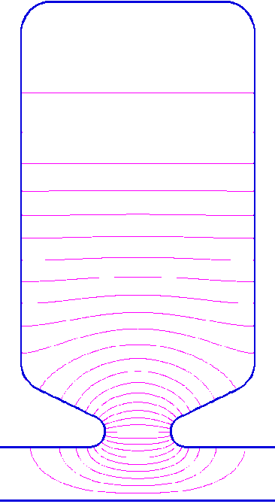
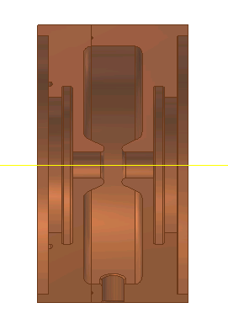
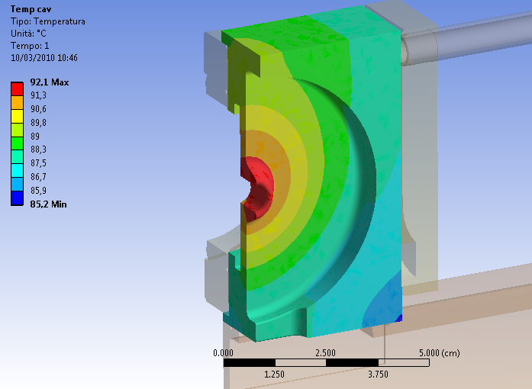
RF & mechanical design
β= 0.38 (E_{kin}=70 MeV)
f₀= 3000 MHz
Q₀= 9000
E_{max}/E₀ = 6.5
max. E
max. H
max. S_{c}
Cooling
ANSYS
nose
P_{ave} = 350 W
Mass Flow = 2.5 L/min
Δf/ΔT= -1.1 MHz / 20K
Notes:
How the cell looks like. Cells of hadron linacs need noses because hadrons have velocities lower than β = 1 and then noses help to increase transit time factor by accumulating electric field in gap region. Otherwise, the change in particle velocity due to energy absortion would spoil synchro between field and particle passage and hence decrease too much transit time factor and efficiency to accelerate particles with determinate E-field.
Power to cool: 350 W.
The change in frequency with temperature was evaluated with simulation programs and it was found that around 1 MHz per 20 degrees.

Slide 12
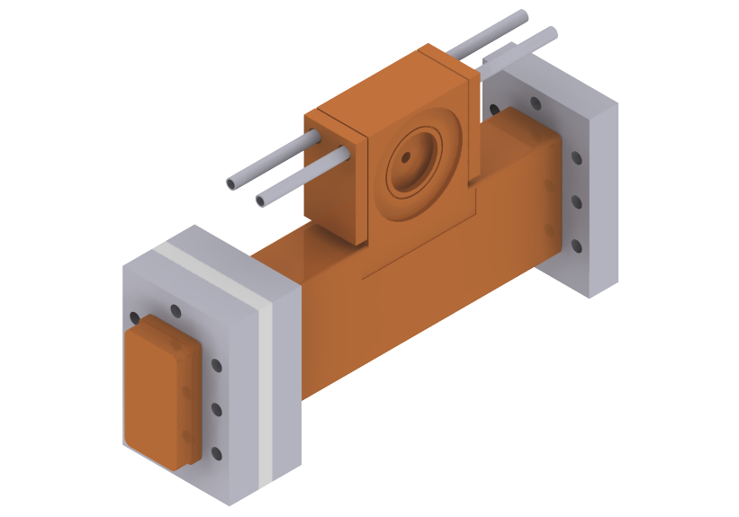
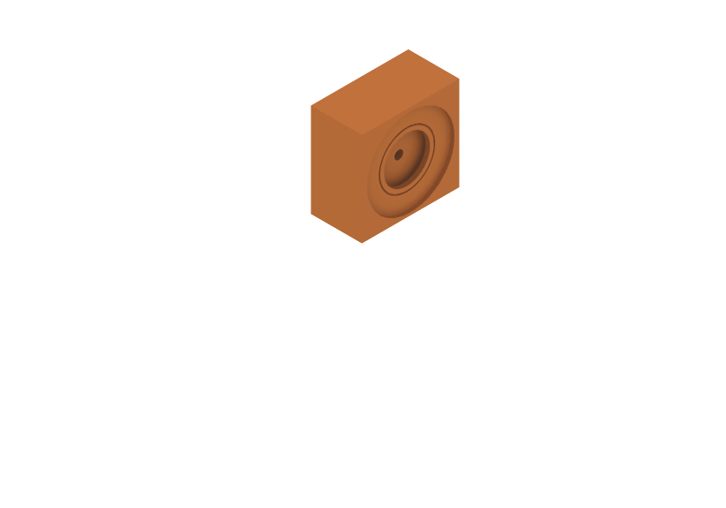
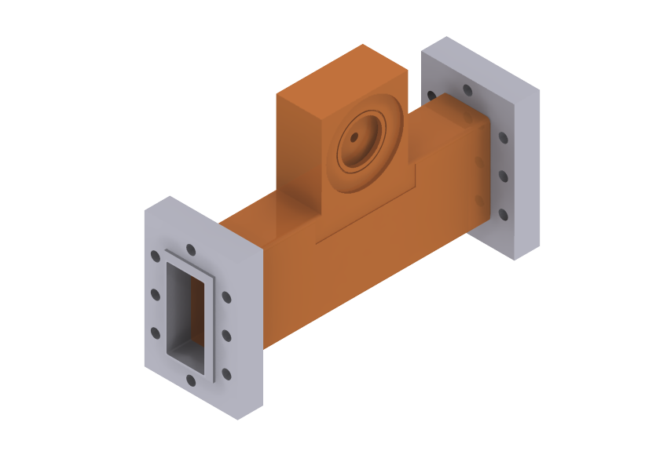
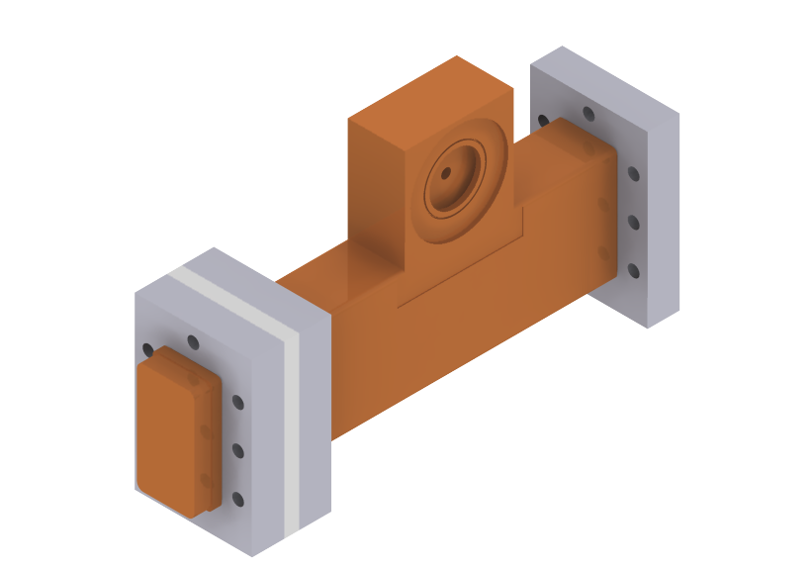
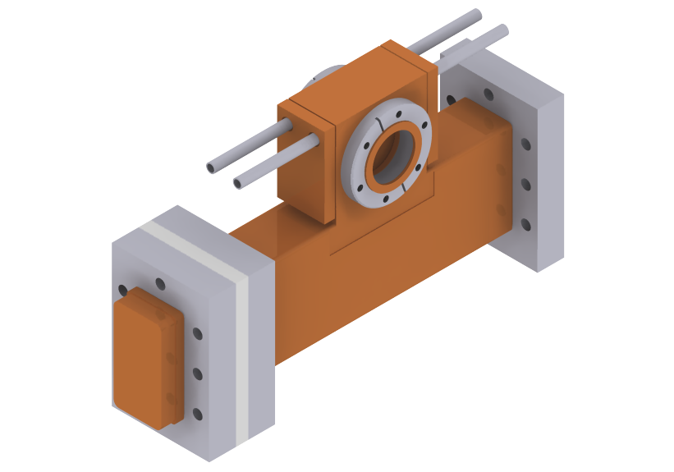
Production
OFE copper
0.02 mm tolerance
0.4 μm roughness
Accelerating cell @ 3 GHz
(two unsymmetrical half cells)
RF coupling system
(waveguide, short circuit)
Cooling system
(two plates, in-out pipes)
Connection to data acquisition
(through CF flanges)
Notes:
I would say that “the prototype [basically] consisted of 5 pieces made of OFE C10100 that were assembled through vacuum brazing in 3 steps”.
The profile of both halfcells has been machined with a 20 mm-bandwidth tolerance. The maximum roughness permitted for the surface [why did you write inner?] is 0.4 mm.
Señalar la cavidad para que la gente se haga una idea de las dimensiones
12

Slide 13
Production
Machining at Veca (Modena, Italy)
Cleaning at CERN (Geneva, Switzerland)
(vacuum) Brazing at Bodycote (Annecy, France)
Done in less than one month!
Notes:
The machining was done at…
All the process was done in less than one month.

Slide 14
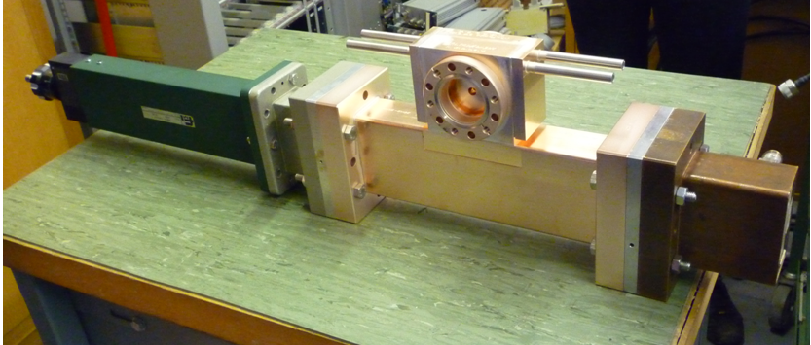
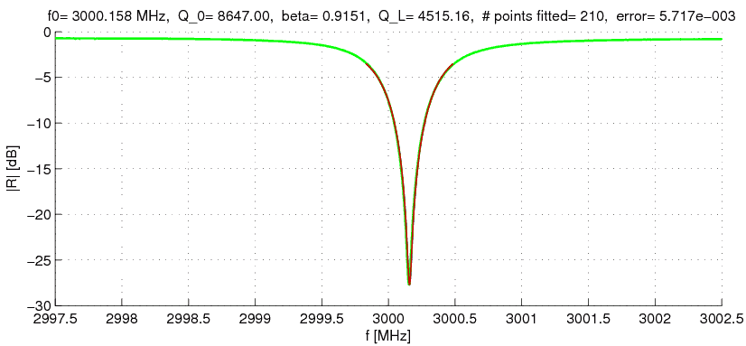
Low power test
RF input
Short Circuit
Test Cavity
f₀= 3000.2 MHz
Q₀= 8650 (96% Q_{0,sim})
β = 0.92, Γ=-27 dB
Notes:
We were on frequency
Q differed 4% from value calculated by simulations

Slide 15
First high-power test: objectives
Debugging test set-up and cavity
First check of cavity behaviour under high-power
Finding improvements for precision test to evaluate scaling laws [BDR(E_{s}, T_{p}, f_{rep})]
Only 1-2 weeks foreseen for test
Purpose of first test:
1. First check of RF behaviour of test cavity
2. Debugging set-up and test of cavity
3. Finding improvements for precision test (machining, instrumentation, data acquisition) to evaluate scaling laws [BDR(Es, Tp, frep)]
Notes:
There was a time slot of 1 week at CTF3 so we profited and did the first high-power test of the cavity. Little time, only 1-2 weeks foreseen for test. Furthermore, the test was performed during CTF3 linac start-up, so many interventions (down time) on the facility were done.

Slide 16
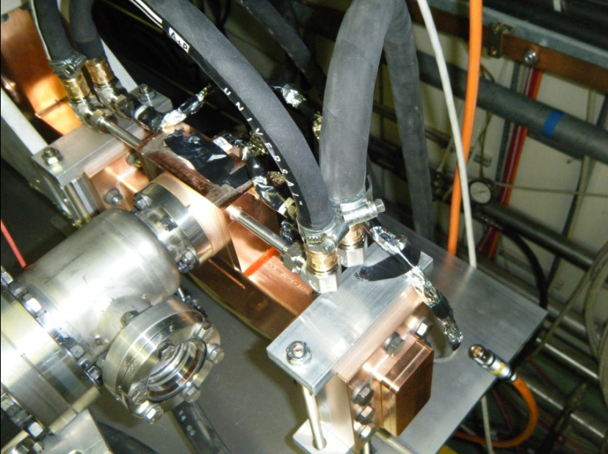
High power test: set-up
@ CTF3
Faraday Cup
Peak Power Analyser
Temperature sensors
no Data Acquisition System
no control system for stabilising frequency & amplitude
no RF Pickup
Notes:
The test was performed at CTF3. In order to monitorize the behaviour of the cavity, we used… . We did not have…
pressure reducer installed
no water flow meter installed

Slide 17
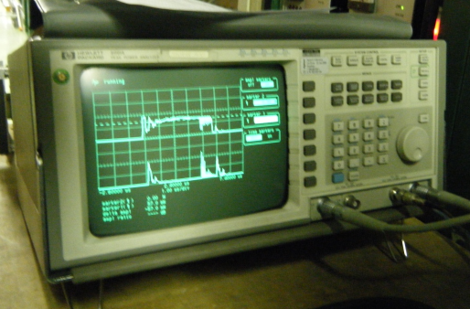
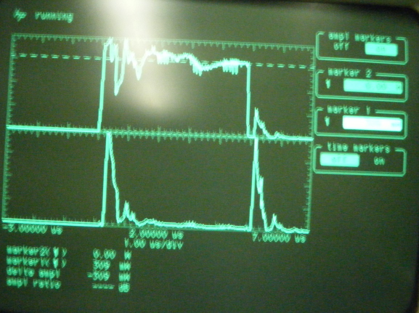
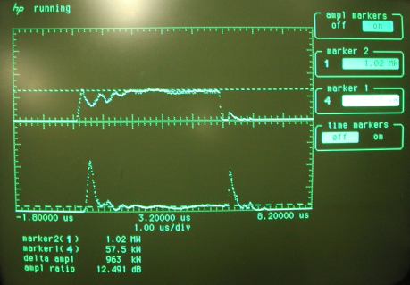
High power test: measurements
Peak Power Meter
P_{FW}
P_{REF}
T_{pulse} = 5 μs
no RF Pickup → relying on power measurements
f_{rep} = 50 Hz
  P_{cav} = P_{FW}-P_{RF}
  At resonance: adjusting frequency until P_{REF}(f) < 10% P_{FW}(f)
  Hot cavity
  E_{acc}
E_{S}= E_{S,calculated} * 0.93
17
Notes:
As we did not have antenna in the cavity we had to rely completely on the power measurements to calculate the fields inside the cavity. Here we can see the power forwarded to and reflected by the cavity. The pulse if 5 us long and it is send with a repetition rate of 50 Hz. We considered that we were at resonance when less than 10% of power forwarded was reflected by cavity. From power in the cavity we could calculate E. As cavity hot, more power dissipated and so less used for creating fields → factor.
Imprecision 5% power to determine power (show picture).
We do not have antenna in cavity so we are blind:Rely completely on power measurements into cavity. no RF pickup=> relying on power measurements to calculate fields inside cavity + simulations for R_{sh.}
Measurements: 10% static (uncorrelated errors)
5% dynamic errors. All static errors cancel for relative measurements.
The power absorbed by the cavity was calculated by subtracting the reflected power from the forwarded power. From the obtained value we could obtain the field in the cavity.
Pulse compressor installed on klystron but it is not used: that makes pulse funny;
Imprecision 5% power to determine power.

Slide 18
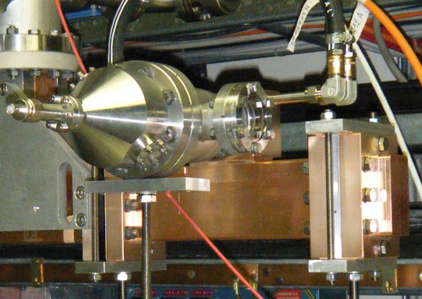
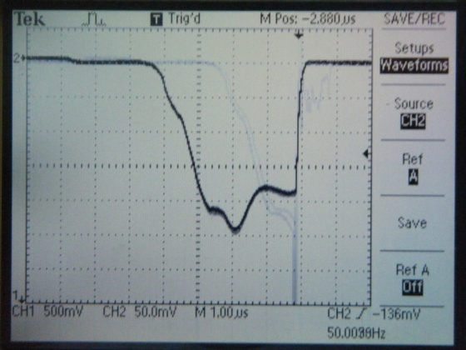
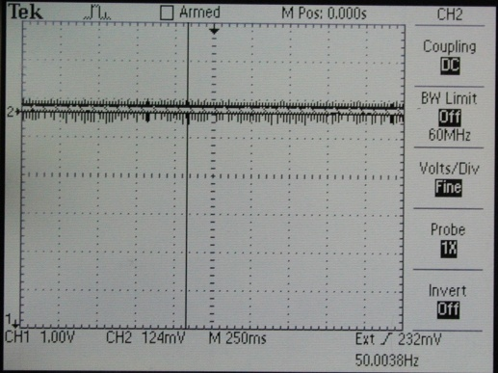
High power test: breakdown evaluation
Faraday Cup
Breakdown!
T_{Flat top}= 3 μs
Breakdown!
125 pulses, 1 BD
→ BDR= 0.8 • 10⁻²
18

Slide 19
High power test: first results
# Set | t_{FLAT} [µs] | P_{ABS} +/- ε [kW] | E_{S} [+/- 10 MV/m] | S_{c} [MW/mm2] | BDR/L [bpp/m] | Kilp.
1 | 1.5 | 830 +/- 40 | 380 | 2.4 | 5.E-02 | 8.1
1 | 1.5 | 850 +/- 40 | 390 | 2.4 | 5.E-02 | 8.2
1 | 1.5 | 900 +/- 50 | 400 | 2.6 | 6.E-02 | 8.4
2 | 2.0 | 120 +/- 10 | 150 | 0.4 | -- | 3.1
2 | 2.0 | 120 +/- 10 | 150 | 0.4 | -- | 3.1
2 | 2.0 | 300 +/- 20 | 230 | 0.9 | 4.E-03 | 4.9
2 | 2.0 | 300 +/- 20 | 230 | 0.9 | 4.E-03 | 4.9
1 | 2.0 | 400 +/- 20 | 270 | 1.2 | -- | 5.6
2 | 2.0 | 520 +/- 30 | 300 | 1.5 | 3.E-02 | 6.4
2 | 2.0 | 520 +/- 30 | 300 | 1.5 | 4.E-02 | 6.4
2 | 2.0 | 600 +/- 30 | 330 | 1.7 | 4.E-02 | 7.0
1 | 2.0 | 790 +/- 40 | 370 | 2.3 | 5.E-02 | 7.9
2 | 2.0 | 820 +/- 40 | 380 | 2.4 | 8.E-02 | 8.0
1 | 2.0 | 860 +/- 40 | 390 | 2.5 | 1.E-01 | 8.3
1 | 2.5 | 590 +/- 30 | 320 | 1.7 | 6.E-02 | 6.9
2 | 2.5 | 590 +/- 30 | 320 | 1.7 | 4.E-02 | 6.9
1 | 2.5 | 720 +/- 40 | 360 | 2.1 | 7.E-02 | 7.6
1 | 2.5 | 800 +/- 40 | 380 | 2.3 | 8.E-02 | 8.0
2 | 2.5 | 800 +/- 40 | 380 | 2.3 | 9.E-02 | 8.0

Slide 20
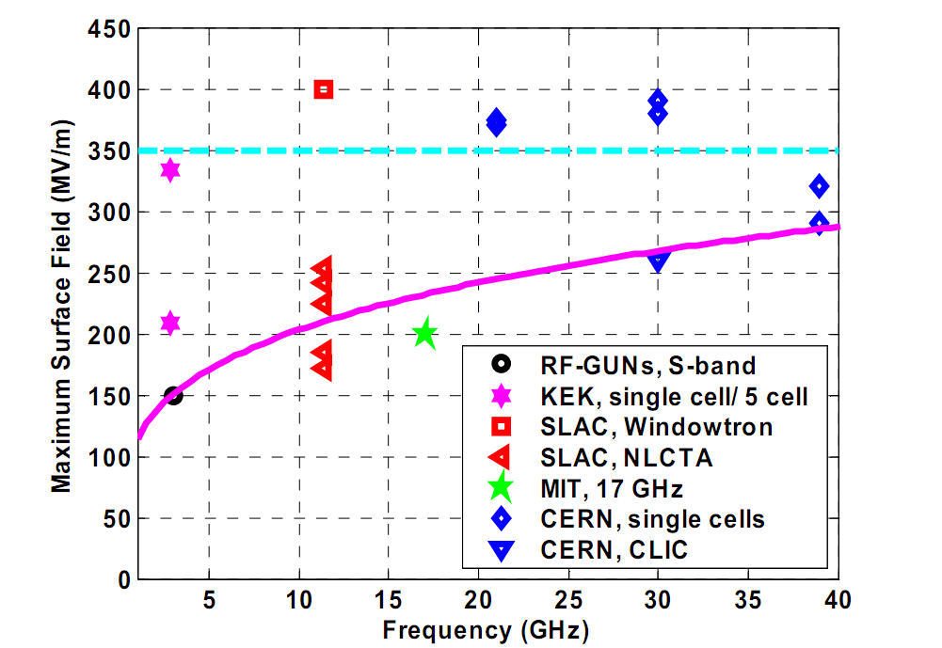
High power test: comparison to other tests
TERA
Limit in copper to surface field by breakdown surface damage
Gradient limitations for high frequency accelerators, S. Döbert, SLAC, Menlo Park, CA 94025, USA (2004)
20
Notes:
Maximum surface field as function of frequency. The data points are measured at different pulse lengths.
In 2004 Steffan Doebert presented the maximum surface field reached by different copper cavities as function of frequency. The blue line show the limit in copper to surface field by breakdown surface damage.
The red spot shows the maximum surface field achieved with our cavity.

Slide 21
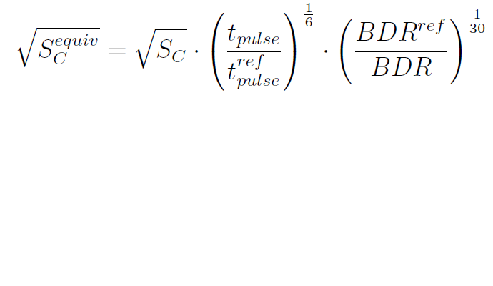
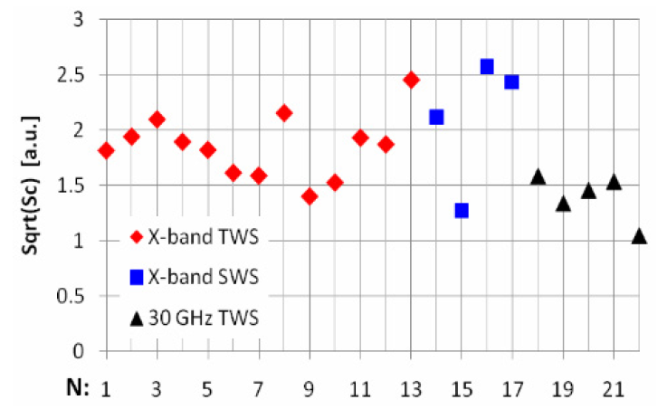
High power test: comparison to other tests
The modified Poynting vector as an RF constraint to high gradient performance
21
The square root of S_{C} has been scaled to t_{pulse} =200 ns and BDR=10⁻⁶ bbp/m
first results
Sqrt(S_{c}) є [1.3-1.6]
A New Local Field Quantity Describing the High Gradient Limit of Accelerating Structures, A. Grudiev, S. Calatroni, and W. Wuensch, Phys.Rev. Accel. Beams (2009) 102001
21
Notes:
Further : scaling like this in order to compare structures.
Alexej will speak about this concept (ask him directly)

Slide 22
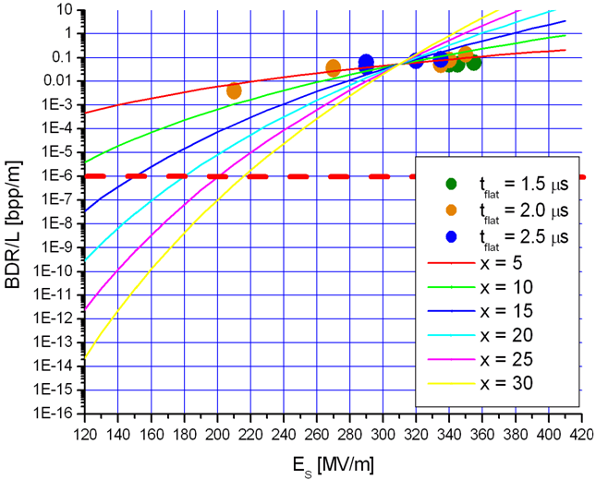
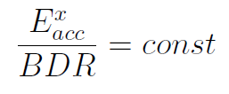
High power test: scaling laws
Treatment Session:
3 minutes @ 400 Hz
Max. 1 BD per session
Max.BDR:
10⁻⁶ bpp/m
X = 30 (other exp.)
X = 6 TERA
22
Notes:
We should not forget that cavity was too hot.
12 and 3 GHz the same.
In principle we would like to have 1 BD per session as maximum. The multipainting technique could solve the problem if more than one BD per session occurs.
Data was scaled to
Here we plot
Our data do not follow the scaling law but E^6.
In the next test we intend to explore the region of lower fields, but we will need:
Time (more statistics is needed, specially for determining very low BDR!)
Data adquisition system
Analysis instrumentation
Feedback freq-amplitude

Slide 23
High power test: scaling laws
Treatment Session:
3 minutes @ 400 Hz
Max. 1 BD per session
Not enough statistics for scaling law’s evaluation
Max.BDR:
10⁻⁶ bpp/m
X = 30 (other exp.)
X = 6 TERA
23
Notes:
We should not forget that cavity was too hot.
12 and 3 GHz the same.
In principle we would like to have 1 BD per session as maximum. The multipainting technique could solve the problem if more than one BD per session occurs.
Data was scaled to
Here we plot
Our data do not follow the scaling law but E^6.
In the next test we intend to explore the region of lower fields, but we will need:
Time (more statistics is needed, specially for determining very low BDR!)
Data adquisition system
Analysis instrumentation
Feedback freq-amplitude

Slide 24
Surface inspection around nose region
[90X Optical Microscope]
max. E
max. H
max. S_{c}
Activity in the cavity:
~ 14000 breakdowns
Notes:
As we intend to test the cavity again, the cavity cannot be cut for inspection. Hence, the inspection is limited to a small region. We opened one of the flanges that cover the bore hole of the cavity and we used an optical microscope with a maximum magnification of 90. The maximum angles at which we could inspect are shown in the picture.
We have taken nice pictures of the cavity nose region, were maximum E-field and Poynting vector are reached.
[Put scheme of Superfish]
During 40 hours of operation, the cavity suffered around14400 breakdowns. Point out activity, craters about micrometers diameter, (check) roughness less than 0.4 υm,

Slide 25
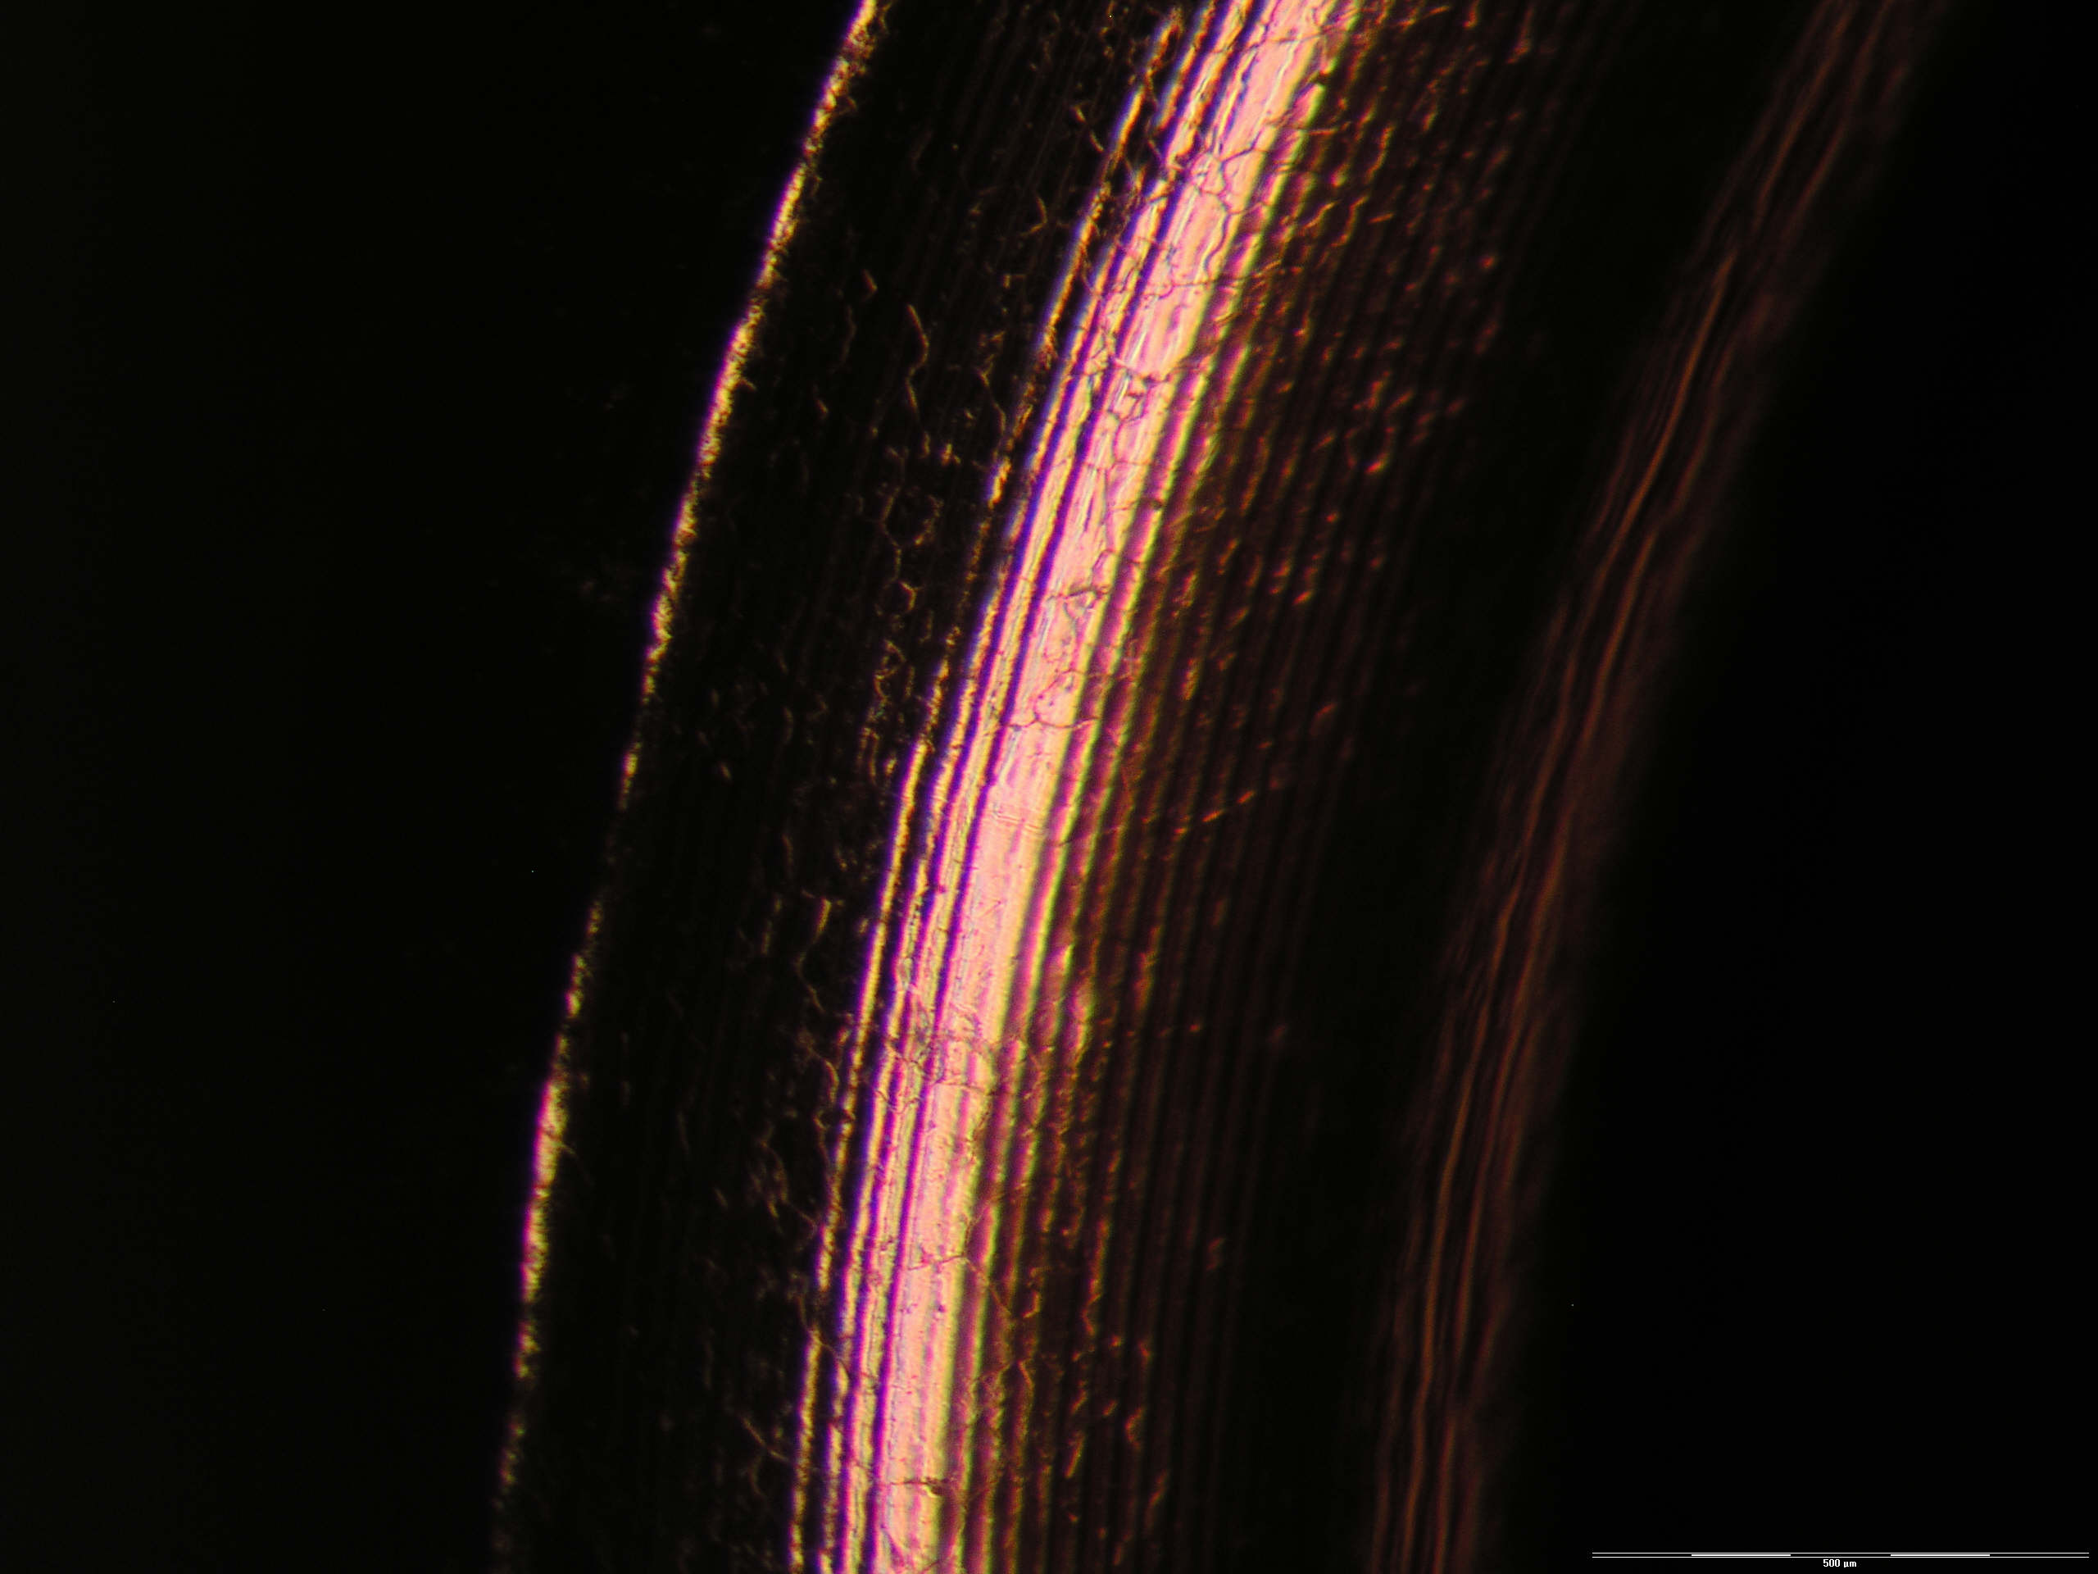
Surface inspection around nose region
50X
Copper Grains
(tenths of μm)
Max. roughness:
0.4 μm
0.5 mm
Notes:
We have taken nice pictures of the cavity nose region, were maximum E-field and Poynting vector are reached.
[Put scheme of Superfish]
During 40 hours of operation, the cavity suffered around14400 breakdowns. Point out activity, craters about micrometers diameter, (check) roughness less than 0.4 υm (?),

Slide 26
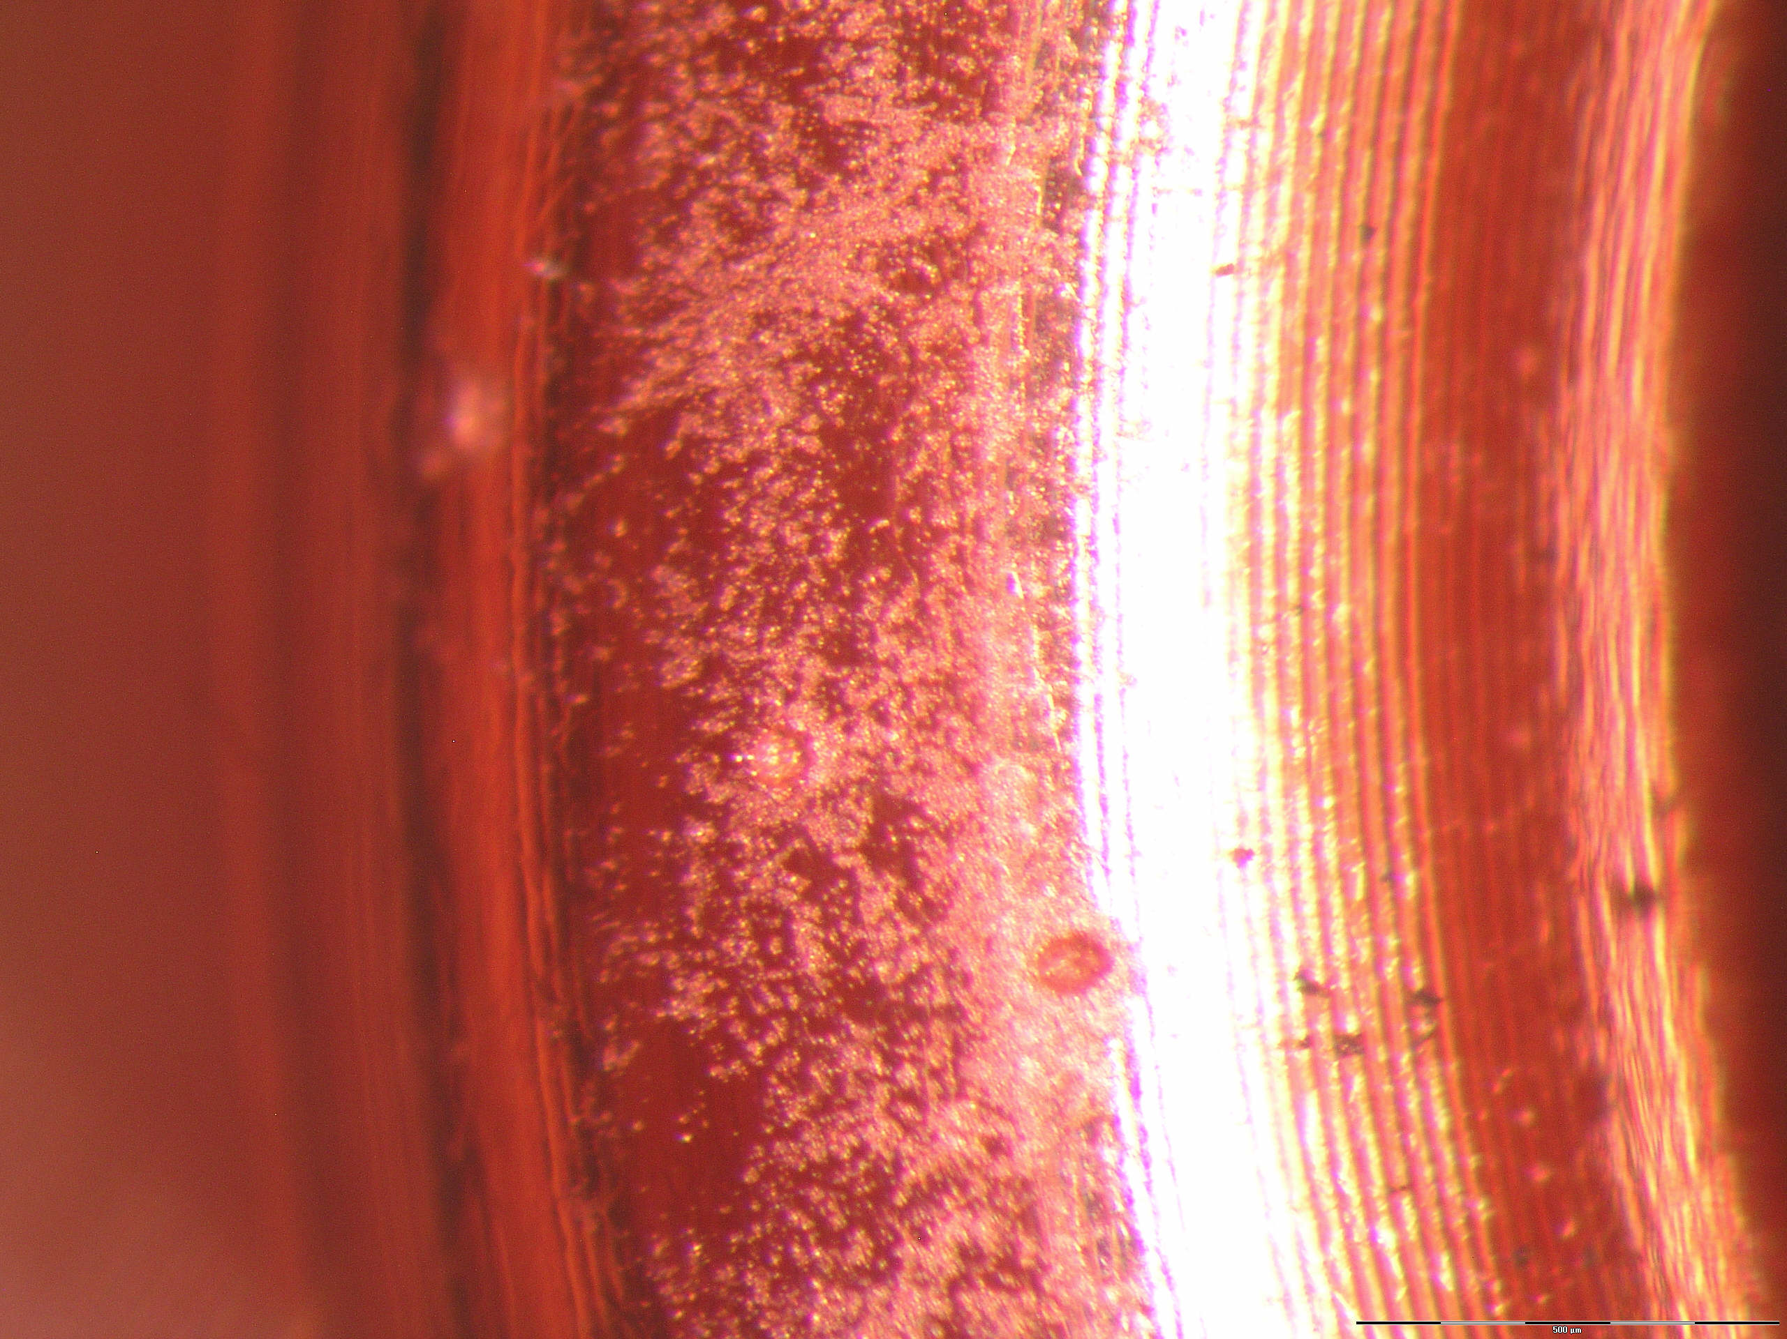
Surface inspection around nose region
50X
Several craters… and a lot of activity
0.5 mm

Slide 27
Summary
Excellent Pre-Test, cavity works, even first results
SYSTEM | results / improvements
Vacuum system | very good
Cavity - low power | very good >96% Q₀, f₀ ok, β=0.92 ( Γ<-27dB)
Cavity - high power | very good E_{S} > 350 MV/m, BDR < 2 • 10⁻¹ /m, T_{pulse} = 2 μs
Cooling | freq. shift too big => water flow too small

Slide 28
Summary
Excellent Pre-Test, cavity works, even first results
SYSTEM | results / improvements
Vacuum system | very good
Cavity - low power | very good >96% Q₀, f₀ ok, β=0.92 ( Γ<-27dB)
Cavity - high power | very good E_{S} > 350 MV/m, BDR < 2 • 10⁻¹ /m, T_{pulse} = 2 μs
Cooling | freq. shift too big => water flow too small
Improvements for high-precision test
  cooling / water flow control
  data acquisition (P_{forward}, P_{reflected}, φ_{forward}, φ_{reflected}, V_{faraday cup}, vacuum)
  control system for stabilising frequency & amplitude

Slide 29
Next steps: a lot to do!
High-precision high-power test of the 3GHz test cavity
Design, construction and high-power test of another single-cell cavity operating at 5.7 GHz
    to evaluate scaling laws
    learn more about breakdown phenomena
→ Design has already begun; to be tested before the end of 2010!
Notes:
Of course, we still have to performe a high-precision high-power test of the 3GHz test cavity
Experience has been so satisfactory that we have begun the design of another single-cell cavity, this time operating at 5.7 GHz, that will be built and high-power tested before the end of 2010. to design, built and high-power test another single-cell cavity. In this case, it will operate at 5.7 GHz and will include based on experience adquired with our 3GHz cavity. Test surfaces, diff. Field points, other freq., etc.
Apply experience acquired

Slide 30
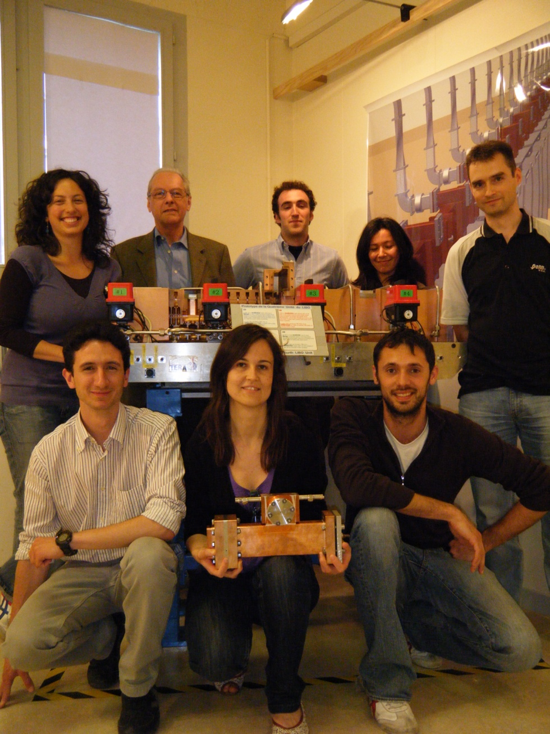
Thanks to…
CLIC RF and Breakdown Group
CTF3 Group
CERN General Services
VECA, Bodycote, ADAM
Vodafone
All the Cyclinac team for their support
And all of you for the attention!
The research leading to these results has received funding from the Seventh Framework Programme [FP7/2007-2013] under grant agreement n° 215840-2.
TERA -Cyclinac team
Notes:
So I would like to thank…
And of course, thank you for the attention you paid.

Slide 31
BACK-UP SLIDES

Slide 32
RF & mechanical design
Requirements
  Average power to cool (350 W)
  Nº of parallel circuit (2)
  Turbulent flow
  Avoid erosion/corrosion
  Reference temp. for coolant properties (37ºC)
  High heat transfer coefficient
Choices
  dT _{in-out} = 1ºC
  D_{eq} = 5.5 mm
  Re = 13900
  v = 1.77 m/s
  h = 10020 W/m2/K
  Mass flow 2.5 l/min
  Δf₀ / ΔT_{RF} = - 1.1 MHz / 20 K

Slide 33

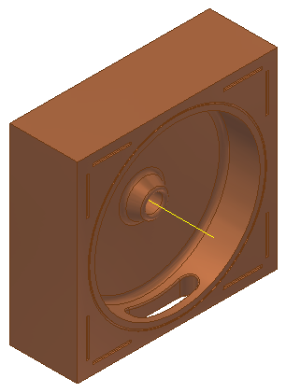
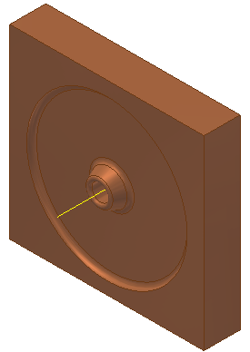
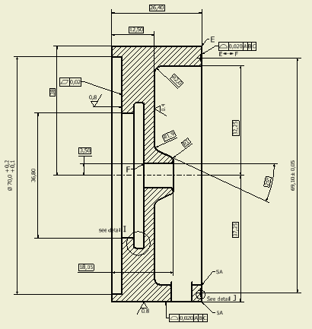
Halfcell design
33
Øcell [mm] | 64.50
coupling slot [mm] | 25.75 x 6.00
cavity profile | 0.02 mm tolerance Ra 0.4
material | OFE copper

Slide 34
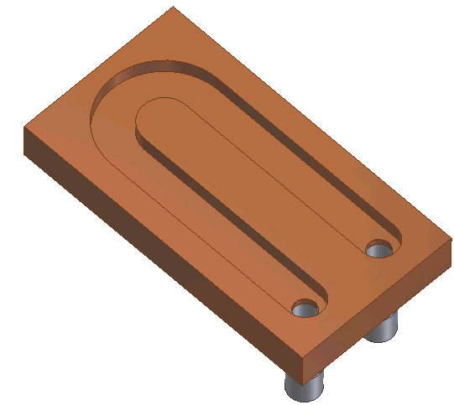
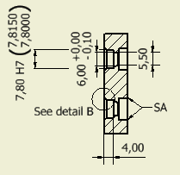
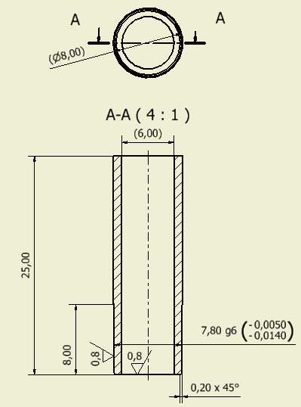
Cooling design
OFE Copper / 316 L
Two pipes coated and brazed to cooling plate
Q_{water} < 2.5 l/min

Slide 35
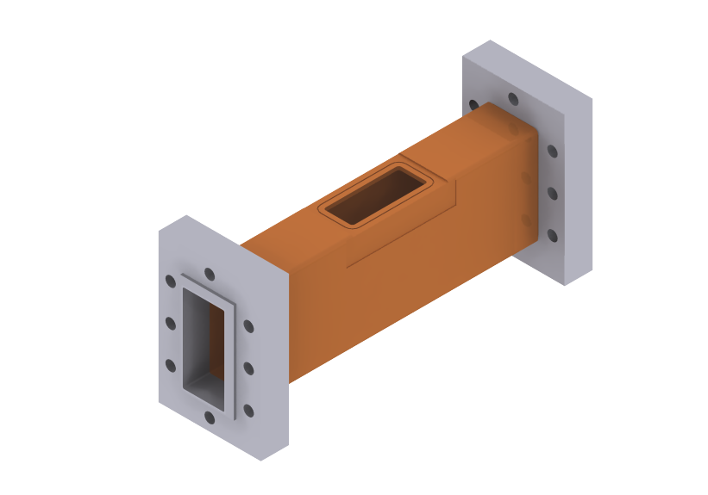
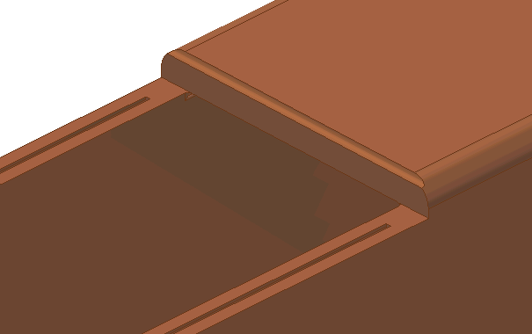
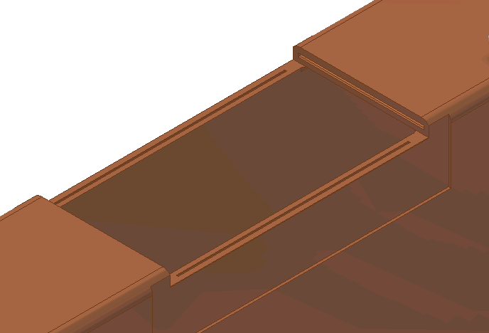
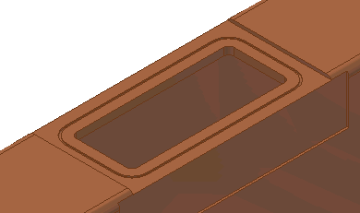
Waveguide design
Design evolution:
Standard WR-284 (OFE copper)
with two LIL flanges for connection to RF source and short

Slide 36
Cavity Performance
E_{S}= 150 MV/m S_{C}= 0.46 MW/mm²
E_{S}/E₀= 6.5 P = 128 kW
SF
E_{K}= 47 MV/m
Measure
Measure
Measure
t_{FLAT} [µs] | P_{ABS} [kW] | E_{S}[MV/m] | E₀[MV/m] | Sc [MW/mm2] | BDR/L [bpp/m] | Kilp
1.5 | 670 | 340 | 53 | 2.39 | 5.2E-02 | 7.3
1.5 | 680 | 345 | 53 | 2.44 | 5.1E-02 | 7.4
1.5 | 720 | 355 | 55 | 2.57 | 6.0E-02 | 7.6
2.0 | 100 | 130 | 20 | 0.35 | -- | 2.8
2.0 | 100 | 130 | 20 | 0.35 | -- | 2.8
2.0 | 240 | 210 | 32 | 0.87 | 3.9E-03 | 4.4
2.0 | 240 | 210 | 32 | 0.87 | 4.1E-03 | 4.4
2.0 | 320 | 240 | 36 | 1.15 | -- | 5.1
2.0 | 420 | 270 | 42 | 1.50 | 3.2E-02 | 5.8
2.0 | 420 | 270 | 42 | 1.50 | 3.8E-02 | 5.8
2.0 | 480 | 290 | 45 | 1.73 | 4.0E-02 | 6.2
2.0 | 630 | 335 | 51 | 2.28 | 5.0E-02 | 7.1
2.0 | 660 | 340 | 52 | 2.37 | 7.8E-02 | 7.3
2.0 | 690 | 350 | 54 | 2.48 | 1.4E-01 | 7.4
2.5 | 470 | 290 | 44 | 1.70 | 6.3E-02 | 6.2
2.5 | 480 | 290 | 44 | 1.71 | 4.1E-02 | 6.2
2.5 | 570 | 320 | 49 | 2.06 | 7.2E-02 | 6.8
2.5 | 640 | 335 | 52 | 2.30 | 8.2E-02 | 7.2
2.5 | 640 | 335 | 52 | 2.31 | 8.6E-02 | 7.2
Old values
MAX

Slide 37
Surface inspection around nose region
[90X Optical Microscope]
Activity in the cavity:
~ 14000 breakdowns
Notes:
As we intend to test the cavity again, the cavity cannot be cut for inspection. Hence, the inspection is limited to a small region. We opened one of the flanges that cover the bore hole of the cavity and we used an optical microscope with a maximum magnification of 90. The maximum angles at which we could inspect are shown in the picture.
We have taken nice pictures of the cavity nose region, were maximum E-field and Poynting vector are reached.
[Put scheme of Superfish]
During 40 hours of operation, the cavity suffered around14400 breakdowns. Point out activity, craters about micrometers diameter, (check) roughness less than 0.4 υm,

Slide 38
