Slide 1
4th Annual X-band Structure Collaboration Meeting. 3-5 May 2010, CERN
ENGINEERING DESIGN
OF
RF STRUCTURES
A. Samoshkin (JINR, Dubna), 04 May 2010

Slide 2
CONTENTS
ACCELERATING STRUCTURES ( AS )
TEST STRUCTURES
BASELINE (Disks Sealed)
ALTERNATIVES (Quadrants)
FUNDAMENTAL
CLIC STRUCTURES
CLEX TWO BEAM TEST STAND
CLEX TEST MODULES
POWER EXTRACTION STRUCTURES ( PETS )
TEST STRUCTURES
CLIC TWO BEAM TEST STAND (TBTS)
CLIC TEST MODULES

Slide 3
SUMMARY ON TEST STRUCTURES CONFIGURATIONS
- BASELINE OPTION
* SEE SLIDE 8

Slide 4
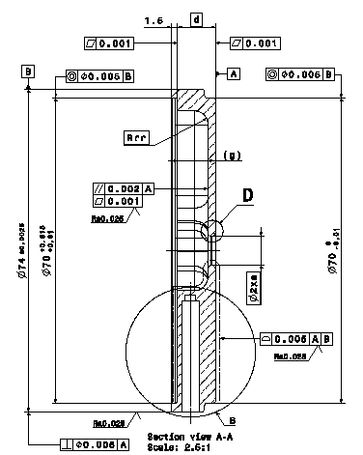
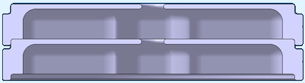
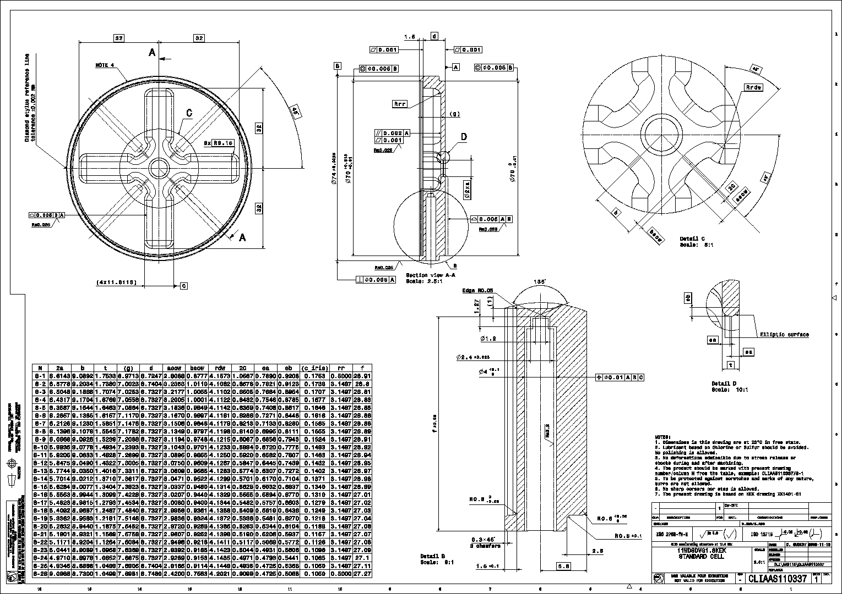
BASELINE TEST AS ( DISKS, SEALED )
Asymmetric Disks with Interlocking, WG Damping, Sealed, Bonded, Push-Pull Tuning
Interlocking for Disks positioning
XXXXXXXXXXXXXXXXX
Gaps: MIN=0.005 mm, MAX=0.0125mm
Assembly Ref.→ B ( Ø EXT ±0.0025 )
  Coupler design (assembly problem) → tolerances are under revision

Slide 5
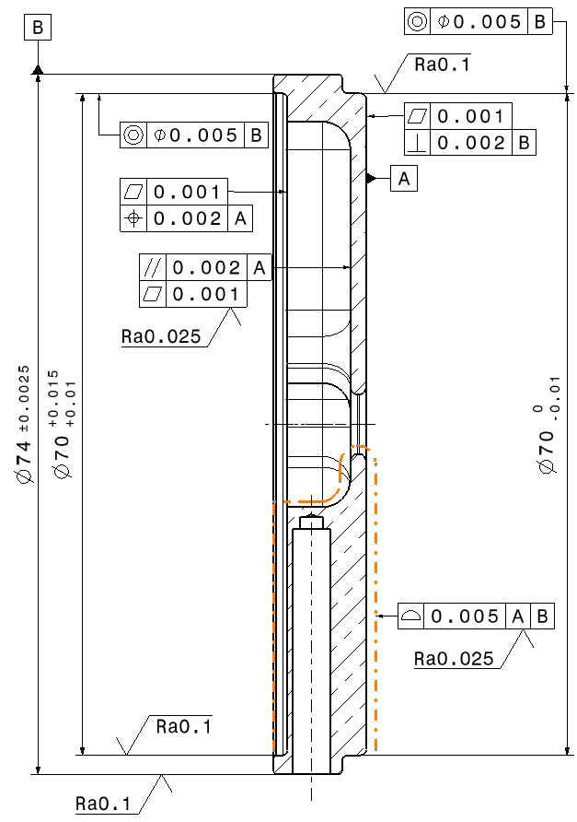
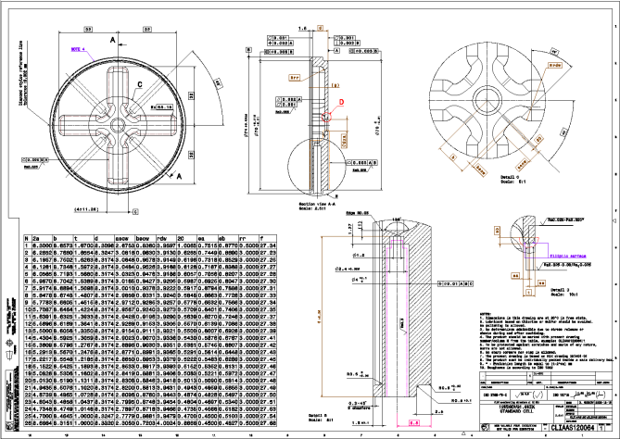
TOLERANCES
  Due to tough beam position demand the RF shape of structure requires:
  - tolerances & shape accuracy of 5µm;
  - surface roughness of 25 nm
  The diffusion bonding procedure requires a good flatness of contact surfaces (1µm)
  To provide the needed disks concentricity while assembling the ext. Ø tolerance must be ± 2.5 µm

Slide 6
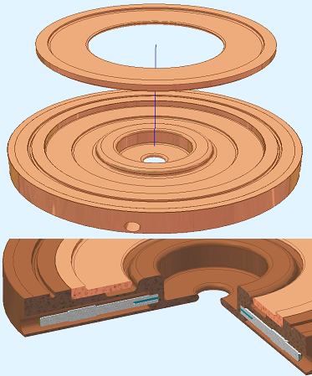
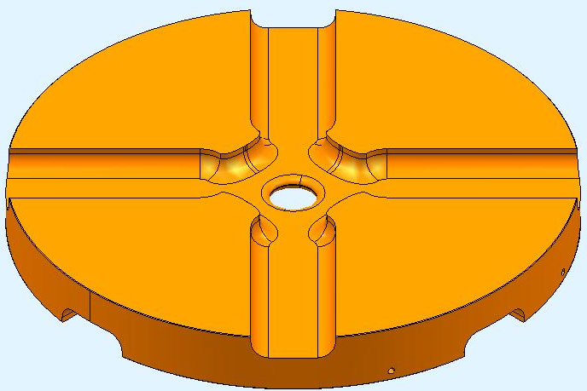
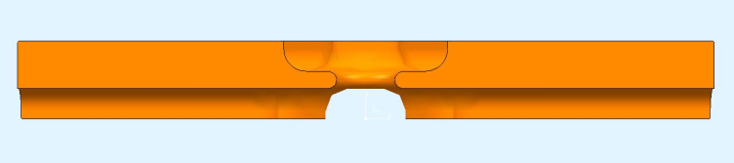
ALTERNATIVE DESIGN OF THE DISKS
RADIAL CHOKE DAMPING
SYMMETRIC DISK DESIGN
DISK 2
DISK 1
TUNING STUD
PUSH - PULL
HIP-CERN COLLABORATION
TSINGHUA UNIVERSITY-CERN
  Future design of Detuned Damped Structure (DDS) in collaboration with University of Manchester. (also part of EUCARD WP9.2)

Slide 7
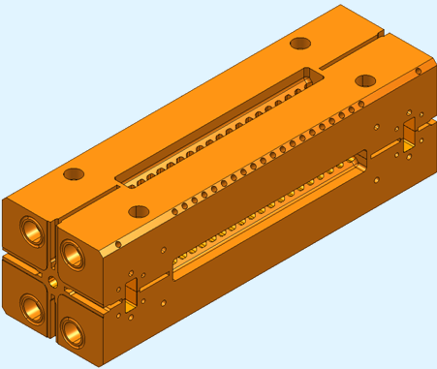
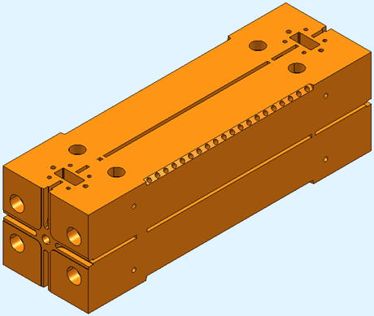
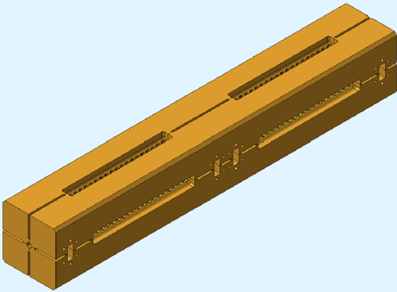
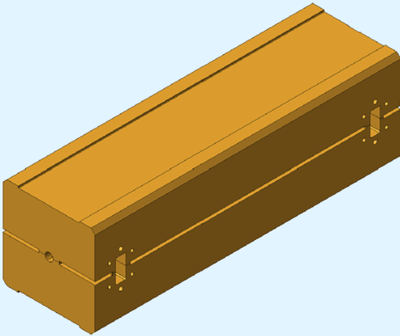
ALTERNATIVE AS DESIGN
DAMPED & NON DAMPED QUADRANTS (ALTERNATIVE)
11.424 GHZ,
18 cells, damped, tank, quadrants, push-only tuning
11WNSQVG1
11.424 GHZ,
18 cells, non-damped, tank, quadrants, push-only tuning
11WDSQVG1
FUTURE TESTS (ALTERNATIVE) – HALVES & DOUBLE LENGTH QUADRANTS

Slide 8
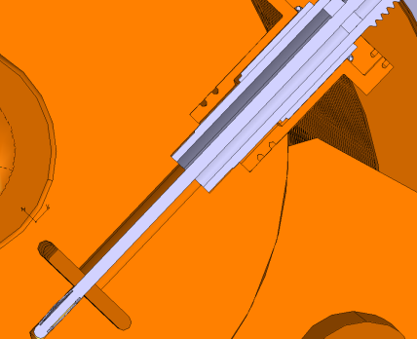
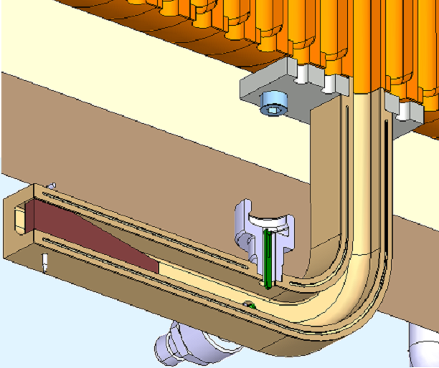
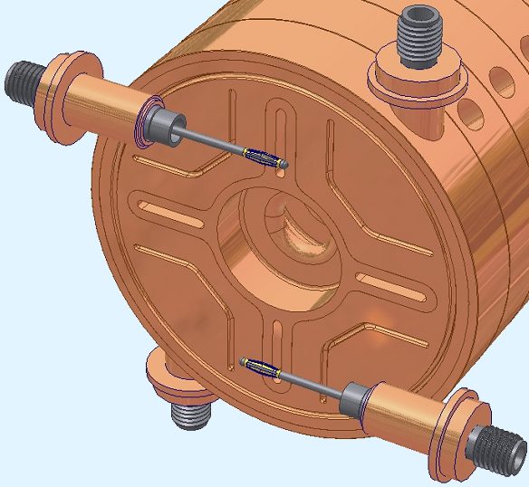
DESIGN OF WAKEFIELD MONITORS
AS DISK
FEEDTHROUGH
CEA-CERN COLLABORATION
COOLING BLOCK
PSI-ST-CERN DEVELOPMENT
For CERN TBTS (phase 2)
PSI-XFEL X-band structure

Slide 9
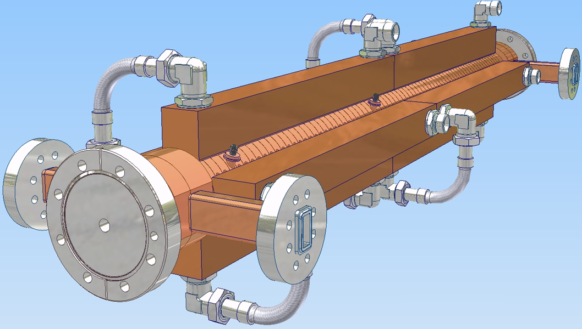
PSI-XFEL X-BAND STRUCTURE
LEGRIS CONNECTOR
WFM CELLS ( 36-45, 63-72 )
COOLING BLOCK
VACUUM FLANGES
FEEDTHROUGH
WITZENMANN FLEXIBLE HOSE
11.994 GHZ, 73 cells, non-damped, sealed, disks Ø65mm, push-pull tuning

Slide 10
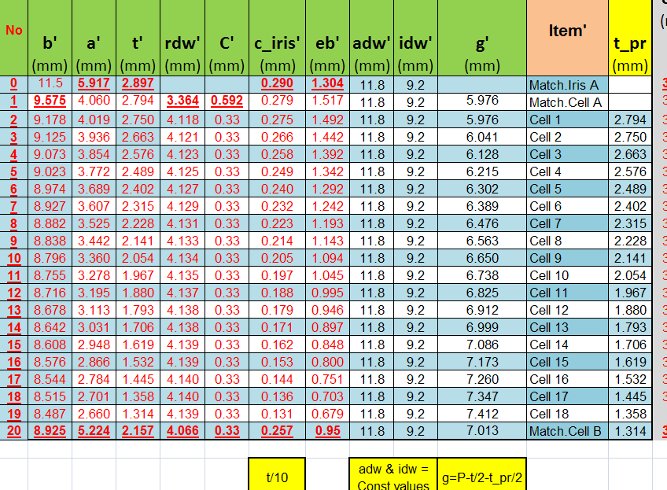
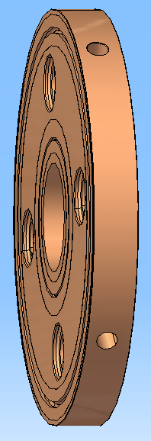
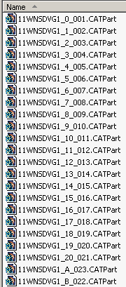
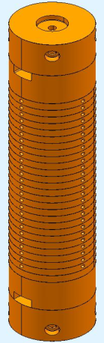
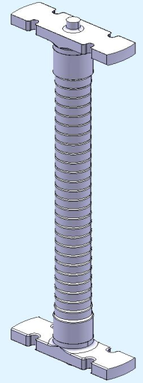
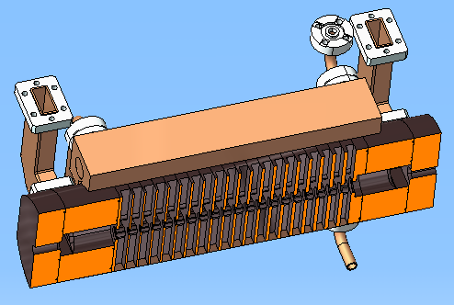
PARAMETER-BASED MECH. DESIGN
RF INPUT
GENERATED
3D PARTS
3D PART
ASSEMBLY
FEEDBACK FROM INDUSTRY
RF CHECK
EDMS, CDD, MTF
S T
SmarTeam
ARCHIVING
ASSEMBLY DESIGN

Slide 11
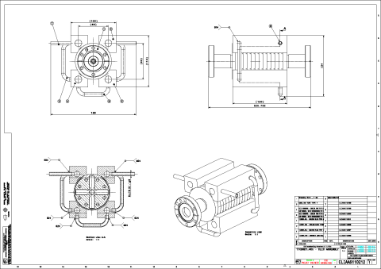
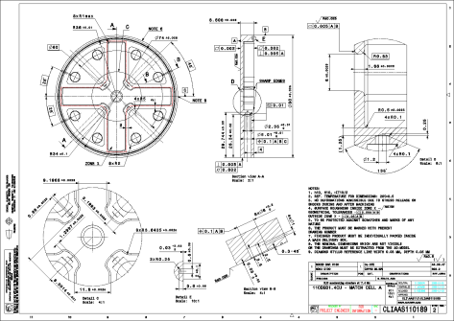
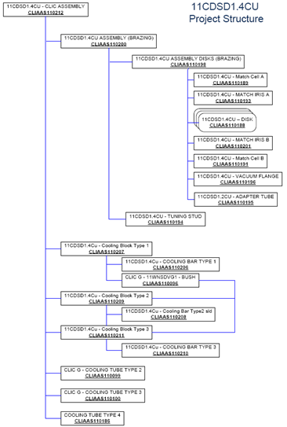

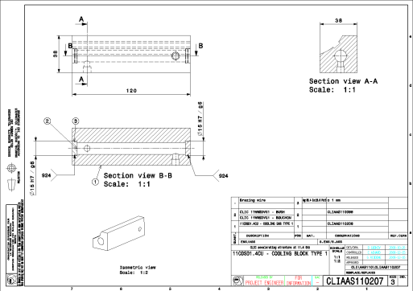
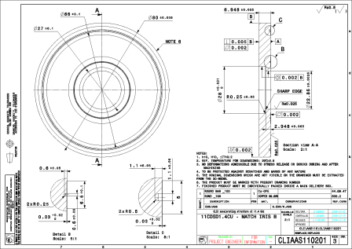
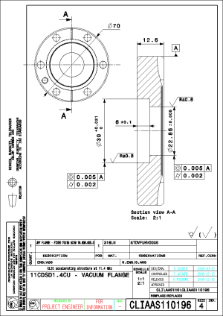
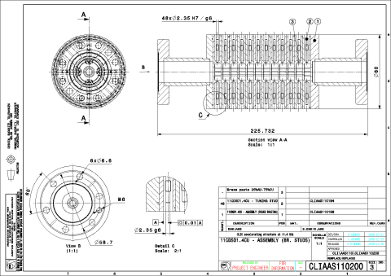
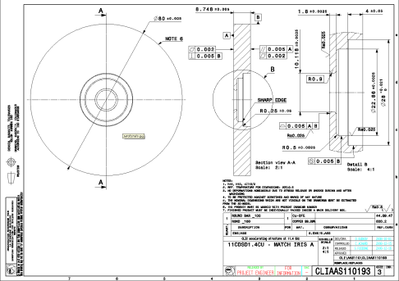
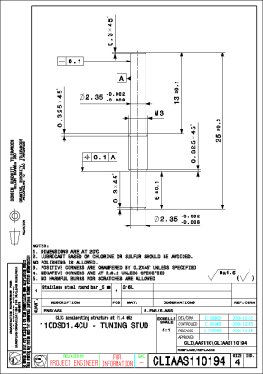
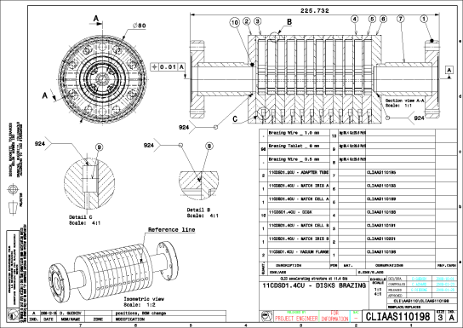
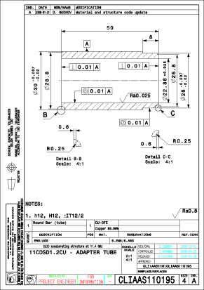

TECHNICAL DRAWINGS
Project Structure

Slide 12
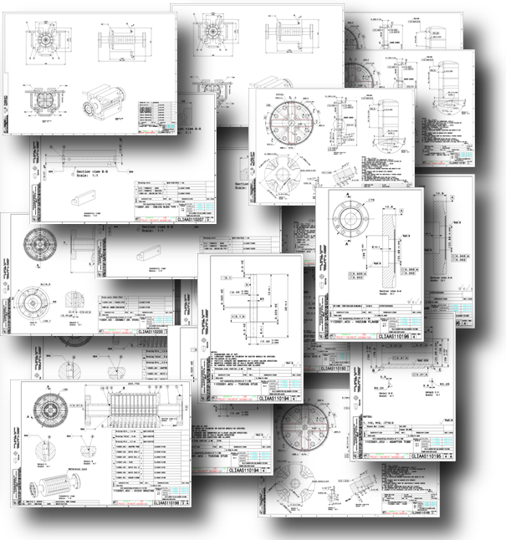

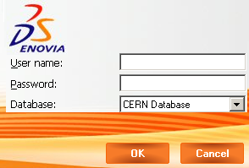
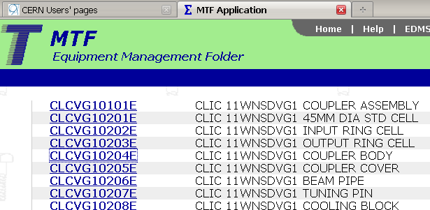
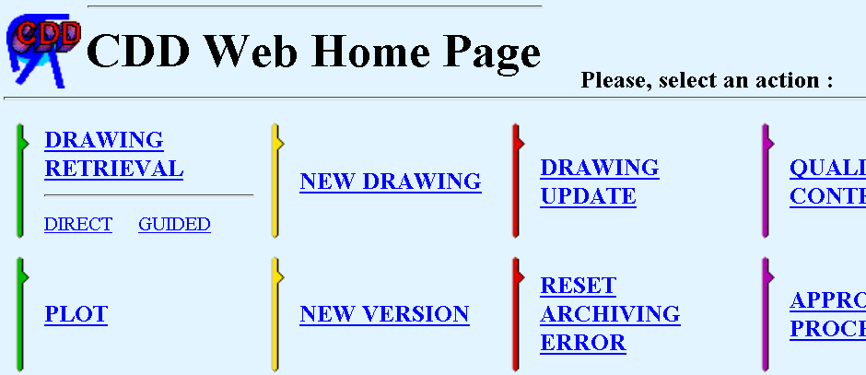
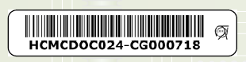
TECHNICAL DOCUMENTATION MANAGEMENT
CERN Engineering & Equipment Data Management System
Follow-up of each manufactured component
Drawings are stored in SmarTeam db, which is linked to CERN Drawing Directory (CDD)
& Equipment Management System (MTF)

Slide 13
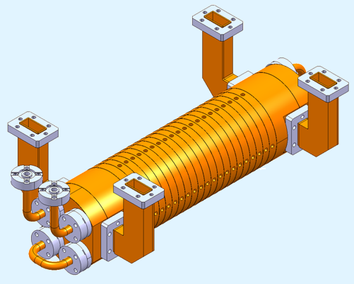
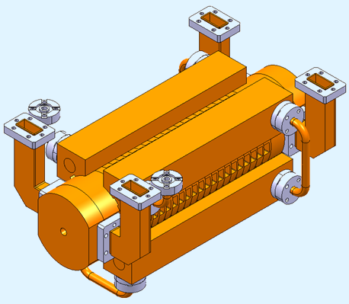
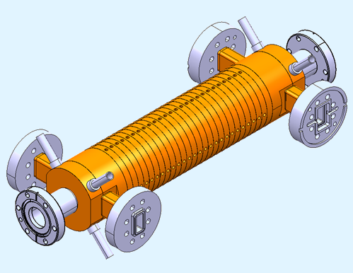
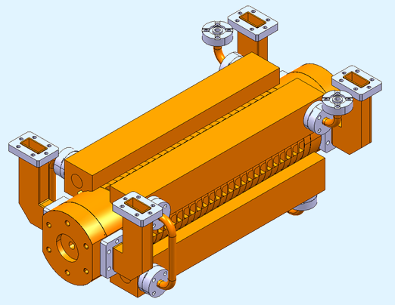
DESIGNED AS IN DISKS
Tank → Sealed Vac. Brazing → H₂ Diffusion Bonding
11.424 GHz, 18 cells, non-damped, tank, disks Ø80mm, push only tuning
11.424, 18 cells, damped, tank, disks Ø80mm, push only tuning
11/12WNSDVG1 T (T18)
11/12WDSDVG1 T (TD18)
11.424 & 11.994 GHz, 24 cells, damped, tank, disks Ø80mm, push only tuning
11.424 & 11.994 GHz, 24 cells, non-damped, sealed, disks Ø80mm, push only tuning
11/12WNSDVG1.8 S (T24)
11/12WDSDVG1.8T (TD24)

Slide 14
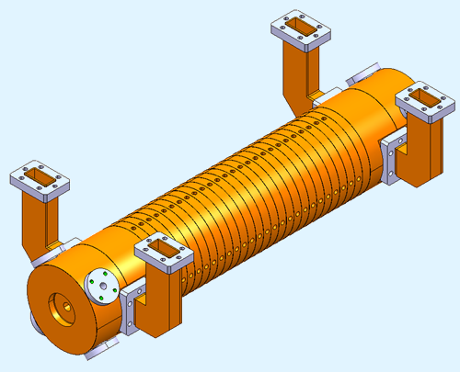
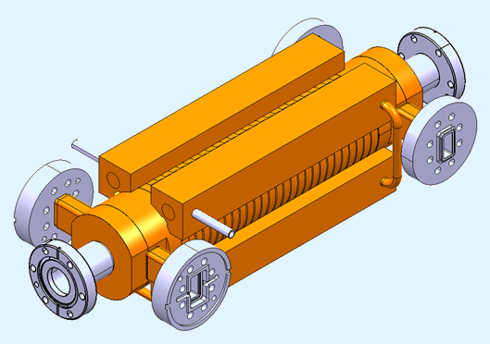
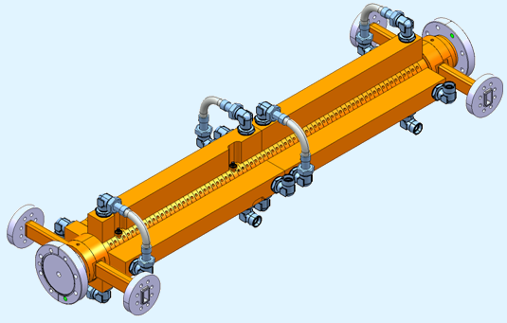
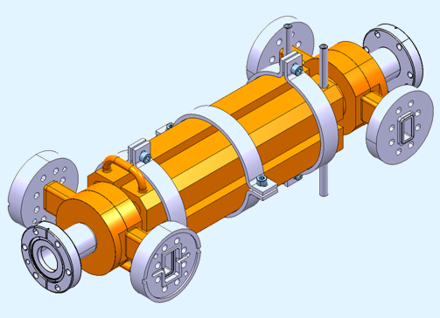
DESIGNED AS IN DISKS
11/12WDSDVG1.8S (TD24)
11.424 & 11.994 GHz, 24 cells, non-damped, tank, disks Ø80mm, push only tuning
11.424 & 11.994 GHz, 24 cells, damped, sealed, disks Ø80mm, push only tuning
11/12WNSDVG1.8 T (T24)
11WNSDVG1.8 VB (T24)
CLIAPSI
11.424, 24 cells, non-damped, sealed (tank), disks Ø45mm, push only tuning
11.994 GHZ, 73 cells, non-damped, sealed, disks Ø65mm, push-pull tuning

Slide 15
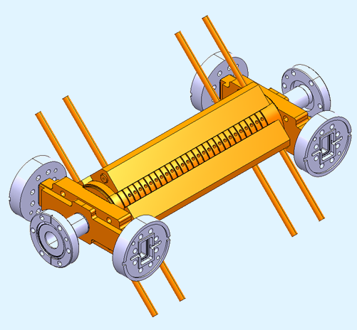
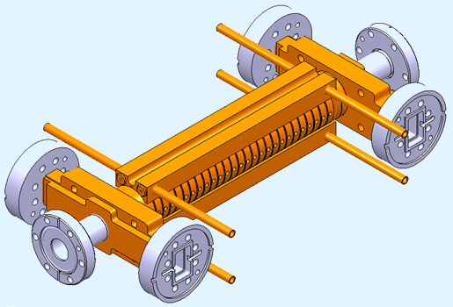
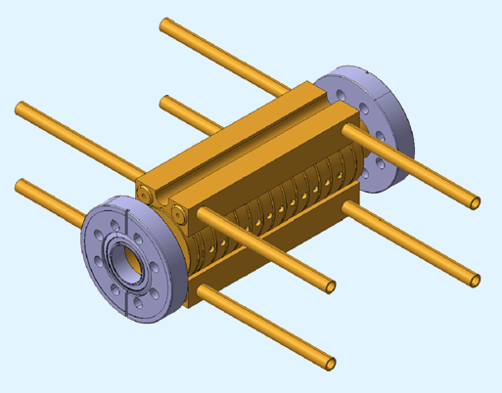
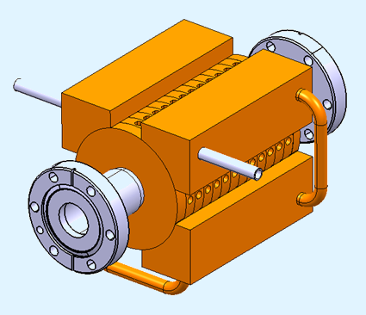
DESIGNED AS IN DISKS
11.424 & 11.994 GHz, 24 cells, damped, sealed, disks Ø74mm, push-pull tuning
11/12WNSDVG1.8 KS (T24)
11.424 & 11.994 GHz, 24 cells, non-damped, sealed, disks Ø45mm, push-pull tuning
11/12WDSDVG1.8 KS (TD24)
FUNDAMENTAL STRUCTURES
CD10
C10
11.424, 10 cells, damped, sealed, disks Ø80mm, push-pull tuning
11.424 GHz, 10 cells, non-damped, sealed, disks Ø45mm, push-pull tuning

Slide 16

CLEX 2BTS ( RF BEAM )
STEPS TOWARDS CLIC MODULE DESIGN
TBTS, Phase 2.2
CLEX Modules → evolution based on this design
COOLING CIRCUIT
WFM
TD24 with WFM (CEA-CERN)
12WDSDVG1.8T
COOLING BAR

Slide 17

AS FOR PROTOTYPE MODULES ( LAB, NO RF )
STEPS TOWARDS CLIC MODULE DESIGN
LOADS CONNECTION
VACUUM MANIFOLD
COOLING CIRCUIT
RF DISTRIBUTION
DAMPING MATERIAL
Validation of Technical Systems Integration

Slide 18

AS FOR CLIC MODULES
STEPS TOWARDS CLIC MODULE DESIGN
WG FROM PETS
RF SPLITTER
WITH CMF
SPLITTER
COOLING
VAC MANIFOLD
A S
SPLITTER
WFM
LOADS

Slide 19


AS FOR CLIC MODULES
STEPS TOWARDS CLIC MODULE DESIGN
HIGH – POWER LOAD
HIGH ORDER MODE DAMPING
PETS - AS RF NETWORK

Slide 20



PETS
PETS mockup for
test module in the lab
COUPLER
MINI-TANK
PETS octants assembly
S₁=212838.222 mm²
PETS OCTANT
  CU-OFE octal prism with slots
  The internal surface area calculation was done with CATIA Engineering optimizer module.
SiC BAR
DAMPING BAR FIXATION
S₂=209235.153 mm²
PETS with damping material

Slide 21

PETS
  Structure (8 octants) with “compact” couplers, Vacuum “Mini-tank”, “On-off” mechanism ( t «off» → 20 ms )
  Cooling circuits (size for 0.5% beam loss, couplers water-cooled, bars cooled by conduction)
VACUUM MANIFOLD
COMPACT COUPLER
WITH ON-OFF MECHANISM
PETS OCTANTS
VACUUM MINI-TANK
PETS for CLIC
  PETS prototype is currently under production by CIEMAT. (EUCARD WP9.2)

Slide 22


PETS ON-OFF MECHANISM
TO ACC. STRUCTURE
ACTUATOR
PISTON
COOLING CHANNEL
OUTLET
REFLECTOR
COMPACT COUPLER
COOLING INLET
Assembly of PETS “On-Off” mechanism combined with compact coupler

Slide 23
CONCLUSIONS
Engineering design is a challenging task.
The requirements from different technical systems (RF, vacuum, cooling, etc) have to be taken into account during design & integration.
The alignment and stabilization issues have to be considered as well for CLEX structures
Next milestones:
TD24 R05 with SiC, CLIC DDS & PETS “On-Off” unit
Collaboration with KEK, SLAC, PSI, CEA, HIP, CIEMAT and many other Institutes is very fruitful.

Slide 24
REFERENCES
Used materials:
«SLAC Work Status for the CLIC High Gradient Accelerator Structure R&D», J. Wang, CLIC09 Workshop
«CERN production methods», G. Riddone, CLIC09 Workshop
«Mechanical design of PSI-XFEL X-band structure», D. Gudkov, June 2009, CLIC RF Structure Development Meeting.
«Module Integration Issues», A. Samoshkin, CLIC09 Workshop
Thanks to:
Claude Achard
Said Atieh
Alexej Grudiev
Dmitry Gudkov
Serge Lebet
Risto Nousiainen
Germana Riddone
Anastasiya Solodko
Igor Syratchev
Juwen Wang
Riccardo Zennaro
… and many others

Slide 25
THANKS FOR YOUR ATTENTION !

