Slide 1
A short history leading to Annex II
2003:
Fermilab & Indian researchers started a dialogue for future collaboration in the area of particle accelerator (High intensity Superconducting Proton Accelerator) and in particle physics.
Indo-US interaction meeting for collaborative research on Linear Collider & Neutrino Physics sponsored by DST was organized at INSA premises at New Delhi.
2005:
Agreement on Science & Technology Cooperation between US & India was signed at Washington DC on October 17. This is a broad umbrella agreement.
2006:
DOE & DAE-DST gave approval to setup an Institute to Institute MoU to collaborate on ILC and more specifically for the development of superconducting radio frequency linac.
2009:
DAE laboratories & Fermi lab signed an addendum to the MoU. Followed by several other addendum in the subsequent years.
2010:
DST approved participation of Indian Universities in the Fermi lab ongoing neutrino programs like NOVA, MIPP etc. This helped several Indian Universities to send students to Fermi lab in subsequent years.

Slide 2
A short history leading to Annex II
2011:
US-DOE and India-DAE signed an implementing agreement for cooperation in the area of accelerator and particle detector research and Development for discovery science. Under this agreement two project annexes to be developed. One for accelerator and the other for neutrino physics.
2014
Situation in US changed drastically after US P5 recommendation in 2014 for the development of coherent short & long baseline neutrino program hosted at Fermilab & to form a new international collaboration to design & execute a highly capable long baseline (LBNE) facility hosted by US.
Nigel arranged a working meeting on July 21-22, 2014. It was a small meeting of around 25-30 people from America, Europe & Asia.
India and US (Fermilab) started exchanging ideas for possible collaboration between Fermilab hosted neutrino project and Indian neutrino project beneficial for both programs as well as for the global neutrino community.
It was also the time when Nigel himself took a lead role in monitoring the progress of the India-Fermilab accelerator collaboration that was ongoing with two visits to India every year.
2015:
Project annex I was signed.
2018:
Project Annex II signed on 16th April 2018

Slide 3
Annex-II -Areas of Scientific Cooperation
Research and Development and simulation of detectors
Maintenance and operation of detectors
Analysis and publication of data
Training of graduate students and junior scientists
Exchange of personnel for reviews
Joint participation in the neutrino physics collaboration between the Tata Institute of Fundamental Research (TIFR) and Fermilab, detailed terms for which will be set forth in a separate Memorandum of Understanding (MOU) between TIFR and Fermilab.

Slide 4
Areas for Technical Cooperation -I
Detector Technology for the Deep Underground Neutrino Experiment (DUNE), hosted by the United States
  Liquid Argon Time Projection Chamber (TPC) components
  Magnet design and fabrication
  High precision charged particle tracking
  Electromagnetic and hadron calorimeters
  Muon detectors
  High performance electronics
  High performance computing
  High Power particle beam systems

Slide 5
Areas for Technical Cooperation -II
Detector Technology for the India-based Neutrino Observatory (INO), hosted by India
  Cosmic ray shields
  Gas purification and recirculation and alternate gas mixtures
  High performance electronics and data acquisition systems
  Systems integration
  Liquid Argon/Xenon test system and detector components for INO and dark matter
  Coharent Neutrino detector for supernova neutrinos
  Cryogenic Indium detector for solar neutrinos
Contributions:
  The engineering resources, design, manufacturing and supply of detector hardware from DAE to DOE, amounting up to $US10 million are the planned in-kind contributions from the DAE over the years 2017-2021
  The detector and physics design, technology, supporting infrastructure, knowledge transfers and associated hardware from DOE to Indian institutions matching the indian contribution of upto $US10 million are the in-kind contributions from DOE.

Slide 6
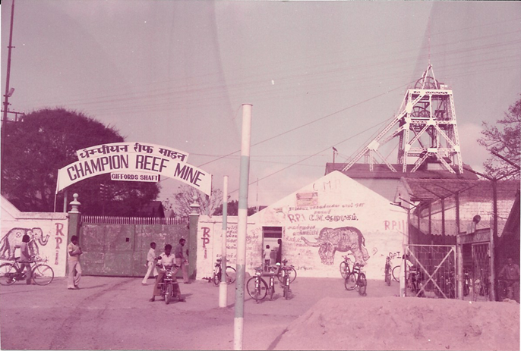
1951 Start of KGF activities
First set of measurements were carried out at Nundydurg Mines

Slide 7
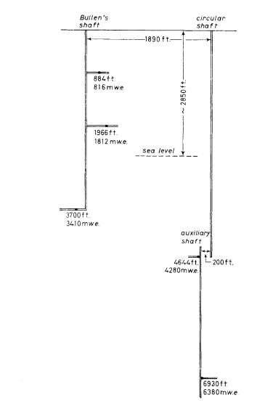
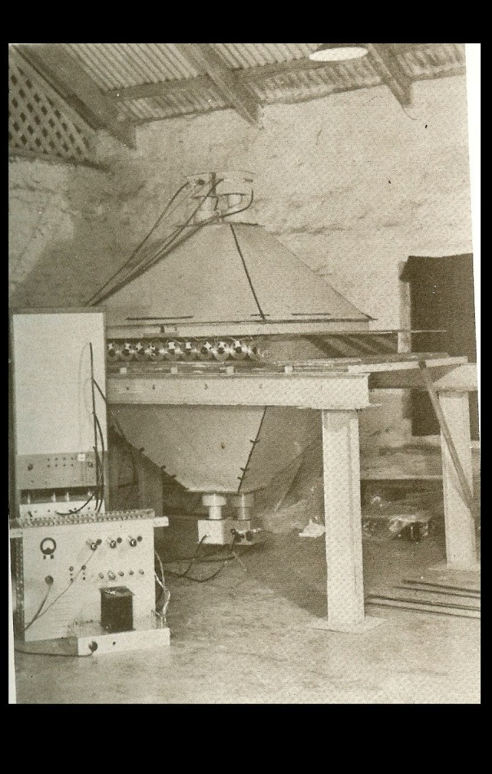
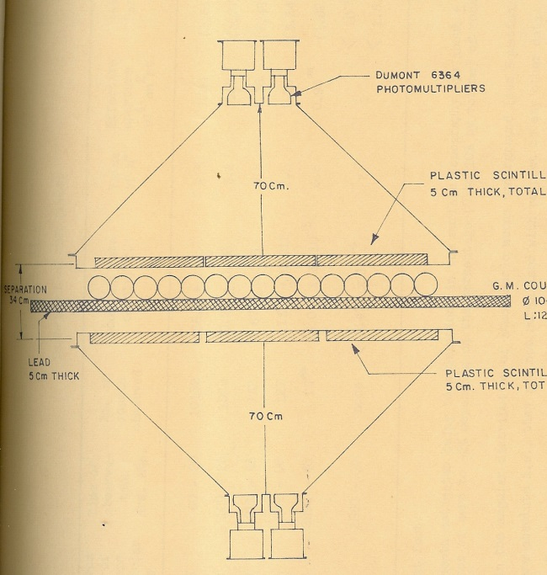

KGF 1960-1963
Up to a depth of 2.7 km. ( 800 – 8400 mwe)

Slide 8
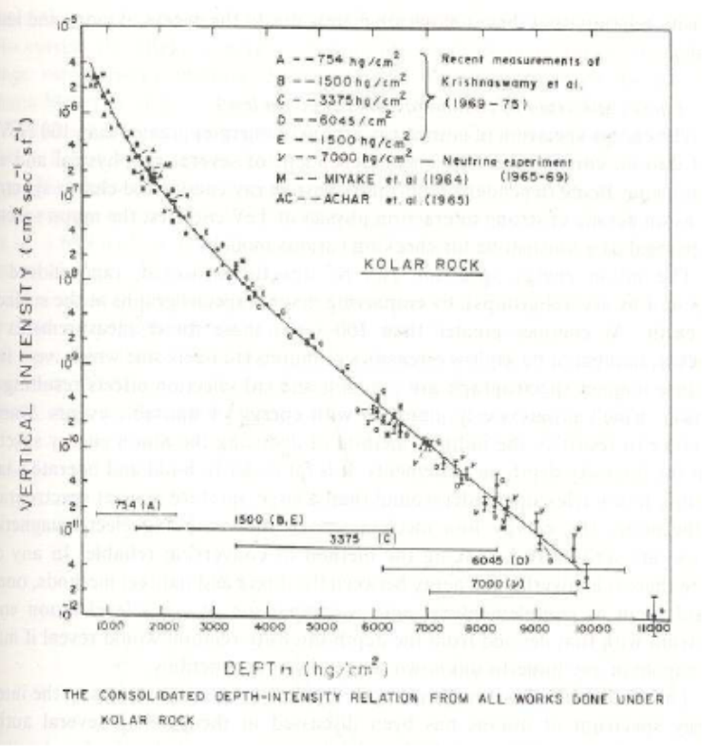
Most comprehensive Depth-intensity curve

Slide 9
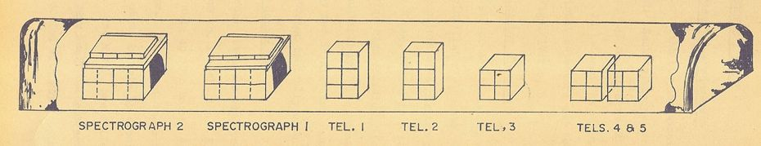
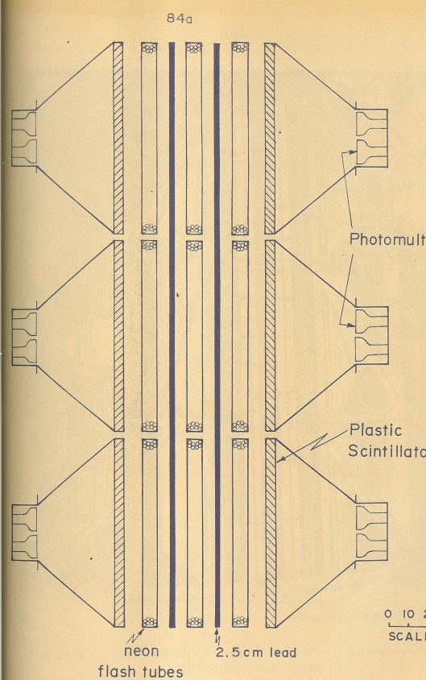
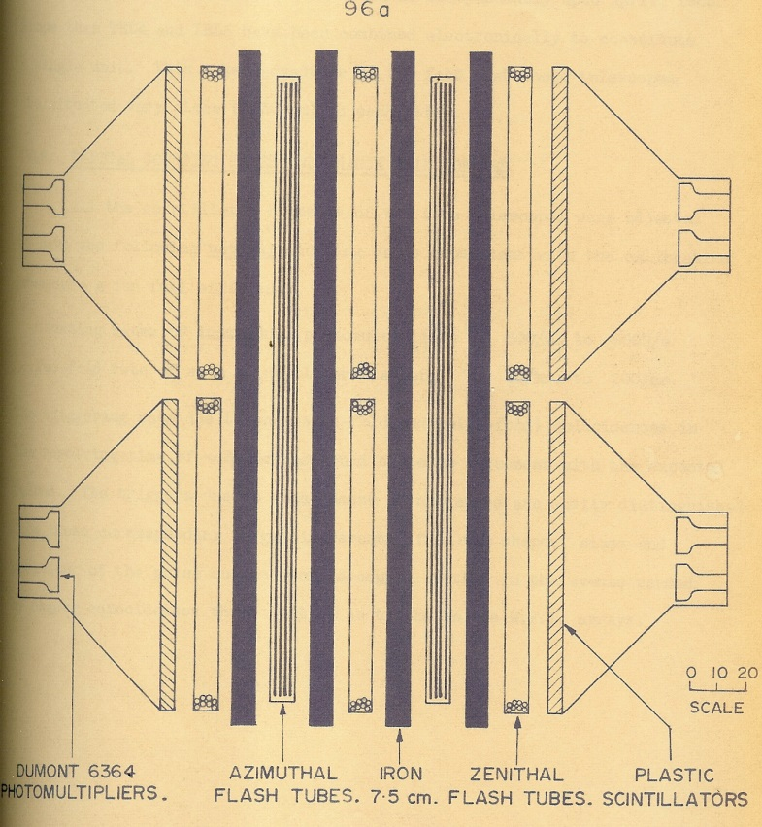
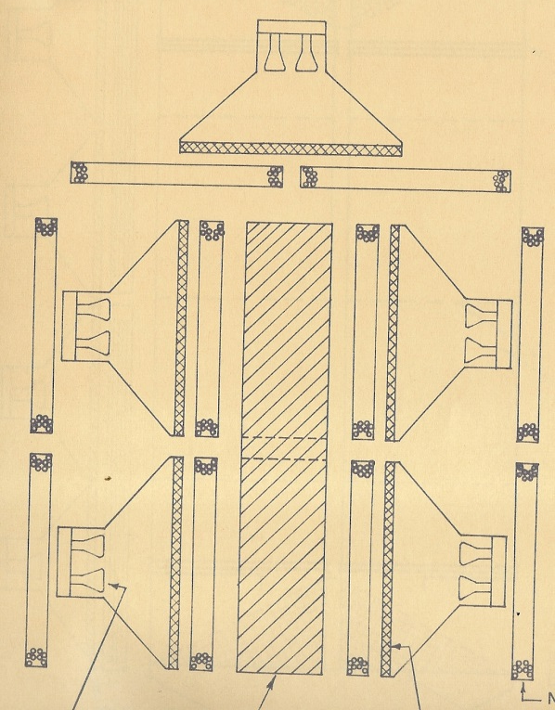
Neutrino Experiment at KGF 1965 onwards

Slide 10
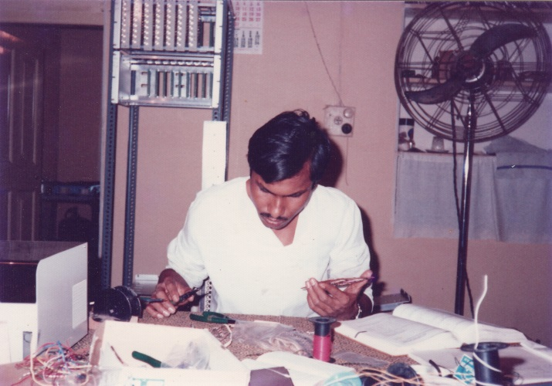
KGF Phase I Nucleon Decay Detector (1979-1992)

Slide 11
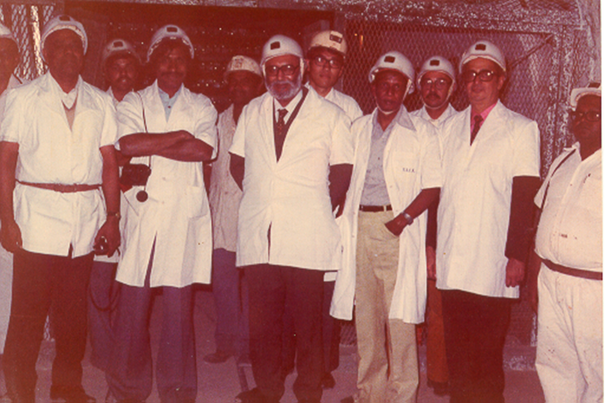
KGF Phase-I Nucleon Decay Detector

Slide 12
KGF Phase-II Nucleon decay Experiment 1984-1992

Slide 13
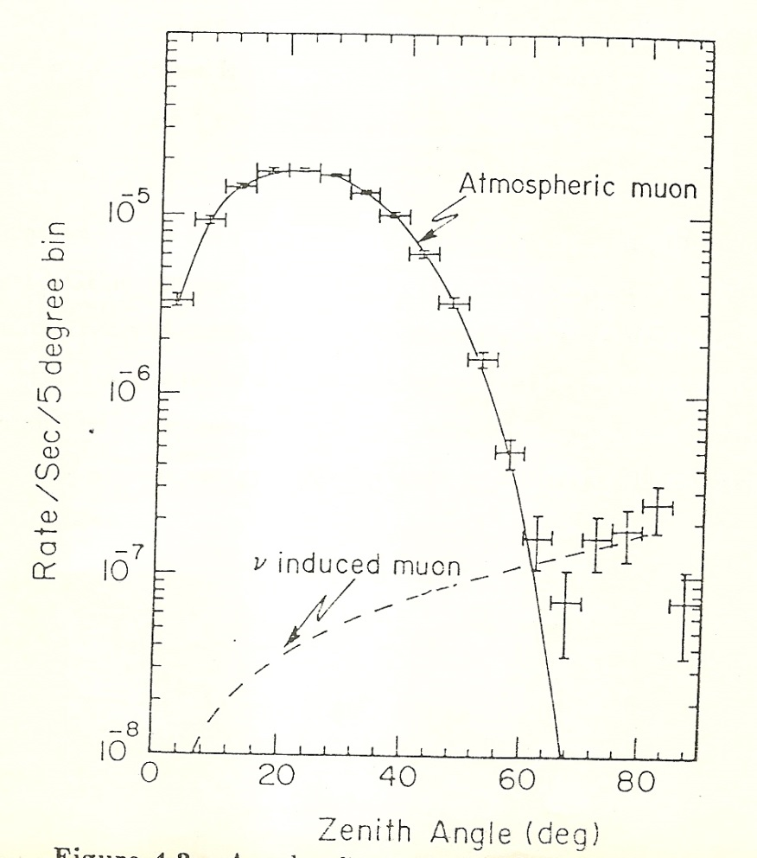
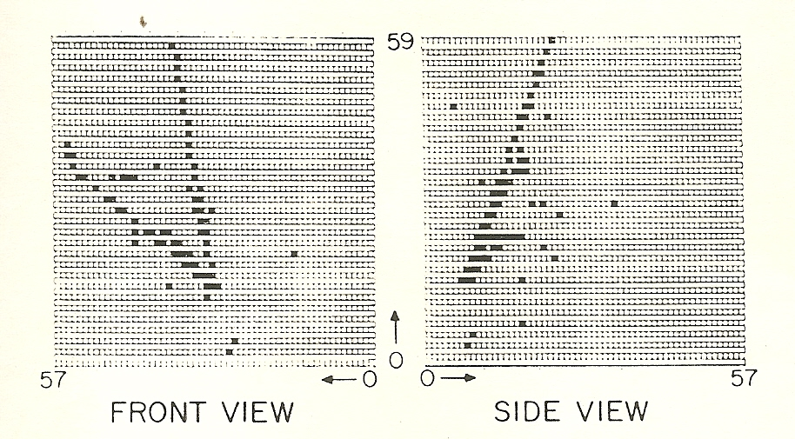
Neutrino Events

Slide 14
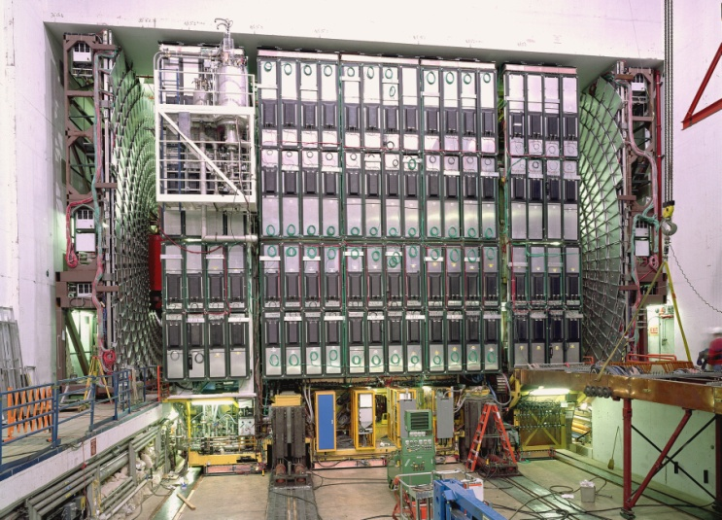
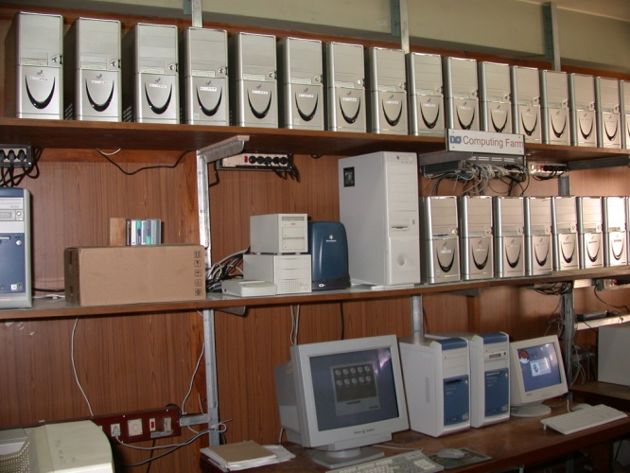
DØ Detector fabrication

Slide 15
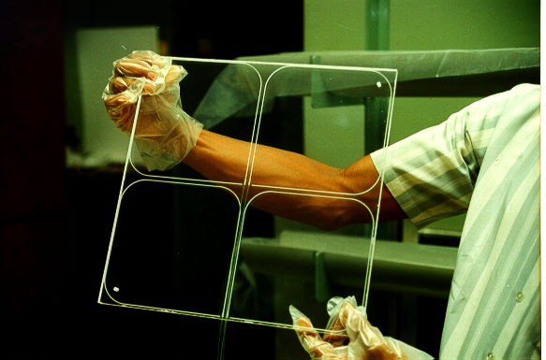
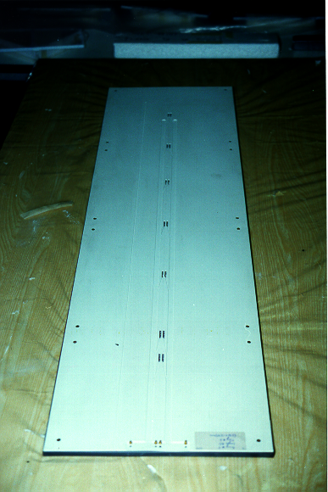
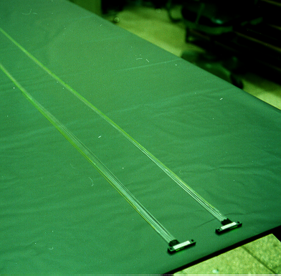
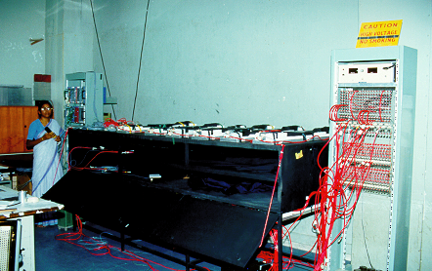
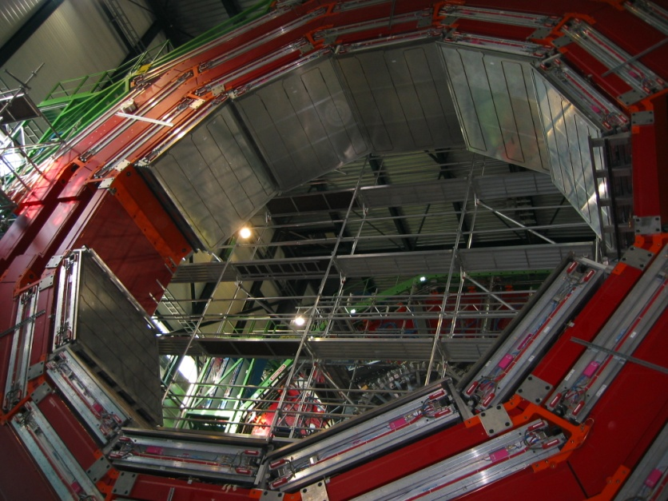
CMS Detector Fabrication work

Slide 16
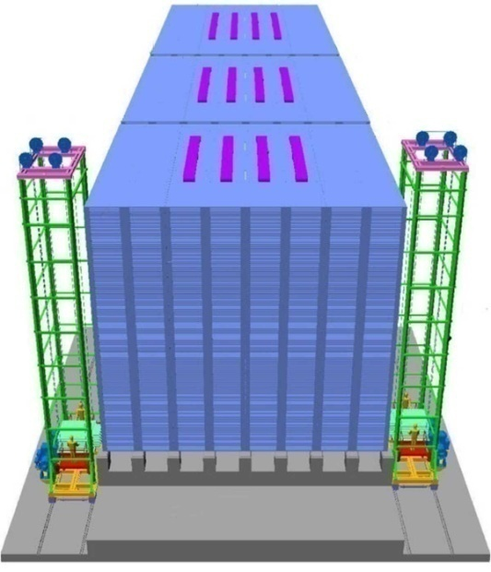
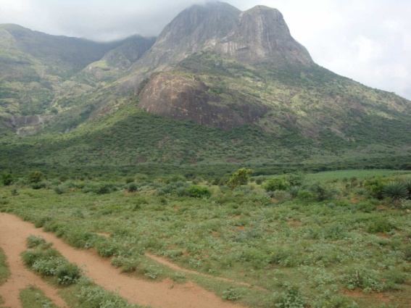
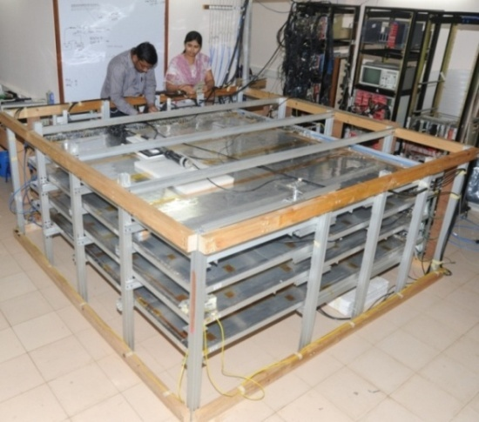
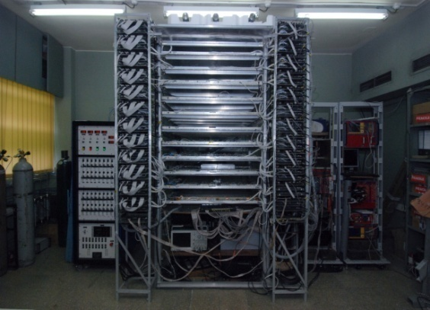
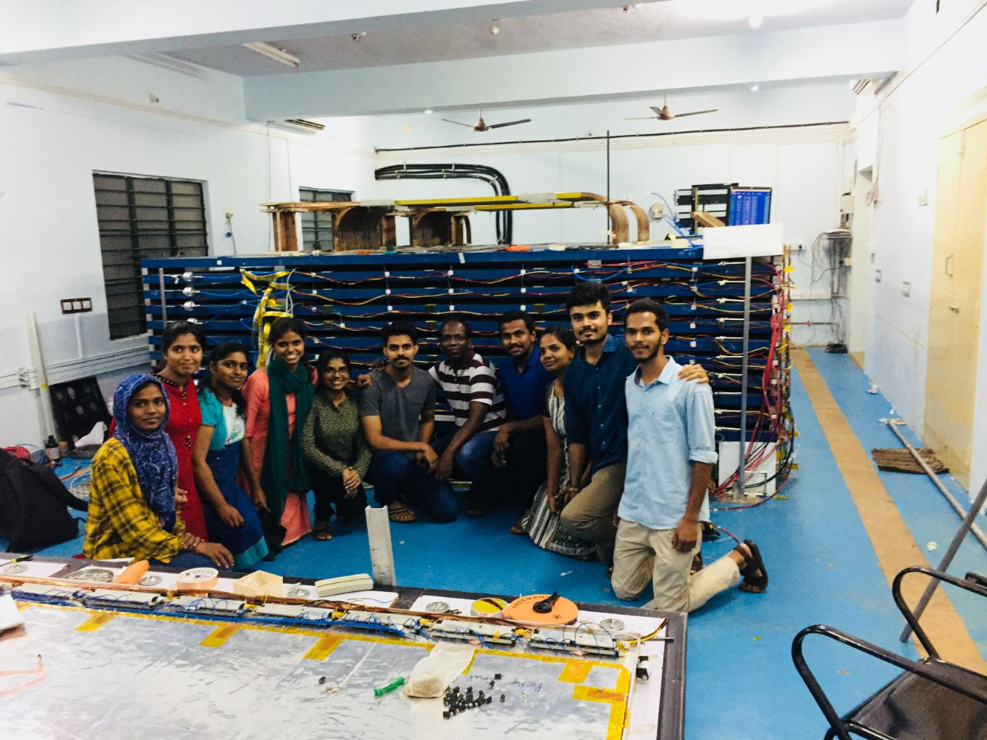
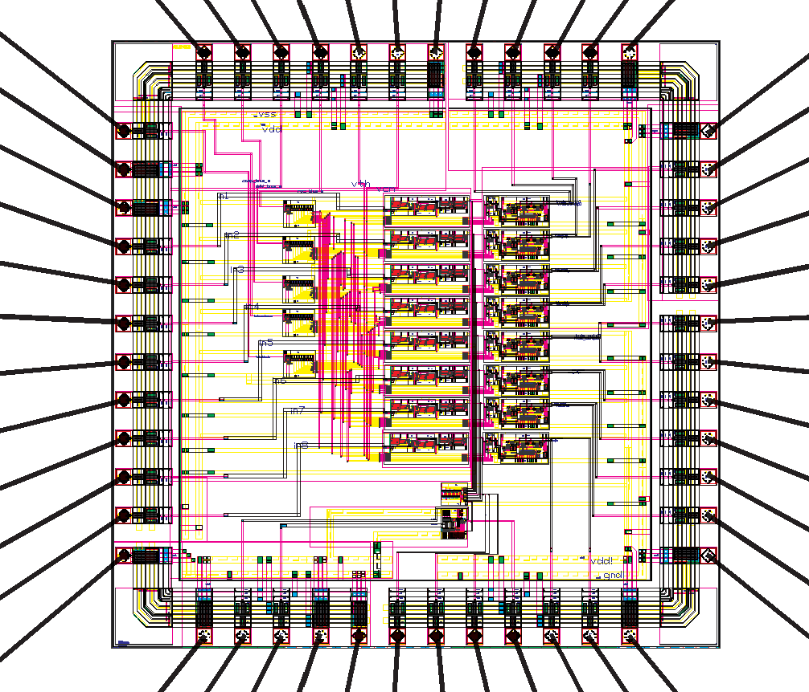
India-Based Neutrino
Observatory
(INO)
ICAL
( conceptual)
INO site at
Bodi West Hills
RPC Test stand at TIFR
2mX2m RPC Test Stand at TIFR
ASIC for RPC designed at BARC

