Slide 1

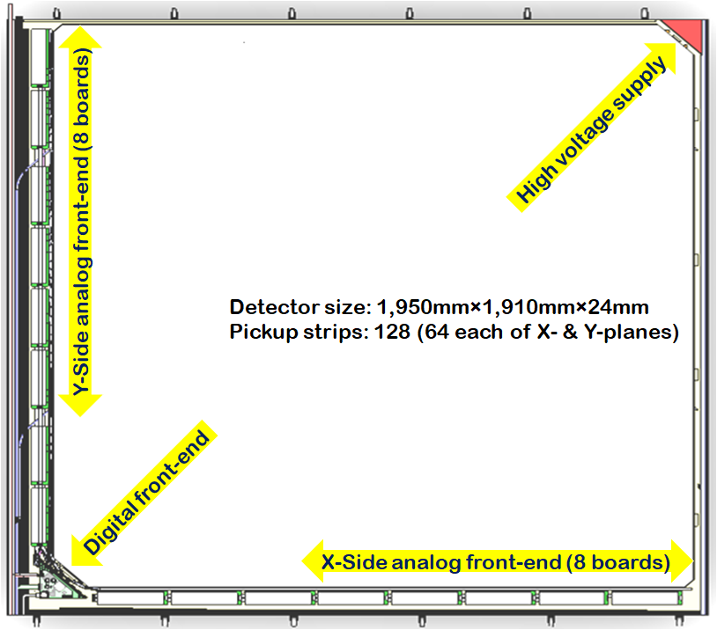
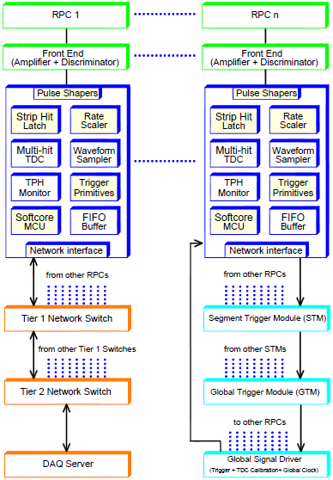
Highlights of detector and instrumentation developments for INO project

Slide 2
ICAL, e-ICAL and m-ICAL
Parameter | ICAL | e-ICAL | m-ICAL
No. of modules | 3 | 1 | 1
Module dimensions | 16.2m×16m×14.5m | 8m×8mx2m (90:1) | 4m×4mx1m (720:1)
Detector dimensions | 49m×16m×14.5m | 8m×8mx2m | 4m×4mx1m
No. of layers | 150 | 20 | 10
Iron plate thickness | 56mm | 56mm | 56mm
Gap for RPC trays | 40mm | 40mm | 45mm
Magnetic field | 1.3Tesla | 1.3Tesla | 1.3Tesla
RPC dimensions | 1,950mm×1,910mm×24mm | 1,950mm×1,910mm×24mm | 1,950mm×1,910mm×24mm
Readout strip pitch | 30mm | 30mm | 30mm
No. of RPCs/Road/Layer | 8 | 4 | 2
No. of Roads/Layer/Module | 8 | 4 | 1
No. of RPC units/Layer | 192 | 16 | 2
No. of RPC units | 28,800 (107,266m²) | 320 (1,192m²) (90:1) | 20 (74.5m²) (1440:1)
No. of readout strips | 3,686,400 | 40,960 (90:1) | 2,560 (1440:1)

Slide 3
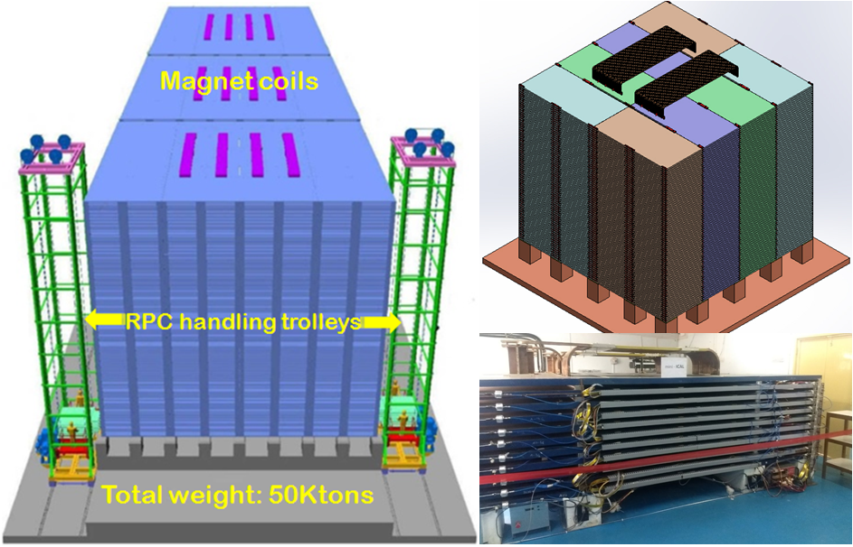
ICAL, e-ICAL and m-ICAL

Slide 4
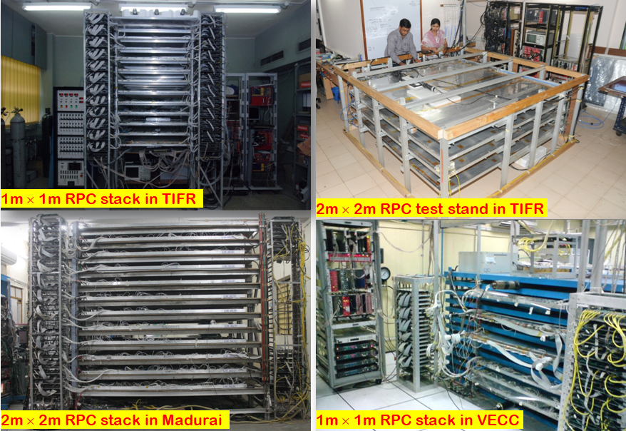
Bench marking of RPC detectors

Slide 5
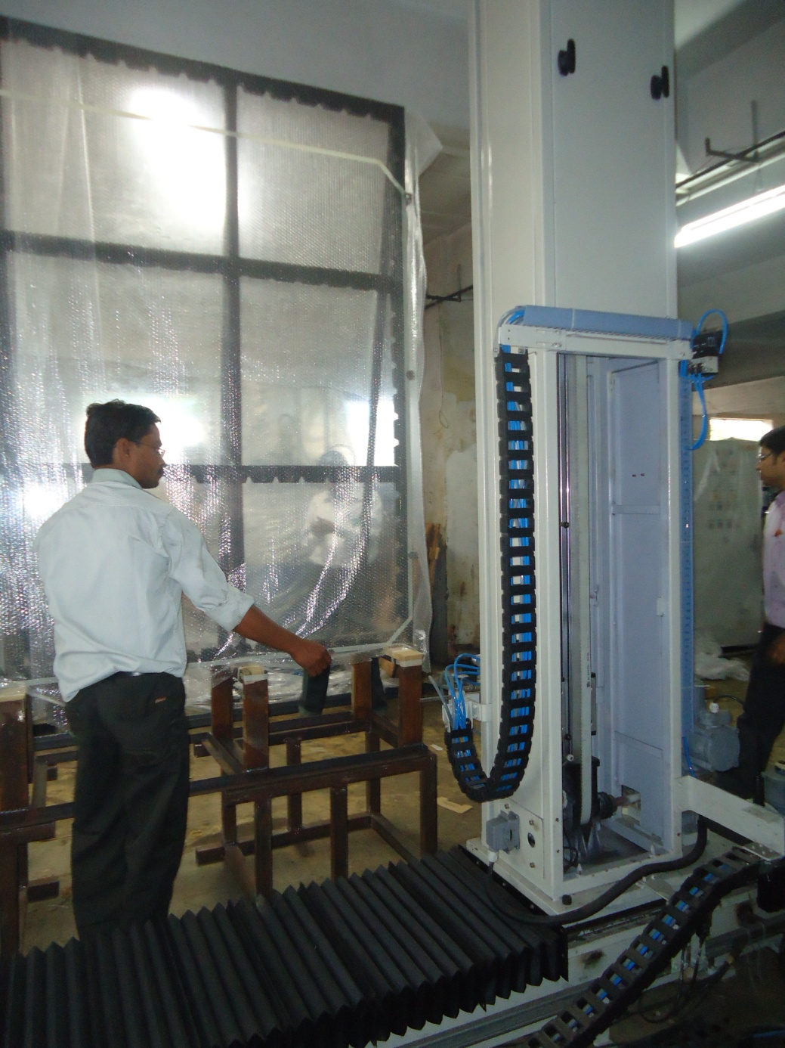
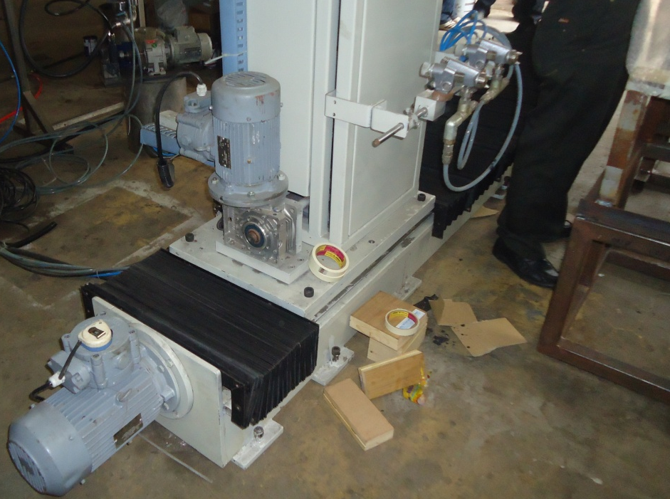
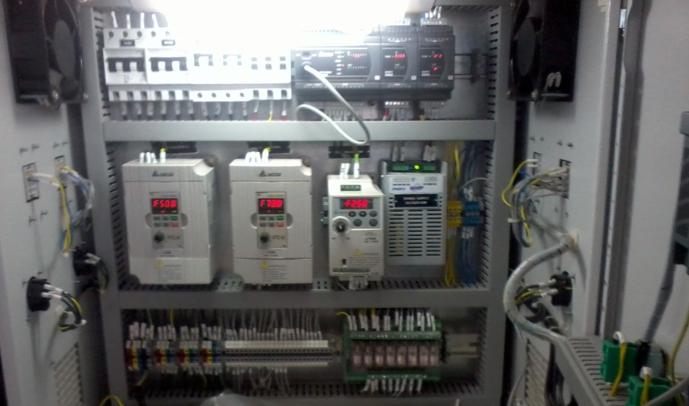
Glass spray painting robot

Slide 6
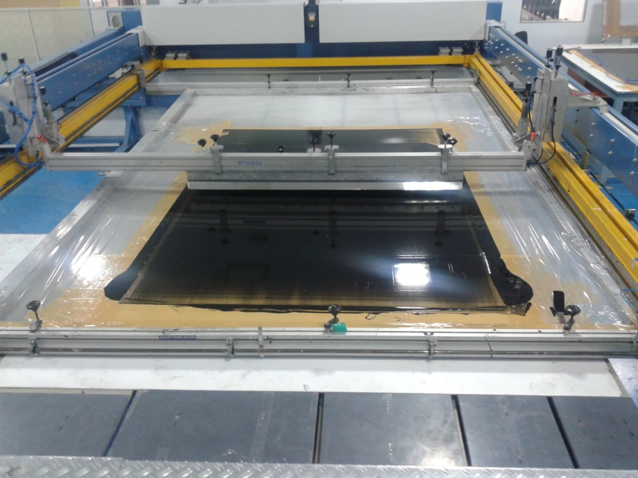
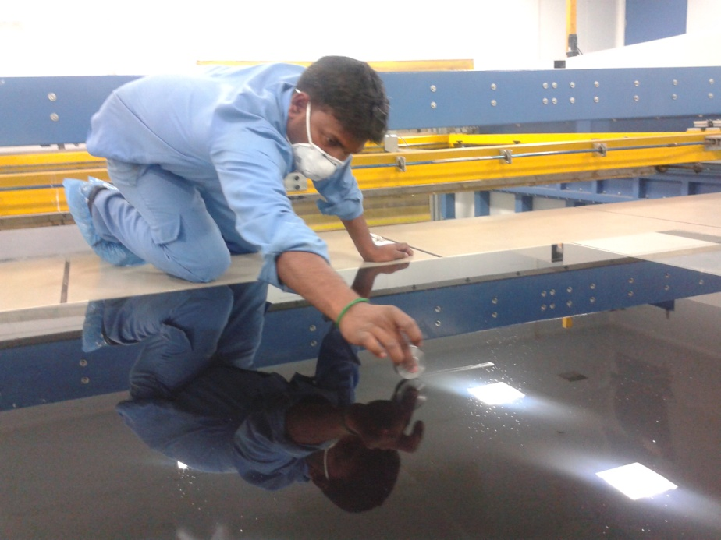
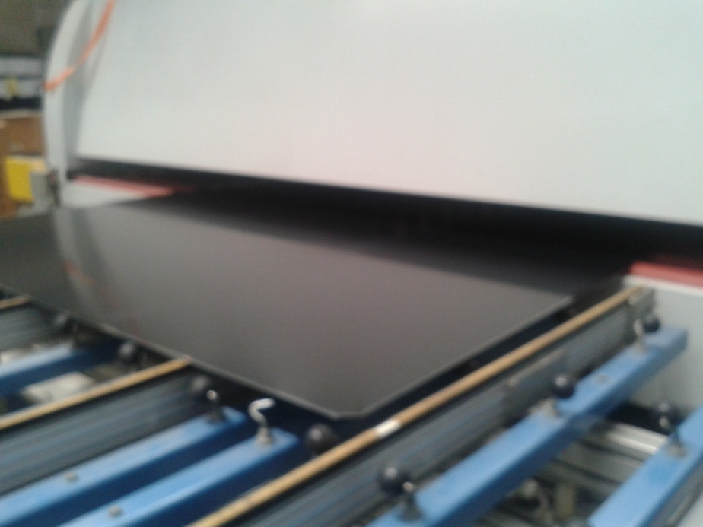
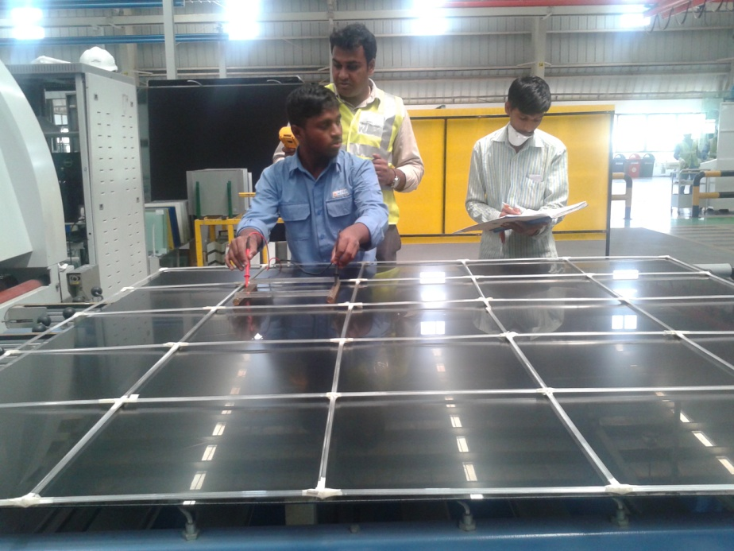
Screen printing on electrodes

Slide 7
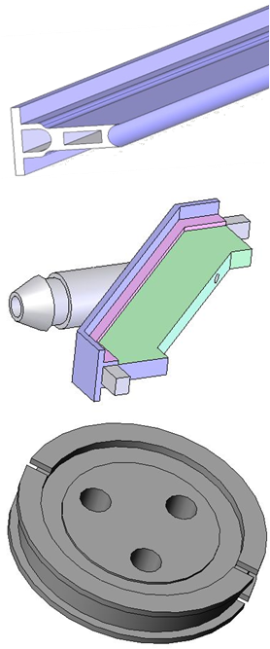
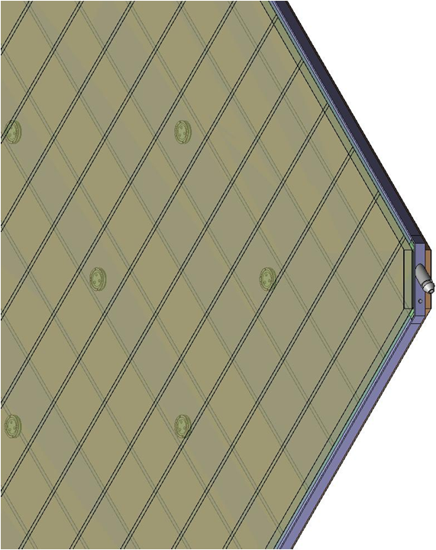
Materials for gas gap fabrication
Edge spacer
Schematic of an assembled gas volume
Gas nozzle
Glass spacer

Slide 8
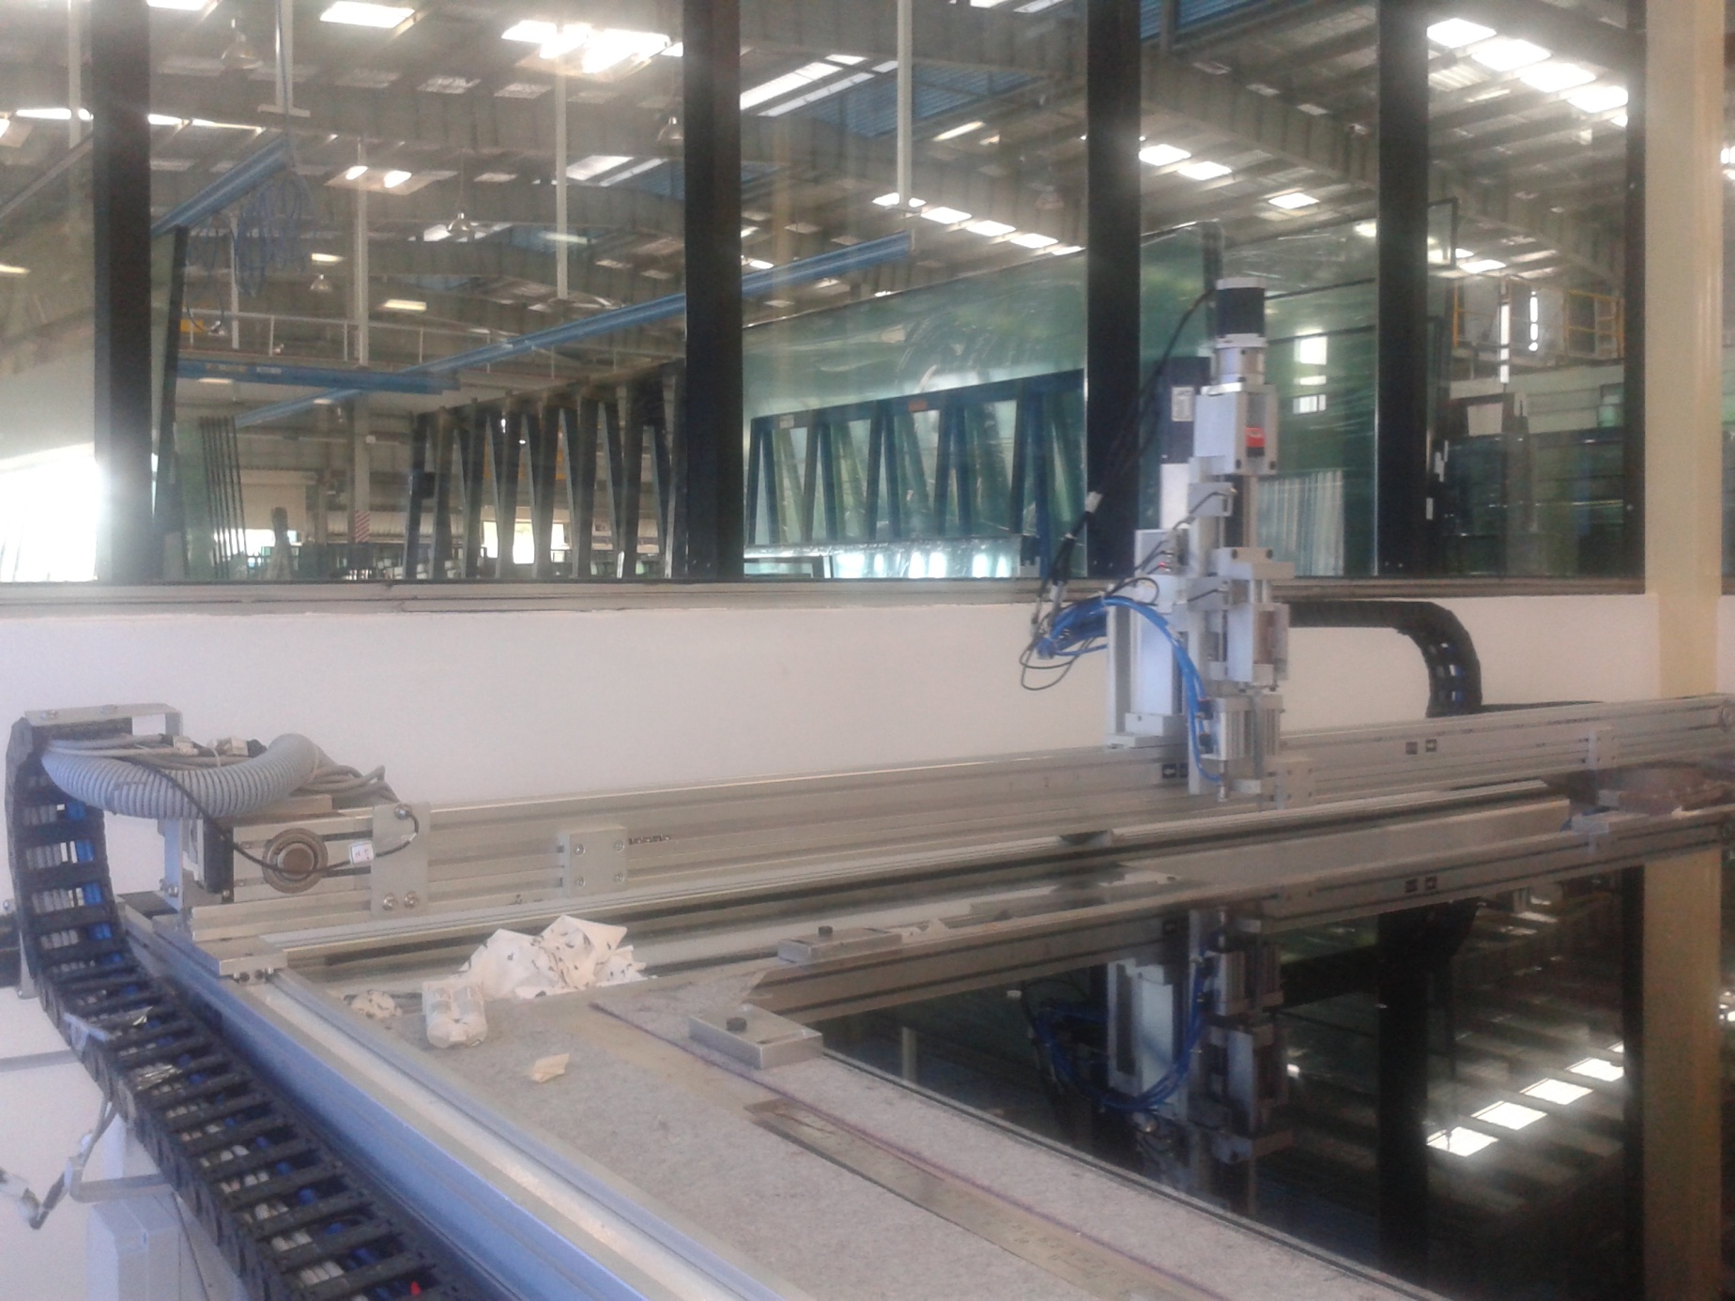
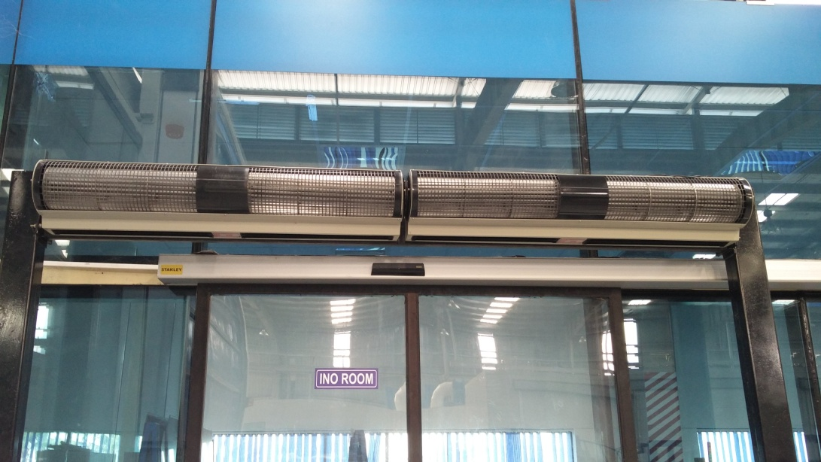
Automatic RPC gap making

Slide 9
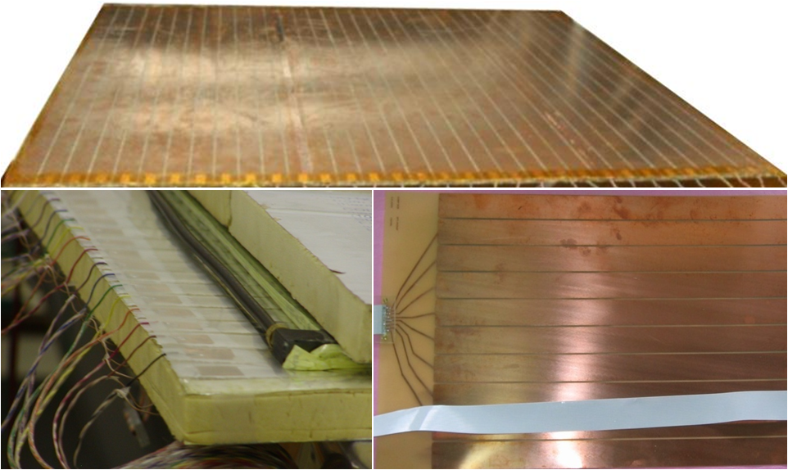
Development of Pickup panels
Polypropylene as well
as PVC panels are
also developed.
Honeycomb panel
Foam panel
G-10 panel

Slide 10
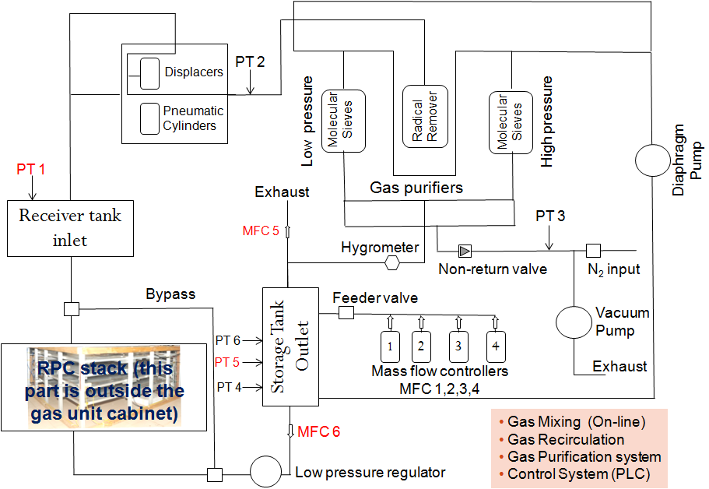
Closed loop gas system
About 200,000 litres (60 LPG cylinders) of gas will be circulating in the ICAL detector all the time.
Regenerate, Recycle and Reuse

Slide 11
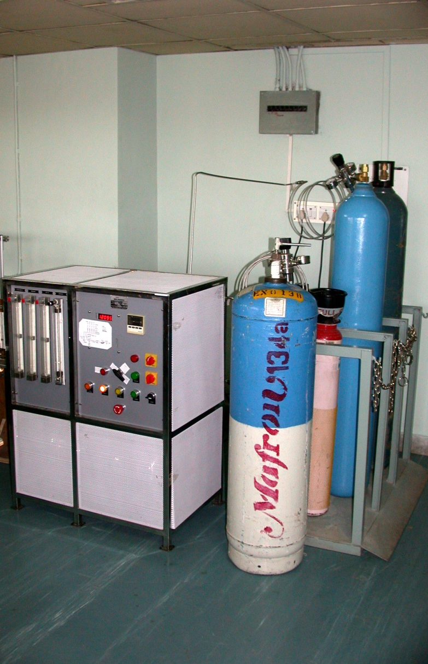
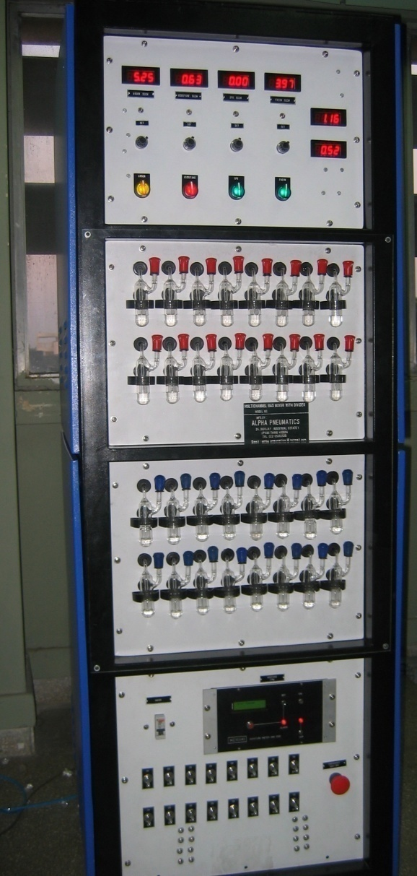
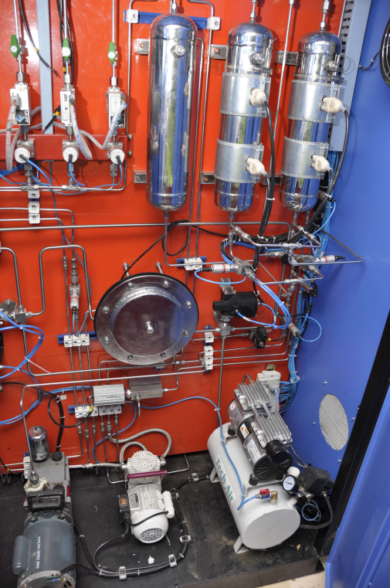
Development of Gas systems
ICAL detector holds about 200,000 litres of gas all the time.
Gas recycling system ensures that almost no gas is wasted.

Slide 12
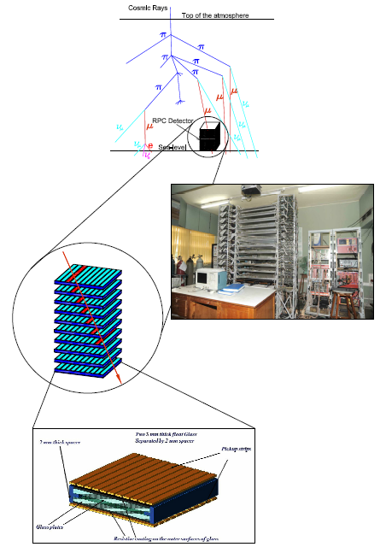

Functions of ICAL electronics
Signal pickup and analog front-end
Strip hit latch
Pulse shapers, timing units
Background noise rate monitor
Digital front-end and controller
Data network interface and architecture
Multilevel trigger system
Calibration and time stamping unit
Backend data concentrators
Event building, data storage systems
On-line data quality monitors
Slow control and monitoring
  Gas, magnet, power supplies
  Ambient parameters
  Safety and interlocks
Voice and video communications
Remote access to detector sub-systems and data

Slide 13
Challenges of ICAL electronics
Large number of electronic data readout channels. This necessitates large scale integration and/or multiplexing of electronics.
Large dimensions of one unit of RPC. This has bearing on the way the signals from the detector are routed to the front-end electronic units.
Large dimensions of the ICAL detector. Disparate distances (i.e. delays of signals in cables) of RPCs from the backend requires elaborate calibration procedures for global signals.
Road structure for the mounting of RPCs. This necessarily imposes constraint that signals from both X & Y planes of the RPC unit, along with other service and power supply lines are brought out only from the transverse direction of the detector.
About 25cm gap is available between the face of the detector and the service trolleys. Any installations on the face of the detector have to be designed with this consideration.
About 40mm gap between iron layers is available for the RPC detector. Thickness of the RPC holding tray, thickness of tray sliding track, tolerances of the iron plate thickness, height of the on detector high voltage module, analog and digital front-end modules, routing of cables and all other service lines must fit in this gap.
Effect of fringe magnetic field on the performance.
Low power consumption per channel (25mW/channel → 100KW/detector)

Slide 14
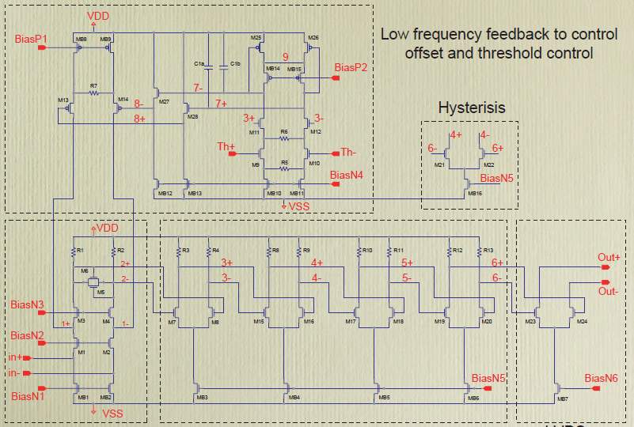
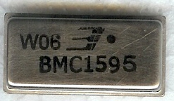
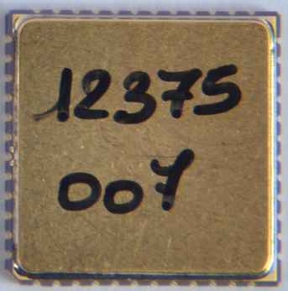

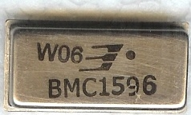
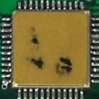
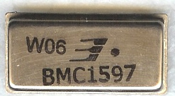
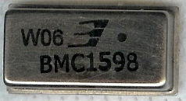
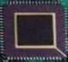
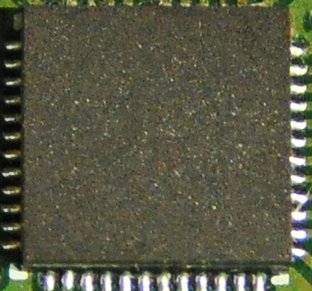
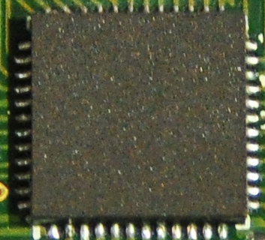
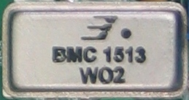
Design and fabrication of ICs
Analog
Mixed
Digital
QFN-48
package
QFN-48
package
Fast preamplifiers
(Hybrid Micro Circuits)
Fast preamplifiers and comparators (ASICs)
Timing circuits (ASICs)

Slide 15
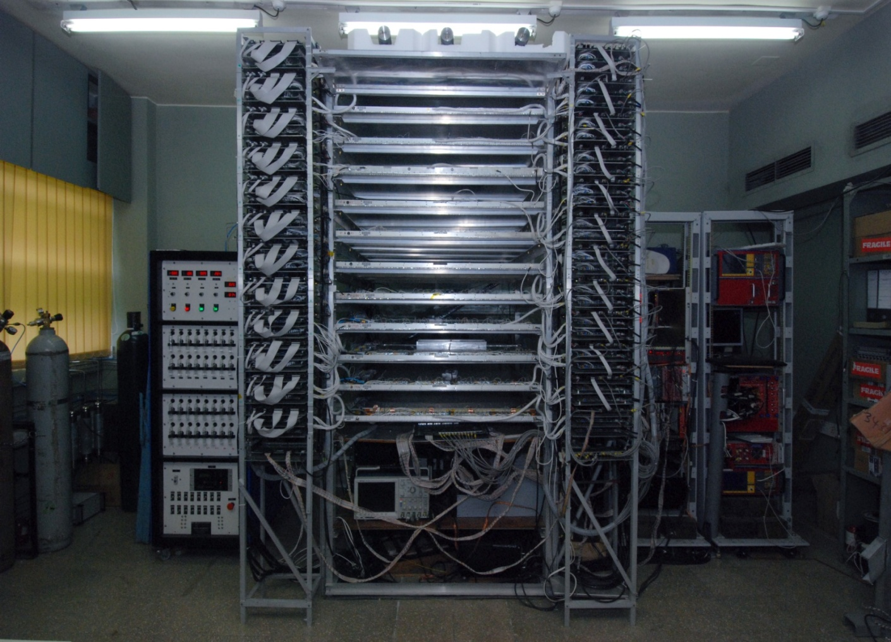
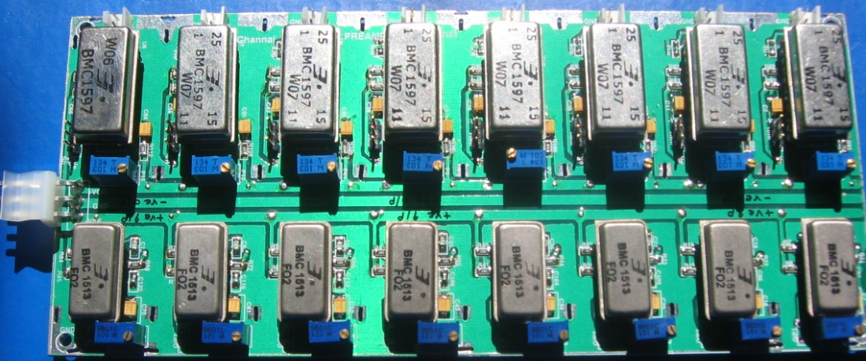
HMC preamps for ICAL test stands
BMC1595
(Negative In – Negative Out)
BMC1596
(Positive In – Positive Out)
BMC1597
(Positive In – Dual Out)
BMC1598
(Negative In – Dual Out)
BMC1513
(Negative In – Negative Out)
Input & Output impedance: 50Ω
Nominal gain: 10
Rise time: ~1.2 ns
Bandwidth: 350MHz
Package: 22-pin DIP
Power Supply : ± 6V
Power Consumption:110mW

Slide 16
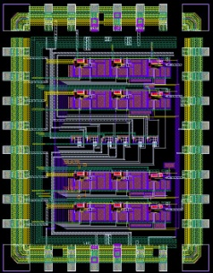
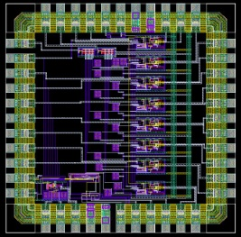
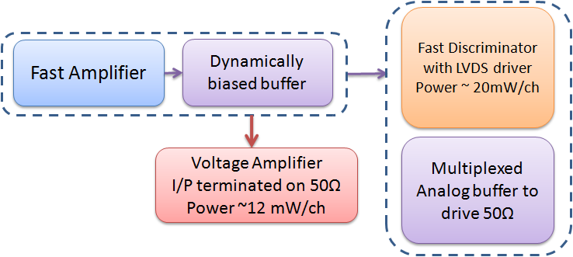
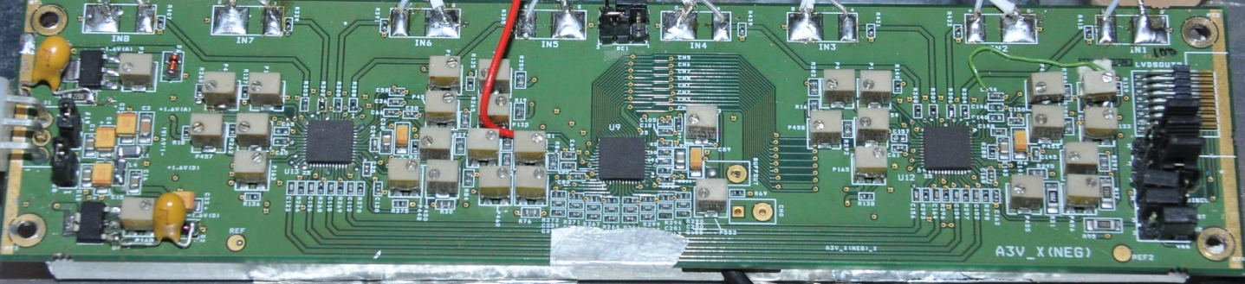
Voltage amplifier ASICs
An 8-channel AFE board using two, 4-channel preamplifier and one, 8-channel discriminator ASICs designed, fabricated and extensively tested on RPC test stands at BARC and TIFR.
Horizontal mounting in the RPC tray agreed upon for the Engineering Module as the board dimension couldn’t reduced below 200mm × 45mm.
Small volume order for the ASIC chipset in QFN package and boards produced.
Chip packing options, board manufacturer development, automatic assembly lines and test equipment are being planned.
SOIC-28
package
(11mmx18mm)
CLCC-44
package
(16mmx16mm)
QFN-48
package
QFN-48
package
0.35μm SiGe BiCMOS process

Slide 17
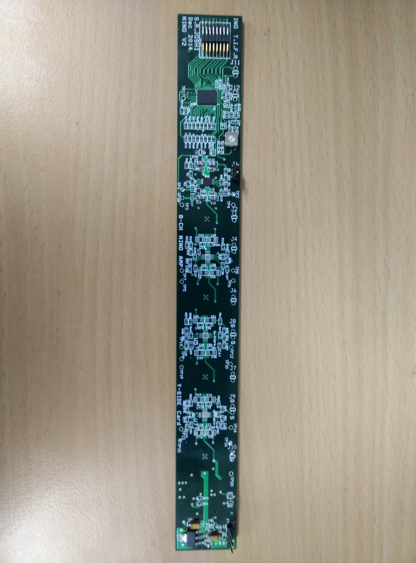
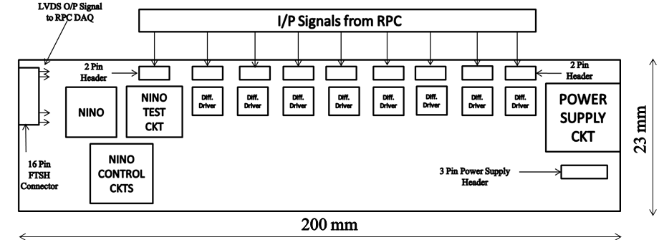
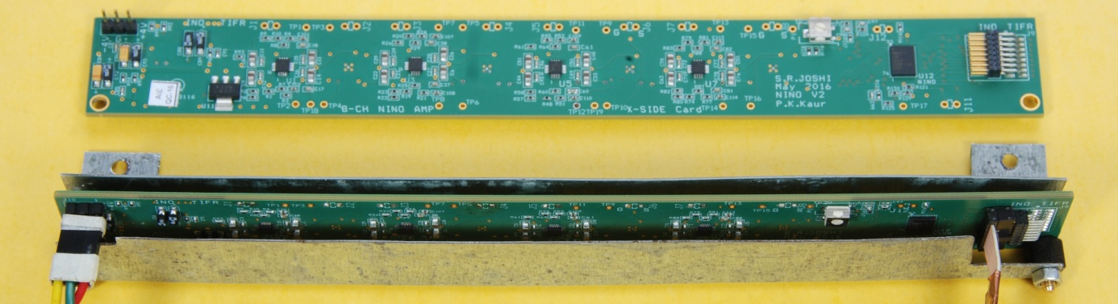
Analog Front-End boards with NINO ASICs
Accepts inputs from 8 pickup strips of an SRPC.
8 differential drivers of unity gain.
One NINO chip with threshold control and other accessory circuits.
17

Slide 18
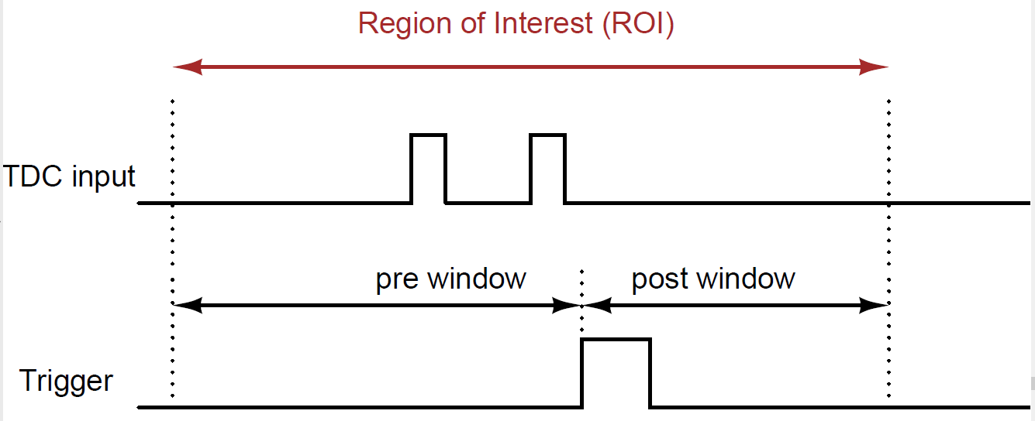
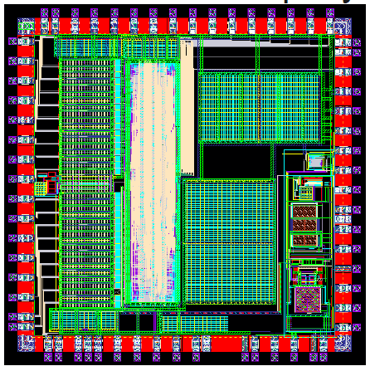
ICAL’s TDC ASIC
Principle
  Two fine TDCs to measure start/stop distance to clock edge (T1, T2)
  Coarse TDC to count the number of clocks between start and stop (T3)
  TDC output = T3+T1-T2
Features and specifications
  UMC 130nm technology, QFN64 package, 3.2mm×3.2mm in size
  Input clock: 10MHz (250MHz to DLL internally generated by PLL)
  16 hit channels, 1 trigger and 1 calibration channel
  Four paired time stamps: leading edge 65.5µs (125ps), pulse width 64ns (250ps)
  Readout buffers: 91 locations
  32-bit/hit, data on 4-and 11-line SPI bus.
  Self test features

Slide 19
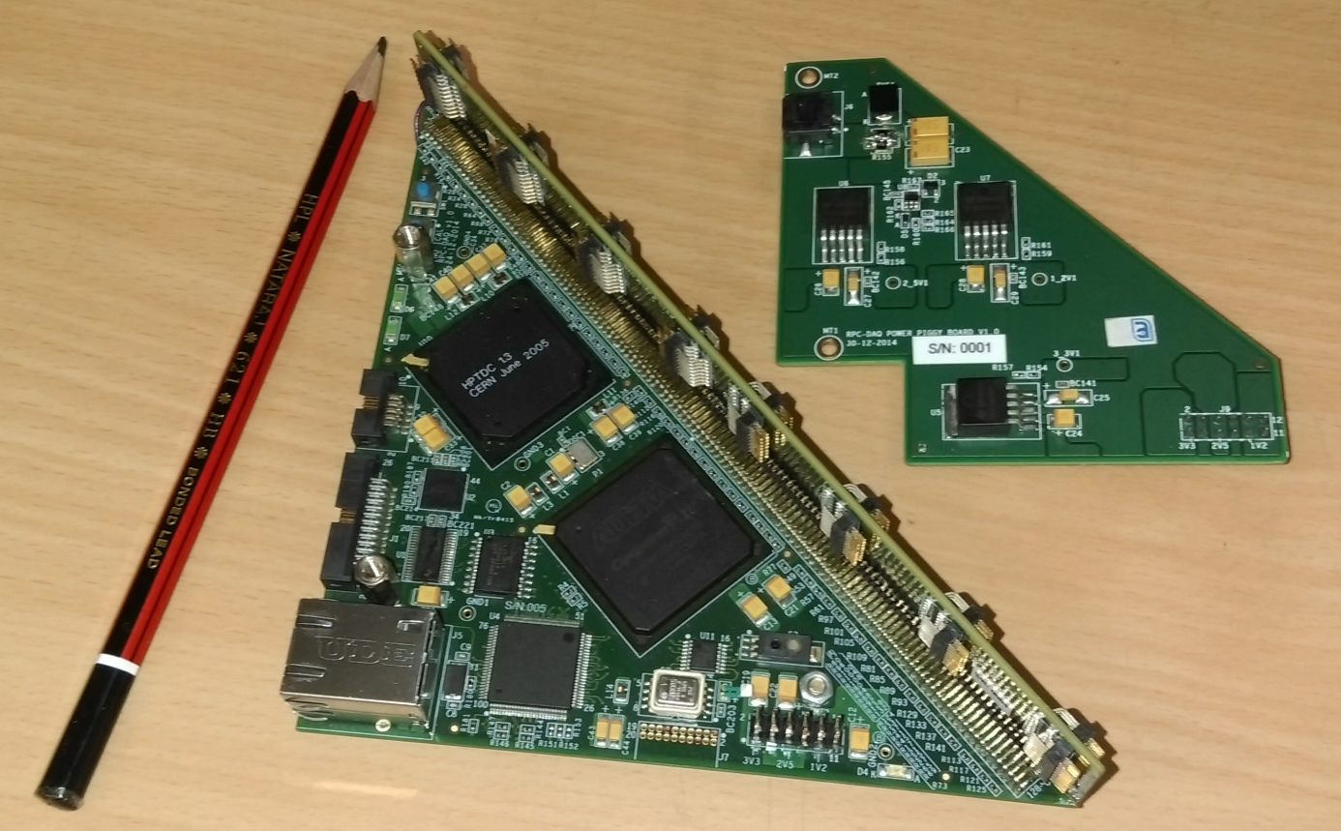
First module of ICAL’s DFE
Altera Cyclone 4
HPTDC
Wiznet 5300
Three boards

Slide 20
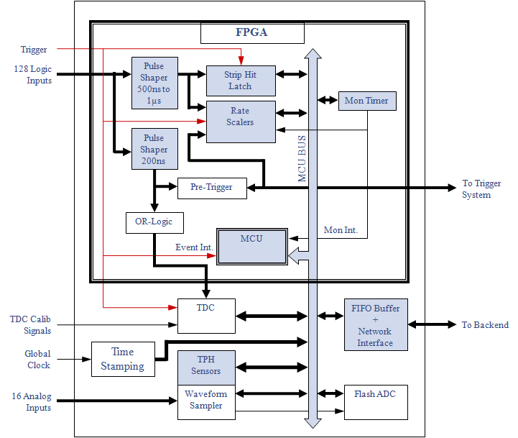
DFE module – the workhorse
Unshaped, digitized, LVDS RPC signals from 128 strips (64x + 64y)
16 analog RPC signals, each signal is a summed or multiplexed output of 8 RPC amplified signals.
Global trigger
TDC calibration signals
TCP/IP connection to backend for command and data transfer.

Slide 21
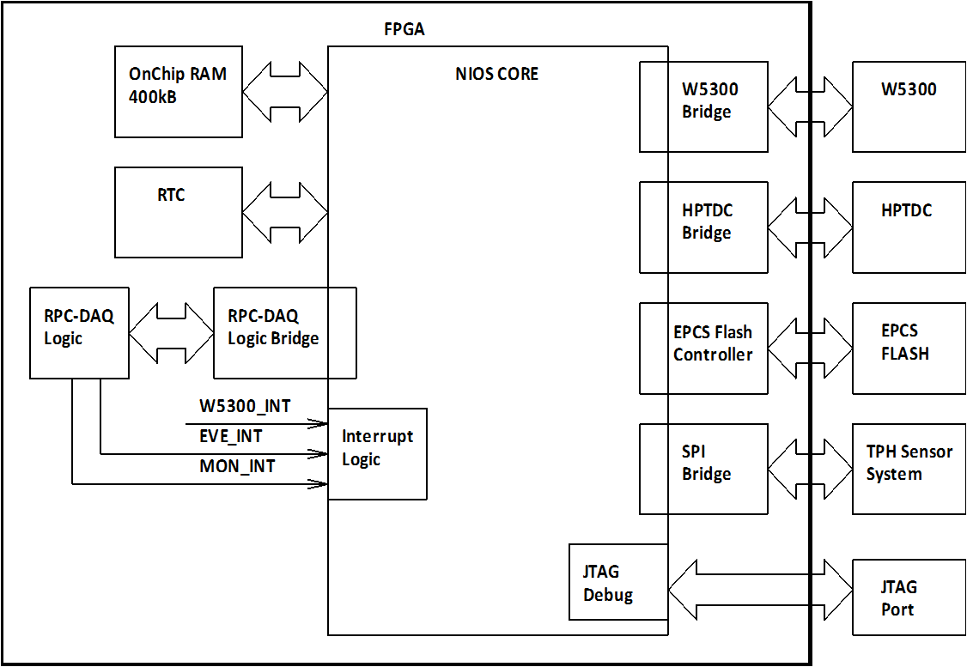
Soft-core processor
(EP4CE115F780)
Event data acquisition
Monitoring data acquisition
Command interface
Remote system upgradation
HV control and Monitoring
Read/Write Hardware register access
Flash memory Access
TDC JTAG Access
Wiznet Network Interface

Slide 22
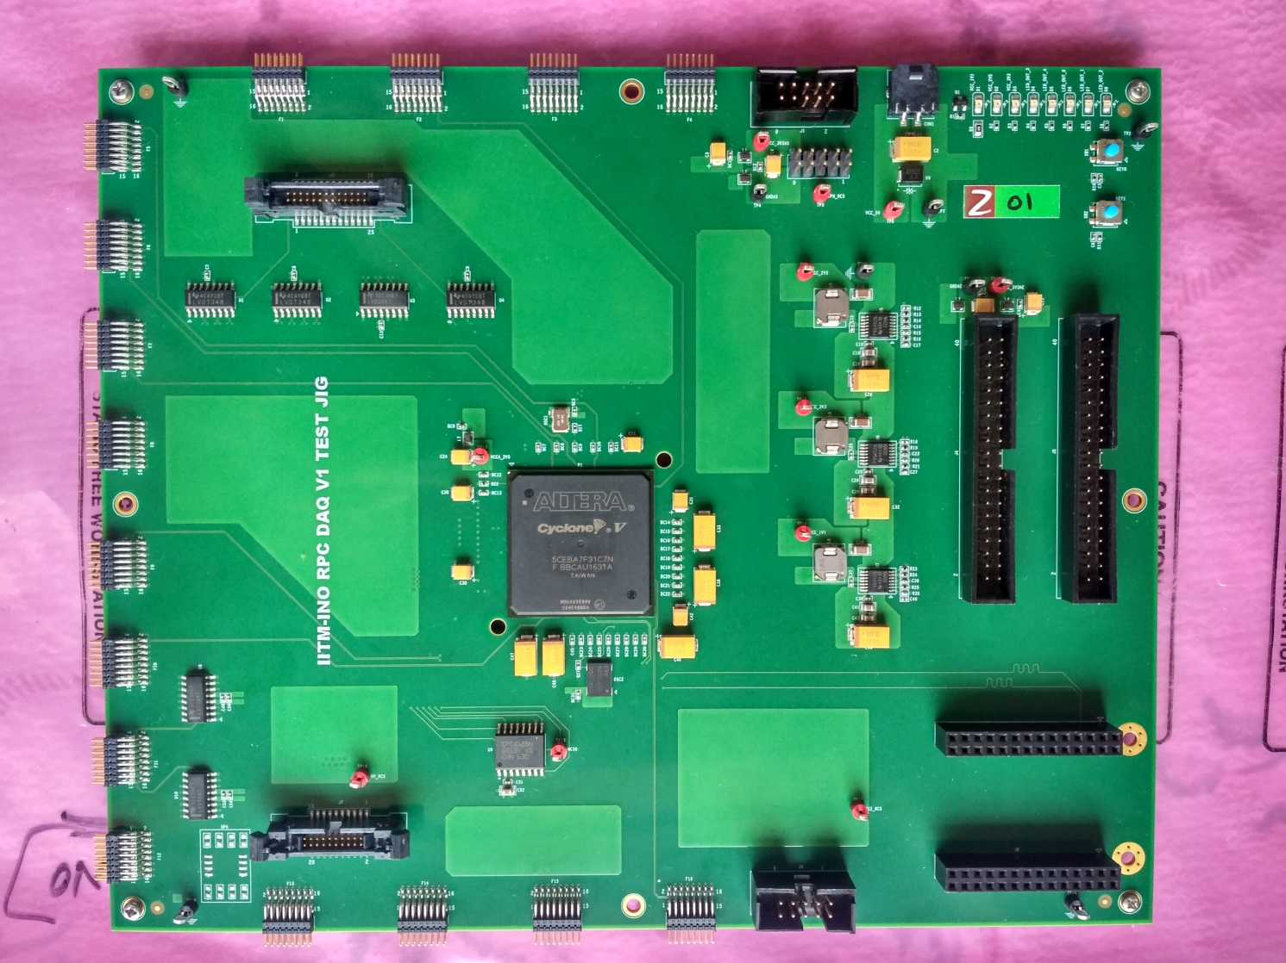
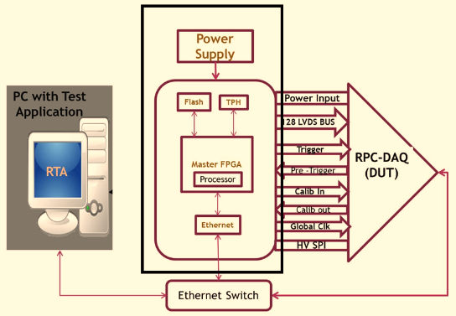
Test jig for DFE production QC

Slide 23
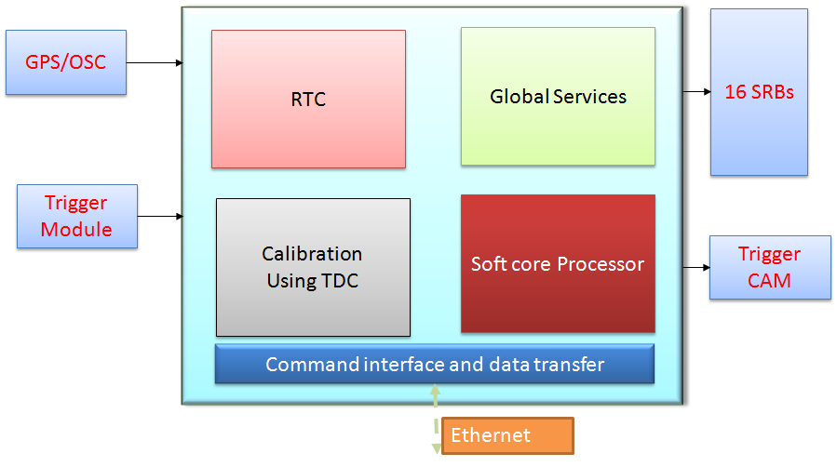
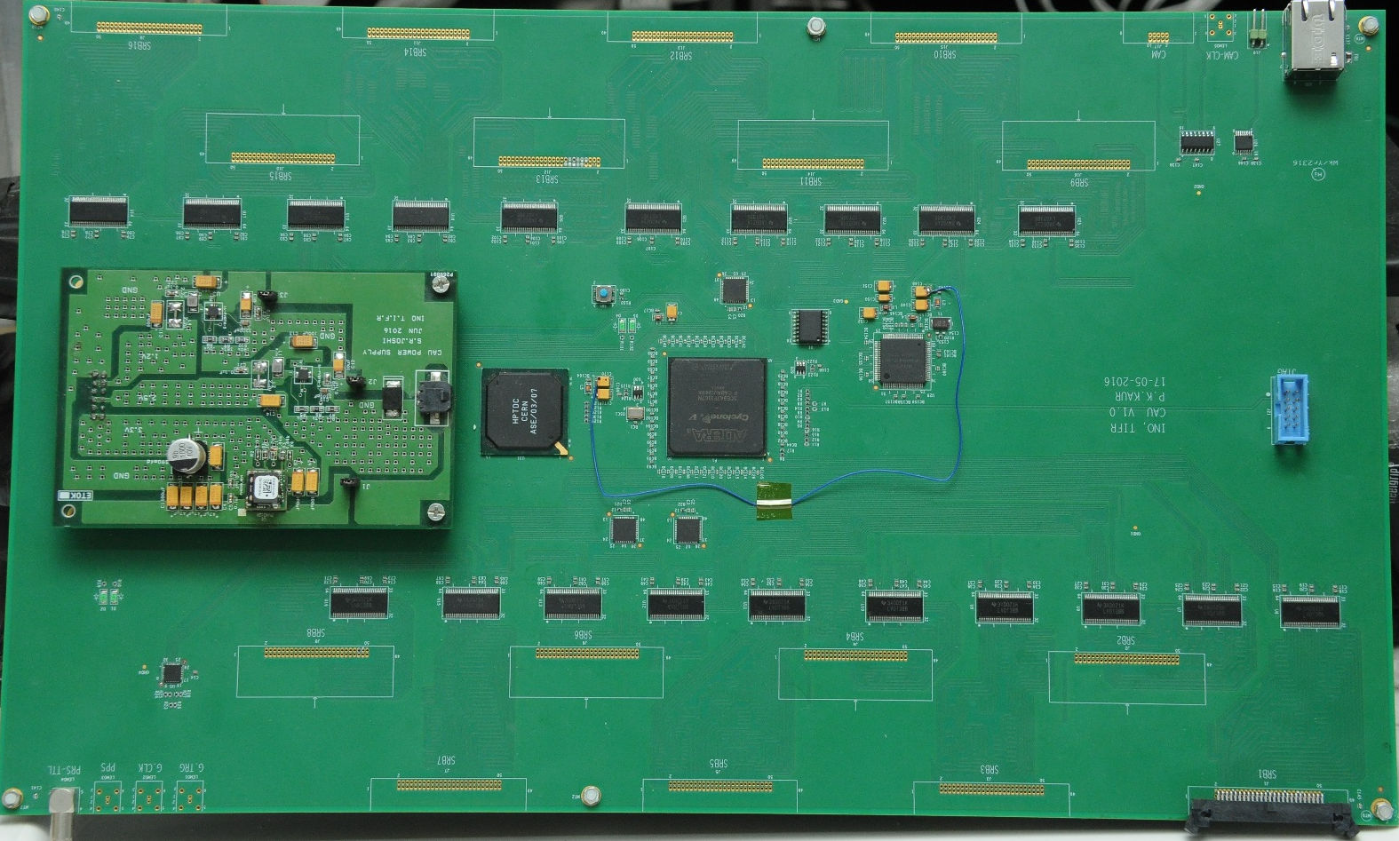
Calibration module

Slide 24

ICAL trigger scheme
Insitu trigger generation. Autonomous; shares data bus with readout system
For ICAL, trigger system is based only on topology of the event; no other measurement data is used
Huge bank of combinatorial circuits; Programmability is the game, FPGAs, ASICs are the players
Distributed
architecture

Slide 25



Trigger criteria

Slide 26

Trigger system for e-ICAL

Slide 27

Back-end data concentrator hardware

Slide 28



High voltage power supply
Output voltage adjustable in the range ± 0-6KV (to generate 0-12KV) with output current up to 2µA.
HV load regulation: better than 0.1% F.S
Output ripple/noise voltage: within 200 mV (p-p).
Adjustable HV Ramp rate 10-1000 Volts/ sec, HV on/off control, HV output read back facility.
HV load current read back facility with a resolution of 5 nA.
Required LV Input supply: 12V @200mA
Ambient fringe magnetic field: 500 gauss

Slide 29

Status and future outlook
Development and characterisation of large area glass RPC detectors completed.
They are being produced in multiple industries now.
Prototype closed loop gas system is operational, working on the scalable design for the e-ICAL and ICAL.
Design of baseline ICAL detector electronics completed, reviewed.
Prototypes and limited quantities of various components and modules were produced, technologies and vendors identified.
Detectors and electronics are being used in many ICAL prototype detectors, including the m-ICAL which is currently under operation.
Useful experience gained and a number of problems were identified – useful when scaling up production for e-ICAL and ICAL.

