Slide 1
ProtoDUNE, DUNE Near Detector, and Opportunities
Stefan Söldner-Rembold
University of Manchester, UK
DUNE-India Meeting
TIFR, Mumbai
2 November 2018

Slide 2
Outline
Collaboration organization
The 2+1+1 Far Detector model
ProtoDUNE detectors at CERN
Near Detector
Summary and Opportunities for Involvement

Slide 3
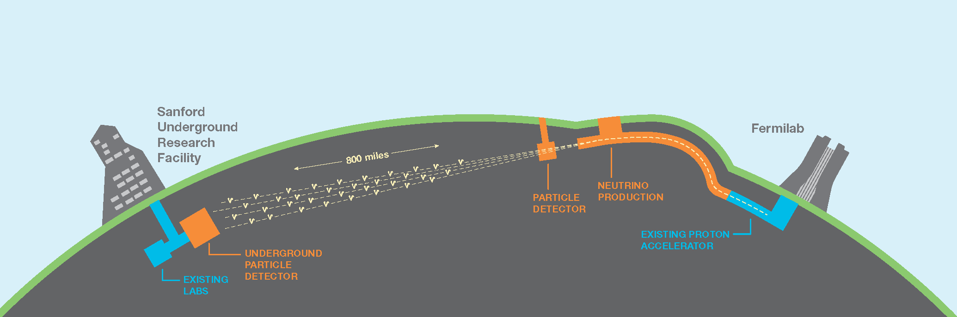
DUNE Main Components
May 2018
1300 km
FD
ND
  A high-power, wide-band neutrino beam (~ GeV energy range).
  A ≈ 40 kt liquid-argon Far Detector in South Dakota, located 1478 m underground in a former gold mine.
  A Near Detector located approximately 575 m from the neutrino source at Fermilab close to Chicago.

Slide 4
Organisation and Management
  Many simultaneous DUNE activities
    Far Detector
    Near Detector
    Physics studies
    Prototype detectors (ProtoDUNEs)
    Funding and Resource Matrix, Technical Design Reports
  Project requires well-defined management structures
  DUNE Management Plan
  Collaboration Governance Document
  Collaboration organization evolving to address challenges
  Far Detector Consortia formed in August 2017
  Executive Board formed in July 2018
  Near Detector Design Group formed in September 2018
  New Calibration and Computing Consortia formed in October 2018

Slide 5







DUNE Consortia
Single-Phase
APA: Christos Touramanis (Liverpool)
Photon Detection System: Ettore Segreto (Campinas)
TPC Electronics: Dave Christian (FNAL)
Dual-Phase
CRP (interim): Dominique Duchesneau (LAPP)
Photon Detection System: Ines Gil Botella (CIEMAT)
TPC Electronics: Dario Autiero (IPNL)
Joint DP/SP
HV System: Francesco Pietropaolo (CERN)
DAQ: Dave Newbold (Bristol)
Slow Controls/Instrumentation: Sowjanya Gollapinni (Tennessee)
Computing: Heidi Schellman (Oregon State)
Calibration: Jose Maneira (LIP)

Slide 6
Management Structure
Collaboration Governance
Senior
Management
Technical &
Project Coordination
National Reps.
& Resource
Planning
Operational

Slide 7
Executive Board
Executive Board is main management body of the Collaboration.
Membership is all leaders of major activities in the Collaboration (including Consortium Leaders, Physics Coordinators etc.). In total, about 20 members.
Main motivation: have formal decision making structure to execute large-scale project with buy-in from all major stakeholders in the Collaboration.
EB meets regularly, about once a month, alternating with the Technical Board (TB).

Slide 8
Far Detector Strategy: 2+1+1 = 4
Full detector requires 4 FD modules: “2 + 1 + 1 model”
    2 Single-phase FD modules, one of which will be the first module
    1 Dual-phase FD module
    1 “Opportunity” FD module
TDR in 2019 will propose two Far Detector modules which will serve as input for “CD2/3b” review of US scope of the project (current planning is 1 SP + 1 DP module).
Final decision will depend on ProtoDUNE results
Planning assumptions are 2 SP + 1 DP
4th module not yet covered – pixel readout one option for which there exists active interest.

Slide 9
Staging Assumptions
Year 1 (2026): 20-kt FD (SP/DP) with 1.07 MW (80-GeV) beam and initial ND constraints
Year 2 (2027): 30-kt FD
Year 4 (2029): 40-kt FD and improved ND constraints (4th module technology still open, “module of opportunity”)
Year 7 (2032): upgrade to 2.14 MW (80-GeV proton) beam
Exposure (kt-MW-years) | Exposure (Years)
171 | 5
300 | 7
556 | 10
984 | 15

Slide 10
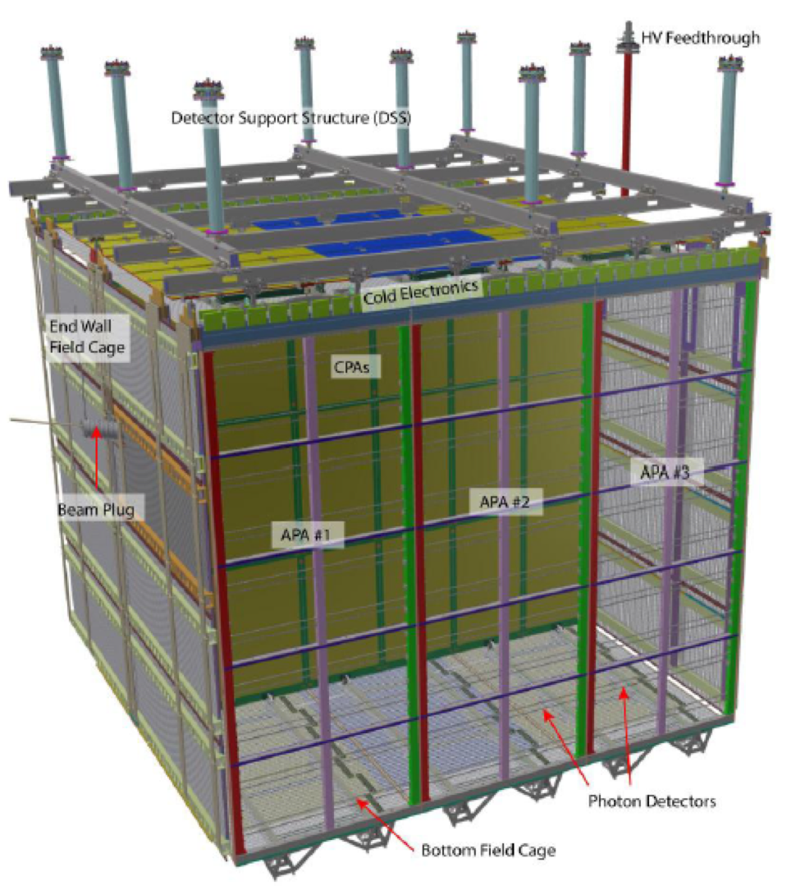
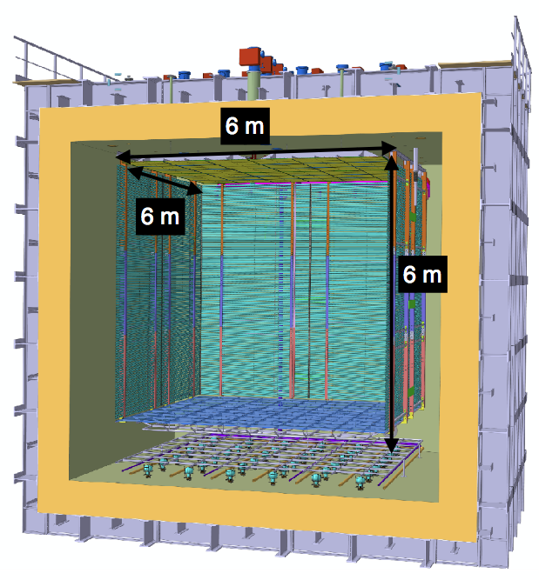
ProtoDUNE(s)
About ~1/20 of a DUNE module
Single Phase
Dual Phase
Active volume 6.9 x 7.2 x 6 m³
Active volume 6 x 6 x 6 m³

Slide 11
ProtoDUNE Goals
Detectors use full scale elements designed for DUNE → test of FD engineering solutions and installation procedures
Single-phase and dual-phase design → validation of technology, detector response and long-term stability
Two low-energy beam lines → characterization of LArTPC response to charged particles in the same energy range (1 – 7 GeV) as neutrino interactions in DUNE
International Collaboration → building the community and forming expertise for DUNE

Slide 12
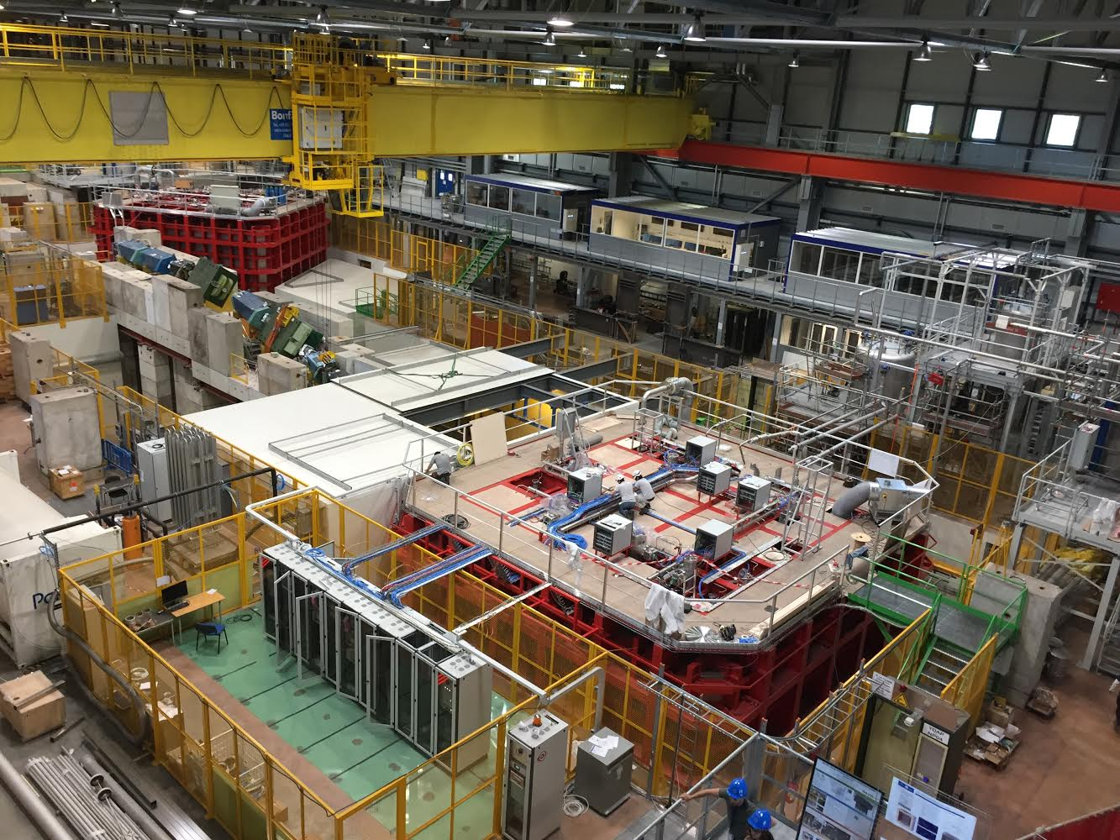

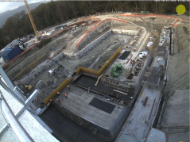
CERN Neutrino Platform
Dec 2015

Slide 13
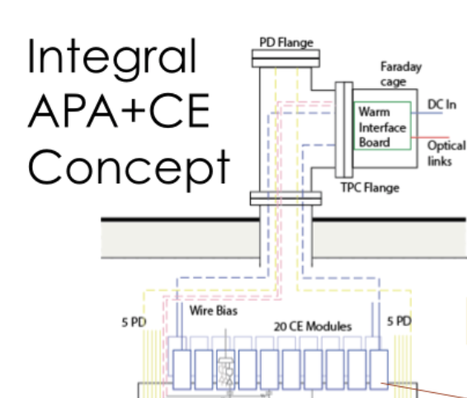
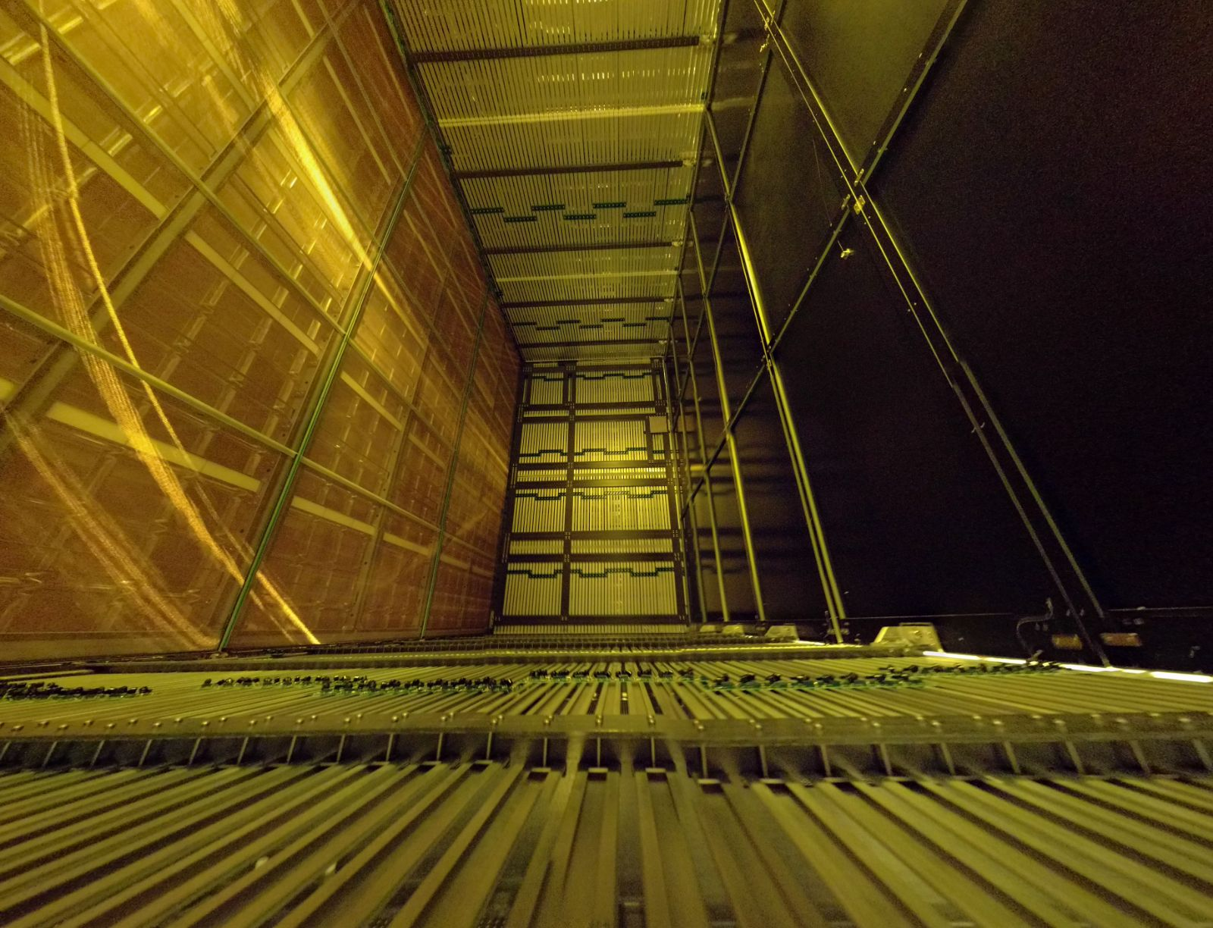
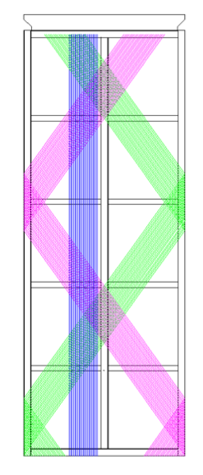
APAs in ProtoDUNE
6m

Slide 14
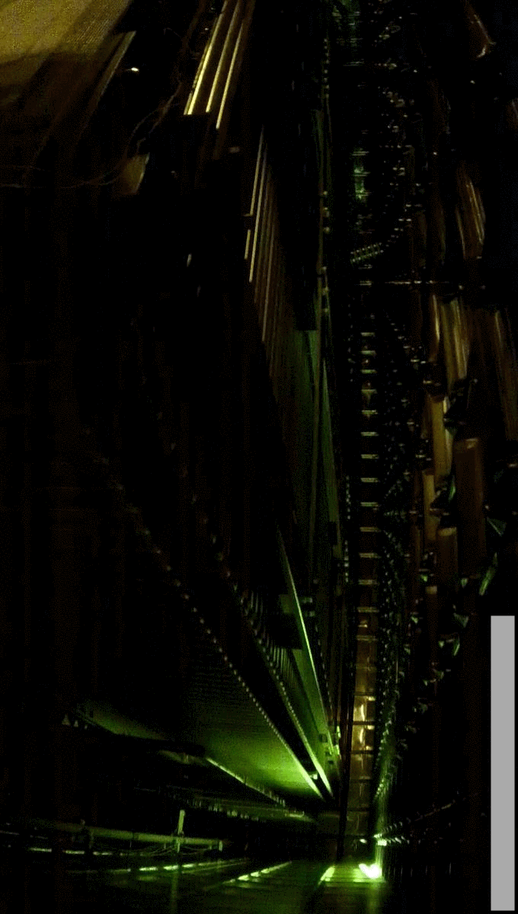
Cryogenics
Purging, cooling, and filling
July 15 – September 13, 2018
Maximum temperature gradient of 50K
770 tons of liquid argon (about 40 trucks)

Slide 15
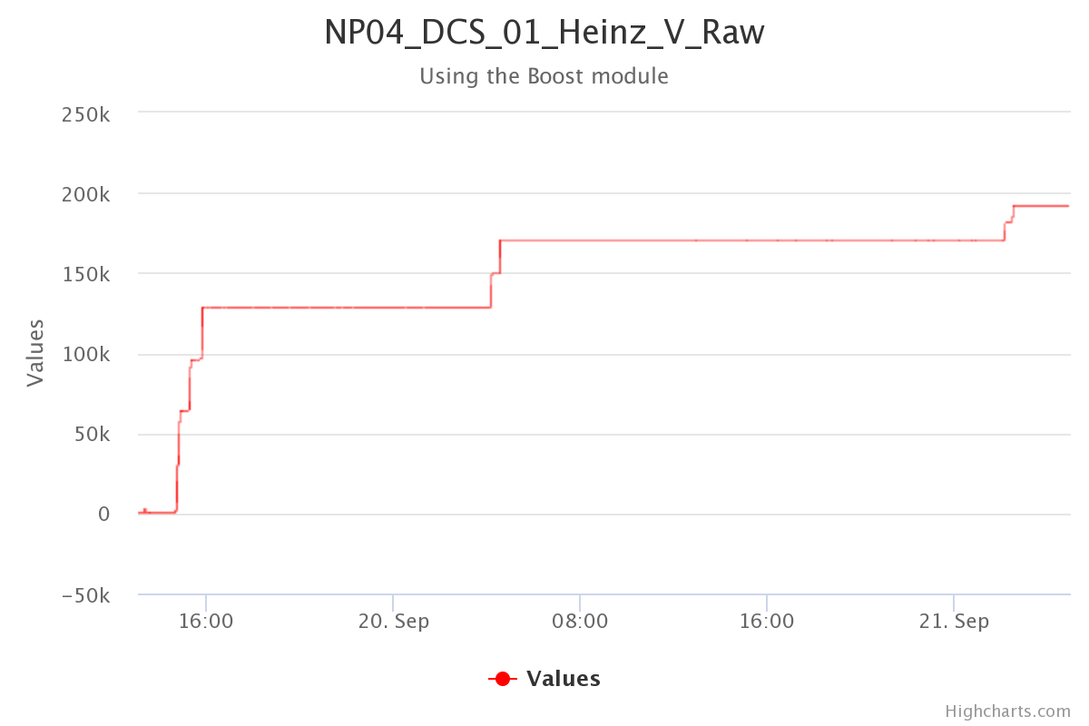
High Voltage
Sept. 21 - h. 2:32 am - CDT
nominal
El.Field
500 V/cm
180 kV
HV Ramp from 0 to 180 kV (Nominal)

Slide 16
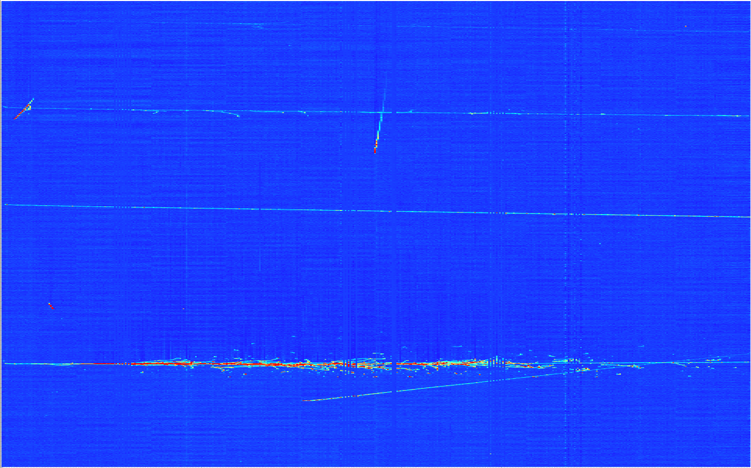

Halo Muon with EM Shower
proto
SP

Slide 17
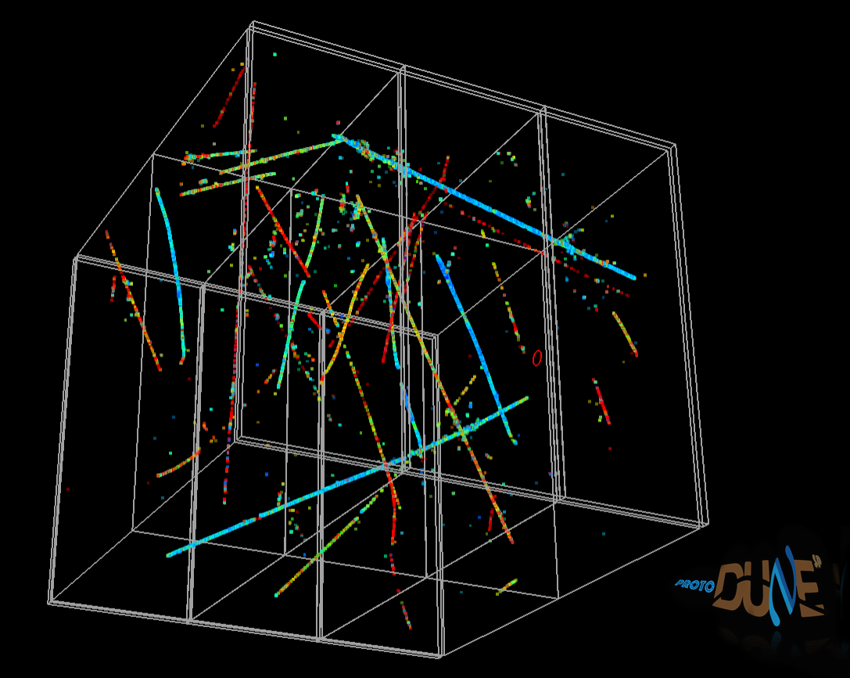
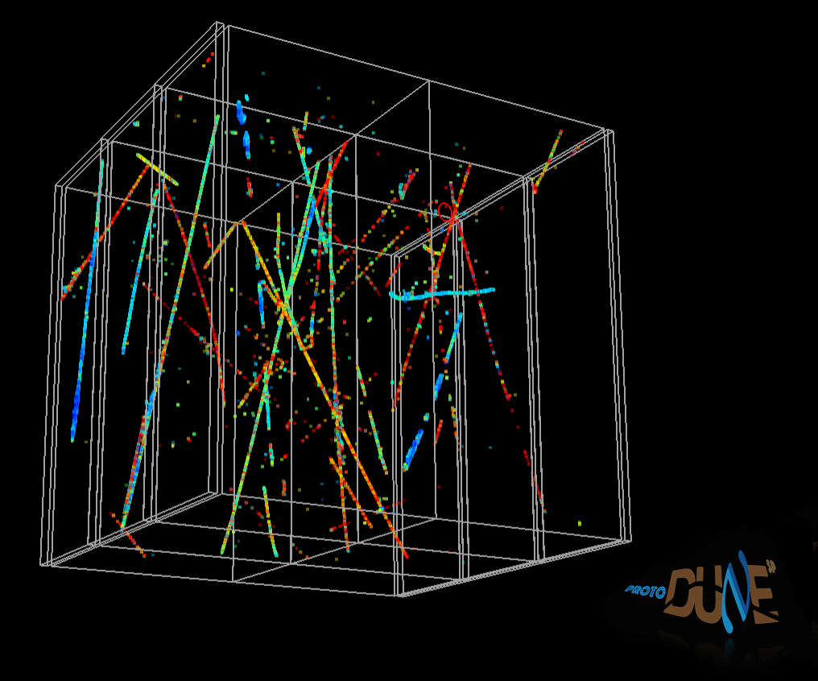
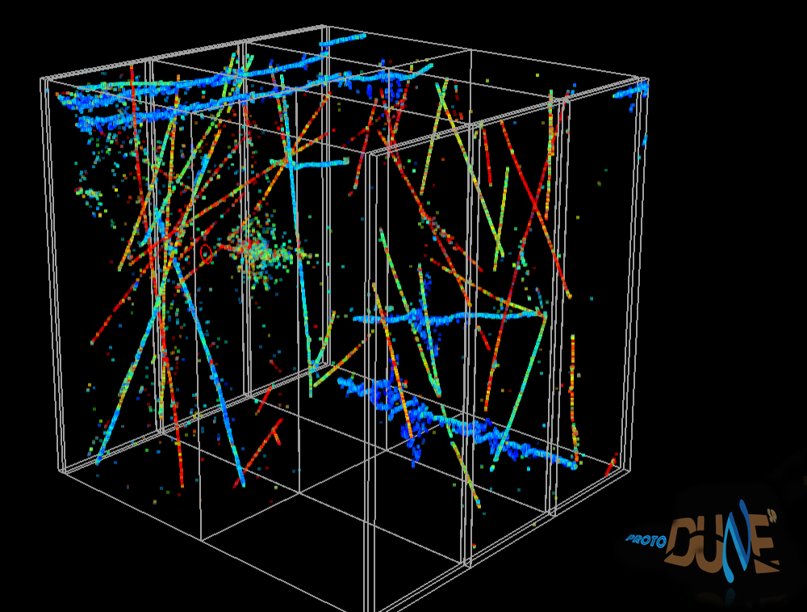
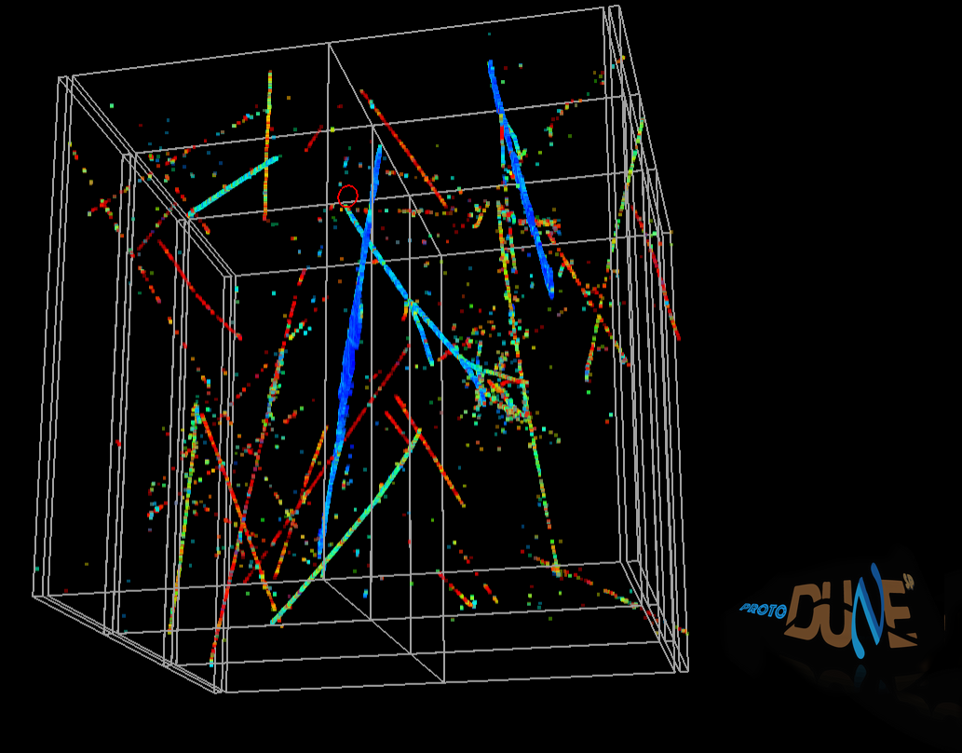
3D Cosmic Events

Slide 18
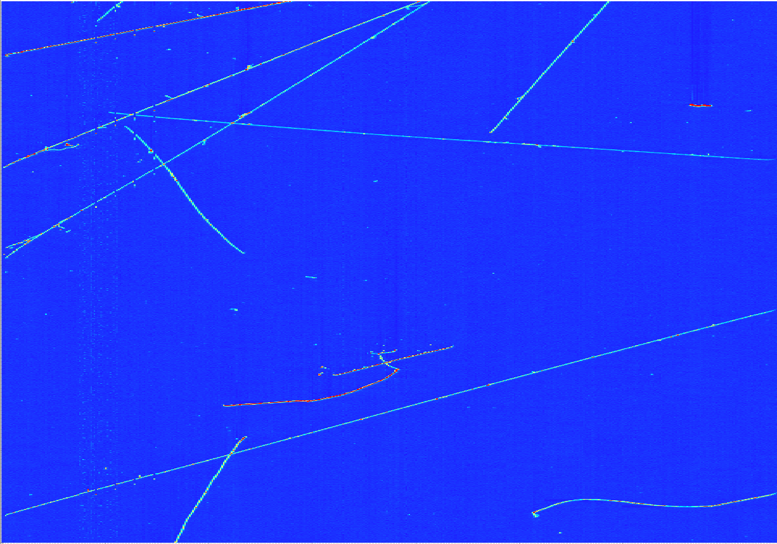
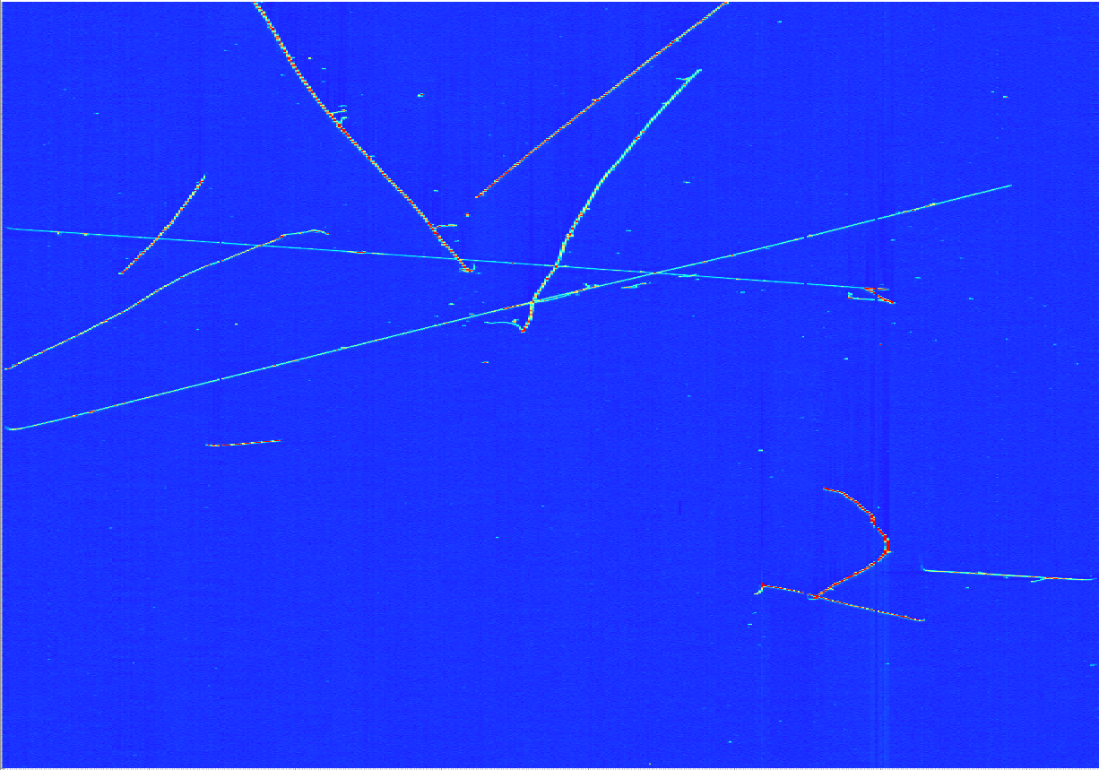
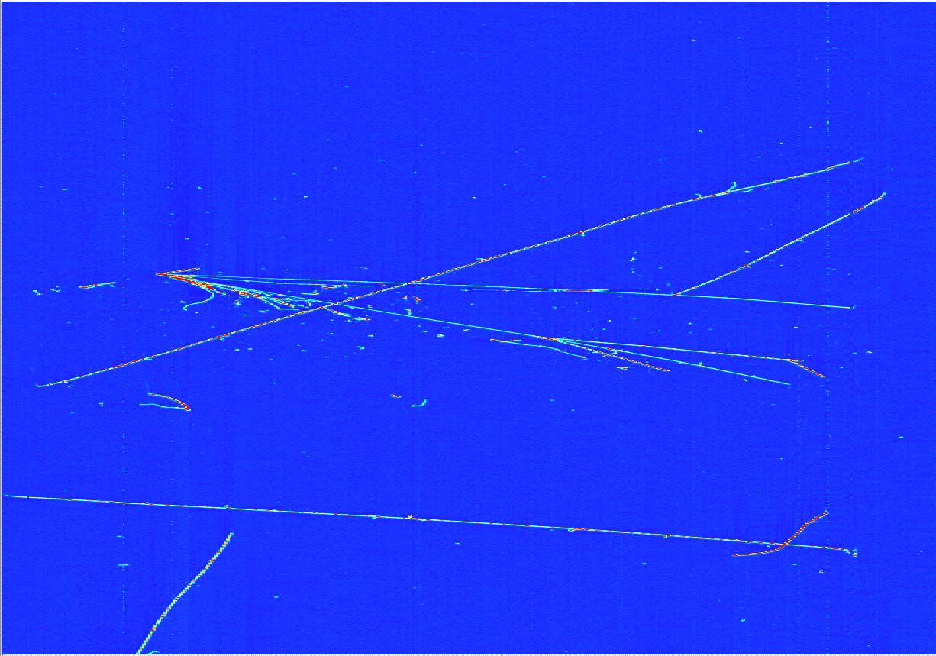
7 GeV Beam Pion
proto
SP
7 meters

Slide 19
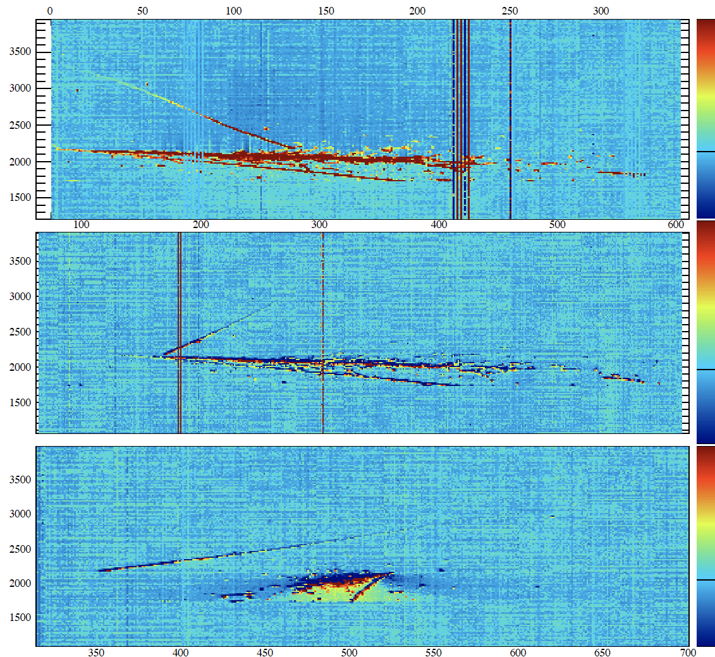
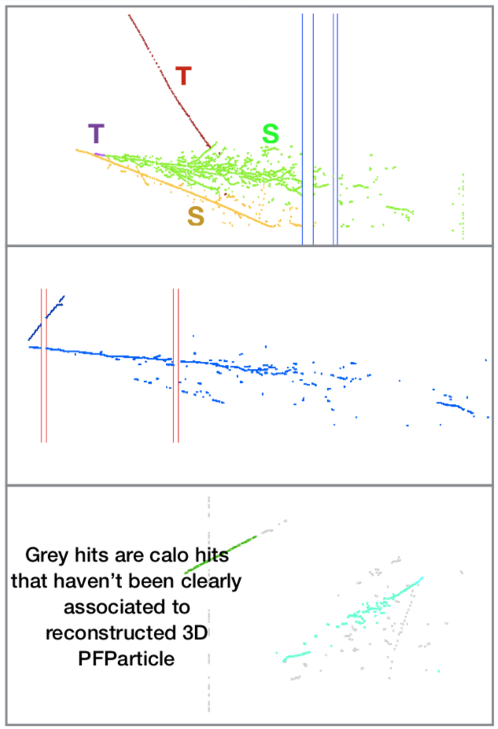


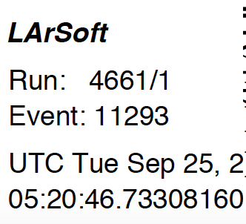
Collection plane
=Shower
=Track
topology looks consistent with 𝜋⁰ ➝𝛾𝛾
PANDORA Reconstruction
Alternative techniques use deep learning and convolutional neural network

Slide 20
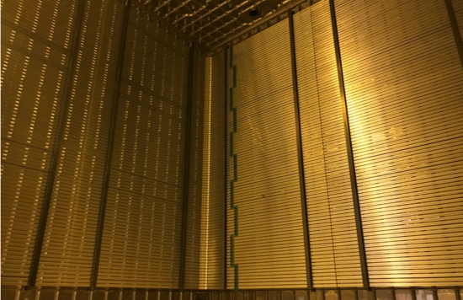
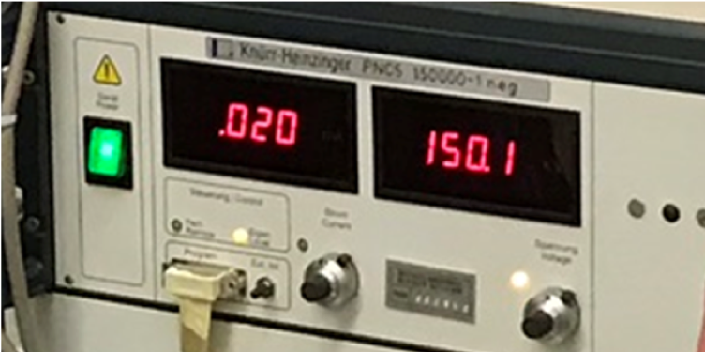
ProtoDUNE Dual Phase
Holding 150 kV
Successful cold box tests for CRP
Expect first data in March/April 2018
CRP Construction

Slide 21
Near Detector
Constrain systematic uncertainties for long-baseline oscillation analysis (large effect on exposure required!).
Determine flux, cross sections, and detector systematics (transfer matrix)

Slide 22
DUNE Near Detector
Constrain systematic uncertainties for long-baseline oscillation analysis
  flux, cross-section, and detector
In addition, >100 million interactions will also enable a rich non-oscillation physics programme
DUNE ND design concept is an integrated system composed of multiple detectors:
  Highly segmented Liquid-argon TPC (ArgonCube)
  Magnetized multi-purpose tracker (High Pressure Gas TPC)
  3D Scintillator Technology (3DST)
  Electromagnetic calorimeter/Muon Chambers
  Newly built magnet
Preserve option to move detector sideways (PRISM)

Slide 23
DUNE Near Detector
DUNE ND Recommendation approved by EB
  Formed new Near Detector Design Group (NDDG) to implement Recommendation and produce first design for CDR
  Conveners: Alan Bross (FNAL), Alfons Weber (Oxford/RAL), Hiro Tanaka (SLAC)
  ND Conceptual Design Report (CDR) planned for 2019
  Editors: Steven Manly (Rochester), Mike Kordosky (William & Mary)
Lots of room to increase international participation in the future.

Slide 24
Near Detector: LArTPC Concept
High ND rate requires different TPC design from FD
Segmented, optically isolated drift regions
0.5 m drift (versus the multimeter drift of FD)
Pixelated readout, low power electronics
Continuous resistive plane field shaping
ND studies done with 4x3x5 m³ TPC:
Gives 3x2x3m³ fiducial volume
Expect 37M CC ν_{μ} interactions/yr

Slide 25
High pressure gaseous Ar TPC
Copy ALICE TPC (no inner cylinder)
Repurpose readout chambers (2019)
Fill the central hole with new chamber
New front end electronics
Run with 10 atm mix Ar-CH₄ (90%-10%)
Surround TPC with high-performance ECAL
Collider track reconstruction not so great for DUNE use. New software, GArSOFT, to be used.
Investigating use of hydrogen
At 10 Atm, ~80k CC ν_{μ} events/year

Slide 26
EM Calorimetry for TPC
ECAL used for timing (t₀) for reconstruction
ECAL used for π⁰ (photon) reconstruction
Exploring neutron detection/association performance
Software studies beginning

Slide 27
Magnet
Inside coils: TPC + ECAL + pressure vessel, maybe 3DST
Instrumented steel to help with muon-pion separation and/or deeper calorimetry
Three superconducting coil concept with two kicker coils to minimize flux bleed.
UA1-like warm dipole
Getting serious now that ND concept adopted
Conventional warm “UA1-like” design
  Rectangular volume not optimal for cylindrical TPC
  Power and cooling significant ongoing cost
Superconducting designs being considered
Desire to minimize material between LAr and GArTPC

Slide 28
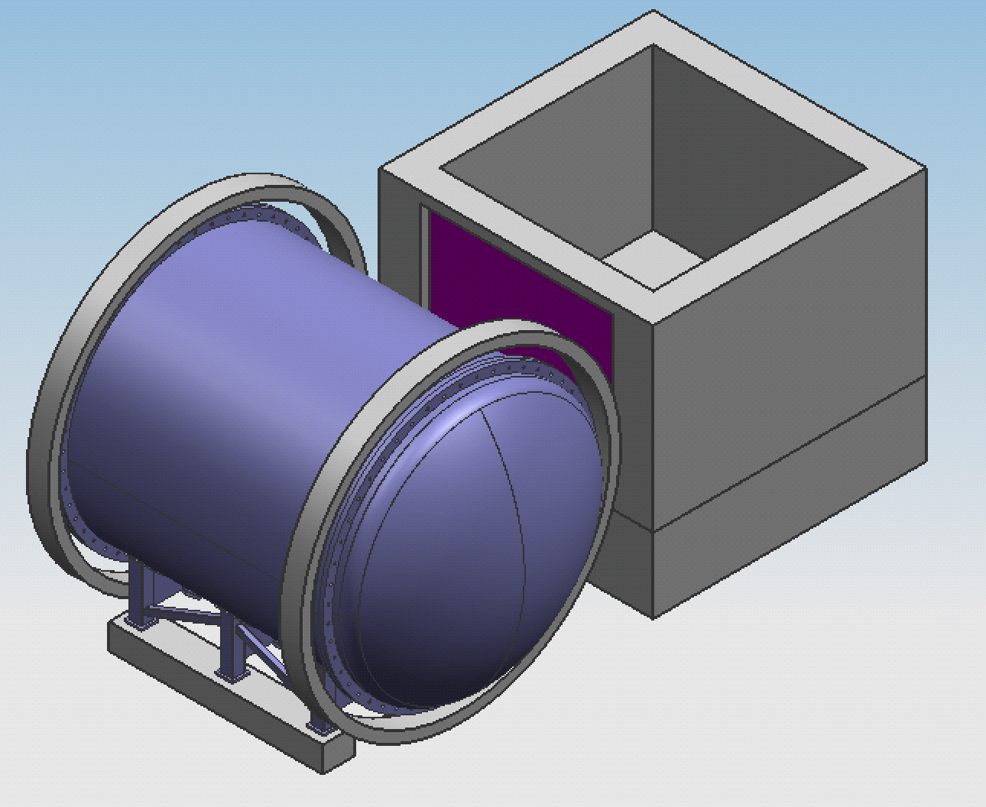
Conceptual layout: LAr+HPgTPC
ν
SC coil option
Steel and muon tag system to be determined.

Slide 29
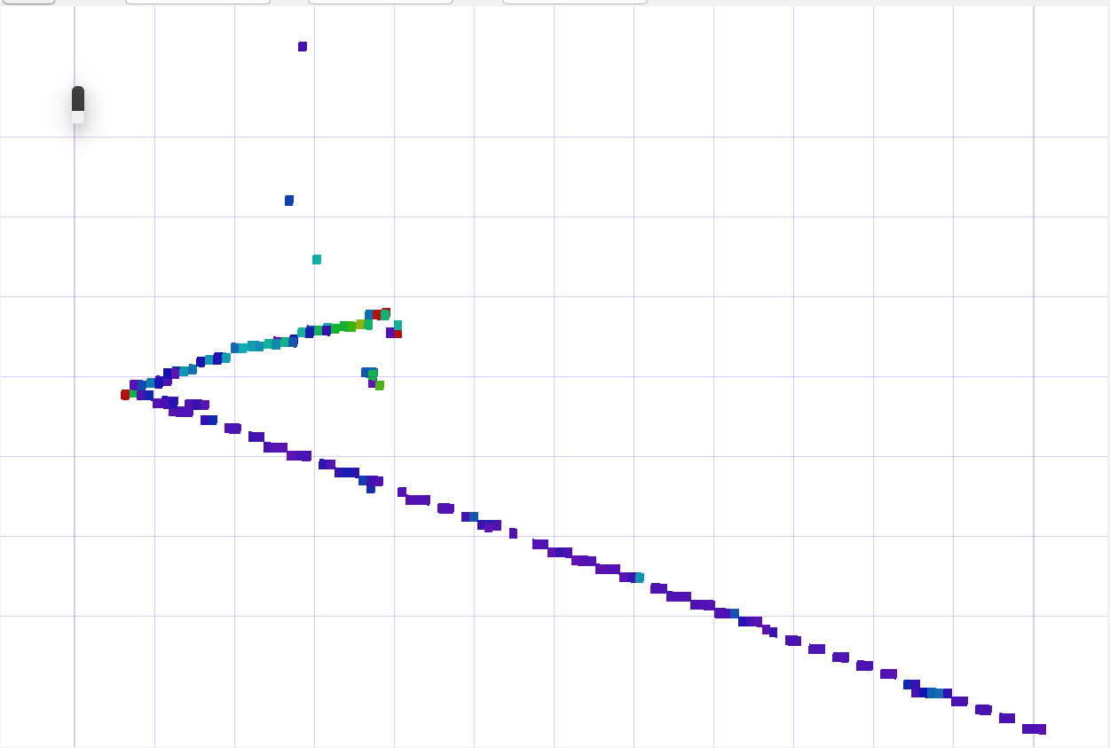
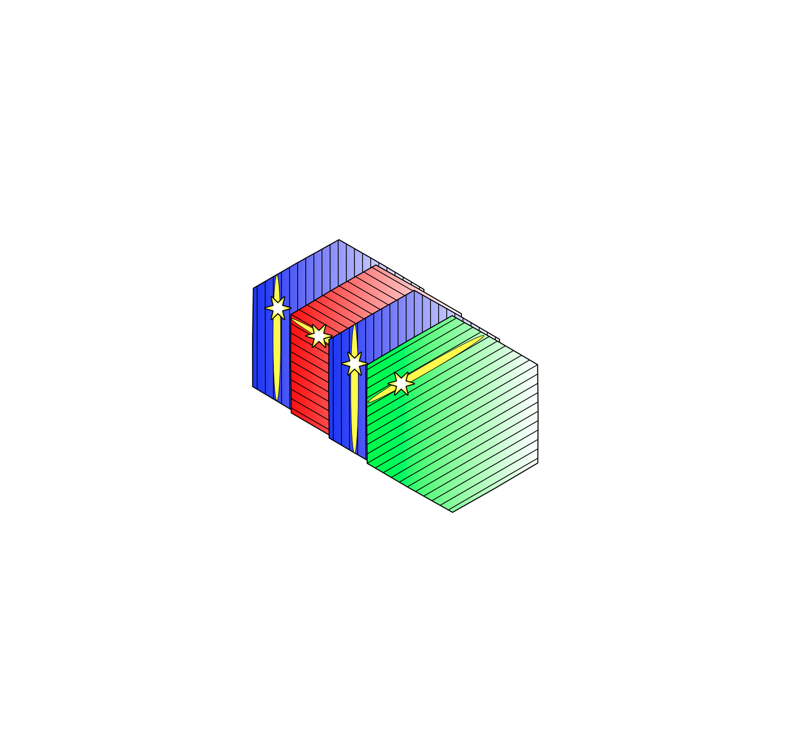
3D Scintillator Tracker
Use 1cm cubes with WLS fiber along three (2 under study) orthogonal dimensions
  Avoids performance drop at 90º typical of planar geometries
Design functionally identical to T2K’s ND280 upgrade SuperFGD detector
Size and integration with the rest of ND under study
  Inside pressure vessel of HPgTPC
  In own magnet with muon spectrometer and stays on axis when other parts move off axis
  Other?

Slide 30
The DUNE Prism Concept
Capability to move ND for off-axis measurements (DUNE-Prism)
Allows to resolve degeneracies between energy dependent physics effects (CP violation) and detector systematics.

Slide 31
Evolving NDDG Organization

Slide 32
Muon System(s)
There is a need for an external muon system for the magnetic detector, since dE/dx cannot discriminate between π and μ in the HPgTPC over the full momentum range.
An external muon system may also be needed for the LAr detector depending on whether or not the detector moves off-axis with the LAr.
We hope to benefit from Indian groups long history with muon detectors in the ICAL at INO.
In addition, work at other DUNE institutions, BNL in particular, would present an excellent opportunity for collaboration and possible technological extensions in this area
    Cathode strip detectors
    Integrated (ASIC) readout

Slide 33
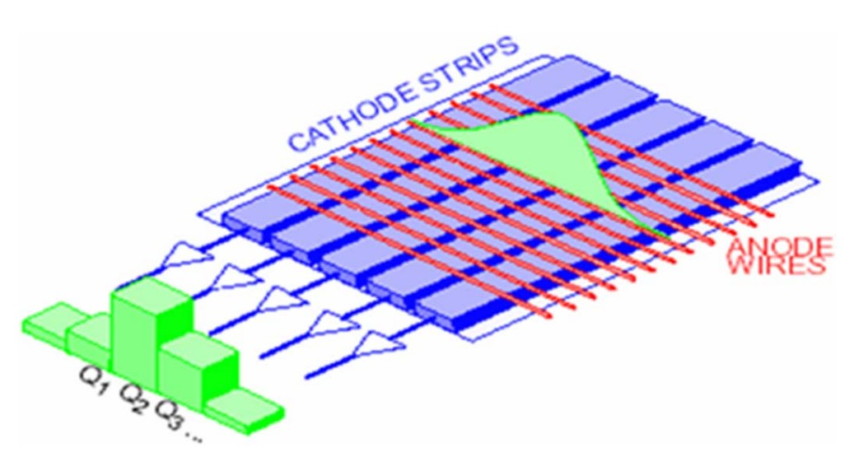
Muon system technology
e.g., Cathode Strip Chamber (CSC)
Choice of technology not defined yet

Slide 34
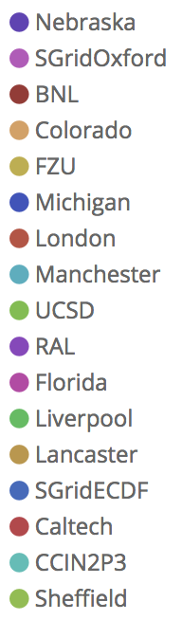
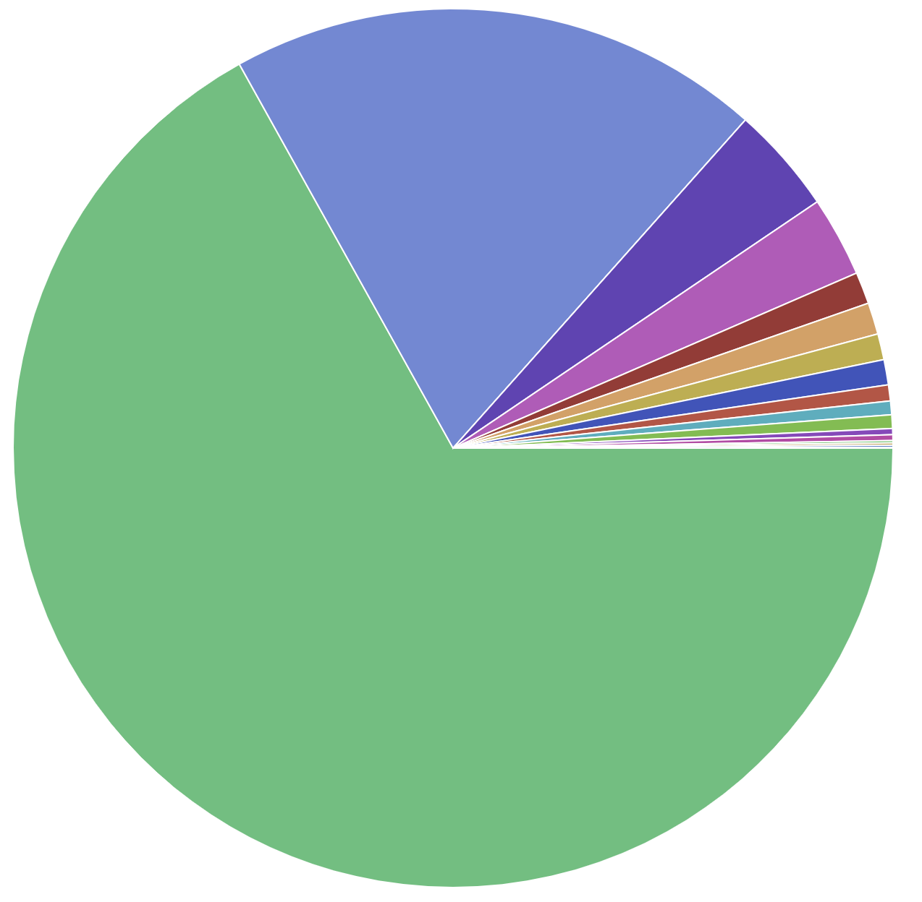
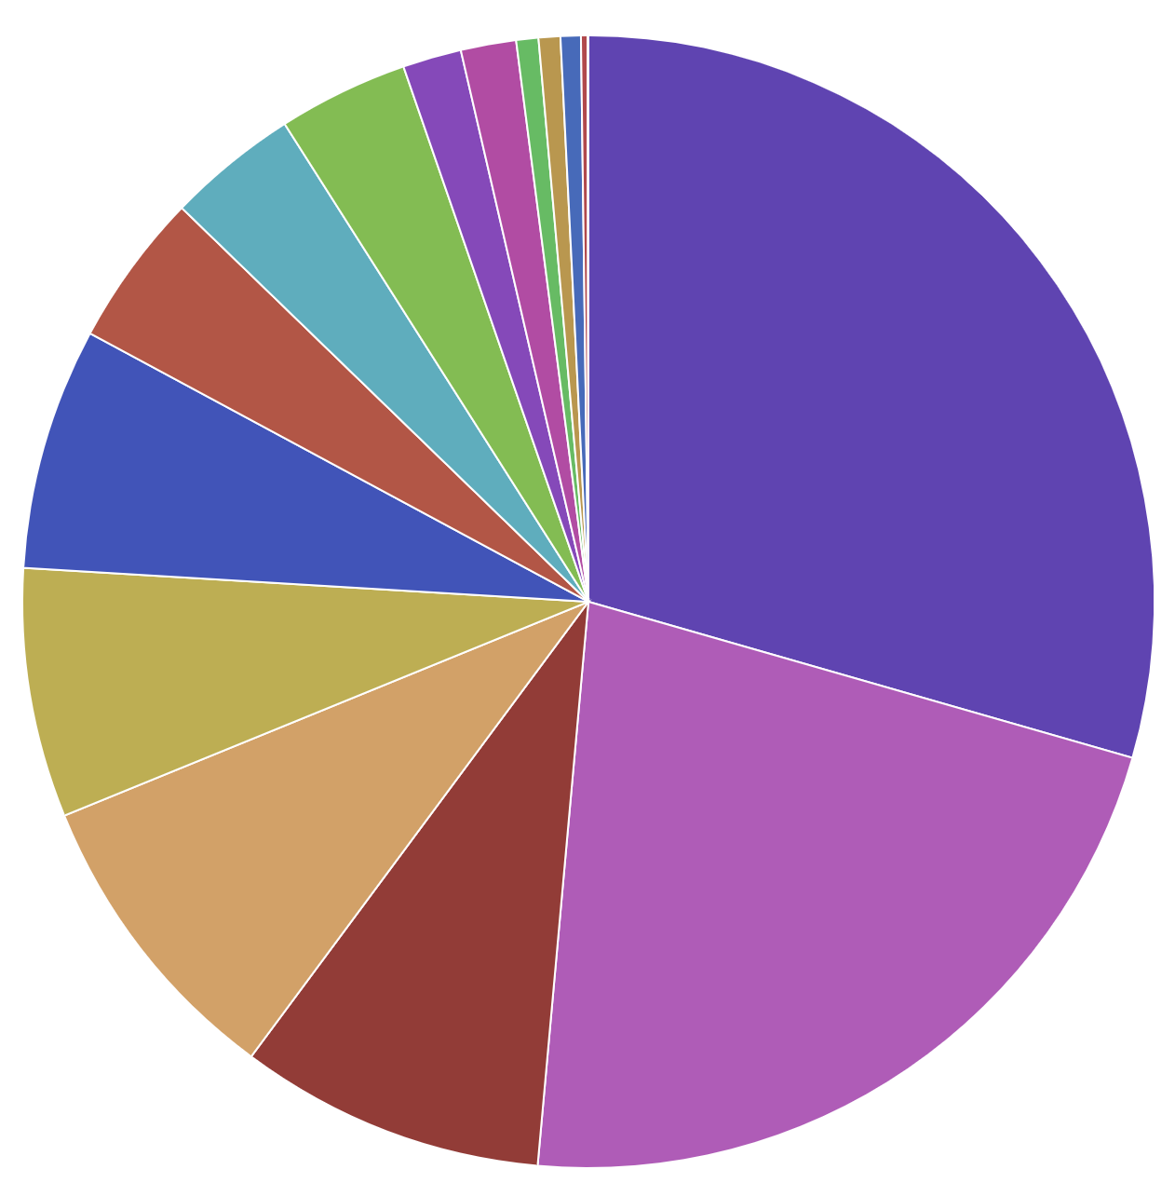
Computing
Development of DUNE computing model following example of LHC grid organization.
Relevant for both FD and ND.
Recently formed Computing Consortium.

Slide 35
Areas for Collaboration
Muon system
Magnet system
DUNE-PRISM
  Mechanical engineering, transport structure, motion control
Software development and Computing (both ND and FD)
…….
Final remark: we are a truly global project and the organization of the Collaboration is optimized to allow international participation.

