Slide 1

Energy Deposition in ECAL of DUNE
Baba V K S Potukuchi

Slide 2
Experimental HEP
Streamer Chamber (SLAC )
BEBC (CERN)
E632 (USA)
L3 (CERN)
5. WA98 (CERN)
6. STAR (BNL, USA)
7. ALICE (CERN)
8. CBM (GSI)
9. NOVA (Fermilab)
Want to be in DUNE.

Slide 3
Physics & Detector
simulations
For any Detector simulation
we need to understand first
what type of particles are produced and
what are their energies.
This from M.Cs like GENIE etc.

Slide 4
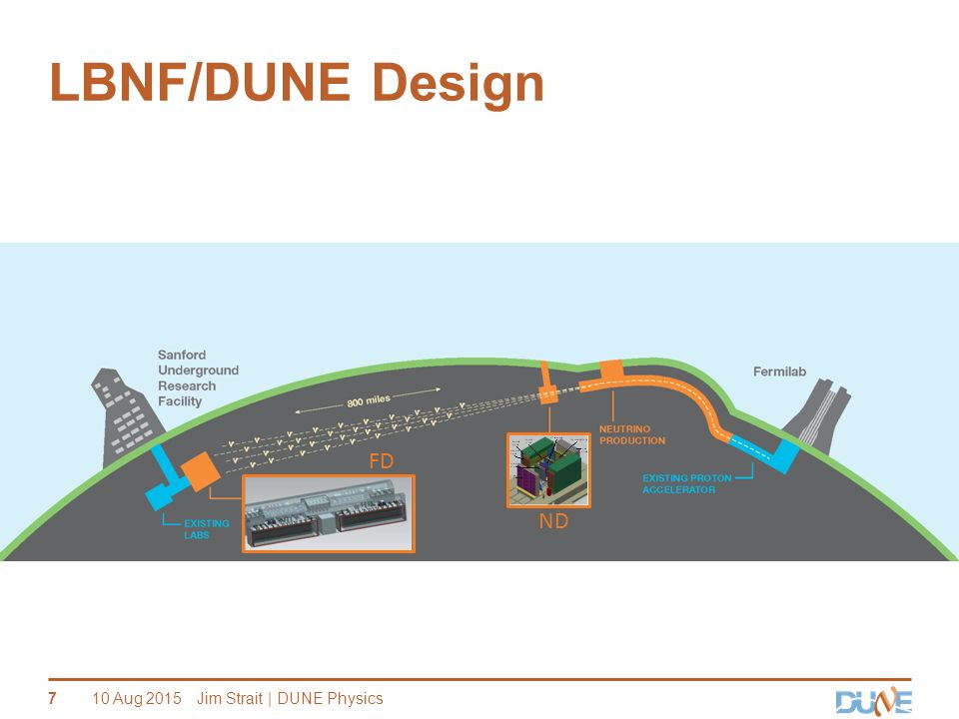

Slide 5
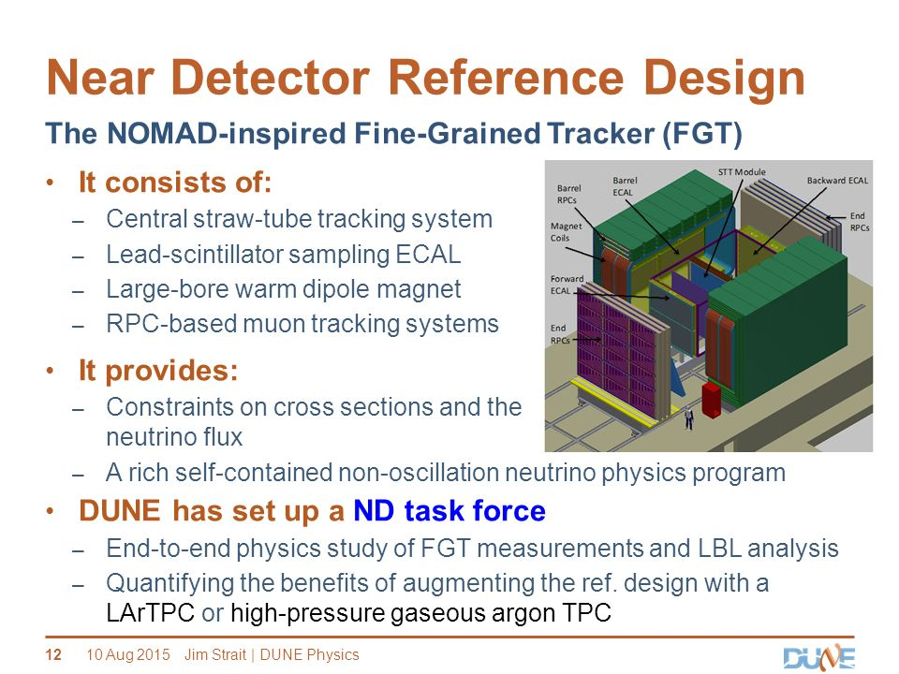

Slide 6
EM Calorimeter (ECAL)
After Discussion with Bipul Bhuyan & others
I have taken some ECAL dimensions
and started GEANT Simulations of ECAL
WITH PHOTONS as PARTICLES TO BE
DETECTED. ( ECAL can detect also e- and e+ and some low energy hadrons which also can deposit a small energy in ECAL )

Slide 7
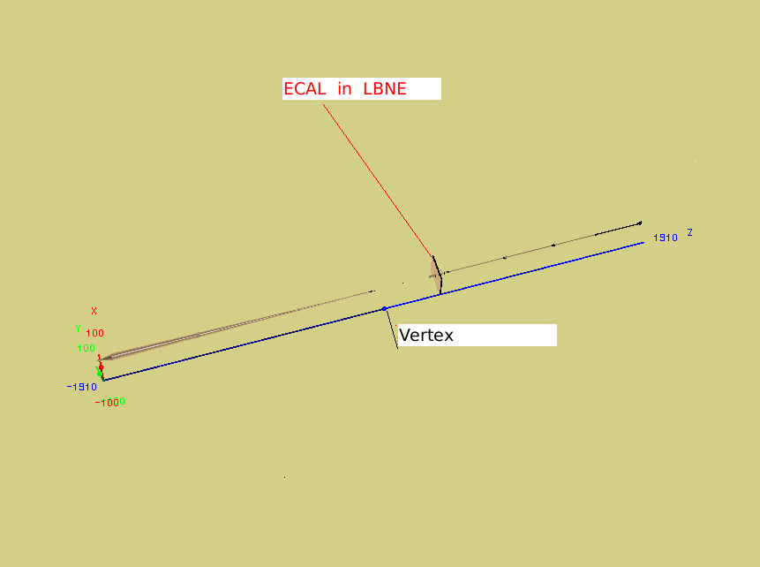
ECAL in Standalone framework

Slide 8
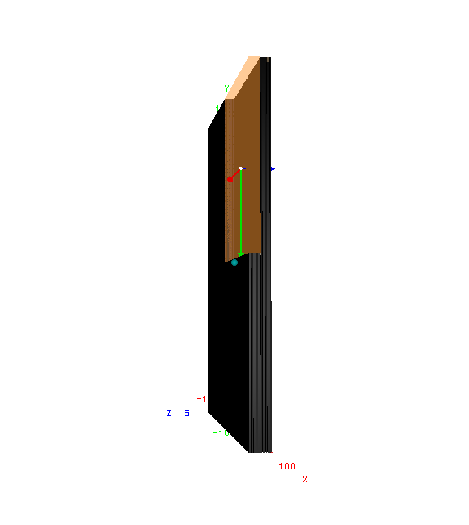
ECAL in 10 Layers
Each Layer Consists of
thicknesses
Pb Absorber ( .175 cm )
Scintillator ( 1.0 cm )

Slide 9
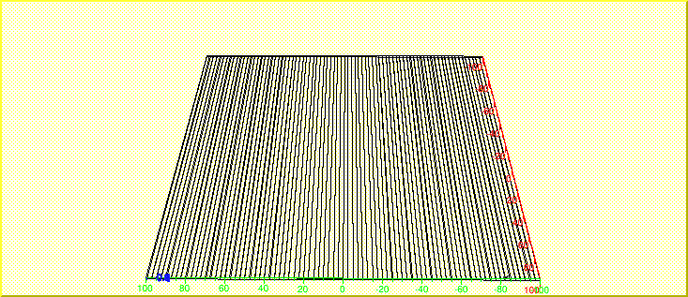
There are 80 Vertical
Strips of Scintillator in
each X-Type Module
Length 200 cm
Width 2.5 cm

Slide 10
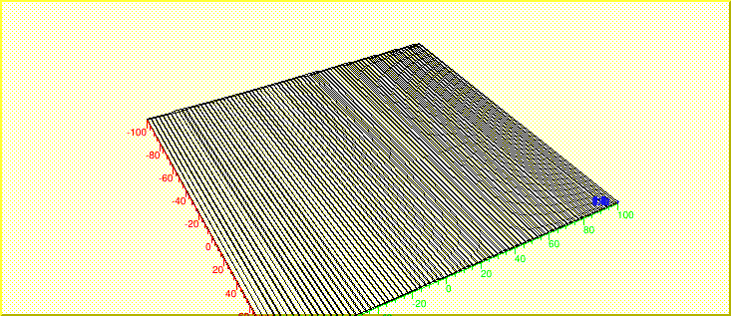
And also There are 80 Horizontal
Strips of Scintillator in
each Y-Type Module
Length 200 cm
Width 2.5 cm

Slide 11
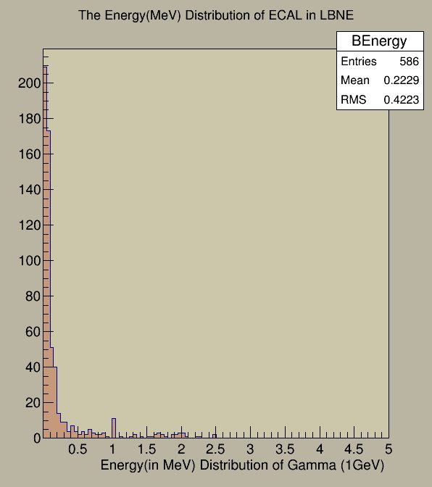
Energy Deposition of 1 GeV Gamma in ECAL

Slide 12
Results & Conclusions
The Gamma is putting very small fraction of Energy .
We need to increase the Dimensions of ECAL Absorber
and Scintillator (if required)
From MC , we know , what energy Gammas are expected
to be produced. Accordingly, we can tune the Detector
dimensions.
We have now got complete detector code (including
STT & Mag.Field and RPCs ) available, we have already
started doing simulations , using that code.

Slide 13
Thank You

Slide 14


Now ?????

