Slide 1
Recent technological developments at Electronics Division, BARC and possible contribution for DUNE
Anita Behere,
Head, Electronics Division,
BARC

Slide 2
Recent completed development activities of ED
Electronics for imaging camera for MACE (Major Atmospheric Cherenkov Experiments) telescope
Supervisory control and operator console Software for MACE telescope
Trigger System and Backend DAQ software for mini ICAL

Slide 3
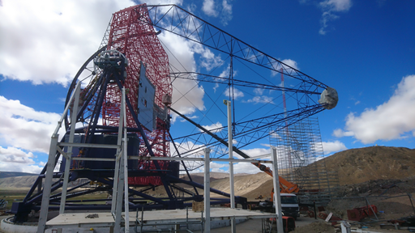
Major Atmospheric Cherenkov Experiment (MACE) is a very high energy gamma ray telescope designed to operate in the energy range 20 GeV – few TeV.
Location: Hanle, Ladakh, India
Energy Range: 20 GeV – 5 TeV
Light Collector: 21m diameter
Mirror Facets: 356 panels
No. of PMT: 1088
Event Rate: 1 kHz
Camera Weight: 1200kg
Notes:
MACE telescope is the largest gamma ray telescope in the northern hemisphere and the second largest in the world.

Slide 4
Imaging camera for MACE telescope
Key technologies:
  Camera mount
  Full custom
  Local HV
  Wideband signals
  High speed sampling
  Pattern based trigger
  FPGA based event processing
  Diagnostics

Slide 5
Dynamic Range of 20 GeV – few TeV => 3-2000 pe with dual gain channels
operating threshold =>3-5 pe, programmable
Trigger cluster definition programmable – coincidence window of 5ns
HV generation within camera close to PMTs: Programmable HV for uniform gain for PMTs
Digitizing PMT signal profile at 1 GSPS and charge computation
Event acquisition at rate of 1KEvents/s with Time stamping with 1us accuracy
Ensuring safe operating conditions for PMTs in view of exposure to excessive incident light
Control and monitoring of camera to ensure stable operating conditions
Event dead time of ~ 50 uS
Sustained data throughput 14 Mbytes/Sec

Slide 6

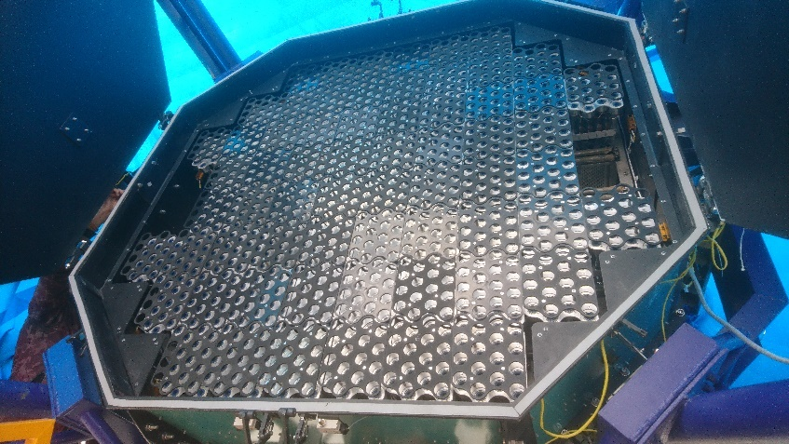
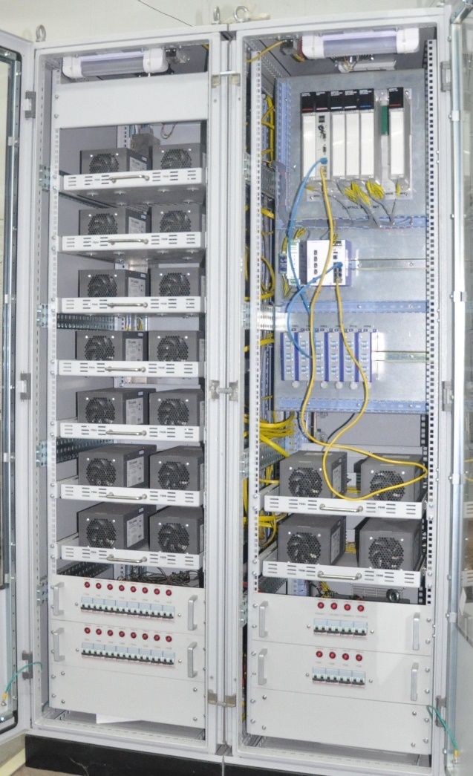
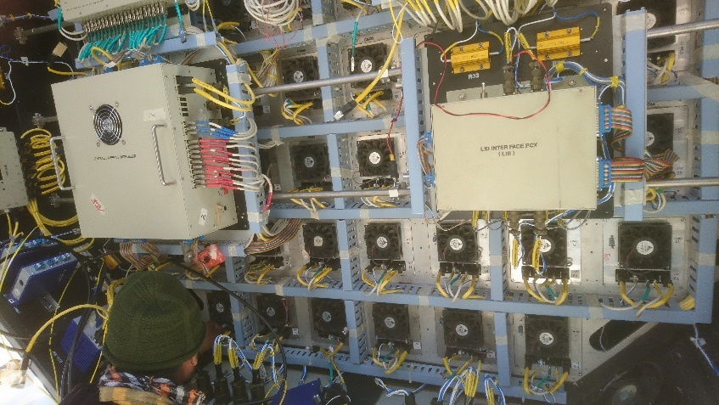
Front view
64 CIMs assembled
Rear view

Slide 7
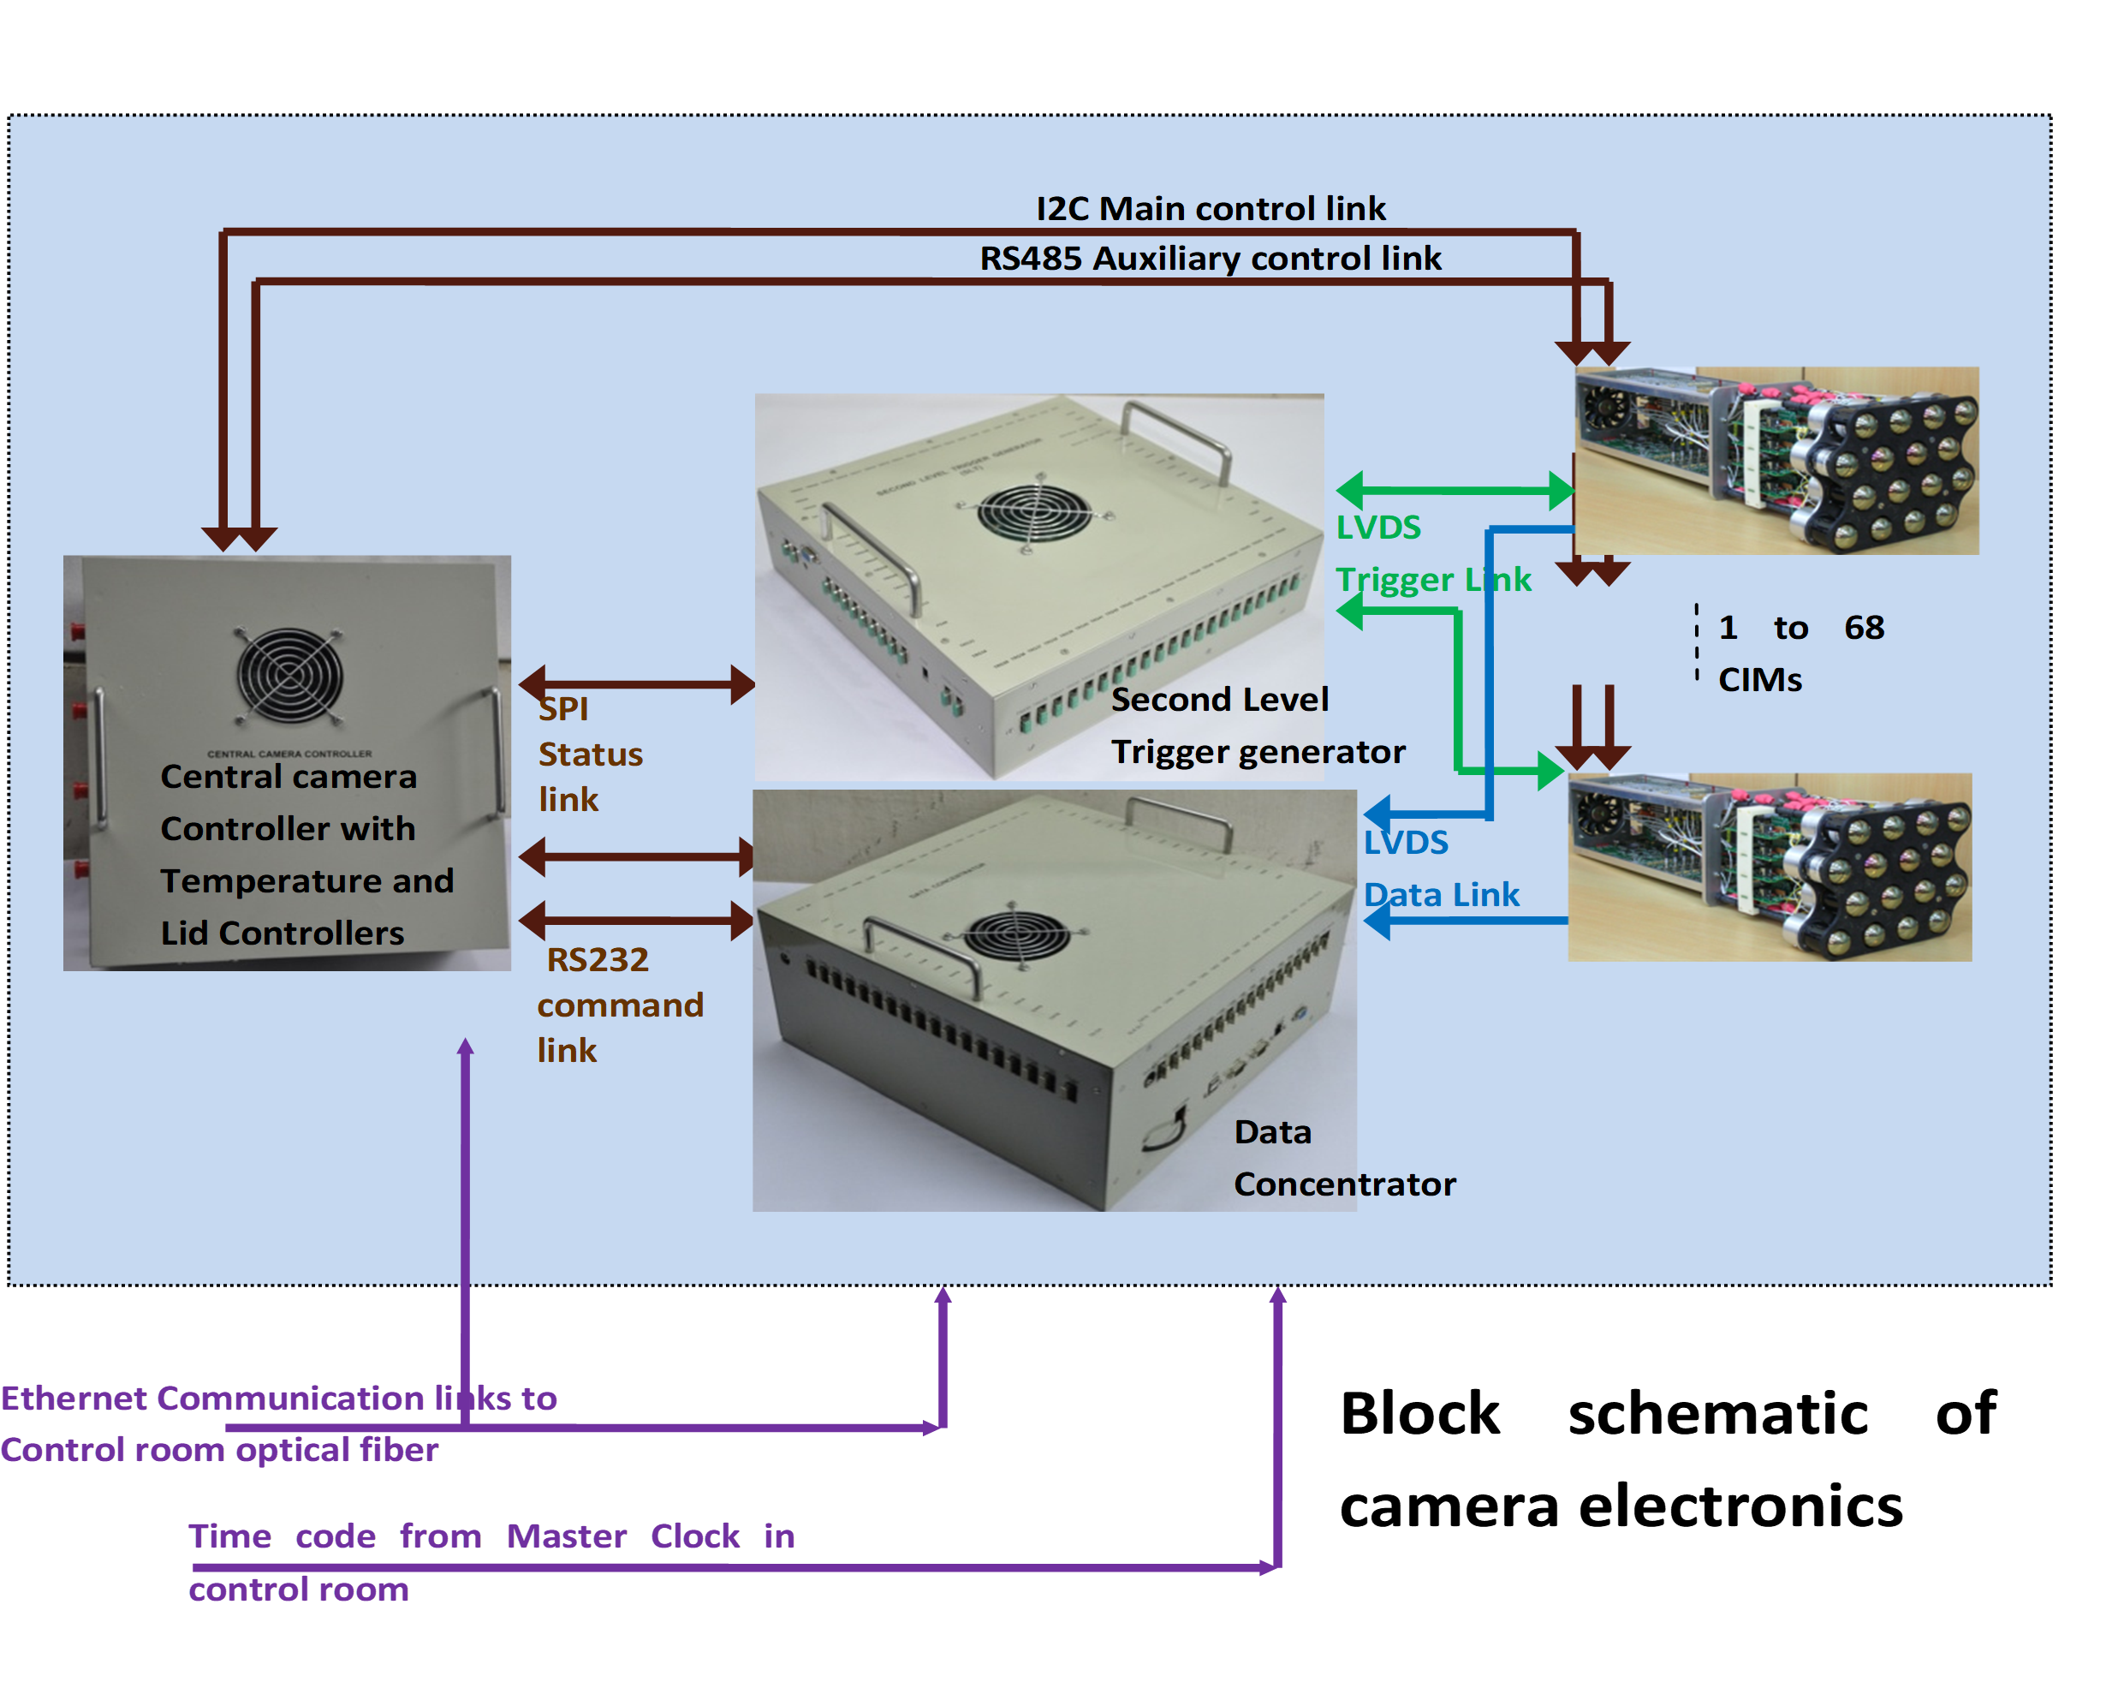

Slide 8
Quality Assurance plan during prototype and production phases- ECIL
Environmental Qualification during prototype, at 4200 m altitude power off condition.
1) Cold Test for survival and operating condition as as per IEC 60068-2
2) Dry heat Test
3) Sinusoidal Vibration Test Fc as per IEC 60068-2
ESS (During Production)
1) Thermal shock on assembled PCBs using automatic change over chamber
2) Thermal cycling on assembled PCBs and modules.
3) Random vibration of Modules

Slide 9
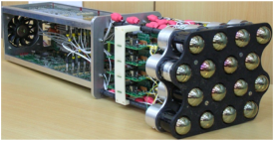
The 16 channel Camera Integrated Module (CIM)
68 nos. = 1088 channels

Slide 10
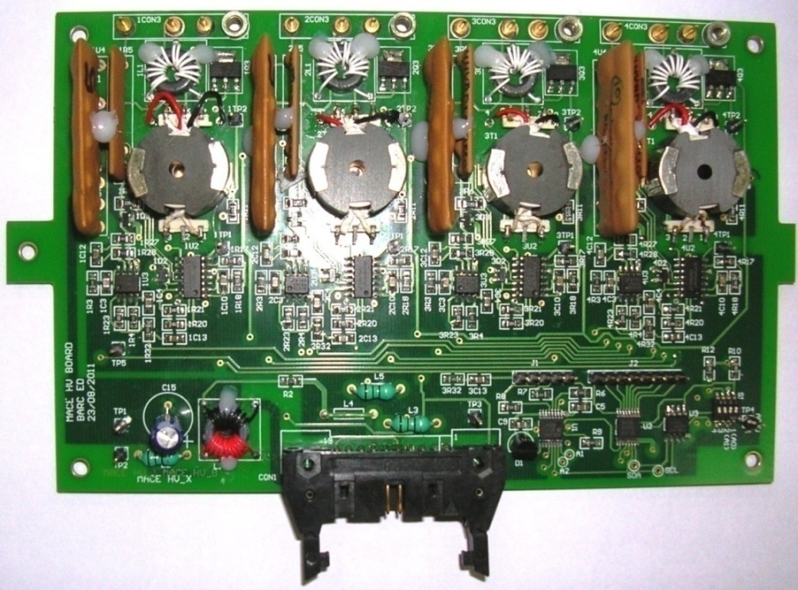
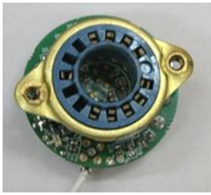
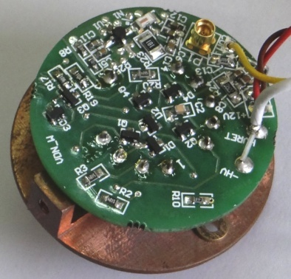
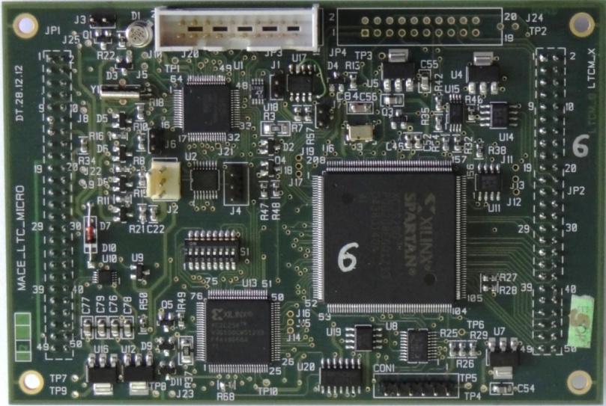
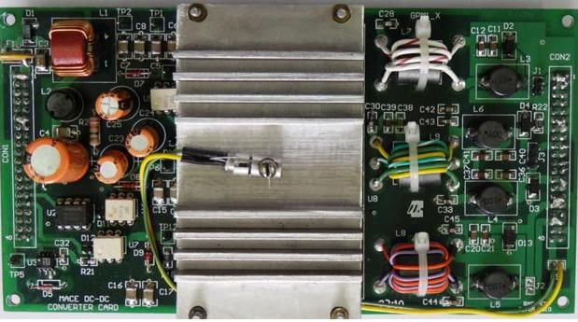
Photographs of PCBS in CIM
PA VDN Assembly
Quad HV PCB
LTC_Micro board
DC-DC Power Converter Board.

Slide 11
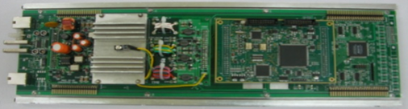
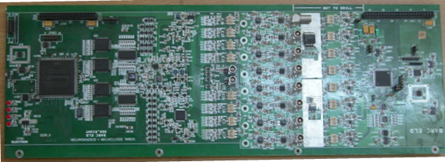
Photographs of PCBS in CIM
LTC_BASE with add-on boards DC-DC and Local controller LTC_Micro
SDD board

Slide 12
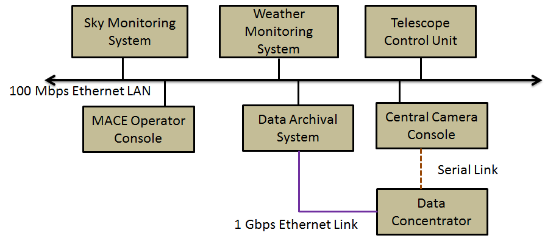
MACE Telescope – software development
Major Subsystems of MACE Telescope

Slide 13
Operator Console
Complete control and monitoring of experiment from local or remote
Scalable Architecture
    Additional subsystem
    Increased Throughput
  Redundant & fault tolerant s/w
  State based Interlocks
Auto-Schedule Generation
Auto-Operation based on schedule
Multiple OCs for display
3D Visualization
Periodic Status
Alarm Display and Logging
Fault management
Remote management

Slide 14
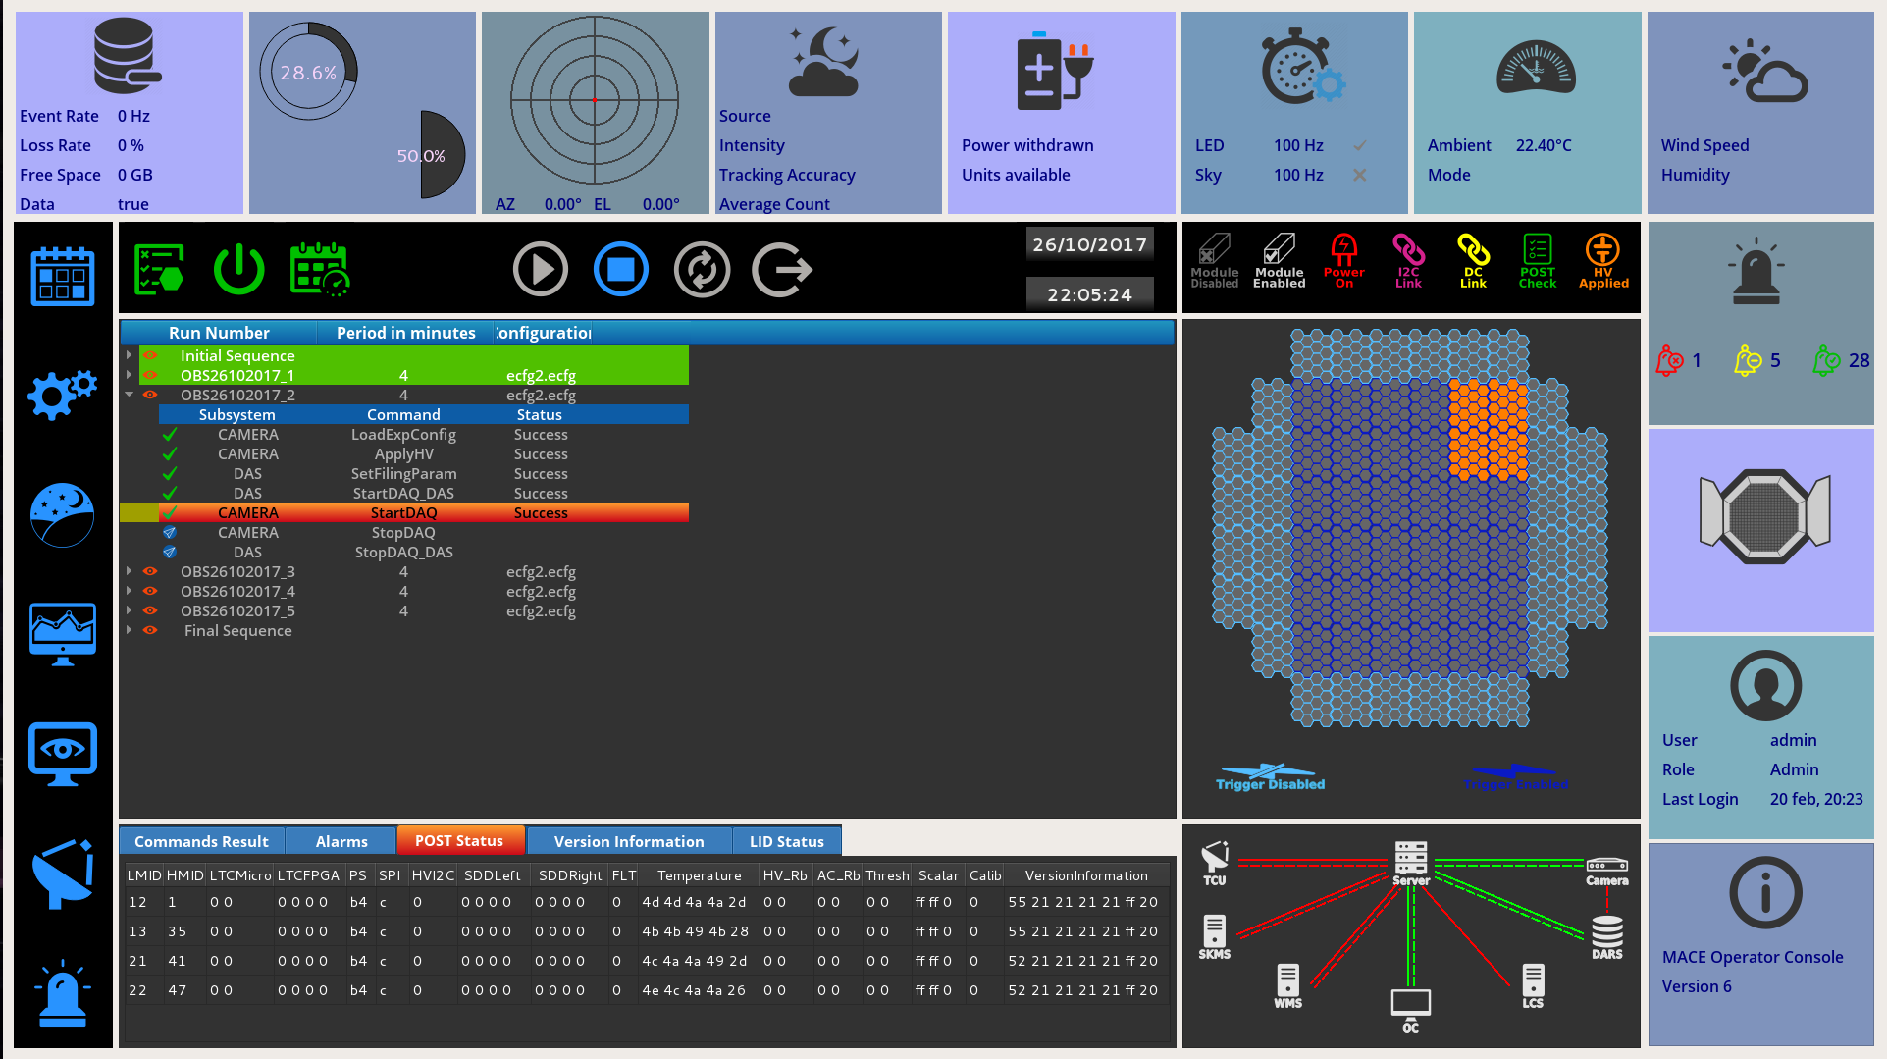
Notes:
Integrated Operator Console with multiple displays which launches with a splash screen where user can login providing credentials.
Solid and Dash line for control and data connection

Slide 15
Pre-Observation support
Prepare a schedule – Scheduler
Prepare system and experimental configuration – Configuration Manager
Selection of mode – MACE Operator Console
  Observation mode – SKMS, WMS, TCU, LCS, Camera, DARS
  Camera test mode - DARS, Camera
  TCU test mode – TCU
Power on subsystems required for selected mode – MACE Operator Console
Load schedule made for that day for selected mode – MACE Operator Console
Notes:
2)Schedule: Console has the responsibility to provide a utility to make the schedule for the observation. The schedule can be made offline on daily as well as monthly basis. The inputs like the source to be observed, Observation start time, duration and other specific configuration details will be transferred from the OWS should be read by the DACS from a set of files which can be updated as and when required by the operator through configuration utility installed on Operator Console. It is desirable to have scheduler utility sufficiently portable to support operation from remote location
3) The Operator Workstation should provide the facility to generate the sequence of commands required for a each observation run for a given schedule, so that it can be used later for automatic execution of a schedule. It should select the set of commands from a given task list required for execution of given observation run, including the pre/post operations as well as initialization tasks if required.
4) System parameter set‐up: All System Configuration Parameters i.e. Calibration Parameters, Power ON value of the HV, Safe HV Value, Active Modules etc. should be read by the DACS from
a set of files which can be updated as and when required by the operator through configuration utility installed on Operator Console.
5) Experimental Parameter set‐up: All the Experimental Configuration parameters of the telescope like threshold values of the individual discriminator channels, HV values for all channels, trigger logic etc. should be read by the DACS from a set of files which can be updated as and when required by the operator through configuration utility installed on Operator Console.
6) All the operations listed in sequence should be time‐lined, and time required for pre/post operations should be taken care of in order to start the data acquisition for particular observation run at desired Time.
7) System availability check: Operator Workstation has to ensure the availability of the subsystems required for the observation

Slide 16
Scheduler - Generation of schedule
The schedule can be planned for day, lunation, up to a year or any specific period.
The software provides the default source list along with default zenith angle/time/direction range.
During the interval selected for the schedule, the visible sources - Optical, Galatic and Extra Galatic are displayed
Setting Run duration - default value of 20 minutes.
Selecting mode of observation – track, ON/OFF, WOBBLE

Slide 17
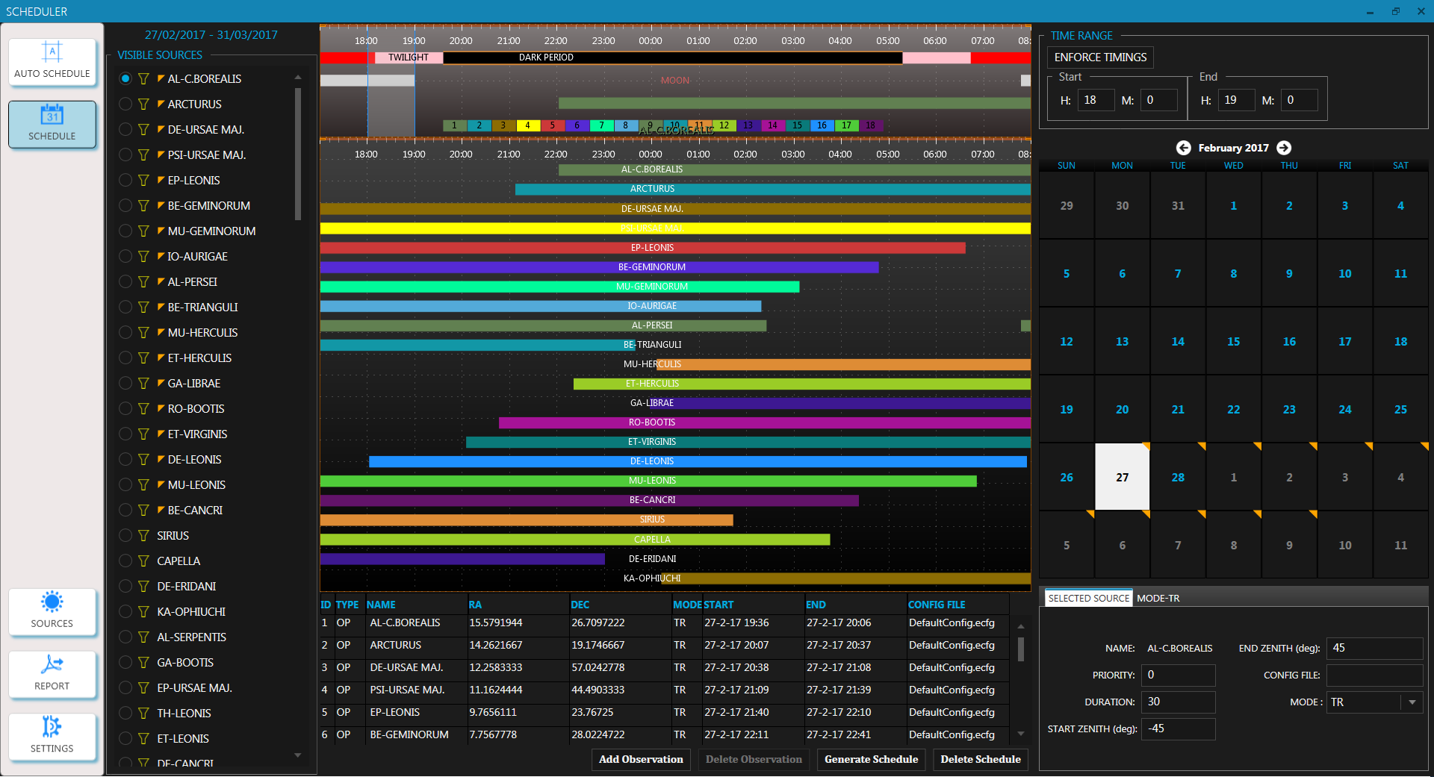
Scheduler

Slide 18
Embedded software
Central Camera Controller – Coordinate all activities & interfaces to all systems on camera – Camera Lid, calibration, event acquisition, telemetry, error detection and recovery, self diagnostics
Data Concentrator – Optimization for throughput
    DMA based data transfer from PCI FIFO
    Pre-allocated memory using memory pools
    Zero Copy
    Lock-Less Queues
    Only user mode locks with atomic operations

Slide 19
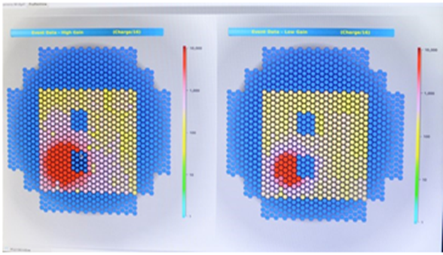
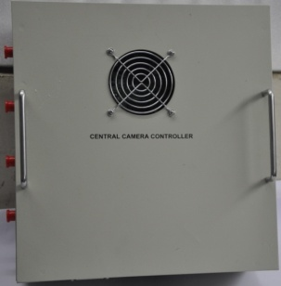
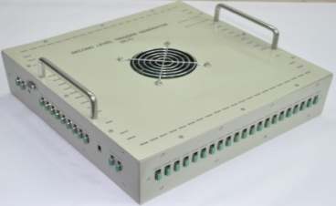

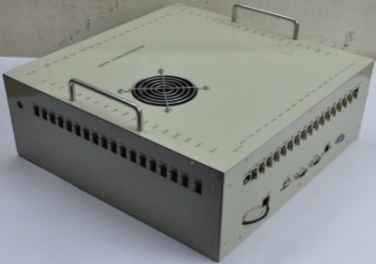
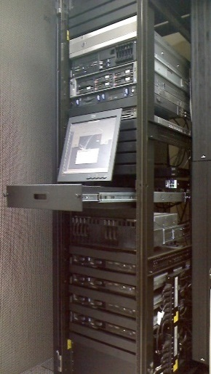
MACE Camera: Data and Control Flow
In Control Room
Mounted in Camera Assembly
Event Data Display
Second Level Trigger generator
1 to 68 CIMs
Central camera Controller
MACE OC
Optical fiber link to Control room
Data Concentrator
Data Archival

Slide 20
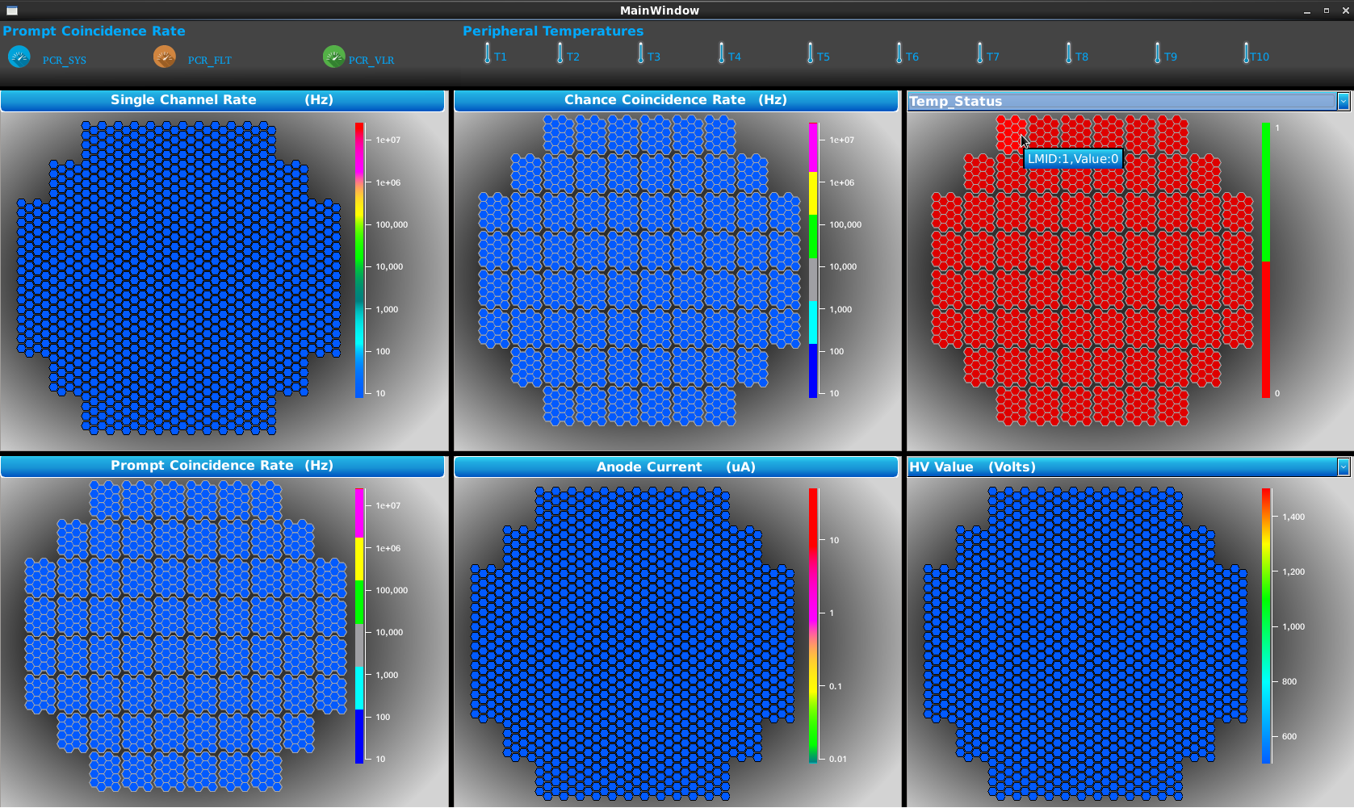
Telemetry Monitoring
Single Channel Rate, Chance Coincidence Rate, Prompt Coincidence Rate
HV, Anode Current, Discrimination Threshold
CIM and Camera Temperature
Status of Power supply and its Temperature.

Slide 21
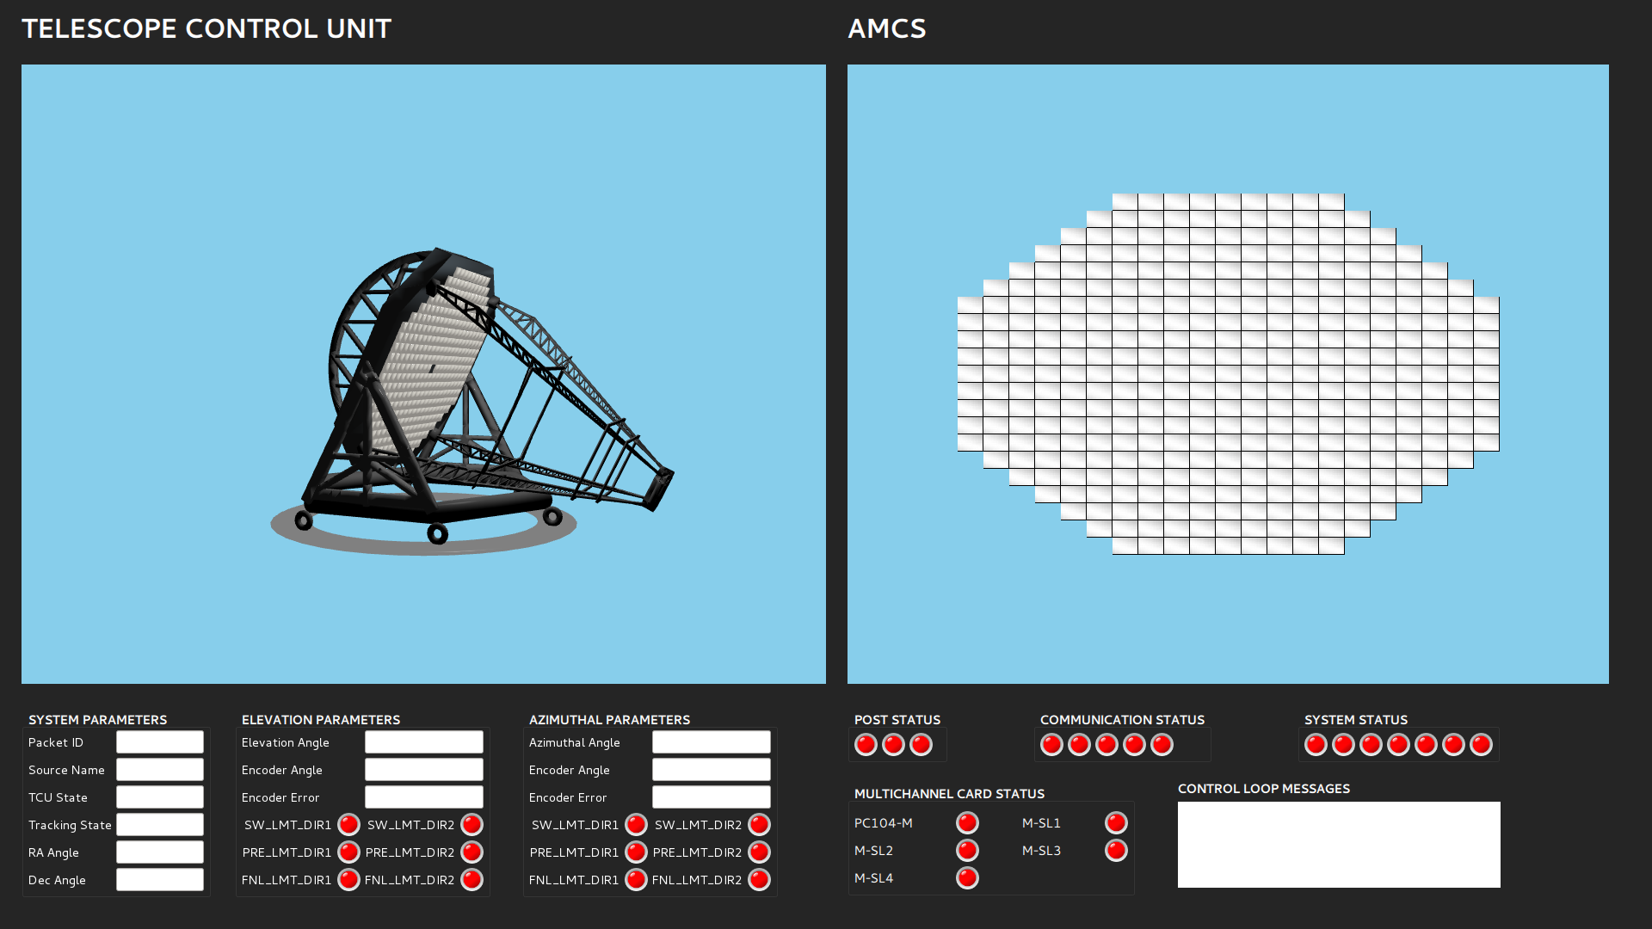
Observation Monitoring –Tracking Status
Movement of Telescope: source position
Start of Experiment: track the source
Tracking of telescope
Run Complete: Park
Status of Mirrors: enabled/disabled

Slide 22
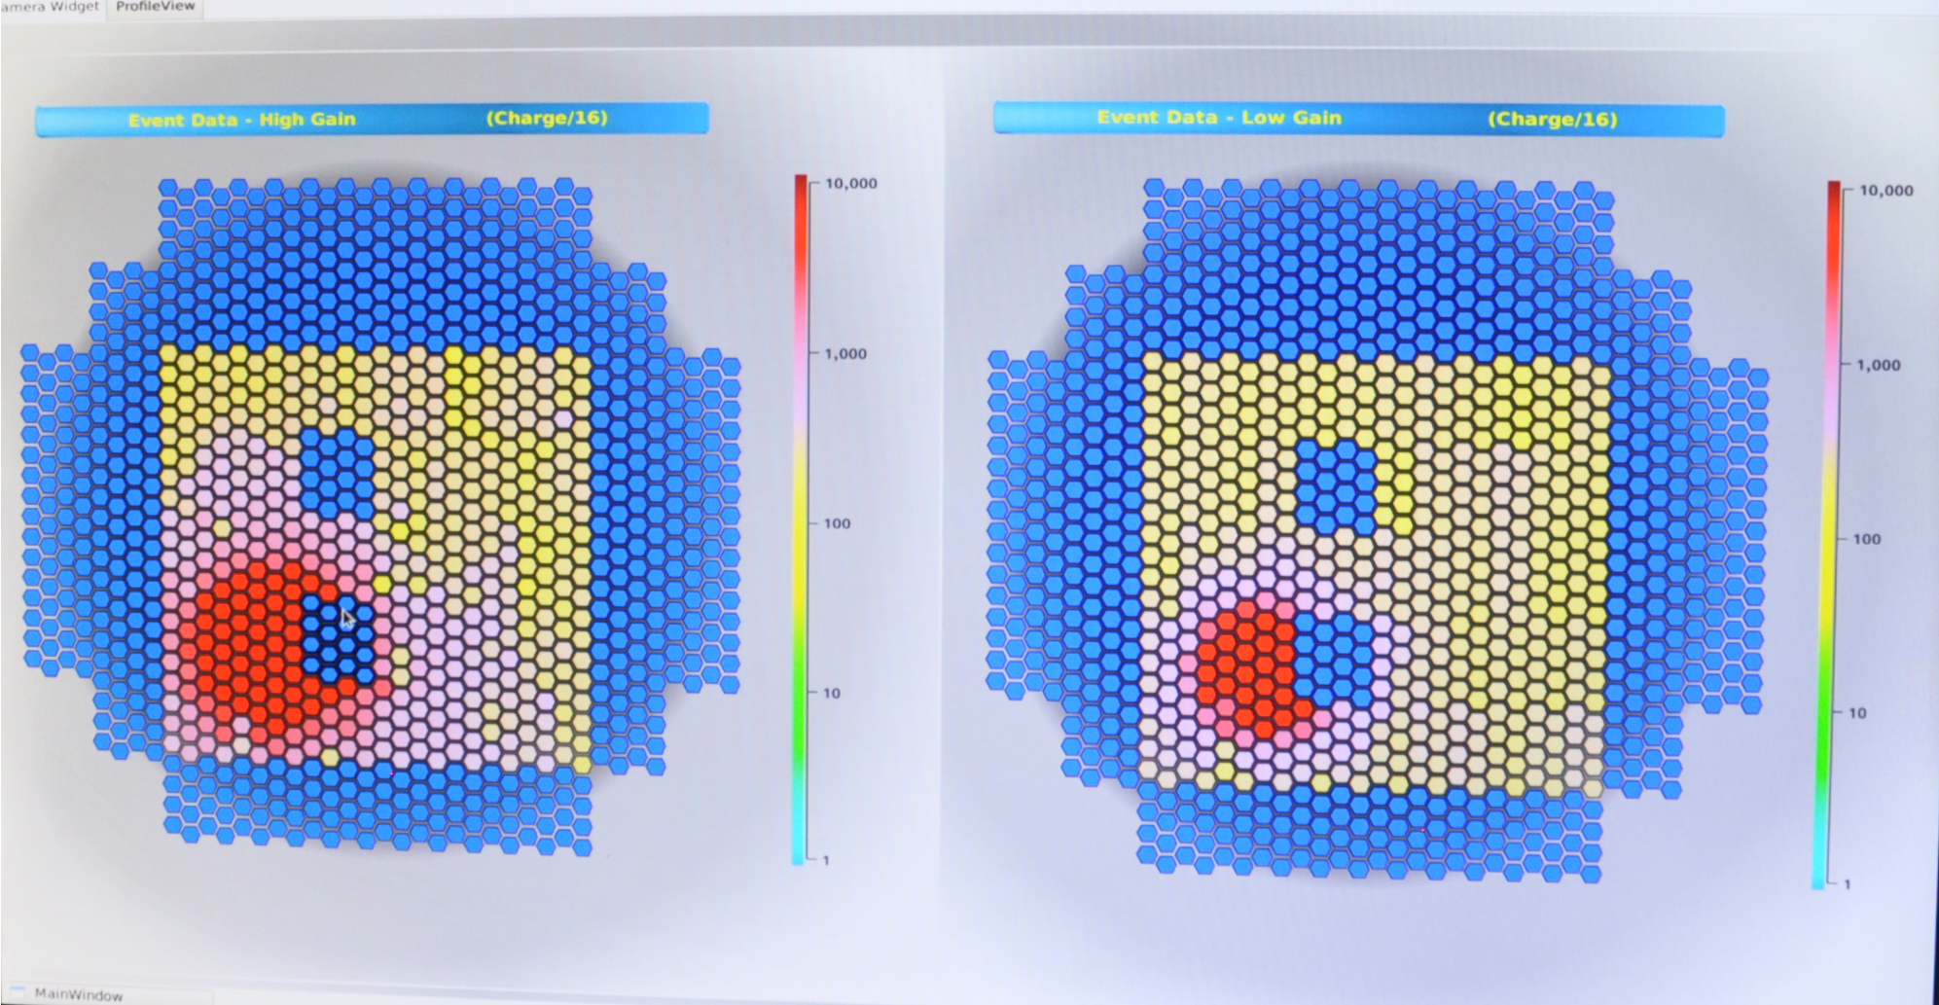
Event display at MACE operator Console for LED Pulsar illumination
Event data displayed with a programmable periodicity
Module and Pixel Highlights.
Profile data for the selected module
LED pulsar illumination
Notes:
Maximum Event size per CIM ≈ 2080 Bytes (for N=16)
Profile data for N hit≈ 124 * N Bytes
ROI = 31
Expected Channels Hit fraction = 5%, (N=55)
Charge Data = 64 Bytes
Header + CRC = 32 Bytes
Total Minimum expected event size = 7K Bytes ( Charge).
Total Maximum expected event size = 14KBytes (Charge + profile)
With 1 K Event Rate, 14MB/Sec data to be sent to ground station for archiving.
During burst, events at DC can be as close as 500 µ sec
Thus the event size from CIM can be calculated for three different cases as:1)
Charge only data:12 + 2*2*8 +4 = 48 bytes for each SDD = 96 bytes for CIM
96 * 68 + 28 + 32 = 6.584KBytes for camera2)
Full profile data12 + 2*2*8 + 2*2*8*31 = 1040 bytes for each SDD = 2080 for CIM
1040*68 + 28 + 32 = 141.5 KBytes for camera3)
no-hit suppressed data for 5% hit ratio⇨ 13.3KBytes

Slide 23
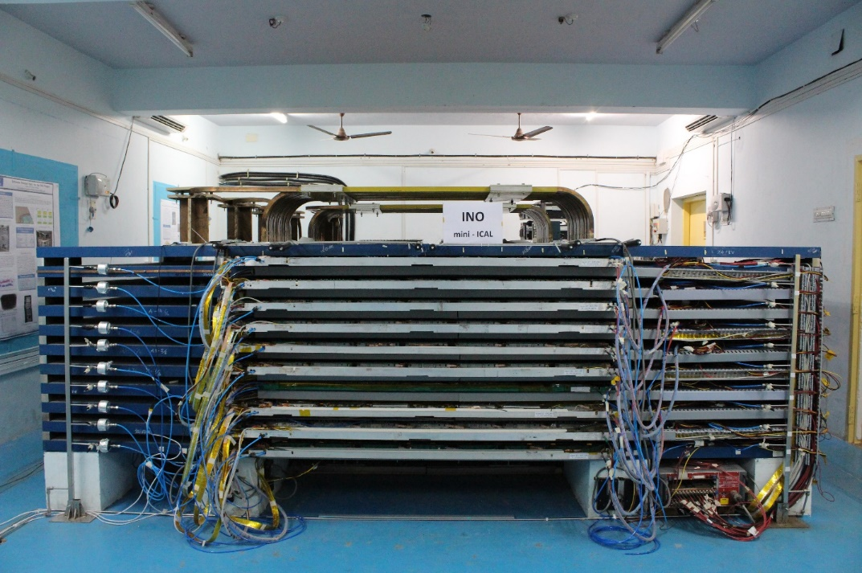
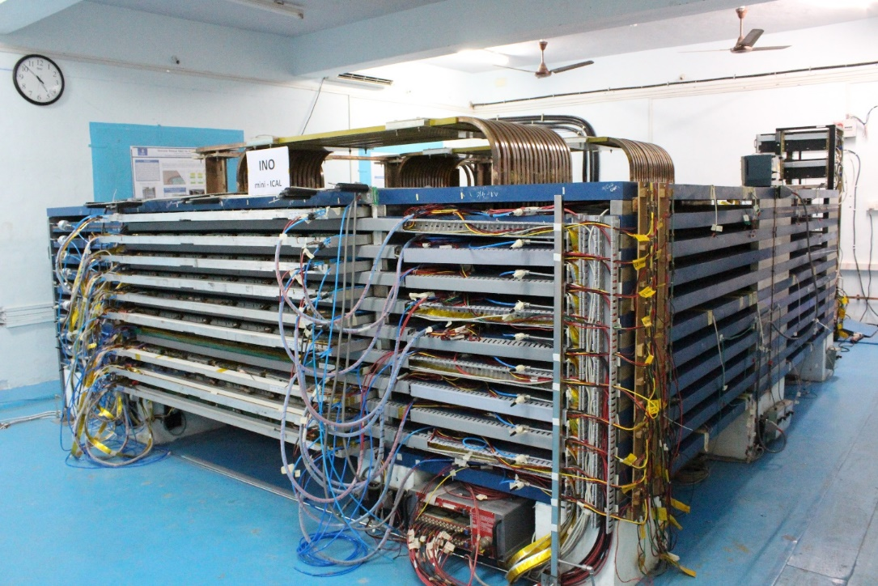
INO – mini ICAL detector
At IICHEP, Madurai
Trigger System
Backend DAQ software

Slide 24
Requirement Specifications for the Trigger System
Functional Requirement:
  Satisfying MxN/P trigger condition within a nominal coincidence window of 100 ns anywhere within detector volume with uniform trigger efficiency -
  Generation and distribution of global trigger signal.
  Maximum Trigger Latency: 1us Maximum
Back-end Computer system interface requirements
  Masking feature for each of the pre-trigger signals from each of the RPCs.
  Monitoring the rates of pre-trigger signals, segment level triggers and global trigger.

Slide 25
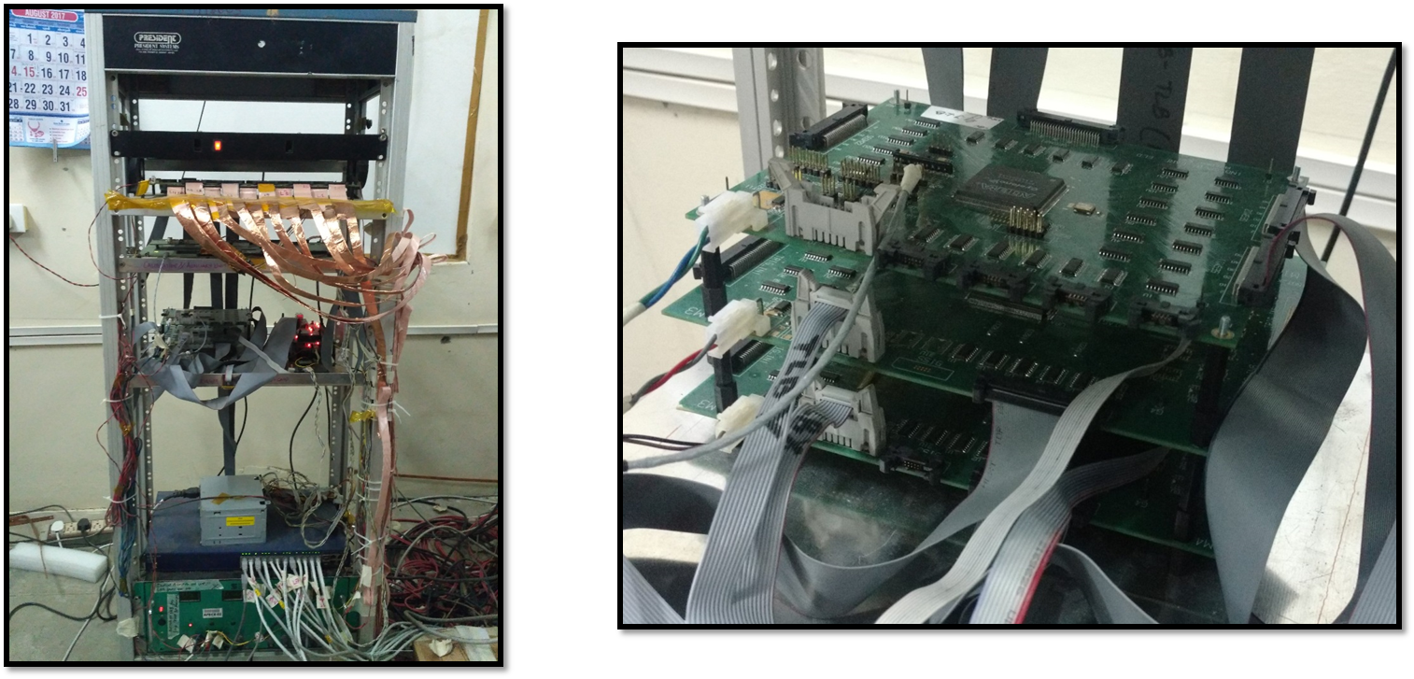
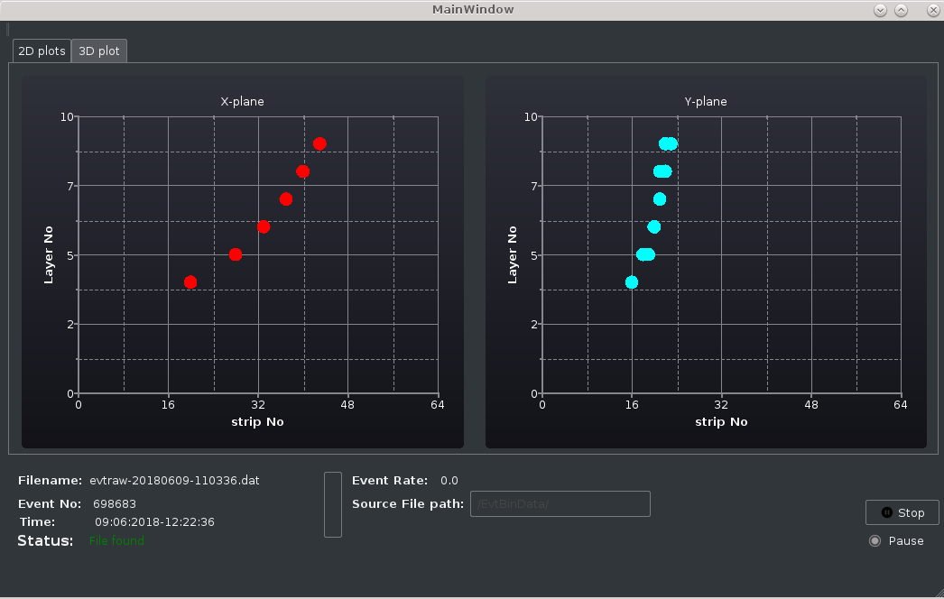
Trigger System

Slide 26
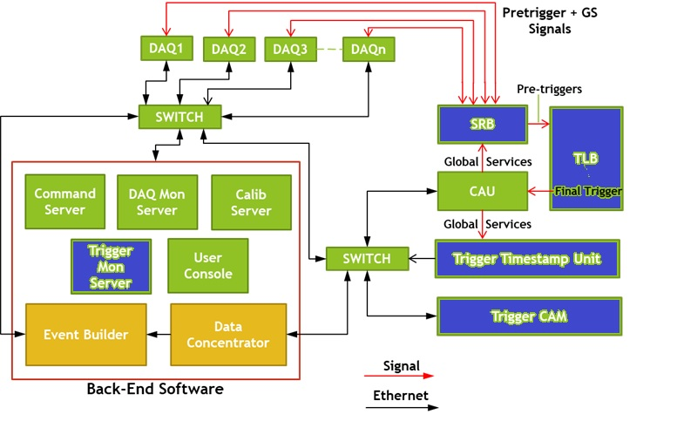
Integrated System

Slide 27
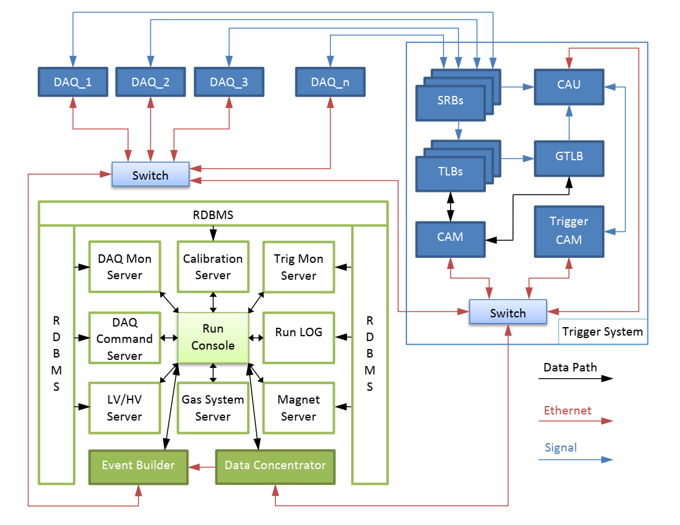
BDAQ for mini-ICAL
Architectural highlights
Lock less concurrent data structures
Scalable network client /server
Event aggregation
Data Processing with pluggable algorithm and pipelining
Control Components based FSM
Type providers for accessing unstructured binary data
Presentation Framework – Qt, WPF, Root
Data Storage – NoSQL based, ROOT Based
Technologies: F#, C#, LINQ, Berkeley DB , C++ interop
Exploitation of computational power of Multicore, GPU for performance enhancement

Slide 28
Software Trigger : 64 core, 200ns Tw, 200Hz SCR
Advantages
Possibility of varying trigger criteria
No complex wiring
Scalable
Global approach
Use of Commodity processor
Parallel implementation
Partition: Functional decomposition
Minimizing communication
Geometric Decomposition of data
Efficient Data structure
Cache optimization
T / 6642.8
T
186 msec
4 msec
0.8 msec
.06 msec
.028 msec
Hough transform with accumulator as Dictionary
(θ, rho) -> set of Hit Ids
Hough transform with accumulator as Array of collection of bits
Optimized memory allocations to reduce GC invocations
Parallel run over 32 CPUs
Parallel run over 64 CPUs
(postulated)
Sequential
Parallel
Incremental gain in performance
T
T₁ = T / 46.5
T₂ = T₁ / 5
T₃ = T₂ / 13.4
T₄ = T₃ / 2.14
28
Notes:
28
28

Slide 29
Practices and Standards
Iterative Incremental Lifecycle
Test Driven Development
Pair Programming
Design Patterns
UML
Refactoring
Coding Standard
Continuous Integration
Reusable Components

Slide 30
Areas of Interest
Hardware: Design and development
  full custom or backplane based DAQ and Data concentrators with high speed interfaces
  Different trigger architectures
Software:
Real Time acquisition Framework for large scale mega science experiments.
Advanced Event data visualization techniques
Event data storage and archival techniques
Design of parallel algorithms for faster data processing.
Design of trigger-less system
Information rich operator consoles for control and monitoring using multiple displays.
Hardware & Software co-design for system level optimization

Slide 31
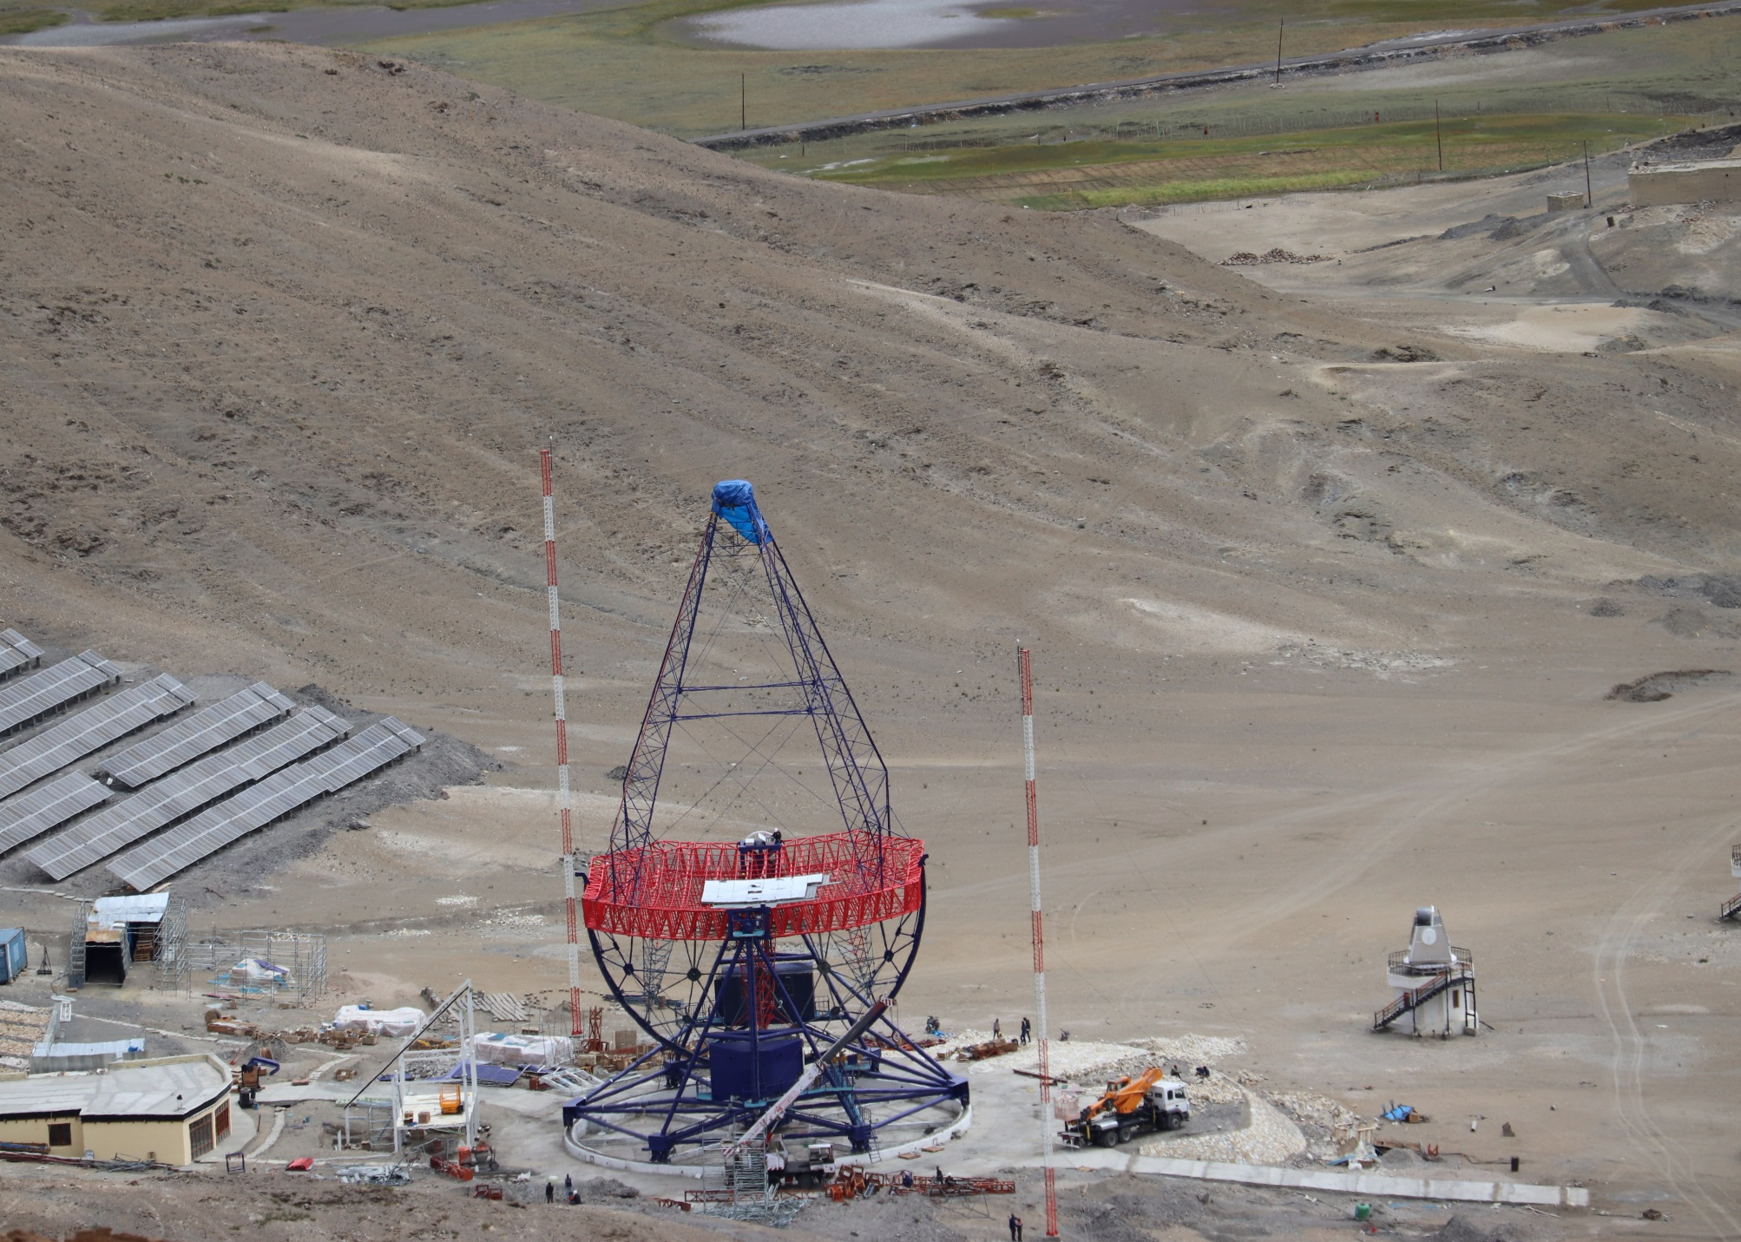
Thanks

