Slide 1




Thin LGADs characterization using Ion Beam Induced Charge (IBIC) and Time-resolved IBIC at the Centro Nacional de Aceleradores.
M.C. Jiménez-Ramos¹*, J. García López ^{1, 2}, M. Rodriguez ¹, A. Villalpando ¹, I. Vila², S. Hidalgo³, G. Pellegrini³, A. Doblas³, E. Currás², R. Jaramillo², J. Gómez Camacho^{1,2}
¹ Centro Nacional de Aceleradores (CNA)
² Departamento de Física Atómica, Molecular y Nuclear. Universidad de Sevilla
³Instituto de Física de Cantabria (IFCA-UC-CSIC).
⁴Instituto de Microelectrónica de Barcelona (IMB-CNM, CSIC)
(*) mcyjr@us.es

Slide 2




What is Ion Beam Induced Charge?
Electrodes
MeV
ion beam
1- Deposited Energy
h
E_{initial}
e-
2- Carriers generation
3- Transport
V₀
4- Output signal
V_{out}
Charge sensitive
preamplifier
Amplifier
ADC
+
MCA
Vout=f (E deposited
&
free carrier transport)
Same electronic chain as used in nuclear spectroscopy
33th RD50 Workshop

Slide 3
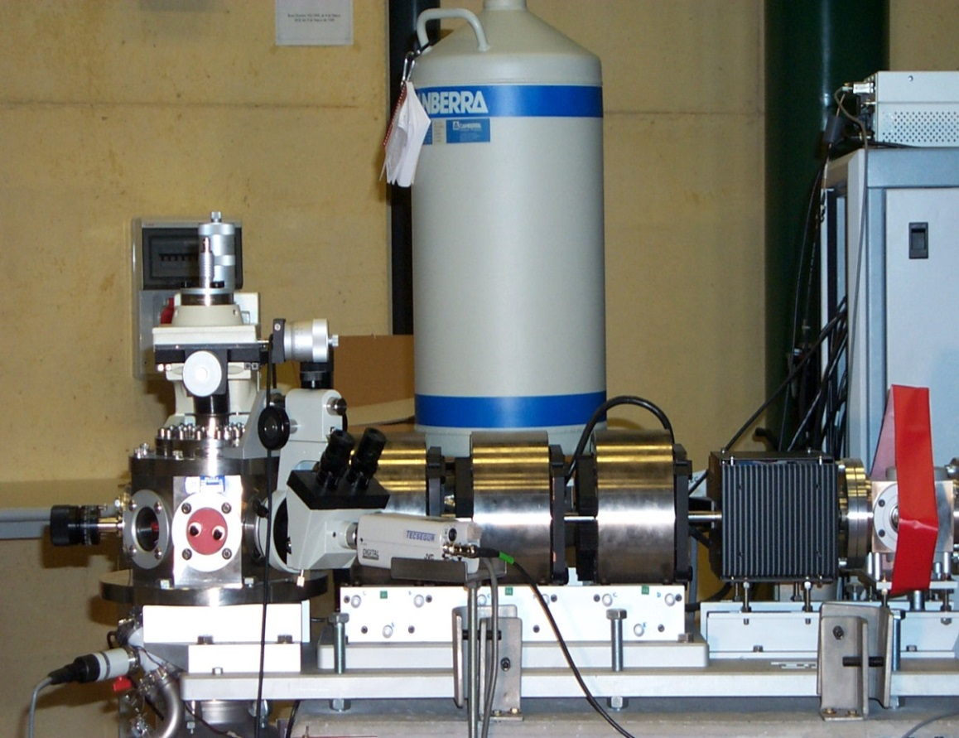
What is Ion Beam Induced Charge?
Nuclear microprobe
X, Y scanning system
B
E
A
M
Magnetic Q-poles
~ 2 μm spot
sample
Ion beam current: nA to few pps (micrometric slits)
Scanning system: few mm²
Synchronous signal acquisition system with scanning: mappings
33th RD50 Workshop

Slide 4
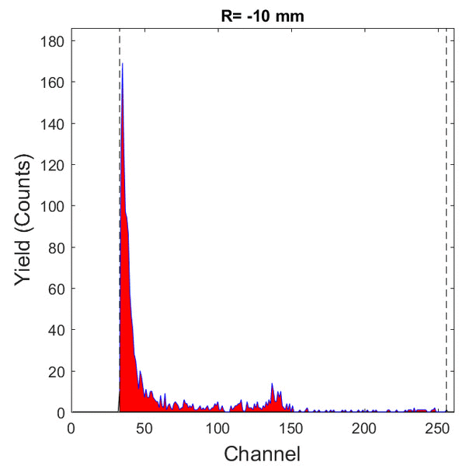
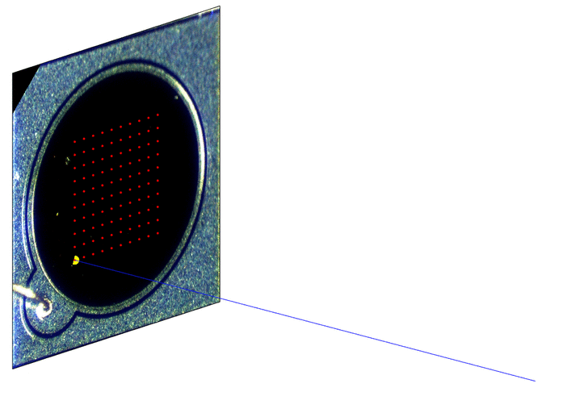
What is Ion Beam Induced Charge?
Sum spectrum from the whole scan
Channel ~ Q generated ~ E measured
33th RD50 Workshop

Slide 5
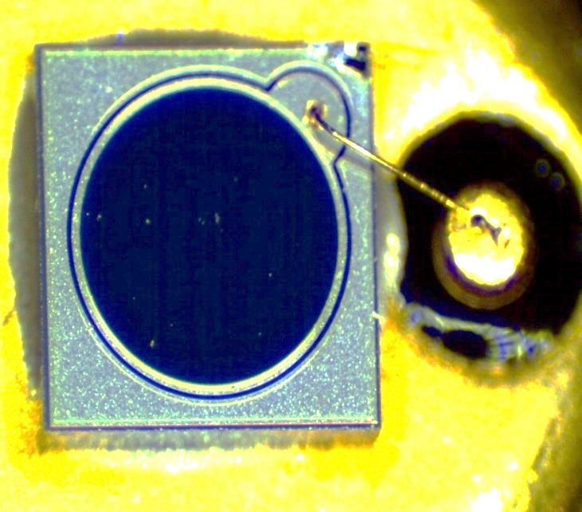
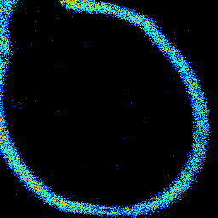
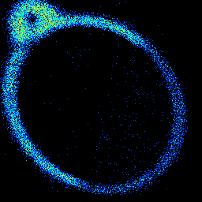
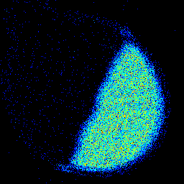
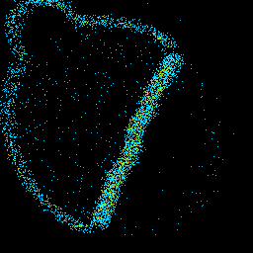
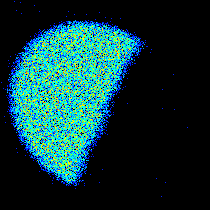
What is Ion Beam Induced Charge?
A
B
C
D
E
Pristine zone
Scan area
0
1
2
3
Irradiated zone
4
5
6
7
A
B
8
C
9
D
E
10
11
33th RD50 Workshop

Slide 6
RD50 Proposal
33th RD50 Workshop

Slide 7
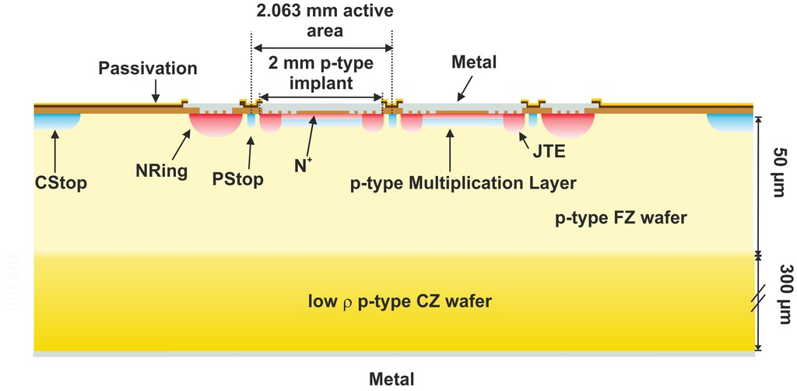
Four sectors 50 µm LGAD fabricated by IMB-CNM
Lateral charge collection homogeneity
Peripheral Structures
Gain curve
TRIBIC
33th RD50 Workshop

Slide 8
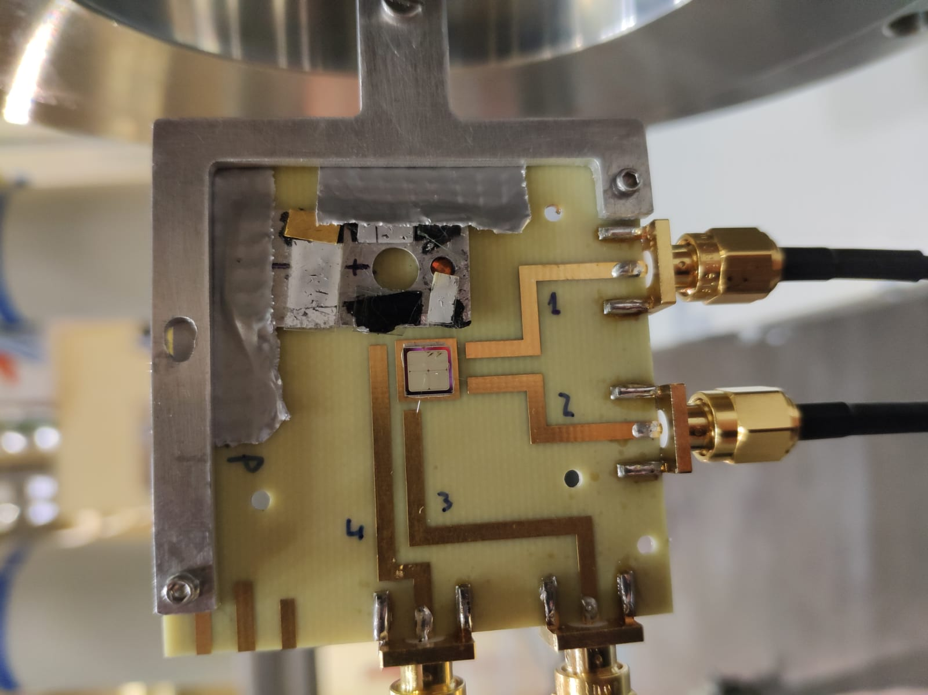
Four sectors 50 µm LGAD assembly by IFCA
- Bonding and electrical characterization by IFCA/CERN
- Dedicated PCB for laser and IBIC measuremts
33th RD50 Workshop

Slide 9
Charge generated across the detector
Total charge in 50 µm:
3 MeV protons → 50fC
MIP → 0,6 fC
33th RD50 Workshop

Slide 10
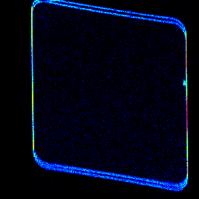
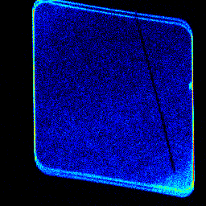
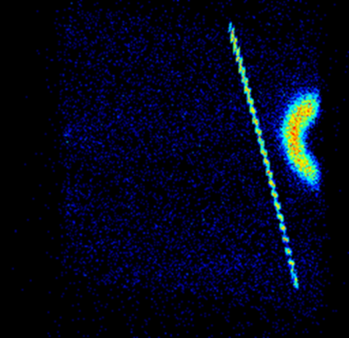
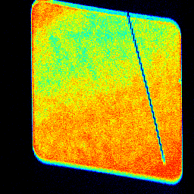
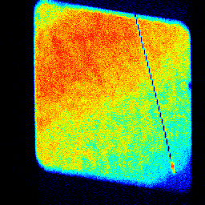
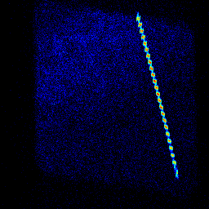
Charge Collection homogeneity
LGAD W4-B231 #3: 3 MeV protons & +90V; 2.5*2.5 mm²
Lateral charge collection is not homogeneous (<10%)
Peripheral Structures are observed
A defect is seen (red circle)
The wire bonding is well resolved
E
F
G
H
I
The color intensity is related to the number of counts in each position and the maps are related to the different energy windows

Slide 11
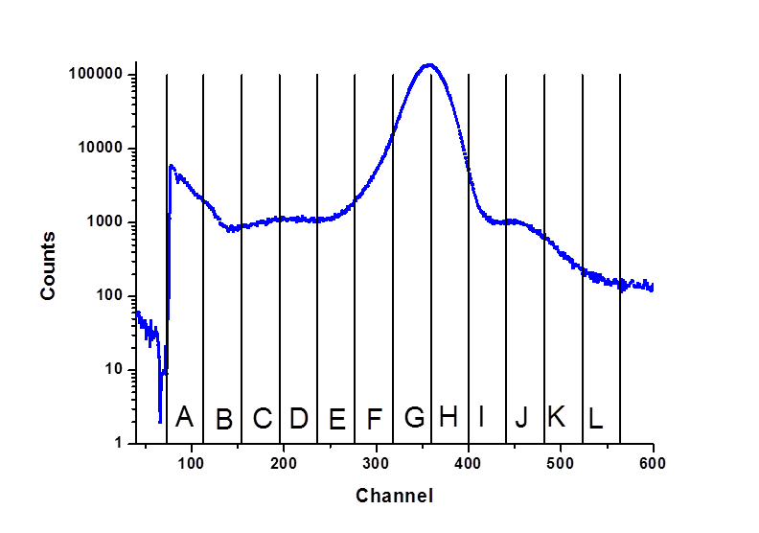
Peripheral Structures
Signals from channel 1 & 2
Channel 1
∼ 20 µm
∼ 80 µm
Channel 2
∼ 20 µm
∼ 1960 µm
V1= V2 = +90V
33th RD50 Workshop

Slide 12

Peripheral Structures: LGAD vs PIN
LGAD
One structure for each sector with a CCE value lower than 50%.
Analysis along the vertical direction
90 µm
End of multiplication layer of each sector
PIN
Single structure with ∼ 1/2 CCE shared by the two sectors
P-stop common for the two sectors
33th RD50 Workshop

Slide 13
LGAD W4-B231 #3 vs W4-B232P #3
30th RD50 Workshop 5-7 June 2017 Kraków

Slide 14
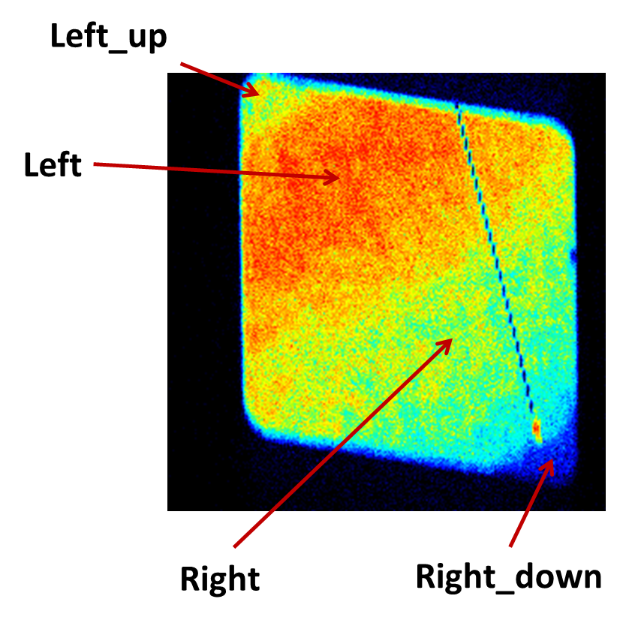
Gain Curve
Gain vs Voltage for different positions within the sensor
G(40V) > G(45V) > G(50V)!!!
3 MeV protons
33th RD50 Workshop

Slide 15
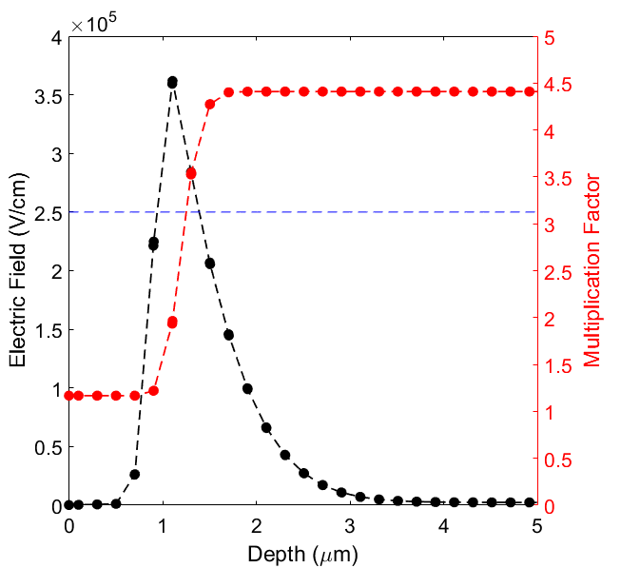
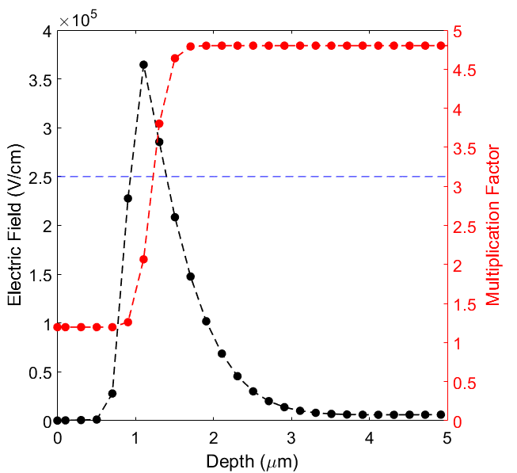
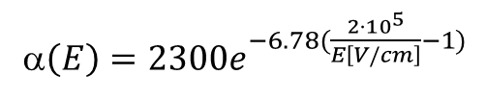
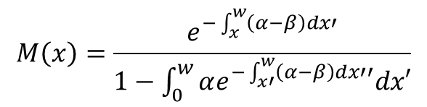
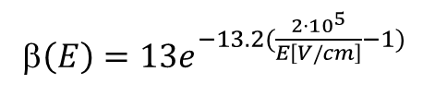
LGAD W4-B231: Gain calculations
Multiplication Factor
Ionization coefficients
Y. Musienko et al., NIMA, 2000.
α$\left(E\right)=2300e^{−6.78(\frac{{2·10}^{5}}{E\left[V/cm\right]}−1)}$
electrons
$$M\left(x\right)=\frac{e^{−\int_{x}^{w}{\left(α−β\right)dx′}}}{1−\int_{0}^{w}{αe^{−\int_{x′}^{w}{\left(α−β\right)dx′′}}dx′}}$$
β$\left(E\right)=13e^{−13.2(\frac{{2·10}^{5}}{E\left[V/cm\right]}−1)}$
holes
40 V
80 V
Calculation: 4.4
IBIC: 5.7
Calculation: 1.09
IBIC: 1.07
Absolute Gain (@40V)=
Gain (80V)/ Gain (40 V)=

Slide 16
TRIBIC (preliminary measurements)
Electrodes
Generation of e-h pairs
Ionization profile dE/dx (SRIM)
Without amplification stage between detector and scope
Self-trigger: working in DAQ improvements
External trigger system ongoing
MeV
ion beam
h
E_{initial}
e-
Fast oscilloscope
Transient signal
(TRIBIC)
33th RD50 Workshop

Slide 17
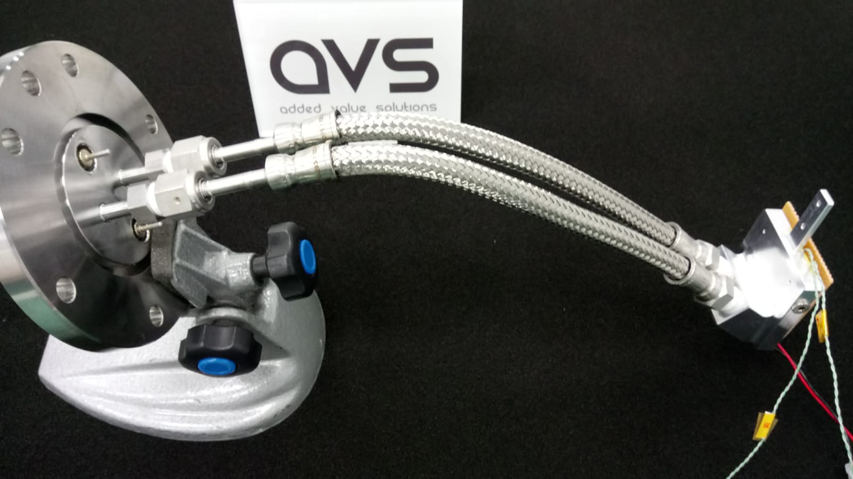
New sample holder for IBIC at -20ºC

Slide 18
Thank you for your attention

Slide 19
LGAD W4-B231: Gain Curve
G (LGAD)/G (PIN) = 5.8 for 3 MeV protons (@40V)
G (LGAD)/G (PIN)= 3.2 for 5.5 MeV protons (@40V)

Slide 20
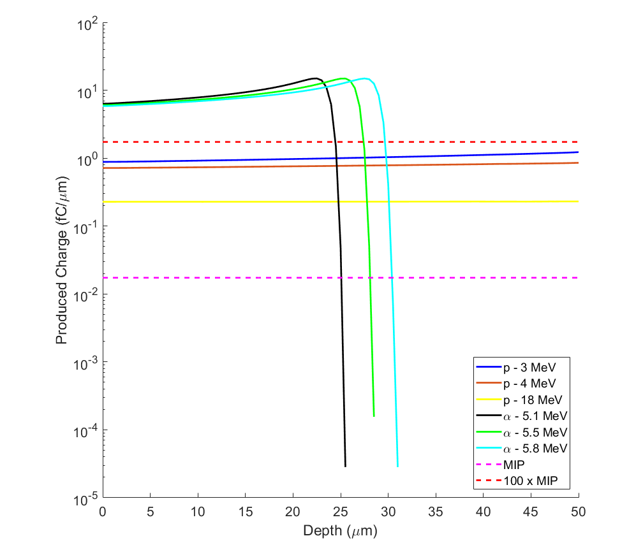
Generated charge profile
33th RD50 Workshop

Slide 21
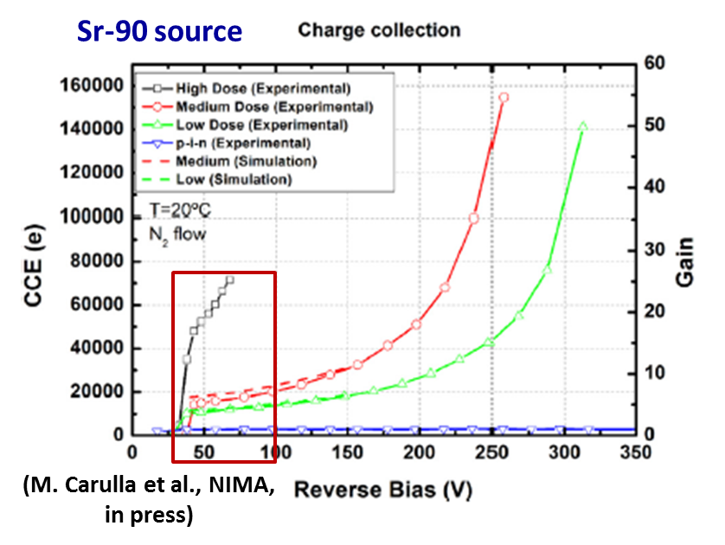

Slide 22
