Slide 1

Status on TRAMOS (Trapping MOS) and DotPix (Quantum Dot Pixel) ongoing developments
Nicolas T. Fourches, IRFU/CEA Saclay, 91191 GIF/YVETTE, France
E-mail: nicolas.fourches@cea.fr
Charles Renard (C2N) and G. Hallais, Francois Jomard (GEMAC), Francois Olivié and coworkers (LAAS), the EMIR network (Jannus/Saclay)
The purpose of the DotPix project is to design a new kind of pixel for inner vertex detectors arrays with enhanced point-to-point resolution. It is based on a single MOS device, which may allow a resolution below the micron making track reconstruction and vertex determination with an unprecedented accuracy. It comprises a buried gate, which acts as a charge-collecting electrode with memory effect and controls the current of a micron-size n-channel MOS transistor. The design of such a pixel requires the massive use of device simulations. Future e+e- colliders (FCC,ILC) will benefit from this development.
Motivations for a new pixel design
How a buried gate can act as collecting electrode
How it can operate as a memory
Designing and fabricating the buried gate
Simulation results
Technological progress
Summary and further work

Slide 2
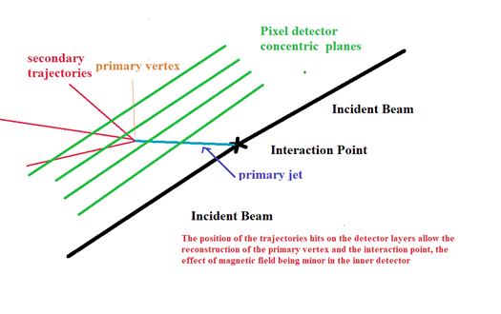
Status on TRAMOS (Trapping MOS) and DotPix (Quantum Dot Pixel) ongoing developments
Nicolas T. Fourches, IRFU/CEA Saclay, 91191 GIF/YVETTE, France
E-mail: nicolas.fourches@cea.fr
Motivations for a new pixel design
Future trackers and vertex detectors need accurate track reconstruction and precise vertex determination down to the micrometer
This is a prerequisite for the e+e- colliders in the future
Fast response should be also sought for bunch identification, this means accessory detector
High radiation hardness is still a challenge however less constraining with respect to hadron colliders
This impose to reduce the area of each pixel , increase the number of pixel per unit area
Low hit rate per pixel , in favor of reduced data flux by data compression , low multiple hit rate , limited single pixel area
High pT events ( - infinite < h < 0) , h=-ln (tan(θ/2)) pseudorapidity, where θ is the angle w.r.t. incident beam

Slide 3
Status on TRAMOS (Trapping MOS) and DotPix (quantum Dot Pixel) ongoing developments
Nicolas T. Fourches, IRFU/CEA Saclay, 91191 GIF/YVETTE, France
E-mail: nicolas.fourches@cea.fr
Motivations for a new pixel design
Classic and modified CMOS pixels, in many cases too slow, need depleted area to be fast (three transistors at least) NIEL tolerance bad in many case due to diffusion the solution has been DMAPS ( with highly resistive substrates)
CCD could be reduced in size but not random addressable.
DEPFET is single device, but should be improved in terms of size
We need a monolithic depleted device with low power consumption, with downscaling possible
Pixel need local readout and memory and a depleted diode, this means many transistors and pixel size > 1 micron squared
We propose to combine every function in a single device pixel : one device + memory in a CMOS compatible process , with a target of 100 nm feature line, and 10 micrometer in depletion layer thickness
Up to now no submicron pixel for charged particle detection has been operating, sizes above 10 x 10 micrometers, this could improve by CMOS downscaling but still need many transistors.

Slide 4
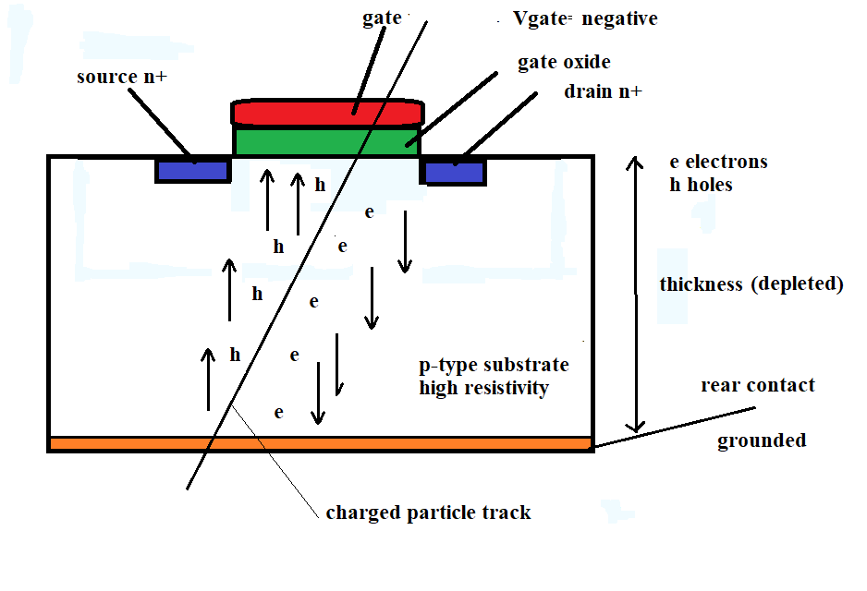
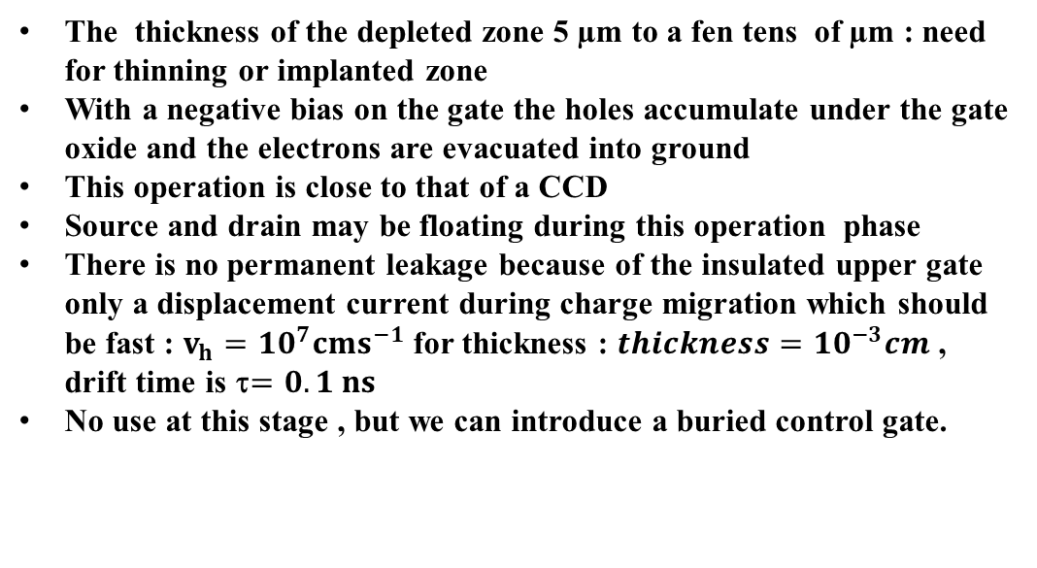
Status on TRAMOS (Trapping MOS) and DotPix (Quantum Dot Pixel) ongoing developments
Nicolas T. Fourches, IRFU/CEA Saclay, 91191 GIF/YVETTE, France
E-mail: nicolas.fourches@cea.fr
How a buried gate can act as collecting electrode
A charged particle make a track in the silicon bulk along the vertical or inclined
We start from a MOS structure, which can be reduced to a MOS capacitor
The thickness of the depleted zone 5 µm to a fen tens of µm : need for thinning or implanted zone
With a negative bias on the gate the holes accumulate under the gate oxide and the electrons are evacuated into ground
This operation is close to that of a CCD
Source and drain may be floating during this operation phase
There is no permanent leakage because of the insulated upper gate only a displacement current during charge migration which should be fast : $v_{h}={10}^{7}cms^{−1}$ for thickness : $thickness={10}^{−3}cm$ , drift time is τ$=0.1 ns$
No use at this stage , but we can introduce a buried control gate.

Slide 5
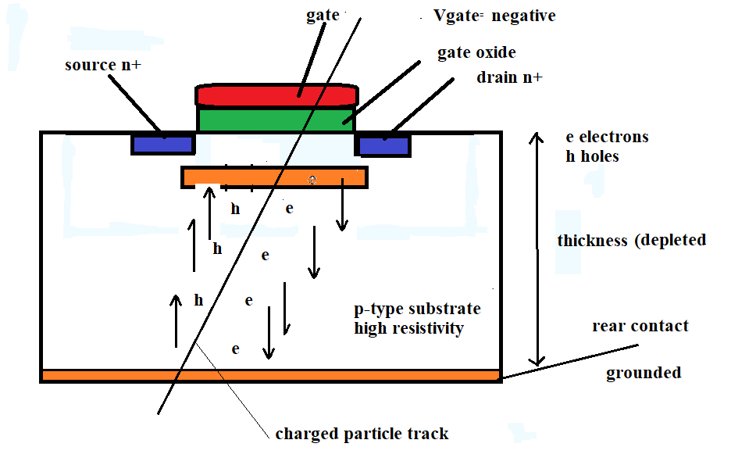
Status on TRAMOS (Trapping MOS) and DotPix (Quantum Dot Pixel) ongoing developments
Nicolas T. Fourches, IRFU/CEA Saclay, 91191 GIF/YVETTE, France
E-mail: nicolas.fourches@cea.fr
How a buried gate can act as collecting electrode
A buried gate is introduced below the channel
With a negative bias on the upper gate the holes accumulate in the buried gate , whereas the electrons are evacuated
The buried gate should act as a potential well for the hole and not for the electrons
The buried gate should also retain the holes during a long enough time
The same holds for the collection time and the permanent leakage current
Source and drain may be floating during this operation phase

Slide 6
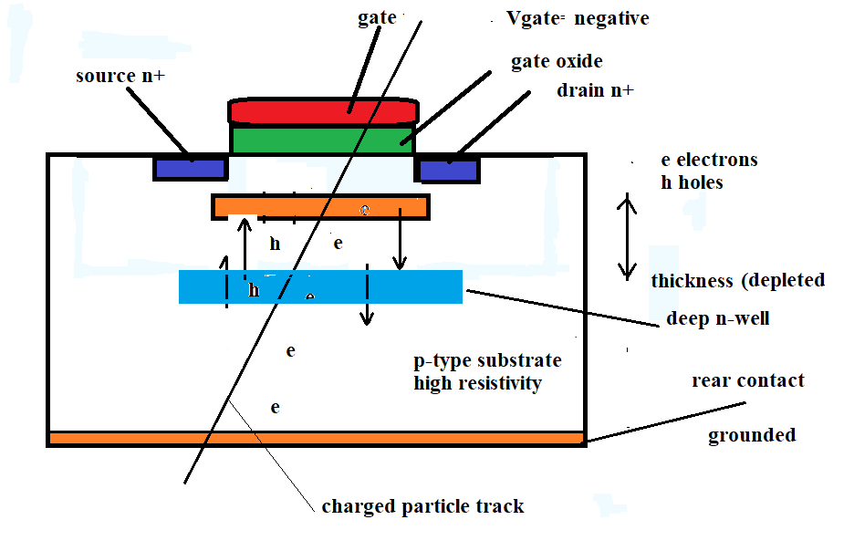
Status on TRAMOS (Trapping MOS) and DotPix (Quantum Dot Pixel) ongoing developments
Nicolas T. Fourches, IRFU/CEA Saclay, 91191 GIF/YVETTE, France
E-mail: nicolas.fourches@cea.fr
How a buried gate can act as collecting electrode
Alternative design with a deep-n-well used for electron/hole separation
The MOS structure can be operated with a slightly positive bias on the upper gate
The buried gate is made of a high density of holes traps
A deep impurity can be used for creating the trap zone
The thickness in which the useful electron-hole pairs are created is
limited ( 1micrometer) , transition region of the buried gate/ deep n-well region
Source and drain can be bias during this phase
This is the first version of the TRAMOS (2010)

Slide 7
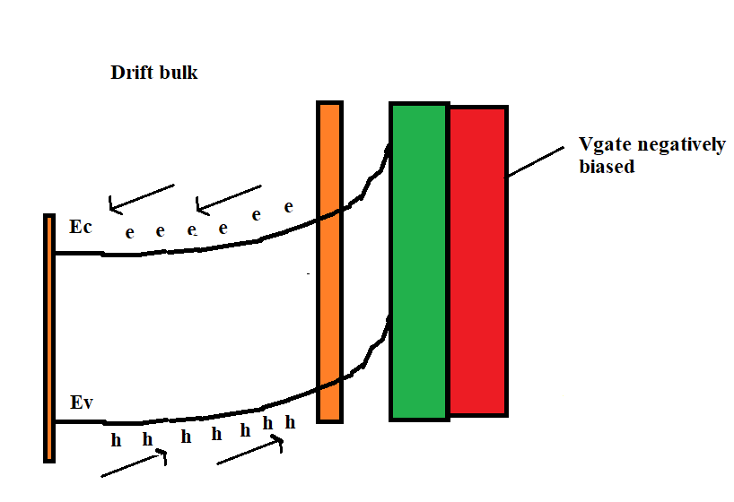
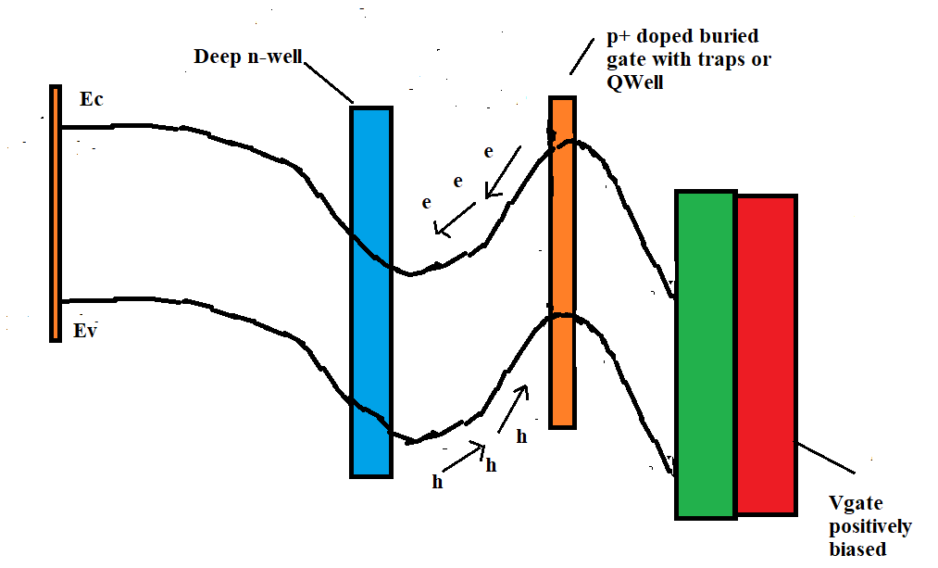
Status on TRAMOS (Trapping MOS) and DotPix (Quantum Dot Pixel) ongoing developments
Nicolas T. Fourches, IRFU/CEA Saclay, 91191 GIF/YVETTE, France
E-mail: nicolas.fourches@cea.fr
How a buried gate can act as collecting electrode
The zone between the deep-n-well and the buried gate enable the drift of holes towards the buried gate
In the absence of deep n-well the holes drift towards the buried gate. This impose that the upper gate should be negatively biased. High resistivity p-type substrate.
We could use the version 2 with a p-channel MOSFET operating permanently with a negative upper gate bias

Slide 8
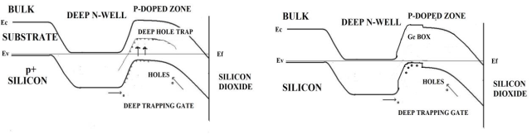
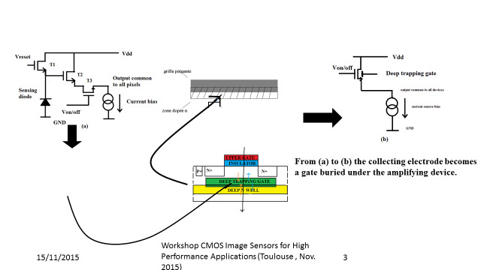
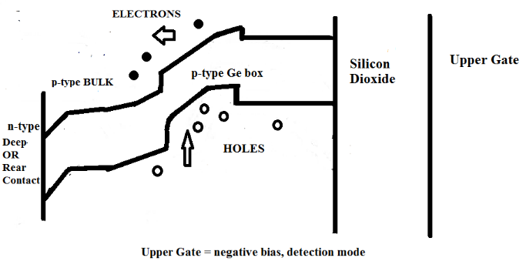
Status on TRAMOS (Trapping MOS) and DotPix (Quantum Dot Pixel) ongoing developments
Nicolas T. Fourches, IRFU/CEA Saclay, 91191 GIF/YVETTE, France
E-mail: nicolas.fourches@cea.fr
How a buried gate can act as collecting electrode
FET with internal gate : the DEPFET (1987) by MPI Munich
The CMOS : MAPS by IPHC Strasbourg
First proposed the TRAMOS (2010)
Then the Dotpix (2016)
TRAMOS + Deep n-well
Use Traps
DOTPiX + Deep n-well
Use VB quantum well

Slide 9
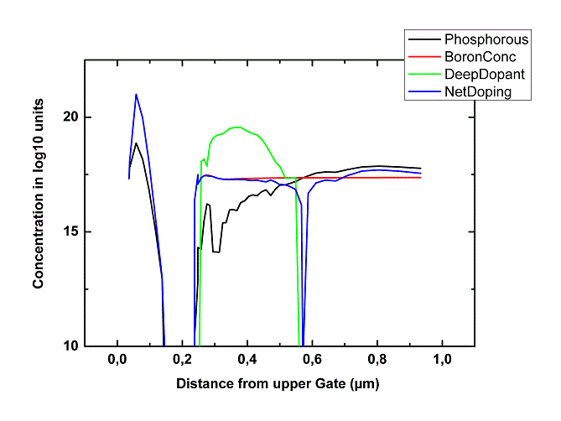
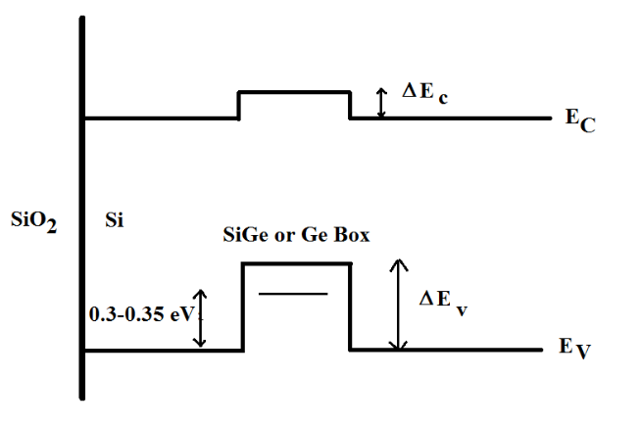
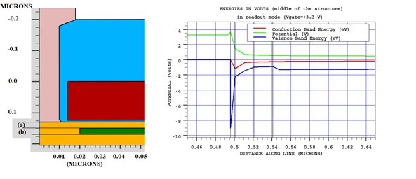
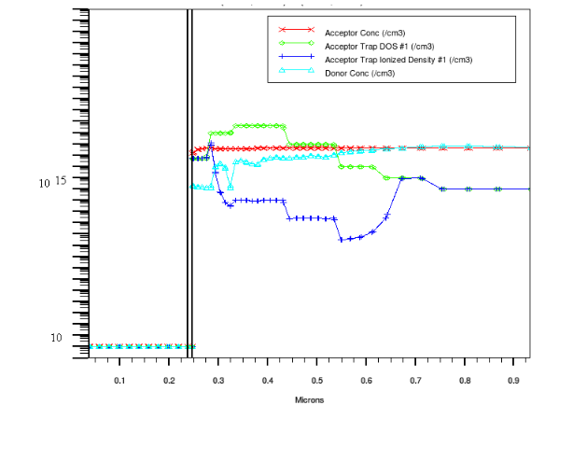
Status on TRAMOS (Trapping MOS) and DotPix (Quantum Dot Pixel) ongoing developments
Nicolas T. Fourches, IRFU/CEA Saclay, 91191 GIF/YVETTE, France
E-mail: nicolas.fourches@cea.fr
How it can operate as a memory
We need a buried gate that act as a control gate for the channel current with the ability to retain its hole charge sufficiently long to enable readout. This means the device should act as a memory.
First use a shallow doped p-type buried with a high concentration of deep impurities (such as Zn) which selectively trap hole and not electrons. Substitutional Zn is double hole trap. Problem how to get a high peak substitutional Zn concentration with no contamination ? Implant +RTP.
Second use a Quantum Well for holes, not for electrons.
In the first solution the thermal emission rate for holes trapped on impurity sites determines the retention time for holes.
In the second solution, hole emission to the VB of silicon and other mechanism set the retention time.
In any case device simulation is the way to evaluate the functionality of the proposed devices as a way to make a proof of principle.
Impurity profile in the TRAMOS
Structure of the DotPix (a)=10-20 nm (b)=20 nm

Slide 10
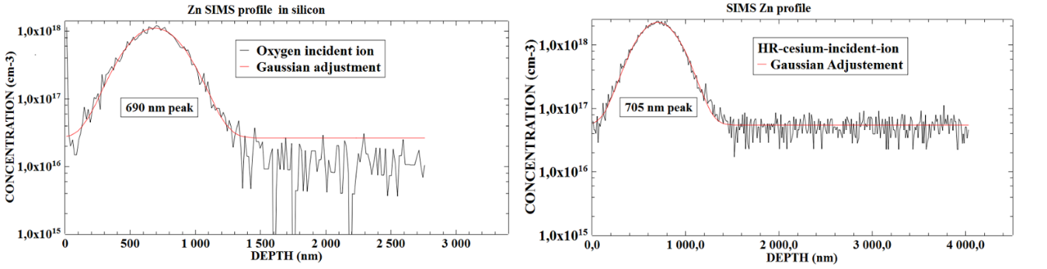
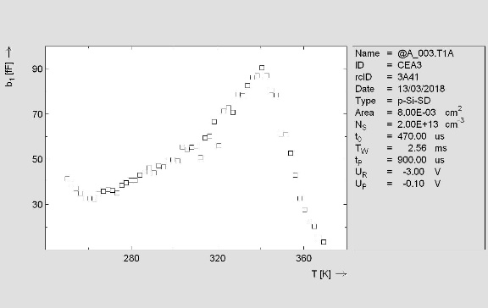
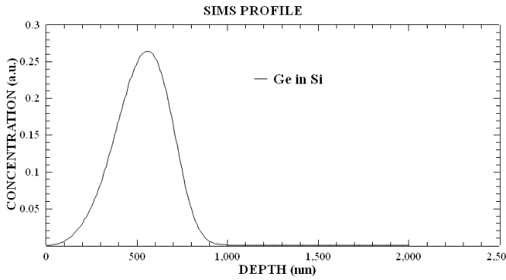
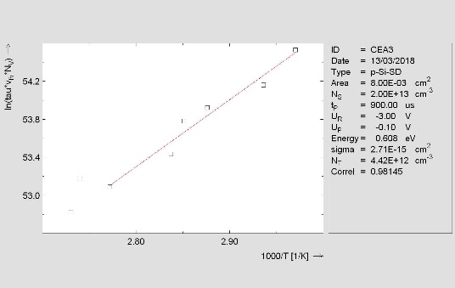
Status on TRAMOS (Trapping MOS) and DotPix (Quantum Dot Pixel) ongoing developments
Nicolas T. Fourches, IRFU/CEA Saclay, 91191 GIF/YVETTE, France
E-mail: nicolas.fourches@cea.fr
Designing and fabricating the buried gate
Zn can be implanted in the bulk silicon during the process of the n-channel MOS transistor
High energy ion implantation can be used but beware of contamination ( 1MeV energy )
But disappointing DLTS results , concentration do not match>> Fermi level pinning
Substitutional Zn acts as a deep double hole trap
Needs stabilizing the buried layer (annealing)
Needs a sharper profile
Ge has been implanted at 1MeV with high doses, the maximum concentration obtained in the samples is 25% with a lot of scatter (down to 6%) , the concentration profile is not sharp but in accord with SRIM simulations
No thermal anneal, was performed after implantation
High dose implantations are take to much time !!!
Could be used however
This is for high resistivity silicon, similar results are obtained on low resistivity silicon
Very preliminary !!!
Credit F. Olivié
Ion implantation : EMIR/Jannus Saclay (MeV range ) SIMS : GEMAC

Slide 11
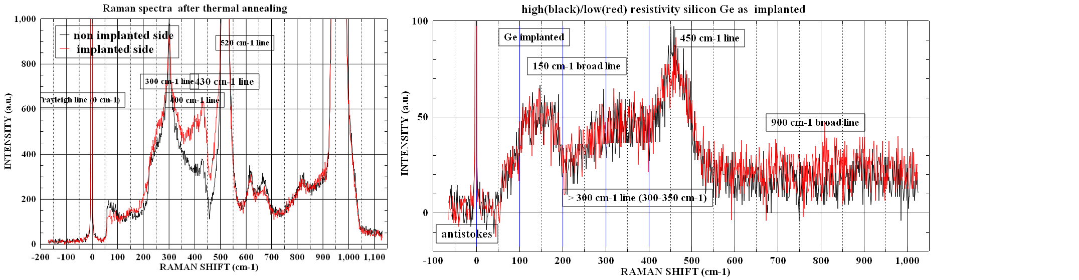
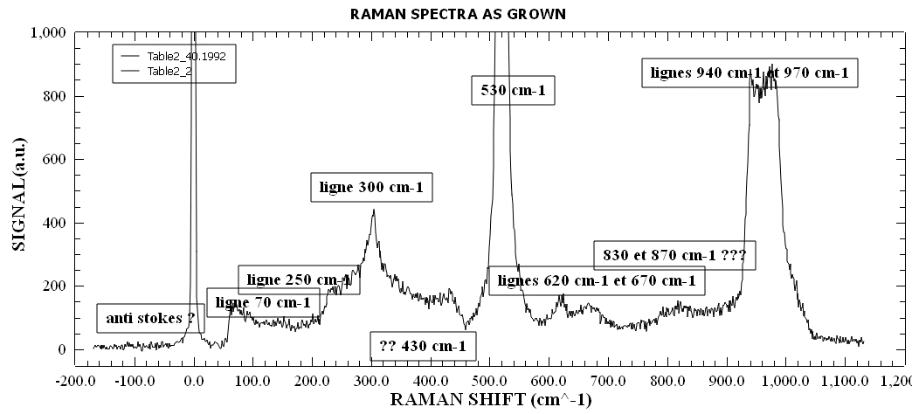
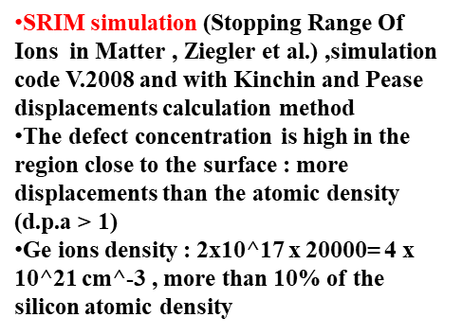
Status on TRAMOS (Trapping MOS) and DotPix (Quantum Dot Pixel) ongoing developments
Nicolas T. Fourches, IRFU/CEA Saclay, 91191 GIF/YVETTE, France
E-mail: nicolas.fourches@cea.fr

Slide 12
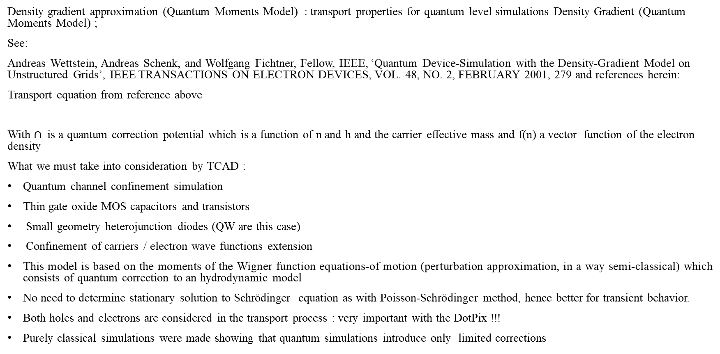

Status on TRAMOS (Trapping MOS) and DotPix (Quantum Dot Pixel) ongoing developments
Nicolas T. Fourches, IRFU/CEA Saclay, 91191 GIF/YVETTE, France
E-mail: nicolas.fourches@cea.fr
Density gradient approximation (Quantum Moments Model) : transport properties for quantum level simulations Density Gradient (Quantum Moments Model) ;
See:
Andreas Wettstein, Andreas Schenk, and Wolfgang Fichtner, Fellow, IEEE, ‘Quantum Device-Simulation with the Density-Gradient Model on Unstructured Grids’, IEEE TRANSACTIONS ON ELECTRON DEVICES, VOL. 48, NO. 2, FEBRUARY 2001, 279 and references herein:
Transport equation from reference above
With $∩$is a quantum correction potential which is a function of n and h and the carrier effective mass and f(n) a vector function of the electron density
What we must take into consideration by TCAD :
Quantum channel confinement simulation
Thin gate oxide MOS capacitors and transistors
Small geometry heterojunction diodes (QW are this case)
Confinement of carriers / electron wave functions extension
This model is based on the moments of the Wigner function equations-of motion (perturbation approximation, in a way semi-classical) which consists of quantum correction to an hydrodynamic model
No need to determine stationary solution to Schrödinger equation as with Poisson-Schrödinger method, hence better for transient behavior.
Both holes and electrons are considered in the transport process : very important with the DotPix !!!
Purely classical simulations were made showing that quantum simulations introduce only limited corrections
$$\vec{j}=qD_{n}{\vec{∇n}}_{}{−µ}_{n}n\vec{∇_{}}\left(∅+∩\right)+f(n)$$

Slide 13
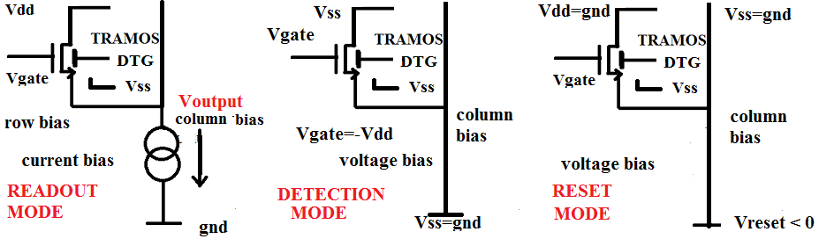
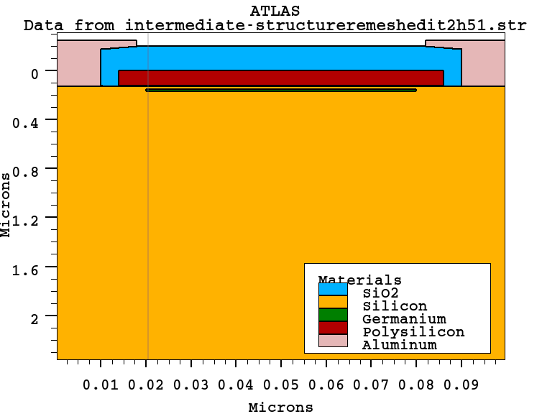
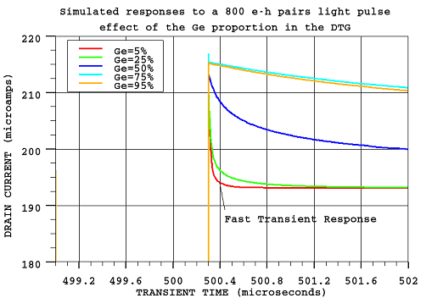
Status on TRAMOS (Trapping MOS) and DotPix (Quantum Dot Pixel) ongoing developments
Nicolas T. Fourches, IRFU/CEA Saclay, 91191 GIF/YVETTE, France
E-mail: nicolas.fourches@cea.fr
Simulation results
Focus on the Quantum Well design (results have been published) Germanium layer in the first figure, the thickness of the structure is set to 10 mm in the simulation file. Quantum density gradient simulations

Slide 14
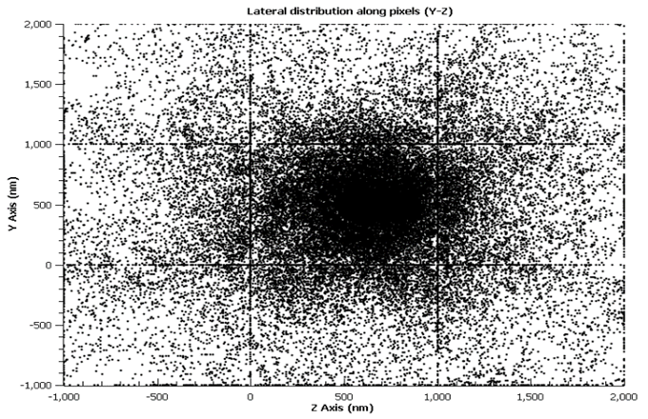
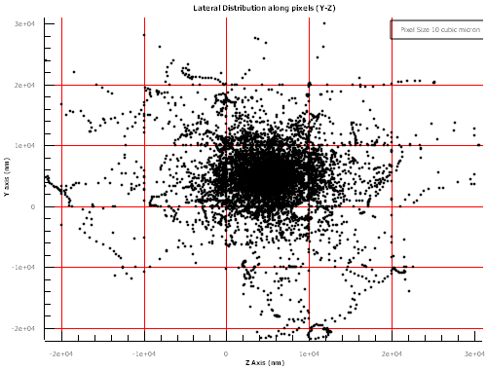
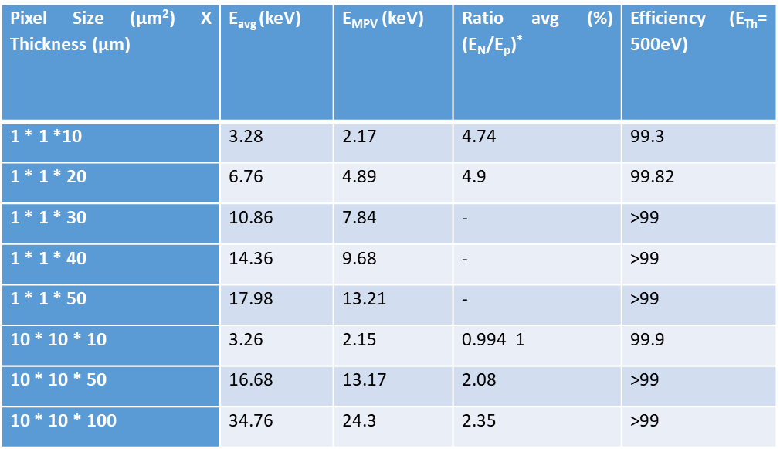
Status on TRAMOS (Trapping MOS) and DotPix (Quantum Dot Pixel) ongoing developments
Nicolas T. Fourches, IRFU/CEA Saclay, 91191 GIF/YVETTE, France
E-mail: nicolas.fourches@cea.fr
Simulation results
The same on Pixel Size 10 μm *10 μm, Thickness 10 μm:
GEANT4 on a 1µm x 1µm x 10µm structure,
Scattered Hits on the Silicon Layer : 130 GeV pions (credit to V. Kumar, Saclay, 2016 , M2 report)
Wafer Thinning is necessary , detection efficiency remains good enough for thicknesses of 10 micrometers

Slide 15
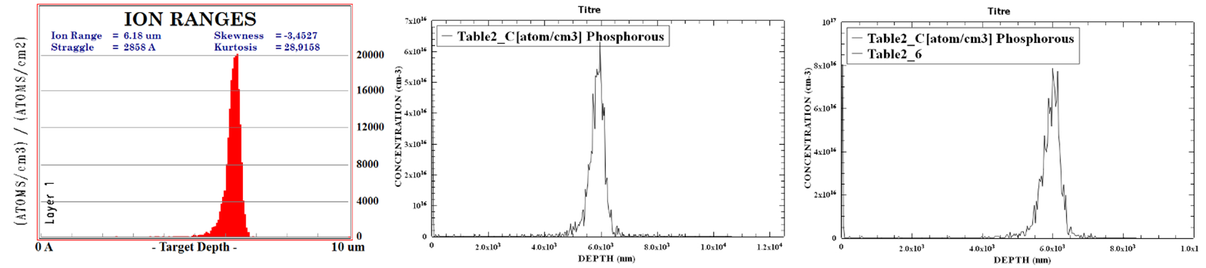

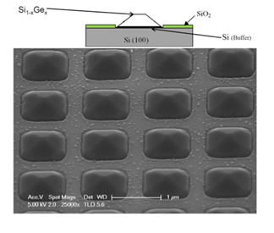



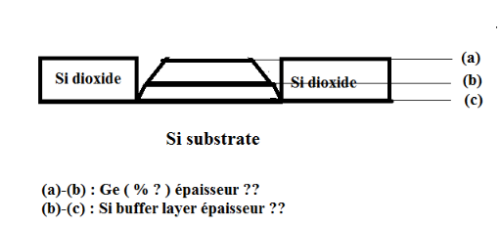


Status on TRAMOS (Trapping MOS) and DotPix (Quantum Dot Pixel) ongoing developments
Nicolas T. Fourches, IRFU/CEA Saclay, 91191 GIF/YVETTE, France
E-mail: nicolas.fourches@cea.fr
Technological progress
SRIM (Stopping and Range of Ions In Matter) simulations and SIMS (Secondary Ion Mass Spectroscopy, GEMAC equipement) for Phosphorous implanted at high energy (14 MeV in silicon ) for Deep-n-well , at 5 μm below the surface, no need for high doses.
Alternative to ion-implantation
UHV/CVD of SiGe on a silicon substrate grown on the whole wafer surface
Si/ grey and Ge/blue
Pseudomorphic layer (4%, lattice mismatch between Ge and Si)
Ge lattice constant : 0.565 nm and Si : 0.5431 nm
Normally Ge/Si compressively strained
Ge >> 20 nm metastable or relaxed
C2N equipement
Selectively etched and
grown

Slide 16
Status on TRAMOS (Trapping MOS) and DotPix (Quantum Dot Pixel) ongoing developments
Nicolas T. Fourches, IRFU/CEA Saclay, 91191 GIF/YVETTE, France
E-mail: nicolas.fourches@cea.fr
Summary and further work
Device simulations have been extended to the case of p-channel device and are encouraging
Characterisation of Si/Ge/Si epi layers are under way. These were made at C2N by Charles Renard and coworkers
Work is under way to make a MOS process with reduced thermal budget, to limit inter diffusion
Participating institutes are welcome, and people too, for simulation, modelling , characterisation and technology
The project is open, some collaboration with DEPFETor CMOS researchers would be particularly appreciated
ILC and FCC would benefit from this R&D , joint R&D ?
Work with facilities or laboratories with material characterisation competences is sought: ion implantation, SIMS, RBS, electrical measurements such DLTS, epitaxial growth and CMOS processing , this would contribute to accelerate the developments along with irradiation facilities
Contributions from : Charles Renard (C2N) and G. Hallais, Francois Jomard (GEMAC), Francois Olivie and coworkers (LAAS), the EMIR network (Jannus/Saclay) with G.Gutierrez
Jannus: Joint Accelerators for Nano and Nuclear Science); C2N Centre de Nano Science et de Nanotechnologies
Laboratoire d’Analyse et d’Architecture des Systèmes; GEMAC (Groupe d’Etude de la Matière Condensée)

Slide 17
Status on TRAMOS (Trapping MOS) and DotPix (Quantum Dot Pixel) ongoing developments
Nicolas T. Fourches, IRFU/CEA Saclay, 91191 GIF/YVETTE, France
E-mail: nicolas.fourches@cea.fr
Work published up to now:
N. Fourches,Y. Degerli, M.Besançon, A.Besson, G. Claus,G. Deptuch, W. Dulinski, M. Goffe, A. Himmi, Y. Li, P. Lutz, F.Orsini, M. Szelezniak.. (2005, October). “Performance of a fast programmable active pixel sensor chip designed for charged particle detection”. In IEEE Nuclear Science Symposium Conference Record, 2005 (Vol. 1, pp. 93-97). IEEE. http://dx.doi.org/10.1109/NSSMIC.2005.1596214
NT. Fourches,“Device simulation of Monolithic Active Pixel Sensors: Radiation damage effects”, Nuclear Science Symposium Record , Pages 2523-2529 , IEEE Transactions On Nuclear Science, Vol. 56, No.6,December 2009, Pages 3743-3751, http://doi.org/10.1109/TNS.2009.2031540
Nicolas T. Fourches, “Ultimate Pixel Based on a Single Transistor With Deep Trapping Gate”, IEEE Transactions On Electron Devices”, Volume 64, Issue 4, (2017) 1619-1623 http://doi.org/10.1109/TED.2017.2670681
N. Fourches, E. Orsier , J du Port de Pontcharra, R. Truche , “Design and test of elementary digital circuits based on monolithic SOI JFETs”, IEEE Transactions on Nuclear Science Vol 45 N° 1 February 1998, http://dx.doi.org/10.1109/23.659553
Nicolas T. Fourches, “A novel CMOS detector based on a deep trapping gate”, Nuclear Science Symposium Conference Record (NSS/MIC, 2010), p 655-658, 2010, Knoxville, Tennessee: http://dx.doi.org/10.1109/NSSMIC.2010.5873840,Nicolas Fourches, "Semiconductor device ", U.S. Patent No. 7,936,018. 3 May 2011
Vishant Kumar, Master II, Thesis, Ecole des Mines de Nantes, defended September 2016, available on request at IRFU
N. T. Fourches, & W. Vervisch, (2016). “Simulations of a silicon pixel based on MOS Deep Trapping Gate Principle, arXiv preprint arXiv: 1602.00263. http://arxiv.org/abs/1602.00263

Slide 18
Status on TRAMOS (Trapping MOS) and DotPix (Quantum Dot Pixel) ongoing developments
Nicolas T. Fourches, IRFU/CEA Saclay, 91191 GIF/YVETTE, France
E-mail: nicolas.fourches@cea.fr
EXTRA SLIDES

Slide 19
Status on TRAMOS (Trapping MOS) and DotPix (Quantum Dot Pixel) ongoing developments
Nicolas T. Fourches, IRFU/CEA Saclay, 91191 GIF/YVETTE, France
E-mail: nicolas.fourches@cea.fr
EXTRA SLIDES
Pixel Size 10 μm *10 μm, Thickness 10 μm:
Appl. Phys. A 50, 151-156 (1990) Applied so,,,,
Physics A S"u'rf aces
© Springer-Verlag 1990
The Electrical Properties of Zinc in Silicon
S. Weiss, R. Beckmann, and R. Kassing
Institut fiir Technische Physik, Universit/it, D-3500 Kassel, Fed. Rep. Germany
Received 25 May 1989/Accepted 7 September 1989
Abstract. Electrically active deep levels related to zinc in silicon are investigated in n- and
p-type silicon using Deep-Level Transient Fourier Spectroscopy (DLTFS) measurements.
While in n-type silicon a level at Ec-0.49 eV is observed, the main zinc-related levels in
p-type silicon are determined to be E v + 0.27 eV and Ev + 0.60 eV. The latter are associated
with zinc situated on regular silicon lattice sites. The emission rate of these centers exhibits a
field dependence which cannot be quantitatively explained with the Poole-Frenkel model.
On the other hand, a shallow level at E v + 0.09 eV is observed only in boron-doped silicon
which may be related to a zinc-boron complex. Other zinc-related levels are found at
E v +0.23 eV and Ev+ 0.33 eV, their concentration depending on that of zinc on substitutional
sites. In addition, the evaluation of depth profiles and the analysis of the field
dependence of the emission rate based on the DLTFS method is presented

