Slide 1



RD50 Acceptor Removal Project
and Defect Characterization at CERN
33rd RD50 Workshop, 26-28 of November, 2018, CERN, Geneva, Switzerland
Y. Gurimskayaª, P. Dias de Almeida^{a,b}, M. Fernández Garcia^{b}, I. Mateuª, M. Mollª, I. Veliscek^{c}
Co-authors: Eckhart Fretwurst^{d}, Ioana Pintilie^{e}, Leonid Makarenko^{f}
ª CERN
^{b} IFCA(CSIC-UC)
^{c} Imperial College London
^{d} Institute for Experimental Physics, University of Hamburg
^{e} National Institute of Material Physics, Magurele, Romania
^{f} Belarusian State University, Minsk, Belarus

Slide 2
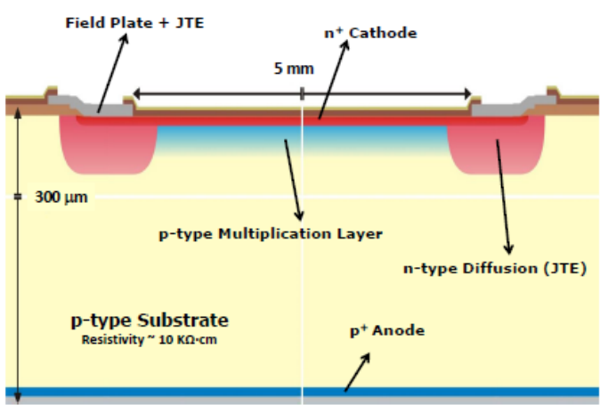
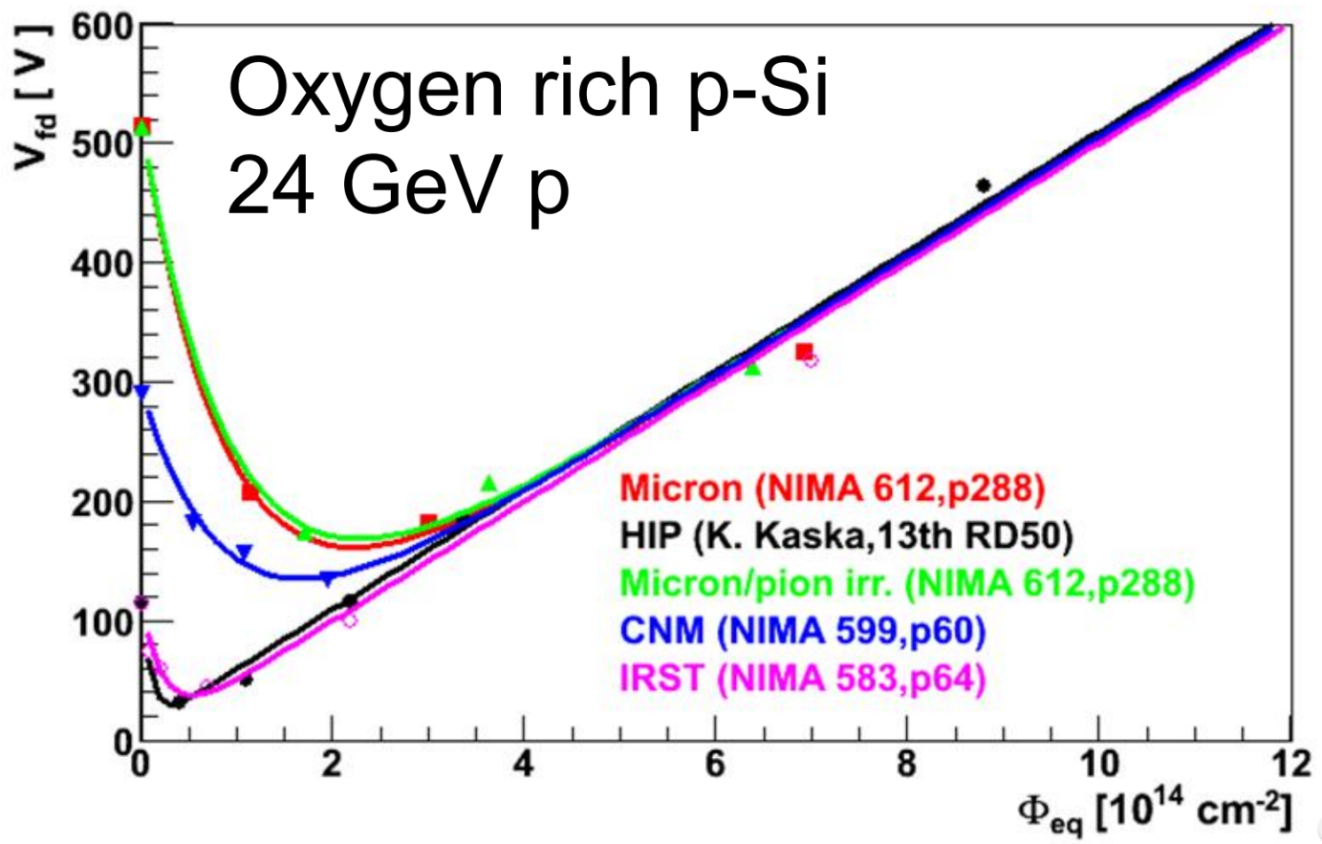
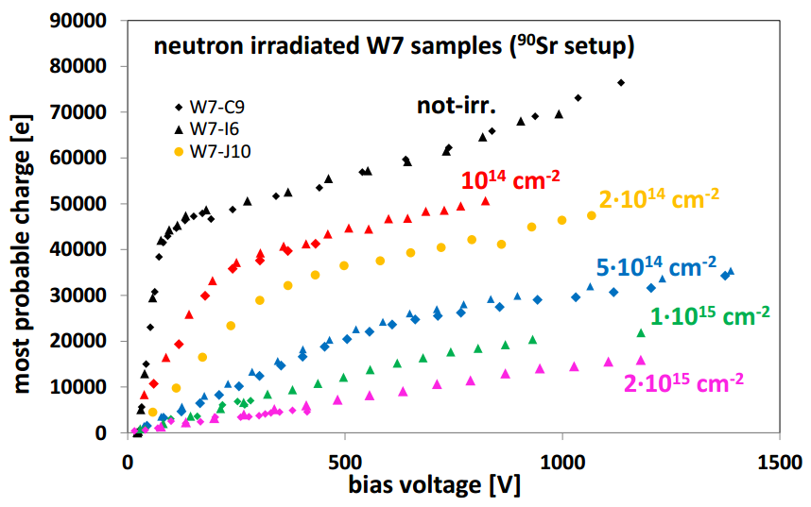
Motivation
‘Acceptor removal’:
Apparent de-activation of B as a shallow dopant with fluence leading to the change of V_{dep} and N_{eff} on the macroscopic level
Macroscopic studies:
Fast timing sensors:
‘Acceptor removal’ is observed in sensors mainly as a shift of V_{dep} obtained from CV measurements
LGAD (Low Gain Avalanche Detector)
Yana Gurimskaya, 33rd RD50 Workshop, 26-28 of November, 2018, CERN, Geneva, Switzerland
G. Kramberger et al, JINST (2015)
G. Kramberger et al, VERTEX (2016)
Gain of these sensors decreases with exposure to the radiation due to the ‘acceptor removal’

Slide 3
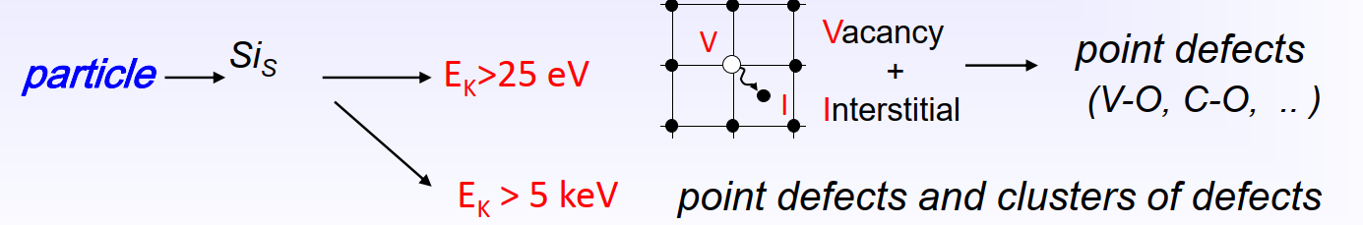
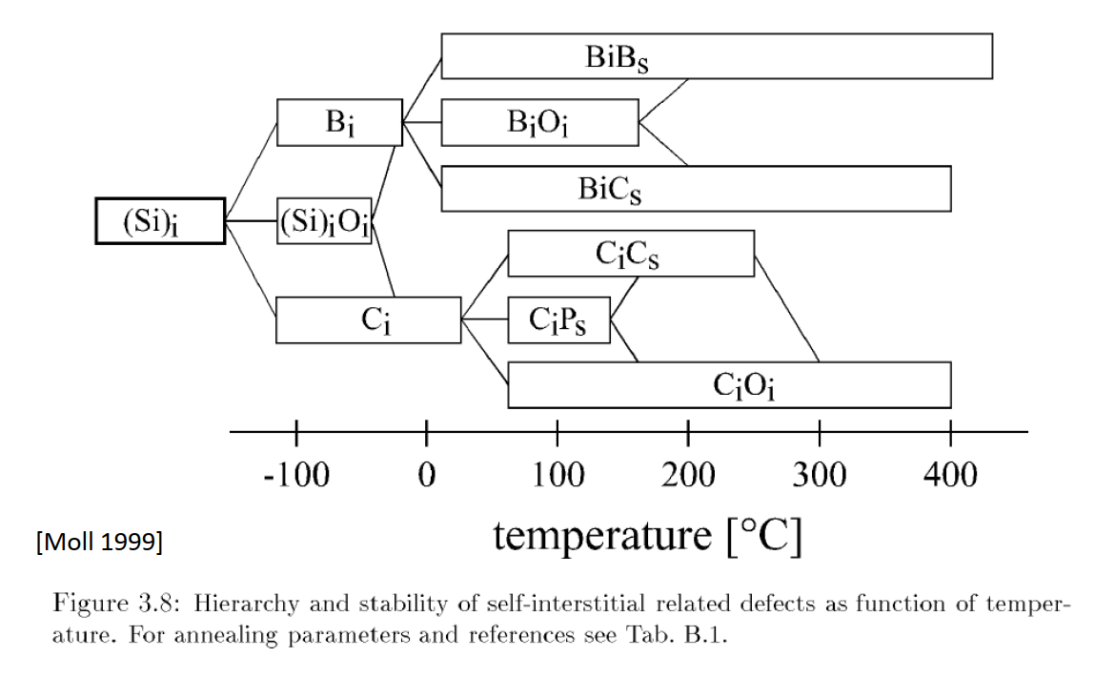
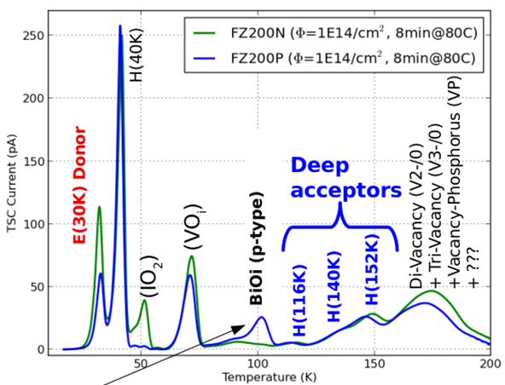
Motivation
‘Acceptor removal’:
Originated from B_{i}O_{i} complex formation on the microscopic level
I + B_{s} → B_{i}
B_{i} + O_{i} → B_{i}O_{i}
B and C competing for interstitials
High 𝞺 Si: O≫C≫B leading to the production of mainly CiOi
Yana Gurimskaya, 33rd RD50 Workshop, 26-28 of November, 2018, CERN, Geneva, Switzerland
TSC measurement on defects produced by 23 MeV protons

Slide 4
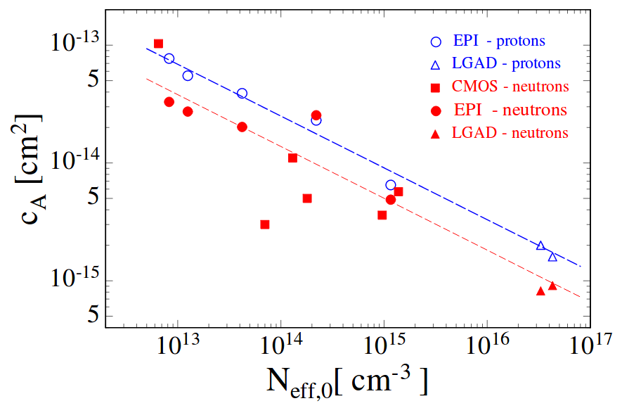
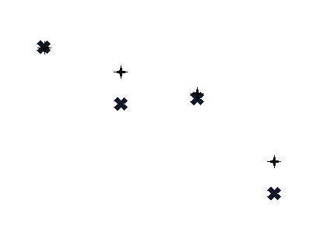
Motivation
Parameterisation as
N_{eff}(𝚽)=N_{C0}exp(-c𝚽)
with (often) complete acceptor removal (N_{C0}=N_{eff,0}) for proton and incomplete - for neutron irradiation
Updated EPI Protons
K. Kaska (2014)
http://repositum.tuwien.ac.at/obvutwhs/content/titleinfo/1633435
A. Affolder et al. (2016)
https://doi.org/10.1088/1748-0221/11/04/P04007
E. Cavallaro et al. (2017)
https://doi.org/10.1088/1748-0221/12/01/C01074
B. Hiti et al. (2017)
https://doi.org/10.1088/1748-0221/12/10/P10020
I. Mandić et al. (2017)
https://doi.org/10.1088/1748-0221/12/02/P02021
P. Dias de Almeida (2017)
https://indico.cern.ch/event/637212/
G. Kramberger (2017)
https://indico.cern.ch/event/577879/
M. Moll (2018)
https://doi.org/10.1109/TNS.2018.2819506
Updated EPI Neutrons
P. Almeida et al, 32nd RD50 workshop (2018)
Yana Gurimskaya, 33rd RD50 Workshop, 26-28 of November, 2018, CERN, Geneva, Switzerland
Solution: dedicated defect and material characterization experiment
A large number of simple test structures with known B content in order to concentrate on the bulk features: unify list of the defects and their impact on sensor properties including introduction rates and annealing behaviour for different types of irradiations and materials

Slide 5

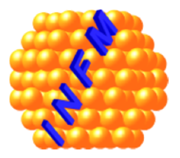


Acceptor Removal project
In the framework of RD50 collaboration
Working group
Yana Gurimskaya, 33rd RD50 Workshop, 26-28 of November, 2018, CERN, Geneva, Switzerland
CERN, Geneva
University of Hamburg, Hamburg
NIMP, Bucharest
BSU, Minsk
TSC and DLTS starting from 2019
Fluence dependence
Isothermal annealing @60∘C
TSC and DLTS
Isochronal annealing
TSC and DLTS
Isothermal annealing @80∘C
DLTS
Isochronal annealing
Forward current injection annealing

Slide 6
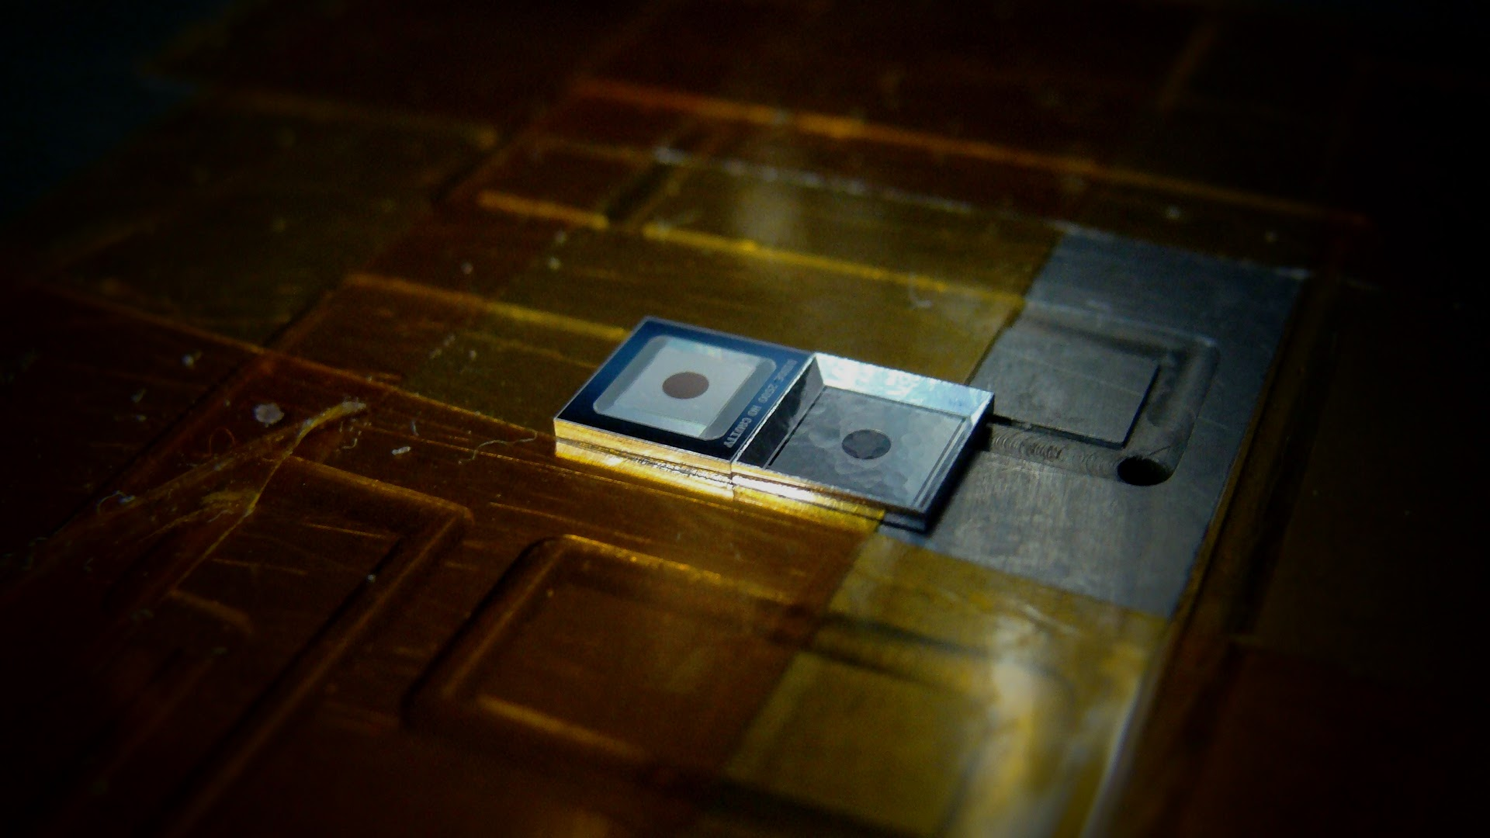
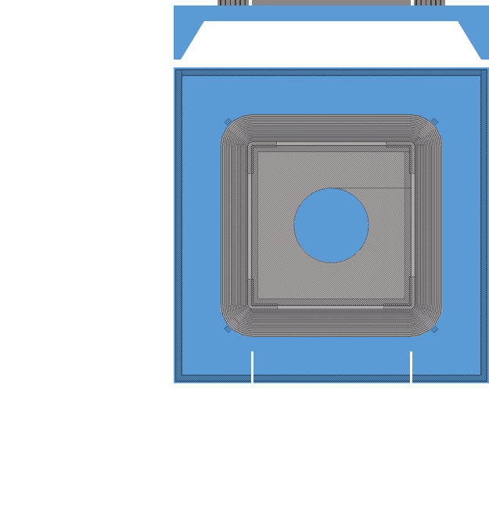
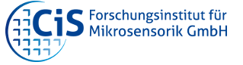
Acceptor Removal project: materials and samples
In the framework of RD50 collaboration
EPI
Resistivity 𝞺 ~ 10 (limited amount),
50, 250 or 1000 Ω·cm
50, 100 or 275 μm
Fz
Resistivity 𝞺 >10 000 Ω·cm
285 μm
50 μm
Yana Gurimskaya, 33rd RD50 Workshop, 26-28 of November, 2018, CERN, Geneva, Switzerland
Cz
Resistivity 𝞺 ~ 100 Ω·cm
100 or 285 μm
2,5 mm

Slide 7

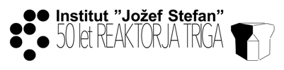
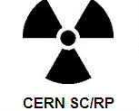

Irradiation Campaign and Distribution
In the framework of the Acceptor Removal project
Proton Irradiation
Neutron Irradiation
Electron Irradiation
24 GeV/c
reactor
3.5 MeV
Yana Gurimskaya, 33rd RD50 Workshop, 26-28 of November, 2018, CERN, Geneva, Switzerland
46 samples in total irradiated with 10 different fluences (1E10 - 5E14 p/cm²)
43 samples in total irradiated with 10 different fluences (6E09 - 3E14 n_{1MeV}/cm²)
Discussion in progress
distribution

Slide 8
Status of TSC measurements at CERN
Proton vs Neutron irradiation
Preliminary TSC results, irradiation type and fluence dependence
Filling conditions variation
Filling temperature dependence and field-enhanced behaviour of TSC spectra
Yana Gurimskaya, 33rd RD50 Workshop, 26-28 of November, 2018, CERN, Geneva, Switzerland
Annealing study
Isothermal annealing study on p-type EPI proton irradiated small pad diodes, Neff vs fluence by TSC measurements
Summary and Outlook
Future plans

Slide 9
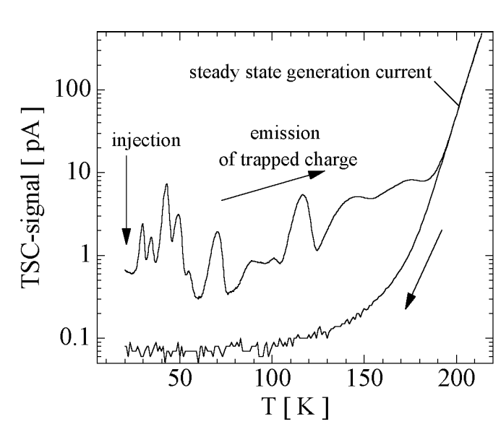
Experimental Details
Materials:
Standard EPI
Resistivity 𝞺 ~ 50, 250 or 1000 Ω·cm
EPI layer 50 μm
Substrate under EPI layer 0-255 μm
p-type Si pad diodes produced by CiS (Erfurt, Germany):
Pad area A: 2.5×2.5 mm² with guard rings
Passivated with openings for connection, window opening on FS and BS for light injection
Active thickness d: 50 μm in this particular case
Irradiation:
PS protons (CERN): fluences 7.8E13 and 3.32E14 n_{eq}/cm²
Reactor neutrons (Ljubljana): fluences 7.8E13 and 3.32E14 n_{eq}/cm²
Microscopic measurements:
TSC (Thermally Stimulated Current) technique: colling (250K 20K) under -100V, trap filling with 1 mA forward current during 60 sec, ramping up to 250K under reverse bias (standard -100V but can vary) with constant heating rate 𝜷=11 K/min
Macroscopic measurements:
IV and CV measurements @ +20 and -20 ∘C, guard ring connected to the ground (analysis of data in progress)
Yana Gurimskaya, 33rd RD50 Workshop, 26-28 of November, 2018, CERN, Geneva, Switzerland

Slide 10
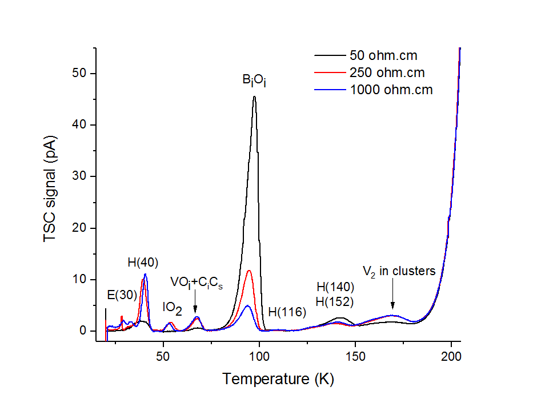
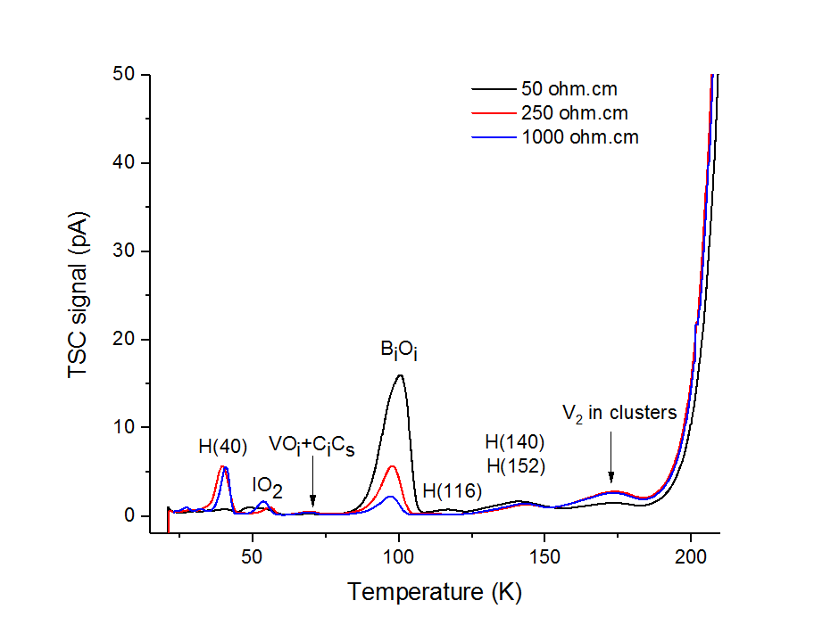
Proton vs Neutron irradiation (𝜙=7.8E18 n_{eq}/cm²). TSC spectra
+SC
Annealing: 10 min @60ºC
-SC
Protons
Neutrons
Yana Gurimskaya, 33rd RD50 Workshop, 26-28 of November, 2018, CERN, Geneva, Switzerland
Comparison of TSC spectra measured on proton and neutron irradiated with fluence 7.8E13 n_{eq}/cm²
thin EPI Si pad diodes with different resistivity.

Slide 11
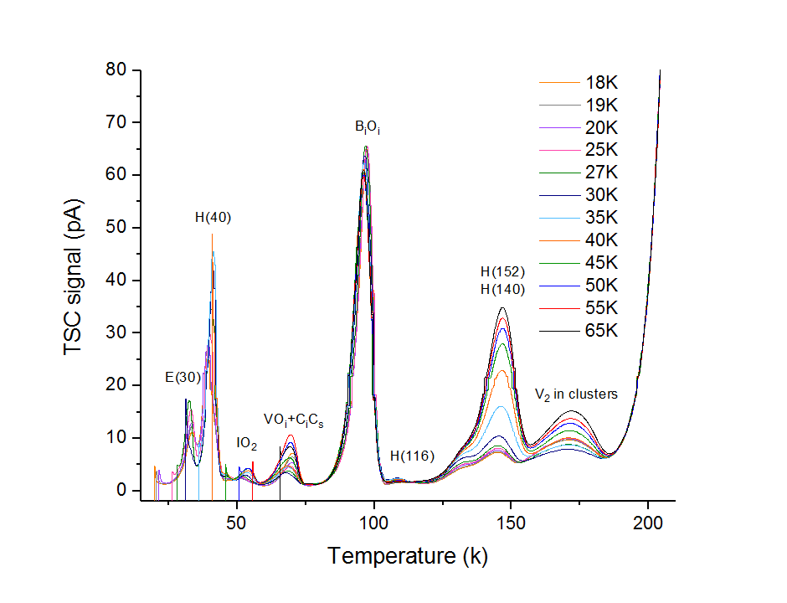

Filling Temperature variation. Protons (𝜙=3.32E14 n_{eq}/cm²)
Annealing: 10 min @60ºC
Yana Gurimskaya, 33rd RD50 Workshop, 26-28 of November, 2018, CERN, Geneva, Switzerland
Peak height of the TSC signal in dependence of the filling temperature T_{fill}=>strong dependence of the peak height for E(30), H(40), H(140-152), V₂ is observed =>can be governed by fractional occupation of the defect or T-dependent capture cross section 𝝈

Slide 12
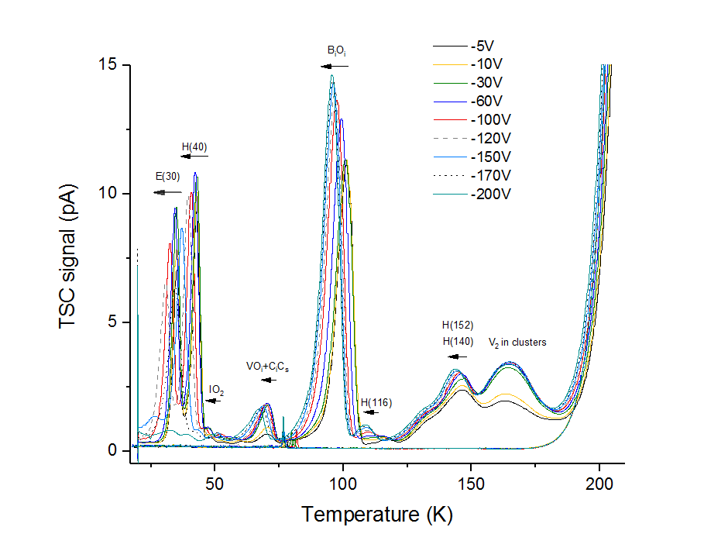
Bias Voltage variation. Protons (𝜙=3.32E14 n_{eq}/cm²)
Annealing: 10 min @60ºC
Yana Gurimskaya, 33rd RD50 Workshop, 26-28 of November, 2018, CERN, Geneva, Switzerland
TSC spectra and temperature shift in the peak position due to the variation of the bias voltage => Poole-Frenkel effect

Slide 13
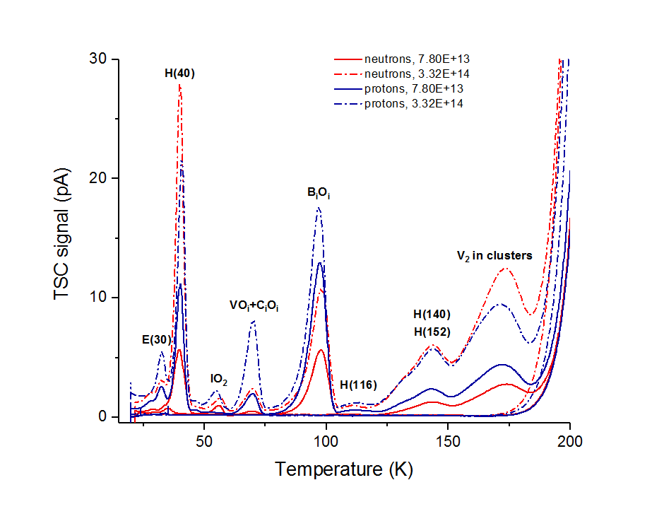
Proton vs Neutron irradiation. TSC comparison
𝞺 = 250 Ω·cm
Annealing: 10 min @60ºC
Yana Gurimskaya, 33rd RD50 Workshop, 26-28 of November, 2018, CERN, Geneva, Switzerland
High 𝝆 - E(27) defect
Fluence and particle type dependance of TSC spectra measured on thin EPI Si pad diodes with 250 ohm.cm resistivity

Slide 14

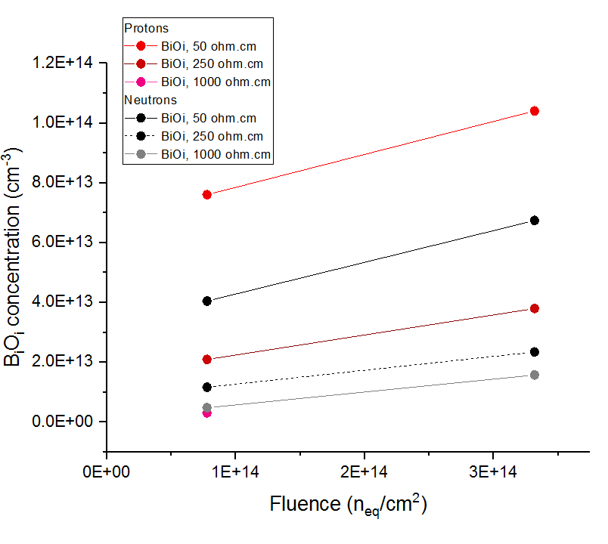
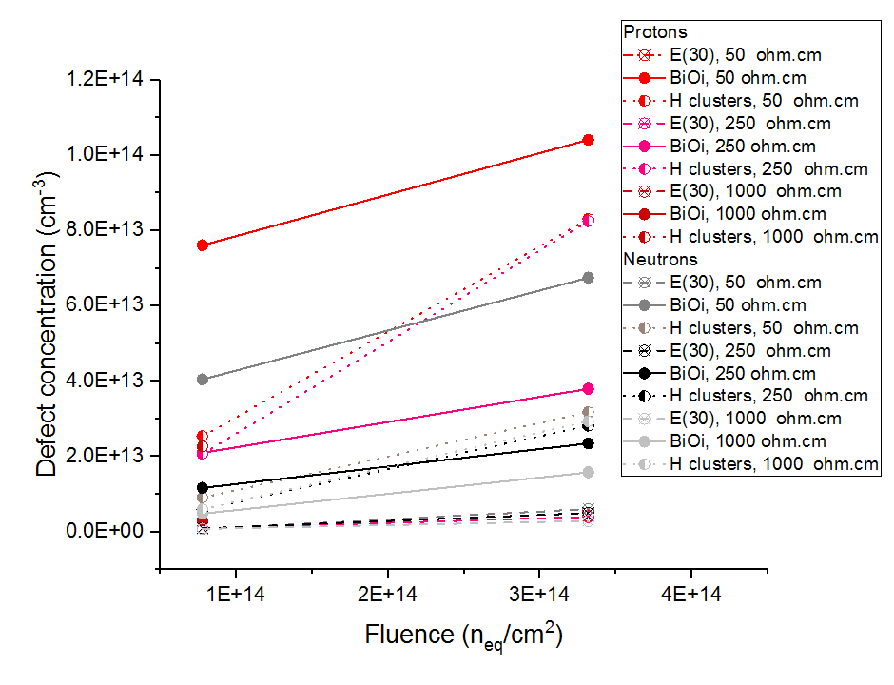
Proton vs Neutron irradiation. Defect concentration
Yana Gurimskaya, 33rd RD50 Workshop, 26-28 of November, 2018, CERN, Geneva, Switzerland
Concentration of the defects B_{i}O_{i} and E(30), H(40), B_{i}O_{i} and clusters vs resistivity and type of irradiation

Slide 15
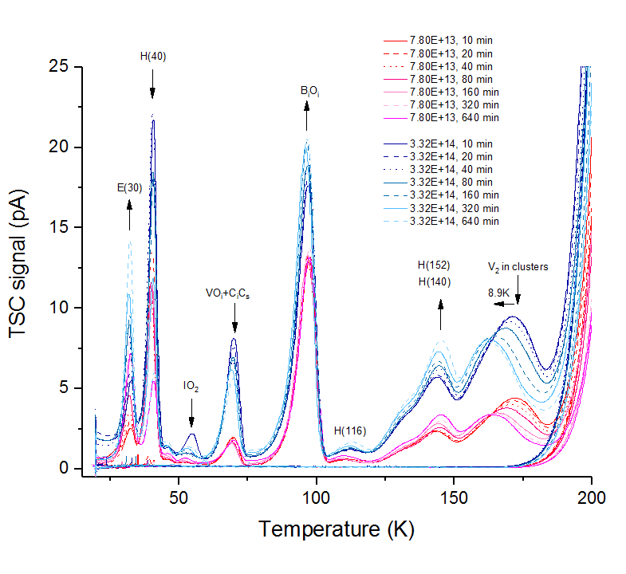
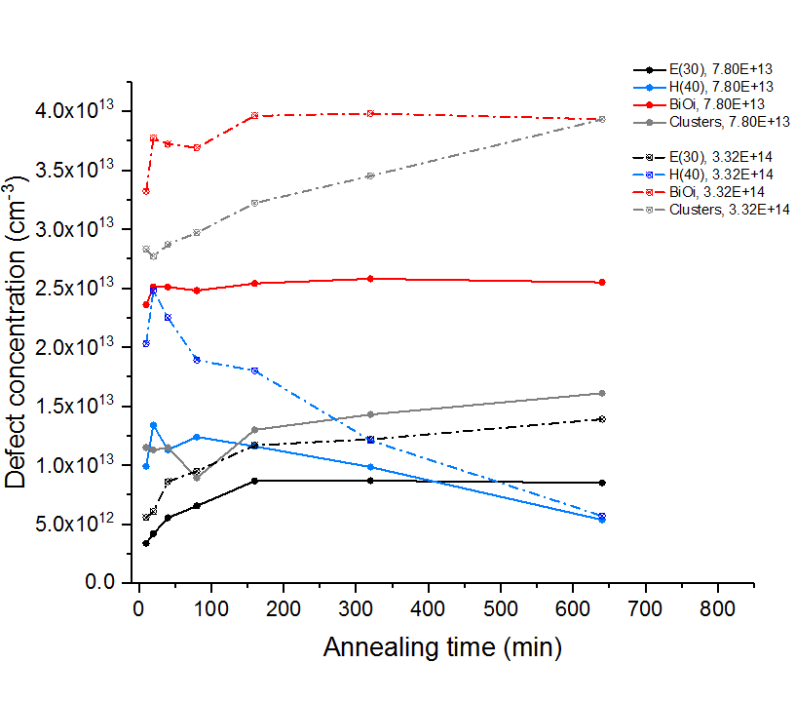
Isothermal Annealing @60∘C. Protons
Annealing evolution of the TSC spectra and defects concentration in p-type EPI silicon sensors obtained by TSC spectroscopy method due to the proton irradiation with two different fluences: 7.8E13 n_{eq}/cm² and 3.32E14 n_{eq}/cm².
Yana Gurimskaya, 33rd RD50 Workshop, 26-28 of November, 2018, CERN, Geneva, Switzerland

Slide 16
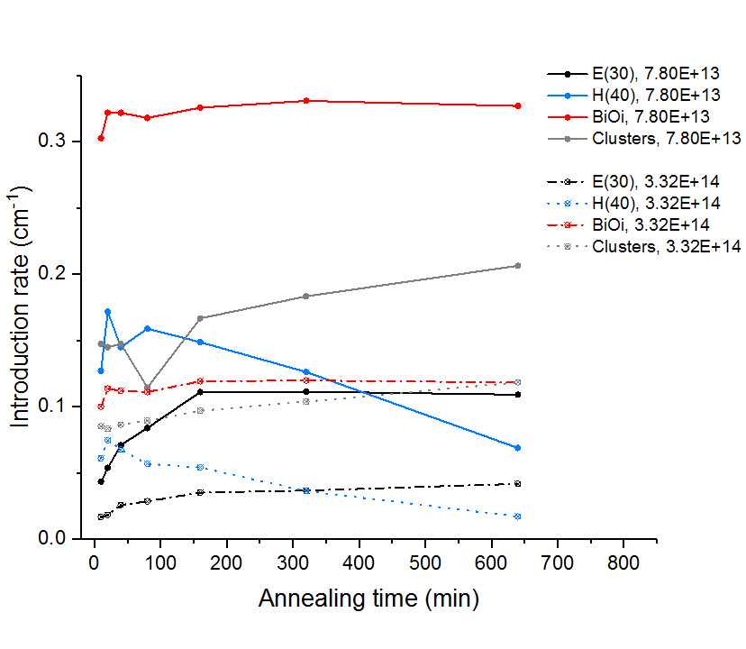
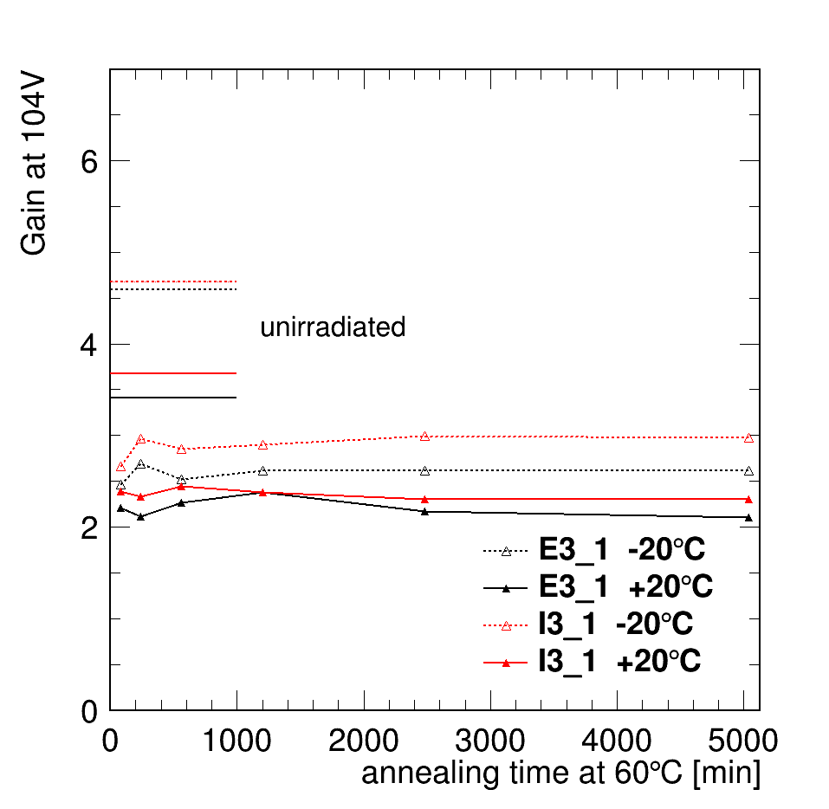
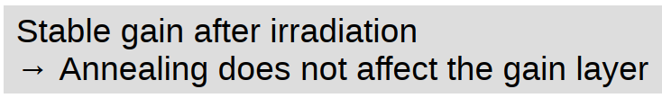
Isothermal Annealing @60∘C. Protons
Evolution of the defects concentrations normalized by fluence in p-type EPI silicon sensors obtained by TSC spectroscopy method due to the proton irradiation with two different fluences of 7.8E13 n_{eq}/cm² and 3.32E14 n_{eq}/cm² with isothermal annealing. Comparison with the results on annealing study of LGADs.
Yana Gurimskaya, 33rd RD50 Workshop, 26-28 of November, 2018, CERN, Geneva, Switzerland
See presentation of Moritz O. Wiehe “Annealing and Characterization of LGADs”
B_{i}O_{i} concentration is flat doesn’t change much with annealing

Slide 17
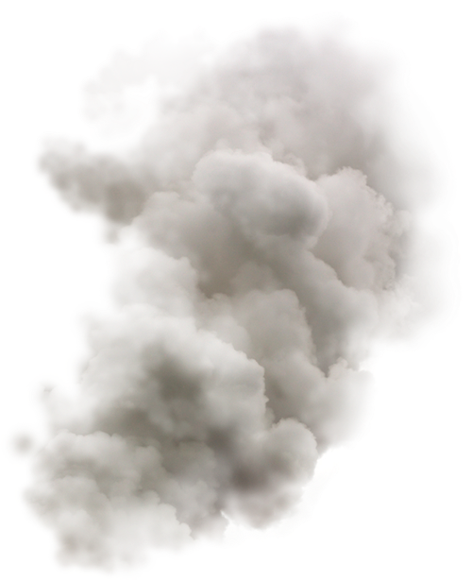
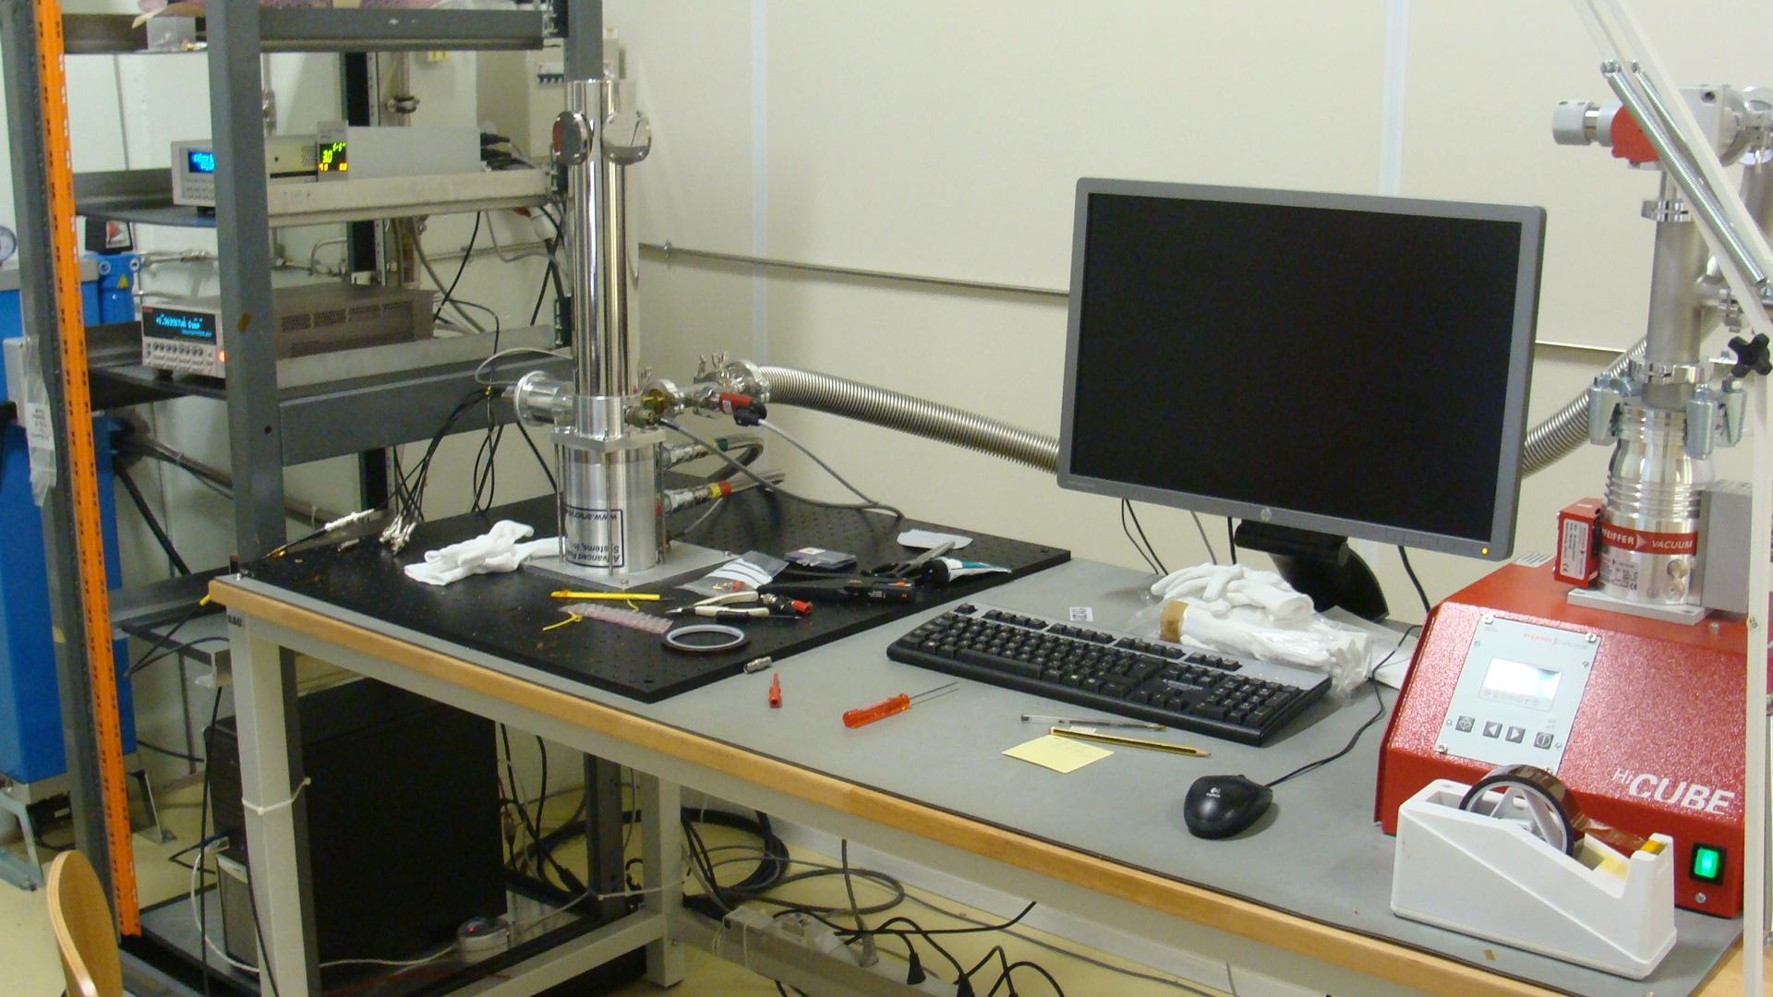
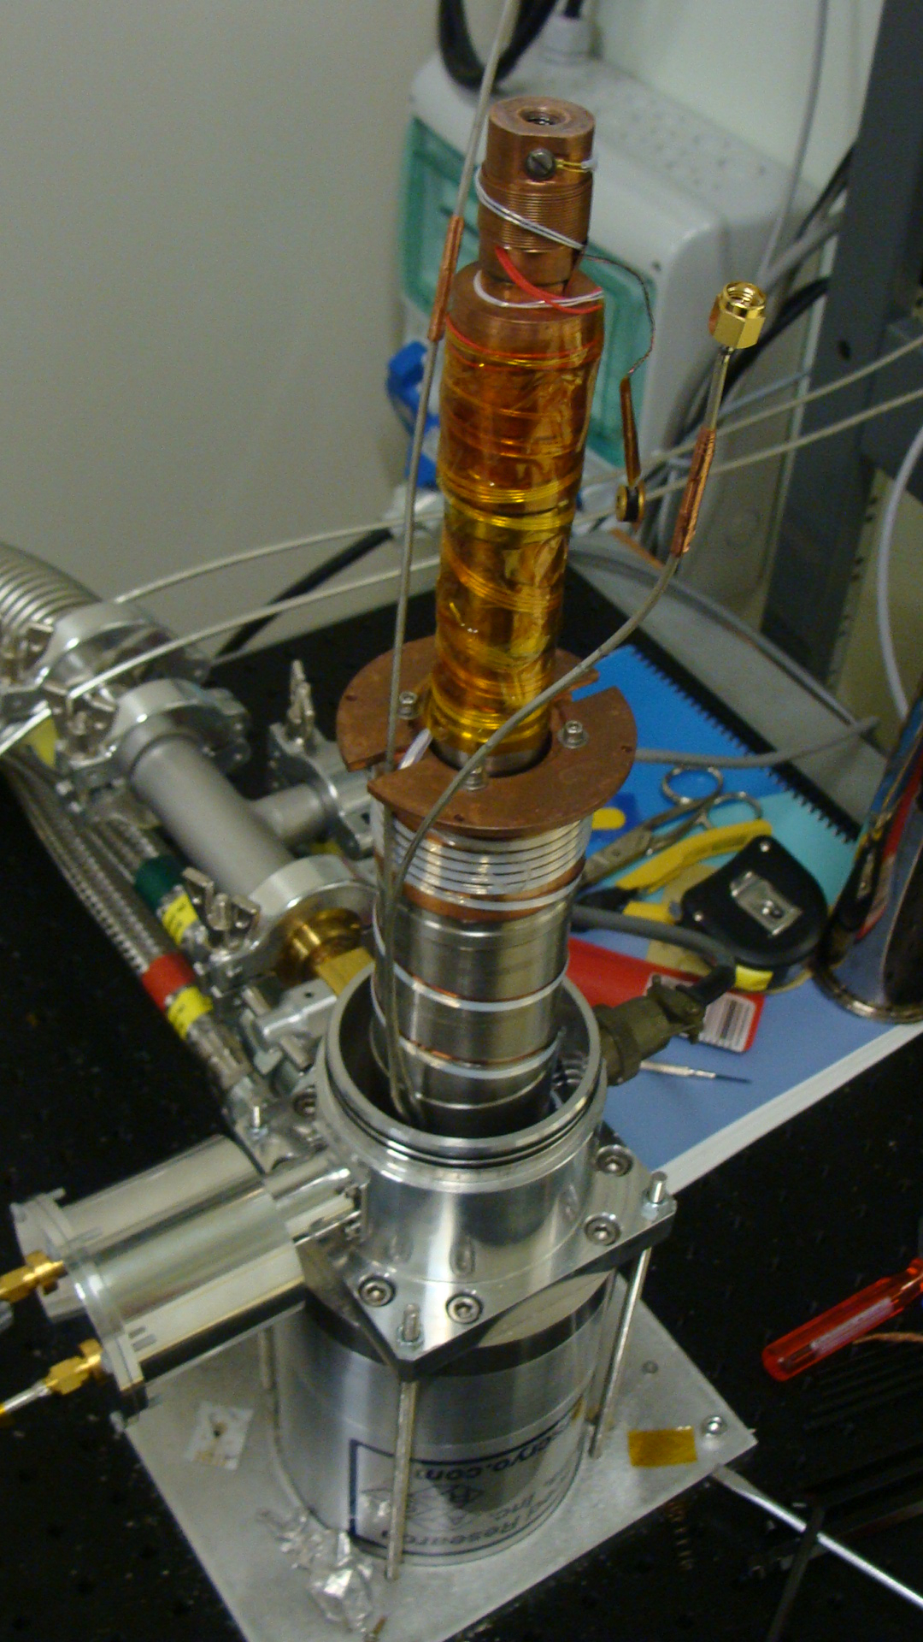
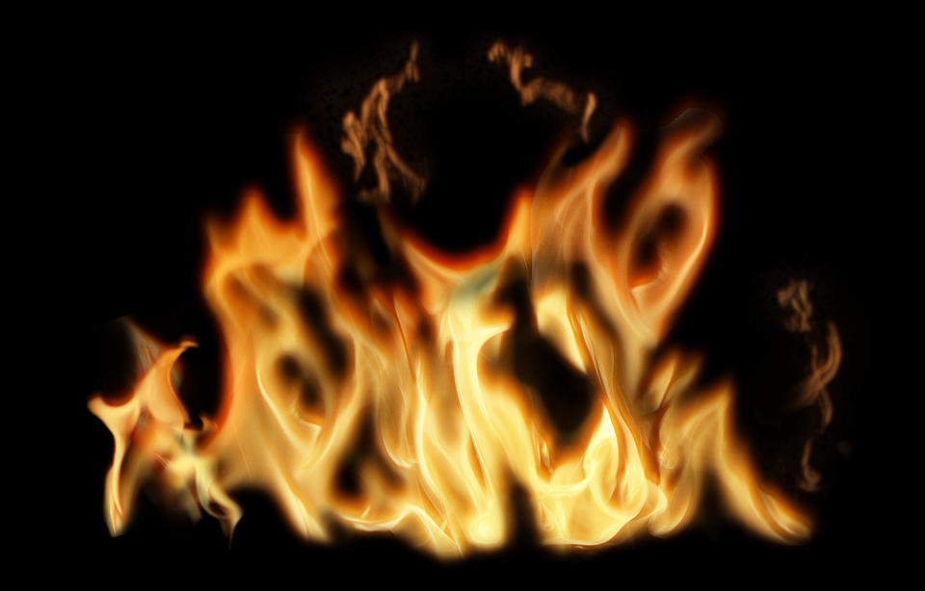

TSC workstation
>10 000 hours of working time
Yana Gurimskaya, 33rd RD50 Workshop, 26-28 of November, 2018, CERN, Geneva, Switzerland
sudden loss of cooling power
to Advanced Research Systems

Slide 18
Summary and Outlook
A new acceptor removal measurement campaign was started within four RD50 research centers - CERN, Hamburg University, NIMP Magurele/Bucharest and University of Minsk: irradiations and distribution of the samples are on the way, first data are presented or will be presented in the workshop
Strong dependence between B_{i}O_{i} production and the resistivity was detected for both proton and neutron irradiation
First thermal annealing studies show that B_{i}O_{i} does not anneal @60ºC (max 640 min), which is coherent with the annealing study results on LGADs: the gain is not affected by the annealing
Further measurements should be performed for additional fluences and other materials - Cz and Fz. Additional TSC with red light illumination, determination of the signatures for other observed defects should be obtained to complete existing result. Comparison with macroscopic measurements is on its way
Yana Gurimskaya, 33rd RD50 Workshop, 26-28 of November, 2018, CERN, Geneva, Switzerland

Slide 19

Yana Gurimskaya, 33rd RD50 Workshop, 26-28 of November, 2018, CERN, Geneva, Switzerland

Slide 20
Spare slides
Yana Gurimskaya, 33rd RD50 Workshop, 26-28 of November, 2018, CERN, Geneva, Switzerland

Slide 21

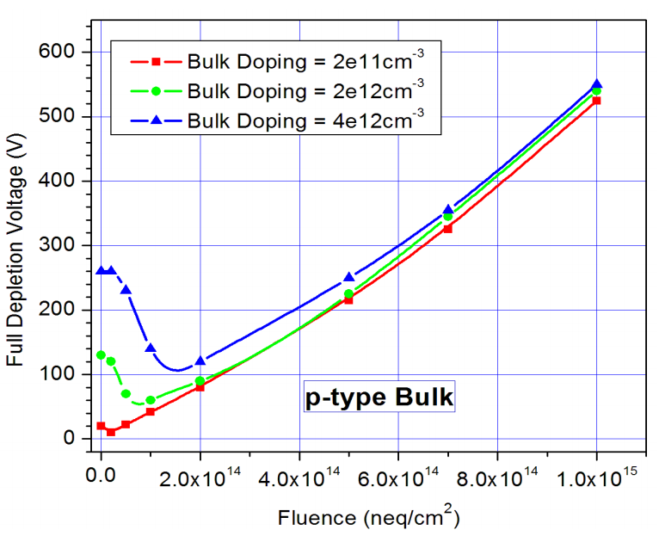
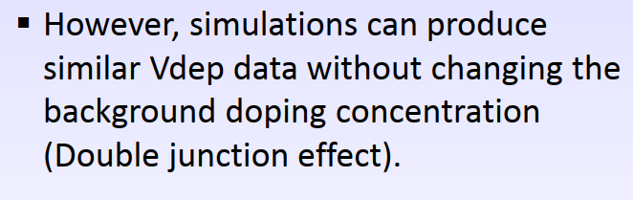
Acceptor removal
G. Kramberger, 23rd RD50 Workshop
  Apparent dopant removal due to the irradiation
  Parameterization as
  For neutron irradiation, incomplete acceptor removal is also considered (N_{c} < N_{eff0})
Yana Gurimskaya, 33rd RD50 Workshop, 26-28 of November, 2018, CERN, Geneva, Switzerland
Ranjeet Dalal et al, 25th RD50 Workshop
Simulation can qualitatively reproduce this behaviour without Boron removal

Slide 22
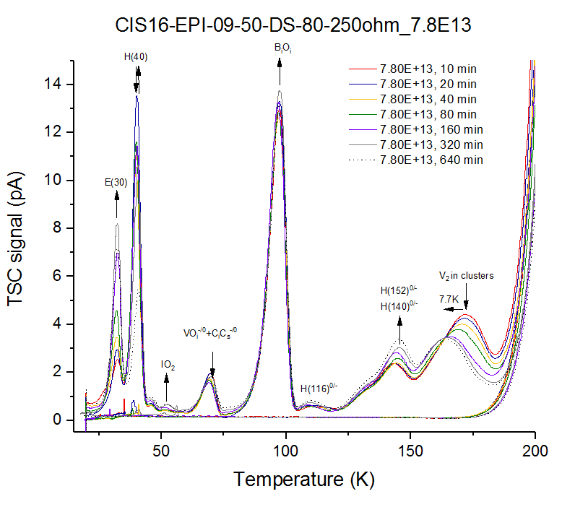
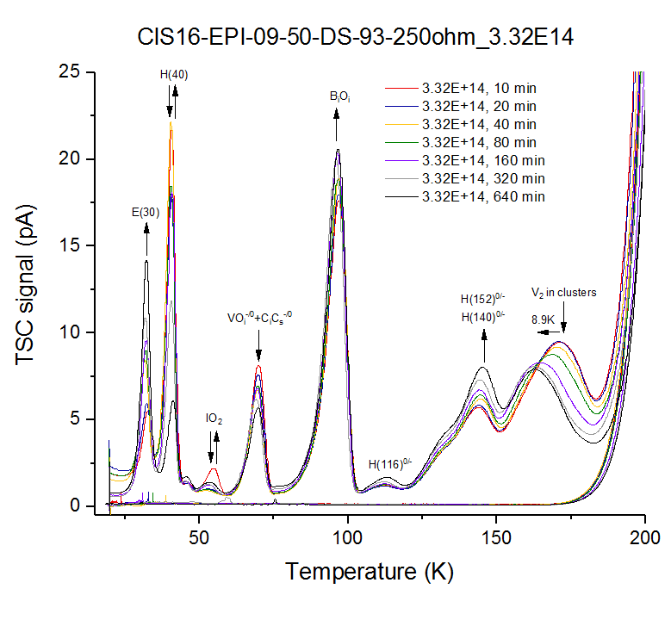
Isothermal Annealing @60∘C. Protons
Yana Gurimskaya, 33rd RD50 Workshop, 26-28 of November, 2018, CERN, Geneva, Switzerland

Slide 23
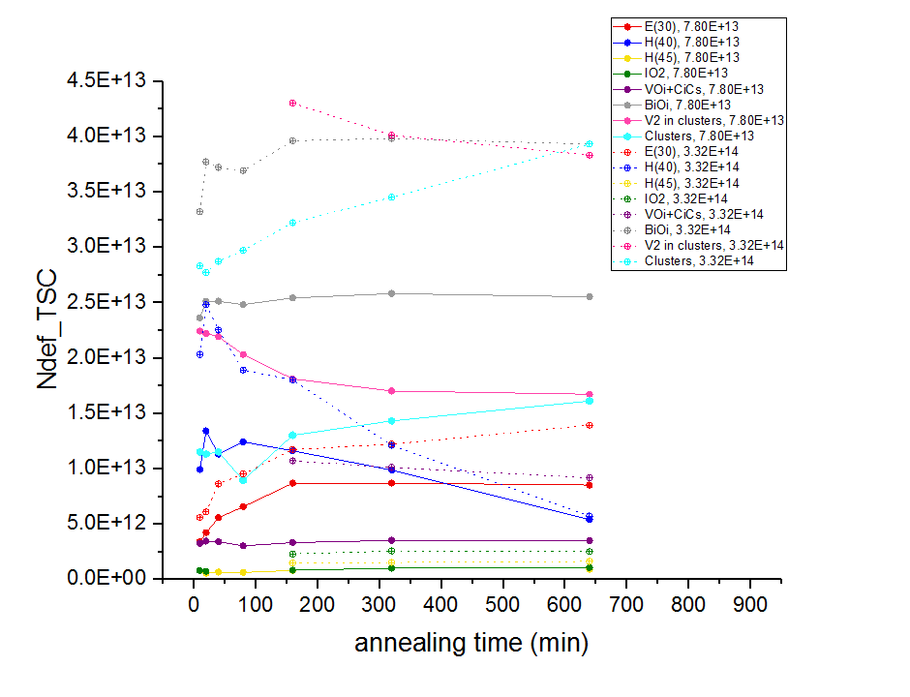
Isothermal Annealing @60∘C. Protons
Yana Gurimskaya, 33rd RD50 Workshop, 26-28 of November, 2018, CERN, Geneva, Switzerland

Slide 24
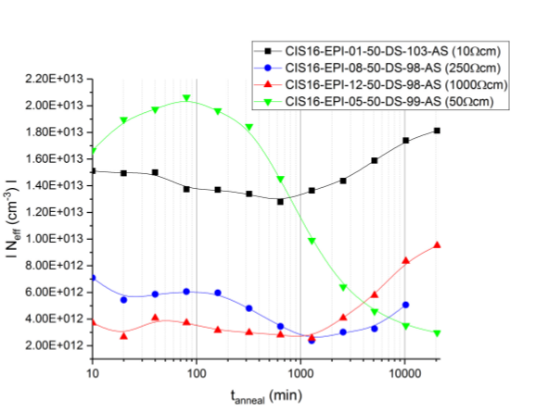
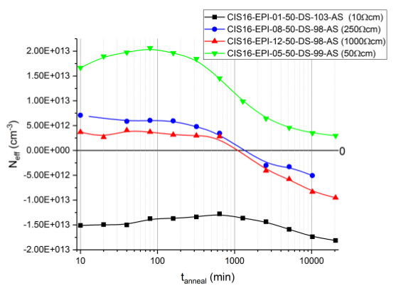
Annealing Study Interpretation of Neff
Data
Interpretation of the data assuming type inversion
Annealing at 60ºC
Up to 20480 min or ~14 days of accumulated annealing
Neff calculated from CV measurements

