Slide 1

Electrically active defects in unirradiated p-type silicon detectors fabricated by different vendors
Cristina Besleaga Stan, Roxana Radu, Raluca Negrea and Ioana Pintilie
National Institute of Materials Physics, Bucharest-Magurele, Romania

Slide 2
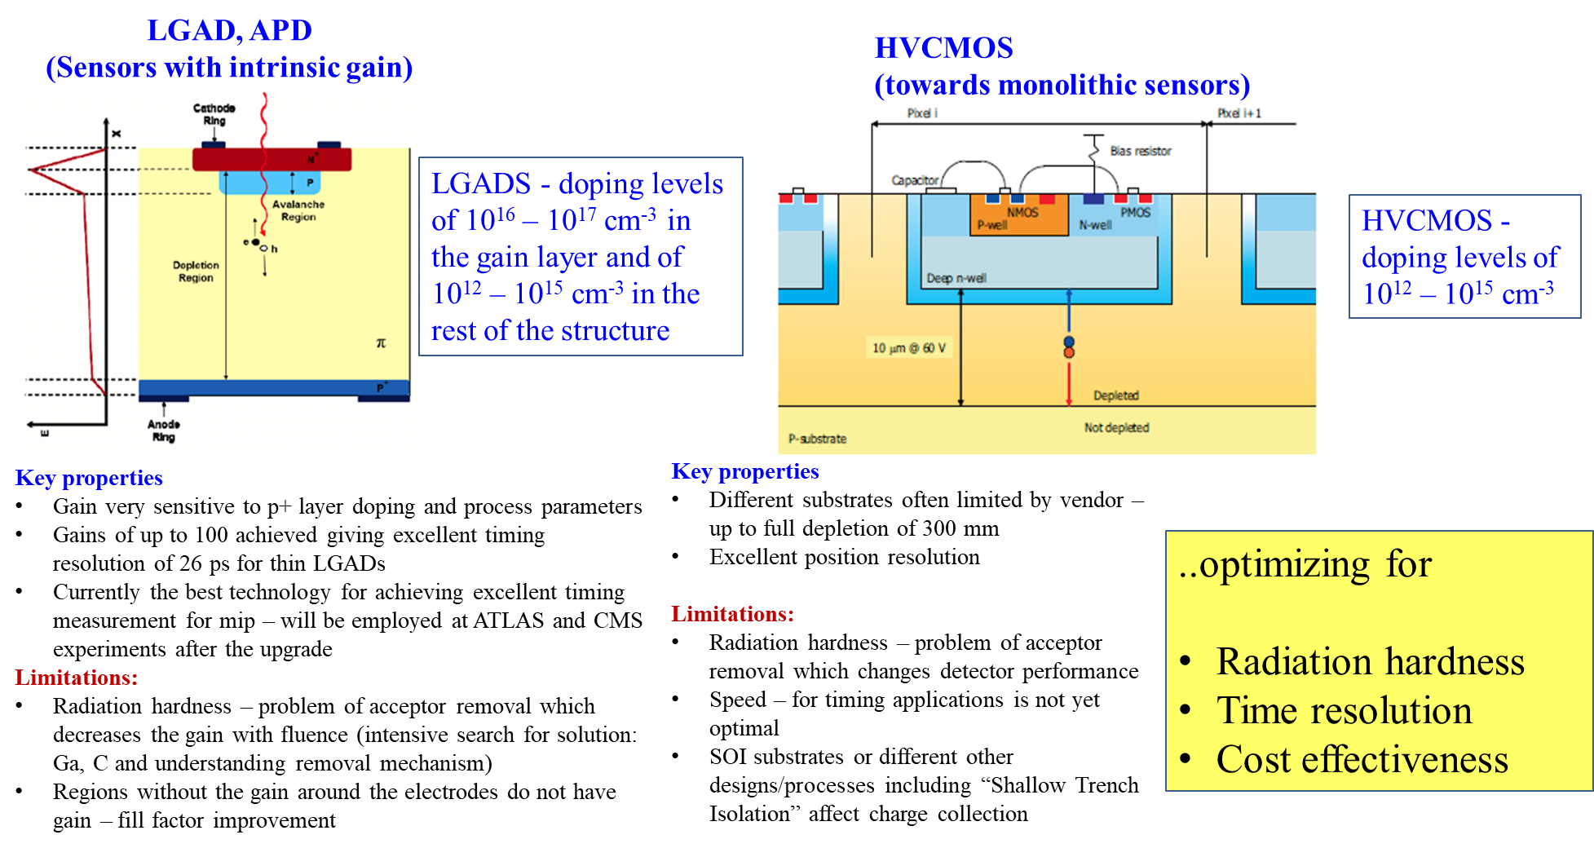
Motivation
New structures based on p-type silicon

Slide 3
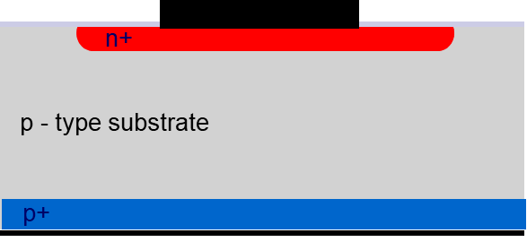
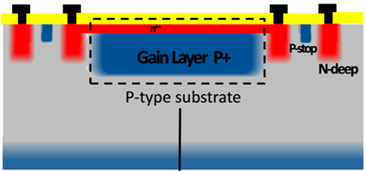
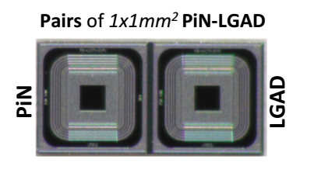
Investigated unirradiated p-type samples
PiN pads
LGADs
20 different p-type bulk Boron doped STFZ diodes manufactured by different companies:
Hamamatsu (2)
Infineon Technologies (6)
Fondazione Bruno Kessler (FBK) (12)
14 LGAD structures produced on STFZ silicon by
- Fondazione Bruno Kessler (FBK) with defect engineered gain layers - implantations of B or Ga alone and co-doped with C

Slide 4
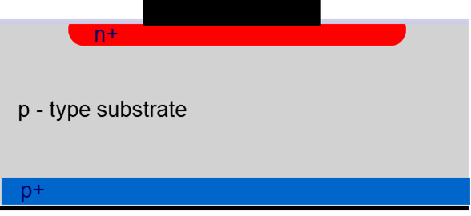
PiN pad diodes – Hamamatsu and Infineon
Nr | Sample | Depletion voltage (V_{dep}) | Doping concentration N_{eff} (cm⁻³) | Leakage Current Normalized at 20°C (A) | Area (cm²) | Current density (A/cm²)
1 | VPX18592 | 180 | 4.42x10¹² | 3.28x10⁻⁹ | 0.25 | 1.48x10⁻⁸
2 | VPX21779 | 140 | 4.8 x10¹² | 2.51x10⁻⁹ | 0.065 | 4x10⁻⁸
3a | VE711408-09 | 150 | 2.5 x10¹² | 6.22x10⁻⁸ | 0.25 | 2.488x10⁻⁷
3b | VE711408-24 | 240 | 3.5 x 10¹² | 8.83x10⁻⁹ | 0.25 | 3.532x10⁻⁸
4a | VE543425-06 | 53 | 2 x 10¹² | 2.4x10⁻⁸ | 0.25 | 9.6x10⁻⁸
4b | VE543425-10 | 60 | 2.2 x 10¹² | 1.49x10⁻⁸ | 0.25 | 5.96x10⁻⁸
5 | VL740654-18 | No saturation>500V | 3.5 x 10¹² | Max at 500V 1x10⁻⁹ | 0.065 | 1.538x10⁻⁸
6 | VE525852-01 | 66 | 2 x 10¹² | 2.32x10⁻⁸ | 0.25 | 9.28x10⁻⁸

Slide 5
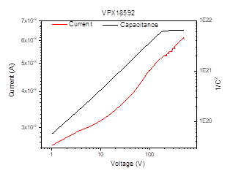
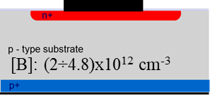
PiN diodes – Hamamatsu
C-V, I-V characteristics
DLTS investigations
VPX samples
- there are several intrinsic defects in the volume of the samples generated during the growth or processing of the wafers
- the amount of trapping centers for holes much larger than of those for electrons
- H(217K) – a trap for holes is the defect found in the highest concentration, also not homogeneous distributed in the bulk (more near the n⁺ contact)
Depletion voltage (V) | 180
Leakage Current at 20°C (A) | 3.28x10⁻⁹
Area (cm²) | 0.25
Width (um) | 214
LC/vol (A/cm²) | 1.48x10⁻⁸

Slide 6
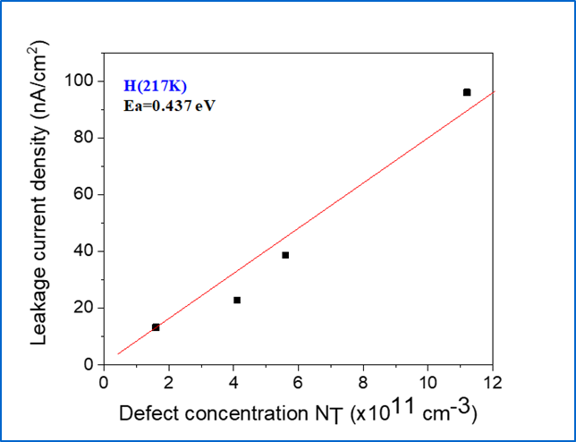
PiN diodes – Infineon
Large differences in defect concentrations from sample to sample
Large variations in Leakage Current - H(217K) could be the cause

Slide 7
PiN diodes – Hamamatsu and Infineon
Characterization of H(217K) defect
From maxima analyses (activation energy and apparent capture cross section)
From transient analyses at constant temperatures:
  direct measurement of the capture cross section for holes
  Activation energy, entropy factor
Method | Activation energy E_{a} (eV) | Capture cross section σ_{p} (cm²) at the peak temperature
Maxima analysis | 0.42 | 9.1x10⁻¹⁶ 3 x10⁻¹⁷ X_{T} =30.3
Transient and capture measurement at (217K) | 0.437

Slide 8
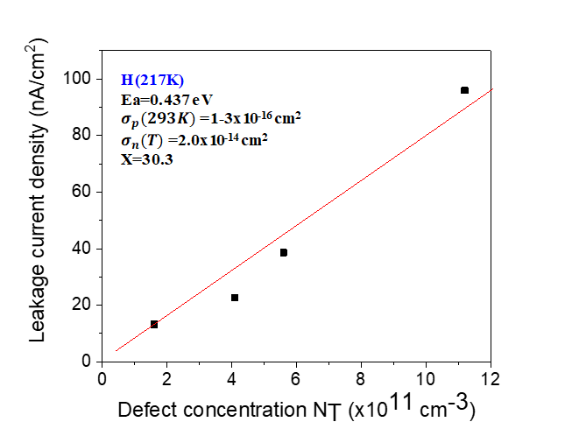
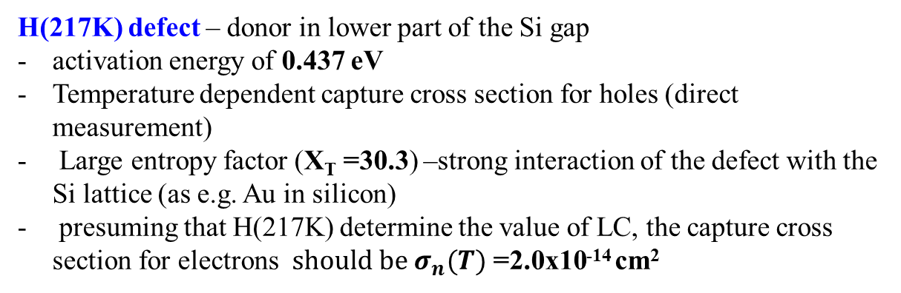
Impact of H(217K) defect on electrical characteristics at 20⁰ C
H(217K) defect – donor in lower part of the Si gap
activation energy of 0.437 eV
Temperature dependent capture cross section for holes (direct measurement)
Large entropy factor (X_{T} =30.3) –strong interaction of the defect with the Si lattice (as e.g. Au in silicon)
presuming that H(217K) determine the value of LC, the capture cross section for electrons $should be σ_{n}(T)$ =2.0x10⁻¹⁴ cm²
Schockley-Read-Hall - statistics used to calculate the impact the detected defects have on the device electrical performance
⇒ large impact LC, not charged at 20⁰ C

Slide 9
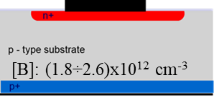
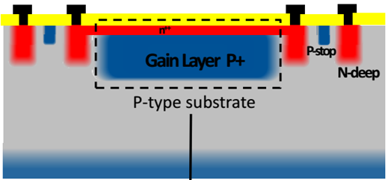
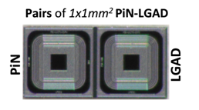
PiN and LGAD diodes -FBK
FBK UFSD2 W1 B-0.98L | Wafer 1, the gain layer implanted with B with dose 0.98 (Low diffusion-2% less)
FBK UFSD2 W6 BC-1.02 HL | Wafer 6, the gain layer implanted with B with dose 1.02(High diffusion-2% more) and co-implanted with carbon-low diffusion
FBK UFSD2 W8 B-1.02H | Wafer 8 the gain layer implanted with B with dose 1.02 (High diffusion-2% more)
FBK UFSD2 W14 G-1.04L | Wafer 14, the gain layer implanted with gallium with dose 1.04 (Low diffusion)
FBK UFSD2 W18 G-1.08L | Wafer 18, the gain layer implanted with gallium with dose 1.08 (Low diffusion)
FBK UFSD2 W15 GC-1.04LL | Wafer 15, the gain layer implanted with gallium with dose 1.04 (Low diffusion) and co-implanted with carbon-low diffusion

Slide 10
PiN diodes -FBK
 | Sample | Comments | Depletion voltage (V_{dep}) | Leakage Current Normalized at 20°C (A) | Area(mm²)- thickness (µm) | N_{eff} from CV(cm⁻³)
1 | FBK UFSD2 W1 B-0.98L | 4 ring | 3.48 | 3.03x10⁻¹¹ | 1 mm²- 50 μm | 1.83x10¹²
2 | FBK UFSD2 W1 B-0.98L | 2 rings | 3.42 | 4.03x10⁻¹¹ | 1 mm²- 50 μm | 1.79 x10¹²
3 | FBK UFSD2 W6 BC-1.02 HL | 4 rings | 3.40 | 3.35x10⁻¹¹ | 1 mm²- 50 μm | 1.78 x10¹²
4 | FBK UFSD2 W6 BC-1.02 HL | 2 rings | 3.49 | 2.80x10⁻¹¹ | 1 mm²- 50 μm | 1.83 x10¹²
5 | FBK UFSD2 W8 B-1.02H | 2 rings | 3.48 | 2.18x10⁻¹¹ | 1 mm²- 50 μm | 1.83 x10¹²
6 | FBK UFSD2 W8 B-1.02H | 4 ring | 3.38 | 3.55x10⁻¹¹ | 1 mm²- 50 μm | 1.77 x10¹²
7 | FBK UFSD2 W14 G-1.04L | 4 rings | 3.51 | 7.54x10⁻¹⁰ | 1 mm²- 50 μm | 1.84 x10¹²
8 | FBK UFSD2 W14 G-1.04L | 2 rings | 3.40 | 1.09x10⁻⁹ | 1 mm²- 50 μm | 1.78 x10¹²
9 | FBK UFSD2 W18 G-1.08L | 4 rings | 3.95 | 1.22x10⁻⁹ | 1 mm²- 50 μm | 2.07 x10¹²
10 | FBK UFSD2 W18 G-1.08L | 2 rings | 4.05 | 2.81x10⁻⁹ | 1 mm²- 50 μm | 2.15 x10¹²
11 | FBK UFSD2 W15 GC-1.04LL | 4 rings | 4.29 | 4.71x10⁻⁹ | 1 mm²- 50 μm | 2.25 x10¹²
12 | FBK UFSD2 W15 GC-1.04LL | 2 rings | 4.90 | 6.09x10⁻⁹ | 1 mm²- 50 μm | 2.62 x10¹²
leakage current of all 12 unirradiated PiN diodes.
-diodes processed on W1,W6 and W8 wafers has lower LC then those processed on W14, W15 and W18 wafers

Slide 11
LGAD diodes -FBK
 | Sample | Comments | Depletion voltage of the gain layer(V) | Full depletion voltage of sensor(V) | Leakage Current Normalized at 20°C (A) (full depletion) | Area(mm²)- thickness (mm) | N_{eff gain layer} from CV(cm⁻³) | N_{eff bulk} from CV(cm⁻³)
1 | FBK UFSD2 W1 B-0.98L | 4 ring | 22 | 25 | 7.27x10⁻¹¹ | 1 MM- 50 μm | 5.9x10¹⁶ | 1.83x10¹²
2 | FBK UFSD2 W1 B-0.98L | 2 rings | 22 | 25 | 6.42x10⁻¹¹ | 1 MM- 50 μm | 5.9x10¹⁶ | 1.79 x10¹²
3 | FBK UFSD2 W6 BC-1.02 HL | 4 rings | 22 | 25 | 2.45x10⁻¹⁰ | 1 MM- 50 μm | 5.9x10¹⁶ | 1.78 x10¹²
4 | FBK UFSD2 W6 BC-1.02 HL | 2 rings | 22 | 25 | 2.49x10⁻¹⁰ | 1 MM- 50 μm | 5.9x10¹⁶ | 1.83 x10¹²
5 | FBK UFSD2 W8 B-1.02H | 2 rings | 22 | 25 | 4.72x10⁻¹¹ | 1 MM- 50 μm | 5.9x10¹⁶ | 1.83 x10¹²
6 | FBK UFSD2 W8 B-1.02H | 4 ring | 22 | 25 | 6.75x10⁻¹¹ | 1 MM- 50 μm | 5.9x10¹⁶ | 1.77 x10¹²
7 | FBK UFSD2 W14 G-1.04L | 4 rings | 30 | 35 | 1.54x10⁻⁶ | 1 MM- 50 μm | 3.95x10¹⁶ | 1.84 x10¹²
8 | FBK UFSD2 W14 G-1.04L | 2 rings | 30 | 35 | 1.72x10⁻⁶ | 1 MM- 50 μm | 3.95x10¹⁶ | 1.78 x10¹²
9 | FBK UFSD2 W18 G-1.08L | 4 rings | 30 | 35 | 1.2x10⁻⁶ | 1 MM- 50 μm | 3.95x10¹⁶ | 2.07 x10¹²
10 | FBK UFSD2 W18 G-1.08L | 2 rings | 30 | 35 | 5.1x10⁻⁵ | 1 MM- 50 μm | 3.95x10¹⁶ | 2.36 x10¹²
11 | FBK UFSD2 W15 GC-1.04LL | 4 rings | 30 | 35 | 2.4x10⁻⁶ | 1 MM- 50 μm | 3.95x10¹⁶ | 2.25 x10¹²
12 | FBK UFSD2 W15 GC-1.04LL | 2 rings | 30 | 35 | 2.04x10⁻⁸ | 1 MM- 50 μm | 3.95x10¹⁶ | 2.62 x10¹²
Similar to PiN diodes, also the LGADs processed on W1,W6 and W8 wafers has lower LC then those processed on W14, W15 and W18 wafers

Slide 12

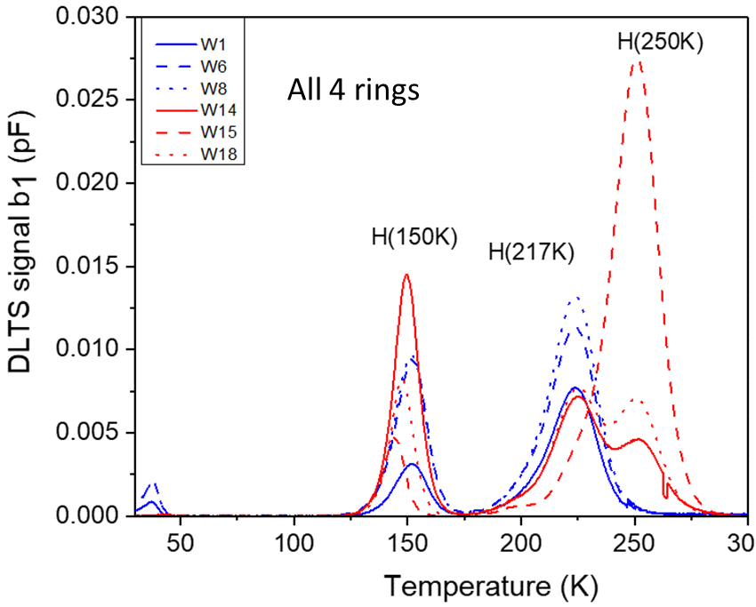
PiN diodes -FBK
Schockley-Read-Hall - statistics used to calculate the impact the detected defects have on the device electrical performance
DLTS investigations
H(250K) trapping parameters: E_{a}=0.52 eV, σ_{p}= 3x10⁻¹⁵ cm² (direct measurement constant with T )

Slide 13
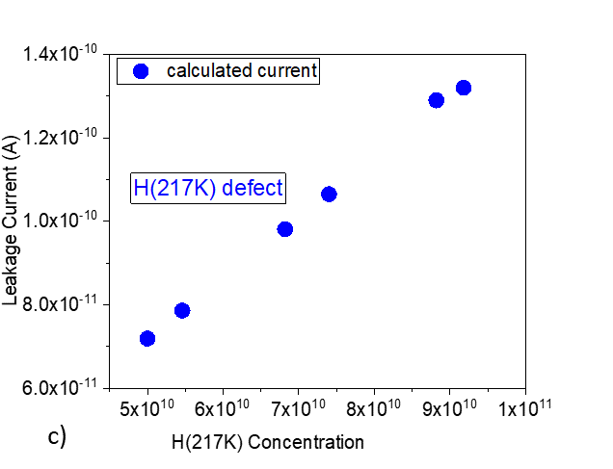
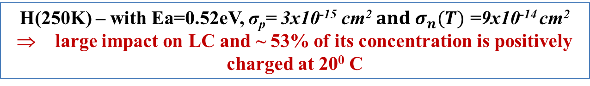
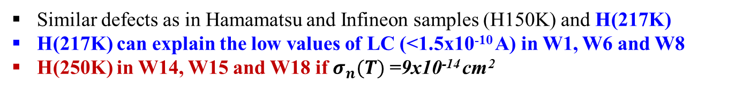
PiN diodes -FBK
Similar defects as in Hamamatsu and Infineon samples (H150K) and H(217K)
H(217K) can explain the low values of LC (<1.5x10⁻¹⁰ A) in W1, W6 and W8
H(250K) in W14, W15 and W18 if$σ_{n}(T)$ =9x10⁻¹⁴ cm²
H(250K) – with Ea=0.52eV, σ_{p}= 3x10⁻¹⁵ cm² $and σ_{n}(T)$ =9x10⁻¹⁴ cm²
⇒ large impact on LC and ~ 53% of its concentration is positively charged at 20⁰ C

Slide 14
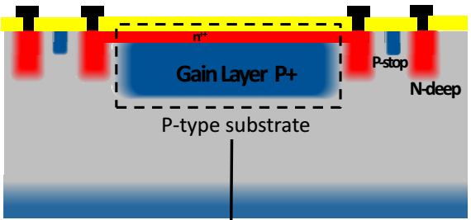
Un-irradiated LGAD sensors
Examples on FBK STFZ Si with gain layer implanted with:
B and co-implanted with C
and
Ga and co-implanted with C.
a) HRTEM images at the SiOx-Si interface and (b) a detail from the Si; (c) FFT pattern corresponding to the image (a).
The HRTEM analyses on samples implanted with boron, gallium or co-implanted with carbon reveal a continuous pattern of high resolution fringes, without any obvious structural defects.
(a) TEM image at low magnification showing the structure of W6 sample(LGAD implanted with B&C) and (b) EELS spectra extracted from the areas inside of green circles.

Slide 15
Conclusions
we found several electrically active defects in as-grown/processed samples manufactured by different vendors
Defect/impact | Activation energy (eV) | Capture cross section for holes at 20⁰ C (cm²) | Capture cross section for electrons at 20⁰ C (cm²)
H(150K) | 0.31 eV | 7x10⁻¹⁵
H(217K) Impact on LC | 0.437 eV | 1.25x10⁻¹⁶ (XT=30.3) | 2.0x10⁻¹⁴ cm²
H(250K) Impact on both LC and Neff | 0.52 eV | 3x10⁻¹⁵ | 9x10⁻¹⁴ cm²
Common to p-type Si
Most likely due to accidental impurification of the wafers

Slide 16
Near future research activities
Proceed with DLTS measurements on LGAD samples produced by FBK (DLTS not available for the moment)
Irradiation of the existing defect engineered FBK sensors (neutrons and/or protons) – this year with 1MeV neutrons
Start investigation on EPI PiN pad samples (STFZ has large amount of processing induced defects in different concentrations even when processed on wafers from the same batch)

Slide 17
Thank you for your attention !

