Slide 1

Defect investigations in 1 MeV neutron irradiated PiN pads and LGADs
Cristina Besleaga Stan, Roxana Radu, Raluca Negrea and Ioana Pintilie
National Institute of Materials Physics, Bucharest-Magurele, Romania

Slide 2
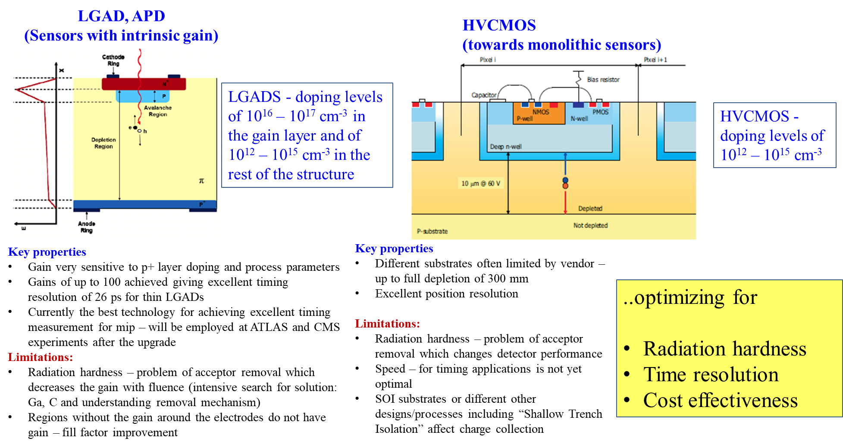
Motivation: new structures based on p-type silicon

Slide 3
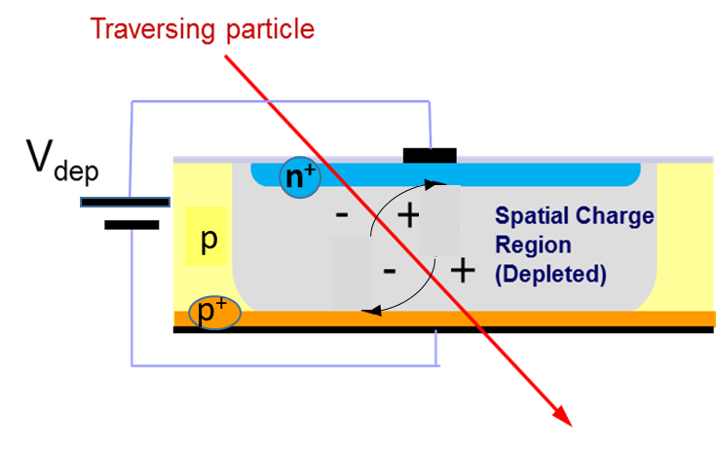
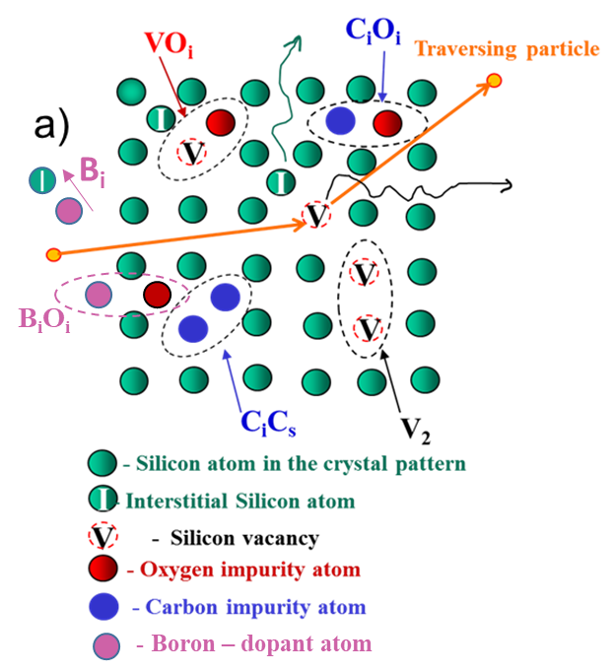
The general objective is to improve the radiation hardness of different types of silicon sensors (single pads, pixel and strips, LGAD and HVCMOS) built on
p-type standard float zone (different Boron content)
And
defect engineered material:
Carbon enrichment of Boron doped silicon
Gallium doped silicon, Carbon enrichment
Competing reactions involving Boron, Carbon, Si_{i} and O_{i}
– point defects
V+O→VO
V₂
I+C_{s}→C_{i}
C_{i}+C_{s}→C_{i}C_{s}
C_{i}+O_{i}→C_{i}O_{i}
I+B_{s}→B_{i}
B_{i}+O_{i}→B_{i}O_{i}
……?……..
Samples:standard B doped and/or C co-doped , Ga doped
p-type pad silicon
LGAD and HVCMOS
Irradiations with:
1 MeV neutrons (Ljubliana)
23 GeV protons (CERN)

Slide 4
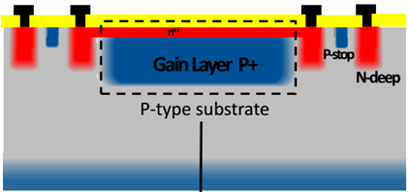
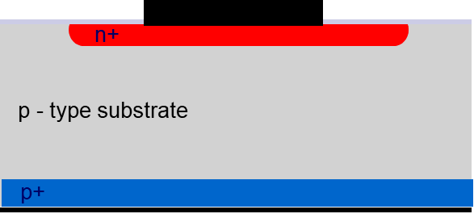
Investigated p-type Samples irradiated with 1 MeV neutrons
- Preliminary results
PiN pads
LGADs
2 p-type bulk Boron doped STFZ diodes from
National Center for Micro-electronics (CNM)–irradiated with 1MeV neutrons, fluences of 1x10¹⁴ and 1x10¹⁵ cm⁻²
4 LGAD structures produced on STFZ silicon from
-National Center for Micro-electronics (CNM) with Boron implanted gain layer– irradiated with 1MeV neutrons, fluences of 1x10¹⁴ and 1x10¹⁵ cm⁻²

Slide 5
Investigated p-type Samples
[B]_{gain layer} ~ 4x10¹⁶ cm⁻³
[B]_{bulk} = 2-5x10¹² cm⁻³
RUN 9088 neutron irradiated-for TSC measurements
NR. | Name | Fluence n/cm2 | Type | Thickness | Full depletion voltage (V) | Depletion voltage of the gain layer (V) | Leakage current at V_{dep}(20 C) (A)
1 | W5-LGB-82P | 1x10¹⁵ | PIN- no gain layer | 50 µm | 16.8 |  | 1.64x10⁻⁵
2 | W5-LGB-72P | 1x10¹⁴ | PIN- no gain layer | 50 µm | 5.6 |  | 1.73x10⁻⁶
3 | W3-LGB71, dose 1.8E13 | 1x10¹⁴ | LGAD | 49 µm bulk, 1 µm B implanted layer | 28.95 | 26.1 | 3.78x10⁻⁶
4 | W11-LGB74, dose 2.0E13 | 1x10¹⁵ | LGAD | 49 µm bulk, 1 µm B implanted layer | 28.5 | 15.9 | 2x10⁻⁵
5 | W3-LGB74, dose 1.8E13 | 1x10¹⁵ | LGAD | 49 µm bulk, 1 µm B implanted layer | 30.4 | 11.6 | 1.89x10⁻⁵
6 | W11-LGB52, dose 2.0E13 | 1x10¹⁴ | LGAD | 49 µm bulk, 1 µm B implanted layer | 33.79 | 31.04 | 1.03x10⁻⁵

Slide 6
Electrical characteristics
[B]_{gain layer} ~ 4x10¹⁶ cm⁻³
[B]_{bulk} = 2-5x10¹² cm⁻³
- Bulk LC LGADs > bulk PiN

Slide 7
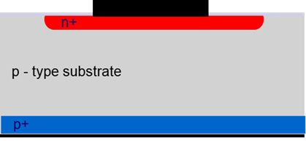
TSC investigations
φ=10¹⁴ cm⁻²
φ=10¹⁵ cm⁻²
As irradiated
- In PiN diodes all defects increase in concentration with fluence (including BiOi)

Slide 8
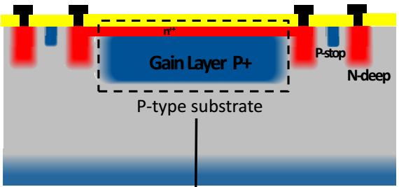
TSC investigations
φ=10¹⁴ cm⁻²
U_{R} = 50V
In LGAD diodes most of the defects increase in concentration with fluence but the BiOi
⇒ A saturation of BiOi possible caused by the limited amount of Oi

Slide 9
TSC investigations
Comparison between LGAD and PiN
φ=10¹⁴ cm⁻² , 30min@80C
point defects and clusters are detected in both PiN and LGAD diodes.
The generation rates are different in the gain layer compared with the bulk (measured on PiN pad diodes) –e.g. more BiOi in LGAD
All these defects and their impact on the electrical performances of the PIN and LGAD diodes are now under evaluation.

Slide 10
Impact on Neff
φ=10¹⁴ cm⁻²
φ=10¹⁵ cm⁻²
- Neff evaluated with defect concentrations determined from TSC > Neff evaluated from CV
- The missing acceptors concentration from TSC increase with the fluence
⇒ possible cause - the existence of Bi – not electrically active (cannot be determined by TSC and deactivates the B dopant)

Slide 11
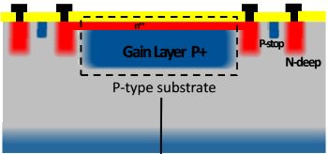
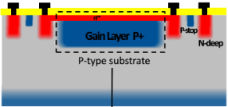
Impact on Neff
φ=10¹⁴ cm⁻²
Defect concentrations – comparison between gain layer and bulk
[B] = 4x10¹⁶ cm⁻³
[B] = 4.8x10¹² cm⁻³
For the gain layer even large differences between Neff from TSC and that from CV
– suggesting the same cause, the generation of B_{i} (not electrically active), in larger amount in the implanted layer than in the bulk

Slide 12
Conclusions and further work
A saturation of BiOi defect in the gain layer is observed starting with a fluence of 10¹⁴ cm⁻²
The TSC evaluation underestimate the acceptor removal process (cannot determine also the Bi defect) and underestimation increases with the amount of B dopant
Annealing studies on 1 MeV CNM samples to be continued up to 10.000 min@80⁰ C
TSC investigations after 1MeV neutrons irradiation, fluences of 10¹⁵ cm⁻² are reliable – one can try to go for higher fluences.
Start the investigations on irradiated defect engineered FBK samples
Start investigation on irradiated EPI PiN pad samples (STFZ has large amount of processing induced defects)

Slide 13
Thank you for your attention !

