Slide 1


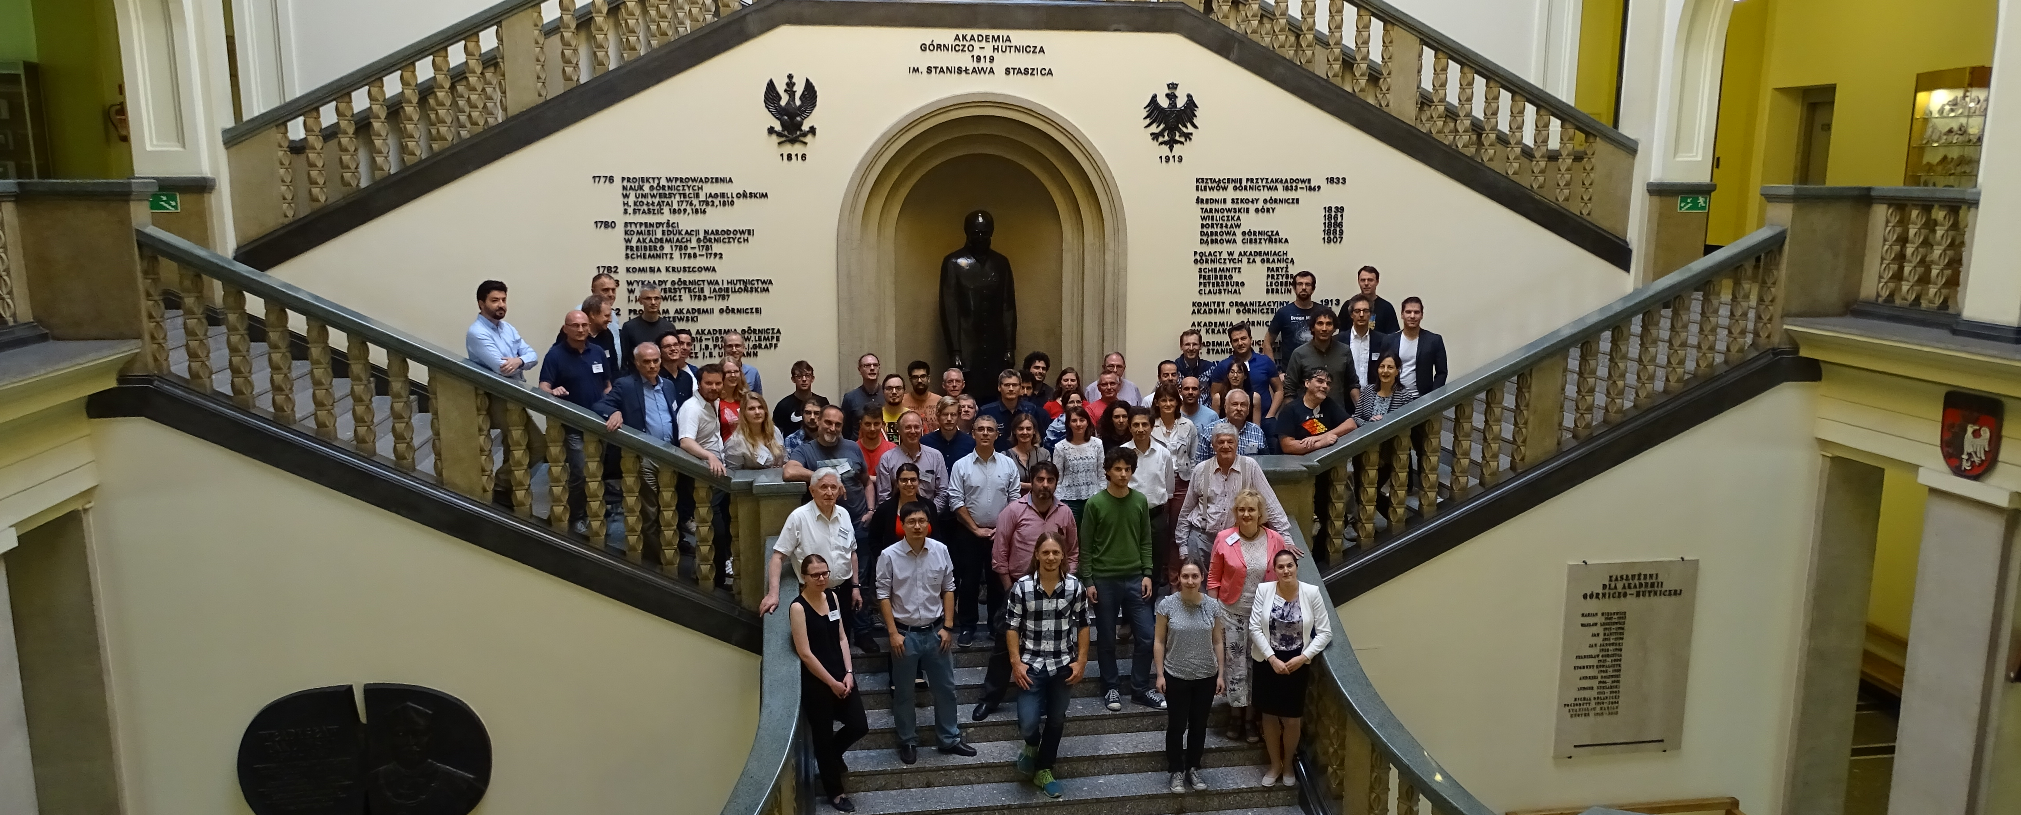
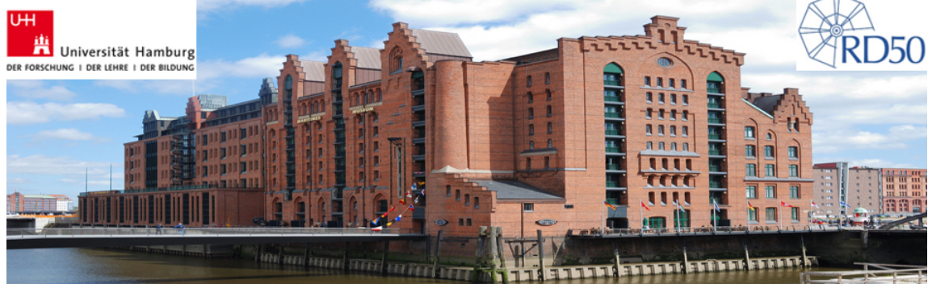
Welcome to the
33rd RD50 Workshop
Radiation hard semiconductor devices for very high luminosity colliders
CERN, 26-28 November 2018
30th RD50 Workshop
Krakow, Poland, June 2017
32nd RD50 Workshop
Hamburg, Germany, June 2017

Slide 2
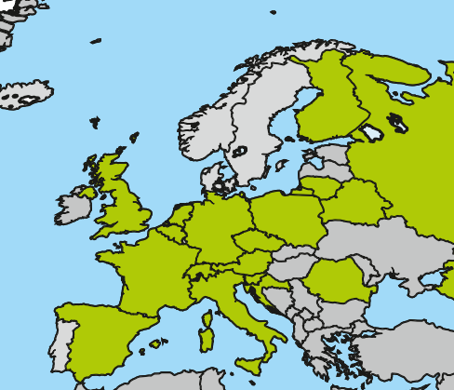
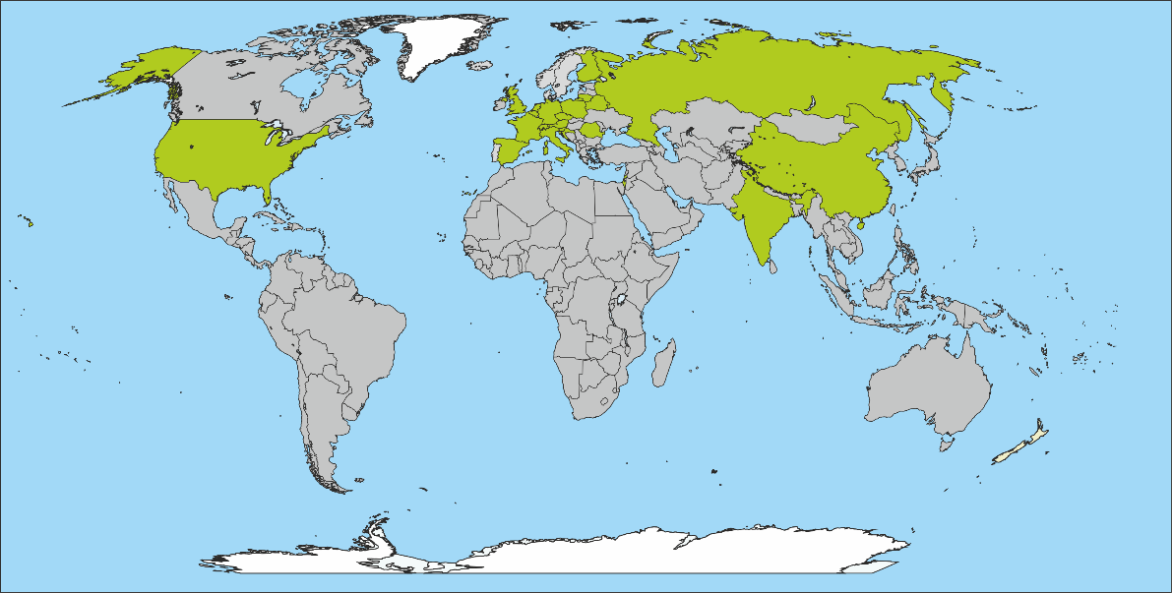
The RD50 Collaboration
RD50: 62 institutes and 367 members
52 European institutes
Austria (HEPHY), Belarus (Minsk), Czech Republic (Prague (3x)), Finland (Helsinki, Lappeenranta ), France (Paris, Orsay), Germany (Bonn, Dortmund, Erfurt, Freiburg, Goettingen, Hamburg (2x), Karlsruhe, Munich(2x)), Italy (Bari, Perugia, Pisa, Trento, Torino), Croatia (Zagreb), Lithuania (Vilnius), Netherlands (NIKHEF), Poland (Krakow, Warsaw(2x)), Romania (Bucharest (2x)), Russia (Moscow, St.Petersburg), Slovenia (Ljubljana), Spain (Barcelona(3x), Santander, Sevilla (2x), Valencia), Switzerland (CERN, PSI, Zurich), United Kingdom (Birmingham, Glasgow, Lancaster, Liverpool, Manchester, Oxford, RAL)
7 North-American institutes
USA (BNL, Brown Uni, Fermilab, LBNL,
New Mexico, Santa Cruz, Syracuse)
1 Middle East institute; Israel (Tel Aviv)
2 Asian institute; China(Beijing), India (Delhi)
Detailed member list: http://cern.ch/rd50

Slide 3
RD50 Organizational Structure
Co-Spokespersons
Gianluigi Casse and Michael Moll
(Liverpool University, UK (CERN EP-DT)
& FBK-CMM, Trento, Italy)
Defect / Material
Characterization
Ioana Pintilie
(NIMP Bucharest)
Detector
Characterization
Eckhart Fretwurst
(Hamburg University)
New Structures
Giulio Pellegrini
(CNM Barcelona)
Full Detector
Systems
Gregor Kramberger
(Ljubljana University)
Characterization of
microscopic properties
of standard-, defect engineered and new materials pre- and post- irradiation
DLTS, TSC, ….
SIMS, SR, …
NIEL (calculations)
Cluster and Point defects
Boron related defects
Characterization of test structures (IV, CV, CCE, TCT,.)
Development and testing of defect engineered devices
EPI, MCZ and other materials
NIEL (experimental)
Device modeling
Operational conditions
Common irradiations
Wafer procurement (M.Moll)
Acceptor removal (Kramberger)
TCAD simulations
3D detectors
Thin detectors
Cost effective solutions
Other new structures
Detectors with internal gain
LGAD: Low Gain Avalanche Det.
Deep depleted Avalanche Det.
Slim Edges
HVCMOS
LGAD (S.Hidalgo)
HVCMOS (E. Vilella)
Slim Edges (V.Fadeyev)
LHC-like tests
Links to HEP(LHC upgrade, FCC)
Links electronics R&D
Low rho strips
Sensor readout (Alibava)
Comparison:
- pad-mini-full detectors
- different producers
Radiation Damage in
HEP detectors
Timing detectors
Test beams
(M.Bomben & G.Casse)
Collaboration Board Chair & Deputy: G.Kramberger (Ljubljana) & J.Vaitkus (Vilnius), Conference committee: U.Parzefall (Freiburg)
CERN contact: M.Moll (EP-DT), Secretary: V.Wedlake (EP-DT), Budget holder & GLIMOS: M.Moll & M.Glaser (EP-DT)

Slide 4
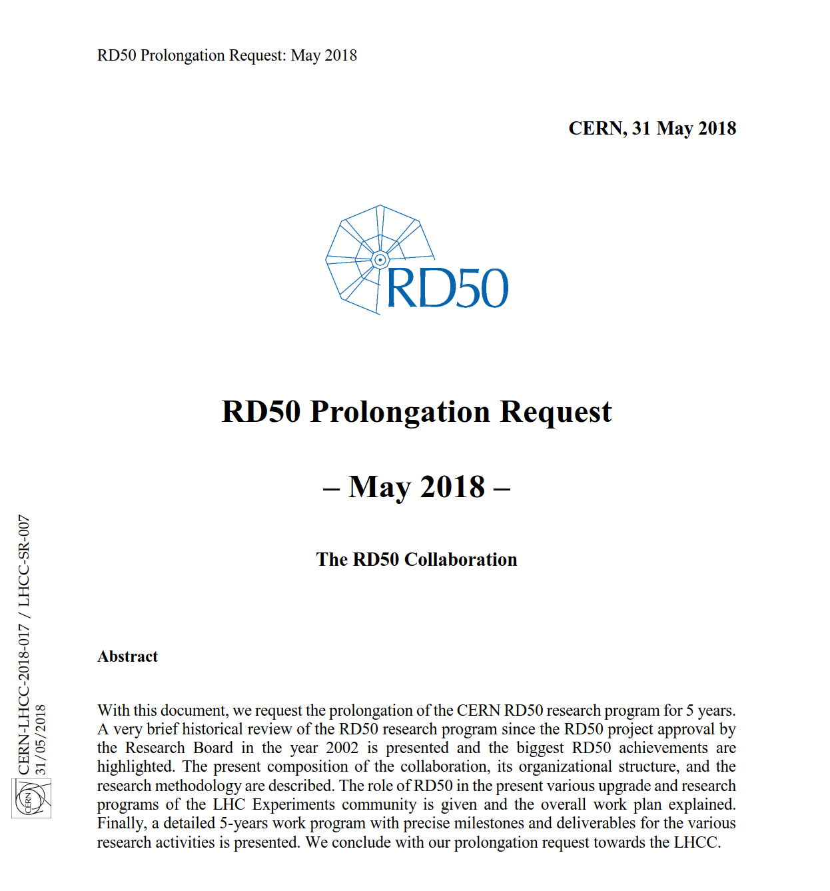
Latest News from the LHCC
2018: LHCC (Large Hadron Collider Committee) reviewed CERN RD experiments, i.e. also RD50
May 2018: RD50 produced a 5 year work plan
June 2018: Very positive feedback from LHCC
July 2018: Research Board Minutes published
RB Minutes: …. RD50 (Development of Radiation Hard Semiconductor Devices for Very High Luminosity Colliders) [6] is recommended by the LHCC for the requested five-year extension, including CERN support at the level currently provided (access to facilities, human resources) which is crucial for the collaboration. Progress will be reviewed every year by the LHCC. The LHCC considers the structure of RD50, with a small but focussed core team and corresponding infrastructure at CERN, and many expert collaborators from around the world, to be an excellent setup. The Research Board extended RD50 for a further five years.
Take a look!
….and make this program happen!
http://cds.cern.ch/record/2622164/files/M-225.pdf
https://cds.cern.ch/record/2320882/files/LHCC-SR-007.pdf
Notes:
HE: 16.5 TeV (CERN-ATS-2010-177)
Plot taken from Igor Mandic (Vienna 2013 presentation)

Slide 5
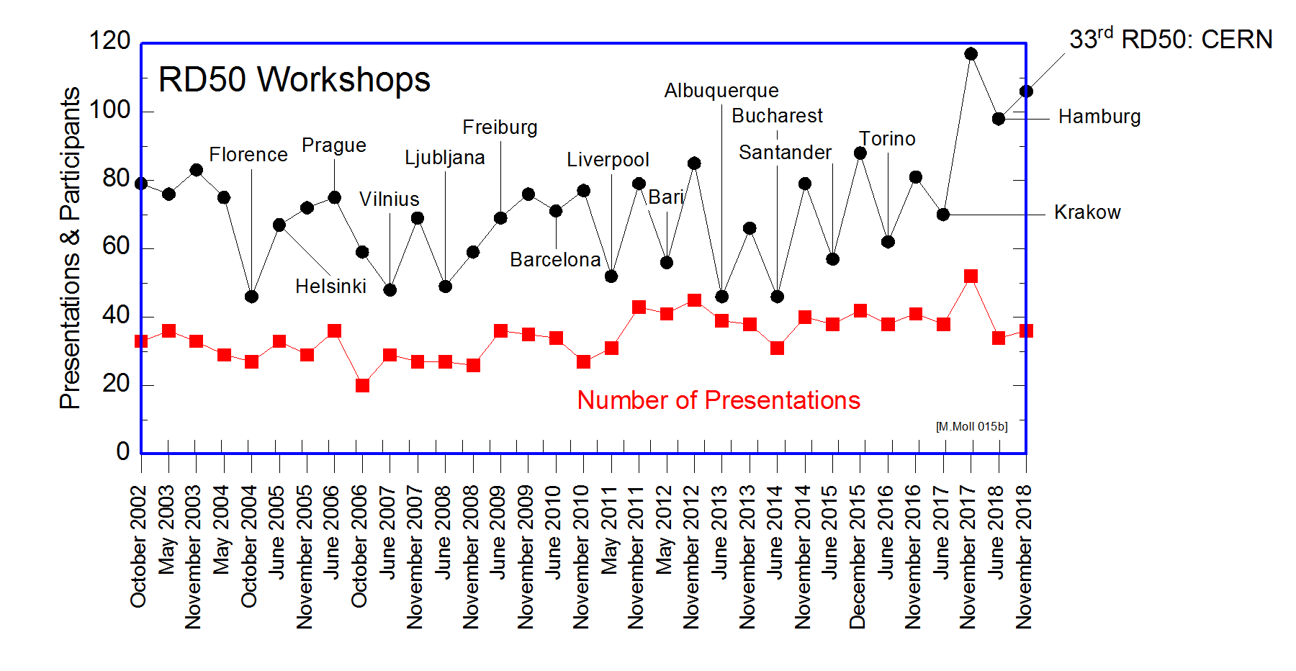
Workshop participation…
This workshop
Next Workshops:
June 2019
Lancaster, UK
November 2019
CERN
June 2020
Zagreb, Croatia
More than 100 participants
  106 participants
  approx. 35 presentations and 7 discussion sessions
  …… these will be 3 intense days, but more relaxed than last Workshop at CERN!

Slide 6
Agenda
Monday
  Radiation Damage at the LHC & Discussion
  Defect and Material Characterization & Discussion
  Collaboration Board (restricted to CB members)
Tuesday
  Precision Timing Detectors & Discussion
  Device Simulations & Discussion
  Characterization Techniques & Discussion
  Dinner (all information given in the registration package!)
Wednesday
  Full Detector Systems (Pixel and Strip Detectors) & Discussion
  CMOS sensors & Discussion
This is a Workshop: Please participate actively in the discussions.

Slide 7
Thanks for organizing this event
Veronique Wedlake
Secretary and Leader of the organization team
….nothing would work without her!
Local organization team (SSD): Matteo, Ruddy, Yana, Pedro, Esteban, William,.…SSD team.
Session Chairs and Discussion Convenors:
Gregor, Gian, Eckhart, Salva, Giulio, Ivan,…… Marco, Joern
Special greetings and thanks to Ioana,
who could not come ….she became grandma..☺
..but prepared the discussion session on defects and will try to connect on vidyo
All speakers for their contributions and for keeping the time!
….for keeping the RD50 budget in shape while being retired in Brazil: Maurice Glaser
Enjoy the Workshop!

Slide 8
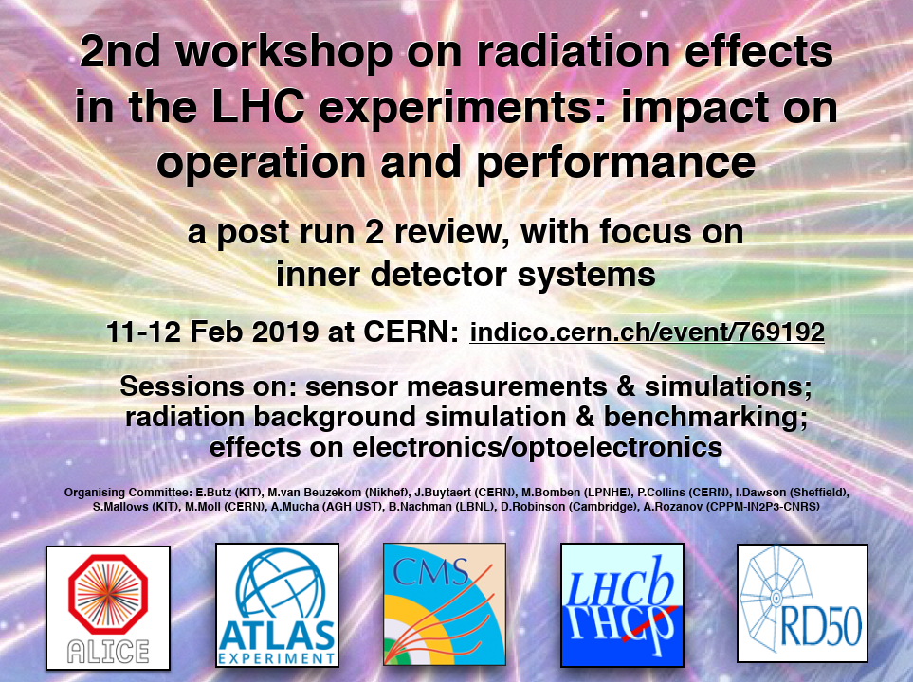
Radiation Damage in LHC Experiments
Radiation Effects at LHC Experiments and Impact on Operation and Performance
  Common Workshop: (ALICE), ATLAS, CMS, LHCb, RD50 [https://indico.cern.ch/event/695271/]
  CERN, 11-12 February 2019
  4 sessions:
    Sensor Measurements
    Electronics/Optoelectronics
    Radiation Background
    Simulation and Monitoring
    Sensor Simulation
  Last Workshop statistics:
    124 participants
    32 talks, discussion sessions
  More details in first session of this Workshop

