Slide 1
Niobium welding tests at CERN
Thomas Demazière
04-09-2018

Slide 2
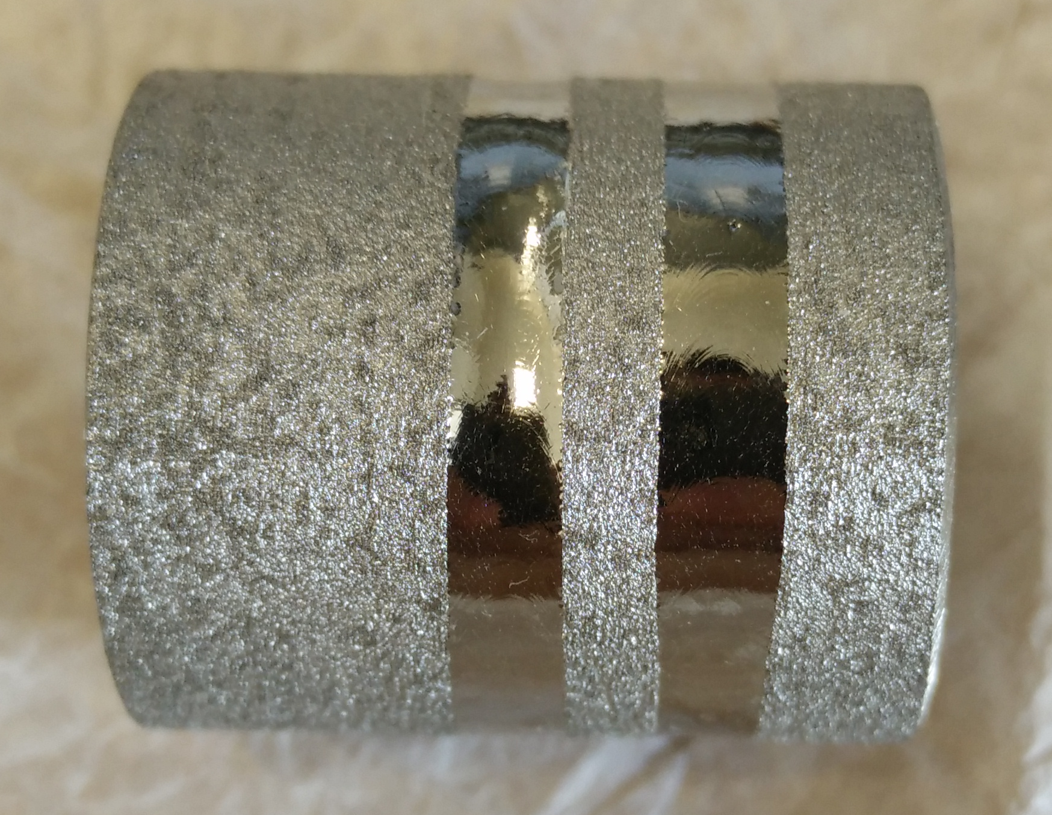
Weldabilty of Nb
Niobium welded at CERN :
RRR300 (99%)
RRR40 for RFD welding tests to come
3D printed Niobium (1 test only)
Niobium welding processes :
EBW
Manual TIG in glove box (sputtering cathodes,…)

Slide 3
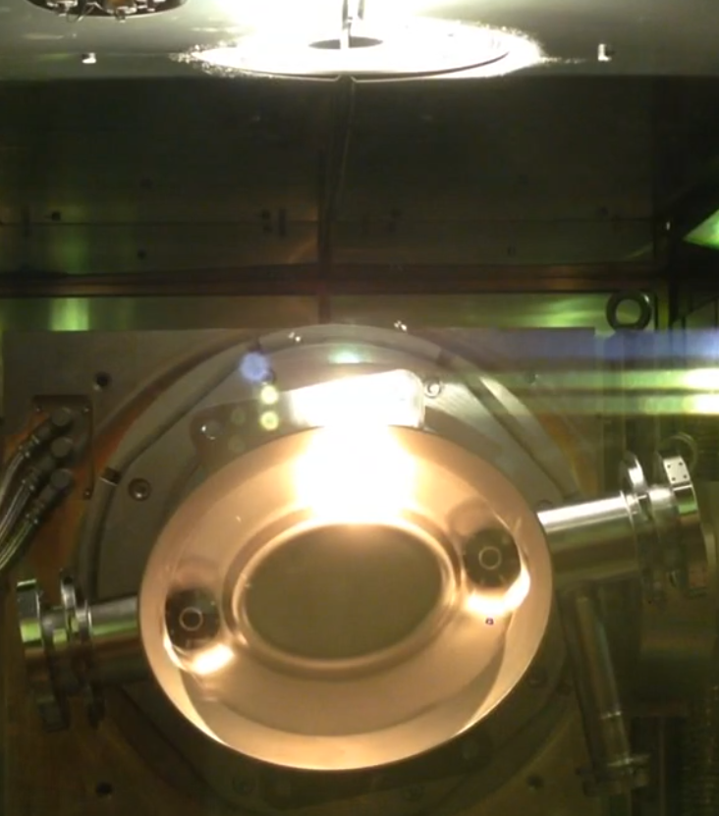
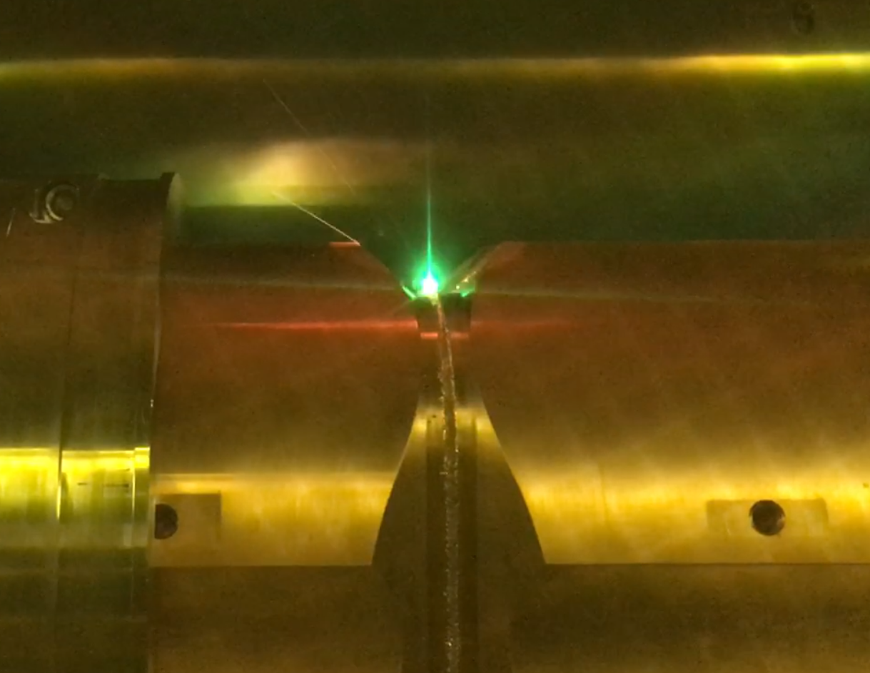
Properties | Niobium | Nb45Ti55 | Copper
Thermal conductivity (W.m⁻¹.K⁻¹) | 54 | 10 | 400
Melting temperature (°C) | 2500 | 1900 | 1080
Density (g.cm⁻³) | 8.57 | 5.7 | 8.96
Linear energy to weld 3 mm (J/mm) | 225 |  | 300
plasma color during welding | bright white (RRR300) bright red (500 ppm) |  | green
Niobium
Beam power : 5 kW
Copper
Beam power : 10 kW

Slide 4
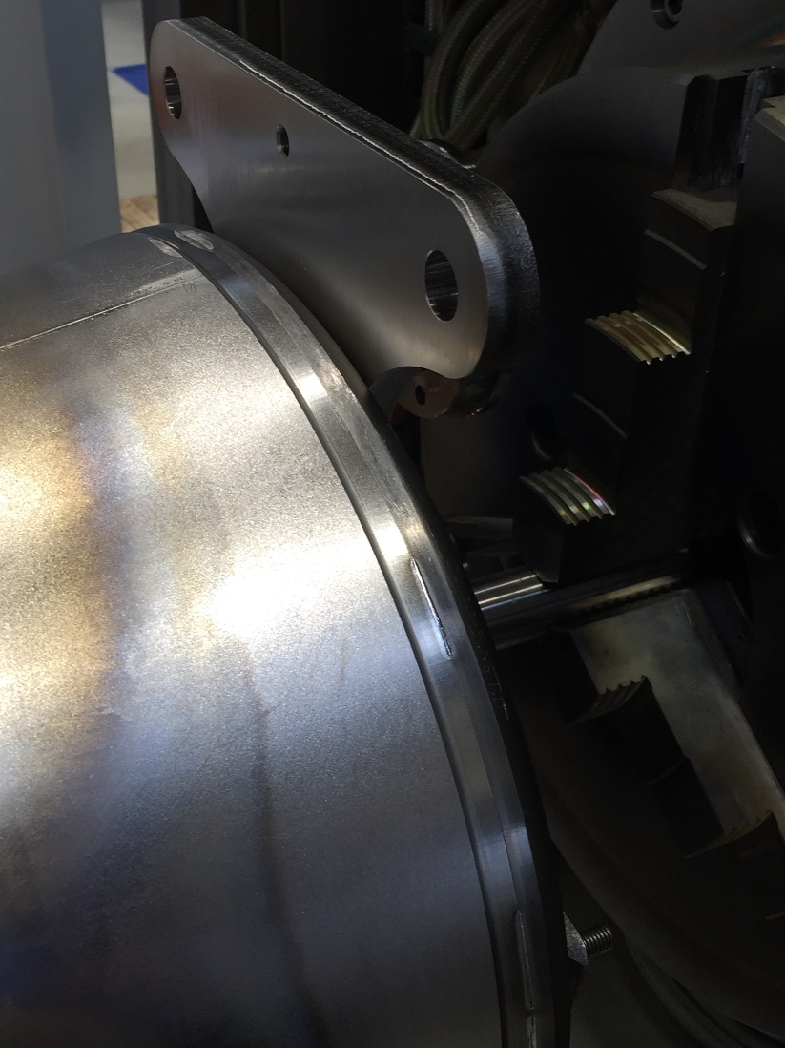
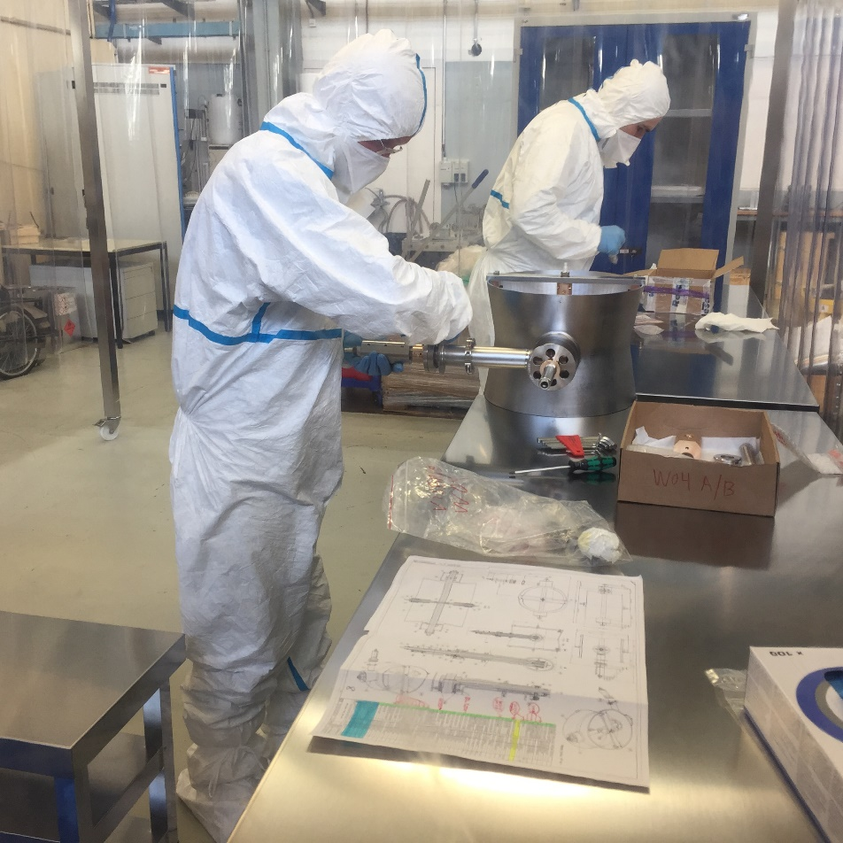
Weldabilty of Nb RRR300
Typical joint preparation :
Machined welded interface
Butt weld (square edges, with or without backing)
BCP 5-25 µm less than 8hrs before welding
Assembly of the parts under laminar flow
Vacuum below 5.10⁻⁵

Slide 5
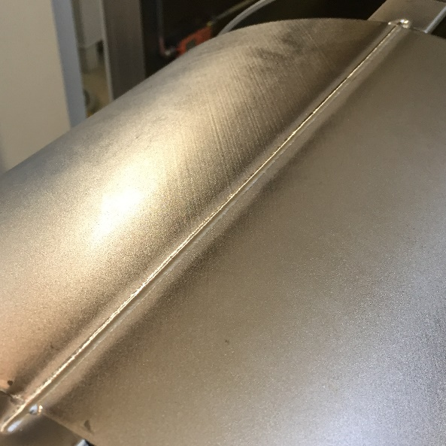
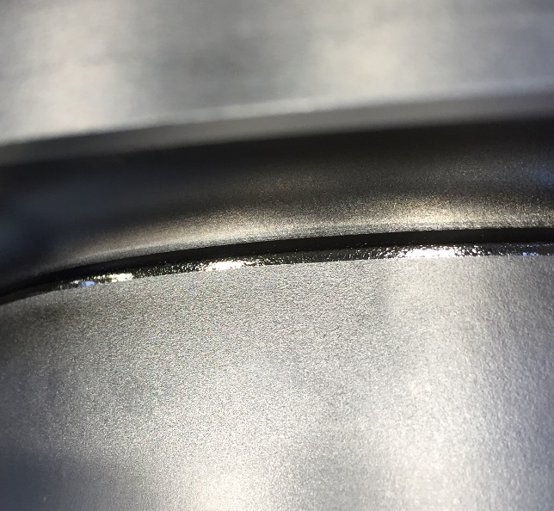
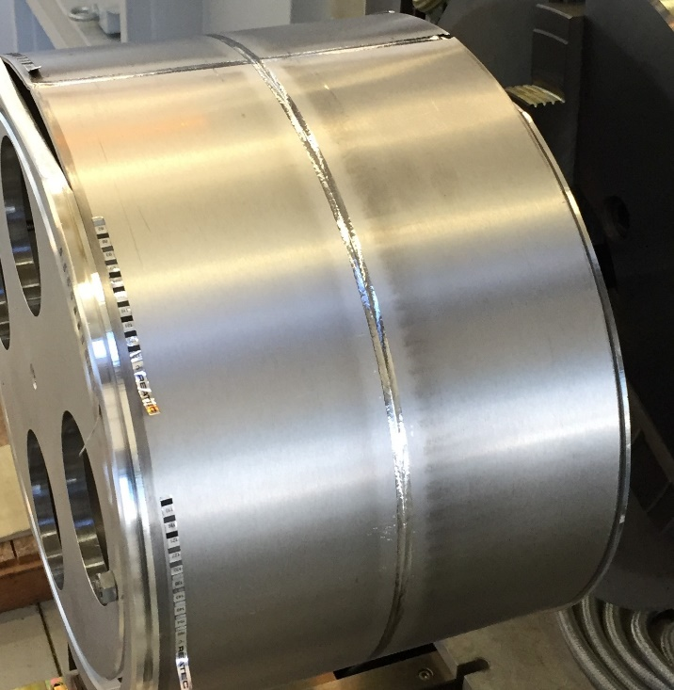
Weldability of Nb RRR300
3 main types of parameters :
Full penetration weld with focused beam
  Lowest distortion
  Root concavity → smoothing mandatory
Smoothing pass
  Necessary for proper surface finish
  Adds shrinkage
Full penetration weld with under focused beam
  Largest distortion
  Parameters challenging to control (risk of lack of fusion or burn through is significant)
  Smooth surface finish, no spatter

Slide 6
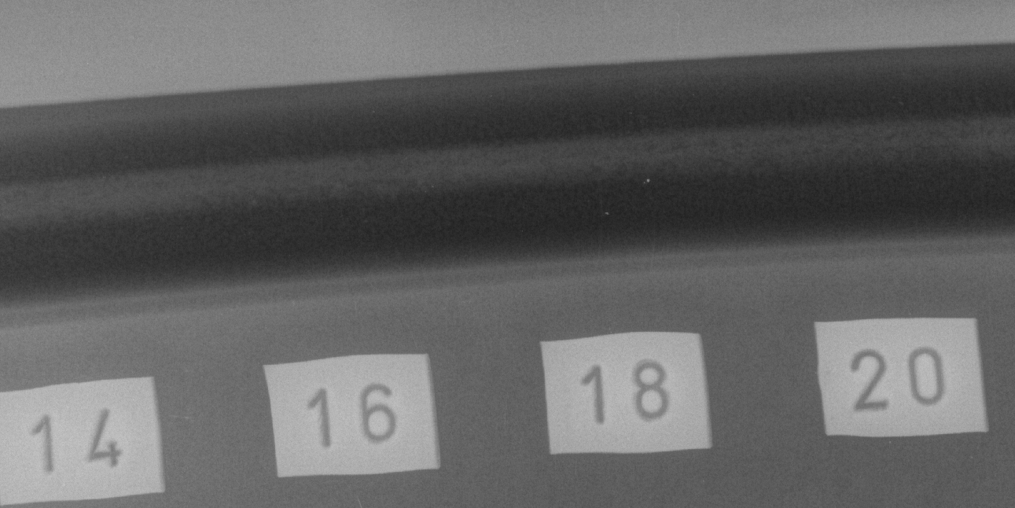
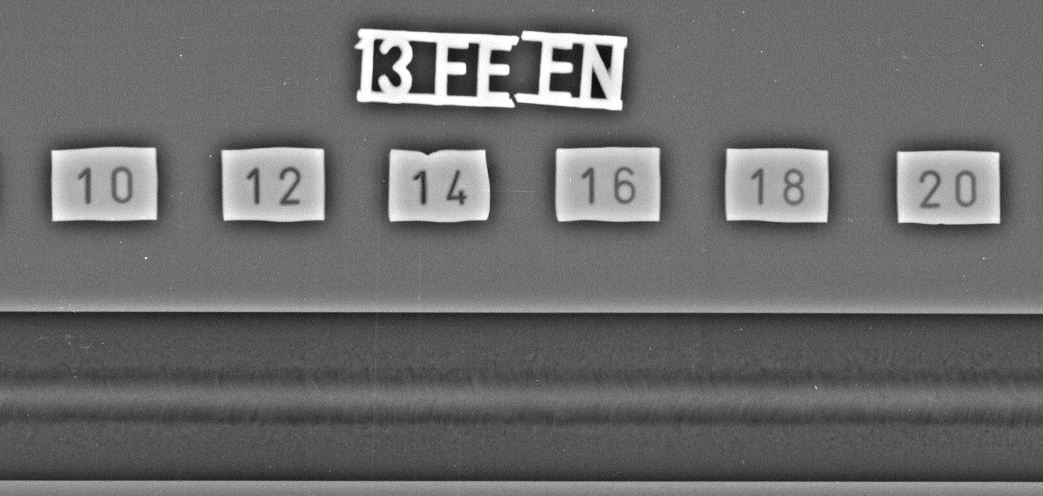
Weldability of Nb RRR300
X-ray results :

Slide 7
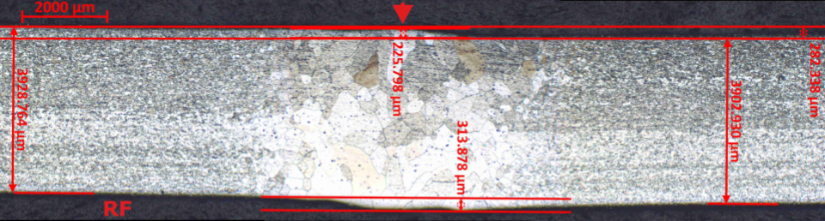
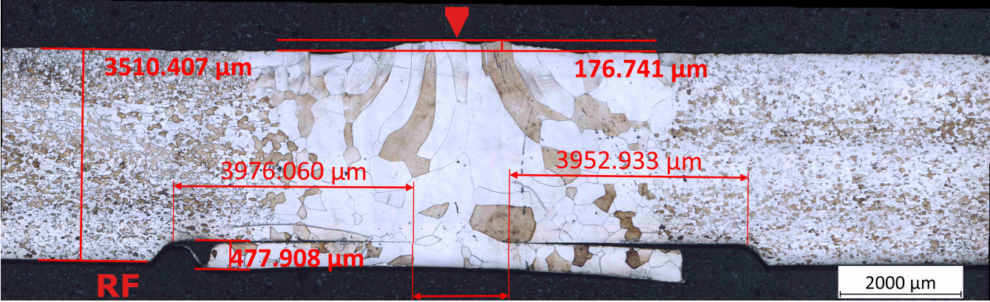
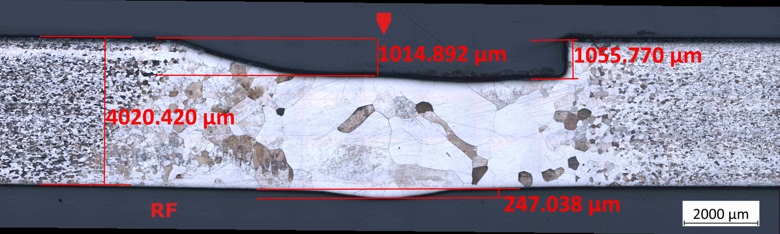
Weldability of Nb RRR300
4 mm / 2 passes
  Energy : 315-350 J/mm per pass
  Rp_{0.2} : 71 Mpa
  Rm : 170 Mpa
  A% : 36%
3 mm / 1 pass (with backing)
  Energy : 340 J/mm
  Rp_{0.2} : 57 Mpa
  Rm : 180 Mpa
  A% : 61%
3 mm / 1 pass
  Energy : 605 J/mm
  Rp_{0.2} : 70 Mpa
  Rm : 144 Mpa
  A% : 23%

Slide 8
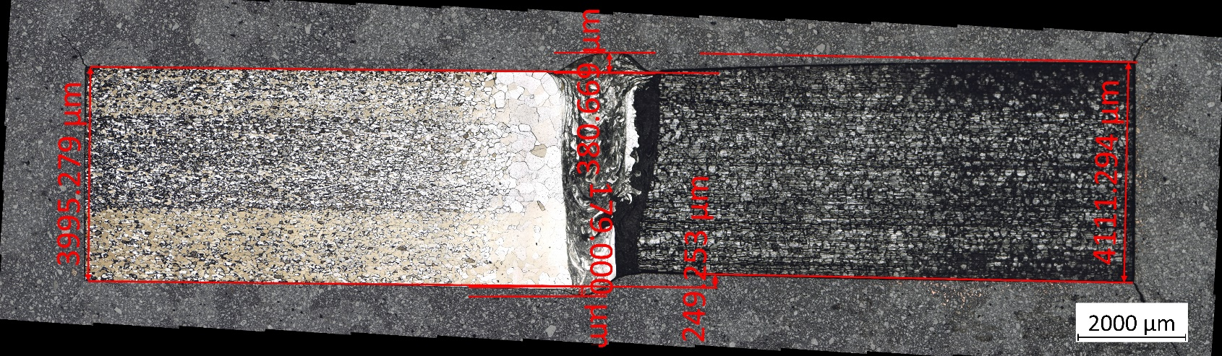
Weldability of Nb45Ti55
Welded only in dissimilar joints (for Crab Cavities project)
Nb to NbTi (EBW)
The beam is focused on the Nb to compensate for the lower energy required to melt NbTi

Slide 9
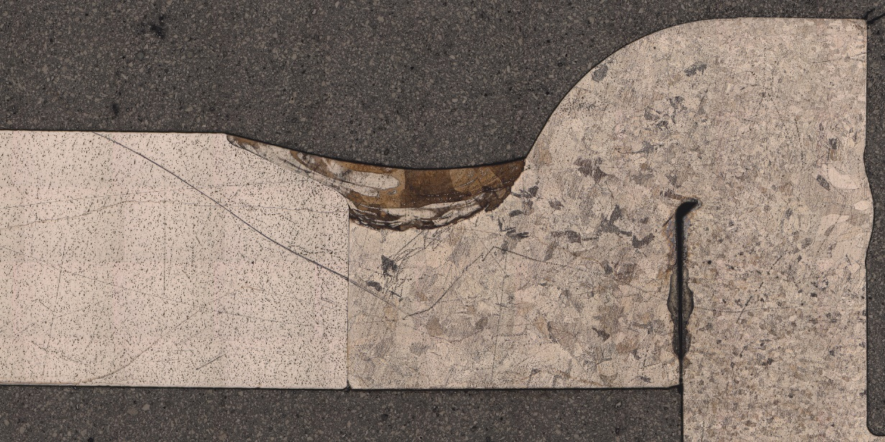
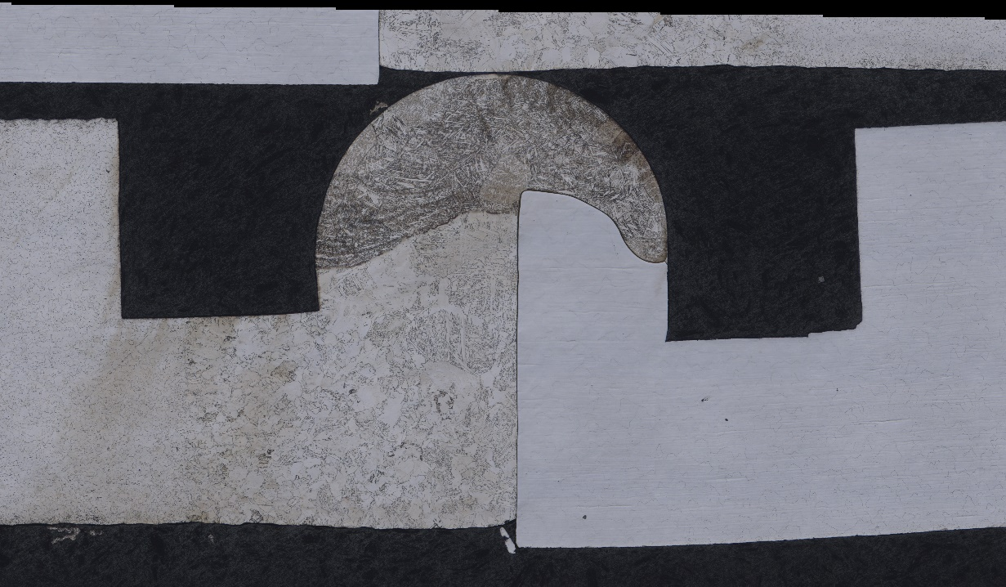
Weldability of Nb45Ti55
Welded only in dissimilar joints (for Crab Cavities project)
Ti Gr.2 to NbTi (manual TIG)
More challenging to accomodate the difference in melting point
Requirements less stringent than for EBW (partial penetration joints, only leak tightness is required)

Slide 10
Conclusion
Niobium and NbTi welded at CERN :
No particular defects observed
Easier parameter setting than with copper
Difficulties come mostly with the high quality requirement and complicated design and tooling assemblies

Slide 11
Thank you for your attention

