Slide 2
Recent BTM SEM grid emittance measurements and investigations
Y. Dutheil, V. Forte, M.A. Fraser
TE-ABT-BTP

Slide 3
Previous analysis
Investigated BCMS 1.5 eV.s beam (with large momentum spread)
Thin lens approximation not viable
  Simulated experiment shows the thin lens approximation underestimates the fitted emittance by ~10%
Quadrupole transfer function did not reproduce well the effect of the quadrupole on the beam
  A single-point calibration current↔gradient was used, taken from the control system
  Magnetic measurement for this quadrupole were made. The effect on the beam is best represented by long coil measurement, see details in [1]
  Gradient difference ~1% and effect of emittance up to 4%
[1] F. Cornuet and G. Patron, ”Mesure magnetique des quadripoles type 130 pour ISOLDE” https://edms.cern.ch/document/859629/1

Slide 4
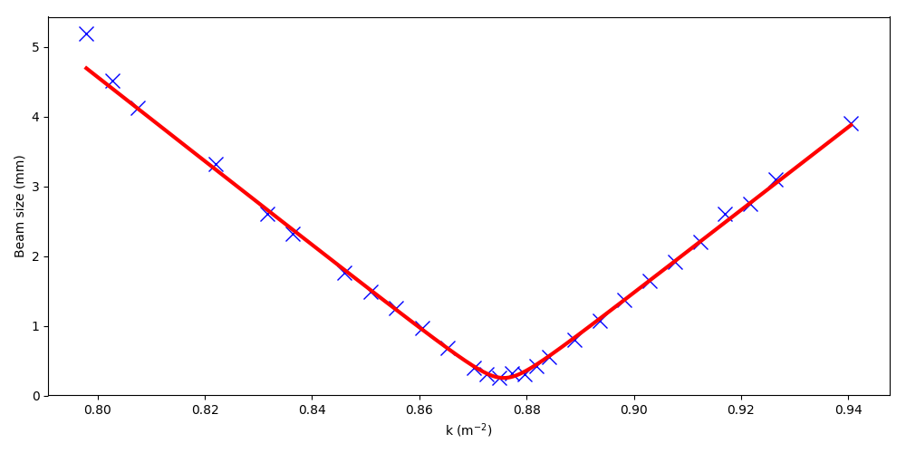
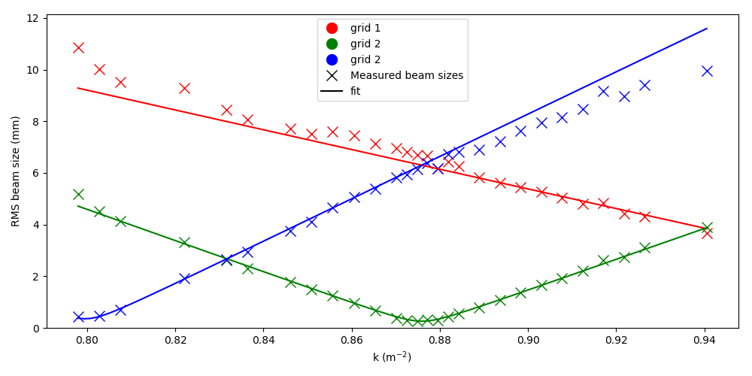



New analysis results
“Zero dispersion” optics measurement: effect of momentum spread is therefore ignored
Thick lens analysis using integrated gradient transfer function
Global fit using MADX and all profiles for the three grids and for all values of quadrupole strength
$ε^{N}=1.449±0.003$𝜇m
$ε^{N}=1.493±0.003$𝜇m
Thin lens with long coil transfer function $ε^{N}=1.296±0.003$𝜇m
Thin lens with previous analysis transfer function $ε^{N}=1.250±0.003$𝜇m
Method tested while clipping out the profile with sigma lower than wire spacing: only marginal effect

Slide 5
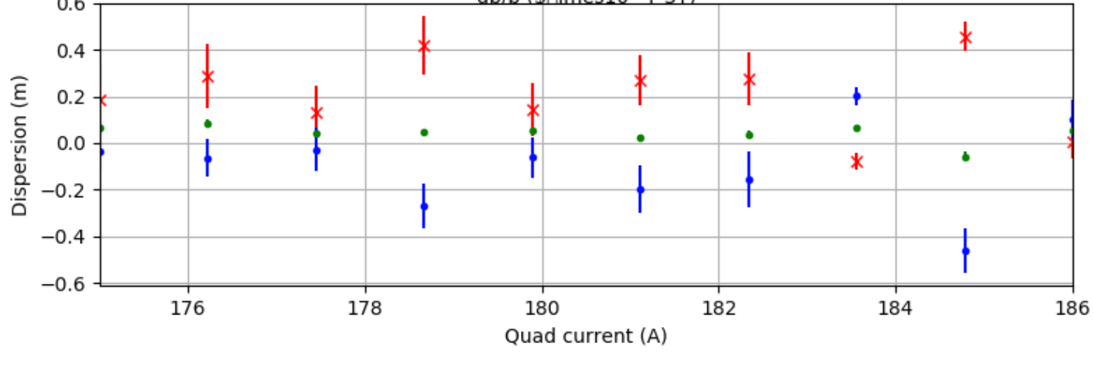
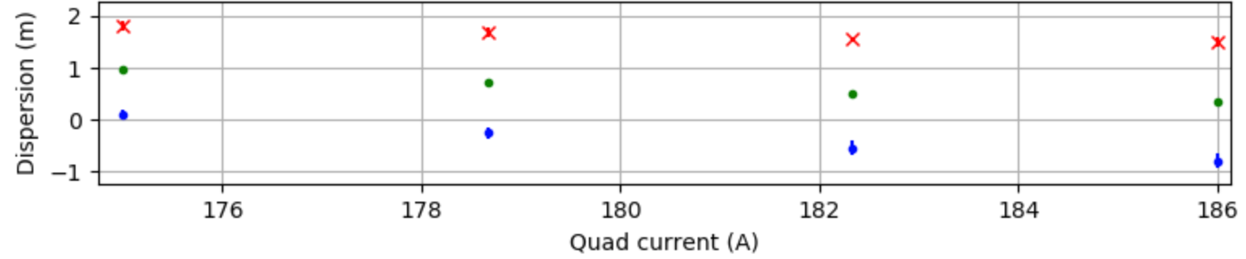
New measurements
This year’s measurements
  Indiv type beam
  Automatic data taking and pre-processing using python/pyjapc
Dispersion measurements as a function of quadrupole strength:
We postulate that the low
momentum spread would have negligible effect on the beam size
Expample : 3mm betatron beam, dpp=10⁻³, Dx=0.1m increases beam size by 1µm.
Low dispersion optics
Normal optics
Grid1
Grid2
Grid3
Notes:
Example
3mm betatron beam, D=0.1m, dpp=E-3 increase of 1um

Slide 6
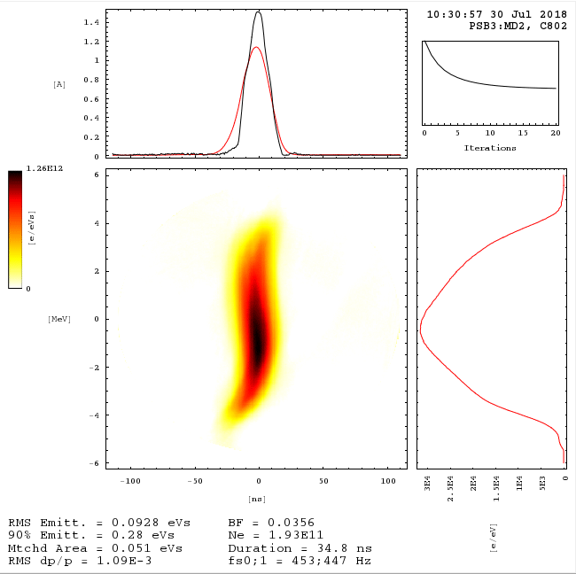
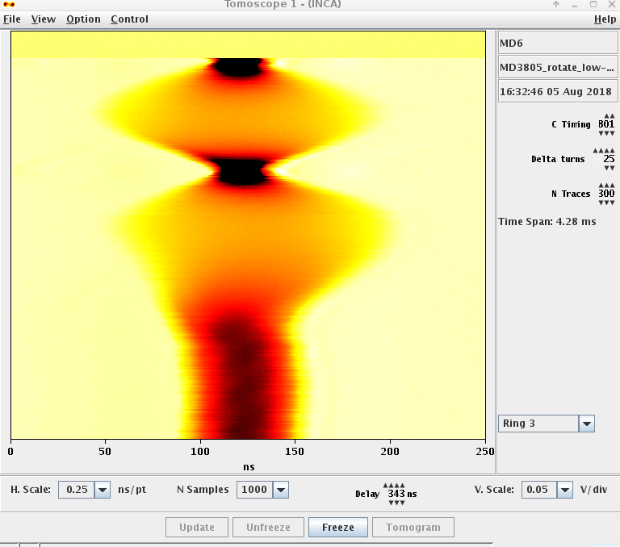
Measurements with two different momentum spreads
S. Albright set up a bunch rotation in the PSB allowing
to get 10⁻³, twice more than the regular indiv beam
Useful to compare fitted emittance with the two
different momentum spread

Slide 7
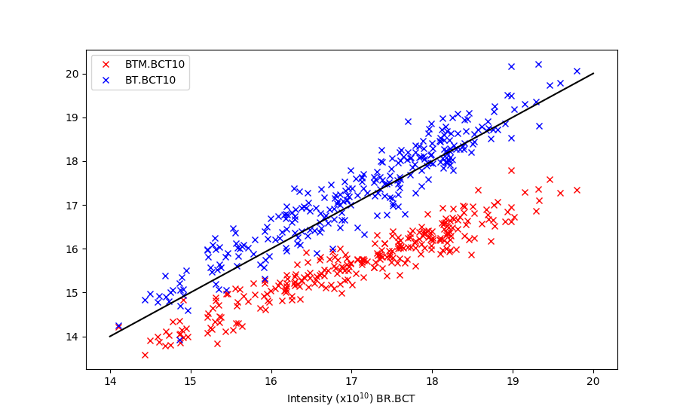
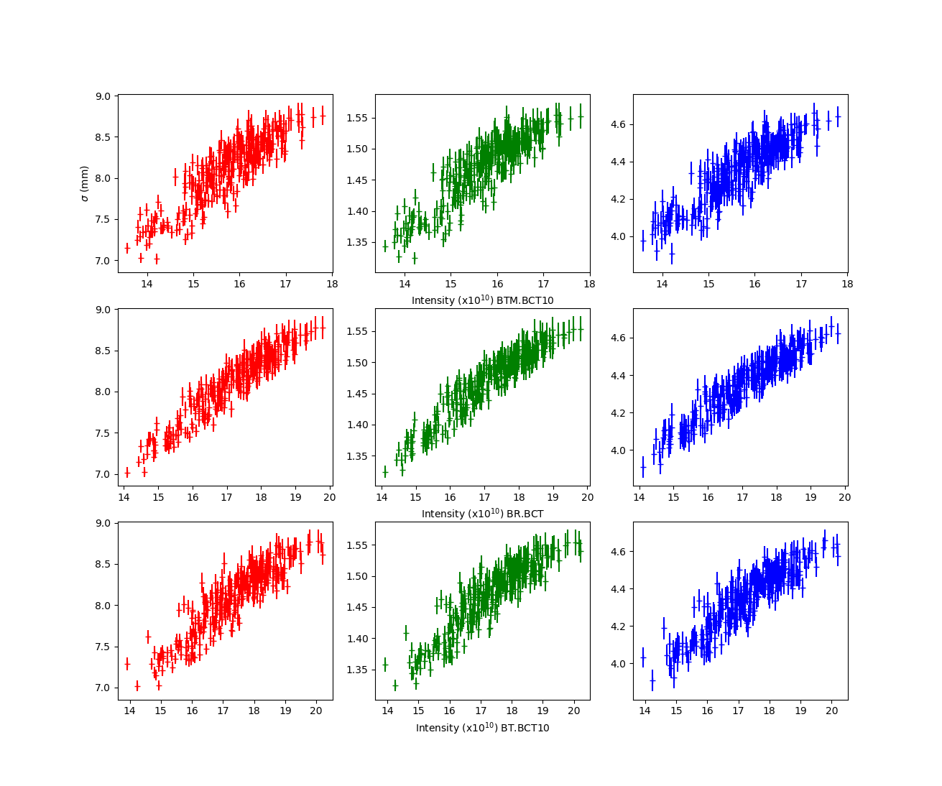
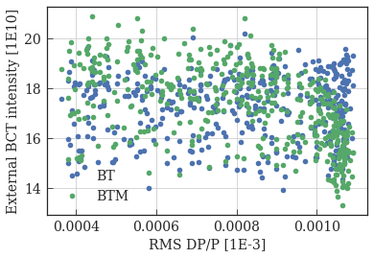
Cycle to cycle horizontal beam size jitter
Strong cycle to cycle variation of the intensity. Also different intensity reported by different devices. Accuracy ~1E10?
Grid1
Grid2
Grid3
Regardless, beam size at the 3 grids correlates strongly with intensity
BTM.BCT10
#extIntensityRing3
Used henceforth
M.A. Fraser
BR.BCT
#extIntensityRing3
BT.BCT10
#extIntensityRing3
Notes:
Put p[lot of matthew upper left he sent some time
He investigated with BI and will retake some data prob artefact
This is shigh momentum spreads beam

Slide 8
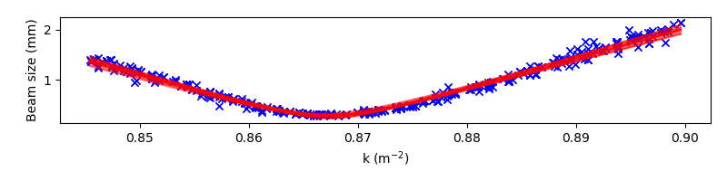
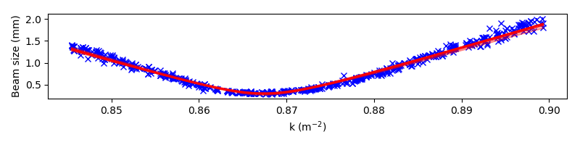
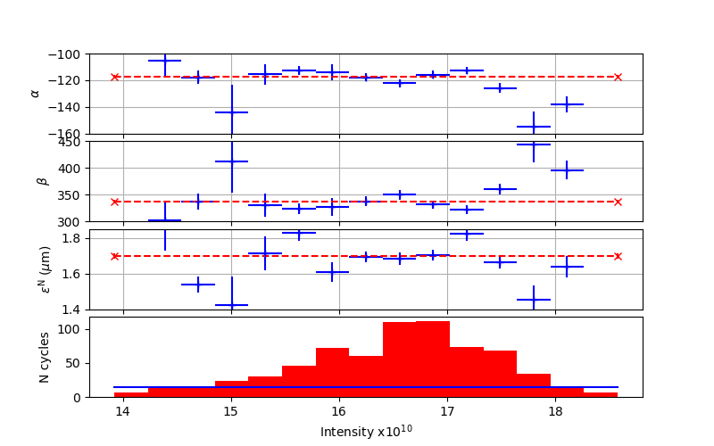
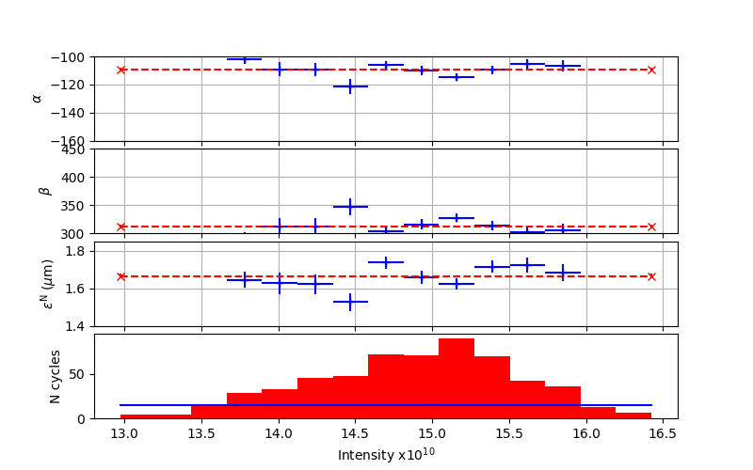
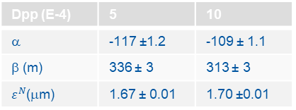
Intensity and momentum spread effects
Two effects are being investigated here. By binning in intensity the data point we probe for emittance-intensity correlation. This is repeated with high and low momentum spread
Regular RF Dpp~5E-4
Bunch rotation Dpp~10E-4
Second grid profiles
Binned scan-k results
Dpp (E-4) | 5 | 10
α | -117 ±1.2 | -109 ± 1.1
β (m) | 336 ± 3 | 313 ± 3
$ε^{N}$(μm) | 1.67 ± 0.01 | 1.70 ±0.01
Notes:
Copy better tomogram

Slide 9
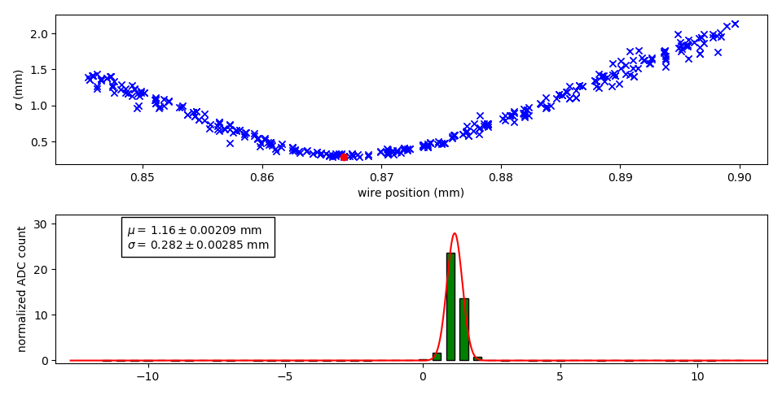
Scan-k, a look at uncertainties
Change of ±10cm on the distance between the quadrupole and the grid changes the fitted emittance by ±0.05μm
Change of ±1% of the quadrupole transfers function changes the fitted emittance by ±1%
Minimum beam size is much smaller than wire spacing
Is it possible to find an optics
with low dp and larger beam-size?
  Use a quadrupole further upstream?
  At the expanse of larger dispersion but
  make a very small momentum spread
  beam 10⁻⁵?

Slide 10
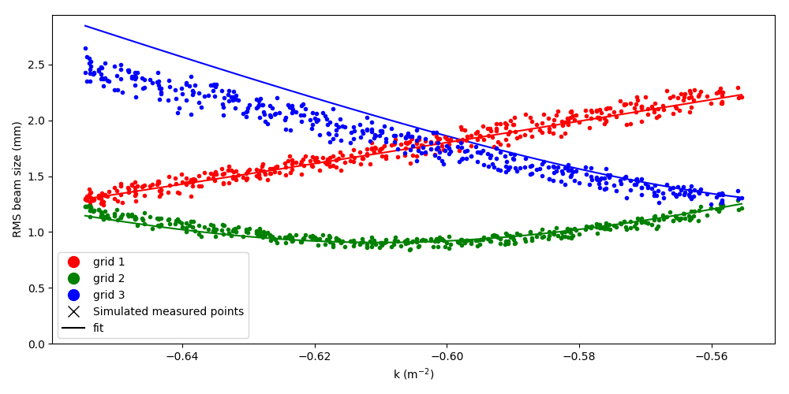
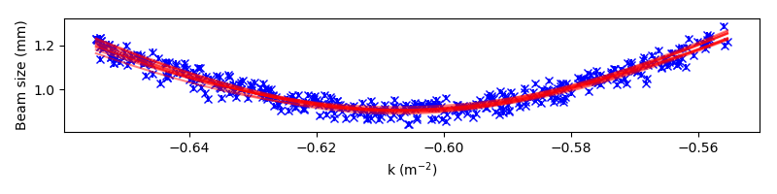
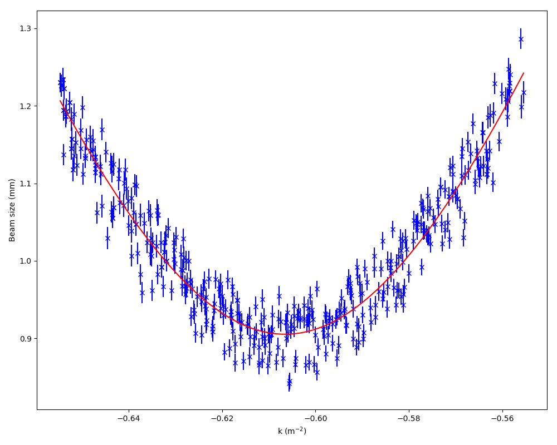
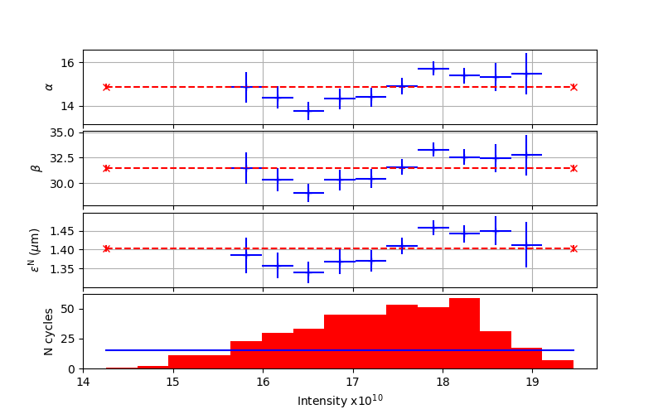
Look at the vertical plane
Different flavors of analysis give 1.32 to 1.4μm
Cleaner, clearer than in the horizontal
Also larger minimum beam size
Notes:
At start of lattice alpha~0 and beta =4.7/5.0
Model are alpha=-0.05, 4.22

Slide 11
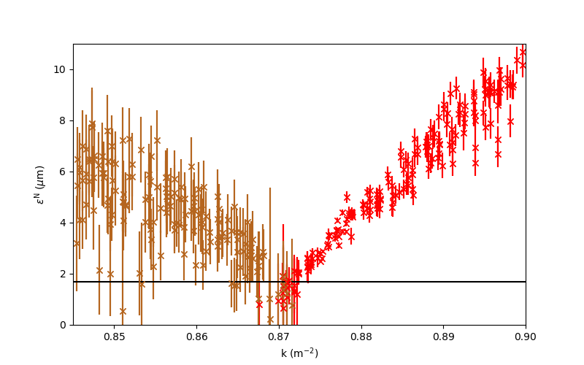
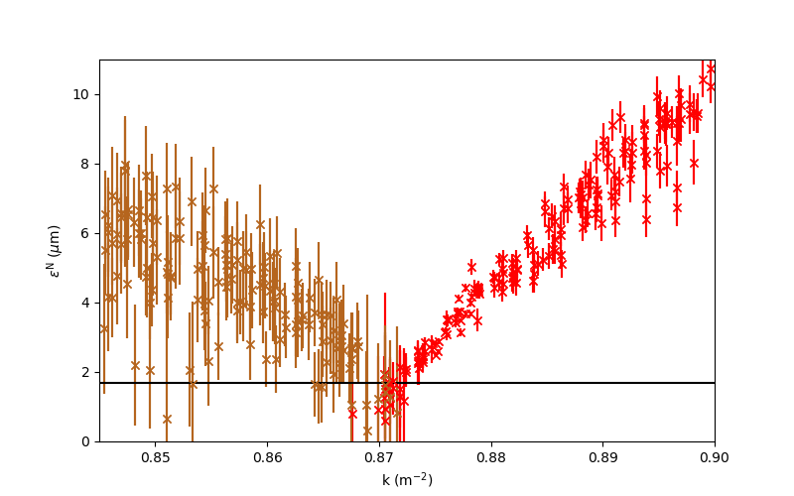
3 grids method, data !
The covariance matrix cannot (mathematically forbidden) have a negative determinant. When this happens here apply a -1 factor and I change the color to dirty brown to highlight my reluctance to this arbitrary manipulation.
Uncertainties of 5cm on the grid positions is used
L1=L2=2.5m
L1=2.485m and L2=2.487m
Negligible difference

Slide 12
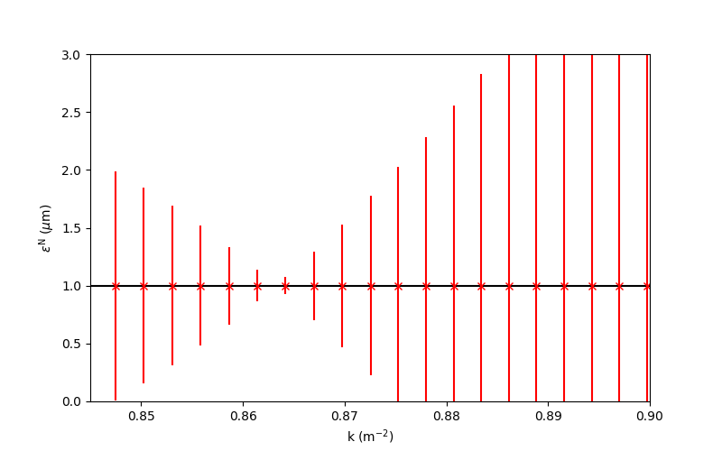
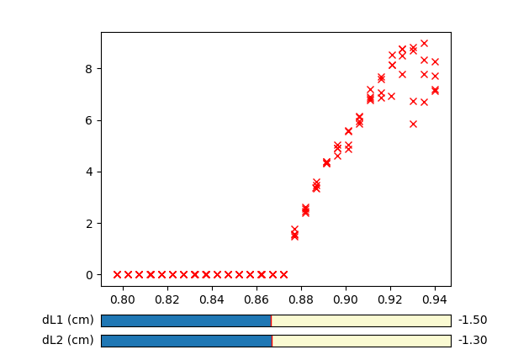
3 grids method looking at uncertainties
Uses perfect profiles, perfect everything, uses MADX.
Uncertainties :
1% relative on the profiles
5cm on the positions of the grids
My notebook to try and change the distances

Slide 13
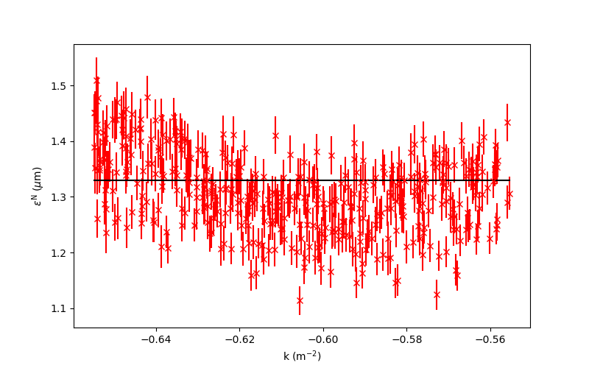
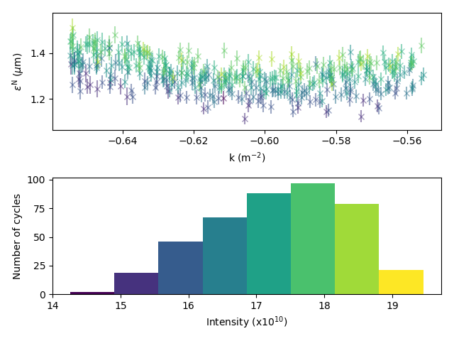
3 grids in vertical plane
Much better than in the horizontal plane
Compatible with the emittance measured using scan-k
Clear correlation between intensity and computed emittance.

Slide 14
Conclusion
Beam characterization using scan-k relies on many parameters
  Quadrupole gradient
  Negligible momentum spread effect
  Negligible effect of beam size on quality of the fit of the profile
3 grids measurement results in the horizontal plane are not conclusive
Vertical measurements are much cleaner
  Indication of correlation between intensity and emittance from scan-k measurement
  Good agreement between 3-grids and scan-k measurements
Recommendations
  Measurement of flat-top extraction kicker pulse shape with short bunch
  Finer grid spacing, at least in the center and maybe grids with heterogenous spacing
  Different optics and/or magnet position leading to larger minimum beam size
  Specific setup with near zero momentum spread
  Bench measurement of the quadrupole used

Slide 15
Beyond beam characterization
The motivation is the matching between PSB and PS
Not unlike in other specialties a stochastic method of matching might well provide the best results
  Light sources use MOGA (or single objective) methods to optimize the lattice for better lifetime
Discussing with V. Forte and M.A. Fraser we could iterate the following process, using python and a minimization algorithm
  Select a change from the initial transfer line setup using theoretically orthogonal knobs on α_{x},β _{x},D _{x},D’ _{x},α_{y},β _{y} and apply it
  Correct the injected trajectory in the CPS by steering the line (Discussing with V. Forte for the algorithm)
  Measure the emittance after injection using wire scanner(s)
  Repeat

Slide 16
Thank you

