Slide 1
Multi-trigger Data Acquisition System for longitudinal beam observation
Pawel Kozlowski
Supervisor: Alexandre Lasheen
Acknowledgements: Heiko Damerau, Valter Costa, Ioan Kozsar, Konstantinos Iliakis

Slide 2
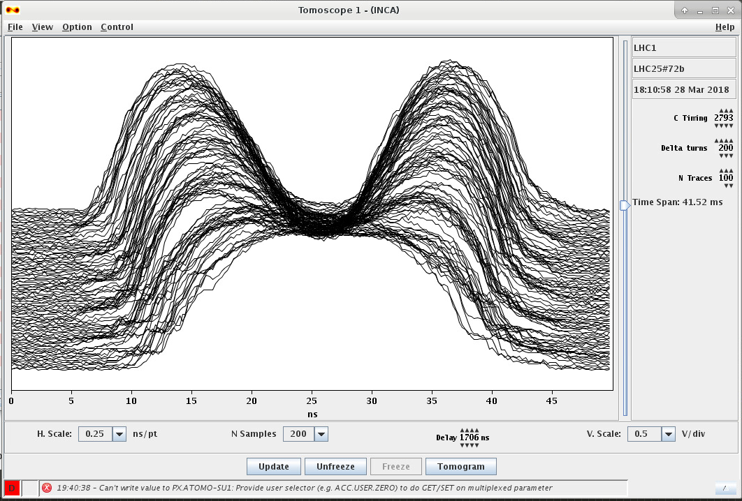
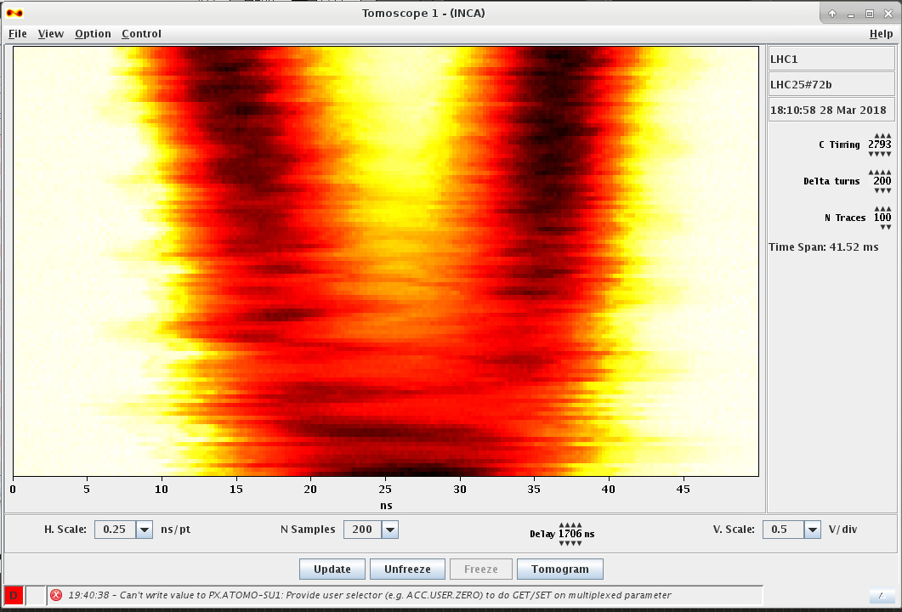
Motivation
Today there exist a tool called “Tomoscope” which is reliable, acquires beam profile data but unfortunately the data comes from many different cycles instead of the same one. Introducing multi-trigger approach enable us to measure many different time intervals during one cycle.
We need to develop scripts to handle the hardware and acquired data
Notes:
I would like to begin with what was available before and what is the general objective.

Slide 3
Outline
Introduction & motivation
Setup
Acquisition application
Performance and limitations
Conclusions
Possible future improvements
Notes:
In the presentation apart from default points I would like to split the main section into three sub-sections – I will describe the setup, application and limitations which are derived from both of them.

Slide 4
1. Introduction
A multi trigger system was installed, allowing to have bursts of triggers along the PS cycle
Now developing a demonstrator to make use of the multi triggers, allowing to do beam observation along the cycle more systematically
To be used to perform MDs till the end of the year (evolution of emittance along the cycle)
Do some tests on the demonstrator to show possibilities and limitations
Notes:
Since the multi-trigger device has been installed, some new opportunities have been opened. It is an amazing way of filtering data in such a way that the necessary data is preserved.
Observation of longitudinal beam profile
Applications: calculation of longitudinal emittance (quality of the beam). Observing increase of bunch
We want bunches to be of the same emittance
Measure beam profile in PS during one cycle
For now it should be a demonstrator, we assume that some noise is accepted (caused e.g. by distance from the beam data source, also reflections)
Gather as much data as possible, push the infrastructure into the limits, discover new possibilities, gather more precise requirements
Perform some analysis algorithms on the data

Slide 5
Outline
Introduction & motivation
Setup
Acquisition application
Performance and limitations
Conclusions
Possible future improvements
Notes:
In next slides I will present the setup which was used for the demonstrator and performance tests.

Slide 6
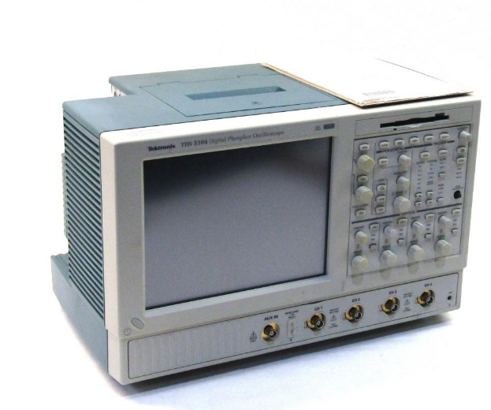
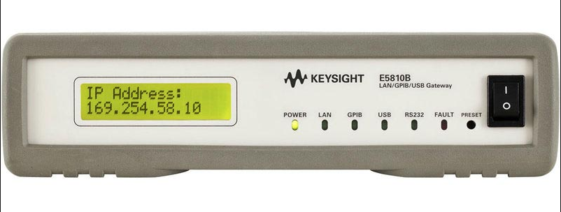
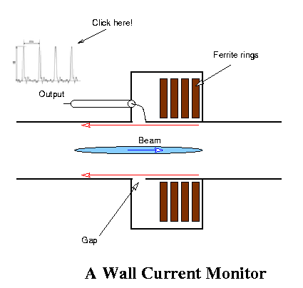

3. Present set-up
Proton Synchrotron Central Building
GPIB
Ethernet Lan cable
LAN
Global network
Python
Pyvisa
Ni-visa drivers
Inspector panel
Multiburst Trigger Control Panel
[2]
Notes:
All the devices are located in PS central building. The multitrigger device which enables us to use certain moments for each cycle of the supercycle

Slide 7
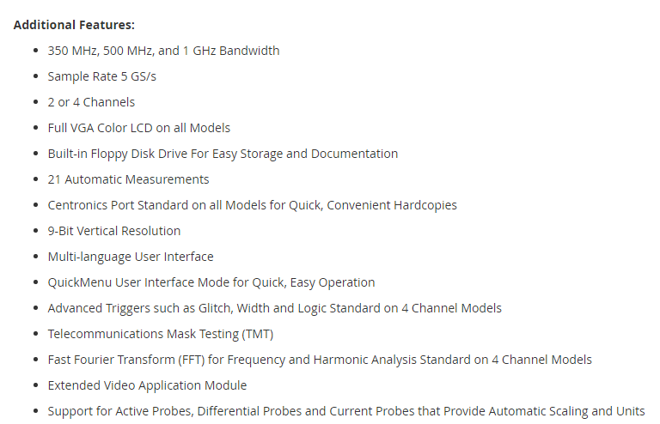
TEKTRONIX TDS5104
8-Bit vertical resolution (more bits with interpolation)
Sample rate 5 GS/s

Slide 8
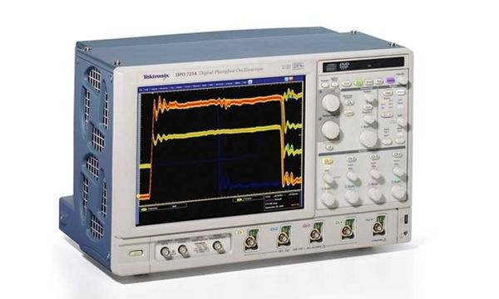
TEKTRONIX DPO7254
8-Bit vertical resolution (more bits with interpolation)
2.5 GHz bandwidth and 10 GS/s real time sampling rate on all channels, 40 GS/s on 1 channel

Slide 9
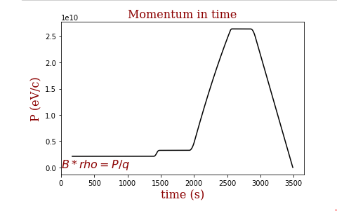
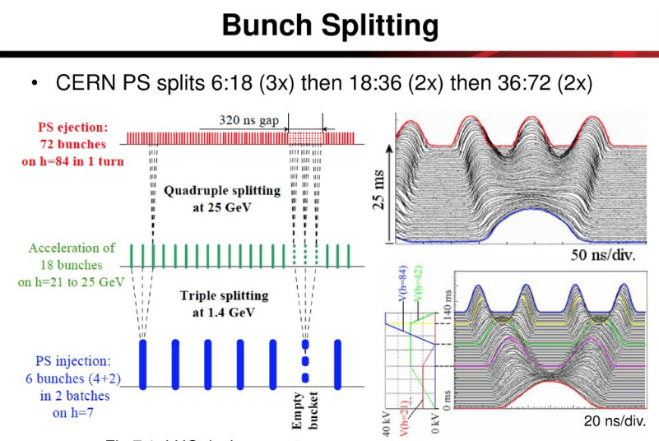
The plot of the acceleration ramp/ cycle
[9]
Flat bottom
Injection
Plateau
(Merge)
Three split
Transition
Landau
Two split(Four split)

Slide 10
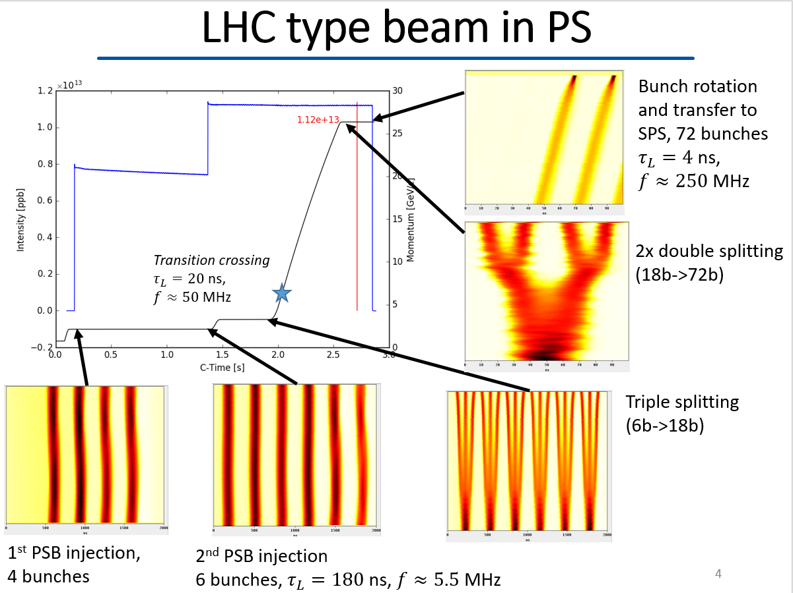

Slide 11
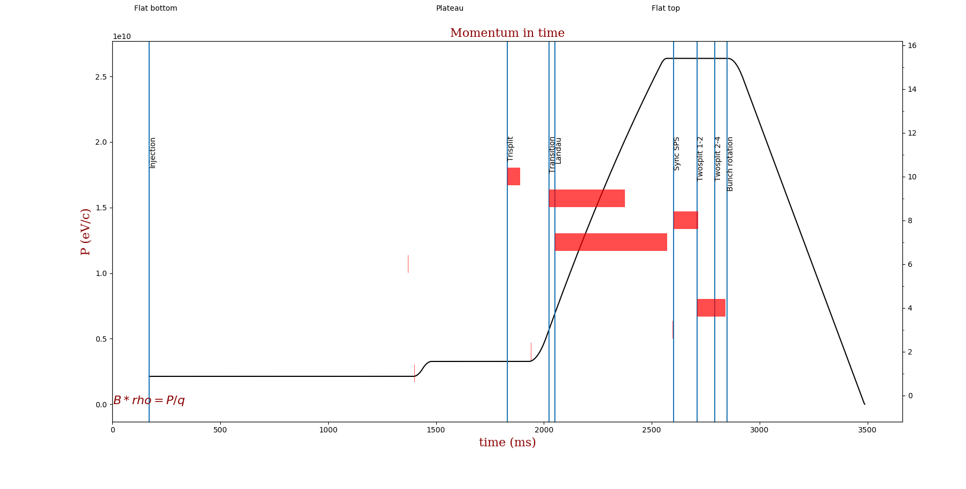
Result – multitrigger visualisation
Notes:
This picture illustrates the coverage of triggers on the magnetic field program timeline. Some special events of particular interest are covered. The events I have chosen here were previously picked by somebody else and were used in Tomoscope – but without possibility of acquiring them altogether during one cycle.
In order to mitigate the trigger coverage issue not only the plots are helpful but also the feature to store “settings” to a file. This way an user is able to store every correct setting for the future – like in Tomoscope. It is proven that the same settings are used most of the time.

Slide 12
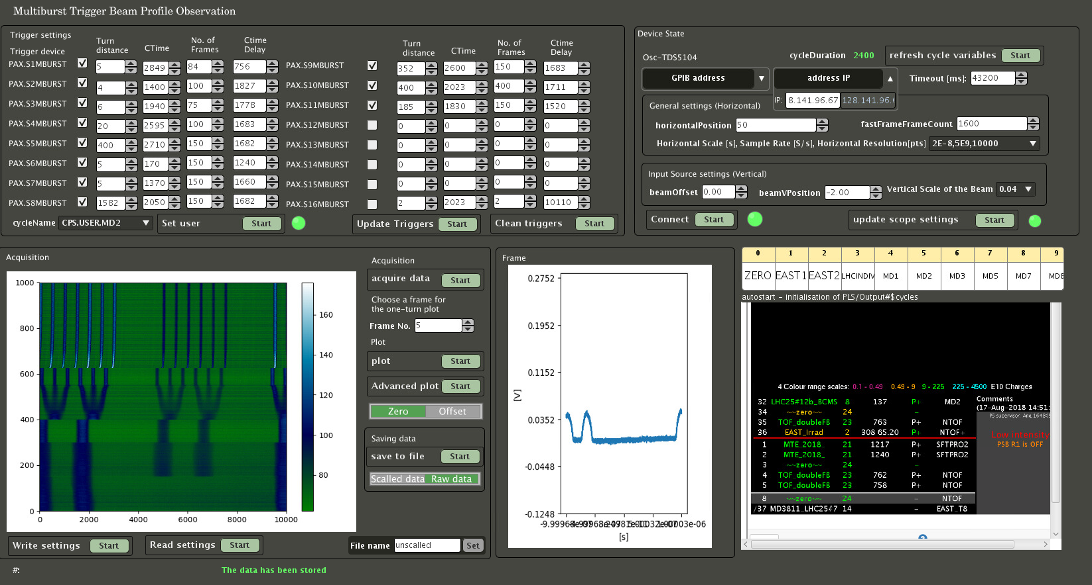
Notes:
I would like to present you the default panel. It contains 5 sections – trigger settings, scope settings, acquisition frame, one-frame view for dynamic range adjustment and the state of the cycles.
This plot illustrates the absence of one bunch – what corresponds to the information about the failure of the system

Slide 13
Notes:
In this section we can set for each cycle 16 triggers with a number of sub-triggers corresponding to number of frames.

Slide 14
Notes:
In this section we are setting some scope attributes. The timeout is synchronized with the length of the cycle. In order to have the same convention as in the tomo please set the beam Offset. There is much more settings which could be applied but we have decided to leave them only in advanced view.

Slide 15
Notes:
The acquisition window depicts the gradient plot of how the beam changes during time (truns chronologically). One frame (x-axis record) covers one turn in this case. The frames does not illustrate every succeeding turn – the distance between turns varies and depends on the “Turn distance” attribute of the trigger. Sometimes we expect more exact information sometimes sparse data. We can perform all default operations on the already acquired data – plot, save. We can also read and write settings which we found appropriate for a given cycle to not to repeat operation of setting up the infrastructure for similar acquisition in the future.

Slide 16
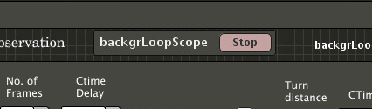
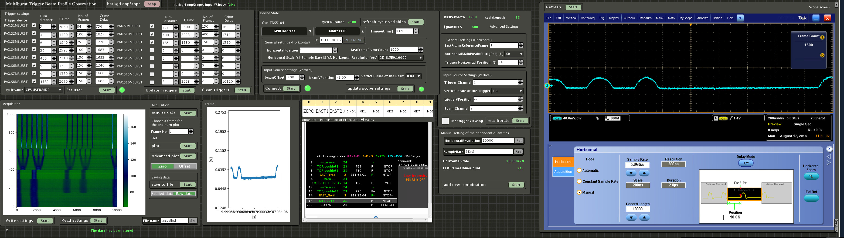
Advanced Panel
More features to control settings of the scope
Possible debugging for the development of the application purpose
Notes:
The application fully utilizes the capabilities of inspector panel. We can use the default console of a blueprint to trace the program execution. In order to make the code more organized and extendable a special central loop has been used. This works well because when an action which requires high performance is running the loop just stops. All the buttons are synchronized so that the user knows if the action is still perfomed.

Slide 17
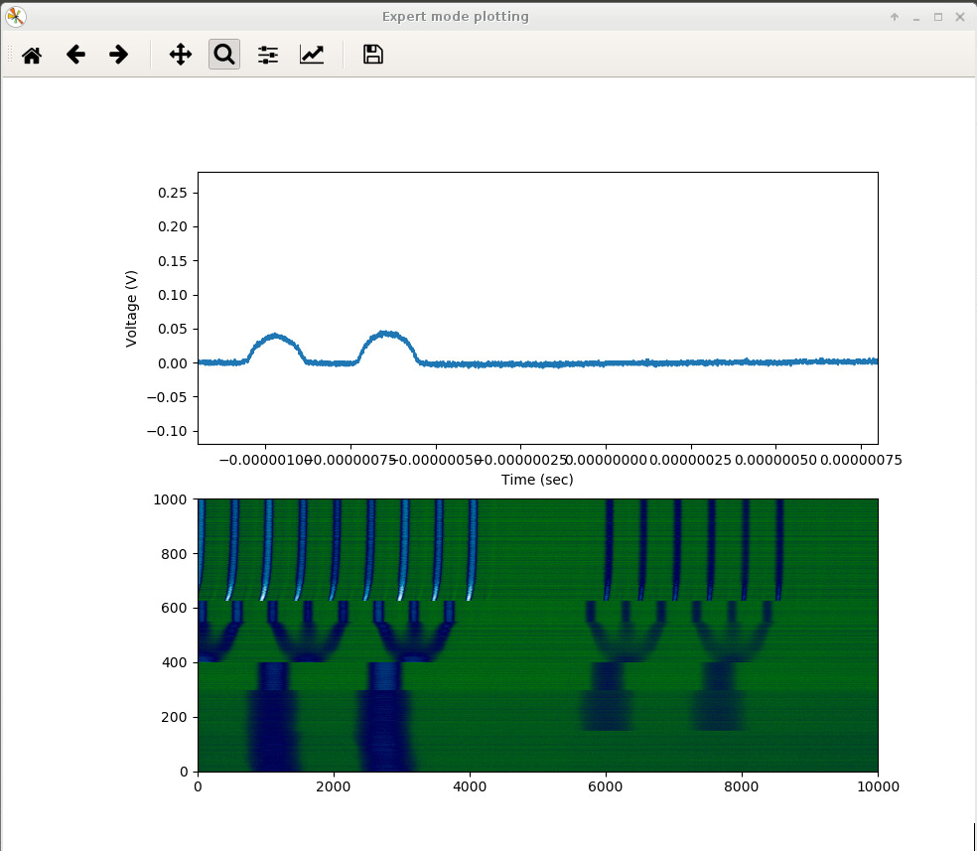
Notes:
Nominal cycle – 6 on the beginning, 72 final bunches

Slide 18
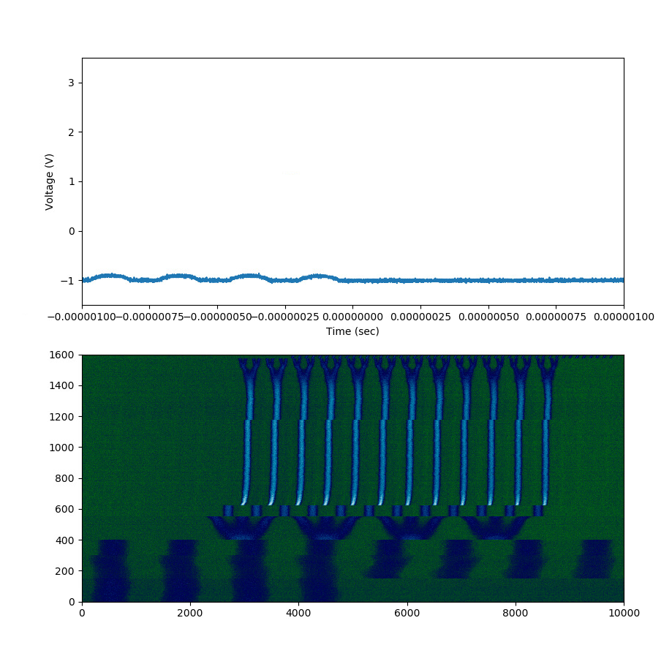
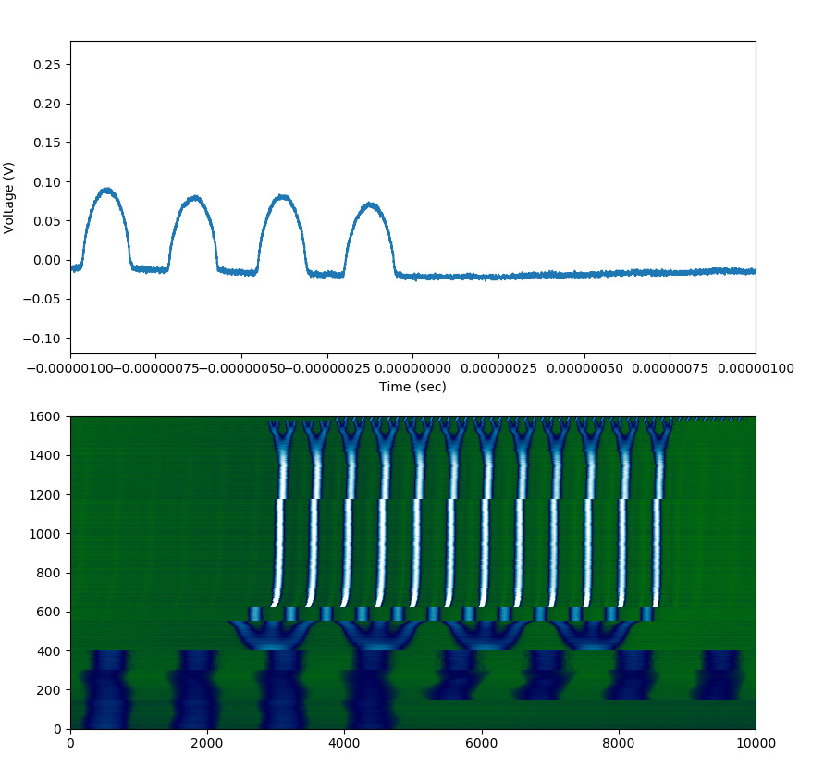
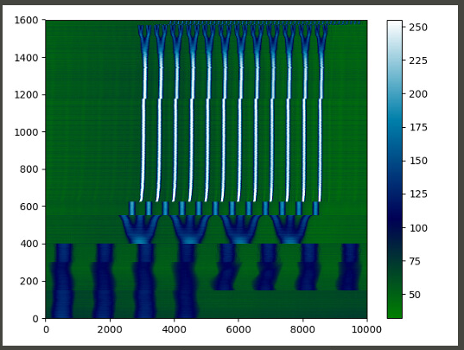
Notes:
The comparison of low and high amplitude which results in poor quality of the plot or saturates in some moments.

Slide 19
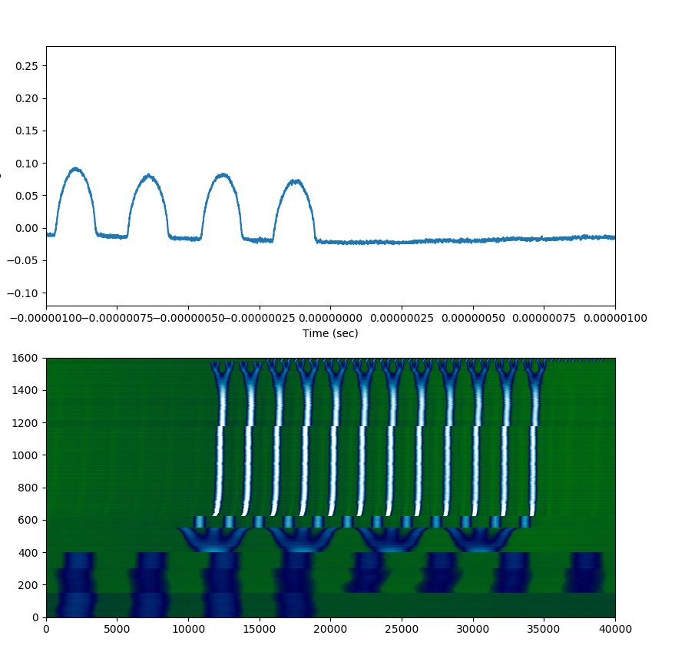
Time of acquisition and transfer:
311.601s
Notes:
This is example of very high quality plot. I have used 20GS/s sampling rate. It is more than we need. The time of acquisition is very long.

Slide 20
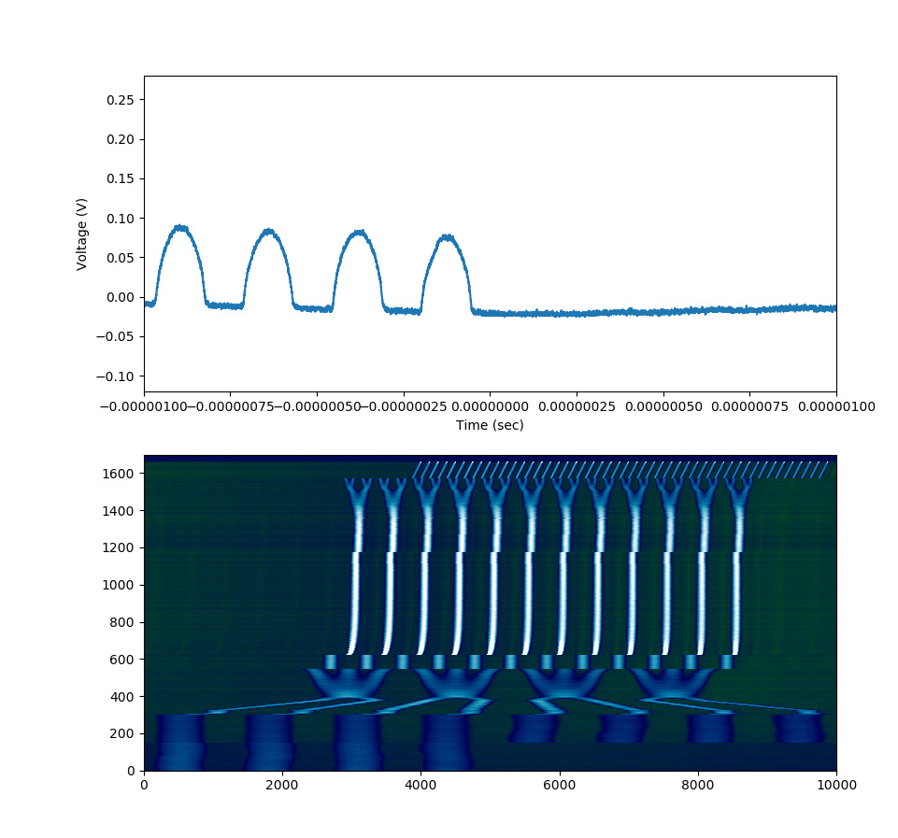
Notes:
BCMS 8 bunches on the beginning, 48 final bunches

Slide 21
Outline
Introduction & motivation
Setup
Acquisition application
Performance and limitations
Conclusions
Possible future improvements

Slide 22
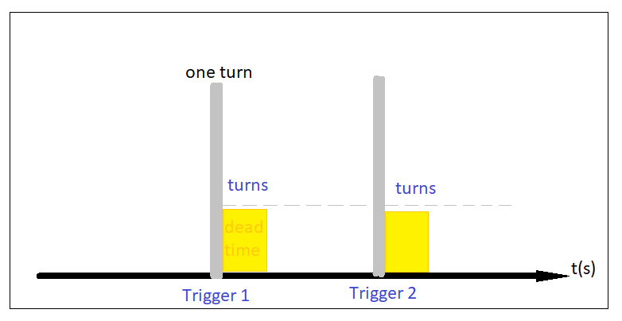
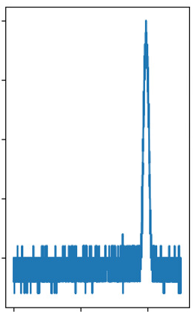
limitations
Memory limitation - increase of the number of frames causes decrease of horizontal resolution. Therefore the quality of data is very limited. (visualised on the left). One of the solution could be just informing the user about not accepting the provided settings. In DPO7254 there is enough memory space for our application.
Some oscilloscope settings cannot be accepted (attributes require values which are not continuous), the difference between possible values varies between different orders of magnitude.
The oscilloscope dead time is normally 2-3 turns, what is more or less: 4.0 – 4.4us. The number of samples has influence on the value.
Limited dynamic vertical range.
Having strict control over triggers.
Notes:
Dead time – time for buffering the data before next acquisition caused by succeeding trigger. (motion inside bucket doesn’t need every turn measurement). Not a major problem as far as we don’t need every turn.
The need for control the vertical scale is mitigated by wide spectrum of views – plots and also ability to take a look at the plot of each frame. Additionally in order to speed the adjustment up the plot function is executed separately from the acquire data function so that an user can rapidly use the buffered by the scope data.

Slide 23
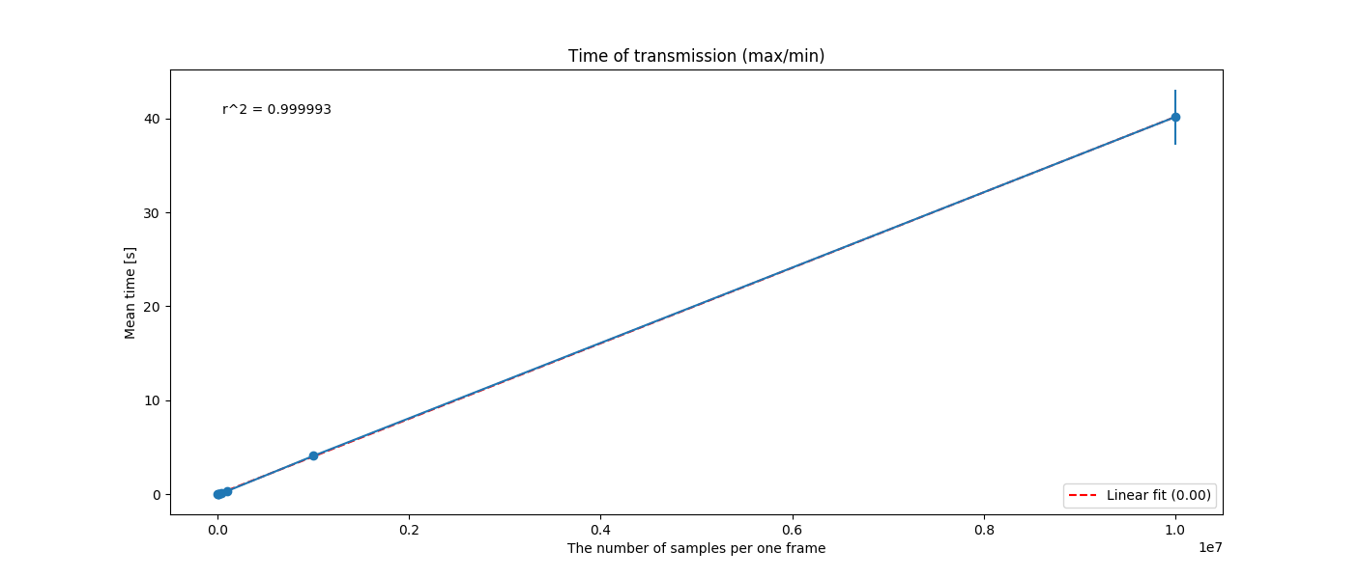
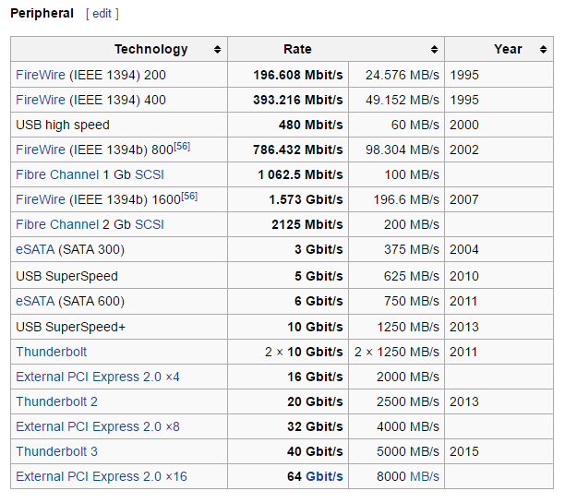
Transfer of Data
The maximum data rate in the original GPIB standard is about 1MByte/s (determined by the transfer from the slowest connected device) .
1600MHz memory can run at a theoretical speed of 12.8 gigabytes per second
Practical case LHC1: 118.29s takes sending 1600 frames * 10000s = 16 000 000 samples
Each sample 8 bits
For high quality data for LHC1: 311.601s takes sending 1600 frames * 40000 = 64000000 samples
[1]
Notes:
Another limitation is transfer rate is not deterministic in non real time systems. What means that the data given by producers does not corresponds to reality.
For example we have obtained 0.25MB/s instead of 1MB/s when acquiring data from the scope.
Other source:
1. Thunderbolt (up to 40 Gbps)
2. USB 3.1 (10 Gbps), then USB 3.0 (5 Gbps)
3. eSATA (6 Gbps)
4. Firewire (6 Gbps)
5. Gigabit Ethernet (1 Gbps)
6. USB 2.0 (480 Mbps)
7. Ethernet (100 Mbps)

Slide 24
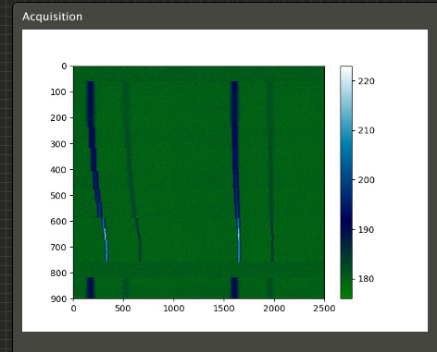
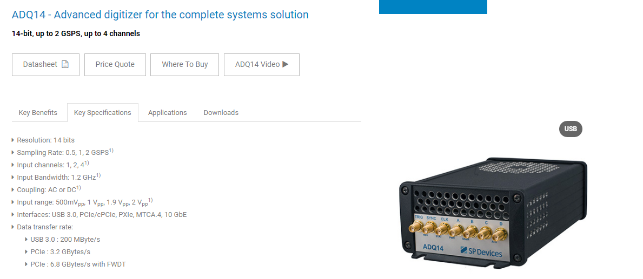
How do we alleviate the limitations
vertical resolution and maximal number of samples
Transfer time
Acknowledgements: Guido Sterbini
Notes:
In EAST cycle there are two bunches one with very large intensity and one with very low, we cant measure the very low one – dynamic range is a limitation in this case.
We are currently testing two digitizers which not only enable to have a streaming mode but also ensure better vertical resolution.
Thanks to Guido we can test ADQ14 and ADQ214. He decided to lend us the devices.

Slide 25
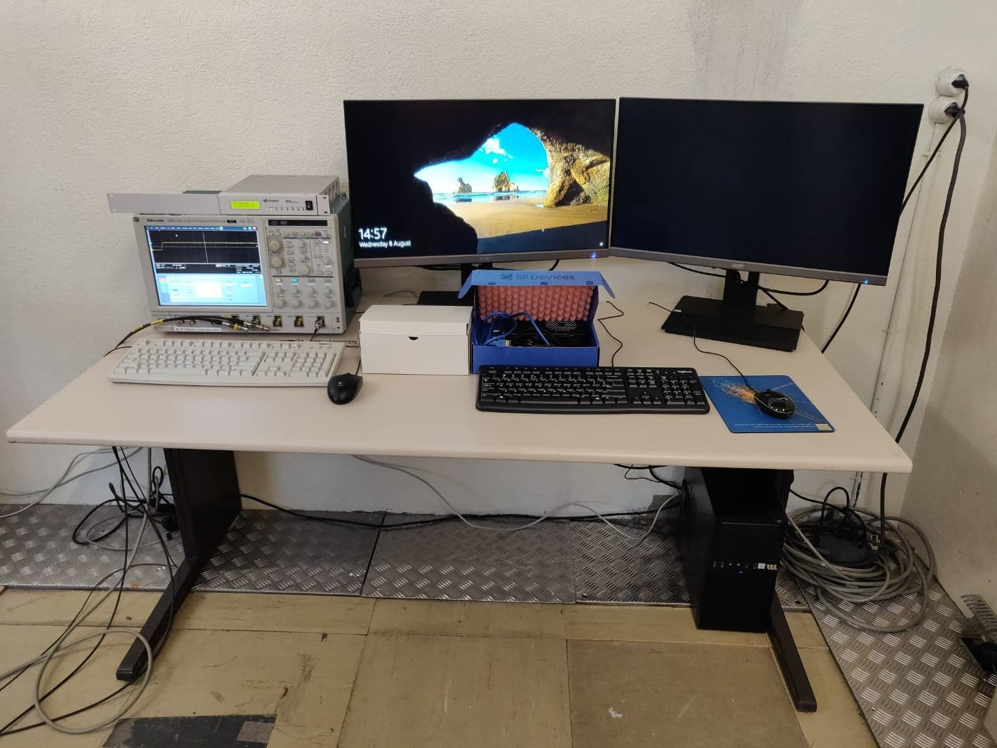
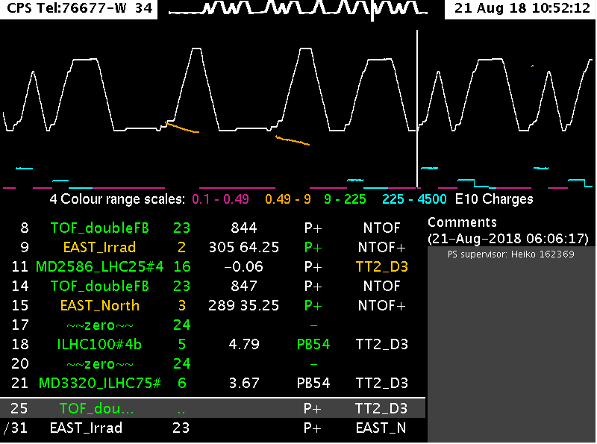
Possible Improvements
As the transfer time from the scope is considerable, it unable us to acquire more than one cycle. We are testing streaming approach on ADQ14 and ADQ214 digitizers.
The last limitation : security concerns regarding old OS, preventing us to use lan instead of GPIB.
Notes:
The streaming mode I have mentioned about allows for better CPU utilization. It is much more flexible approach and makes better use of multiprocessing.
We are investigating feasibility of acquisition of more cycles than one. In order to test faster connections we will acquire data directly in the PS Centr. Building,
then the data will be send further, maybe even to many different users.
Obsbox
Better scope/digitizer (MicroTCA, Obsbox, PCIe daq)
Local acquisition – gathering data directly into computer standing in the PS central building (flexibility in terms of ram/hdd extension, PCIe slot)
Changing the approach from static to dynamic (stream processing) – scala/python/java + spark? GPU or FPGA for on the fly analysis. Split processing to many pipes in different threads.
Minimizing buffering time by distributing data among many memory buffers (similar working principle to the one used in Obsbox?), it is also possible to make a compression before sending data throughout the link
Spreading the solution into SPS
General performance improvement (going down to the lower level programming layers)

Slide 26
To sum up…
Acquisition of 8-bit unsigned data together with scaling factor
Environment for adjusting the parameters of the scope for future execution of the acquisition (e.g. to avoid saturation)
Two plots visualizing the data – a trace made out of many turns and one-turn view
Storing unscaled data(possible adjustment to store in a scaled floating point version)
Storing settings for both triggers and scope for a given cycle (for fast repetition of acquisition in the future)
Possibility to set own multi-trigger settings. A special mechanism deployed to avoid populating trim history with unnecessary data.
A mechanism to force application to show a data even if the scope will answer with lower resolution (e.g. if an user will ask for a high number of frames)
Independent of PLS
Some debugging tools in the “edit” mode for future development

Slide 27
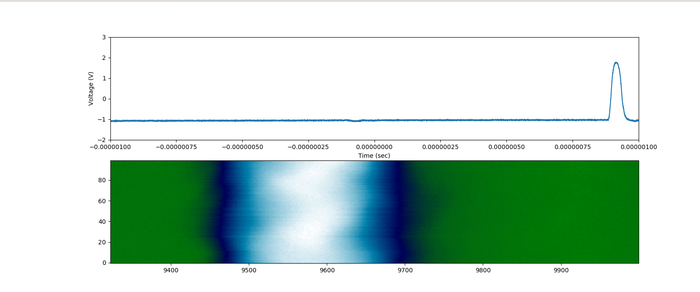
Bonus slides

Slide 28
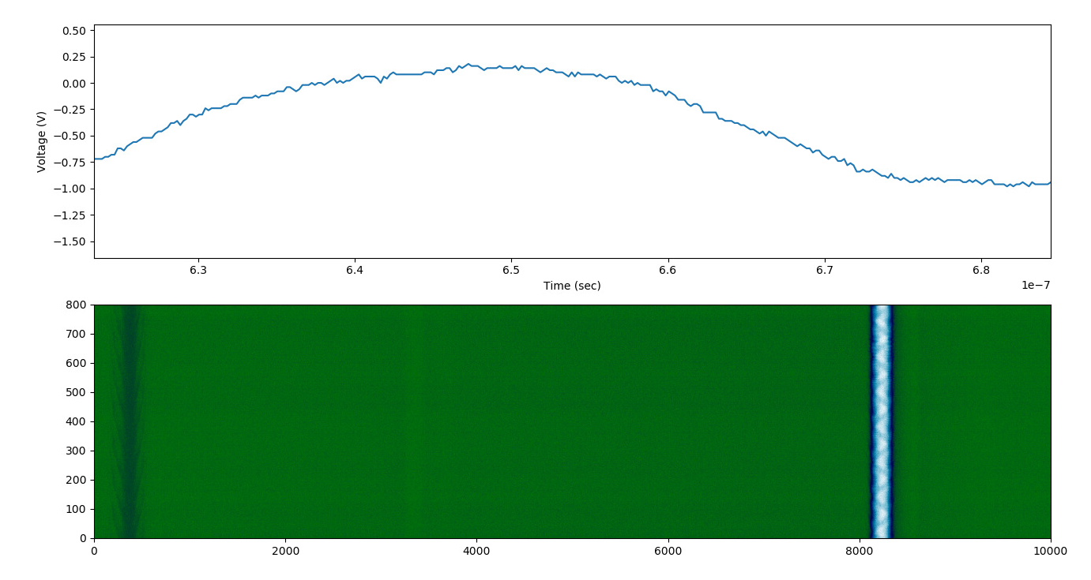

Slide 29
Sampling frequency
Sampling frequency related with RF Bucket size
The fastest change (shortest bunch length) is : 4ns
  In order to see 20 samples of the bunch
  Fs=10Fb => Fs=20/(4e-9)= 5GS/s
  This means that TDS5104 will provide max 20 samples per shortest bunch. The bandwidth is 1 GHz what means that there will be a considerable attenuation in this case. In order to avoid attenuation the limit will be max 4 samples for the bunch.
  DPO7254 in turn is offering much higher sampling rate 40GS/s and bandwidth 2.5 GHz – in this case we can obtain up to 160 samples per shortest bunch or 10 points when avoiding any attenuation apart from 3dB.
  According to http://www.keysight.com/upload/cmc_upload/All/Scope_Fundamentals_for_EE_Students.pptx:
    Required BW for analog applications: ≥ 3X highest sine wave frequency.
    Required BW for digital applications: ≥ 5X highest digital clock rate.

Slide 30
Sources
https://www.online-tech-tips.com/computer-tips/usb-2-0-vs-usb-3-0-vs-esata-vs-thunderbolt-vs-firewire-vs-ethernet-speed/
http://psring.web.cern.ch/psring/psring/misc/wcm.html
https://www.spdevices.com/products/hardware/14-bit-digitizers/adq14
https://doc.xdevs.com/doc/Tektronix/TEK%20TDS%205000%20Series%20Programmer.pdf
https://www.tek.com/oscilloscope/tds7254-manual/tds7000-series-csa7000-series
Introduction to Beam Instrumentation CAS 2013 Trondheim (slides) - Dr. Rhodri Jones
http://pyvisa.readthedocs.io/en/stable/
http://www.testequipmenthq.com/datasheets/TEKTRONIX-TDS5104-Datasheet.pdf
https://cds.cern.ch/record/453506/files/ps-2000-038.pdf

