Slide 1
MD3308: Instability growth-rate vs. chromaticty at injection
D.Amorim, S.Antipov, X.Buffat, E.Carideo, J.Dalla-Costa, T.Dascalu,
J.-C.Dumont, K. Fuchsberger, N.Mounet, A.Oeftiger, B.Salvant, D.Valuch

Slide 2
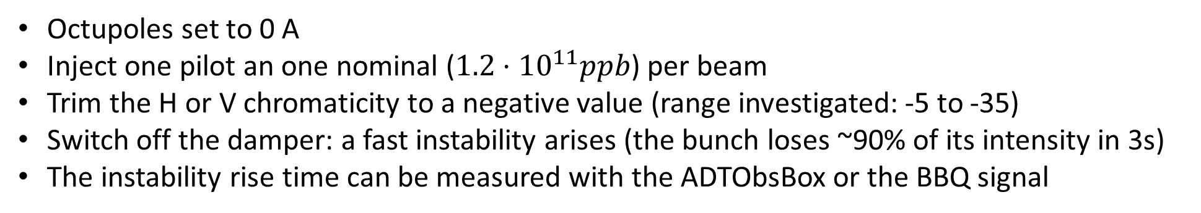
MD motivation
Measure instability growth-rate as a function of chromaticity
  Scan the real part of the machine impedance
  Stay at injection to measure many points
    The strong instability spoils the beam, staying at injection allowed to
    reinject a new bunch for each measurement
MD procedure
Octupoles set to 0 A
Inject one pilot an one nominal ($1.2⋅{10}^{11}ppb$) per beam
Trim the H or V chromaticity to a negative value (range investigated: -5 to -35)
Switch off the damper: a fast instability arises (the bunch loses ~90% of its intensity in 3s)
The instability rise time can be measured with the ADTObsBox or the BBQ signal

Slide 3
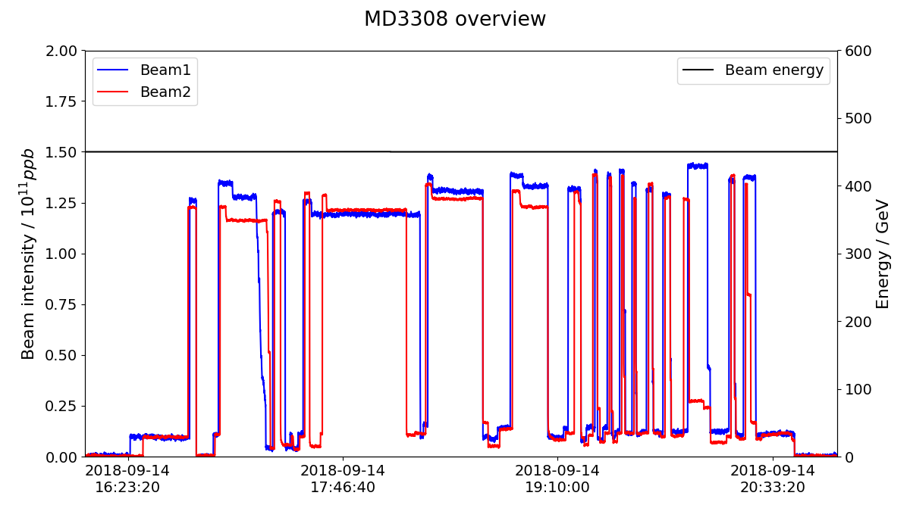
MD overview
-ADT B1H module
investigations
Growth-rate measurement:
Scan of H chromaticity
Scan of V chromaticity
Chromaticity
measurement

Slide 4
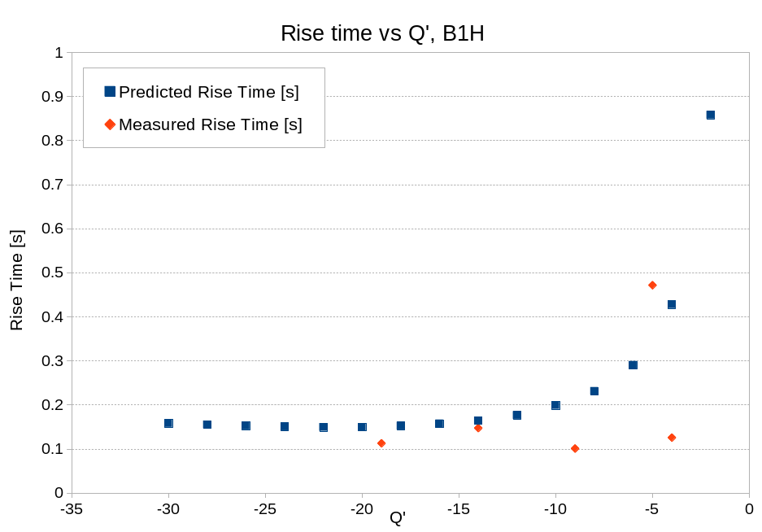
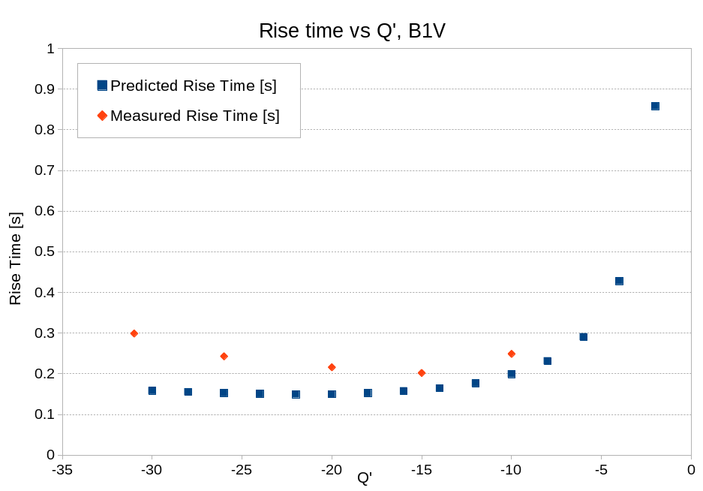
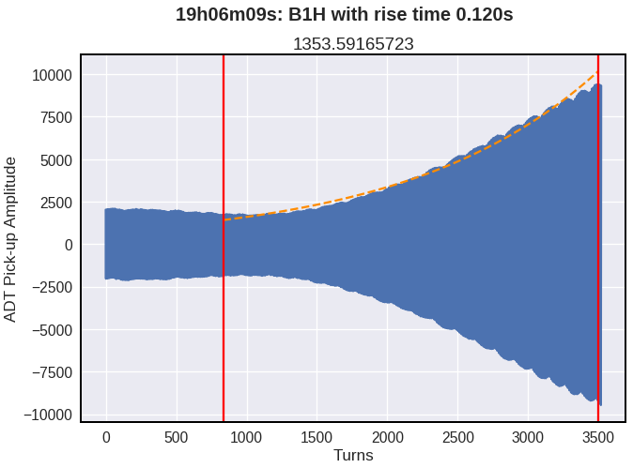
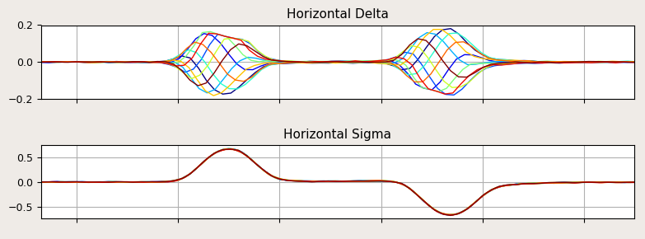
MD results
Some measurement points in B1H are far from predicted values
  Could come from the instability signal fit
In B1, rise times increase for large negative chromaticities

Slide 5
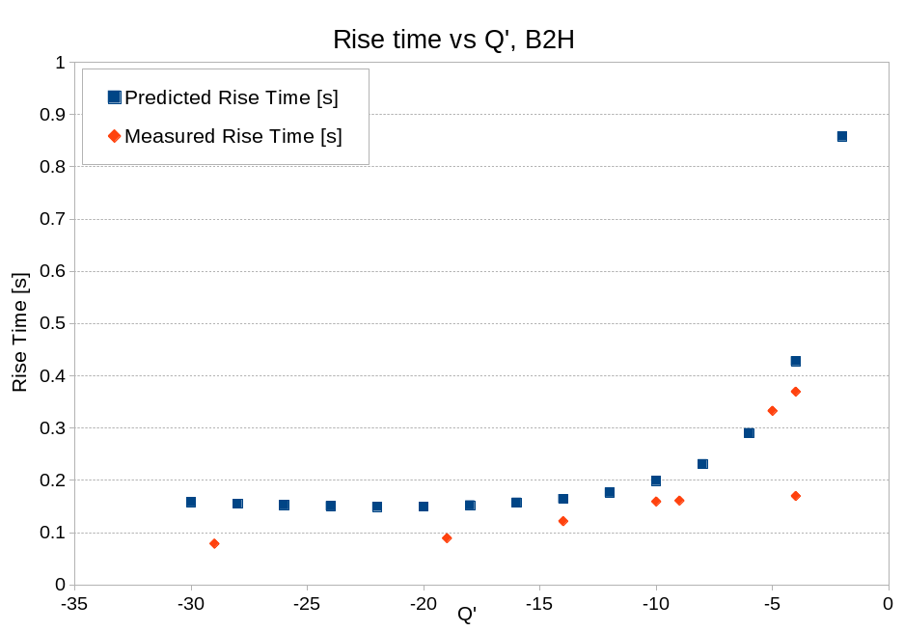
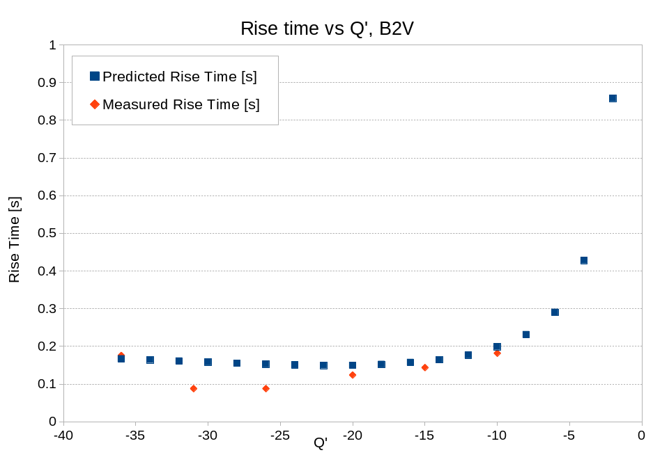
MD results
B2H and B2V behave as predicted for low negative chromaticities
For large negative chromaticities:
  The rise times are below predictions
  They continue to decrease with chromaticity

Slide 6
Summary
Measured instability rise times as a function of chromaticity
  Stayed at injection energy and went to negative chromaticities
  Bunch made unstable by switching off the transverse damper
First measurements were done switching off the damper by sending a timing event
  One of the B1H module could not be switched off
  Tried to trim the gain to ~0 in LSA: the beam stayed stable
  Then with a hardware switch off of the ADT: the beam was untable
The instability rise time measurement was then performed
  First trimming the H chromaticity in the -5 to -35 range
  Then trimming the V chromaticity in the -5 to -40 range
  Fast instability arise
Results are in the predicted range, but the measurement diverge from predictions for large negative chromaticities

