Slide 1
Test results from cryostats for SC Link without thermal shield and ECR
Amalia Ballarino, 13/09/2018
TCC Meeting, 13/09/2018

Slide 2
With contributions to the WP6a from:
SCD (SC Link, design and assembly of test station, implementation of instrumentation, test program)
CRG (implementation of heaters, gas return lines and control system, participation in test campaign)
TF (operation of test station and contribution to data analysis
EN Design office for detailed execution drawings
Test results presented by P. Retz/G. Willering at WP6a meeting on 19/06/2018

Slide 3
Background
When the length of the SC Links was significantly reduced (new underground configuration), we considered the possibility of using flexible cryostats with no active cooling. Rationale: reduced total integrated thermal load (W/m for a shorter length) and same enthalpy available (same mass flow rate and same ΔT_{He}).
Main advantage of passive cryostat: lower weight, much easier handling and smaller outer diameter of the SC Link cryostat; lower cost of the SC Link cryostats; simplified design of the DFH cryostats
Main disadvantage of passive cryostat higher static load.
We took the challenge of launching a procurement for 60 m long passive cryostats with target static heat load of 1.5 W/m.

Slide 4
Industrial procurement
Procurement of six 60 m long semi-flexible cryostats from three companies: Nexans (D), Cryoworld (NL) and Criotec (I). From each company: three cryostats with active shield (4- walls) and three cryostats with passive shield (2-walls)
Cryostats all designed for hosting final multi-cable assembly and meeting heat load, max pressure and pressure drop requirements
Baseline today for WP6a: 4-walls cryostats

Slide 5
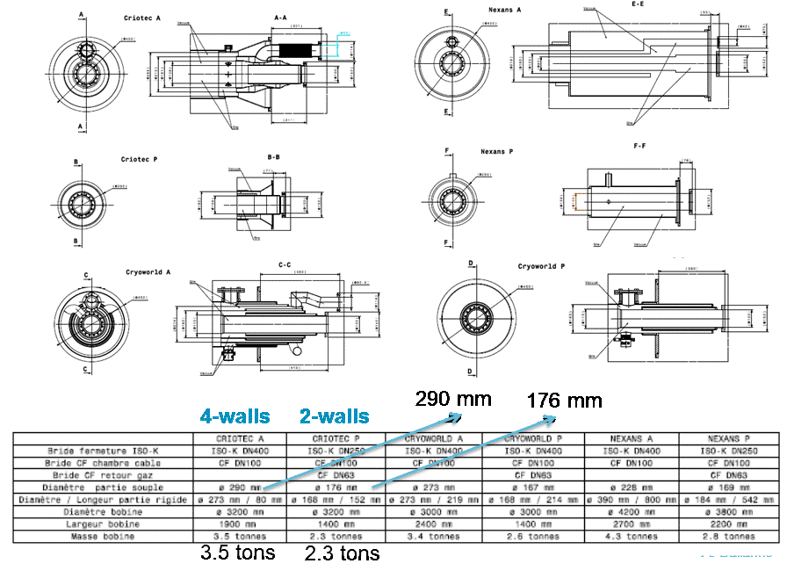
Industrial procurement
A. Ballarino

Slide 6
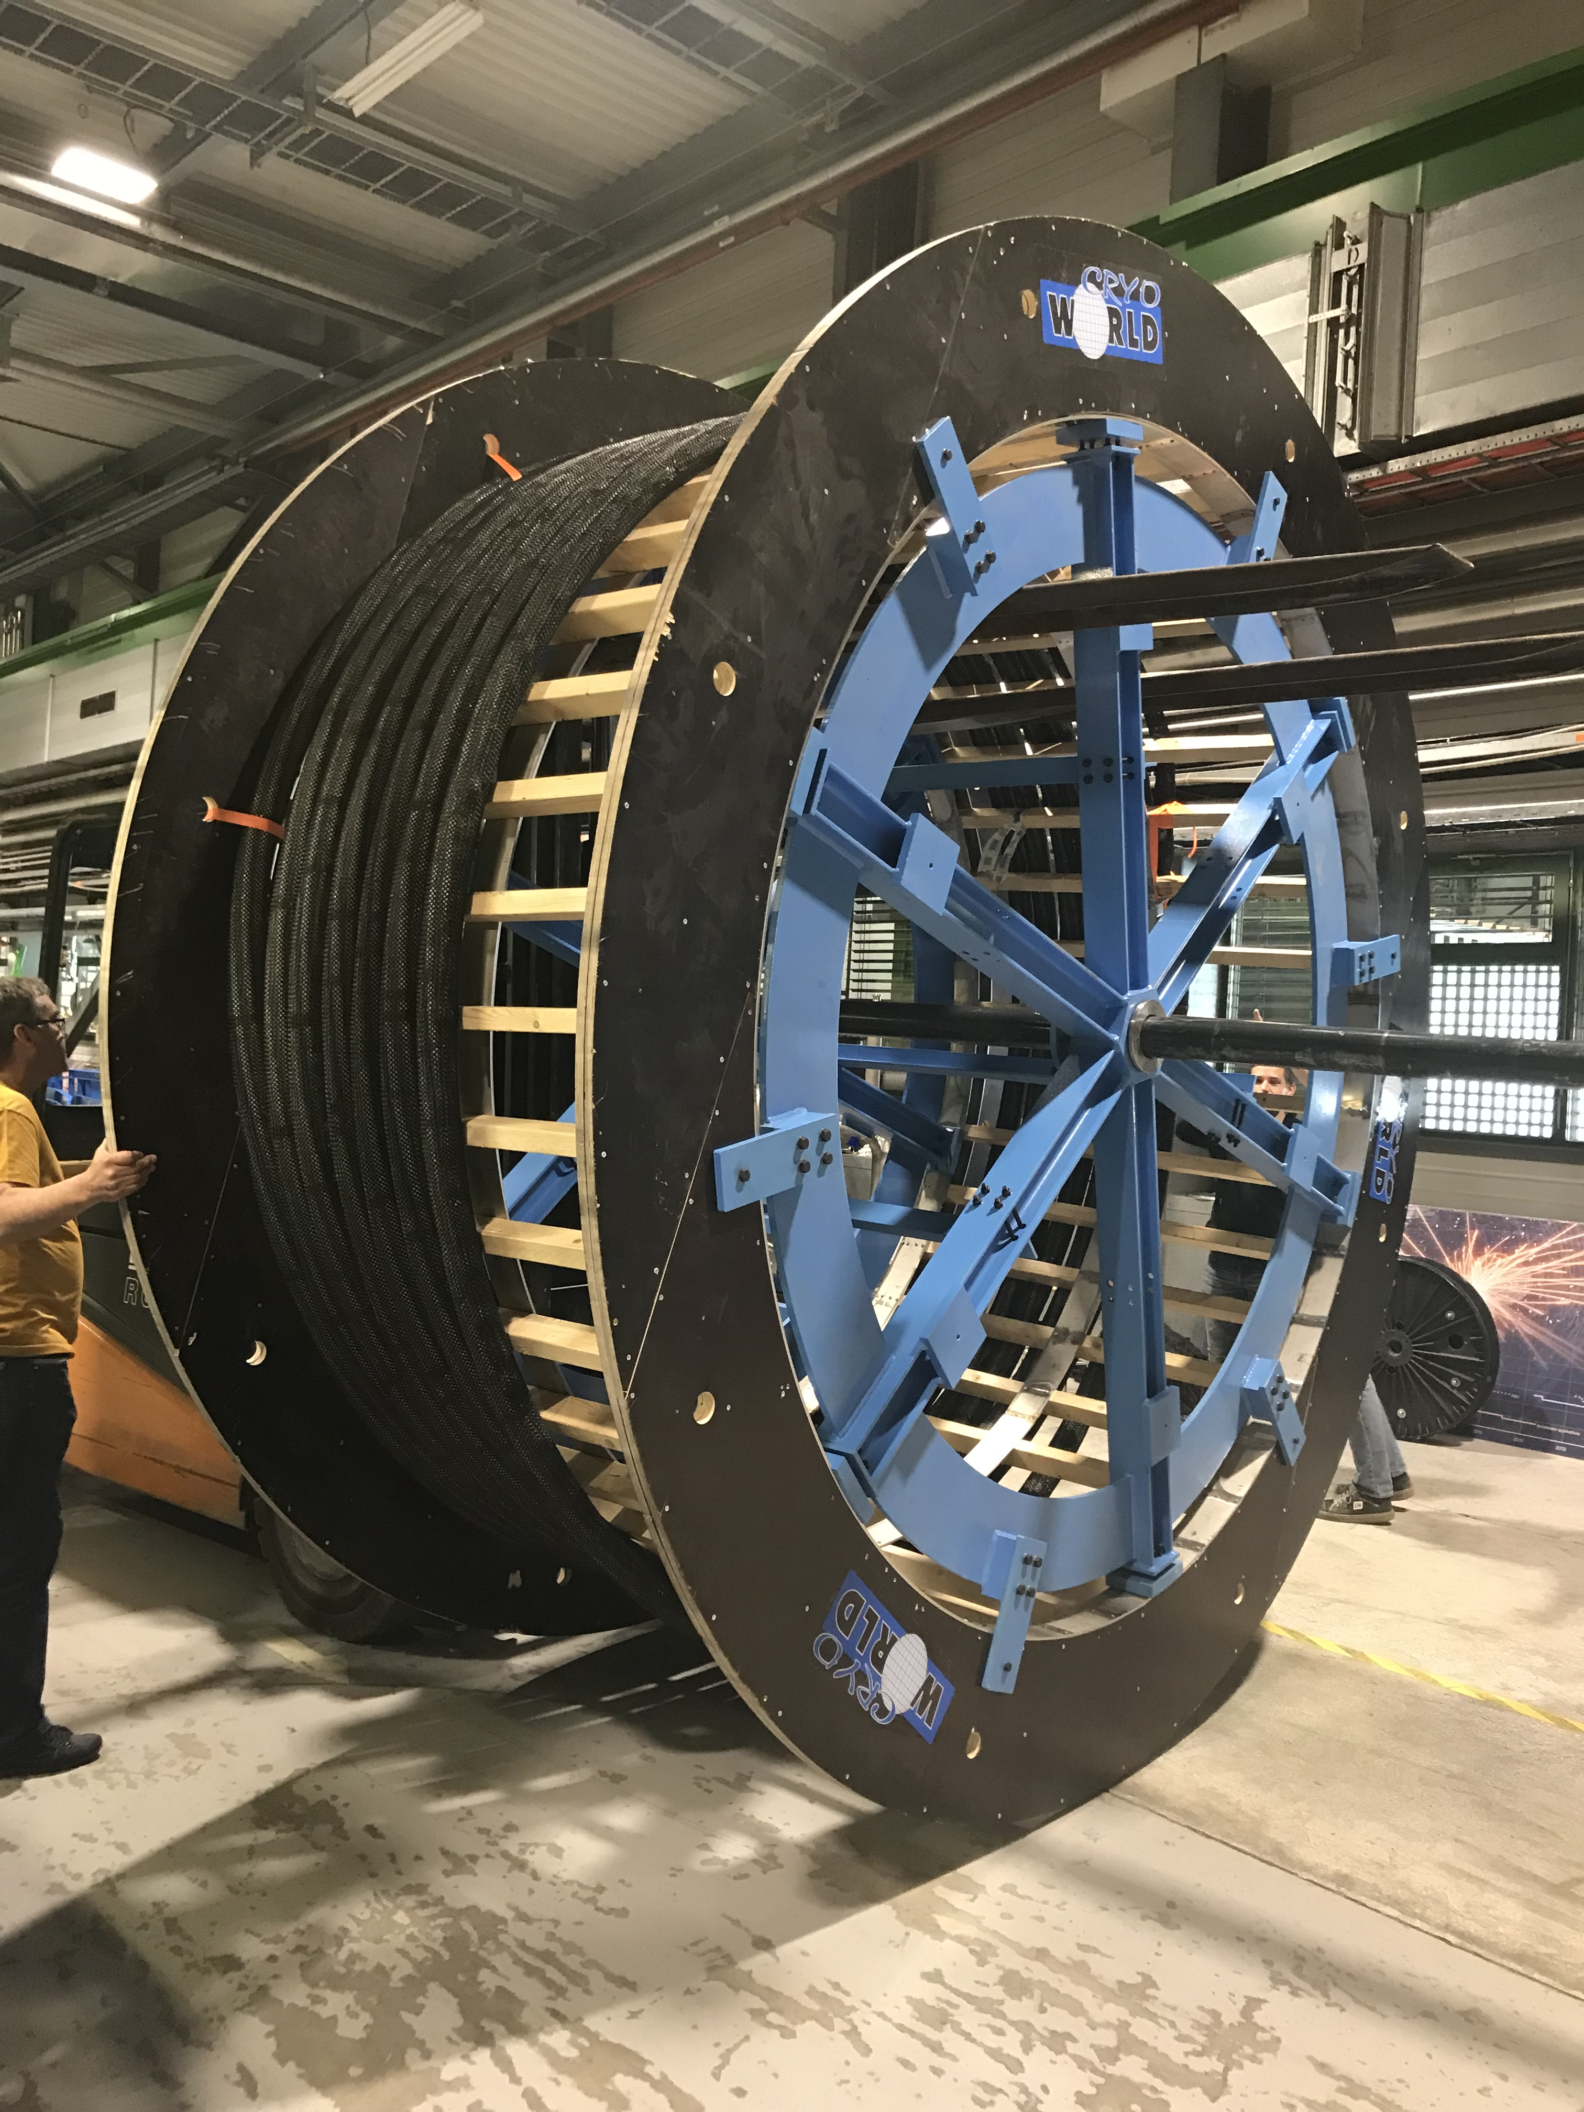
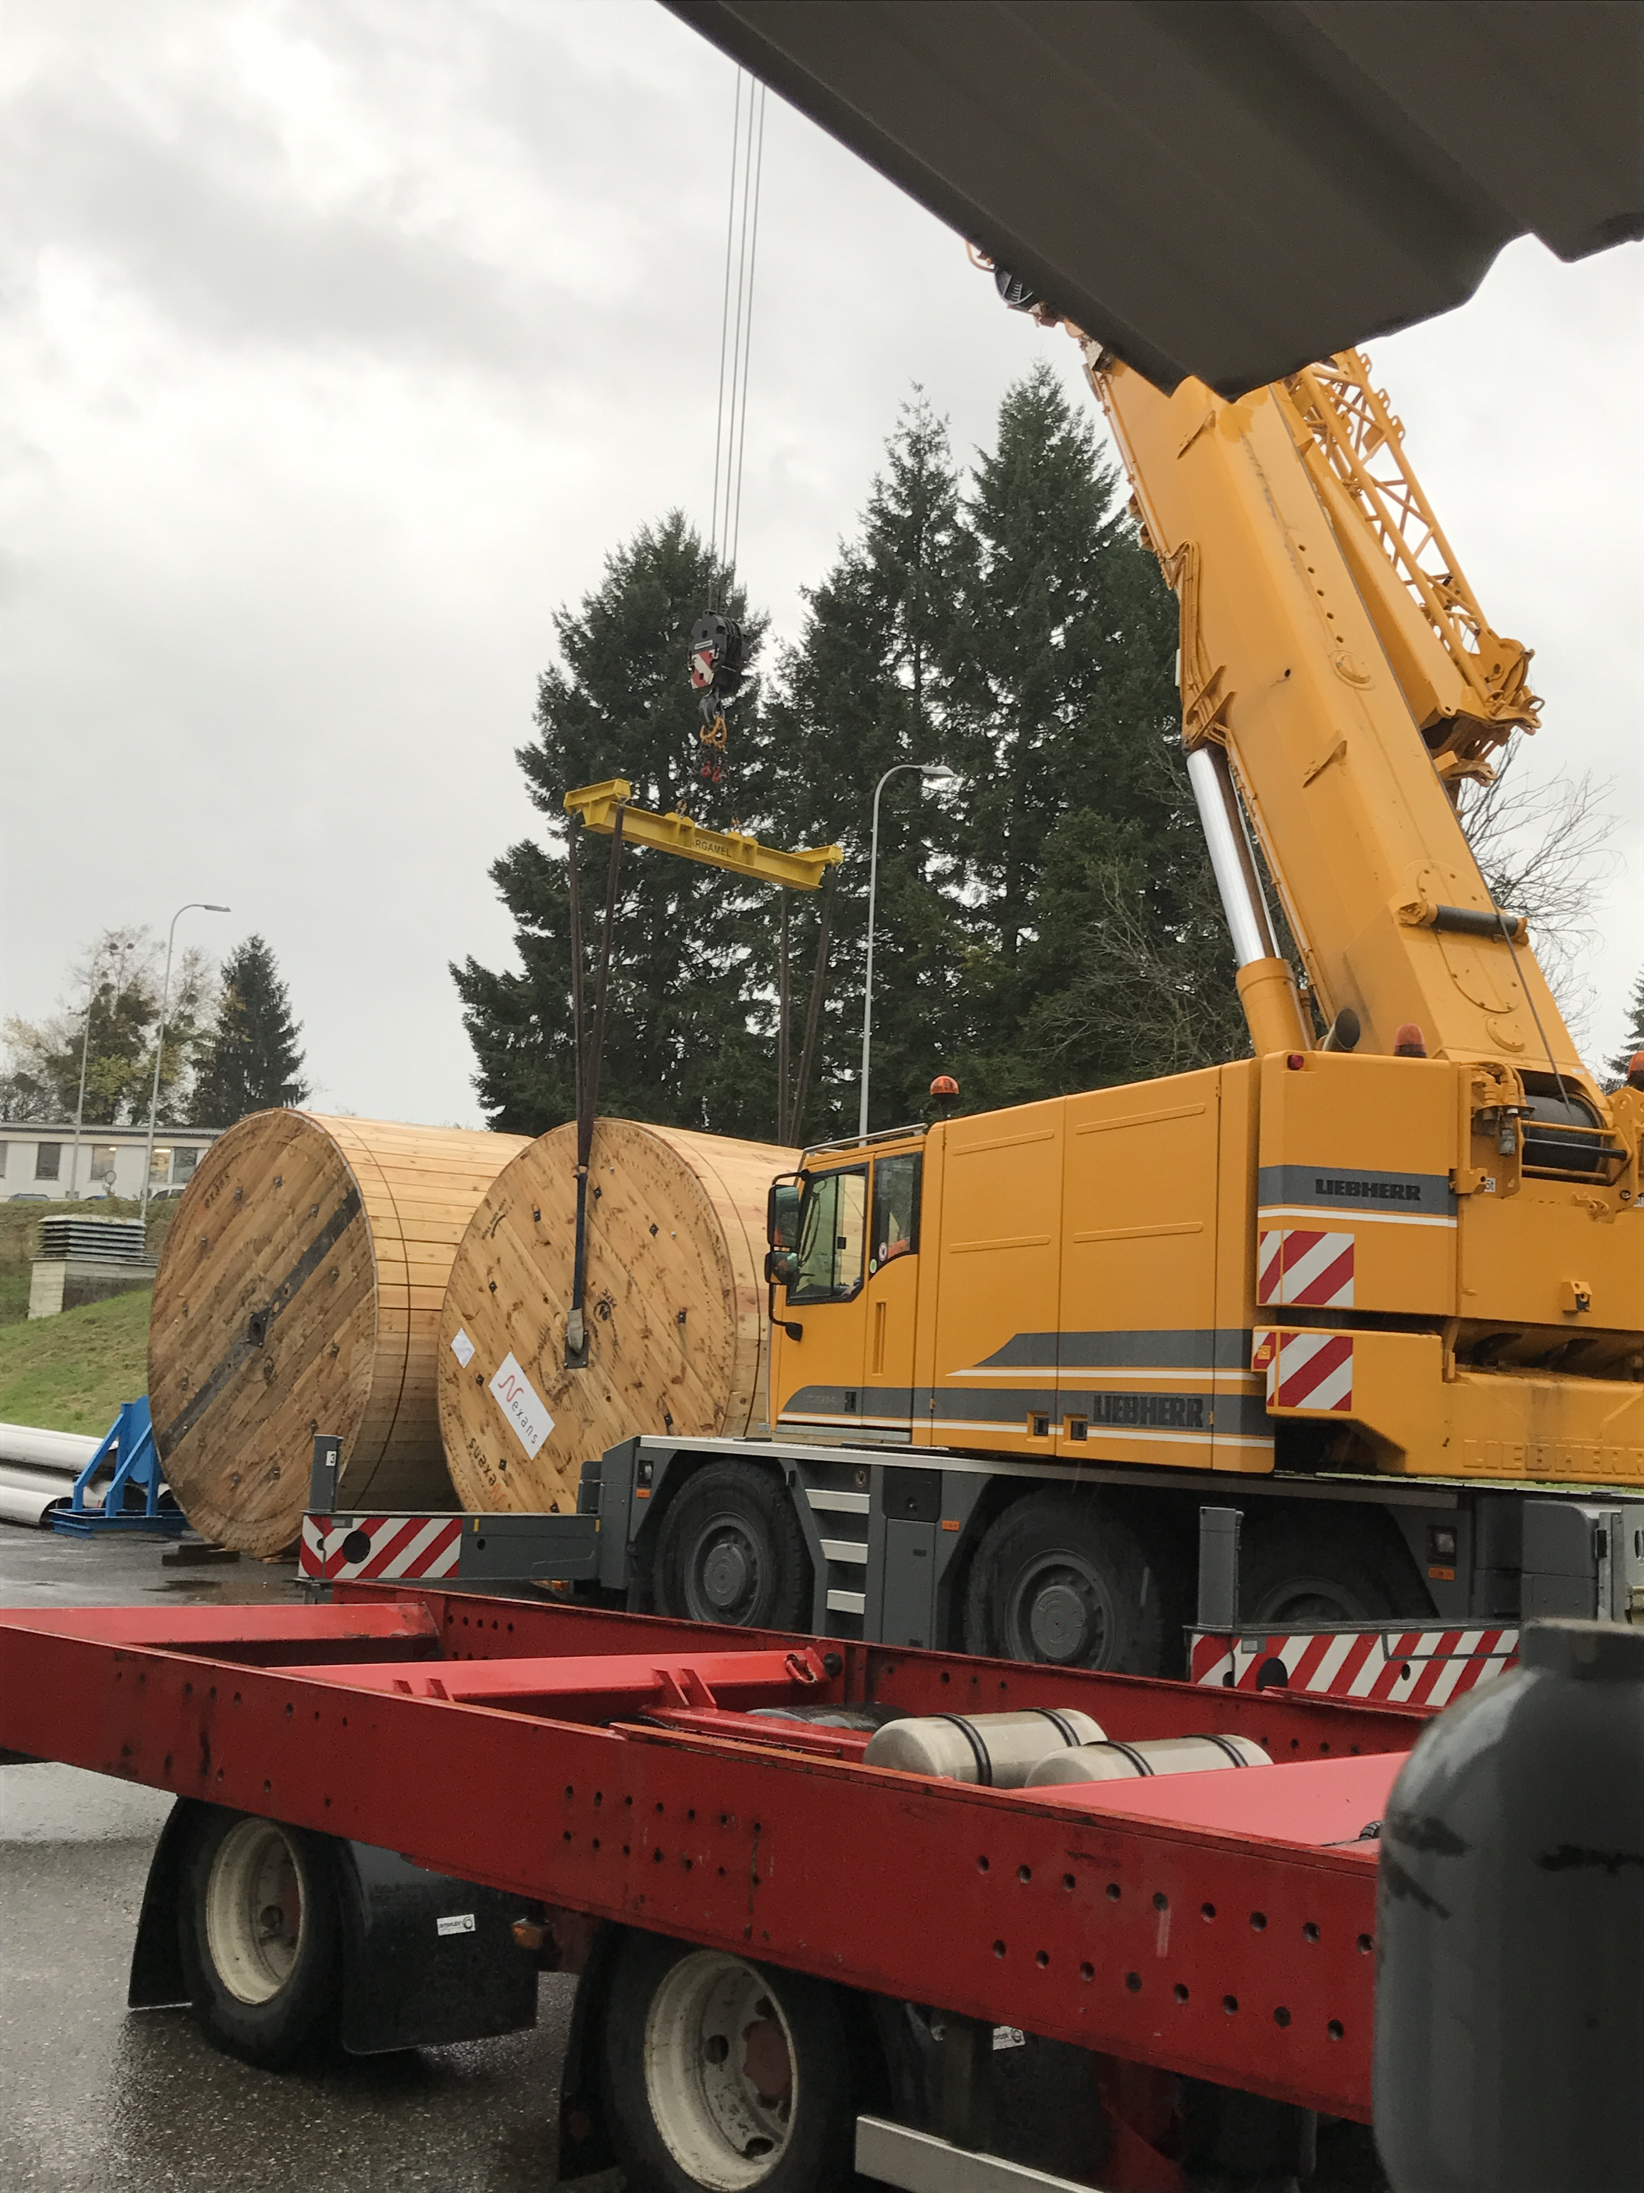
Handling of cryostats
Nexan’s cryostats. Delivery @ CERN

Slide 7
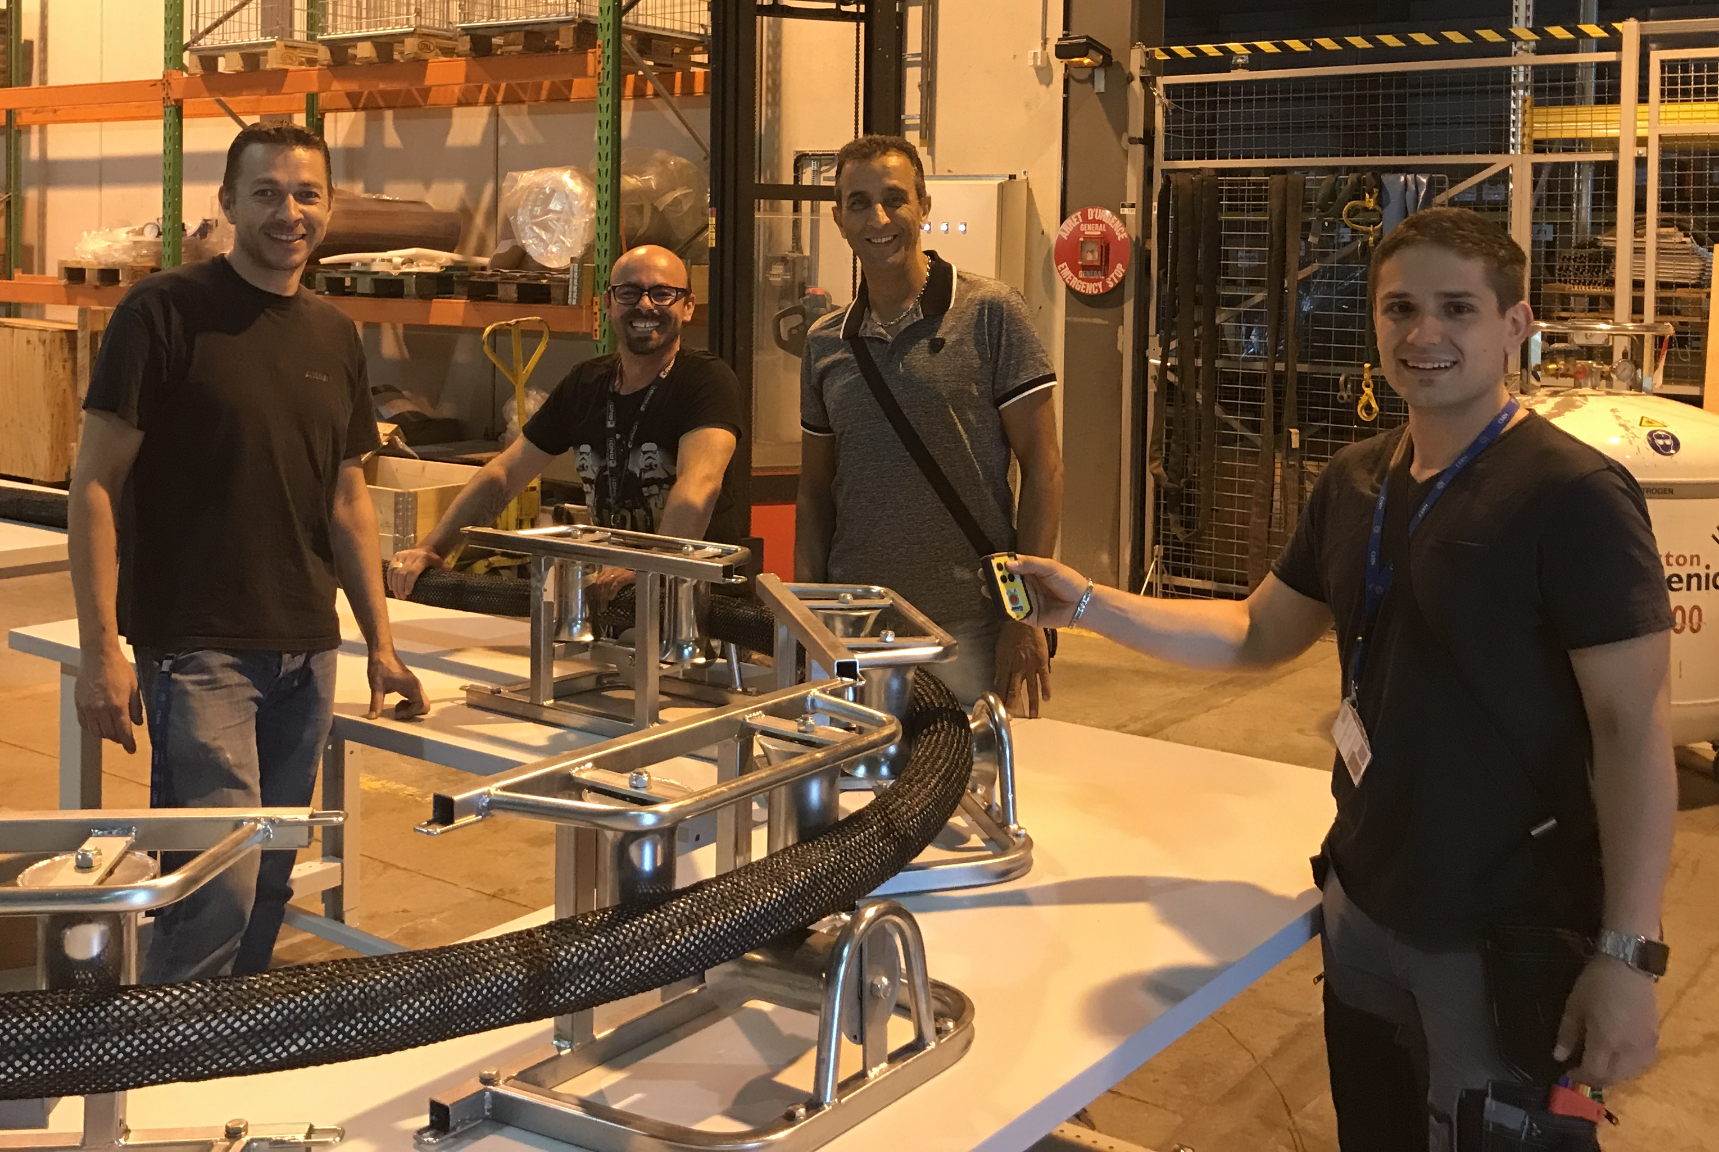
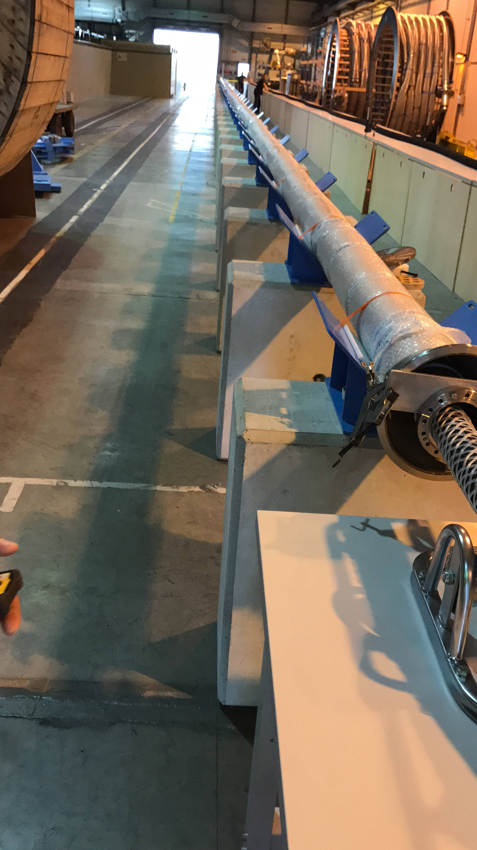
Integration of dummy cable
To make representative pressure drop measurements
(and also: develop techniques for integration of cables,
learn about handling of SC Links)

Slide 8
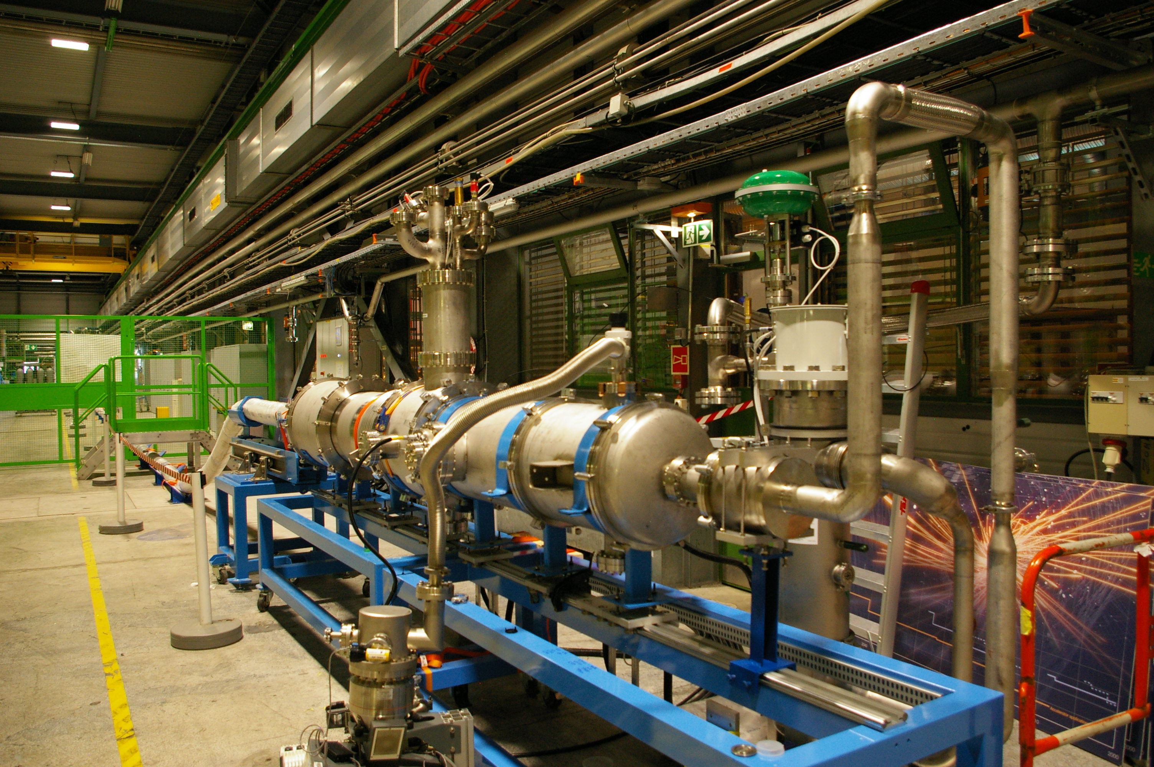
Test station in the SM-18
Length of SC Link: 60 m plus terminations

Slide 9
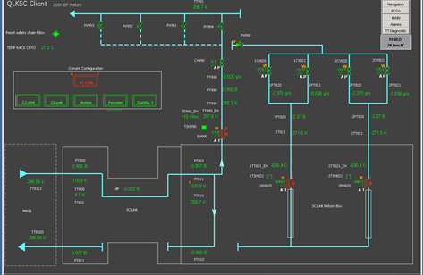
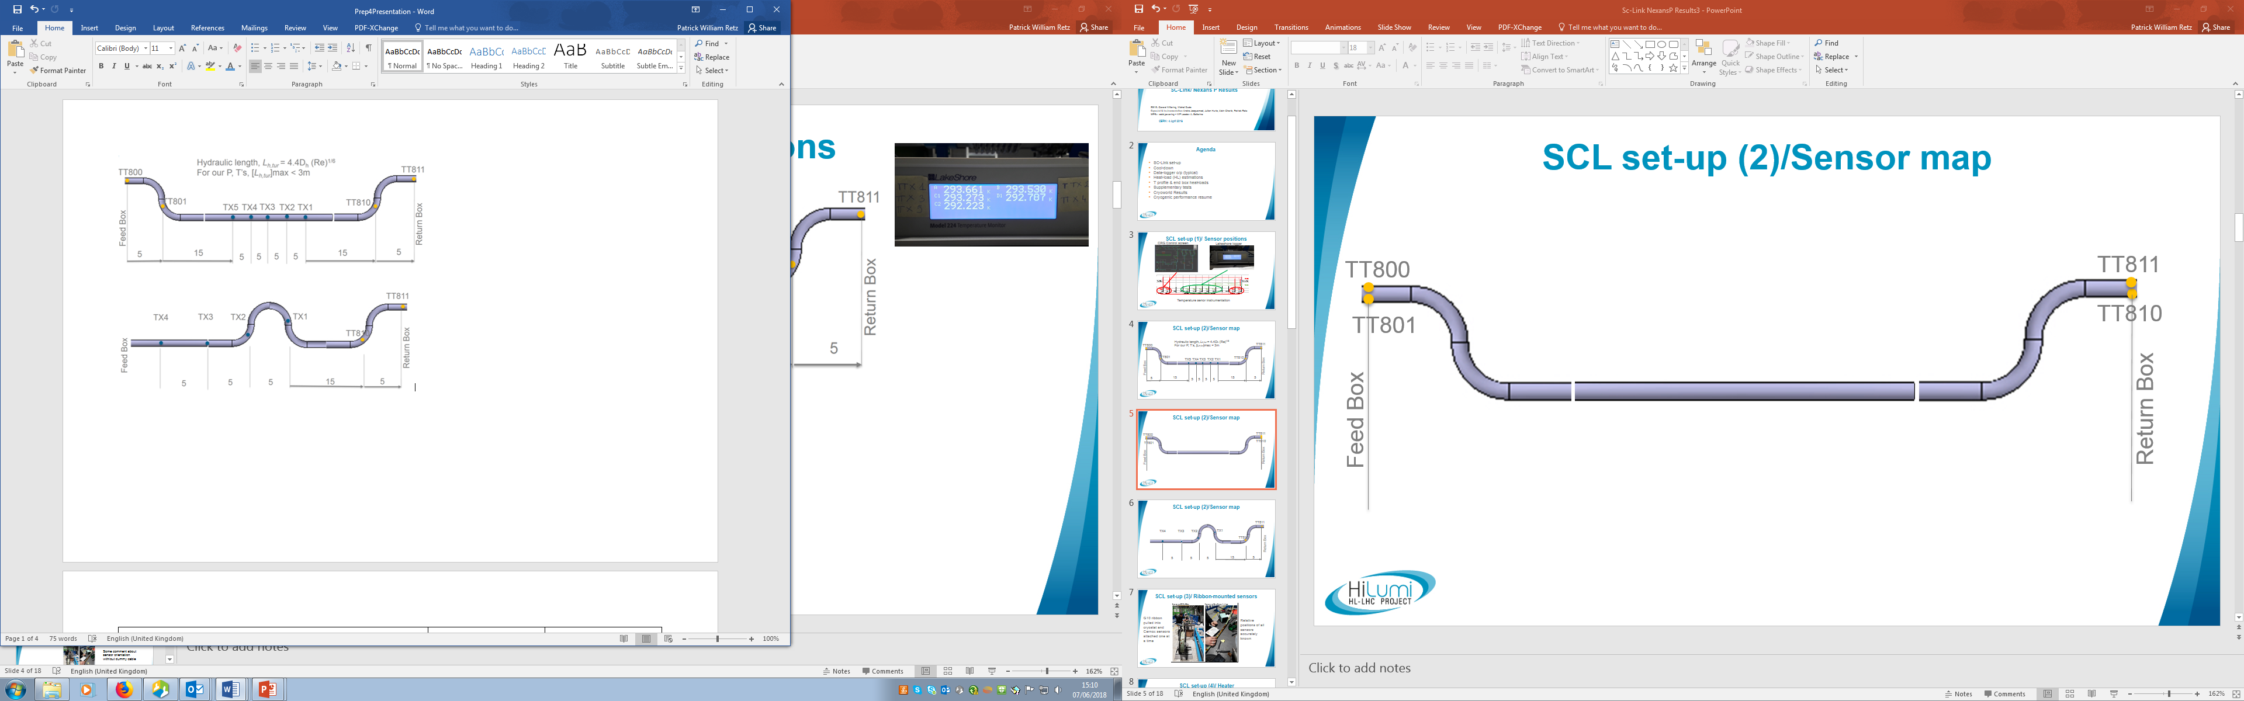
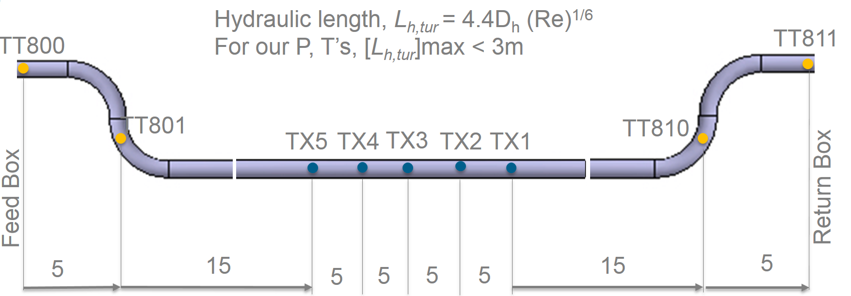
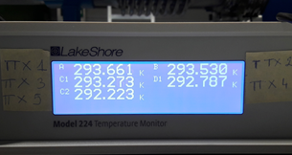
Test Configuration 1

Slide 10
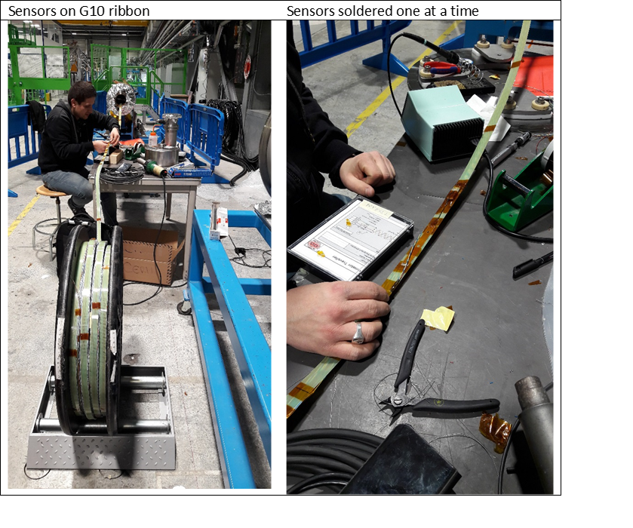
Instrumentation
Cernox ribbon integrated with cable, spooled and transported to SM18

Slide 11
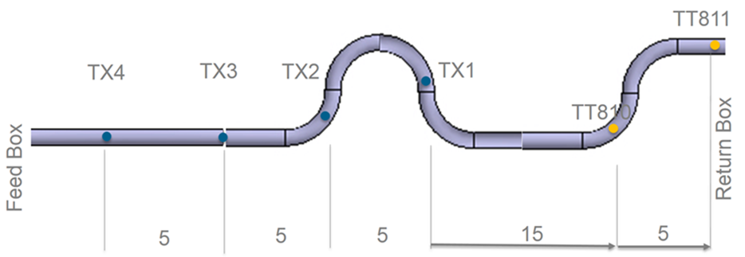
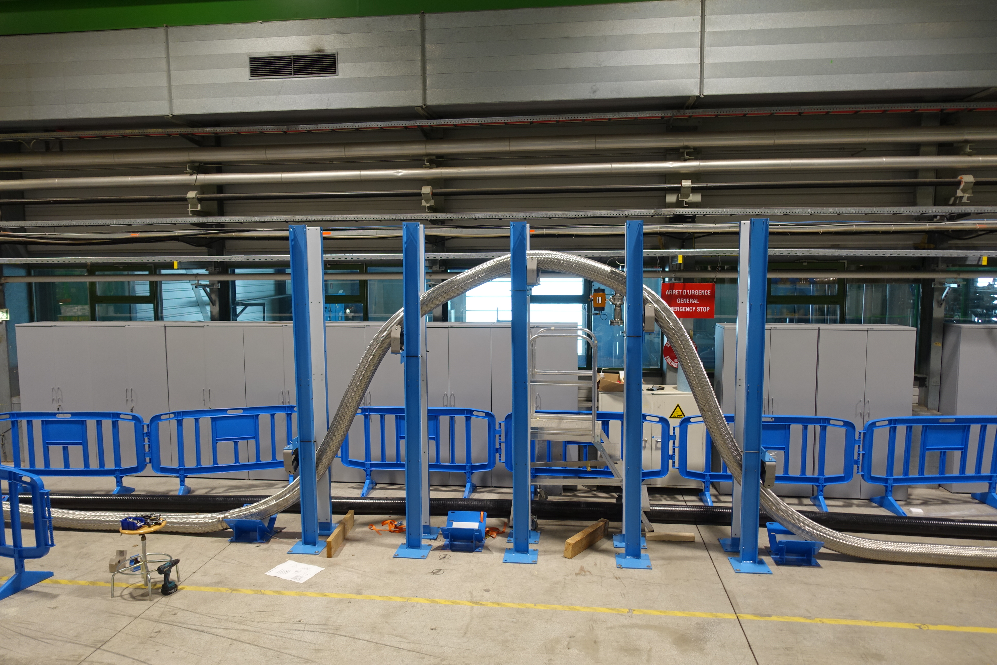
Test configuration 2
Bend NTS
3m

Slide 12
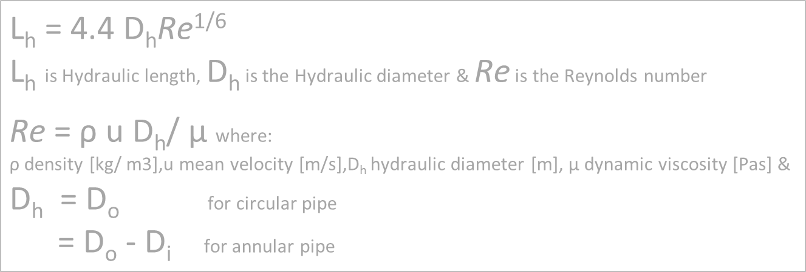
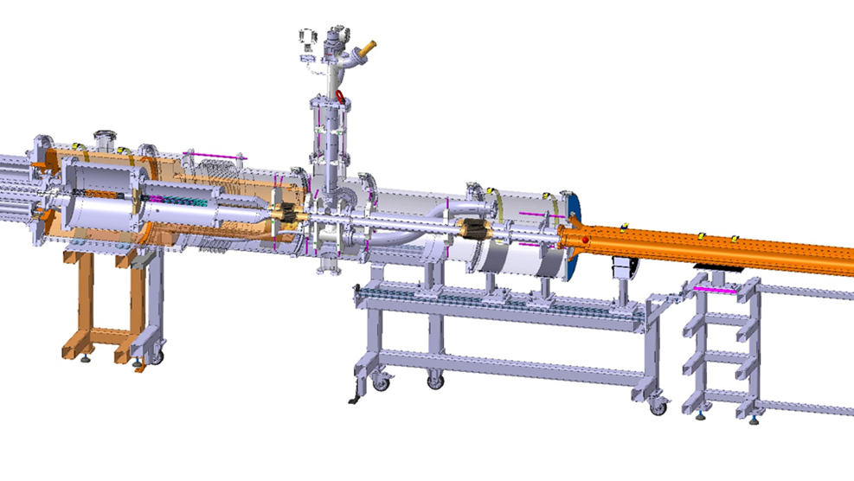
Mass flow rates up to 10 g/s

Slide 13
Test performed

Slide 14
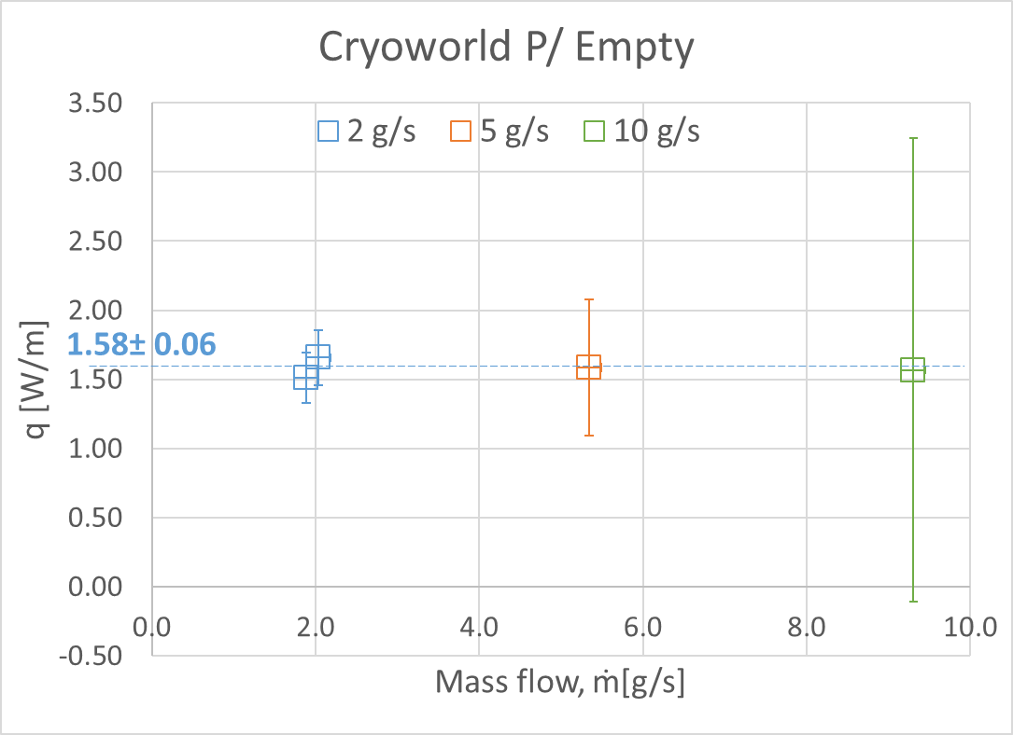
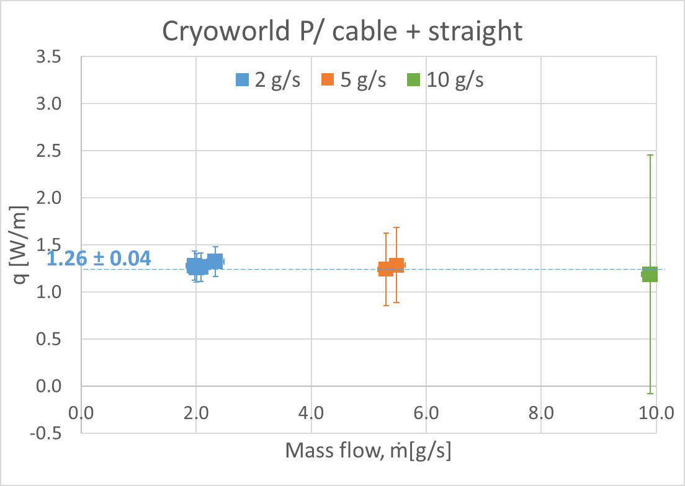
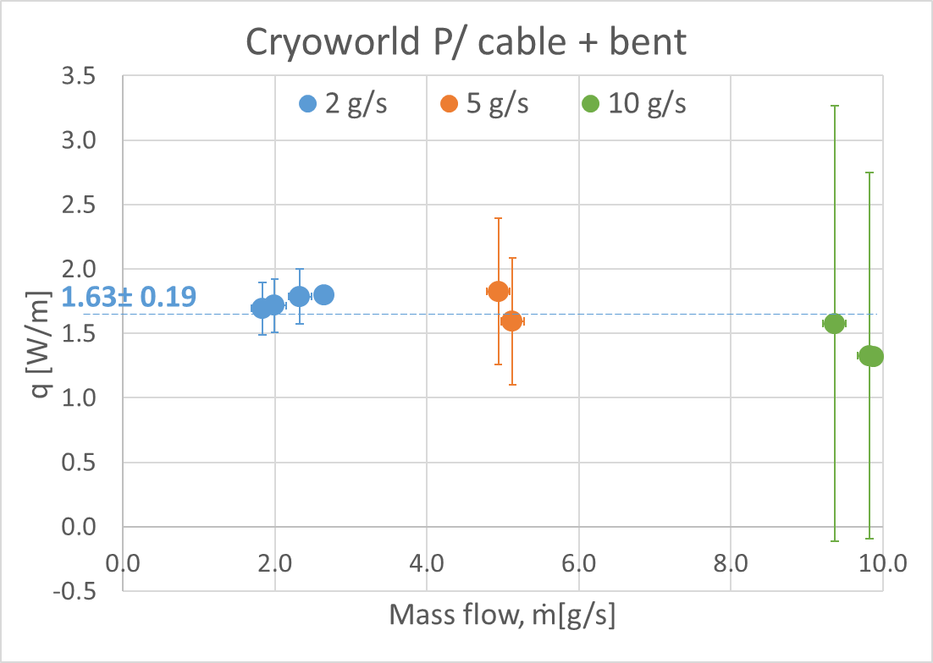
Cryoworld

Slide 15
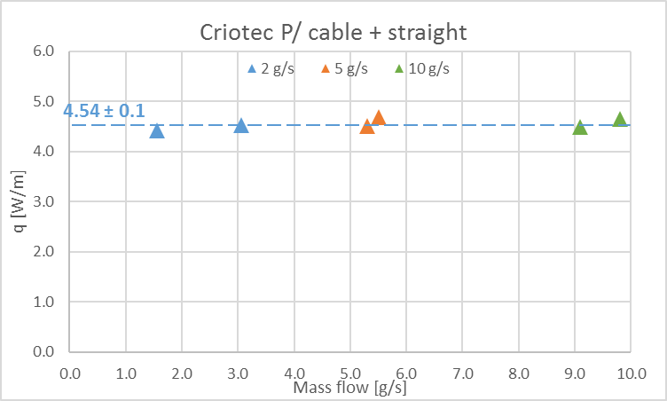
Criotec Results
Images courtesy of Criotec
q calculated from sensors, positioned at ends, over 60m
Repeat test with additional sensors showed high heat-load at Return Box
In spite of the higher heat load, no problems with operation (RT all along the length on the outer vacuum pipeO

Slide 16
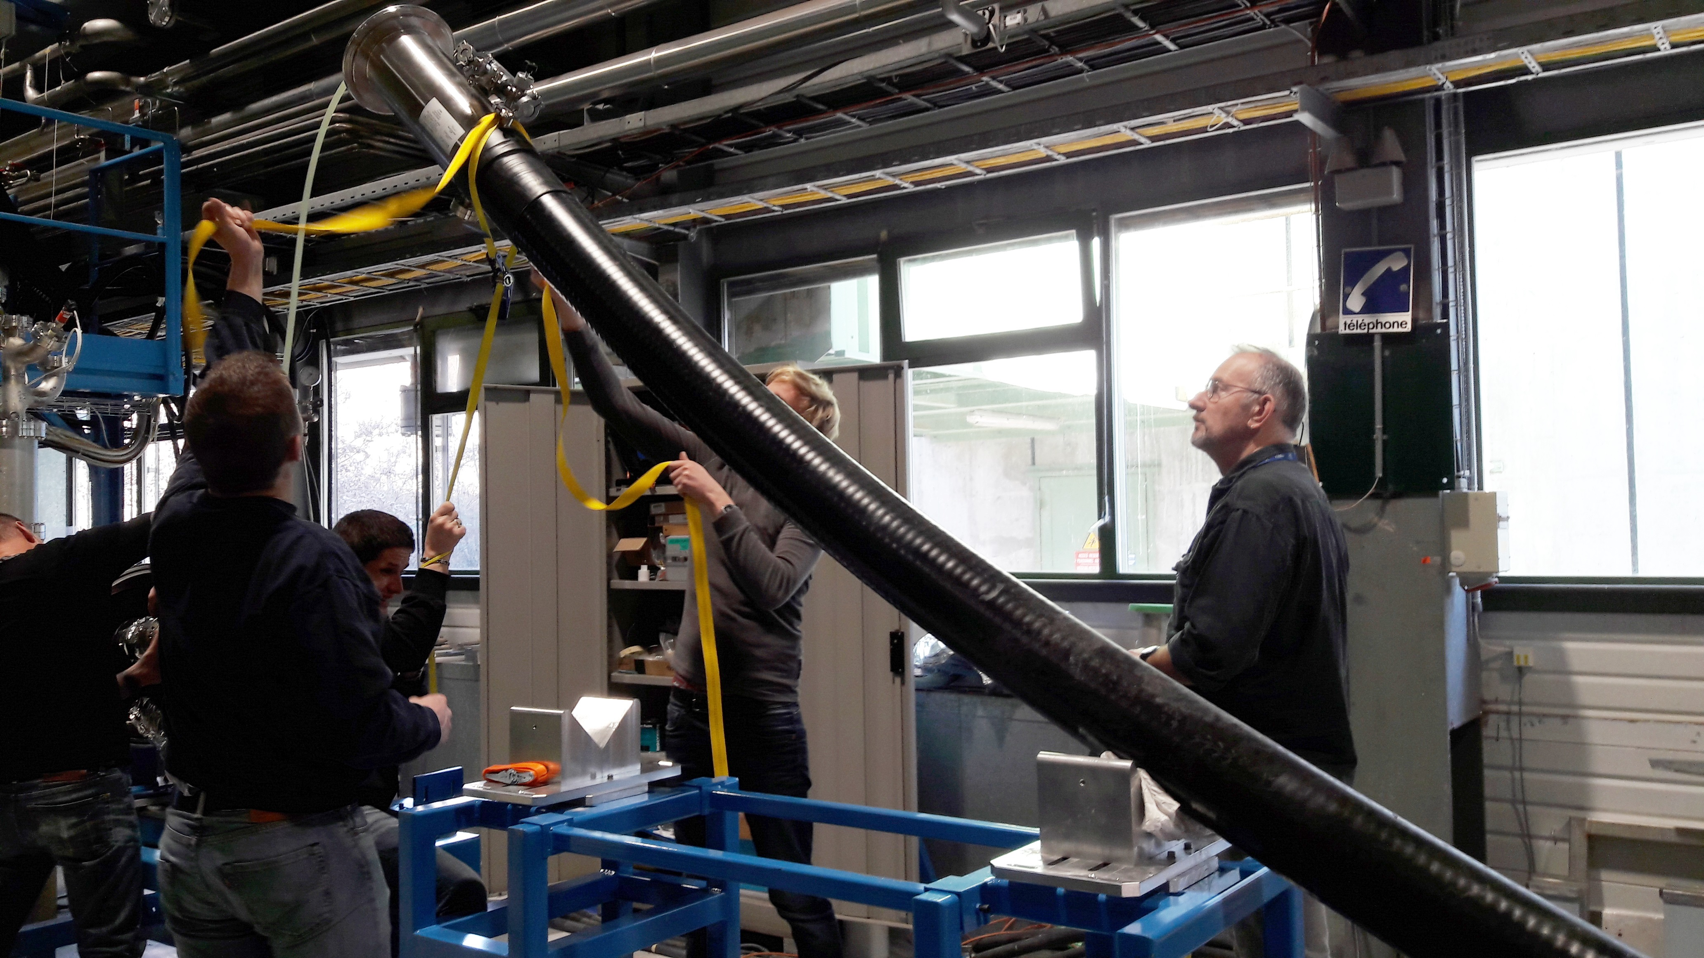
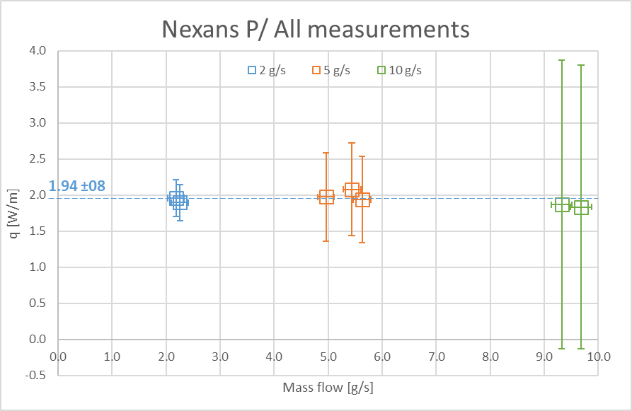
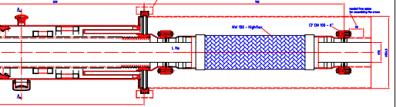
Nexans Results
q based on 20m centre section sensors
Internal construction thought to be similar to Cryoworld
Mechanically very rigid; designed to wit stand high pressures

Slide 17
Comparison with previous CERN SCLinks
Performance as
rigid lines with shield
CERN report 199308379 by N Delruelle et al

Slide 18
Test results
Low heat load can be achieved
Pressure drop is not an issue (measured less than few mbar with mass flow rates of up to 10 g/s)
ECR has been discussed with CRG and drafted
Proposal: specify a heat load < 1.5 W/m for the Triplets (up to 2.5 W/m could be tolerated)
Cryogenic flow scheme already re-elaborated by CRG – and presented at the least WP6a meeting

Slide 19
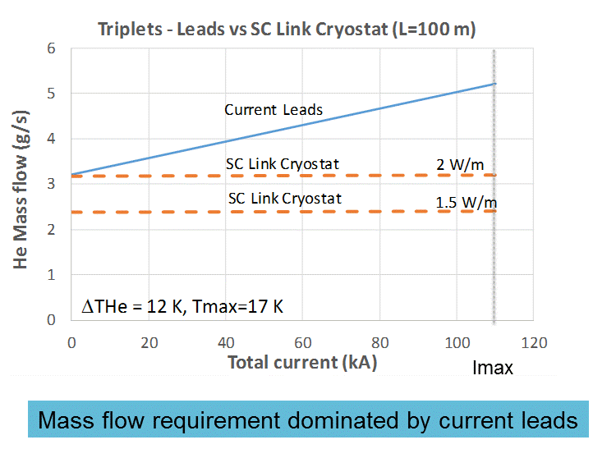
System performance with passive cryostats

Slide 20
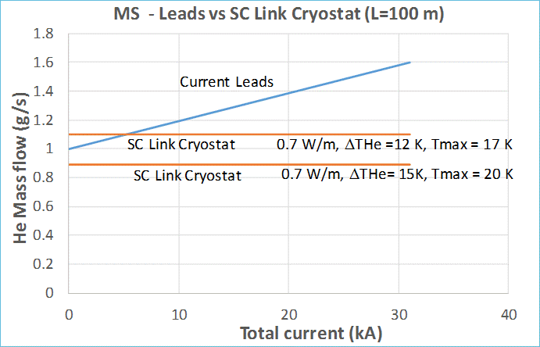
System performance with passive cryostats

Slide 21
Change in baseline
ECR Written
Discussed with CRG and VSC
Ready for being circulated

