Slide 1


Status of the CMS Experiment
- How are we doing ? -
Status of 2018 running & performance of detector sub-components
Plans for LS2 and beyond
Challenges ahead of us
Our Collaboration
Prof. Kerstin Borras
Deutsches Elektronen-Synchrotron (DESY)
RWTH Aachen University

Slide 2
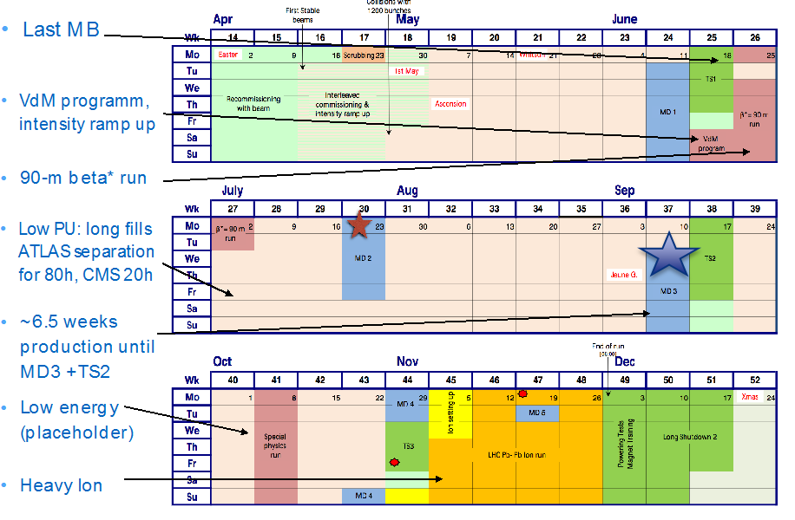
LHC Schedule

Slide 3
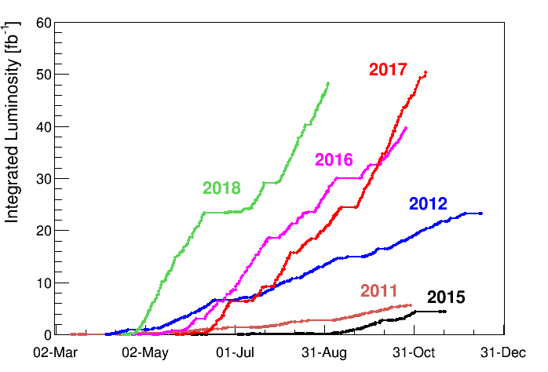
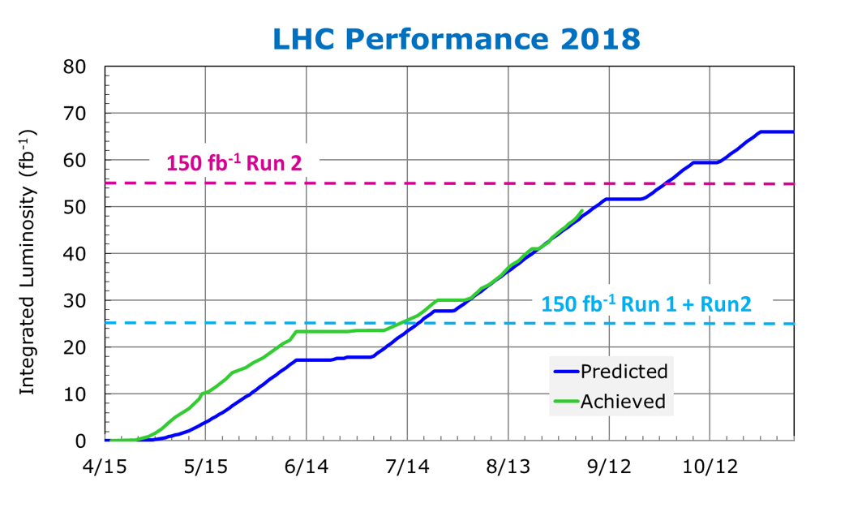
LHC Performance and Prospects
LHC is maintaining a steady slope of ~3.5-4 fb⁻¹/week.
  (when they are no major stops)
LHC delivered > 49.5 fb⁻¹ average ATLAS & CMS, even for CMS > 50 fb⁻¹.
LHC is on track for
> 50 fb⁻¹ by MD3/TS2

Slide 4
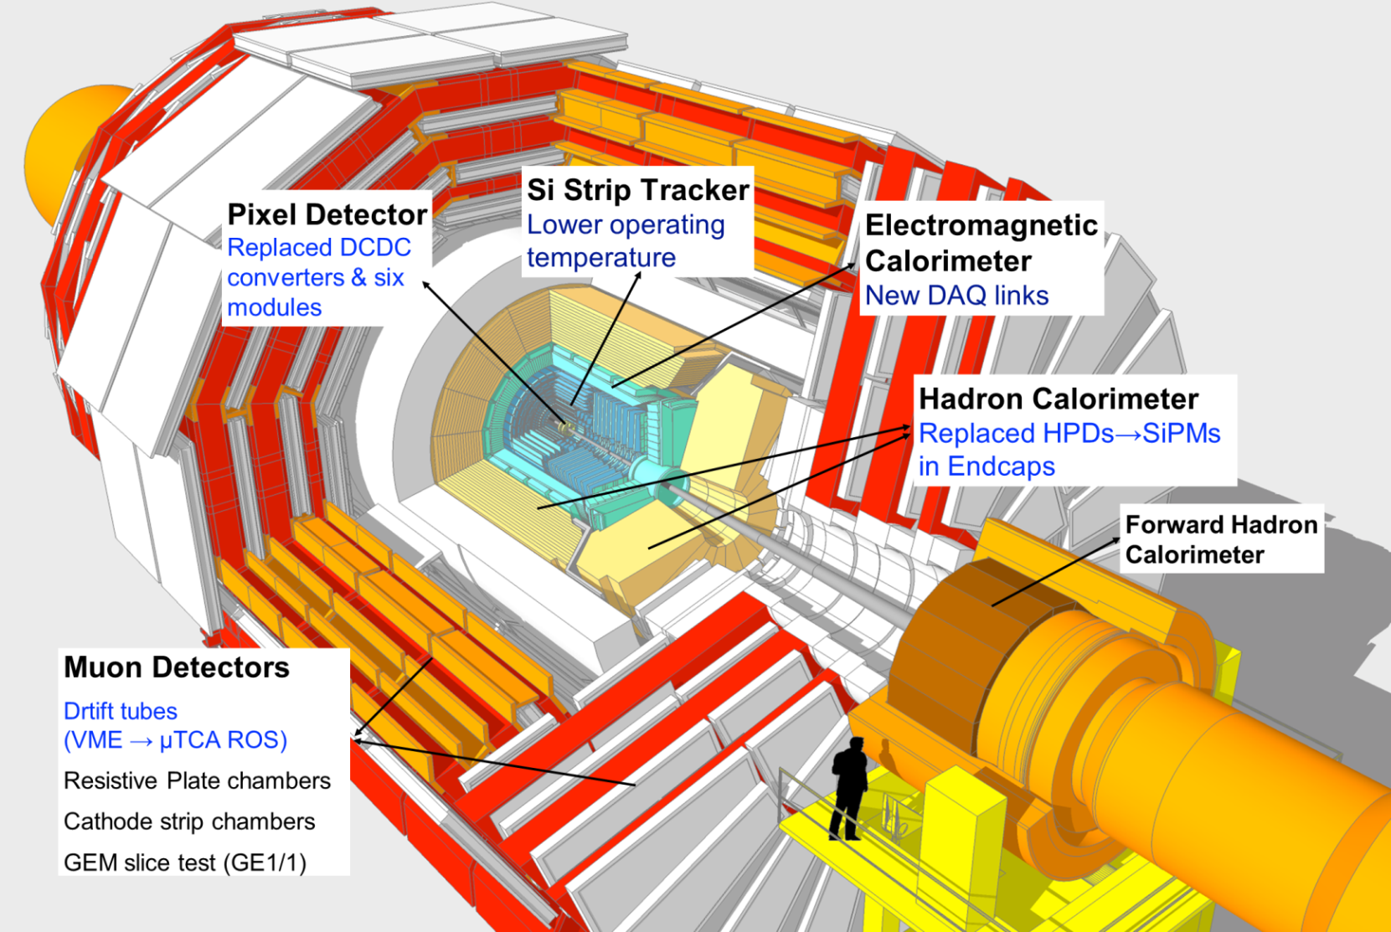
What is new in CMS in 2018 ?

Slide 5
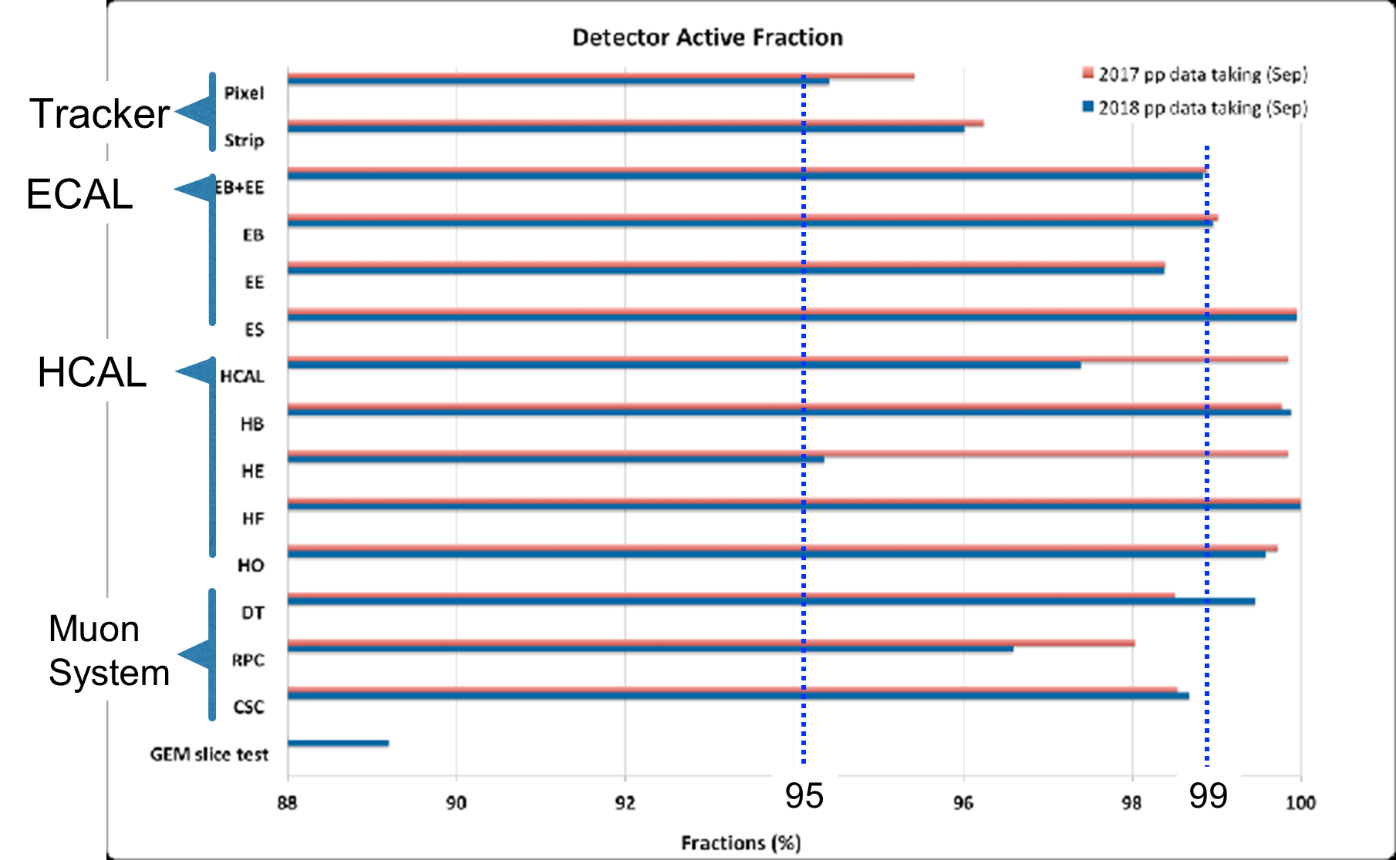
Detector Performance
Excellent & stable performance of all the subdetectors

Slide 6
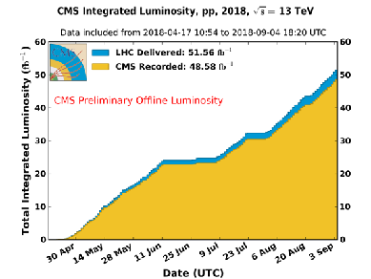
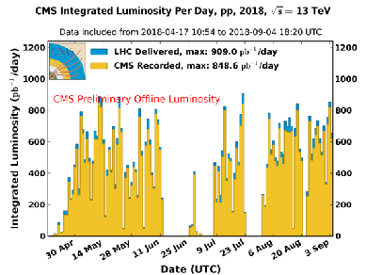
Luminosity for CMS
LHC has delivered >50fb⁻¹
CMS has collected data with >94% recording efficiency
Many thanks to the successful LHC Machine Team !

Slide 7
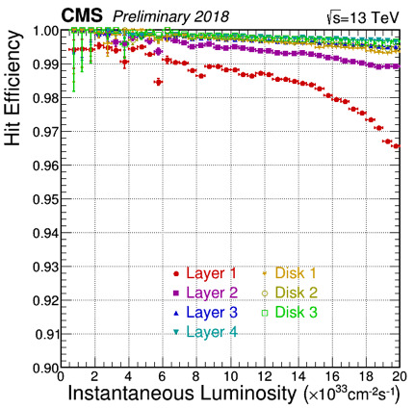
Tracker Commissioning
Pixel and Strip detectors promptly and successfully re-commissioned
replacing Pixel DCDC converters and six modules
lowering the Strips operating temperature by 5ºC (now -20ºC)
Well aligned in time & space
Reconstructed tracks efficiently used in HLT
HV bias settings optimized for charge collection and resolution
Periodic HV bias scans to monitor evolution with integrated radiation
Pretty smooth running at the peak luminosity of ~ 2x10³⁴ cm⁻² s⁻¹
Hit losses below 4% in Pixel Barrel Layer-1 - the most exposed layer
We have seen NO DCDC converter failure so far
Fraction of active channels as high as in 2017 – Pixel: 95.5-96%, Strip: 96.3%

Slide 8
Pixel DCDC Converter Investigations
A lot of progress made by FEAST designers (CERN electronic group) with the help of CMS
Test results and FEAST design investigation indicate that:
  One transistor develops leak current with radiation: in 2017 maximum reached about at the time of the first failures (~30 fb⁻¹)
  Leakage current amplified by a current mirror
  Leakage current NOT drained when the converter is disabled → voltage spikes that break/damage the converter
Therefore: radiation + dis/en-able cycles (to recover SEUs) were the cause of the failures in 2017
NO dis/en-able cycles to recover SEUs in 2018: no failure observed
  SEUs recovered only at the end of each fill with normal power cycles

Slide 9
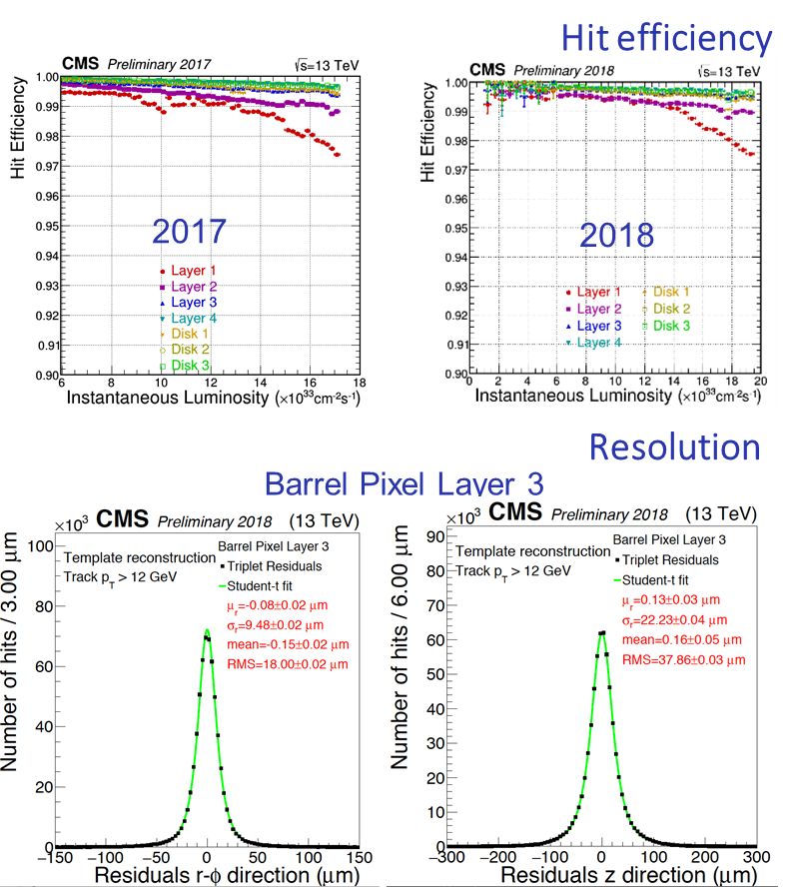
Tracker Performance in a nutshell
Active channels
  Strip: 96.0% and Pixel: 94.4%
  No DCDC converter failure by not disabling
  SEUs recovered only during inter-fills
(only) ~ 2% of data lost because of Tracker
  No operational or reliability issue
Smaller hit losses in 2018:
  Inefficiency reduced with 2018 filling scheme (higher instant. luminosity at the same pileup)
  Additional reduction of efficiency loss achieved by technical improvements in the detector programming procedure to reduce cross talk noise
Residuals determined by the Triplet method:
  Residuals of the third hit with respect to the track refitted to the hit doublet
Very good resolution compatible to 2017 or even better

Slide 10
Tracker Plans for LS2
Pixel detector
  Replacement of BPIX layer 1: with un-irradiated sensors and new ASICs
    Fix SEU sensitivity, timing, dynamic inefficiency and cross talk noise in present ASICs
    First version of new ASICs received and under test – preparing the final submission
  Replacement of DCDC converters: new FEAST ASIC and board to solve the radiation induced leakage current and overcurrent issue
    FEAST v2.2 and a new board will be tested soon
  (Possible) upgrade of the power system: max HV 800 V
  Repair of localized failures and damaged modules
  → re-installation planned in Fall 2020
Strip Tracker
  To be kept cold (below 5 C) as long as possible during LS2
    Periodic monitoring of sensor annealing
  Testing and commissioning the detector to be ready to operate at -25 C during Run 3

Slide 11
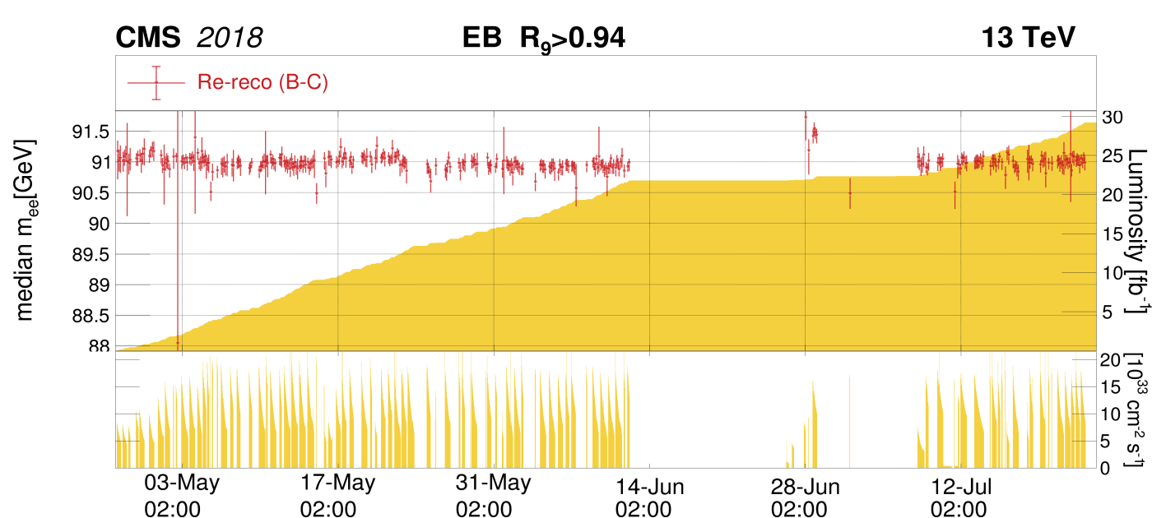
ECAL Status
Improvements in DAQ and Trigger:
  New optical links to CMS DAQ for faster data transmission from ECAL FEDs
  New auto-recovery of front-end errors for higher efficiency and lower dead time.
Data reprocessing of the early part of 2018 will use ECAL time-dependent and energy scale corrections based on W→ev and Z→ ee events.
The energy scale stability is shown in the plot below.
Z→ee mass stability versus time in ECAL Barrel in early part of 2018
Preliminary

Slide 12
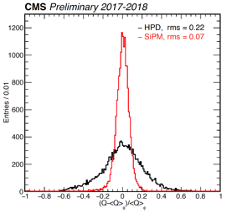
HCAL Phase I Upgrade Part in 2018
Phase-I upgrade of front end electronics of HE - replaced all HPDs with SiPMs
The upgrade has brought many benefits
  Eliminated progressive (and phi asymmetric) HPD damage
  Increased photo detection efficiency by x2.5
      Extend longevity of HE till the end of Run 3
  Increased longitudinal segmentation
  Add per-channel timing information
  Eliminated sources of coherent electronic noise
Much improved uniformity of detector response
  Spread of “raw” response of tiles using Co-60 source wrt the average response of all tiles in given η-ring & layer

Slide 13
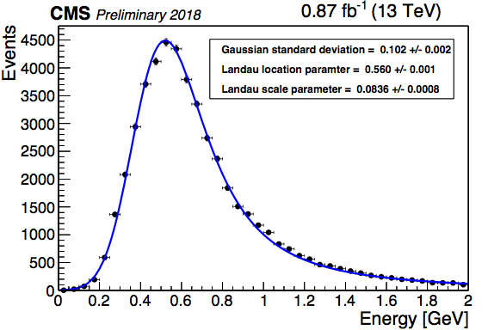
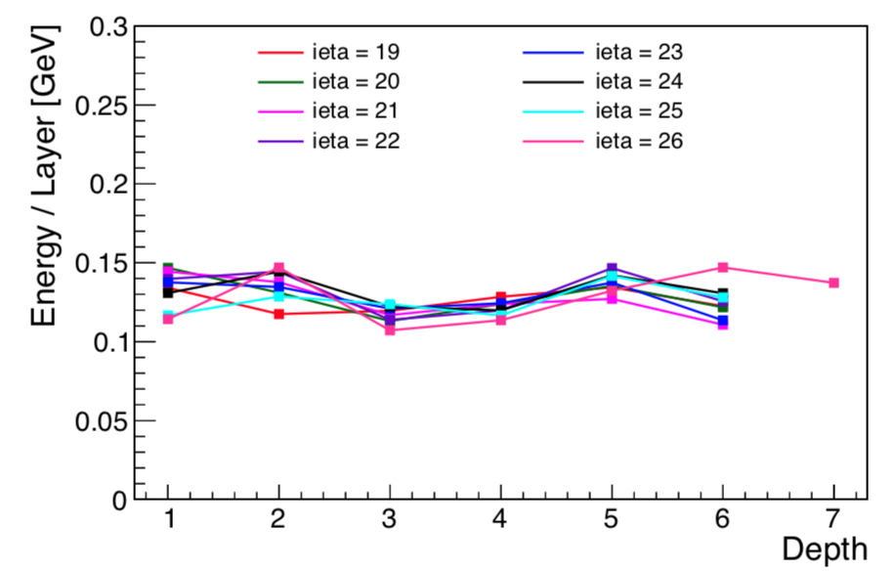
Upgraded HCAL Endcap:
Performance with 2018 collisions
Performance observed with 2017 pilot systems (HEP17) are confirmed with full detector
  Photosensor response is now stable after upgrade to SiPMs
Signal degradation was due to progressing HPD damage
Very much reduced noise from SiPMs compared to HPDs
More uniform response of the detector
Positive experience from calibration
  Inter-channel calibration [DONE]
  Energy scale with isolated tracks [DONE]
Muons are used to equalize the depth response
  Exploiting better S/N of SiPM w.r.t. HPD
Low PU runs
Before depth calib

Slide 14
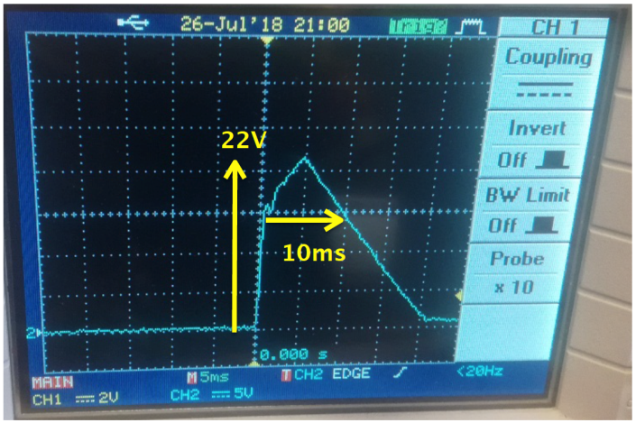
Issues with HEM 15 and HEM 16
Sectors HE minus 15 and 16 are no longer functional (since June 30)
  This has resulted in the loss of readout of ΔΦ=40° on HE minus side (η 1.3-3) corresponding to a 3% of the total HCAL (HB+HE) coverage
The problem can only be solved by opening the endcap (minus side) in December 2018
We now understand what caused the damage, and what failed
  The damage occurred during low voltage power up
  procedure after an interlock due to a fire alarm
  The power supply unit that controlled HEM15/16
  (and only those) incurred in an extremely rare and
  intermittent failure mode
  A voltage transient that reached 22 V was generated
    More than twice as much as the front-end operational
    voltage of 10V and the HW limit of 11 V
  This extremely rare fatal failure mode was never observed before
    Escaped extensive burn-in and post-installation power cycling tests
    After PS extraction, 2 weeks of testing were needed to expose this failure mode on a test stand
    We have also verified that this PS transient does damage the front-end on a test stand
We have implemented an additional safety system to mitigate the risk of further damage
  The incident is being followed up with the power supply company to eliminate the risk of similar behavior from other power supplies
The impact of the HEM15-16 loss has been investigated in a variety of physics analyses
  Trigger rates are OK, impact on physics analyses is generally small and mitigation options in reconstruction code have been implemented and are being further studied

Slide 15
Issues with HEP 10 and HEM 09
HEP10:
  Starting in June, short bursts of bad data occurred a few times a week, and disappeared in early July for several weeks. These bursts are associated with intermittent ngFEC-ngCCM (primary) control link instabilities.
  Link instability re-appeared in mid-August and became more frequent on Aug 26, which led us to switch to the ngCCM redundant control link, which has stabilized operations for now.
  Amount of acquired data declared bad due to HEP10 is approximately 150 pb⁻¹
HEM09:
  No issue from installation until Aug 29, when the primary ngFEC-ngCCM control link quality deteriorated and prevented front-end configuration.
  Switching to the ngCCM redundant control link mostly fixed the immediate problem, but intermittent and short periods of instability have been observed 4 times since.
Investigations are ongoing without disturbing data-taking
  The behavior of the (currently unused) primary links of both these 2 ngCCM modules are been studied, and several monitoring variables are permanently recorded
  Eye diagram of HEP10 primary link was taken during a period of good quality link -- now awaiting for a period of bad quality to repeat
  Collecting all possible evidence to aid investigation of main ngCCM engineer and other experts

Slide 16
Potential impact of HE issues on
HB Phase 1 Upgrade
HEM15-16 damage:
  Following the understanding of the cause of the damage, this does not motivate a significant change of the HB (and HE) ngCCM design
    Active transient voltage suppression system to be developed and deployed for HE and HB
  HB will use Wiener Maraton supplies – experience to be gained during burn-in
  Minor intervention on HB ngCCM is the replacement of AD8042 with higher-rated AD823A component → studies ongoing
HEP10/HEM09 issue:
  Better understanding of these issues, hopefully in the next weeks, is needed to determine if any improvements should be implemented in the HB ngCCM design
HB installation schedule
  Currently foreseen to happen in Mar-Jun and Sep-Dec 2019
  Not strictly necessary to start in March or to be completed by December 2019 from HCAL point of view: ~3 months of contingency for ngCCM investigation and intervention (if needed)

Slide 17
HB Phase 1 Upgrade Progressing
Production and quality control
  Major components: 1700 SiPM arrays and 900 readout cards received and characterized at CERN and Fermilab.
    Conservative yield is >95% for both.
  First 1/3 of SiPM bias/control electronics, ngCCMs, and calibration units to be ready by end September.
    Remaining on track for batched deliveries into November 2018.
Readout module (RM) assembly and burn-in
  First 4 “batch 0” RMs operating as expected in “RBX0” at burn-in site.
  RM assembly: late-Sep through end-Dec (based on HE rate)
    RM mechanical/thermal enclosures & hardware ready at CERN
  Infrastructure is ready for 10-week burn-in of all components before installation starts in March 2019.

Slide 18
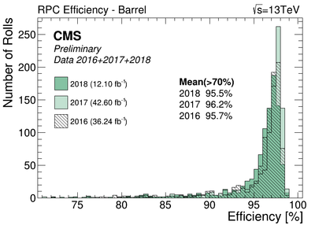
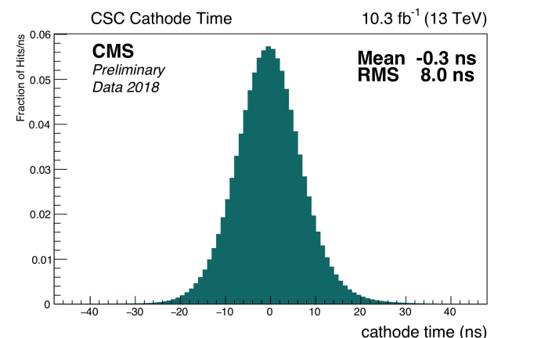
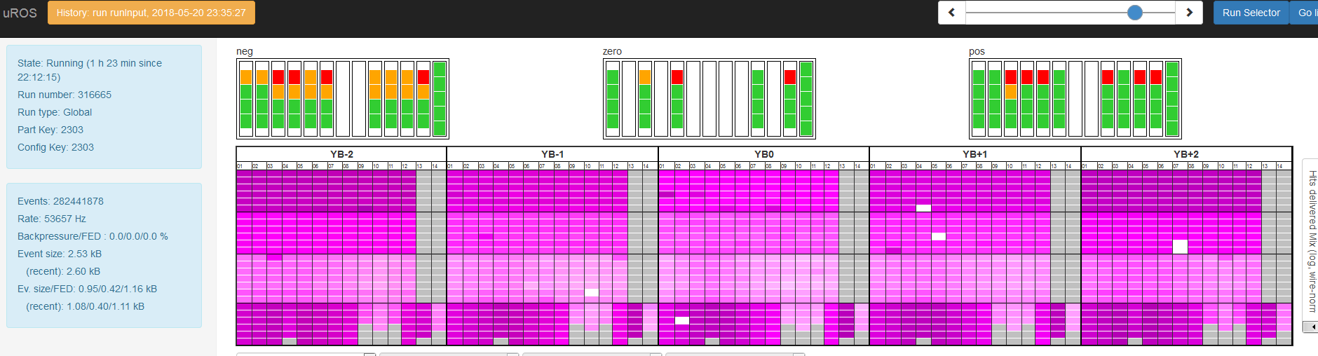
Muon Detectors Performance in 2018
Muon detectors are operating smoothly with minor issues and negligible downtime to CMS
2018
The data analysis of the 2018 data shows a good performance of the detectors and their associated local trigger in agreement with previous year.
Mean 0.0ns
RMS 7.9ns
2017
New uROS system (DT readout) upgraded at the beginning of the year has run so far with no downtime, no data losses nor any relevant incident
10 Triple-GEM detectors (5 GEMINI) were installed in the negative CMS endcap in 2017 (Slice test)
They have been integrated in the CMS Global data taking
The system is under tests and data is being analyzed
Slot1➔ 4 GEMINI
Slot2➔ 1 GEMINI

Slide 19
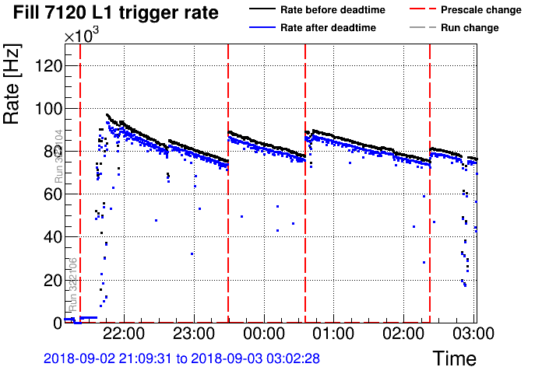
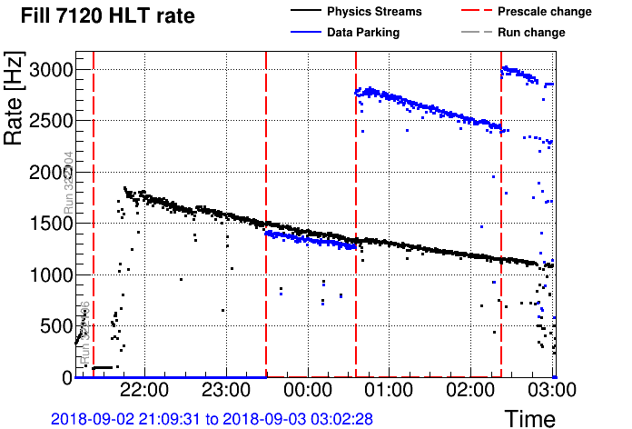
Overall Trigger Status
Smooth running since May, only minor updates to the trigger have been implemented
Total L1 trigger rate around 95 kHz at 2.0e34
  Some trigger thresholds have been lowered (mainly single EG, MET, di-tau), improving turn ons at HLT
  Single electron with 28 GeV pT has been added at HLT (L1 pT > 26 GeV)
HLT physics streams peak rate around 1.8 kHz at 2.0e34
  Still around 1.1 kHz averaged over a 12h fill
Updated L1 and HLT strategy to park an unbiased sample of b-quark enriched sample with increased rate and purity (max rate ~5 kHz)

Slide 20
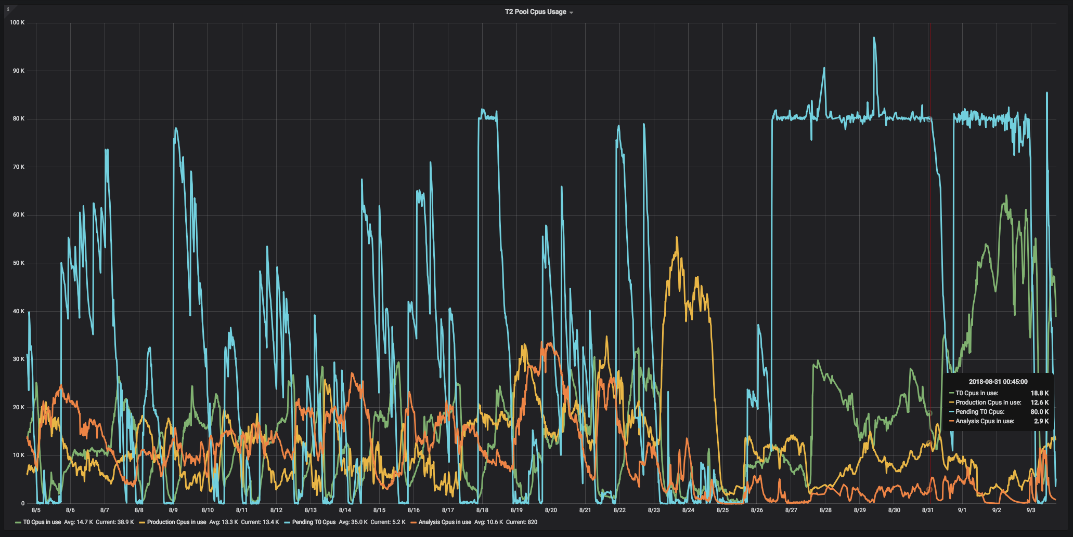
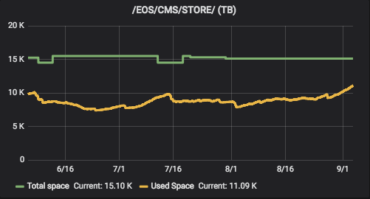
Computing: Data Taking Performance
Generally smooth operations
CMS gained a lot of flexibility from the merging of all CERN resources into a single “site”
  we can use virtually all CERN resources when the Tier-0 needs to process not standard incoming data (high rate, processing of parked samples, ….)
  on the other hand, MC production can utilize all the CERN resources when Tier-0 is idle (MD, TS, pauses of as down as a few hours)
  same for disk areas: no issue even given the unplanned Parking activities
Production using all CERN resources

Slide 21

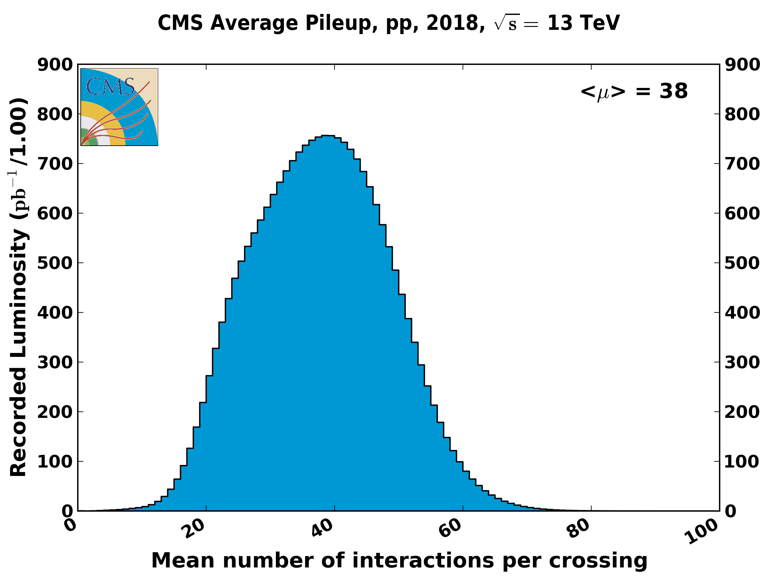
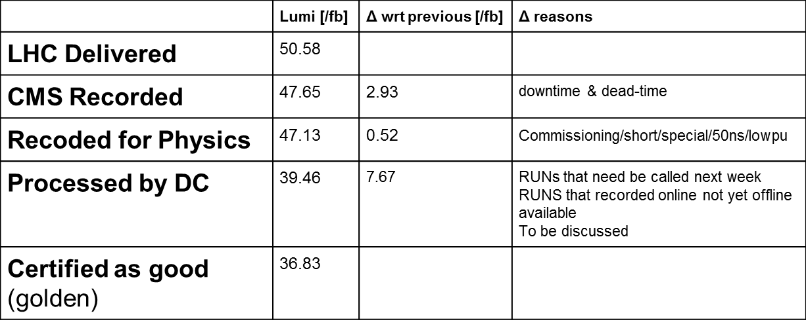
Certification of 2018 Collision Data
Complete up to 5 Sep:
Run range 314472-322252
Accomplished >94% efficiency !

Slide 22
Operation and prompt processing
Smooth operation and prompt processing kept as performant as possible
→ held prompt processing twice:
HCAL sector mis-calibrated in fills 7090 and 7091
  The response corrections have been applied.
Missing of pre-shower in RUN 322088
  Adjusting of the energy scale of the concerned endcap applied.
Reconstruction of datasets for b-parking
1060M reconstructed events (Reprocess & Prompt)
Enabling analysis setup & development of low pt ele reconstruction.
On going studies:
Missing of 40 degree sector of HE minus
  All physics group have shown they can tolerate the extra mEt and fakes and no analysis is compromised
  Particle Flow mitigation has been studied. The fix has been integrated to CMSSW, further studies to start soon.
HCAL first layer mis-calibration leading to neutral hadron deficiency
  Recalibration proposed. Looking into possibility of deploying already in HI run.

Slide 23
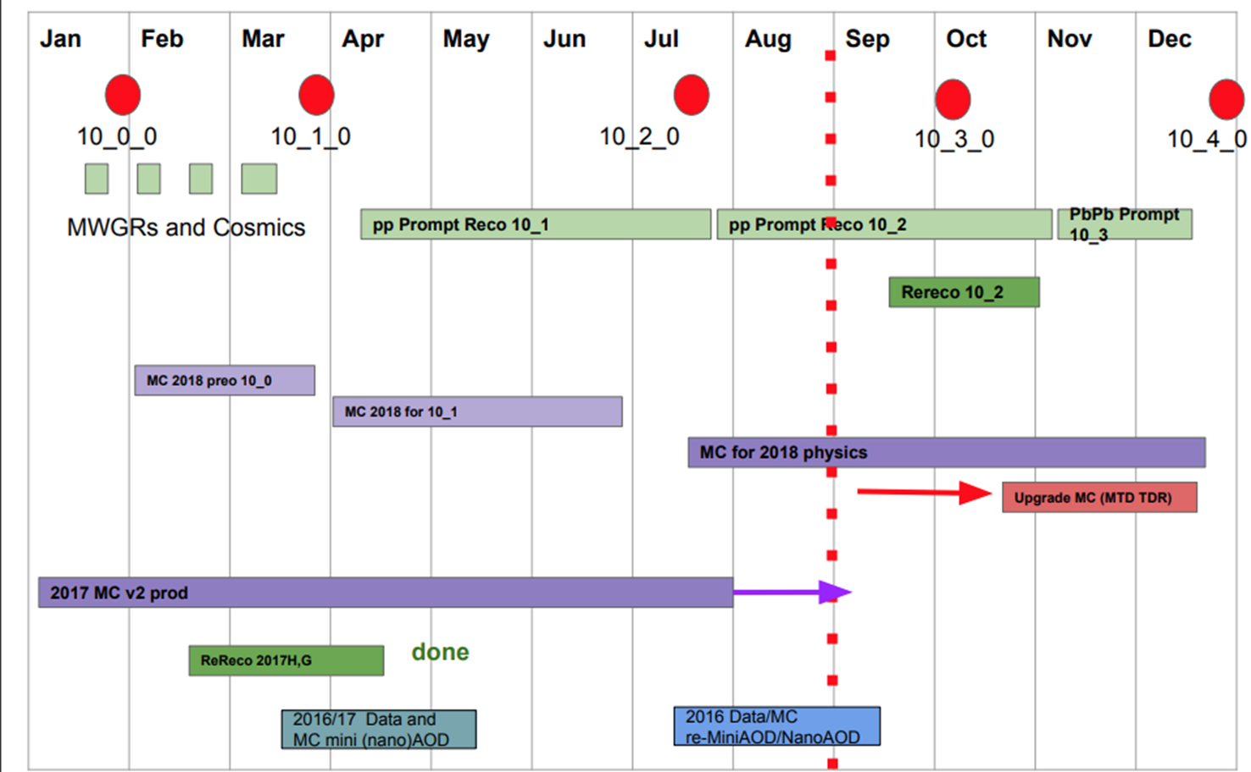
Release and Production Schedule
Details for the planning in PPD and in Computing are in the backup part of this talk.
Plenty of tasks to be covered and obstacles
to be mastered….

Slide 24
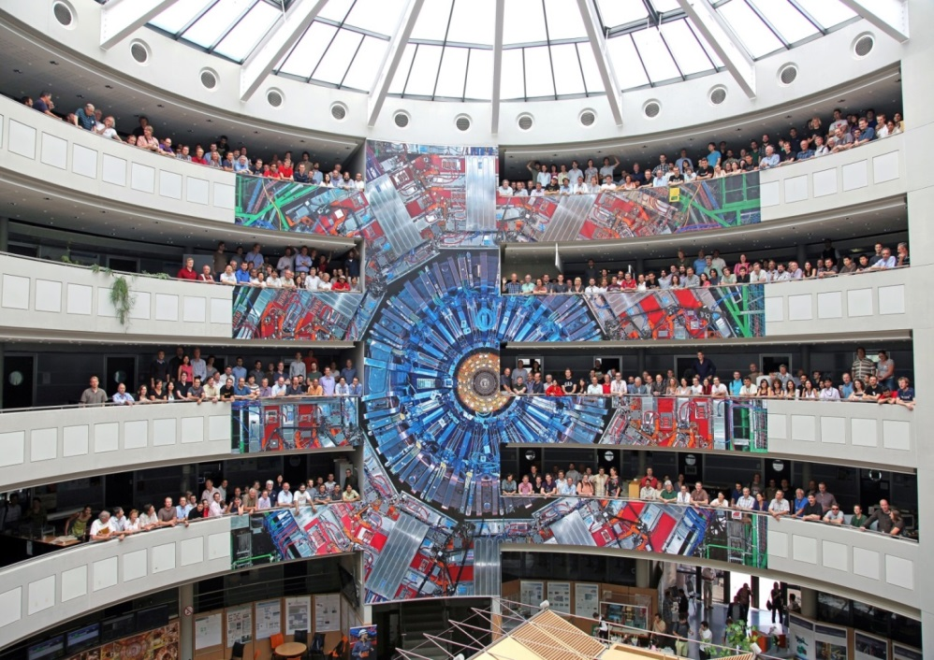
Our Experiment – Our Collaboration

Slide 25
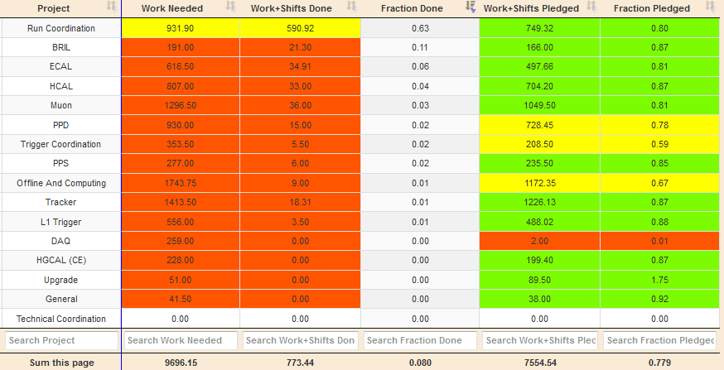
General Situation for EPR 2017 /2018
ERP 2017
7996.70 Needed
7601.96 Pledged
6862.82 Worked
86 % worked ☺
EPR 2018
9696.15 Needed
7554.54 Pledged
773.44 Worked
78 % pledged
→ Need urgently
more pledges
Including Upgrade work increased the EPR due per author to 4 months
→ This is very difficult for many institutes
→ Need to plan carefully for the future !

Slide 26
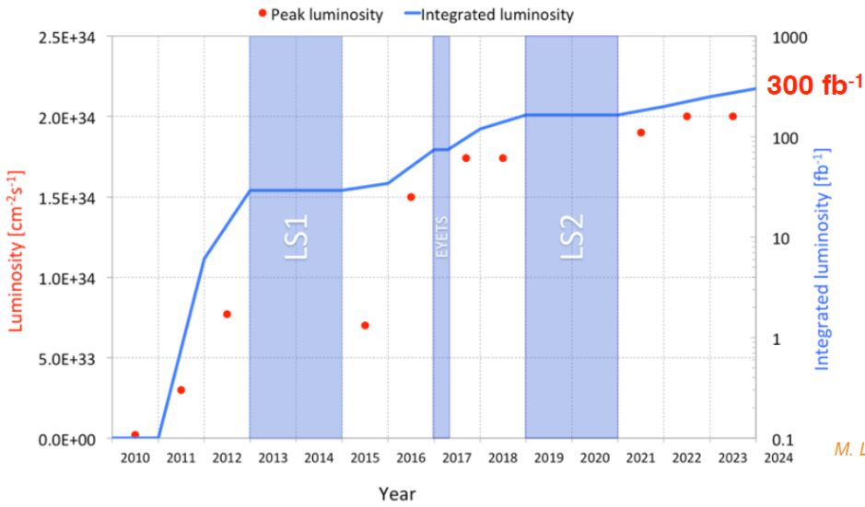
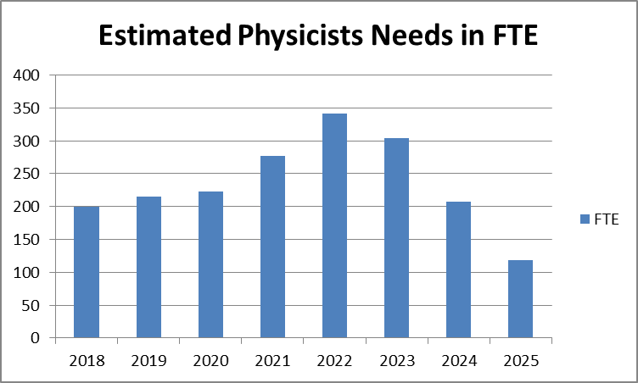

Foresight: The unitarity challenge in CMS
LHC Operation until LS3
Full overlap of Run 3 operation with
Phase II upgrades
→ Unitarity challenge in people-power.
We previously mastered such situations successfully!
LHCC acknowledged:
CMS is able to handle well what even a few years ago was considered to be a major challenge
Collect and reconstruct data and generate Monte Carlo
Perform physics analyses
Construct, install, and commission Phase 1 upgrades
and strongly engage in Phase 2 Upgrades
We can do it again!
Start the mitigations now
(efficiency increase, atomization …)
and be well prepared !
350 physicists FTE
x 3 to include engineers and technicians

Slide 27
New Institutes since January 2018
CB 117: 9th February 2018: voted for 4 new institutes
University of Sonora, Mexico applied for full membership
Qatar cluster of Texas A&M of Qatar and Qatar Universities applied for cooperating membership
St. Joseph University, Lebanon applied for cooperating membership
AGH Cracow applied for associate membership
CB 118: 20th April 2018: voted for 3 new institutes from TOTEM
Eszterházy Károly University (EKE), Hungary, applied for full membership
Tomsk State University, Russia, applied for full membership
AGH Cracow, Department of Computer Science, Poland, applied for full membership
CB 119: 29th June 2018: presentation by
American University of Beirut - Cooperating Institute
CB 120: 2nd October 2018: vote on one & presentation by two new institutes
Vote: American University of Beirut - Cooperating Institute
Presentation: Center for High Throughput Computing,Wisconsin,US: Associated Institute
Presentation: Kyung Hee University, Korea, full member (working already on RPC)

Slide 28
New Institutes in the pipeline
LOI received, preparing application presentation for December:
Bahrain, associated institute (LOI received for last MB)
Bath University, UK, associated institute (electronics) (LOI just received)
LOI in preparation:
Istanbul University, Turkey, full member (working on CT-PPS already)
Bethel University, US, cooperating institute, working with Brown University
In discussion:
Isfahan Institute of Technology, Iran, cooperating institute
San Ignacio de Loyola University, Lima, Peru, potential cooperating institute, needs more time
Mauritius, visit planned in October
Norway, two universities, visit planned in October
New institutes are joining CMS → let‘s help them to phase in quickly.
More new institutes are highly welcome, please spread these news !

Slide 29
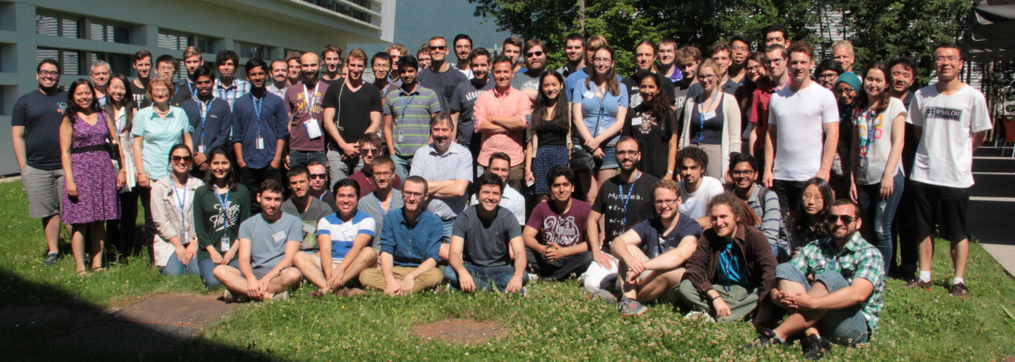
Induction Course: 20 - 22 June 2018
112 Registrations:
50 doctoral students
25 non-doctoral students
15 physicists
17 summer students
10 CERN summer students
Schedule: https://indico.cern.ch/event/734096/timetable/#all
Wed morning: Lectures, afternoon: Visit at Point 5
Thu morning: Lectures, afternoon: Visit of Detector Labs and Facilities in 904
Fri morning: Workshop on Open Data
→ again very positive feedback ☺

Slide 30


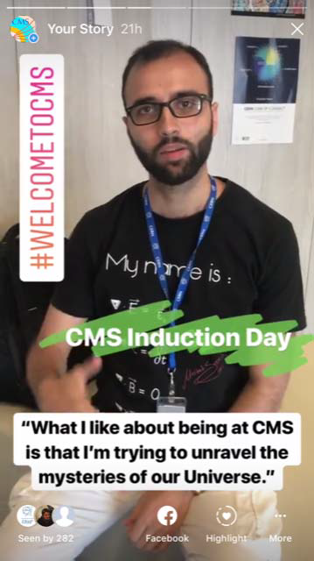
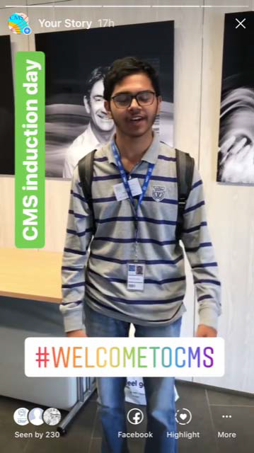
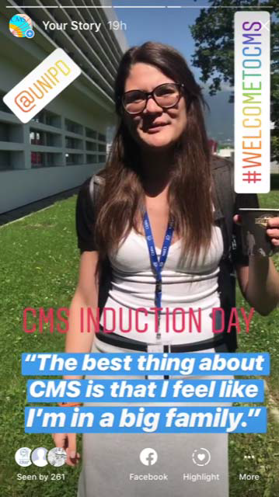
Public Welcome of New Members
Published our Welcome of New Members (thanks to Marzena)
Welcome went online in Instagram and Facebook with the group picture and stories posting one every hour: 15:30, 16:30, 17:30, 18:30 (5 in total)
→ show young people “in action”300-400 views https://www.instagram.com/cmsexperiment/

Slide 31
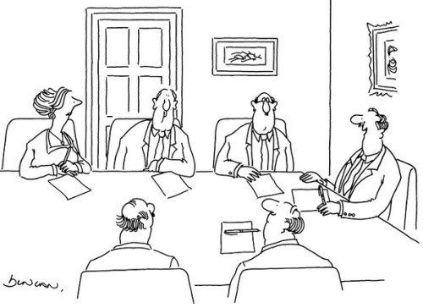
Diversity in CMS
Open Diversity Office Meeting: Tue 26th June 14:00 – 16:00
Women Forum for All: Thu 28th June 13:00 – 14:00
discussion of the collection of events with micro-aggression
https://drive.google.com/file/d/1vORhXLUXQ3HPISIiX2jIVtvsy3MlG3Vd/view?usp=sharing
see definition in the last Women Forum for All:
https://indico.cern.ch/event/722579/contributions/2971244/attachments/1636450/2611100/Narain_CMS-WomensForum-April2018.pdf
discussion on special topics from the sticky note collection
https://docs.google.com/document/d/1lGB-vM4IG6tIlrYpxyuSQfWtsOD5zULKDlFBPbaicIk/edit
discussion of special occurrences in context of conferences (DO)
  Some shocking events,
  few occured even in CMS
  raise awareness and
  discuss potential reactions
„That is an excellent suggestion, Miss Triggs. Perhaps one of the men here would like to make it ?“

Slide 32
Survey on PhD Requirements on
Obstacles in CMS – Overall Impression –
Survey summary is posted to the CB agenda
Analysis details from Engagement Office: https://docs.google.com/document/d/1quqZz9L7cBI9cuz4bWRE8UJI7aUD9WOd2l5yQUM5VO4/edit
71 institutes answered,
88% of these institutes can award a PhD
Majority of the institutes do not need special measures from CMS and, indeed, do not see a need for CMS to get involved in the PhD process of institutes.
Some institutes indicate that help is needed to overcome obstacles
→ Engagement Office will reach out to these institutes in order to understand and to develop potential solutions.
  .

Slide 33
Summary
Our experiment is operating well, all appearing obstacles have been mastered
Thanks to the deeply dedicated colleagues and students
in our collaboration !
A huge set of excellent data is waiting to be analyzed by us
with novel methods and brilliant new ideas.
Several new ideas have been realized to find glimpses of new discoveries.
We know that challenges are ahead of us to cope with the future demands imposed by high intensity, high pile-up and intense upgrade work.
→ We are starting to prepare well to be in time with excellent solutions
Our future is bright
with searches for discoveries and new physics
employing unpreceded data sets
and collecting even more data in HL LHC operation

Slide 34
Backup

Slide 35
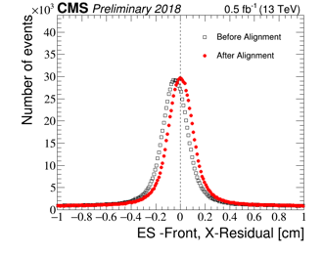
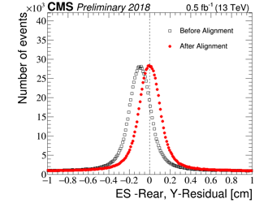
ECAL Performance in 2018
Commissioning 2018
New optical links to CMS DAQ for faster data transmission from ECAL FEDs
Automatic recovery of front end errors for trigger and data links
Alignment
ECAL and Preshower (ES) aligned using 2018 data, after opening/closing CMS
Information is used to tighten the identification cuts for electrons at HLT
Δx and Δy of the ES energy deposits wrt the tracks before and after alignment

Slide 36
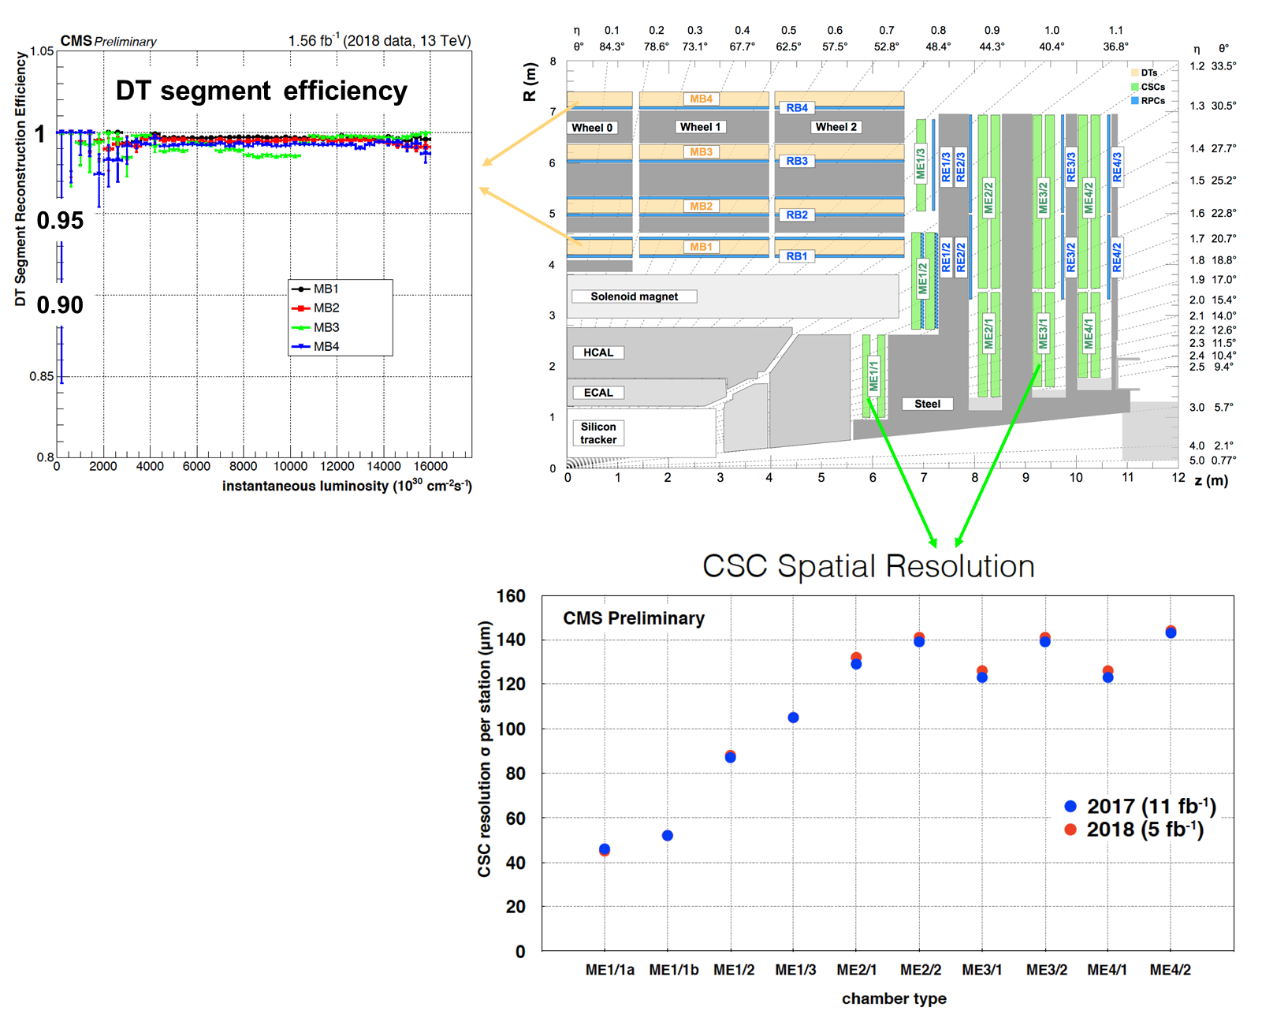
Muon Detectors Performance in 2018
DT readout
system upgraded
from VME→μTCA
Very high segment
efficiency up to
highest luminosities achieved
Detectors performance (local hit & segment efficiencies, resolutions) are in agreement with 2017
  CSC spatial resolution within 40-140 μm, well in agreement with chamber geometry & design specifications

Slide 37
L1 Trigger Performance
The L1 trigger was re-commissioned
with the first collisions
Improved L1T menu with less
pile-up dependence
  New calorimeter trigger primitives &
  physics object calibrations
  Optimized, tighter zero-suppression
  thresholds deployed in L1T for
  ECAL signals at |η| > 2.3
Most of the trigger thresholds are lower than those in 2017, maintaining 20% lower rates even with 30% higher instantaneous luminosity
  Efficiencies for electrons, muons, taus, jets and MET match that in 2017
  L1 rates are well within budget, and there is margin to lower thresholds on some L1 seeds

Slide 38
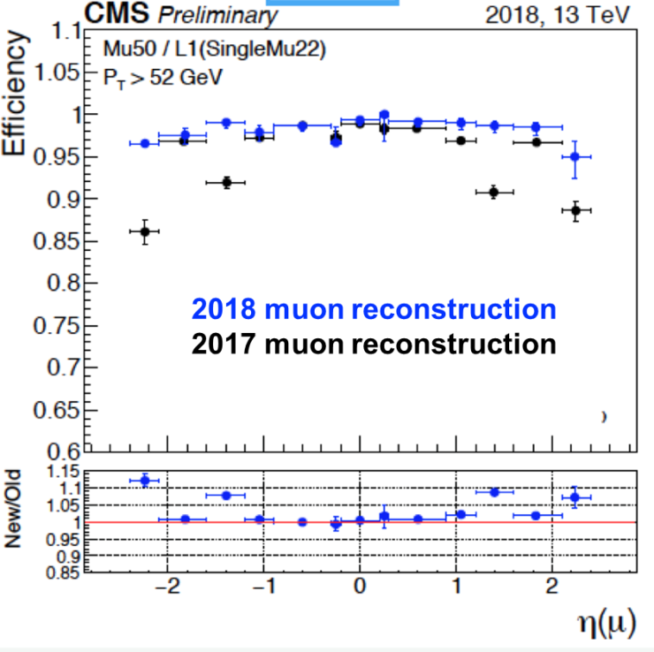
HLT Deployment in 2018
Complete trigger menu deployed since beginning of the ramp & “final” menu in LHC fill 6688 on May 15th
HLT rates within the limits of 1 kHz average and trigger thresholds similar to 2016 & 2017
  Sustainable up to 2.2e34 & pileup=60
  Parked dataset with low pT objects & displaced objects
Changes wrt 2017:
Improved tracking mitigation
in case of pixel inefficiencies,
new muon reconstruction,
jets & MET noise rejection,
new HE readout
HLT CPU requirements increased
a bit to ~330 ms/event/core (wrt 2017) –
within limits of HLT farm

Slide 39
2018 and LS2 Outlook
Datasets for 2018 analysis
Continuous calibration and monitoring of performance of prompt processing
Preparation of re-reco of early 2018 data ( up to end of July )
  To be combined with prompt processing → uniform dataset for whole 2018
Enable physics analyses in December, including object calibration
  Main use case are analyses to cover the whole of runII
Framework of activities for EOY and LS2:
HIN and B-Parking RECO
The ‘ultra legacy’: best performance to reconstruct 2016, 2017 and 2018 data and redo simulated datasets
  Collecting feedback from DPGs & POGs for RunII reprocessing 2019: plan of work to prepare calibration and software for ultimate performance for runII
R&D for PPD and DPGs/POGs during LS2

Slide 40
Production campaigns
Fall18 pp campaigns are running.
Recipe from GEN-SIM to NanoAOD is validated.
  MinBias is done, Pre-Mixing library is very closed to done.
  The first chunk of requests to support POGs injected.
    High stat HEM samples are prepared, to study the mitigation.
PbPb MC campaign has been prepared
Sample used to prepare the HI run are done.
Next step: preparation of MC production campaign for HI.
  Release has been developing.

Slide 41
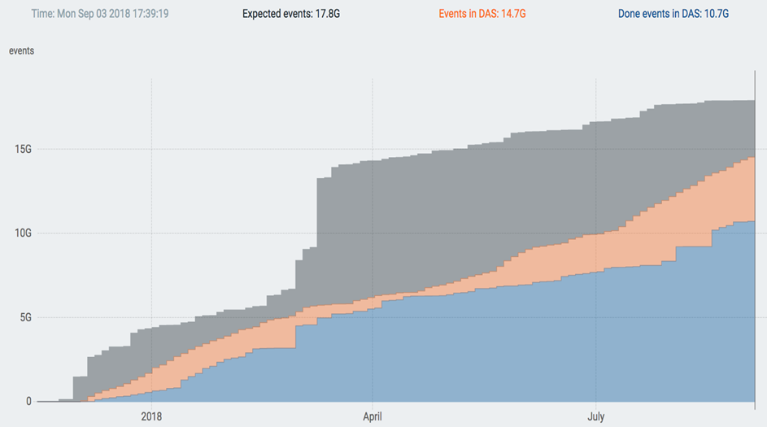
Production activities
Since Xmas, main activity has been the generation of MC17 samples, for Moriond and beyond
Initially planned 12B + contingency, now @ 15B events processed, and still 3 B in (low priority) queues
many smaller campaigns for
  Initial MC18 preparation (trigger, physics objects)
  PhaseII simulations
  reprocessing of 2016/7 data + MC
now about to start a massive MC18 production + reprocessing of DT18 up to now
  physics grade for winter conferences
next in line a production for the MDT TDR, due by Spring 2019
CMS keeping a constant level of 200-220kCores for production, +50kCores for analyses
2016/2107 processings with NanoAOD (DT+MC)
  1 kB/event reached
  physics datasets available to users for a total of 40B events (for a total of just 36 TB)!
  H→ bb paper completely NanoAOD based!

