Slide 1
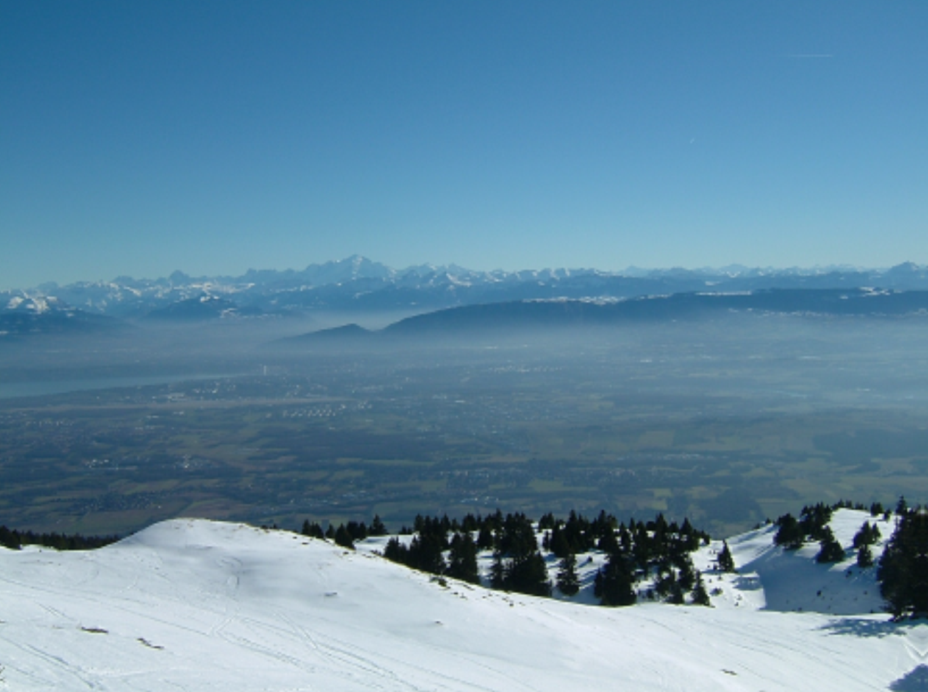
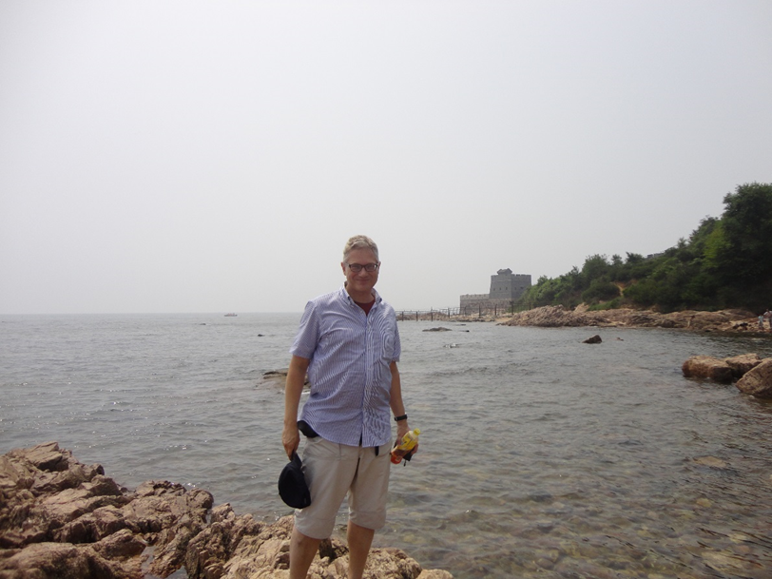






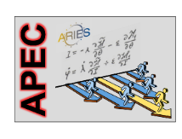
Beyond LHC: Future Circular Colliders
Studies in Europe and China
Geneva site
F. Zimmermann, 20th RDMS CMS Meeting, Tashkent
incl. slides from M. Benedikt (CERN) and J. Gao, X. Lou (IHEP) gratefully acknowledging input from FCC coordination group,
global FCC design study team, CEPC/SPPC design study, and all other contributors
Qinhuangdao site
http://cern.ch/fcc
Work supported by the European Commission under the HORIZON 2020 projects EuroCirCol, grant agreement 654305; EASITrain, grant agreement no. 764879; ARIES, grant agreement 730871; and E-JADE, contract no. 645479

Slide 2

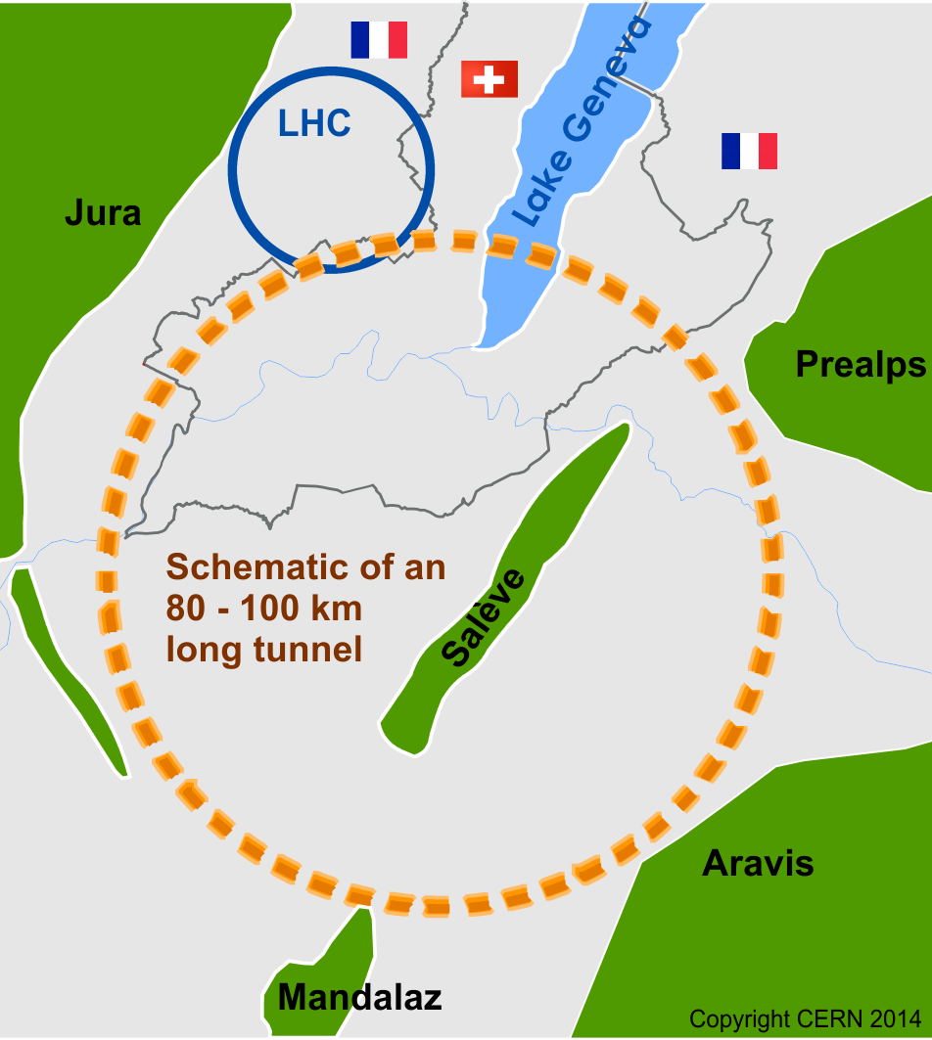

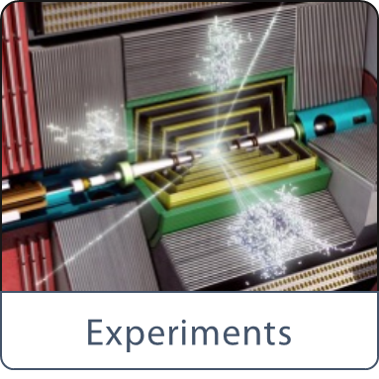
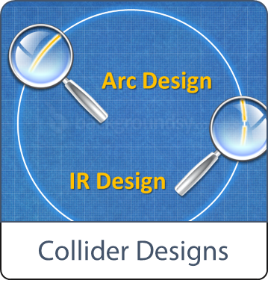
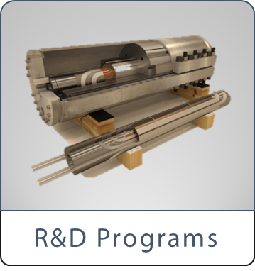


Future Circular Collider study - scope
international FCC collaboration (CERN as host lab) to study:
pp-collider (FCC-hh) → long-term goal, defining infrastructure requirements
~100 km tunnel infrastructure in Geneva area, site specific
e⁺e⁻ collider (FCC-ee), as potential first step
HE-LHC with FCC-hh technology
p-e (FCC-he) option, IP integration, e⁻ from ERL
HE-LHC
~16 T ⇒ 100 TeV pp in 100 km

Slide 3
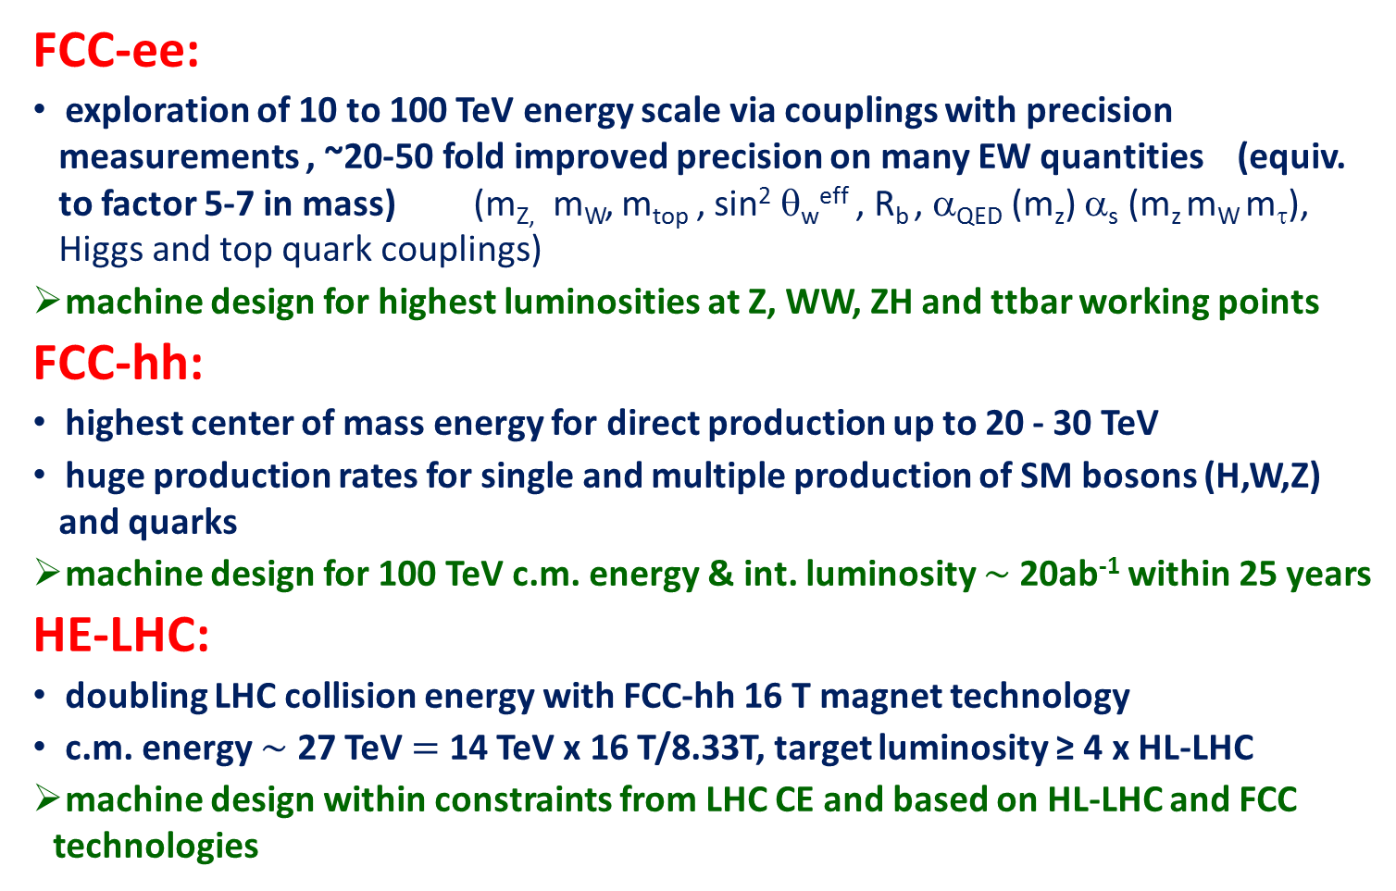
FCC study: physics and performance targets
FCC-ee:
exploration of 10 to 100 TeV energy scale via couplings with precision measurements , ~20-50 fold improved precision on many EW quantities (equiv. to factor 5-7 in mass) (m_{Z,} m_{W}, m_{top} , sin² θ_{w}^{eff} , R_{b} , α_{QED} (m_{z}) α_{s} (m_{z} m_{W} m_{τ}), Higgs and top quark couplings)
machine design for highest luminosities at Z, WW, ZH and ttbar working points
FCC-hh:
highest center of mass energy for direct production up to 20 - 30 TeV
huge production rates for single and multiple production of SM bosons (H,W,Z) and quarks
machine design for 100 TeV c.m. energy & int. luminosity $\sim$20ab⁻¹ within 25 years
HE-LHC:
doubling LHC collision energy with FCC-hh 16 T magnet technology
c.m. energy $\sim$ 27 TeV $=$ 14 TeV x 16 T/8.33T, target luminosity ≥ 4 x HL-LHC
machine design within constraints from LHC CE and based on HL-LHC and FCC technologies

Slide 4
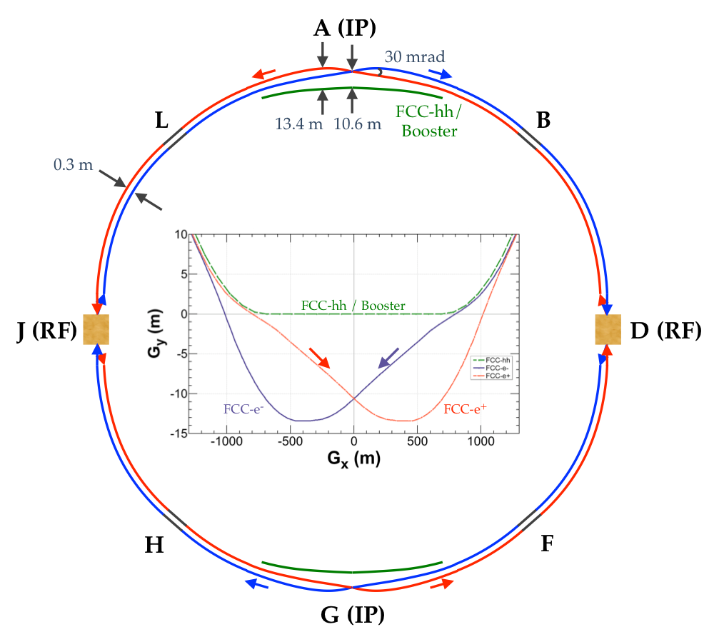
FCC-ee basic design choices
double ring e+ e- collider ~100 km
follows footprint of FCC-hh, except around IPs
asymmetric IR layout and optics to limit synchrotron radiation towards the detector
2 IPs, large horizontal crossing angle 30 mrad, crab-waist optics
synchrotron radiation power 50 MW/beam at all beam energies
top-up injection scheme for high luminosity
requires booster synchrotron in collider tunnel

Slide 5
FCC-ee collider parameters: 4 modes
parameter | Z | WW | H (ZH) | ttbar
beam energy [GeV] | 45 | 80 | 120 | 182.5
beam current [mA] | 1390 | 147 | 29 | 5.4
no. bunches/beam | 16640 | 2000 | 393 | 48
bunch intensity [10¹¹] | 1.7 | 1.5 | 1.5 | 2.3
SR energy loss / turn [GeV] | 0.036 | 0.34 | 1.72 | 9.21
total RF voltage [GV] | 0.1 | 0.44 | 2.0 | 10.9
long. damping time [turns] | 1281 | 235 | 70 | 20
horizontal beta* [m] | 0.15 | 0.2 | 0.3 | 1
vertical beta* [mm] | 0.8 | 1 | 1 | 1.6
horiz. geometric emittance [nm] | 0.27 | 0.28 | 0.63 | 1.46
vert. geom. emittance [pm] | 1.0 | 1.7 | 1.3 | 2.9
bunch length with SR / BS [mm] | 3.5 / 12.1 | 3.0 / 6.0 | 3.3 / 5.3 | 2.0 / 2.5
luminosity per IP [10³⁴ cm⁻²s⁻¹] | >200 | >25 | >7 | >1.4
beam lifetime rad Bhabha / BS [min] | 68 / >200 | 49 / >1000 | 38 / 18 | 40 / 18

Slide 6
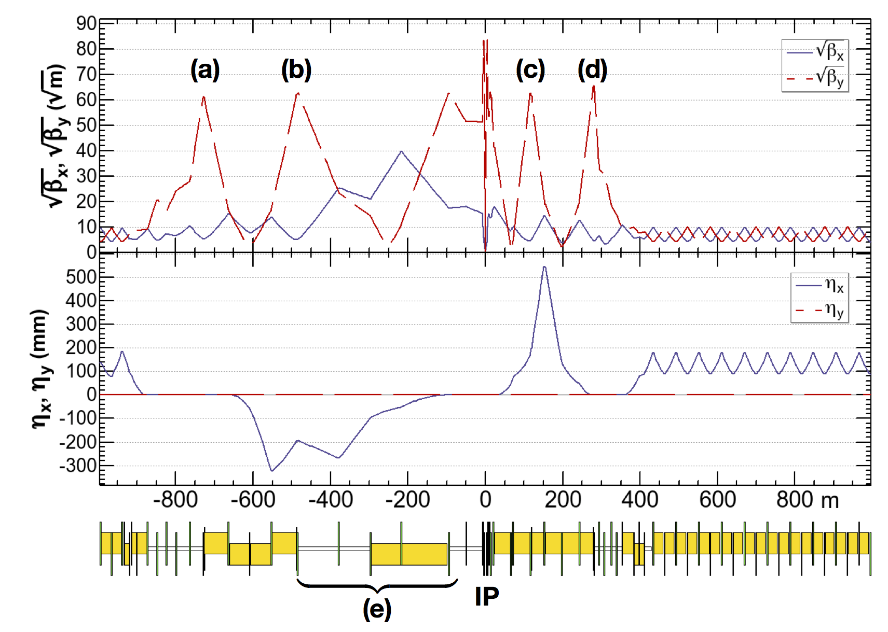
FCC-ee asymmetric crab waist IR optics
asymmetric IR optics to suppress synchrotron radiation toward the IP, E_{critical} <100 keV from 450 m from IP (e)
ttbar 182.5 GeV
yellow boxes:
dipole magnets
K. Oide
4 sextupoles (a – d) for local vertical chromaticity correction and crab waist, optimized for each working point.
Common arc lattice for all energies, 60 deg for Z, W and 90 deg for ZH, tt for maximum stability and luminosity

Slide 7
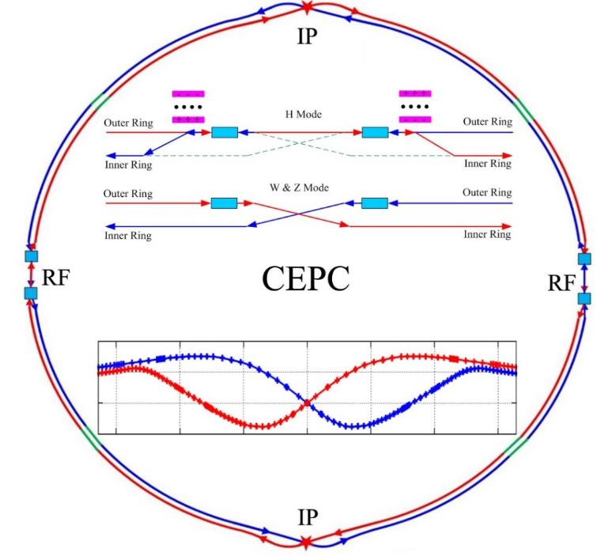
CEPC CDR Baseline: 3 operation modes (no top running)
Higgs factory as first piority (fully partial double ring, with common SRF system for e+ and e- beams)
W and Z factories are incorporated by beam swithyard (W and Z factories are double ring, with
independent SRF system for e+ and e- beams)
Higgs factory baseline SR per beam 30 MW to Minimize AC power
economic CEPC baseline design as Higgs factory:
W, Z factories incorporated with the same SRF system hardware by using beam
switchyard to change from Higgs factory and W, Z factories
synchrotron radiation power per beam at Higgs energy is set to 30MW to minimize
AC power consumption
J. Gao

Slide 8
CEPC CDR Parameters (September 2018)
 | Higgs | W | Z（3T） | Z（2T）
Number of IPs | 2
Beam energy (GeV) | 120 | 80 | 45.5
Circumference (km) | 100
Synchrotron radiation loss/turn (GeV) | 1.73 | 0.34 | 0.036
Crossing angle at IP (mrad) | 16.5×2
Piwinski angle | 2.58 | 7.0 | 23.8
Number of particles/bunch N_{e} (10¹⁰) | 15.0 | 12.0 | 8.0
Bunch number (bunch spacing) | 242 (0.68μs) | 1524 (0.21μs) | 12000 (25ns+10%gap)
Beam current (mA) | 17.4 | 87.9 | 461.0
Synchrotron radiation power /beam (MW) | 30 | 30 | 16.5
Bending radius (km) | 10.7
Momentum compact (10⁻⁵) | 1.11
β function at IP β_{x}* / β_{y}* (m) | 0.36/0.0015 | 0.36/0.0015 | 0.2/0.0015 | 0.2/0.001
Emittance ε_{x}/ε_{y} (nm) | 1.21/0.0031 | 0.54/0.0016 | 0.18/0.004 | 0.18/0.0016
Beam size at IP σ_{x} /σ_{y} (μm) | 20.9/0.068 | 13.9/0.049 | 6.0/0.078 | 6.0/0.04
Beam-beam parameters ξ_{x}/ξ_{y} | 0.031/0.109 | 0.013/0.106 | 0.0041/0.056 | 0.0041/0.072
RF voltage V_{RF} (GV) | 2.17 | 0.47 | 0.10
RF frequency f _{RF} (MHz) (harmonic) | 650 (216816)
Natural bunch length σ_{z} (mm) | 2.72 | 2.98 | 2.42
Bunch length σ_{z} (mm) | 3.26 | 5.9 | 8.5
HOM power/cavity (2 cell) (kw) | 0.54 | 0.75 | 1.94
Natural energy spread (%) | 0.1 | 0.066 | 0.038
Energy acceptance requirement (%) | 1.35 | 0.4 | 0.23
Energy acceptance by RF (%) | 2.06 | 1.47 | 1.7
Photon number due to beamstrahlung | 0.1 | 0.05 | 0.023
Lifetime _simulation (min) | 100
Lifetime (hour) | 0.67 | 1.4 | 4.0 | 2.1
F (hour glass) | 0.89 | 0.94 | 0.99
Luminosity/IP L (10³⁴cm⁻²s⁻¹) | 2.93 | 10.1 | 16.6 | 32.1

Slide 9
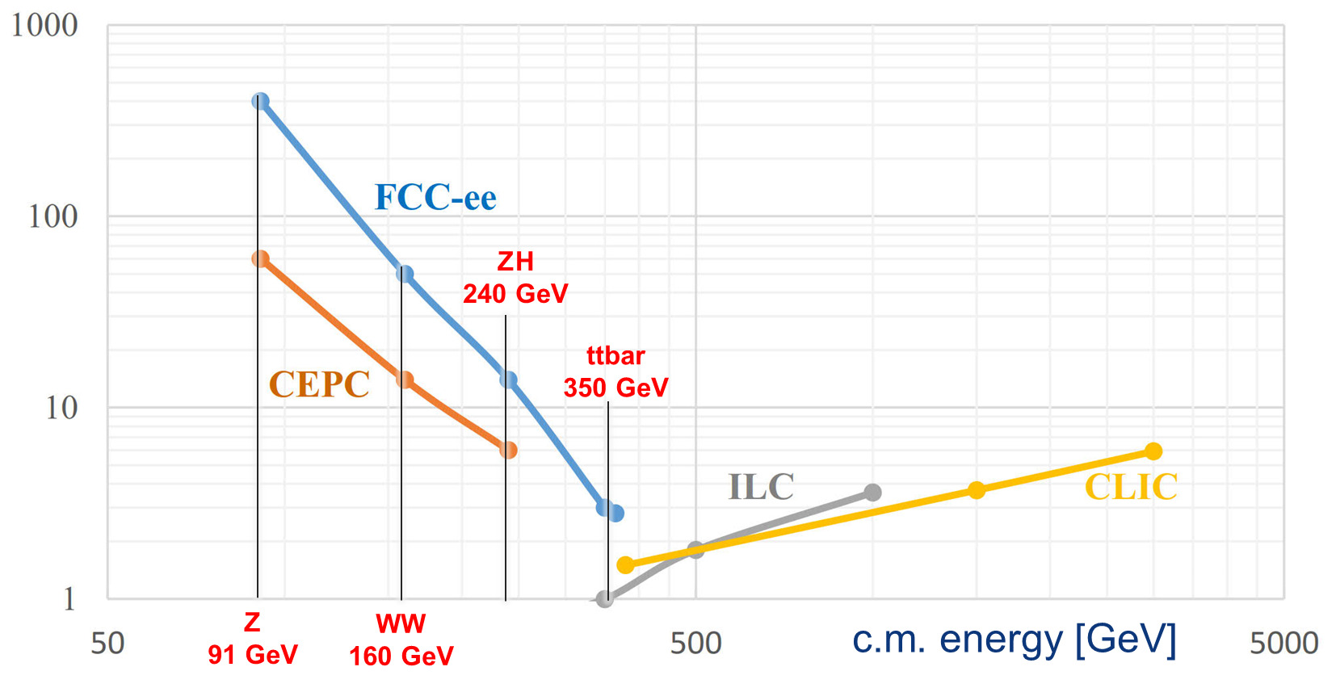
lepton collider luminosities
total luminosity [10³⁴ cm⁻²s⁻¹]
ttbar
350-365 GeV

Slide 10
FCC-ee physics operation model
working point | nominal luminosity/IP [10³⁴ cm⁻²s⁻¹] | total luminosity (2 IPs)/ yr half luminosity in first two years (Z) and first year (ttbar) to account for initial operation | physics goal | run time [years]
Z first 2 years | 100 | 26 ab⁻¹/year | 150 ab⁻¹ | 4
Z later | 200 | 48 ab⁻¹/year
W | 25 | 6 ab⁻¹/year | 10 ab⁻¹ | 1 - 2
H | 7.0 | 1.7 ab⁻¹/year | 5 ab⁻¹ | 3
machine modification for RF installation & rearrangement: 1 year
top 1st year (350 GeV) | 0.8 | 0.2 ab⁻¹/year | 0.2 ab⁻¹ | 1
top later (365 GeV) | 1.4 | 0.34 ab⁻¹/year | 1.5 ab⁻¹ | 4
total program duration: 14 – 15 years - including machine modifications
phase 1 (Z, W, H): 8 – 9 years, phase 2 (top): 6 years

Slide 11
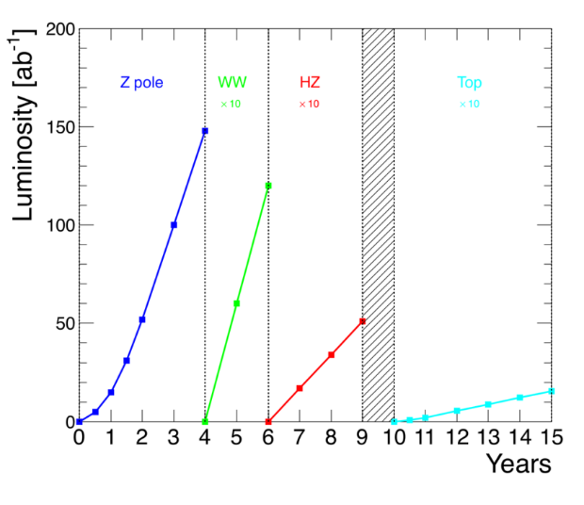
FCC-ee luminosity projection

Slide 12
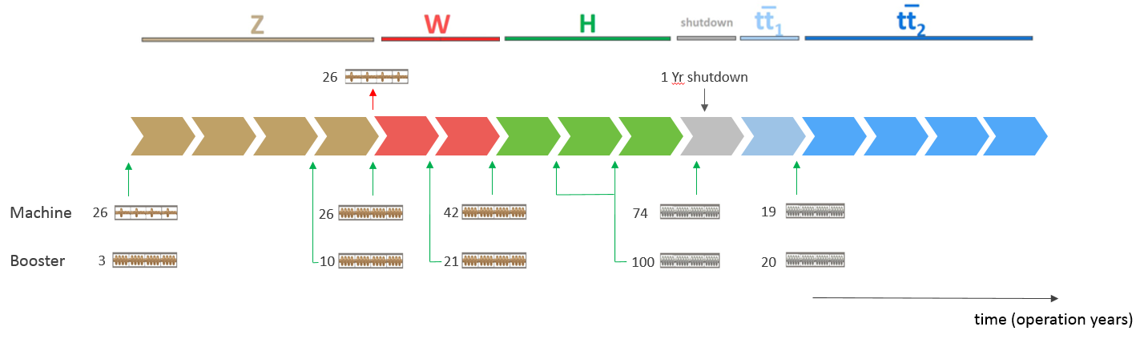
FCC-ee RF staging scenario
“Ampere-class” machine
three sets of RF cavities to cover all options for FCC-ee & booster:
high intensity (Z, FCC-hh): 400 MHz mono-cell cavities (4/cryom.)
higher energy (W, H, t): 400 MHz four-cell cavities (4/cryomodule)
ttbar machine complement: 800 MHz five-cell cavities (4/cryom.)
installation sequence comparable to LEP ( ≈ 30 CM/shutdown)
WP | V_{rf} [GV] | #bunches | I_{beam} [mA]
Z | 0.1 | 16640 | 1390
W | 0.44 | 2000 | 147
H | 2.0 | 393 | 29
ttbar | 10.9 | 48 | 5.4
“high-gradient” machine
O. Brunner

Slide 13
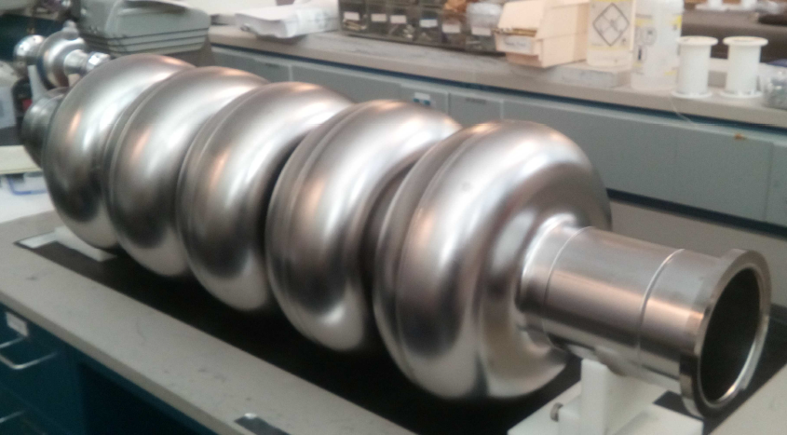
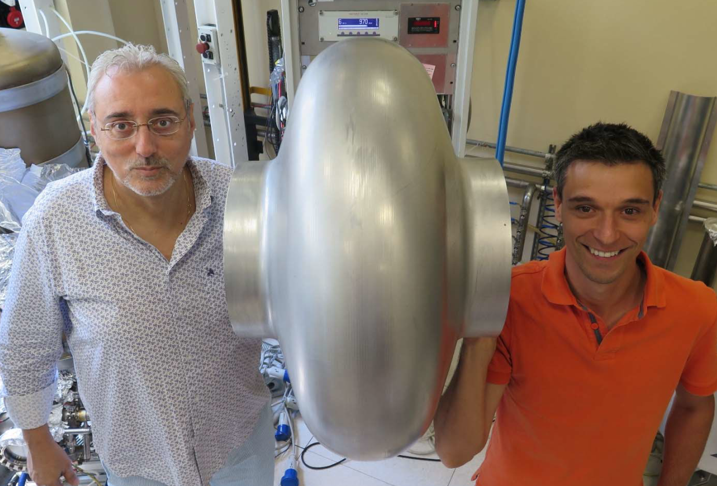
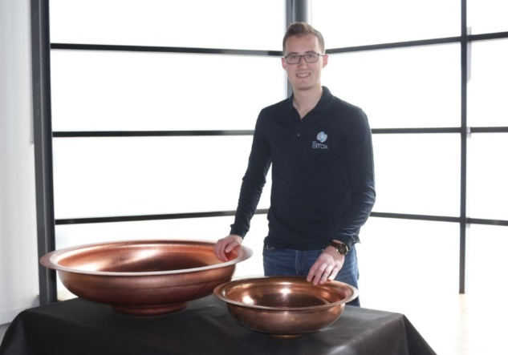
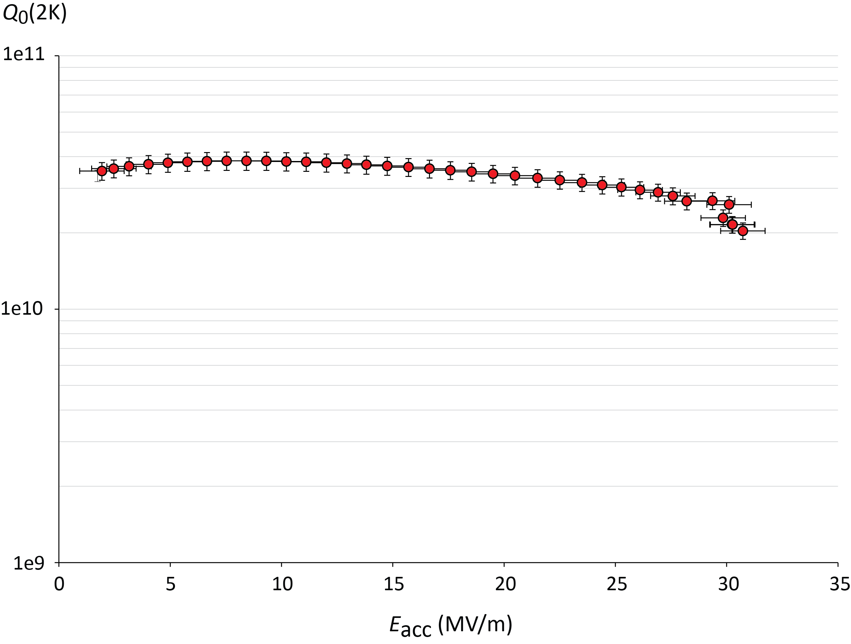

FCC SRF cavity development (examples)
5-cell 800 MHz cavity, JLAB prototype for both FCC-ee (t-tbar) & FCC-eh
CERN half-cells produced by Electro-Hydro-Forming (EHF) at B_{max}
seamless 400 MHz single-cell cavity formed by spinning at INFN-LNL
Legnaro, Feb 2018
JLAB, Oct 25, 2017
F. Marhauser et al
5.5 x 24m²
V. Palmieri † C. Pira
400 MeV, 3 turns,
20 mA, 802 MHz
tooling fabricated and successfully tested with an aluminium cavity
J.-F. Croteau, EASITrain PhD Student
$Q0 3∙{10}^{10}$ @ 2K
high strain rate technology using shockwaves in water from HV discharge.
EHF investigated for half-cells and seamless Nb&Cu cavities
Regime of E_{acc}
requirements
in LHeC, PERLE,
FCC-ee
31 MV/m
quench limit
† We’re saddened by the sudden death of Vincenzo Palmieri this year
O. Brunner, E. Jensen

Slide 14
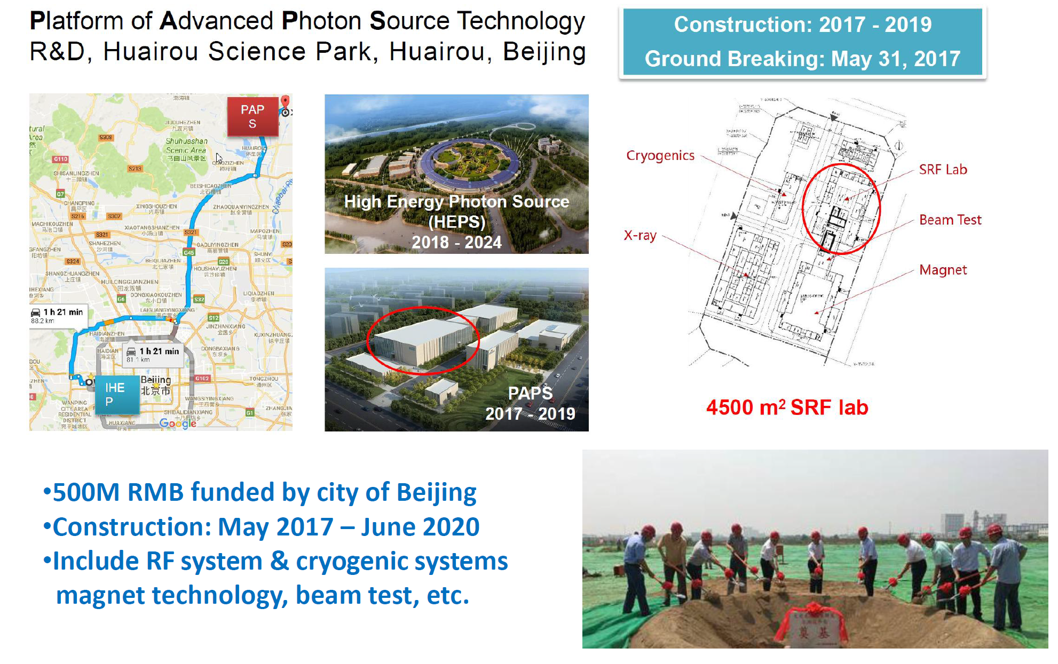
CEPC SRF cavities - production at PAPS

Slide 15
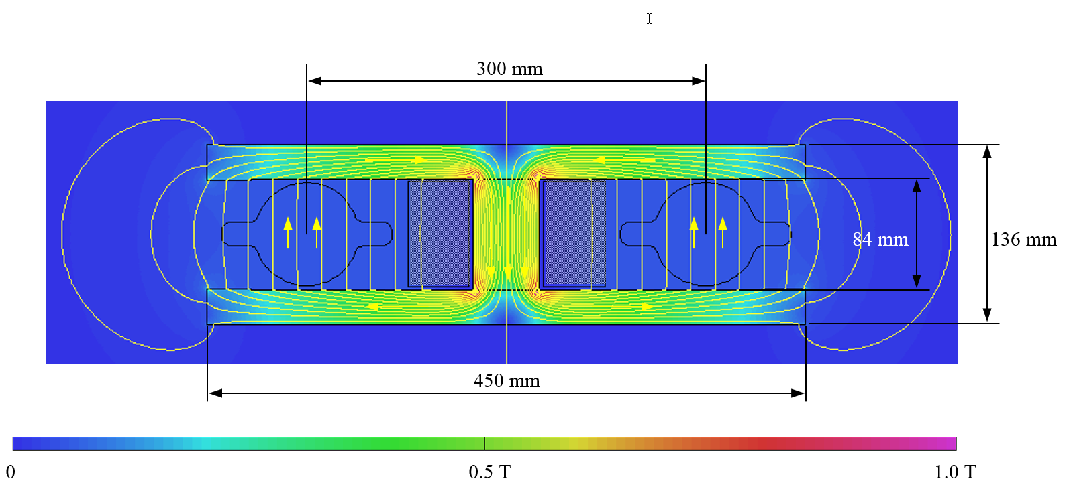
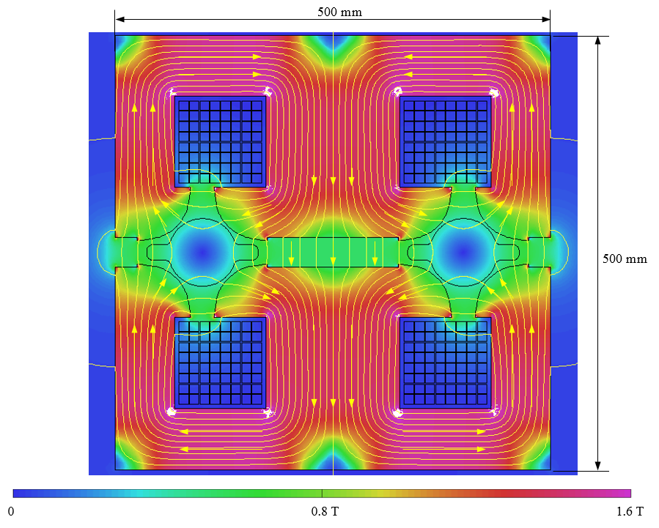
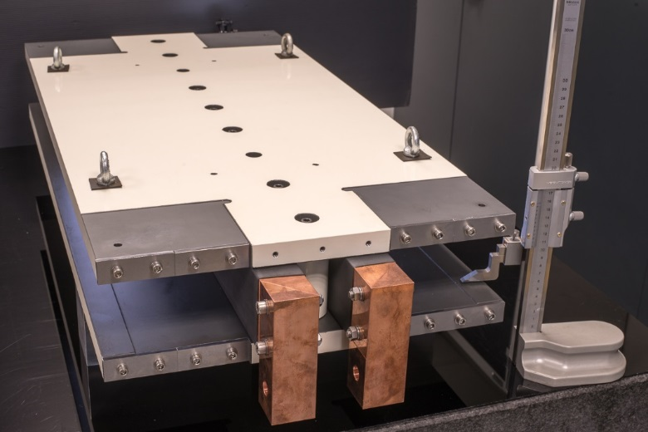
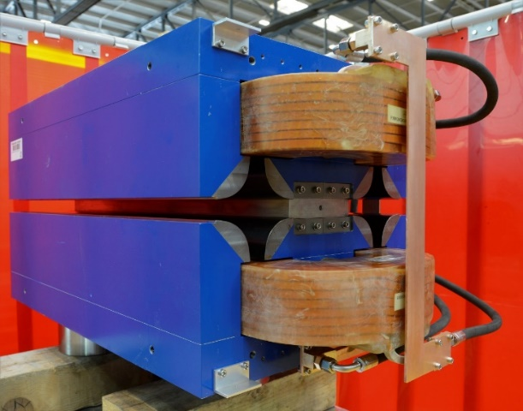
low-power low-cost design for FCC-ee magnets
twin F/D quad design with 2× power saving; 25 MW (at 175 GeV), with Cu conductor
twin-dipole design with 2× power saving
16 MW (at 175 GeV), with Al busbars
first 1 m prototype
first 1 m prototype
A. Milanese

Slide 16
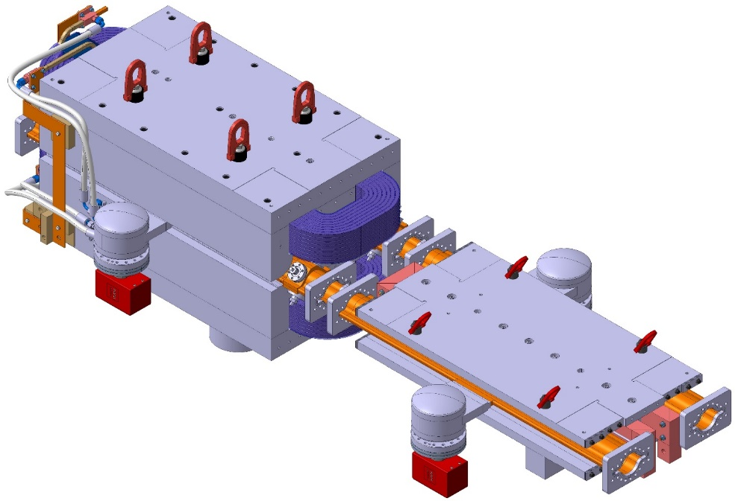
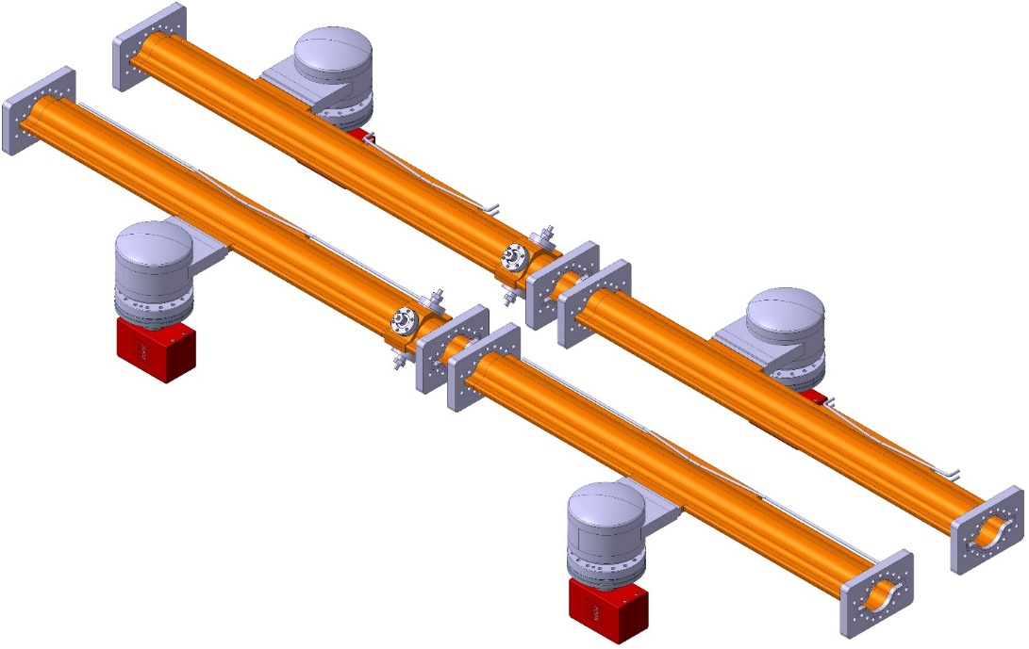
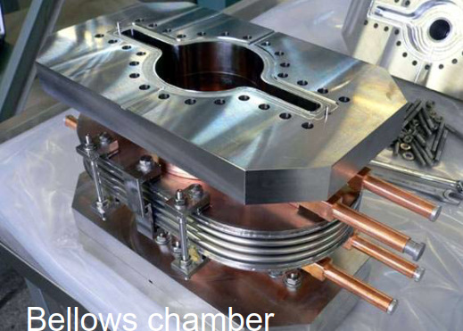
FCC-ee arc vacuum prototyping and integration
Vacuum chamber cross section: 70 mm ID with ”winglets” in the plane of the orbit (SuperKEKB-like);
chambers feature lumped SR absorbers with NEG-pumps placed next to them.
construction of chamber prototypes in coming months and integration with twin magnets
R. Kersevan, C. Garion

Slide 17
FCC-ee injector layout
S. Ogur, K. Oide, Y. Papaphilippou
SLC/SuperKEKB-like 6 GeV linac accelerating; 1 or 2 bunches with repetition rate of 100-200 Hz
same linac used for e+ production @ 4.46 GeV e+ beam emittances reduced in DR @ 1.54 GeV
injection @ 6 GeV into of Pre-Booster Ring (SPS or new ring) and acceleration to 20 GeV
injection to main Booster @ 20 GeV and interleaved filling of e+/e- (below 20 min for full filling) and continuous top-up
CEPC: 10 GeV linac, no prebooster

Slide 18



FCC-ee el. power consumption [MW]
Beam energy (GeV) | 45.6 Z | 80 W | 120 ZH | 182.5 ttbar
RF (SR = 100) | 163 | 163 | 145 | 145
Collider cryo | 1 | 9 | 14 | 46
Collider magnets | 4 | 12 | 26 | 60
Booster RF & cryo | 3 | 4 | 6 | 8
Booster magnets | 0 | 1 | 2 | 5
Pre injector | 10 | 10 | 10 | 10
Physics detector | 8 | 8 | 8 | 8
Data center | 4 | 4 | 4 | 4
Cooling & ventilation | 30 | 31 | 31 | 37
General services | 36 | 36 | 36 | 36
Total | 259 | 278 | 282 | 359

Slide 19
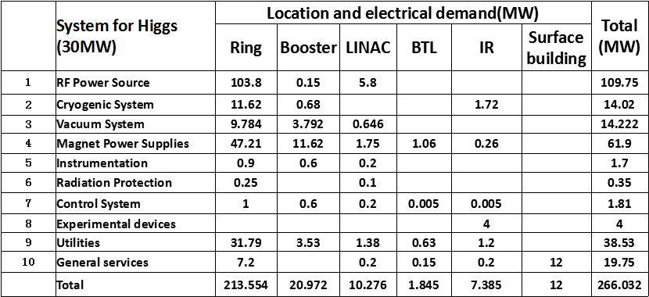
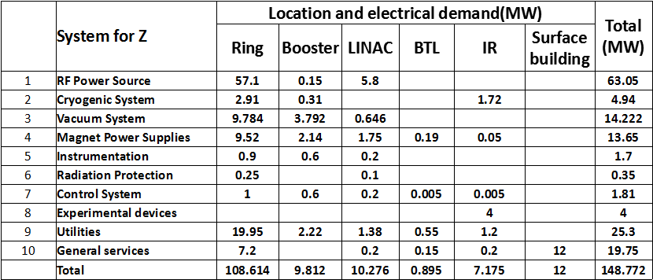
CEPC Power for Higgs and Z
CEPC power & comparing efficiency
2.5x less luminosity than FCC-ee at ~equal power
266MW
8x less luminosity than FCC-ee at ~60% the power
149MW
J. Gao

Slide 20
sketch of FCC-ee physics
EXPLORE 10-100 TeV energy scale (and beyond) with Precision Measurements
DISCOVER a violation of flavour conservation or universality & unitarity
DISCOVER dark matter as «invisible decay» of H or Z (or in LHC loopholes)
DISCOVER very weakly coupled particle in 5-100 GeV energy scale
such as: Right-Handed neutrinos, Dark Photons
“First Look at the Physics Case of TLEP”, JHEP 1401 (2014) 164;
ZH cross-section receives a E_{cm} -dependent correction from λ_{H}
investigating now : the possibility of reaching 5σ observation of Higgs self coupling at FCC-ee:
4 detectors + recast of running scenario
A. Blondel, ICHEP 2018

Slide 21

FCC-hh collider parameters
parameter | FCC-hh |  | HE-LHC | HL-LHC | LHC
collision energy cms [TeV] | 100 |  | 27 | 14 | 14
dipole field [T] | 16 |  | 16 | 8.33 | 8.33
circumference [km] | 97.75 |  | 26.7 | 26.7 | 26.7
beam current [A] | 0.5 |  | 1.1 | 1.1 | 0.58
bunch intensity [10¹¹] | 1 |  | 2.2 | 2.2 | 1.15
bunch spacing [ns] | 25 |  | 25 | 25 | 25
synchr. rad. power / ring [kW] | 2400 |  | 101 | 7.3 | 3.6
SR power / length [W/m/ap.] | 28.4 |  | 4.6 | 0.33 | 0.17
long. emit. damping time [h] | 0.54 |  | 1.8 | 12.9 | 12.9
beta* [m] | 1.1 | 0.3 | 0.45 | 0.15 (min.) | 0.55
normalized emittance [μm] | 2.2 |  | 2.5 | 2.5 | 3.75
peak luminosity [10³⁴ cm⁻²s⁻¹] | 5 | 30 | 16 | 5 (lev.) | 1
events/bunch crossing | 170 | 1000 | 460 | 132 | 27
stored energy/beam [GJ] | 8.4 |  | 1.3 | 0.7 | 0.36

Slide 22
FCC-hh layout and optics
circumference 97.8 km
two high-luminosity experiments (A & G)
two other experiments (L & B) combined with injection upstream of experiments
two collimation insertions
  betatron cleaning (J)
  momentum cleaning (F)
Extraction/dump insertion (D)
RF insertion (H)
integrated optics for full ring established, beam dynamics studies confirm design goals

Slide 23
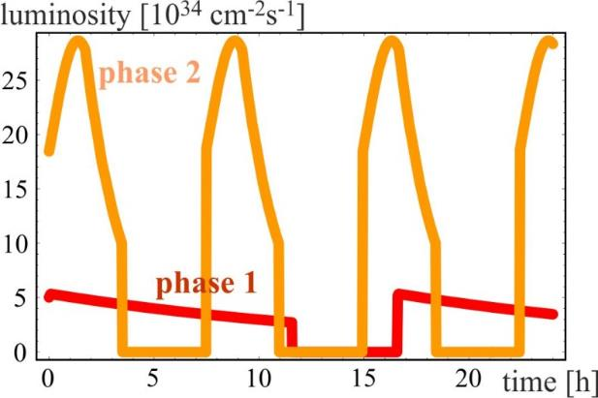
FCC-hh operation phases
phase 1 (initial):
β*=1.1 m, ΔQ_{tot}=0.01, t_{ta}=5 h
250 fb⁻¹ / year
radiation damping: τ~1 h
phase 2 (nominal):
β*=0.3 m, ΔQ_{tot}=0.03, t_{ta}=4 h
1 ab⁻¹ / year
transition via operation experience,
no HW modification
phase 2: Interplay of radiation damping,
luminosity burn-off, controlled transverse blow-up
total integrated luminosity over 25 years of operation O(20) ab⁻¹/experiment - consistent with physics goals

Slide 24
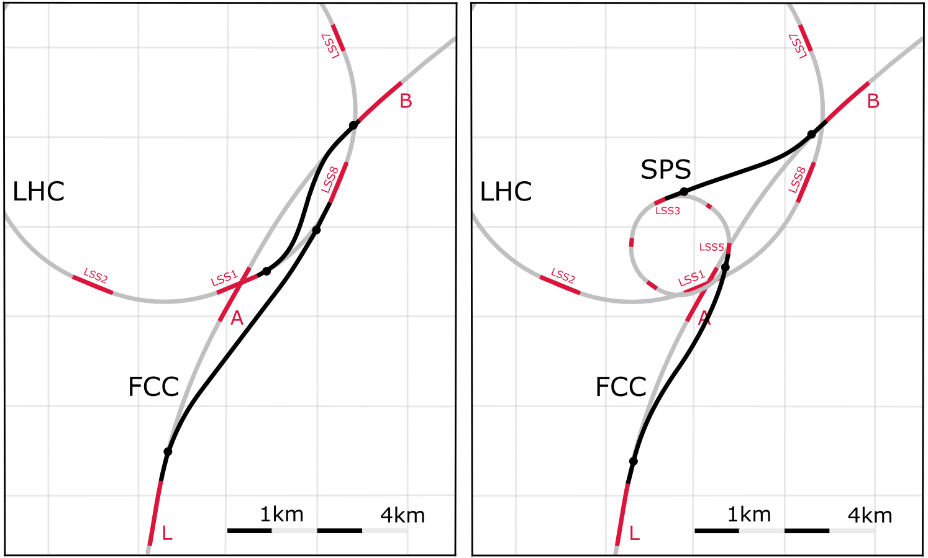
FCC-hh injector options
Baseline:
LHC @ 3.3 TeV
Alternative:
scSPS @ 1.3 TeV
Total of O(5.5 km) superconducting bends in transfer lines from LHC, at 7.2 T
O(6.5 km) normal-conducting bends from SPS, at 1.8 T
Current baseline: Injection energy 3.3 TeV LHC → Field-swing FCC-hh like LHC
Alternative options: Injection from SPS_{upgrade} around 1.3 TeV
SPS_{upgrade} could be based on fast-cycling SC magnets, 6-7T, ~ 1T/s ramp, cf. SIS 300 design
SPS_{upgrade} would also be an ideal injector for HE LHC (as alternative to the 450 GeV SPS)

Slide 25
worldwide FCC Nb₃Sn program
Main development goal is wire performance increase:
J_{c} (16T, 4.2K) > 1500 A/mm² →50% increase wrt HL-LHC wire
Reduced coil & magnet cross-section
5400 mm²
3150 mm²
~1.7 times less SC
~10% margin
HL-LHC
~10% margin
FCC ultimate
Conductor activities for FCC started in 2017:
Bochvar Institute (production at TVEL), Russia
KEK (Jastec and Furukawa), Japan
KAT, Korea
Columbus, Italy
University of Geneva, Switzerland
Technical University of Vienna, Austria
SPIN, Italy
University of Freiberg, Germany
  In addition, agreements under preparation:
  Bruker, Germany
  Luvata Pori, Finland
after only one year development, prototype Nb₃Sn wires from several new industrial FCC partners (Japan, Korea, Russia) already achieve HL-LHC performance

Slide 26
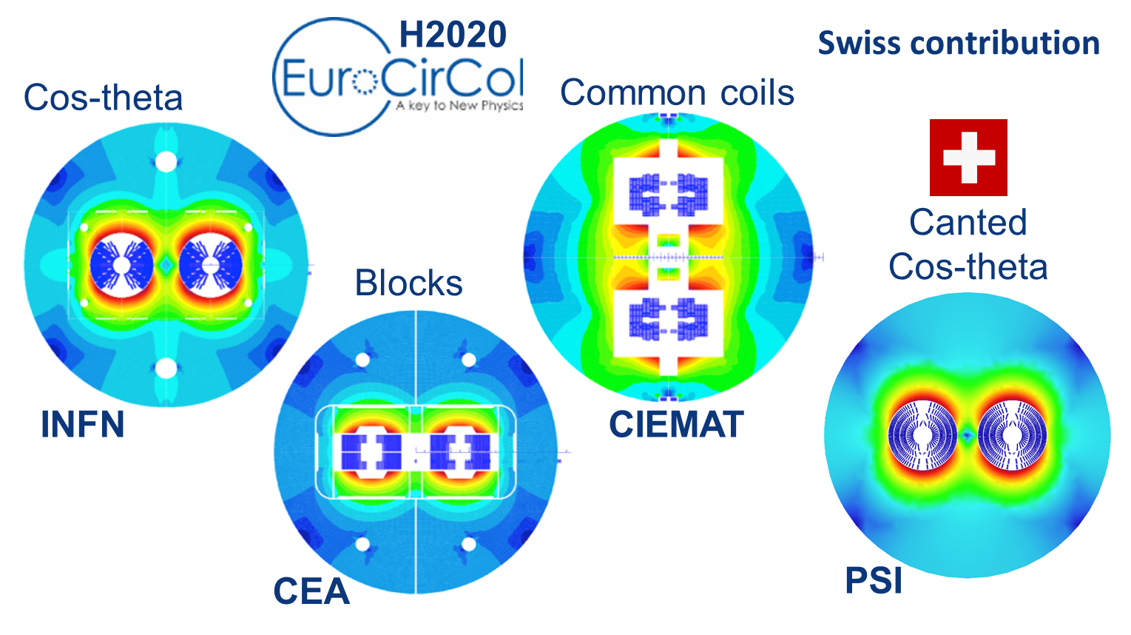
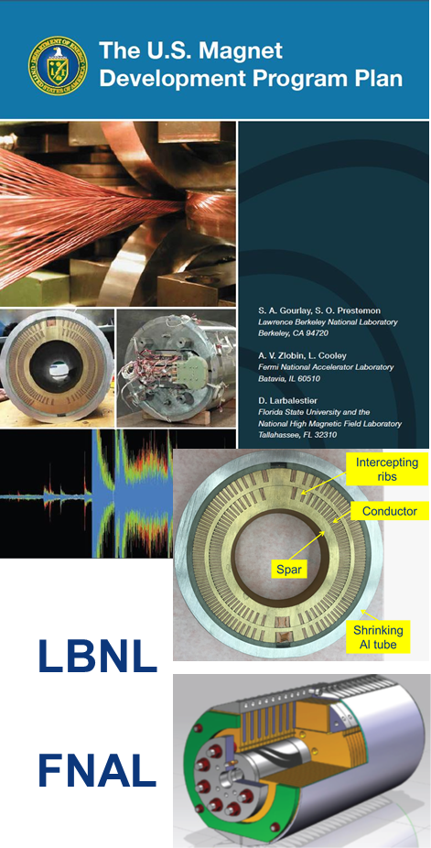
16 T dipole design activities & options
M. Benedikt
short model magnets (1.5 m lengths) built from 2018 – 2022
Russian 16 T magnet program launched by BINP recently

Slide 27
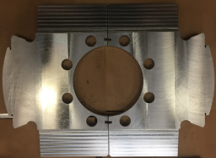
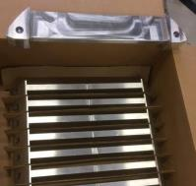
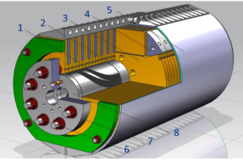
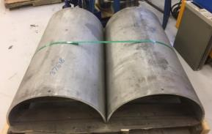
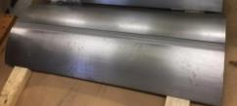
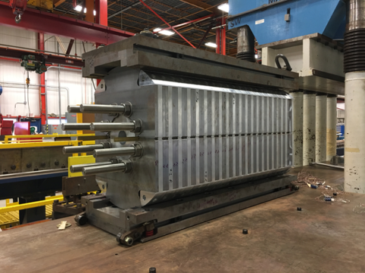
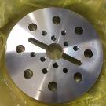
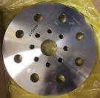
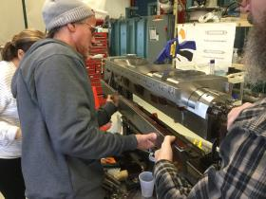
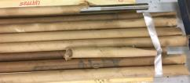
15 T dipole demonstrator (US MDP)
Iron Laminations
AL I-Clamps
StSt Skin
Fillers
End Plates
Axial Rods
All coil parts, structural components and tooling are available at FNAL
Coil fabrication and the work with mechanical structure are in progress
First magnet test in September 2018
A. Zlobin

Slide 28
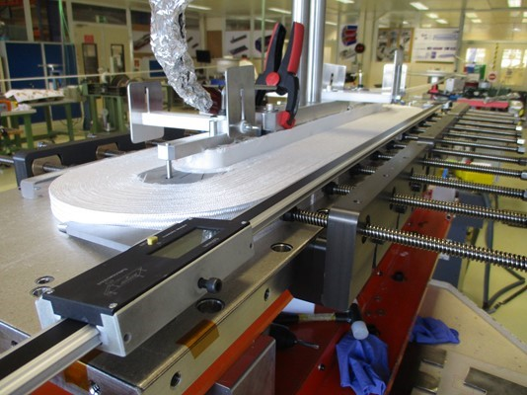
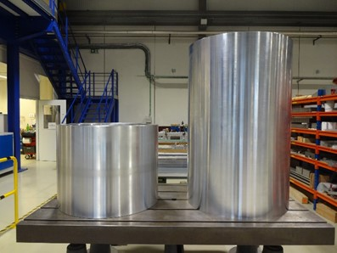
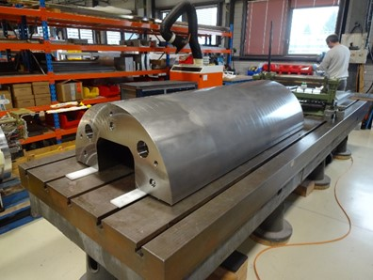
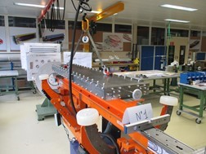
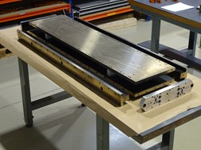
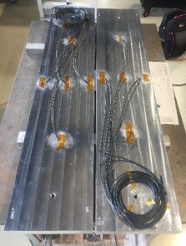
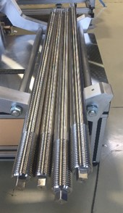
16 T ERMC construction at CERN
First ERMC coil winding
Aluminum shell
Magnet yoke
Dummy coils
Coil Reaction Tool
Coil Impregnation Tool
D. Tommasini
Axial rods
Coil fabrication
Winding of the first coil has been completed. Preparation for reaction on-going. All tooling for coil production ready
Magnet assembly
Components and tooling ready. Dummy assembly to characterize the structure behavior on-going.

Slide 29
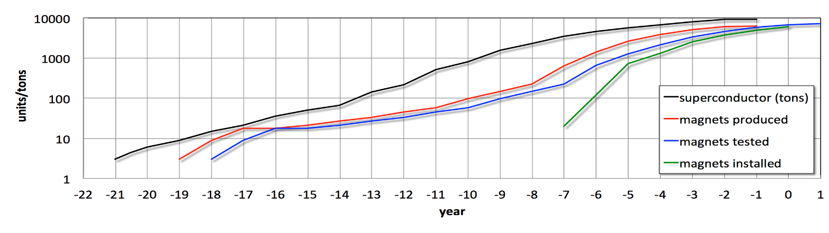

FCC 16 T magnet R&D schedule
total duration of magnet program: ~20 years
would follow HL-LHC Nb₃Sn program with long models w industry from 2023/24
M. Benedikt, L. Bottura

Slide 30


HE-LHC integration aspects
  working hypothesis for HE LHC design:
  no major CE modifications on tunnel and caverns
  similar geometry and layout as LHC machine & experiments
  maximum magnet cryostat diameter $\sim$1200 mm
  maximum QRL diameter $\sim$830 mm
  LHC tunnel diameter 3.8 m
integration and design strategy:
development of optimized 16 T magnet, compatible with HE LHC requirements
new cryogenic layout to limit QRL dimension
V. Mertens, M. Benedikt

Slide 31





16 T dipole design evolution
Coil optimization and margin 18 → 14%
Inter-beam distance 250 → 204 mm
Stray-field < 0.1 T at cryostat
Half-sector cooling instead of full sector (as for LHC)
to limit cross section of cryogenic distribution line
800 mm 600 mm
Cosine-theta (baseline)
Block-type coils
Common-coils
higher heat load and integration limitations:
8 additional 1.8 K refrigeration units wrt. LHC
8 new higher-power 4.5 K cryoplants
2015 2017

Slide 32

HE-LHC IR layout
triplet lengths:
LHC: 30.4 m
HL-LHC: 41. 8 m
HE-LHC: 56 m (13.5 TeV);
ca. 11 m
for crab cavities
L. van Riesen Haupt

Slide 33



HE-LHC IR optics & triplet shielding
rriplet quadrupole design with 2 cm inner tungsten shielding
for 10 ab⁻¹ integral luminosity: $\sim$40 MGy peak dose (peak at Q3 can be reduced w addt’l shielding)
J. Abelleira
General optics design work ongoing for HE LHC with focus on: injection (energy), field quality, physical & dynamic aperture, protection
l* = 23 m,
TAS 1.8 m long
(as for HL-LHC,
different radius)
  collision optics
  with β*=0.25 m
L. van Riesen Haupt

Slide 34
SPPC main parameters
Parameter | Unit | SPPC |  |  | FCC
 |  | PreCDR | “CDR” | “Ultimate”
Circumference | km | 54.4 | 100 | 100 | 100
c.m. energy | TeV | 70.6 | 75 | 125-150 | 100
dipole field | T | 20 | 12 | 20-24 | 16
injection energy | TeV | 2.1 | 2.1 | 4.2 | 3.3
#IPs |  | 2 | 2 | 2 | 2
luminosity per IP | 10³⁵ cm⁻²s⁻¹ | 1.2 | 1.0 | - | 0.5 |  | 3.0
norm. emittance | μm | 4.1 | 2.4 | ? | 2.2 (0.44)
IP beta function | m | 0.75 | 0.75 | - | 1.1 |  | 0.3
beam current | A | 1.0 | 0.7 | - | 0.5
bunch separation | ns | 25 | 25 | - | 25 (5) | 25 (5)
bunch population | 10¹¹ | 2.0 | 1.5 | - | 1.0 (0.2) | 1.0 (0.2
SR power /beam | MW | 2.1 | 1.1 | - | 2.5
SR heat load/ap | W/m | 45 | 13 | - | 30
J. Tang

Slide 35

SppC layout 2017
coexistence ee, pp, ep
two high-luminosity pp experiments
two other experiments for AA & ep
one (combined) collimation insertion
one RF insertion
extraction insertion
injection insertion
greenfield injector chain
J. Gao
circumference: 100 km
J. Gao, X. Lou, J. Tang

Slide 36

SppC injector chain
J. Gao
p-Linac: proton superconducting linac
p-RCS: proton rapid cycling synchrotron
MSS: Medium-Stage Synchrotron
SS: Super Synchrotron
ion beams: dedicated linac (I-Linac) and RCS (I-RCS)

Slide 37

SppC: wire from Fe-based HTS*
*discovered at TIT/Japan in 2008
Chinese 10-year R&D target
for SPPC collider

Slide 38

SppC: China-Domestic Collaboration on HTS
In October 2016, A consortium for High-temperature superconducting materials, industrialization and applications was formed in China, with participation of major research and production institutions on HTS.
China is actually leading the development of Fe-HTS technology in the world; world-first 100-m Fe-HTS wire was made by CAS-Institute of Electrical Engineering in the last year .
J. Gao,
J. Tang,
Q. Xu

Slide 39



SppC Design of 12-T Fe-based Dipole Magnet
C. Wang, E. Kong (USTC), Q. Xu et al.
Yoke OD
500mm
Table 1: Main parameters of the cables
Cable | Hight | Width-i | Width-o | Ns | Strand | Filament | Insulation
IRONBASED1 | 8 | 1.5 | 1.5 | 20 | IRON-BASED | FE-BASED | 0.15
IRONBASED2 | 5.6 | 1.5 | 1.5 | 14 | IRON-BASED | FE-BASED | 0.15
IRONBASED3 | 5 | 1.5 | 1.5 | 12 | IRON-BASED | FE-BASED | 0.15
Table 2: Main parameters of the strand
Strand | diam. | cu/sc | RRR | Tref | Bref | Jc@ BrTr | dJc/dB
IRON-BASED | 0.802 | 1 | 200 | 4.2 | 10 | 4000 | 111
One meter of such magnet requires iron-based HTS strand length of 6.08 km

Slide 40




FCC-hh cryogenic beam vacuum system
synchrotron radiation (~ 30 W/m/beam (@16 T field) (cf. LHC <0.2W/m) ~ 5 MW total load in arcs
absorption of synchrotron radiation at higher temperature (> 1.8 K) for cryogenic efficiency
provision of beam vacuum, suppression of photo-electrons, electron cloud effect, impedance, etc.
FCC-hh beam-screen test set-up at ANKA/Germany:
beam tests since June 2017, for prototypes,
confirming vacuum design simulations
X-ray fan
2.5 GeV ANKA/KIT storage ring
ANKA e⁻ photon spectrum
= FCC –hh spectrum

Slide 41
FCC-hh cryoplants – energy efficiency
BS temperature choice through overall optimisation:
cryoplant power consumption
vacuum system performance
impedance and beam stability
300MW
200MW
100MW
L. Tavian, P. Lebrun
optimum beam screen operation temperature 40 - 60 K
electrical power for beam screen cooling ~100 MW .

Slide 42



FCC implementation - footprint baseline
present baseline position established considering:
lowest risk for construction
fastest and cheapest construction
feasible positions for large span caverns (most challenging structures)
next step: review of surface site locations and machine layout
J. Osborne, J. Stanyard

Slide 43





CEPC Site Selections
6
1
1)
4
4
2
2)
5
1) Qinhuangdao, Hebei Province（Completed in 2014）
2) Huangling, Shanxi Province（Completed in 2017)
3) Shenshan, Guangdong Province(Completed in 2016)
4) Baoding (Xiong an), Hebei Province (Started in August 2017)
5) Huzhou, Zhejiang Province (Started in March 2018)
6) Chuangchun, Jilin Province (Started in May 2018)
3)
3
J. Gao

Slide 44


Item | Huangling | Shenshan | Funing
Project layout
Construction difficulty | Moderate | Relatively difficult | Relatively easy
Huangling (100 km)
Shenshan (100 km)
Funing (100 km)
X. Lou
Notes:
Huangling: The site is mainly on the loess plateau. The buried depth of the tunnel and the depth of the shafts are quite different. The construction access layout is relatively simple.
Shen-Shan: The site is mainly the low mountain area. The buried depth of the tunnel and the depth of the shafts are large, and the construction access layout is relatively complicated.
Funing: The site is generally the low hilly areas; underground burial depth is not big; the construction site conditions are better; the construction access layout is relatively simple.

Slide 45


FCC – tunnel integration in arcs
  FCC-ee FCC-hh
  5.5 m inner diameter
V. Mertens

Slide 46
CEPC/SppC – tunnel integration in arcs
  6.0 m width, hosting 5 rings simulatenously
J. Gao

Slide 47

CE schedule studies
Total construction duration 7 years
First sectors ready after 4.5 years
4.5yrs
6.5yrs

Slide 48

technical schedule for each of three options
schedule constrained by 16 T magnets & CE
→ earliest possible beam operation dates
FCC-ee: 2039
FCC-hh: 2043
HE-LHC: 2040 (with HL-LHC stop LS5 / 2034)

Slide 49

CEPC Schedule (ideal)
Time of previous IHEP institutional review
design issues
R&D items
Pre-CDR
design, funding
R&D program
intl. collaboration
site study
seek approval, site decision
construction during 14th 5-
year plan
commissioning
CEPC data-taking starts before the LHC program ends around 2035
earlier than the FCC(hh, ee)
possibly concurrent, but advantageous and complementary to ILC
X. Lou

Slide 50


Global FCC Collaboration
124
Institutes
30
Companies
32
Countries
EC
H2020

Slide 51
FCC Collaboration Status
123 collaboration members & CERN as host institute, April 2018
AIBU, Bolu,Turkey
Ankara U., Turkey
Aristode U Thessaloniki, Greece
Athens U., Greece
Austrian Inst. of Tech., Vienna, Austria
Basel U., Switzerland
Belgrade U., Serbia
Bern U., Switzerland
BINP, Novosibirsk, Russia
Birmingham U., UK
BUAP Universidad, Puebla, Mexico
CASE (SUNY/BNL), USA
CBPF, Brazil
CEA Grenoble, France
CEA Saclay, France
CELLS/ALBA, Cerdanyola del Vallès, Spain
CIEMAT, Madrid,Spain
CINVESTAV, Mexico
CSIC, Madrid, Spain
CSIL, Milan, Italy
CNRS, Paris, France
CNR-SPIN, Genova, Italy
Cockcroft Institute, Daresbury, UK
Colima U., Mexico
UCPH Copenhagen, Denmark
CUNI, Prague, Czech Republic
TU Darmstadt, Germany
TU Delft, Netherlands
TU Dortmund, Germany
DOE, Washington, USA
TU Dresden, Germany
Duke U, Durham, USA
EPFL, Lausanne, Switzerland
UT Enschede, Netherlands
ESS, Lund, Sweden
ETHZ, Switzerland
FNAL, Batavia, USA
Fraunhofer, Dortmund, Germany
Genoa U., Genoa, Italy
Geneva U., Switzerland
Giresun U., Turkey
Goethe U. Frankfurt, Germany
GSI, Darmstadt, Germany
GWNU, Gangneung, South Korea
Guanajuato U., Mexico
Hellenic Open U., Patra, Greece
HEPHY, Vienna, Austria
Houston U., USA
ICMAB-CSIC, Bellatera, Spain
IFIC-CSIC, Paterna, Spain
IIT Kanpur, India
IFAE, Bellaterra, Spain
IFJ PAN Krakow, Poland
INFN, Frascati/Rome, Italy
INP Minsk, Belarus
DESY, Hamburg, Germany
Iowa U., USA
IPM Tehran, Iran
Irvine UC, USA
Isik U., Sile, Turkey
Istanbul U., Turkey
Istanbul Aydin U., Turkey
JAI, Oxford, UK
JINR Dubna, Russia
Jefferson LAB, Newport News, USA
FZ Jülich, Germany
KAIST, Yuseong gu, South Korea
KEK, Ibaraki, Japan
KIAS, Seoul, South Korea
King’s College London, UK
KIT Karlsruhe, Germany
KU Leuven, Belgium
KU, Seoul, South Korea
Korea U. Sejong, South Korea
Lancaster U., UK
LAPP, Annecy, France
Liverpool U., UK
Lund U., Sweden
Malta U, Malta
MAX IV, Lund, Sweden

Slide 52
FCC Collaboration Status
123 collaboration members & CERN as host institute, April 2018
Melbourne U, Australia
MEPhI, Moscow, Russia
Michigan U, Ann Arbor, USA
MINES ParisTech, Paris, France
MISiS, Moscow, Russia
MIT, Cambridge, USA
Naturhistorisches Museum, Vienna, Austria
NIKHEF, Netherlands
Northern Illinois U., Dekalb, USA
NC PHEP Minsk, Belarus
Okan U., Istanbul, Turkey
Oxford U., UK
Patras U, Greece
Piri Reis, Istanbul, Turkey
PSI, Villigen, Switzerland
Rostock U., Germany
RTU, Riga, Latvia
Santa Barbara UC, USA
Sapienza/Rome, Italy
SFTC, Daresbury, UK
Siegen U., Germany
Silesia U., Katowice, Poland
SINP MSU, Moscow, Russia
Stanford U., USA
Stuttgart U., Germany
Tel Aviv U., Israel
TOBB ETU, Ankara, Turkey
TU Bergakademie Freiberg, Germany
TU Tampere, Finland
TU Vienna, Austria
UAS TW, Austria
ULUDAG, Turkey
UNICAL, Cosenza, Italy
UNIMAN, Manchester, UK
UNIMI, Milan, Italy
UNIROMA3, Rome, Italy
UPC, Barcelona, Spain
URJC, Spain
USASK & CLS, Canada
UTOKYO, Tokyo, Japan
Wigner RCP, Budapest, Hungary
Wroclaw UT, Poland
Wirtschaftsuniversität Wien, Austria
Uzbekistan missing !?

Slide 53
EU H2020 Design Study EuroCirCol
European Union Horizon 2020 program
Support for FCC-hh study
3 MEURO co-funding
Started June 2015, ends in May 2019
Scope:
FCC-hh collider
Optics Design (arc and IR)
Cryogenic beam vacuum system design including beam tests at ANKA
16 T dipole design, construction folder for demonstrator magnets
Notes:
New slide from Davide.
Showing that conductor development is launched at international level, Russia, Japan, (Korea and Europe in preparation)
Underline importance of that development as main cost driver for the hadron collider machine.

Slide 54


EASITrain Marie Curie Training Network
European Advanced Superconductivity Innovation and Training Network
selected for funding by EC in May 2017, started 1 October 2017
SC wires at low temperatures for magnets (Nb₃Sn, MgB₂, HTS)
Superconducting thin films for RF and beam screen (Nb₃Sn, Tl)
Electrohydraulic forming for RF structures
Turbocompressor for Nelium refrigeration
Magnet cooling architectures
Horizon 2020 program
Funding for 15 Early Stage Researchers over 3 years & training
13 Beneficiaries
I-CUBE
12 Partners
J. Gutleber

Slide 55
FCC Planning – CDR Production
CDR Concise summary volumes 1 (PH), 2 (hh), 4 (ee), 6 (HE):
  Completion of design work, coherent and consistent; contents for concise volumes by end June 2018
  Overall final editing July – August 2018; Proof reading and approval September – October
  “Print-ready” versions by November 2018
CDR long technical volumes 3, 5, 7:
  Collection of input (from status June 2018) during July – October 2018.
  Overall volume editing November 2018 – January 2019; Proof reading and approval February – March 2019
Cost study based on CDR status (June 2018), other documents for ESU, June - November 2018
M. Benedikt

Slide 56


CEPC Accelerator from Pre-CDR to CDR
J. Gao
CEPC accelerator CDR completed in June 2018 (released on Spet. 2 2018)
  Executive Summary
  Introduction
  Machine Layout and Performance
  Operation Scenarios
  CEPC Collider
  CEPC Booster
  CEPC Linac
  Systems Common to the CEPC Linac, Booster
  and Collider
  8. Super Proton Proton Collider
  9. Conventional Facilities
  10. Environment, Health and Safety
  11. R&D Program
  12. Project Plan, Cost and Schedule
  Appendix 1: CEPC Parameter List
  Appendix 2: CEPC Technical Component List
  Appendix 3: CEPC Electric Power Requirement
  Appendix 4: Advanced Partial Double Ring
  Appendix 5: CEPC Injector Based on Plasma Wakefield Accelerator
  Appendix 6: Operation as a High Intensity γ-ray Source
  Appendix 7: Operation for e-p, e-A and Heavy Ion Collision
  Appendix 8: Opportunities for Polarization in the CEPC
  Appendix 9: International Review Report
Draft CDR for
Mini International
Review in Nov. 2017
March 2015
April 2017
CDR International Reviewed June 28-30, 2018, final CDR (accelerator) released on Sept. 2, 2018

Slide 57

CEPC Path to Realization
Science & Technology is strongly supported by the present central government ➔ it also is a “requirement” for local governments (difference seen in Beijing & Shanghai since 2016)
not difficult to find local support for the site
in March 2018 State Council announced “Implementation method to support China-initiated large international science projects and plans”
  science of matter, evolution of the universe, life science, earth, energy, …
  goal:
    up to 2020, 3-5 preparatory projects; 1-2 construction projects
    up to 2035, 6-10 preparatory projects; ? construction projects
  Ppossible competitors: $\sim$ 50 ideas collected, fusion reactor, space program, brain program, investigation of the Qinghai-Tibet Plateau, CEPC, …
CEPC/IHEP are working with MOST to be included in the roadmap planning, project selection, etc.
X. Lou

Slide 58
FCC-hh detector – reference design
latest l* = 40 m
4 T, 10 m bore solenoid, 4 T forward solenoids, no shielding coil
14 GJ stored energy
rotational symmetry for tracking!
20 m diameter (~ ATLAS)
15 m shaft
~1 billion project
W. Riegler et al.

Slide 59
sketch of FCC-hh physics
FCC-hh is a HUGE discovery machine (if nature …), but not only
- Highest center of mass energy → a big step in high mass reach!
ex: strongly coupled new particles up to >30 TeV
Excited quarks, Z’, W’, up to ~tens of TeV
Final word on natural Supersymmetry, extra Higgs etc.. reach up to 5-20 TeV ; Sensitivity to high energy phenomena in e.g. WW scattering
- HUGE production rates for single & multiple production of H,W,Z & quarks
-- Higgs precision tests using ratios to e.g. γγ/μμ/ ττ/ZZ, ttH/ttZ @<% level
-- Precise determination of triple Higgs coupling (~3% level) and quartic Higgs coupling
-- detection of rare decays H→ Vγ (V= ρ,ϕ,J/ψ,ϒ,Z…)
-- search for invisibles (DM searches, RH neutrinos in W decays)
-- renewed interest for long lived (very weakly coupled) particles.
-- rich top and HF physics program
- Cleaner signals for high Pt physics
-- allows clean signals for channels presently difficult at LHC (e.g. H→ bb)
λ_{H} at the few percent level
M. Magano et al., Physics at a 100 TeV pp collider: CERN Yellow Report (2017) no.3

Slide 60
example synergy of FCC-ee/hh/eh
g_{Hxx} | FCC-ee | FCC-hh | FCC-eh
ZZ | 0.22 % | < 1% *
WW | 0.47%
Γ_{H} | 1.6%
γγ | 4.2% | <1%
Zγ | -- | 1%
ttH | 13% | 1%
bb | 0.7% |  | 0.5%
ττ | 0.8%
cc | 0.7% |  | 1.8%
gg | 1.0%
μμ | 8.6% | 1-2%
uu,dd | H→ ργ? | H→ ργ?
ss | H→ φγ ? | H→ φγ ?
ee | ee → H
HH | 40% | ~3-5% | 20%
inv, exo | <0.55% | 10⁻³ | 5%
HIGGS PHYSICS
Higgs couplings g_{Hxx} precisions
hh, eh precisions assume
SM or ee measurements
Ffor FCC-hh : H→ ZZ to serve
as cross-normalization
(well measured at FCC-ee)
for ttH, combination of
±4% (model dependent)HL-LHC
with FCC-ee will lead to
ttH coupling to ± 3%...
model independent!
for g_{HHH} investigating now : the possibility of reaching 5σ observation at FCC-ee:
4 detectors
+ recast of running scenario

Slide 61

how to go further – beyond FCC-hh?
muon collider* is back !
3 recent new ideas :
LEMMA μ production by e⁺ annihilation
Gamma factory for e⁺ generation
full exploitation of FCC complex
*first proposed by Gersh Budker in 1969

Slide 62
from US-MAP (2015) to LEMMA scheme (2017)
key challenges
~10¹³-10¹⁴ μ / sec
tertiary particle pgπgμ:
fast cooling
(τ=2μs)
by 10⁶ (6D)
fast acceleration
mitigating μ decay
background
from μ decay
Positron Beam
e+ ring
μ⁺
LHeC-class e+ source & e+ acceleration at 45 GeV
(circular/linear options)
μ⁻
isochronous rings
100 KW target
key challenges
~10¹¹ μ / sec from e⁺e⁻gμ+μ−
M. Antonelli, M. Boscolo, P. Raimondi et al.
key
R&D
10¹⁵ e⁺/sec, 100 kW class target, NON destructive process in e+ ring

Slide 63



“Gamma Factory” based on “PSI”
Compton back scattering at LHC or FCC
high photon energies,
high cross section
W. Krasny
FCC based Gamma Factory could provide >10¹⁷ e⁺/s

Slide 64


γ factory proof-of-principle experiment in the LHC
Pb⁺⁸¹ beam lifetime $\sim$38 hours
(and first electrons in the LHC…)
“… this was a HUGE deal! One of the main scientiﬁc advances in the whole of physics this year!”
Dima Budker

Slide 65

cost & power efficiency of future lepton colliders
Cost-figure-of-merit versus power-figure-of-merit for future lepton colliders (Jean-Pierre Delahaye)

Slide 66

Combining Gamma Factory, LEMMA,
FCC-ee and FCC-hh
$$L≈f_{rev}{\dot{N}}_{μ}\frac{{\dot{N}}_{μ}}{ε_{N}}\frac{1}{3^{6}}γτ^{2}\frac{1}{4πβ^{∗}}=\frac{1}{3^{6}}\left\{{\left(\frac{eF_{dip}}{2πm_{μ}}\right)}^{3}\frac{τ_{0}^{2}}{4πc^{2}}\right\}\left[B^{3}C^{2}\right]\left[{\dot{N}}_{μ}\frac{{\dot{N}}_{μ}}{ε_{N}}\right]\frac{1}{β^{∗}}$$
100 TeV μ collider in C=100 km FCC tunnel with B=16 T → L>10³⁴ cm⁻²s⁻¹

Slide 67
a few conclusions
FCC study develops high-performance energy frontier circular colliders for post-LHC era – input to ESU’19/20
parallel effort in China (CEPC/SppC) – Chinese decision could come within 2 to 5 years
worldwide R&D programs on key technologies: Nb₃Sn superconductor, high-field magnets, highly-efficient SC RF
international FCC collaboration growing steadily, many R&D opportunities; all of the community invited to join
FCC concept supports attractive staged long-term strategy for particle physics: FCC-ee → FCC-hh → FCC-μμ
highest-luminosity collisions up to very high energies; collider program extending well into the 22nd century

Slide 68

FCC CDR Presentation
Event
PARIS
29 / 30 January, 2019

Slide 69
EuroCirCol Final Meeting
FCCWeek 2019
https://indico.cern.ch/event/727555
Brussels
24-28 June, 2019

