Slide 1
A possibility of RDMS participation in scintillator module production
S.V.Afanasiev¹, A.Yu.Boyarintsev², M.V.Danilov^{3,4}, Yu.V.Ershov¹, I.A.Golutvin¹, N.V.Gorbunov¹, B.V.Grynyov², A.I.Malakhov¹, E.V.Popova⁴, V.A.Smirnov¹, B.S.Yuldashev⁵, N.I.Zamyatin¹, A.V.Zarubin¹
¹ JINR, Dubna, Russia
² Institute for Scintillation Materials (ISMA), Kharkov, Ukraine
³ Lebedev Physical Institute (LPI), Moscow, Russia
⁴ National Research Nuclear University (MEPhI), Moscow, Russia
⁵ Institute of Nuclear Physics (INP), Tashkent, Uzbekistan

Slide 2
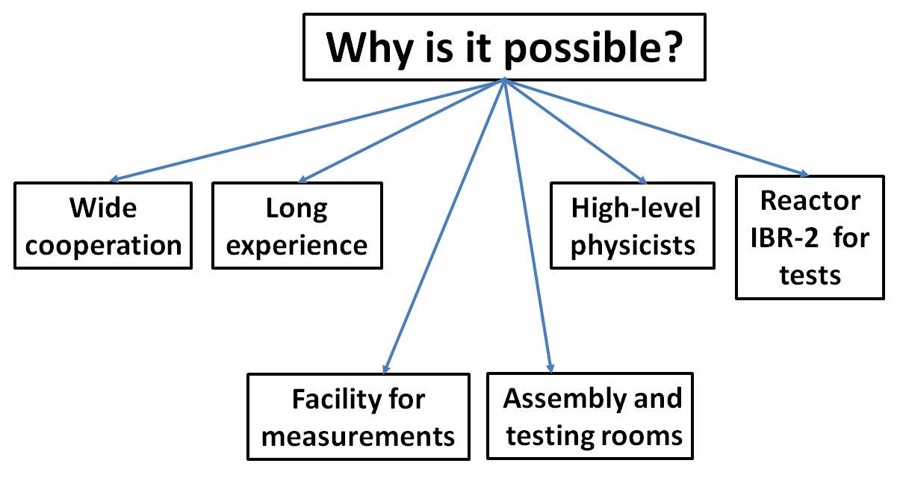

Slide 3

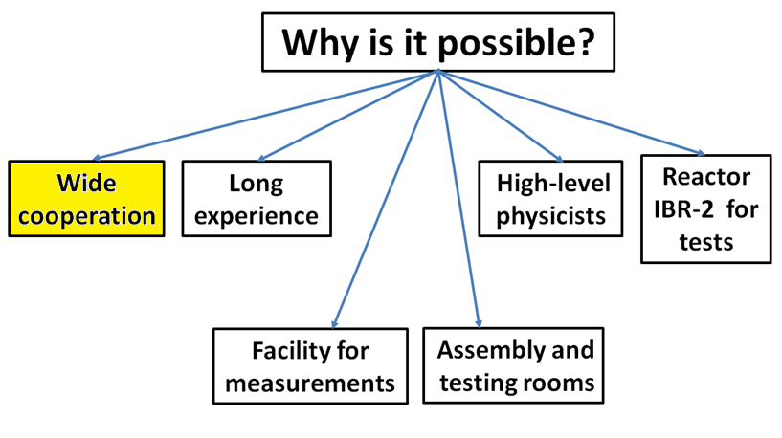

Slide 4
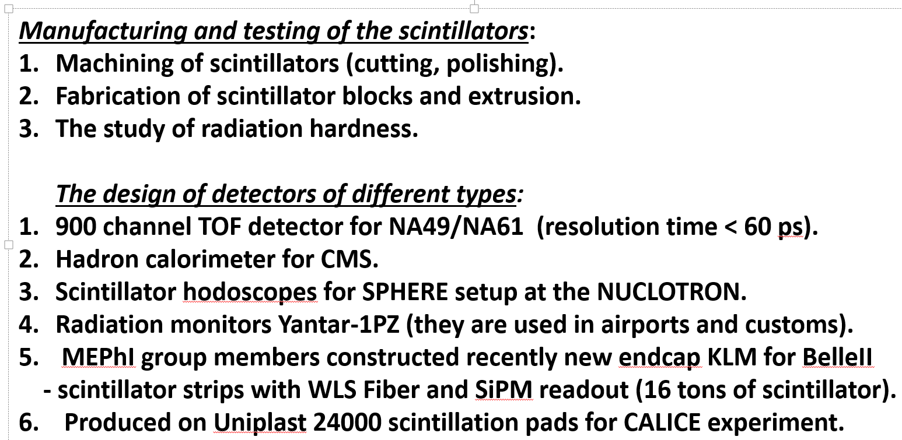
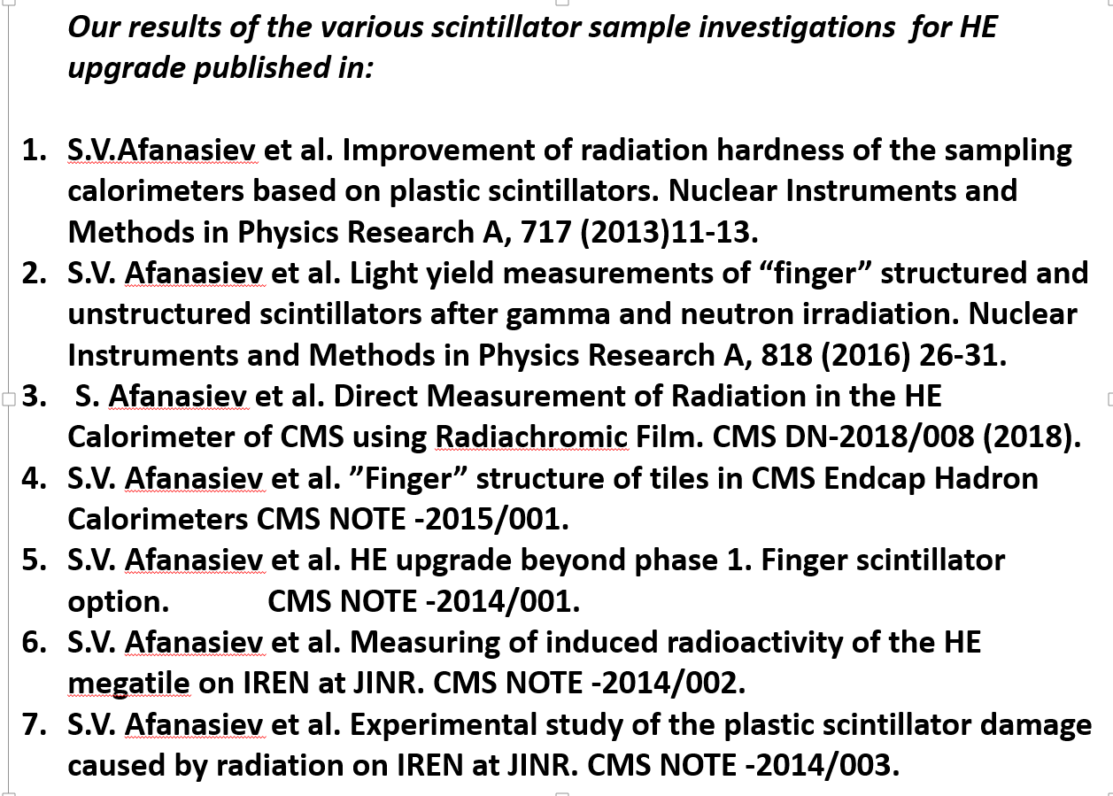
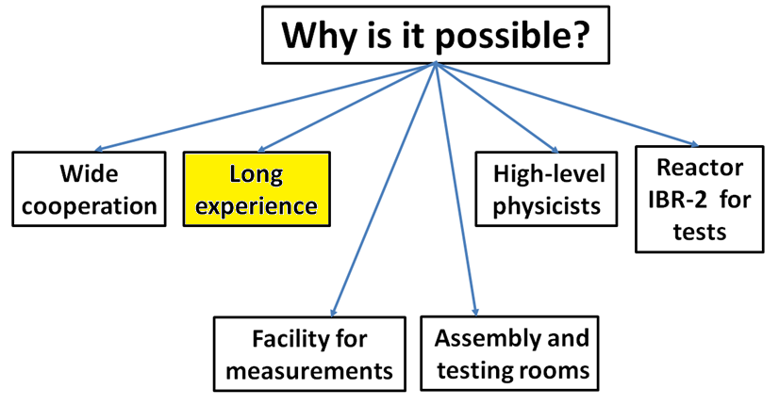

Slide 5
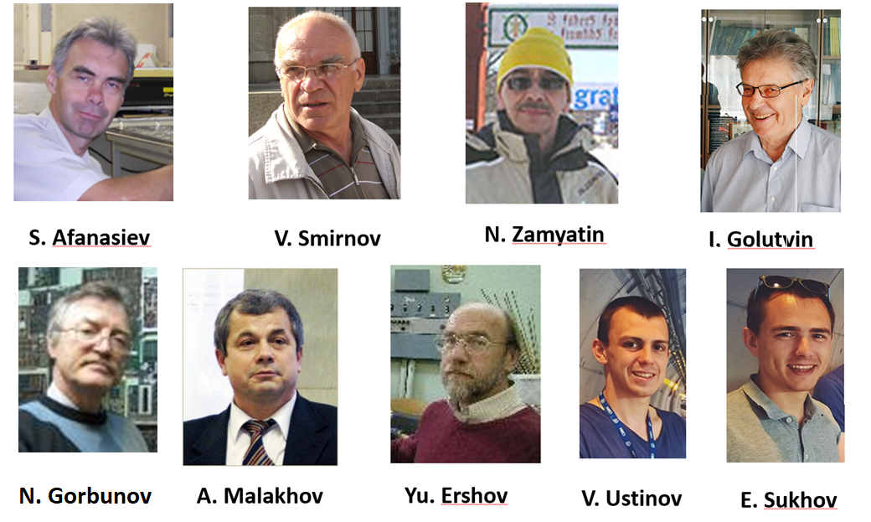
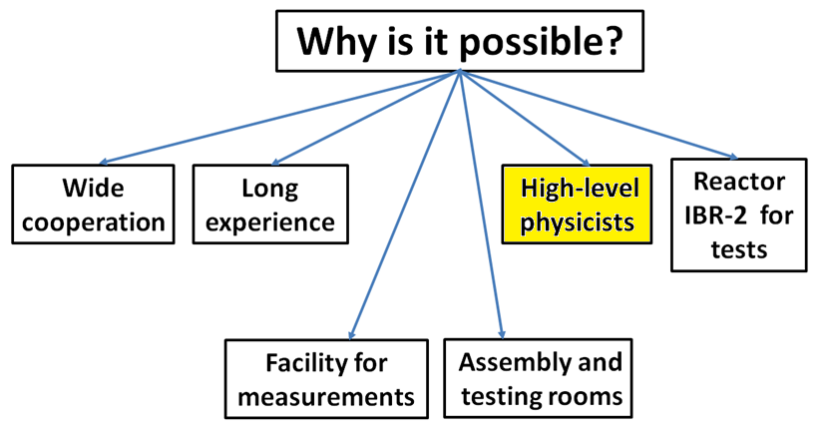

Slide 6
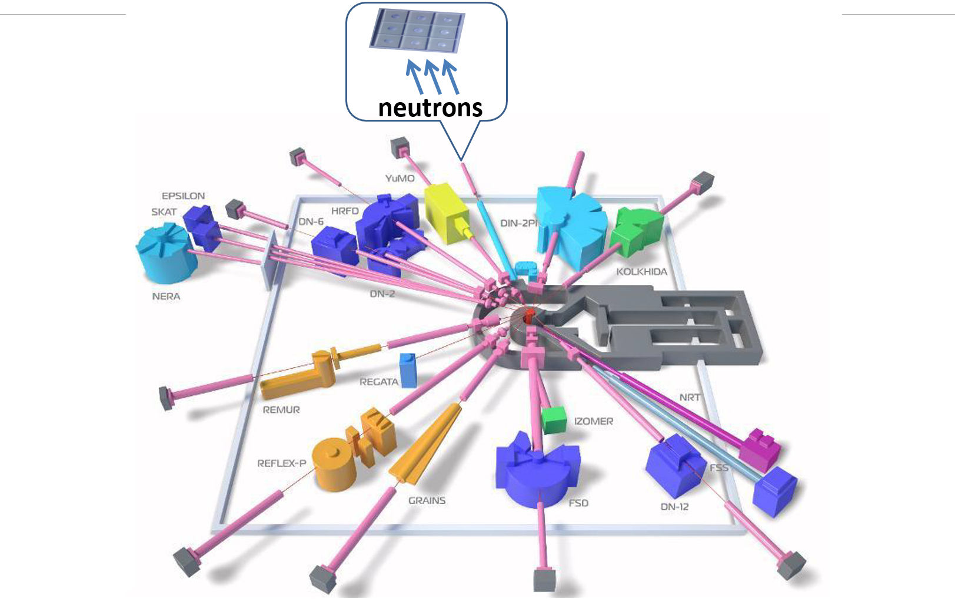
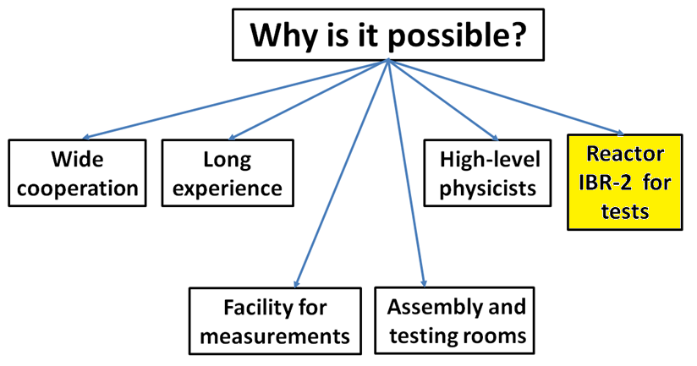

Slide 7
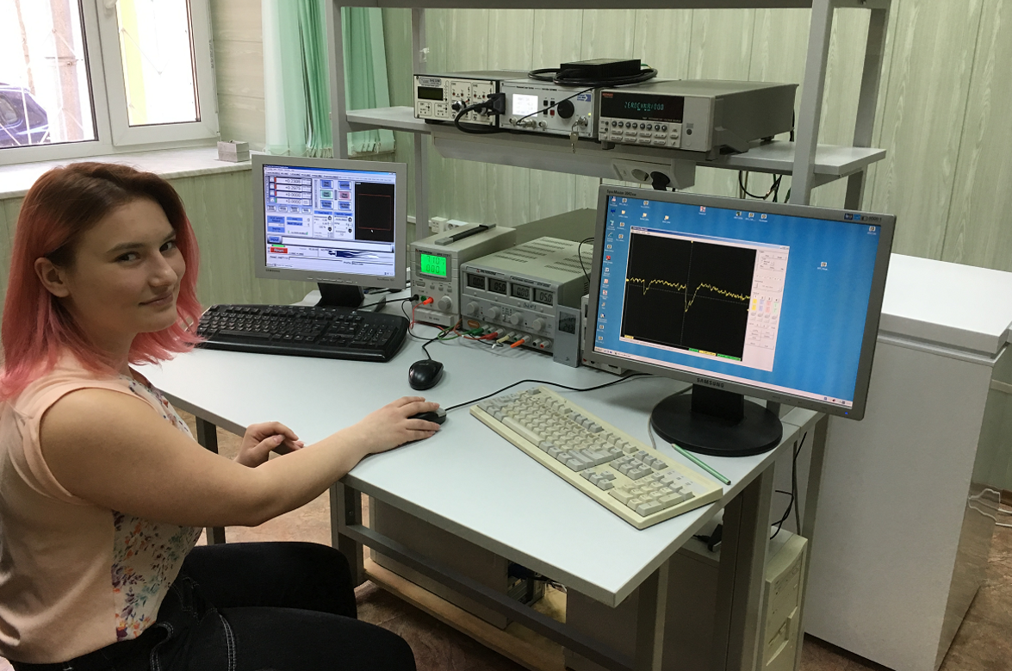
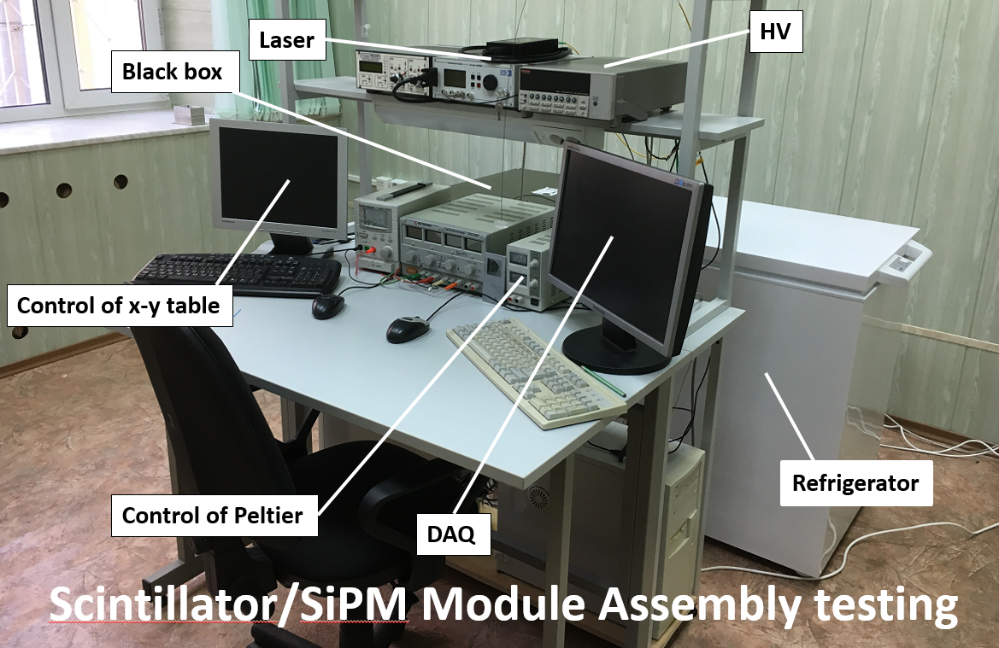
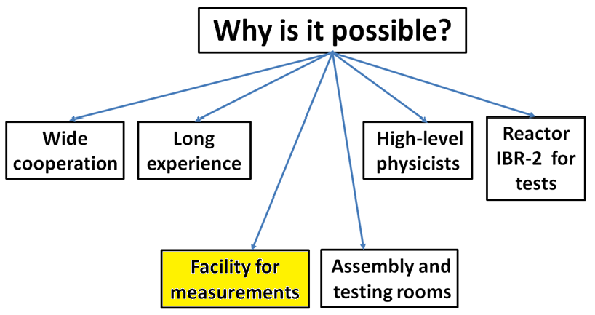

Slide 8
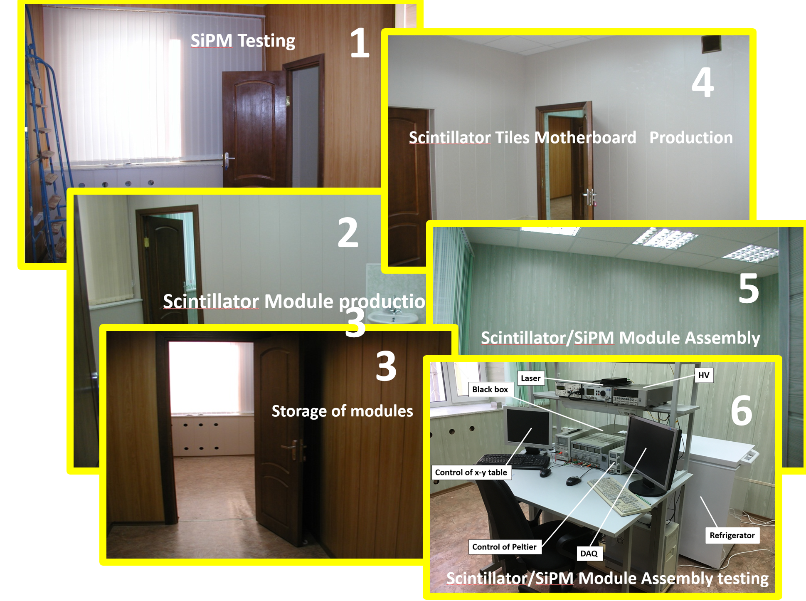
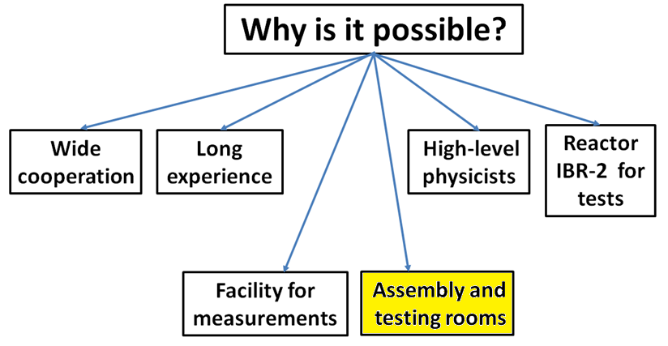

Slide 9
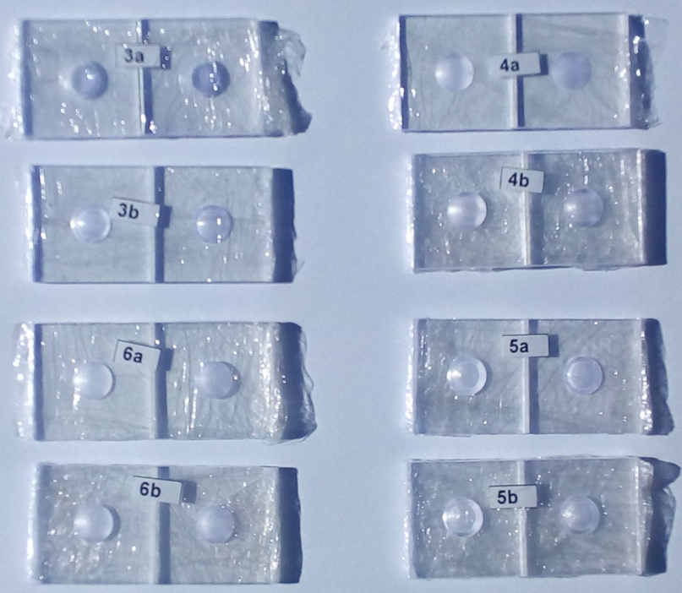
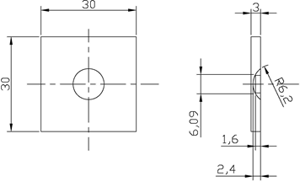
A single tiles option
Samples 30x30x3 mm³
The surface quality | The surface of the dimple | The number of samples
Polished surface | Polished | 2
 | Matte | 2
Non polished surface | Polished | 2
 | Matte | 2
Dimple

Slide 10
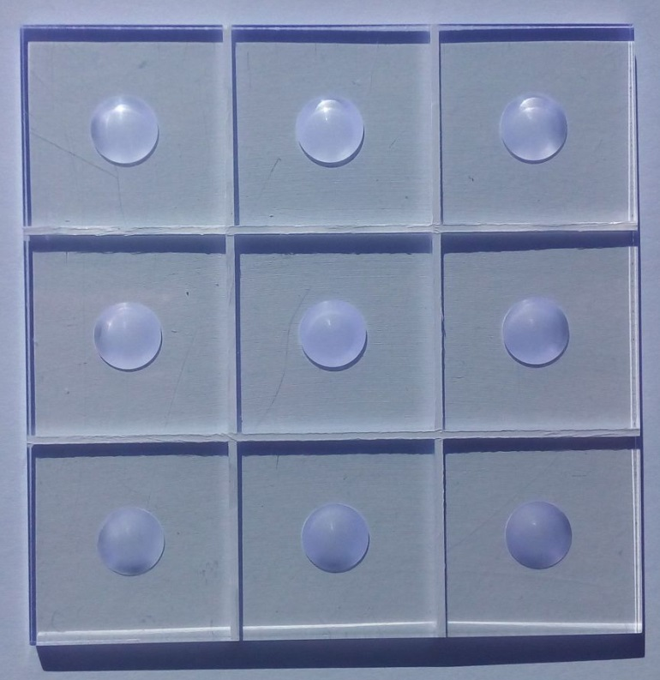
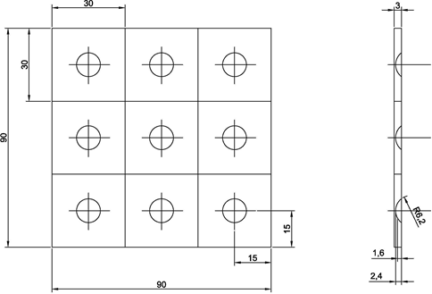
Block tiles
3x3 samples assembled 92x92x3 mm³
The surface quality | The surface of the dimple | The number of samples
Polished surface | Polished | 1
 | Matte | 1
Non polished surface | Polished | 1
 | Matte | 1
Dimple

Slide 11
The plan of tiles research in Dubna
Single tiles
- influence of the dimples geometry and surface quality on the light collection;
- influence of the quality of the tile surfaces on the light yield;
- the choice of reflector for the surface of the tile;
- studies of light collection from the tiles (from 20x20x3 mm³ to 56x56x3 mm³);
- temperature investigation of the tile with a reflector from -30ºC to +30ºC;
radiation test of the tiles with a reflector up to
5 Mrad.

Slide 12
Block tiles
- study of the technology to produce tiles separated by a groove;
- check of the technology of assembly of macrotile using separate tiles;
- checking the mechanical strength of the joint tiles after temperature cycles;
- study of the cross talk between the tiles for different options of assemblies;
- radiation test of the block of tiles up to 5 Mrad and neutron flux up to 10¹² cm⁻²;
- radiation test of assembly with final read-out electronics boards (DESY design).

Slide 13
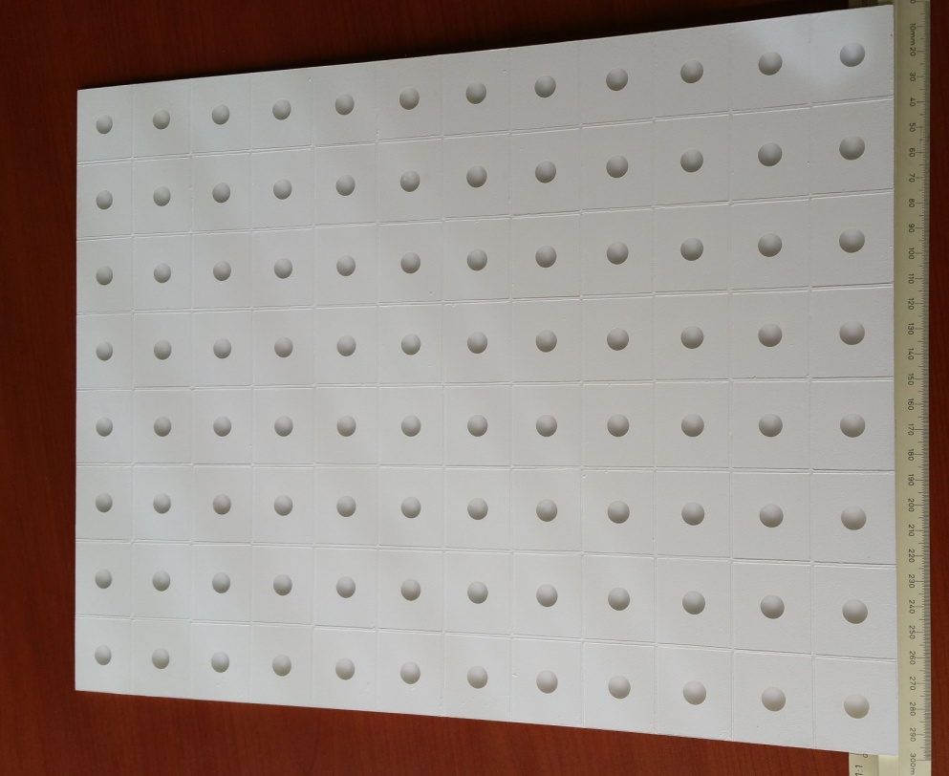
Scintillator Macrotile

Slide 14
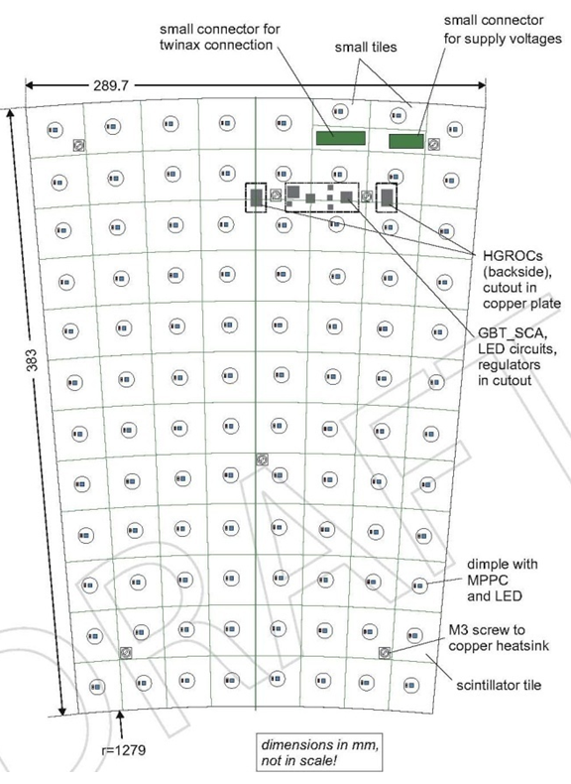
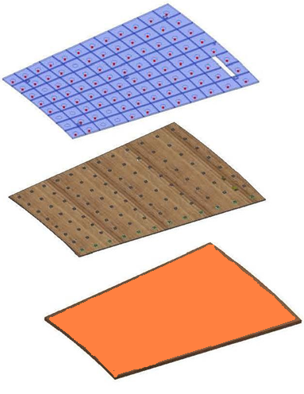
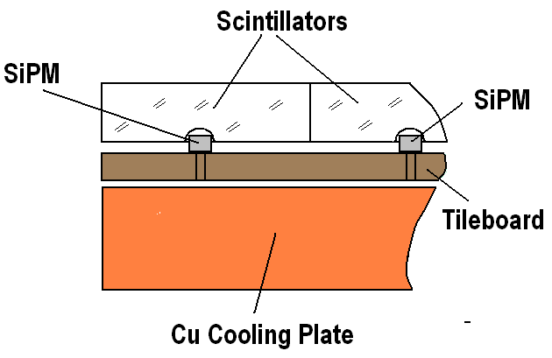
Scintillator/SiPM Module Prototype
Scintillator Tiles Module
Tileboard (SiPM and electronics)
Cu Cooling Plate
S=6mm

Slide 15
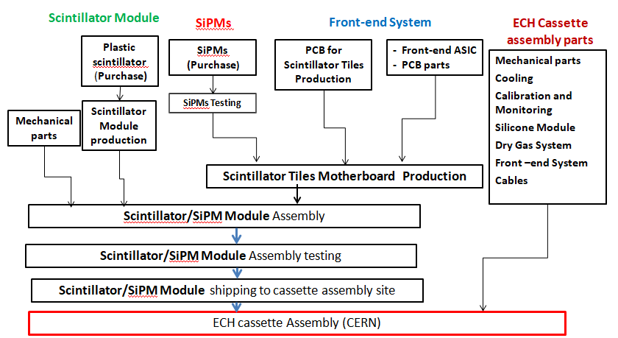
Currently we assume that the commercially produced scintillator (EJ 260) will be used.
We expect that delivery of scintillation materials, number of components and electronics will be provided by other partners from CMS collaboration.

Slide 16
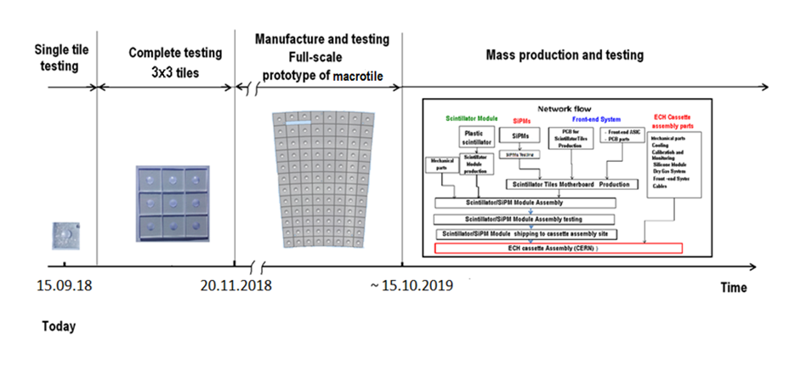
Schedule

Slide 17
Thank you for the attention !

