Slide 1
BI LHC Planning for LS2
Global LHC LS2 Planning
https://espace.cern.ch/en-dep-mef-lpc/LS2/Global%20Schedules/Forms/AllItems.aspx
BI Planning
Input required

Slide 2
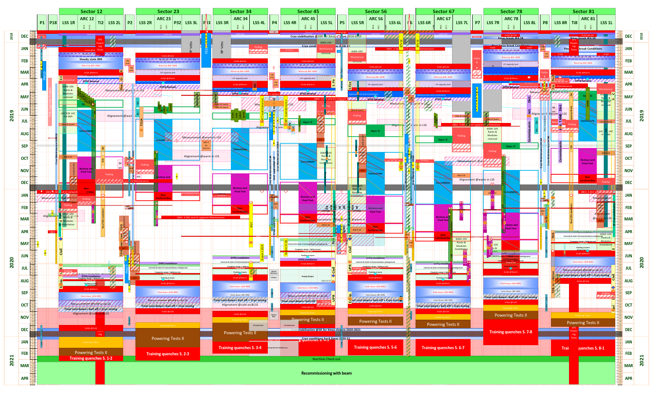
Global planning: Start 03.12.18
Warm-up
End of easy access

Slide 3
Dates for LS2
Start: 03.12.2018, Progressive access, depending on point
All maintenance + service work finished by February 2020
Maintenance + service instrument check until April 2020
Difficult access as from August 2020

Slide 4
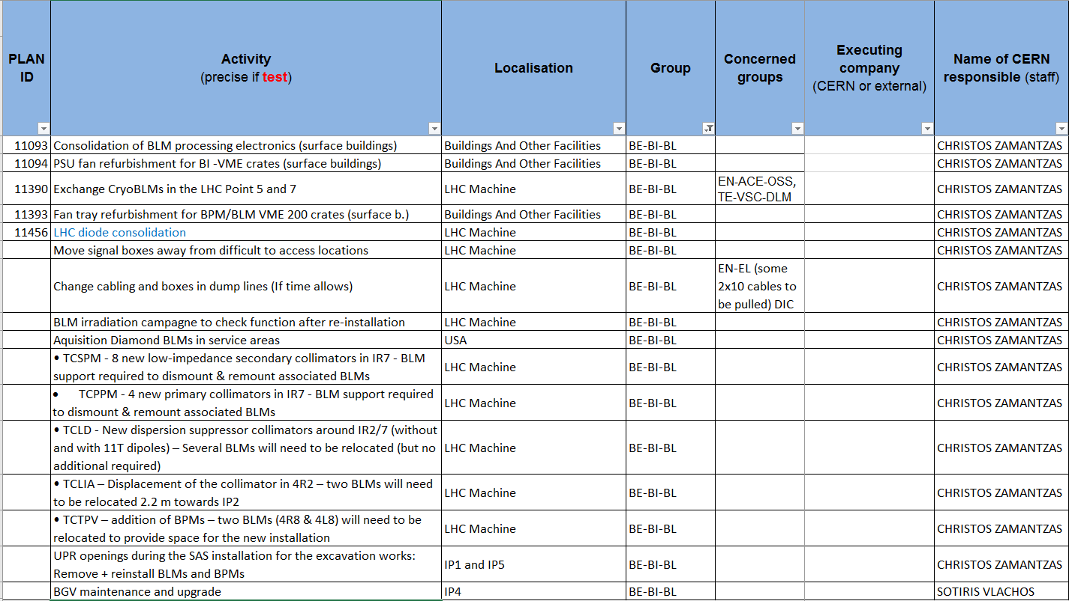
Activities: BL

Slide 5
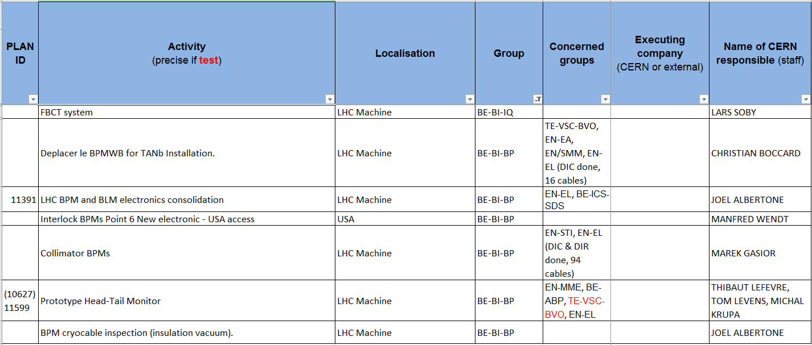
Activities: IP and BP

Slide 6
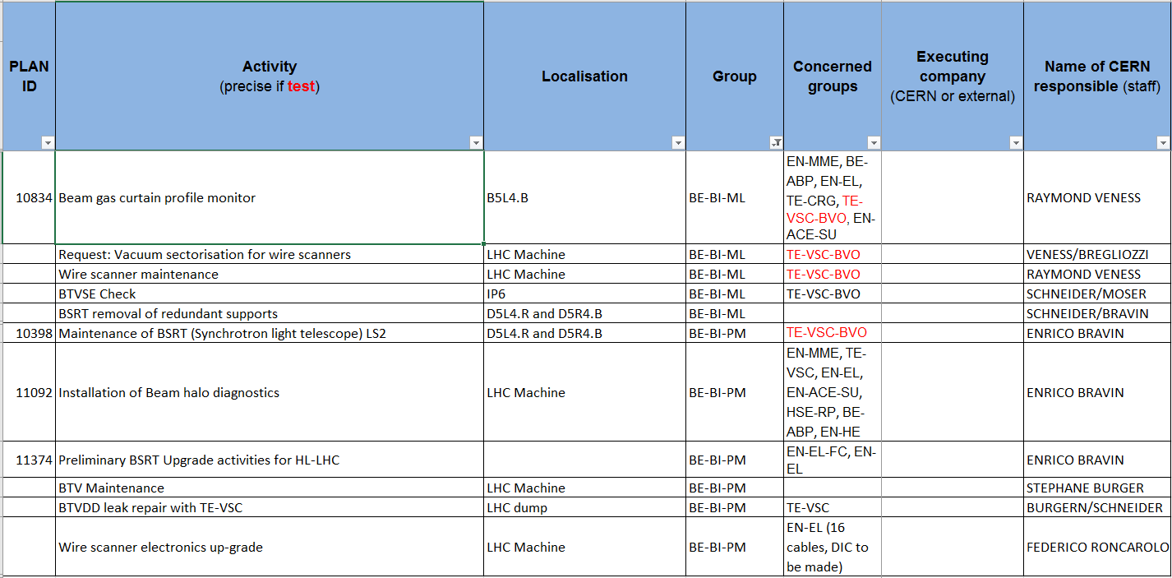
Activities: PM and ML

Slide 7
Input required
Dates
Storage in tunnel or surface
Lockout procedure
Other issues? (Blocking of passage….)

